Slide 1
Engineering Thermodynamics I
Lecture 13
Refrigeration Cycles
Lecturer: Dr. Melaku Desta

Slide 2
Lecture learning outcomes:
At the end of this lecture, you will be able to:
Explain how refrigeration and heat pumps function to transfer heat from one location to another, enhancing thermal management in various applications.
Identify different types of refrigerants, their properties, environmental impact, and how they facilitate heat transfer in refrigeration systems.
Analyze the theoretical basis of the Carnot refrigeration and heat pump cycles, including efficiency and limitations.
Illustrate the working principles of the vapor-compression refrigeration cycle, its key components, and its role in modern refrigeration systems.
Compare real-world vapor-compression refrigeration cycles
to ideal models, accounting for inefficiencies such as pressure
drops and heat losses.
vi. Use knowledge of refrigeration cycles and heat pumps
to assess performance and efficiency in engineering
applications.

Slide 3
Content
Refrigeration and Heat Pump
Refrigerant
Reversed Carnot Refrigerator and Heat Pump
The Vapor-Compression Refrigeration Cycle
Real Vapor-Compression Refrigeration Cycle
Summary
References

Slide 4
1. Refrigeration and Heat Pumps
Refrigeration: A process of transferring heat from a low-temperature region to a high-temperature one to maintain a cooled space at a desired temperature.
Heat Pump: Operates on the same principle as a refrigerator but is used to supply heat to a space by absorbing heat from a colder source (e.g., outside air or ground).
Key Difference:
  Refrigerator → Cools a space (primary goal: heat removal).
  Heat Pump → Heats a space (primary goal: heat addition).

Slide 5
1. Refrigeration and Heat Pumps Cont…
The main components of refrigerators and Heat Pumps:
Compressor – Compresses refrigerant gas, increasing its pressure and temperature.
Condenser – A heat exchanger where high-pressure refrigerant releases heat to the surroundings (condenses into liquid).
  In a refrigerator, heat is expelled outside.
  In a heat pump, heat is delivered indoors.

Slide 6
1. Refrigeration and Heat Pumps Cont…
Expansion Valve (Throttling Device) – Reduces refrigerant pressure, causing cooling and partial evaporation.
Evaporator – Absorbs heat from the cooled space (inside fridge or outdoor air for heat pumps), turning refrigerant into low-pressure vapor.
Refrigerant – to absorb and release heat, allowing for efficient cooling or heating.
Both Refrigerators and Heat Pumps use a refrigerant, compressor, condenser, evaporator, and expansion device to achieve their respective goals.

Slide 7
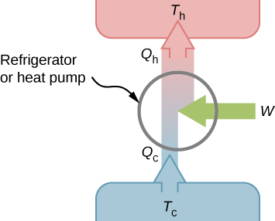
1. Refrigeration and Heat Pumps Cont…
Figure 1: Schematic Representation of a Refrigerator or Heat Pump
url: https://pressbooks.online.ucf.edu/app/uploads/sites/372/2021/04/CNX_UPhysics_21_03_Fridge.jpg

Slide 8
1. Refrigeration and Heat Pumps Cont…
Both refrigerators and heat pumps are based on the reversed Carnot cycle, a theoretical cycle that is the most efficient way to transfer heat [1].
The cycle involves transferring heat from a cold source (e.g., the inside of a refrigerator) to a warmer sink (e.g., the surrounding environment).
The refrigerant is continuously circulated through this cycle, absorbing heat at low temperatures and releasing it at higher temperatures.

Slide 9
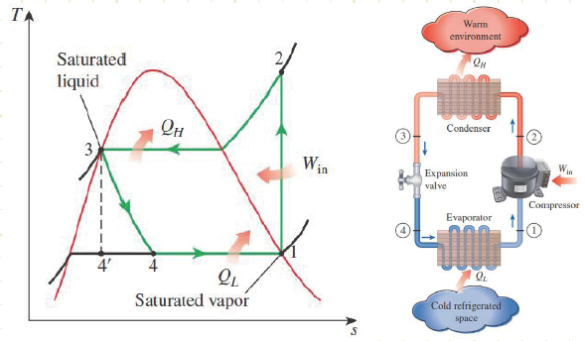
1. Refrigeration and Heat Pumps Cont….
The working principle of a Refrigerator:
  Figure 2: Components of a Refrigerator
url: https://www.engineersedge.com/graphics/chap14-1.png

Slide 10
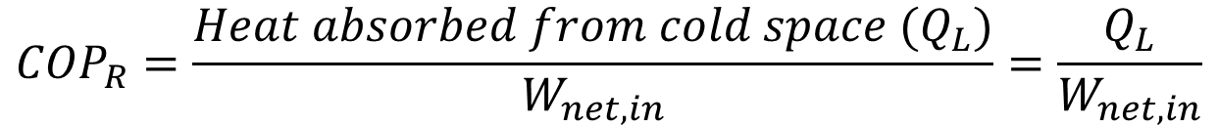
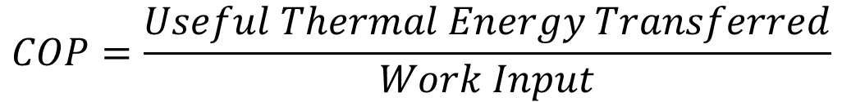
1. Refrigerators and Heat Pumps Cont…
The Coefficient of Performance (COP) measures the efficiency of a refrigerator or heat pump by comparing the desired thermal energy transfer to the work input required to achieve it.
For a refrigerator,
$$COP=\frac{Useful Thermal Energy Transferred}{Work Input}$$
$${COP}_{R}=\frac{{Heat absorbed from cold space (Q}_{L})}{W_{net,in}}=\frac{Q_{L}}{W_{net,in}}$$

Slide 11
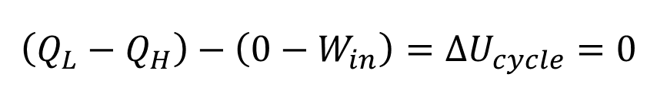
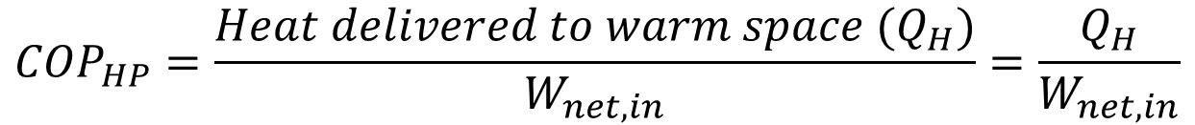
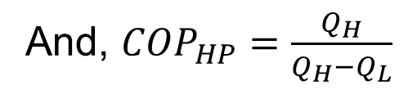
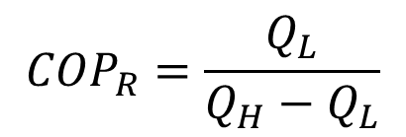

1. Refrigerators and Heat Pumps Cont…
And for a Heat Pump,
From first law of thermodynamics,
$${COP}_{HP}=\frac{{Heat delivered to warm space (Q}_{H})}{W_{net,in}}=\frac{Q_{H}}{W_{net,in}}$$
$$\left(Q_{L}−Q_{H}\right)−\left(0−W_{in}\right)=ΔU_{cycle}=0$$
$$W_{in}=W_{net,in}=Q_{H}−Q_{L}$$
$${COP}_{R}=\frac{Q_{L}}{Q_{H}−Q_{L}}$$
And, ${COP}_{HP}=\frac{Q_{H}}{Q_{H}−Q_{L}}$

Slide 12

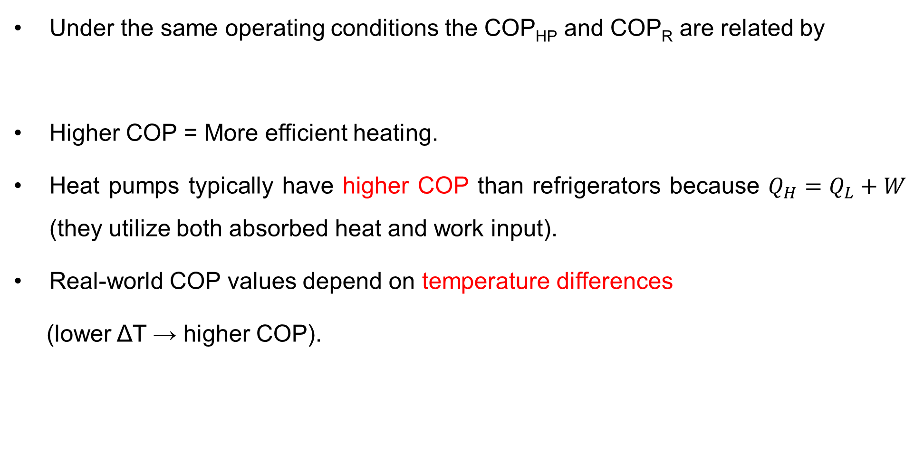
1. Refrigerators and Heat Pumps Cont…
Under the same operating conditions the COP_{HP} and COP_{R} are related by
Higher COP = More efficient heating.
Heat pumps typically have higher COP than refrigerators because $Q_{H}=Q_{L}+W$ (they utilize both absorbed heat and work input).
Real-world COP values depend on temperature differences
(lower ΔT → higher COP).
$${COP}_{HP}={COP}_{R}+1$$

Slide 13
2. Refrigerant
The refrigerant is a heat carrying medium which during their cycle (i.e. compression, condensation, expansion and evaporation) in the refrigeration system absorbs heat from a low temperature system and discards the heat so absorbed to a higher temperature medium [2].
The natural ice and mixture of ice and salt were the first refrigerants.
In 1834, ether, ammonia, sulpur dioxide, methyl chloride and carbon dioxide came into use as refrigerants in compression cycle refrigeration machines [1].
The suitability of a refrigerant for a certain application is
determined by it physical, thermodynamic, chemical
properties and by various practical factors.

Slide 14
2. Refrigerant Cont…
There is no one refrigerant which can be used for all types of application i.e. there is no ideal refrigerant.
Classifications of Refrigerants
The refrigerants may, broadly, be classified into the following two groups:
1. Primary Refrigerants:- which directly take part in the refrigeration system
  Halo- Carbon or organic refrigerants
  Azeotrope refrigerants
  Inorganic Refrigerants, and
  Hydro Carbon refrigerants

Slide 15
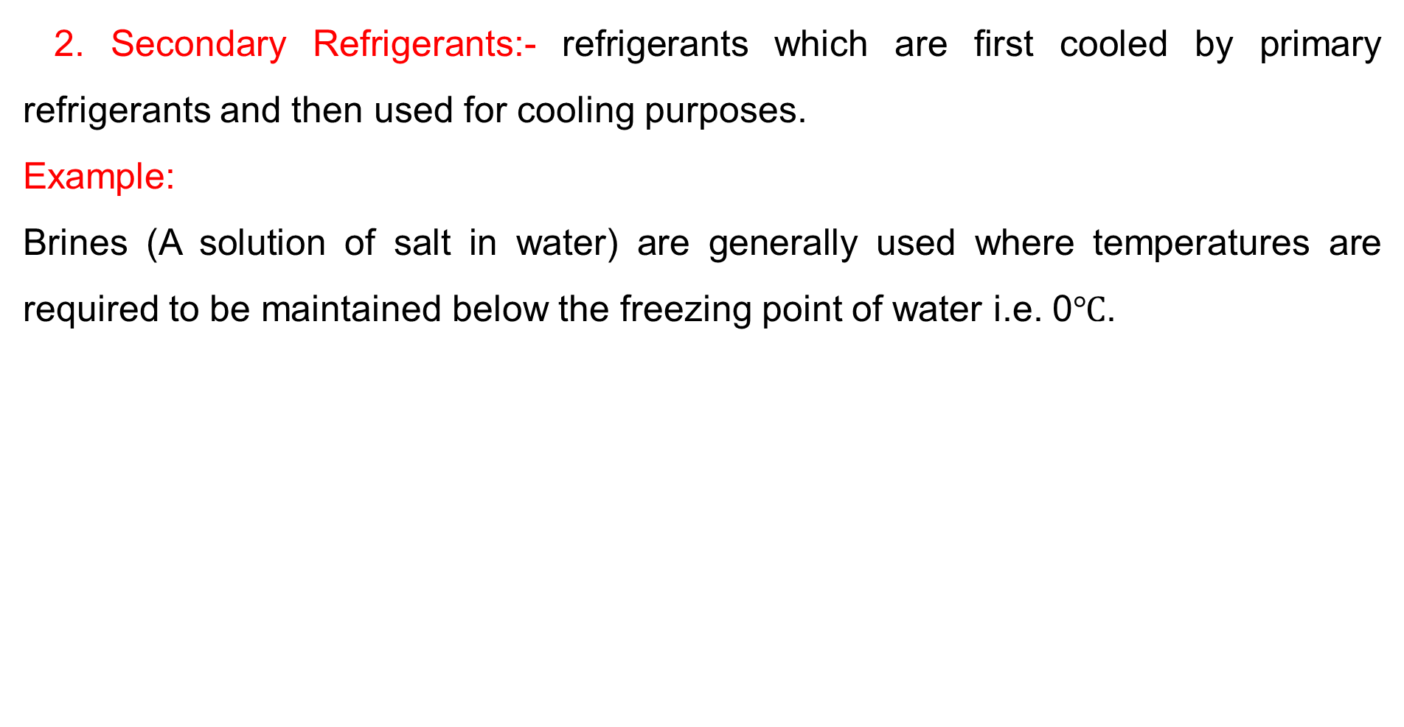
2. Refrigerant Cont…
2. Secondary Refrigerants:- refrigerants which are first cooled by primary refrigerants and then used for cooling purposes.
Example:
Brines (A solution of salt in water) are generally used where temperatures are required to be maintained below the freezing point of water i.e. 0$℃$.

Slide 16
2. Refrigerant Cont…
Designation of refrigerants
Since a large number of refrigerants have been developed over the years for a wide variety of applications, a numbering system has been adopted to designate various refrigerants.
From the number, one can get some useful information about the type of refrigerant, its chemical composition, molecular weight etc.
All the refrigerants are designated by R followed by a
unique number.

Slide 17
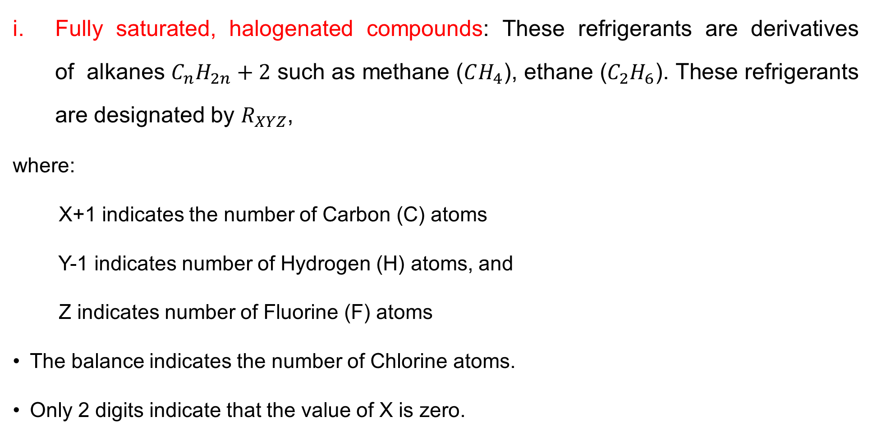
2. Refrigerant Cont…
Fully saturated, halogenated compounds: These refrigerants are derivatives of alkanes $C_{n}H_{2n}+2$ such as methane ($CH_{4}$), ethane ($C_{2}H_{6}$). These refrigerants are designated by $R_{XYZ}$,
where:
X+1 indicates the number of Carbon (C) atoms
Y-1 indicates number of Hydrogen (H) atoms, and
Z indicates number of Fluorine (F) atoms
The balance indicates the number of Chlorine atoms.
Only 2 digits indicate that the value of X is zero.

Slide 18

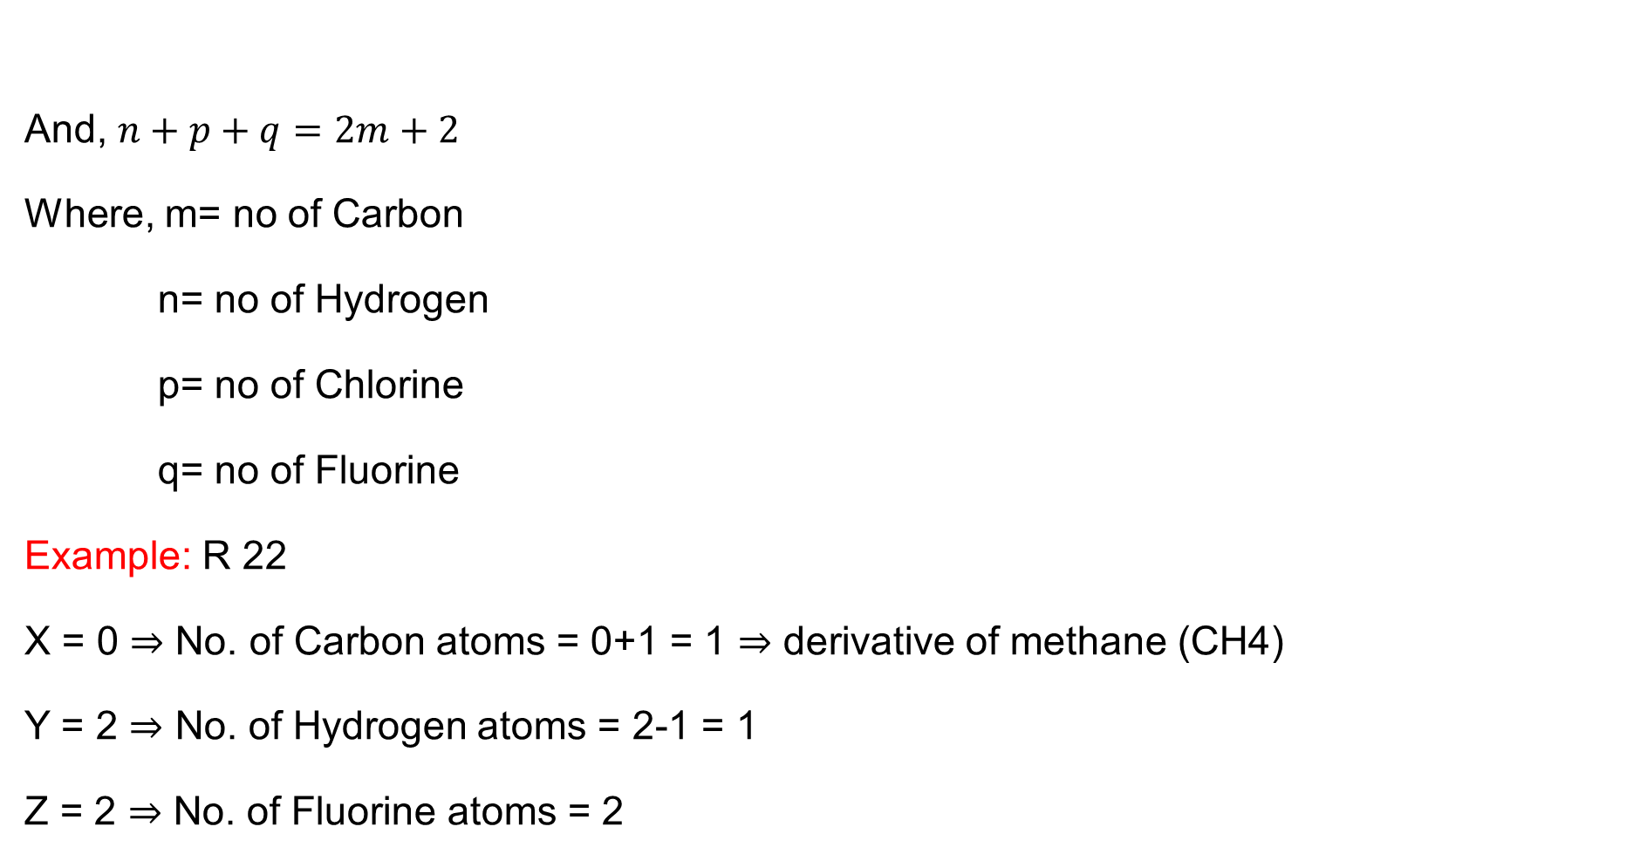
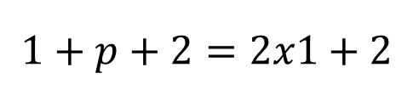
2. Refrigerant Cont…
And, $n+p+q=2m+2$
Where, m= no of Carbon
n= no of Hydrogen
p= no of Chlorine
q= no of Fluorine
Example: R 22
X = 0 ⇒ No. of Carbon atoms = 0+1 = 1 ⇒ derivative of methane (CH4)
Y = 2 ⇒ No. of Hydrogen atoms = 2-1 = 1
Z = 2 ⇒ No. of Fluorine atoms = 2
$$C_{m}H_{n}{Cl}_{p}F_{q}$$
X+1 indicates the number of Carbon (C) atoms
Y-1 indicates number of Hydrogen (H) atoms, and
Z indicates number of Fluorine (F) atoms
$$1+p+2=2x1+2$$

Slide 19
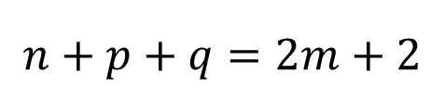
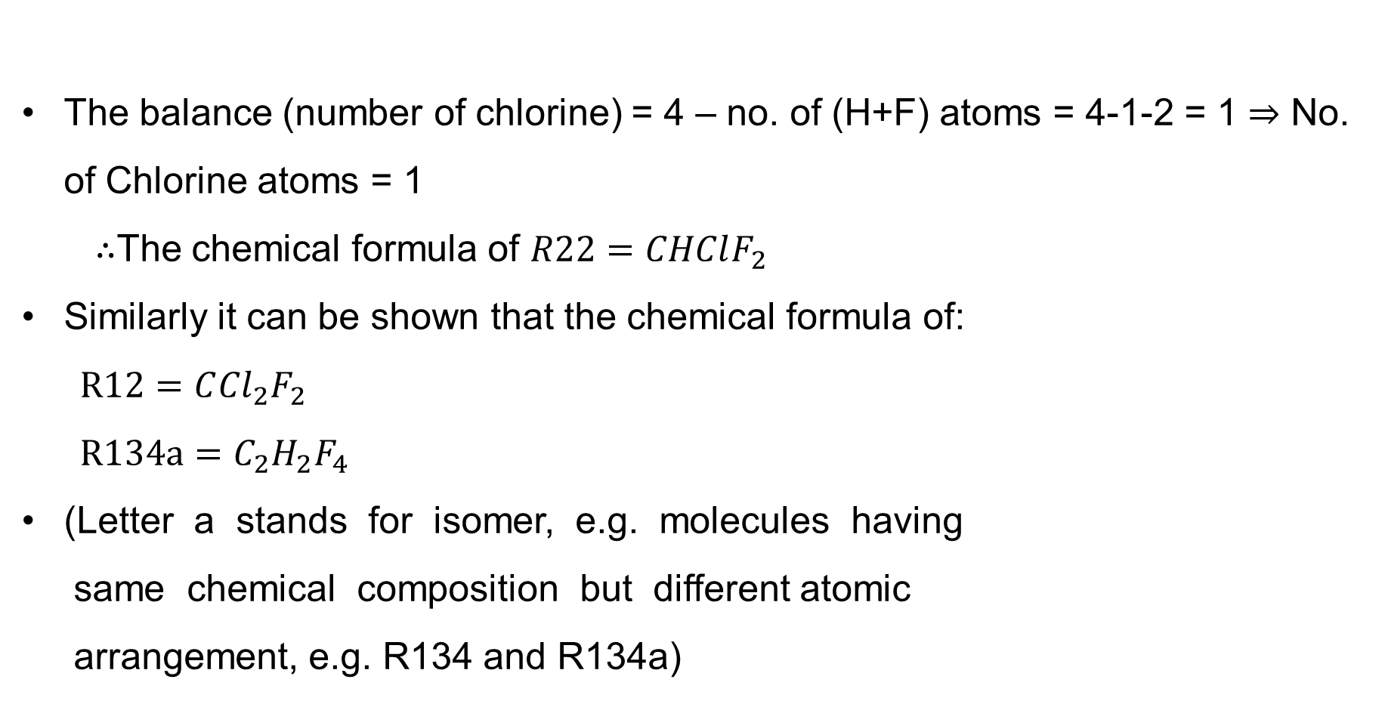
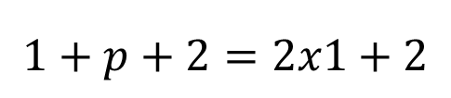
2. Refrigerant Cont…
$$n+p+q=2m+2$$
$$1+p+2=2x1+2$$
The balance (number of chlorine) = 4 – no. of (H+F) atoms = 4-1-2 = 1 ⇒ No. of Chlorine atoms = 1
∴The chemical formula of $R22=CHClF_{2}$
Similarly it can be shown that the chemical formula of:
$$R12=C{Cl}_{2}F_{2}$$
$R134a={C_{2}H}_{2}F_{4}$
(Letter a stands for isomer, e.g. molecules having
same chemical composition but different atomic
arrangement, e.g. R134 and R134a)

Slide 20
2. Refrigerant Cont…
Inorganic refrigerants: they were exclusively used before the introduction of halo-carbon refrigerants.
  They are still in use due to their inherent thermodynamic and physical properties.
  These are designated by number 7 followed by the molecular weight of the refrigerant (rounded-off).
Example:
  Ammonia: Molecular weight is 17; R 717
  Carbon dioxide: Molecular weight is 44; R 744
  Water: Molecular weight is 18, R 718

Slide 21
2. Refrigerant Cont…
Mixtures:
  Azeotropic (stable mixtures of refrigerants) are designated by 500 series
Example:
  R 500: Mixture of R 12 (73.8 %) and R 152a (26.2%)
  R 502: Mixture of R 22 (48.8 %) and R 115 (51.2%)
  R503: Mixture of R 23 (40.1 %) and R 13 (59.9%)
  R507A: Mixture of R 125 (50%) and R 143a (50%)

Slide 22
2. Refrigerant Cont…
Zeotropic refrigerants (e.g. non-azeotropic mixtures) are designated by 400 series.
Example:
  R404A : Mixture of R 125 (44%), R 143a (52%) and R 134a (4%)
  R407A : Mixture of R 32 (20%), R 125 (40%) and R 134a (40%)
  R407B : Mixture of R 32 (10%), R 125 (70%) and R 134a (20%)
  R410A : Mixture of R 32 (50%) and R 125 (50%)

Slide 23
2. Refrigerant Cont…
Hydrocarbon Refrigerants: Successfully used in industrial and commercial installations.
  They possess satisfactory thermodynamic properties but are highly flammable and explosive.
Example:
  Propane (C3H8): R 290
  n-butane (C4H10): R 600
  iso-butane (C4H10): R 600a

Slide 24
2. Refrigerant Cont…
Criteria for refrigerant selection
The desirable characteristics for a widely used refrigerant include:
• Environmental acceptability
• Chemical stability
• Materials compatibility
• Refrigeration-cycle performance
• Adherence to nonflammable and nontoxic guidelines
• Boiling point

Slide 25
3. Reversed Carnot Refrigerator and Heat Pump
Recall that the Carnot cycle is a theoretical thermodynamic cycle that provides the maximum possible efficiency for a heat engine operating between two temperature reservoirs.
While real-world devices cannot achieve this ideal performance, the Carnot model helps engineers optimize designs and compare efficiencies.
When reversed, it becomes the Carnot refrigerator or Carnot heat pump, serving as an ideal benchmark for refrigeration and heating systems.
The applications of refrigerators and heat pumps are:
  Refrigerators: Household cooling, industrial refrigeration.
  Heat Pumps: Space heating, geothermal systems, HVAC

Slide 26
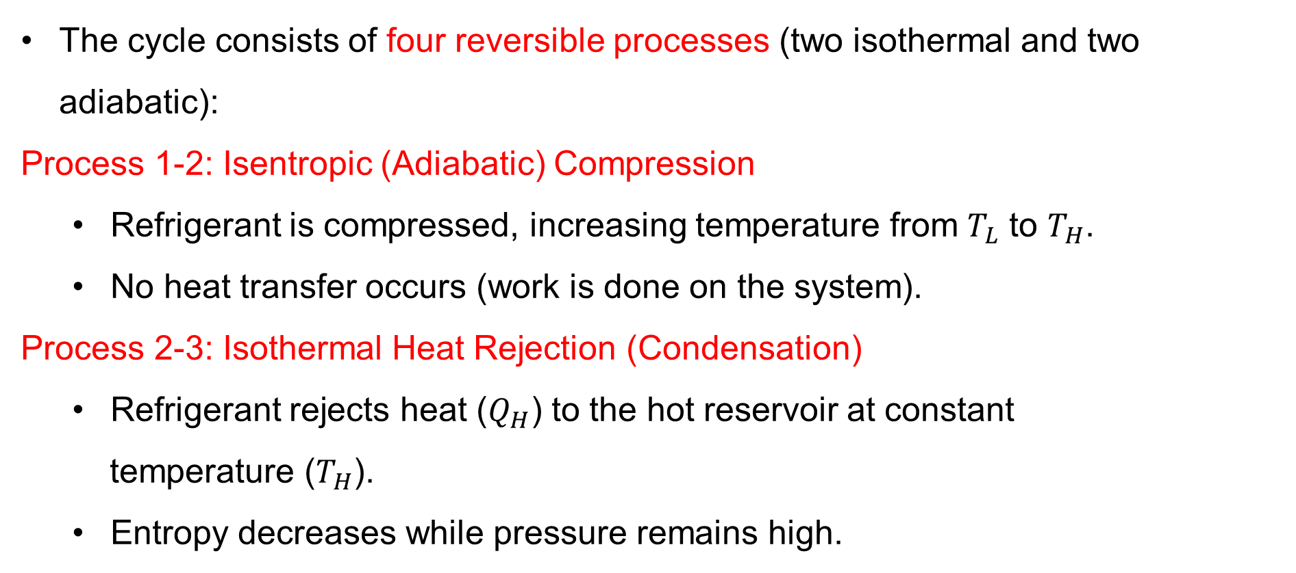
3. Reversed Carnot Refrigerator and Heat Pump Cont…
The cycle consists of four reversible processes (two isothermal and two adiabatic):
Process 1-2: Isentropic (Adiabatic) Compression
  Refrigerant is compressed, increasing temperature from $T_{L}$​ to $T_{H}$​.
  No heat transfer occurs (work is done on the system).
Process 2-3: Isothermal Heat Rejection (Condensation)
  Refrigerant rejects heat ($Q_{H}$​) to the hot reservoir at constant
  temperature ($T_{H}$​).
  Entropy decreases while pressure remains high.

Slide 27
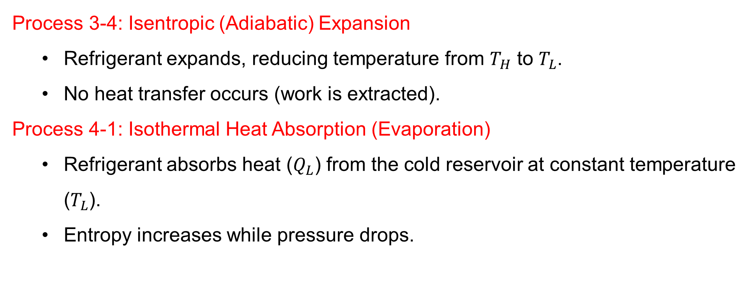
3. Reversed Carnot Refrigerator and Heat Pump Cont…
Process 3-4: Isentropic (Adiabatic) Expansion
  Refrigerant expands, reducing temperature from $T_{H}$ to $T_{L}$.
  No heat transfer occurs (work is extracted).
Process 4-1: Isothermal Heat Absorption (Evaporation)
  Refrigerant absorbs heat ($Q_{L}$​) from the cold reservoir at constant temperature ($T_{L}$​).
  Entropy increases while pressure drops.

Slide 28
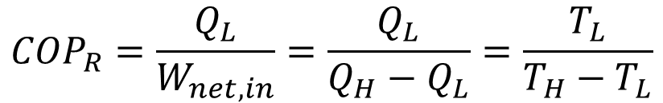
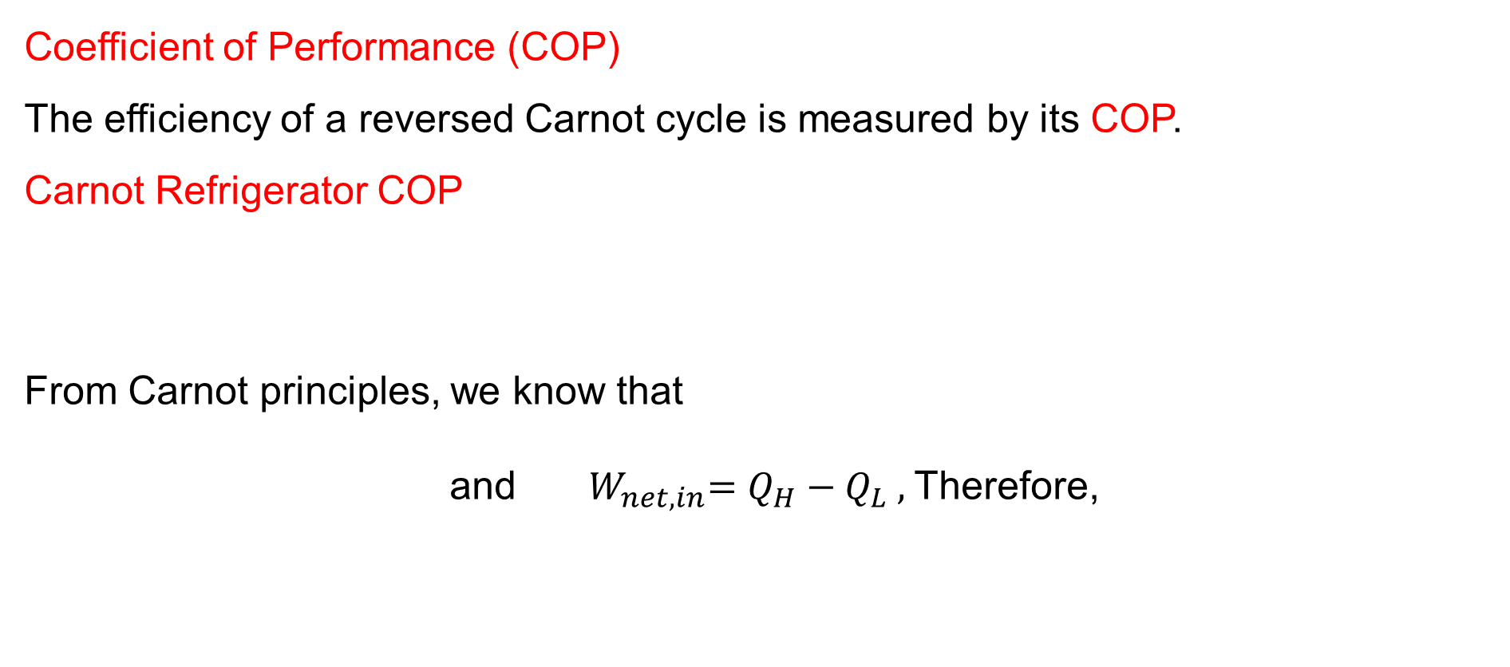
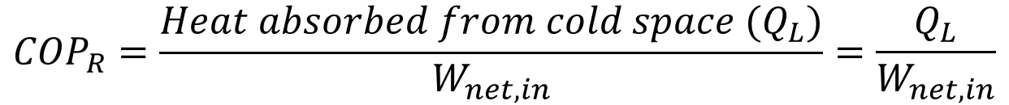
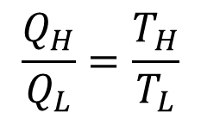
3. Reversed Carnot Refrigerator and Heat Pump Cont…
Coefficient of Performance (COP)
The efficiency of a reversed Carnot cycle is measured by its COP.
Carnot Refrigerator COP
From Carnot principles, we know that
and ${ W}_{net,in}=Q_{H}−Q_{L} ,$Therefore,
$${COP}_{R}=\frac{{Heat absorbed from cold space (Q}_{L})}{W_{net,in}}=\frac{Q_{L}}{W_{net,in}}$$
$$\frac{Q_{H}}{Q_{L}}=\frac{T_{H}}{T_{L}}$$
$${COP}_{R}=\frac{Q_{L}}{W_{net,in}}=\frac{Q_{L}}{Q_{H}−Q_{L}}=\frac{T_{L}}{T_{H}−T_{L}}$$

Slide 29
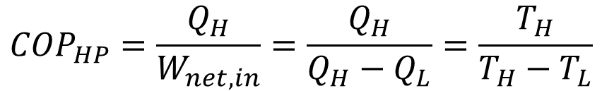
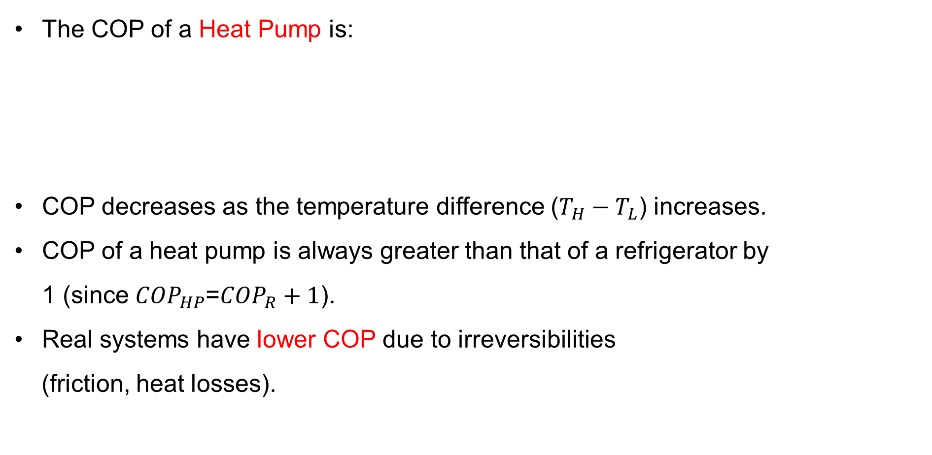
3. Reversed Carnot Refrigerator and Heat Pump Cont…
The COP of a Heat Pump is:
COP decreases as the temperature difference ($T_{H}−T_{L}$) increases.
COP of a heat pump is always greater than that of a refrigerator by 1 (since ${COP}_{HP}$=${COP}_{R}+1$).
Real systems have lower COP due to irreversibilities
(friction, heat losses).
$${COP}_{HP}=\frac{Q_{H}}{W_{net,in}}=\frac{Q_{H}}{Q_{H}−Q_{L}}=\frac{T_{H}}{T_{H}−T_{L}}$$

Slide 30
3. Reversed Carnot Refrigerator and Heat Pump Cont…
What are the practical limitations of a reversed Carnot Refrigerator and heat pump?
While the Carnot cycle sets the theoretical maximum efficiency, real refrigerators and heat pumps face challenges:
  Isothermal processes require infinite time (real processes are not perfectly reversible).
  Adiabatic processes are difficult to achieve (heat losses occur).
  Real refrigerants have non-ideal properties (phase changes,
  pressure drops).

Slide 31
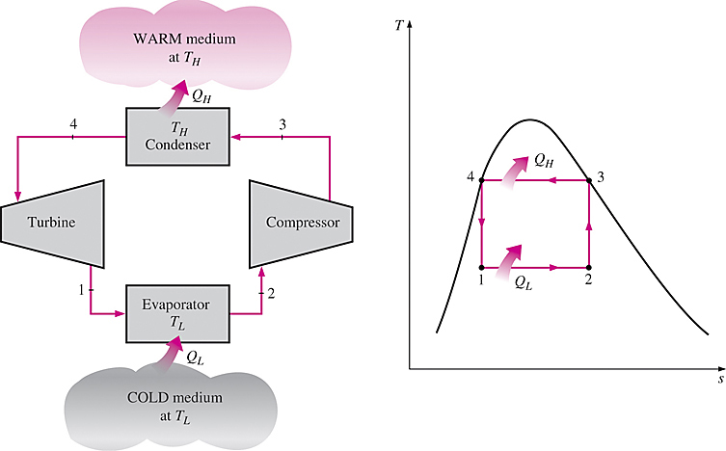
3. Reversed Carnot Refrigerator and Heat Pump Cont…
The Reversed Carnot Refrigerator and Heat Pump provides the highest possible COP for refrigeration and heat pump systems [3].
However, it is not a suitable model for refrigeration cycles since processes 2-3 and 4-1 are not practical because;
Process 2-3 involves the compression of a liquid–vapor mixture, which requires a compressor that will handle two phases, and process 4-1 involves the expansion of high-moisture-content refrigerant in a turbine.
  Figure 3: Schematic and T-s diagram of Reversed Carnot Refrigerator
url: https://encrypted-tbn0.gstatic.com/images?q=tbn:ANd9GcRT1402Sjc01umzGHMBFLwx_VJaFF2JprF3Y0Yyt9N93AX9QCNnY1s7hLQWkto0OExz8UI&usqp=CAU

Slide 32
4. The Vapor- Compression Refrigeration Cycle
The vapor-compression refrigeration cycle (VCR) is the ideal model for refrigeration systems.
Unlike the reversed Carnot cycle, the refrigerant is vaporized completely before it is compressed and the turbine is replaced with a throttling device.
The vapor compression refrigeration cycle is the most widely used refrigeration system in [4]:
    Domestic refrigerators and freezers
    Air conditioning systems
    Industrial refrigeration (food processing, chemical plants)
    Heat pumps for space heating

Slide 33
4. The Vapor- Compression Refrigeration Cycle Cont…
It operates by circulating a refrigerant through four main components, undergoing phase changes to transfer heat from a low-temperature region to a high-temperature region [5].
Vapor Compression Refrigeration cycle uses a volatile refrigerant that alternates between liquid and vapor states.
It is more practical than Carnot cycle while following similar thermodynamic principles.

Slide 34
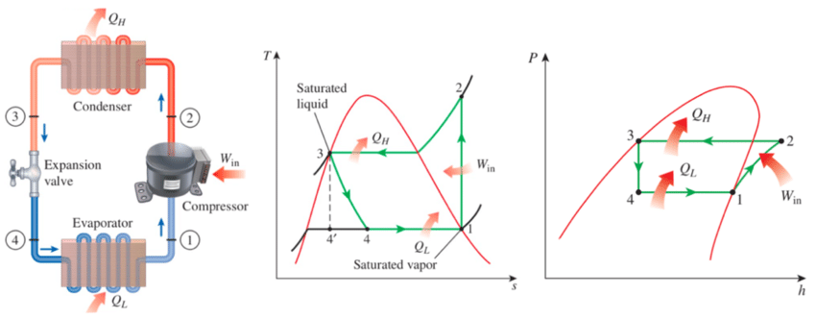
4. The Vapor- Compression Refrigeration Cycle Cont…
  Figure 4: Schematic diagram, T-s diagram and P-h diagram of an Ideal Vapor-Compression Refrigeration cycle
url: https://www.researchgate.net/publication/326912104/figure/fig2/AS:657525586272256@1533777724722/a-b-c-Schematic-and-T-s-diagram-for-the-ideal-vapor-compression-refrigeration-cycle.png

Slide 35
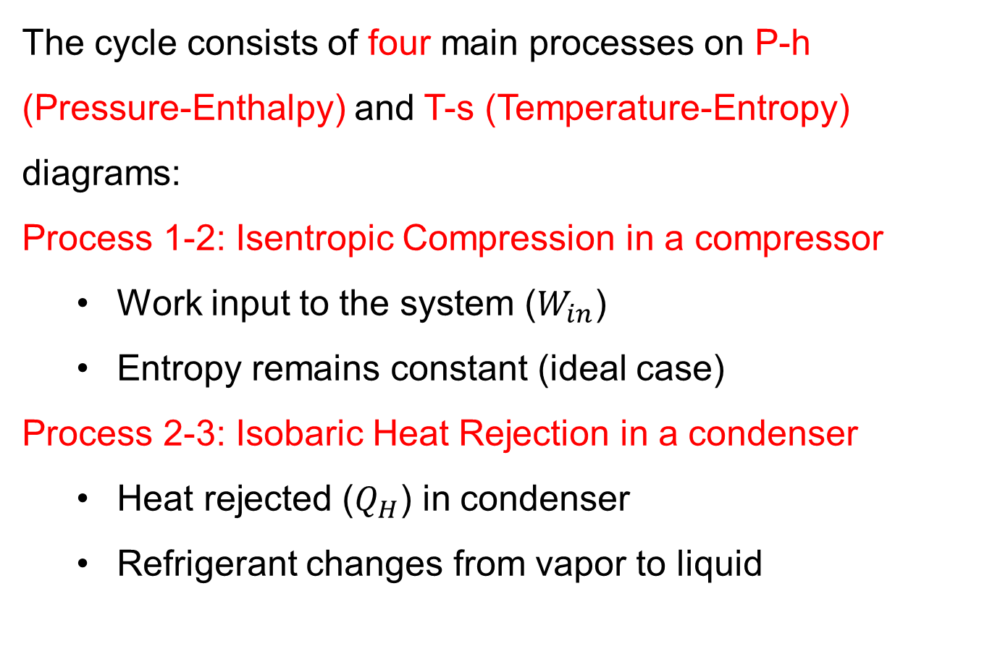
4. The Vapor- Compression Refrigeration Cycle Cont…
The cycle consists of four main processes on P-h (Pressure-Enthalpy) and T-s (Temperature-Entropy) diagrams:
Process 1-2: Isentropic Compression in a compressor
  Work input to the system ($W_{in}$)
  Entropy remains constant (ideal case)
Process 2-3: Isobaric Heat Rejection in a condenser
  Heat rejected ($Q_{H}$) in condenser
  Refrigerant changes from vapor to liquid

Slide 36
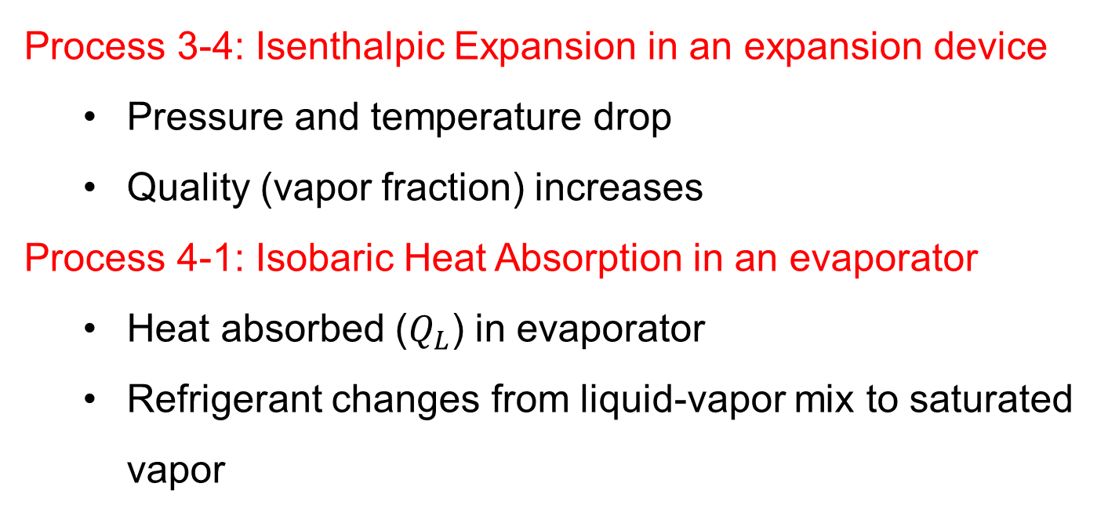
4.The Vapor- Compression Refrigeration Cycle Cont…
Process 3-4: Isenthalpic Expansion in an expansion device
  Pressure and temperature drop
  Quality (vapor fraction) increases
Process 4-1: Isobaric Heat Absorption in an evaporator
  Heat absorbed ($Q_{L}$) in evaporator
  Refrigerant changes from liquid-vapor mix to saturated vapor

Slide 37
5. Real Vapor- Compression Refrigeration Cycle
The Real Vapor-Compression Refrigeration Cycle differs from the ideal cycle due to various practical inefficiencies and irreversibilities that occur in actual systems.
Understanding these deviations is crucial for proper system design, performance analysis, and troubleshooting.
The major deviations from ideal cycles are:
1. Compression Process
Actual compression is not isentropic and the effects are:
  Higher discharge temperature
  Increased work input
  Lower volumetric efficiency

Slide 38
5. Real Vapor- Compression Refrigeration Cycle Cont…
2. Pressure Drops
Occur in:
  Suction and discharge lines
  Condenser and evaporator
  Filter-driers
The consequences of pressure drops are:
  Reduced system capacity
  Increased compression ratio
  Lower COP

Slide 39
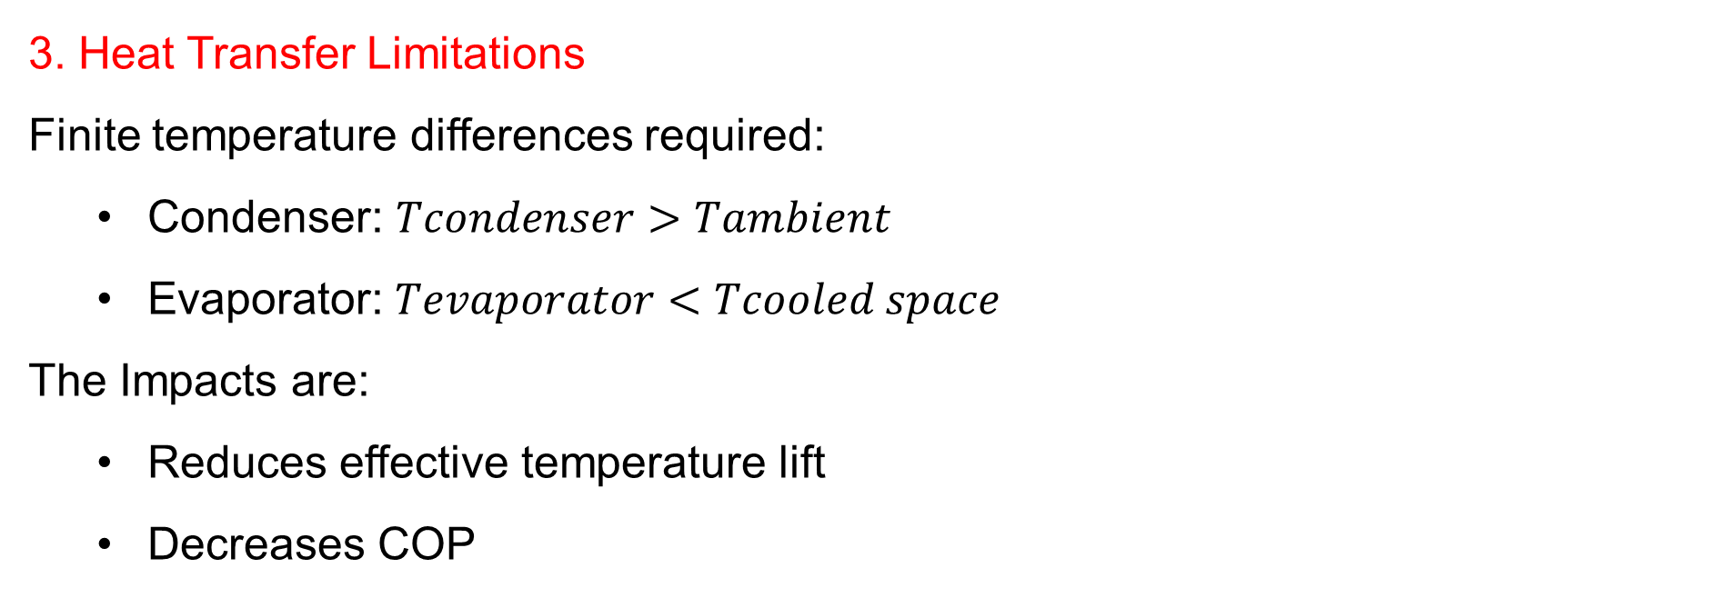
5. Real Vapor- Compression Refrigeration Cycle Cont…
3. Heat Transfer Limitations
Finite temperature differences required:
  Condenser: $Tcondenser>Tambient$
  Evaporator: $Tevaporator<Tcooled space$
The Impacts are:
  Reduces effective temperature lift
  Decreases COP

Slide 40
5. Real Vapor- Compression Refrigeration Cycle Cont…
4. Subcooling and Superheating
Desirable subcooling:
  Prevents flash gas formation
  Increases refrigerating effect
Necessary superheating:
  Ensures dry compression
  Prevents liquid slugging

Slide 41
5. Real Vapor- Compression Refrigeration Cycle Cont…
Pre-Caution For Domestic Refrigerators
Open the refrigerator door the fewest times possible
Cool the hot foods to room temperature first before putting them into the refrigerator
Clean the condenser coils
Check the door gasket for air leaks
Avoid unnecessarily low temperature settings
Avoid excessive ice build-up on the interior surfaces
of the evaporator
7. Do not block the air flow passages to and from the
condenser coils

Slide 42
Summary
Refrigerant is a working fluid that absorbs and releases heat during phase changes in refrigeration and heat pump systems.
Reversed Carnot Refrigerator and Heat Pump are idealized thermodynamic cycles demonstrating the highest theoretical efficiency for cooling and heating applications.
The Vapor-Compression Refrigeration Cycle is a widely used refrigeration method involving four main components where the refrigerant undergoes phase changes to transfer heat effectively.
Real Vapor-Compression Refrigeration Cycle is a practical version of the ideal cycle, accounting for inefficiencies such as pressure drops, irreversibilities.
Coefficient of Performance (COP) is a measure of efficiency
for refrigeration and heat pump systems, defined as the
ratio of desired output (cooling or heating) to energy input.

Slide 43
References
,
[1]. Thermodynamics – An Engineering Approach, Cengel Y A.,Bole M A., McGraw-Hill Education, 8th edition 2015.
[2]. Principles of Refrigeration, Dossat, R. J., & Horan, T. J. (2001). (5th ed.). Prentice Hall.
[3]. Fundamentals of Engineering Thermodynamics, Moran, M. J., Shapiro, H. N., Boettner, D. D., & Bailey, M. B. (2018). (9th ed.). Wiley.
[4]. Advances in vapor compression refrigeration technologies: A review. Wang, M., Zhang, X., & Zhao, Y. (2018). Renewable and Sustainable Energy Reviews, 81, 1493-1504. Elsevier.
[5]. Experimental investigation of the effect of condenser subcooling in R134a and R1234yf vapor compression systems. Pottker, G., & Hrnjak, P. (2015). International Journal of Refrigeration, 57, 29-39. Elsevier.

Slide 44
Thank you !

