Slide 1
Engineering Thermodynamics I
Lecture 14
Refrigeration Cycles
Lecturer: Dr. Melaku Desta

Slide 2
Lecture learning outcomes:
At the end of this lecture, you will be able to:
Understanding the fundamental principles, processes, and efficiency of the ideal vapor compression refrigeration cycle under perfect conditions.
Learn to evaluate system performance using thermodynamic laws and energy balance equations.
Identify deviations from the ideal cycle due to inefficiencies like pressure drops, heat losses, and non-ideal compressor behavior.
Analyze the differences between vapor compression and vapor absorption refrigeration cycles in working principles, energy sources,
and practical applications.
vi. Discover methods to enhance refrigeration cycle
performance, including component optimization and
alternative refrigerants.

Slide 3
Content
Vapor Compression Refrigeration Cycle
Ideal Vapor Compression Refrigeration Cycle
Energy Analysis of Vapor Compression Refrigeration Cycle
Real Vapor Compression Refrigeration Cycle
Vapor Absorption Refrigeration Cycle
Summary
References

Slide 4
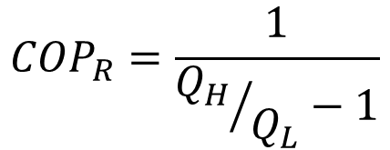
1. Vapor Compression Refrigeration Cycle
Reversed Carnot cycle is not a suitable model for refrigeration cycle
  Involves the compression of a liquid-vapor mixture, which requires a compressor that will handle two phase.
  Involves the expansion of high-moisture-content refrigerant in a turbine
  It consists two reversible isothermal and two isentropic processes.
  For the Carnot refrigeration cycle
$${COP}_{R}=\frac{1}{{Q_{H}}/{Q_{L}}−1}$$

Slide 5
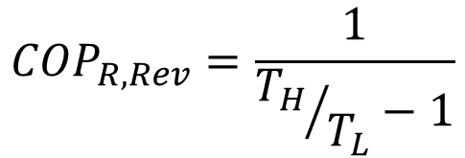
1. Vapor Compression Refrigeration Cycle Cont…
Replacing Heat transfer ratios by the ratios of the absolute temperatures of the high and low temperature reservoirs
It is the maximum theoretical value for the specified temperature limits.
Actual COP may approach this values as the design is improved,
but it can never reach.
$${COP}_{R,Rev}=\frac{1}{{T_{H}}/{T_{L}}−1}$$

Slide 6
2. Ideal Vapor Compression Refrigeration Cycle
The ideal vapor compression refrigeration cycle is the most widely used refrigeration system [1] and,
It consists of four processes
  Isentropic compression in a compressor
  Constant-pressure heat rejection in a condenser
  Throttling in an expansion device
  Constant-pressure heat absorption in an evaporator

Slide 7
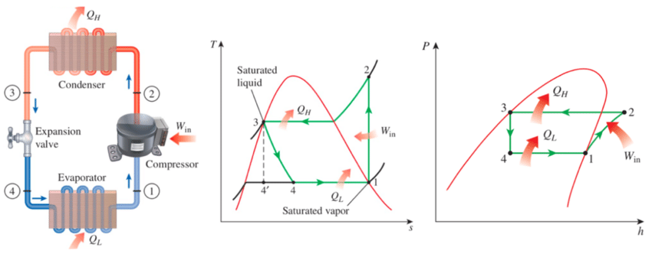
2. Ideal Vapor Compression Refrigeration Cycle Cont…
Working Principle of VCR Cycle
  Figure 1: Schematic diagram, T-s diagram and P-h diagram of an Ideal Vapor-Compression Refrigeration cycle
url: https://www.researchgate.net/publication/326912104/figure/fig2/AS:657525586272256@1533777724722/a-b-c-Schematic-and-T-s-diagram-for-the-ideal-vapor-compression-refrigeration-cycle.png

Slide 8
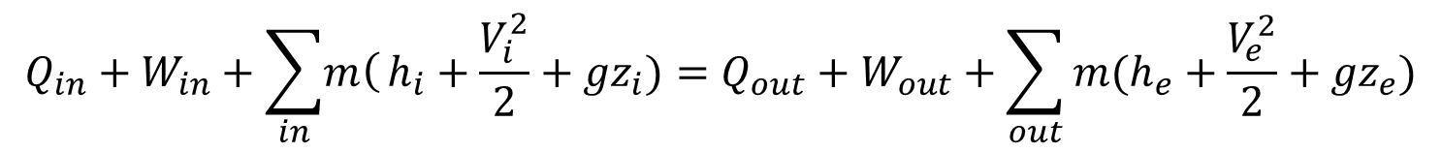
3. Energy Analysis of Vapor Compression Refrigeration Cycle
Energy Analysis of Vapor Compression Refrigeration Cycle
The general energy balance equation for open systems from the First law of thermodynamics is:
The energy analysis for the components of the vapor compression refrigeration cycle, i.e., compressor, condenser, expansion valve and
evaporator are derived below:
$$Q_{in}+W_{in}+\sum_{in}{\left.m\right(}h_{i}+\frac{V_{i}^{2}}{2}+{gz}_{i})=Q_{out}+W_{out}+\sum_{out}{m(h_{e}+\frac{V_{e}^{2}}{2}+{gz}_{e})}$$

Slide 9
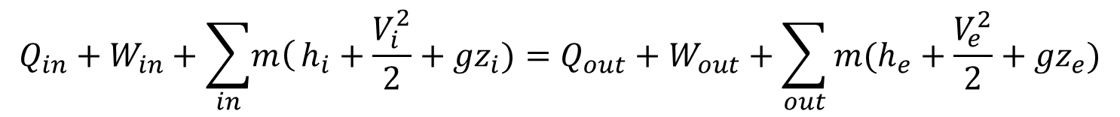
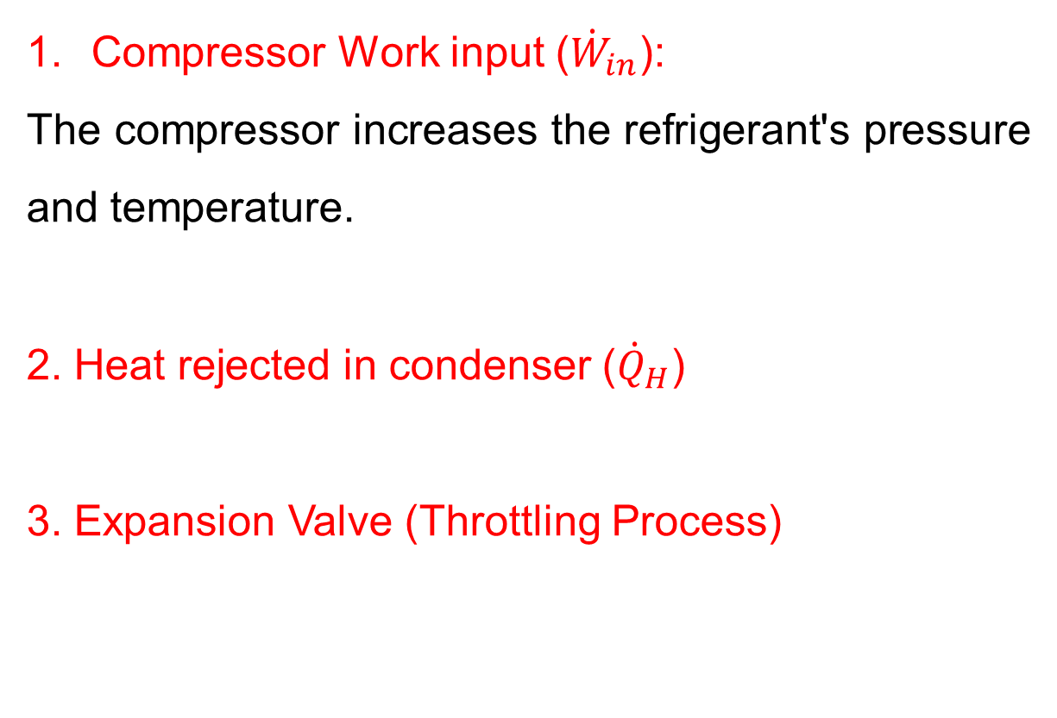

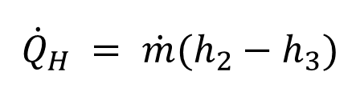

3. Energy Analysis of Vapor Compression Refrigeration Cycle Cont…
$$Q_{in}+W_{in}+\sum_{in}{\left.m\right(}h_{i}+\frac{V_{i}^{2}}{2}+{gz}_{i})=Q_{out}+W_{out}+\sum_{out}{m(h_{e}+\frac{V_{e}^{2}}{2}+{gz}_{e})}$$
Compressor Work input (${\dot{W}}_{in}$):
The compressor increases the refrigerant's pressure and temperature.
2. Heat rejected in condenser (${\dot{Q}}_{H}$)
3. Expansion Valve (Throttling Process)
$${\dot{W}}_{in}= \dot{m}(h_{2}−h_{1})$$
$${\dot{Q}}_{H} = \dot{m}(h_{2}−h_{3})$$
$$h_{3}=h_{4}$$

Slide 10
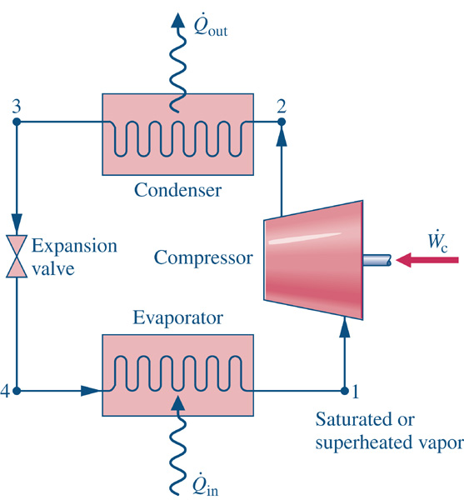
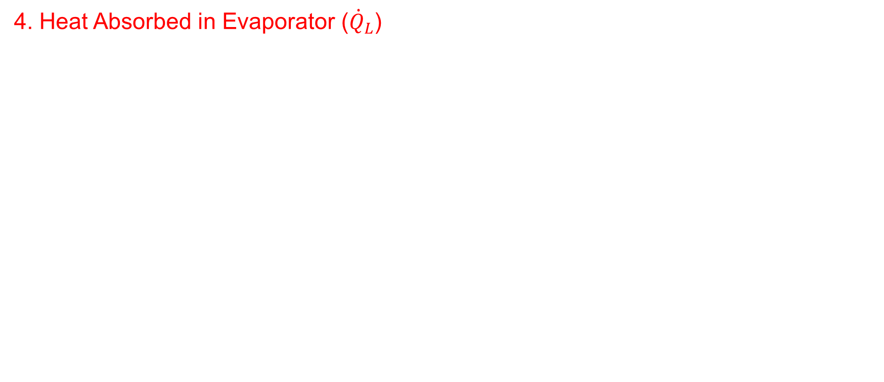
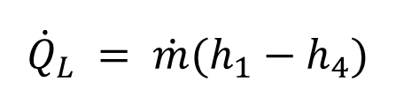
3. Energy Analysis of Vapor Compression Refrigeration Cycle Cont…
$$Q_{in}+W_{in}+\sum_{in}{\left.m\right(}h_{i}+\frac{V_{i}^{2}}{2}+{gz}_{i})=Q_{out}+W_{out}+\sum_{out}{m(h_{e}+\frac{V_{e}^{2}}{2}+{gz}_{e})}$$
4. Heat Absorbed in Evaporator (${\dot{Q}}_{L}$)
$${\dot{Q}}_{L} = \dot{m}(h_{1}−h_{4})$$
  Figure 2: Schematic diagram of a Vapor-Compression Refrigeration cycle
url: https://media.cheggcdn.com/media/568/568247de-742f-400f-b91f-8e0eb94052d5/php5lxL8G.png

Slide 11
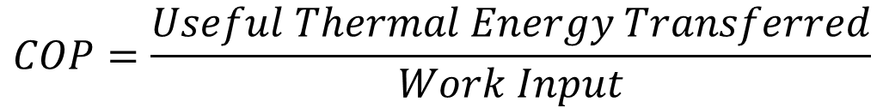
3. Energy Analysis of Vapor Compression Refrigeration Cycle Cont…
The coefficient of performance of the system becomes:
The coefficient of performance of a refrigerator becomes:
And, the coefficient of performance of a heat pump becomes:
$$COP=\frac{Useful Thermal Energy Transferred}{Work Input}$$
$${COP}_{R}=\frac{{Heat absorbed from cold space (Q}_{L})}{W_{net,in}}=\frac{Q_{L}}{W_{net,in}}=\frac{h_{1}−h_{4}}{h_{2}−h_{1}}$$
$${COP}_{HP}=\frac{{Heat delivered to warm space (Q}_{H})}{W_{net,in}}=\frac{Q_{H}}{W_{net,in}}=\frac{h_{2}−h_{3}}{h_{2}−h_{1}}$$

Slide 12
3. Energy Analysis of Vapor Compression Refrigeration Cycle Cont…
Refrigeration effect and capacity
The refrigeration effect and refrigeration capacity are two key parameters that define the performance of a vapor compression refrigeration system [2].
Refrigeration Effect (Cooling Effect per Unit Mass)
It is the amount of heat absorbed by the refrigerant in the evaporator per unit mass of refrigerant circulated.
$${Refrigeration Effect: q}_{in}=h_{1}−h_{4}$$

Slide 13
3. Energy Analysis of Vapor Compression Refrigeration Cycle Cont…
2. Refrigeration Capacity (Total Cooling Power)
It is the rate at which heat is absorbed in the evaporator, representing the system’s cooling power.
Refrigeration capacity is often expressed in tons of refrigeration.
1 ton of refrigeration is the steady state heat transfer rate
required to melt 1 ton of ice at 32°F in 24 hours [3].
1 ton = 12,000 Btu/hr = 3.516 kW
$$Refrigeration Capacity: {\dot{Q}}_{in}=\dot{m}(h_{1}−h_{4})$$

Slide 14
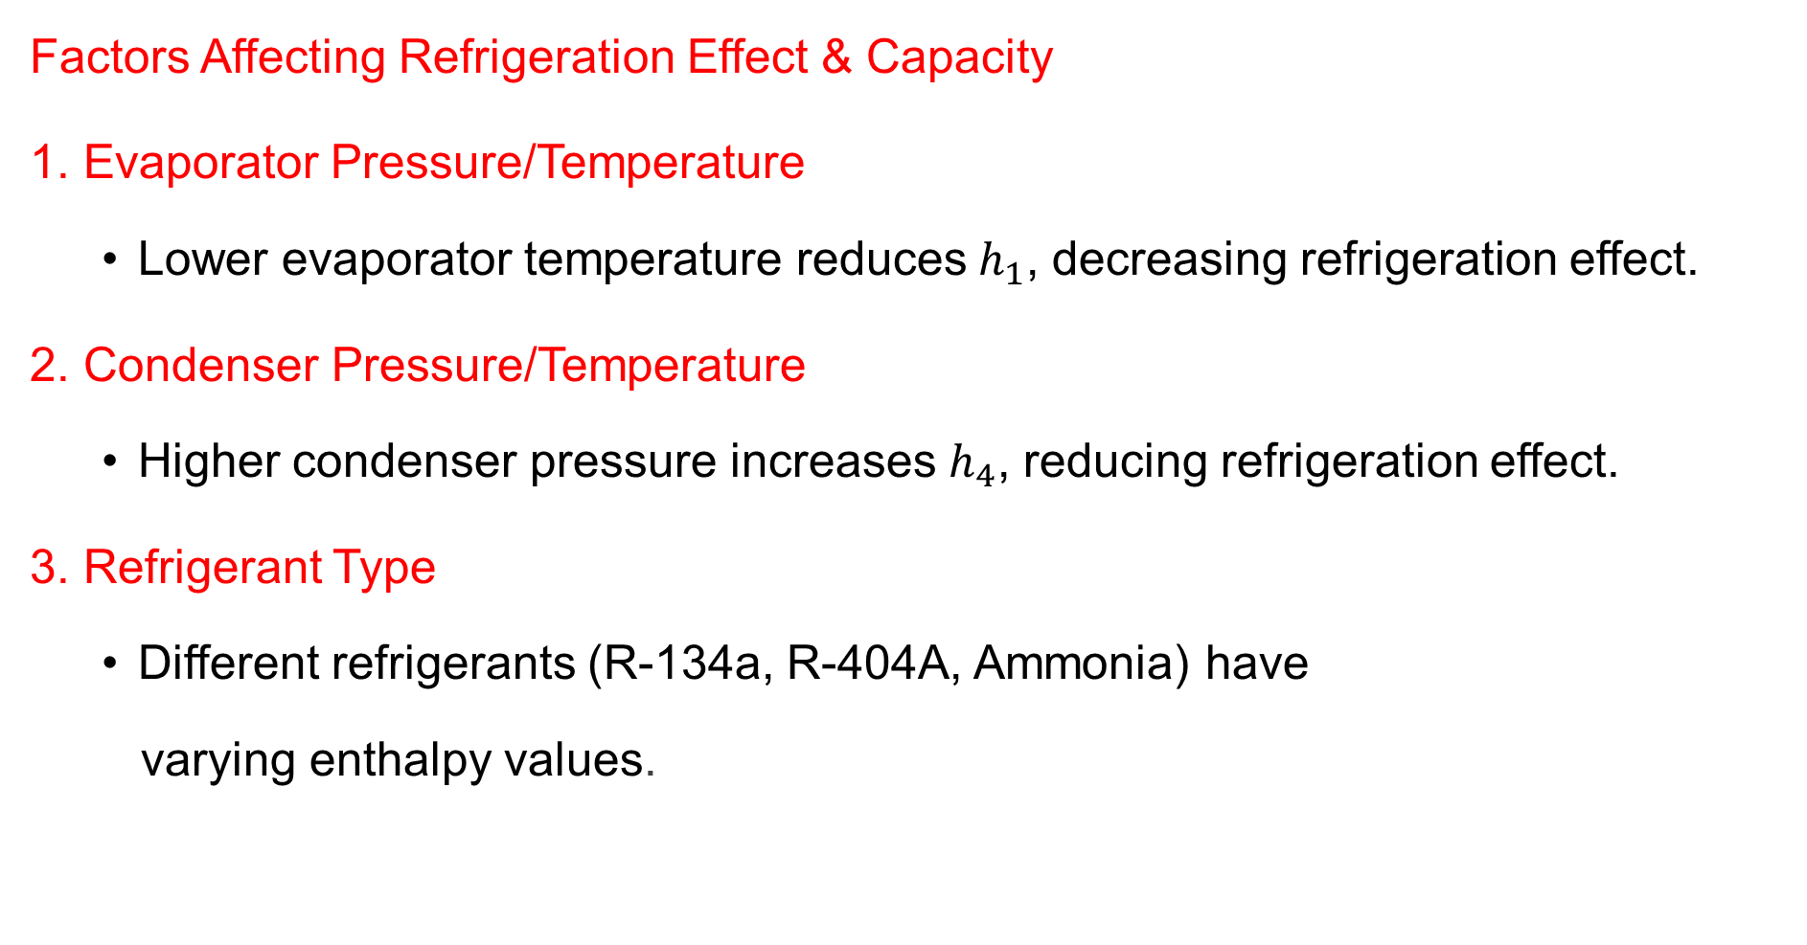
3. Energy Analysis of Vapor Compression Refrigeration Cycle Cont…
Factors Affecting Refrigeration Effect & Capacity
Evaporator Pressure/Temperature
  Lower evaporator temperature reduces${ h}_{1}$​, decreasing refrigeration effect.
Condenser Pressure/Temperature
  Higher condenser pressure increases $h_{4}$​, reducing refrigeration effect.
Refrigerant Type
  Different refrigerants (R-134a, R-404A, Ammonia) have
  varying enthalpy values.

Slide 15
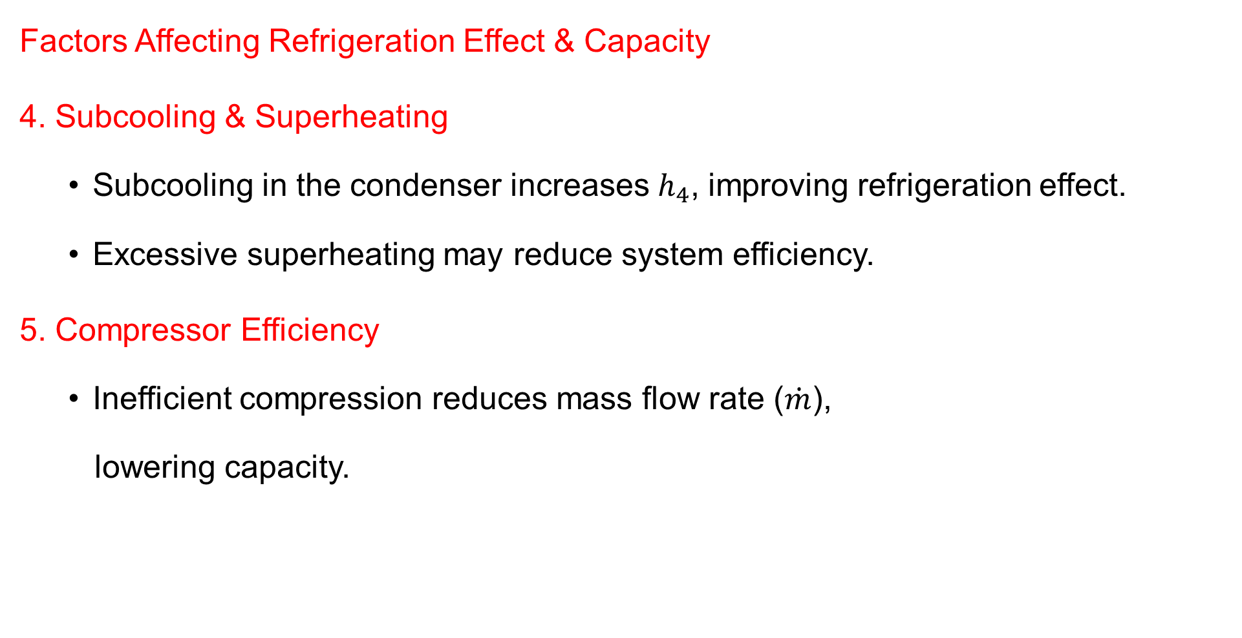
3. Energy Analysis of Vapor Compression Refrigeration Cycle Cont…
Factors Affecting Refrigeration Effect & Capacity
4. Subcooling & Superheating
  Subcooling in the condenser increases $h_{4}$​, improving refrigeration effect.
  Excessive superheating may reduce system efficiency.
5. Compressor Efficiency
  Inefficient compression reduces mass flow rate ($\dot{m}$),
  lowering capacity.

Slide 16
3. Energy Analysis of Vapor Compression Refrigeration Cycle Cont…
Example:
A refrigerator uses R-134a as the working fluid and operates on an ideal vapor-compression cycle between 0.14 MPa (evaporator pressure) and 0.8 MPa (condenser pressure). The refrigerant mass flow rate is 0.06 kg/s. Determine
  the rate of heat removal from the refrigerated space
  the power input to the compressor,
  the rate of heat rejection to the environment, and
  the coefficient of performance.

Slide 17
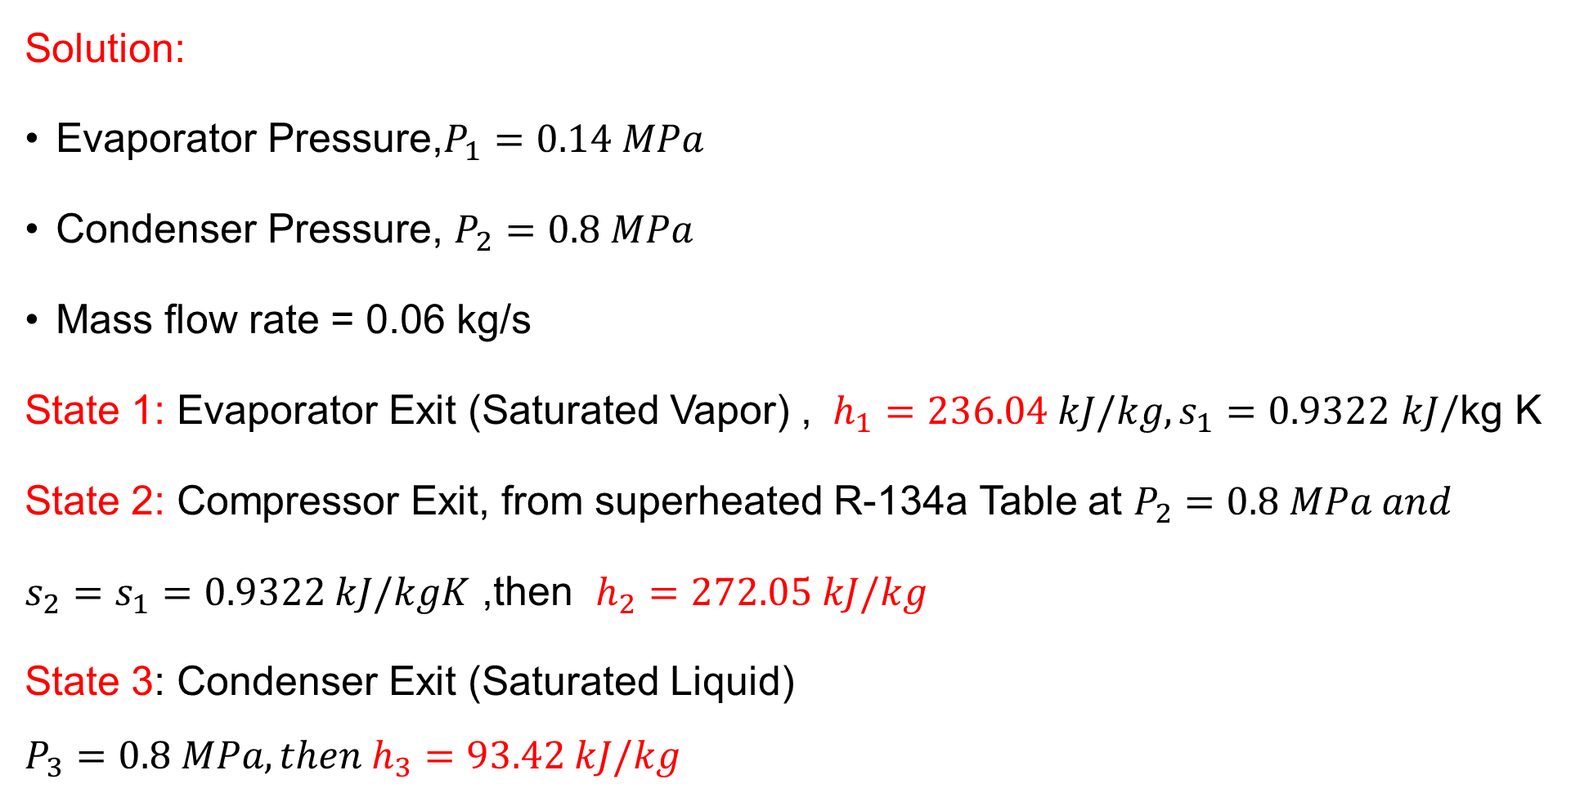
3. Energy Analysis of Vapor Compression Refrigeration Cycle Cont…
Solution:
Evaporator Pressure,$P_{1}=0.14 MPa$
Condenser Pressure, $P_{2}=0.8 MPa$
Mass flow rate = 0.06 kg/s
State 1: Evaporator Exit (Saturated Vapor) , $h_{1}=236.04 kJ/kg, s_{1}=0.9322 kJ/\text{kg} \text{K}$
State 2: Compressor Exit, from superheated R-134a Table at $P_{2}=0.8 MPa and$
$s_{2}=s_{1}=0.9322 kJ/kgK$ ,then $h_{2}=272.05 kJ/kg$
State 3: Condenser Exit (Saturated Liquid)
$$P_{3}=0.8 MPa, then h_{3}=93.42 kJ/kg$$

Slide 18
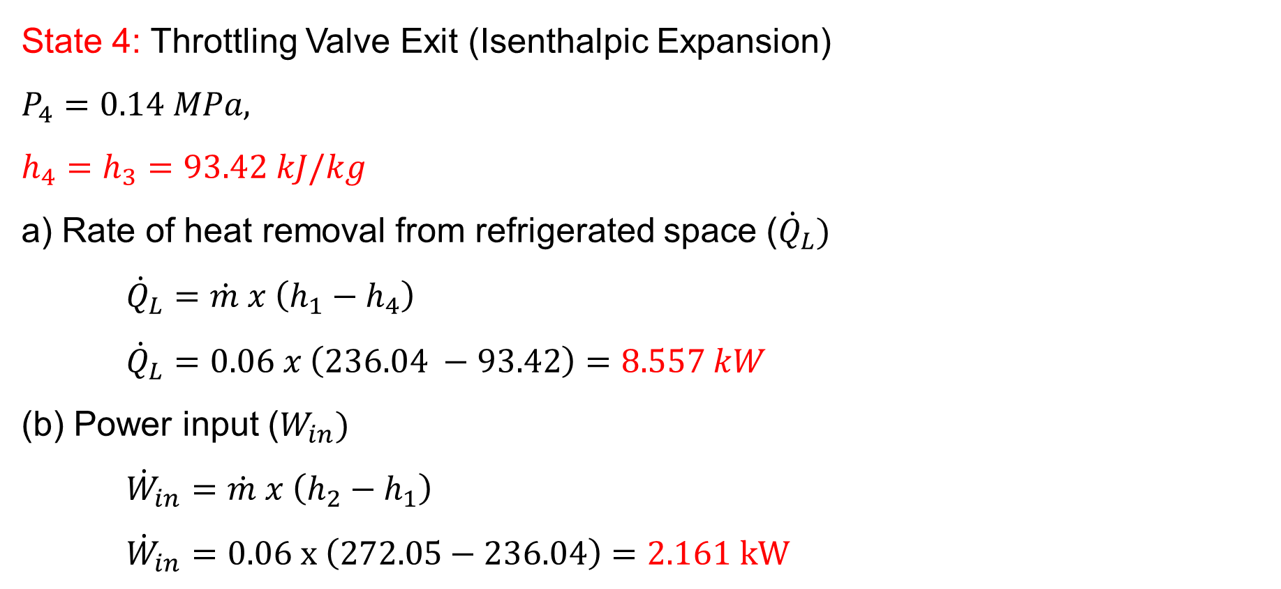
3. Energy Analysis of Vapor Compression Refrigeration Cycle Cont…
State 4: Throttling Valve Exit (Isenthalpic Expansion)
$$P_{4}=0.14 MPa,$$
$$h_{4}=h_{3}=93.42 kJ/kg$$
a) Rate of heat removal from refrigerated space (${\dot{Q}}_{L})$
    $${\dot{Q}}_{L}=\dot{m} x \left(h_{1}−h_{4}\right)$$
${\dot{Q}}_{L}=0.06 x \left(236.04 −93.42\right)=8.557 kW$
(b) Power input ($W_{in})$
    $${\dot{W}}_{in}=\dot{m} x \left(h_{2}−h_{1}\right)$$
    $${\dot{W}}_{in}=0.06 x \left(272.05−236.04\right)=2.161 kW$$

Slide 19
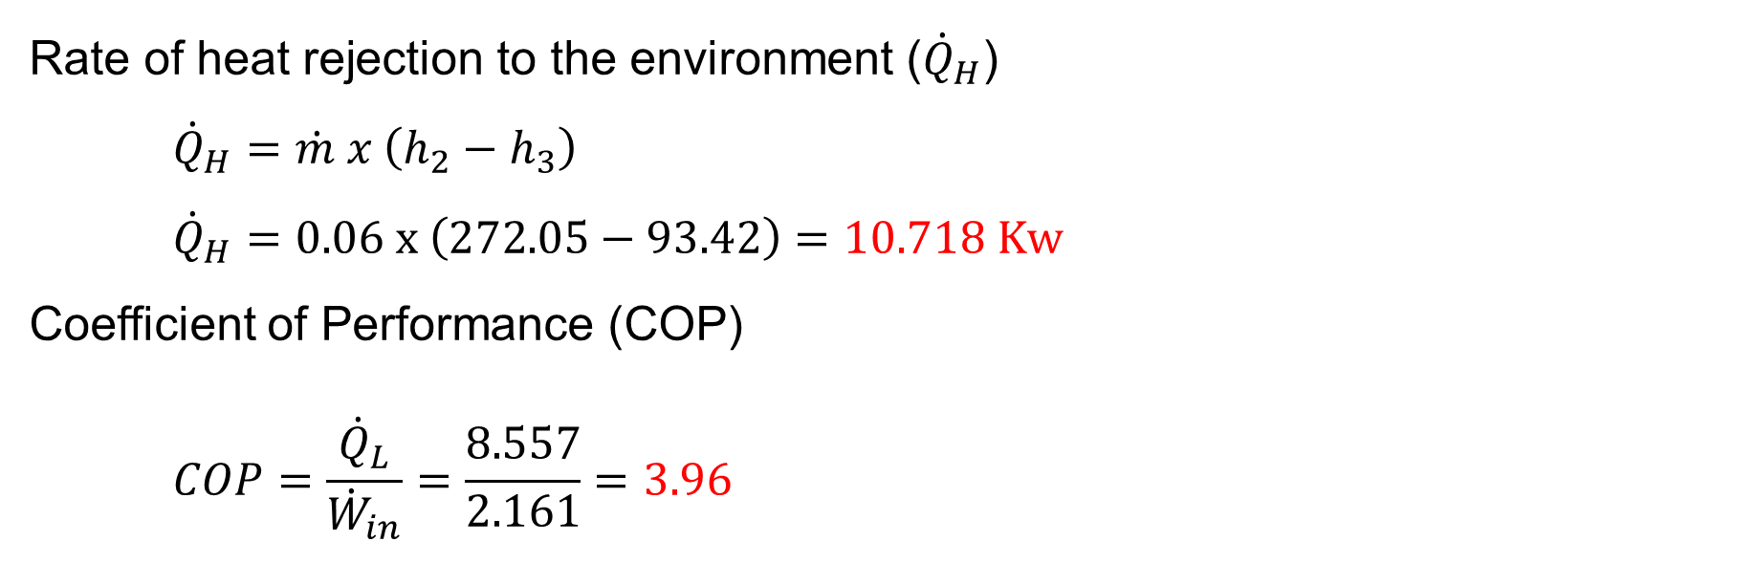
3. Energy Analysis of Vapor Compression Refrigeration Cycle Cont…
Rate of heat rejection to the environment (${\dot{Q}}_{H}$)
    $${\dot{Q}}_{H}=\dot{m} x \left(h_{2}−h_{3}\right)$$
    $${\dot{Q}}_{H}=0.06 x \left(272.05−93.42\right)=10.718 Kw$$
Coefficient of Performance (COP)
    $$COP=\frac{{\dot{Q}}_{L}}{{\dot{W}}_{in}}=\frac{8.557}{2.161}=3.96$$

Slide 20
4. Real Vapor Compression Refrigeration Cycle
While the ideal cycle assumes no losses, the actual cycle includes real-world inefficiencies such as pressure drops, irreversibilities, and non-isentropic compression.
Understanding these deviations is essential for improving system performance.
What are the deviations from the Ideal Cycle?
In reality, several factors affect the cycle's efficiency:
Non-Isentropic Compression:
  Due to mechanical inefficiencies and heat transfer,
  the compressor consumes more power than
  theoretically required.

Slide 21
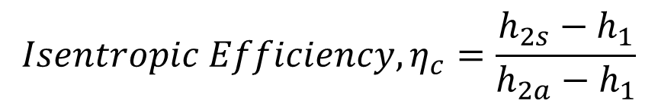
4. Real Vapor Compression Refrigeration Cycle Cont…
2. Pressure Drops:
  Friction losses in pipes and heat exchangers reduce the system’s efficiency.
3. Superheating & Subcooling:
  These processes affect performance by changing refrigerant properties before compression and expansion.
4. Heat Losses:
  Some heat exchange occurs with the environment,
  affecting cooling efficiency
$${Isentropic Efficiency, η}_{c}=\frac{h_{2s}−h_{1}}{h_{2a}−h_{1}}$$

Slide 22
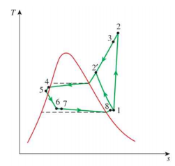
4. Real Vapor Compression Refrigeration Cycle Cont…
Modified T-s diagram for real vapor compression refrigeration cycle:
Figure 3: T-s diagram of the Real Vapor Compression Refrigeration cycle
url: https://media.cheggcdn.com/media/ab4/ab46b443-b47a-41ad-a8e8-589a5ef9a086/phpjkWIwu

Slide 23
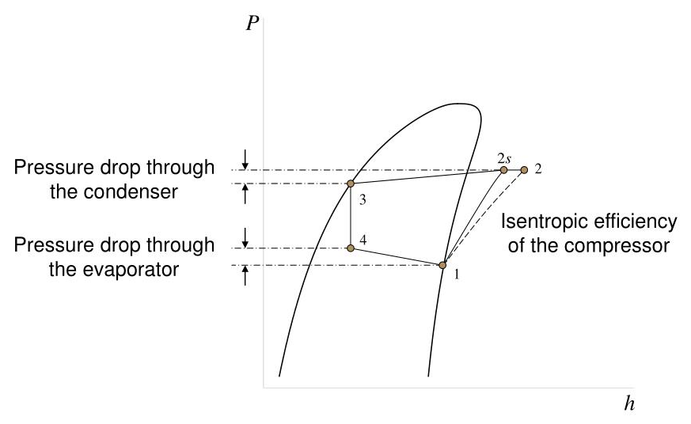
4. Real Vapor Compression Refrigeration Cycle Cont…
Modified P-h diagram for real vapor compression refrigeration cycle:
Figure 4: P-h diagram of the Real Vapor Compression Refrigeration cycle
url: https://image3.slideserve.com/6698726/vcr-cycle-irreversibilities-l.jpg

Slide 24
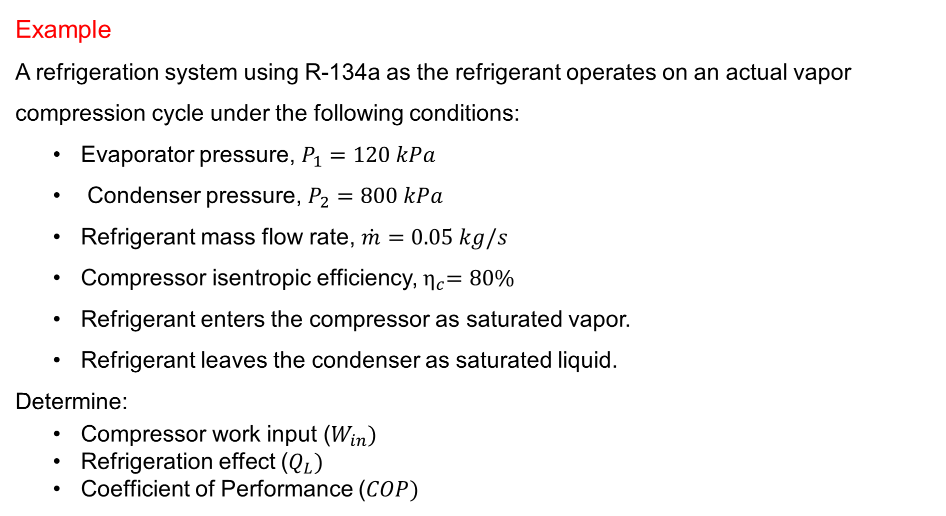
4. Real Vapor Compression Refrigeration Cycle Cont…
Example
A refrigeration system using R-134a as the refrigerant operates on an actual vapor compression cycle under the following conditions:
  Evaporator pressure, $P_{1}=120 kPa$
  Condenser pressure, $P_{2}=800 kPa$
  Refrigerant mass flow rate, $\dot{m}=0.05 kg/s$
  Compressor isentropic efficiency,${ η}_{c}=80\%$
  Refrigerant enters the compressor as saturated vapor.
  Refrigerant leaves the condenser as saturated liquid.
Determine:
  Compressor work input ($W_{in})$
  Refrigeration effect ($Q_{L})$
  Coefficient of Performance ($COP)$

Slide 25
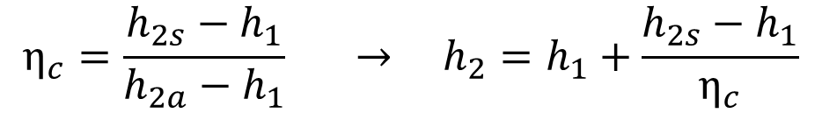
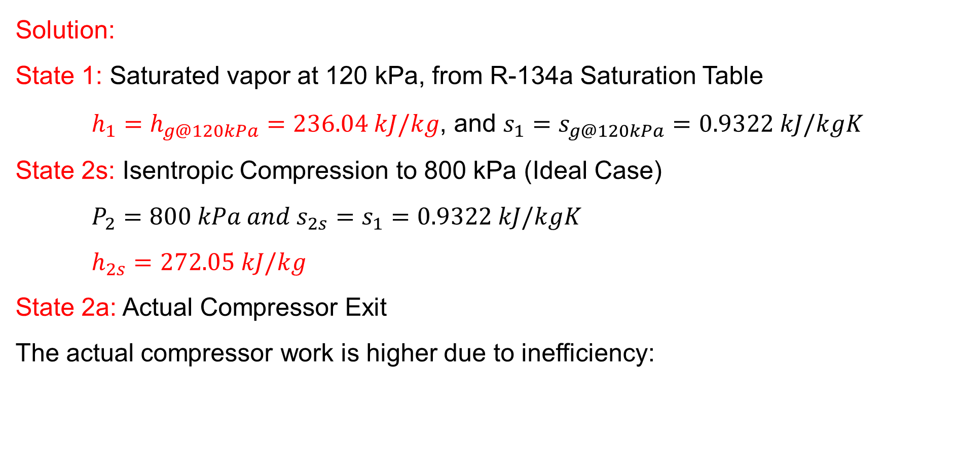
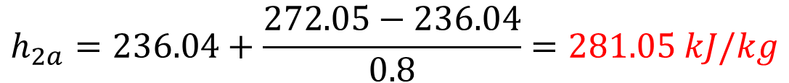
4. Real Vapor Compression Refrigeration Cycle Cont…
Solution:
State 1: Saturated vapor at 120 kPa, from R-134a Saturation Table
    $h_{1}=h_{g@120kPa}=236.04 kJ/kg$, and $s_{1}=s_{g@120kPa}=0.9322 kJ/kgK$
State 2s: Isentropic Compression to 800 kPa (Ideal Case)
    $$P_{2}=800 kPa and s_{2s}=s_{1}=0.9322 kJ/kgK$$
    $$h_{2s}=272.05 kJ/kg$$
State 2a: Actual Compressor Exit
The actual compressor work is higher due to inefficiency:
$$η_{c}=\frac{h_{2s}−h_{1}}{h_{2a}−h_{1}} → h_{2}=h_{1}+\frac{h_{2s}−h_{1}}{η_{c}}$$
$$h_{2a}=236.04+\frac{272.05−236.04}{0.8}=281.05 kJ/kg$$

Slide 26


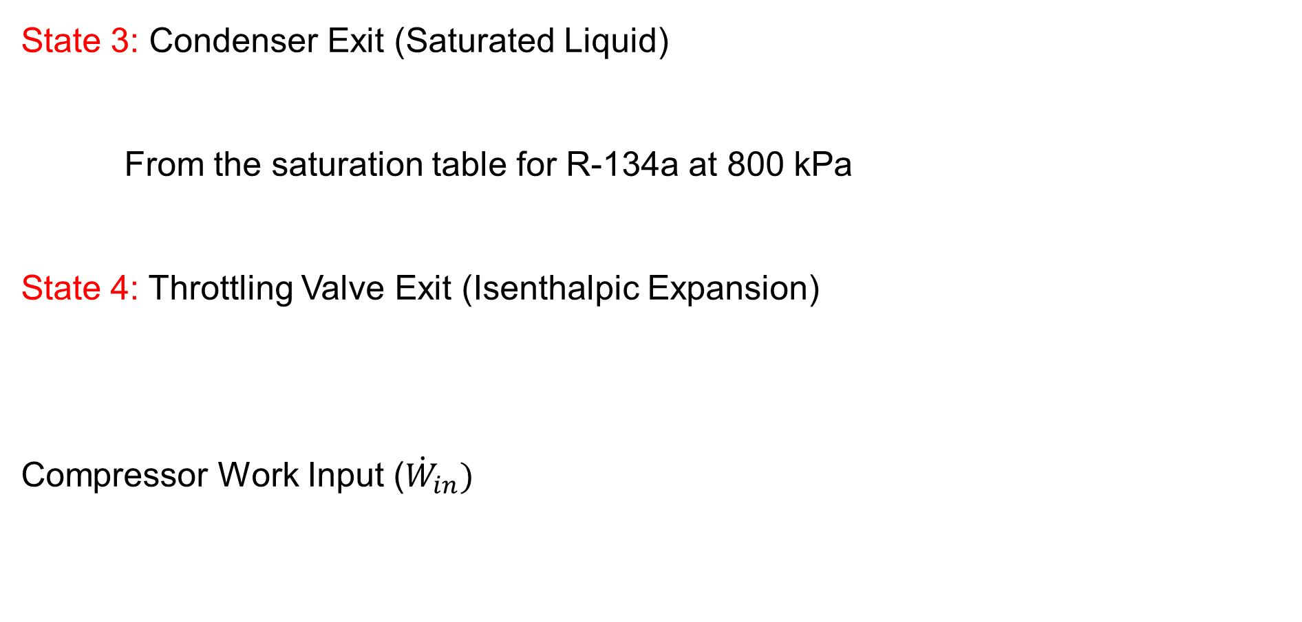



4. Real Vapor Compression Refrigeration Cycle Cont…
State 3: Condenser Exit (Saturated Liquid)
From the saturation table for R-134a at 800 kPa
State 4: Throttling Valve Exit (Isenthalpic Expansion)
Compressor Work Input (${\dot{W}}_{in})$
$$P_{3}=800 kPa$$
$$h_{3}=93.42 kJ/kg$$
$$P_{4}=120 kPa$$
$$h_{3}{=h}_{4}=93.42 kJ/kg$$
$${\dot{W}}_{in}=\dot{m} x (h_{2a}−h_{1})$$
$${\dot{W}}_{in}=0.05 x \left(281.05−236.04\right)=2.25 kW$$

Slide 27
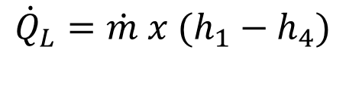
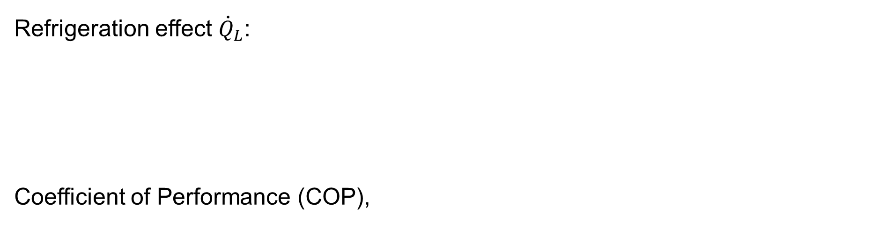
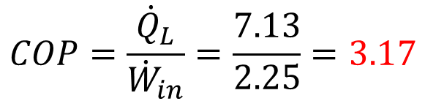
4. Real Vapor Compression Refrigeration Cycle Cont…
Refrigeration effect ${\dot{Q}}_{L}$:
Coefficient of Performance (COP),
$${\dot{Q}}_{L}=\dot{m} x (h_{1}−h_{4})$$
$${\dot{Q}}_{L}=0.05 x \left(236.04−93.42\right)=7.13 kW$$
$$COP=\frac{{\dot{Q}}_{L}}{{\dot{W}}_{in}}=\frac{7.13}{2.25}=3.17$$
To improve efficiency:
Using multi-stage compression reduces work input.
Employing intercoolers and reheaters improves thermodynamic
performance.
Optimizing refrigerant selection for environmental and
efficiency considerations.

Slide 28
5. Vapor Absorption Refrigeration Cycle (VAR)
The Vapor Absorption Refrigeration Cycle (VAR) is an alternative to the conventional vapor compression refrigeration cycle (VCR).
Instead of using a mechanical compressor, it relies on thermal energy (heat) to drive the refrigeration process.
Unlike vapor compression refrigeration (VCR) systems, the required input to absorption systems is in the form of heat.
VARs are called heat operated or thermal energy driven systems.
Widely used in various refrigeration and air conditioning
applications [4].

Slide 29
5. Vapor Absorption Refrigeration Cycle Cont…
They are preferred when low-grade energy such as waste heat or solar energy is available.
Since conventional absorption systems use natural refrigerants such as water or ammonia they are environment friendly [5].
VAR differ from VCR only in the method of compressing the refrigerant
Compressor is replaced by three main elements
    an absorber,
    a solution pump, and
    a generator.

Slide 30
5. Vapor Absorption Refrigeration Cycle Cont…
The components of VAR
Component | Function
Absorber | Absorbs refrigerant vapor into the absorbent (e.g., NH₃ in H₂O).
Pump | Increases pressure of the liquid solution (NH₃ + H₂O).
Generator | Uses heat to separate refrigerant (NH₃) from the absorbent (H₂O).
Condenser | Condenses high-pressure refrigerant vapor into liquid.
Expansion Valve | Reduces pressure of the refrigerant before evaporation.
Evaporator | Absorbs heat from the cooling space, turning liquid refrigerant into vapor.

Slide 31
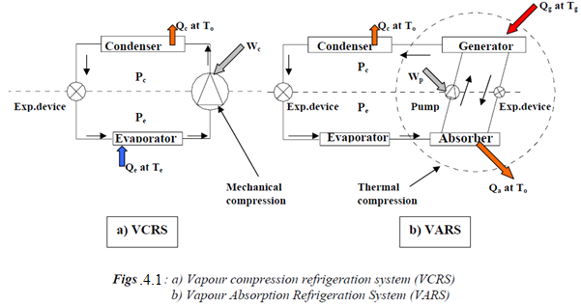
5. Vapor Absorption Refrigeration Cycle Cont…
The difference between VCR and VAR
Figure 5: The differences between VCR and VAR
url: https://ecampusontario.pressbooks.pub/app/uploads/sites/3587/2023/10/comparions-300x175.png

Slide 32
5. Vapor Absorption Refrigeration Cycle Cont…
The VAR operates based on the principle of absorbing refrigerant vapor into an absorbent, then releasing it using heat.
The most widely used system is the Ammonia–Water system
  Ammonia (NH₃) serves as the refrigerant and
  Water (H₂O) as the transport medium
Water–Lithium Bromide and
  Water serves as the refrigerant
Water–Lithium Chloride systems
  Water serves as the refrigerant

Slide 33
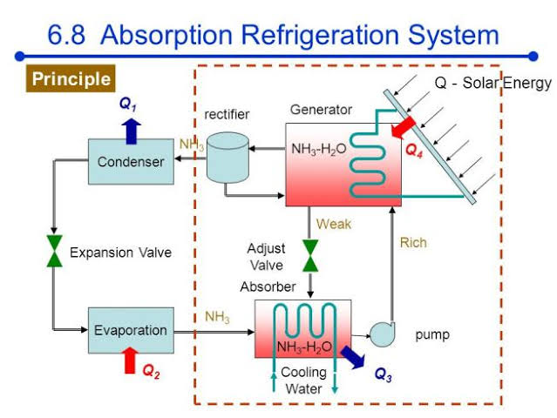
5. Vapor Absorption Refrigeration Cycle Cont…
The working principle of Ammonia (NH₃) –Water (H₂O) VAR systems
Figure 6: Working principle of Ammonia-Water VAR System
url: https://encrypted-tbn1.gstatic.com/images?q=tbn:ANd9GcSMr71cw7swRUZQV8jdzh2_sMnx2PMamdfEzEsW9jjMoj2xLZJG

Slide 34
5. Vapor Absorption Refrigeration Cycle Cont…
The working principle of NH₃ + H₂O VARC
Step 1: Absorption
  Refrigerant vapor (NH₃) from the evaporator is absorbed by a weak absorbent (H₂O) in the absorber.
  This forms a strong solution (NH₃ + H₂O) and releases heat, which is removed by cooling water.
Step 2: Pumping
  The pump increases the pressure of the strong solution and sends it to the generator.

Slide 35
5. Vapor Absorption Refrigeration Cycle Cont…
Step 3: Generation (Desorption)
  In the generator, heat (from steam, waste heat, or solar energy) is supplied to separate NH₃ vapor from H₂O.
  The weak solution (H₂O) returns to the absorber via a pressure-reducing valve.
Step 4: Condensation
  The high-pressure NH₃ vapor moves to the condenser, where it rejects heat and condenses into liquid NH₃.

Slide 36
5. Vapor Absorption Refrigeration Cycle Cont…
Step 5: Expansion & Evaporation
  Liquid NH₃ passes through an expansion valve, reducing its pressure and temperature
  In the evaporator, it absorbs heat from the refrigerated space, turning back into vapor.

Slide 37
5. Vapor Absorption Refrigeration Cycle Cont…
Advantages of VAR
No moving parts (except pump) → Less maintenance.
Can use waste heat/solar energy → Energy-efficient.
Environmentally friendly (uses natural refrigerants like NH₃).
Disadvantages of VAR
Lower COP compared to VCR.
Bulky system (requires absorber, generator, etc.).
Corrosion issues (especially with LiBr systems).

Slide 38
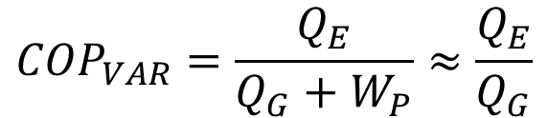
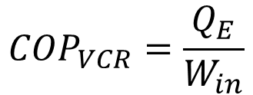
5. Vapor Absorption Refrigeration Cycle Cont…
Performance Evaluation of Vapor Absorption Refrigeration Cycles
The solution pump work is often negligible compared to the generator heat input.
Thus the COPs for compression and absorption systems are given by:
$${COP}_{VCR}=\frac{Q_{E}}{W_{in}}$$
$${COP}_{VAR}=\frac{Q_{E}}{Q_{G}+W_{P}}≈\frac{Q_{E}}{Q_{G}}$$

Slide 39
5. Vapor Absorption Refrigeration Cycle Cont…
Comparison of Coefficient of Performance of VCR and VAR
The COP of VCRs will be much higher than the COP of VARs as a high grade mechanical energy is used in the former, while a low-grade thermal energy is used in the latter.
However, comparing these systems based on COPs is not fully justified, as mechanical energy is more expensive than thermal energy.

Slide 40
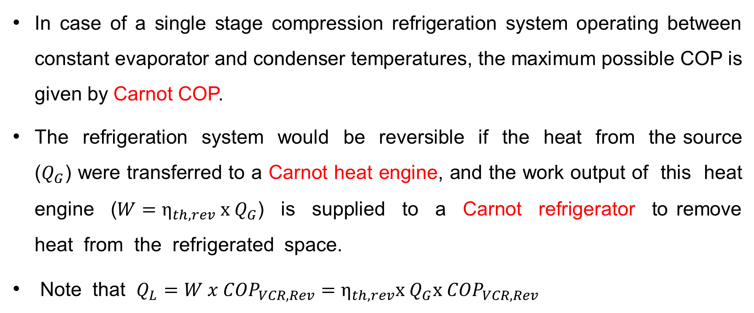
5. Vapor Absorption Refrigeration Cycle Cont…
In case of a single stage compression refrigeration system operating between constant evaporator and condenser temperatures, the maximum possible COP is given by Carnot COP.
The refrigeration system would be reversible if the heat from the source ($Q_{G}$) were transferred to a Carnot heat engine, and the work output of this heat engine ($W=η_{th, rev} x Q_{G}$) is supplied to a Carnot refrigerator to remove heat from the refrigerated space.
Note that $Q_{L}=W x {COP}_{VCR, Rev}=η_{th, rev}x Q_{G}x {COP}_{VCR,Rev}$
$${COP}_{VAR,Rev}=\frac{Q_{L}}{Q_{G}}=η_{th, rev} x {COP}_{VCRC,Rev}=\left(1−\frac{T_{o}}{T_{s}}\right)\left(\frac{T_{L}}{T_{o}−T_{L}}\right)$$

Slide 41
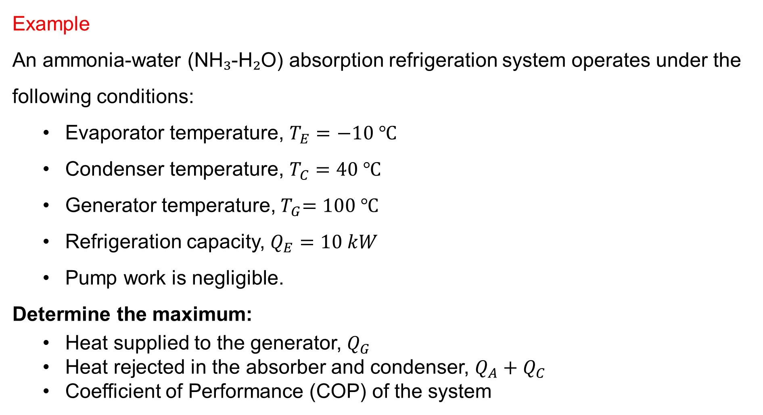
5. Vapor Absorption Refrigeration Cycle Cont…
Example
An ammonia-water (NH₃-H₂O) absorption refrigeration system operates under the following conditions:
  Evaporator temperature, $T_{E}=−10 ℃$
  Condenser temperature, $T_{C}=40 ℃$
  Generator temperature,${ T}_{G}=100 ℃$
  Refrigeration capacity, $Q_{E}=10 kW$
  Pump work is negligible.
Determine the maximum:
  Heat supplied to the generator, $Q_{G}$
  Heat rejected in the absorber and condenser, $Q_{A}+Q_{C}$
  Coefficient of Performance (COP) of the system

Slide 42
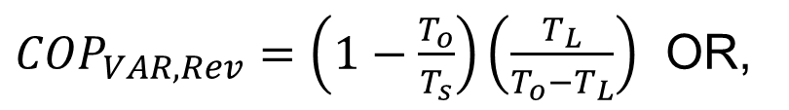

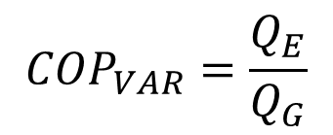

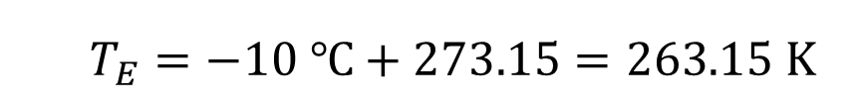
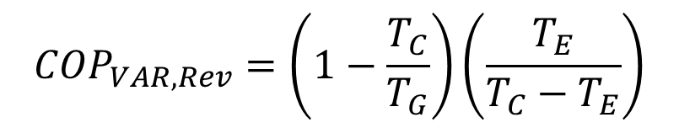
5. Vapor Absorption Refrigeration Cycle Cont…
Solution:
Determine the COP of the Absorption System:
Let’s determine the Carnot COP of an absorption refrigerator:
$${COP}_{VAR}=\frac{Q_{E}}{Q_{G}}$$
${COP}_{VAR,Rev}=\left(1−\frac{T_{o}}{T_{s}}\right)\left(\frac{T_{L}}{T_{o}−T_{L}}\right)$ OR,
$${COP}_{VAR,Rev}=\left(1−\frac{T_{C}}{T_{G}}\right)\left(\frac{T_{E}}{T_{C}−T_{E}}\right)$$
  $$T_{E}=−10 ℃+273.15=263.15 K$$
  ${ T}_{C}=40 ℃+273.15=313.15 K$
${ T}_{G}=100 ℃+273.15=373.15 K$

Slide 43
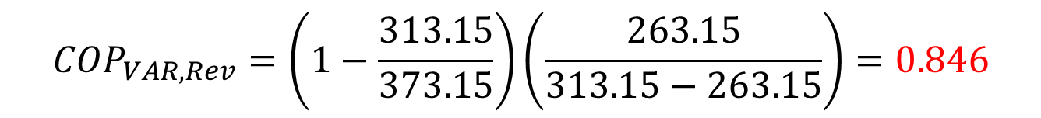
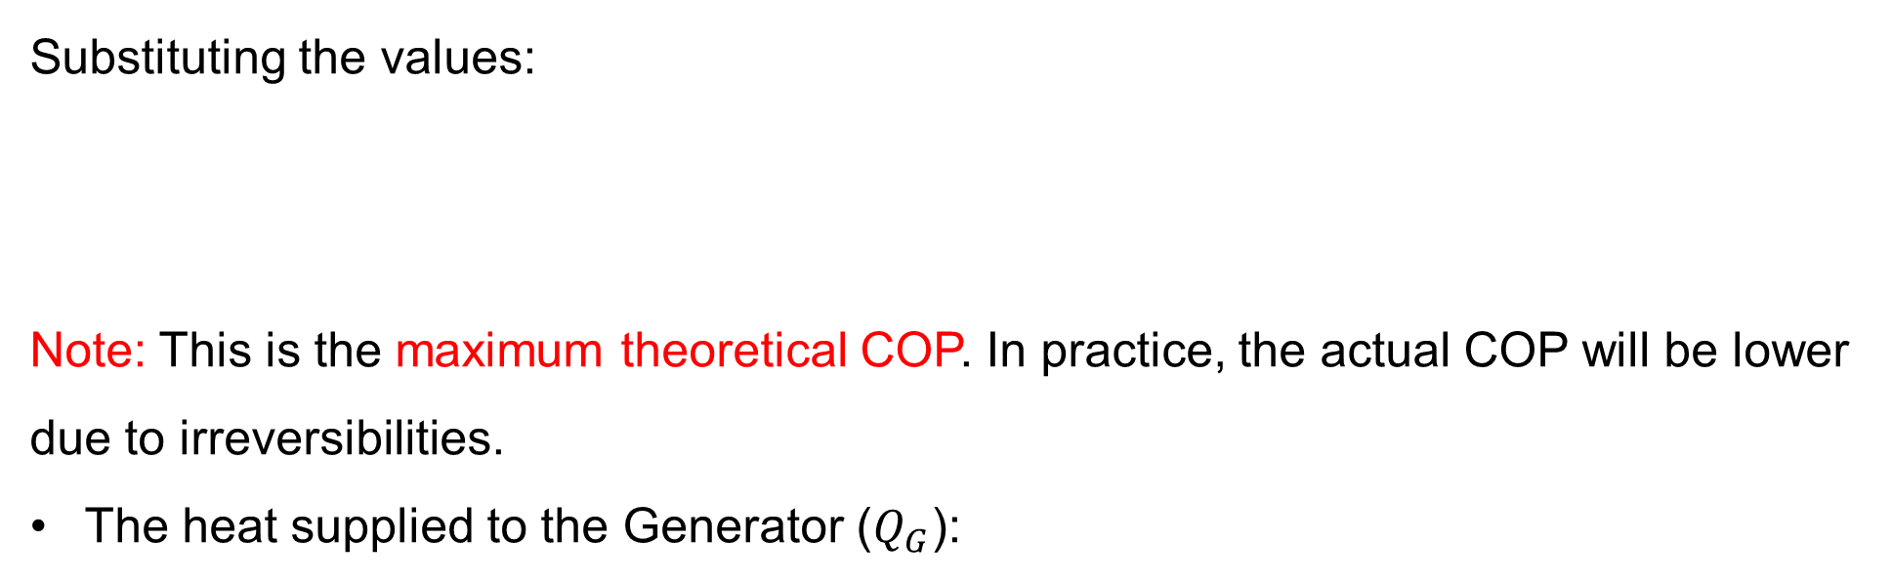
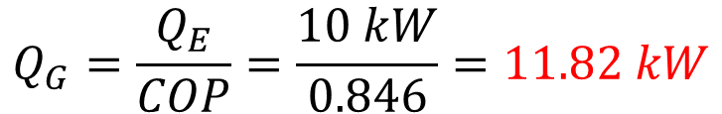
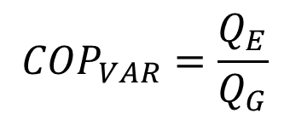
5. Vapor Absorption Refrigeration Cycle Cont…
Substituting the values:
Note: This is the maximum theoretical COP. In practice, the actual COP will be lower due to irreversibilities.
The heat supplied to the Generator ($Q_{G}$):
$${COP}_{VAR,Rev}=\left(1−\frac{313.15}{373.15}\right)\left(\frac{263.15}{313.15−263.15}\right)=0.846$$
$${COP}_{VAR}=\frac{Q_{E}}{Q_{G}}$$
$$Q_{G}=\frac{Q_{E}}{COP}=\frac{10 kW}{0.846}=11.82 kW$$

Slide 44

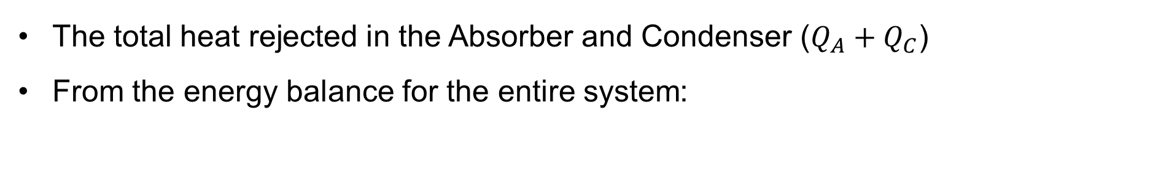
5. Vapor Absorption Refrigeration Cycle Cont…
The total heat rejected in the Absorber and Condenser ($Q_{A}+Q_{C}$)
From the energy balance for the entire system:
$$Q_{G}+Q_{E}=Q_{A}+Q_{C}$$
$$Q_{A}+Q_{C}=11.82 kW+10 kW=21.82 kW$$

Slide 45
Summary
Ideal Vapor Compression Refrigeration Cycle operates with four main processes—compression, condensation, expansion, and evaporation—under idealized conditions without inefficiencies like friction or pressure drops.
Energy analysis of Vapor Compression Refrigeration Cycle evaluates energy consumption and efficiency using performance parameters like the coefficient of performance (COP), which measures cooling effect relative to work input.
Real Vapor Compression Refrigeration Cycle considers practical losses such as pressure drops, non-ideal compressor efficiency, and refrigerant property variations, leading to deviations from the ideal cycle.
Vapor Absorption Refrigeration Cycle uses thermal energy (rather than mechanical work) to drive the refrigeration cycle, commonly employing
a liquid absorbent and refrigerant pair, such as lithium
bromide and water.

Slide 46
References
,
[1]. Thermodynamics – An Engineering Approach, Cengel Y A.,Bole M A., McGraw-Hill Education, 8th edition 2015.
[2]. Refrigeration and Air Conditioning Technology, William C. Whitman, William M. Johnson, John A. Tomczyk, Cengage Learning, 2022 (9th Edition).
[3]. Principles of Refrigeration, Roy J. Dossat, Horace J. Horan, Pearson, 2002, (5th Edition)
[4]. Absorption Cooling: Advances in Refrigeration and Heat Pump Technology, Kim Choon Ng, Bidyut Baran Saha, Anutosh Chakraborty, Springer, 2017.
[5]. Absorption Chillers and Heat Pumps, Keith E. Herold, Reinhard Radermacher, Sanford A. Klein, CRC Press, 2016.

Slide 47
Thank you !

