Slide 1
Engineering Thermodynamics I
Week 15
Assessments
Final Exam
Lecturer: Dr. Melaku Desta

Slide 2
This exam contains two parts:
  Multiple Choice Questions (40 Questions_2 marks each)
  Short Answer Questions (4 Questions_ 5 marks each)
  Total marks = 100
  Attempt all questions
  Time allotted: 90 minutes

Slide 3
Multiple Choice Questions
What is a thermodynamic system?
  A) Everything in the universe except the system
  B) The physical space separating the system from the surroundings
  C) A quantity of matter or a region in space chosen for study
  D) The external environment interacting with the system
Which type of thermodynamic system does not allow the transfer of mass but allows energy transfer?
  A) Open system
  B) Closed system
  C) Isolated system
  D) Adiabatic system

Slide 4
Multiple Choice Questions
Which of the following is an intensive property of a thermodynamic system?
  A) Mass
  B) Volume
  C) Temperature
  D) Total Energy
Which pair consists of both extensive properties?
  A) Pressure and Enthalpy
  B) Density and Internal Energy
  C) Volume and Entropy
  D) Temperature and Specific Heat

Slide 5
Multiple Choice Questions
The state of a thermodynamic system is defined by:
  A) Only its temperature and pressure
  B) A set of independent thermodynamic properties
  C) The path taken to reach the current condition
  D) Only its internal energy and volume
A thermodynamic process describes:
  A) The initial and final equilibrium states only
  B) The series of intermediate states through which the system passes
  C) The surroundings of the system
  D) Only the work done during the change

Slide 6
Multiple Choice Questions
A quasi-static process is characterized by:
  A) Rapid changes and system disequilibrium
  B) No heat transfer with the surroundings
  C) Infinitely slow changes maintaining near-equilibrium at all times
  D) Irreversibility due to finite driving forces
Which process is reversible?
  A) Free expansion of a gas into a vacuum
  B) Heat transfer across a finite temperature difference
  C) Frictionless, quasi-static compression of a gas
  D) Mixing of two dissimilar gases

Slide 7
Multiple Choice Questions
The First Law of Thermodynamics for a closed system is best expressed as:
  A) Q=W
  B) ΔU=Q−W
  C) ΔU=Q+W
  D) ΔU=W−Q
10. Which of the following is not a mechanism of energy transfer in thermodynamics?
  A) Heat
  B) Work
  C) Mass flow
  D) Radiation

Slide 8
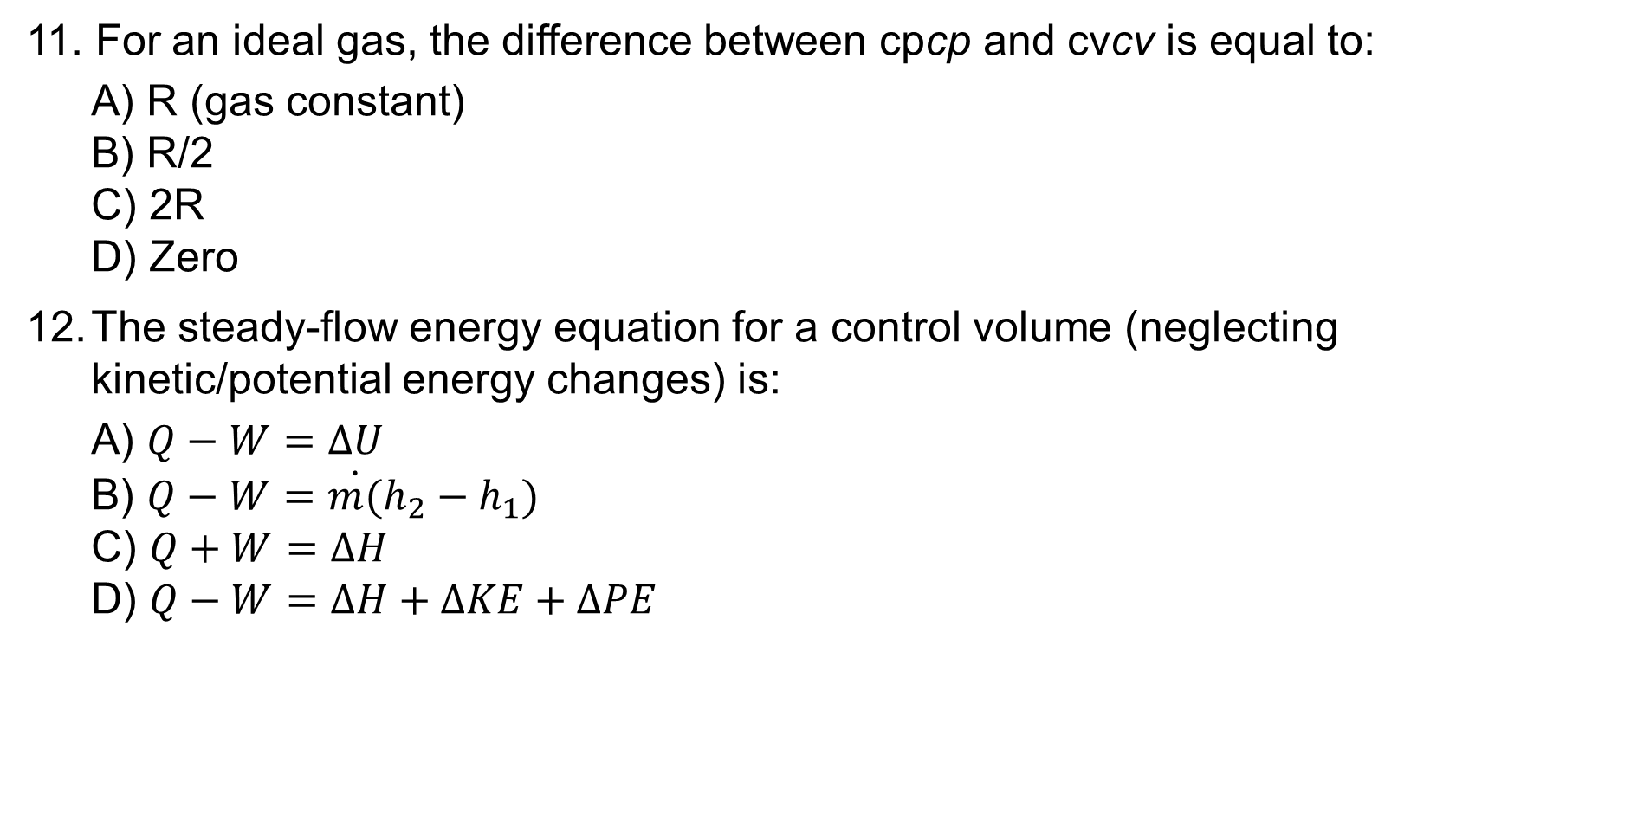
Multiple Choice Questions
11. For an ideal gas, the difference between cpcp​ and cvcv​ is equal to:
  A) R (gas constant)
  B) R/2​
  C) 2R
  D) Zero
The steady-flow energy equation for a control volume (neglecting kinetic/potential energy changes) is:
  A) $Q−W=∆U$
  B) $Q−W=\dot{m(}h_{2}−h_{1})$
  C) $Q+W=∆H$
  D) $Q−W=∆H+∆KE+∆PE$

Slide 9
Multiple Choice Questions
13. Flow work is associated with:
  A) The energy required to push fluid into/out of a control volume
  B) The kinetic energy of the fluid
  C) The internal energy of the fluid
  D) The heat transfer during flow
14. In a nozzle, which energy form increases at the expense of enthalpy?
  A) Internal energy
  B) Kinetic energy
  C) Potential energy
  D) Flow work

Slide 10
Multiple Choice Questions
During a phase-change process of a pure substance, the temperature and pressure:
  A) Both remain constant
  B) Both increase
  C) Both decrease
  D) Temperature increases while pressure decreases
16. Which of the following qualifies as a pure substance?
  A) Air (mixture of N₂, O₂, etc.)
  B) Saltwater solution
  C) Liquid water in equilibrium with its vapor
  D) A mixture of ice and liquid water

Slide 11
Multiple Choice Questions
17. On a T-v (Temperature-specific volume) diagram, the critical point is defined as:
  A) The highest temperature where liquid and vapor coexist
  B) The point where liquid and solid phases merge
  C) The point where latent heat becomes zero
  D) The lowest pressure where a substance can exist as a liquid
18. The term "saturated liquid" refers to a state where:
  A) The liquid is at its boiling point and any heat addition causes vaporization
  B) The liquid contains dissolved gases
  C) The liquid is superheated
  D) The liquid is at its freezing point

Slide 12
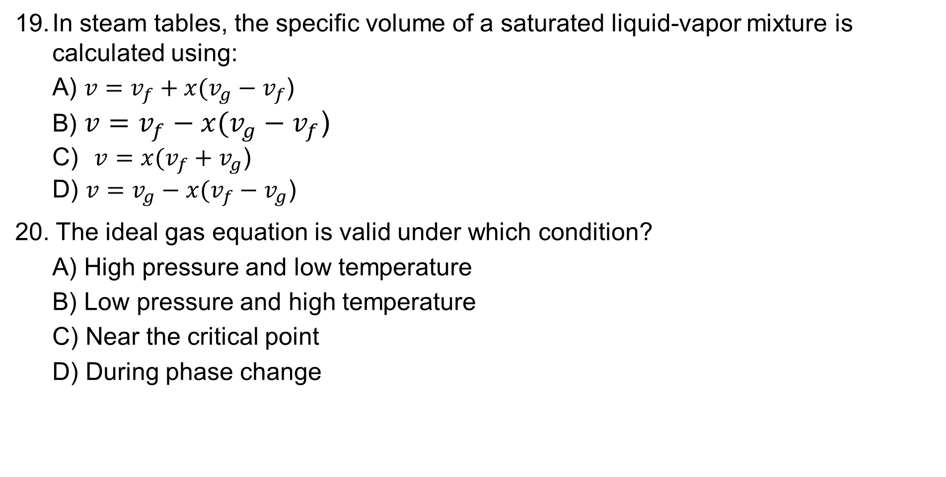
Multiple Choice Questions
In steam tables, the specific volume of a saturated liquid-vapor mixture is calculated using:
  A) $v=v_{f}+x(v_{g}−v_{f}$)
  B) $v=v_{f}−x(v_{g}−v_{f}$)
  C) $v=x(v_{f}+v_{g}\text{)}$
  D) $v=v_{g}−x(v_{f}−v_{g}$)
20. The ideal gas equation is valid under which condition?
  A) High pressure and low temperature
  B) Low pressure and high temperature
  C) Near the critical point
  D) During phase change

Slide 13
Multiple Choice Questions
21. The compressibility factor (Z) for an ideal gas is:
  A) Z=0
  B) Z=1
  C) Z=∞
  D) Z=Pv/RT
22. The principle of corresponding states suggests that:
  A) All gases have the same equation of state
  B) All gases behave identically at the same reduced pressure and temperature
  C) Compressibility factor is always unity
  D) Vapor pressure is independent of molecular structure

Slide 14
Multiple Choice Questions
23. The Second Law of Thermodynamics implies that:
  A) Energy cannot be created or destroyed
  B) Heat always flows from a hotter body to a colder one spontaneously
  C) The entropy of an isolated system can never decrease
  D) Both (B) and (C)
24. A thermal energy reservoir is defined as a body that:
  A) Can absorb or reject finite amounts of heat without changing temperature
  B) Has infinite heat capacity
  C) Operates in a reversible cycle
  D) Both (A) and (B)

Slide 15
Multiple Choice Questions
25. The efficiency of a Carnot heat engine operating between 500 K and 300 K is:
  A) 20%
  B) 40%
  C) 60%
  D) 80%
26. In a Rankine cycle, which process converts thermal energy into mechanical work?
  A) Isentropic compression in the pump
  B) Heat addition in the boiler
  C) Isentropic expansion in the turbine
  D) Heat rejection in the condenser

Slide 16
Multiple Choice Questions
A heat engine rejecting 200 kJ of heat to a sink at 300 K while absorbing 400 kJ from a source at 600 K violates:
  A) The First Law
  B) The Second Law
  C) Both laws
  D) Neither law
28. The coefficient of performance (COP) of a refrigerator is defined as:
  A) Heat absorbed from the cold reservoir divided by work input
  B) Work input divided by heat rejected to the hot reservoir
  C) Heat rejected to the hot reservoir divided by work input
  D) Work input divided by heat absorbed from the cold reservoir

Slide 17
Multiple Choice Questions
29. The Kelvin-Planck statement of the Second Law says:
  A) Heat cannot spontaneously flow from a colder to a hotter body
  B) No heat engine can have 100% thermal efficiency
  C) The entropy of an isolated system never decreases
  D) All reversible engines have the same efficiency
30. The Carnot cycle consists of:
  A) Two isothermal and two isentropic processes
  B) Two isobaric and two isentropic processes
  C) Two isothermal and two isochoric processes
  D) Two adiabatic and two isochoric processes

Slide 18
Multiple Choice Questions
31. A Carnot refrigerator operates between 250 K and 300 K. Its COP is:
  A) 0.2
  B) 5
  C) 1.2
  D) 6
A real refrigerator’s COP is always less than a Carnot refrigerator’s COP because:
  A) Real processes are irreversible
  B) Heat leaks occur in the system
  C) The compressor is not 100% efficient
  D) All of the above

Slide 19
Multiple Choice Questions
33. Entropy generation (Sgen) during a process is a measure of:
  A) Heat transfer efficiency
  B) Irreversibilities
  C) Work output
  D) Enthalpy change
For a pure substance undergoing an isothermal process, the entropy change can be determined from property tables using:
A) The difference in specific entropies at the initial and final pressures
B) The difference in specific enthalpies divided by temperature
C) The specific heat at constant pressure multiplied by temperature change
D) The quality of the mixture alone

Slide 20
Multiple Choice Questions
The isentropic efficiency of a turbine is defined as:
A) Actual work output divided by isentropic work output
B) Isentropic work output divided by actual work input
C) Actual enthalpy drop divided by isentropic enthalpy drop
D) Both A and C are correct
Which of the following is NOT one of the air-standard assumptions?
A) The working fluid is air and behaves as an ideal gas
B) All processes are internally reversible
C) The combustion process is replaced by heat addition from an external source
D) The exhaust process is modeled as heat rejection to the surroundings
E) Specific heats remain constant at ambient temperature values

Slide 21
Multiple Choice Questions
In the Otto cycle, the thermal efficiency depends primarily on:
A) The maximum temperature reached during the cycle
B) The compression ratio alone
C) The amount of heat added during combustion
D) The ambient air pressure
E) Both A and C
The main reason actual vapor power cycles deviate from ideal Rankine cycles is:
A) Pressure drops in piping and heat exchangers
B) Irreversibilities in turbine and pump
C) Heat losses to surroundings
D) All of the above
E) None of the above

Slide 22
Multiple Choice Questions
Which component in the ideal vapor-compression cycle is responsible for increasing the refrigerant pressure?
  A) Evaporator
  B) Compressor
  C) Condenser
  D) Expansion valve
Compared to the ideal cycle, actual refrigeration systems typically have:
  A) Higher COP due to superheating
  B) Pressure drops in heat exchangers and piping
  C) Isentropic compression and expansion
  D) No subcooling of the condensed refrigerant

Slide 23
Short Answer Questions
Why is the Otto cycle used in gasoline engines instead of the Diesel cycle?
__________________________________________________________________________________________________________________________________________________________________________________________________________________________________________________________________.
What is the key difference between the Rankine cycle and the Brayton cycle?
_____________________________________________________________________________________________________________________________________________________________________________________________________________________________________________________________________________________________________.

Slide 24
Short Answer Questions
Why is the Coefficient of Performance (COP) of a refrigeration cycle typically higher than the efficiency of a heat engine?
_________________________________________________________________________________________________________________________________________________________________________________________________________________________________.
How does the Carnot cycle set an upper limit for thermal efficiency?
________________________________________________________________________________________________________________________________________________________________________________________________________________________________________________________________.

Slide 25
Thank you !

