Slide 1
Advanced Power System Analysis
Lecture 1
Basics of Power Transmission Line components
Lecturer: Teshome Goa (Assist. Prof.)
Lecture learning outcomes:
At the end of this lecture, you will be able to:
Understand the importance of power system analysis
Identify the transmission line components
Define the transmission line conductors
Knows the importance of two-port network analysis

Slide 2
Outlines
Introduction
Basics of Power Transmission Line component(BPTLC)
Transmission Line Conductors(TLC)
Two-port network Analysis
Summary
References

Slide 3
1. Introduction
Power System is a network of high tension wires/cables by which the generated Electrical power is transmitted and distributed throughout a region. Its main components are:
Generation System- Energy Conversion Methods
Transmission System- Ultra-high, Extra-high, High and Medium Voltage levels
Distribution System- Low voltage levels
The Load or Energy sink- Resistive, Capacitive and inductive Electrical devices
Power system is one of the largest man-made network that necessitates the insight knowledge's and understanding of the entire systems

Slide 4
Introduction Cont.…
Running this very large system, which may interconnected as prenticed in Fig.1 is a real difficult task[1].
It needs the skills and understanding of its structure, network modeling, normal and abnormal operation, and the solution techniques for all problems.
Needs the problems to be solved by both the scholars, students and the industrial bodies.
Understanding of entire network is essential
Generally, power flow needs:
The basic understanding of network parameters like transmission lines, linearization of complex equations, the network analysis techniques, types of network buses.

Slide 5
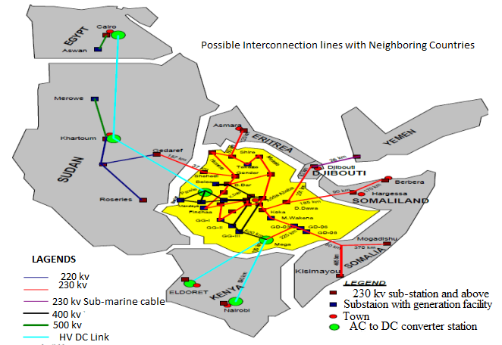
Introduction Cont.…
Figure 1: Ethiopian power network interconnection Plan.
Url: https://ai2-s2-public.s3.amazonaws.com/figures/2017-08-08/72b2d93ae770e42d2faf708b109285a437cd990c/26-Figure12-1.png

Slide 6
2. Basics of Power Transmission Line Component
(BPTLC)
Power transmission lines are vital for transmitting electrical energy from power plants to substations and ultimately to the load centers . It comprises :
Conductors
Transmission towers
Insulators
Circuit breakers
Switches

Slide 7
BPTLC Cont.…
Voltage regulators
Capacitors and reactors (VARs)
Grounding or earthling systems
Arrestors
Other electromechanical components

Slide 8
3. Transmission Line Conductors(TLC)
The design of a transmission line conductors depends on four electrical parameters[2]:
Series resistance
Series inductance
Shunt capacitance
Shunt conductance
The series resistance relies on the physical composition of the conductor at a given temperature.
Series inductance is produced by the presence of magnetic fields around the conductors, and depend on their geometrical arrangement of conductors.

Slide 9
TLC Cont.….
The shunt capacitances are produced by the presence of electrostatic fields around the conductors, and depend on their geometrical arrangement.
Lastly, the shunt conductance exist due to the leakage currents flowing across insulators and air gaps between conductors .
Shunt conductance is mostly neglected during different power flow analysis since a leakage current is considerably small compared to nominal current.
Generally, the presences of these components, their magnitude and their impact on the network analysis varies with the network structure (two-port), the length of transmission line and its KV.

Slide 10
TLC Cont.….
a. Resistance: AC resistance of a conductor in a transmission line is determined based on the calculation of DC resistance.
Accordingly, if DC current is flowing along a rounded cylindrical conductor, the current is uniformly distributed over its cross-section area as given by;
eqn. (1)
Where; -is conductor resistivity at a given temperature (V-m)
L- conductor length (m)
A- conductor cross-section area (m²)
If AC current instead of the DC current is flowing, the conductor effective resistance is
higher due to frequency or skin effect.

Slide 11
TLC Cont.….
Frequency Effect: The frequency of AC voltage produces a second effect on the conductor resistance due to the non-uniform distribution of current, which is known as skin effect.
The current tends to flow towards the conductor's surface as frequency rises, while the current density
falls in the middle.
The skin effect raises the effective resistance by decreasing the effective cross-section area that the current uses as given by Fig. 2.
Additionally, the presence of additional current-carrying conductors in the immediate proximity causes a slight increase in resistance[3].

Slide 12
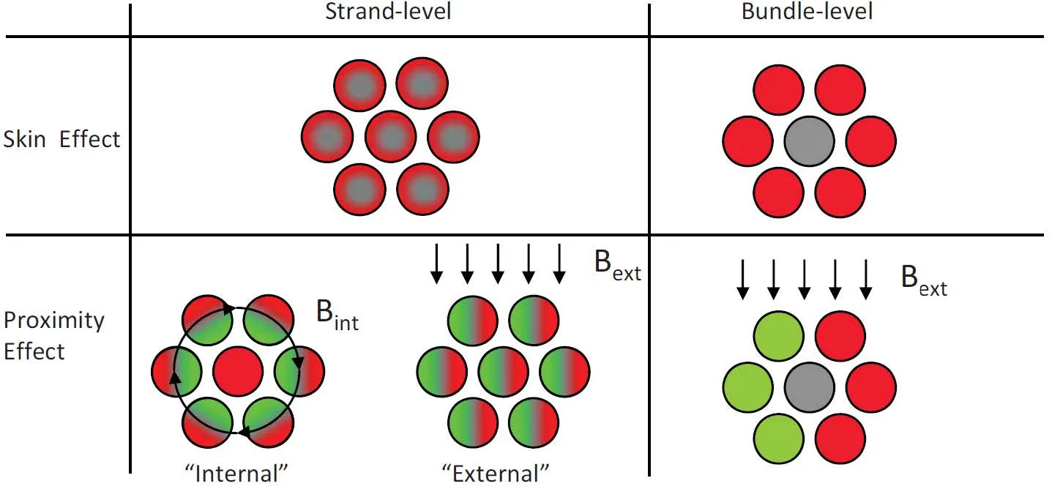
TLC Cont.….
Figure 2. The skin effect raises as frequency increases.
Url: https://rubadue.com/wp-content/uploads/2023/12/July-22-Blog-Post-Skin-Effect-and-Proximity-Effect-Losses.webp

Slide 13
TLC Cont.….
Other variations in resistance are caused by
Temperature
strengthening of stranded conductors
Bundle conductors arrangement
The resistivity of any conductive material varies linearly over an operating temperature, and therefore, the resistance of any conductor suffers the same variations.
As temperature rises, the conductor resistance increases linearly, over normal operating temperatures as presented as:
eqn.(2)
Where; R₂ is resistance at second temperature t_{2,} R₁ is resistance at initial temperature t₁,
and T is the temperature coefficient for the particular material.

Slide 14
TLC Cont.….
Strengthening of Bundle Conductor Effect: most of the recent transmission lines are bundled
There are two types of transmission line conductors: overhead and underground.
Overhead conductors, made of bare metal and suspended on insulators, are preferred over underground conductors because of the lower cost and easy maintenance.
Also, overhead transmission lines use aluminum conductors, because of the lower cost and lighter weight compared to copper conductors.

Slide 15
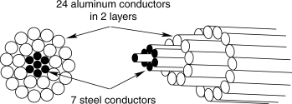
TLC Cont.….
There are different types of commercially available aluminum conductors:
Aluminum-conductor-steel-reinforced (ACSR)
Aluminum-conductor-alloy-reinforced (ACAR)
All-aluminum-conductor (AAC)
All-aluminum alloy- conductor (AAAC). The aluminum conductor, stranded structure is presented in Fig.3
Figure 3. stranded Aluminum conductor.
Url: https://ars.els-cdn.com/content/image/3-s2.0-B012176480X005076-gr6.gif

Slide 16
TLC Cont.….
ACSR is one of the most used conductors in transmission lines.
The purpose of introducing a steel core inside the stranded aluminum conductors is to obtain strength
A stranded conductor offers more flexibility and easier to manufacture than a solid large conductor high strength-to-weight ratio
The resistance of each wound conductor at any layer, per unit length, is based on its total length as presented in eqn.3.
eqn.(3)
Where , R_{cond} is resistance of the wound conductor, ‘l’ is the length of the wound conductor and ‘p’ is relative pitch of wound conductor as given by eqn.4.
eqn.(4)

Slide 17
TLC Cont.….
Then, the parallel combination of n conductors with the same diameter per layer gives the total resistance per layer as follows:
eqn.(5)
Similarly, the total resistance of the stranded conductor is evaluated by the parallel combination of resistances per layer as presented in eqn.6 and 7.
eqn.(6)
Then, eqn.(7)

Slide 18
TLC Cont.….
Equation 7 indicates that the total resistance of high-voltage transmission lines, which may be more than one conductor per phase reduces the total resistances for increasing the current carrying capability of conductor while reducing the corona effect
Corona effect occurs when the surface potential gradient of a conductor exceeds the dielectric strength of the surrounding air
which produces ionization in the area close to the conductor, with consequent corona losses, audible noise, and radio interference will be takes place.

Slide 19
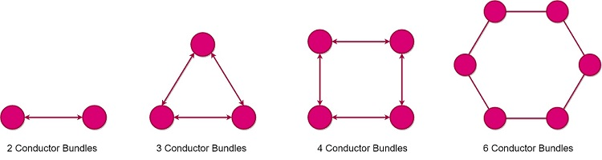
TLC Cont.….
Accordingly, by increasing the number of conductors per phase, the total cross-section area increases, the current capacity increases, and the total AC resistance decreases proportionally to the number of conductors per bundle
Conductor bundles may be applied to any voltage but are commonly used for high voltage as presented in Fig.4.
Figure 4. Bundled conductor in transmission line.
Url: https://studyelectrical.com/wp-content/uploads/2019/01/Bundled-Conductors-Types.jpg

Slide 20
TLC Cont.….
b. Inductance and Inductive Reactance: A current-carrying conductor produces concentric magnetic flux lines around the conductor.
If the current varies with the time, the magnetic flux changes and a voltage is induced
Therefore, an inductance is present and defined as the ratio of the magnetic flux linkage to the cu-rrent flowing through conductor.
The magnetic flux produced by the current in transmission line conductors produces a total inductance whose magnitude depends on the line configuration

Slide 21
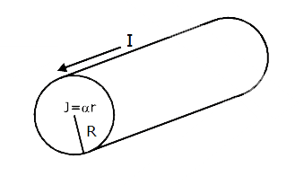
TLC Cont.….
For the calculation of transmission line inductance, knowing the following parameters must be needed:
Magnetic field intensity ‘H’, Magnetic field density ‘B’ and Flux linkage ‘λ’
Consider an infinitely long, solid cylindrical conductor with radius r, carrying current I as shown in Fig.5.
Figure 5.A n infinitely long, solid cylindrical conductor with radius.
Url: https://d10lpgp6xz60nq.cloudfront.net/physics_images/MOT_CON_JEE_PHY_C26_E02_051_Q01.png

Slide 22
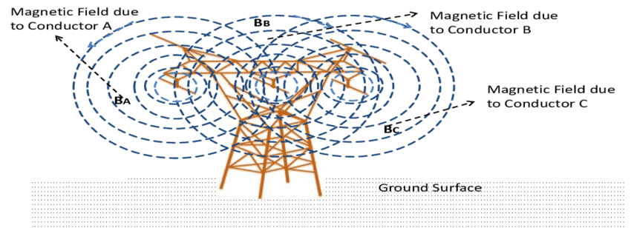
TLC Cont.….
If the conductor is made of a non-magnetic material, and the current is assumed uniformly distributed (no skin effect), then the internal and external magnetic fields are generated is given in Fig.6
Figure 6. The internal and external magnetic fields generated by conductor.
Url: https://www.researchgate.net/publication/308379950/figure/fig6/AS:668715272126475@1536445553542/Magnetic-field-produced-by-a-three-phase-transmission-line-not-to-scale.png

Slide 23
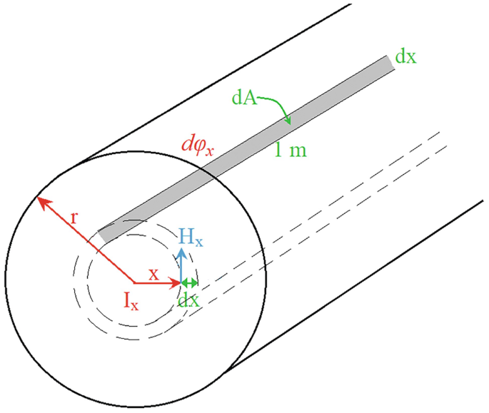
TLC Cont.….
To obtain the internal inductance, a magnetic field with radius x inside the conductor of length l is chosen, as shown in Fig. 7.
The fraction of the current I_{x} enclosed in the area of the circle chosen is determined by:
eqn.(8)
Figure 7. The internal magnetic field for radius x.
Url: https://www.google.com/url?sa=i&url=https%3A%2F%2Flink.springer.com%2Fchapter%2F10.1007%2F978-3-031-64691-1_5&psig=AOvVaw2iLYWS4Ue0Cvi9wI_TjfiB&ust=1742297276354000&source=images&cd=vfe&opi=89978449&ved=0CBQQjRxqFwoTCJCw4KiBkYwDFQAAAAAdAAAAABA-

Slide 24
TLC Cont.….
Ampere’s law determines the magnetic field intensity H _{x} , constant at any point along the circle contour as
eqn.(9)
, for non magnetic materials
The differential flux ԁϕ, enclosed in a ring of thickness dx for a 1-m length of conductor and the differential flux linkage dλ in the respective area are:
eqn.(10)

Slide 25
TLC Cont.….
The internal flux linkage and inductance are obtained by integrating the differential flux linkage from x = 0 to x = r is given by:
eqn.(11)
Then, the external inductance is evaluated assuming that the total current I is concentrated at the conductor surface (maximum skin effect).

Slide 26
TLC Cont.….
The external magnetic field at any point for circle of radius y, the magnetic field intensity H_{y} and the magnetic field density B_{y} , per unit length are:
eqn.(12)
The differential flux dϕ enclosed in a ring of thickness dy is:
eqn.(13)

Slide 27
TLC Cont.….
As the total current I flows in the surface conductor, then the differential flux linkage dλ has the same magnitude as the differential flux dϕ.
eqn.(14)
By integrating the flux linkage from at any point D1 to D2 is given by
eqn.(15)
In general, the total external flux linkage from the surface of the conductor to any point D, per unit length is:
eqn.(16)

Slide 28
TLC Cont.….
Then, the total flux linkage and inductance are summation of the internal and external flux linkage at any point D and given by eqn.17.
eqn.(17)
where GMR (geometric mean radius)=0.7788r

Slide 29
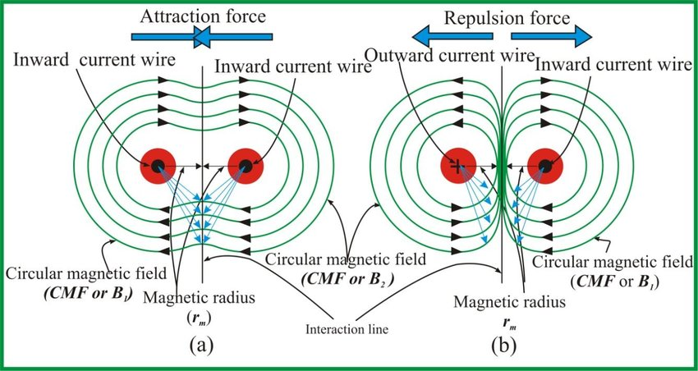
TLC Cont.….
Inductance of a Two-Wire Single-Phase Line:
Consider a two-wire single-phase line with solid cylindrical conductors A and B with the same radius r, same length l, and separated by a distance D, where D > r, and conducting the same current I, as shown in Fig 8.
The current flows from the source to the load in conductor A and returns in conductor B (I_{A}= -I_{B}).
Figure 8. Electric magnetic field between two conductors.
Url: https://www.researchgate.net/publication/328134515/figure/fig2/AS:679156815773698@1538935011314/Two-conductors-19-in-a-as-in-Fig1-a-carrying-currents-with-similar-direction-each.jpg
D
P

Slide 30
TLC Cont.….
One conductor's magnetic flux connects the other conductor.
The flux generated by conductor A and the flux generated by conductor B that links conductor A make up the total flux linking conductor A.
Consequently, at point P, the total flux linkage from conductors A and B is:
eqn.(18)
The expressions of the flux linkages above, per unit length, are:
eqn.(19)

Slide 31
TLC Cont.…
The total flux linkage of the system at point P is the algebraic summation of λ_{AP} and λ_{Bp}
eqn.(20)
For equal radius , the total flux linkage and inductance at infinity point are given as;
_{eqn(21)}

Slide 32
TLC Cont.….
Inductance of a Three-Phase Line :
Using the same approach the inductance for three phase system is developed[4].
If GMR value is the same for all conductors, the total flux linkage expression is the same for all phases and the equivalent inductance per phase is:
eqn.(22)

Slide 33
TLC Cont.….
c. Capacitance and Capacitive Reactance[4]:
Capacitance exists among transmission line conductors due to their potential difference.
To evaluate the capacitance between conductors in a surrounding medium with permittivity ε, it is necessary to determine the voltage between the conductors, and the electric field strength of the surrounding.
eqn.(23)
The per phase capacitance of three phase system, is given by:
eqn.(24)

Slide 34
      4. Two-port Network Analysis(TPNA)
Normally, the four power system parameters are distributed in transmission line and determined using two port network while relating the sending end parameter with the receiving end parameters.
The voltage V_{s} and current I_{s} at the sending end are connected to the voltage V_{R} and current I_{R} at the receiving end by the use of ABCD constants, as follows:
eqn.(25)
Transmission lines are divided into three categories based on the voltage levels and distance coverage they cover: short, medium, and long.

Slide 35
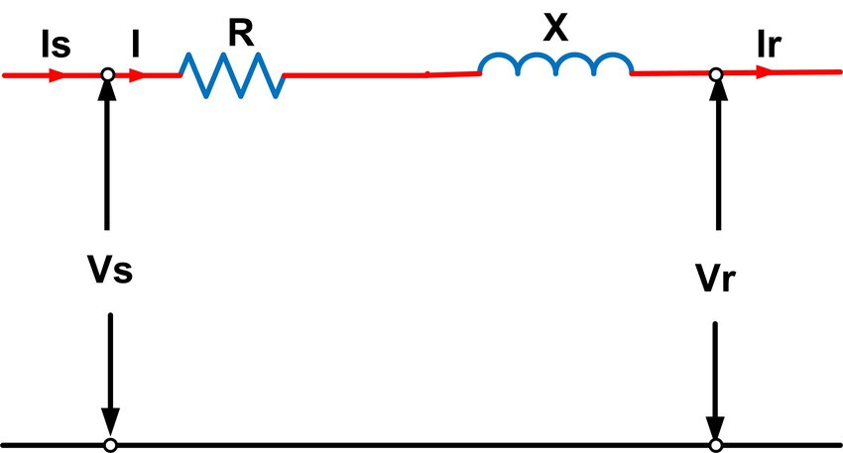
      TPNA Cont.….
Short transmission line: If the operating voltage is less than 20 kV and a transmission distance of less than 80 km.
In the case of a short transmission line, the effects of capacitance and conductance may be neglected
All that is left to consider are the series resistance and inductance.
While resistance and inductance are dispersed along the length of a line in reality, for short lines, the resistance and inductance are believed to be aggregated at a single location as presented in Fig.9[5].
Figure 9. Short transmission line representation.
Url: https://www.researchgate.net/figure/Short-transmission-line-model_fig1_352064823

Slide 36
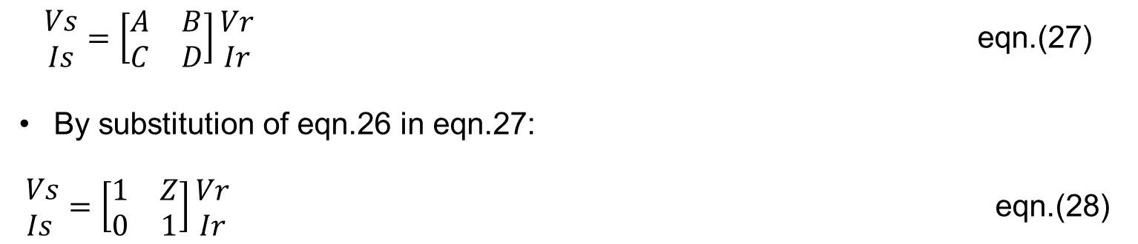
      TPNA Cont.….
Based on the two-port network, the short transmission lines, sending and receiving end parameters are related as:
eqn.(26)
$\begin{matrix}Vs \\ Is\end{matrix}=\left[\begin{matrix}A & B \\ C & D\end{matrix}\right]\begin{matrix}Vr \\ Ir\end{matrix}$ eqn.(27)
By substitution of eqn.26 in eqn.27:
$\begin{matrix} Vs \\ Is\end{matrix}=\left[\begin{matrix}1 & Z \\ 0 & 1\end{matrix}\right]\begin{matrix}Vr \\ Ir\end{matrix}$ eqn.(28)

Slide 37
      TPNA Cont.…
Medium transmission line: A medium transmission line is one that has a voltage of between 20 and 100 kilovolts and a length of 80 to 250 km.
Since the voltage is high, it is necessary to take the capacitance effects into consideration.
As a result, all admissions are combined at the sending, receiving, or center.
The following techniques are employed more frequently presented in Figs. 10 & 11, respectively:
Nominal T
nominal π

Slide 38
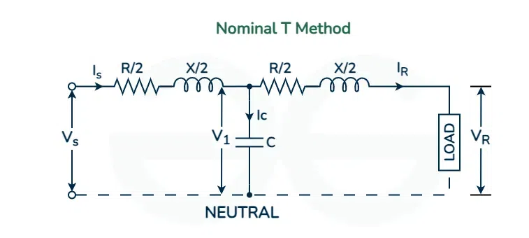
      TPNA Cont.….
Figure 10: Nominal T-method Short Transmission line.
URL: https://media.geeksforgeeks.org/wp-content/uploads/20240418091804/Nominal-T-Method.webp
The ABCD parameter is calculated as;
Voltage at the mid-point of the line
eqn.(29)

Slide 39
      TPNA Cont.….
Current in the capacitor,
eqn.(30)
Then, the sending-end current and Voltage are given by:
eqn.(31)
eqn.(32)

Slide 40
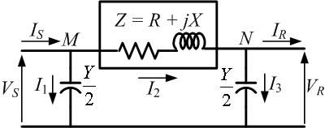
      TPNA Cont.….
Nominal π method.
According to this strategy, the complete resistance and inductive reactance are concentrated at the center of the line, while half of the total line capacitance is focused at each end as presented in Fig.11.
Figure 11. Nominal π method medium transmission line.
url: https://archive.nptel.ac.in/content/storage2/courses/108104051/chapter_2/2_4.html
Using the same procedures, the sending end voltage and current are given by:
eqn.(33)
eqn.(34)

Slide 41
      TPNA Cont.….
Long Transmission Line: Transmission lines that span more than 250 km (150 miles) are considered lengthy.
The approximation of the shunt admittance by two constant capacitors at each end of the line is insufficiently accurate for long lines.
Rather, the series impedance and the shunt capacitance need to be thought of as dispersed quantities, and the differential equations of the line should be solved to determine the voltages and currents on it.
On the other hand, a long transmission line can be modeled as a π model with modified shunt admittance Y' and series impedance Z', and calculations can be done on that model using ABCD constants for Fig.12.

Slide 42
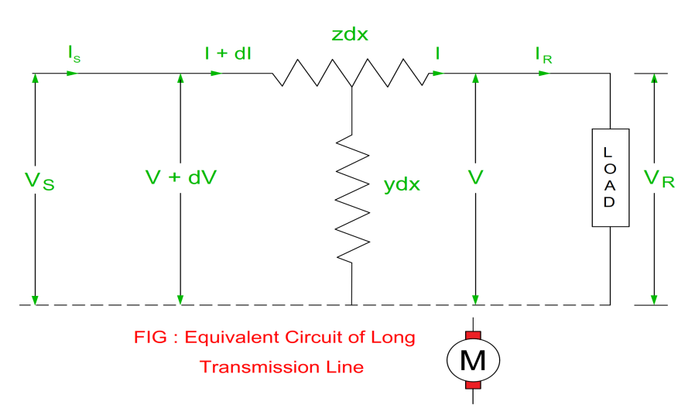
      TPNA Cont.….
The series impedance and shunt admittance adjusted values are:
Figure 12. Long transmission line representation.
URL: https://www.myelectrical2015.com/2022/04/abcd-parameters-of-long-transmission.html#google_vignette
eqn.(35)
Where, Z is the series impedance of the line; Y is the shunt admittance of the line; d is the length of the line; γ is the propagation constant of the line:
eqn.(36)

Slide 43
      TPNA Cont.….
Where, z is the series impedance per km and y is the shunt admittance per km.
When γd decreases, the ratios tend to 1.0, transforming the model into a medium-length line model.
For a long transmission line, the ABCD constants are;
eqn.(37)

Slide 44
Summary
Power system network is one of highly meshed the largest man-made system that needs the understanding of network parameters, the operation of intended network during normal and abnormal condition and hence requires the remedial actions
The four power system components, which are very important for the network understandings are: resistance, inductance, capacitance and conductance.
The network conductor resistance depends on the types of conductor, its geometer and environmental conditions.
The transmission lines can be categorized into three: short, medium and long based on its length and voltage ratings
The analysis used to evaluate the receiving end parameters of power network with the sending end parameters based on the transmission line type is known as Two-port network analysis

Slide 45
References
[1]. H., Gärtner and A., Stamps. ‘’Ethiopian power grid: electrical power engineering & environment’’. Technische Universiteit Eindhoven. Pp:1-33, 2014,. https://pure.tue.nl/ws/files/4282573/778636.pdf
[2].G., Leonard. ‘’Electric Power Generation, Transmission, and Distribution: Transmission Line Parameters’’. Tylor and Francis Group, 1st edition. Pp.1-512, 2007. Doi: https://doi.org/10.1201/9781420009255.
[3]. M.Zaręba; T., Szczegielniak and P. Jabłoński. ‘’’Influence of the Skin and Proximity Effects on the Thermal Field in a System of Two Parallel Round Conductors’’. Energies 2023, 16, 6341. https://doi.org/10.3390/en16176341.
[4]. C., Francesca and R., Jordi-Roger. ‘’Calculation of the inductance of conductive nonmagnetic conductors by means of finite element method simulations’’. International Journal of Electrical Engineering & Education,. V.57(3), 2018. https://doi.org/10.1177/002072091880044.

Slide 46
Thank you !

