Slide 1
Advanced Power System Analysis
Lecture 2
Per-phase and Per unit analysis
Lecturer: Teshome Goa (Assist. Prof.)
Lecture learning outcomes:
At the end of this lecture, you will be able to:
Understand the single phase power system
Know the three phase power system
Identify the importance of per phase analysis in balanced three phase system
Define per unit analysis in power system.

Slide 2
Outlines
Introduction
Single Phase Power System
Three Phase Power System
Per Phase Analysis
Per Unit Analysis
Summary
References

Slide 3
1. Introduction
Power network consist of three-phase alternating current (AC) circuits, which is complex and equal in magnitude with 120 degree phase shift
The three phase system analysis is very complex and takes time to compute different power network parameters.
Simplifying these complex calculations is important in system analysis.
Accordingly, per-phase analysis is defined as a tool used to simplify the analysis of multi/three-phase power systems while converting it into single phase form[1].
Which is useful in fault analysis, system modeling, and load flow calculations.

Slide 4
Introduction Cont.…
In a three-phase system, each phase can be analyzed independently, considering symmetrical components.
Basic Steps in Per-Phase Analysis:
Assume the system is balanced.
Analyze one phase as a representative of the whole system.
This reduces the complexity of analyzing three phases separately.
Generally, per-phase analysis employed because of simplicity in understanding, easier for fault analysis and CPD design.
Reduces computation time in symmetrical load scenarios.

Slide 5
Introduction Cont.…
Per-Unit is a normalization technique that simplifies calculations in power systems , specifically makes the system having different units into the same unit[2].
All system quantities (voltage, current, power, impedance, etc.) are expressed as a fraction of a base
unit.
Simplifies the comparison of different components in the system.
Avoids dealing with large numerical values, making calculations easier
Reduce the errors while referring the transformers from one side to the others in power system analysis

Slide 6
2. Single Phase Power System (SPPS)
Alternating current flowing via two wires in a power circuit is known as single-phase power[3].
This is often set up as one live or phase wire that distributes the current to the load and one neutral wire that returns it to the source.
Commonly used in residential, commercial, and small industrial applications.
Basic components needed are; AC source, transmission lines and Loads
Single-phase systems are simpler and cheaper to implement compared to three-phase systems.
The circuit diagram for single phase two-wire and three wire system is given by Fig.1

Slide 7
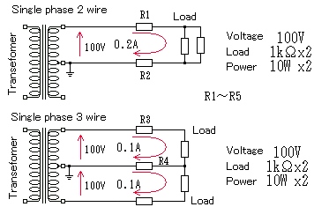
SPPS Cont.….
The total resistance =500 ohm
Power total=20 W
R5
Figure 1. The circuit diagram representation of single phase system.
Url: https://e.as76.net/asn/gif/tan3.gif.

Slide 8
SPPS Cont.….
As presented in Fig.1, the single phase power system comprises:
Voltage Source with transformers: This could be a generator or the utility grid providing alternating current.
The voltage is typically sinusoidal with a frequency of 50 or 60 Hz, depending on the region.
Conductors : There are two primary conductors:
Live Wire (L): The wire that carries the current to the load.
Neutral (N): The return path for the current, completing the circuit.
Load: This could be any device or appliance that consumes electrical energy, such as lights, motors, or home appliances.

Slide 9
SPPS Cont.….
Phasor Representation of single phase system: The voltage and current under normal conditions are sinusoidal, and their relationship can be described in terms of phasors, complex numbers as presented in Fig.2
The loads can be(resistance, inductance, and capacitance)
Phasor diagrams present a graphical representation, plotted on a coordinate system, of the phase
relationship between the voltages and currents within passive components or a whole circuit
The generalized sinusoidal expression given as: A(t) = Am sin(ωt ± Φ) represents the sinusoid in the time-domain form.

Slide 10
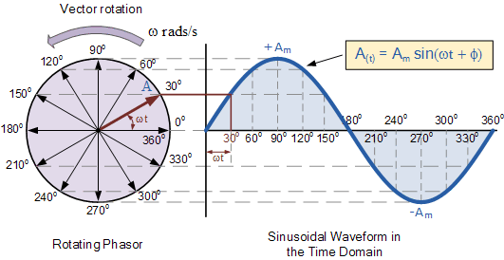
SPPS Cont.….
Figure 2. Phasor Diagrams for a Sinusoidal Waveform.
Url: https://www.electronics-tutorials.ws/wp-content/uploads/2018/05/accircuits-acp25.gif.

Slide 11
SPPS Cont.….
The Phasor analysis is used to know the single phase current, voltage and power relations
Its goal is to simplify the analysis of constant frequency AC systems. Using the phasor analysis, I, V &P are determined as
v(t) = V_{max} cos(ωt + θ_{v}) eqn.(1)
i(t) = I_{max} cos(ωt + θ_{I})
Root Mean Square (RMS) voltage of sinusoid
eqn.(2)

Slide 12
SPPS Cont.….
Based on the Euler’s identity;
eqn.(3)
Accordingly, the phase notation is rewritten as :
eqn.(4)
Where, V is the r.m.s voltage.
The r.m.s , cosine-referenced voltage is:
eqn.(5)

Slide 13
SPPS Cont.….
Then, the power, P(t) is given as;
eqn.(6)
Then, the average power is given by:
eqn.(7)
Complex Power
eqn.(8)
Where, P is real power, Q is reactive power, S is apparent power and Փ is
the power factor

Slide 14
3. Three Phase Power System(TPPS)
Single phase is used only in low voltage, low power settings, such as residential and some commercial
A balanced three-phase system which is presented in Fig.3 has [4]:
  Three voltage sources with equal magnitude, but with an angle shift of 120°
  Equal loads on each phase
  Equal impedance on the lines connecting the generators to the loads
Bulk power systems are almost exclusively three phase.

Slide 15
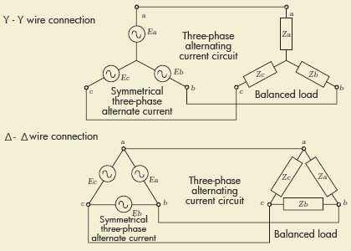
STPS Cont.….
,
Figure 3. Balanced Three Phase system with (Y-Y) and (Δ-Δ), No-Neutral current.
url: https://www.chip1stop.com/sp/wp-content/uploads/tutorials026_001_en.gif

Slide 16
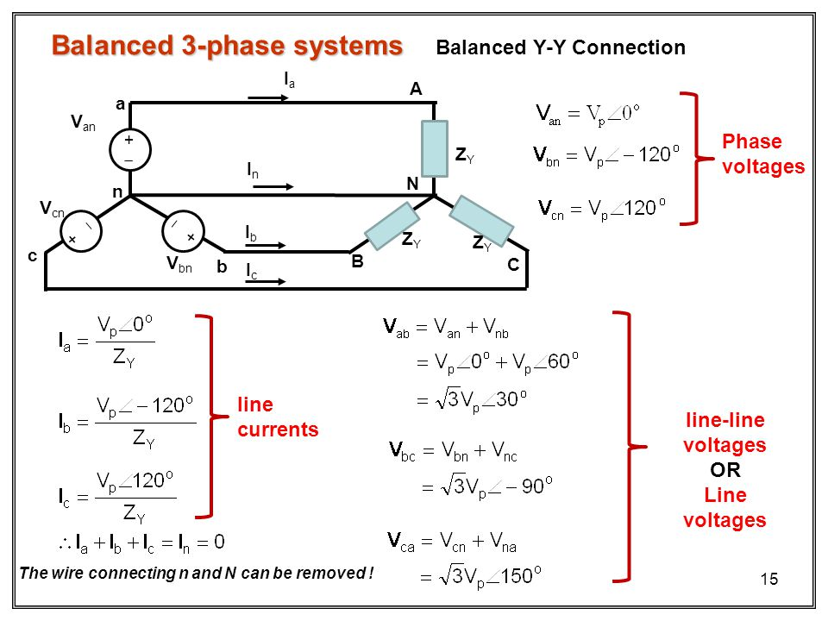
STPS Cont.….
Assume Y-Y connection as presented in Fig.4
and determine the three phase power
Figure 4. The Balanced (Y-Y) three Phase system relationship.
Url:https://slideplayer.com/slide/5867350/19/images/15/Balanced+3-phase+systems.jpg
Eqn.(9)

Slide 17
STPS Cont.….
As observed in Fig.4, in electrical power systems, there are two ways to connect 3φ systems(generators, transformers and load)
  i. Wye (Y)
  ii. Delta (Δ)
  For Y-connected system where phase A is reference voltage and then, each phase voltage based on Fig.5 is given by:
  eqn.(10)

Slide 18
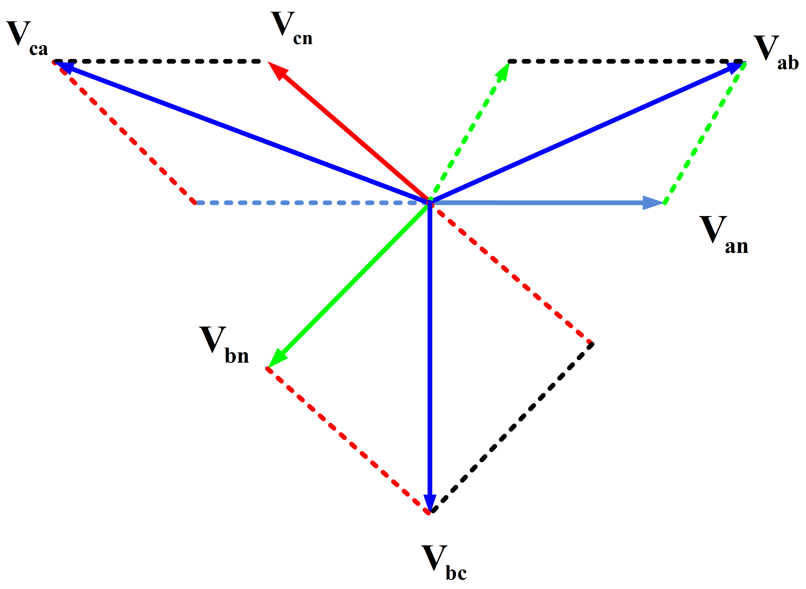
STPS Cont.….
Figure 5. Three Phase star (Y)connected current voltage relationship.
Url: https://electricalacademia.com/electric-power/star-wye-connection-and-three-phase-power-voltage-and-current/

Slide 19
STPS Cont.….
The Line Voltages based on the Y-connected system is given as:
If α = 0
eqn.(11)
It implies that both the phase and Line to line voltages of three phase system are balanced.

Slide 20
STPS Cont.….
To determine the total power in three phase Y-connected system both in phase and Line are given by:
The power while considering line:
eqn.(12)
By substitution, for star connected system is:
eqn.(13)

Slide 21
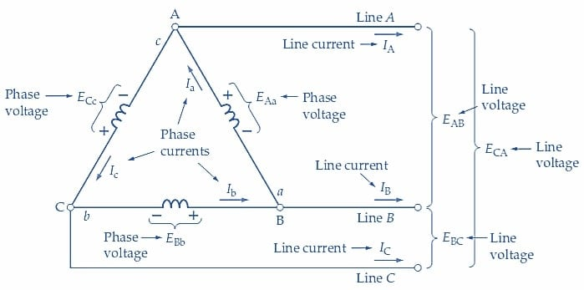
STPS Cont.….
Similarly the power for Delta connected system based on Fig.6 is determined as:
In this type of connection where the three phases are connected in a closed loop, forming a triangle:
The the line voltage equal to the phase voltage, and the line current being √3*times the phase current.
Eqn.(14)
Eqn.(15)
Figure 6. Delta connected system current-voltage relationship.
Url: https://eepower.com/uploads/articles/determining-phase-and-line-voltages-and-currents-in-delta-connected-generators-fig1.jpg

Slide 22
STPS Cont.….
Example 1: Assume a Δ-connected load is supplied from a 3φ 11 kV (L-L) source with Z = 50∠30° Ω balanced load. Determine the line currents and voltage considering reference voltage V_{ab} with 0 degree reference angle.
Given:
Which means
Then, the line currents are
Then, the phase currents are determined as:
Per-phase analysis

Slide 23
STPS Cont.….
Which is,
Then, I_{b} and I_{c} can be determined as:
Per-phase analysis

Slide 24
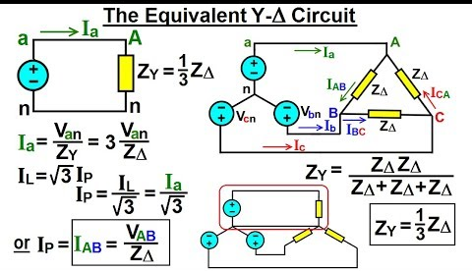
STPS Cont.….
Delta-wye transformation: sometimes referred to as a pi-to-tee transformation, makes it easier to
analyze and compute circuits in three-phase power systems
Which is used by transforming a delta (Δ) network to an equivalent wye (Y) network or vice versa.
This is especially useful for unbalanced loads as presented in Fig.7
Figure 7. Star-Delta conversion.
Url:https://i.ytimg.com/vi/k7_SMjgVsUo/hqdefault.jpg

Slide 25
STPS Cont.….
Thus, to simplify and use balanced three phase system analysis, the delta connected loads is converted into star as follows:
The delta-connected loads can be replaced by Y-connected load with :
eqn.(16)
The delta-connected source can be replaced by Y-connected source with :
eqn.(17)
Which means, from Delta side :
eqn.(18)

Slide 26
STPS Cont.….
From star connected side:
eqn.(19)
For balanced three phase system without having neutral point, the summation of three phase current
is zero, means :
eqn.(20)
Then, by substitution eqn.(19) is rewritten as:
eqn.(21)

Slide 27
STPS Cont.…
Advantage of balanced three phase system analysis:
Offers higher power transmission efficiency, smoother power delivery, and reduced vibration in
rotating machinery compared to single-phase systems.
Balanced three phase system can transmit more power for same amount of wire, twice as much as single phase
Torque produced by three-phase machines is constant
Three phase machines use less material for same power rating
Three phase machines start more easily than single phase machines

Slide 28
4. Per Phase Analysis
Disadvantage of Balanced three phase system:
Require more conductors and transformers compared to single-phase systems
increasing infrastructure costs
Complex and difficult to find out each parameter during calculations.
As a solution the per-phase analysis is used.
Per phase analysis allows analysis of three phase systems with the same effort as for a single phase system

Slide 29
Per Phase Analysis Cont.….
For per-phase analysis the following points are used:
All loads and sources Y connected
No mutual Inductance between phases
All neutrals are at the same potential
All phases are completely decoupled
All system values are the same sequence as sources.
The sequence order are phase b lags phase-a and phase-c lags phase-b, known as “positive” sequence;

Slide 30
Per Phase Analysis Cont.…
Steps for per phase analysis
Convert all Δ load/sources to equivalent Y’s
Solve phase “a” independent of the other phases
Total system power S = 3 V_{a} I_{a}*
If desired, phase “b” and “c” values can be determined by inspection (i.e., ±120° degree phase shifts)
If necessary, go back to original circuit to determine line-line values or internal Δ values.

Slide 31
5. Per Unit Analysis
In power systems, variables are normalized using per unit analysis to prevent issues with referencing impedances across transformers.
It entails selecting basis values for current, voltage, power, and impedance, and then expressing each quantity as a ratio of its real to base values
Accordingly, the ratio of the actual value in any value to the chosen base value of the same unit is known as; per unit value, it has a unit less quantities
A key problem in analyzing power systems is the large number of transformers.
  It would be very difficult to continually have to refer impedances to the different sides of the transformers.

Slide 32
Per Unit Analysis Cont.….
Referring quantities from one side of the transformer to the other side leads serious errors generation, which can be avoided using per unit system.
Voltages, currents and impedances expressed in per unit do not change when they are referred
Per unit impedances of electrical equipment of similar type usually lie within a narrow range, when the equipment ratings are used as base values.
Transformer connections do not affect the per unit values.

Slide 33
Per Unit Analysis Cont.….
In power systems the basic quantities which are very important are voltage, current, impedance and power.
For all per unit calculations a base KVA or MVA and a base KV are chosen.
The following are some of the steps for selection of base values.
Rating of the largest plant or unit for base MVA or KVA.
The total capacity of a plant or system for base MVA or KVA.
Any arbitrary value.

Slide 34
Per Unit Analysis Cont.….
Once the base values or reference values are chosen. the other quantities can be obtained as;
Pick a 1-Ф if VA base for the entire system, S_{B}
Pick a voltage base for each different voltage level, V_{B}. Voltage bases are related by transformer turns ratios. V is phase voltage for 1-Ф
Calculate the current base, I_{B} = S_{B}/V_{B}
Calculate the impedance base, Z_{B}= (V_{B})²/S_{B}
Convert actual values to per unit
Convert back to actual as necessary

Slide 35
Per Unit Analysis Cont.….
Pick a 3-Ф VA base for the entire system,
Pick a voltage base for each different voltage level, V_{B}. Voltages are line to line.
Calculate the current base, I_{B}
eqn.(22)
IV. Calculate the impedance base
eqn.(23)

Slide 36
Per Unit Analysis Cont.….
Per Unit Change to Common MVA Base
Parameters for equipment are often given using power rating of equipment as the MVA base
To analyze a system all per unit data must be on a common power base
eqn.(24)

Slide 37
Summary
This lecture provides clear presentation of per-phase and per unit analysis fundamental and their importance in power system analysis, specifically in load flow, fault and power stability analysis
Thus, the voltage, current and power relationship in single-phase, and three phase power system is presented
Then, the relationship between three phase balanced system with single phase system using per phase analysis is dictated
In addition, the advantage of three phase system over single phase system is also incorporated
The per unit importance of per unit analysis in terms of reducing the transformer effect in power system analysis also discussed.

Slide 38
References
[1]. L. Gopi and G. Narayanan. "Per-Phase Analysis, Efficient Implementation and Performance Evaluation of a 24-Sector Discontinuous PWM for Split-Phase Induction Motor Drives" . IEEE Transactions on Industry Applications. Vol. 59(1), pp. 897-909, 2023. doi: 10.1109/TIA.2022.3215136.
[2]. H., Lei; Q., Jie and Z.,Yi. ‘’Normalization Techniques in Training DNNs: Methodology, Analysis and Application’’. IEEE Transactions on Pattern Analysis and Machine Intelligence PP(99):1-20. DOI:10.1109/TPAMI.2023.3250241.
[3]. W.L, Jacques.’’The Fundamental Concepts of Power Theories for Single-phase and Three-phase Voltages and Currents Part 27 in a Series of Tutorials on Instrumentation and Measurement’’. IEEE Instrumentation & Measurement Magazine. 2010. V.13(5), pp: 37 – 44. DOI:10.1109/MIM.2010.5585073
[4]. L., Hakim; M., Wahidi; U., Murdika and etl:. "A three-phase power flow analysis for electrical power distribution system with low voltage profile“. 2nd International Conference on Information Technology, Computer, and Electrical Engineering (ICITACEE). 2015. pp. 303-308. doi: 10.1109/ICITACEE.2015.7437819..

Slide 39
Thank you !

