Slide 1
Advanced Power System Analysis
Lecture 3
Load Flow studies
Lecturer: Teshome Goa (Assist. Prof.)
Lecture learning outcomes:
At the end of this lecture, you will be able to:
Understand the Basics of Load Flow Analysis
Know the Importance of Power Flow Analysis
Model Power System Network for Load Flow Studies
Demonstrate how to formulate the Y-bus Admittance Matrix

Slide 2
Outlines
Introduction
Objectives of Power Flow Analysis(OPFA
Power System Network Model
Bus Admittance Matrix Formulation
Summary
References

Slide 3
1. Introduction
Power system analysis is very important for the development of any country.
Thus, knowing the operating characteristic of power system is crucial for the sustainable development
goals of any country.
Power network has the following characteristics:
It can be easily converted to electric energy from other different energy resources and hence it can be also converted to other forms of energy.
It can be transmitted and distributed over large area and long distance: Comprising the generation
units, transformers, high voltage substations, transmission lines, medium and low voltage substations ,
and loads

Slide 4
Introduction Cont.…
Energy should be optimized, because it can be generated in large quantities at one location and distributed to sites where the energy is needed.
Accordingly, the load flow analysis is a very important and fundamental tool in power system analysis.
Its results play the major role to operators in terms of controlling the system and economic schedule, as well as during the expansion and design stages.
Accordingly, the purpose of any load flow analysis is to compute precise steady-state voltages and
voltage angles of all buses in the network[1].
Then, to determining the lines real and reactive power flow and the total power mismatch at generation units.

Slide 5
Introduction Cont.…
It helps to observe whether the lines and transformers are loaded or not, which is very important for
reliable, efficient and affordable power supply.
The load flow solution also gives the base conditions of the system elements when the transient or
fault response behavior of the system is to be studied.
Generally, the power flow analysis gives the actual operating condition of the network components like generation , transmission system, transformers and loads operations
This can be achieved in online system by carrying numerous load flow solution techniques under
a variety of conditions.

Slide 6
Introduction Cont.…
Accordingly, the power flow also known as “Load Flow” solution is used for:
Planning, operating and controlling the system
The expansion of exiting systems
Knowing the effect of interconnection, adding new loads, new generation, lines, used to select size and location of VAR equipment's
Generally, the load flow gives the real operating condition the network and planning future demands
based on the steady-state load as presented in Fig.1

Slide 7
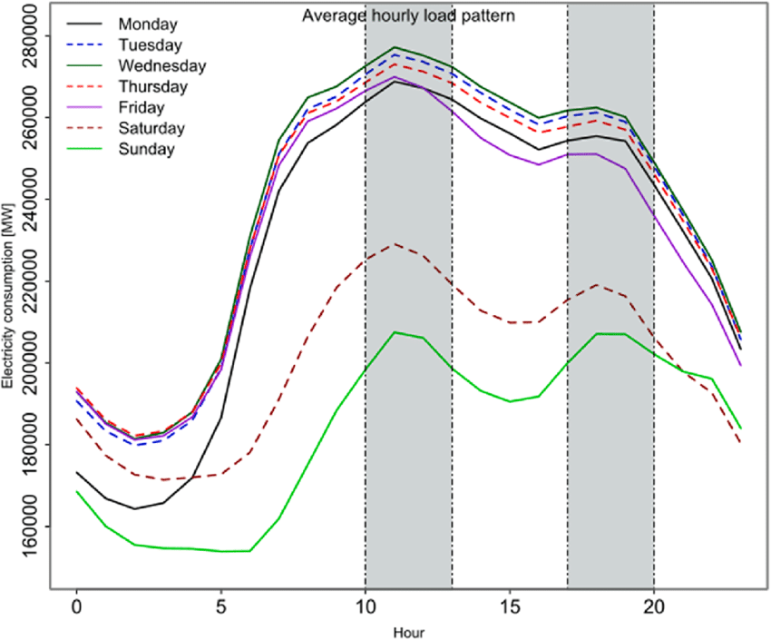
Introduction Cont.…
Figure 1 shows the actual operating condition of the weekly load variations as per the customer
requirements.
Figure 1. The average hourly load change through time.
https://www.researchgate.net/figure/Day-of-the-week-and-hourly-pattern-of-electricity-demand-Notes-The-shaded-areas_fig2_347597852

Slide 8
2. Objectives of Power Flow Analysis(OPFA)
To find out the voltage magnitude and its phase angle at each bus
To determine the active and reactive power flow in each line
Thus, each bus has four state variables[2]:
voltage magnitude
voltage phase angle
real power injection
reactive power injection
In order to perform the analysis, two parameters out of four state variables should
be defined or given

Slide 9
OPFA Cont.….
For the successful operation of static power flow analysis ;
Generation must supplies demand (load) and loss.
Node voltage magnitudes must be remain close to rated values.
Generator must operates within specified real and reactive power limits.
lines and transformers should not be overloaded
Finally, to apply power flow analysis the knowledge(Modeling) of power network, admittance
matrix formulation and understanding the types of network buses are very important.

Slide 10
3. Power System Network Model(PSNM)
Power flow analysis begins with understanding of power network structures.
The network modeling for power flow analysis includes creating a mathematical representation of a
network to analyze and simulate the load flow under numerous conditions.
These helps in determining the network bus voltage magnitudes, phase angles, and power flows
Common components of Power System Network Modeling are[3] :
Generator modeling
Buses: represents modeling of the points where the electrical components like generators, loads,
and transformers are connected.
Transmission Lines: Represent the network of power transmission.

Slide 11
PSNM Cont.….
1. Generator Modeling:
A crucial component for simulating and examining the behavior of power networks is generator
modeling for power system analysis.
The kind of generator and the degree of information needed for the investigation determine the modeling strategy.
The following categories of generator models are frequently used in power system analysis:
1.1 Synchronous Generator model:
Power systems frequently use synchronous generators, which are commonly represented as follows:

Slide 12
PSNM Cont.….
Constant Power Simple Output Model: A generator can be thought of a continuous power source, with a fixed output power and variable reactive power or voltage source behind synchronous reactance based on the state of the system.
This model is frequently employed in load flow analysis or for simple power flow investigations where steady-state operation is the main emphasis.
ii. Detailed Model : The excitation system, turbine-governor dynamics, and the generator's voltage
regulation like AVR, dynamics are all included thorough models.
Dynamic simulations and transient stability require these models.

Slide 13
PSNM Cont.….
iii. The Swing Equation
The rotor dynamics of a synchronous machine are described by eqn.(1).
It is commonly applied in research of transient stability and symbolizes the balance between electrical and mechanical power as presented in eqn.(1):
eqn.(1)
Where, Pm is the input power or mechanical power, Pe is the output electrical power, M is the machine's inertia constant and 𝛿 is the angle of the rotor.

Slide 14
PSNM Cont.….
1.2 Induction Generator Model
Typically, induction generators are found in industrial settings or in wind turbines.
Since these generators are asynchronous devices, modeling them is easier.
Usually, the slip or the difference between synchronous and rotor speeds controls their behavior.
Equation (2) for power balance and rotor dynamics forms the foundation of the basic model.
eqn.(2)

Slide 15
PSNM Cont.….
1.3 Excitation System Modeling of Generators[4]:
Excitation system modifies the field current, which regulates the rotor's magnetic field and, ultimately,
the generator's voltage output.
Excitation system models includes:
The simplified voltage control model modifies the field current through a feedback loop
The detailed excitation system model contains dynamic equations for the stabilizer,
exciter, AVR, and other parts as presented in Fig.2.

Slide 16
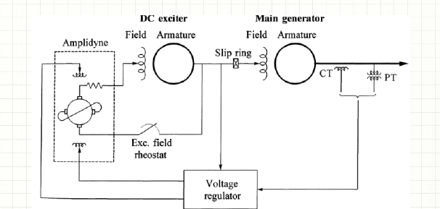
PSNM Cont.…
Figure 2. Generator excitation system model.
Url: https://eepowerschool.com/wp-content/uploads/2018/06/DC-excitation-system-with-amplidyne-voltage-regulators.png

Slide 17
PSNM Cont.….
1.4 Power System Stabilizer Model(PSSs)[5]:
In order to increase system stability, PSSs are frequently incorporated into generator models.
They provide damping by adjusting the generator's excitation system, which suppresses oscillations in
the power system.
For dynamic stability analysis, PSS models and generator models are typically used together.
Figure 3 presents the power system stabilizer connection

Slide 18
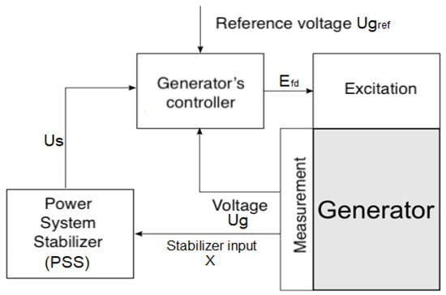
PSNM Cont.…
Figure 3. Power system Stabilizer block diagram.
https://pub.mdpi-res.com/energies/energies-14-06631/article_deploy/html/images/energies-14-06631-g001-550.jpg?1634285799

Slide 19
PSNM Cont.…
1.5 Time Domain Simulations Model:
Among the extensive dynamic equations used to simulate generators in time-domain simulations are
the rotor dynamics, excitation system, turbine-governor dynamics, and load models.
Fault analysis, post-fault recovery, and transient stability analysis all depend on these models.
1.6 Short Circuits Analysis Models: Summary of Circuits Models are essential for simulating how a
generator would react to a malfunction.
These studies use the machine's transient characteristics and reactance to simulate
the behavior of generators.

Slide 20
PSNM Cont.…
1.7 Voltage and Frequency control model: Crucial to regulate the frequency and voltage of generators in a networked system.
The governor dynamics manage the generator's speed and, in turn, frequency, while the AVR controls
the voltage.
Due to the numerous interactions between the electricity system and these two subsystems, accurate modeling is required for stability analysis.
2. Transmission lines model
The transmission line is modeled with its series impedance (resistance and reactance) and may
include shunt admittance for more detailed long transmission line analysis.

Slide 21
PSNM Cont.…
3. Transformers: Transformers are used for voltage regulation
It is also important in the power flow model, they are typically represented by their impedance and
transformation ratio.
4. Loads: Represent the demand for power, real and reactive power load.
These are typically modeled as PQ bus where the real and reactive power is specified.
There are two types of load in power system, frequency independent and frequency dependent loads.

Slide 22
PSNM Cont.…
Generally, for the power system analysis, the knowledge of the following four parameters are very
important.
The network structure based on the detail model of each component
Energy conservation principles
Bus admittance matrix formulation based on the types of transmission line and
The types of power network buses and their functions
The five bus network structure with detail model of each component is presented in Fig.4

Slide 23
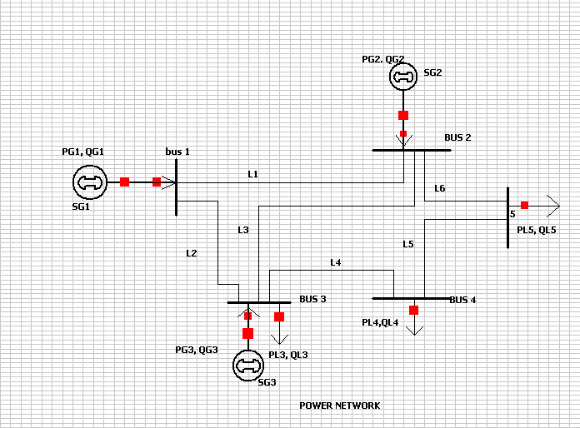
PSNM Cont.…
Figure 4. Five bus Power network single line diagram representation

Slide 24
PSNM Cont.…
Figure 4 operates on the premise of energy conservation at all times.
In power flow, energy conservation refers to the idea that, under ideal circumstances the amount of
energy entering a system must equal the total amount of energy exiting the system, assuming no losses or outside energy sources.
In electrical power systems, this idea is essential, especially when studying power flow analysis.
The process of figuring out an electrical power system's steady-state operating conditions is known as
power flow analysis, or load flow analysis

Slide 25
PSNM Cont.…
It entails figuring out the power flows on transmission lines, the voltages at different buses (nodes), and
the system's load and generation conditions.
Since the power entering the system must balance the power generated and spent within the system,
energy conservation is essential to this process.
Energy conservation comprises:
Balance between Generation and Consumption: The total active power (real power) generated must match the sum of the active power losses in the system and the active power consumed by loads.

Slide 26
PSNM Cont.…
Reactive power generation also needs to balance the reactive power that system supplies
The power that performs useful tasks, such as heating, lighting, and mechanical labor, is known as
active power (P).
It needs to be balanced throughout the system. The system's stability will be impacted by any surplus or shortfall
Reactive Power (Q): Reactive power is essential for sustaining system voltage levels and enables
voltage regulation.

Slide 27
PSNM Cont.…
It needs to be balanced, just like active power. Voltage instability can be brought on by inadequate
reactive power.
Losses: In actuality, resistance in transmission lines and other parts (such transformers and generators) causes losses.
Transmission Lines and Resistance to Motion: Heat losses may result from the impedance introduced
by transmission cables.
With the belief that power loss is proportional to the square of the current (I²R losses), power flow modeis account for these losses.

Slide 28
PSNM Cont.…
Mathematical, the real ,reactive power and apparent power at each node, for instances at bus ‘k’ based on Fig.5 is given by:
eqn.(3)

Slide 29
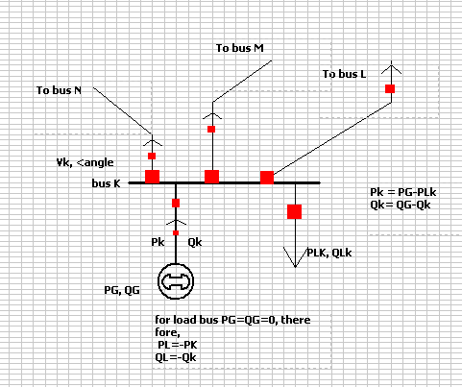
PSNM Cont.…
Figure 5. The power balance expression at bus ‘k’.

Slide 30
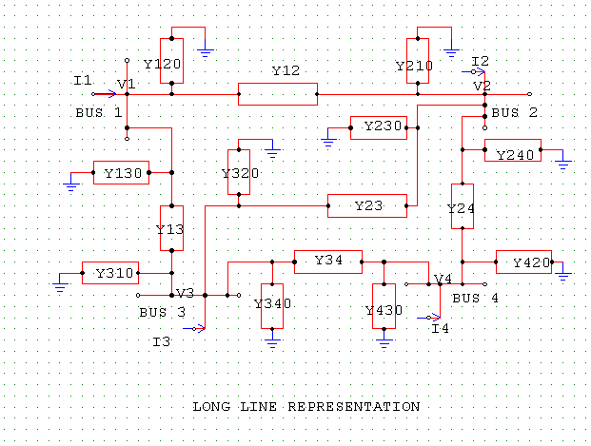
4. Bus Admittance Matrix Formulation(BAMF)
Formulation of bus admittance matrix is another important parameter needed to determined
for power flow analysis.
The power network should be represented in circuit form , for instances the four bus is given in Fig.6.
Figure 6. The π-model long transmission line representation of four bus system

Slide 31
BAMF Cont.….
To find out the current ‘I’ flowing into bus i; apply KCL at each bus and currents are determined by:
eqn.(4)

Slide 32
BAMF Cont.….
The current I in matrix form will be given as;
eqn.(5)
Then, the admittance matrix is given by:
eqn.(6)
=

Slide 33
BAMF Cont.….
The diagonal element Y11, Y22, Y33 and Y44 are called self (driving point) admittance
Which is the sum of all admittances connected to the node identified by the repeated subscripts
The other admittances are called mutual (transfer) admittance of the nodes, which is negative of
admittances connected directly between two nodes.
The admittance matrix for N-bus system can be easily determined using the above formula.

Slide 34
BAMF Cont.….
Characteristics of Y-bus matrix are:
N*N matrix
Sparse where as Z matrix is full matrix
Symmetric matrix
Diagonal elements of Y-bus matrix is the summation of all elements connected to bus-i
Off-diagonal elements of Y bus matrix is simply obtained as negative of the magnitude of admittance
connected between i and j

Slide 35
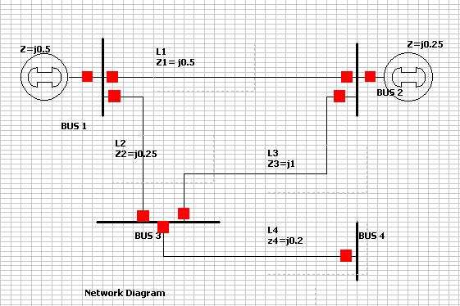
BAMF Cont.….
Example; Determine the Y-bus matrix for the four bus network given below

Slide 36
Summary
The load flow analysis and its importance in the power network analysis is discussed in this lecture
Thus, the significance of load flow analysis in terms supporting the countries GDPs, power system
planning and operation is also discussed.
It is observed that the aim of load flow analysis is to determine the network bus voltage, its angle, line real and reactive power flows during steady state operating conditions, which are very important for the power utility companies as well as the customers
Besides this, important parameters for load flow analysis such as the knowledge of network modeling , the importance of energy conservation , bus admittance matrix formulation and types of network buses are well discussed.

Slide 37
References
[1]. E.,Fergany. ‘’A.A. Reviews on Load Flow Methods in Electric Distribution Networks’’. Arch Computed Methods Eng. 2024. Doi: https://doi.org/10.1007/s11831-024-10191-7.
[2]. C., Enes; Y., Cemal;Y., Ercan and K.,Hamdi. ‘Importance of Power Flow and Load Analysis in Pre-Installation Power Systems’’. 2019 3rd International Symposium on Multidisciplinary Studies and Innovative Technologies (ISMSIT). Pp.1-5, 2019. DOI:10.1109/ISMSIT.2019.8932900.
[3]. B., Babak and E., Zia. ‘‘Power System Dynamic Modeling and Analysis in Evolving Networks’’. Springer NATURE.2024. https://link.springer.com/referencework/10.1007/978-3-031-47821-5
[4]. P., Pan; H., Shi; G., Chen and etl:. ‘’Modeling and Operating Characteristics of Excitation System for Variable Speed Pumped Storage Unit with Full-Size Converter’’. Electronics. V.13(505). 2024 . https://doi.org/10.3390/electronics13030505.
[5]. M., Honarvar; G., Shahgholian; H., Mahmoodian and etl:. "Reviewing Power System Stabilizer (PSS) Parameters Optimization Using Evolutionary Meta-Heuristic Algorithms for Power System Stability“. IEEE 21st Jubilee International Symposium on Intelligent Systems and Informatics (SISY). 2023. pp. 000481-000486. Doi: 10.1109/SISY60376.2023.10417875.

Slide 38
Thank you !

