Slide 1
Advanced Power System Analysis
Lecture 4
Load Flow Studies
Lecturer: Teshome Goa (Assist. Prof.)
Lecture learning outcomes:
At the end of this lecture, you will be able to:
Understand the types of power network buses
Identify the voltage controlling methods for load buses
Develop the power flow equations

Slide 2
Outlines
Introduction
2. Types of Power Network buses (TPNB)
3. Power Flow Equation Formulation (PFEF)
Summary
References

Slide 3
1. Introduction
Buses are essential nodes where various system elements (such as generators, loads, and transmission lines) are connected in power system analysis.
Important electrical parameters including phase angle, voltage magnitude, power generation, and power demand are described or computed at each bus.
Based on known and unknown electrical factors, buses are divided into three primary kinds to make
power flow studies easier to understand[1]:
Load bus
Generator bus
Swing bus

Slide 4
Introduction Cont.….
The classification is just to determine the unknown parameters based on the known parameter as presented in Table 1. Table 1. Types of Power Network Buses
Types of bus | Known Variables | Unknown Variables | Unknown variables are commuted using
Load Bus/PQ Bus(Uncontrolled bus) | -Load real power -Load reactive power | -Bus Voltage -Bus Voltage angle | -Load flow analysis
PV bus/generator bus (Voltage controlled bus ) | -Real Power of generator -Bus voltage | -Reactive Power -Bus voltage angle | -Load flow analysis
Swing/ Salck Bus | -Bus voltage -Bus voltage angle | -Real Power -Reactive power | -Load flow analysis

Slide 5
2. Types of Power Network Buses (TPNB)
A. Load bus:
A bus where there is only loads connected and no generation exists (both P_{Gi} and Q_{Gi} are zero) is called a load bus[2].
At this bus, the real power demand (P_{Di}) and reactive power demand (Q_{Di}) are drawn from the supply.
In a power balance equation P_{Di} and Q_{Di} are treated as negative quantities since generated powers P_{Gi} and Q_{Gi} are assumed positive.
Load buses represent locations in the power system where electrical energy is consumed, such as:
Residential buildings
Industrial plants
Commercial complexes

Slide 6
TPNB Cont.…
The voltage magnitude (V) and its angle(δ) are not specified at load bus and needs to be determined
through power flow analysis
Load bus is also known as uncontrolled bus, because its voltage is not directly controlled but fluctuates according to the network's power balance.
Particularly, the distribution of generation and reactive power support, determines the voltage at this
bus, which is not directly under the control of demand side.
Accordingly, the voltage at the load bus is considered as a dependent variable.

Slide 7
TPNB Cont.…
Which is based on the system equations and cannot be fixed or controlled, in contrast to a generator
bus (PV bus) or slack bus.
However, the power system operation and its stability depend heavily on controlling the voltage in a load bus, which is influenced by both real and reactive power flow.
Accordingly, based on the equipment available and the complexity of the system, there are a number of ways to control the voltage on a load bus, including the following common methods[3]:
i. Compensation for Reactive Power
Voltage levels are directly impacted by reactive power and it can be managed using:
Shunt Capacitors: Boosts voltage, reactive power should be added to the system.

Slide 8
TPNB Cont.…
Shunt Reactors: it is used for voltage reduction in power network
Reactor absorb the system's reactive power during operation
Synchronous Condensers: it is used for reactive power control either by supplying or absorbing as
required.
With the aid of a speed drive, a little steed motor accelerates the synchronous condenser to network synchronous speed.
The voltage and power factor will be fully related to the excitation.

Slide 9
TPNB Cont.…
Depending on the voltage and power factor reference, the regulator will begin to function.
The network breaker will be closed once the synchronous condenser and the network are in
synchronization.
The SC is operational online as presented in Fig.1.
The pony motor will be de-energised and run idle with the SC upon successful synchronization.
STATCOMs and Static VAR Compensators (SVC): it is a devices that works based on power electronics that regulate reactive power dynamically[4].
Common reactive power compensators are presented in Fig.2

Slide 10
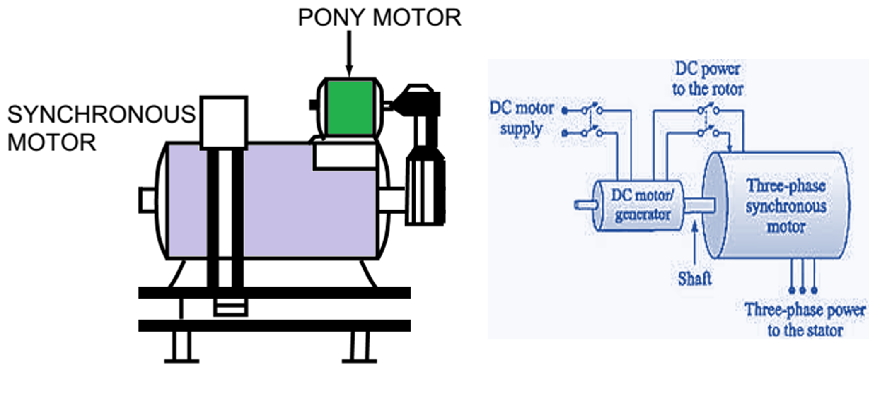
TPNB Cont.…
Figure 1. Synchronous Condensers Operating Principle.
Url: https://www.electricaldesks.com/2023/01/starting-methods-of-synchronous-motor.html

Slide 11
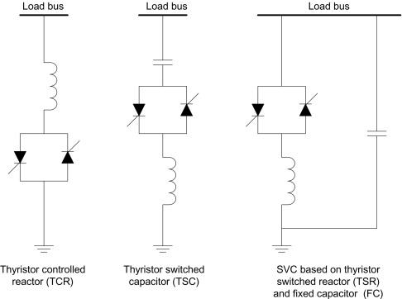
TPNB Cont.…
Figure 2. Three different types of Reactive power compensators.
Url: https://ars.els-cdn.com/content/image/3-s2.0-B9780081025925000090-f09-43-9780081025925.jpg

Slide 12
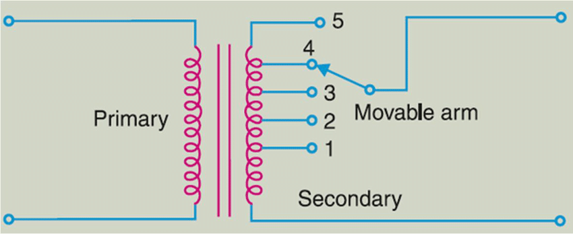
TPNB Cont.…
ii. Tap-Changing Transformers:
Modifies the transformer's turn ratio based on eqn.1 as given in Fig.3:
eqn.(1)
On-Load Tap-Changing Transformers (OLTCs) control voltage at the secondary (load) side.
It’s commonly used for both the transmission and distribution system.
Figure 3. Transformer Tap-changing control
Url: https://www.researchgate.net/publication/325947632/figure/fig1/AS:640662626107392@1529757281303/Tap-changer-with-tapings-on-secondary-side.png

Slide 13
TPNB Cont.…
iii. Automatic voltage regulator(AVR) or Generator voltage control:
If a generator is near the load bus: generators' Automatic Voltage Regulators (AVRs) can be changed to affect the voltage of nearby buses.
Reactive power can be added to the grid by generators.
However, the regulator can be manual or automatic as presented as presented in Fig.4

Slide 14
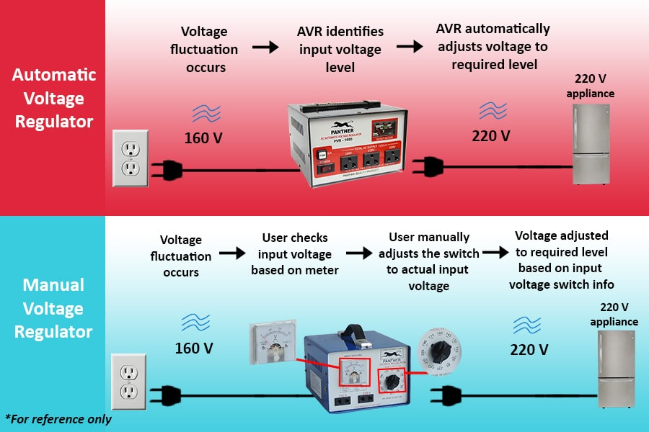
TPNB Cont.…
Figure 4 . Automatic voltage regulator ( AVR )
Url: https://panther.ph/wp-content/uploads/2020/06/Visual-Graphic-of-AVR-vs-Manual-min.jpg

Slide 15
TPNB Cont.…
iv. Shifting or Load Shedding
If an overload is causing the voltage to drop:
Remove non-essential loads.
Transfer loads to off-peak times.
v. Automation of Distribution and Smart Grid Management
Utilize control algorithms, communication networks, and sensors to: Track voltage in real time
Automate reactive power device switching
Modify the output of distributed generation such as solar inverters controlled by
Volt-VAR

Slide 16
TPNB Cont.…
Generally, the voltage of load is controlled using the formula presented in eqn.2 for all cases
eqn.(2)
Where, V is the load bus voltage, Vs is the sending bus voltage, Q is reactive power demand at the bus,
X is the line reactance
Accordingly increasing Q (load) drops voltage, and supplying Q (compensation) raises voltage.

Slide 17
TPNB Cont.…
2. PV or Voltage controlled bus/ generator bus[5]:
A voltage controlled bus is any bus in the system where the voltage magnitude can be controlled.
At each bus to which there is an alternator connected, the MW generation can be controlled by
adjusting the prime mover as presented in Fig.5.
Means, the phase angle of the rotor is directly related to the real power generated by the machine.
The voltage magnitude can be controlled by adjusting generator excitation.

Slide 18
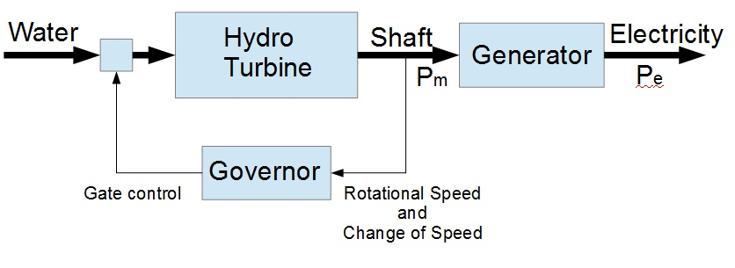
TPNB Cont.…
The real power(P) and Voltage (V) are known, whereas, the voltage phase angle and reactive power (Q) are needs to be determined.
The limits on the value of the reactive power are also specified.
Figure 5. The MW control Adjusting Prim mover.
https://www.kiwithinker.com/wp-content/uploads/2017/06/Simple-Governor-2.jpg

Slide 19
TPNB Cont.…
3. Slack/ Swing bus:
The place where total energy balance or power mismatch is determined.
In a power flow study, the Slack Bus, also known as the Swing Bus, serves as a reference bus.
After all other buses have been calculated, it supplies or absorbs the remaining power, particularly real and reactive power, to balance the system.
Its voltage magnitude and angle are specified, usually 𝑉=1.0 p.u,𝛿=0∘
It absorbs system losses.

Slide 20
TPNB Cont.…
Slack bus is normally needed to maintain the energy or power flow conservation as given by:
eqn.(3)
However, the loss is not known prior to power flow and needs to select the reference bus.
Accordingly, one generator bus should be selected as the slack bus, which determines the total power
flow mismatches(Real and reactive power flow )

Slide 21
TPNB Cont.…
In reality a physical bus that is always slack does not exist.
For simulation purposes, the slack can be any generator (or a collection of generators).
Participation factors or distributed slack buses are employed in multi-area systems.
Limitation: It could become impractical if the slack bus ends up providing too much power as a result of
high losses or excessive demands
Thus, it requires caution in large or complicated systems; numerous swing buses or dispersed slack
may be required.

Slide 22
TPNB Cont.…
Generally, the slack bus is not considered in power flow iterative solutions in the same way as PQ and PV buses.
After finding out the parameters for other bus, the slack bus’s real and reactive power are determined
as outputs
In summary, slack bus maintains the balance of reactive and actual power.
Essential for resolving power flow problems.
This depicts the generator or generators that manage imbalances in the system.

Slide 23
3. Power Flow Equation Formulation (PFEF)
The relationship between bus current and voltage in the linear network can be defined by the following node eqns.[6].
eqn.(4)
Thus,
eqn.(5)
Where, I_{i} and V_{j} are the injected current at bus i and voltage at bus j, respectively.
Not that the power system parameters( voltage at sending and receiving end, impedance between the sending and receiving end bus are given in polar form as given by:
eqn.(6)

Slide 24
PFEF Cont.…
Then, the voltage at a typical bus ‘i’ of the system and at any bus ‘j’ and impedance between bus ‘i’ and j in polar coordinates are given by:
eqn.(7)
eqn.(8)
eqn.(9)

Slide 25
PFEF Cont.…
Generally, the complex power injected by the source into bus ‘j’ is given by:
eqn.(10)
Where, i is the network bus equivalent to i= 1,2,….n bus.
Substituting eqn.(5) instead of the current at i^{th} bus, I_{i} in eqn.(10) gives;
eqn.(11)
The complex power at any bus ‘i’ is also given by:
eqn.(12)
Which implies that the complex power is equivalent to:
eqn.(13)

Slide 26
PFEF Cont.…
Relating eqn.(11) and eqn.(13) gives:
eqn.(14)
Then, using the polar coordinate of each parameter gives:
eqn.(15)
Separating real and imaginary part gives:
eqn.(16)

Slide 27
PFEF Cont.…
Eqn.16, reveals the polar form of the load flow equations or static load flow equations.
They are usually expressed in the following forms as mathematical models of the load flow problem.
eqn.(17)
But during operating condition all the power system variables are not kept constant at rated values and iterative solution is needed

Slide 28
PFEF Cont.…
In case of iterative techniques, the solution is obtained in an orderly fashion starting from its initial
approximate solution based on initial guess.
The number of steps needed to obtain real solution depends on the initial guess’s , problem size and the iterative technique used.
Thus, based on the named constraints, the approximate solution may converge, diverge or oscillate.
The round-off error in this case goes on getting corrected in each step.

Slide 29
PFEF Cont.…
Commonly used iterative load flow techniques are;
Gauss–Seidel Load Flow Method
Newton–Raphson Load Flow Method
Fast decoupled Load Flow Method

Slide 30
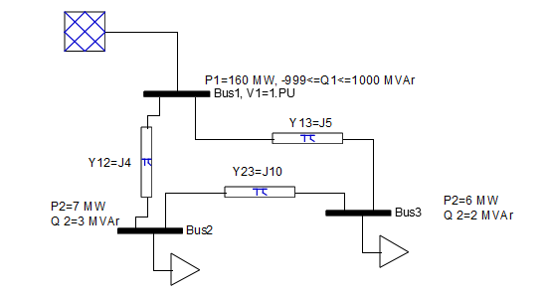
Example: Three bus System Power Network Power Flow
Example: For the data given in Fig.6, find the power flow results, real and reactive power at bus 2 and 3 during operating condition. Assume bus 1 is slack bus , whereas, bus 2 and 3 are the load buses.
Figure 6. Three bus system power network data

Slide 31
Example Cont.….
Solution:
Step 1: determine the Y-bus matrix. Y=3*3 matrix
The solution for diagonal elements and off diagonal elements are:

Slide 32
Example Cont.….
Based on equation 16, the power flow equation at bus-2 and 3 are given by:
Assume the voltage and its angle at load buses are 1p.u and 0 degree for each. Then, the real and
reactive power at bus two is calculated as

Slide 33
Example Cont.….
For bus 3, it’s given as:
Then, the real and reactive power during operation is given by
and

Slide 34
Summary
In this lecture, one of the important parameters for power flow analysis called power network bus type
is discussed
The three types of buses namely swing bus, generator bus and load bus based on the known and
unknown parameters
The load bus is known as uncontrolled bus , whereas, the generator buses are called voltage controlled bus
The place where total power mismatch takes place is called swing/slack bus
The voltage of load bus is controlled using compensators

Slide 35
References
[1]. HZ., Wang and R., Thomas. "On Bus Type Assignments in Random Topology Power Grid Models“. 48th Hawaii International Conference on System Sciences, Kauai, HI, USA. 2015, pp. 2671-2679, doi: https://doi.org/10.1109/HICSS.2015.322.
[2]. S., Tiwari; M., Ansari; K., Kumar and etl. "Load Flow Analysis of IEEE 14 Bus System Using ANN Technique“. 2018 International Conference on Sustainable Energy, Electronics, and Computing Systems (SEEMS), Greater Noida, India. 2018, pp: 1-5. https://doi.org/10.1109/SEEMS.2018.8687353.
[3]. A., Nigam; K., Sharma ; M., Bilal and etl. ‘’Reactive power compensation during the convergence of grid system with FACTS devices’’. Results in Engineering. V.23(102449), 2024. https://doi.org/10.1016/j.rineng.2024.102449.
[4]. S., Anwar and D.,Tanmoy. ‘Voltage Stability Improvement using STATCOM and SVC ’’. International Journal of Computer Applications. V. 88(14) , 2014 . Doi:10.5120/15424-4070.
[5]. C., Zhang; X., Dou; Y., Lv and X. Xie, "Multi-Bus-Based Distributed Secondary Voltage Control for Micro-grids.’’ IEEE 20th International Conference on Industrial Informatics (INDIN), Perth, Australia, 2022. pp. 146-150, doi: https://doi.org/10.1109/INDIN51773.2022.9976098.
[6]. B., Hakim; Ch., Ahmed and Ou., Abderrazak. ‘’A generic power flow formulation for flexible
modeling and fast solving for large-scale unbalanced networks’’. International Journal of
Electrical Power & Energy Systems. V.148, 2023. https://doi.org/10.1016/j.ijepes.2023.108956.

Slide 36
Thank you !

