Slide 1
Advanced Power System Analysis
Lecture 6
Load Flow Study Using Power System Software and
MATLAB source coding
Lecturer: Teshome Goa (Assist. Prof.)
Lecture learning outcomes:
At the end of this lecture, you will be able to:
Determine the Y-bus matrix using direct method
Identify the power flow simulation software
Solve the Gauss–Seidel load Flow solution
Develop the flowchart of MATLAB source code for power flow techniques

Slide 2
Outlines
Introduction
Common Power System Analysis Software
Gauss–Seidel Method Solved Problem
Load Flow Solution Using PSAT Simulator
Gauss–Seidel Iterative Algorithm Using MATLAB
Newton Raphson Algorithm (NRA)
Summary
References

Slide 3
1. Introduction
Using power system software is essential to analyze large power system network, because it’s useful to:
Analyze large-scale systems (1000+ buses) quickly.
Avoid human error in tedious matrix calculations.
Modify system data easily like changing loads or line impedances.
Modeling, analyzing and determining the network parameter within short period of time is easily achieved

Slide 4
2. Common Power System Analysis Software
i. Electrical Transient Analyser Program (ETAP)[1]:
Relay coordination, lightening, load flow, short circuit, and transient analysis are among its uses.
Ideal for power utility planning, commercial and industrial power systems.
Advantages: Comprehensive analytical modules, integrated one-line graphic, and user-friendly GUI.
ii. PowerWorld Simulator [2].
Used for the time-domain simulation, Voltage stability, OPF, load flow, and contingency analysis.
Very good for utility grid simulation, education, and visualization.
Highly interactive for simulation, excellent user-friendliness, and visible outcomes

Slide 5
Software Cont.…
iii. DIgSILENT PowerFactory
Used for: Coordination of protection, dynamic simulation, and advanced power system analysis of load flow.
Ideal for: Renewable energy integration, transmission networks, and utilities.
Advantages: Detailed modeling, scripting support, and high degree of customization.
iv. The Siemens PSSE , Power System Simulator for Engineering
Stability analysis, dynamic simulation, and load flow are among its uses.
Ideal for the research use and transmission networks.
Benefits include a large selection of plugins and industry ,and academic trust.

Slide 6
Software Cont.…
V. PSAT, MATLAB/Simulink
Utilized for automation, dynamic systems, load flow, and custom simulation.
Ideal for Power electronics, control systems, and research.
Adaptability, large library, and simple code integration makes it more adaptable
Better for GUI, continuation power flow analysis and the system network voltage stability analysis based on the most fluctuating demands
The maximum load multipliers can be determined
Accordingly, the PSAT simulation software and MATLAB Simulink are used in
this lecture

Slide 7
Software's Cont.…
2.1 PSAT software[3] : Without having to deal with lists of data directly, PSAT uses the Simulink environment and its graphical characteristics to provide a CAD tool that can construct power networks, visualize
the topology, and modify the data contained within.
But simulink isn't the greatest technique to approach a power system network; it was designed for control
diagrams with variables for inputs and outputs.
Consequently, simulink's time domain functions and control block diagram-building capabilities are not
used.
PSAT just creates a data file after reading the data from the Simulink model.

Slide 8
Software's Cont.…
Steps to use PSAT simulation software are[4]:
Step-1: Define bus data
Step-2:Define the generator data
Step-3:Define line/branch data
Step-4: Define the iterative solution techniques to formulate problems
Step-5: Model the network
Step-6: Load and simulate the power flow results
Step-7: Develop the results and record it.

Slide 9
3. Gauss–Seidel Method Solved Problem(GSMSP)
Example: The system data for a load flow solution are given in the following Tables. Determine the voltages at the end of first iteration by Gauss–Seidel method. Take a = 1.2.
Table 1. Line parameter Table 2. Bus data
Bus code | x
1-2 | 0.15
1-3 | 0.3
1-4 | 0.4
2-3 | 0.3
3-4 | 0.15
Bus | P | Q | V | Remarks
1 | - | - | 1.0 | Swing bus
2 | 0.5 | -0.2 | - | PQ Bus
3 | -1.0 | 0.5 | - | PQ Bus
4 | 0.3 | -0.1 | - | PQ Bus

Slide 10
GSMSP Cont.…
Solution:
First, we need to convert reactance (x) into admittance using Y=1/X as:
Table 3: Bus admittance conversion
Line | Reactance (X) | Y
1–2 | 0.15 | −j6.67
1-3 | 0.3 | −j3.33
1-4 | 0.4 | −j2.5
2-3 | 0.3 | −j3.33
3-4 | 0.15 | −j6.67

Slide 11
GSMSP Cont.…
Step -1: Form bus admittance matrix for four bus network: Y=4*4 matrix.
The diagonal, Off-diagonal elements and Y-Bus matrix is given by:

Slide 12
GSMSP Cont.…
Step-2: select slack bus, which is bus-1 and its voltage and angle are: V=1.05 p.u, δ=0:
Step 3. Assume initial values of voltages for all buses except the slack bus.
Step 4. Set convergence criterion , ε=0.01
Step 5. Set iteration count k = 0.
Step 6. Bus count i = 1. If ‘i’ is the slack bus, then there will be an increment in the bus count.
Step 7. Solve the voltage equation for bus i as we know that.

Slide 13
GSMSP Cont.…
Step 7. Solve the voltage equation for load bus i as we know that.
But, the load real and reactive power at each demand is given by:

Slide 14
GSMSP Cont.…

Slide 15
4. Load Flow Solution Using PSAT Simulator
PSAT is a free software downloaded for free, which is used for GUI, power flow simulation, stability
analysis, contingency analysis and OPF.
Accordingly, the above four bus problem can be also solved using PSAT simulation
Steps to use PSAT for power flow analysis are:
Open the PSAT from your storage and type >>psat in Matlab directory and then Fig.1 will be displayed in the MATLAB.

Slide 16
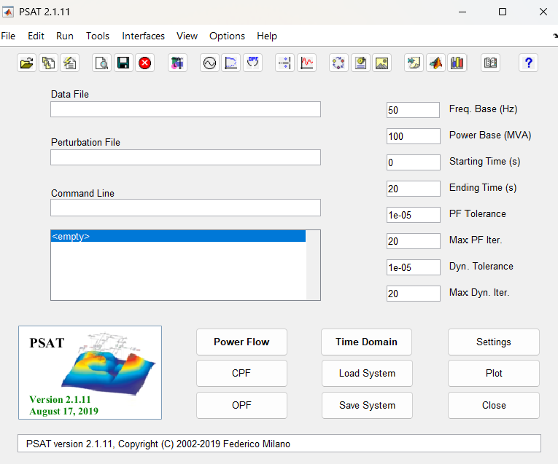
PSAT Simulator Cont.…
Figure 1. PSAT window for power flow simulation

Slide 17
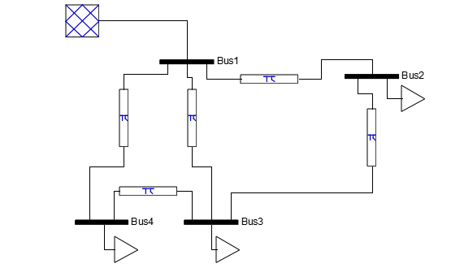
PSAT Simulator Cont.…
2. Model the network using the data find in PSAT library based on your input file, which given in Fig.2.
3. Save the data using .mdl form.
Figure 2. Four Bus PSAT Model

Slide 18
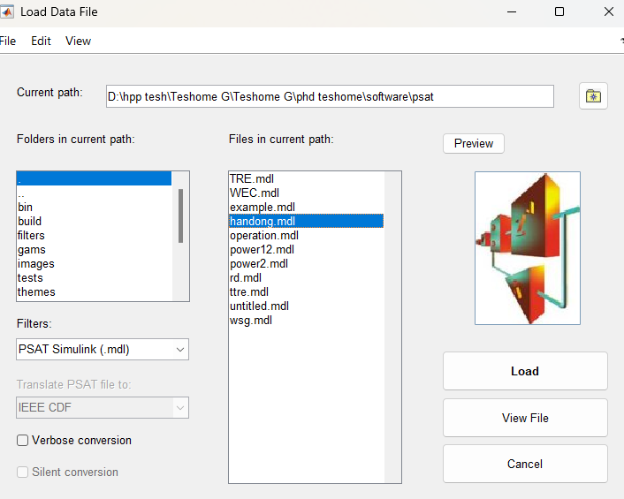
PSAT Simulator Cont.…
4. Load the saved model to MATLAB Simulink as provided in Fig.3
Figure 3. Loading the PSAT model to MATLAB Simulink library

Slide 19
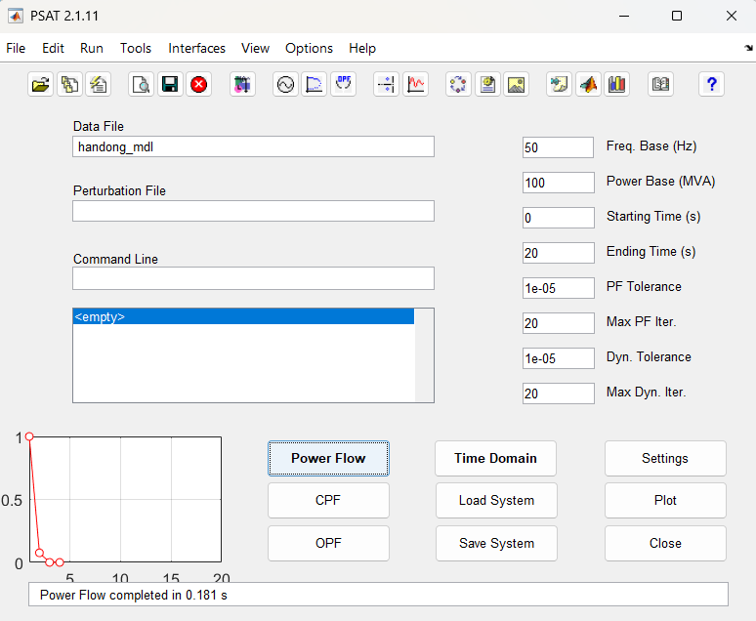
PSAT Simulator Cont.…
5. Run the load flow analysis and develop the results based on Fig.4
Figure 4. Four bus power network PSAT simulation

Slide 20
PSAT Simulator Cont.…
Voltage of Line #3 from bus <Bus1> to bus <Bus4> differs more than 10% from the base defined at the connected bus <Bus1>
PF solver: Newton-Raphson method
Single slack bus model
Iteration = 1 Maximum Convergence Error = 0.070141
Iteration = 2 Maximum Convergence Error = 0.0053507
Iteration = 3 Maximum Convergence Error = 2.8229e-05
Iteration = 4 Maximum Convergence Error = 8.035e-10
Power Flow completed in 0.111 s

Slide 21
PSAT Simulator Cont.…
PF solver: Fast decoupled method
Single slack bus model
Iteration = 1 Maximum Convergences Error = 0.46145
Iteration = 2 Maximum Convergences Error = 0.014233
Iteration = 3 Maximum Convergences Error = 0.00052403
Iteration = 4 Maximum Convergences Error = 1.685e-05
Iteration = 5 Maximum Convergences Error = 5.9762e-07
Power Flow completed in 0.094 s

Slide 22
PSAT Simulator Cont.…
Voltage of Line #3 from bus <Bus1> to bus <Bus4> differs more than 10% from the base defined at the connected bus <Bus1>
PF solver: Robust power flow method
Single slack bus model
Iteration = 1 Maximum Convergence Error = 0.070141
Iteration = 2 Maximum Convergence Error = 0.0053507
Iteration = 3 Maximum Convergence Error = 2.8229e-05
Iteration = 4 Maximum Convergence Error = 8.035e-10
Power Flow completed in 0.08 s

Slide 23
PSAT Simulator Cont.…
Number of Iterations:4
Maximum P mismatch [MW] =2.22045E-14
Maximum Q mismatch [MVar] =1.0783E-12
Table 4. Power flow results
Bus | V | phase | P gen | Q gen | P load | Q load
 | [kV] | [rad] | [MW] | [MVar] | [MW] | [MVar]
Bus1 | 132 | 0 | 20 | -10.30 E-14 | 0 | 0
Bus2 | 130.4924 | 0.026949 | -5.6E-15 | -7.2E-14 | -50 | 20
Bus3 | 136.1981 | -0.06802 | -2.2E-14 | -2E-13 | 100 | -50
Bus4 | 132.2764 | -0.00359 | 1.67E-14 | 1.08E-12 | -30 | 10

Slide 24
PSAT Simulator Cont.…
Table 5. Line flows in forward direction
From Bus | To Bus | Line | P Flow | Q Flow | P Loss | Q Loss
 |  |  | [MW] | [MVar] | [MW] | [MVar]
Bus1 | Bus2 | 1 | -17.7586 | 7.853683 | 0 | 0.565574
Bus1 | Bus3 | 2 | 23.37621 | -9.80605 | -3.6E-15 | 1.927818
Bus1 | Bus4 | 3 | 14.38242 | -8.34898 | 0 | 0.06914
Bus2 | Bus3 | 4 | 32.24136 | -12.7119 | 0 | 3.687035
Bus3 | Bus4 | 5 | -44.3824 | 21.8672 | 0 | 3.449082

Slide 25
PSAT Simulator Cont.…
Table 6. Line flows in backward direction
From Bus | To Bus | Line | P Flow | Q Flow | P Loss | Q Loss
 |  |  | [MW] | [MVar] | [MW] | [MVar]
Bus2 | Bus1 | 1 | 17.75864 | -7.28811 | 0 | 0.565574
Bus3 | Bus1 | 2 | -23.3762 | 11.73387 | -3.6E-15 | 1.927818
Bus4 | Bus1 | 3 | -14.3824 | 8.418122 | 0 | 0.06914
Bus3 | Bus2 | 4 | -32.2414 | 16.39893 | 0 | 3.687035
Bus4 | Bus3 | 5 | 44.38242 | -18.4181 | 0 | 3.449082

Slide 26
PSAT Simulator Cont.…
Table 7. Global summary report
Total generation
Real power [mw] |  | 20
Reactive power [mvar] |  | -10.3014
Total load
Real power [mw] |  | 20
Reactive power [mvar] |  | -20
Total losses
Real power [mw] |  | -7.1e-15
Reactive power [mvar] |  | 9.69865
Limit violation statistics
all voltages except bus three are within limits.
all reactive power within limits.
all current flows within limits.
all real power flows within limits.
all apparent power flows within limits.

Slide 27
PSAT Simulator Cont.…
Figure 5. Four bus voltage of PSAT simulation

Slide 28
5. Gauss–Seidel Iterative Algorithm Using MATLAB
The GS iterative solution using MATLAB source code applies for developing
The y-bus matrix
PV bus power flow solution
PQ bus power flow solutions
The power mismatch calculations
The flowchart to develop GS based load flow solution is presented in Fig.6

Slide 29
GSIA Cont.…
Start
Read system data
Develop Y-bus
Set swing bus
Flat start voltage V=1+j0 and set ε
Set iteration count, k=0
Bus count, i=1
Check swing bus
Calculate the voltage
Set K=k+1
Calculate the change in bus voltage
Figure 6. GS power flow source code flowchart.
Use acceleration of convergence
i=i+1
Check if ΔVmax <ε
Check if
i<=n
Calculate ΔVmax
Calculate power flow and loss
End

Slide 30
6. Newton Raphson Algorithm (NRA)
Determine
Calculate Jacobean matrix
Solve the following equation to find Δδ_{(i)} and ΔV_{(i)}
Power flows and losses on the network branches
Lastly, determine the slack bus's real and reactive power

Slide 31
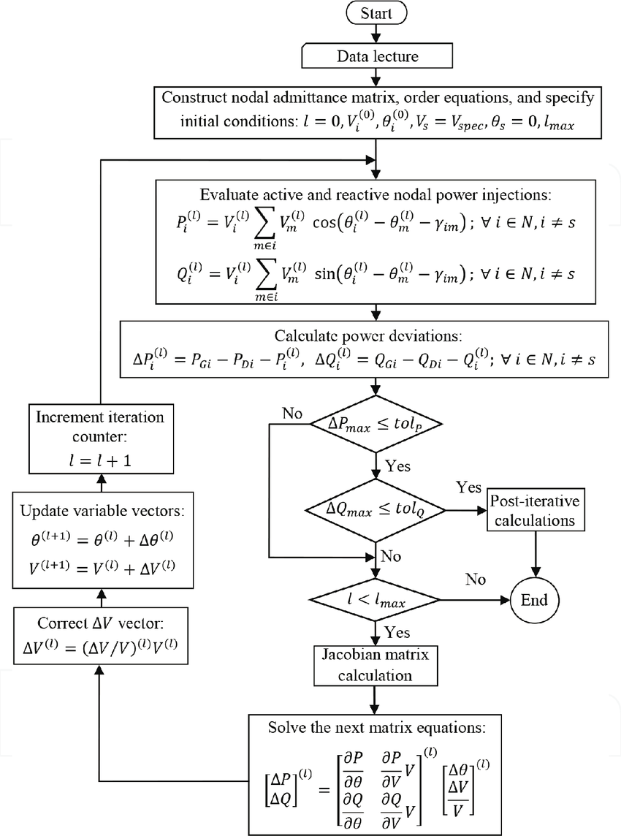
NRA Cont.…
Figure 7 : NR load flow algorithm.
Url: https://www.researchgate.net/publication/367688833/figure/fig1/AS:11431281116672819@1675288548779/Flow-chart-for-solving-power-flow-problems-by-Newton-Raphson-method.png

Slide 32
NRA Cont.…
Example 2: The same system data for a load flow solution are given in the following Tables. Determine
the Y bus matrix using direct method
Table 7. Line parameter Table 8. Bus data
Bus code | x
1-2 | 0.15
1-3 | 0.3
1-4 | 0.4
2-3 | 0.3
3-4 | 0.15
Bus | P | Q | V | Remarks
1 | - | - | 1.0 | Swing bus
2 | 0.5 | -0.2 | - | PQ Bus
3 | -1.0 | 0.5 | - | PQ Bus
4 | 0.3 | -0.1 | - | PQ Bus

Slide 33
NRA Cont.…
The source code for Y-bus matrix using direct method is given as:
% Formation of admittance matrices Using Direct Method
clear all;
clc;
close all;
k=input('\n\n Give the number of buses n=');
B=input('\n\n enter your:\n>>1.for impedance 2.for admittance\n');
if (B==2)
fprintf('\n\n Enter the admittance value:');
end
if(B==1)
fprintf('\n\n Enter the impedance value:');
end
for i=1:k
for j=i+1:k
a(i,j)=0;
fprintf('\n write the bus %d to bus %d values:',i,j);
a(i,j)=input('');
if(B~=2&a(i,j)~=0)
a(i,j)=1/a(i,j);
end
a(j,i)=a(i,j);
end
end
d=input('\n\n for admittance value in source?\n Press “1” for yes and “0” for no:');
if (d==1)
for i=1:k
fprintf('\n Enter for bus %d:',i);a(i,i)=input('');
end
end
for i=1:k
for j=1:k
if(i~=j)
a(i,i)=a(i,i)+a(i,j);
y(i,j)=-a(i,j);
end
end
y(i,i)=a(i,i);
end
fprintf('\n\n Y bus=:>>\n\n');
display(y);

Slide 34
NRA Cont.…
y = 12.5000 -6.6667 -3.3333 -2.5000
-6.6667 10.0000 -3.3333 0
-3.3333 -3.3333 13.3333 -6.6667
-2.5000 0 -6.6667 9.1667

Slide 35
NRA Cont.…
Example 3. Using the flowchart presented in Fig.7 develop the MATLAB source code for NR load
flow and Determine, the bus admittance matrix and line flow based on the following bus and line data of IEEE-6 bus test system[5].
% IEEE 6-BUS TEST SYSTEM
% Bus Bus Voltage Angle ---Load---- ----Generator-- Static Mvar
% No code Mag. Degree MW Mvar MW Mvar Qmin Qmax+Qc/ -Ql
busdata= [1 1 1.05 0.0 0.0 0.0 0.0 0.0 0 0 0
2 2 1.05 0.0 0.0 0.0 50.0 0.0 -10 80 0
3 2 1.07 0.0 0.0 0.0 60.0 0.0 -10 95 0
4 0 0.0 0.0 70.0 70.0 0.0 0.0 0 0 0
5 0 0.0 0.0 70.0 70.0 0.0 0.0 0 0 0
6 0 0.0 0.0 70.0 70.0 0.0 0.0 0 0 0];
% Bus bus R X 1/2 B = 1 for lines
% nl nr p.u. p.u. p.u. > 1 or < 1 tr. tap at bus nl
linedata=[1 2 0.1 0.2 0.002 1
1 4 0.05 0.2 0.02 1
1 5 0.08 0.3 0.03 1
2 3 0.05 0.25 0.03 1
2 4 0.05 0.1 0.01 1
2 5 0.1 0.3 0.02 1
2 6 0.07 0.2 0.025 1
3 5 0.12 0.26 0.025 1
3 6 0.02 0.1 0.01 1
4 5 0.2 0.4 0.04 1
5 6 0.1 0.3 0.03 1];

Slide 36
NRA Cont.…
Y=
Columns 1 2 3 4 through 5
4.0063 -11.7659i -2.0000 + 4.0000i 0.0000 + 0.0000i -1.1765 + 4.7059i -0.8299 + 3.1120i
-2.0000 + 4.0000i 9.3283 -23.2135i -0.7692 + 3.8462i -4.0000 + 8.0000i -1.0000 + 3.0000i
0.0000 + 0.0000i -0.7692 + 3.8462i 4.1557 -16.5673i 0.0000 + 0.0000i -1.4634 + 3.1707i
-1.1765 + 4.7059i -4.0000 + 8.0000i 0.0000 + 0.0000i 6.1765 -14.6359i -1.0000 + 2.0000i
-0.8299 + 3.1120i -1.0000 + 3.0000i -1.4634 + 3.1707i -1.0000 + 2.0000i 5.2933 -14.1378i
0.0000 + 0.0000i -1.5590 + 4.4543i -1.9231 + 9.6154i 0.0000 + 0.0000i -1.0000 + 3.0000i
Column 6
0.0000 + 0.0000i
-1.5590 + 4.4543i
-1.9231 + 9.6154i
0.0000 + 0.0000i
-1.0000 + 3.0000i
4.4821 -17.0047i

Slide 37
NRA Cont.…
Power Flow Solution by Newton-Raphson Method
Maximum Power Mismatch = 0.079723
No. of Iterations = 2
Bus Voltage Angle ------Load------ ---Generation---Injected'No. Mag. Degree MW Mvar MW Mvar Mvar
1 1.050 0.000 0.000 0.000 -116.739 32.052 0.000
2 1.050 5.645 0.000 0.000 50.000 -71.815 0.000
3 1.070 7.706 0.000 0.000 60.000 -20.796 0.000
4 1.051 3.729 70.000 70.000 0.000 0.000 0.000
5 1.065 4.678 70.000 70.000 0.000 0.000 0.000
6 1.069 6.542 70.000 70.000 0.000 0.000 0.000
,

Slide 38
NRA Cont.…
Line- Power at bus & line -Line lossTransformer
from to MW Mvar MVA Mvar tap
1 -116.739 32.052 121.059
2 -42.307 23.606 48.447 2.138 3.836
4 -33.582 6.986 34.301 0.550 -2.214
5 -29.356 0.582 29.362 0.636 -4.323
2 50.000 -71.815 87.507
1 44.445 -19.770 48.644 2.138 3.836
3 -17.106 -7.995 18.882 0.143 -6.029
4 29.446 -15.955 33.491 0.493 -1.220
5 4.121 -8.706 9.632 0.054 -4.311
6 -10.883 -8.741 13.958 0.098 -5.332
3 60.000 -20.796 63.502
2 17.249 1.967 17.360 0.143 -6.029
5 20.134 -9.403 22.221 0.470 -4.679
6 22.641 -4.137 23.016 0.091 -1.832
4 0.000 0.000 0.000
1 34.132 -9.200 35.350 0.550 -2.214
2 -28.953 14.735 32.486 0.493 -1.220
5 -5.169 -5.494 7.543 0.051 -8.850
5 0.000 0.000 0.000
1 29.992 -4.905 30.391 0.636 -4.323
2 -4.068 4.394 5.988 0.054 -4.311
3 -19.664 4.723 20.223 0.470 -4.679
4 5.219 -3.356 6.205 0.051 -8.850
6 -11.470 -0.792 11.498 0.122 -6.462
6 0.000 0.000 0.000
2 10.980 3.409 11.497 0.098 -5.332
3 -22.550 2.306 22.668 0.091 -1.832
5 11.593 -5.670 12.905 0.122 -6.462
Total loss 4.845 -41.416
Project assignment : For example 2, develop the NR load flow solution. Take acc = 1.2.

Slide 39
Summary
In this lecture, the solved problem, Simulation and Source code of Power flow analysis are presented.
Thus, using the simulation software and developing MATLAB source code is very important to solve large number of buses and equations within short period of time.
It reduces the computational time and hence minimizes the error
In addition, the types of power flow simulation software's with its brief example is presented

Slide 40
References
[1]. J., Prabhu; S., Sharma; M., Nataraj and D., Tripathi. ‘’Design of electrical system based on load flow analysis using ETAP for IEC projects’’. IEEE 6th International Conference on Power Systems (ICPS), 2016, pp. 1-6. doi: https://doi.org/10.1109/ICPES.2016.7584103.
[2]. S., Syafaruddin and S., Latief. "Lesson Learned from Power System Design with PoweWorld Simulator“. Conference on Power Engineering and Renewable Energy (ICPERE), Solo, Indonesia, 2018. pp. 1-6. doi: https://doi.org/10.1109/ICPERE.2018.8739687.
[3]. L., Vanfretti and F., Milano. "Application of the PSAT, an Open Source Software, for Educational and Research Purposes“. IEEE Power Engineering Society General Meeting, USA, 2007. pp. 1-7, doi: 10.1109/PES.2007.385952.
[4]. B., Ashutosh and B., Dhananjay. ‘’Power Flow Analysis using PSAT’’. International Journal of Enhanced Research in Science Technology & Engineering.V.2(4), 2013, pp:100-105.
[5]. P., Venkatesh; B., Manikandan, S., Charles and A., Srinivasan. ‘’Book:Electrical power systems: Analysis, Security and Deregulation’’. Asoke K. Ghosh, PHI Learning Private Limited

Slide 41
Thank you !

