Slide 1
Advanced Power System Analysis
Lecture 7
Fault analysis
Lecturer: Teshome Goa (Assist. Prof.)
Lecture learning outcomes:
At the end of this lecture, you will be able to:
Understand the Importance of Fault Analysis in Power System
Know the Behavior of Short Circuit in Power System Components
Identify the Sub-transient, Transient and Steady State current of Synchronous Generator
Differentiate the Types of Fault in Power System Network

Slide 2
Outlines
Introduction
Short-Circuit on Power System Components
Transient on a Transmission Line
Short-circuit on a Synchronous Machine
Types of Fault in power system
Summary
References

Slide 3
1. Introduction
Fault analysis in a power system is very important to select the circuit protective devices settings such
as switchgear, CB, relays and the overall system stability operations[1].
A power system is not static but changes during the operation
Which leads to switching ON or OFF of generators and transmission lines and planning, specially the
addition of generators and transmission lines.
Which necessitates the fault analysis routinely performed by the utility engineers.

Slide 4
Introduction Cont.…
Faults usually occurs due to:
Insulation failure of equipment.
Flashover of lines initiated by a lighting stroke.
Permanent damage to conductors and towers or accidental faulty operations.
Switching problem
Open circuit of lines

Slide 5
Introduction Cont.…
Lightning Strike Event Sequence for fault occurrence[2]
An ionized path to ground was created when lightning struck the cable.
With a rise time of 10 s and a dissipation period of 200 s, a single average stroke may have 25,000 amps.
Lightning can appear to glitter when multiple strokes occur in a single flash, and the entire event can last up
to one second.
After lightning stroke energy has expended, ionized air maintains the conduction route, leading to enormous fault currents, frequently exceeding 25,000 amps.
2. Conduction path is maintained by ionized air after lightning stroke energy has dissipated,
resulting in high fault currents , often > 25,000 amps.

Slide 6
Introduction Cont.…
Within one to two cycles , around 16 ms relays at both ends of line detect high currents, signaling
circuit breakers to open the line
In this case the nearby locations see decreased voltages
Circuit breakers open to de-energize the line in an additional one to two cycles. Because ;
  Breaking tens of thousands of amps of fault current is not easy as small feat
  With the line removed, voltages usually return to near normal
Circuit breakers may reclose after several seconds, trying to restore faulted line to service

Slide 7
Introduction Cont.…
Fault currents cause equipment damage due to both thermal and mechanical processes
Accordingly, the goal of fault analysis is to determine the magnitudes of the currents present during the fault which is;
Needs to determine the maximum current to insure devices can survive the fault
Needs to determine the maximum current the circuit breakers (CBs) need to interrupt and to correctly
size the CBs
It also helps in determining the maximum short circuit capacity of the substations

Slide 8
2. Short-Circuit on Power System Components
A connection with almost zero resistance that raises the nodes' potential to equal zero is called a short circuit.
The system's source voltage and impedance, as well as the impedance from generations to loads,
influence this fault current, which is exponentially huge [3].
The voltage drop is zero and the current is only constrained by system reactance in a perfect bolted fault, where currents can reach tens of kilo-amperes.
Severe thermal heating, mechanical stresses on machinery, high magnetic stress, arcing, and the
possibility of fire or explosion are all brought on by fault currents.
The components must therefore be able to tolerate these forces or be promptly
isolated during a fault.

Slide 9
Short-Circuit on Power System Cont.…
In power systems, transient short-circuit events, which can last anywhere from a few microseconds to a
few seconds.
Which can lead to serious problems such as oscillations, overvoltage's, and even equipment failure.
These transients, which can be caused by faults, switching, or lightning as presented in Fig.1, can cause components to be damaged by excessive heat or insulation breakdown.
Protection measures, such as the use of specialized equipment and the selection of insulation, are essential to reducing these negative effects.

Slide 10
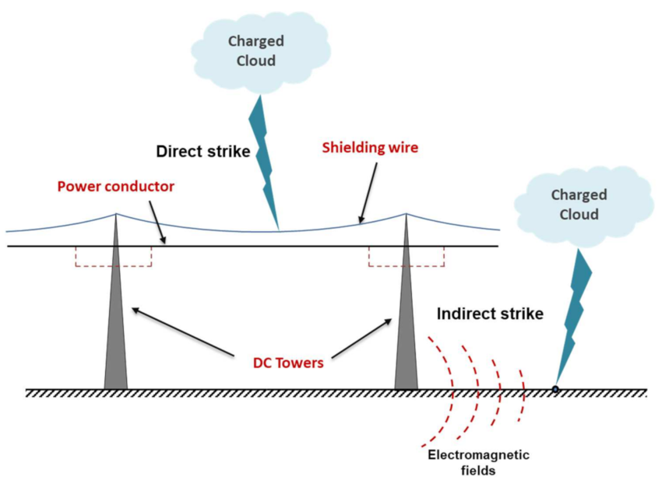
Short-Circuit on Power System Cont.…
Figure 1. Lightening strike that leads to short-circuit in powers system.
Url: https://www.researchgate.net/publication/358664204/figure/fig1/AS:11431281397047971@1745502699797/Schematic-diagram-of-lightning-strike-mechanisms.tif

Slide 11
Short-Circuit on Power System Cont.…
A transient is a non-steady-state event that occurs after a sudden disruption and involves rapid changes, ranging from milliseconds to seconds, before settling into a new steady state.
Very fast speed surges (µs–ms) can be caused by lightning or capacitor switching;
Medium-speed short-circuit transients (a cycles, ms) can be caused by faults; and
slow stability transients (seconds) can be caused by large load changes.

Slide 12
Short-Circuit on Power System Cont.…
The high surge electromagnetic waves travelling at the speed of light caused by disturbances on lines
A voltage/current wave that travels along the line is caused by an sudden fault.
Substations or switchgear may experience overvoltage spikes as a result of these waves reflecting at
line ends or impedance changes.
Transient faults may be larger than steady-state values.

Slide 13
Short-Circuit on Power System Cont.…
For example, peak voltages and currents from a lightning strike or short circuit may be significantly higher than normal operating levels.
Typically, a fault current waveform has three intervals:
The first few cycles of the sub-transient phase are characterized by an exceptionally high AC current that rapidly decreases with the damper winding time constant τ'', or roughly 5–10× rated current peak value
Transient period: After damper effects subside, a lower AC current than in the sub-transient period with the field winding's time constant τ' remains.

Slide 14
Short-Circuit on Power System Cont.…
Steady-state phase: The fault current finally drops to the steady short-circuit value
It’s often less than 2× rated current when the machine reaches the synchronous reactance limit.
The three currents wave form are provided in Fig.2
DC offset: A DC (constant) offset is applied to the AC current if the fault is applied at a non-zero
position on the AC wave.
As the generator's inductive time constant increases, this offset results in asymmetry and decays.

Slide 15
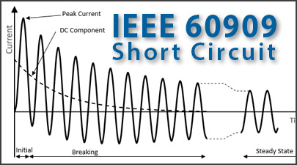
Short-Circuit on Power System Cont.…
Figure 2. The three current wave form during fault condition.
url:https://www.easypower.com/images/thumbnails/IEEE_60909_Thumbnail_-_405_1.jpg

Slide 16
3. Transient on a Transmission Line
Let us consider the short-circuit transient on a transmission line[4].
Certain simplifying assumptions are made at this stage.
Assume the line is fed from the constant voltage source and short-circuit takes place when the line is unloaded and the line capacitance is negligible
Consider the series R–L circuit as shown in Fig.3.
The closing of switch at t = 0 represents a first approximation of a three-phase short-circuit at the
terminals of an unloaded transmission line.

Slide 17
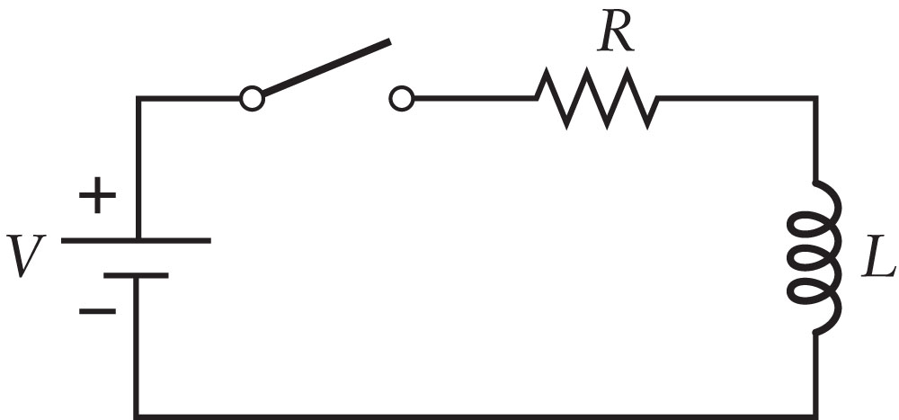
Transient on a Transmission Line Cont.….
The current is assumed to be zero before switch closes, and the source angle α determines the source voltage at t = 0.
Figure 3. RL circuit representation of Transmission line.
Url: https://media.cheggcdn.com/media/39a/s1000x467/39a2b0ef-58be-4d36-8462-03d02a190f91/phpqFjHMe.png

Slide 18
Transient on a Transmission Line Cont.….
Now, the Kirchhoff’s voltage law equation for the circuit is given by:
eqn.(1)
This current has AC and DC part as given by:
eqn.(2)
where symmetrical short-circuit current and Dc offset current as given by:
eqn.(3)
Then, impedance is:
eqn.(4)

Slide 19
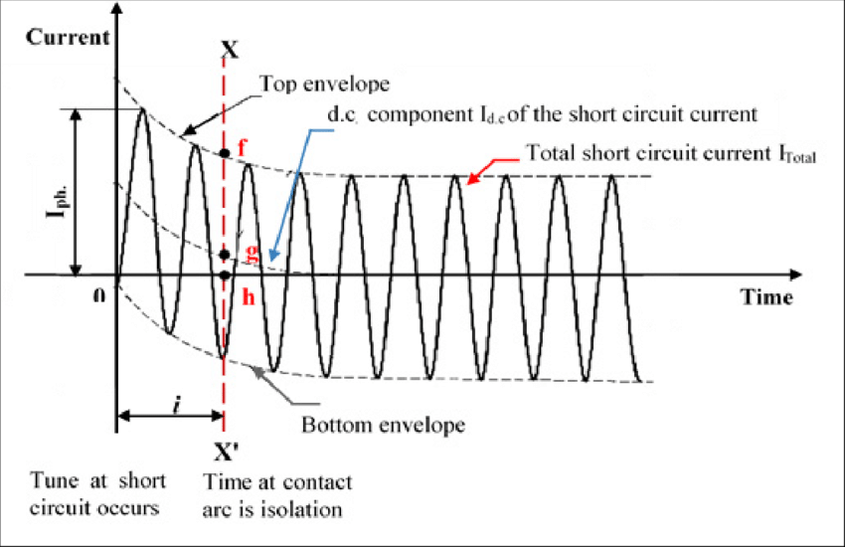
Transient on a Transmission Line Cont.….
The overall short-circuit current of transmission line is presented in Fig.4
Figure 4. Short-circuit current envelop of transmission line.
https://www.researchgate.net/publication/321330378/figure/fig3/AS:628024638701568@1526744150027/Fig-1-Short-circuit-current-transients-waveform-1-Symmetrical-and-asymmetrical.png

Slide 20
Transient on a Transmission Line Cont.….
The total short-circuit current i(t), the value corresponding to the first peak is called maximum momentary short-circuit current i_{mm}.
If the decay of the transient current in this short time is neglected, then
eqn.(5)
Since the transmission line resistance is small, ፀ=90°:
eqn.(6)

Slide 21
Transient on a Transmission Line Cont.….
Thus, i_{mm} has the maximum possible value when α = 0.
This implies that the effect of short-circuit will be severe if the fault occurs when the voltage wave is
going through zero. Thus
eqn.(7)
Which is called double effect.
For the selection of circuit breakers, the momentary short-circuit current is taken corresponding to its
maximum possible value.

Slide 22
4. Short-circuit on a Synchronous Machine
The machines linked to the power system determine how much current flows through the network during a fault.
A synchronous machine's current flows in three different ways due to the influence of the armature current on the flux that produces the voltage: immediately following the fault, a few cycles later, and under sustained or steady state conditions, as shown in Fig. 5.
Furthermore, the instantaneous value at the moment of fault occurrence results in an exponentially
declining DC component.

Slide 23
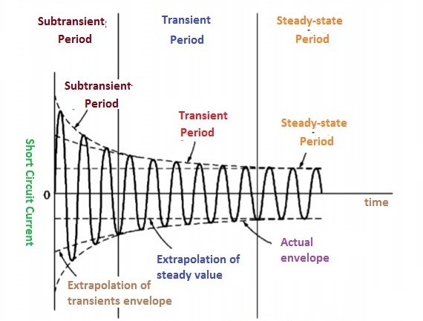
Short-circuit on a Synchronous Machine Cont.…
Figure 5. The three types of currents during fault response of synchronous machine.
Url: https://www.theengineeringknowledge.com/wp-content/uploads/2019/10/The-symmetric-ac-COmponent-of-the-fault-current.jpg

Slide 24
Short-circuit on a Synchronous Machine Cont.…
Furthermore, as Fig. 5 illustrates, the synchronous machine's AC current peak value varies with time.
which is due to the removal of the unidirectional component of the transient waveform and a change in
impedances
The effective impedance is extremely low because of the initial low back emf at the fault location, which
causes large current.
The initial current may be multiple times the steady state value even in the absence of the DC transient
component.

Slide 25
Short-circuit on a Synchronous Machine Cont.…
The sub-transient reactance Xd'' for the first 10 to 20 ms of fault, the transient reactance Xd' for up to around 500 ms, and the steady state reactance Xd (synchronous reactance).
A demagnetizing flux is produced by an alternator's armature reaction under the steady state three-phase short-circuit condition.
A reactance known as the armature reaction reactance, or Xa, is used to illustrate this effect.
Synchronous reactance, Xs is the sum of the armature reactance (Xa) and leakage reactance (X_{l}).
The synchronous reactance in a salient pole alternator is known as the direct axis reactance, Xd.

Slide 26
Short-circuit on a Synchronous Machine Cont.…
Direct axis sub-transient reactance ( X_{d}’’ ):
The DC offset current is present in all three stator phases at the moment of the short circuit.
The transient effect of this DC offset current can cause current to be induced in the damper winding
and rotor field winding.
The primary flux will be augmented by the flux created by the increase in field current and damper winding current.
As seen in Fig.6, two reactance's in parallel with Xa might be used to illustrate this effect.

Slide 27
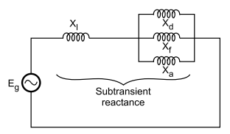
Short-circuit on a Synchronous Machine Cont.…
In this case, X_{f} stands for the flux produced by the field winding's induced current, and X_{dw} for the damper winding's induced current. The total reactance is given by:
eqn.(8)
Figure 6. Direct axis sub-transient reactance's.
Url:https://www.poriyaan.in/media/imgPori/images11/DtHP5JP.png

Slide 28
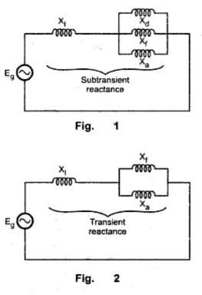
Short-circuit on a Synchronous Machine Cont.…
Direct axis transient reactance ( X_{d}’ ): The reactance is effective after the damper winding currents have died out
The transient reactance of the machine is shown in Fig.7
eqn.(9)
Figure 7. Transient reactance's circuit diagram.
Url: https://blogger.googleusercontent.com/img/b/R29vZ2xl/AVvXsEhJvE4LATcVlyz9YEQjMMbdMn241b8IJV0gr5TRlxpzfv9tUiO8W1qHuXwjxZk2iPg2-IbeEonCPYZX48Z91vs-jHbfizcC-VdnzcHr9BQSF5X12u48iEbOhWpf2MhXbFyUOMjCdFerE02c/s1600/ccc126.jpeg

Slide 29
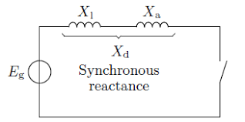
Short-circuit on a Synchronous Machine Cont.…
Direct axis synchronous reactance or steady state condition reactance:
The transient state will exist for a few cycles and then the steady state conditions are achieved as the effect of field winding current will also die out in short time depending on its time constant.
Thus the steady state total reactance as shown in Fig.8 is given by the sum of Xa and Xl .
eqn.(10)
Figure 8. Direct axis synchronous reactance.
url:https://www.researchgate.net/figure/Steady-state-short-circuit-model-of-a-synchronous-machine_fig1_281268957

Slide 30
Short-circuit on a Synchronous Machine Cont.…
The fundamental frequency component of armature current following the sudden application of short-circuit to the armature of an initially unloaded machine can be expressed as:
eqn.(11)
where E_{g} is the r.m.s line to line neutral pre-fault terminal voltage of the unloaded synchronous machine. The armature resistance is neglected in the above equation.
Note that at time t = 0, when the fault occurs the rms value of current, which is called the rms sub-transient fault current, I’’
eqn.(12)

Slide 31
Short-circuit on a Synchronous Machine Cont.…
The duration of I’’ is determined by the time constant т’’_{d} , which is called the direct axis short-circuit sub-transient time constant.
At a later time, when t is large compared to т’’_{d} , but small compared to the direct axis short-circuit transient time constant т’d , the first exponential term has decayed almost to zero, but the second exponential has not decayed significantly.
The r.m.s AC fault current then equals to the r.m.s transient fault current and given by:
eqn.(12)

Slide 32
Short-circuit on a Synchronous Machine Cont.…
When t is much larger than т’d , the rms AC fault current approaches its steady state value, given by:
eqn.(13)
The sub-transient reactance, the transient reactance, and the steady state reactance, respectively,
define the sub-transient, transient, and steady state periods following a defect.
The values of these reactance's are rising.
The equivalent components of the short-circuit current have diminishing magnitudes (|I’’| > |I’| > |I |), and (Xd’’< Xd’< Xd).
The rms value of the ac component of the fault current just after the fault occurs, with the dc component eliminated, is the initial symmetrical rms current.

Slide 33
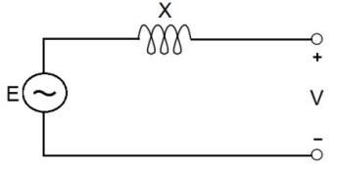
Short-circuit on a Synchronous Machine Cont.…
During a fault the only devices that can contribute fault current are those with energy storage
Thus the models of generators (and other rotating machines) are very important since they contribute the bulk of the fault current.
Generators can be approximated as a constant voltage behind a time-varying reactance as presented in Fig.9
Figure 9. Approximate Generator Model.
Url: https://www.researchgate.net/publication/323244764/figure/fig4/AS:667649172336651@1536191375287/Representation-of-a-generator-as-a-constant-voltage-source-behind-transient-reactance.jpg

Slide 34
Short-circuit on a Synchronous Machine Cont.…
To simplify analysis of fault currents in networks we'll make several simplifications:
  Transmission lines are represented by their series reactance
  Transformers are represented by their leakage reactance
  Synchronous machines are modeled as a constant voltage behind direct-axis sub-transient reactance
  Induction motors are ignored or treated as synchronous machines
  Other (non spinning) loads are ignored

Slide 35
5. Types of Fault in Power System
There are two main types of faults[5].
Symmetric faults: system remains balanced; these faults are relatively rare, but are the easiest to analyze so we’ll consider them first.
Unsymmetrical faults: system is no longer balanced; very common, but more difficult to analyze
The most common type of fault on a three phase system by far is the single line-to-ground (SL-G), followed by the line-to-line faults (L-L), double line-to-ground (DL-G) faults, and balanced three phase faults

Slide 36
Summary
In this lecture, the basic of short circuit analysis and its impotence is discussed.
Accordingly, the short circuit analysis is mainly needed to determine the magnitude faults in power system, which aims determine the size of circuit protective devices.
Besides this, modeling power system components specifically transmission lines and synchronous generator during transient condition
Specially, the generator model during transients, sub transients and steady state condition are discussed
The equivalent components of the short-circuit current have diminishing magnitudes (|I’’| > |I’| > |I |), and (X_{d}’’< X_{d}’< X_{d}).
Finally, the two common types of fault known as symmetrical and unsymmetrical
faults are discussed.

Slide 37
References
[1]. I., Khandoker; K., Dowon and A., Ahmed. ‘’A review on adaptive power system protection schemes for future smart and micro grids, challenges and opportunities’’. Elsevier: Electric Power Systems Research. V. 230, 2024. doi: https://doi.org/10.1016/j.epsr.2024.110241.
[2]. E. Prasetyo, N. Silaen, A. I. Arif and I. M. S. Merta, "Lightning Performance of 70 kV Overhead-Line Sub-Transmission in Bandung," 2022 IEEE PES 14th Asia-Pacific Power and Energy Engineering Conference (APPEEC), Melbourne, Australia, 2022, pp. 1-6, https://doi.org/10.1109/APPEEC53445.2022.10072250.
[3]. S., Jie; F., Josep; M., Leonardo and etl:. "A short-circuit calculation solver for power systems with power electronics converters ‘’. Elsevier: International Journal of Electrical Power & Energy Systems. V.157, 2024. https://doi.org/10.1016/j.ijepes.2024.109839
[4]. B., Brusilowicz and J., Herlender. "Transmission Line Modelling and Simulating for Transient Analysis’’. Modern Electric Power Systems (MEPS), 2019, pp. 1-6, doi: https://doi.org/10.1109/MEPS46793.2019.9395054.
[5]. T., Nieminen; O., Väänänen; P., Puttonen; T., Flyktman and A., Latvala, "Identifying electric power system fault types with Deep Neural Network“. IEEE International Workshop on Metrology for Industry 4.0 & IoT (MetroInd4.0&IoT), Brescia, Italy, 2023, pp. 371-375, doi: https://doi.org/10.1109/MetroInd4.0IoT57462.2023.10180194.

Slide 38
Thank you !

