Slide 1
Advanced Power System Analysis
Lecture 8
Fault analysis
Lecturer: Teshome Goa (Assist. Prof.)
Lecture learning outcomes:
At the end of this lecture, you will be able to:
Understand the symmetrical three phase fault
Know the symmetrical fault analysis methods
Analyze the short-circuit MVA Level calculations
Know how to select the circuit breaker ratings

Slide 2
Outlines
Introduction: Symmetrical Short-circuit
Symmetrical Fault Analysis Methods
Short-circuit MVA Level Calculations
Selection of Circuit Breaker Ratings
Solved Problems using Analytical and Software
Summary
References

Slide 3
1. Introduction: Symmetrical Short-circuit
Any situation in which all three of the system's phases are either earthed or short-circuited to one another is known as a three-phase fault[1].
This kind of problem is characterized as a simultaneous short-circuited fault that generates symmetrical current at all three phases.
It is the most severe kind, but it doesn't happen very often.
The internal EMF of the machine in the system, internal impedances, and the impedance in the network between the machine and the problem all affect this fault current.
Figure. 1 shows the circuit schematic for a three-phase fault.

Slide 4
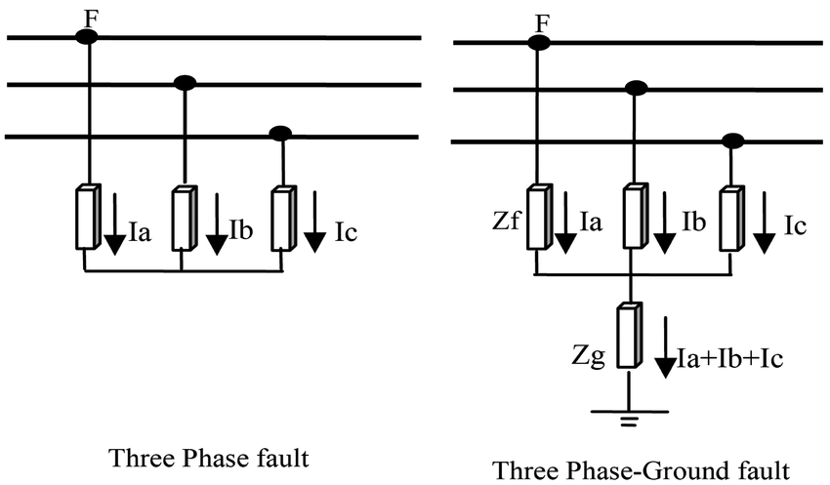
Introduction Cont.…
,
Figure 1. Circuit diagram of three phase fault .
Url: https://www.researchgate.net/publication/3275710/figure/fig4/AS:394697127284739@1471114536548/Two-most-common-symmetrical-fault-types.png

Slide 5
Introduction Cont.…
The balanced three-phase faults may be analyzed using per phase basis analysis or equivalent single-phase circuit.
The short circuit analysis of symmetrical fault is usually carried out in per-unit quantities
This in general is a balanced condition, and we just need to know the positive-sequence network to
analyses faults.
Further, the single line diagram can be used, as all the three-phases carry equal currents displaced by
120°.

Slide 6
Introduction Cont.…
Three-phase faults, with or without earth, usually makes only 5% of the first faults in a power system[2].
Line-earth faults make up 80% of unbalanced faults, followed by double line faults with or without earth (15%), which frequently develop into three-phase faults, and open circuit faults.
A fault describes a change in the structural network that is comparable to that brought on by the addition of impedance at the fault location.
The defect is known as a fastened fault or solid fault if the fault impedance is zero.

Slide 7
2. Symmetrical Fault Analysis Methods
Analytical techniques and computer-aided modeling/ simulation are used to do the fault analysis[3].
The development of mathematical formulas for power system modeling, which aids in identifying fault
currents, is the mainstay of analytical techniques.
In contrast, the computer-aided approaches simulate fault scenarios and analyses the system's response using various power system software.
The most widely used analytical techniques are the bus-impedance matrix, supper position,
and Thevenin equivalent approaches.

Slide 8
Symmetrical Fault Analysis Methods Cont.…
Common software's are:
Power World simulator
PSAT
ETAP
Digsiglent
PSS
Others

Slide 9
Symmetrical Fault Analysis Methods Cont.…
The Thevenin’s theorem : is used for three phase balanced fault analysis using the following steps:
Assume all pre-fault voltage magnitudes are 1.0 per unit and all pre-fault currents are zero.
Draw the single line diagram.
Draw the per unit reactance diagram, which is determined from the per unit analysis
Determine the Pre-fault bus voltage and currents, which are obtained from the load flow analysis result.
Replace the reactance's of synchronous machines by their sub-transient or transient values.
Short-circuited all the emf sources, to determine the passive Thevenin’s network

Slide 10
Symmetrical Fault Analysis Methods Cont.…
Draw the Thvenin's equivalent circuit viewed from the faulted bus.
Determine the fault current using the theorem
eqn.(1)
where, E_{th} or V° is the pre-fault voltage
Determine the current contributed by the generator and motor , etc
eqn.(2)
eqn.(3)

Slide 11
Symmetrical Fault Analysis Methods Cont.…
Determine the post-fault voltage
eqn.(4)
Determine the post-fault line flows
eqn.(5)

Slide 12
3. Short-circuit MVA Level Calculations
In a power system, the maximum fault current that can flow into a zero impedance fault is necessary to be known for switch gear solution[4].
It can be either symmetrical three-phase value or value of any asymmetrical condition.
Thus, the fault-level describes the value for the symmetrical condition.
The fault level is usually expressed in MVA or the corresponding per unit value, with the maximum fault current value being converted using the nominal voltage rating.

Slide 13
Short-circuit MVA Level Calculations Cont.…
The short-circuit capacity , SCC is defined by the product of magnitude of pre-fault bus voltage and
post-fault current as given by:
eqn.(6)
The per unit voltage for nominal value is unity, so that:
eqn.(7)

Slide 14
Short-circuit MVA Level Calculations Cont.…
Then, the base current is determined as:
eqn.(8)
Then, fault current in Amp is:
eqn.(9)
The SCC of a bus is known as the fault level of the bus.
Thus, the ability power network bus to maintain its voltage is directly proportional to its SCC.
Generally, an infinitely strong bus /grid has an infinite SCC, with zero equivalent
impedance and will maintain its voltage under all conditions.

Slide 15
Short-circuit MVA Level Calculations Cont.…
Synchronous generators cause the short-circuit current's magnitude to vary with time.
It starts off at its highest value and then steadily declines.
Circuit breakers are severely affected by these higher fault levels, allowing the usage of current-limiting reactors.
Since CBs must tolerate recovery voltage across the breaker after an arc interruption, the short-circuit MVA is a more accurate measure of the stress on CBs than the short-circuit current.
The internal Emf of the network's machines, their impedances, and the impedances between the machines and the fault all affect the current that flows during a problem.

Slide 16
4. Selection of Circuit Breaker Ratings
It is protective devices that can be used in power system to correct the system in the event of a fault.
In normal working condition they can be used as a switch.
Hence the two functions of CBs are as follows:
To act as switch for normal load conditions
To automatically isolate the faulty part in the event of a fault

Slide 17
Selection of Circuit Breaker Ratings Cont.…
Two of the CB ratings which require the computation of SC current are:
1. Rated momentary current and
2. Rated symmetrical interrupting current.
Symmetrical short-circuit current is obtained by using sub-transient reactance for synchronous machines.
Momentary current (rms) is then calculated by multiplying the symmetrical momentary current by a factor of 1.6 to account for the presence of dc offset current.

Slide 18
Selection of Circuit Breaker Ratings Cont.…
The CB for a particular application is selected on the basis of the following ratings.
Normal working power level specified as rated interrupting current or rated interrupting kVA.
The fault level specified as either the rated short-circuit interrupting current or rated short-circuit current interrupting MVA.
Momentary current rating
Normal working voltage
Speed of CB

Slide 19
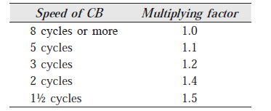
Selection of Circuit Breaker Ratings Cont.…
Sub-transient reactance's for synchronous generators and transient reactance's for synchronous motors are used to calculate the symmetrical current that has to be interrupted.
The symmetrical SC current is multiplied by a factor as shown in the table below to account for the DC offset value that must be added in order to obtain the current to be interrupted.
eqn.(10)

Slide 20
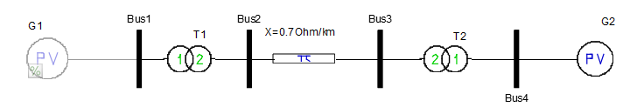
5. Solved Problems using Analytical and Software
Example 1. The two identical generators G1 and G2 rated 15 kV, 25MVA and have a transient reactance of 0.2 p.u. at their own bases. Two transformers, T1 and T2 are also identical rated 15/45 kV, 8 MVA and reactance of 0.06 p.u. based on their own MVA base. It’s observed that 60 km long 0.7 ohm/km/phase transmission line is connected between the two generators. Determine, the three phase fault current, when fault occurs at one-third of the line.

Slide 21
Solved Problems Cont.…
Solution :
Select: MVA_{b}=25 MVA and Kv_{b}=15kv
Reactance of two generators are same with the given value since the selected base values are similar:
The reactance of two transformers T1 and T2 in new base , 25 MVA while referring primary side voltage is given by:

Slide 22
Solved Problems Cont.…
The reactance of transmission line in per unit if fault is takes place at its one-third and the remaining two-third are given by:
Thus,
Then, base impedance, per unit impedances at one-third and two-third are given by :

Slide 23
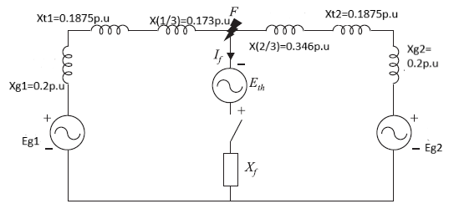
Solved Problems Cont.…
The pre-fault reactance diagram is given as:
Then, the Thevenin equivalent impedance is calculated as:

Slide 24
Solved Problems Cont.…
Then, the fault current while considering pre-fault voltage unity and the fault impedance =0 is given by:
Fault current in amp is equal to fault current in p.u. * base current:

Slide 25
Solved Problems Cont.…
It is observed that the short circuit current is very high compared to the normal current.

Slide 26
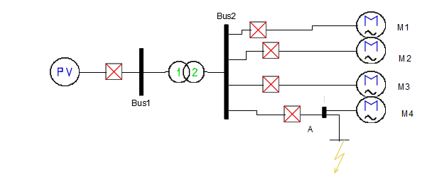
Solved Problems Cont.…
Example 2: A 30 MVA, 15 kV generator with 10% sub-transient reactance is connected through a transformer to a bus which supplies four identical motors, as shown in Fig. below . The sub-transient reactance Xd ’’ of each motor is 10% on a base of 10 MVA, 3.3 kV. The three-phase rating of the transformer is 30 MVA, 15/3.3 kV, with a leakage reactance of 10%. The bus voltage at the motors is 3.3 kV when a three-phase fault occurs at the point F. For the fault specified, calculate (i) the sub-transient current in the fault, (ii) the sub-transient current in breaker A and (iii) the momentary current in breaker A.

Slide 27
Solved Problems Cont.…
Solution : First we need to develop the circuit diagram as:
S_{base}=30 MVA, V_{b}=15kv
Then, Xg’’@30MVA=0.1p.u,

Slide 28
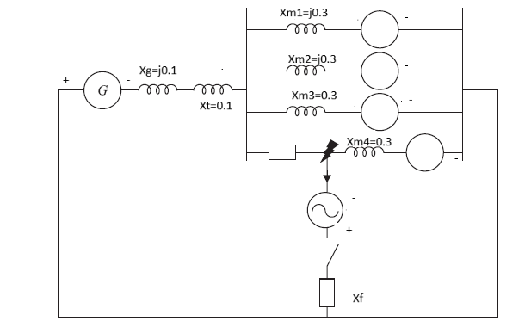
Solved Problems Cont.…
The per unit reactance of each motor in new base is:
The pre-fault circuit diagram is given as:

Slide 29
Solved Problems Cont.…
The sub-transient reactance's are then determined while considering the initial no load conditions
Which means all reactance's are connected in parallel if the fault is at point A is given by:
Then, the fault current for unity pre-fault voltage is calculated as :

Slide 30
Solved Problems Cont.…
The fault current in ampere is determined as:
It is observed that the fault current exponentially increased to higher Value.
Thus, the sub transient current in breaker A is supplied by the generator and three motors, and the sub transients in breaker A maybe written as.

Slide 31
Solved Problems Cont.…
Which is:
Then, the fault current for unity pre-fault voltage is calculated as :
Finally, to determine the momentary current through breaker, we need to add the DC offset , and needs to multiply the current by a factor of 1.6 as a momentary current is given by:

Slide 32
Solved Problems Cont.…
Example 1. The two identical generators G1 and G2 rated 15 kV, 25MVA and have a transient reactance of 0.2 p.u. at their own bases. Two transformers, T1 and T2 are also identical rated 15/45 kV, 8 MVA and reactance of 0.06 p.u. based on their own MVA base. It’s observed that 60 km long 0.7 ohm/km/phase transmission line is connected between the two generators. Determine, the three phase fault current, when fault occurs at one-third of the line using PowerWorld simulator software's
Solution:
The first step is converting all the network parameters into the same per unit value, which is already determined.
Model the network using PowerWorld simulator as presented in Fig.below

Slide 33
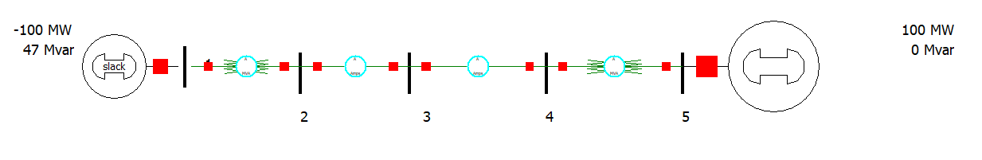
Solved Problems Cont.…
,
Then, for the three phase fault at bus 3, one-third of 60km transmission line is calculated as:
Thus, select the fault analysis techniques from the power world simulator toolbar and the following data will be displayed.

Slide 34
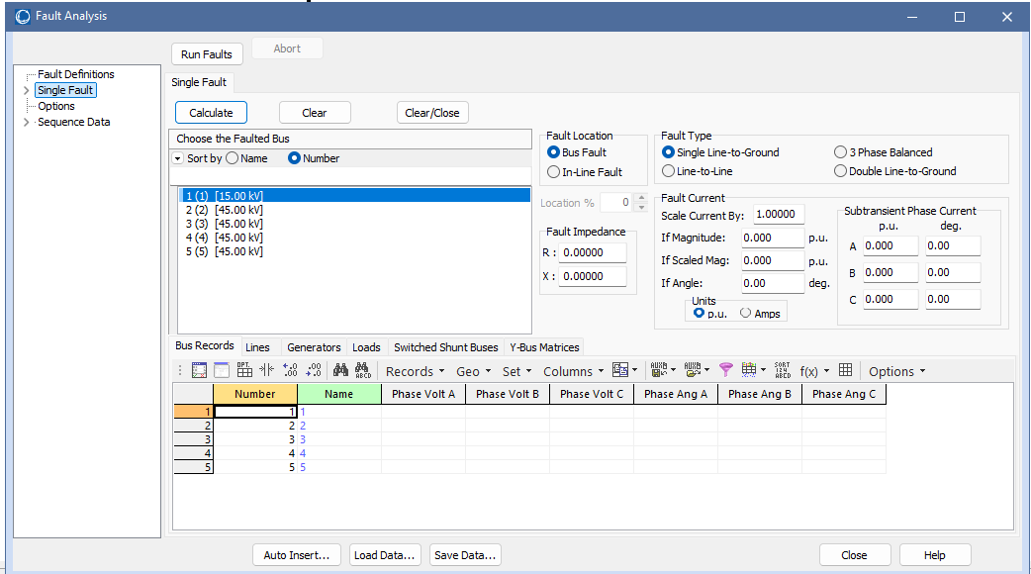
Solved Problems Cont.…
Then, apply the fault at bus 3 and the following fault results will be generated

Slide 35
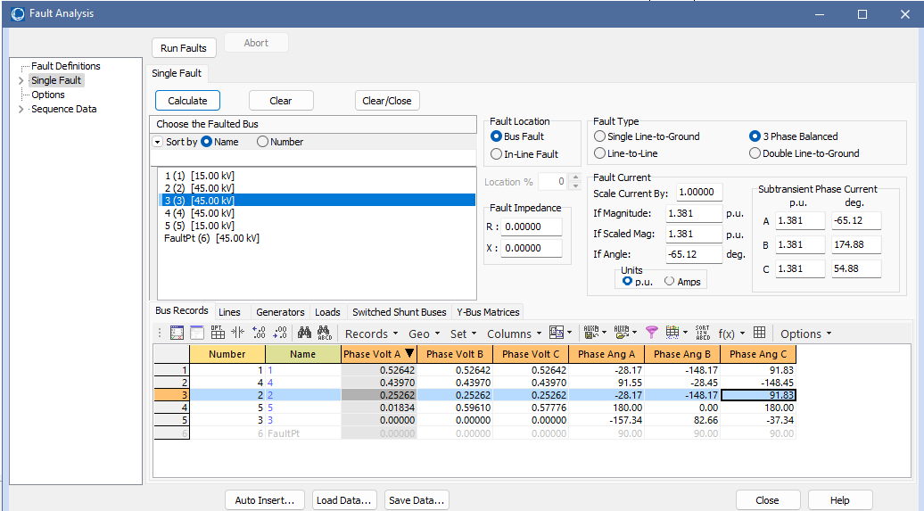
Solved Problems Cont.…

Slide 36
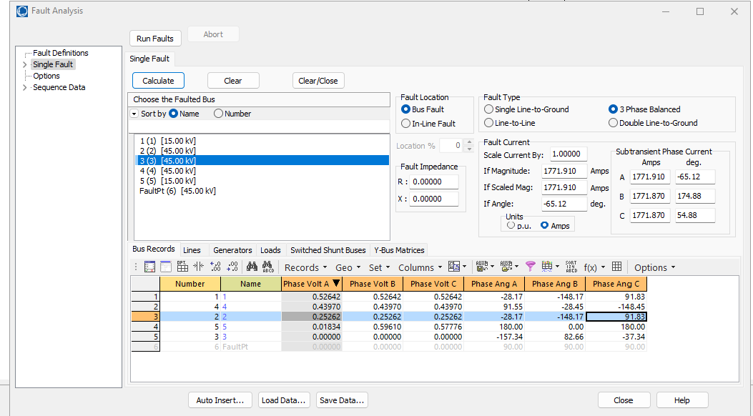
Solved Problems Cont.…

Slide 37
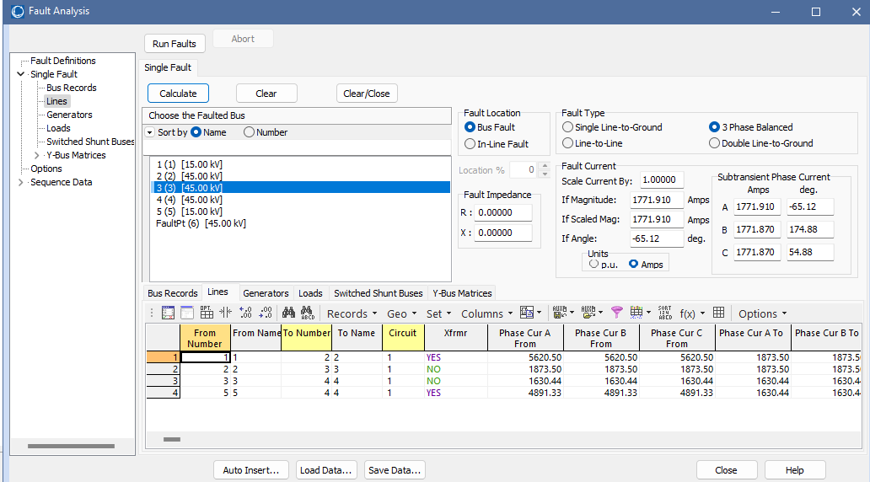
Solved Problems Cont.…

Slide 38
Summary
In this lecture, the symmetrical or balanced three phase fault analysis is presented .
The three phase symmetrical fault is when three power lines are shorted together with or without ground impendences.
This types of fault is the most severe types of faults in power system network though its frequency of occurrence is rare
Besides this, the short circuit MVA , the circuit breakers fault level and its momentary current selection is also discussed in this lecture.
the two technics known as analytical method and software simulation of fault analysis is also discussed in this presentation. Lastly, the analytical method example of determining the magnitude of fault current for sub transient condition and the circuit breaker momentary current is determined.

Slide 39
References
[1].Sh., Zhongsheng and D.,Zumrat. ‘’Development of 3-phase fault detection, protection, and automation application with the present of DG in AC power system using GOOSE protocol’’. Helyion. V.10(6), 2024. doi: https://doi.org/10.1016/j.heliyon.2024.e27482.
[2]. E., Arturo Conde. "Overcurrent Relay Advances for Modern Electricity Networks “. Book: Acedemic Press, 2023. pp. 267-293. doi: https://doi.org/10.1016/B978-0-323-91777-3.00008-8.
[3]. D., Vguzmán A., Pablo and A., Javier Gómez. "Analytical Approach to Internal Fault Simulation in Power Transformers Based on Fault-Related Incremental Currents “. IEEE Transactions on Power Delivery , 2006. pp. 142-149, doi: 10.1109/TPWRD.2005.848672.
[4]. L., Aung Zaw. ‘Short Circuit Analysis of 33/11/0.4 kV Distribution System Using ETAP’’. (IJLTEMAS).V.8(5), 2019. https://www.ijltemas.in/DigitalLibrary/Vol.8Issue5/79-85.pdf

Slide 40
Thank you !

