Slide 1
Advanced Power System Analysis
Lecture 9
Fault analysis
Lecturer: Teshome Goa (Assist. Prof.)
Lecture learning outcomes:
At the end of this lecture, you will be able to:
Understand the importance of unbalanced fault analysis
Know the formulation of symmetrical matrix for unbalanced fault analysis.
Identify the three sequence networks and their relationship with Phase
parameters.
iv. Develop the sequence network for unbalanced fault analysis

Slide 2
Outlines
Introduction: Unsymmetrical Fault
Sequence Networks
Symmetrical Analysis for Unbalanced Faults
Single Line-to-Ground (SL-G) Faults
The Line-to-Line (L-L) Unbalanced Faults
Double Line-to-Ground(LL-G) Faults
Summary
References

Slide 3
1. Introduction: Unsymmetrical Fault
Except for the balanced three-phase fault, faults result in an unbalanced system[1].
The most common types of faults are single line-ground (SLG) and line-line (LL).
Other types are double line-ground (DLG), open conductor, and balanced three phase.
System is only unbalanced at point of fault!
The easiest method to analyze unbalanced system operation due to faults is through the use of symmetrical components

Slide 4
2. Sequence Networks
The key idea of symmetrical component analysis is to decompose the system into three sequence networks[2]. The networks are then coupled only at the point of the unbalance (i.e., the fault)
The three sequence networks are known as the
  positive sequence (this is the one we’ve been using)
  negative sequence
  zero sequence

Slide 5
Sequence Networks Cont.….
Positive Sequence Sets: A regular three-phase electrical system that is balanced is represented by a positive sequence network.
In symmetrical component analysis, which aids in the study of unbalanced faults in electrical power systems, it is one of three sequence networks.
Only positive sequence voltages, currents, and impedances are present in the positive sequence network.
The positive sequence sets have three phase currents/voltages with equal magnitude, with phase b lagging phase a by 120°, and phase c lagging phase b by 120°.
We’ve been studying positive sequence sets

Slide 6
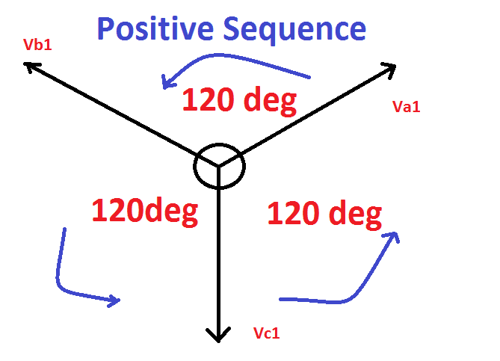
Sequence Networks Cont.….
Positive sequence sets have zero neutral current
Figure 1. Positive sequence network sequence diagram.
Url: https://www.electrical4u.net/wp-content/uploads/2018/06/Symmetrical-Components-positive-Sequence.png

Slide 7
Sequence Networks Cont.….
Negative Sequence Sets: The negative sequence impedance is created due to negative sequence current flow.
Negative sequence current in a three-phase system refers to a current component that rotates in the
opposite direction to the positive sequence current, indicating an unbalanced condition in the system.
It's a result of asymmetrical currents or voltages, which can be caused by factors like unbalanced loads or faults.
The negative sequence sets have three phase currents/voltages with equal magnitude, with phase b
leading phase a by 120°, and phase c leading phase b by 120°.
Negative sequence sets are similar to positive sequence, except the phase
order is reversed as presented in Fig.2

Slide 8
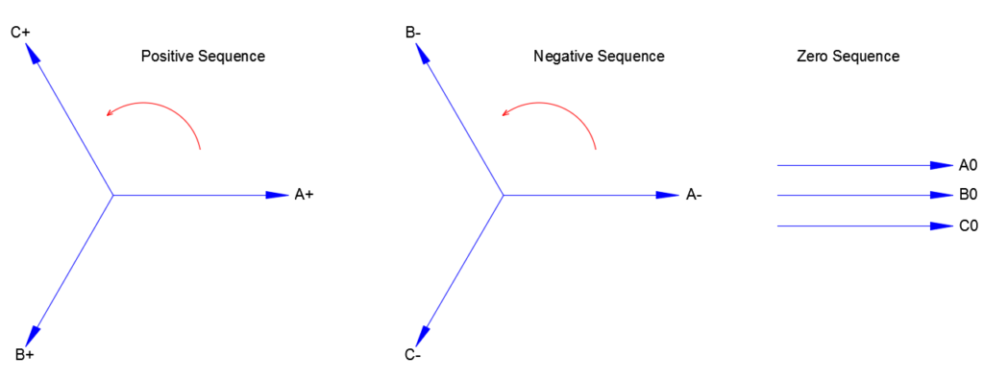
Sequence Networks Cont.….
Figure 2. The three sequence currents/voltages of unsymmetrical fault.
Url:https://voltage-disturbance.com/wp-content/uploads/2018/06/Positive-Negative-Zero-Sequence-Components-1024x396.png
Negative sequence sets have zero neutral current

Slide 9
Sequence Networks Cont.….
Zero Sequence Sets: When the phase currents in a three-phase system are out of balance and do not add up to zero, the current that occurs is referred to as zero sequence current.
In a three-phase system, it is basically the "common" or "residual" current that flows when the phase currents are not balanced.
Unbalanced loads, defects, or non-linear loads are some of the causes of this unbalanced situation.
Three values with equal magnitude and angle make up zero sequence sets.
Neutral current is present in zero sequence sets.

Slide 10
Sequence Networks Cont.….
Sequence Set Representation: Any arbitrary set of three phases, say I_{a}, I_{b}, I_{c} or V_{a}, V_{b}, V_{c} can be represented as a sum of the three sequence sets:
eqn.(1)
eqn.(1)
Where, and are the zero, positive and negative sequence currents and
voltages, respectively

Slide 11
Sequence Networks Cont.….
Now, the unsymmetrical components can be converted into symmetrical sequences while referring the three sequences network and the phase-sequence current relationship as given by:
Consider, α=120^{0,} which the phase-shift of balanced three phase power system and assume :
^{eqn.(3)}
^{Which means}

Slide 12
Sequence Networks Cont.….
Consider phase A as a reference to develop the symmetrical components.
Considering the analogy of zero, positive and negative sequences network of Phase b, and c with
respect to phase A are:
eqn.(4)
Then, the symmetrical matrix is given as:
eqn.(5)

Slide 13
Sequence Networks Cont.….
Thus,
eqn.(6)
Which is:
eqn.(7)

Slide 14
Sequence Networks Cont.….
While defining the symmetrical component Transformation matrix as ‘A’ , which is:
eqn.(8)
Then, the phase voltage/current and sequence components are related as:
eqn.(9)

Slide 15
Sequence Networks Cont.….
Considering the Inverse matrix, the sequence parameters are determined if phase values are given as :
From the above formula:
eqn.(10)
eqn.(11)

Slide 16
Sequence Networks Cont.….
Example: For three phase power systems phase current with equal magnitude and 120 0 as given below. Determine the three sequence currents using symmetrical Matrix.
Solution :
Determine sequence Matrix A as:

Slide 17
Sequence Networks Cont.….
Then, the sequence currents are;
Which means

Slide 18
Sequence Networks Cont.….
Then, the three sequence currents are:

Slide 19
Sequence Networks Cont.….
It’s observed that for balanced three phase currents we have only positive sequence currents.
But, in fault condition the system will not the same as presented in example one.
Example 2: Assume the three phase voltage are give below and determine the sequence voltages
Solution:

Slide 20
Symmetric Components Cont.….
The positive and negative sequence voltages are given by:
Then, the sequence voltage are

Slide 21
3. Symmetrical Analysis for Unbalanced Faults
By splitting the unbalanced system into three balanced systems: positive, negative, and zero sequence components:
Symmetrical components make it easier to analyze unbalanced faults in three-phase systems[3].
This approach is essential for comprehending and evaluating a variety of fault situations, especially those with varying phase magnitudes or sequences.
Accordingly, the symmetrical components analysis aims at developing the relationship between symmetrical currents and voltage due to the three sequence reactance's
Then, the phase voltage and currents will determined using symmetrical matrix
relations

Slide 22
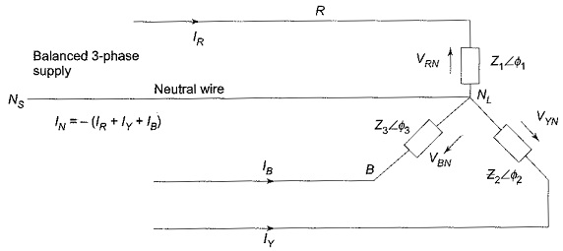
Symmetrical Analysis Cont.…
Consider the star connected load as presented in Fig.3
In a three-phase star-connected balanced load, the line voltage is √3 times the phase voltage, and the line current is equal to the phase current.
Each phase in a balanced star connection has the same magnitude of voltage and current, and the phase difference between them is 120
Figure 3. Three phase balanced load.
Url: https://www.eeeguide.com/wp-content/uploads/2019/12/Unbalanced-Three-Phase-Circuit-Analysis-4.jpg

Slide 23
Symmetrical Analysis Cont.…
Consider the following wye-connected load:
If R=a, B=b and Y=c, then
eqn.(12)
By substitution :
eqn.(13)

Slide 24
Symmetrical Analysis Cont.…
The matrix form is
eqn.(14)
Thus,
eqn.(15)
which is similar with:

Slide 25
Symmetrical Analysis Cont.…
Accordingly, the sequence voltage and currents are related as:
eqn.(16)
This is can be decoupled as:
eqn.(17)

Slide 26
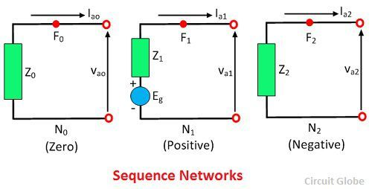
Symmetrical Analysis Cont.…
Their sequence diagram of generator is presented in Fig.4.
Figure 4. The three sequence Network.
Url: https://circuitglobe.com/wp-content/uploads/2017/04/sequence-network-image-2.jpg

Slide 27
Symmetrical Analysis Cont.…
The key points from Fig.4 is that the generators only produce positive sequence voltages
Thus, only the positive sequence network has a voltage source and the others are shorted while performing the unbalanced fault analysis
In addition, during a fault condition the positive and negative sequence impedance of generators are assumed to be the same approximately equal to sub-transient reactance (Z⁺ ≈ Z⁻ ≈ X_{d}”)
The zero sequence impedance is usually substantially smaller.
The value of Z_{n} depends on whether the generator is grounded

Slide 28
Symmetrical Analysis Cont.…
The positive and negative sequence diagrams for transformers are similar to the transmission lines.
However, the zero sequence network impedance depends on both how the transformer is grounded and the type of connection(Star or Delta).
For instance, if the transformer primary and secondary is connected as Y-Y grounded both side, the transformer zero sequence reactance single line diagram similar with transmission line.
All types of transformers connection and the zero sequence reactance representation
is presented in Fig.5

Slide 29
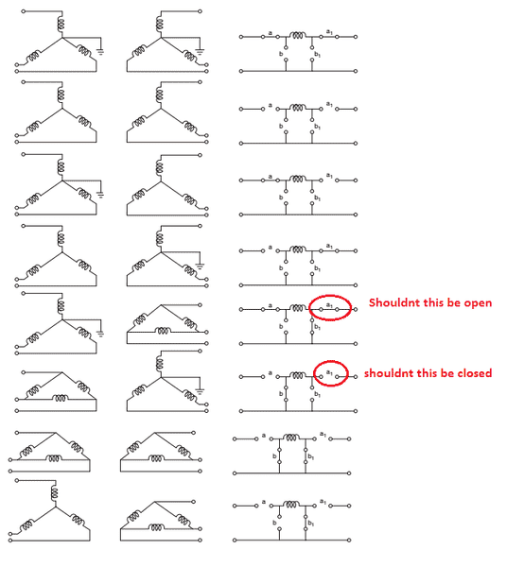
Symmetrical Analysis Cont.…
Once the positive, negative and zero sequence reactance is known using thevenin equivalent form, then the fault current and voltage can be calculated based on the types of fault as given by:
Figure 5. Representation of zero sequence diagram for transformer.
Url:https://www.physicsforums.com/attachments/upload_2018-1-28_19-33-30-png.219267/

Slide 30
4. Single Line-to-Ground (SL-G) Faults
The faults , unbalance the network, but only at the fault location if it is an unbalanced fault.
This causes a coupling of the sequence networks, flow of the sequence current and hence sequence voltage.
But, the way how the sequence networks are coupled is highly depends on the fault type.
Therefore, it’s important develop a mathematical relationship for several common faults.
Assume, a SLG fault only one phase has non-zero fault current is takes place at phase A,
which is presented in Fig.6.

Slide 31
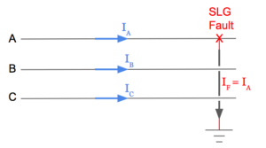
SL-G Faults Cont.….
Thus, the fault currents are:
eqn.(18)
Figure 6. Single line to ground Fault.
Url: https://www.electricalpereview.com/wp-content/uploads/2018/02/Single-Line-to-ground-fault-transmission-three-phase-diagram.png
From sequence network:
eqn.(19)

Slide 32
SL-G Faults Cont.….
Then, the voltage at faulted location is determined as
eqn.(20)
The phase voltage and sequence voltages are related as:
eqn.(21)
Finally, the only way that three sequence currents are equal and the fault voltage
is the summation of sequence voltage is when the network is connected in
radial form as represented in Fig.7

Slide 33
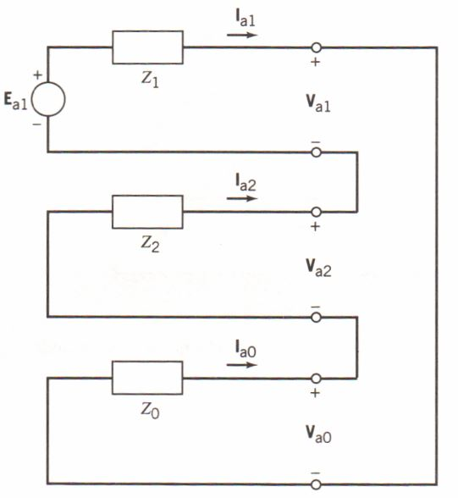
SL-G Faults Cont.….
From the presented connection the fault currents can be easily calculated: if
and the fault current is :
eqn.(22)
Figure7. The circuit diagram of SL-G fault.
Url:https://electricalacademia.com/wp-content/uploads/2018/05/single-line-to-ground-fault-interconnection.jpg

Slide 34
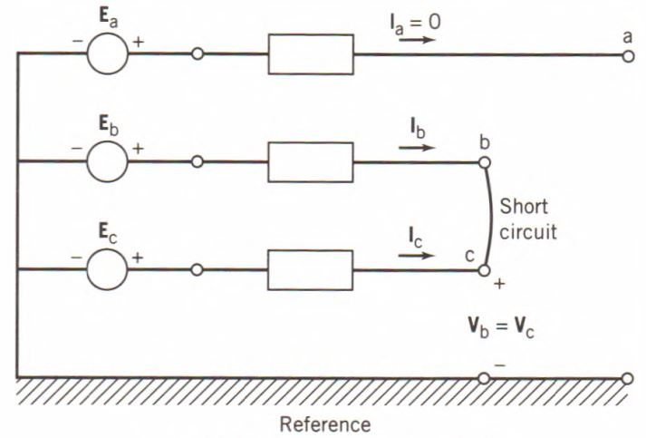
5. The Line-to-Line (L-L) Unbalanced Faults
The other , second most common types of fault is line-to-line, which occurs when two of the conductors come in contact with each other.
Assume the fault is between phase b and c on Fig.7
The current and voltage relations are:
eqn.(23)
Figure 7. L-L fault(b-c). https://blogger.googleusercontent.com/img/b/R29vZ2xl/AVvXsEiYI9FdpG1VjKFqI3edf6lStIleuVjFDNx1wxCW3iZ7MnAs0vbQdfAAwbd-OqbCXBJIo_Y_XIeuIoKc5xuxIyxSkiaDdrYQFLZgPmia1l3TEFimBhHwZyRm7hFPEo4gvcxLweLhfrwscaO8/s1600/A-line-to-line-fault..jpg

Slide 35
L-L Unbalanced Faults Cont.…
Using the current and voltage symmetry :
eqn.(24)

Slide 36
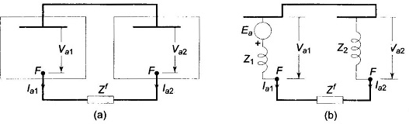
L-L Unbalanced Faults Cont.…
The above two conditions are satisfied when the positive and negative sequence reactance's are connected parallel as presented in Fig.8
Figure 8. Line to Line fault sequence network. Url:https://www.eeeguide.com/wp-content/uploads/2016/12/Line-to-Line-Fault-012.jpg
Then, the currents are determined as:
eqn.(25)

Slide 37
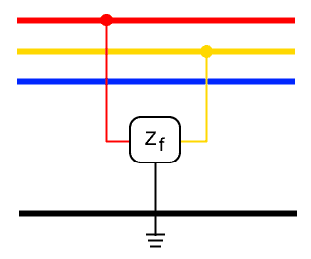
6. Double Line-to-Ground(LL-G) Faults
A double line-to-ground (DLG) problem occurs when two line conductors make contact with ground and one another.
Assume Fig.9, the fault between Phase b and c with ground impedances .
c
b
a
Figure 9. Double line to ground fault. Url: https://www.electricaltechnology.org/wp-content/uploads/2022/07/Double-Line-to-Ground-L-L-G-Fault.png
eqn.(25)

Slide 38
LL-G Faults Cont.…..
Because of the ground impedance the zero sequence current is not zero and the current relation is:
eqn.(26)
Then, the voltage relation is:
eqn.(27)

Slide 39
LL-G Faults Cont.…..
eqn.(28)
eqn.(29)
eqn.(30)

Slide 40
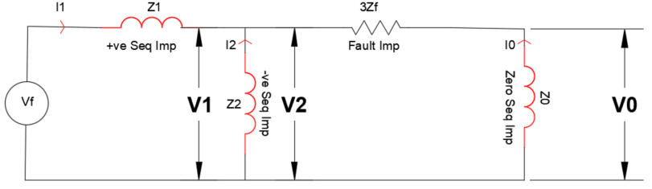
LL-G Faults Cont.…..
Based on the above relations the three sequence networks are connected as given in Fig.10
Figure10: DL-G fault sequence network. Url:https://voltage-disturbance.com/wp-content/uploads/2019/11/Sequence-network-for-phase-phase-ground-fault.png
eqn.(31)

Slide 41
Summary
In this lecture, the unbalanced three phase fault analysis is presented.
These type of fault the most common types of faults in power system, which occurs more frequently compered to balanced three phase fault.
Around 85% of the unbalanced fault is L-G, the remaining 15 % is L-L and L-L-G faults
To perform the unsymmetrical fault a symmetrical component method is used
The symmetrical matrix, which relates sequence currents and voltage with phase currents and voltage better for unbalanced fault analysis
Using the symmetrical components the sequence network for positive ,
negative and zero sequences are well developed

Slide 42
References
[1]. T., Dung and G., Radomir. ‘’Developing a Tool for Symmetrical and Unsymmetrical Faults Analysis in Power System’’. International Conference on System Science and Engineering (ICSSE), 20121. DOI:10.1109/ICSSE52999.2021.9538422.
[2]. A., Syed; Nasar and F., Trutt. "Electric Power Systems: Fault Calculations and Power System Protection “. Taylor& Francis Group, 2018.
[3]. M., Nehrir. "A simple approach to analysis of faulted power systems’’. Elsevier: Electric Power Systems Research. V.4(2) 1981, Pp:.105-109, https://doi.org/10.1016/0378-7796(81)90013-4.

Slide 43
Thank you !

