Slide 1
Advanced Power System Analysis
Lecture 10
Fault analysis
Lecturer: Teshome Goa (Assist. Prof.)
Lecture learning outcomes:
At the end of this lecture, you will be able to:
Knows how to solve the symmetrical components current
Understand the basic steps in formulating sequence diagrams.
Performs the fault analysis for different unbalanced faults.
Know the basic procedures regarding large power network fault analysis

Slide 2
Outlines
Introduction
Solved problems
Sequence Diagram Formulation
Examples on Unsymmetrical Fault
Fault Analysis in Large Network
Summary
References

Slide 3
1. Introduction
The analysis of unbalanced fault with some solved problems is very important to understand the behavior of power network during different types of creditable contingency like (L-G , L-L and LL-G) fault conditions.
It helps to know the characteristic of fault currents during unbalanced fault conditions.
In addition, the importance of symmetrical analysis for unbalanced system is checked with some solved problem[1]
Then, the circuit protective capacity can be selected based on the magnitude and types of faults

Slide 4
Introduction Cont.….
In large power networks, the analysis both symmetrical and unsymmetrical faults are developed using the same scenarios as presented before with slight modification.
Because, large power system network comprises a lot of generation units, transformers , transmission
lines and loads are interconnected together and needs special attentions , and knowledge of power system analysis.
Thus , the symmetrical faults in large system involve all three phases of either the bus or lines experiencing a short circuit to each other or to ground
while unsymmetrical faults affect only one or two phases of buses or lines
The large system analysis needs formulation of bus admittance matrix and supper
position theorems[2].

Slide 5
2. Solved Problems
Examples on determining the symmetrical Components of Unbalanced system.
Example 1: If a Three-phase of four 4-wire system having the current at each phase is given below. Calculate the positive, negative and zero sequence currents in phase-a and the return current.
Solution :

Slide 6
Solved Problems Cont.….

Slide 7
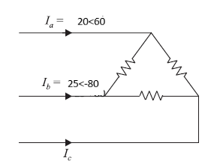
Solved Problems Cont.….
Sequence Networks :Example 2: A delta connected balance resistive load is connected across an unbalanced three-phase supply shown in Fig. below with currents in line a and b given. Determine the symmetrical components of the currents.
Solution:
For delta connected load, the summation of three phase current is equal to zero as given by:

Slide 8
Solved Problems Cont.….
Then, the symmetrical component current is determined from the relation
Which means

Slide 9
Solved Problems Cont.….
The positive and negative sequence currents are:

Slide 10
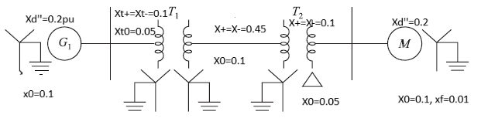
3. Sequence Diagram Formulation
Example 3: Develop the three (positive , negative and zero) sequence diagrams for the single line diagram presented below. Assume the positive and negative sequence reactance of generator and motor is equal to their respective sub-transient reactance.

Slide 11
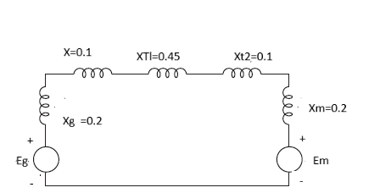
Sequence Diagram Formulation Cont.…
Solution:
From the sequence diagram formulation, only the positive sequence network has a source voltage and the other two sequence network will not have source voltage
Accordingly , the positive sequence diagram while only consider the positive sequence reactance of all the connected parameters are given by:
Figure 1. Positive sequence reactance diagram

Slide 12
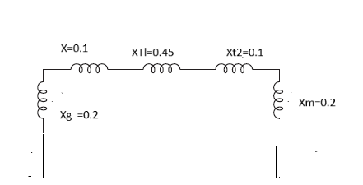
Sequence Diagram Formulation Cont.…
Then, the negative sequence diagram is developed and presented below.
For negative sequence there is no source voltage, means both generator and motor voltages are shorted
Finally, since the positive and negative sequence value for all components are same, the circuit is given as :
Figure 2. Negative sequence Diagram

Slide 13
Sequence Diagram Formulation Cont.…
Lastly, the zero sequence diagram is formulated
It’s known that zero sequence reactance's depends on the types of transformer connection and how the transformer is grounded or not
Accordingly, the generator side transformer is connected as Y-Y grounded both side means its reactance diagram is similar with line reactance
Whereas, the load side transformer is connected as Delta-Y grounded , its connection is open from delta side and connected the other network from star-side , and then grounded.

Slide 14
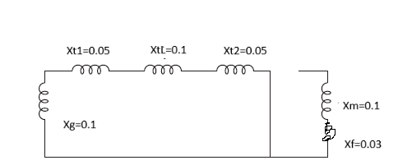
Sequence Diagram Formulation Cont.…
Then, the circuit diagram of zero sequence network while considering the zero sequence reactance of each components, the ground impedance of motor and the transformer connection types, and its grounding is presented as:
Figure 3. Zero sequence reactance diagram

Slide 15
4.Examples on Unsymmetrical Fault
Example Four: Consider the single line given at example three and assume the SL-G fault is takes place at the terminal of the motor. Assume the generator and motor are at 100 MVA and 15 Kv each and all the reactance's are at common bases. Determine the fault current at the terminal of motor.
Solution:
Develop the three sequence diagram
Find out the thevinen equivalent of each sequence
Develop the SL-G fault sequence diagram
Find the sequence currents
Determine the fault current in p.u and amp
Determine the momentary current of CB

Slide 16
Examples on Unsymmetrical Fault Cont.…
The three sequence diagram is already developed earlier as:
Positive sequence Negative sequence zero sequence
If the fault is at the terminal of motor , their Thenenin equivalent reactance's are developed as :

Slide 17
Examples on Unsymmetrical Fault Cont.…
Which are:
Then, the three sequence impedance are connected in series and the
sequence currents and fault current is determined as:

Slide 18
Examples on Unsymmetrical Fault Cont.…
For single line-ground fault all the sequence currents are equal as:
Then, the fault current at a phase in p.u and amp is:

Slide 19
Examples on Unsymmetrical Fault Cont.…
Then, the voltage across faulted line and ground is:

Slide 20
Examples on Unsymmetrical Fault Cont.…
Example Five : Consider the single line given at example three and assume the L-L fault is takes place at the terminal of the motor. Assume the generator and motor are at 100 MVA and 15 Kv each and all the reactance's are at common bases. Determine the fault current at the terminal of motor if the fault is between line b and c.
Solution
Develop the three sequence diagram
Find out the thevinen equivalent of each sequence
Develop the L-L fault sequence diagram
Find the sequence currents
Determine the fault current in p.u and amp
Determine the momentary current of CB

Slide 21
Examples on Unsymmetrical Fault Cont.…
The sequence diagram is similar with that of S-L ground fault if the fault is at the same place
The thevenin equivalent impedance of each sequence is the same with the SL-G fault
The only difference is the sequence network of L-L, which connecting the negative and positive sequence parallel
The fault current in phase b is equal with phase b but opposite in sign, whereas the fault current at phase a is zero.
The voltage at b and c are equal
The zero sequence current is zero.
If they are connected in parallel, the sequence currents are determined as:

Slide 22
Examples on Unsymmetrical Fault Cont.…
,
Then, from symmetrical network the fault current are:

Slide 23
Examples on Unsymmetrical Fault Cont.…
Example Six: Consider the single line given at example three and assume the LL-G fault is takes place at the terminal of the motor. Assume the generator and motor are at 100 MVA and 15 Kv each and all the reactance's are at common bases. Determine the fault current at the terminal of motor if the fault is between line b and c with ground .
Solution
Develop the three sequence diagram
Find out the thevinin equivalent of each sequence
Develop the LL-G fault sequence diagram
Find the sequence currents
Determine the fault current in p.u and amp
Determine the momentary current of CB

Slide 24
Examples on Unsymmetrical Fault Cont.…
All the steps are the same except how the L-L-G fault sequence network is connected.
It’s discussed that in this types of fault, the equivalent circuit is when the negative and zero sequence networks are connected parallel and then connected radial to positive sequence
In addition, the zero sequence current not zero line L-L fault
The fault voltage at b and c are equal
Generally, it’s determined as

Slide 25
Examples on Unsymmetrical Fault Cont.…
Since positive and negative sequence voltages are equal, we can determine the negative sequence current using
By the same steps the fault currents are
determined as:

Slide 26
5. Fault Analysis in Large Network
Fault analysis in meshed and highly interconnected large power network needs to know how the network is integrated, loads are connected and hence their types[3].
It requires the development of admittance matrix, then converting into per unit value, determining the fault currents either using analytical method simulating faults and analyzing their impact to ensure system stability and integrity.
This is crucial for determining the appropriate circuit protective devices settings and switchgear capacities,
Its intention is to improve the overall reliability of the power grid.

Slide 27
Fault Analysis in Large Network Cont.….
Formulating bus admittance matrix /impedance matrix is the first step in large network fault analysis
The best method in solving large network fault analysis is using supper-position method:
This method starts in analyzing the network current and voltage prior to fault and during fault as:
eqn.(1)
Where, the superscript 1 and 2 means pre-fault and faulted condition, respectively

Slide 28
Fault Analysis in Large Network Cont.….
The superposition approach can be easily used as:
The current is zero except for faulted point as given by:
eqn.(2)
To use this approach the fault currents should be firs determined .

Slide 29
Fault Analysis in Large Network Cont.….
Steps are:
Determine Y bus matrix and Z-bus matrix, which is the inverse of Y-bus
eqn.(3)
For fault at bus i we get

Slide 30
Fault Analysis in Large Network Cont.….
Then, voltage during fault is also determined using the superposition method as
eqn.(4)
Then , the generalized step is: assume the pre-fault voltages are known
Calculate Zbus for each sequence
For a fault at bus i, the Zii values are the thevenin equivalent impedances; the pre-fault voltage is the positive sequence thevenin voltage
Connect and solve the thevenin equivalent sequence networks to determine the fault current
Sequence voltages throughout the system are

Slide 31
Fault Analysis in Large Network Cont.….
Sequence voltages throughout the system are given by
eqn.(5)
Phase values are determined from the sequence values

Slide 32
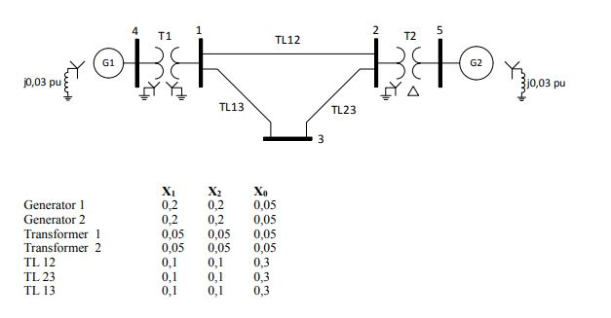
Fault Analysis in Large Network Cont.….
Project assignment: For the following figure determine the fault current considering the fault analysis for large power network. Assume the Single line to ground fault is takes place at bus 3.
Figure 4. The single diagram of three bus system.
Url:https://media.cheggcdn.com/media/e2f/e2f91d3f-2494-444d-9104-ad55ddcd66ee/phpLXDGEl.png

Slide 33
Summary
In this lecture, solved problems for unbalanced fault is discussed.
The formulation sequence networks for positive, negative and zero sequences are presented.
Specifically, the importance of transformer connection types and grounding on zero sequence network formulation is discussed.
The fault analysis example for symmetrical components, L-G, L-L and LL-G is discussed
In addition, the principle of superposition analysis for faults in large power network is also discussed
Finally, the project works based on the large network analysis given

Slide 34
References
[1]. C., Chivon; D., Yahya; S., Sarot and L.,Young-II. ‘Symmetrical components-based robust stabilizing control of a grid-connected inverter under unbalanced voltage sag’’. Journal of engineering, 2024. https://doi.org/10.1049/tje2.70000.
[2]. C.,Hantao. "Bus Admittance Matrix Revisited: Performance Challenges on Modern Computers “. IEEE Open Access Journal of Power and Energy,. 2024. pp:.99. DOI:10.1109/OAJPE.2024.3366117
[3]. M., Zhen-Lei and L., Xiao-Jian. "Data-driven fault detection for large-scale network systems: A mixed optimization approach’’. Elsevier: Applied Mathematics and Computation. V.426(1), 2022. https://doi.org/10.1016/j.amc.2022.127134.

Slide 35
Thank you !

