Slide 1
Advanced Power System Analysis
Lecture 11
Power System Stability
Lecturer: Teshome Goa (Assist. Prof.)
Lecture learning outcomes:
At the end of this lecture, you will be able to:
Knows the basics of power system stability
Identify the types of power system stability and their behaviors.
Knows how to model power system network for transient stability analysis .
Formulate the swing equations based on different machine systems

Slide 2
Outlines
Introduction
Classification of Power System Stability
Transient Stability
Power Angle Equation of a Two Machine System
Power Angle Equation of a Salient Pole Machine
Swing Equation
Summary
References

Slide 3
1. Introduction
In order to operate as an interconnected system, the synchronous machines must remain in synchronism with one another
Synchronism requires that the rotors turn at exactly the same speed, frequency and the same phase
sequence[1].
Loss of synchronism results in a condition in which no net power can be transferred between the machines
But, during different credible contingency cases, such as steady state, dynamic or transient stability problems, the system may or may-not synchronous each other .
Thus, the system is said to unstable if the system will not regain its normal operating
states followed by different contingencies.

Slide 4
Introduction Cont.…
The modern electric power system is a complex and nonlinear dynamic network that relies on various control mechanisms to maintain equilibrium by balancing real and reactive power.
During normal operations, these controllers help to keep the system stable.
When a disturbance occurs, the system is temporarily unbalanced and shift to a new equilibrium, which may differ from the original.
The system’s ability to regain stability depends on its strength and the nature of the disturbance.
Stability is defined as the system’s ability to stay in or return to a balanced operating state after a disturbances

Slide 5
Introduction Cont.….
A system is said to be transiently unstable if following a disturbance one or more of the generators lose synchronism
Common reasons for transient stability are faults in the transmission system, sudden change of bulk load, loss of operating units, line switching are the examples of large disturbances.
In general, the post disturbance operating equilibrium is different from the pre disturbance equilibrium point.
Since the severe disturbances involve a large deviation in rotor angles, nonlinear dynamical model of the system is considered for the transient stability studies

Slide 6
2. Classification of Power System Stability
Power system stability is classified based on the physical nature of the disturbance and the time frame of system response[2].
It is broadly divided into three main categories as presented in Fig.1:
Rotor angle stability
Voltage stability
Frequency stability

Slide 7
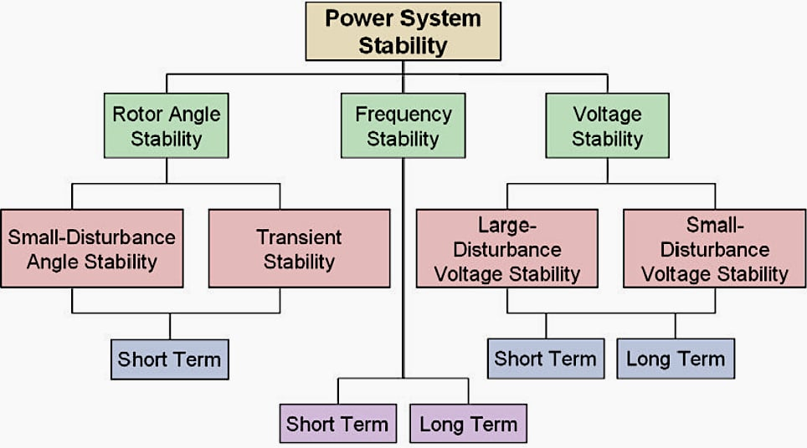
Classification of Power System Stability Cont.…
Figure 1. Types of power system stability.
Url: https://electrical-engineering-portal.com/wp-content/uploads/2025/05/power-stability-classification.jpg

Slide 8
Classification of Power System Stability Cont.…
1. Rotor Angle Stability:
The ability of the interconnected power system network to maintain the synchronous operation of multiple generating plants in the event of a disturbance is known as angle stability.
Maintaining the system's actual power requirements is its primary focus.
The investigation of electromechanical oscillation present in power system is part of the stability problem.
Systemic disturbance can be minor or major, slow or abrupt.

Slide 9
Classification of Power System Stability Cont.…
Angle stability can also be classified as small signal stability or transient stability, depending on the type of disturbance.
The angle stability means ability of synchronous machines in a power system to remain in synchronism after being subjected to a disturbance. It is subcategorized as
Small-Signal Stability: Stability under small disturbances, such as minor load changes.
Transient Stability: Stability under large disturbances, such as faults or loss of generation.

Slide 10
Classification of Power System Stability Cont.…
a. Small Signal stability.
The ability of the system to maintain synchronism under small and sudden disturbances is known as small signal stability.
These instability problem happen all the time in the system because of small changes in loads and generation.
Small signal instability may be caused by either an inadequate damping torque resulting in undammed angle oscillations in the system or an inadequate synchronizing torque that causes repeated increases in the rotor angles.
it’s normally happen due to the gradual change in loads or demands in power network

Slide 11
Classification of Power System Stability Cont.…
Initial operating point, transmission system strength, generators excitation, and other system controls are some of the variables that affect stability.
The linearized dynamical model of the system can be utilized for analysis because the disturbances are minimal.
The following types of small signal stability can be further classified.
i. Local modes or machine-system modes, which result from a generating plant unit rotating with the system as a whole, the oscillation frequency can be anything between 0.7 and 2 Hz.
Ii. A group of coherent generating units swinging with another group or groups of
coherent units is known as the inter-area mode

Slide 12
Classification of Power System Stability Cont.…
Generally speaking, there are weak tie-lines connecting these groups.
The oscillation frequency can be anything between 0.1 and 0.7 Hz.
Iii. The control mode, which results from the system's poorly adjusted controllers, including exciters,
speed governors, HVDC converters, SVC, etc.
iv. Torsional mode, which results from the interplay between the electrical circuit oscillations involving
many controllers and series compensated lines and the mechanical oscillation
of the turbine generator shaft system.

Slide 13
Classification of Power System Stability Cont.…
b. Large –signal stability (Transient )
The term "transient stability" reflects the system's major interruptions.
It is the ability of the system and its generating units to maintain synchronization after a significant (severe) and sudden large disturbances include:
like line switching, operating unit loss, sudden shifts in bulk load, and transmission system faults
When such disturbances occur, the operating equilibrium after the disturbance is typically different from
the pre-disturbance equilibrium point.

Slide 14
Classification of Power System Stability Cont.…
For the transient stability studies, a nonlinear dynamical model of the system is taken into consideration because the severe shocks include a significant variation in rotor angles.
2. Voltage Stability: The ability of a power system to maintain steady acceptable voltages at all buses under normal condition and after being subjected to a disturbance.
The power network is said be voltage stable if voltages after a disturbance are close to pre-disturbance values.
A system is voltage unstable if a disturbance leads to uncontrollable voltage drop/reduction
Voltage stability is very important for secure operation of power systems, especially
under large and heavy load condition

Slide 15
Classification of Power System Stability Cont.…
Causes of Voltage Instability
Load behaviors
Inadequate reactive power support
Long transmission lines
High power transfer levels
Generator reactive power limits
Voltage instability leads to Voltage Collapse, which is a process where the system
voltage drops uncontrollably due to instability and often leads to blackout.

Slide 16
Classification of Power System Stability Cont.…
Classification of Voltage stability as:
Large-Disturbance Voltage Stability(Ranges from minutes to tens of minutes: this disturbance is due to
the system’s ability to maintain voltages after large disturbances.
It is often associated with issues related to reactive power transfer and the system's capacity to efficiently distribute power and lead to voltage collapse, where the system voltage drops to unacceptable levels
Slower-acting devices like tap-changing transformers, thermostatically controlled loads, and generator
AVR are necessary for long-term voltage stability.

Slide 17
Classification of Power System Stability Cont.…
These devices show up as a gradual drop in voltage at certain network buses over extended periods of time
The system's reaction to little variations in load is referred to as small-disturbance voltage stability (measured in milliseconds to a few seconds).
Its issue pertains to the dynamics of load characteristics, excitation systems, and synchronous machines.
Reactive power compensation (SVC, STATCOM), shunt capacitors/reactors, FACTS devices, tap-changing transformers, and demand response are common ways to increase voltage stability.

Slide 18
Classification of Power System Stability Cont.…
3. Frequency Stability: it refers to the ability of a system to maintain steady frequency following a severe system upset resulting in significant imbalance between generation and load..
Frequency stability analysis is needed because:
It is an indicator of the balance between generation and demand. Unstable network frequency results in:
Generator tripping
Load shedding
Total system collapse or blackout

Slide 19
Classification of Power System Stability Cont.…
Generally, the three stability problems like angle, voltage and frequency are classified as steady ,
dynamic and Transient stability as given as:
Steady state stability refers to the ability of the power system to regain synchronism after small and slow disturbances, such as gradual power change.
An extension of the steady-state stability is known as the dynamic stability.
The dynamic stability is concerned with small disturbances lasting for a long time with the inclusion of automatic control devices.
Transient stability studies that deals with the sudden disturbances such as the large
fault, the sudden outage of a line or the sudden application of loads.

Slide 20
3. Transient Stability
In a steady state operation, the generators maintain equilibrium between the electrical power Pe, output and the mechanical input power (Pm) from the turbine by operating at a constant synchronous speed with zero rotor acceleration[3].
An imbalance with the mechanical power input results from a disturbance in the electrical network that alters the generators' (real power) output.
Since the turbine's mechanical power input cannot change instantly, the rotors' stored kinetic energy is used to initially meet the change in electrical power requirements, causing the rotors to accelerate or decelerate and altering their angle position..

Slide 21
Transient Stability Cont.…
Severe disturbances may cause a large excursion in the rotor angles.
Transient stability studies are required to ensure that the system can withstand the transient condition
following a major disturbance. it requires:
The calculation of the electrical power output of generators during pre-fault, fault and post-fault
This involves solution of network power flow equations, which are nonlinear algebraic in nature.
Solving the rotor dynamic equations to study the variation of rotor angle with time.
The generator mechanical dynamics is described by the nonlinear differential
equation known as swing equation

Slide 22
Transient Stability Cont.…
The system is said to be stable during the post-disturbance period, if the rotors of all the machines achieve constant synchronous speed.
To simplify the transient stability analysis, the classical approach has been utilized and adopted in this lecture.
Assumptions of Transient Stability Analysis
Mechanical input to the generator remains constant (i.e. speed governing system action is neglected).
Machine damping and AVR action are neglected. Synchronous machine is modeled as constant voltage source behind the transient reactance.

Slide 23
Transient Stability Cont.…
Network transients are neglected. Thus static model of network can be used.
Loads are represented as constant impedance/admittance type.
Mechanical angle of each machine rotor coincides with the electrical phase of voltage behind transient reactance.
In addition, the transmission line resistances and saliency of the synchronous machine can also be neglected, which gives conservative results.
The static network equations and the machine dynamics can be formulated
as given below.

Slide 24
Transient Stability Cont.…
Machine damping and AVR action are neglected. Synchronous machine is modeled as constant voltage source behind the transient reactance.
Network transients are neglected.
Thus static model of network can be used.
Loads are represented as constant impedance/admittance type.
Mechanical angle of each machine rotor coincides with the electrical phase of voltage behind transient
reactance.
In addition, the transmission line resistances and saliency of the synchronous
machine can also be neglected, which gives conservative results.

Slide 25
4. Power Angle Equation of a Two Machine System
For transient stability analysis, the synchronous generator electrical and mechanical model should be carried out first.
Needs to develop models for the generator valid during the transient time frame of several seconds following a system disturbance
The simplest generator model, known as the classical model, treats the generator as a voltage source behind the direct-axis transient reactance; the voltage magnitude is fixed, but its angle changes according to the mechanical dynamics
The power angle equation of two-machines and silent pole machine system are
mostly used to develop the electrical model of machines[4].

Slide 26
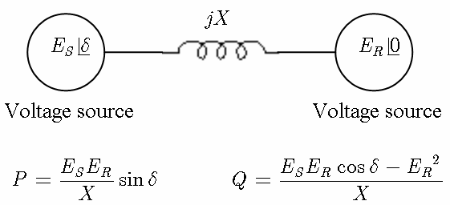
Power Angle Equation Cont.…
In power systems, a two-machine system model is used to study the dynamics between a generator and a motor, or between two generators.
The power angle equation helps us understand the stability and power transfer in such systems as presented in Fig.2
Figure 2. Two machine system. Url:
https://www.researchgate.net/publication/4129063/figure/fig8/AS:668667348021259@1536434127192/Active-and-reactive-power-transfer-between-two-sources.ppm

Slide 27
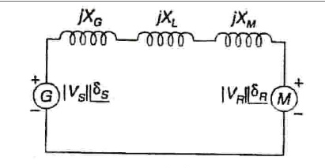
Power Angle Equation Cont.…
Since any synchronous machine is represented by a constant voltage source connected in series with a reactance X, this information is used to build the reactance diagram.
The reactance can be sub-transient (Xd), transient (Xd), or steady state synchronous (Xd), depending on the condition being studied.
As seen in Figure 3, the one-line diagram above can therefore be represented in terms of a reactance diagram.
Figure 3. Reactance diagram of Two machine system.
Url: https://cdn.numerade.com/ask_images/a090e69c4908406e9ea7e36e5cb7bf5e.jpg

Slide 28
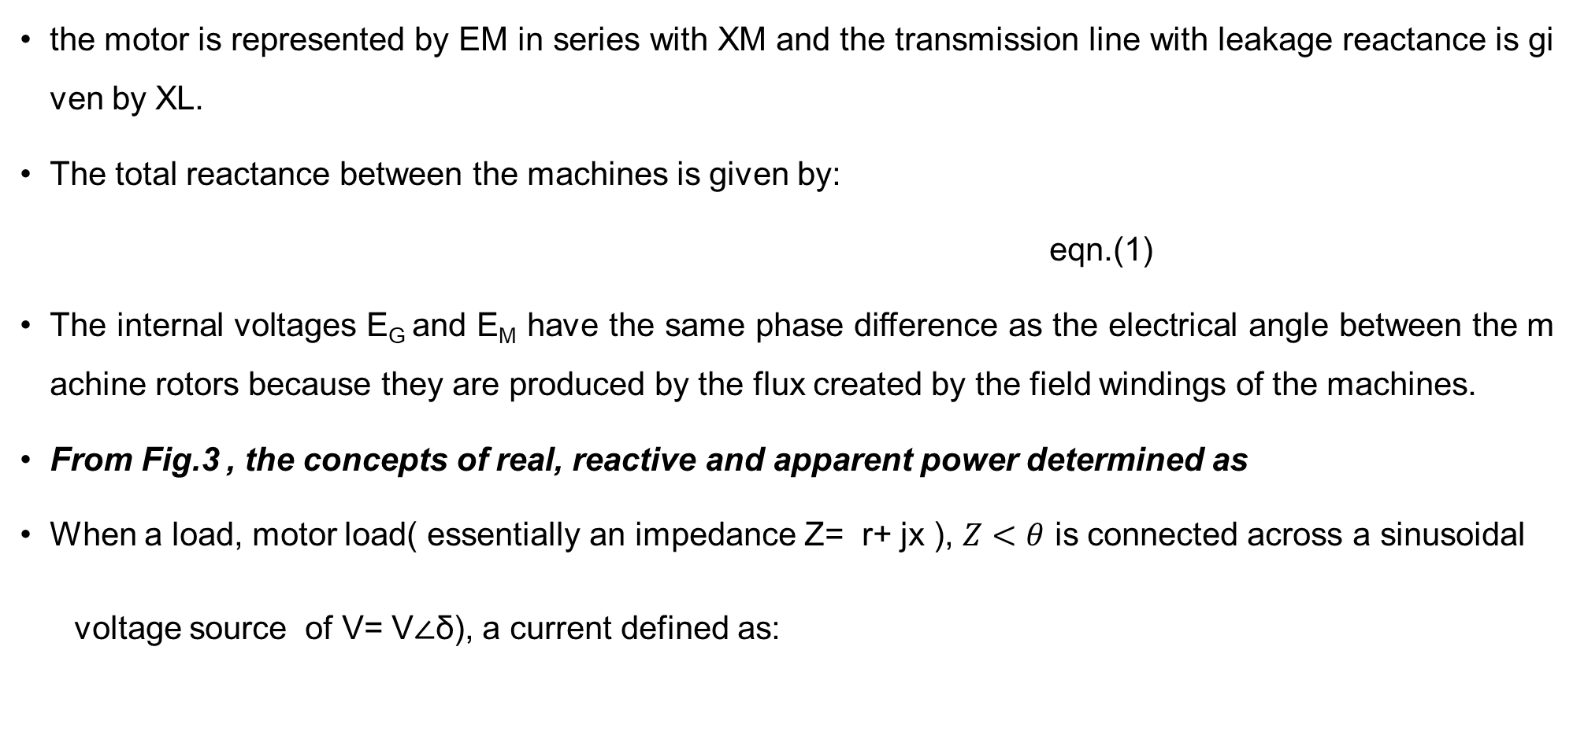
Power Angle Equation Cont.…
the motor is represented by EM in series with XM and the transmission line with leakage reactance is given by XL.
The total reactance between the machines is given by:
eqn.(1)
The internal voltages E_{G} and E_{M} have the same phase difference as the electrical angle between the machine rotors because they are produced by the flux created by the field windings of the machines.
From Fig.3 , the concepts of real, reactive and apparent power determined as
When a load, motor load( essentially an impedance Z= r+ jx ), $Z<θ$ is connected across a sinusoidal
voltage source of V= V∠δ), a current defined as:

Slide 29
Power Angle Equation Cont.…
eqn.(2)
Then, the power delivered from generator to the system is:
eqn.(3)
The power received by load is :
eqn.(4)

Slide 30
Power Angle Equation Cont.…
Then, the active and reactive power at the sending and receiving ends are given as:
eqn.(5)
Since reactance is typically much higher than resistance for a high voltage transmission line, resistance has little to no influence and can be taken for granted.
As a result, the equations become:

Slide 31
Power Angle Equation Cont.…
eqn.(6)
The above equation is rewritten as while considering the sending end voltage as reference is:
eqn.(7)
Where,

Slide 32
Power Angle Equation Cont.…
From the equations 7, the following can be deduced :
1. Small changes in will have significant effect on the real power flow, while small changes in voltage magnitudes will not have appreciable effect on the real power flow.
2. If V1 leads V2, the real power flows from bus 1 to bus 2, while if V₁ lags V₂ the power flows from bus 2 to 1
3. Assuming r=0, the theoretical maximum power (static transmission capacity) occurs when:
eqn.(8)
Which is the steady state stability limit.
Hence this equation is called the power angle equation and if the curve δ against
P is plotted, it is called the power angle curve as shown in Fig.4

Slide 33
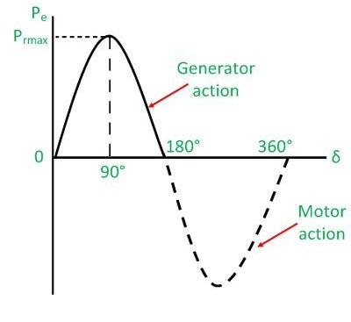
Power Angle Equation Cont.…
From Fig. 4, the slope 𝜕𝑃/𝜕𝛿 is positive (−90⁰≤𝛿≤90⁰), it means that an increase in displacement angle results in an increase in transmitted power and hence the system will be stable, accelerating .
Figure 4. The power angle curve.
Url. https://circuitglobe.com/wp-content/uploads/2016/05/power-angle-curve-11-compressor.jpg

Slide 34
5. Power Angle Equation of a Salient Pole Machine
A synchronous machine with poles that physically projecting, that is, jutting out from the rotor surface is known as a salient pole machine.
These machines are usually alternators or motors as presented in Fig.5.
The non-salient pole or cylindrical rotor type, in which the rotor has a smooth cylindrical shape, is in contrast to this design.
The power angle equation of a salient pole synchronous machine differs from that of a cylindrical rotor due to the presence of non-uniform air gap, which leads to different reactance's along the direct-axis (Xd) and quadrature-axis (Xq).

Slide 35
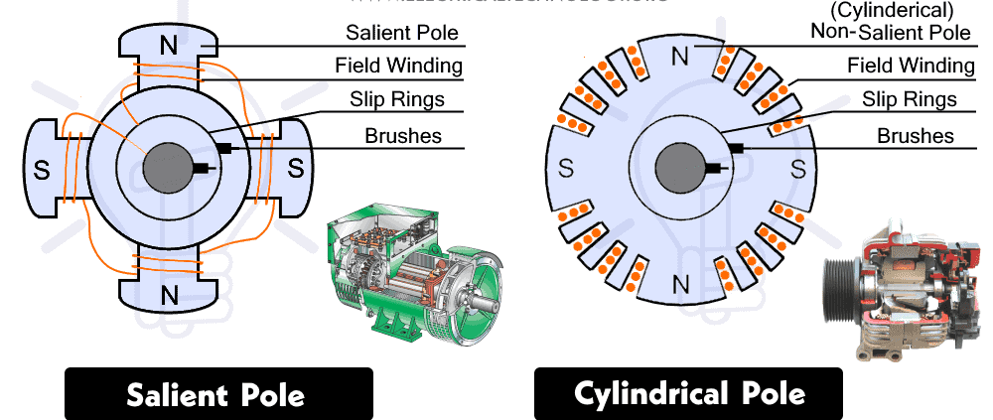
Power Angle Equation of a Salient Pole Cont.….
Figure 5. The difference between Salient and cylindrical pole Machines.
Url: https://www.electricaltechnology.org/wp-content/uploads/2023/01/Difference-Between-Salient-Pole-Cylindrical-Pole-Alternator.png

Slide 36
Power Angle Equation of a Salient Pole Cont.….
The electrical power output of a salient pole generator is given by:
eqn.(9)
Where, P is power developed (per phase), V₁ is the Internal EMF of the machine, V₂ is the terminal voltage, δ is the power angle, X_{d} is direct-axis synchronous reactance and Xq​ = is quadrature-axis synchronous reactance
The power angle equation for a basic two-machine system is equivalent to the excitation
power of a silent pole machine.

Slide 37
Power Angle Equation of a Salient Pole Cont.….
The reluctance power has a maximum value of δ = 45° and varies as sin2δ.
Even if the field is not excited, this term would still exist because it is not dependent on field excitation.
Ten to twenty percent of the excitation component is made up of the reluctance component.
Studies on steady state stability typically overlook the reluctance component of power.
It is taken as the original power angle equation of a basic two machine system for a non-salient
pole machine, Xd = Xq.

Slide 38
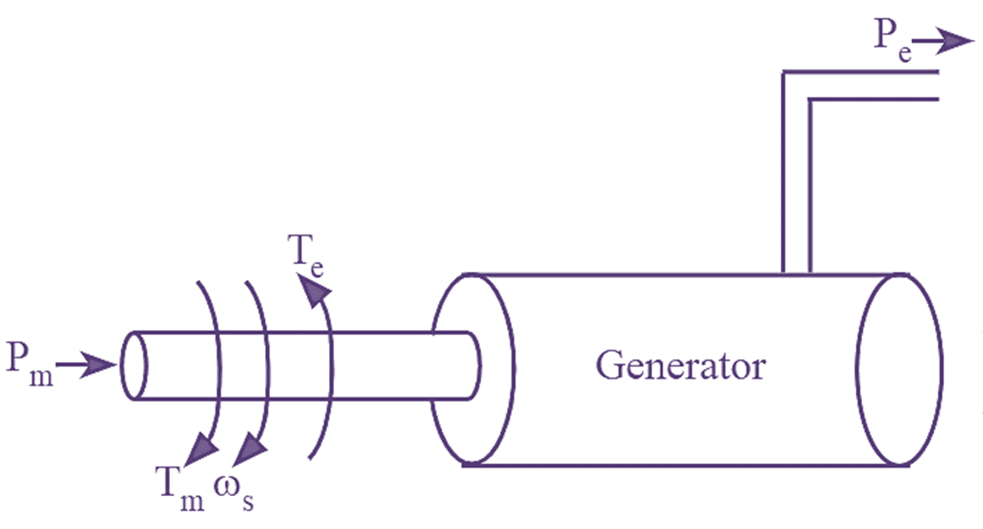
6. Swing Equation
The swing equation describes how a synchronous machine behaves during the transient phase.
It describes the relationship between electrical and mechanical power during different operating conditions
Thus, the mechanical model of generator for steam turbine presented in Fig.6 is developed as
Figure 6. The electromechanical system of steam power plant.
Url:https://electricalworkbook.com/wp-content/uploads/2022/12/swing-equation.png

Slide 39
Swing Equation Cont.….
It’s know that the torque exerted on a spinning body is given by the product of moment of inertia J (kg·m2) and angular acceleration a (rad/s²), that torque on turbine and rotor is:
eqn.(10)
Accordingly, from Fig.6 , the relationship between electrical and mechanical power is given by:
eqn.(11)
where, T_{m} is mechanical input torque(N-M), J moment of inertia of turbine & rotor, α_{m} is angular acceleration of turbine & rotor, T_{D} is the damping torque and T_{e} is equivalent electrical torque

Slide 40
Swing Equation Cont.….
In general, power is equivalent to the product of torque and angular speed.
Thus, when the synchronous generator is rotating at synchronous speed, eqn.(11) can be rewritten as:
eqn.(12)
If the damping torque is neglected at initial condition, eqn.(12) is rewritten as:
eqn.(13)
Where, P_{m} is a mechanical input power that is constant through out the time and P_{e} is an electrical power varies with time, t.

Slide 41
Swing Equation Cont.….
Assume "ፀ" for changing time "t" in seconds, which represents rotor's actual angular position in radians
It is convenient to measure ፀ using a reference axis that rotates at the synchronous speed.
Assuming that δ is the rotor's angular displacement in electrical degrees from the synchronously rotating reference axis and ωs is the synchronous speed in electrical radians,
Then, "ፀ" can be calculated by adding the torque angle δ of the rotor with respect to the rotating reference axis and the time-varying angle ω_{s}t on the rotating reference axis. Which is:
eqn.(14)

Slide 42
Swing Equation Cont.….
By substituting α_{m} of eqn.(13) by eqn.(14) gives :
eqn.(15)
Where, Jω_{s} is the inertia of a machine at synchronous speed
The angular momentum of rotating machine is M=Jω_{s} , which means
eqn.(16)
Accordingly, eqn.(16) is known as the swing equation, which is a nonlinear second order differential equation
During normal operating conditions, the relative position of the rotor axis and the
resultant magnetic field axis is fixed.

Slide 43
Swing Equation Cont.….
The angle between the two is known as the power angle or torque angle and is denoted by δ.
During any disturbance, the rotor will decelerate or accelerate with respect to the synchronous rotating air gap mmf, and a relative motion begins.
The equation describing this relative motion is known as the swing equation.
If after this oscillatory period, the rotor locks back into synchronous speed, the generator will maintain its stability, the rotor returns to its original position.
If the disturbance is created by a change in generation, load, or network conditions, the rotor comes to a new operating power angle relative to the synchronous revolving field.

Slide 44
Summary
In this lecture, the power system stability, which is the synchronism of two more interconnected generators in a power plant is discussed
In line with synchronism, the three types of power stability problems: Angle stability, Voltage stability and frequency stability problems are discussed.
In addition, the difference between, steady state, dynamic and transient stability problems is also discussed well.
Specifically, the modeling of electrical and mechanical components for transient stability analysis is also
developed well.
Finally, the importance's of swing equation formulation for transient stability analysis is also incorporated
Swing equation helps to know whether the rotor locks back into synchronous speed after
oscillation or not

Slide 45
References
[1]. H., Silva; M., Nadarajah; M., Haque and S., Shafiq. ‘’Modelling of Power System Restoration of a Synchronous Generator-Driven Network“. 12th International Electrical Engineering Congress (iEECON), Pattaya, Thailand, 2024, pp. 1-6. doi:10.1109/iEECON60677.2024.10537941.
[2]. N., Hatziargyriou; M., Ovica; R., Claudia and et al,. "Definition and Classification of Power System Stability – Revisited & Extended“. IEEE Transactions on Power Systems. V.36(4), pp. 3271-3281, 2021. DOI: 10.1109/TPWRS.2020.3041774.
[3]. S., Ali and V.,Abolfazl. "Transient stability prediction of power system; a review on methods, classification and considerations’’. Elsevier: Electric Power Systems Research. V.190, 2021. https://doi.org/10.1016/j.epsr.2020.106853
[4]. A., Zaidi and Q., Cheng. "An Approximation Solution of the Swing Equation Using Particle Swarm Optimization“. IEEE Conference on Technologies for Sustainability (SusTech),
Long Beach, CA, USA, 2018, pp. 1-5, Doi: 10.1109/SusTech.2018.8671355.

Slide 46
Thank you !

