Slide 1
Advanced Power System Analysis
Lecture 12
Power System Stability
Lecturer: Teshome Goa (Assist. Prof.)
Lecture learning outcomes:
At the end of this lecture, you will be able to:
Knows the importance of graphical representation of swing curve in Power stability
Understand the necessities of Inertia constant and kinetic energy for stability.
Understand equal area criteria importance in stability analysis
Knows the basics of computerized methods for stability analysis

Slide 2
Outlines
Introduction
Constants Used in Stability Analysis
Change in Rotor Angle for Loaded Machine
Equal Area Criterion
Sudden three Phase fault in the Transmission Line stability
Computerized Method of Swing Equation solutions
Summary
References

Slide 3
1. Introduction
Plotting the swing curve in a system is required to ascertain whether the power system is stable following a disruption.
This curve indicates instability in the system if it indicates that the angle between any two machines tends to increase indefinitely[1].
It is likely, but not guaranteed that the system is stable following all disruptions, the angle between the two machines achieves its maximum value and then starts to decrease, oscillating with a constant amplitude.
The machines can be made to come to rest in relation to one another using a straightforward graphical method, which is called the equal area criteria for stability.

Slide 4
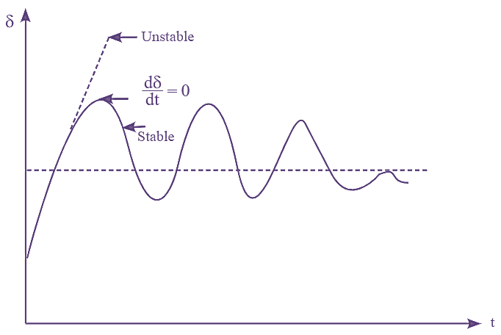
Introduction Cont.….
It gives information on stability, demonstrate δ's tendency to shift and/or rise above the point of return.
The system is unstable if δ keeps rising over time.
It is assumed that the system will stay stable if δ begins to decline after reaching a maximum value as presented in Fig.1.
Figure 1. Swing Curve.
Url:https://electricalworkbook.com/wp-content/uploads/2022/12/Swing-Curve.png

Slide 5
2. Constants Used in Stability Analysis
The three constant terms, Inertia constant (M), Kinetic energy (N) and inertia constant (N), which are the three fundamental components to address the swing equation and equal area criteria as given by[2]:
From swing equation:
eqn.(1)
Which means, if power is given by (W or Pu), δ is electrical angle and t is second , then, the constant M may be defined as the power in MW required to produce an angular acceleration per electrical angle, s.
Then, the kinetic energy, N of the rotor at synchronous speed denoted by N is given by:
eqn.(2)
Where, ω_{s} =2πn_{s}(mechanical rad/s) or 2πf(360f) in electrical rad/s and n_{s} is
the speed in r.p.s

Slide 6
Constants Used in Stability Cont.….
Practically, generators of the same MVA ratings may not have the same kinetic energy and momentum.
To express them in a common way, the constant H called inertia constant is used, which defined as the
ratio of stored kinetic energy to volt ampere rating of machine as given by:
eqn.(3)
Then, finding out equivalent H constant is very important in which ‘n’ number of generators connected in parallel to the same bus bar in reality
Assume, (S1, S2,….Sn), (H1, H2,..Hn) and (N1, N2…Nn) are the base MVA, inertia
Constant and Kinetic energy of individual machines, respectively .

Slide 7
Constants Used in Stability Cont.….
And (Se, He , Ne and Sb) are the equivalent MVA, inertia constant, Kinetic energy of machines and common base MVA, respectively
Then, the energy stored in equivalent machine is given by:
eqn.(4)
If Se=Sb is the summation of each generator base and, then
eqn.(5)
For identical machines, S1=S2=Sn=S, and H1=H2=H3=Hn, means Sb= n*S.
Then, by substitution: eqn.(6)

Slide 8
Constants Used in Stability Cont.….
As a result, the equivalent H constant of multiple identical machines running in parallel is equal to the H
constant of any single machine.
Equivalent M constant of two machines: a similar machine connected via a reactance to an infinite
bus can be used in place of two synchronous machines connected by a reactance.
Two machines swing equation is provided by:
eqn.(7)
And eqn.(8)

Slide 9
Constants Used in Stability Cont.….
By subtracting, eqn.(8) from eqn.(7)
eqn.(9)
If δ is the relative angle between the rotors of the two machines, then δ=δ₁ – δ₂ gives:
eqn.(10)

Slide 10
Constants Used in Stability Cont.….
Multiplying both sides of eqn.(10) by M1M2 /(M1 + M2), gives
eqn.(11)
The swing equation of an equivalent machine is given by:
eqn.(12)
Finally, the relationship between inertia constant M and inertia constant H is:
eqn.(13)

Slide 11
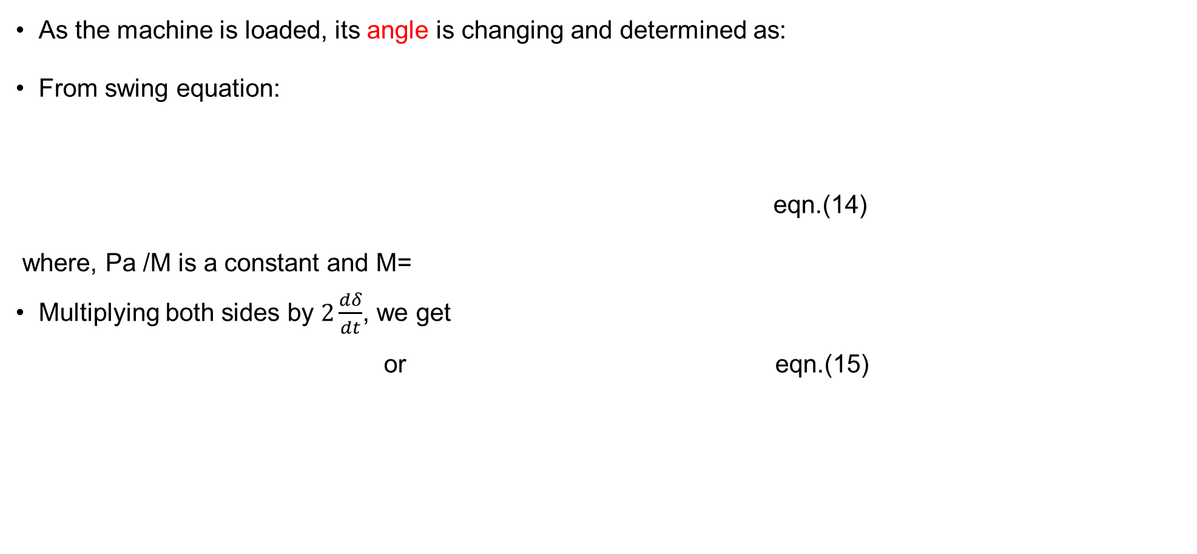
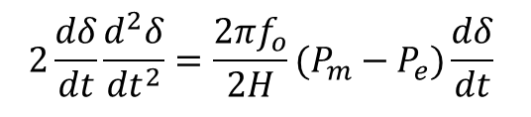
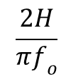
3. Change in Rotor Angle for Loaded Machine
As the machine is loaded, its angle is changing and determined as:
From swing equation:
eqn.(14)
where, Pa /M is a constant and M=
Multiplying both sides by $2\frac{dδ}{dt}$, we get
or eqn.(15)
$$\frac{2H}{πf_{o}}$$
$$2\frac{dδ}{dt}\frac{d^{2}δ}{{dt}^{2}}=\frac{2πf_{o}}{2H}(P_{m}−P_{e})\frac{dδ}{dt}$$

Slide 12
Change in Rotor Angle for Loaded Machine Cont.…
Upon integration of the above eqn. 15 gives
eqn.(16)
Integrating again gives :
eqn.(17)

Slide 13
Change in Rotor Angle for Loaded Machine Cont.…
Then by substitution, we get:
eqn.(18)
Which is the change in rotor angle at anytime

Slide 14
4. Equal area criteria
In a system to determine whether a power system is stable after a disturbance, it is necessary to plot the swing curve[3].
If this curve shows that the angle between any two machines tends to increase without limit, system is
unstable.
If after all disturbances, the angle between the two machines reaches the maximum value and thereafter decreasing, thus oscillating with constant amplitude, is probability or ot certain the system is stable.
There is a simple graphical method of determining whether the machines come to rest with respect to each other, method used to determine this is known as the equal area criterion for stability.

Slide 15
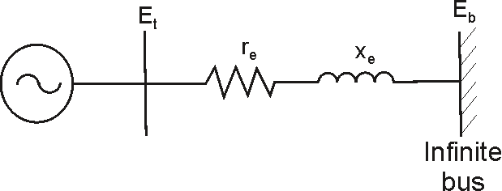
Equal area criteria Cont.…
Consider a machine connected to an infinite bus presented in Fig.2
Figure 2. Single Machine to Infinite bus(SMIB).
Url:https://www.researchgate.net/publication/236009431/figure/fig1/AS:363465500839938@1463668336782/Single-Machine-connected-to-infinite-bus-system.png

Slide 16
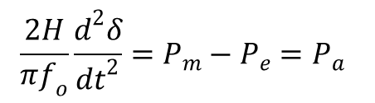
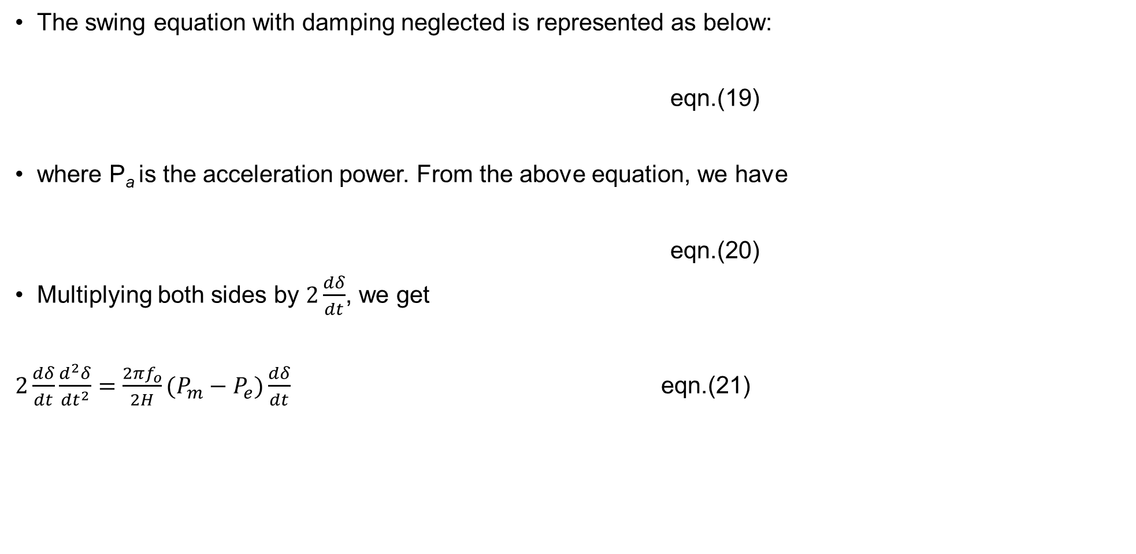
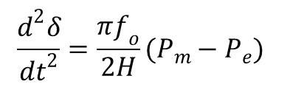
Equal area criteria Cont.…
The swing equation with damping neglected is represented as below:
eqn.(19)
where P_{a} is the acceleration power. From the above equation, we have
eqn.(20)
Multiplying both sides by $2\frac{dδ}{dt}$, we get
$2\frac{dδ}{dt}\frac{d^{2}δ}{{dt}^{2}}=\frac{2πf_{o}}{2H}(P_{m}−P_{e})\frac{dδ}{dt}$ eqn.(21)
$$\frac{2H}{πf_{o}}\frac{d^{2}δ}{{dt}^{2}}=P_{m}−P_{e}=P_{a}$$
$$\frac{d^{2}δ}{{dt}^{2}}=\frac{πf_{o}}{2H}(P_{m}−P_{e})$$

Slide 17
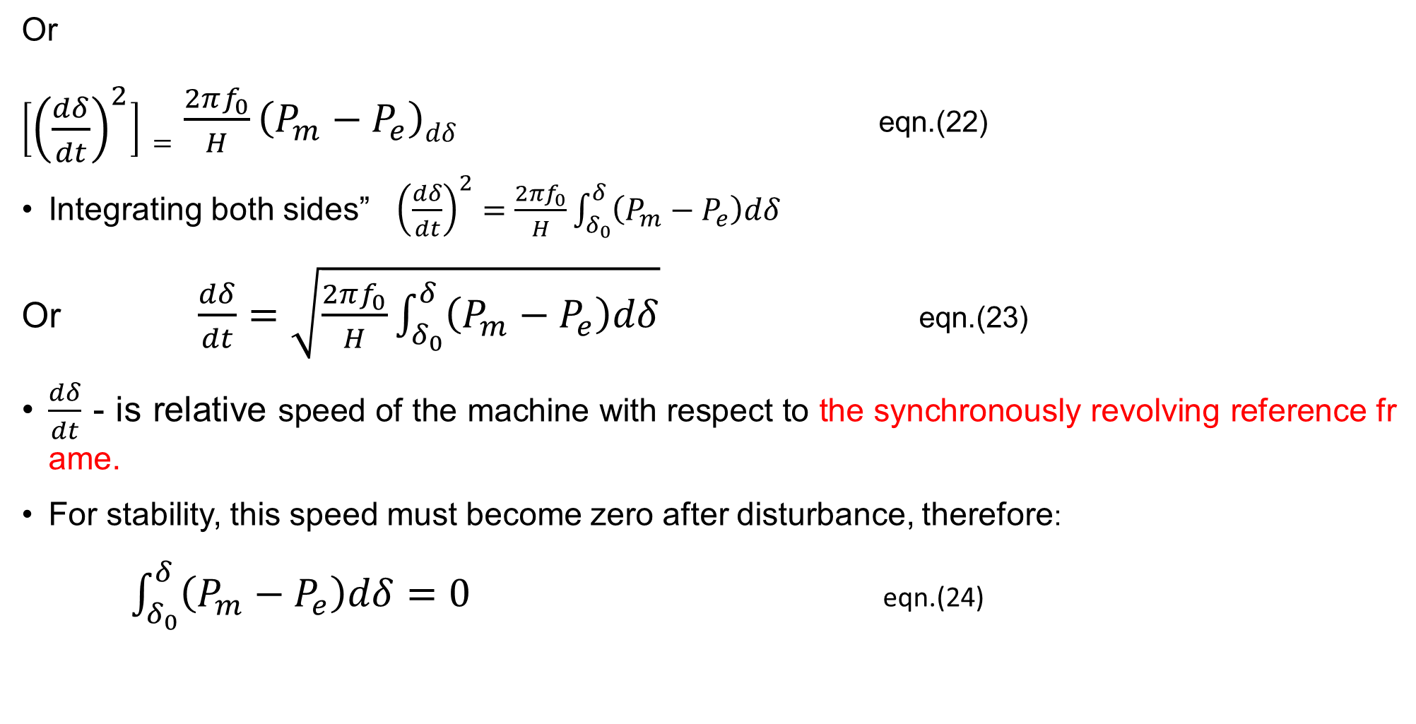
Equal area criteria Cont.…
Or
$\left[{\left(\frac{dδ}{dt}\right)}^{2}\right]=\frac{2πf_{0}}{H}\left(P_{m}−P_{e}\right)dδ$ eqn.(22)
Integrating both sides” ${\left(\frac{dδ}{dt}\right)}^{2}=\frac{2πf_{0}}{H}\int_{δ_{0}}^{δ}{\left(P_{m}−P_{e}\right)dδ}$
Or $\frac{dδ}{dt}=\sqrt{\frac{2πf_{0}}{H}\int_{δ_{0}}^{δ}{\left(P_{m}−P_{e}\right)dδ}}$ eqn.(23)
$\frac{dδ}{dt}$ - is relative speed of the machine with respect to the synchronously revolving reference frame.
For stability, this speed must become zero after disturbance, therefore:
$\int_{δ_{0}}^{δ}{\left(P_{m}−P_{e}\right)dδ}=0$ eqn.(24)

Slide 18
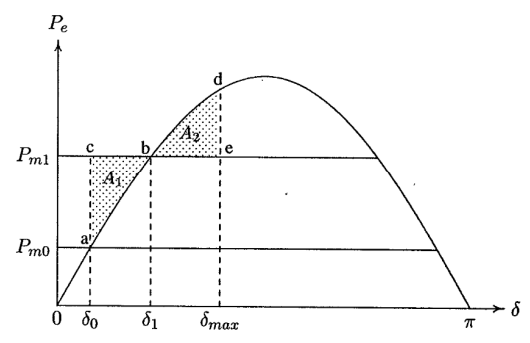
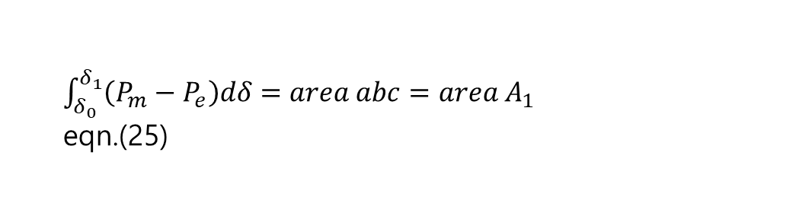
Equal area criteria Cont.…
Let us consider a machine operating at the equilibrium point δ₀, corresponding to the mechanical power input P_{m0} = P_{e0} as shown in the Fig.3..
Consider a sudden step increase in the input power represented by the horizontal line P_{m1}.
Since P_{m1} > P_{e0}, the accelerating power on the rotor is positive and the power angle δ increases.
The excessive energy stored in the rotor during the initial acceleration is
$\int_{δ_{0}}^{δ_{1}}{\left(P_{m}−P_{e}\right)dδ}=area abc=area A_{1}$ eqn.(25)
Figure 3. Equal area criteria for sudden change in load.
Url:https://www.researchgate.net/publication/365064451/figure/fig1/AS:11431281094570778@1667510256364/Equal-area-criteria-for-sudden-change-in-load.ppm

Slide 19
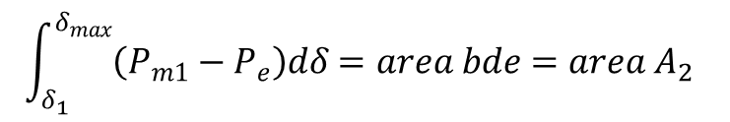
Equal area criteria Cont.…
With increase in δ, the electrical power increases, and when δ = δ₁, the electrical power matches the new input power P_{m1}.
Though the accelerating power is zero at this point, the rotor is running above synchronous speed, hence, δ and electrical power P_{e} will continue to increase.
Now P_{m} ˂ P_{e}, causing the rotor to decelerate towards synchronous speed until δ = δ_{max}.
Accordingly, the rotor must swing past point ‘b’ until an equal amount of energy is given up by the rotating masses.
The energy given up by the rotor as it decelerates back to synchronous speed is
eqn.(26)
$$\int_{δ_{1}}^{δ_{max}}{\left(P_{m1}−P_{e}\right)dδ}=area bde=area A_{2}$$

Slide 20
Equal area criteria Cont.…
The resultant is that the rotor swings to point b and the angle δmax , at which point:
|area A₁| = |area A₂|
This is known as the equal-area criterion.
The rotor angle would oscillate back and forth between δ₀ and δ_{max} and its natural frequency.
If there is damping in the machine, it would make these oscillations to subside and a new steady-state
operation established at point b.
The equal area criterion can be used to determine the maximum additional power P_{m} which can be applied to system but stability still maintained.

Slide 21
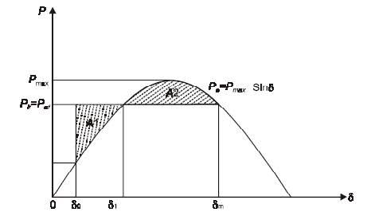
Equal area criteria Cont.…
Stability can only be maintained if area A₂ at least equal to area A₁ can still be located above P_{m}.
The limit of stability occurs when δ_{max} is at the intersection of line P_{m} and the power angle curve for 90⁰ ˂ δ ˂ 180⁰ as shown in the Fig.4
Figure 4. The transient stability limit.
Url: https://encrypted-tbn0.gstatic.com/images?q=tbn:ANd9GcSGO3IYm2yk4KopQLW6qdaAjVT3fZ2PzkiiQORLdAjPcfxXSPGLiP4BqxsSdHjieyLyZrg&usqp=CAU

Slide 22
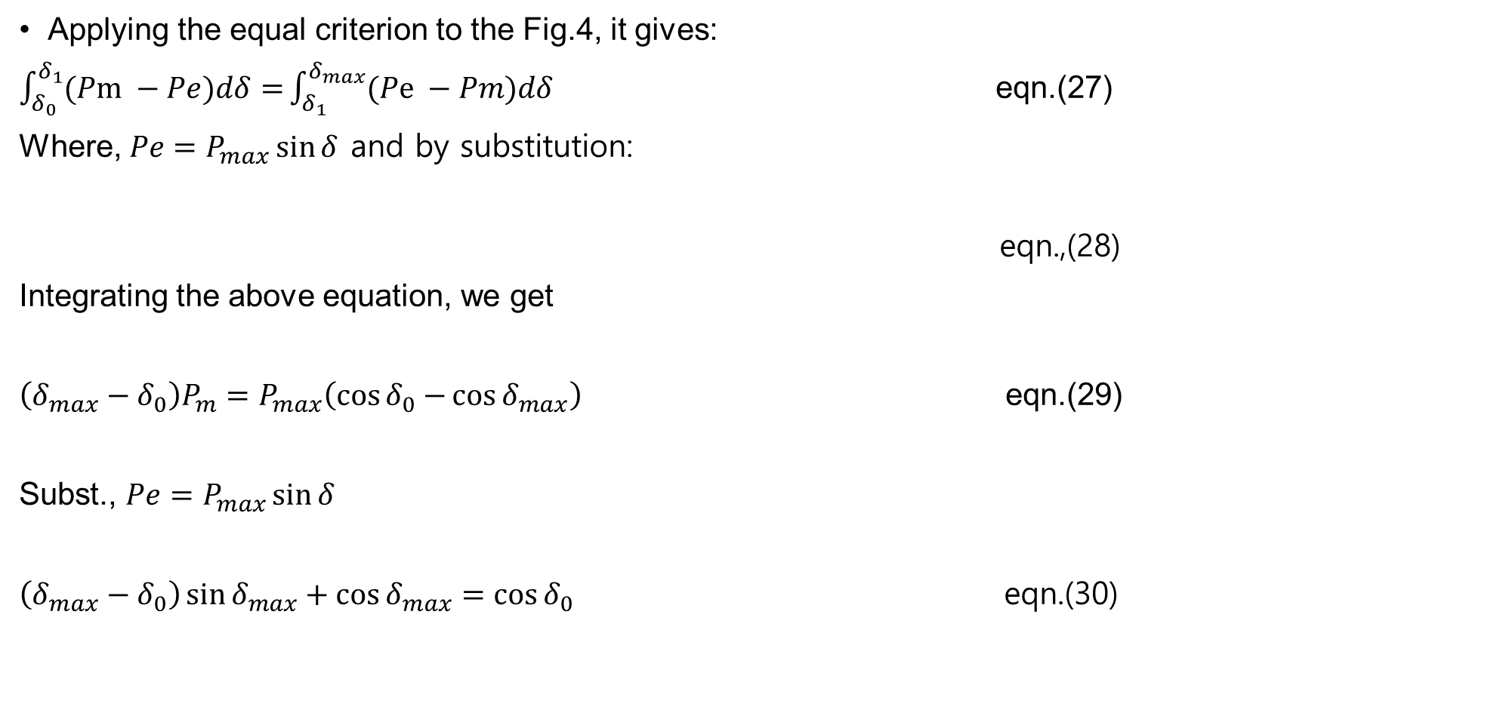
Equal area criteria Cont.…
Applying the equal criterion to the Fig.4, it gives:
$\int_{δ_{0}}^{δ_{1}}{(Pm −Pe)dδ=}\int_{δ_{1}}^{δ_{max}}{(Pe −Pm)dδ}$ eqn.(27)
Where, ${Pe=P}_{max}\sin{δ}$ and by substitution:
eqn.,(28)
Integrating the above equation, we get
$\left(δ_{max}−δ_{0}\right)P_{m}=P_{max}\left(\cos{δ_{0}−}\cos{δ_{max}}\right)$ eqn.(29)
Subst., ${Pe=P}_{max}\sin{δ}$
$\left(δ_{max}−δ_{0}\right)\sin{δ_{max}}+\cos{δ_{max}}=\cos{δ_{0}}$ eqn.(30)
$$P_{m}\left(δ_{1}−δ_{0}\right)−\int_{δ_{0}}^{δ_{1}}{P_{max}\sin{δ}dδ=}\int_{δ_{1}}^{δ_{max}}{P_{max}\sin{δ}dδ−P_{m}\left(δ_{max}−δ_{1}\right)}$$

Slide 23

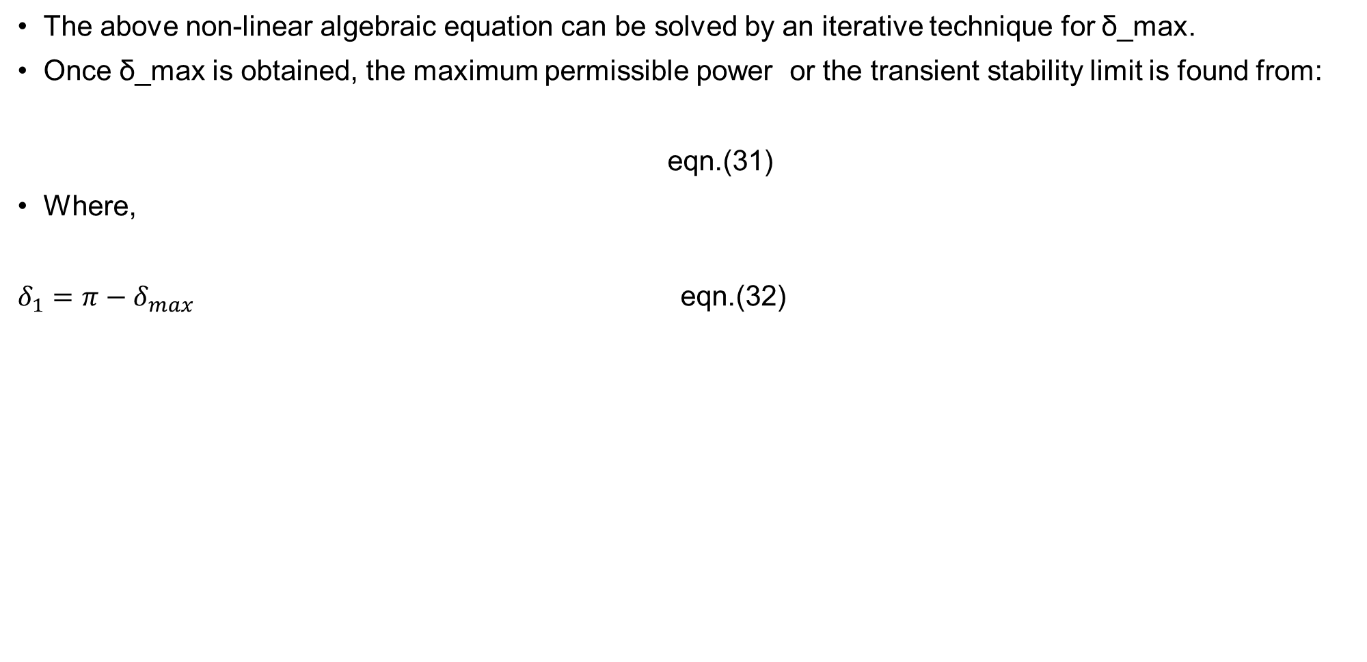
Equal area criteria Cont.…
The above non-linear algebraic equation can be solved by an iterative technique for δ_max.
Once δ_max is obtained, the maximum permissible power or the transient stability limit is found from:
eqn.(31)
Where,
$δ_{1}=π−δ_{max}$ eqn.(32)
$$P_{m}=P_{max}\sin{δ_{1}}$$

Slide 24
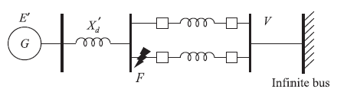
5. Sudden three Phase fault in the Transmission Line
To determine the rotor angle, fault clearing time of circuit breaker and its speed in transient fault analysis, first network classified into pre-fault, during fault and post fault conditions[4].
Consider the three-phase short-circuit fault which occurs at the sending of the transmission line 2 of single machine connected to an infinite system with double circuit transmission line as presented in Fig.5
Pre-fault condition: prior to a fault, both transmission lines are connected as shown in Fig.5.
The power angle curve is given by
eqn.(33)
Figure 5. Double Transmission line

Slide 25
Sudden three Phase Cont..
Where,
eqn.(34)
During fault condition, upon the occurrence of three phase fault at the sending of the transmission line 2, the generator gets isolated from the power system for the purpose of power flow looks the shortest path, and the fault lasts. Which means, P_{e2} = 0.
The rotor therefore accelerates and δ angle increases, synchronism will be lost unless the fault is cleared in time.
Post-fault condition: The circuit breakers at the two ends of the faulted line open
at time t_{c} (corresponding to angle δc), the clearing time, disconnecting the faulted line
The power angle curve is given by: eqn.(35)

Slide 26
Sudden three Phase Cont..
Where,
eqn.(36)
Obviously, (P_{max2}, and P_{max3}) < P_{max1}, means the rotor now starts to decelerate as shown in Fig.6.
The system will be stable if a decelerating area A2 can be found equal to accelerating area A1 before δ reaches the maximum allowable value δmax.
As area A1 depends upon the clearing time t_{c}, the clearing time must be less than a certain value (critical clearing time) for the system to be stable.
It is to be observed that the equal area criterion helps to determine the critical clearing angle and not the critical clearing time.
Critical clearing time can be obtained by numerical solution of the swing equation.

Slide 27
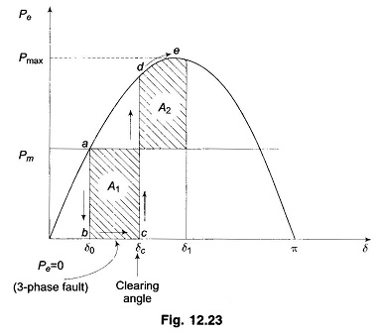
Sudden three Phase Cont..
Figure 6. Power curve of 3-phase fault at the beginning of line 2.
Url: https://www.eeeguide.com/wp-content/uploads/2016/12/Equal-Area-Criterion-in-Power-System-042.jpg

Slide 28
Sudden three Phase Cont..
Example 1: The moment of inertia of a 4 pole, 100 MVA, 15 kV, 3-Ф, 0.85 power factor, 50 Hz turbo alternator is 20,000 kg·m². Calculate H and M.
Solution:

Slide 29
Sudden three Phase Cont..
Example 2: A 50 Hz, 4 pole, turbo alternator rated 100 MVA, 15 kV has an inertia constant of 10 MJ/MVA. Determine:
the energy stored in the rotor at synchronous speed
the rotor acceleration if the mechanical input is suddenly raised to 100MW for an electric load of 45MW. (Neglect mechanical and electrical losses).
Solution:

Slide 30
Sudden three Phase Cont..
Example 3: A generator A is rated at 50 Hz, 80 MW, 90 MVA, 3000 rpm and has an inertia constant H = 6 MJ/MVA. The corresponding data for another generator B is 50 Hz, 110 MW, 150 MVA, 1500 rpm, and 5 MJ/MVA.
If two generators operate in parallel, calculate H for the equivalent generator on a base of 100 MVA.
If the power station is connected to another power station which has two of each type of genera or, calculate H for the equivalent generator connected to an infinite bus bar.
Solution : a. we know that :
b. For another power station of the same generators :

Slide 31
Sudden three Phase Cont..
Example 4. A 150 MVA, 15 kV, 50 Hz, 4 pole turbo alternator has an inertia constant of 8MJ/MVA.
a. Determine the stored energy in the rotor at synchronous speed.
b. The machine is operating at a load of 130 MW when the load suddenly increases to 180 MW. Determine the rotor delay. Neglect losses.
c. The retardation/delay calculated above is maintained for 4 cycles. Determine the change in power angle and the rotor speed in rpm at the end of this period. Solution :

Slide 32
Sudden three Phase Cont..
It’s know that change in rotor angle. where t is the time period for acceleration or retardation.

Slide 33
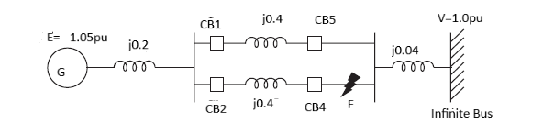
Sudden three Phase Cont..
Example 5. Given the circuit as shown in the figure below where three-phase fault is applied on one end of a line near circuit breaker CB4. Find the critical fault clearing angle for clearing the fault with simultaneous opening of breaker CB2 and CB4. The generator is delivering 1.0 p.u. MW at the instant preceding the fault. All the p.u. quantities are on the common MVA.
Solution. During , pre-fault condition the thevining equivalent reactance is :
Then, the electrical power transferred to infinite bus is given by:

Slide 34
Sudden three Phase Cont..
During fault condition: The fault occurs at the end of the line 2 or near bus 2, no power is transferred from the circuit, Pe2=0
Post-fault condition: With the opening of the faulted line, say by simultaneous opening of the circuit breakers CB2 and CB4, the post-fault transfer reactance while removing line 2 is given by:
The power transferred to infinite bus is:
The initial angle:

Slide 35
Sudden three Phase Cont..
And,
Then,

Slide 36
5. Computerized Method of Swing Equation solutions
The dynamic behavior of a synchronous generator's rotor angle during disturbances is described by
the swing equation, a second-order differential equation.
Since there is no analytical solution for this non-linear differential equation, approximate solutions are obtained by computerized techniques. Some of them are:
a. Numerical Integration
b. Step by step method.
c. Euler’s method.
d. Modified Euler’s method.
e. Runge–Kutta method.

Slide 37
Computerized Method Cont.…
Numerical Integration: Most computerized methods employ numerical integration techniques to approximate the solution over time.
Point-by-Point Method: A simple but less accurate method where the solution is advanced one time step at a time using a basic approximation of the derivative.
Modified Euler Method: A more accurate method that involves predicting values at each time step and
then correcting them using average derivatives.
Runge-Kutta Methods: A more accurate class of methods that use intermediate variable values at each time step to calculate weighted average changes, resulting in higher accuracy
In order to apply these methods you can either use simulation software's or codes

Slide 38
Summary
In this lecture, the importance of plotting the swing curve to ascertain whether the power system is stable following a disruption is discussed
If this curve shows that the angle between any two machines tends to increase without limit, the system is unstable
In line with this, the importance of constants like kinetic energy, inertia constant (H) and M in transient stability analysis is presented.
In addition, the effect of sudden load change in power angle stability is also presented.
Then, the simple graphical method of determining whether the machines come to rest with respect to each other called equal area criteria is discussed.
Finally, the compterized method to solve stability analysis is also included

Slide 39
References
[1]. Y., Su; S., Cheng; J., Wen and J., Zhang. "Power System Dynamic Stability Analysis and Stability Type Discrimination“. Proceedings of the 41st International Universities Power Engineering Conference, Newcastle upon Tyne, UK, 2006, pp. 516-520. DOI: 10.1109/UPEC.2006.367531
[2]. Z., Liu; C., Hong and C., Guo. "Equivalent Inertia Estimation of Power System Based on Kinetic Energy Theorem." IEEE International Conference on Power Science and Technology (ICPST), Kunming, China, 2023, pp. 905-910. DOI: 10.1109/ICPST56889.2023.10165186.
[3]. S., Yong; M., Jinpeng; K., Jürgen and Z., Meng. ‘’’Equal-area criterion in power systems revisited’’. Proc. R. Soc. http://doi.org/10.1098/rspa.2017.0733.
[4]. X., Chierthaichingpangxao; S., Phommixay and K., Somsai. "Improvement of Power Oscillation Damping by Using a Unified Power Flow Controller: Case Study of NamTheun 2 Transmission Line“. International Electrical Engineering Congress (iEECON), Krabi, Thailand, 2023, pp. 295-299. doi: 10.1109/iEECON56657.2023.10126868.

Slide 40
Thank you !

