Slide 1
Advanced Power System Analysis
Lecture 13
Power System Security
Lecturer: Teshome Goa (Assist. Prof.)
Lecture learning outcomes:
At the end of this lecture, you will be able to:
Understand power system security analysis
Identify the factors that affects power system security
Knows the importance of contingency analysis in power security
Understand the two common types of linear sensitivity analysis

Slide 2
Outlines
Introduction
Factors Affecting Power System Security
Contingency Analysis
Security analysis using Linear sensitivity
AC Power Flow Security Analysis
Summary
References

Slide 3
1. Introduction
Power system security is the capacity of a power system to function consistently in the face of emergencies and disruptions [1].
It entails ensuring that frequency and voltage remain within preset ranges despite unforeseen circumstances like as changes in demand or equipment malfunctions.
A safe power system is designed to withstand one plausible situation.
Despite their similarities, the objectives of power system security and stability are distinct [2].
The main focus of security is on the system's overall resilience to disturbances
and reliable power delivery.

Slide 4
Introduction Cont.….
While stability is a specific aspect of the system's response to changes, security is essentially a more generic phrase that incorporates stability as a critical component. .
Power System Security is very important in Modern Grid for[3]:
Assures Reliable Power Supply
Prevents service disruptions, blackouts, and blackouts
Protects against physical and cyber-threats(in modern grid)
Enhances the use of Renewable Energy integration

Slide 5
Introduction Cont.….
Specially, renewable energy like wind and solar PV are variable, systems must be safe and flexible
while connecting to the grid.
Prevents economic losses
Industries might lose millions of dollars every hour due to power outages , which needs security analysis
Facilitates smart grid functions for system automation
Automation requires secure communication and control to maintain grid stability in emergency situations
Security helps in effectively managing errors, disruptions, and changes in load
The compression of modern secure grid and traditional is presented in Fig.1

Slide 6
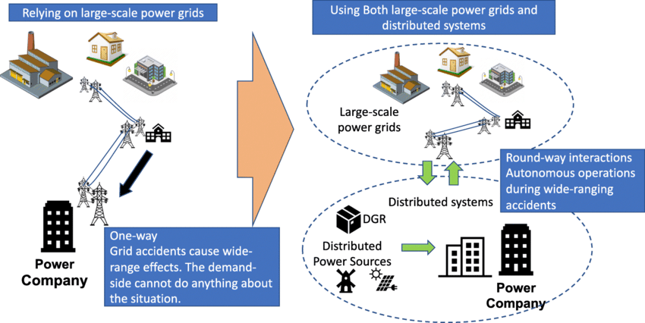
Introduction Cont.….
Figure 1. Traditional vs modern Smart Grid.
Url: https://www.researchgate.net/publication/344725564/figure/fig1/AS:963961080012812@1606837639914/Comparison-of-the-organizations-of-traditional-power-grid-and-smart-grid.png

Slide 7
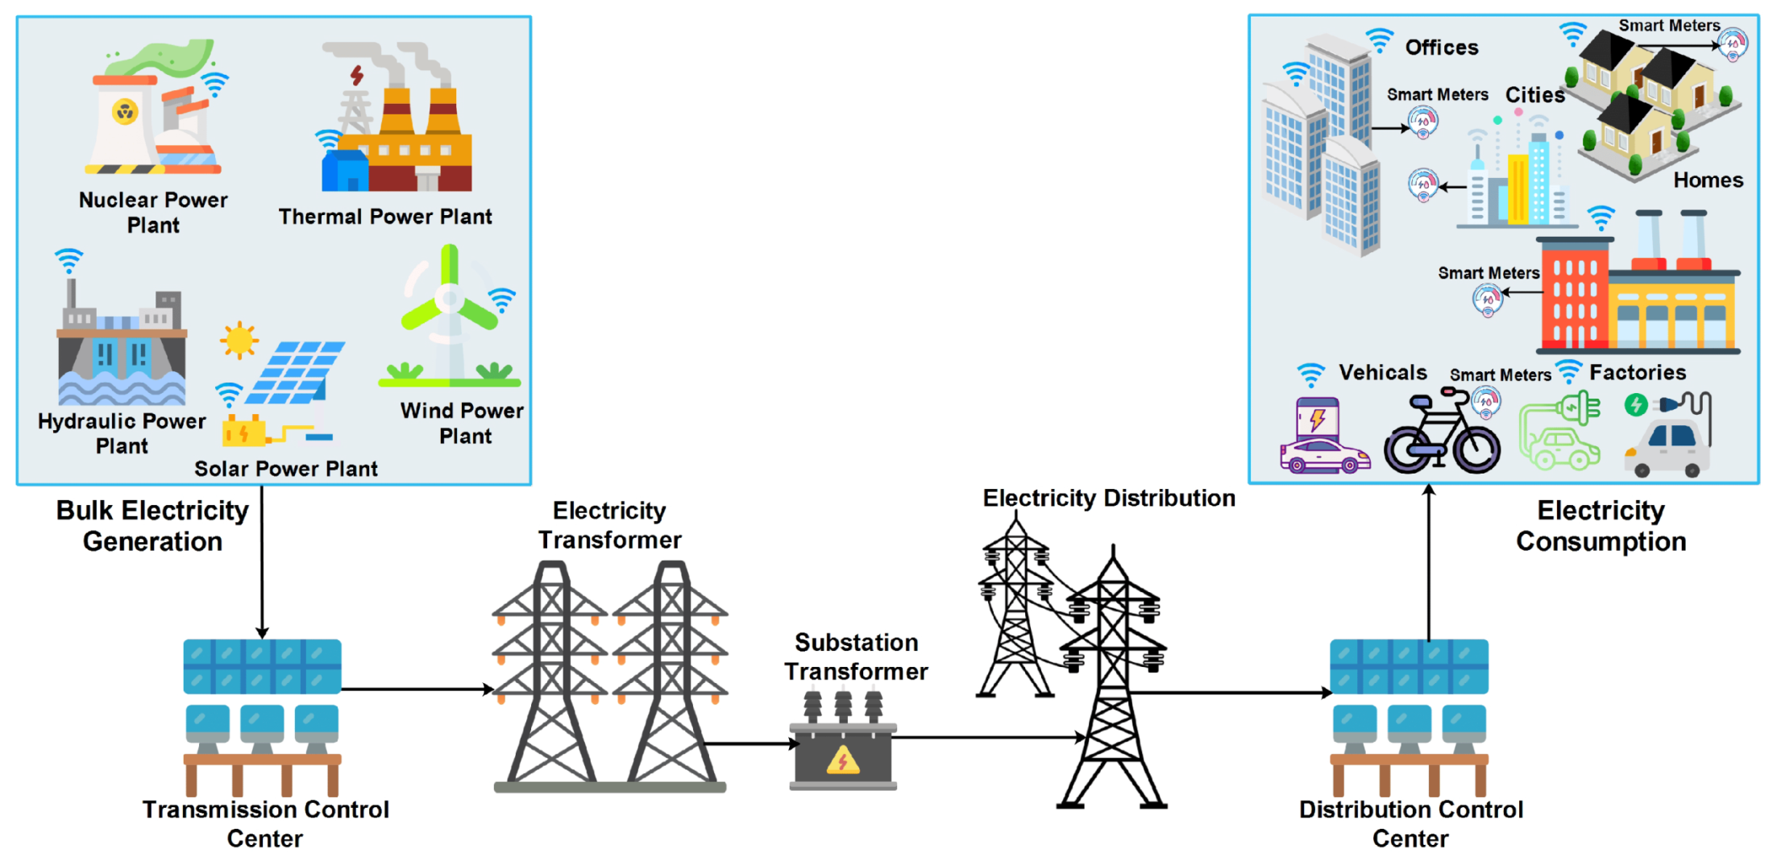
Introduction Cont.….
Figure 2. shows why cyber threats are affecting modern power network
Figure 2. Modern Smart Grid cyber security treats .
Url:https://pub.mdpi-res.com/energies/energies-15-06799/article_deploy/html/images/energies-15-06799-g001.png?1663662089

Slide 8
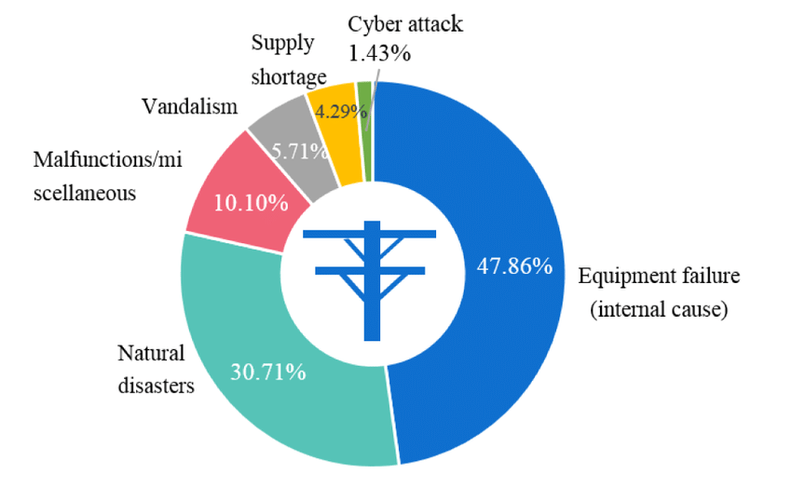
Introduction Cont.….
Figure 3 shows the security related problems data
Figure 3. The power outage causes 140 worldwide data.
url: https://www.researchgate.net/profile/Yanling-Lin-2/publication/316025063/figure/fig1/AS:641858111823874@1530042307474/Power-outage-causes-for-140-worldwide-outage-data-from-1965-to-2012.png.

Slide 9
Introduction Cont.….
Therefore, procedures intended to maintain system functionality in the event of component failure are
part of power system security.
For example, in order to maintain the auxiliary equipment failure, the generating unit may be turned off.
The other units on the system may therefore handle the loss without experiencing excessive frequency
decrease or having to shed load, as long as the appropriate amount of spinning reserve is maintained.
Automatic relaying may remove a transmission line that has been damaged.
A cascading failure occurs when one system failure triggers another, ultimately
leading to a system blackout, which need security analysis.

Slide 10
Introduction Cont.….
The three main functions of system security are performed in an operation control center are:
a. Monitoring of the system (SCADA, state estimation).
b. Contingencies analysis
c. Security constraint Optimal power flow (SCOPF).
The most crucial of the three is system monitoring, which provides operators with pertinent, current information on the state of the electrical system.
Contingency analysis, which enables systems to be operated defensively,
is the second key security function..

Slide 11
Introduction Cont.….
The third security function is security-constrained optimum power flow, which combines an optimal power flow with a contingency analysis.
This aims to alter the generation's optimal dispatch along with other modifications so that no unplanned events lead to a security analysis violation.
To understand the above functions, divide the operating states of the power system into four as:
Optimal dispatch
Post-contingency
Secure dispatch
Secure post-contingency

Slide 12
Introduction Cont.….
Optimal Dispatch: Pre-contingency state focused on economic efficiency, but may lack security.
Post-Contingency: State after a contingency occurs, possibly violating security limits like line overloads, voltage issues, frequency problem etc.
Secure Dispatch: Pre-contingency state with adjustments made to ensure system security.
Secure Post-Contingency: System state after contingency analysis and corrective actions have been
applied to maintain security

Slide 13
2. Factors Affecting Power System Security
Several factors can affect the security of a power system. These can be broadly categorized into technical, operational, environmental, and economic factors[4]. Key factors are:
System Loading Conditions: Overloading increases the risk of voltage issues, overheating, and
instability
Network Topology: Weak or poorly connected networks reduce flexibility and increase the chance of cascading failures.
Generation Mix and Availability: A diverse and reliable generation mix enhances security, while generator outages pose stability risks..

Slide 14
Factors Affecting Security Cont.….
Contingency Planning and Analysis: Preparing for "N-1" or "N-2" events ensures system reliability; poor planning increases outage risks.
Reactive Power Management: Sufficient reactive power is vital for voltage stability;
its shortages can lead to voltage collapse.
Protection System Performance: Well-coordinated protection systems limit fault impact; failures can escalate disturbances.

Slide 15
Factors Affecting Security Cont.….
System Monitoring and Control: Real-time tools like SCADA and PMUs enhance awareness; poor data quality delays responses.
Communication Systems: Reliable communication ensures effective control and protection; failures disrupt timely actions.
Weather and Environmental Conditions: Severe weather and natural disasters can damage infrastructure and cause widespread outages.

Slide 16
Factors Affecting Security Cont.….
Human and Operator Actions: Skilled operator response is vital; errors or delays can worsen disturbances.
Cyber security Threats: Digital systems are vulnerable to cyber attacks, which can disrupt monitoring and protection.
Demand Variability and Forecasting Errors: Sudden load changes or inaccurate forecasts can cause imbalances, especially with renewable integration
Reserve Margin and Spinning Reserves: Sufficient reserves ensure backup during generator failures;
low reserves limit system recovery during disturbances

Slide 17
3. Contingency Analysis
Let's assume that there are ‘n’ power system components.
If one of these component like, a generator or a transmission system line fails or goes out , single failure, this is known as N-1 contingency analysis.
On the other hand, an event is referred to as N-2 contingency analysis if two components, such as two
lines in a transmission system or a generator and a transmission line in the system, fail (outage of two failures.
Based on the contingency analysis, you can observe the steady operation of power system as presented in Fig. 4[5].
A flow chart for the contingency analysis process is provided in Fig.5

Slide 18
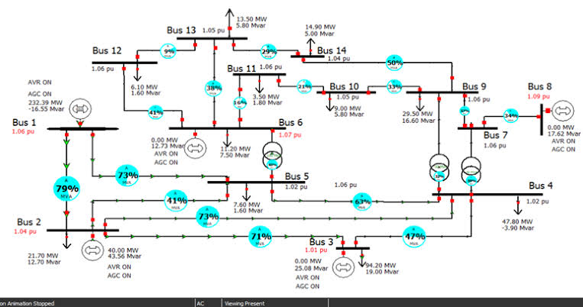
Contingency Analysis Cont.…
Figure 4. Power flow based on Contingency case[5].
Url: https://encrypted-tbn0.gstatic.com/images?q=tbn:ANd9GcQUexeVzLz1UZfvPDQfqC0TStz7G7pwBmmpg5iCT8-KOLtfAvRnlRHSSMX7Qywe6yxBRwk&usqp=CAU

Slide 19
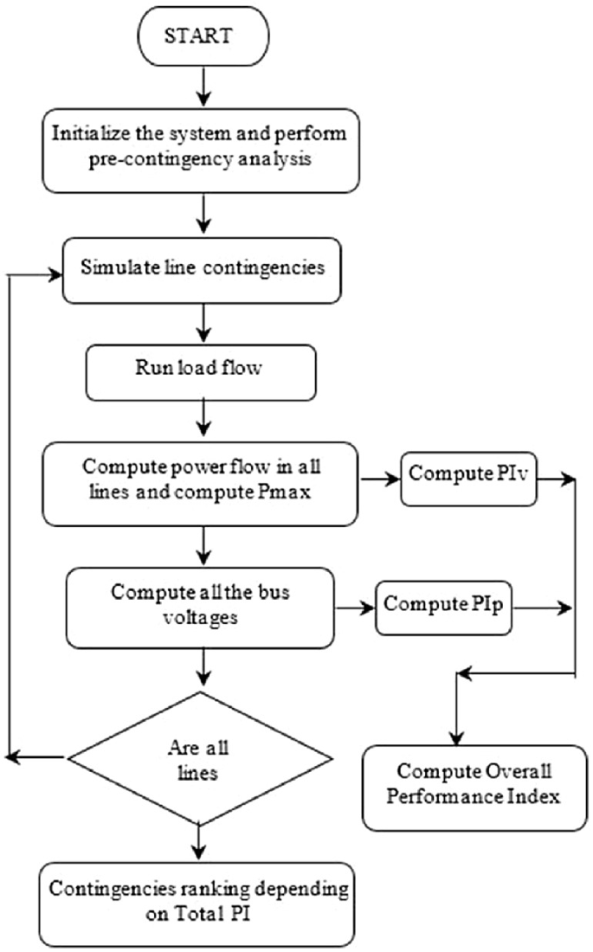
Contingency Analysis Cont.…
Figure 5. Contingency analysis flowchart.
https://media.springernature.com/lw685/springer-static/image/chp%3A10.1007%2F978-981-19-2764-5_7/MediaObjects/520115_1_En_7_Fig2_HTML.png

Slide 20
4. Security Analysis Using Linear Sensitivity
Investigating numerous potential outages is time-consuming, but linear sensitivity factors offer a fast and simple way to estimate possible overloads.
Derived from DC load flow, they show how small changes in generation or system parameters affect line flows, voltages, and angles.
Linear sensitivity analysis involves calculating how small changes in system parameters (e.g., generation, load, network topology) affect system variables such as power flows,
bus voltages, and angles.

Slide 21
Security Analysis Cont.…..
Common sensitivity factors are:
a. Power Transfer Distribution Factor (PTDF)
b. Line Outage Distribution Factor (LODF)
c. Generation Shift Factor (GSF)
Power Transfer Distribution Factor (PTDF): PTDFs quantify how much power flow on a transmission line changes due to a unit power transaction between two buses.
PTDFs are derived from the DC power flow model and are used for transfer analysis.

Slide 22
Security Analysis Cont.…..
Sensitivity analysis helps identify the most critical contingencies affecting system performance, aiding in prioritization and reliability improvement.
The linear sensitivity method, based on DC load flow, effectively estimates line flow changes due to generation shifts.
However, it only calculates active power flows (MW) and does not provide bus voltages or reactive power (MVAR) data.
Which is its drawback / limitation

Slide 23
Security Analysis Cont.…..
There, are two linear sensitivity factors :
Generation shift factors – change in line flow (Δfl) due to generation outage (ΔPi)
Generation Shift Factors (GSFs) quantify how a change in power output from a generator affects power flow on a specific transmission line as given by:
eqn.(1)
2. Line outage distribution factors - change in line flow (Δf_{l}) due to line outage (f_{k})
eqn.(2)
Accordingly, the loading of line is checked for the generation and line outage cases
through sensitivity analysis

Slide 24
Security Analysis Cont.…..
The flow on line ‘l’ under the assumption that all the generators in the interconnection participate in making up the loss, use eqn.3
eqn.(3)
Where, Y_{ji} is proportionality factor for pick-up on generating unit ‘j’ when unit ‘i’ fails
The power flow on line ‘l’ with line k out can be determined using the ‘d factors
eqn.(4)
Where, f⁰ is the pre-outage flow on each line;
Accordingly, the severity of outage can ranked on the descending order,.

Slide 25
5. AC Power Flow Security Analysis
AC Power Flow Security Analysis studies the power system’s behavior considering both active (MW) and reactive (MVAR) power flows, voltage magnitudes, and angles.
It provides a detailed and accurate assessment of system security by checking voltage limits, thermal limits, and stability under normal and contingency conditions, helping ensure reliable and secure operation.
It also gives the response to different stability problems
Consider the compensators design and their operation

Slide 26
AC Power Flow Security Analysis Cont.…
Contingency Ranking Through Performance indices(PI) :
Based on PI, the contingencies are ranked in rough order of severity employing contingency selection algorithms to shorten the list.
The performance indices shows, which line is overloaded or not.
Thus, the overload performance of N interconnected line outage one by one is curried out using eqn.5
eqn.(5)

Slide 27
AC Power Flow Security Analysis Cont.…
The line results in higher PI valued ranked at the top definition for the overload performance index (PI) is as follows:
The selection steps, then involves a mater of developing the PI table from the largest to least values .
Another way, to perform an outage case selection is called 1P1Q method, which is used to perform the ranking considering both real and reactive power effect on the network stability.
It is considered as a decoupled power flow, which is used to determine power flow through the lines and the voltage limit violation at each node. Thus, a different PI can is rewritten as:
  eqn.(6)

Slide 28
AC Power Flow Security Analysis Cont.…
Contingency evaluation:
Contingency evaluation is typically done by analyzing individual cases in order of severity, focusing primarily on voltage magnitude as the key factor.
Detailed AC power flow analysis checks for network overloads and voltage limit violations.
Since many cases need studying, the solution speed is also crucial.
A flow chart , Fig 6 illustrates this AC power flow contingency checking process.

Slide 29
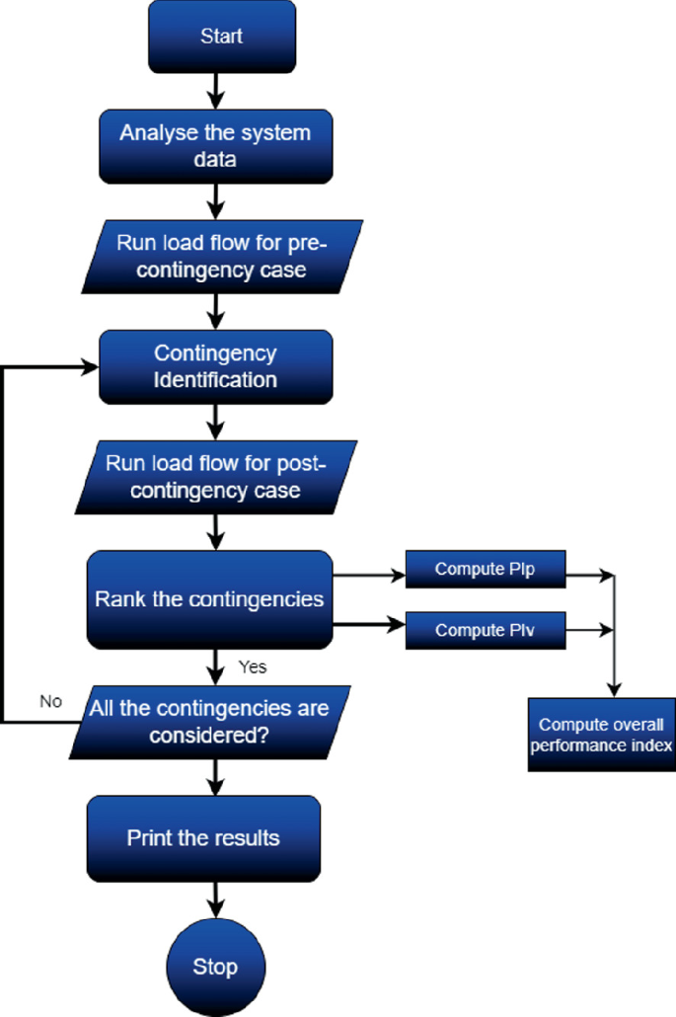
AC Power Flow Security Analysis Cont.…
Figure 6. Security based contingency evaluation .
url: https://media.springernature.com/lw685/springer-static/image/chp%3A10.1007%2F978-981-97-5227-0_9/MediaObjects/611018_1_En_9_Fig3_HTML.png

Slide 30
AC Power Flow Security Analysis Cont.…
operating state:
Power system security is classified into four states for better operational understanding:
Normal State: No overloads, all variables within limits; system can securely handle contingencies.
Alert State: All constraints met, but system is vulnerable and close to possible equipment overload if conditions worsen.
Emergency state : system still intact
Extremis state : refers to a severe emergency condition when disruption is critical, though the full description wasn’t provided.

Slide 31
AC Power Flow Security Analysis Cont.…
    Emergency State: Occurs after a severe disruption from the alert state; many buses may have low voltages or overloads beyond short-term limits. The system remains operational and can return to alert state via emergency controls.
    Extremis State: Involves cascading outages or major system shutdowns if controls fail. Actions like load shedding and system separation aim to prevent widespread blackouts.
    Restorative State: Focuses on reconnecting facilities and gradually restoring system load through control measures to recover from disruptions
    The four states is presented in Fig.7

Slide 32
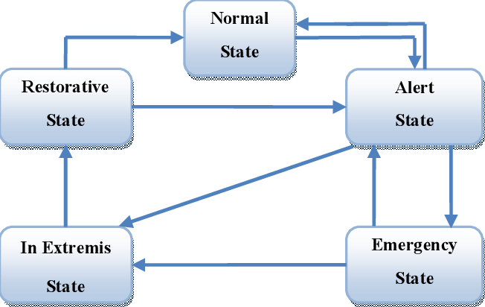
AC Power Flow Security Analysis Cont.…
Figure. 7 Power network Operating states.
Url: https://www.researchgate.net/publication/317420441/figure/fig1/AS:672891641270274@1537441277307/Operating-states-of-power-system.png

Slide 33
AC Power Flow Security Analysis Cont.…
Finally, the mitigation or corrective action is recommended based on the above state for better contingency evaluations
Accordingly, when a contingency causes instability or overloads, corrective actions are needed.
These include upgrading infrastructure, adding generation or flexible loads, deploying advanced control schemes
Like dynamic line ratings, voltage regulation, and adopting new operational procedures to improve grid resilience..

Slide 34
Summary
In this lecture, the importance of security analysis in power system network is presented.
Power security analysis is the capacity of a power system to function consistently in the face of emergencies and disruptions
Then, the crucial aspect of security analysis in terms of power economics, renewable energy integration, capacity expansion and overall system reliability is also briefly discussed.
In line with this, factors that affect system security like contingency prediction, system monitoring, circuit protective devices, cyber security and others are discussed
Finally, two sensitivity analysis(generator shift and line shift sensitivity factors) while
monitoring the credible contingency effect on entire network security are discussed.

Slide 35
References
[1]. M., Yasit; A., Ramasamy; V., Renuga and etl:. "Power system resilience and strategies for a sustainable infrastructure: A review ‘’. Elsevier: Alexandria Engineering Journal. V. 105, pp: 261-279, 2024. https://doi.org/10.1016/j.aej.2024.06.092
[2]. C., Fu; J., Zhang; S., and etl:. "A new security and stability control strategy for power systems considering the output characteristics of new energy sources“. 4th International Conference on Intelligent Power and Systems (ICIPS), Yichang, China, 2024, pp. 667-672. DOI: 10.1109/ICIPS64173.2024.10900098.
[3]. A., Stefanov and C., Liu. "Cyber-power system security in a smart grid environment’’. IEEE PES Innovative Smart Grid Technologies (ISGT), Washington, DC, USA, 2012, pp. 1-3, doi: 10.1109/ISGT.2012.6175560.
[4]. B., Zhang; Li., Wang; Z., Zhang Wen-hao and etl:. "Implementation of Power System Security and Reliability Considering Risk Under Environment of Electricity Market.’’ IEEE/PES Transmission & Distribution Conference & Exposition: Asia and Pacific, Dalian, China, 2005, pp. 1-6, doi: 10.1109/TDC.2005.1547049.
[5]. A., Ibrahim and R., Muhyaddin. ‘’Contingency Analysis to Evaluate Power System Security and Voltage Stability for The Critical Buses’’. International Journal of Engineering Research & Technology (IJERT). Vol. 11(2), 2022.

Slide 36
Thank you !

