Slide 1
Advanced Power System Analysis
Lecture 14
Assessment/Evaluation modalities
Lecturer: Teshome Goa (Assist. Prof.)
Final exam on Advanced Power System Analysis
The exam contains Three parts:
Part I:Multiple choice, Part II: True-False and Part III: Subjective questions
The total Mark is : 100% Time allowed: 1:30 hrs
Name:_____________________ ID no:_____________

Slide 2
Instruction I: Multiple choice questions
For the questions, Question number one up to question number 25 choose the correct answer from the given multiple choices and circle the right answer.
Each question weights : 2 marks .

Slide 3
Question number one and two
Which one of the following power system component is the pace where energy conversion takes palce
Generation
Load
Transmission Line
Distribution system
2. Power flow needs
The basic understanding of network parameters
linearization of complex equations
the network analysis techniques and types of network buses
All

Slide 4
Question number Three and Four
3. -------------is transmission line parameter produced by the presence of magnetic fields around the conductors
Shunt capacitance
Series resistance
Series inductance
shunt conductance
4. One of the following model is more appropriate for long-transmission line while using load flow analysis
Series resistance and reactance
T-method
Nominal π-Method
A and B

Slide 5
Question number Five and Six
Which one of the following is not true about per phase analysis
All loads and sources are Y connected
Mutual Inductance between phases
All neutrals are at the same potential
All phases are completely decoupled
6. Which one is true for the successful operation of static power flow analysis
A. Generation must supplies demand (load) and loss.
B. Node voltage magnitudes must be remain close to rated values.
C. Generator must operates within specified real and reactive power limits.
D. All

Slide 6
Question number seven and eight
7. One of the following load flow analysis does not consider the rotor angle effect in reactive load
Fast decoupled
Newton Raphson
Gauss Seidal
none
8. Which one of the following bus in power system is the place where power mismatch takes place
A. Swing bus
B. PV bus
C. Generator bus
D. Load bus

Slide 7
Question number nine and ten
9. which, one of the following is not used as reactive power compensator to increase voltage magnitude
Shunt capacitor
Tap-changing transformers
Shunt reactor
SVC
Which one of the following is power flow simulation software
PSAT.
ETAP
Powerworld simulator
All

Slide 8
Question number eleven and twelve
11.Faults usually occurs due to:
Insulation failure of equipment.
Flashover of lines initiated by a lighting stroke.
Permanent damage to conductors and towers or accidental faulty operations.
All
12. One of the following currant during fault is much-much greater than the others
The rated current
Sub-transient current
Steady current
Transient current

Slide 9
Question number 13 and 14
13. One of the following not true about balanced three phase fault
The most frequent fault in power system
The most severe types of fault
Fault current symmetrical in all phases
A & C
14. The three symmetrical currents are equal in one of the following fault condition
Line to line
Three phase
Line to ground
Double line to ground

Slide 10
Question number 15 and 16
The zero sequence current is not existing in;
Line to ground fault .
Double line fault
C. Double line to ground fault
D. None.
16. One of the following not true
Negative sequence current flow in opposite to positive sequence current
Both negative sequence and positive sequence reactance diagram have source voltage
For line to line fault the positive and negative sequence currents are equal in magnitude and opposite in sign
All

Slide 11
Question number 17 and 18
17. One of the following types of transformer connection is act as a transmission line reactance model while developing zero sequence diagram
Star (Y)-star( Y) grounded from both side
Star grounded in primary and delta in secondary
primarily delta whereas secondary star-grounded
Both side are delta
18. One of the following not true
A. All phases have fault current for single line to ground fault
B. The unbalanced fault makes system unbalance at point of fault
C. Double line to ground fault have zero sequence current
D. All

Slide 12
Question number 19 and 20
19. Which one of the following is not true about the need of frequency stability analysis:
A. It is an indicator of the balance between generation and demand. Unstable network frequency results in
B. Generator tripping
C. Load shedding doesn’t lead to frequency instability
D. None
20.Which one of the following true while doing Transient Stability Analysis
A. Mechanical input to the generator remains constant
B. machine damping and AVR neglected
C. Loads are represented as constant impedance/admittance
D. All

Slide 13
Question number 21 and 22
,
21. One of the following is true for power angle curve
A. Power is maximum when rotor angle is 90 degree
B. Power is minimum when rotor angle is 45 degree
C. For loaded machine, the acceleration power is zero
D. None
22. For two machines operating at the equilibrium point δ0, the corresponding to the mechanical and electrical power are related as: Pm0 = Pe0 as shown in the Fig.3..
A. Pm0 > Pe0
B. Pm0 = Pe0
C. Pm0 < Pe0
D. A & B

Slide 14
Question number 23 and 24
23. The sudden three phase fault at the beginning of one of two parallel connected transmission line that connects generator to infinite bus results in
A. The power transfer to grid during fault is greater than pre-fault current
B. No net power transfer to the grid during fault
C. The power transfer to grid during fault greater than post-fault current
D. A and c
24. Power System Security is very important in Modern Grid to:
Assures Reliable Power Supply
Prevents service disruptions, blackouts, and blackouts
Protects against physical and cyber-threats(in modern grid)
All

Slide 15
Question number 25
25. System state after contingency analysis and corrective actions have been
applied to maintain security is:
a. Optimal dispatch
b. Secure dispatch
c. Secure-post contingency dispatch
d. post-contingency dispatch

Slide 16
Instruction II. Say true if the statement is correct and say false if the presented statement wrong
Each questions worth: 2 points

Slide 17
Question 1-5
Three phase fault is the most frequent types of fault in power system
Inductance exist in power transmission line due to the magnetic field between conductors
Per unit analysis reduce the errors occur in power system analysis related the presence of large number of Transformers
Load bus is a voltage controlled bus
Swing bus is the place where power mismatch is calculated

Slide 18
Question 6-10
6. The circuit breaker momentary current is equal to transient current
7. Guess seidal load flow has better convergence than Newton raphson power flow
8. Three phase fault in power transmission line is one of the source for steady state stability problem
9. Synchronism means when two or more parallel connected generators are spinning at the same speed, frequency and the same phase shift
10. Power system security similar with power stability

Slide 19
Question 11-15
11. The zero sequence current for double line fault is equivalent to zero
12. N bus power system will have N*N admittance matrix
13. Transient current in power system is greater than sub-transient current
14. The fault analysis is helpful in sizing switch gears
15. Unsymmetrical fault analysis uses the symmetrical matrix while calculating fault currents and voltage

Slide 20
Instruction III. Answer the following four questions as per the Request in space provided
Total mark= 20% Each question weights five marks

Slide 21
Question number 31
    31. Synchronism requires that the rotors turn at exactly the:
    __________________________________________________________________________________________________________________________________________________________________________________________________________________________________________________________________________________________________________________________

Slide 22
Question number 32
32. Present the balanced and unbalanced types of faults in descending order based on their frequency of occurrence
__________________________________________________________________________________
__________________________________________________________________________________
__________________________________________________________________________________
__________________________________________________________________________________

Slide 23
Question number 33
33. The common sources of voltage stability problem are:
______________________________________________________________________________________________________________________________________________________________________________________________________________________________________________________________________________________________________________________________________________________________________________________________________________________________________________________________________________________________________

Slide 24
Question number 34
34. The types of power stability are:
____________________________________________________________________________________________________________________________________________________________________________________________________________________________________________________________________________________________________________________________________________________________________________________________________________________________________________________________________________

Slide 25
Answer Q. 1- Q.25
Instruction I:
1 | A | 11 | D | 21 | A
2 | D | 12 | B | 22 | B
3 | C | 13 | A | 23 | B
4 | C | 14 | C | 24 | D
5 | B | 15 | B | 25 | C
6 | D | 16 | B
7 | A | 17 | A
8 | A | 18 | A
9 | C | 19 | C
10 | D | 20 | D

Slide 26
Answer For True-False Questions Q. 1- Q.15
False
True
True
False
True
False
False
False
True
False
True
True
False
True
True

Slide 27
Answer Q. 31
31.
Speed
Frequency
The same phase shifts .

Slide 28
Answer Q. 32
32.
Line to Ground (85%)
Double line.
Double line to ground
Balanced three Phase fault

Slide 29
Answer Q. 33
33.
Load behaviors
Inadequate reactive power support
Long transmission lines
High power transfer levels
Generator reactive power limits

Slide 30
Answer Q. 34
34.
Angle stability
Voltage stability
Frequency stability
.

Slide 31
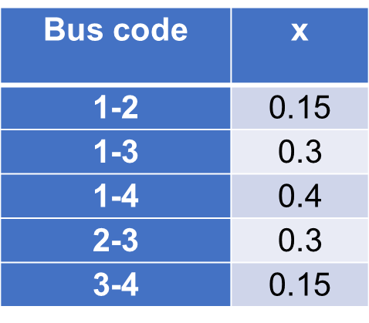
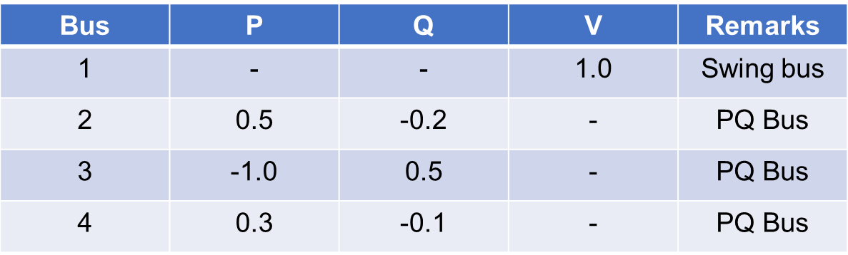
Project Assignment
The system data for a load flow solution are given in the following Tables. Determine: a. the voltages at the end of 2nd iteration using Gauss–Seidel and NR methods then compare results. Take a = 1.2.
Table 1. Line parameter Table 2. Bus data
b. Use the power simulator software's(PSAT) and determine the results and compare it with answer in a.

Slide 32
Thank you !

