Slide 1

Lecture 10
Promoting Your Business
English for Mathematics
Itha Priyastiti
Universitas Kristen Wira Wacana Sumba

Slide 2
Review
Conjunctions & Transition Words
  Write your brochures smoothly and professionally using conjunctions and transition words.
If Conditionals
  Describe real or hypothetical results of real or hypothetical situations.

Slide 3
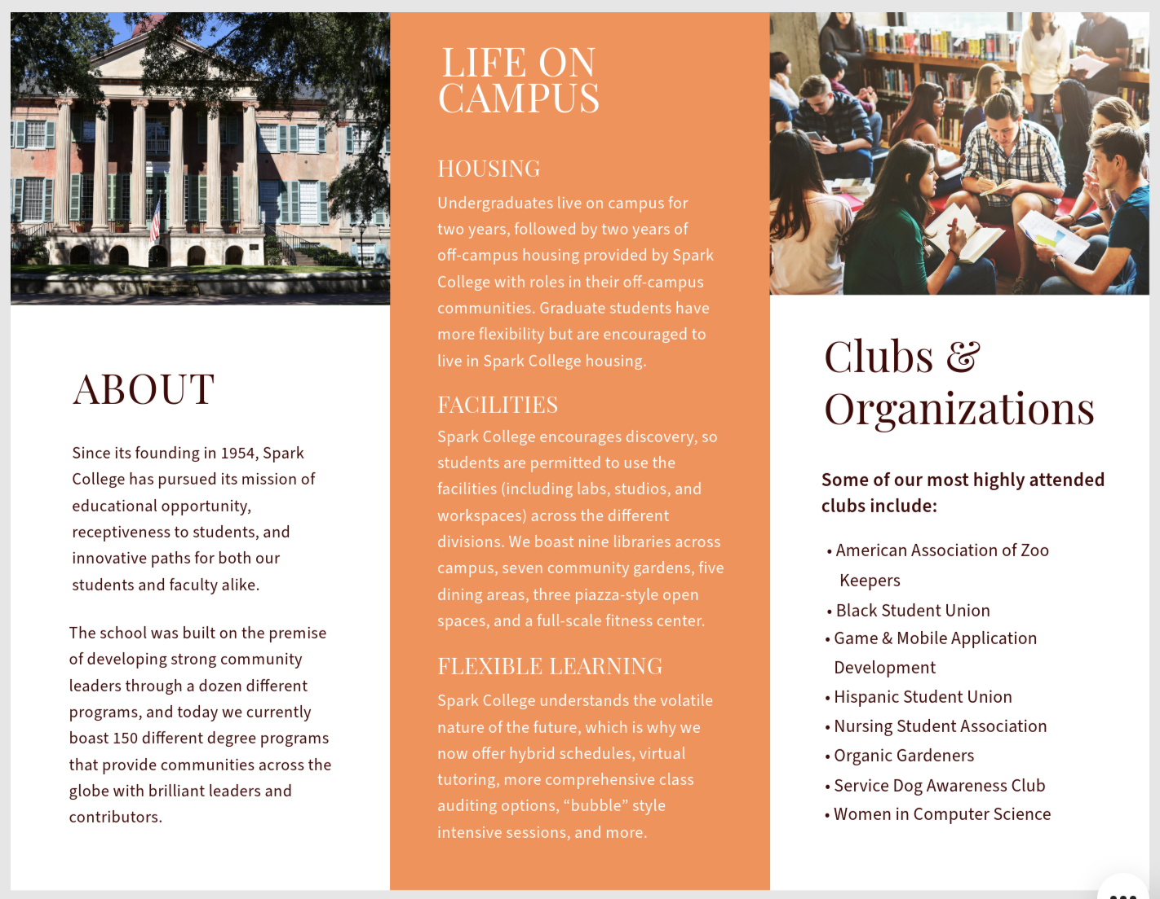
Brainstorming
Flyers and brochures are alternatives to promote your business.
You have learned conjunctions and transition words to help you create a well-organized brochure.
It is time to learn how crucial it is to write them in a persuasive way.
Let’s read a brief passage written in a hypothetical brochure.
While reading, pay attention to the highlighted sentences.
Source: https://shorturl.at/K1Ii4

Slide 4
Reading
"Why Choose Our Math Tutoring Services?"
Are you struggling to understand math concepts? Do you find it difficult to keep up with your classmates? Our expert tutors can help you! With our personalized approach, we guarantee improvement in your math grades. You should join our program because we have a team of certified math experts who specialize in making complex concepts easy to understand. Our tutors will help you master algebra, calculus, and geometry in no time.
If you enroll in our tutoring services, you will develop better problem-solving skills and be more confident in your math abilities. This course will help you succeed in your exams and beyond. Don’t wait until the last minute—sign up now to get the help you need!
What do you think of the passage?
Are you convinced?

Slide 5
Persuasive Language
Persuasive language is a form of communication meant to persuade someone to do or believe something.
It is a text that invites or influences someone or the reader to follow the writer's feelings.
It is created by a person, institution/agency, or company to convince and influence people to buy or use a product or service marketed to the general public.
(Vita Losi & Rosida, 2022)

Slide 6
Persuasive Language
Apriyanti and Sumira (2021) describe:
In writing a brochure that is intended to convince readers to believe in an idea or opinion and to do an action, a set of strategies for persuasion is needed (logos, pathos, and ethos).

Slide 7
Persuasive Language
  an argument or reason used by a writer to convince the reader about his/or opinion.
LOGOS
  the character or the reputation and experience of the writer, which makes readers trust what he or she conveyed
passion and feeling which commit to what is being said and done by the writer.
Classification including: inclination to succeed
PATHOS
ETHOS

Slide 8
Persuasive Language
‘should’
Earlier, you find these sentences in the brochure:
You should join our program because we have a team of certified math experts who specialize in making complex concepts easy to understand.
Our tutors will help you master algebra, calculus, and geometry in no time.
If you enroll in our tutoring services, you will develop better problem-solving skills and be more confident in your math abilities.
This course will help you succeed in your exams and beyond.
Don’t wait until the last minute—sign up now to get the help you need!
’will’
‘if conditional’
’will’
‘don’t’; ‘”sign up now!’ 🡪 instruction

Slide 9
Persuasive Language
You found directive phrases (“Don’t wait until the last minute”; “Sign up now!”) in the business profile/ brochure because they are precise and also give a clear call to action)
As Yuliah et al., (2021) found that among the 10 types of persuasive languages used in the advertisement in Forbes magazines, they mention the use of short sentences, use of imperatives, simple and colloquial language.
In the earlier passage, you also found the use of if conditional.
Remember the use of the If Conditional?

Slide 10
Persuasive Language
Sometimes, you need to “tease” your potential customers with future scenarios (their desired outcome of a certain situation).
If conditionals will allow us to discuss potential scenarios and their outcomes by setting conditions.
It is useful for referring to two events and how they relate to one another. This means that various professionals in different industries often use them to demonstrate why they've put a particular proposal together or similar (Indeed Editorial Team, 2025)

Slide 11
Future Tense
You can apply conditional clauses in your brochure.
You have learned First Conditional. Also called the “future real” conditional, it is used to describe a realistic action that might lead to a future result.
Now, it is time to learn the “future”.

Slide 12
Future Tense
Future forms in English are formed using auxiliary verbs. One of the most commonly used constructions is “going to” plus the base form of the main verb.
Subject
BE (not)
GOING TO
REST OF SENTENCE
I
am (not)
join
the tutoring program.
You/ We/ They/ Rambu and Umbu
are (not)
She/ It/ Rambu
Is (not)

Slide 13
The future with ‘going to’
“Going to” for future plans
“Going to” is used to talk about future events that have been planned in advance, rather than decided upon at the time of speaking.
Our tutoring center is going to expand to other cities in Sumba Timur.
Base form of verb.
“Be” matches the subject of the sentence.
“Going to” doesn’t change with the subject.

Slide 14
The future with ‘going to’
“Going to” for prediction
“Going to” is used to make predictions when there is evidence in the present moment.
With fun and effective tutoring sessions, your child is going to build strong Math skills.
Evidence in the present moment means that you can make a prediction.
“Going to” gives the prediction

Slide 15
The future with ‘going to’
Questions with “going to”
Questions with “going to” are formed by swapping the subject and “be.”
open admission soon.
The tutoring center
is going to
going to open admission soon?
Is
the tutoring center

Slide 16
The future with ‘will’
“Will” is used to form some future tenses in English.
It can be used in several different ways, which are all different from the future with “going to.”
To form future with ‘will’:
Subject
WILL
(not)
BASE FORM OF VERB
REST OF SENTENCE
I/ You/ We/ They/ Rambu and Umbu/ He/ She/ It/ Rambu
will (not)
join
the tutoring program.
‘will’ doesn’t change with the subject

Slide 17

The future with ‘will’
English uses “will” when talking about the future in four main ways (Hall & Barduhn, 2016):
To make a prediction about what you think will happen.
“Will” is used to talk about predictions about the future when there is no firm evidence for that prediction.
What if we offer discounts for the first 10 applicants? I think it will attract more students to join.
This prediction is not based on evidence.

Slide 18

The future with ‘will’
To offer to do something for someone.
“Will” is also used to offer to do something for someone.
Excuse me. Where is the library?
Come! I will show you.
Offering help
To make a promise.
Our tutors will help you master algebra, calculus, and geometry in no time.

Slide 19
The future with ‘will’
To describe a decision you’ve just made.
“Will” is used to describe quick decisions that someone has made at the time of speaking.
They are often a solution to an unexpected problem.
The cafeteria is full. I will order food online.
“Will” shows you have just made the decision.

Slide 20
The future with ‘will’
TIP:
Remember to use the future with “going to” for predictions based on current evidence, and for decisions made before the time of speaking.

Slide 21
Exercise 1
Choose either "will" or "going to" to complete each sentence.
Our tutoring center _______ launch a new program for math excellence next month.
Don’t miss out! You _______ love how quickly your child improves.
We _______ offer discounts for students who register this week.
My team _______ meet tomorrow to plan our weekend workshop.
Students _______ benefit from our personalized learning strategies.

Slide 22
Discussion
Choose either "will" or "going to" to complete each sentence.
Our tutoring center launch a new program for math excellence .
is going to
next month.
This is a planned future event
will
Don’t miss out! You love how quickly your child improves.
This is a persuasive prediction
are going to
We offer discounts for students who register this week.
This is a promotional action

Slide 23
Discussion
is going to
weekend workshop.
My team meet tomorrow to plan our
This is a scheduled plan
Students benefit from our personalized learning strategies.
will
This is a promise/ persuasive statement

Slide 24
Exercise 2
Rewrite each sentence below using either "will" or "going to" to sound more persuasive for a brochure.
We plan to open the admission.
We are sure that students will enjoy our teaching methods.
We intend to use interactive learning games.
We think parents will be happy with the progress.

Slide 25
Discussion
We plan to open the admission .
We open admission soon.
are going to
“Going to” is used because the action (opening a class) is already planned or decided.
It reflects a specific intention or arrangement, making the sentence sound confident and informative in a brochure.
We are sure that students will enjoy our teaching methods.
Students enjoy our teaching methods.
will
“Will” expresses a strong prediction or promise based on confidence.
This sentence becomes more direct and persuasive, ideal for marketing language.

Slide 26
Discussion
We intend to use interactive learning games.
We use interactive learning games.
are going to
“Going to” fits well with the word “intend,” as it shows a clear plan that is going to happen soon.
This gives readers assurance that the method is part of the program’s strategy.
We think parents will be happy with the progress.
Parents be happy with the progress.
will
“Will” used here to make a positive prediction based on the program’s expected success.
Removing “we think” makes the sentence more assertive and persuasive.

Slide 27
Take Home Notes
To promote your business, you have to be able to introduce it using persuasive languages.
Persuasive language is a form of communication meant to convince and influence people to buy or use a product or service marketed to the general public.
You can use future tense as a persuasive way to promote your business because it offers your plans and promises.

Slide 28
Take Home Notes
going to
  for future plans
  to make predictions based on evidence
will
  to make a prediction
  to offer to do something for someone
  to make promises
  to describe a decision that you’ve just made

Slide 29
References
Apriyanti, D., & Sumira. (2021). Analyzing Persuasive Strategies Used in e-Brochures. Proceedings of the International Conference on Science and Technology, 256–258. https://doi.org/10.2991/assehr.k.210424.049
Azar, B. S., & Hagen, S. A. H. (2009). Understanding English Grammar (4th ed.). Pearson Education.
Hall, D., & Barduhn, S. (2016). English for Everyone: English Grammar Guide. Dorling Kindersley Limited.
Indeed Editorial Team. (2025, March 4). What is a conditional statement? (With uses and examples). Indeed Career Guide. https://shorturl.at/OhnvU
Vita Losi, R., & Rosida, S. (2022). Persuasive Language Used on Advertisements of Instagram Posts. Titian: Jurnal Ilmu Humaniora, 06(1), 54–64. https://online-journal.unja.ac.id/index.php/titian
Yuliah, S., Fitriyandi, J., & Yahya, M. (2021). The Persuasive Language Used in Advertisements in Magazine. Jurnal Bahasa Inggris Terapan, 7(2), 119–129. https://doi.org/10.35313/jbit.v7i2.3620

Slide 30
Thank you, and see you in the next lecture!

