Slide 1

English for Mathematics
Lecture 12
Assessing Your Students
Itha Priyastiti
Universitas Kristen Wira Wacana Sumba

Slide 2

Review

Slide 3
Professional Language
As a professional entrepreneur, maintain your professionalism.
Use professional language for formal documents.
Although brochures or flyers aim to attract potential customer, professional language will keep the credibility of your business.
Passive voices are frequently used in the professional language.
Professional Language
  Clarity and Conciseness
  Audience Awareness
  Structured Organization
  Formal Tone
  Purpose-Driven Content
Passive Voice
  The agent is obvious
  The agent is unknown/ unimportant
  Focus on the action/ process/ result

Slide 4

Today’s Agenda
Passive voice (for reporting assessments professionally)
Data interpretation (reading and analyzing test results)

Slide 5
Assessment Reporting

Slide 6
Brainstorming
How do you know if your students are doing well?
What method can you use to evaluate students’ ability?
Suskie (2018)
Student-level assessment assesses how well individual students have achieved course learning goals
Assessment aims to give students feedback and grades on their learning.
Assessment can be administered through tests, quizzes, assignments, and the like.

Slide 7
Assessment Reporting
Professional tutoring center build good rapport with the stakeholder (students, parents).
Reporting the students’ progress and achievement is one way to build trust.
To write professional tutoring reports:
Keep the information about what specifically was worked on short and to the point.
Communicate if the student is on path to their goals as stated in the work order.
Be specific if the parent needs to take action to support the student.
https://www.learnspeed.com/write-a-great-tutor-session-report/

Slide 8
Passive Voice in Assessment Reporting
Remember the reasons you use passive voice?
Passive voice is preferred when you want to focus on the action/ process/ result.
See the following:

Slide 9
Passive Voice in Assessment Reporting
Active
Passive
The tutor gave the test last week.
The tutor graded all assignments.
SmartSteps has observed the students’ progress.
The test was given last week.
All assignments were graded.
The students’ progress have been observed.
Passive voice is used to focus on what was done, not who did it.
The sentences sound more objective and professional.

Slide 10
Passive
Voice
Past
Future
Modals

Slide 11
Passives in the Past
English uses the passive voice in the past to stress the effect of an action that happened in the past.
The past simple passive is used when referring to a single completed action in the past, focusing on the effect rather than the cause.
SUBJECT
WAS/ WERE
PAST PARTICIPLE
REST OF SENTENCE
The test
was
given
last week.
The main verb is a past participle.
The thing that receives the action.
“was” is for singular subjects, and “were” is for plural subjects.

Slide 12
Passives in the Past
Examples on how to change from active to passive:
Active voice
The tutors
gave
personalized feedback.
subject
verb
object
Passive voice
Personalized feedback
was
given
(by the tutors)
‘be’ is added
‘gave’ changes to ‘given’

Slide 13
Passives in the Past
Let’s see another example:
Active voice
The tutors
did not
share
the test results
publicly.
subject
negative verb
object
adverb
Passive voice
The test results
were not
shared
publicly.
‘share’ changes to ‘shared’
‘be’ is added

Slide 14
The Passives in the Future
English uses the passive voice in the future to stress the effect of an action that will happen in the future, rather than the cause of that action.
The future simple passive is usually formed with ‘will’ rather than ‘going to’ (Hall & Barduhn, 2016).
SUBJECT
WILL BE
PAST PARTICIPLE
REST OF SENTENCE
Remedial support
will be
provided
throughout the year.
The main verb is a past participle.
The thing that receives the action.
“will be” does not change with any subject.

Slide 15
The Passives in the Future
Examples on how to change from active to passive:
Active voice
SmartSteps
will
send
the progress report
to parents.
subject
main verb
object
adverb
Passive voice
The progress report
will be
sent
to parents.
‘be’ is added
‘send’ changes to ‘sent’

Slide 16
The Passives in the Future
Examples on how to change from active to passive:
Active voice
SmartSteps
will not
share
progress updates
without parental consent.
subject
main verb
object
adverb
Passive voice
Progress updates
will not be
shared
without parental consent.
‘share’ changes to ‘shared’

Slide 17
Passives with Modals
Modal verbs in English can be used in passive forms.
As with other passive constructions, the emphasis changes to the object that receives the action.
SUBJECT
MODAL VERB
‘BE’
PAST PARTICIPLE
REST OF SENTENCE
Any changes in the schedule
must
be
reported
to the registrar.
The thing that receives the action.
The main verb is a past participle form
Other modal verbs can go here
‘be’ stays the same no matter what the subject is.

Slide 18
Passive with Modals
Examples on how to change from active to passive:
Active voice
SmartSteps
cannot
refund
the registration fee
after the deadline.
subject
modal
main verb
object
adverb
Passive voice
The registration fee
cannot be
refunded
after the deadline.
‘refund’ changes to ‘refunded’

Slide 19
Exercise
Transform the following active sentences to passives.
The tutors assessed the students last Friday.
The coordinator will review the test results tomorrow.
Our admin will distribute the test schedule next Monday.
The evaluator gave feedback to all participants.
The panel discussed the improvement strategies yesterday.
The instructor will mark the writing section by hand.

Slide 20
Discussion
Transform the following active sentences to passives.
1
The tutors
assessed
the students
last Friday.
subject
past simple verb
object
adverb
The students
were
assessed
last Friday.
Passive voice:
The students were assessed last Friday.

Slide 21
Discussion
Transform the following active sentences to passives.
2
The coordinator
will
review
the test result
tomorrow.
subject
object
adverb
future tense
main verb
The test result
will be
reviewed
tomorrow.
Passive voice:
The test result will be reviewed tomorrow.

Slide 22
Discussion
Transform the following active sentences to passives.
3
Our admin
will
distribute
the test schedule
next Monday.
subject
future tense
main verb
object
adverb
The test result
will be
distributed
next Monday.
Passive voice:
The test schedule will be distributed next Monday.

Slide 23
Discussion
Transform the following active sentences to passives.
4
The evaluator
gave
feedback
to all participants.
subject
past simple verb
object
adverb
Feedback
was
given
to all participants.
Passive voice:
Feedback was given to all participants.

Slide 24
Discussion
Transform the following active sentences to passives.
5
The panel
discussed
the improvement strategies
yesterday.
subject
past simple verb
object
adverb
The improvement strategies
were
discussed
yesterday.
Passive voice:
The improvement strategies were discussed yesterday.

Slide 25
Discussion
Transform the following active sentences to passives.
6
The instructor
will
mark
the writing section
by hand.
subject
future tense
main verb
object
adverb
The writing section
will be
marked
by hand.
Passive voice:
The writing section will be marked by hand.

Slide 26

Charts
&
Data Interpretation

Slide 27

Charts & Data Interpretation
The next steps to remember after assessing your students are summarizing and storing evidence of the results.
You have learned types of charts. As tutors, you can select the appropriate type of chart to display your data. Please revisit Lecture 3.
Suskie (2018) mentions that most evidence of student learning can be summarized with simple tallies and percentages.
As a manager of the tutoring center, you will need to read the report of your students’ progress and achievements then write it in a formal report.
Therefore, you should understand on how to interpret the data and to report it professionally.

Slide 28
Charts & Data Interpretation
Table 1 Early Math Final Assessment
Student | Result
Umbu | Good
Rambu | Poor
Jack | Average
Rose | Excellent
Dorus | Excellent
Bunga | Excellent
Lily | Good
Lilo | Good
Stitch | Poor
Ellie | Good
How to put the data in Table 1 into percentage?
Count the total number of students in the Early Math Class.
This is the denominator for your percentage calculation.
Total Students = Excellent + Good + Average + Poor.
Total students: 10

Slide 29
Charts & Data Interpretation
Count the Number of Students in Each Category.
Make a list or table like:
Table 1
Early Math Final Assessment
Result
Excellent | 3
Good | 4
Average | 1
Poor | 2
Calculate the Percentage for Each Category.
Use this formula:
Percentage = (Number in Category / Total Students) × 100
Excellent = (3/10) x 100
30%
Do the same for the rest.

Slide 30
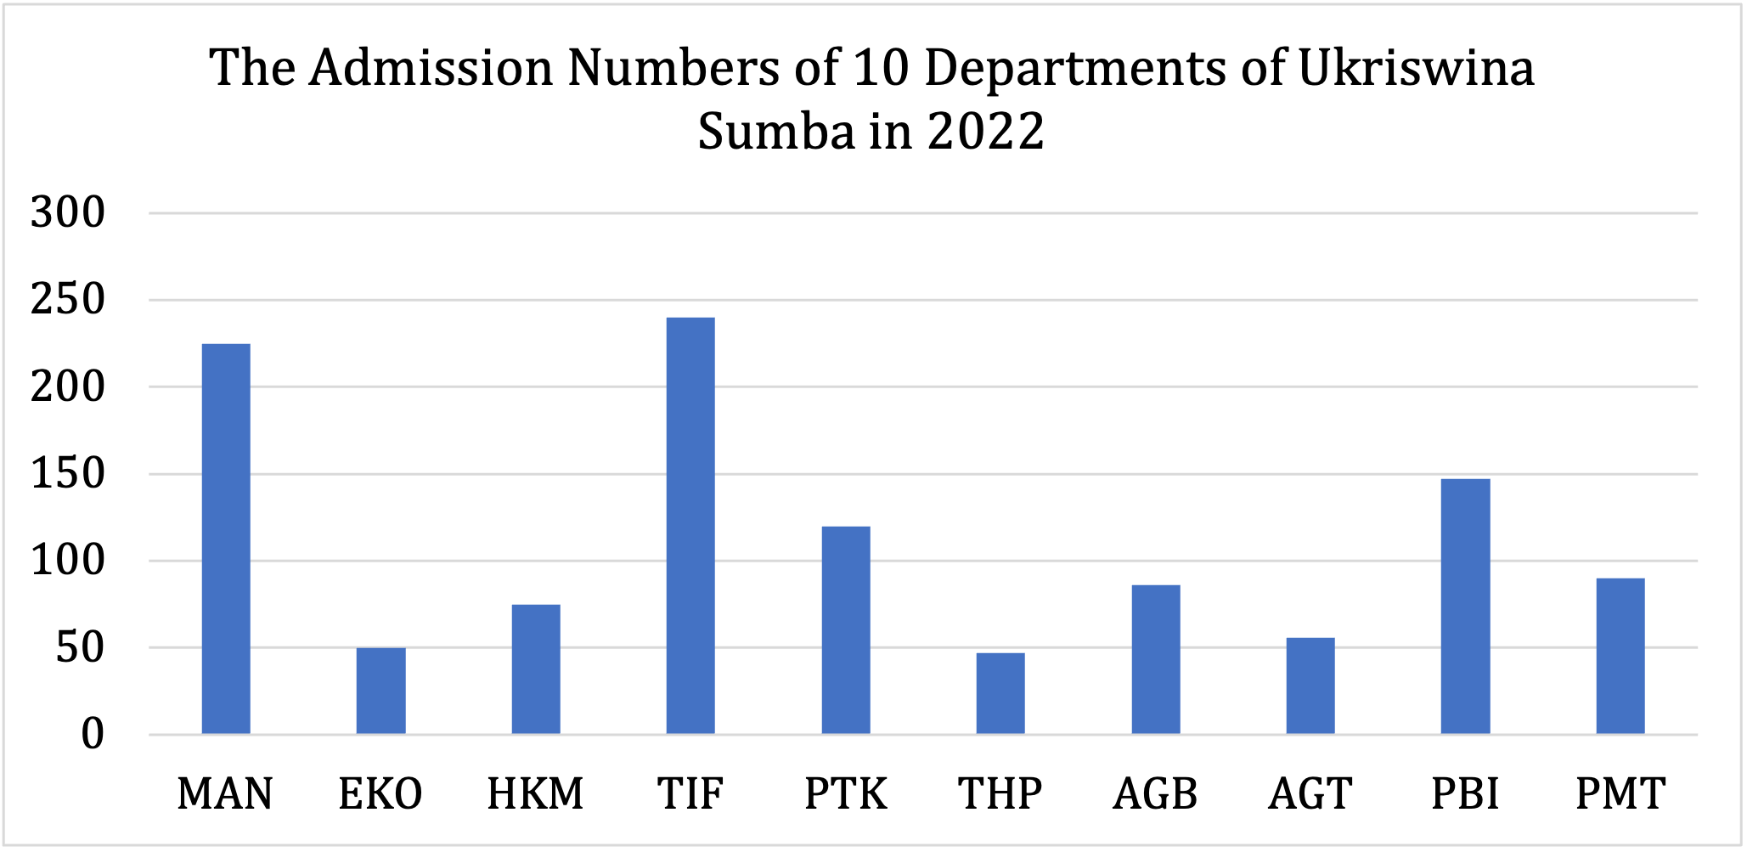
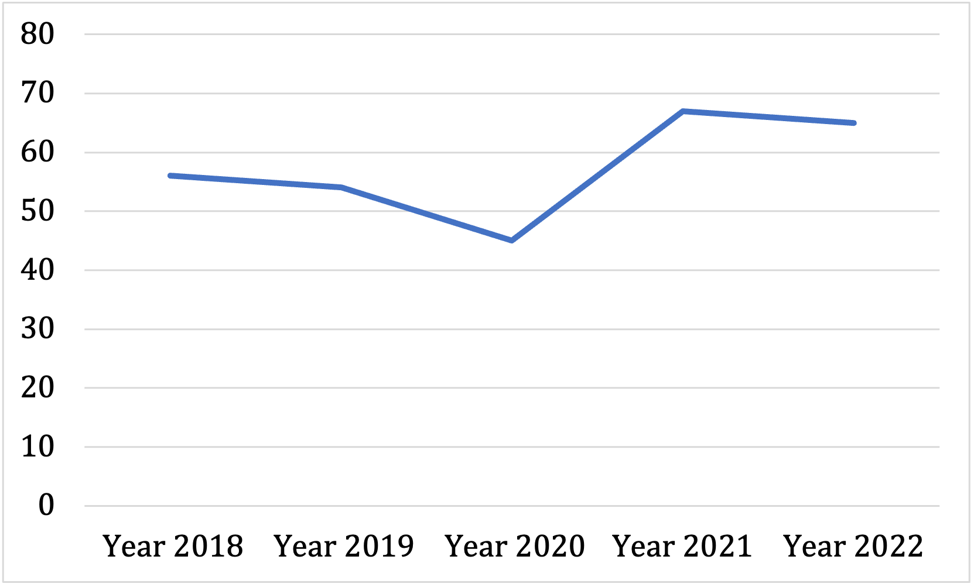
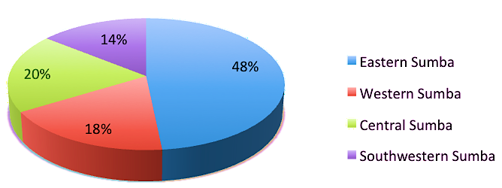
Types of Charts
A (vertical or horizontal) bar chart is used to compare unlike (different) items
A line chart depicts changes over a period of time, showing data and trends
A pie chart displays the size of each part as a percentage of a whole.

Slide 31

Charts & Data Interpretation
Examples on how to report the data:
According to the chart...
It can be seen that...
The majority of students...
Only a few students...
Most students were placed in the … category.

Slide 32
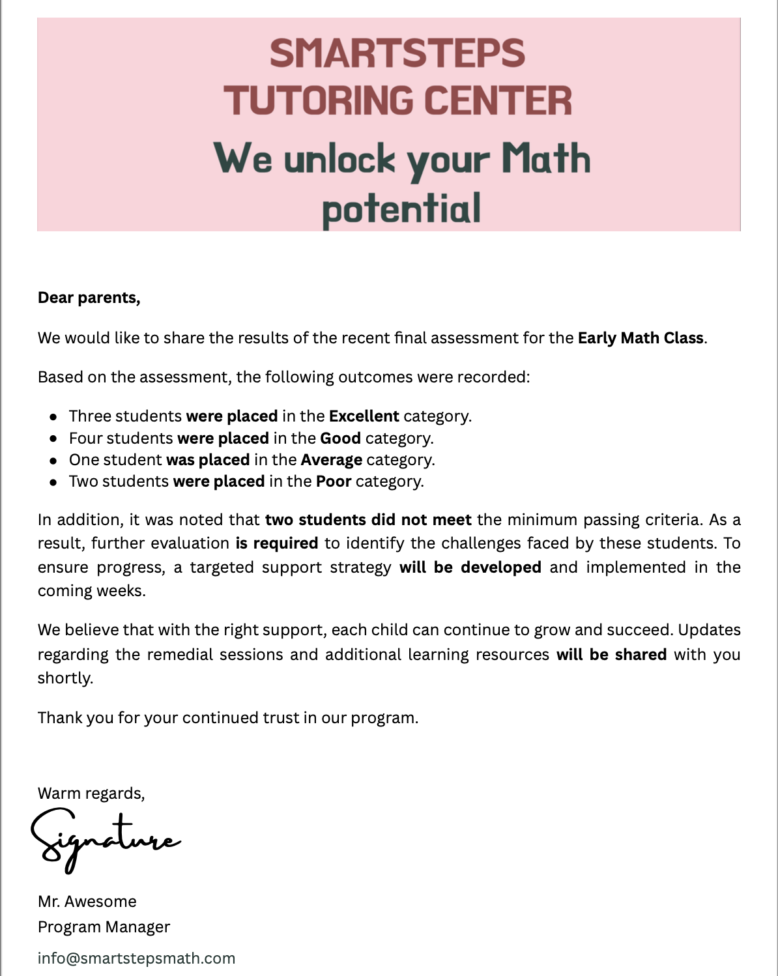
Charts & Data Interpretation
Three students were placed in the Excellent category.
Four students were placed in the Good category.
One student was placed in the Average category.
Two students were placed in the Poor category.

Slide 33
Charts & Data Interpretation
In addition, it was noted that two students did not meet the minimum passing criteria. As a result, further evaluation is required to identify the challenges faced by these students. To ensure progress, a targeted support strategy will be developed and implemented in the coming weeks.
We believe that with the right support, each child can continue to grow and succeed. Updates regarding the remedial sessions and additional learning resources will be shared with you shortly.

Slide 34
TAKE HOME NOTES

Slide 35
Passive Voice in the Past
  to stress the effect of an action that happened in the past.
Passive Voice in Future
  to stress the effect of an action that will happen in the future, rather than the cause of that action.
  usually formed with ‘will’ rather than ‘going to’.
Passive Voice with Modals
  As with other passive constructions, the emphasis changes to the object that receives the action.
Use the passive voice in your report with these points in mind:
You want to focus on the action/ result/ effect.

Slide 36
References
Azar, B. S., & Hagen, S. A. H. (2009). Understanding English Grammar (4th ed.). Pearson Education.
Hall, D. and Barduhn, S. (2016). English for Everyone. Edited by J. Siklos and A. Singer. New York: DK Publishing.
Learnspeed. (2025). Write A Great Tutor Session Report. https://www.learnspeed.com/write-a-great-tutor-session-report/
Suskie, L. (2018). Assessing Student Learning (3rd ed.). Jossey-Bass.

Slide 37
Thank you, and see you in the next lecture!

