Slide 1

ENGLISH FOR MATHEMATICS
LECTURE 14
UNDERSTANDING STUDENTS NEEDS
Itha Priyastiti
Universitas Kristen Wira Wacana Sumba

Slide 2

REVIEW

Slide 3
Passive in the Past
  to stress the effect of an action that happened in the past.
Passive Voice in Future
  to stress the effect of an action that will happen in the future, rather than the cause of that action.
  usually formed with ‘will’ rather than ‘going to’.
Passive with Modals
  As with other passive constructions, the emphasis changes to the object that receives the action.
Use the passive voice in your report with these points in mind:
You want to focus on the action/ result/ effect.

Slide 4

Brainstorming
“Why is understanding students' needs important in a tutoring business?”
As a professional tutoring center, it is beneficial to collect feedback from your stakeholders (students, parents, other users).
Distributing regular survey is recommended.
You can use the feedbacks to improve your tutoring center.
Despite the importance of overall result of your survey, individual (each) student’s testimonial is also an important point to consider.

Slide 5
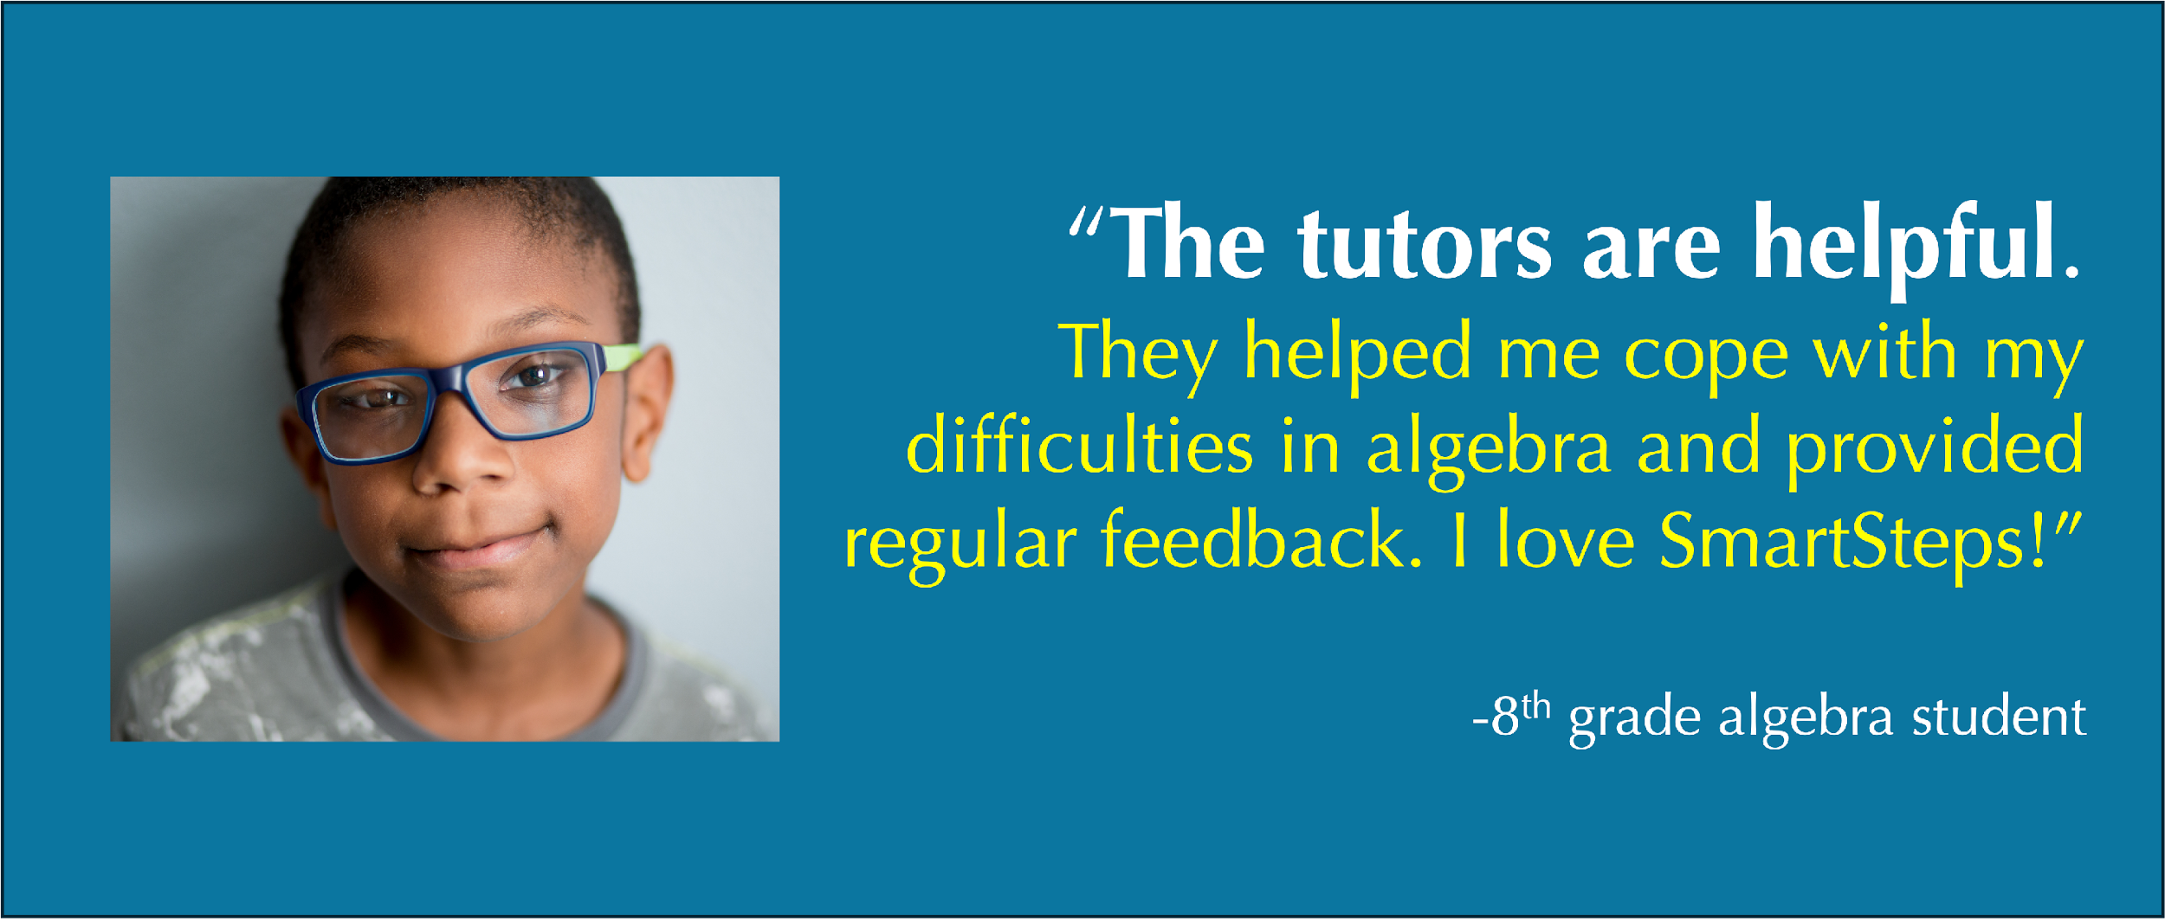

Brainstorming
What kinds of feedback might students give about a class?
positive feedback
What if students give negative feedback?

Slide 6
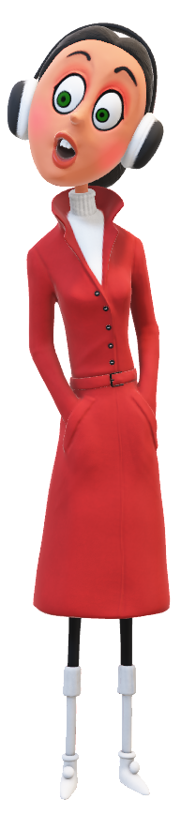

Brainstorming
“Well, I enjoy the games in class, but sometimes the instructions are not clear.”
“How’s your class going?”
Negative feedback should not be seen as a failure, but as an opportunity to grow.
Listening to all types of feedback (including the critical ones) shows professionalism and helps improve the quality of your services.

Slide 7
Understanding Students Needs
When tutors address specific challenges, students are more likely to progress and succeed.
Personalize learning
Improve student outcomes
Tailoring lessons to fit students' strengths and weaknesses makes learning more effective and engaging
Showing that you care about students' individual needs enhances your credibility and professionalism.
Increase satisfaction and retention
Build trust and reputation
Satisfied students (and parents) are more likely to continue with the program and recommend it to others.
Design better programs
Understanding needs helps you create targeted classes, materials, and schedules that truly meet demand.

Slide 8

Reading
&
Writing

Slide 9
Reading
“How’s your class going?”
“Well, I enjoy the games in class, but sometimes the instructions are not clear”
clearer instructions
What do you think of the student’s feedback? What does he need?
Find the keywords from the feedback/ testimonial.

Slide 10
Reading
Use your reading skill! ☺
Responding to feedback, you need to be specific of what the needs.
Here are useful steps to do so:
1. Read and Understand the Feedback
Focus on what is being said and why.
Identify whether the feedback is:
About content difficulty
About pace or delivery
About materials or resources
About emotional needs or comfort
Key strategy:
Underline or highlight problem words/phrases (e.g., “too fast,” “confusing,” “not enough…”)

Slide 11
Reading
Think critically! ☺
2. Identify the Core Problem/ Need
What is the main concern or challenge the student is expressing?
Categorize the concerns/ challenges if needed
academic, instructional, emotional, etc.

Slide 12
Reading
3. Provide the Antithesis as a Solution
Create a specific and targeted response that addresses the opposite of the issue, which becomes the proposed solution.
Use modals, future forms, passive voice, or reported speech to sound more professional and action-oriented.
Feedback | Identified Problem/ Need | Antithesis
“The pace is too fast.” | Speed of delivery | The pace will be adjusted to allow more time for understanding.
“The games are fun, but I don’t understand the instructions.” | Clarity of instructions | Instructions will be simplified and explained step-by step.

Slide 13
Exercise
You have collected the survey result and found some feedbacks from the students.
Take some time to read the feedbacks and try to identify what the students need.
Umbu says: “There are not enough examples for practice.”
Rambu says: “We don’t get enough time to solve problems during class.”
Dorus says: “ It’s hard to focus when the class is noisy.”
Bunga says: “I couldn’t understand the explanation of algebra.”
Lilo says: “It’s hard to hear the teacher from the back of the room.
Stitch says: “We need more feedback on our homework.”

Slide 14
Discussion
What do the students need?
1. Umbu says: “There are not enough examples for practice.”
Problem/ Need: lack of examples
Recommendation: More practice examples will be added to each lesson.
2. Rambu says: “We don’t get enough time to solve problems during class.”
Problem/ Need: lack of time
Recommendation: Additional problem-solving time will be allocated during each session.

Slide 15
Discussion
Problem/ Need: The learning environment is not quiet enough.
What do the students need?
3. Dorus says: “ It’s hard to focus when the class is noisy.”
Recommendation: A quieter learning environment will be maintained to support student concentration.
4. Bunga says: “I couldn’t understand the explanation of algebra.”
The student struggled with the explanation or delivery.
Recommendation: A clearer explanation of algebra topics will be provided in the next class.

Slide 16
Discussion
Problem/ Need: Classroom setup or voice projection.
What do the students need?
5. Lilo says: “It’s hard to hear the teacher from the back of the room.
Recommendation: Seating arrangements and audio delivery will be adjusted to ensure clarity.
6. Stitch says: “We need more feedback on our homework.”
Problem/ Need: more regular and helpful feedback.
Recommendation: Homework feedback will be given more frequently and in greater detail.

Slide 17
Discussion
You're a tutor or a manager. How do you share what your students have said with your team or with parents?
We don’t always quote students word-for-word in a business or professional context.
Instead, we use reported/ indirect speech to summarize and communicate what students have expressed — professionally and clearly.

Slide 18
Reported
Speech

Slide 19


Reported Speech
”I enjoyed Ms. Pretty’s class last semester.”
”Sorry, I didn’t hear you. What did you say?”
” I said, I enjoyed Ms. Pretty’s class last semester.”
Dorus
Bunga

Slide 20

Reported Speech
Yesterday, the tutor said: “Some students did not pass the exams. So remedial class is offered.”
”I didn’t hear what the teacher said yesterday. What did he say?”
The tutor said that some students had not passed the exams. So remedial class is offered.
Umbu
Dorus

Slide 21
Reported Speech
Reported/ indirect speech is often used to describe what someone said at an earlier point in time.
No quotation marks are used in reported speech.
(Azar & Hagen, 2009; Hall & Barduhn, 2016).
Indirect speech allows us to maintain politeness, conflict avoidance, and diplomacy in communication.
It helps in summarizing or paraphrasing information and eases us to communicate complex thoughts.
(Po Yin & Yang Kuo, 2013; IEEE, 2016)

Slide 22
Reported Speech
Rephrasing in reported speech protects student identity and maintains professionalism.
Why reported speech?
In reports, team meetings, or emails to parents, you need to report what students say without using casual or direct quotes.
Professional Communication
Confidentiality and Sensitivity
In many tutoring businesses, managers write weekly or monthly reports about student performance and feedback.
These reports rely on reported speech.
Accurate Summary of Feedback
Essentials for Report
Reported speech helps condense and paraphrase the key points of student feedback.

Slide 23
Reported Speech
Imagine yourself as a program manager. You have a team meeting to discuss the students’ feedbacks about their classes.
This is one of the feedback:
Dorus says: “I don’t understand percentages at all.”
You will NOT say: “Dorus says I don’t understand percentages at all.”
Why?
Reported/ indirect speech is used to describe what someone (NOT you) said at an earlier point in time.

Slide 24

Reported Speech
“How was your class today?”
“It was great! I loved the games.”
My son said that he had loved the games in class.

Slide 25
Reported Speech
Useful verbs for reported speech: say, tell, explain, suggest, report, mention, complain, ask
Direct Speech
Dorus says: “I don’t understand percentages at all.”
Reported/ Indirect Speech
One student said that he didn’t understand percentages.

Slide 26
Reported Speech
Useful verbs for reported speech: say, tell, explain, suggest, report, mention, complain, ask
Direct Speech
Umbu, Bunga, and Rambu write in the feedback: “Don’t speak too fast.”
Reported/ Indirect Speech
Some students suggested not to speak too fast.
See the difference? Reported speech sounds more polished and professional; protects students’ confidentiality and sensitivity.
Now, let’s talk about the difference between direct speech and reported speech.
Notice any differences between direct speech and reported speech?

Slide 27
Reported Speech
Direct Speech
The student says: “ I don’t understand percentages at all.”
statement
Reported/ Indirect Speech
One student said that they didn’t understand percentages.
Can you identify the direct speech? Is it a question, statement, or imperative?

Slide 28
Reported Speech
Direct Speech
The student says: “ I don’t understand percentages at all.”
Reported/ Indirect Speech
One student said that they didn’t understand percentages.
1
4
2
3
Reported verb
Replacement quotation mark with ‘that’
Pronoun
Tenses

Slide 29
Reported Speech
Useful verbs for reported speech: say, tell, explain, suggest, report, mention, complain, ask
Direct Speech
Umbu, Bunga, and Rambu write in the feedback: “Don’t speak too fast!”
imperative
Reported/ Indirect Speech
Some students suggested not to speak too fast.
Can you identify the direct speech? Is it a question, statement, or imperative?

Slide 30
Reported Speech
Direct Speech
Umbu, Bunga, and Rambu write in the feedback: “Don’t speak too fast!”
1
Reported/ Indirect Speech
Some students suggested not to speak too fast.
2
4
3
Removal of quotation mark
Pronoun
Reported verb
Tenses

Slide 31
Reported Speech
Direct Speech
Bunga writes in the feedback: “Do you provide a remedial program?”
question
Reported/ Indirect Speech
A students asked whether we offered a remedial program.
Can you identify the direct speech? Is it a question, statement, or imperative?

Slide 32
Reported Speech
Direct Speech
Bunga writes in the feedback: “Do you provide a remedial program?”
Reported/ Indirect Speech
A student asked whether we provided a remedial program.
1
1
4
2
3
Pronoun
Reported verb
Replacement of quotation mark with ‘whether’
Tenses

Slide 33
Reported Speech
When you transform direct speech to indirect/ reported speech, there are changes to remember:
Tenses
Exclusion of the quotation mark
Pronouns
Reported verbs
Time and place references

Slide 34
Take Home
Notes

Slide 35
Understanding Students Needs
Positive and negative feedback from your stakeholders (students, parents, other users) are beneficial to improve your tutoring center.
Responding to feedback, you need to be specific of what the needs.
Read and Understand the Feedback
Identify the Core Problem/ Need
Provide the Antithesis as a Solution

Slide 36
Reported Speech
Use reported/ indirect speech in reports, discussion in team meetings, emails to parents or stakeholders.
If you’re going to run your own tutoring business, you won’t just teach. You’ll also communicate with your team and clients.
Reported speech is a key part of that professional communication!

Slide 37
Reported Speech
Indirect speech allows us to:
Professional Communication
Confidentiality and Sensitivity
Accurate Summary of Feedback
Essentials for Report

Slide 38
Reported Speech
When you transform direct speech to indirect/ reported speech, there are changes to remember:
Tenses
Exclusion of the quotation mark
Pronouns
Reported verbs
Time and place references

Slide 39
References
Azar, B. S., & Hagen, S. A. H. (2009). Understanding English Grammar (4th ed.). Pearson Education.
Hall, D. and Barduhn, S. (2016). English for Everyone. Edited by J. Siklos and A. Singer. New York: DK Publishing.
IEEE. (2016, November 19). The Impact of Indirect Speech Acts on Professional Communication. IEEE ProComm. https://procomm.ieee.org/the-impact-of-indirect-speech-acts-on-professional-communication/#:~:text=In%20responding%20to%20someone%27s%20ideas,disagreement%2C%20but%20also%20to%20avoi
Yin, C. P., & Kuo, F. Y. (2013). A study of how information system professionals comprehend indirect and direct speech acts in project communication. IEEE Transactions on Professional Communication, 56(3), 226–241. https://doi.org/10.1109/TPC.2013.2263648

Slide 40
Thank you, and see you in the next lecture!

