Slide 1

English for Mathematics
Lecture 15
Boast Your Success!
Itha Priyastiti
Universitas Kristen Wira Wacana Sumba

Slide 2

Review

Slide 3
Understanding Students Needs
Positive and negative feedback from your stakeholders (students, parents, other users) are beneficial to improve your tutoring center.
Responding to feedback, you need to be specific of what the needs.
Read and Understand the Feedback
Identify the Core Problem/ Need
Provide the Antithesis as a Solution

Slide 4
Reported Speech
Use reported/ indirect speech in reports, discussion in team meetings, emails to parents or stakeholders.
If you’re going to run your own tutoring business, you won’t just teach. You’ll also communicate with your team and clients.
Reported speech is a key part of that professional communication!
Indirect speech allows us to:
Professional Communication
Confidentiality and Sensitivity
Accurate Summary of Feedback
Essentials for Report

Slide 5
Reported Speech
When you transform direct speech to indirect/ reported speech, there are changes to remember:
Tenses
Exclusion of the quotation mark
Pronouns
Reported verbs
Time and place references

Slide 6

Today’s Agenda
Previously, you have learned how to handle feedback from your stakeholders as well as provide solutions and recommendations.
Today, let’s learn on how to present and report the positive feedback to boast your business to potential customers using reported speech.

Slide 7
Brainstorming
Have you heard of testimonials?
What are testimonials in business?
What is the use of testimonials in business?

Slide 8

Satisfaction
Testimonials

Slide 9
Satisfaction as Your Success Testimonials
As a professional tutoring center, it is beneficial to collect feedback from your stakeholders (students, parents, other users).
Distributing regular survey is recommended.
The survey results are the testimonials of your business.
Positive feedback from satisfied customers, gathered through surveys, can be repurposed into testimonials to showcase success stories and encourage potential clients.
These testimonials can be strategically placed on websites, social media, marketing emails, and even in ads to influence purchasing decisions.

Slide 10
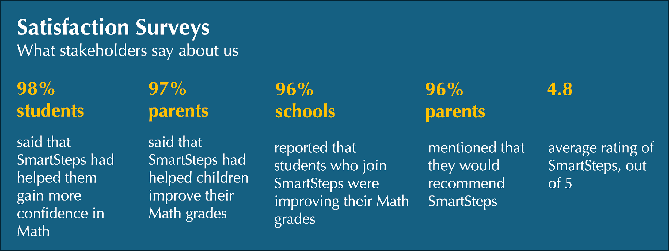
Satisfaction as Your Success Testimonials
The following is the result of overall feedback from SmartSteps

Slide 11
Students’ Satisfaction
Service providing institutions ‘emphasize’ the importance of service quality because in that situation, the relationship with existing customers is enriched while drawing new customers (Tsevi, 2020)
Arif and Ilyas (2013) said that “satisfaction is the emotional state resulting from evaluating the fulfilment of expectations through performance” (in Han et al., 2025, p. 34).
Bolliger and Erichsen (2013) Student satisfaction refers to "the importance learners place on their academic experiences within an instructional context” (in Han et al., 2025, p. 34).
Student satisfaction can be described as the enjoyment and achievement students derive from their study Environment (Han, et.al., 2025)
Further, Han et al., (2025) describe factors that affecting student satisfaction of tutoring classes in a private tutoring center:

Slide 12
Students’ Satisfaction
the act of paying attention to and addressing students' thoughts
the ability or competency required to properly perform the duties
of a teacher, including student understanding, development, and implementation of learning
Teachers’ Competence
Teachers’ Responsiveness
involves both asynchronous (discussion boards and email) and synchronous (chat and video conferencing) communication
Teachers’ Empathy
Learner-Facilitator Interaction
understanding and
responding to others' thoughts and emotions, involving cognitive comprehension and suitable emotional
reactions.
peer feedback on assignments, sharing work, and providing feedback to one another, discussions, share thoughts, pose questions, and collectively construct new knowledge
Learner-Learner Interaction

Slide 13

Reporting Satisfaction to Boast Your Success

Slide 14
Reporting Satisfaction to Boast Your Success
Useful verbs for reported speech: say, tell, explain, suggest, report, mention, complain, ask
Inflected verbs from the direct speech

Slide 15
Tenses in Reported Speech
Hall and Barduhn (2016) describe that:
the reported verb usually “goes back” a tense.
The tense used in reported speech is usually one tense back in time from the tense in direct speech.
Azar and Hagen (2009)
Changing verbs to past forms in reported speech is common in both speaking and writing.

Slide 16
Tenses in Reported Speech
present continuous tense
Present Continuous
“Students who join SmartSteps are improving their Math grades”
Past Continuous
Schools reported that students who join SmartSteps were improving their Math grades.
past continuous tense
present perfect tense
Present Perfect
“SmartSteps have helped us gain more confidence in Math.”
Past Perfect
Students said that SmartSteps had helped them gain more confidence in Math
past perfect tense

Slide 17
Tenses in Reported Speech
future with ‘will’
Future with ‘will’
“We will recommend SmartSteps”
Modal verb ‘would’
Parents mentioned that they would recommend SmartSteps.
modals with ‘would’
Modal verb ‘can’
Modal verb ‘can’
“After joining SmartSteps, I can complete difficult operations!”
Modal verb ‘could’
Students reported that they could complete difficult operations.
Modal verb ‘could’

Slide 18
Reported Speech & The Past Simple
The past simple in direct speech can either stay as the past simple or change to the past perfect in reported speech. The meaning is the same
past simple
Direct Speech with Past Simple
“My Math grade improved after I joined SmartSteps.”
Reported Speech with Past Simple/ Past Perfect
Students reported that their Math grade improved after they joined Smartsteps.
past simple
Students reported that their Math grade had improved after they had joined Smartsteps.
past perfect

Slide 19
Reported Speech Without Change of Tense
How about present simple in the reported speech?
If the situation described is ongoing or facts, the verb does not have to change tense in reported speech.
Direct Speech
1. “SmartSteps is the best”
2. “We love SmartSteps!”
3. “SmartSteps trully helps students unlock their potentials!”
present simple
1. Students said that SmartSteps is the best.
Reported Speech
2. Students said that they love SmartSteps.
3. Schools admitted that SmartSteps trully helps students unlock their potentials.

Slide 20
Pronouns in Reported Speech
You may have noticed that the pronouns are also changed when direct speech is transformed into indirect/ reported speech.
It is because when using reported speech, you report what someone else has said.
Therefore, you are no longer talking from the first speaker’s point of view but conveyed from a third-person perspectives.
The speaker is not directly quoting the original words but is instead paraphrasing or summarizing the message.
See the following:

Slide 21
Pronouns in Reported Speech
Direct Speech
“We will recommend SmartSteps”
‘We’ is changed to ‘parents’
Reported Speech
Parents mentioned that they would recommend SmartSteps.
reported verb
Direct Speech
“After joining SmartSteps, I can complete difficult operations!”
‘I’ is changed to ‘students’
Reported Speech
Students reported that they could complete difficult operations.
reported verb

Slide 22




Time and Place in Reported Speech
Time and place references and pronouns sometimes also change (Hall & Barduhn, 2016).
If speech is reported some time after it was said, words used to talk about times and places may need to change.
Dorus said that he had not attended the class the day before.
The time reference is “yesterday” in direct speech.
”I didn’t attend the class yesterday.”
The time reference is “the day before” in reported speech.
Dorus
Dorus
MAY
MAY
MAY
14
15
16

Slide 23

Time and Place in Reported Speech
The time reference is “tomorrow” in direct speech.
The tutor said that he would upload the material the following day.
”I would upload the material tomorrow”
The time reference is “the following day” in reported speech.
MAY
MAY
14
16

Slide 24


Time and Place in Reported Speech
The place reference is “here” in direct speech.
He told me that life was peaceful there.
”Life is peaceful here”.
The place reference is “there” in reported speech.
Dorus

Slide 25
Exercises
Imagine you are going to create your business testimonial page. Write “Student Success” page using reported speech. Use the following direct testimonials!

Slide 26
Exercises
Change the following direct testimonials to the reported forms!
Dorus says, “The materials were really easy to understand.”
were
Reported speech:
Dorus said that the materials were/ had been really easy to understand.
For your business page:
Students said that the materials were/ had been really easy to understand.

Slide 27
Exercises
Change the following direct testimonials to the reported forms!
wasn’t
now
Bunga says, “I wasn’t confident in math before, but now I enjoy solving problems.”
I
I
enjoy
3
1
4
Reported speech:
2
1
3
Bunga mentioned that she wasn’t/ had not been confident in math before, but since joining SmartSteps, she enjoyed solving problems.
1
4
For your business page:
Bunga/ A student mentioned that she wasn’t/ had not been confident in math before, but since joining SmartSteps, she enjoyed solving problems.

Slide 28
Exercises
Change the following direct testimonials to the reported forms!
Rambu says, “The tutors always explain patiently and clearly.”
explain
Reported speech:
Rambu said that the tutors always explained patiently and clearly.
For your business page:
Students admit that the tutors always explain patiently and clearly.

Slide 29
Exercises
Change the following direct testimonials to the reported forms!
Umbu says, “I liked the practice sessions.”
I
liked
Reported speech:
Umbu said that he had liked the practice sessions.
For your business page:
Students admit that they liked the practice sessions.

Slide 30

Take Home
Notes

Slide 31
Testimonials for Business Success
Why is it important to share students’ (and other stakeholders’) satisfactions in a tutoring business?
They act as your success testimonials
They will build trust
They will become a free form of promotion
Factors affecting student satisfaction of tutoring classes in a private tutoring center:

Slide 32
Students’ Satisfaction
Teachers’ Competence
Teachers’ Responsiveness
Teachers’ Empathy
Learner-Facilitator Interaction
Learner-Learner Interaction

Slide 33
Reported Speech
When you transform direct speech to indirect/ reported speech, there are changes to remember:
Tenses
Exclusion of the quotation mark
Pronouns
Reported verbs
Time and place references

Slide 34
References
Azar, B. S., & Hagen, S. A. H. (2009). Understanding English Grammar (4th ed.). Pearson Education.
Hall, D. and Barduhn, S. (2016). English for Everyone. Edited by J. Siklos and A. Singer. New York: DK Publishing.
Han, J., Phongsatha, S., & Asavisanu, P. (2025). Factors Affecting Student Satisfaction of Tutoring Classes in a Private Tutoring Center. International Journal of Sociologies and Anthropologies Science Reviews, 5(1), 33–50. https://doi.org/10.60027/ijsasr.2025.5155
Tsevi, L. (2020). Tutor Service Quality and Student Satisfaction: A Study of Distance Education Students at University of Ghana Learning Centres. www.nab.gov.gh

Slide 35
Thank you for the great semester!
Stay healthy, stay positive, shoot for the stars, aim for the moon!

