Slide 1
Chemical Reaction Engineering II- Reactor Design (ChEg 4101)
Prerequisite: Chemical Reaction Engineering I-Reaction Kinetics (ChEg3104)
Lecture 1: Introduction to Reactor Design
Week 1
Lecturer: Adamu Esubalew (PhD, ChEg)
Addis Ababa, Ethiopia

Slide 2
Lecture learning outcomes
At the end of the lecture, you will be able to:
define the principles of reaction engineering,
identify type of reactors and their classification modes,
describe the cases why do you design, when do you design and how to design reactors, and
Explain the basic equations of materials and energy balances for reactors design.

Slide 3
Presentation outlines
  Overview of reaction engineering
  Chemical reactors and their classifications
  Reactor design
  Materials and energy balances

Slide 4
1.1. Overview of reaction engineering
Chemical plants are combinations of both physical operations and chemical process.
Physical operations: physical treatments or operations (e.g heat transfer, fluid flow, mass transfer and separation processes).
Chemical process: Chemical reaction occurs, and reactants are converted into products in the reactors.

Slide 5
Cont’d
The study of chemical reaction engineering combines the study of chemical kinetics with the reactors design.
Chemical kinetics and reactor design are the heart of producing almost all industrial chemicals.
Chemical kinetics is the study of chemical reaction rates and reaction mechanisms.

Slide 6
Cont’d
A reaction system that operates in the safest and most efficient manner leads to the economic success.
Otherwise, if a reaction system produces a large amount of undesirable product, subsequent purification and separation of the desired product could make the entire process economically unfeasible.
6

Slide 7
Cont’d
The rate of reaction tells us how fast the number of moles of chemical species are being consumed to form another chemical species.
The term chemical species refers to any chemical component or element with a given identity.
7

Slide 8
Cont’d
The identity of a chemical species is determined by the kind, number, and configuration of that species’ atoms.
Chemical reaction has taken place when a detectable number of molecules of one or more species have lost their identity.
8

Slide 9
Cont’d
Mass conservation law states that total mass is neither created nor destroyed when a chemical reaction occurs. i.e. the total collective mass of all the different species in the reactor is constant.
However, for individual species involved in a particular reaction, there is rate of disappearance of mass of a particular species.
9

Slide 10
Cont’d
The rate of disappearance of a species, A, is the number of A molecules that lose its chemical identity per unit time per unit volume.
In order for a particular species to be formed in the reactor, some prescribed fraction of another species must lose its chemical identity.
10

Slide 11
Cont’d
The three basic ways of a species may lose its chemical identity: decomposition, combination, and isomerization.
Decomposition: the molecule loses its identity by being broken-down into smaller molecules, atoms, or atom fragments.
11

Slide 12
Cont’d
Combination: In which the molecule loses its identity by combining with other molecules or atom to form another molecules or atoms.
Isomerization: in which the molecule loses its identity through a change in configuration although the molecule neither adds other molecules to itself nor breaks into smaller molecules.
12

Slide 13
The rate of chemical reaction can be expressed in different ways.
The four things about the reaction rate:
the rate of formation of species j (mole/time/volume),
an algebraic equation,
independent of the type of reactor in which reaction is carried out,
a function of the properties of the reacting materials and reaction conditions.
13

Slide 14
Activity 1.1
  Define physical operations and chemical process.
  What is chemical kinetics?
  What is chemical reaction engineering?
  Explain the three basic ways of a species may lose its chemical identity.
14

Slide 15
1.2. Chemical reactors and their classifications
1.2.1. Chemical reactors
They are vessels/containers in which chemical reactions take place.
Reactors = sizes of reactors + auxiliaries.
Ranges from laboratory to industrial scales.
Reactor auxiliaries: stirrer, heat exchanger/coils, temperature detector, conductivity meter, pressure gauge and flow meter.
15

Slide 16
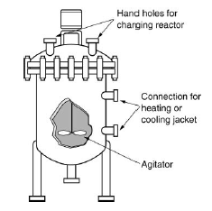
Cont’d
Figure 1. 1 Homogeneous batch reactor ( Fogler H.S., 2015)
16

Slide 17
Cont’d
Stirrer: to keep composition and temperature as uniform as possible in the reactor.
A stirrer presents in some reactors: batch, semi-batch and continues stirred tank reactor (CSTR).
Heat exchanger/coils: devices that facilitates heat exchange, based on the absorption or evolution of the heat of reaction.
17

Slide 18
Cont’d
Temperature detector: to detect temperature of reactor systems.
Conductivity meter: to determine the progress of the reaction in real time.
Pressure gauge: to measure/ regulate the pressure.
Flow meter: to control the flow rate of feed/ product.
18

Slide 19
1.2.1 Classification of Reactors
Reactors can be classified based phase involved, method of operation and thermal operation in the process.
1.2.1. 1. Reactors classification based on phase involved
Based on phases involved, reactors are classified into two categories:
Homogeneous reactors: reactants and products have the same phase.
Heterogeneous reactors: reactants and products have two or more phases.
19

Slide 20
Cont.
Homogenous reactors are further classified into three types:
batch reactors (BRs),
continuous stirred tank reactors (CSTRs), and
plug flow reactors (PFRs).
Batch reactors: chemical reactors where the reactants are fed into reactors at once and mixed thoroughly, and the products are withdrawn at once from them after chemical reaction.
20

Slide 21
Cont.
Batch reactors are primarily used for the production of specialty chemicals to obtain reaction rate data in order to determine reaction-rate laws and rate-law parameters, rate constant (k), reaction rate (r_{i}).
They are used to scale-up laboratory experiments to pilot-plant operation or to full-scale production.
21

Slide 22
Cont.
Continuous stirred tank reactors (CSTRs): CSTRs are reactors where the reactants are continuously fed into reactors and mixed thoroughly, and products are continuously withdrawn from them.
They are versatile and efficient systems for carrying out continuous chemical reactions.
CSTRs are typically used for liquid-phase reactions.
22

Slide 23
Cont.
Plug flow reactors (PFRs): where the reactants move through the reactors as a plug with minimal mixing in the axial direction, and products withdraw with continuous manner.
The fluid moves in a uniform manner along the length of the reactors.
This results in a gradient of concentration (C) and temperature (T) along the length (L) of the reactors.
i.e. C= f(L), and T= f(L)
23

Slide 24
Cont.
Heterogeneous reactors are further classified into two categories:
Catalytic reactors (CRs)
Non-catalytic reactors ( NCRs)
Catalytic reactors: CRs are specialized chemical reactors that utilize catalysts to accelerate chemical reactions. E.g. Fixed bed, movable bed, and fluidized bed reactors.
24

Slide 25
Cont.
Non-catalytic reactors (NCRs): NCRs are types of reactors where the reactants exist in different phases, but no catalyst is involved in facilitating the reaction.
They play a crucial role in various industrial applications where solid-phase reactions are involved.
In NCRs, reaction occurs between solid and gas or solid and liquid phases, and the reaction rates are influenced by mass transfer and chemical kinetics.
25

Slide 26
Cont.
1.2.1. 2. Reactors classification based on mode of operation
The classifications of reactors based on modes of operations are batch reactors, semi-batch reactors and continuous reactors (CSTRs and PFRs).
Batch reactors: Reactants are fed into the reactors at once and products withdraw from reactors after completion of the reaction process.
26

Slide 27
Cont.
Semi-batch reactors: Some reactants are fed into the reactors at once and some reactant are fed in a continuous manner; and withdrawal of products can be either continuous or batch process.
Continuous flow reactors (CSTRs and PFRs): The reactants are fed into the reactors and products are withdrawn from the reactors in the continuously.
27

Slide 28
Cont.
1.3.1.3. Reactors classification based on thermal operations
Based on thermal operations, reactors are classified into:
Isothermal reactors: Reactors in which the operating temperatures are constant with chemical reactions.
Non-isothermal reactors: Reactors in which operating temperatures vary with chemical reactions.
28

Slide 29
Cont.
Based on thermal operations, reactors are classified into:
Adiabatic reactors: Reactors in which there are no heat exchanges between reactors and the surroundings. i.e. there are no heat additions into reactors or heat removals from reactors.
Non-adiabatic reactors: Reactors in which there are heat exchanges between reactors and the surroundings. i.e. there are heat additions into reactors or heat removals from reactors.
29

Slide 30
Cont’d
Activity 1.2
  Define chemical reactors.
  Describe the functions of reactor auxiliaries.
  Explain the ways of reactors classifications.
  Identify the dereference between homogenous reactors and heterogenous reactors
30

Slide 31
1.3. Reactor design
Reactors are designed to produce a specified product at a given rate from the given reactants at maximum profit and low production cost.
Performance of reactor is the most important factor in design of the whole plant (industry).
Therefore, good reactor design determines the profit of a plant.
31

Slide 32
Cont…
The two cases when reactors design are required:
Development of a new chemical process or plant, and
Modification of an existing chemical process.
When there is new product development and unable to produce it by the existing reactors, it is mandatory to design a new reactor. .i.e. design of a reactor is required for development of a new chemical process or plant.
32

Slide 33
Cont.…
When the performance of the existing chemical process is reduced or unable to fulfill the production capacity, modification of an existing chemical process is implemented.
The modification is implemented for:
expanding an existing plant (adding a new reactor tie with old reactor), or
replacing an existing reactor by a new reactor.
33

Slide 34
Cont..
1.3.1. Basic knowledge requirements in reactor design are the followings:
Basic chemical Engineering principles (chemical reaction kinetics, mass & heat transfers, fluid flow properties and thermodynamics)
Design tools and data,
Chemical process type
Mathematics
Material engineering
Engineering judgment
34

Slide 35
Cont.
The standard procedures to design a reactor are the followings:
Step 1: Develop an appropriate rate equation,
Step 2: Develop a material balance equation,
Step 3: Develop an energy balance equation,
Step 4: Combine them and evaluate,
Step 5: Make mechanical design & check its performance,&
Step 6: Evaluate its economic feasibility.
35

Slide 36
Cont.
The design procedures are essentially the same for both homogeneous and heterogeneous reactors.
The only difference in heterogeneous reaction is finding the appropriate rate of equation can be more complicated.
A complete reactor design involves two types of design:
Process design ,and
mechanical design (It is not covered in this course)
36

Slide 37
Cont..
Process design: The process design includes:
Sizing of the reactor and its general configurations
Identifying operating conditions (T, P, composition)
Optimizing operating condition for the required output
Determining pressure drop associated with flow of reaction mixtures
37

Slide 38
1.3.2. Basics to be considered for reactor design
Reactor type selection
The criteria of reactor type choice based on:
cost of reactor ,
type of process (batch, Continuous and semi-batch process),
type and nature of reactants and product,
type and nature of reaction (exothermic and endothermic reaction, catalytic and non-catalytic reactions, and
production capacity (small scale and large scale).
38

Slide 39
Cont…
Stirrer (Agitator ) selection
Stirrer or agitator is required to mix two or more liquid reactants, solid liquid reactants or immiscible reactants (e.g propeller, paddle, magnetic).
Stirrers are not required for the following reaction cases:
Highly viscosity of reactants.
39

Slide 40
Cont…
Gas phase reactions: Gases are easily expanded, can be easily distributed.
Biological (pharmaceutical) reactions: If the agitator is rotated at high RPM, then it can have cause damage to the cells.
Catalytic reactions: Agitation causes catalyst particle breakdown.
40

Slide 41
Cont.
Modes of process operations selection
Steady-state condition: The concentration of the reactants and products, reaction temperature and reaction rate are unchanged with the time.
There are no accumulations of materials and energy.
Type of operation is simple to model.
41

Slide 42
Cont.
Unsteady-state condition: The spatial variables such as concentrations of reactants and products, reaction temperature and reaction rate change with time.
There are accumulations of both materials and energy in the reactor, and the operation is complex to model for multiple reactants. Example, batch & semi-batch reactors.
42

Slide 43
Cont’d
Calculations of conversion begins with stoicheometric reaction.
Consider the following general equation
aA + bB cC + dD (1.1)
Where A & B are reactants, C& D are products; a, b, c & d are stoichiometric coefficients, respectively.
Conversion: It measures how much reactants are converted into products.
It can be determined in terms of mole or concentration basis.
43

Slide 44
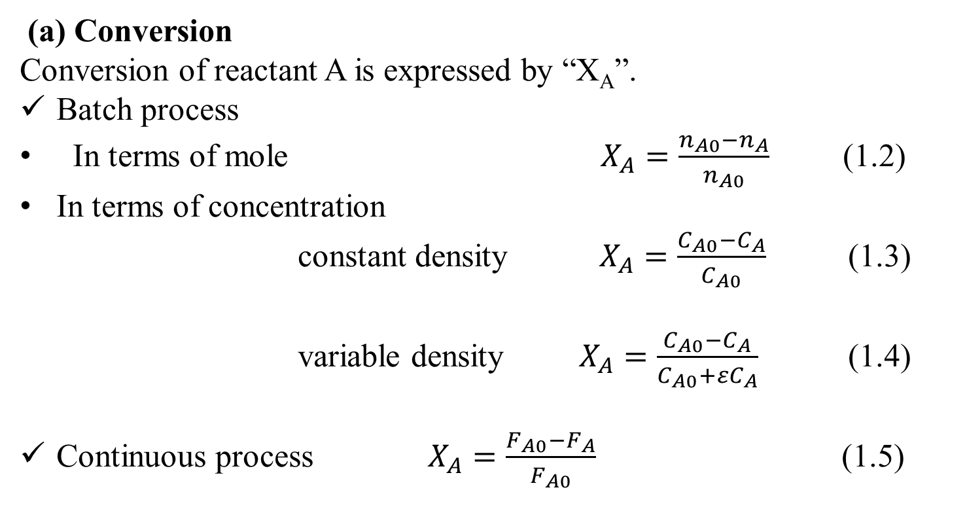
Cont..
(a) Conversion
Conversion of reactant A is expressed by “X_{A}”.
Batch process
In terms of mole $X_{A}=\frac{n_{A0}−n_{A}}{n_{A0}}$ (1.2)
In terms of concentration
constant density $X_{A}=\frac{C_{A0}−C_{A}}{C_{A0}}$ (1.3)
variable density $X_{A}=\frac{C_{A0}−C_{A}}{C_{A0}+{εC}_{A}}$ (1.4)
Continuous process $X_{A}=\frac{F_{A0}−F_{A}}{F_{A0}}$ (1.5)
44

Slide 45
1.4. Materials and Energy Balances
Material and energy balances are used to determine the quantity of materials and energy flows across reactors boundary.
A reactor is designated to represent materials and energy flows in Figure 1.2.
In flows
Out flows
Reactor
Figure 1.2 Materials and energy flows across a reactor
45

Slide 46
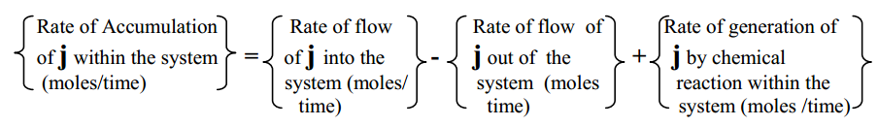
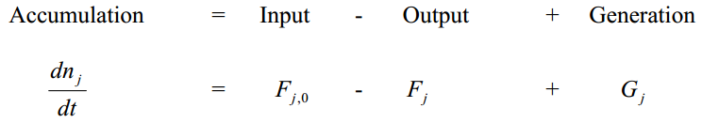
1.4.1. Materials balance in reactors
Material balance: It quantifies flow of materials across reactors Number of moles is not conserved. (Levenspiel, 2011).
For a component j at any instant time t
(1.6)
46

Slide 47

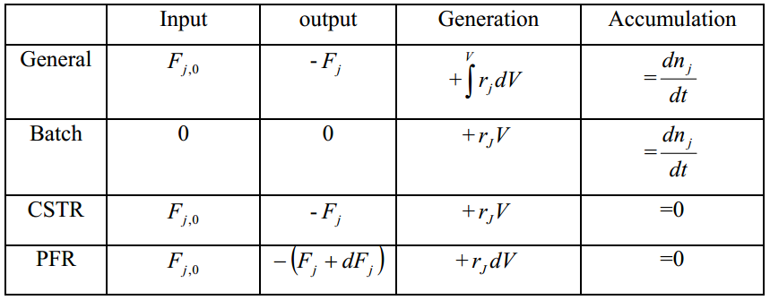
Cont’d
(1.7)
Table 1. 1 materials balance equations for batch, CSTR and PFR reactors
47

Slide 48
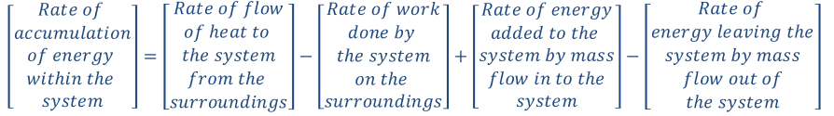
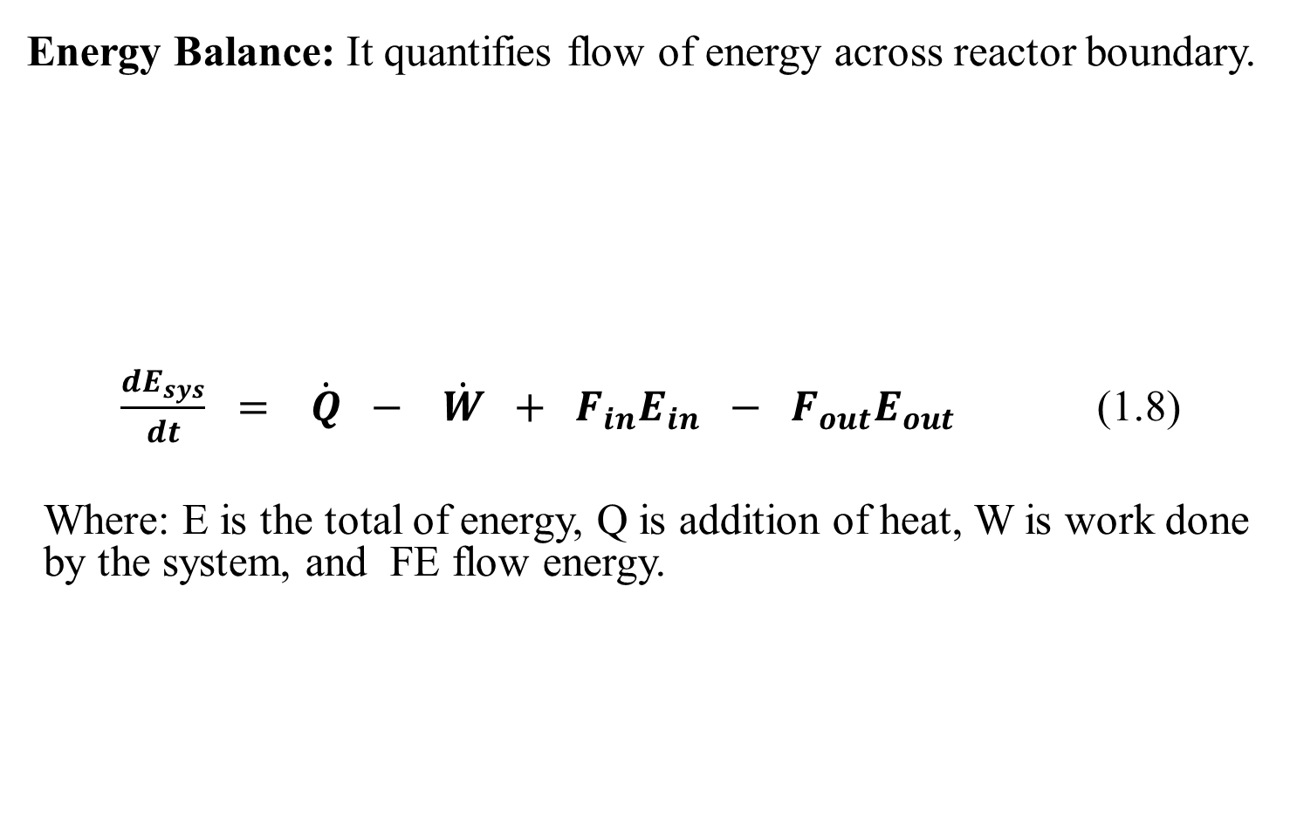
1.4.2. Energy balance in reactors
Energy Balance: It quantifies flow of energy across reactor boundary.
$\frac{{dE}_{sys}}{dt} = \dot{Q} − \dot{W} + F_{in}E_{in} − F_{out}E_{out}$ (1.8)
Where: E is the total of energy, Q is addition of heat, W is work done by the system, and FE flow energy.
48

Slide 49
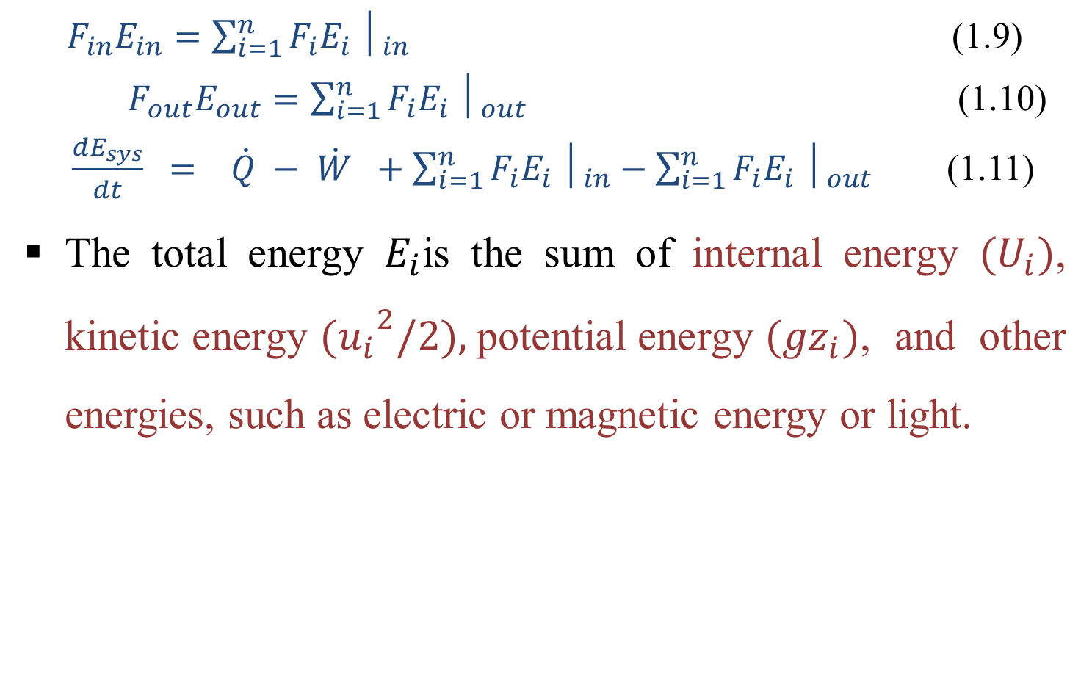
Cont’d
$F_{in}E_{in}=\sum_{i=1}^{n}{F_{i}E_{i}}│_{in}$ (1.9)
    ${ F}_{out}E_{out}=\sum_{i=1}^{n}{F_{i}E_{i}}│_{out}$ (1.10)
  $\frac{{dE}_{sys}}{dt} = \dot{Q} − \dot{W} +\sum_{i=1}^{n}{F_{i}E_{i}}│_{in}−\sum_{i=1}^{n}{F_{i}E_{i}}│_{out}$ (1.11)
The total energy $E_{i}$is the sum of internal energy $(U_{i})$, kinetic energy ${(u_{i}}^{2}/2),$potential energy ${(gz}_{i})$, and other energies, such as electric or magnetic energy or light.
49

Slide 50
1.5. Summary
Reaction engineering = chemical kinetics + reactors design.
A species may lose its chemical identity by decomposition, combination, and isomerization.
Chemical reactors are vessels/containers
Reactors can be classified based phase, method of operation and thermal operation.
Reactor design is required due to development of a new chemical process, and modification of an existing chemical process.
Materials and energy balances = quantify of materials and energy flows across reactors boundary.
50

Slide 51
References
Chemical Reaction Engineering, Levenspiel, O John Wiely& Sons, 3rd edition, 2011.
Elements of Chemical Engineering, Fogler, HS Prentice- Hall Inc Prentice- Hall Inc, 2015.
Thank you!
51

