Slide 1
Chemical Reaction Engineering II- Reactor Design (ChEg 4101)
Prerequisite: Chemical Reaction Engineering I-Reaction Kinetics (ChEg3104)
Lecture 2: Design of Isothermal Ideal Batch Reactor
Week 2
Lecturer: Adamu Esubalew (PhD, ChEg)
Addis Ababa, Ethiopia

Slide 2
Lecture learning outcomes
At the end of the lecture, you will be able to:
  identify reaction time, auxiliary time, and size or volume reactor required for isothermal ideal batch reactor, and
  design isothermal ideal batch reactor using materials and energy balance equations.

Slide 3
Presentation outlines
Introduction to isothermal batch reactor
Reaction time and auxiliary time of batch reactor
Size or Volume of batch reactor
Isothermal batch reactor design equations
Summary

Slide 4
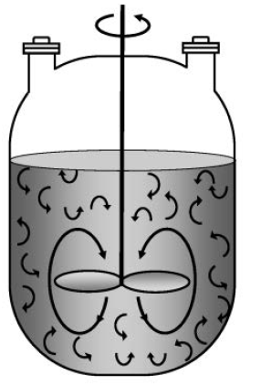
2.1 Introduction to isothermal batch reactor
Isothermal batch reactor: It is a reactor in which reactants are mixed together and the reaction is allowed to proceed at constant temperature for a given time in a closed vessel with no inlet or outlet flows. i.e. the reaction temperature is constant throughout the reactor.
Figure 2. 1 A batch reactor with mixing patterns (Fogler, 2015, pg. 11)
4

Slide 5
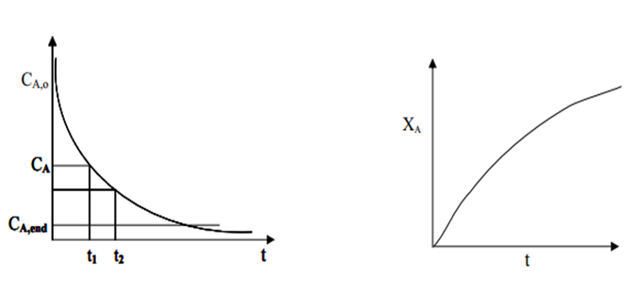
For isothermal batch reactor, concentrations, reaction rate and conversion are functions of reaction time.
(a)
(b)
Figure 2.2. Variation of (a) concentration and (b) conversion with time in a batch reactor
5

Slide 6
It is assumed that perfect mixing of contents throughout a reactor.
The reaction proceeds quickly at first and then proceeds slowly.
Batch reactors are normally used for small-scale operation, testing new processes, manufacturing of expensive products, and processes difficult to convert to continuous.
6

Slide 7
The advantage is that high conversions can be achieved due to leaving the reactants in reactor.
The disadvantages are high labor costs, auxiliary time, variability of products (batch to batch), and they are difficult to operate/automate for large-scale production.
7

Slide 8
To model a batch reactor, it is assumed that at any given time the reactor is well-mixed so that the composition, temperature, and pressure are the same everywhere in the reactor.
For liquid-phase reactions, the entire volume of the reactor is not filled by the liquid, and the reaction volume is the volume of the liquid which is less than the reactor volume.
8

Slide 9
2.2 Reaction time and auxiliary time
Reaction time (t_{r}) is the time required of chemical reaction to reach a particular specified conversion.
It is determined by applying material balance equation.
Auxiliary time is also determined beside of reaction time.
Total time is sum of reaction time and auxiliary time.
Total time is the time elapsed to complete one batch operation.
Total time is also called cycle time.
9

Slide 10
Cont’d
Auxiliary time includes different periods of a batch operation such as raw material preparation time (sample measuring time, solution preparation time, charging time, heating up time), discharging time and washing (cleaning) time.
In general, four types of periods are required to complete one batch process. They are:
Preparation time,
Reaction time,
Recovery time, and
Cleaning time.
10

Slide 11
Cont’d
Preparation time (t_{ch} ): It is the length of time required for fresh reactants are charged to reactor and made ready them for reaction.
Reaction time (t_{r}): It is the length of time required for the reactants to be converted into products to the desired conversion.
Recovery time (t_{d} ):It is the time required for the products completely discharged from the reactor.
11

Slide 12
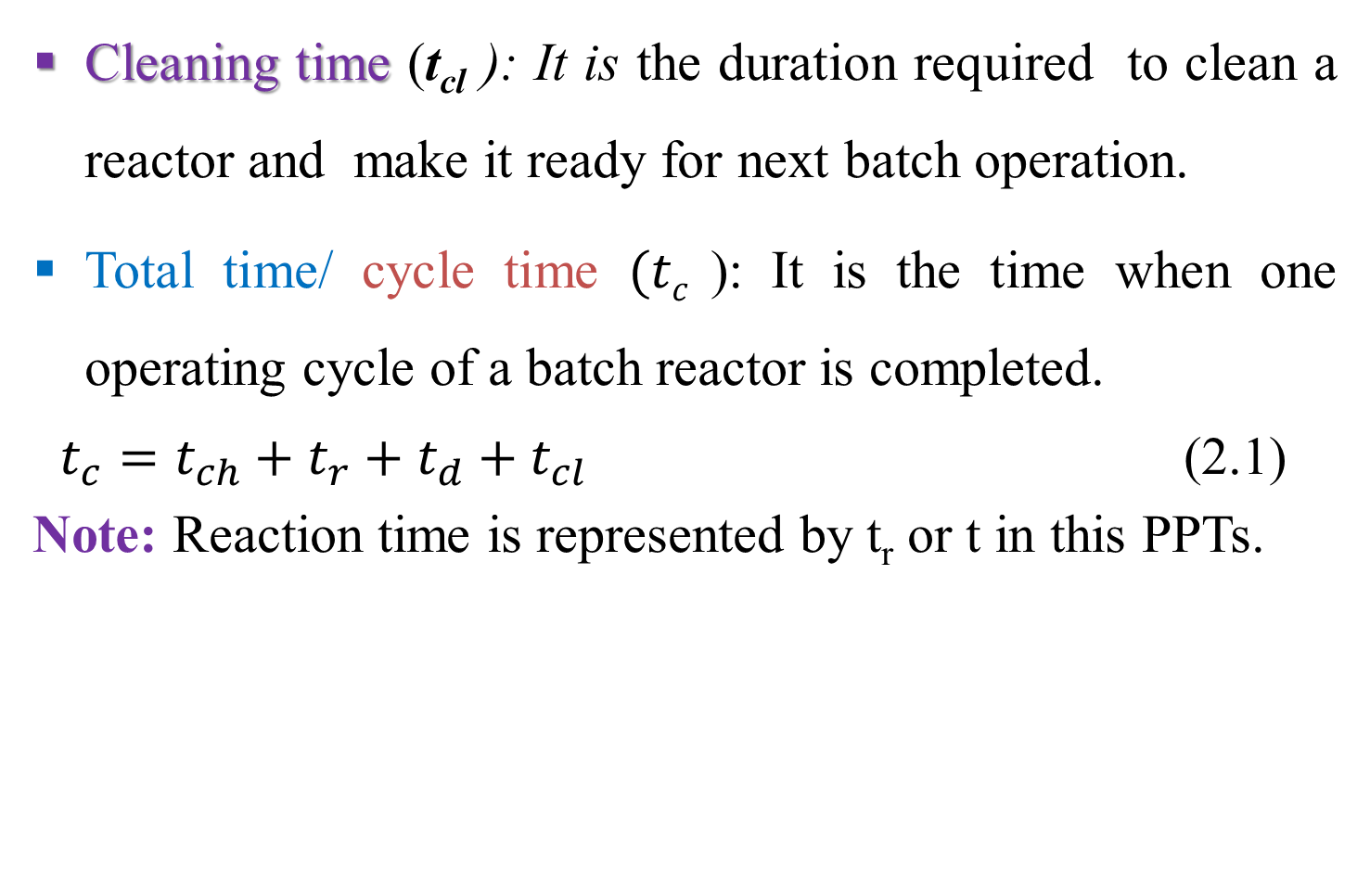
Cont’d
Cleaning time (t_{cl} ): It is the duration required to clean a reactor and make it ready for next batch operation.
Total time/ cycle time $(tc$ ): It is the time when one operating cycle of a batch reactor is completed.
$t_{c}=t_{ch}+t_{r}+t_{d}+t_{cl}$ (2.1)
Note: Reaction time is represented by t_{r} or t in this PPTs.
12

Slide 13
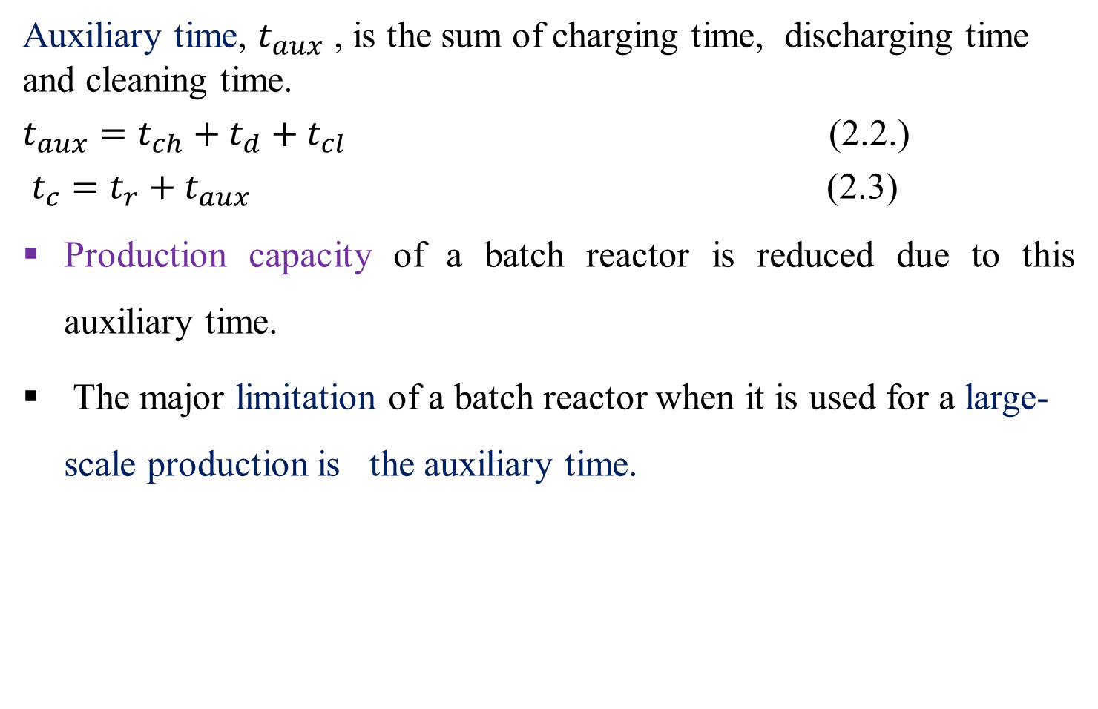
Cont’d
Auxiliary time, $t_{aux}$ , is the sum of charging time, discharging time and cleaning time.
$t_{aux}=t_{ch}+t_{d}+t_{cl}$ (2.2.)
$t_{c}=t_{r}+t_{aux}$ (2.3)
Production capacity of a batch reactor is reduced due to this auxiliary time.
The major limitation of a batch reactor when it is used for a large-scale production is the auxiliary time.
13

Slide 14
2.3. The size or volume of batch reactor
The size or volume reactor required is the main design parameter for batch reactor.
Size or volume of a batch reactor required is not directly calculated from material balance.
It is determined after calculating the cycle time (total time) required for a batch operation.
14

Slide 15
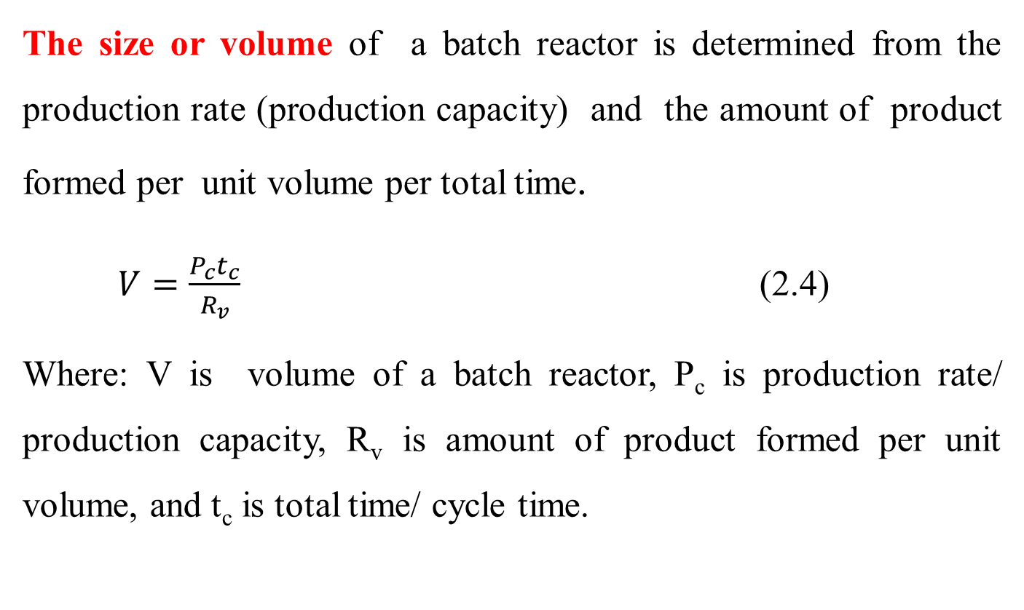
Cont’d
The size or volume of a batch reactor is determined from the production rate (production capacity) and the amount of product formed per unit volume per total time.
    $V=\frac{P_{c}t_{c}}{R_{v}}$ (2.4)
Where: V is volume of a batch reactor, P_{c} is production rate/ production capacity, R_{v} is amount of product formed per unit volume, and t_{c} is total time/ cycle time.
15

Slide 16

2.4. Isothermal batch reactor design equations
The process design of isothermal reactor can be obtained by using materials and energy balance .
Consider the following simple reaction which is take placed in the batch reactor as shown in Figure 2. 3.
A------------------> R (2.5)
Where: A is reactant and R is product.
Figure 2.3. A batch reactor
16

Slide 17
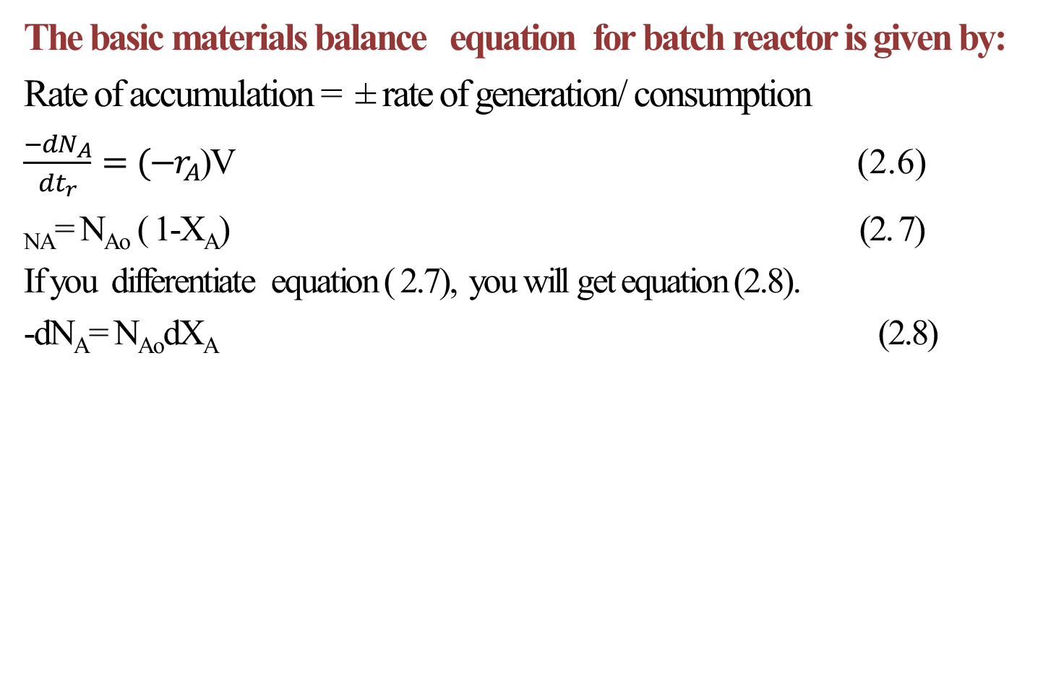
Cont’d
The basic materials balance equation for batch reactor is given by:
Rate of accumulation = ± rate of generation/ consumption
$\frac{−dN_{A}}{dt_{r}}={(−r}_{A}$)V (2.6)
_{NA}= N_{Ao} ( 1-X_{A}) (2. 7)
If you differentiate equation ( 2.7), you will get equation (2.8).
-dN_{A}= N_{Ao}dX_{A} (2.8)
17

Slide 18
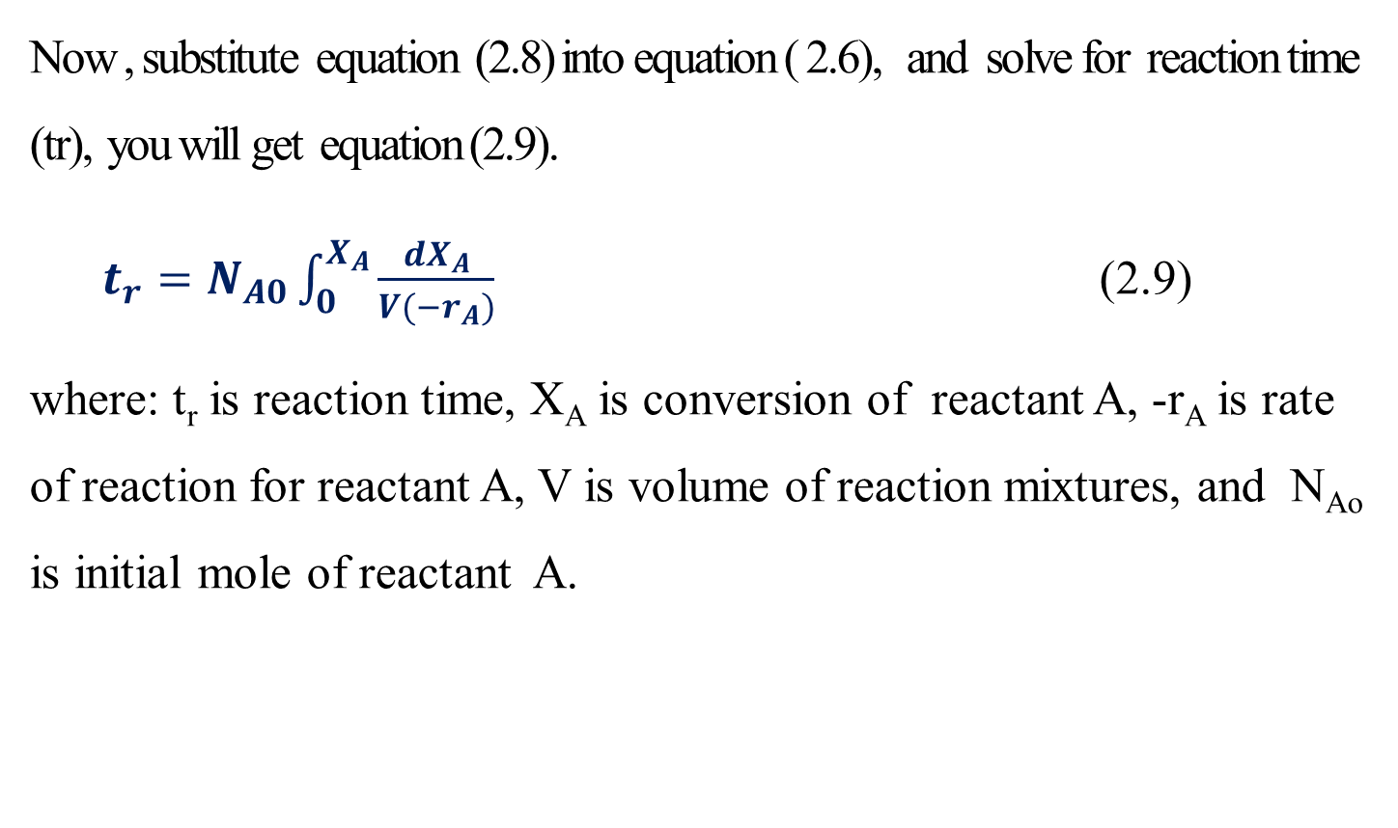
Cont’d
Now , substitute equation (2.8) into equation ( 2.6), and solve for reaction time (tr), you will get equation (2.9).
  $t_{r}=N_{A0}\int_{0}^{X_{A}}{\frac{{dX}_{A}}{V{(−r}_{A})}}$ (2.9)
where: t_{r} is reaction time, X_{A} is conversion of reactant A, -r_{A} is rate of reaction for reactant A, V is volume of reaction mixtures, and N_{Ao} is initial mole of reactant A.
18

Slide 19
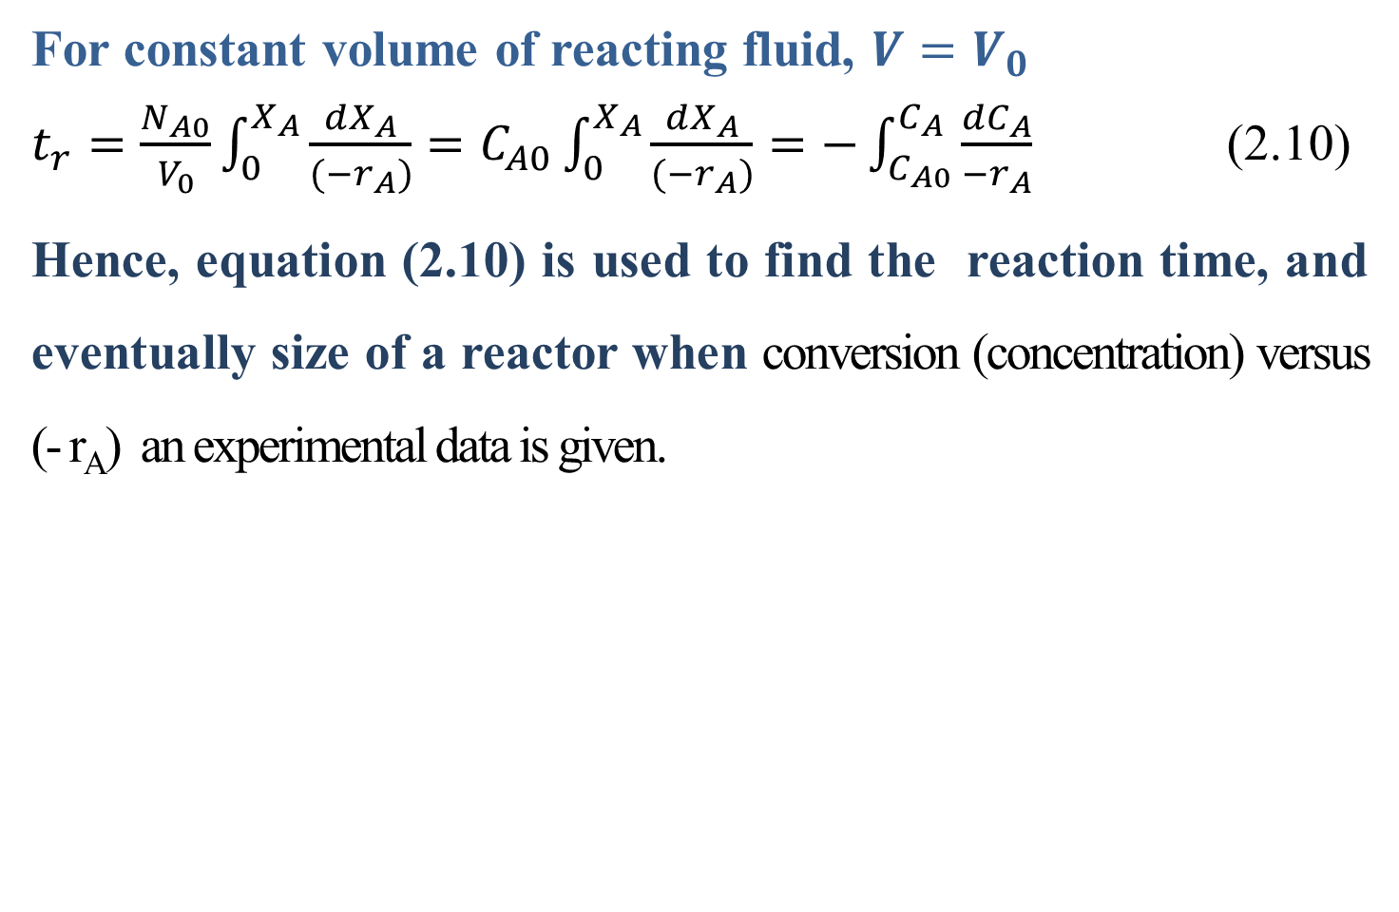
Cont’d
For constant volume of reacting fluid, $V=V_{0}$
$t_{r}=\frac{N_{A0}}{V_{0}}\int_{0}^{X_{A}}{\frac{{dX}_{A}}{{(−r}_{A})}}=C_{A0}\int_{0}^{X_{A}}{\frac{{dX}_{A}}{{(−r}_{A})}}=−\int_{C_{A0}}^{C_{A}}{\frac{{dC}_{A}}{{−r}_{A}}}$ (2.10)
Hence, equation (2.10) is used to find the reaction time, and eventually size of a reactor when conversion (concentration) versus (- r_{A}) an experimental data is given.
19

Slide 20
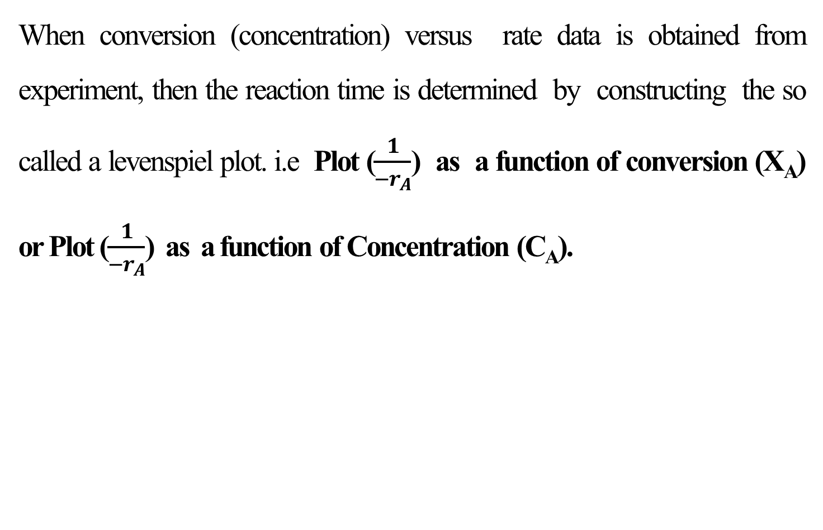
Cont’d
When conversion (concentration) versus rate data is obtained from experiment, then the reaction time is determined by constructing the so called a levenspiel plot. i.e Plot ($\frac{1}{{−r}_{A}}$) as a function of conversion (X_{A}) or Plot ($\frac{1}{{−r}_{A}}$) as a function of Concentration (C_{A}).
20

Slide 21
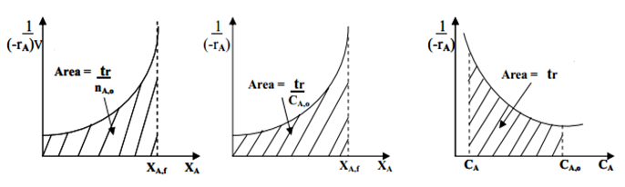
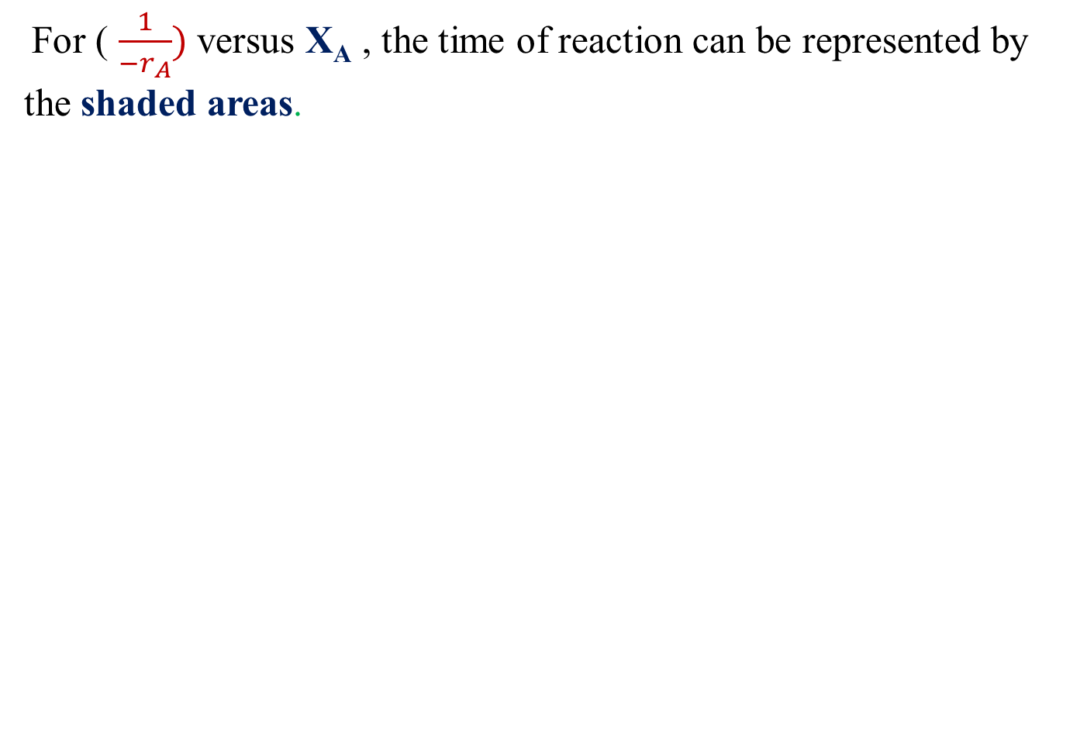
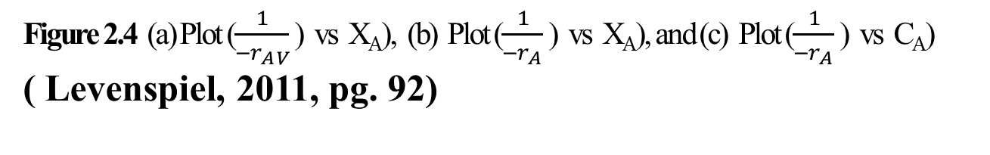
Cont’d
For ( $\frac{1}{−r_{A}})$versus X_{A} , the time of reaction can be represented by the shaded areas.
(a)
(b)
(c)
Figure 2.4 (a) Plot ($\frac{1}{{−r}_{A V}}$ ) vs X_{A}), (b) Plot ($\frac{1}{{−r}_{A }}$ ) vs X_{A}), and (c) Plot ($\frac{1}{{−r}_{A }}$ ) vs C_{A})
( Levenspiel, 2011, pg. 92)
21

Slide 22
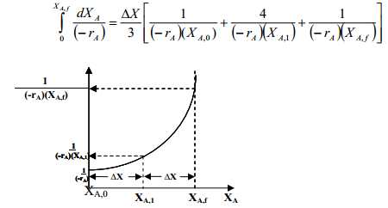
Cont’d
The integral also can be evaluated using numerical methods such as, Trapezoidal rule, Simpson's rule, Five-point quadratic formula.
Simpson's one third rule to evaluate the integral is given by:
(2.11)
Figure 2. 5 Simpson’s one-third rule plot of ($\frac{1}{{−r}_{A}X_{Af}}$ ) vs X_{A})
22

Slide 23
Activity 2.1
Consider an elementary isothermal and constant volume reaction.
A ---------> P
The laboratory investigation in a batch reactor at 422K and total pressure of 10 atm, and chemical reaction rate as a function of conversion is given below. The initial charge is an equi-molar mixture of A and inert. Calculate the reaction time required to convert 40% A.
X_{A} | 0 | 0.1 | 0.2 | 0.3 | 0.4
-r_{A} (mol/ dm³ h) | 0.0053 | 0.0052 | 0.0050 | 0.0045 | 0.0040
23

Slide 24
Cont’d
Given: elementary reaction, constant volume, total pressure (P)= 10 atm, T=422K, initial Equi-molar mixture of inert and reactant A, and X_{A} is 0.40.
Required: Determine the reaction time (t_{r})
Assumption: Isothermal Batch reactor.
Solution: From ideal gas law, PV= NRT
The initial partial pressure of A(P_{Ao}) = mole fraction of A * total Pressure
P_{Ao}=y* P= 0.5*10 atm= 5 atm= 506.625 kPa.
24

Slide 25
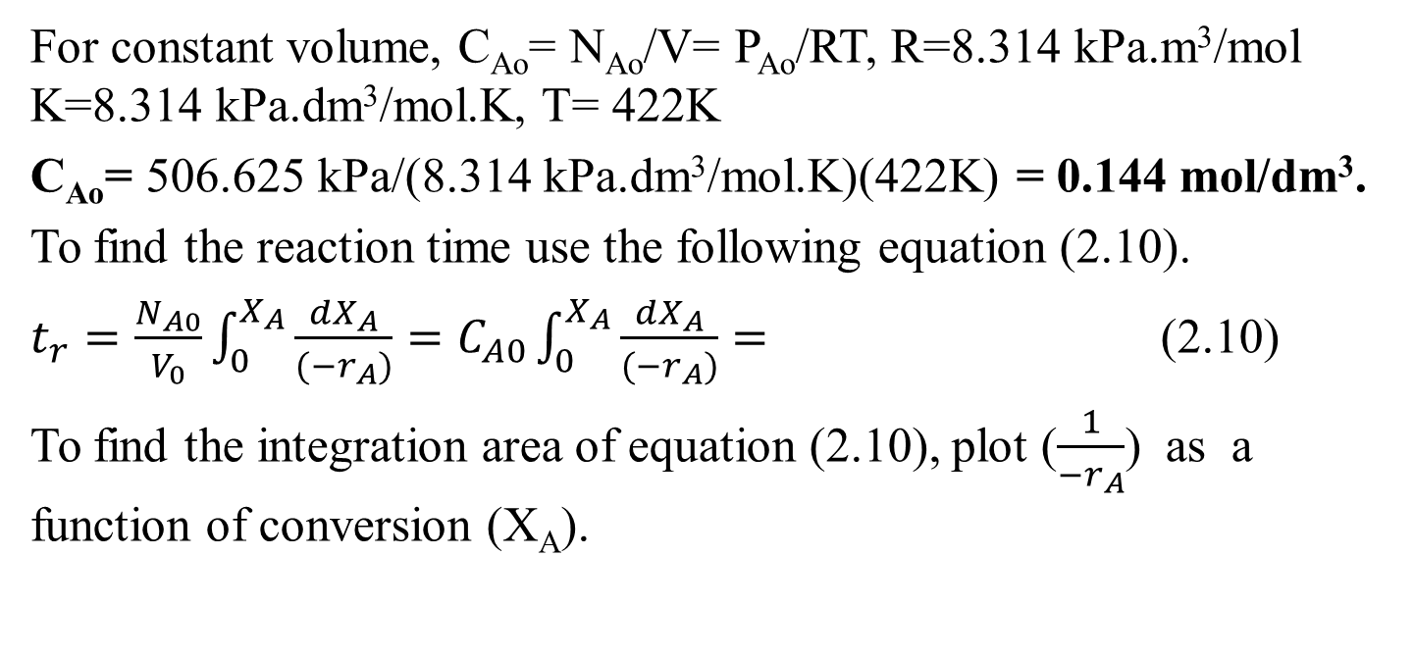
Cont’d
For constant volume, C_{Ao}= N_{Ao}/V= P_{Ao}/RT, R=8.314 kPa.m³/mol K=8.314 kPa.dm³/mol.K, T= 422K
C_{Ao}= 506.625 kPa/(8.314 kPa.dm³/mol.K)(422K) = 0.144 mol/dm³.
To find the reaction time use the following equation (2.10).
$t_{r}=\frac{N_{A0}}{V_{0}}\int_{0}^{X_{A}}{\frac{{dX}_{A}}{{(−r}_{A})}}=C_{A0}\int_{0}^{X_{A}}{\frac{{dX}_{A}}{{(−r}_{A})}}=$ (2.10)
To find the integration area of equation (2.10), plot ($\frac{1}{{−r}_{A}}$) as a function of conversion (X_{A}).
25

Slide 26
Cont’d
The data of 1/-r_{A} as a function of conversion is given below.
The area under the curve is the ratio of reaction time to initial concentration of reactant A. i.e. Area under the curve= t_{r}/ C_{Ao.} You can plot the following data using appropriate tools to find the area under the curve. For example, here the plot is carried out using origin 18 software (trial version) as shown in Figure 2.6.
X_{A} | 0 | 0.1 | 0.2 | 0.3 | 0.4
1/-r_{A} (dm³ h/mol) | 189 | 192 | 200 | 222 | 250
26

Slide 27
Cont’d
Figure 2. 6 plot of (1/-r_{A}) vs X_{A}
The reaction time (t_{r}) = C_{Ao} * Area under the curve
t_{r}= C_{Ao}* Area
t_{r}= 0.144 mol/dm³* 83.4 dm³.h/mol
Hence, t_{r}= 12 h
27

Slide 28
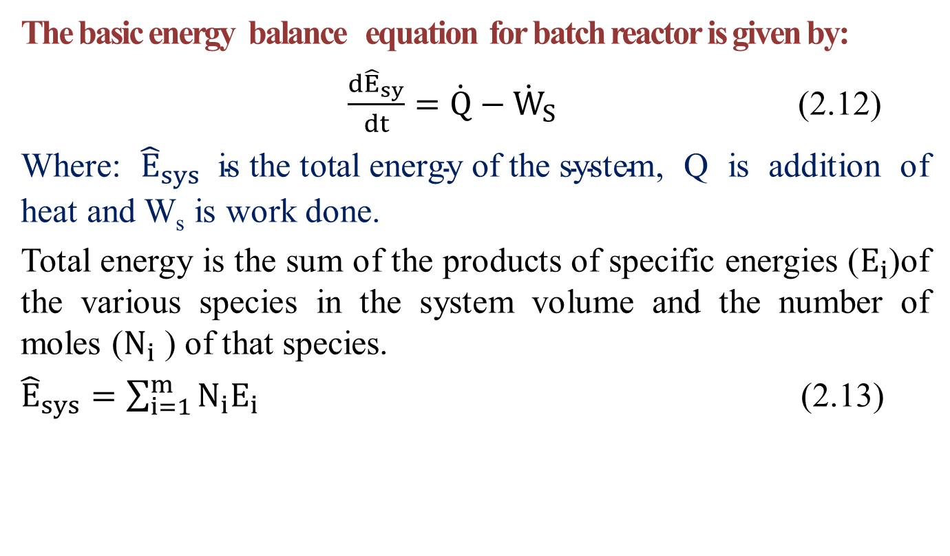
Cont’d
The basic energy balance equation for batch reactor is given by:
$\frac{{d\hat{E}}_{sy}}{dt}=\dot{Q}−{\dot{W}}_{S}$ (2.12)
Where: ${\hat{E}}_{sys} \text{is} \text{the} \text{total} \text{energy} \text{of} \text{the} \text{system}$, Q is addition of heat and W_{s} is work done.
Total energy is the sum of the products of specific energies ($E_{i}$)of the various species in the system volume and the number of moles ($N_{i}$ ) of that species.
${\hat{E}}_{sys}=\sum_{i=1}^{m}{N_{i}E_{i}}$ (2.13)
28

Slide 29
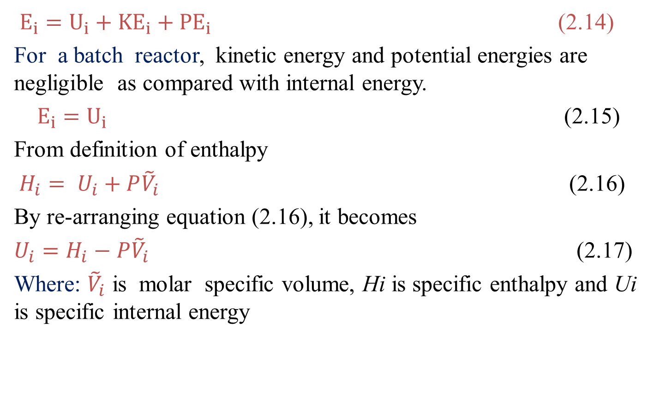
Cont’d
$E_{i}=U_{i}+{KE}_{i}+{PE}_{i}$ (2.14)
For a batch reactor, kinetic energy and potential energies are negligible as compared with internal energy.
$E_{i}=U_{i}$ (2.15)
From definition of enthalpy
$H_{i}= U_{i}+P{\tilde{V}}_{i}$ (2.16)
By re-arranging equation (2.16), it becomes
$U_{i}=H_{i}−P{\tilde{V}}_{i}$ (2.17)
Where: ${\tilde{V}}_{i}$ is molar specific volume, Hi is specific enthalpy and Ui is specific internal energy
29

Slide 30
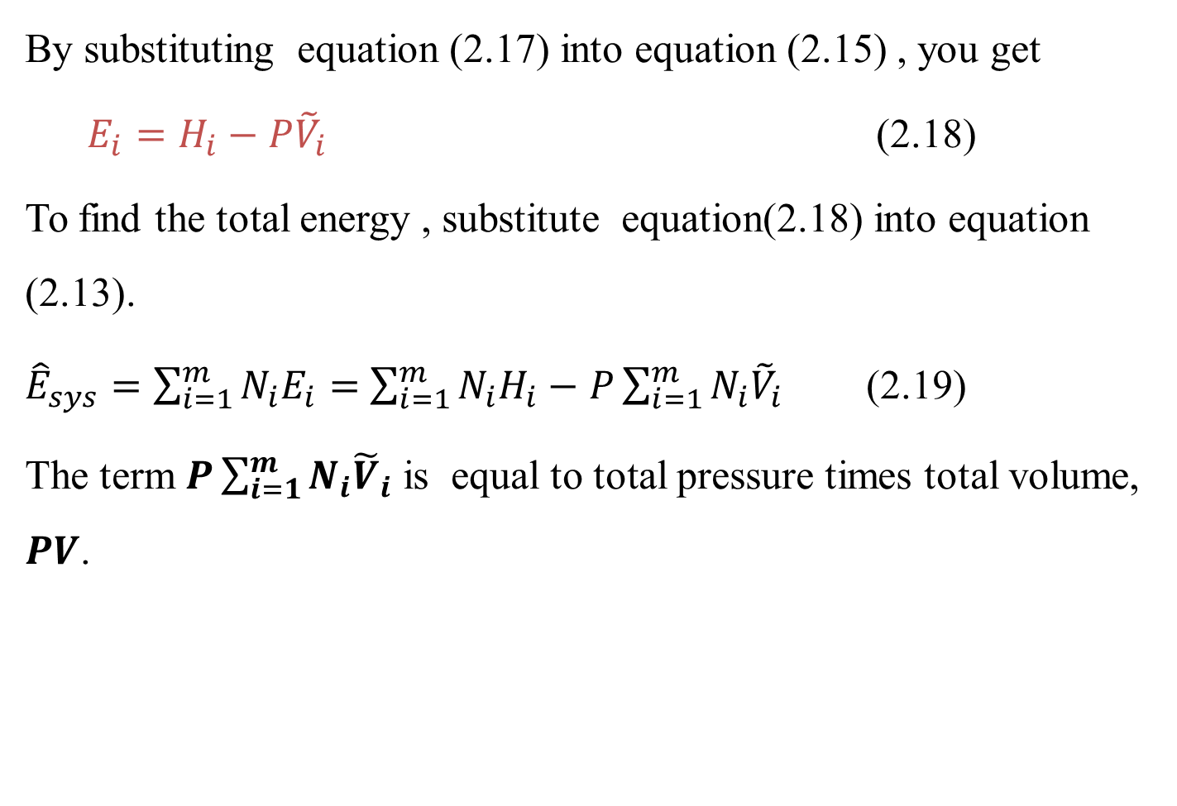
Cont’d
By substituting equation (2.17) into equation (2.15) , you get
$E_{i}=H_{i}−P{\tilde{V}}_{i}$ (2.18)
To find the total energy , substitute equation(2.18) into equation (2.13).
${\hat{E}}_{sys}=\sum_{i=1}^{m}{N_{i}E_{i}=}$ $\sum_{i=1}^{m}{N_{i}H_{i}−}$ $P\sum_{i=1}^{m}{N_{i}{\tilde{V}}_{i}}$ (2.19)
The term $P\sum_{i=1}^{m}{N_{i}{\tilde{V}}_{i}}$ is equal to total pressure times total volume, $PV$.
30

Slide 31
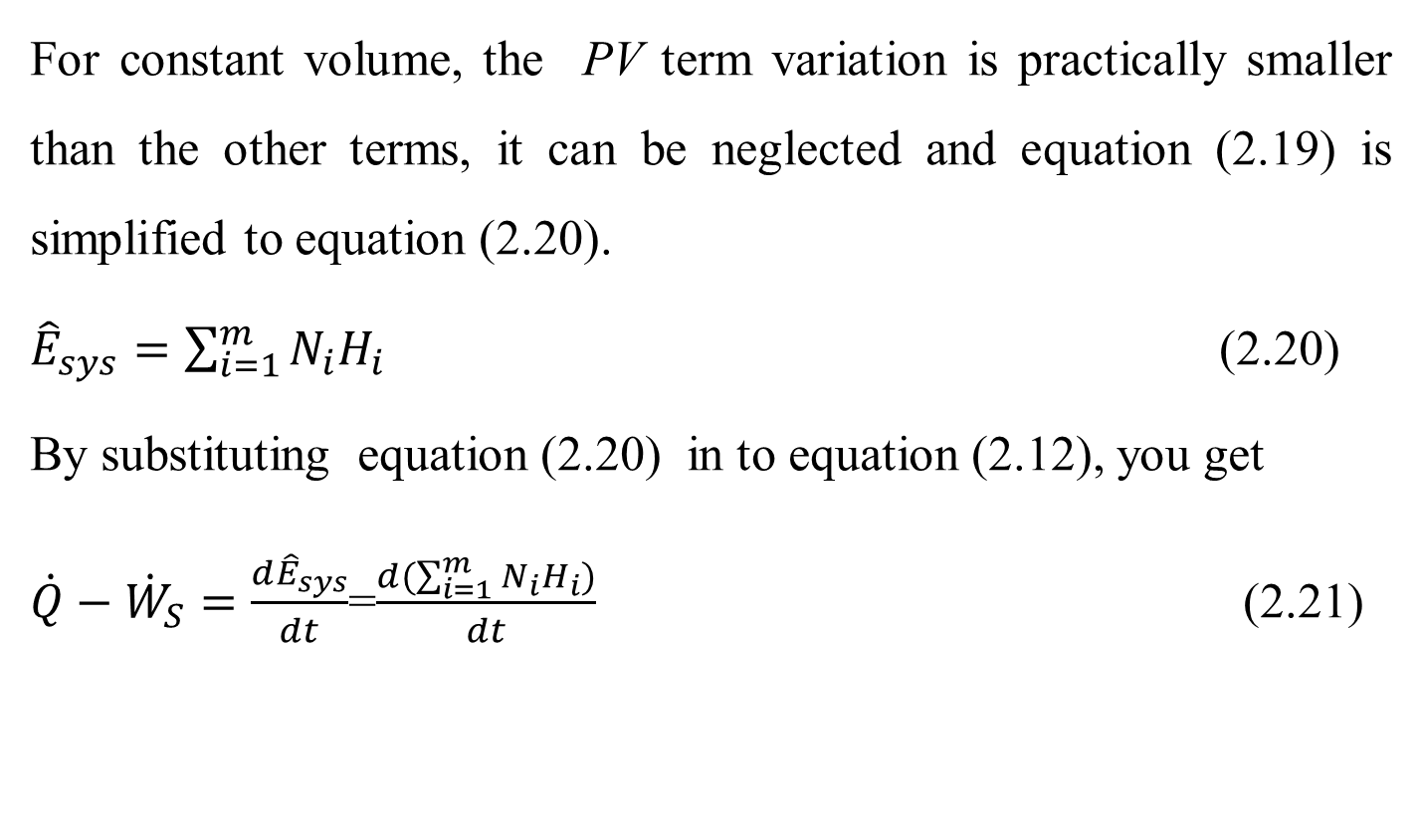
Cont’d
For constant volume, the PV term variation is practically smaller than the other terms, it can be neglected and equation (2.19) is simplified to equation (2.20).
${\hat{E}}_{sys}=\sum_{i=1}^{m}{N_{i}H_{i}}$ (2.20)
By substituting equation (2.20) in to equation (2.12), you get
$\dot{Q}−{\dot{W}}_{S}=\frac{d{\hat{E}}_{sys}}{dt}$=$\frac{d(\sum_{i=1}^{m}{N_{i}H_{i})}}{dt}$ (2.21)
31

Slide 32
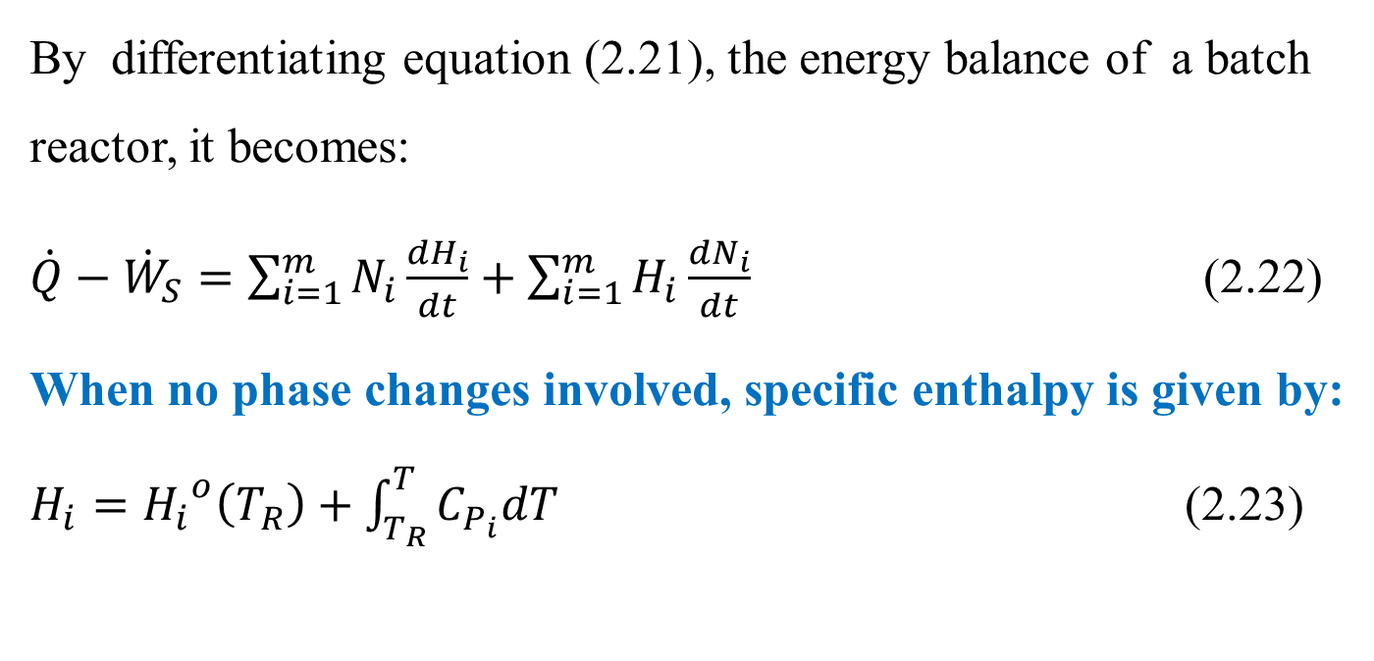
Cont’d
By differentiating equation (2.21), the energy balance of a batch reactor, it becomes:
$\dot{Q}−{\dot{W}}_{S}=\sum_{i=1}^{m}{N_{i}}\frac{{dH}_{i}}{dt}+\sum_{i=1}^{m}{H_{i}\frac{{dN}_{i}}{dt}}$ (2.22)
When no phase changes involved, specific enthalpy is given by: $H_{i}={H_{i}}^{o}\left(T_{R}\right)+\int_{T_{R}}^{T}{C_{P_{i}}dT}$ (2.23)
32

Slide 33
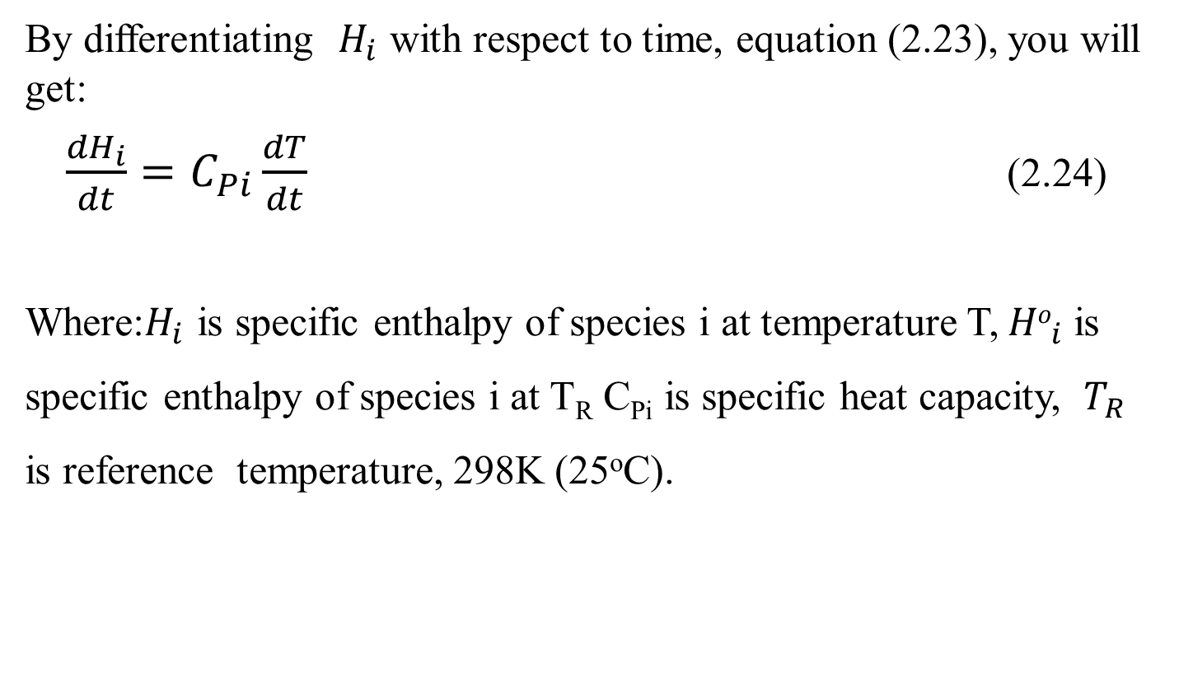
Cont’d
By differentiating $H_{i}$ with respect to time, equation (2.23), you will get:
$\frac{{dH}_{i}}{dt}=C_{Pi}\frac{dT}{dt}$ (2.24)
Where:$H_{i}$ is specific enthalpy of species i at temperature T, ${Ho}_{i}$is specific enthalpy of species i at T_{R} C_{Pi} is specific heat capacity, $T_{R}$ is reference temperature, 298K (25ºC).
33

Slide 34
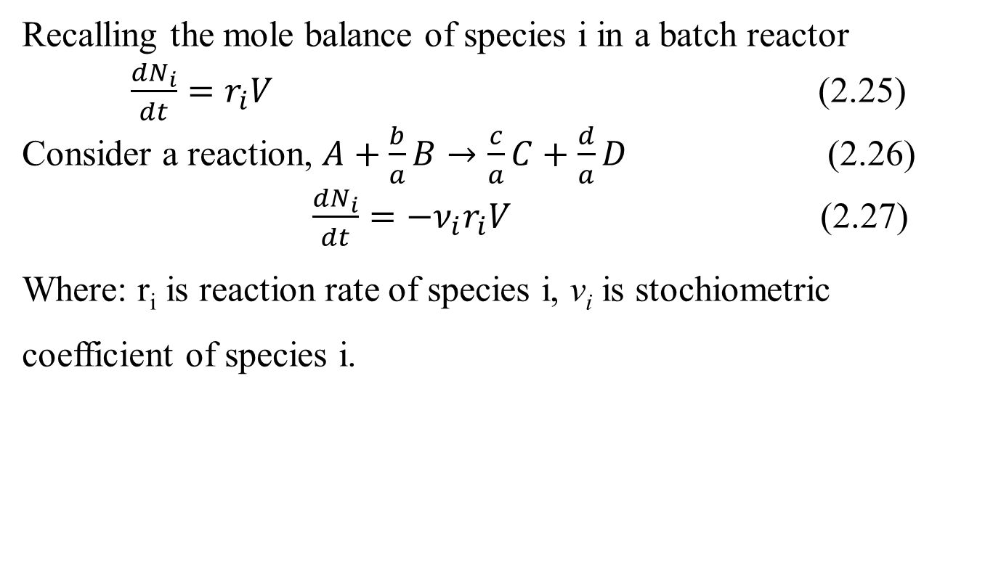
Cont’d
Recalling the mole balance of species i in a batch reactor
$\frac{{dN}_{i}}{dt}=r_{i}V$ (2.25)
Consider a reaction, $A+\frac{b}{a}B→\frac{c}{a}C+\frac{d}{a}D$ (2.26)
$\frac{{dN}_{i}}{dt}=−{\text{ν}}_{i}r_{i}V$ (2.27)
Where: r_{i} is reaction rate of species i, v_{i} is stochiometric coefficient of species i.
34

Slide 35
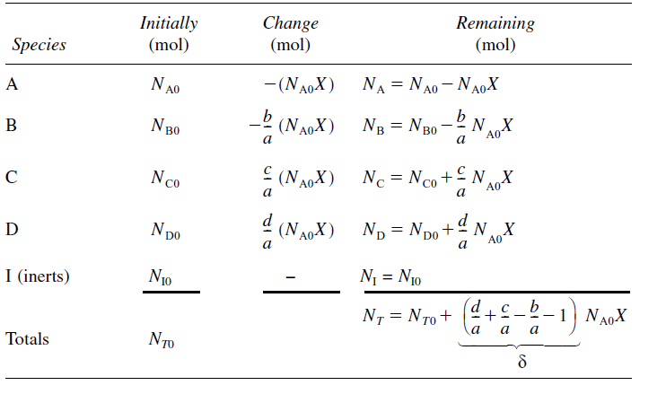
Cont’d
Table 2.1. Stoichiometric table for a batch system (Fogler, 2015, pg. 108).
35

Slide 36
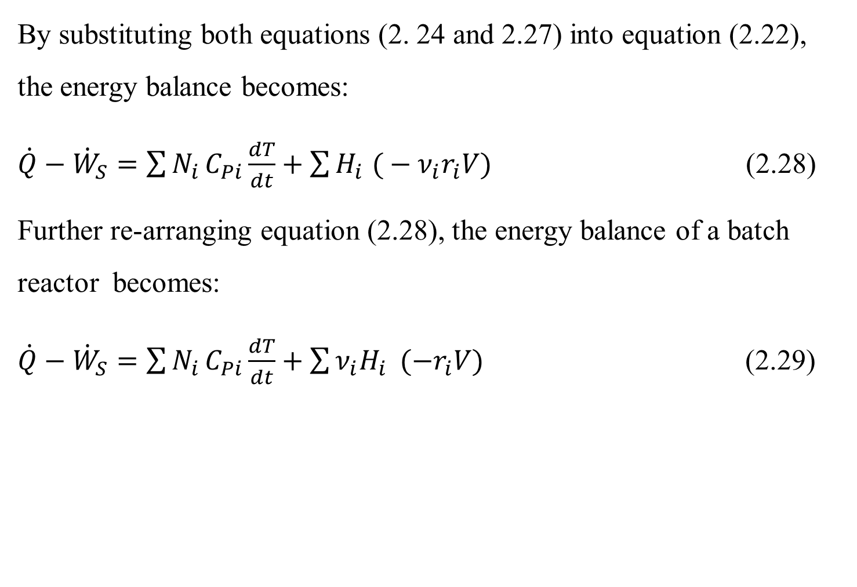
Cont’d
By substituting both equations (2. 24 and 2.27) into equation (2.22), the energy balance becomes:
$\dot{Q}−{\dot{W}}_{S}=\sum{N_{i}}C_{Pi}\frac{dT}{dt}+\sum{H_{i} (}−{\text{ν}}_{i}r_{i}V)$ (2.28)
Further re-arranging equation (2.28), the energy balance of a batch reactor becomes:
$\dot{Q}−{\dot{W}}_{S}=\sum{N_{i}}C_{Pi}\frac{dT}{dt}+\sum{{\text{ν}}_{i}H_{i} }(−r_{i}V)$ (2.29)
36

Slide 37
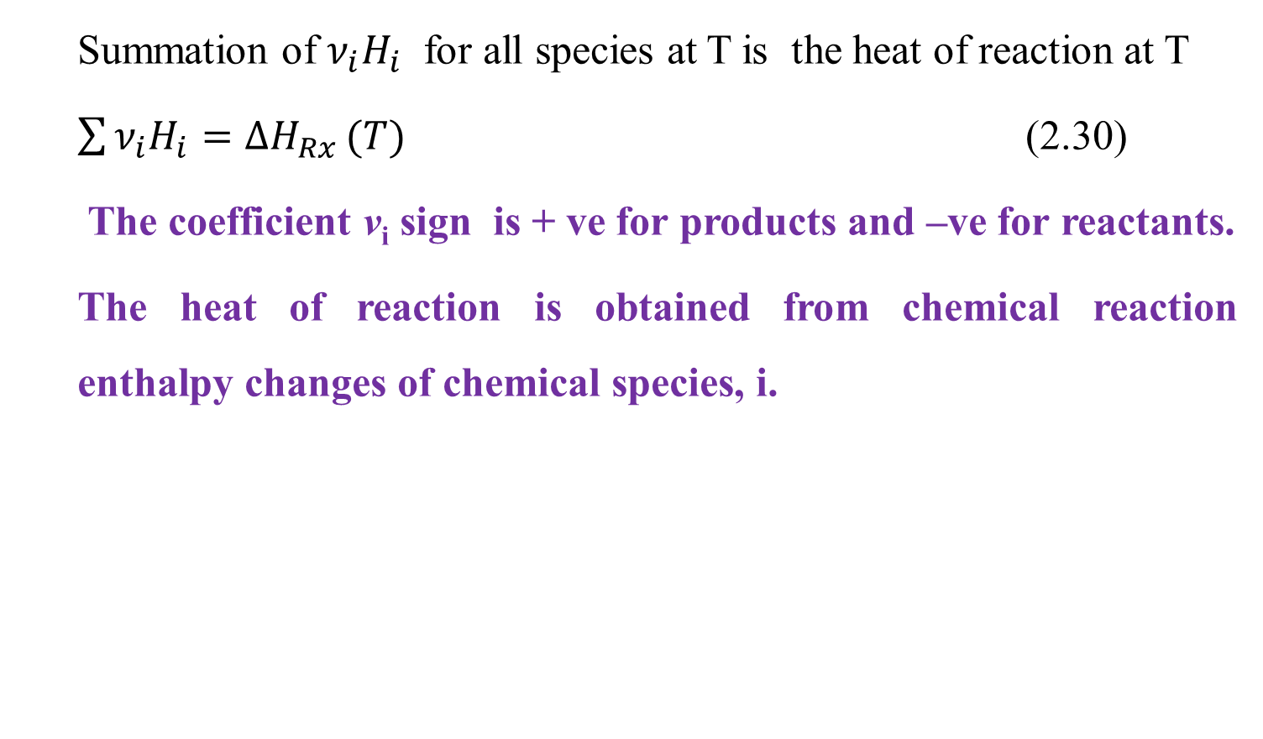
Cont’d
Summation of ${\text{ν}}_{i}H_{i}$ for all species at T is the heat of reaction at T
$\sum{{\text{ν}}_{i}H_{i}=∆H_{Rx}}(T)$ (2.30)
The coefficient v_{i} sign is + ve for products and –ve for reactants.
The heat of reaction is obtained from chemical reaction enthalpy changes of chemical species, i.
37

Slide 38
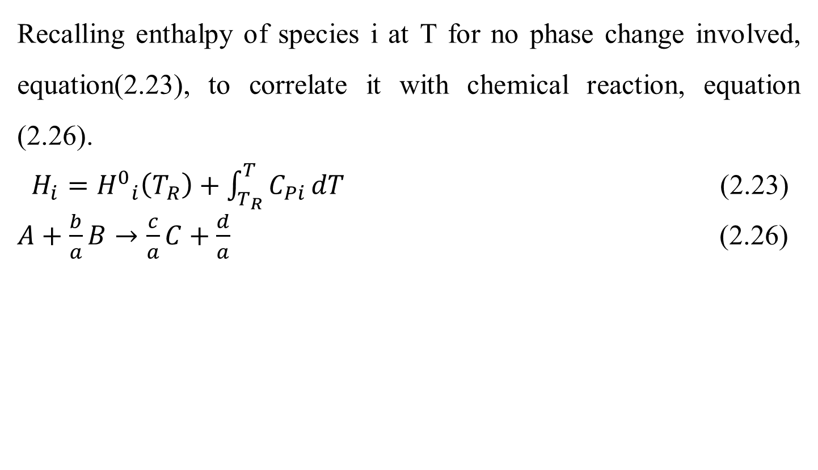
Cont’d
Recalling enthalpy of species i at T for no phase change involved, equation(2.23), to correlate it with chemical reaction, equation (2.26).
$H_{i}={H^{0}}_{i}\left(T_{R}\right)+\int_{T_{R}}^{T}{C_{Pi}}dT$ (2.23)
$A+\frac{b}{a}B→\frac{c}{a}C+\frac{d}{a}$ (2.26)
38

Slide 39
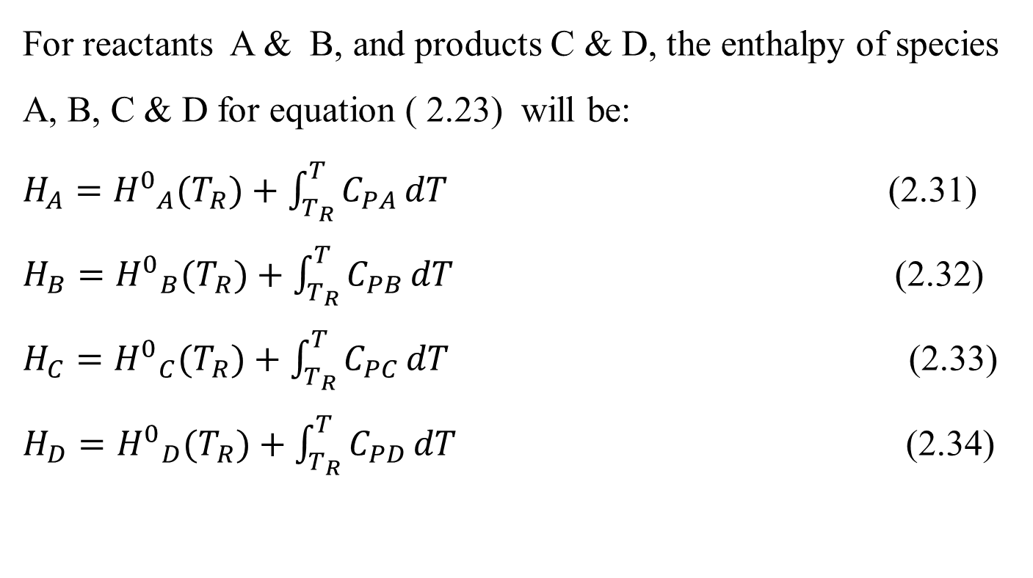
Cont’d
For reactants A & B, and products C & D, the enthalpy of species A, B, C & D for equation ( 2.23) will be:
$H_{A}={H^{0}}_{A}(T_{R})+\int_{T_{R}}^{T}{C_{PA}}dT$ (2.31)
$H_{B}={H^{0}}_{B}(T_{R})+\int_{T_{R}}^{T}{C_{PB}}dT$ (2.32)
$H_{C}={H^{0}}_{C}(T_{R})+\int_{T_{R}}^{T}{C_{PC}}dT$ (2.33)
$H_{D}={H^{0}}_{D}(T_{R})+\int_{T_{R}}^{T}{C_{PD}}dT$ (2.34)
39

Slide 40
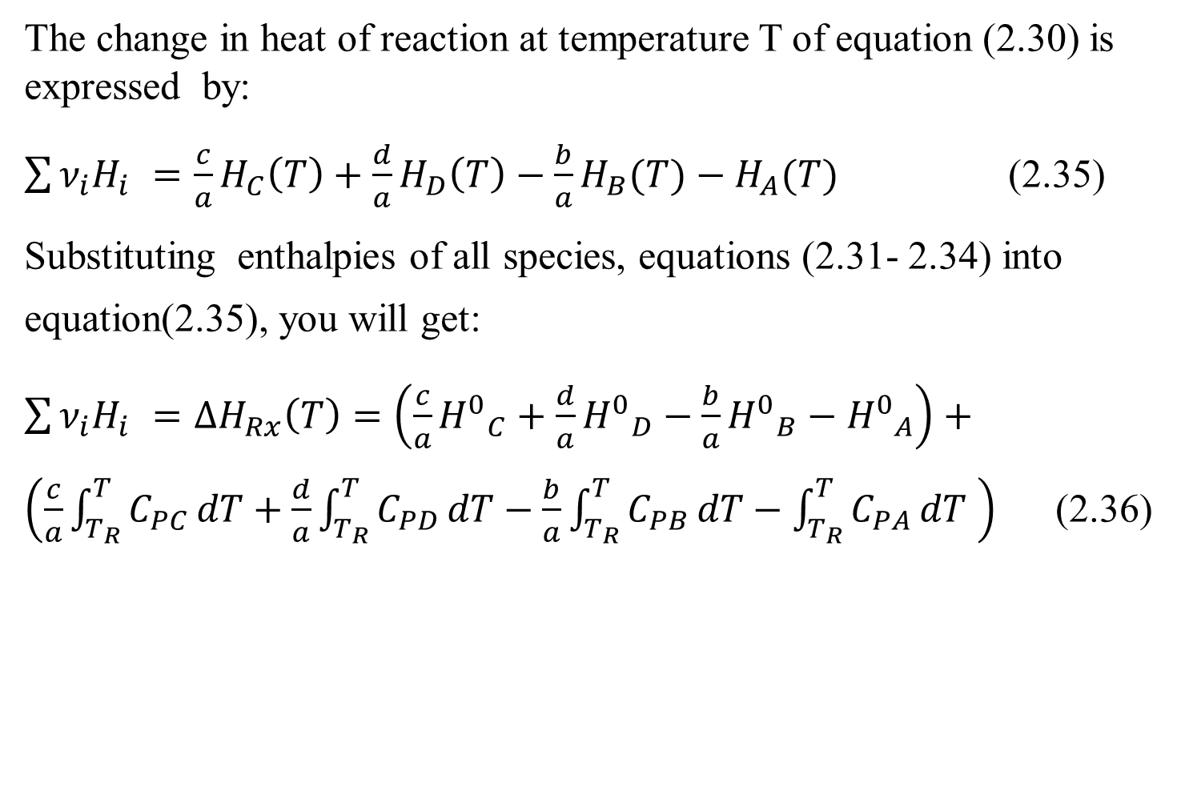
Cont’d
The change in heat of reaction at temperature T of equation (2.30) is expressed by:
$\sum{{\text{ν}}_{i}H_{i} }=\frac{c}{a}H_{C}\left(T\right)+\frac{d}{a}H_{D}\left(T\right)−\frac{b}{a}H_{B}(T)−H_{A}(T)$ (2.35)
Substituting enthalpies of all species, equations (2.31- 2.34) into equation(2.35), you will get:
$\sum{{\text{ν}}_{i}H_{i} }={∆H}_{Rx}\left(T\right)=\left(\frac{c}{a}{H^{0}}_{C}+\frac{d}{a}{H^{0}}_{D}−\frac{b}{a}{H^{0}}_{B}−{H^{0}}_{A}\right)+\left(\frac{c}{a}\int_{T_{R}}^{T}{C_{PC}}dT+\frac{d}{a}\int_{T_{R}}^{T}{C_{PD}}dT−\frac{b}{a}\int_{T_{R}}^{T}{C_{PB}}dT−\int_{T_{R}}^{T}{C_{PA}}dT \right)$ (2.36)
40

Slide 41
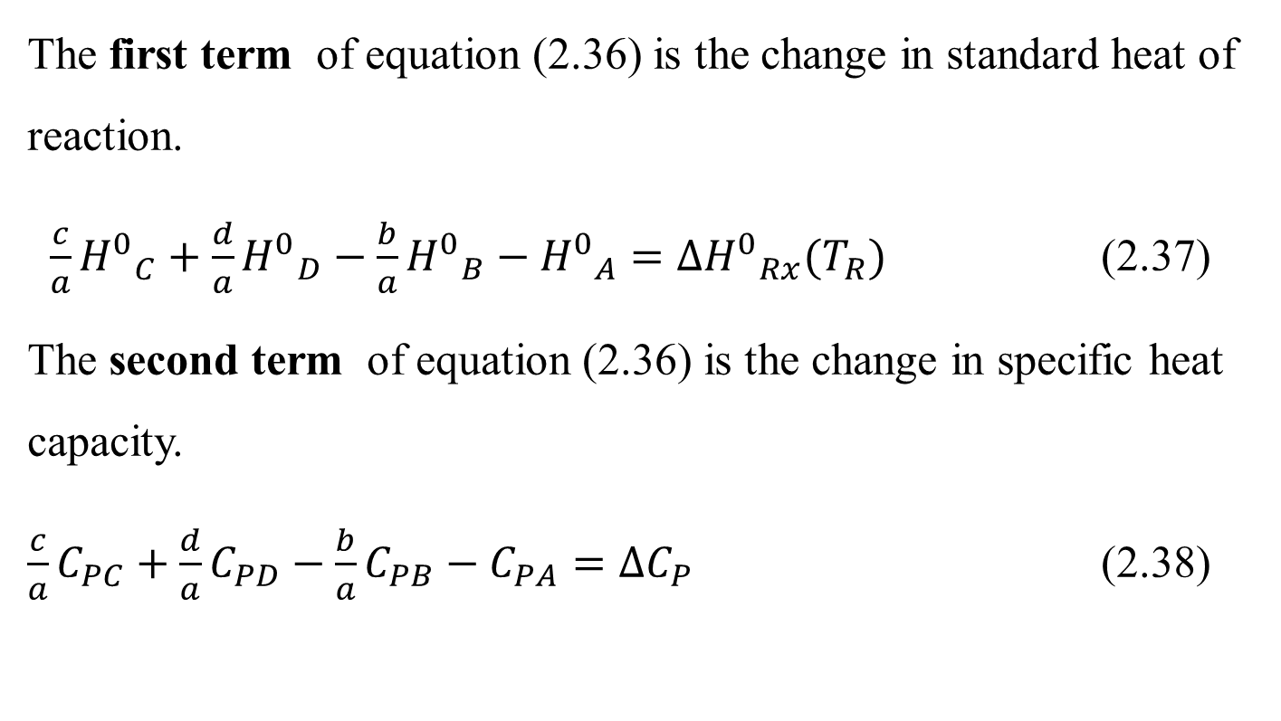
Cont’d
The first term of equation (2.36) is the change in standard heat of reaction.
$\frac{c}{a}{H^{0}}_{C}+\frac{d}{a}{H^{0}}_{D}−\frac{b}{a}{H^{0}}_{B}−{H^{0}}_{A}={{∆H}^{0}}_{Rx}(T_{R})$ (2.37)
The second term of equation (2.36) is the change in specific heat capacity.
$\frac{c}{a}C_{PC}+\frac{d}{a}C_{PD}−\frac{b}{a}C_{PB}−C_{PA}={∆C}_{P}$ (2.38)
41

Slide 42
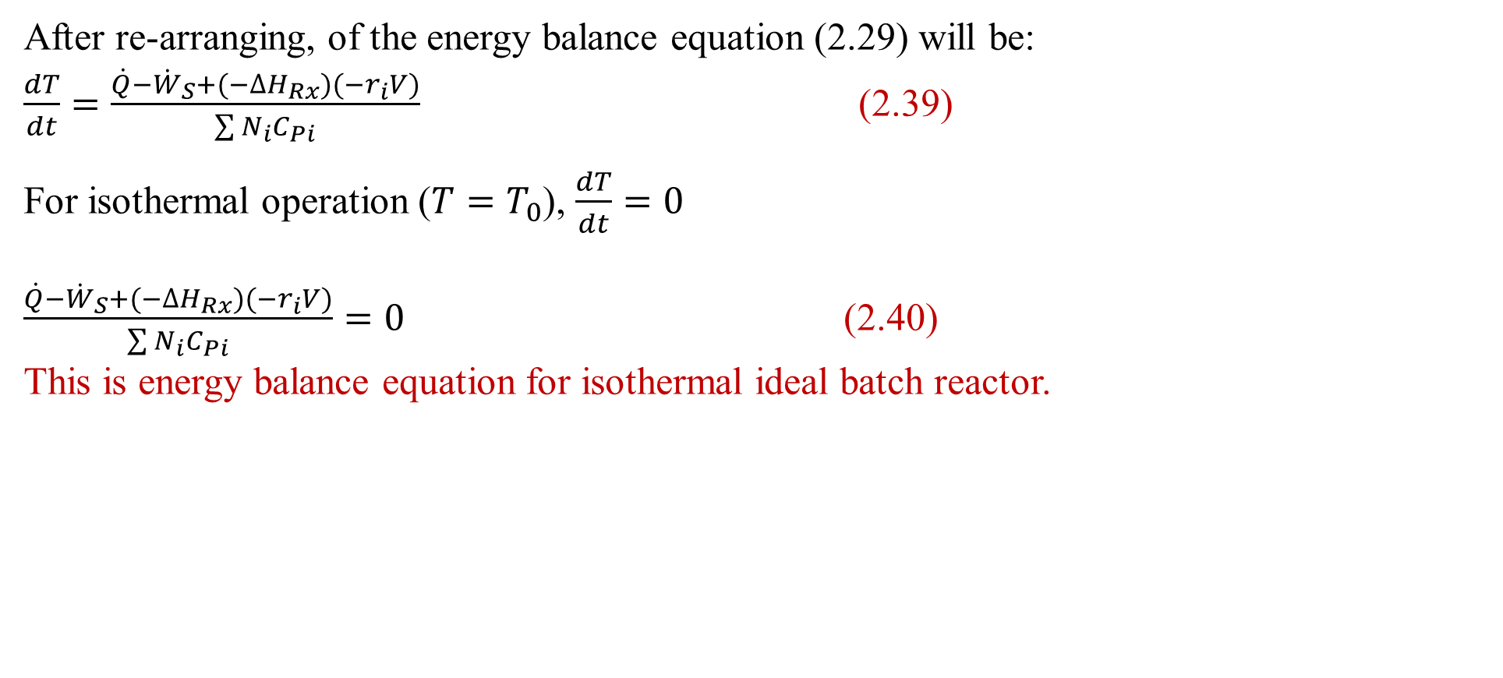
Cont’d
After re-arranging, of the energy balance equation (2.29) will be:
$\frac{dT}{dt}=\frac{\dot{Q}−{\dot{W}}_{S}+(−∆H_{Rx})(−r_{i}V)}{\sum{N_{i}}C_{Pi}}$ (2.39)
For isothermal operation ($T=T_{0}$), $\frac{dT}{dt}=0$
$\frac{\dot{Q}−{\dot{W}}_{S}+(−∆H_{Rx})(−r_{i}V)}{\sum{N_{i}}C_{Pi}}=0$ (2.40)
This is energy balance equation for isothermal ideal batch reactor.
42

Slide 43
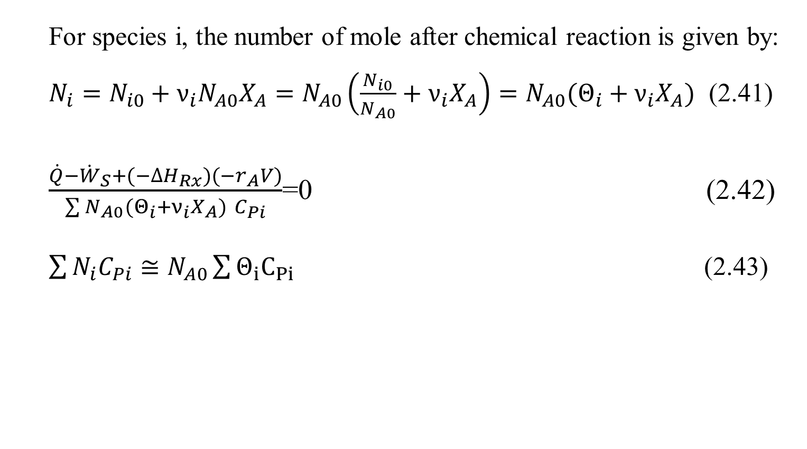
Cont’d
For species i, the number of mole after chemical reaction is given by:
$N_{i}=N_{i0}+ν_{i}N_{A0}X_{A}=N_{A0}\left(\frac{N_{i0}}{N_{A0}}+ν_{i}X_{A}\right)=N_{A0}(Θ_{i}+ν_{i}X_{A})$ (2.41)
$\frac{\dot{Q}−{\dot{W}}_{S}+(−∆H_{Rx})(−r_{A}V)}{\sum{N_{A0}(Θ_{i}+ν_{i}X_{A}) }C_{Pi}}$=0 (2.42)
$\sum{N_{i}C_{Pi}}≅N_{A0}\sum{Θ_{i}C_{Pi}}$ (2.43)
43

Slide 44
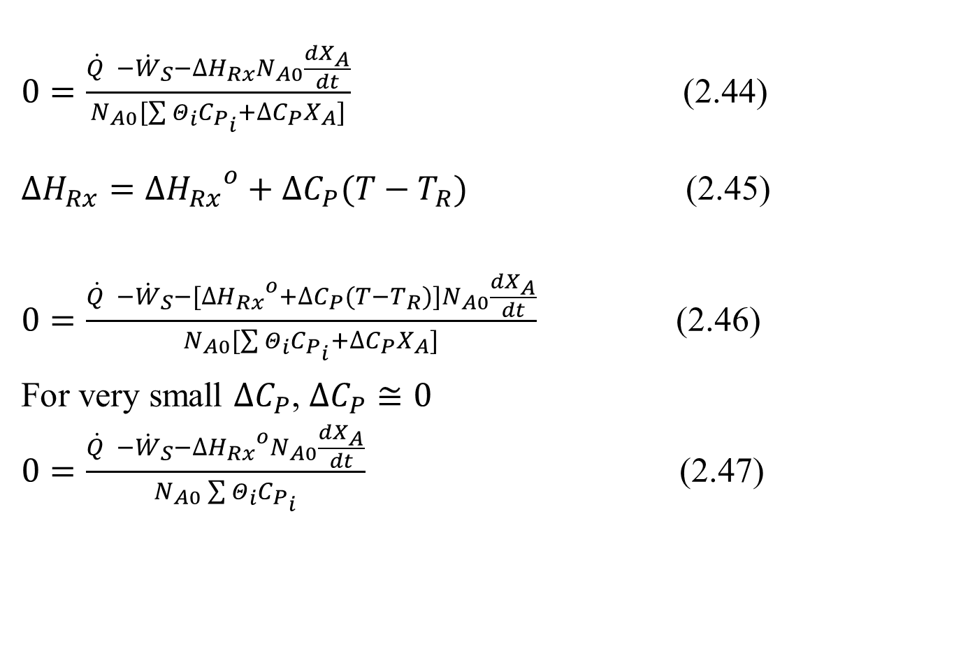
Cont’d
$0=\frac{\dot{Q} −{\dot{W}}_{S}−∆H_{Rx}N_{A0}\frac{{dX}_{A}}{dt}}{N_{A0}[\sum{Θ_{i}C_{P_{i}}+∆C_{P}X_{A}]}}$ (2.44)
$∆H_{Rx}={∆H_{Rx}}^{o}+∆C_{P}(T−T_{R})$ (2.45)
$0=\frac{\dot{Q} −{\dot{W}}_{S}−[{∆H_{Rx}}^{o}+∆C_{P}(T−T_{R})]N_{A0}\frac{{dX}_{A}}{dt}}{N_{A0}[\sum{Θ_{i}C_{P_{i}}+∆C_{P}X_{A}]}}$ (2.46)
For very small $∆C_{P}$, $∆C_{P}≅0$
$0=\frac{\dot{Q} −{\dot{W}}_{S}−{∆H_{Rx}}^{o}N_{A0}\frac{{dX}_{A}}{dt}}{N_{A0}\sum{Θ_{i}C_{P_{i}}}}$ (2.47)
44

Slide 45
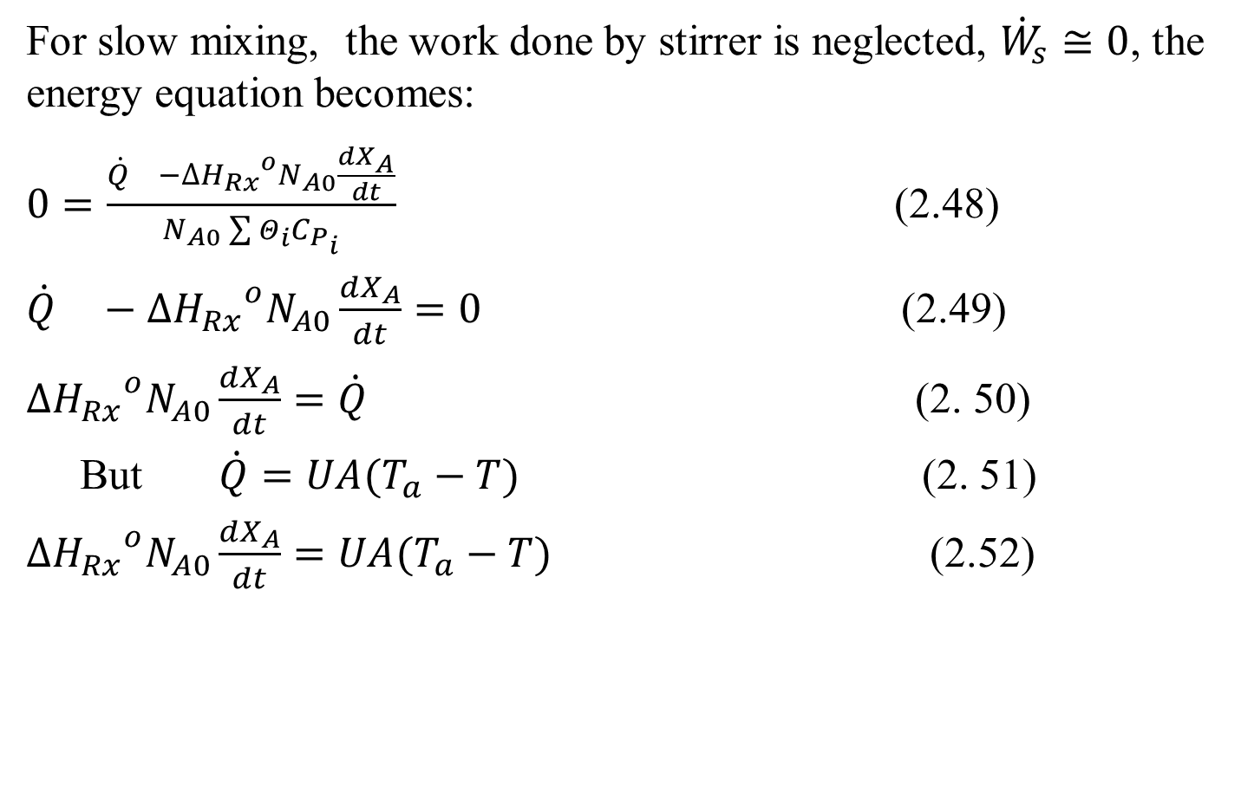
Cont’d
For slow mixing, the work done by stirrer is neglected, ${\dot{W}}_{s}≅0$, the energy equation becomes:
$0=\frac{\dot{Q} −{∆H_{Rx}}^{o}N_{A0}\frac{{dX}_{A}}{dt}}{N_{A0}\sum{Θ_{i}C_{P_{i}}}}$ (2.48)
$\dot{Q} −{∆H_{Rx}}^{o}N_{A0}\frac{{dX}_{A}}{dt}=0$ (2.49)
${∆H_{Rx}}^{o}N_{A0}\frac{{dX}_{A}}{dt}=\dot{Q}$ (2. 50)
But $\dot{Q}=UA(T_{a}−T)$ (2. 51)
${∆H_{Rx}}^{o}N_{A0}\frac{{dX}_{A}}{dt}=UA(T_{a}−T)$ (2.52)
45

Slide 46
Activity 2.2.
The irreversible elementary reaction is carried out in a batch reactor at 60ºC in an isothermal condition. The feed is a mixture of reactants of A and B with concentration of 4 mol/L. The composition is equimolar of A and B. The reaction is assumed that the volume of mixtures in a batch reactor is constant. The reaction rate is second order with respect to reactant A, and the reaction rate constant is 0.12 L/mol.min. The production capacity rate is 38.4 mol/min. The maximum conversion of reactant A is reached to 96%. The auxiliary time of the batch process is 20 min. The reaction is given in the following stoichiometry equation: A+ B------->2R
Based on the given data, determine: (a) the reaction time (t_{r}), (b) the concentration of product (R) and the reactor volume (V).
46

Slide 47
Cont’d
Given: Elementary reaction, Isothermal batch reactor, Equimolar concentration of reactants A& B
A+ B------->2R, C_{Ao}+ C_{Bo}= 4 mol/L, C_{Ao}= C_{Bo}= 2 mol/L
Secord order reaction with respect to reactant A, and the reaction rate constant (k)=0.12 L/mol.min.
Production capacity rate is 38.4 mol/min.
Maximum conversion of reactant A (X_{A})= 96%= 0.96.
Auxiliary time = 20 min.
47

Slide 48
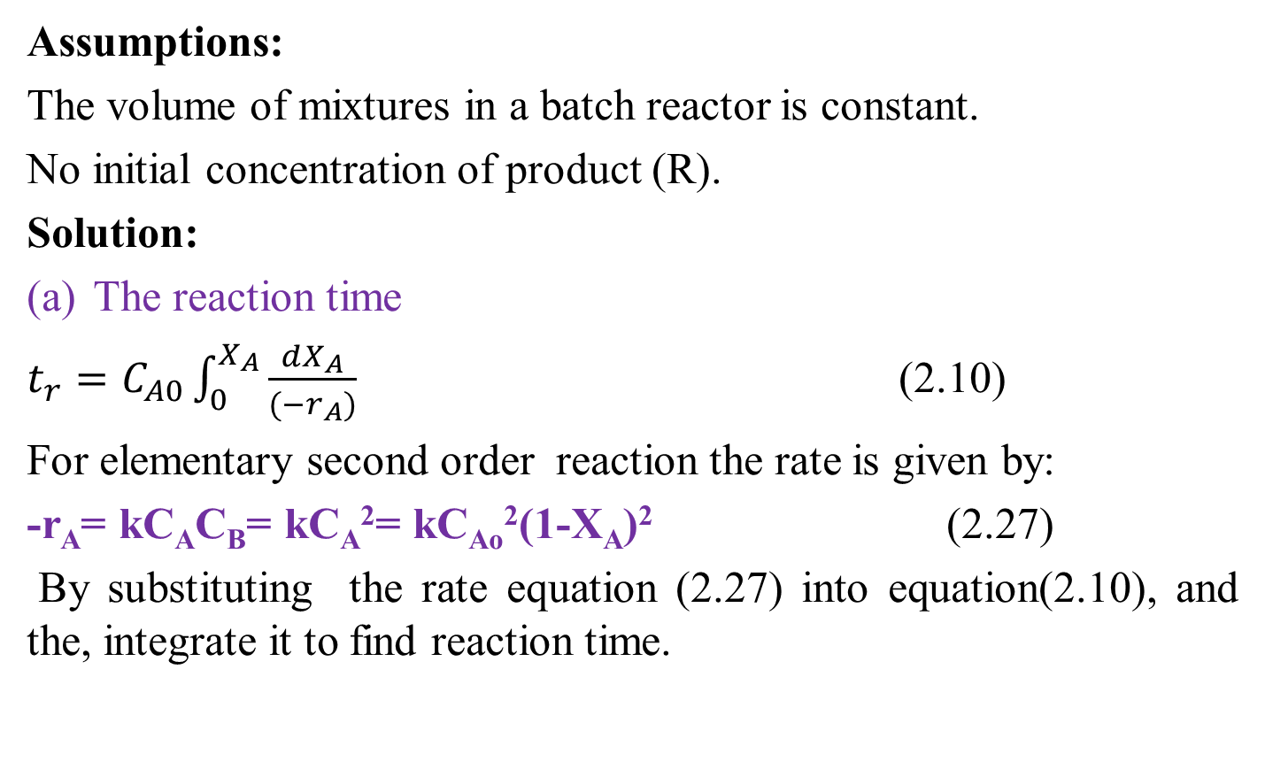
Cont’d
Assumptions:
The volume of mixtures in a batch reactor is constant.
No initial concentration of product (R).
Solution:
The reaction time
$t_{r}=C_{A0}\int_{0}^{X_{A}}{\frac{{dX}_{A}}{{(−r}_{A})}}$ (2.10)
For elementary second order reaction the rate is given by:
-r_{A}= kC_{A}C_{B}= kC_{A}²= kC_{Ao}²(1-X_{A})² (2.27)
By substituting the rate equation (2.27) into equation(2.10), and the, integrate it to find reaction time.
48

Slide 49
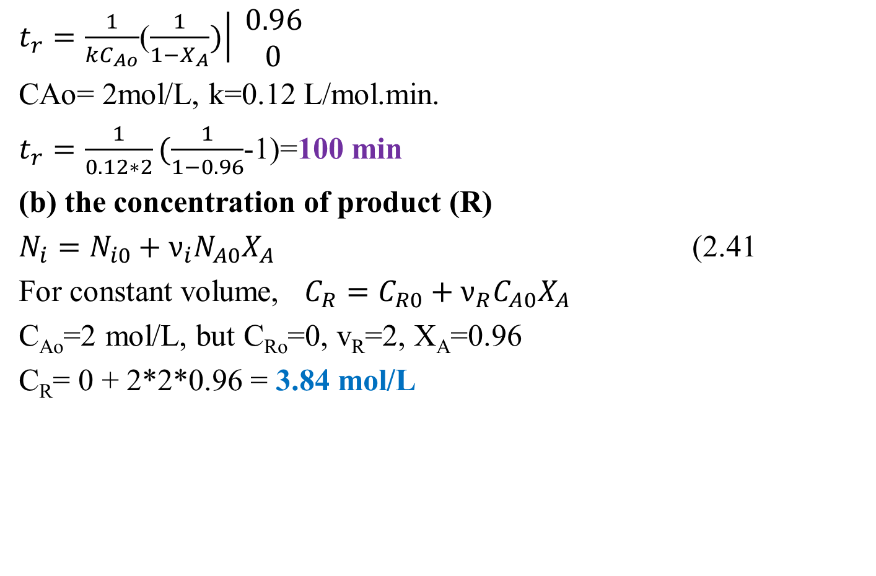
Cont’d
$t_{r}=\frac{1}{kC_{Ao}}$($\left.\frac{1}{1−X_{A}})\right| \begin{matrix}0.96 \\ 0\end{matrix}$
CAo= 2mol/L, k=0.12 L/mol.min.
$t_{r}=\frac{1}{0.12∗2}(\frac{1}{1−0.96}$-1)=100 min
(b) the concentration of product (R)
$N_{i}=N_{i0}+ν_{i}N_{A0}X_{A}$ (2.41
For constant volume, $C_{R}=C_{R0}+ν_{R}C_{A0}X_{A}$
C_{Ao}=2 mol/L, but C_{Ro}=0, v_{R}=2, X_{A}=0.96
C_{R}= 0 + 2*2*0.96 = 3.84 mol/L
49

Slide 50
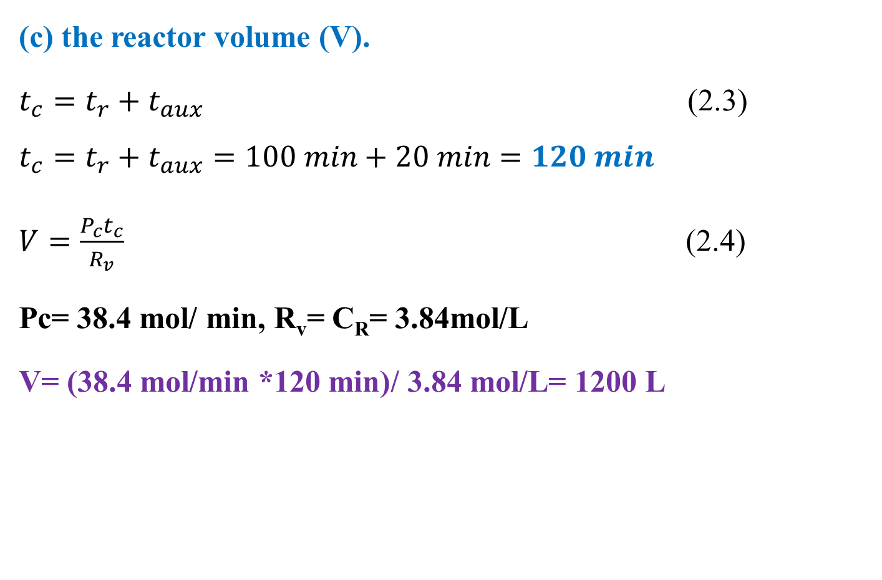
Cont’d
(c) the reactor volume (V).
$t_{c}=t_{r}+t_{aux}$ (2.3)
$$t_{c}=t_{r}+t_{aux}=100 min+20 min=120 min$$
$V=\frac{P_{c}t_{c}}{R_{v}}$ (2.4)
Pc= 38.4 mol/ min, R_{v}= C_{R}= 3.84mol/L
V= (38.4 mol/min *120 min)/ 3.84 mol/L= 1200 L
50

Slide 51
2.5. Summary
For isothermal batch reactor, concentrations, reaction rate and conversion are functions of reaction time (t_{r}).
Conversion, reaction time and size or volume of reactor are main aims of isothermal batch reactor design.
tr is determined from reaction rate & materials balance equations.
Reactor volume is determined from production capacity/ production rate, total cycle time and products formed per unit volume.
51

Slide 52
References
Chemical Reaction Engineering, Levenspiel, O John Wiely& Sons, 3rd edition, 2011.
Elements of Chemical Engineering, Fogler, HS Prentice- Hall Inc Prentice- Hall Inc,5th edition, 2015.
Thank you!
52

