Slide 1
Chemical Reaction Engineering II- Reactor Design (ChEg 4101)
Prerequisite: Chemical Reaction Engineering I-Reaction Kinetics (ChEg3104)
Lecture 5: Design of Isothermal Ideal Plug Flow Reactor
Week 5
Lecturer: Adamu Esubalew (PhD, ChEg)
Addis Ababa, Ethiopia

Slide 2
Lecture learning outcomes
At the end of the lecture, you will be able to:
  describe the characteristics of plug flow reactor,
  identify space time and volume required for isothermal ideal plug flow reactor, and
  design isothermal ideal plug flow reactor using materials and energy balance equations.

Slide 3
Presentation outlines
Introduction to plug flow reactor
Space time of plug flow reactor
Design of isothermal ideal plug flow reactor using materials and energy balance equations
Summary

Slide 4
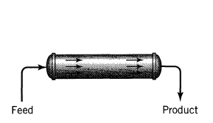
5.1. Introduction to Plug Flow Reactor
Plug flow reactor (PFR): A hollow pipe or cylindrical tube reactor in which the feed enters at one end of tube and the product stream leaves at the other end.
A plug flow reactor is depicted in Figure 5.1 (Levenspiel, 2011, pg.90).
It is also called tubular flow reactor (TFR).
Figure 5.1. Plug flow reactor
4

Slide 5
Cont’d
Ideal plug flow reactor works in the steady state conditions:
  Each element of the feeds spends equal time in the reactor,
  The total mass flow rate through any cross section of the reactor is the same, and
  Conditions at any point in the reactor are independent of time.
Therefore, PFR is a reactor where the reactants move through the reactors as a plug with no mixing in the axial direction, and products withdraw with continuous manner.
5

Slide 6
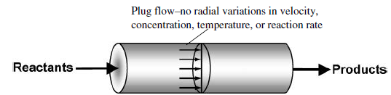
Cont’d
For plug flow reactor which is shown in Figure 5.2 (Fogler, 2015, pg.15), the fluid flow is assumed to be a piston flow:
Fluid is flowing at constant speed (speed at the center and near to wall of the reactor is equal);
There is uniform mixing in radial direction. i.e. no dead zone formation near to the wall of the reactor; and
There is no mixing in the axial direction.
Figure 5.2. Plug flow reactor
6

Slide 7
Cont’d
For PFR, the concentration/ conversion of the reaction mixture depends on the distance from the inlet point of reactor to the outlet of reactor. i.e. concentration/conversion of a mixture is a function the length of a PFR as shown in Figure 5.3 (Levenspiel, 2011, pg.101).
Figure 5.3. Concentration/conversion as a function of PFR length reactor
7

Slide 8
Cont’d
The plug flow reactor can be built in the widest diversity of forms, form short pipe to a mile long pipe.
Long pipe reactor is used for low temperature and relatively slow reactions through which the reactants flow comparatively with slow velocity.
Short pipe reactors are used for high temperature furnace.
For isothermal PFR, there is no temperature variation at any point in the reactor.
Designing of an isothermal ideal plug flow reactor means to find the size (volume) of a reactor and the space/ residence time for a certain specified conversion.
8

Slide 9
5.2 Space time of PFR
Space time is the time required to process one reactor volume of feed measured at specified conditions.
Just as the reaction time (t) is the natural performance measure for a batch reactor, space-time is the measure of a PFR proper performance .
Apace time is represented by tau (τ).
9

Slide 10
Cont’d
In ideal PFR, all fluids enter in the reactor will stay in the reactor and leave it at the same space time.
It is the required period of fluid elements stay inside PFR from inlet to outlet streams.
The space time is the time necessary to process one reactor volume of fluid based on entrance conditions.
10

Slide 11
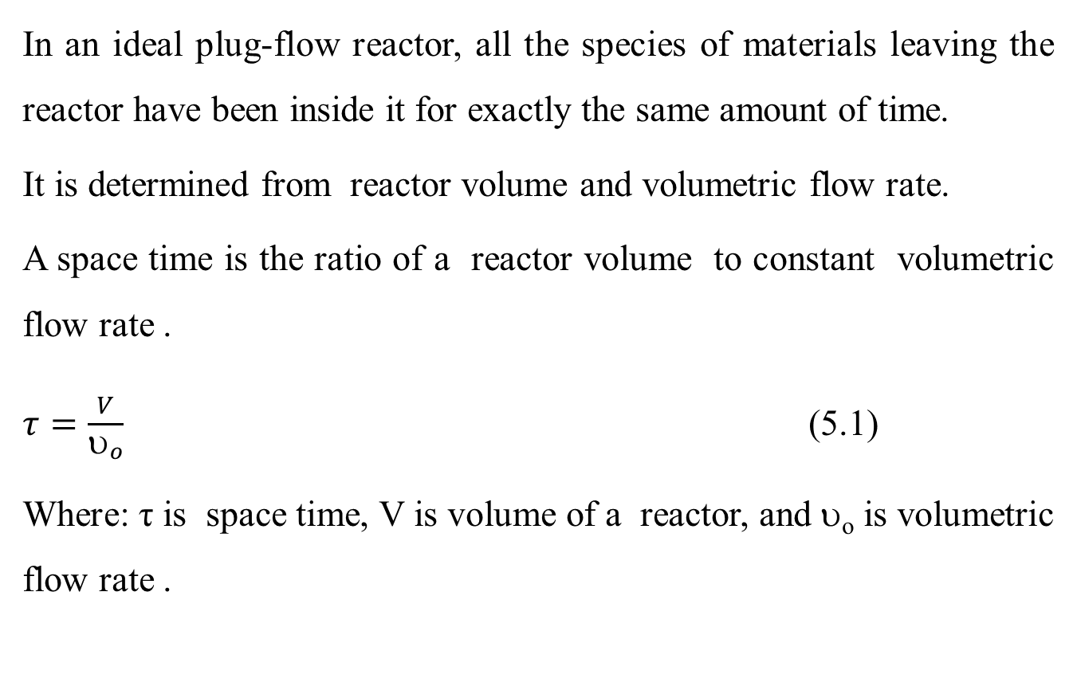
Cont’d
In an ideal plug-flow reactor, all the species of materials leaving the reactor have been inside it for exactly the same amount of time.
It is determined from reactor volume and volumetric flow rate.
A space time is the ratio of a reactor volume to constant volumetric flow rate .
$τ=\frac{V}{υ_{o}}$ (5.1)
Where: τ is space time, V is volume of a reactor, and υ_{o} is volumetric flow rate .
11

Slide 12
5.3 Design of Isothermal Ideal PFR
In a plug flow reactor, the composition of the fluid varies from point to point along a flow path.
Consequently, the material balance for a reaction component must be made for a differential element of volume, dV.
For the reactor as a whole the differential section of reactor of volume, differential element of volume must be integrated.
The process design of an ideal PFR is conducted using materials and energy balance equations.
12

Slide 13
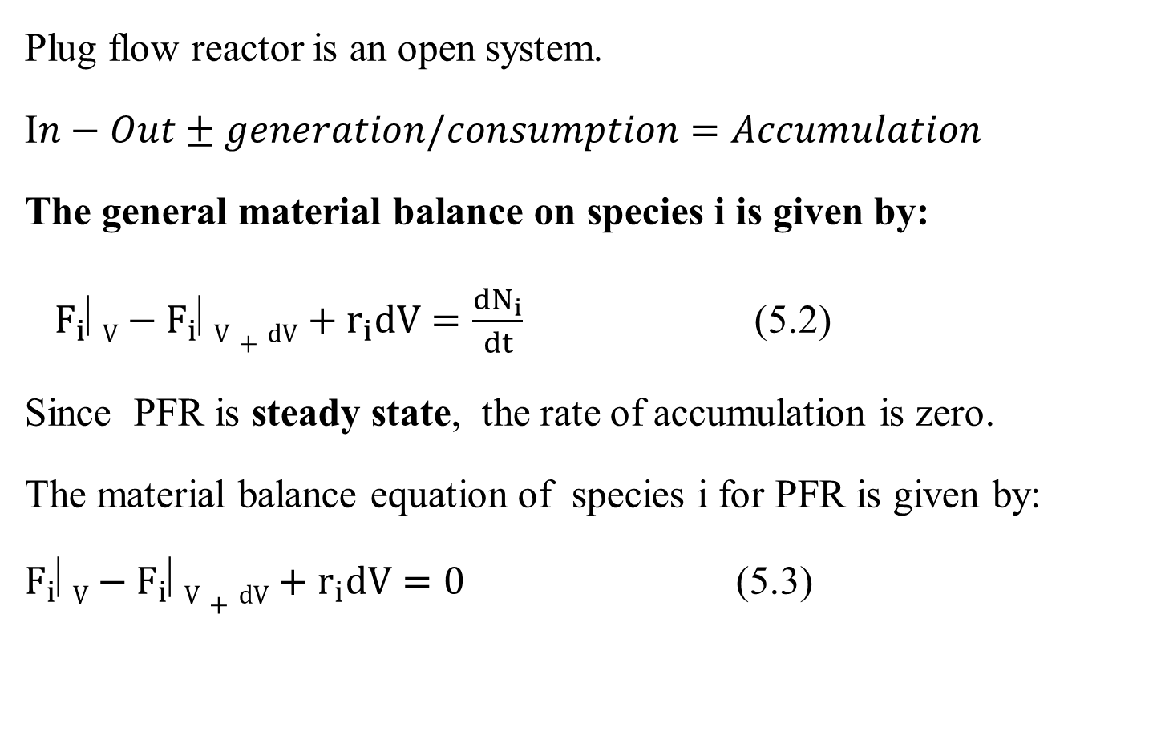
5.3.1. Materials balance equation
Plug flow reactor is an open system.
I$n−Out±generation/consumption=Accumulation$
The general material balance on species i is given by:
$F_{i}⬇V−F_{i}⬇V+dV+r_{i}dV=\frac{{dN}_{i}}{dt}$ (5.2)
Since PFR is steady state, the rate of accumulation is zero.
The material balance equation of species i for PFR is given by:
$F_{i}⬇V−F_{i}⬇V+dV+r_{i}dV=0$ (5.3)
13

Slide 14
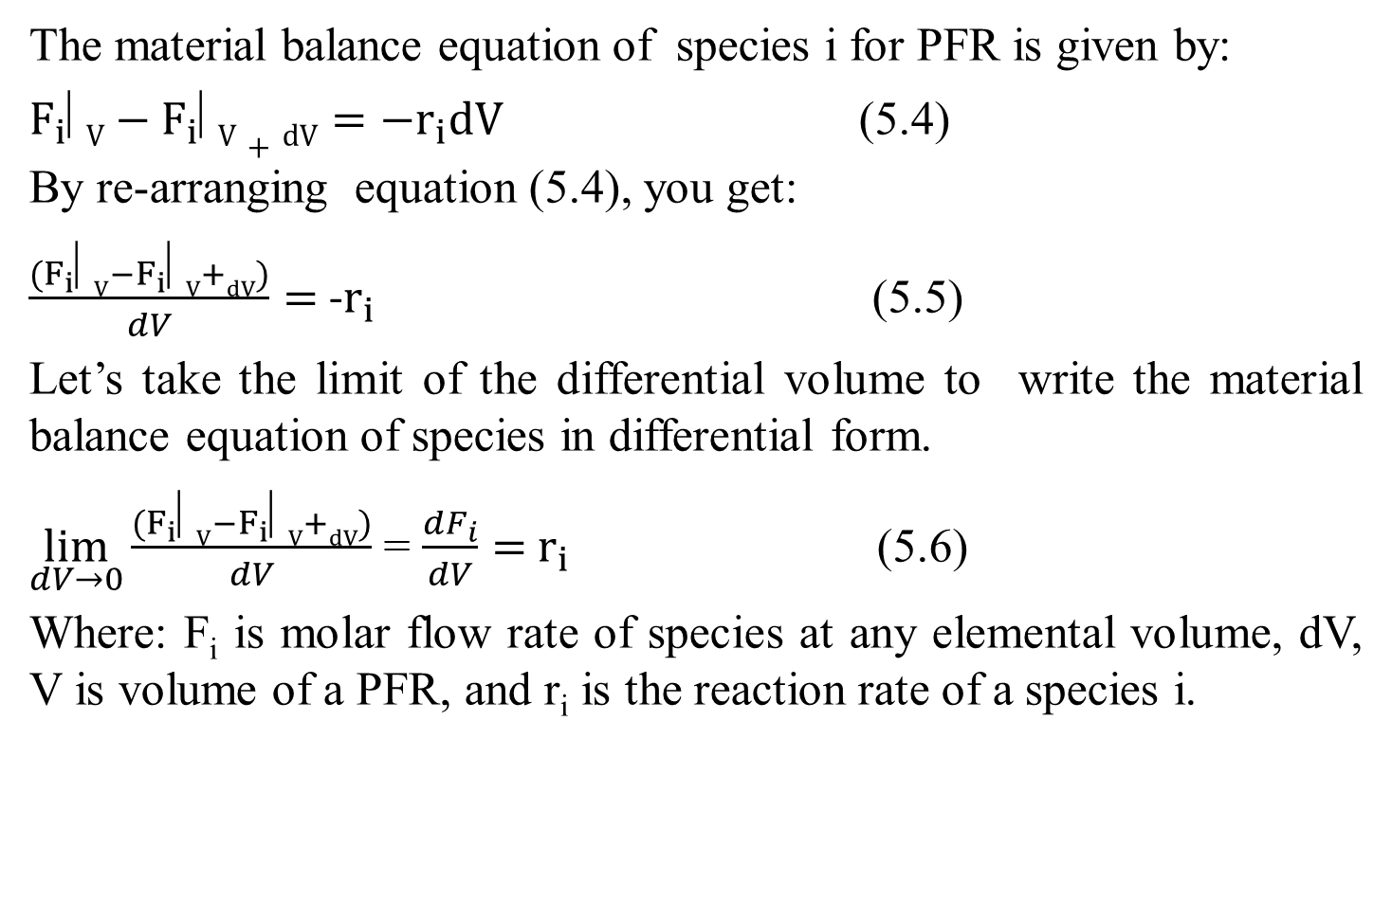
Cont’d
The material balance equation of species i for PFR is given by:
$F_{i}⬇V−F_{i}⬇V+dV=−r_{i}dV$ (5.4)
By re-arranging equation (5.4), you get:
$\frac{(F_{i}⬇V−F_{i}⬇V+dV)}{dV}=$ -$r_{i}$ (5.5)
Let’s take the limit of the differential volume to write the material balance equation of species in differential form.
$\lim_{dV→0}{\frac{(F_{i}⬇V−F_{i}⬇V+dV)}{dV}}$ = $\frac{{dF}_{i}}{dV}=$ $r_{i}$ (5.6)
Where: F_{i} is molar flow rate of species at any elemental volume, dV, V is volume of a PFR, and r_{i} is the reaction rate of a species i.
14

Slide 15
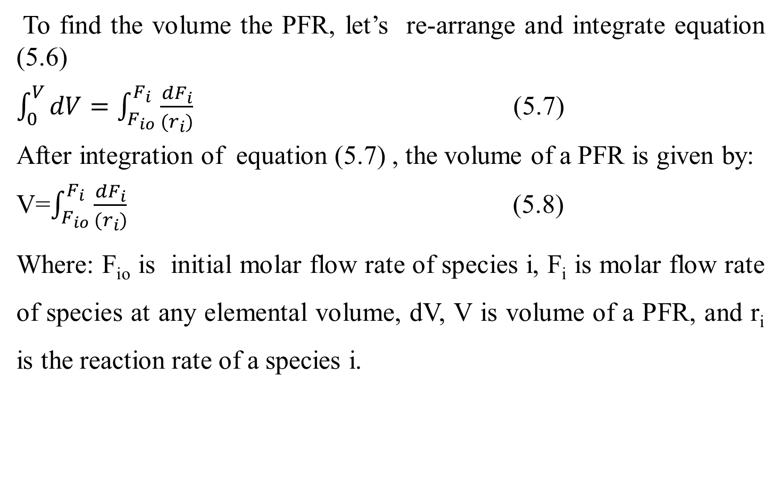
Cont’d
To find the volume the PFR, let’s re-arrange and integrate equation (5.6)
$\int_{0}^{V}{dV=\int_{F_{io}}^{F_{i}}{\frac{{dF}_{i}}{(r_{i})}}}$ (5.7)
After integration of equation (5.7) , the volume of a PFR is given by:
V=$\int_{F_{io}}^{F_{i}}{\frac{{dF}_{i}}{(r_{i})}}$ (5.8)
Where: F_{io} is initial molar flow rate of species i, F_{i} is molar flow rate of species at any elemental volume, dV, V is volume of a PFR, and r_{i} is the reaction rate of a species i.
15

Slide 16

Cont’d
Consider the following simple reaction which is take placed in the PFR as shown in equation (5.9).
A------------------> P (5.9)
Where: A is reactant and P is product.
The chemical reaction species A which flows across in a differential elemental volume (dV) is depicted in Figure 5.4 (Levenspiel, 2011, pg.101).
Figure 5.4. Chemical reaction in differential volume of PFR
16

Slide 17
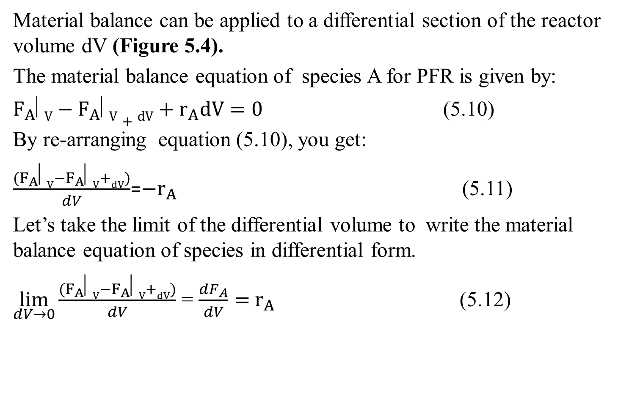
Cont’d
Material balance can be applied to a differential section of the reactor volume dV (Figure 5.4).
The material balance equation of species A for PFR is given by:
$F_{A}⬇V−F_{A}⬇V+dV+r_{A}dV=0$ (5.10)
By re-arranging equation (5.10), you get:
$\frac{(F_{A}⬇V−F_{A}⬇V+dV)}{dV}$=${−r}_{A}$ (5.11)
Let’s take the limit of the differential volume to write the material balance equation of species in differential form.
$\lim_{dV→0}{\frac{(F_{A}⬇V−F_{A}⬇V+dV)}{dV}}$ = $\frac{{dF}_{A}}{dV}=$ $r_{A}$ (5.12)
17

Slide 18
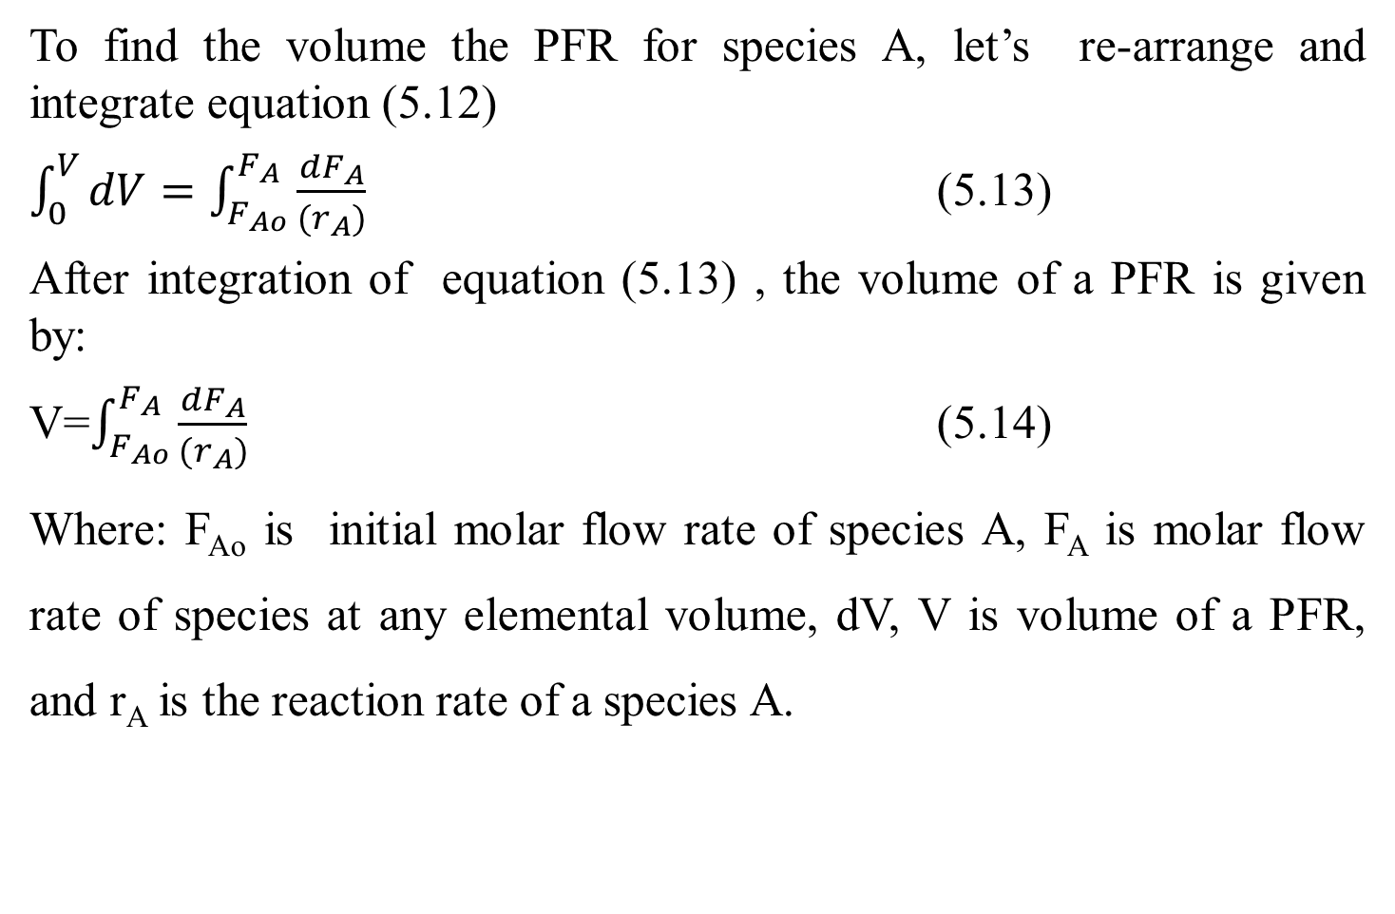
Cont’d
To find the volume the PFR for species A, let’s re-arrange and integrate equation (5.12)
$\int_{0}^{V}{dV=\int_{F_{Ao}}^{F_{A}}{\frac{{dF}_{A}}{(r_{A})}}}$ (5.13)
After integration of equation (5.13) , the volume of a PFR is given by:
V=$\int_{F_{Ao}}^{F_{A}}{\frac{{dF}_{A}}{(r_{A})}}$ (5.14)
Where: F_{Ao} is initial molar flow rate of species A, F_{A} is molar flow rate of species at any elemental volume, dV, V is volume of a PFR, and r_{A} is the reaction rate of a species A.
18

Slide 19
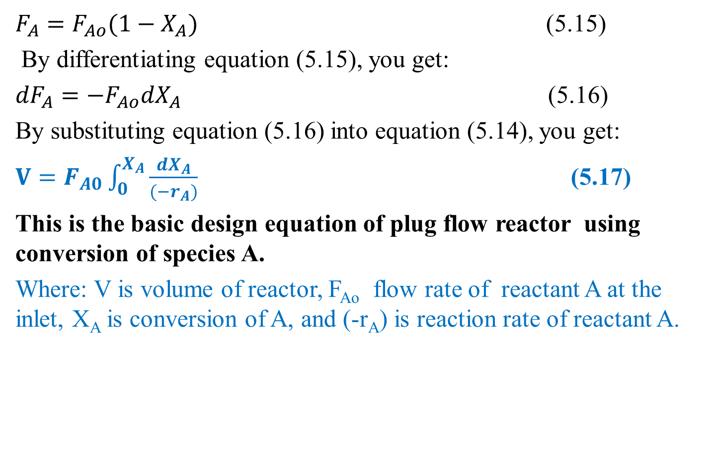
Cont’d
$F_{A}=F_{Ao}(1−X_{A})$ (5.15)
By differentiating equation (5.15), you get:
${dF}_{A}={−F}_{Ao}{dX}_{A}$ (5.16)
By substituting equation (5.16) into equation (5.14), you get:
$V=F_{A0}\int_{0}^{X_{A}}{\frac{{dX}_{A}}{{(−r}_{A})}}$ (5.17)
This is the basic design equation of plug flow reactor using conversion of species A.
Where: V is volume of reactor, F_{Ao} flow rate of reactant A at the inlet, X_{A} is conversion of A, and (-r_{A}) is reaction rate of reactant A.
19

Slide 20
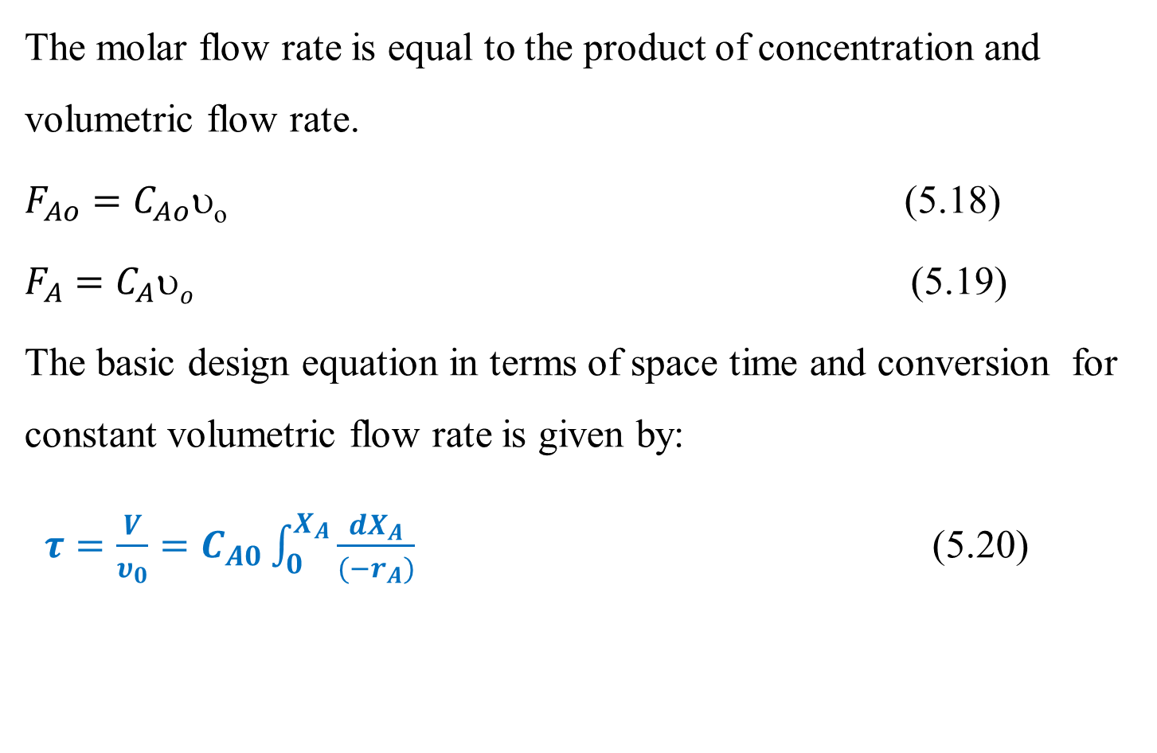
Cont’d
The molar flow rate is equal to the product of concentration and volumetric flow rate.
$F_{Ao}=C_{Ao}$_{o} (5.18)
$F_{A}=C_{A}o$ (5.19)
The basic design equation in terms of space time and conversion for constant volumetric flow rate is given by:
$τ=\frac{V}{υ_{0}}=C_{A0}\int_{0}^{X_{A}}{\frac{{dX}_{A}}{{(−r}_{A})}}$ (5.20)
20

Slide 21
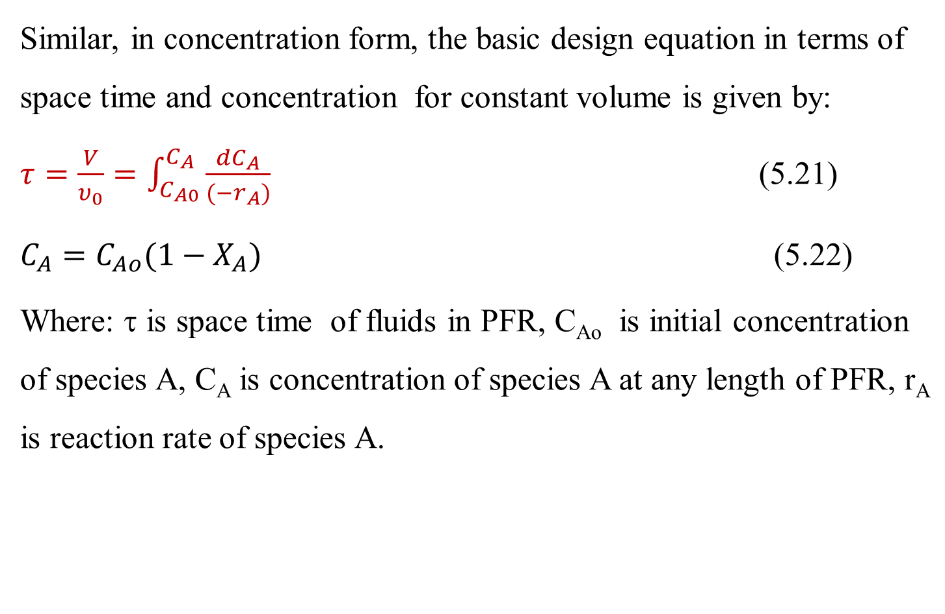
Cont’d
Similar, in concentration form, the basic design equation in terms of space time and concentration for constant volume is given by:
$τ=\frac{V}{υ_{0}}=\int_{C_{A0}}^{C_{A}}{\frac{{dC}_{A}}{{(−r}_{A})}}$ (5.21)
$C_{A}=C_{Ao}(1−X_{A})$ (5.22)
Where: τ is space time of fluids in PFR, C_{Ao} is initial concentration of species A, C_{A} is concentration of species A at any length of PFR, r_{A} is reaction rate of species A.
21

Slide 22
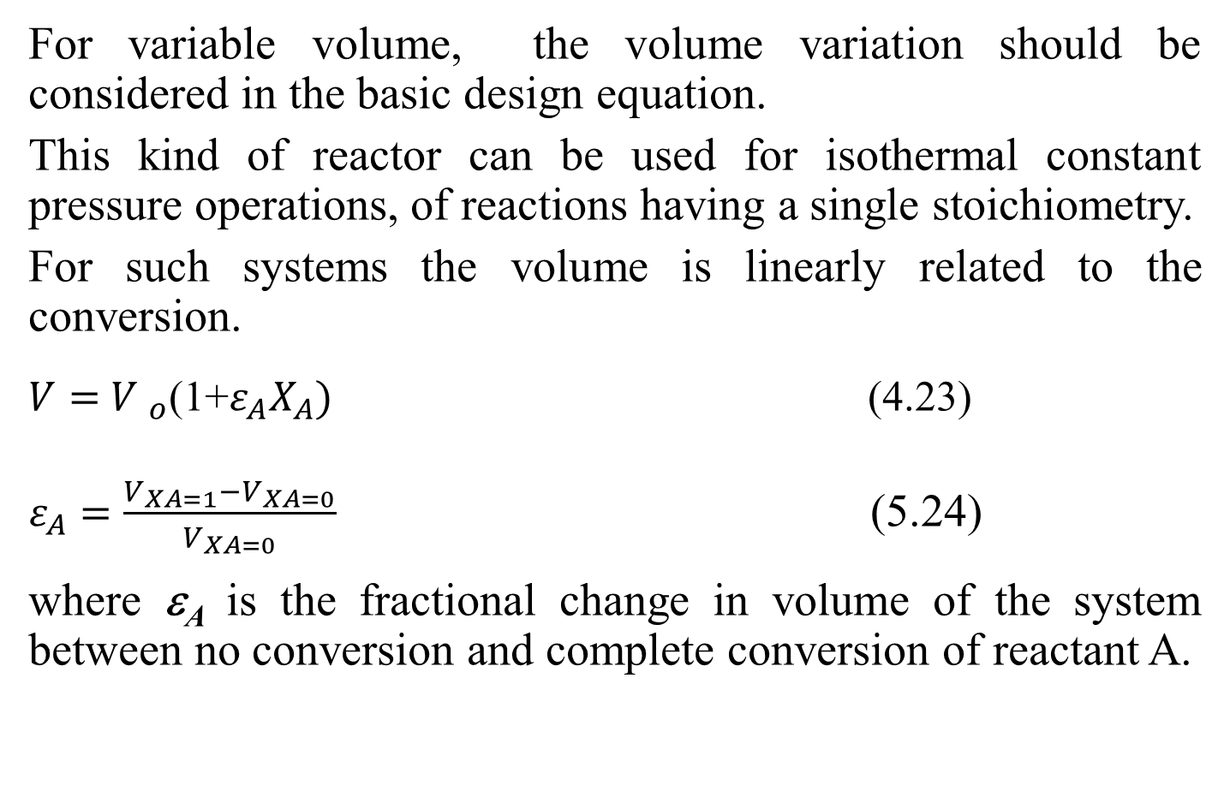
Cont’d
For variable volume, the volume variation should be considered in the basic design equation.
This kind of reactor can be used for isothermal constant pressure operations, of reactions having a single stoichiometry.
For such systems the volume is linearly related to the conversion.
$V=$ ${V }_{o}$(1+$ε_{A}X_{A})$ (4.23)
$ε_{A}=\frac{V_{XA=1}−V_{XA=0}}{V_{XA=0}}$ (5.24)
where ε_{A} is the fractional change in volume of the system between no conversion and complete conversion of reactant A.
22

Slide 23
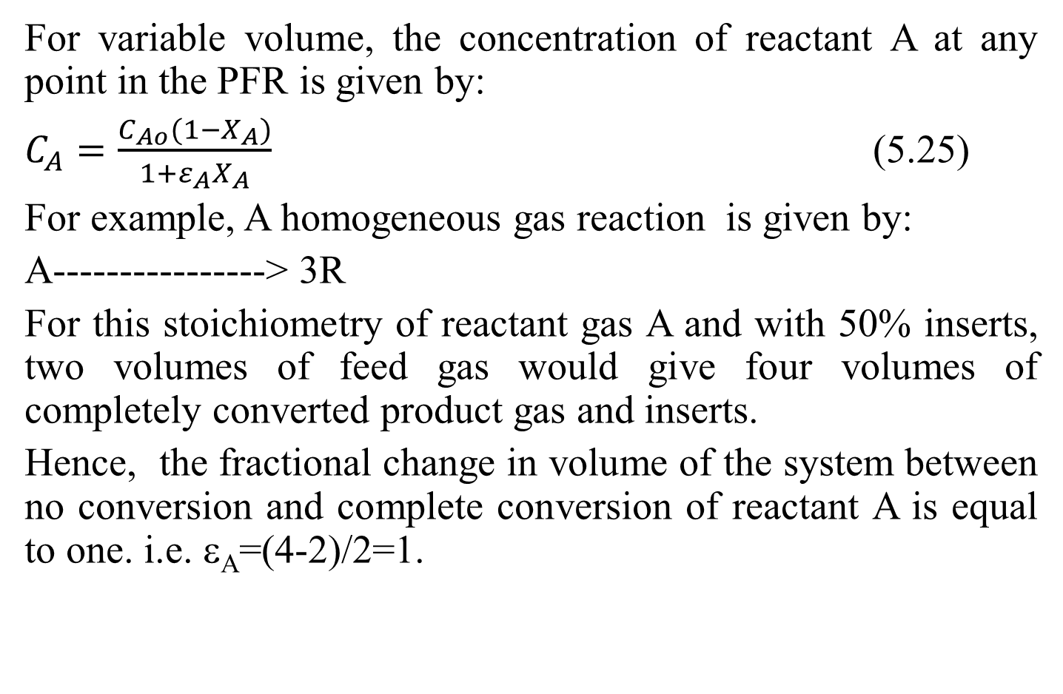
Cont’d
For variable volume, the concentration of reactant A at any point in the PFR is given by:
$C_{A}=\frac{C_{Ao}(1−X_{A})}{1+ε_{A}X_{A}}$ (5.25)
For example, A homogeneous gas reaction is given by:
A----------------> 3R
For this stoichiometry of reactant gas A and with 50% inserts, two volumes of feed gas would give four volumes of completely converted product gas and inserts.
Hence, the fractional change in volume of the system between no conversion and complete conversion of reactant A is equal to one. i.e. ε_{A}=(4-2)/2=1.
23

Slide 24
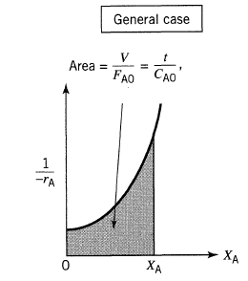
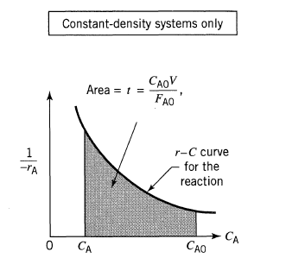
Cont’d
The volume of a PFR is determined from reaction rate and conversion/ concentration data using numerical or graphical method.
The (a) X_{A} with (1/-r_{A}) plot, and (b) C_{A} with (1/-r_{A}) plot graphical representations are as shown in Figure 5.5 (Levenspiel, 2011, pg. 103).
(a) (b)
Figure 5.5. Graphical representation of PFR
24

Slide 25
Activity 5.1
Consider the following elementary reaction which is carried out in isothermal ideal PFR.
A+ B------->C
The molar flow rate of reactants A and B mixture is 0.4 mol/min. The mixtures volumetric rate is 0.1 L/ min. The reactant A and reactant B are equimolar. The reaction rate constant is 0.04 L/mol.min. Determine the volume of a PFR and space time when the conversion of reactant A is reached to 95%. If the radius of a circular PFR is 5 cm, calculate the length of the reactor.
25

Slide 26
Cont’d
Given: Elementary reaction in PFR, A+ B------->C
-r_{A}= kC_{A}C_{B}=kC_{A}² = kC_{Ao}²(1-X_{A})², since F_{Ao}= F_{B0}, then C_{Ao}=C_{B0}, & C_{A}=C_{B} for constant volumetric flow rate.
F_{o}= F_{Ao}+ F_{Bo}= 0.4 mol/min, F_{Ao}= F_{Bo}= 0.2 mol/min
υ_{o}=0.1L/min, X_{A}=95%= 0.95 & k= 0.04 L/mol.min
C_{Ao}= F_{Ao}/υ_{o}= 0.2mol/min/ 0.1 L/min= 2 mol/L
26

Slide 27
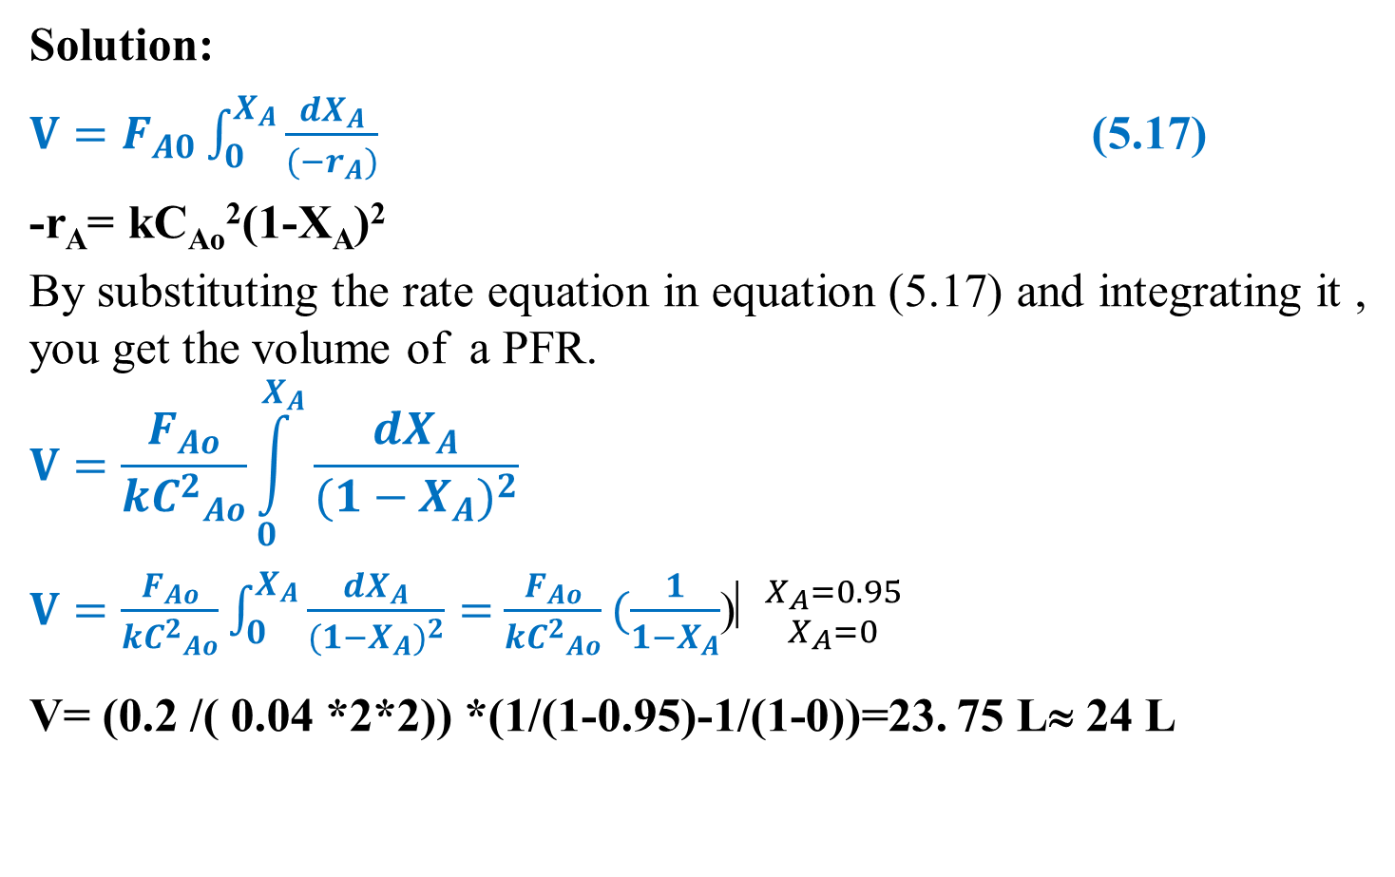
Cont’d
Solution:
$V=F_{A0}\int_{0}^{X_{A}}{\frac{{dX}_{A}}{{(−r}_{A})}}$ (5.17)
-r_{A}= kC_{Ao}²(1-X_{A})²
By substituting the rate equation in equation (5.17) and integrating it , you get the volume of a PFR.
$$V=\frac{F_{Ao}}{k{C^{2}}_{Ao}}\int_{0}^{X_{A}}{\frac{{dX}_{A}}{{(1−X_{A})}^{2}}}$$
$V=\frac{F_{Ao}}{k{C^{2}}_{Ao}}\int_{0}^{X_{A}}{\frac{{dX}_{A}}{{(1−X_{A})}^{2}}}=$ $\frac{F_{Ao}}{k{C^{2}}_{Ao}}(\frac{1}{1−X_{A}}$)⎢${X_{A}=0.95 \atop X_{A}=0}$
V= (0.2 /( 0.04 *2*2)) *(1/(1-0.95)-1/(1-0))=23. 75 L≈ 24 L
27

Slide 28
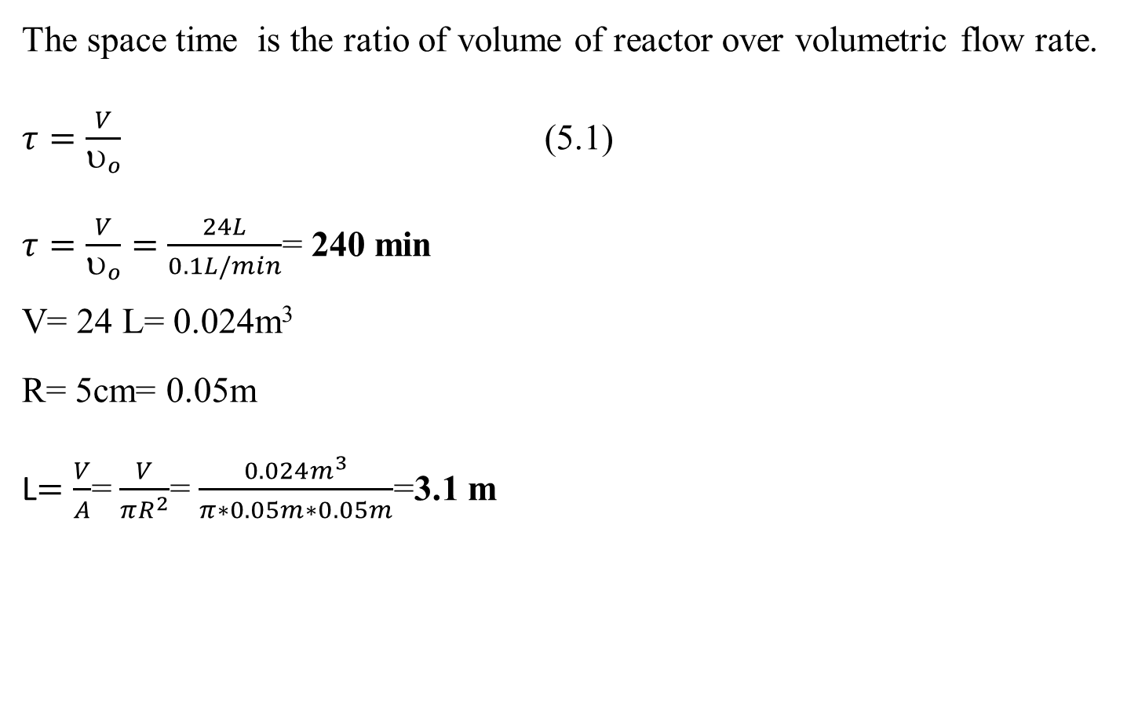
Cont’d
The space time is the ratio of volume of reactor over volumetric flow rate.
$τ=\frac{V}{υ_{o}}$ (5.1)
$τ=\frac{V}{υ_{o}}=\frac{24L}{0.1L/min}$= 240 min
V= 24 L= 0.024m³
R= 5cm= 0.05m
L$=\frac{V}{A}$= $\frac{V}{πR^{2}}$= $\frac{0.024m^{3}}{π∗0.05m∗0.05m}$=3.1 m
28

Slide 29
5.3.2. Energy balance equation
PFR is operated at steady state condition.
Energy balance is performed by applying of the first law of thermodynamics for open system - flow reactors (e.g , PFR).
First law of thermodynamics states that the total energy of the system is constant.
For open system, there is flow of mass and energy across system boundary.
There is flow of energy with flow of mass.
To develop energy balance equation, it is assumed that heat (Q ) is added to the reactor and work (W) is done by the system.
29

Slide 30
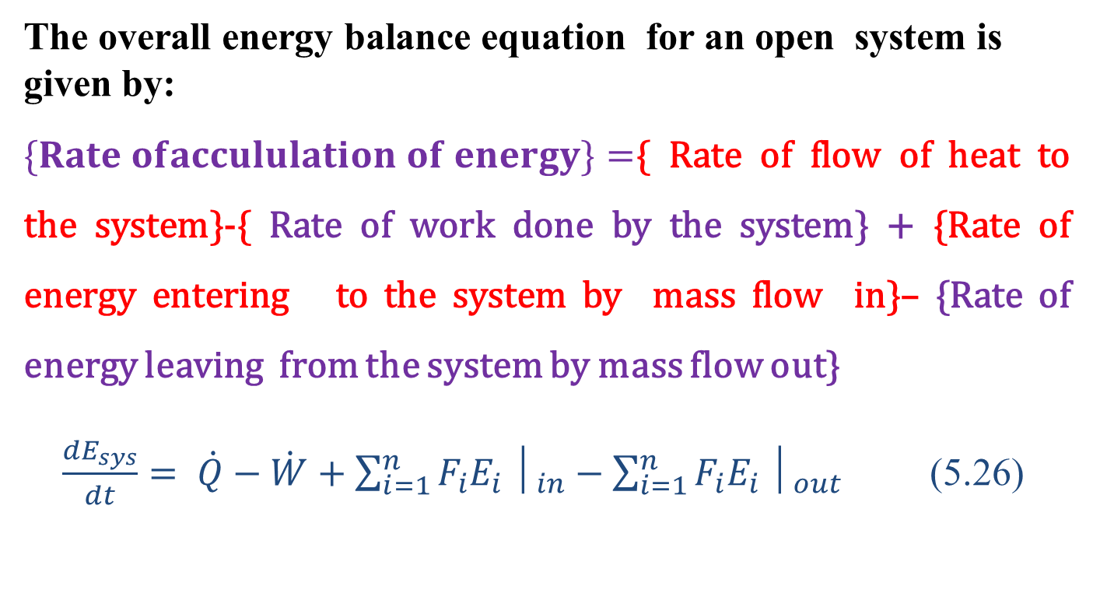
Cont’d
The overall energy balance equation for an open system is given by:
$\{Rate ofaccululation of energy\}=${ Rate of flow of heat to the system}-{ Rate of work done by the system} + {Rate of energy entering to the system by mass flow in}– {Rate of energy leaving from the system by mass flow out}
$\frac{{dE}_{sys}}{dt}= \dot{Q}−\dot{W}+\sum_{i=1}^{n}{F_{i}E_{i}}│_{in}−\sum_{i=1}^{n}{F_{i}E_{i}}│_{out}$ (5.26)
30

Slide 31
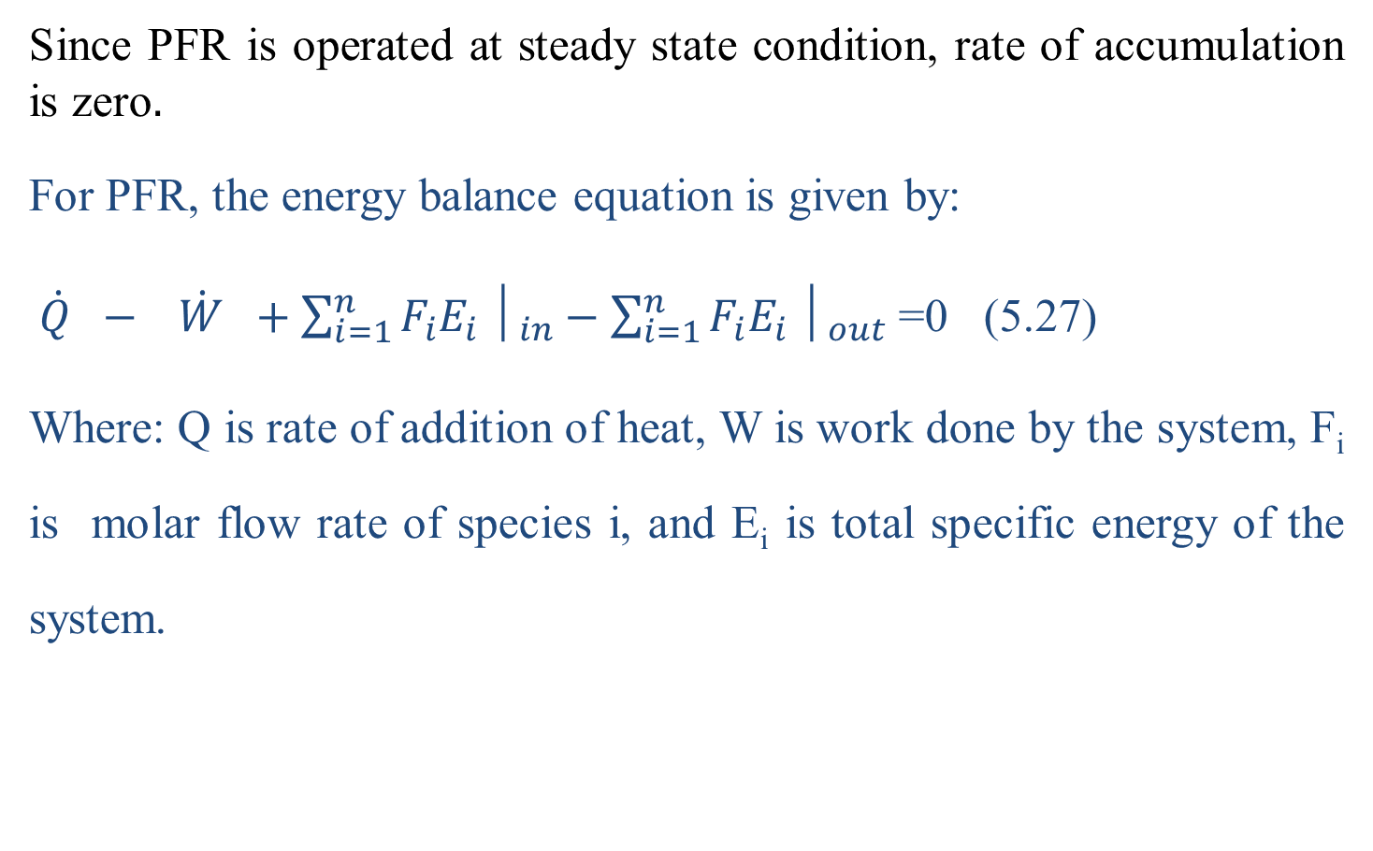
Cont’d
Since PFR is operated at steady state condition, rate of accumulation is zero$.$
For PFR, the energy balance equation is given by:
$\dot{Q} − \dot{W} +\sum_{i=1}^{n}{F_{i}E_{i}}│_{in}−\sum_{i=1}^{n}{F_{i}E_{i}}│_{out}$ =0 (5.27)
Where: Q is rate of addition of heat, W is work done by the system, F_{i} is molar flow rate of species i, and E_{i} is total specific energy of the system.
31

Slide 32
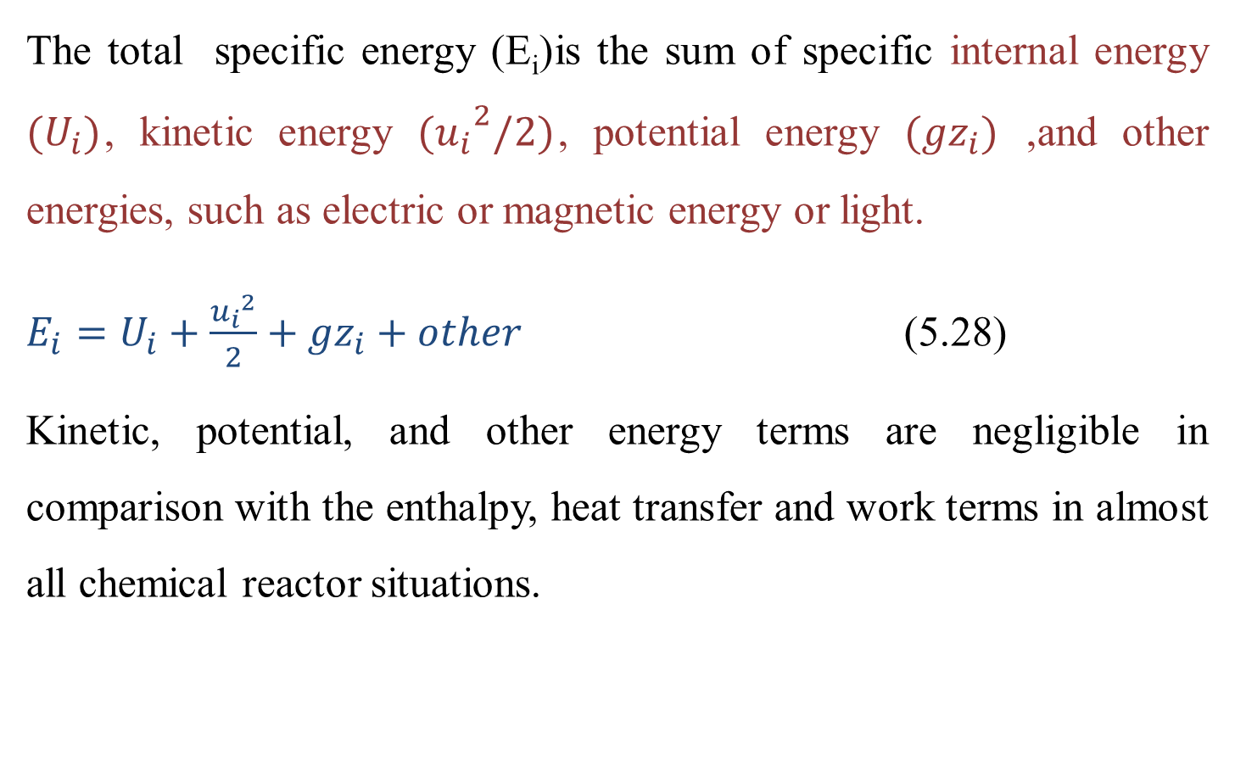
Cont’d
The total specific energy (E_{i})is the sum of specific internal energy $(U_{i})$, kinetic energy ${(u_{i}}^{2}/2)$, potential energy ${(gz}_{i})$ ,and other energies, such as electric or magnetic energy or light.
$E_{i}=U_{i}+\frac{{u_{i}}^{2}}{2}+{gz}_{i}+other$ (5.28)
Kinetic, potential, and other energy terms are negligible in comparison with the enthalpy, heat transfer and work terms in almost all chemical reactor situations.
32

Slide 33
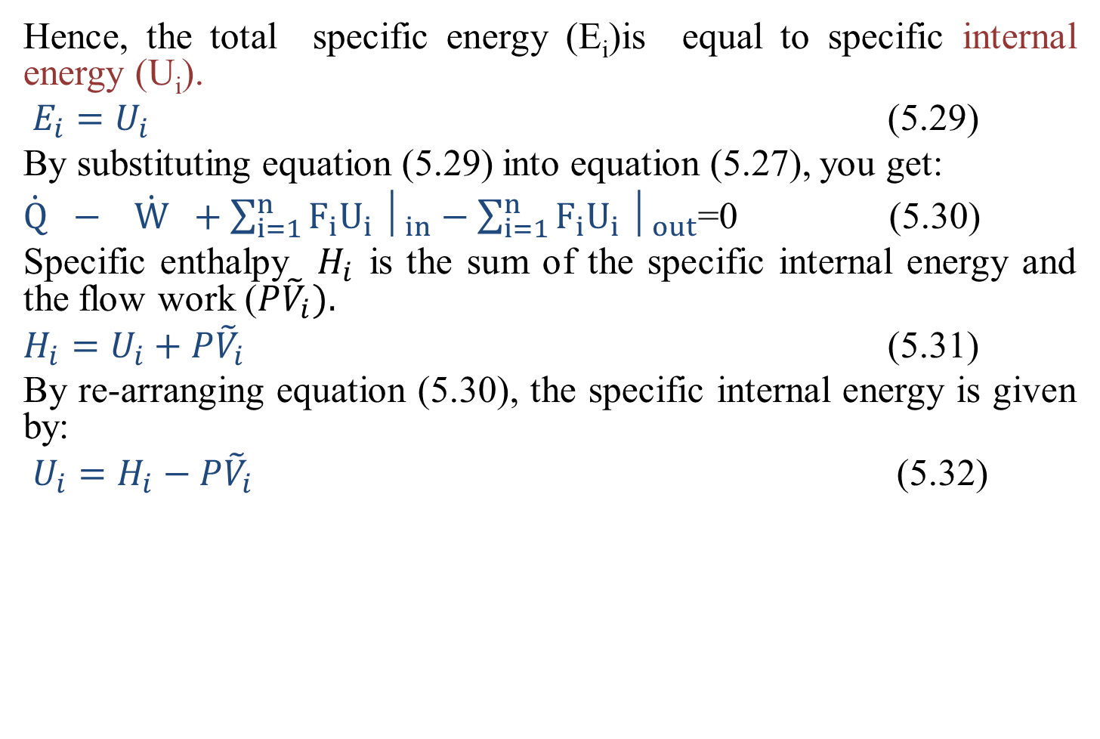
Cont’d
Hence, the total specific energy (E_{i})is equal to specific internal energy (U_{i}).
$E_{i}=U_{i}$ (5.29)
By substituting equation (5.29) into equation (5.27), you get:
$\dot{Q} − \dot{W} +\sum_{i=1}^{n}{F_{i}U_{i}}│_{in}−\sum_{i=1}^{n}{F_{i}U_{i}}│_{out}$=0 (5.30)
Specific enthalpy $H_{i}$ is the sum of the specific internal energy and the flow work ($P{\tilde{V}}_{i}).$
$H_{i}=U_{i}+P{\tilde{V}}_{i}$ (5.31)
By re-arranging equation (5.30), the specific internal energy is given by:
$U_{i}=H_{i}−P{\tilde{V}}_{i}$ (5.32)
33

Slide 34
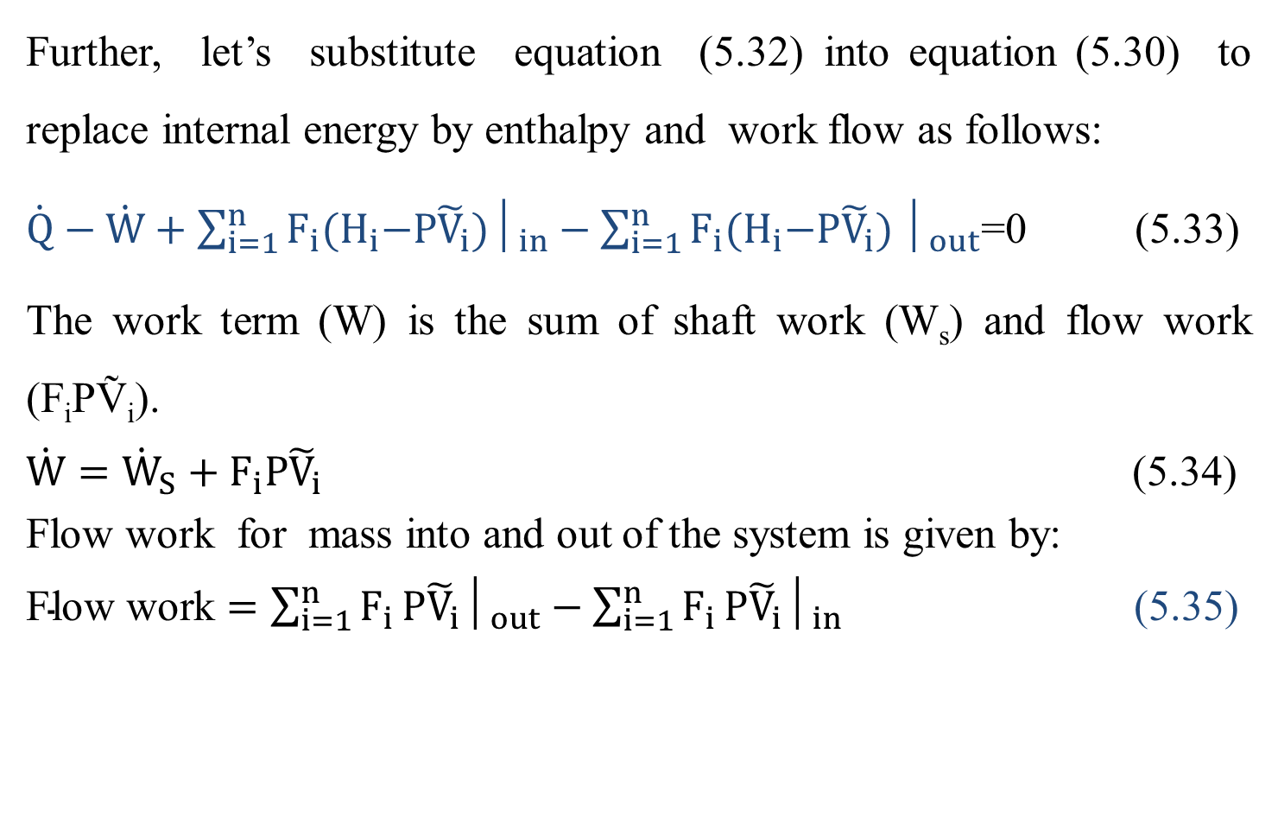
Cont’d
Further, let’s substitute equation (5.32) into equation (5.30) to replace internal energy by enthalpy and work flow as follows:
$\dot{Q}−\dot{W}+\sum_{i=1}^{n}{F_{i}{(H}_{i}−P{\tilde{V}}_{i})│_{in}}−\sum_{i=1}^{n}{F_{i}{(H}_{i}−P{\tilde{V}}_{i})}│_{out}$=0 (5.33)
The work term (W) is the sum of shaft work (W_{s}) and flow work (F_{i}PṼ_{i}).
$\dot{W}={\dot{W}}_{S}+F_{i}P{\tilde{V}}_{i}$ (5.34)
Flow work for mass into and out of the system is given by:
$\text{Flow} \text{work}=\sum_{i=1}^{n}{F_{i}}P{\tilde{V}}_{i}│_{out}−\sum_{i=1}^{n}{F_{i}}P{\tilde{V}}_{i}│_{in}$ (5.35)
34

Slide 35
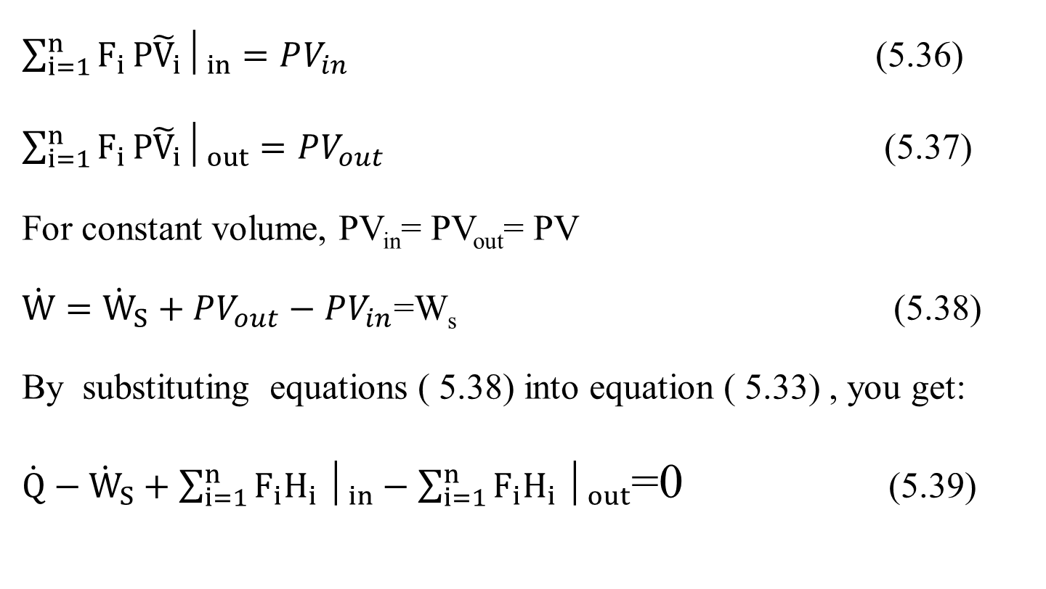
Cont’d
$\sum_{i=1}^{n}{F_{i}}P{\tilde{V}}_{i}│_{in}=PV_{in}$ (5.36)
$\sum_{i=1}^{n}{F_{i}}P{\tilde{V}}_{i}│_{out}=PV_{out}$ (5.37)
For constant volume, PV_{in}= PV_{out}= PV
$\dot{W}={\dot{W}}_{S}+PV_{out}−PV_{in}$=W_{s} (5.38)
By substituting equations ( 5.38) into equation ( 5.33) , you get:
$\dot{Q}−{\dot{W}}_{S}+\sum_{i=1}^{n}{F_{i}H_{i}}│_{in}−\sum_{i=1}^{n}{F_{i}H_{i}}│_{out}$=0 (5.39)
35

Slide 36
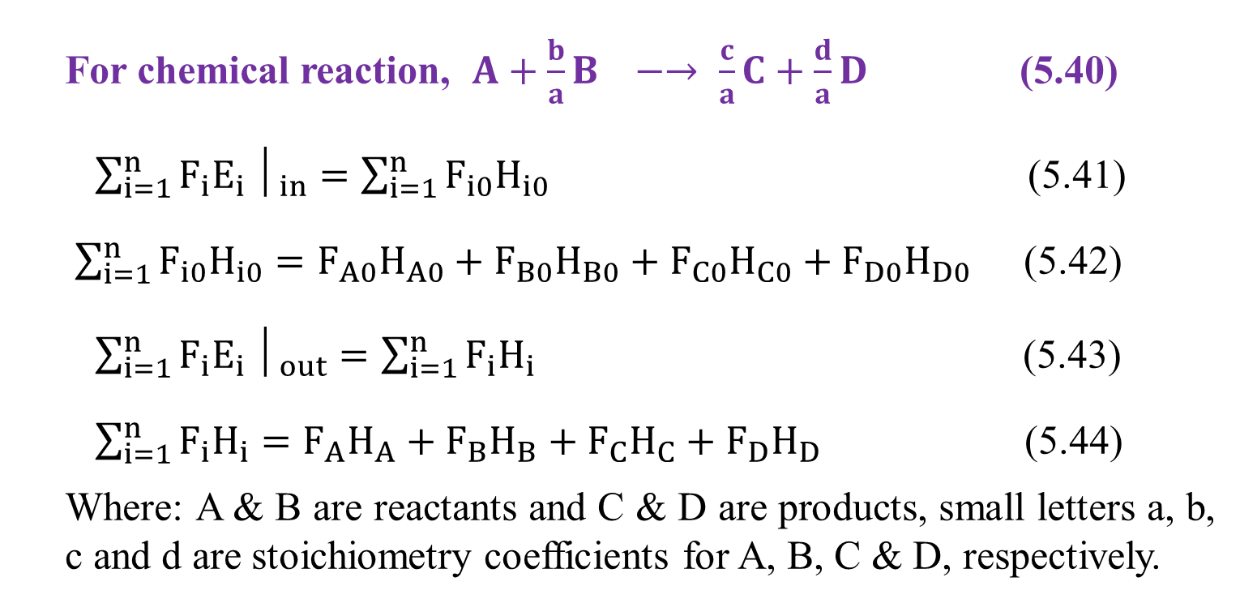
Cont’d
For chemical reaction, $A+\frac{b}{a}B −→ \frac{c}{a}C+\frac{d}{a}D$ (5.40)
$\sum_{i=1}^{n}{F_{i}E_{i}}│_{in}=\sum_{i=1}^{n}{F_{i0}H_{i0}}$ (5.41)
$\sum_{i=1}^{n}{F_{i0}H_{i0}}=F_{A0}H_{A0}+F_{B0}H_{B0}+F_{C0}H_{C0}+F_{D0}H_{D0}$ (5.42)
$\sum_{i=1}^{n}{F_{i}E_{i}}│_{out}=\sum_{i=1}^{n}{F_{i}H_{i}}$ (5.43)
$\sum_{i=1}^{n}{F_{i}H_{i}}=F_{A}H_{A}+F_{B}H_{B}+F_{C}H_{C}+F_{D}H_{D}$ (5.44)
Where: A & B are reactants and C & D are products, small letters a, b, c and d are stoichiometry coefficients for A, B, C & D, respectively.
36

Slide 37
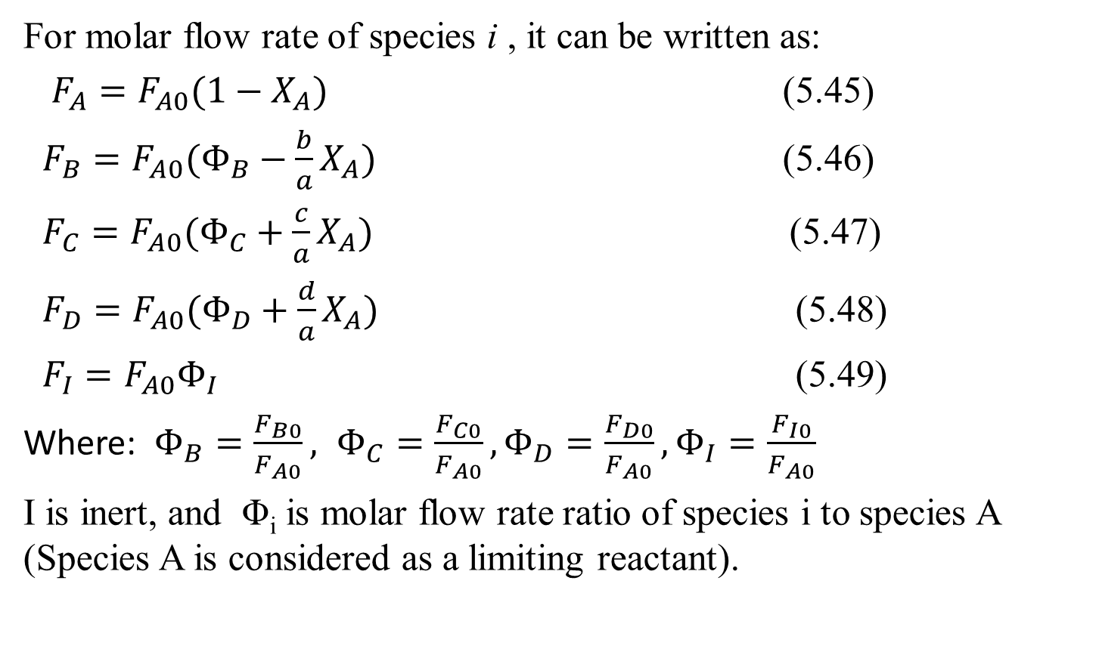
Cont’d
For molar flow rate of species i , it can be written as:
$F_{A}=F_{A0}(1−X_{A})$ (5.45)
$F_{B}=F_{A0}(Φ_{B}−\frac{b}{a}X_{A})$ (5.46)
$F_{C}=F_{A0}(Φ_{C}+\frac{c}{a}X_{A})$ (5.47)
$F_{D}=F_{A0}(Φ_{D}+\frac{d}{a}X_{A})$ (5.48)
$F_{I}=F_{A0}Φ_{I}$ (5.49)
Where: $Φ_{B}=\frac{F_{B0}}{F_{A0}}, Φ_{C}=\frac{F_{C0}}{F_{A0}}, Φ_{D}=\frac{F_{D0}}{F_{A0}}, Φ_{I}=\frac{F_{I0}}{F_{A0}}$
I is inert, and Φ_{i} is molar flow rate ratio of species i to species A (Species A is considered as a limiting reactant).
37

Slide 38
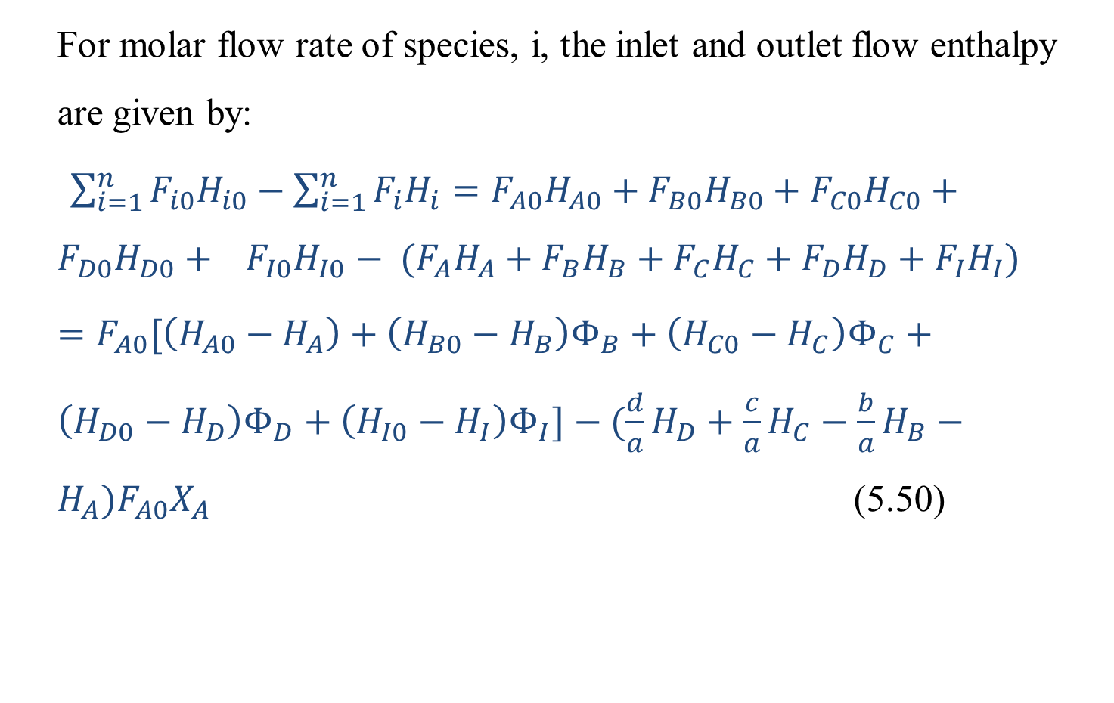
Cont’d
For molar flow rate of species, i, the inlet and outlet flow enthalpy are given by:
$\sum_{i=1}^{n}{F_{i0}H_{i0}}−\sum_{i=1}^{n}{F_{i}H_{i}}=F_{A0}H_{A0}+F_{B0}H_{B0}+F_{C0}H_{C0}+F_{D0}H_{D0}+ F_{I0}H_{I0}− (F_{A}H_{A}+F_{B}H_{B}+F_{C}H_{C}+F_{D}H_{D}+F_{I}H_{I})$
$=F_{A0}[\left(H_{A0}−H_{A}\right)+\left(H_{B0}−H_{B}\right)Φ_{B}+\left(H_{C0}−H_{C}\right)Φ_{C}+\left(H_{D0}−H_{D}\right)Φ_{D}+\left(H_{I0}−H_{I}\right)Φ_{I}]−(\frac{d}{a}H_{D}+\frac{c}{a}H_{C}−\frac{b}{a}H_{B}−H_{A})F_{A0}X_{A}$ (5.50)
38

Slide 39
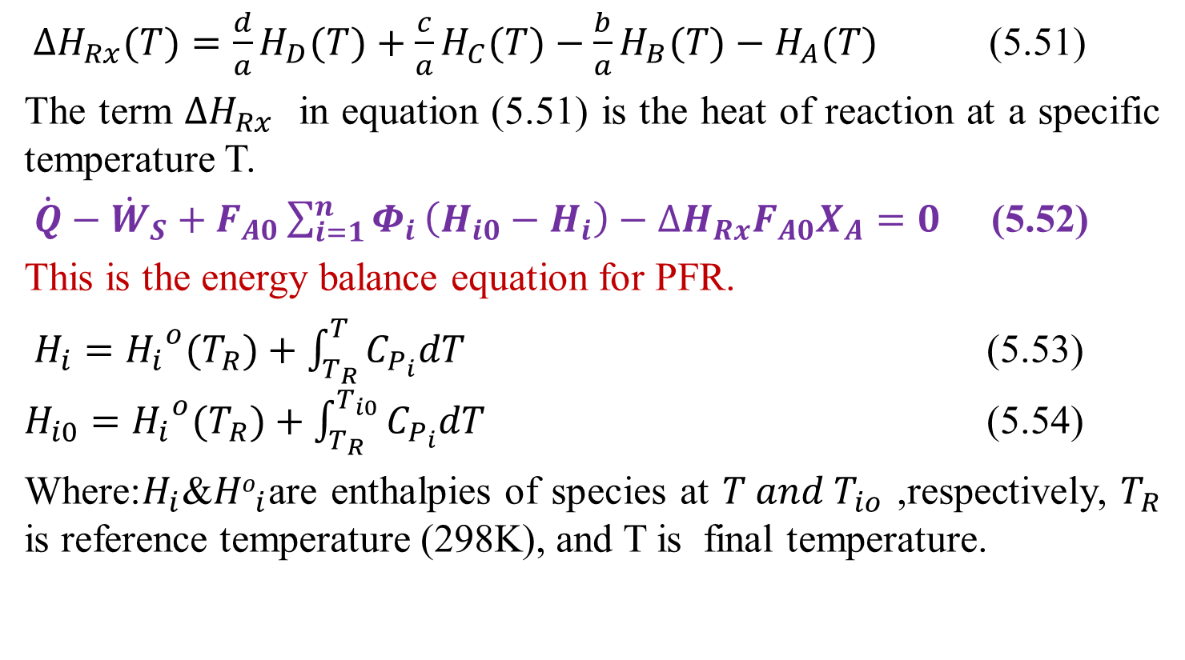
Cont’d
${∆H}_{Rx}(T)=\frac{d}{a}H_{D}(T)+\frac{c}{a}H_{C}(T)−\frac{b}{a}H_{B}(T)−H_{A}(T)$ (5.51)
The term ${∆H}_{Rx}$ in equation (5.51) is the heat of reaction at a specific temperature T.
$\dot{Q}−{\dot{W}}_{S}+F_{A0}\sum_{i=1}^{n}{Φ_{i}}\left(H_{i0}−H_{i}\right)−{∆H}_{Rx}F_{A0}X_{A}=0$ (5.52)
This is the energy balance equation for PFR.
$H_{i}={H_{i}}^{o}(T_{R})+\int_{T_{R}}^{T}{C_{P_{i}}dT}$ (5.53) $H_{i0}={H_{i}}^{o}(T_{R})+\int_{T_{R}}^{T_{i0}}{C_{P_{i}}dT}$ (5.54)
Where:$H_{i}$&${Ho}_{i}$are enthalpies of species at $T and T_{io}$ ,respectively, $T_{R}$ is reference temperature (298K), and T is final temperature.
39

Slide 40
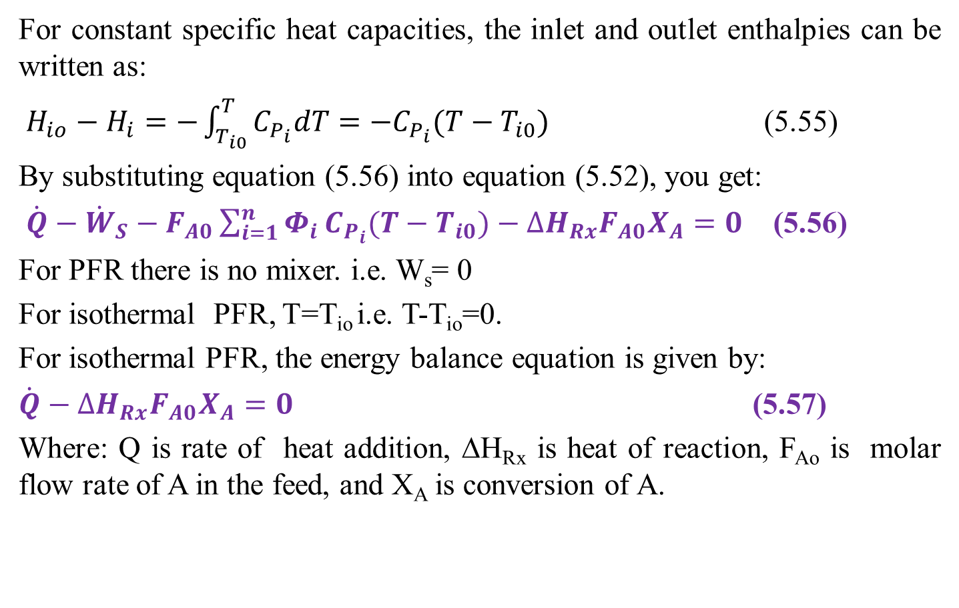
Cont’d
For constant specific heat capacities, the inlet and outlet enthalpies can be written as:
$H_{io}−H_{i}=−\int_{T_{i0}}^{T}{C_{P_{i}}dT=−C_{P_{i}}(T−T_{i0})}$ (5.55)
By substituting equation (5.56) into equation (5.52), you get:
$\dot{Q}−{\dot{W}}_{S}−F_{A0}\sum_{i=1}^{n}{Φ_{i}}C_{P_{i}}(T−T_{i0})−{∆H}_{Rx}F_{A0}X_{A}=0$ (5.56)
For PFR there is no mixer. i.e. W_{s}= 0
For isothermal PFR, T=T_{io} i.e. T-T_{io}=0.
For isothermal PFR, the energy balance equation is given by:
$\dot{Q}−{∆H}_{Rx}F_{A0}X_{A}=0$ (5.57)
Where: Q is rate of heat addition, ΔH_{Rx} is heat of reaction, F_{Ao} is molar flow rate of A in the feed, and X_{A} is conversion of A.
40

Slide 41
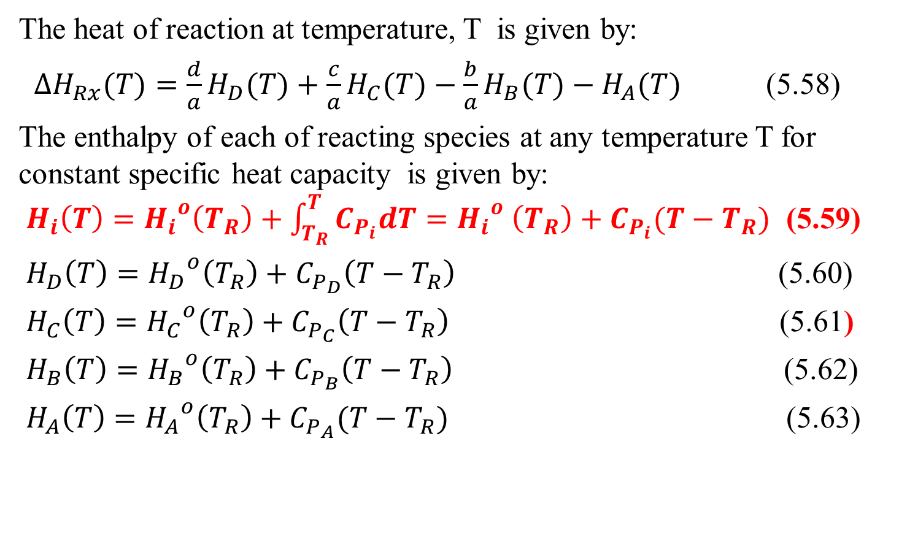
Cont’d
The heat of reaction at temperature, T is given by:
${∆H}_{Rx}(T)=\frac{d}{a}H_{D}(T)+\frac{c}{a}H_{C}(T)−\frac{b}{a}H_{B}(T)−H_{A}(T)$ (5.58)
The enthalpy of each of reacting species at any temperature T for constant specific heat capacity is given by:
$H_{i}\left(T\right)={H_{i}}^{o}\left(T_{R}\right)+\int_{T_{R}}^{T}{C_{P_{i}}dT}={H_{i}}^{o} \left(T_{R}\right)+C_{P_{i}}(T−T_{R})$ (5.59)
$H_{D}\left(T\right)={H_{D}}^{o}\left(T_{R}\right)+C_{P_{D}}\left(T−T_{R}\right)$ (5.60)
$H_{C}\left(T\right)={{H_{C}}^{o}\left(T_{R}\right)+C}_{P_{C}}\left(T−T_{R}\right)$ (5.61)
$H_{B}\left(T\right)={H_{B}}^{o}\left(T_{R}\right)+C_{P_{B}}\left(T−T_{R}\right)$ (5.62)
$H_{A}\left(T\right)={H_{A}}^{o}\left(T_{R}\right)+C_{P_{A}}(T−T_{R})$ (5.63)
41

Slide 42
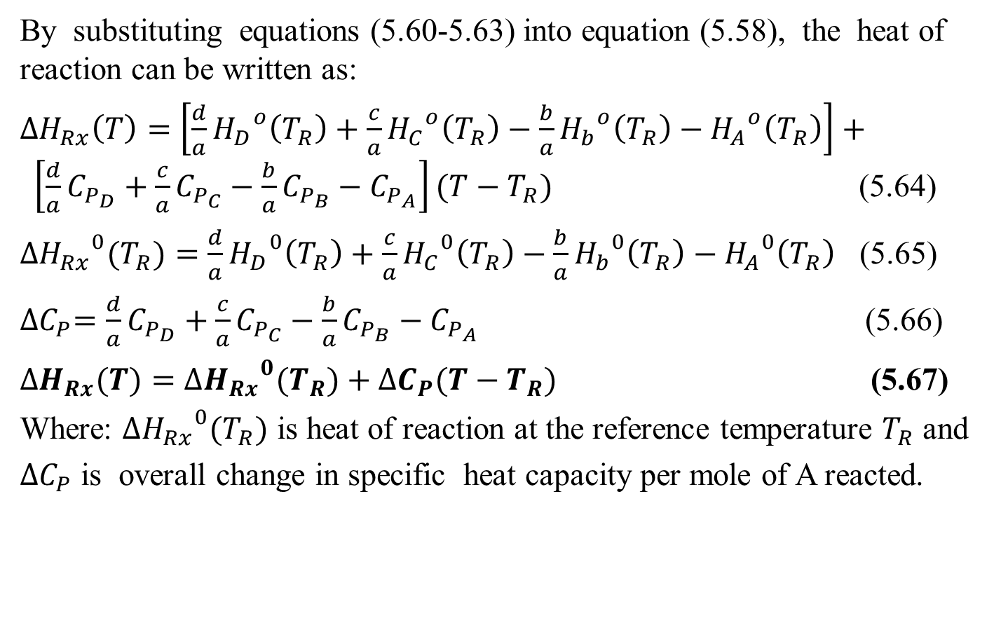
Cont’d
By substituting equations (5.60-5.63) into equation (5.58), the heat of reaction can be written as:
${∆H}_{Rx}\left(T\right)=\left[\frac{d}{a}{H_{D}}^{o}\left(T_{R}\right)+\frac{c}{a}{H_{C}}^{o}\left(T_{R}\right)−\frac{b}{a}{H_{b}}^{o}\left(T_{R}\right)−{H_{A}}^{o}\left(T_{R}\right)\right]+ \left[\frac{d}{a}C_{P_{D}}+\frac{c}{a}C_{P_{C}}−\frac{b}{a}C_{P_{B}}−C_{P_{A}}\right](T−T_{R})$ (5.64)
${{∆H}_{Rx}}^{0}(T_{R})=\frac{d}{a}{H_{D}}^{0}\left(T_{R}\right)+\frac{c}{a}{H_{C}}^{0}\left(T_{R}\right)−\frac{b}{a}{H_{b}}^{0}\left(T_{R}\right)−{H_{A}}^{0}\left(T_{R}\right)$ (5.65)
${∆C}_{P}=\frac{d}{a}C_{P_{D}}+\frac{c}{a}C_{P_{C}}−\frac{b}{a}C_{P_{B}}−C_{P_{A}}$ (5.66)
${∆H}_{Rx}(T)={{∆H}_{Rx}}^{0}(T_{R})+{∆C}_{P}(T−T_{R})$ (5.67)
Where: ${{∆H}_{Rx}}^{0}(T_{R})$ is heat of reaction at the reference temperature $T_{R}$ and
${∆C}_{P}$ is overall change in specific heat capacity per mole of A reacted.
42

Slide 43
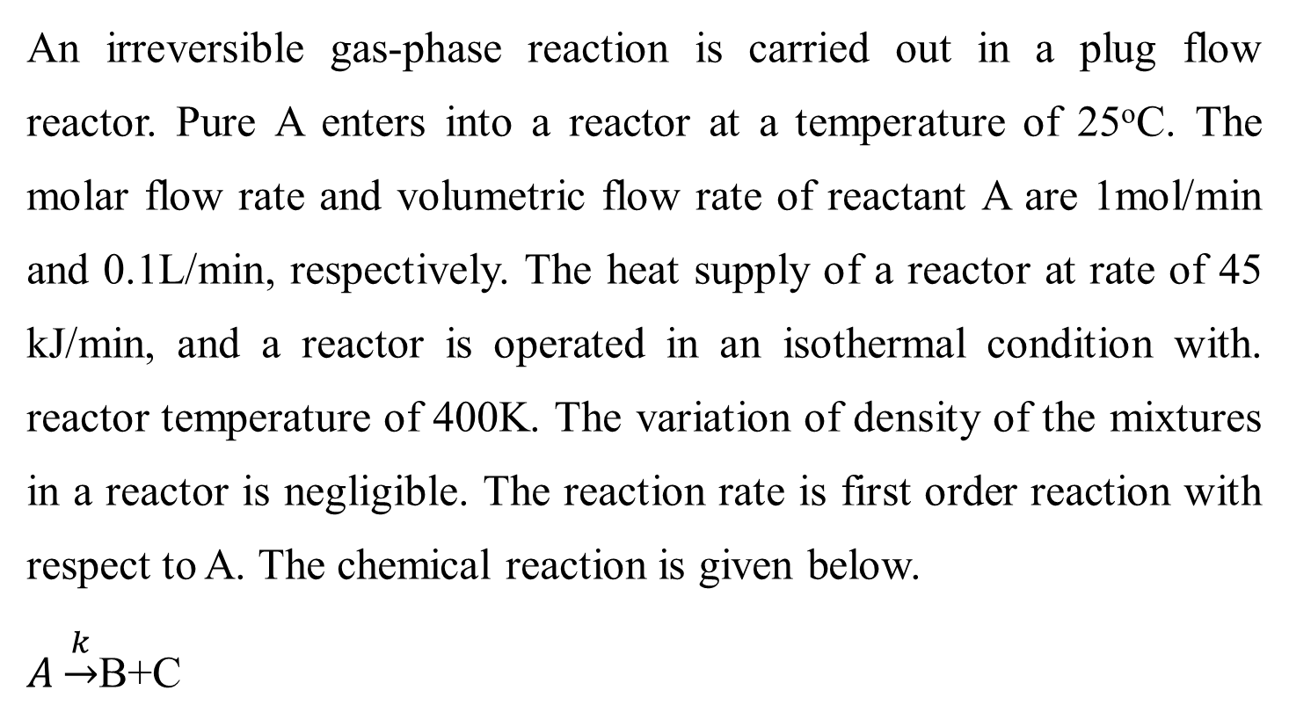
Activity 5.2.
An irreversible gas-phase reaction is carried out in a plug flow reactor. Pure A enters into a reactor at a temperature of 25ºC. The molar flow rate and volumetric flow rate of reactant A are 1mol/min and 0.1L/min, respectively. The heat supply of a reactor at rate of 45 kJ/min, and a reactor is operated in an isothermal condition with. reactor temperature of 400K. The variation of density of the mixtures in a reactor is negligible. The reaction rate is first order reaction with respect to A. The chemical reaction is given below.
$A\underset{→}{k}$B+C
43

Slide 44
Cont’d
Additional information (Activity 5.2)
Hº_{A} (298K) = 20 kJ/mol; Hº_{B} (298K) = 35 kJ/mol; Hº_{C}(298K) = 15 kJ/mol; C_{pA} = 0.15 kJ/mol K; C_{pB} = 0.25 kJ/mol K; C_{pC} = 0.10 kJ/mol K; and k = 0.05 /min.
Based on the given data, determine: (a) conversion of reactant A, (b) the volume of a reactor and (c) space time required.
Given: First order reaction, isothermal PFR, and constant volume.
F_{Ao}=1mol/min, v_{o}= 0.1 L/min, T= 400K, Q= 45 kJ/min; T_{R}=298 K
44

Slide 45
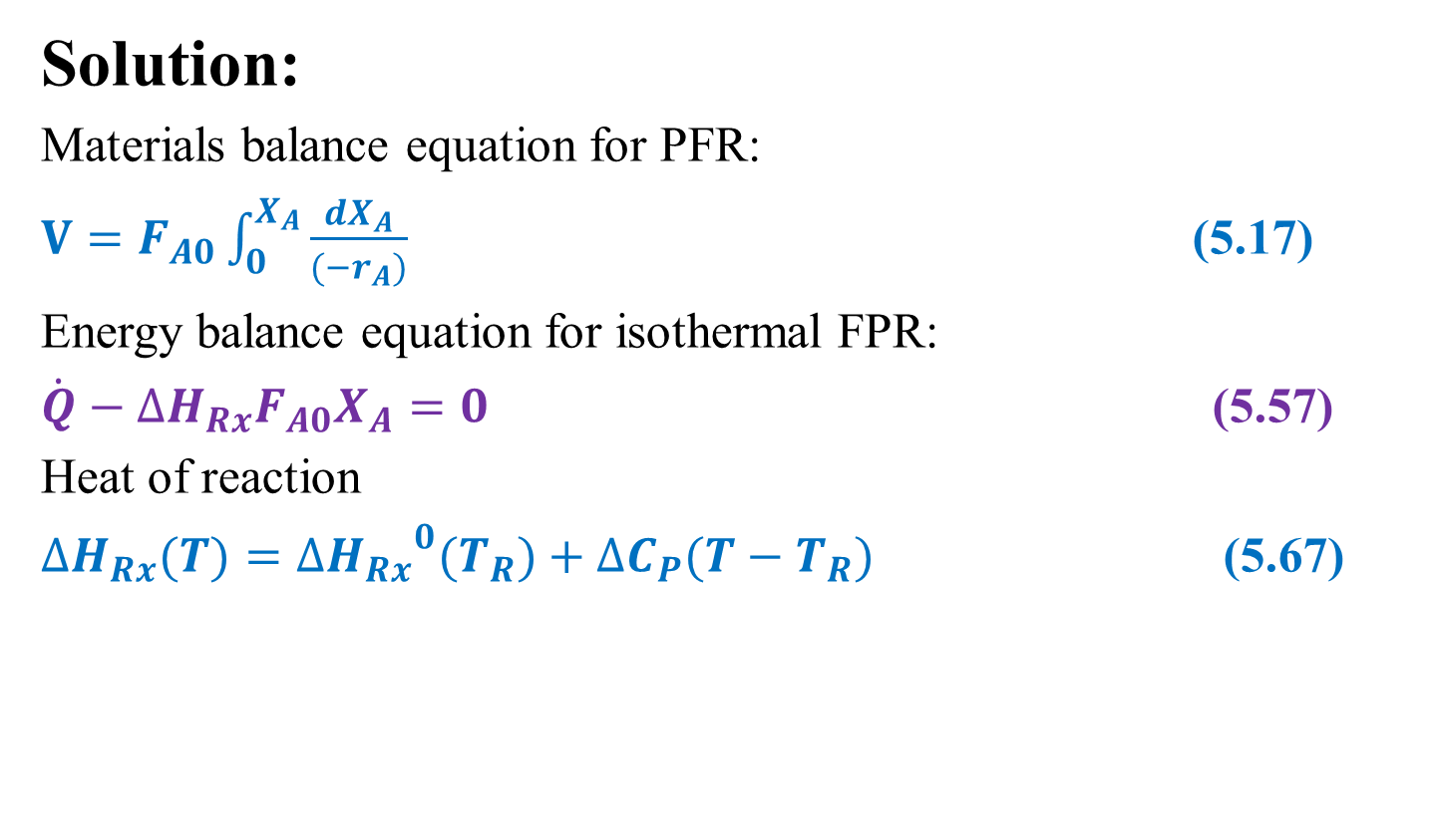
Cont’d
Solution:
Materials balance equation for PFR:
$V=F_{A0}\int_{0}^{X_{A}}{\frac{{dX}_{A}}{{(−r}_{A})}}$ (5.17)
Energy balance equation for isothermal FPR:
$\dot{Q}−{∆H}_{Rx}F_{A0}X_{A}=0$ (5.57)
Heat of reaction
${∆H}_{Rx}(T)={{∆H}_{Rx}}^{0}(T_{R})+{∆C}_{P}(T−T_{R})$ (5.67)
45

Slide 46
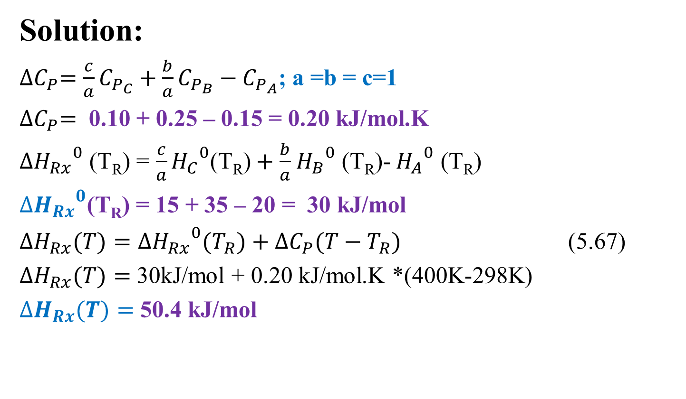
Cont’d
Solution:
${∆C}_{P}=\frac{c}{a}C_{P_{C}}+\frac{b}{a}C_{P_{B}}−C_{P_{A}}$; a =b = c=1
${∆C}_{P}=$ 0.10 + 0.25 – 0.15 = 0.20 kJ/mol.K
${{∆H}_{Rx}}^{0}$ (T_{R}) = $\frac{c}{a}{H_{C}}^{0}\text{(}\text{T}\text{R}\text{)}+\frac{b}{a}$ ${H_{B}}^{0}$ (T_{R})- ${H_{A}}^{0}$ (T_{R})
${{∆H}_{Rx}}^{0}$(T_{R}) = 15 + 35 – 20 = 30 kJ/mol
${∆H}_{Rx}(T)={{∆H}_{Rx}}^{0}(T_{R})+{∆C}_{P}(T−T_{R})$ (5.67)
${∆H}_{Rx}(T)=$ 30kJ/mol + 0.20 kJ/mol.K *(400K-298K)
${∆H}_{Rx}(T)=$ 50.4 kJ/mol
46

Slide 47
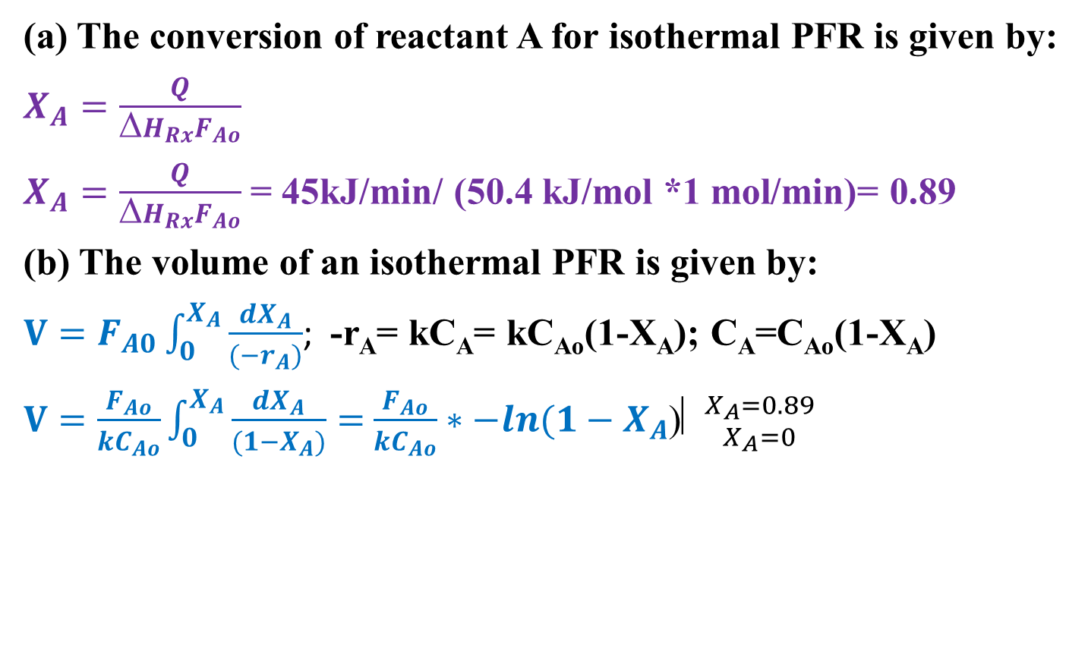
Cont’d
(a) The conversion of reactant A for isothermal PFR is given by:
$X_{A}=\frac{Q}{ΔH_{Rx}F_{Ao}}$
$X_{A}=\frac{Q}{ΔH_{Rx}F_{Ao}}$ = 45kJ/min/ (50.4 kJ/mol *1 mol/min)= 0.89
(b) The volume of an isothermal PFR is given by:
$V=F_{A0}\int_{0}^{X_{A}}{\frac{{dX}_{A}}{{(−r}_{A})}}$; -r_{A}= kC_{A}= kC_{Ao}(1-X_{A}); C_{A}=C_{Ao}(1-X_{A})
$V=\frac{F_{Ao}}{kC_{Ao}}\int_{0}^{X_{A}}{\frac{{dX}_{A}}{(1−X_{A})}}=$ $\frac{F_{Ao}}{kC_{Ao}}∗−ln(1−X_{A}$)⎢${X_{A}=0.89 \atop X_{A}=0}$
47

Slide 48
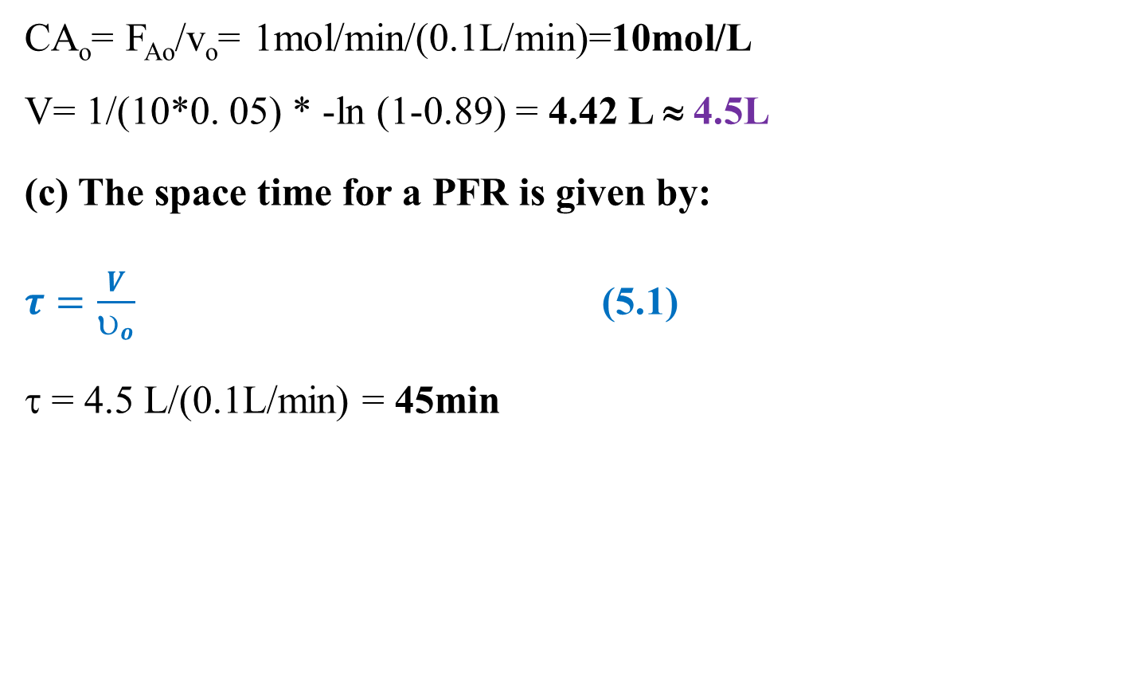
Cont’d
CA_{o}= F_{Ao}/v_{o}= 1mol/min/(0.1L/min)=10mol/L
V= 1/(10*0. 05) * -ln (1-0.89) = 4.42 L ≈ 4.5L
(c) The space time for a PFR is given by:
$τ=\frac{V}{υ_{o}}$ (5.1)
τ = 4.5 L/(0.1L/min) = 45min
48

Slide 49
5.4. Summary
The volume of a PFR is determined from reaction rate and conversion/ concentration using numerical or graphical method.
Space time is determined from reactor volume and volumetric flow rate, which is the measure of a PFR proper performance .
For isothermal PFR, the concentration/conversion of the reaction mixture depends on the distance from the inlet point of reactor to the outlet of reactor. i.e. concentration/conversion of a mixture is a function the length of a PFR.
For isothermal PFR, conversion of species is a function of rate of heat addition/ rate of heat removal for endothermic/exothermic chemical reactions, respectively.
49

Slide 50
References
Chemical Reaction Engineering, Levenspiel, O John Wiely& Sons, 3rd edition, 2011.
Elements of Chemical Engineering, Fogler, HS Prentice- Hall Inc Prentice- Hall Inc, 5th edition, 2015.
Thank you!
50

