Slide 1
Chemical Reaction Engineering II- Reactor Design (ChEg 4101)
Prerequisite: Chemical Reaction Engineering I-Reaction Kinetics (ChEg3104)
Lecture 7: Design of Isothermal Ideal Continuous Stirred Tank Reactor
Week 7
Lecturer: Adamu Esubalew (PhD, ChEg)
Addis Ababa, Ethiopia

Slide 2
Lecture learning outcomes
At the end of the lecture, you will be able to:
describe the characteristics of continuous stirred tank reactor (CSTR),
identify space time and volume required for isothermal ideal CSTR, and
design isothermal ideal CSTR using materials and energy balance equations.

Slide 3
Presentation outlines
Introduction to continuous stirred tank reactor (CSTR)
Design parameters for CSTR
Performance measures for CSTR
Design of isothermal ideal CSTR using materials and energy balance equations
Summary

Slide 4
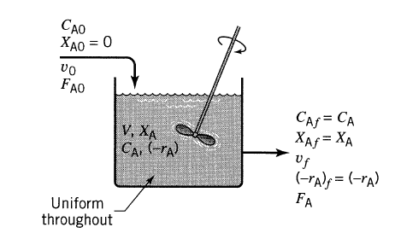
7.1 Introduction to continuous stirred tank reactor
Continuous stirred tank reactor (CSTR): It is a vessel in which reactants are continuously flow into a reactor, and products are continuously flow out from a reactor during chemical reaction.
Consider the following Figure 7.1 which depicts ideal CSTR (Levenspiel, 2011, pg.94).
The reactants concentration in the reactor is equal to at the exit concentration level; low reaction rate takes placed; and low conversion is obtained.
To get higher conversion, one needs a larger volume of reactor and this is one of the disadvantages of such a reactor.
Figure 7.1. CSTR
4

Slide 5
Cont’d
CSTR is also referred to as mixed flow reactor or back-mix reactor.
CSTR is versatile and efficient systems for carrying out continuous chemical reactions.
It is typically used for liquid-phase reactions.
There is no time dependence or position dependence of the temperature, concentration, or reaction rate inside the CSTR. i.e. every variable is the same at every point inside the reactor.
5

Slide 6
Cont’d
Some characteristics of ideal CSTR are the followings:
The fluids in the reactor are assumed to be perfectly mixed. i.e. No stagnant regions formation in the reactor, and the spatial variables throughout the reactor remains the same and are equal to the condition at the outlet.
The space time of all molecules is assumed identical. i.e. No short circuiting of reactants inside the reactor.
It is operated at steady state condition. i.e. The mass flow rate entering to the reactor is equal to the mass flow rate out going from it.
6

Slide 7
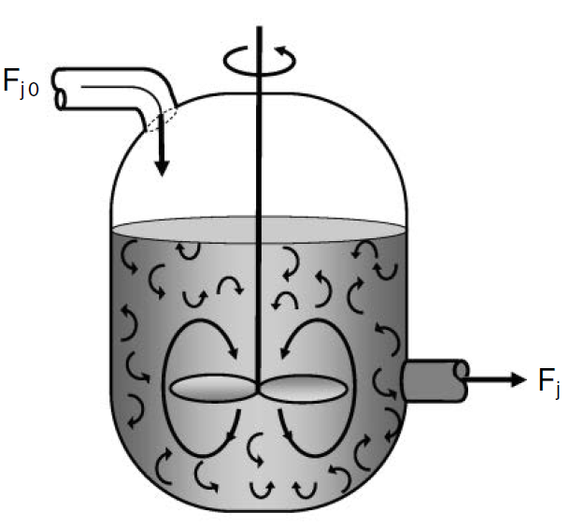
Cont’d
Since the temperature and concentration are identical everywhere within the reaction vessel, they are the same at the exit point as they are elsewhere in the tank.
The temperature and concentration in the exit stream are modeled as being the same as those inside the reactor.
The mixing patterns of a CSTR is shown in Figure 7.2 (Fogler, 2015, pg. 13).
Figure 7.2. CSTR mixing patterns
7

Slide 8
7.2. Design parameters for CSTR
Designing an isothermal CSTR involves several key parameters that need to be considered to ensure optimal operation and efficiency.
Some of the key design parameters for CSTR are the followings:
Reactor volume: It is crucial for determining the space time/ residence time and the amounts of reactants that can be processed.
Volumetric flow rate: It directly influences the space time/ residence time and conversion.
Molar feed rate: It affects rate of reaction and conversion.
8

Slide 9
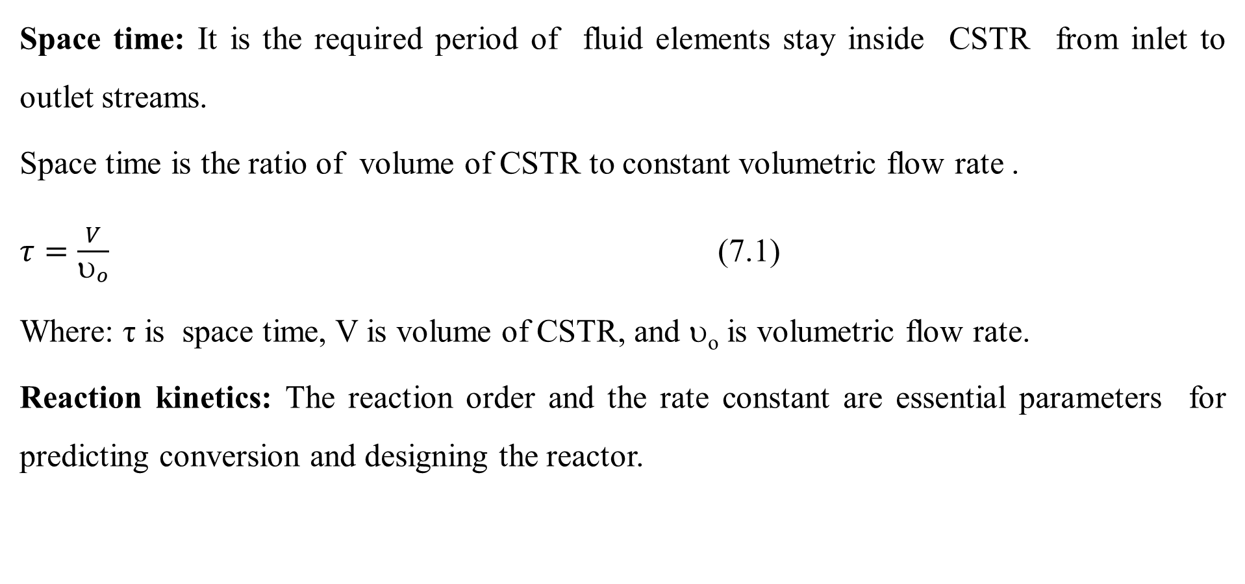
Cont’d
Space time: It is the required period of fluid elements stay inside CSTR from inlet to outlet streams.
Space time is the ratio of volume of CSTR to constant volumetric flow rate .
$τ=\frac{V}{υ_{o}}$ (7.1)
Where: τ is space time, V is volume of CSTR, and υ_{o} is volumetric flow rate.
Reaction kinetics: The reaction order and the rate constant are essential parameters for predicting conversion and designing the reactor.
9

Slide 10
7.3. Performance measures for CSTR
The performance of a CSTR can be evaluated using several key measures that reflect its efficiency, effectiveness, and overall operational characteristics.
Some key performance measures for a CSTR are the followings:
Conversion: It is the fraction of reactants that are converted to products during the reaction.
Yield: It measures the efficiency of converting reactants into desired products.
Selectivity: It refers to the ability of the reactor to produce a desired product over undesired product.
10

Slide 11
Cont’d
Residence time: The average time that a fluid element spends inside the reactor. It influences conversion and reaction kinetics.
Space time: Space time is defined as the time required to process one reactor volume at the inlet flow rate. It is similar to residence time but focuses on reactor volume.
Reaction rate: The rate at which reactants are consumed or products are formed, typically expressed in terms of concentration change over time.
Therefore, the above performance measures provide a comprehensive understanding of how well a CSTR operates under given conditions.
11

Slide 12
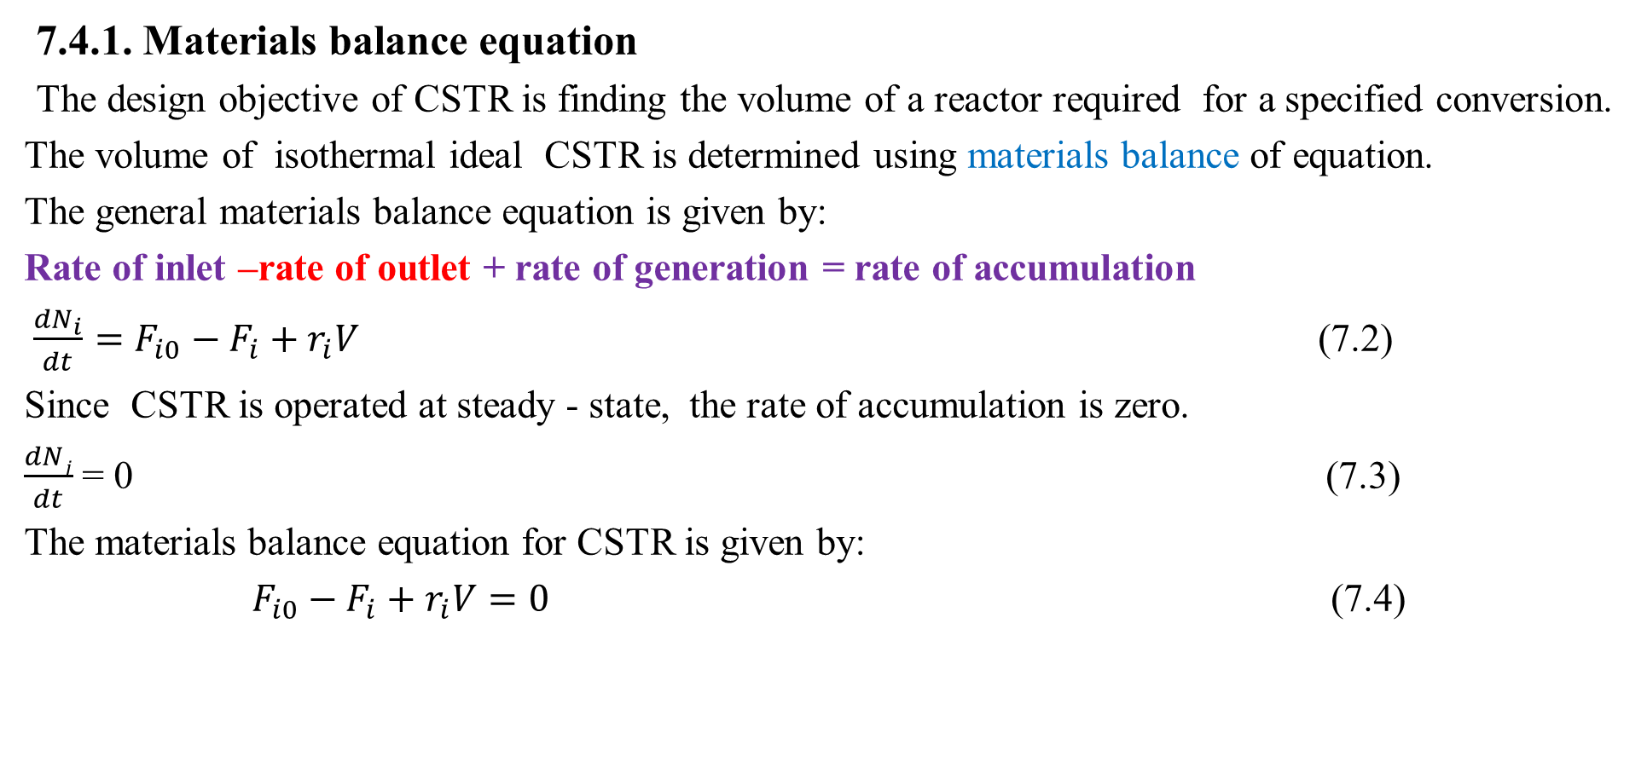
7.4. Design of isothermal CSTR
7.4.1. Materials balance equation
The design objective of CSTR is finding the volume of a reactor required for a specified conversion.
The volume of isothermal ideal CSTR is determined using materials balance of equation.
The general materials balance equation is given by:
Rate of inlet –rate of outlet + rate of generation = rate of accumulation
$\frac{{dN}_{i}}{dt}=F_{i0}−F_{i}+r_{i}V$ (7.2)
Since CSTR is operated at steady - state, the rate of accumulation is zero.
$\frac{dNj}{dt}$= 0 (7.3)
The materials balance equation for CSTR is given by:
$F_{i0}−F_{i}+r_{i}V=0$ (7.4)
12

Slide 13
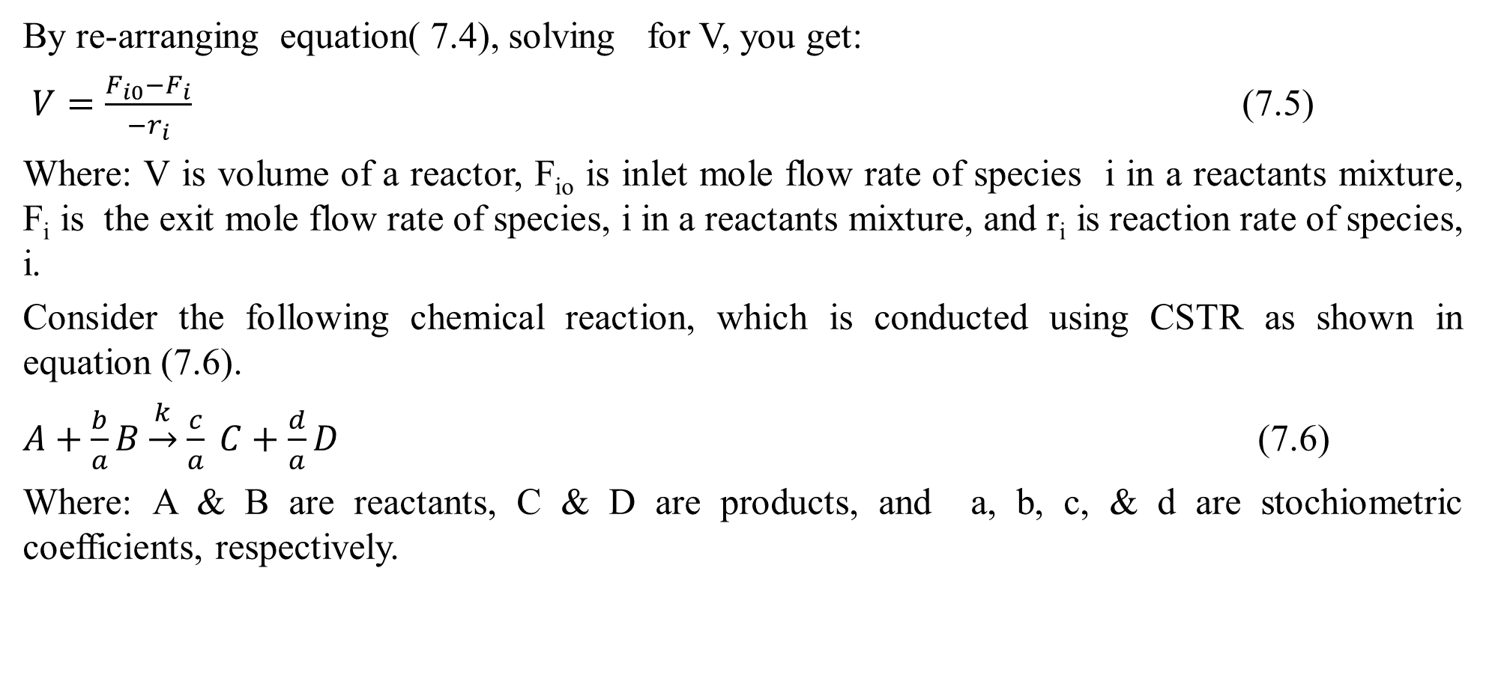
Cont’d
By re-arranging equation( 7.4), solving for V, you get:
$V=\frac{F_{i0}−F_{i}}{{−r}_{i}}$ (7.5)
Where: V is volume of a reactor, F_{io} is inlet mole flow rate of species i in a reactants mixture, F_{i} is the exit mole flow rate of species, i in a reactants mixture, and r_{i} is reaction rate of species, i.
Consider the following chemical reaction, which is conducted using CSTR as shown in equation (7.6).
$A+\frac{b}{a}B\underset{→}{k}$ $\frac{c}{a} C+\frac{d}{a}D$ (7.6)
Where: A & B are reactants, C & D are products, and a, b, c, & d are stochiometric coefficients, respectively.
13

Slide 14
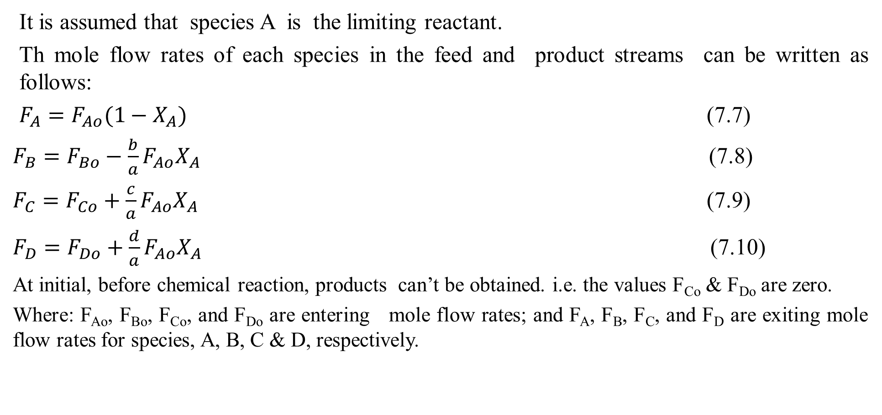
Cont’d
It is assumed that species A is the limiting reactant.
Th mole flow rates of each species in the feed and product streams can be written as follows:
$F_{A}=F_{Ao}(1−X_{A})$ (7.7)
$F_{B}=F_{Bo}−\frac{b}{a}{F_{Ao}X}_{A}$ (7.8)
$F_{C}=F_{Co}+\frac{c}{a}{F_{Ao}X}_{A}$ (7.9)
$F_{D}=F_{Do}+\frac{d}{a}{F_{Ao}X}_{A}$ (7.10)
At initial, before chemical reaction, products can’t be obtained. i.e. the values F_{Co} & F_{Do} are zero.
Where: F_{Ao}, F_{Bo}, F_{Co}, and F_{Do} are entering mole flow rates; and F_{A}, F_{B}, F_{C}, and F_{D} are exiting mole flow rates for species, A, B, C & D, respectively.
14

Slide 15
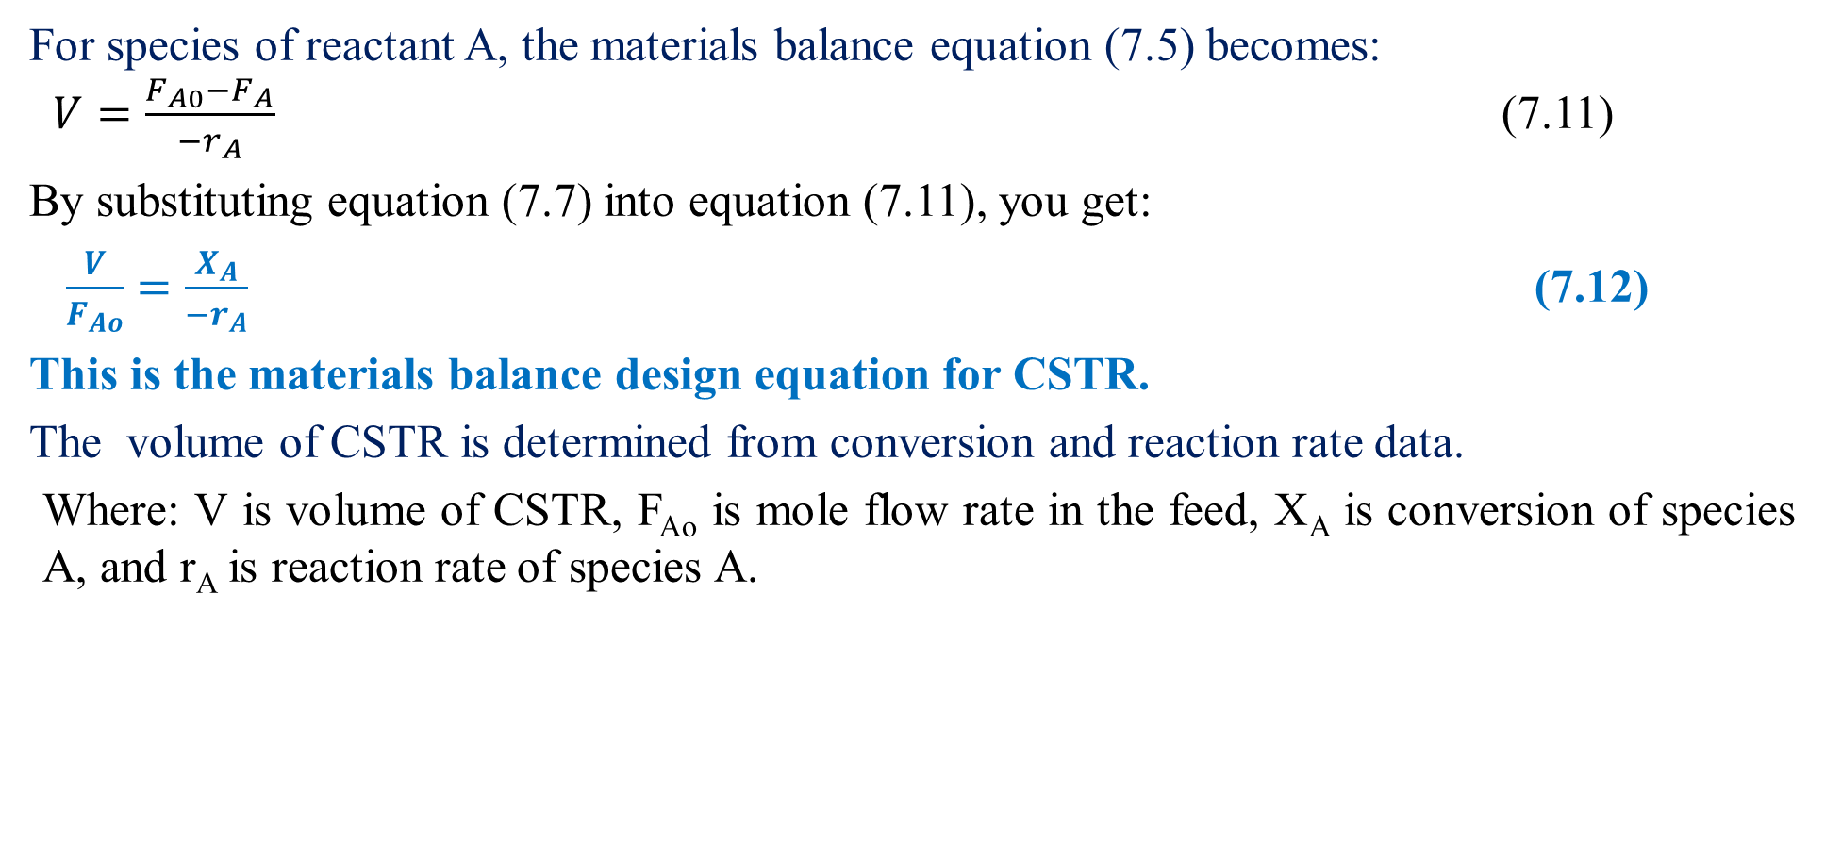
Cont’d
For species of reactant A, the materials balance equation (7.5) becomes:
$V=\frac{F_{A0}−F_{A}}{{−r}_{A}}$ (7.11)
By substituting equation (7.7) into equation (7.11), you get:
$\frac{V}{F_{Ao}}=\frac{X_{A}}{{−r}_{A}}$ (7.12)
This is the materials balance design equation for CSTR.
The volume of CSTR is determined from conversion and reaction rate data.
Where: V is volume of CSTR, F_{Ao} is mole flow rate in the feed, X_{A} is conversion of species A, and r_{A} is reaction rate of species A.
15

Slide 16
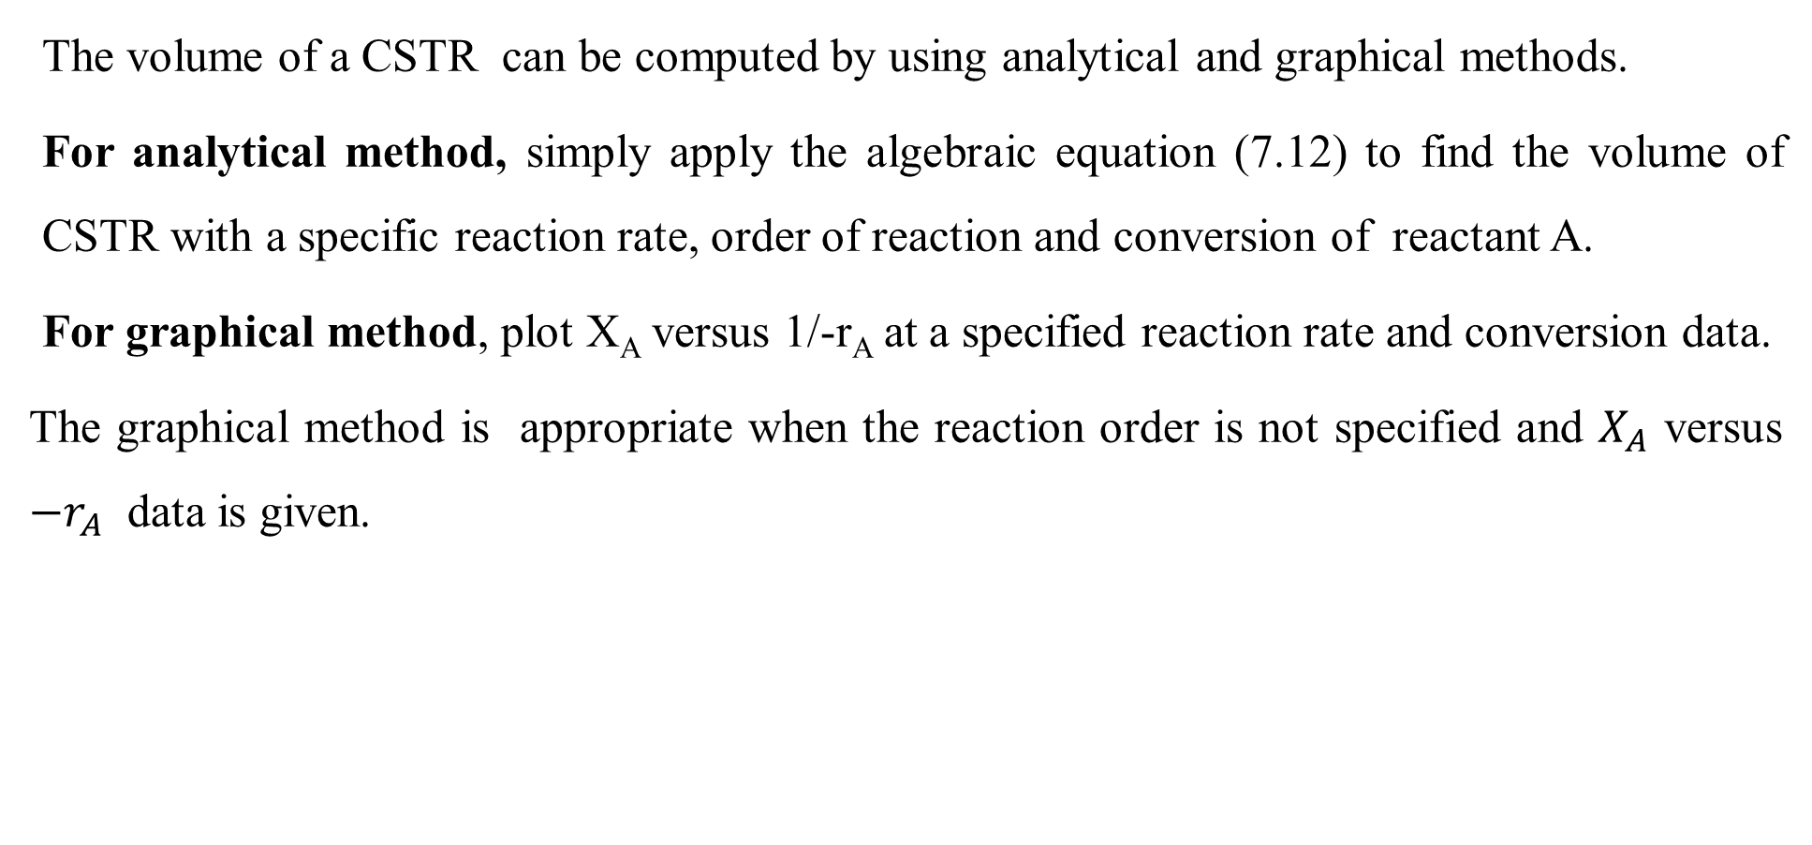
Cont’d
The volume of a CSTR can be computed by using analytical and graphical methods.
For analytical method, simply apply the algebraic equation (7.12) to find the volume of CSTR with a specific reaction rate, order of reaction and conversion of reactant A.
For graphical method, plot X_{A} versus 1/-r_{A} at a specified reaction rate and conversion data.
The graphical method is appropriate when the reaction order is not specified and $X_{A}$ versus ${−r}_{A}$ data is given.
16

Slide 17
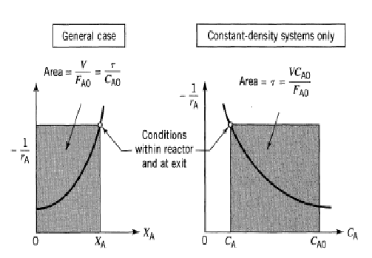
Cont’d
The rectangular area, which is bounded by plotting X_{A} versus 1/-r_{A} is the ratio of volume of CSTR to feed rate of reactant A as shown in Figure 7.3 (Levenspiel, 2011, pg. 95).
Figure 7.3. Graphical representation of the design equations for CSTR.
17

Slide 18
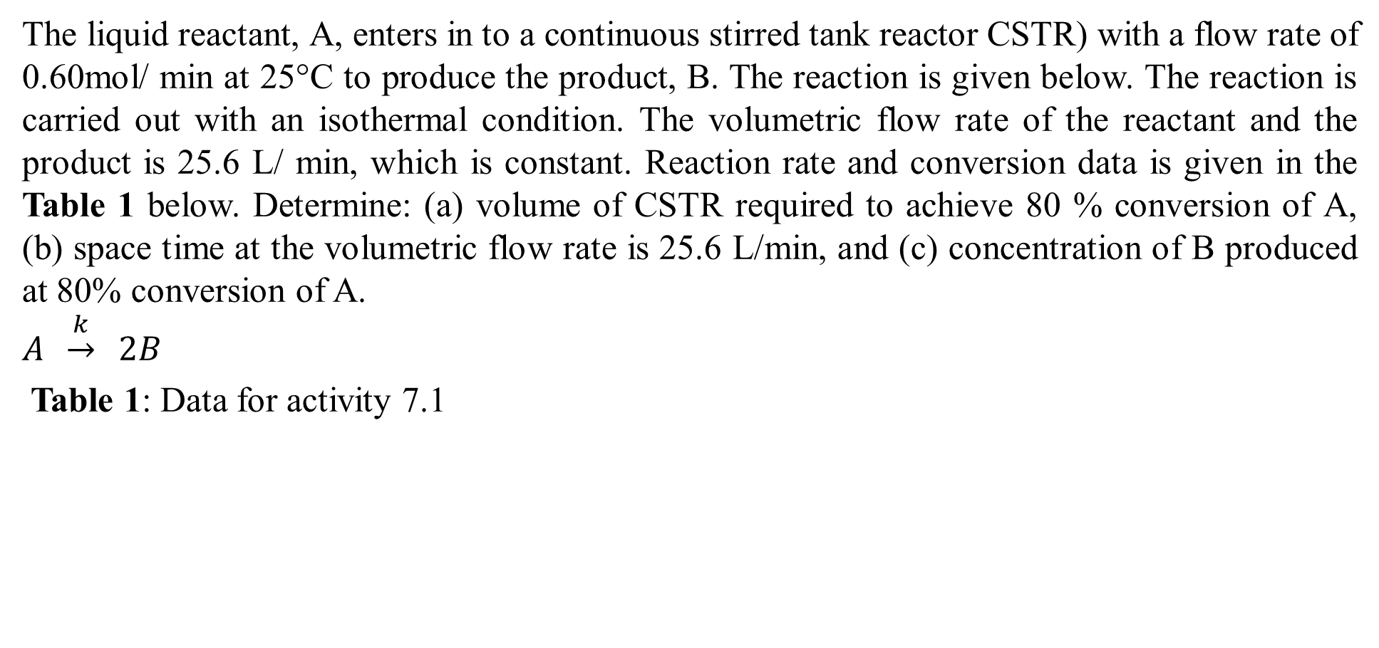
Activity 7.1
The liquid reactant, A, enters in to a continuous stirred tank reactor CSTR) with a flow rate of 0.60mol/ min at 25°C to produce the product, B. The reaction is given below. The reaction is carried out with an isothermal condition. The volumetric flow rate of the reactant and the product is 25.6 L/ min, which is constant. Reaction rate and conversion data is given in the Table 1 below. Determine: (a) volume of CSTR required to achieve 80 % conversion of A, (b) space time at the volumetric flow rate is 25.6 L/min, and (c) concentration of B produced at 80% conversion of A.
$$A \underset{→}{k} 2B$$
Table 1: Data for activity 7.1
X_{A} | 0 | 0.1 | 0.2 | 0.3 | 0.4 | 0.5 | 0.6 | 0.7 | 0.8
-r_{A} (mol /L.min) | 0.0053 | 0.0052 | 0.0050 | 0.0045 | 0.0040 | 0.0033 | 0.0025 | 0.0018 | 0.00125
18

Slide 19
Cont’d
Given: Isothermal CSTR, rate vs conversion data, F_{Ao}= 0.60 mol/min, υ_{o}=25.6L/min,
X_{A}= 80% = 0.8
Table 2: Data for activity 7.1
Required: (a) V=?, (b) τ =?, and (c) C_{B}= ?
X_{A} | 0 | 0.1 | 0.2 | 0.3 | 0.4 | 0.5 | 0.6 | 0.7 | 0.8
1/-r_{A} (L.min/ mol) | 188.7 | 192.3 | 200 | 222.2 | 250 | 303 | 400 | 555.6 | 800
19

Slide 20
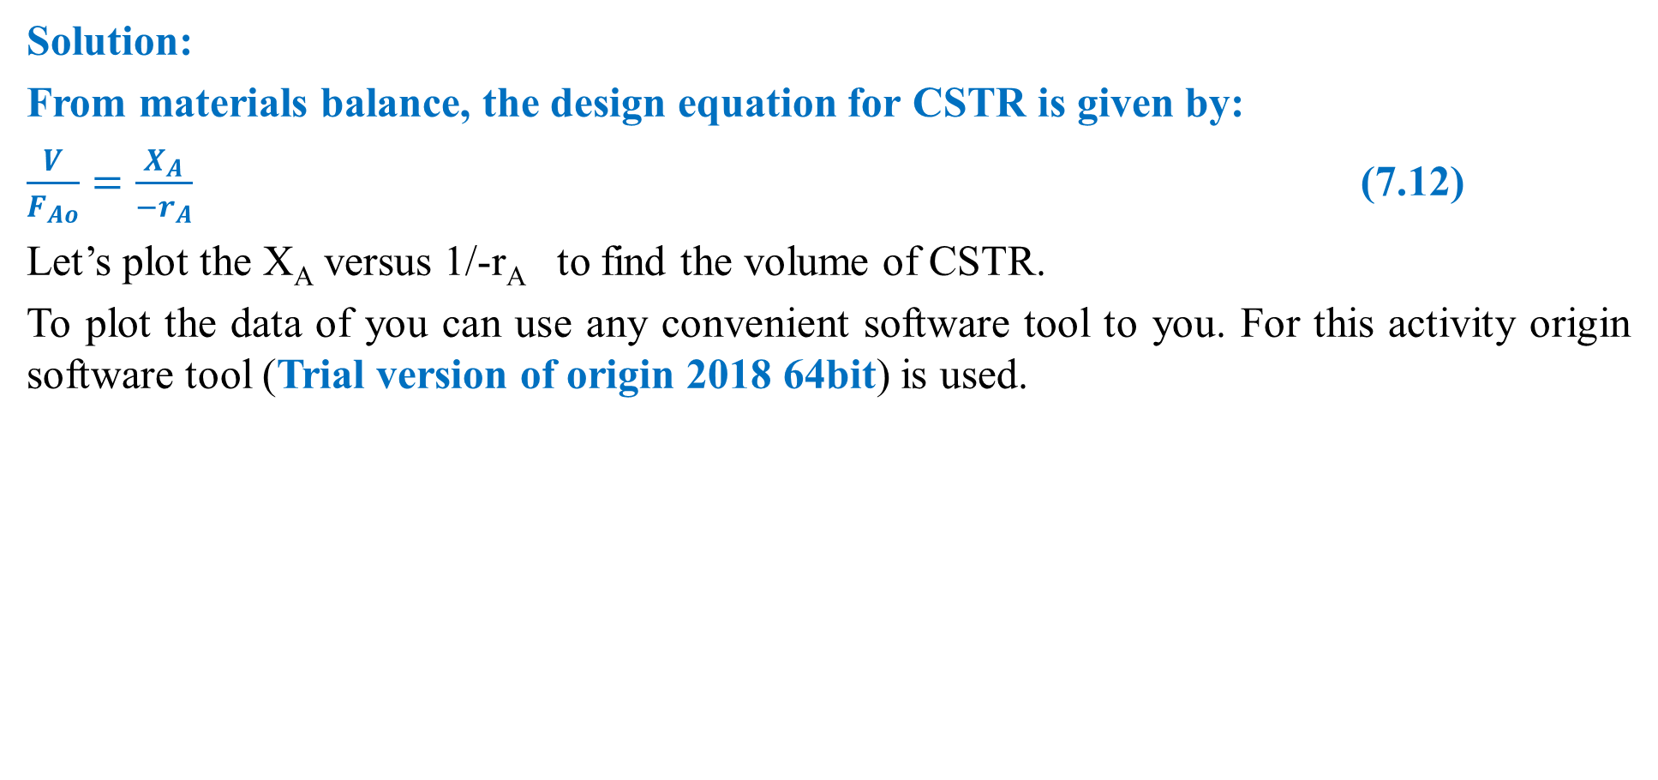
Cont’d
Solution:
From materials balance, the design equation for CSTR is given by:
$\frac{V}{F_{Ao}}=\frac{X_{A}}{{−r}_{A}}$ (7.12)
Let’s plot the X_{A} versus 1/-r_{A} to find the volume of CSTR.
To plot the data of you can use any convenient software tool to you. For this activity origin software tool (Trial version of origin 2018 64bit) is used.
X_{A} | 0 | 0.1 | 0.2 | 0.3 | 0.4 | 0.5 | 0.6 | 0.7 | 0.8
1/-r_{A} (L.min/ mol) | 188.7 | 192.3 | 200 | 222.2 | 250 | 303 | 400 | 555.6 | 800
20

Slide 21
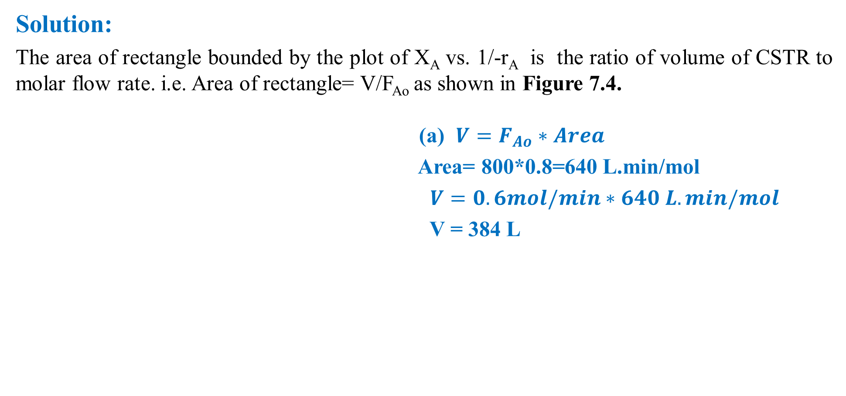
Cont’d
Solution:
The area of rectangle bounded by the plot of X_{A} vs. 1/-r_{A} is the ratio of volume of CSTR to molar flow rate. i.e. Area of rectangle= V/F_{Ao} as shown in Figure 7.4.
(a) $V=F_{Ao}∗Area$
Area= 800*0.8=640 L.min/mol
$V=0.6mol/min∗640 L.min/mol$
V = 384 L
Figure 7.4. X_{A} vs 1/-r_{A} plot for CSTR
21

Slide 22
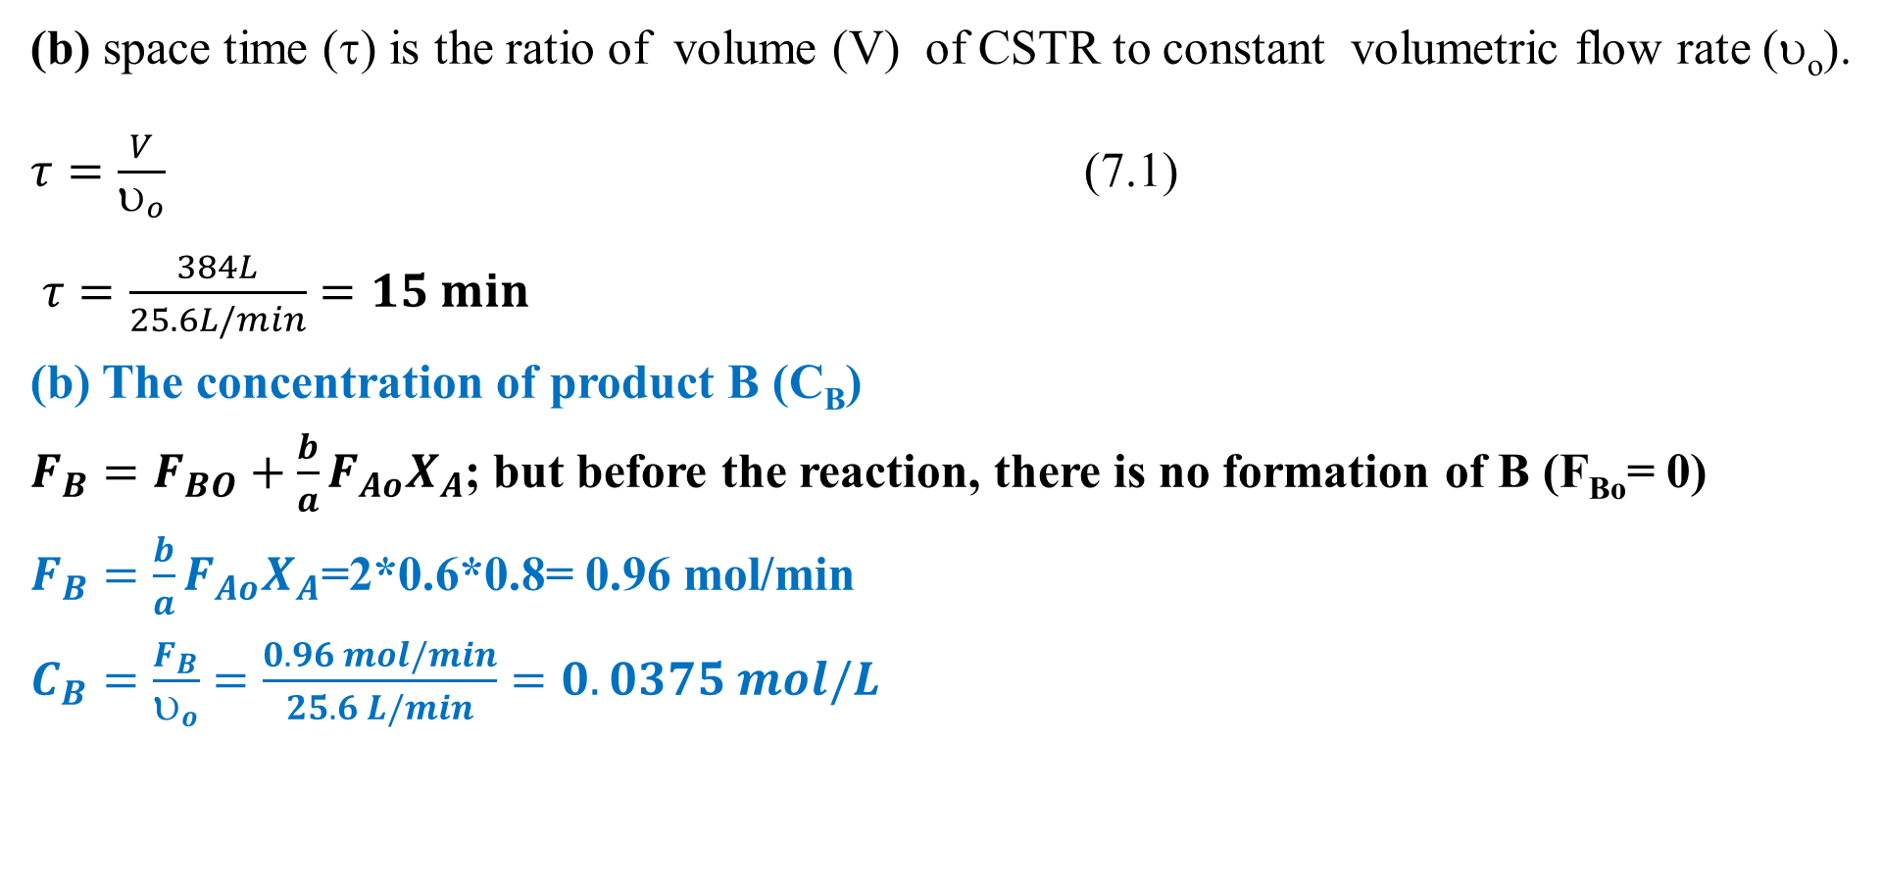
Cont’d
(b) space time (τ) is the ratio of volume (V) of CSTR to constant volumetric flow rate (υ_{o}).
$τ=\frac{V}{υ_{o}}$ (7.1)
$τ=\frac{384L}{25.6L/min}=15 min$
(b) The concentration of product B (C_{B})
$F_{B}=F_{BO}+\frac{b}{a}F_{Ao}X_{A}$; but before the reaction, there is no formation of B (F_{Bo}= 0)
$F_{B}=\frac{b}{a}F_{Ao}X_{A}$=2*0.6*0.8= 0.96 mol/min
$C_{B}=\frac{F_{B}}{υ_{o}}=\frac{0.96 mol/min}{25.6 L/min}=0.0375 mol/L$
22

Slide 23
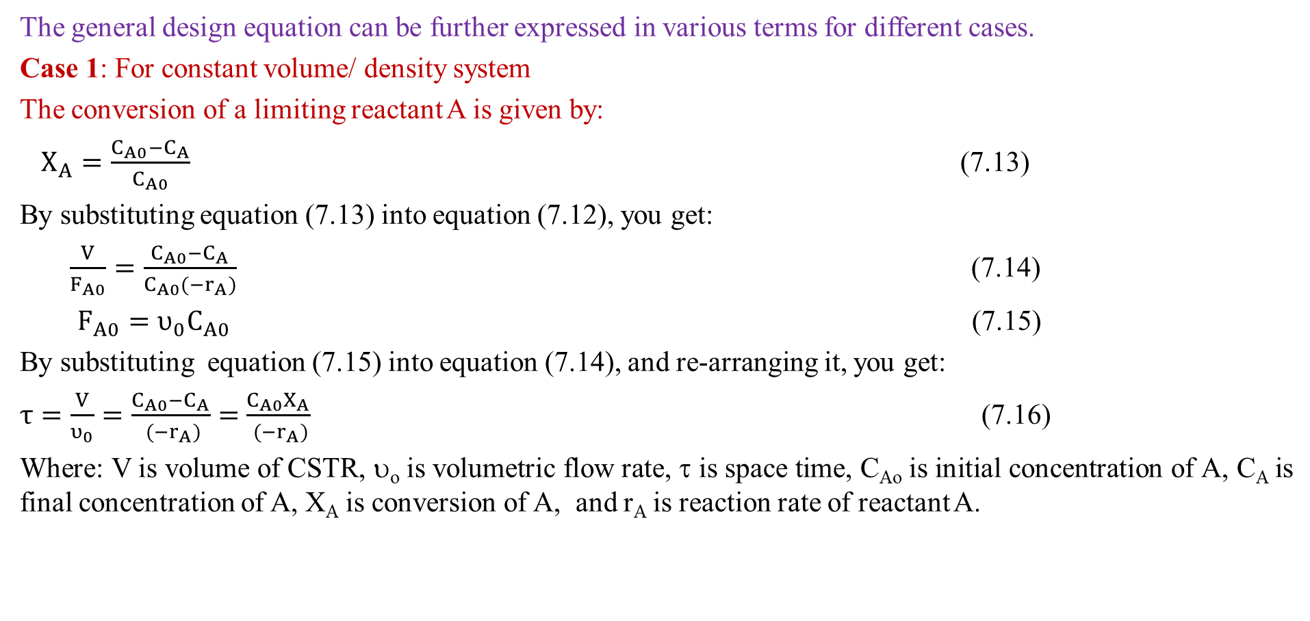
Cont’d
The general design equation can be further expressed in various terms for different cases.
Case 1: For constant volume/ density system
The conversion of a limiting reactant A is given by:
$X_{A}=\frac{C_{A0}−C_{A}}{C_{A0}}$ (7.13)
By substituting equation (7.13) into equation (7.12), you get:
$\frac{V}{F_{A0}}=\frac{C_{A0}−C_{A}}{C_{A0}({−r}_{A})}$ (7.14)
${F_{A0}=υ_{0}C}_{A0}$ (7.15)
By substituting equation (7.15) into equation (7.14), and re-arranging it, you get:
$τ=\frac{V}{υ_{0}}=\frac{C_{A0}−C_{A}}{ ({−r}_{A})}=$ $\frac{C_{A0}X_{A}}{ ({−r}_{A})}$ (7.16)
Where: V is volume of CSTR, υ_{o} is volumetric flow rate, τ is space time, C_{Ao} is initial concentration of A, C_{A} is final concentration of A, X_{A} is conversion of A, and r_{A} is reaction rate of reactant A.
23

Slide 24
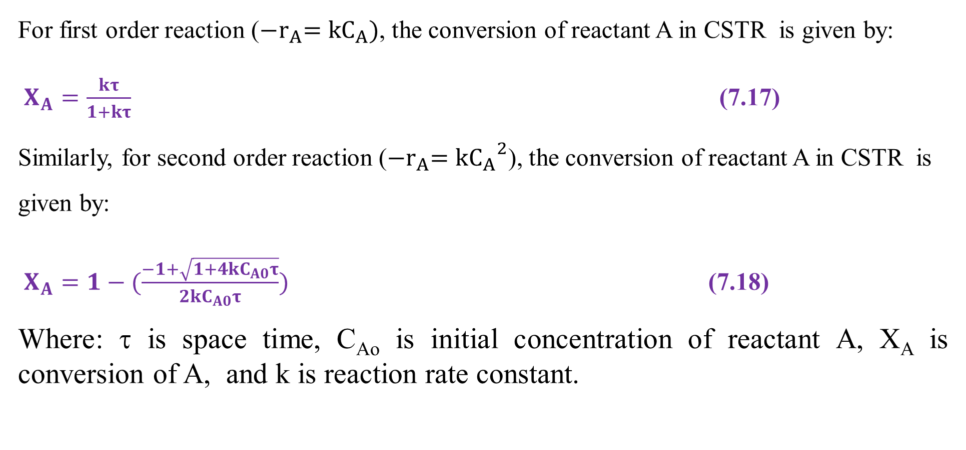
Cont’d
For first order reaction (${−r}_{A}={kC}_{A})$, the conversion of reactant A in CSTR is given by:
$X_{A}=\frac{kτ}{1+kτ}$ (7.17)
Similarly, for second order reaction (${−r}_{A}=k{C_{A}}^{2}$), the conversion of reactant A in CSTR is given by:
$X_{A}=1−(\frac{−1+\sqrt{{1+4kC}_{A0}τ}}{2kC_{A0}τ})$ (7.18)
Where: τ is space time, C_{Ao} is initial concentration of reactant A, X_{A} is conversion of A, and k is reaction rate constant.
24

Slide 25
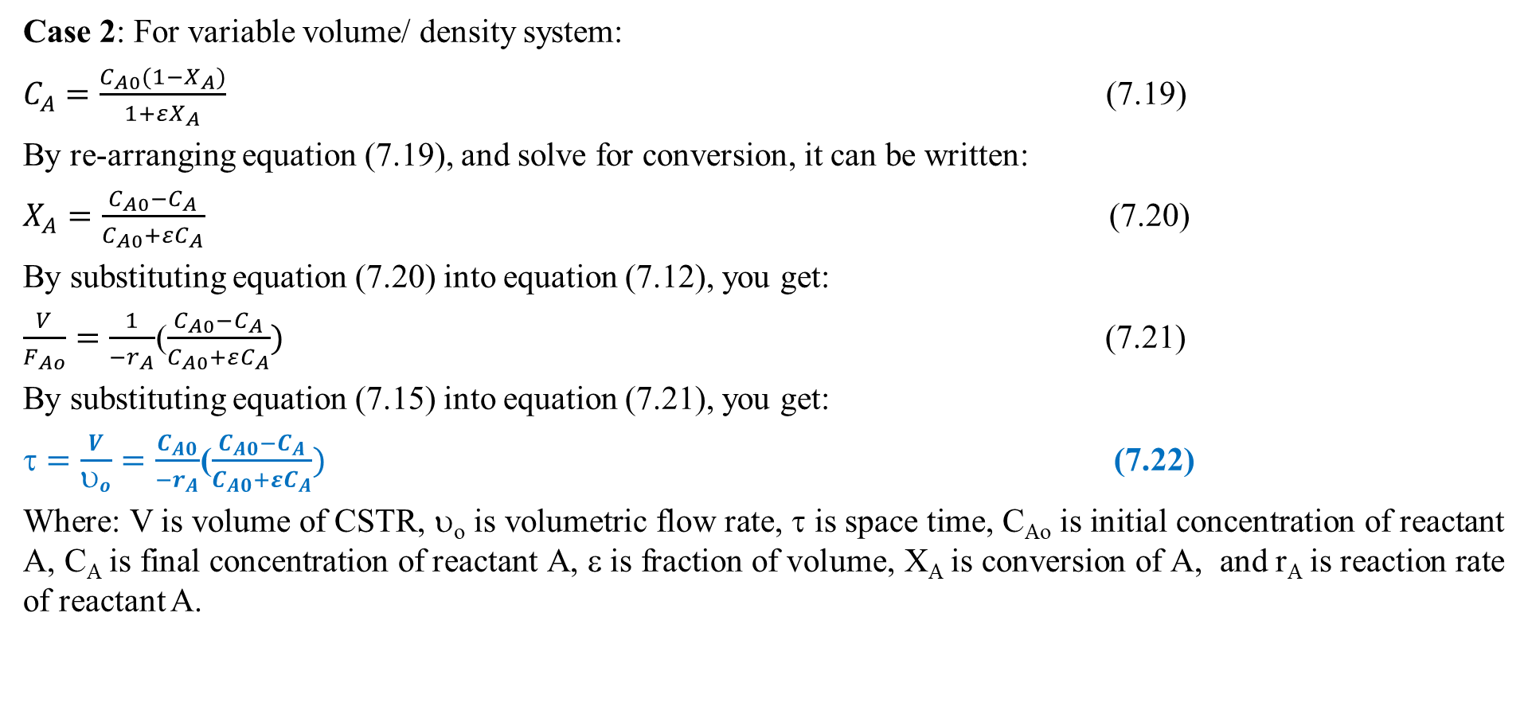
Cont’d
Case 2: For variable volume/ density system:
$C_{A}=\frac{C_{A0}(1−X_{A})}{1+εX_{A}}$ (7.19)
By re-arranging equation (7.19), and solve for conversion, it can be written:
$X_{A}=\frac{C_{A0}−C_{A}}{C_{A0}+εC_{A}}$ (7.20)
By substituting equation (7.20) into equation (7.12), you get:
$\frac{V}{F_{Ao}}=\frac{1}{{−r}_{A}}$($\frac{C_{A0}−C_{A}}{C_{A0}+εC_{A}})$ (7.21)
By substituting equation (7.15) into equation (7.21), you get:
$=\frac{V}{υ_{o}}=\frac{C_{A0}}{{−r}_{A}}$($\frac{C_{A0}−C_{A}}{C_{A0}+εC_{A}})$ (7.22)
Where: V is volume of CSTR, υ_{o} is volumetric flow rate, τ is space time, C_{Ao} is initial concentration of reactant A, C_{A} is final concentration of reactant A, ε is fraction of volume, X_{A} is conversion of A, and r_{A} is reaction rate of reactant A.
25

Slide 26
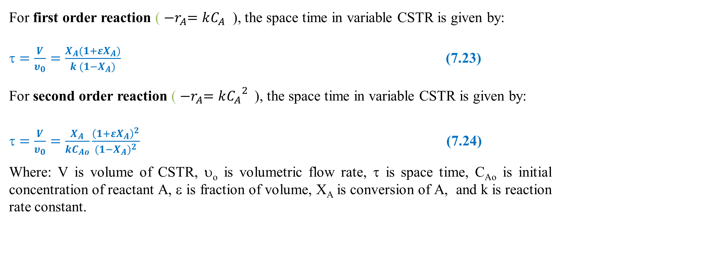
Cont’d
For first order reaction ( ${−r}_{A}=kC_{A}$ ), the space time in variable CSTR is given by:
$=\frac{V}{υ_{0}}=\frac{X_{A}(1+εX_{A})}{k (1−X_{A})}$ (7.23)
For second order reaction ( ${−r}_{A}=k{C_{A}}^{2}$), the space time in variable CSTR is given by:
$=\frac{V}{υ_{0}}=\frac{X_{A}}{kC_{Ao}}\frac{{\left(1+εX_{A}\right)}^{2}}{{(1−X_{A})}^{2}}$ (7.24)
Where: V is volume of CSTR, υ_{o} is volumetric flow rate, τ is space time, C_{Ao} is initial concentration of reactant A, ε is fraction of volume, X_{A} is conversion of A, and k is reaction rate constant.
26

Slide 27
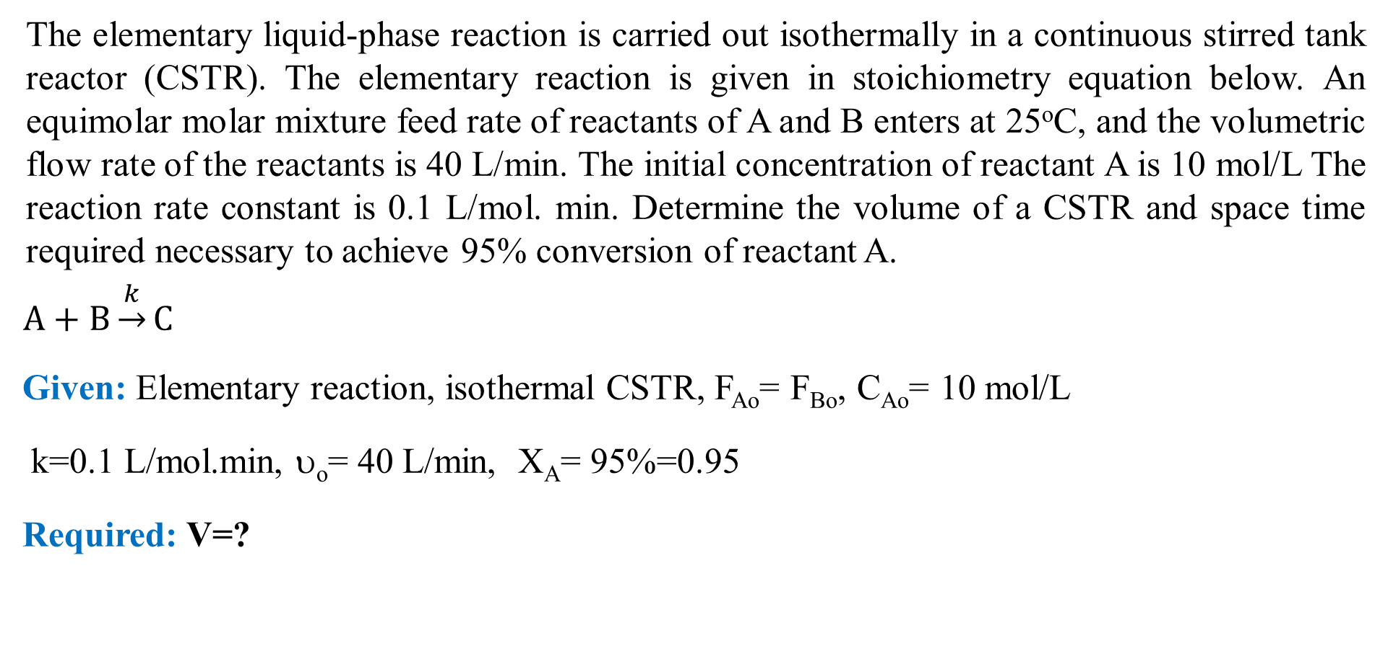
Activity 7.2
The elementary liquid-phase reaction is carried out isothermally in a continuous stirred tank reactor (CSTR). The elementary reaction is given in stoichiometry equation below. An equimolar molar mixture feed rate of reactants of A and B enters at 25ºC, and the volumetric flow rate of the reactants is 40 L/min. The initial concentration of reactant A is 10 mol/L The reaction rate constant is 0.1 L/mol. min. Determine the volume of a CSTR and space time required necessary to achieve 95% conversion of reactant A.
$A+B\underset{→}{k}C$
Given: Elementary reaction, isothermal CSTR, F_{Ao}= F_{Bo}, C_{Ao}= 10 mol/L
k=0.1 L/mol.min, υ_{o}= 40 L/min, X_{A}= 95%=0.95
Required: V=?
27

Slide 28
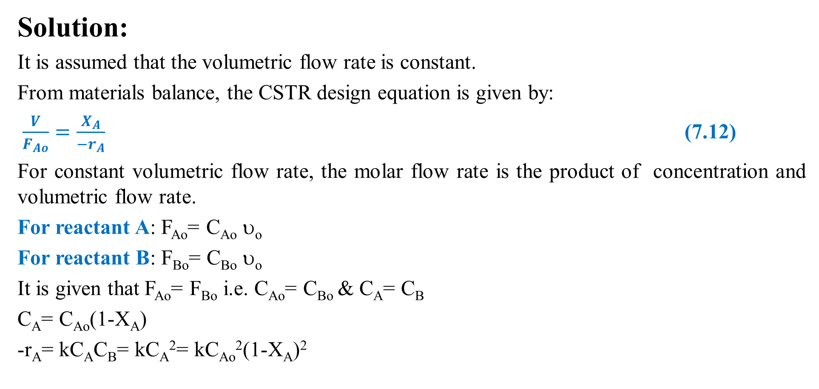
Cont’d
Solution:
It is assumed that the volumetric flow rate is constant.
From materials balance, the CSTR design equation is given by:
$\frac{V}{F_{Ao}}=\frac{X_{A}}{{−r}_{A}}$ (7.12)
For constant volumetric flow rate, the molar flow rate is the product of concentration and volumetric flow rate.
For reactant A: F_{Ao}= C_{Ao} υ_{o}
For reactant B: F_{Bo}= C_{Bo} υ_{o}
It is given that F_{Ao}= F_{Bo} i.e. C_{Ao}= C_{Bo} & C_{A}= C_{B}
C_{A}= C_{Ao}(1-X_{A})
-r_{A}= kC_{A}C_{B}= kC_{A}²= kC_{Ao}²(1-X_{A})²
28

Slide 29
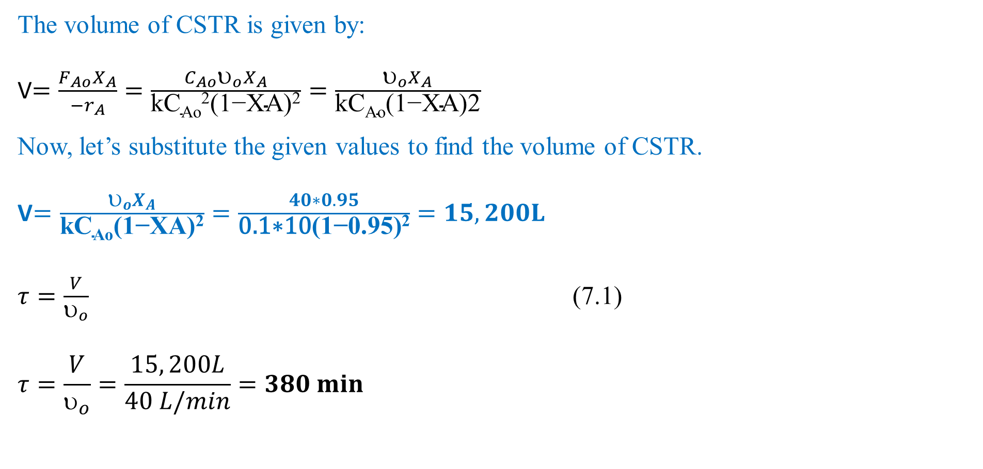
Cont’d
The volume of CSTR is given by:
V$=\frac{{F_{Ao}X}_{A}}{{−r}_{A}}=\frac{C_{Ao}υ_{o}X_{A}}{\text{kC}\text{Ao}\text{2}\text{(1−}\text{XA}\text{)2}}=\frac{υ_{o}X_{A}}{\text{kC}\text{Ao}\text{(1−}\text{XA}\text{)2}}$
Now, let’s substitute the given values to find the volume of CSTR.
V$=\frac{υ_{o}X_{A}}{\text{kC}\text{Ao}\text{(1−}\text{XA}\text{)2}}=\frac{40∗0.95}{\text{0.1∗10}\text{(1−}\text{0.95}\text{)}\text{2}}=15,200L$
$τ=\frac{V}{υ_{o}}$ (7.1)
$$τ=\frac{V}{υ_{o}}=\frac{15, 200L}{40 L/min}=380 min$$
29

Slide 30
7.4.2. Energy balance equation
Energy balance is performed by applying of the first law of thermodynamics for open system - flow reactors (e.g , CSTR).
First law of thermodynamics states that the total energy of the system is constant.
For open system, there is flow of mass and energy across system boundary.
To develop energy balance equation, it is assumed that heat (Q ) is added to the reactor and work (W_{s}) is done by the system.
30

Slide 31


Cont’d
Consider the following CSTR to develop energy balance equation as shown in Figure 7.5.
The feed stream is the input energy rate, and the product stream is the output energy rate.
W_{s}
F_{io}
T_{io}
H_{io}
F_{i}
T
H_{i}
X_{A}
Q
Figure 7.5. CSTR energy flows
31

Slide 32
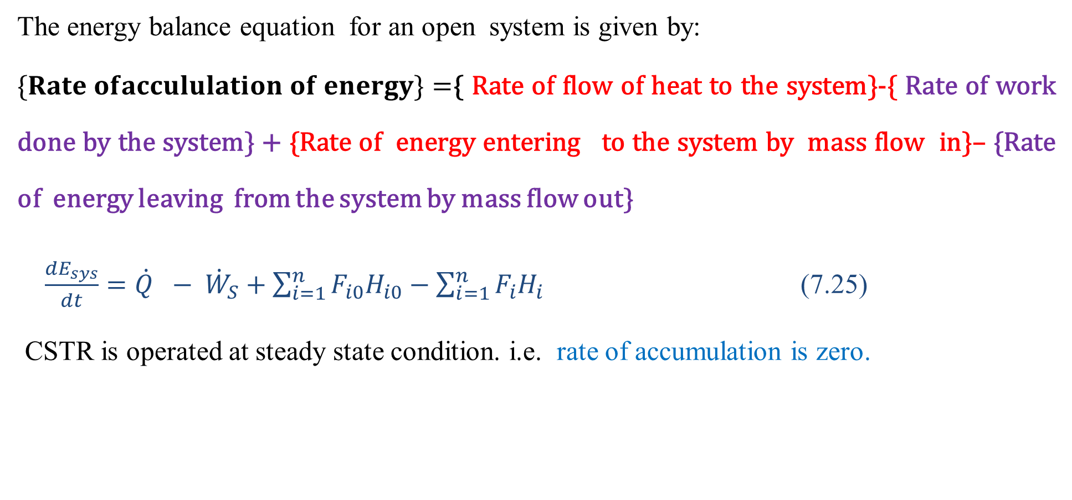
Cont’d
The energy balance equation for an open system is given by:
$\{Rate ofaccululation of energy\}=${ Rate of flow of heat to the system}-{ Rate of work done by the system} + {Rate of energy entering to the system by mass flow in}– {Rate of energy leaving from the system by mass flow out}
$\frac{{dE}_{sys}}{dt}=\dot{Q} − {\dot{W}}_{S}+\sum_{i=1}^{n}{F_{i0}H_{i0}}−\sum_{i=1}^{n}{F_{i}H_{i}}$ (7.25)
CSTR is operated at steady state condition. i.e. rate of accumulation is zero.
32

Slide 33
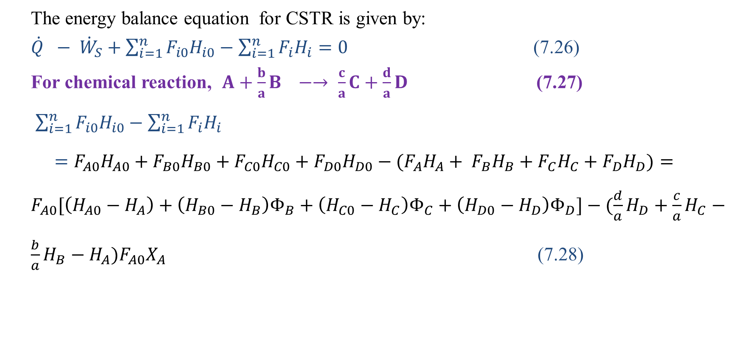
Cont’d
The energy balance equation for CSTR is given by:
$\dot{Q} − {\dot{W}}_{S}+\sum_{i=1}^{n}{F_{i0}H_{i0}}−\sum_{i=1}^{n}{F_{i}H_{i}=0}$ (7.26)
For chemical reaction, $A+\frac{b}{a}B −→ \frac{c}{a}C+\frac{d}{a}D$ (7.27)
$\sum_{i=1}^{n}{F_{i0}H_{i0}}−\sum_{i=1}^{n}{F_{i}H_{i}}$
$=F_{A0}H_{A0}+F_{B0}H_{B0}+F_{C0}H_{C0}+F_{D0}H_{D0}−(F_{A}H_{A}+ F_{B}H_{B}+F_{C}H_{C}+F_{D}H_{D})=F_{A0}[\left(H_{A0}−H_{A}\right)+\left(H_{B0}−H_{B}\right)Φ_{B}+\left(H_{C0}−H_{C}\right)Φ_{C}+\left(H_{D0}−H_{D}\right)Φ_{D}]−(\frac{d}{a}H_{D}+\frac{c}{a}H_{C}−\frac{b}{a}H_{B}−H_{A})F_{A0}X_{A}$ (7.28)
33

Slide 34
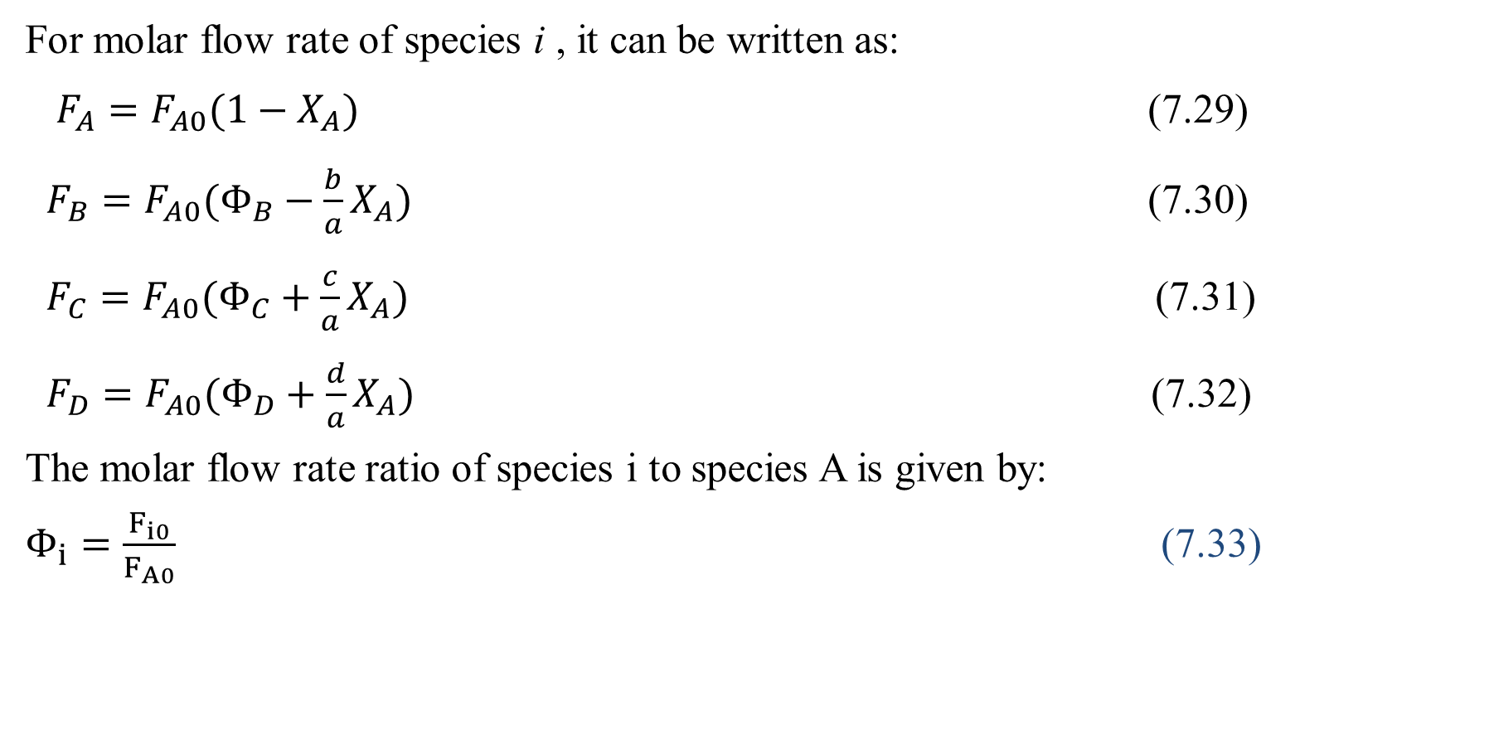
Cont’d
For molar flow rate of species i , it can be written as:
$F_{A}=F_{A0}(1−X_{A})$ (7.29)
$F_{B}=F_{A0}(Φ_{B}−\frac{b}{a}X_{A})$ (7.30)
$F_{C}=F_{A0}(Φ_{C}+\frac{c}{a}X_{A})$ (7.31)
$F_{D}=F_{A0}(Φ_{D}+\frac{d}{a}X_{A})$ (7.32)
The molar flow rate ratio of species i to species A is given by:
$Φ_{i}=\frac{F_{i0}}{F_{A0}}$ (7.33)
34

Slide 35
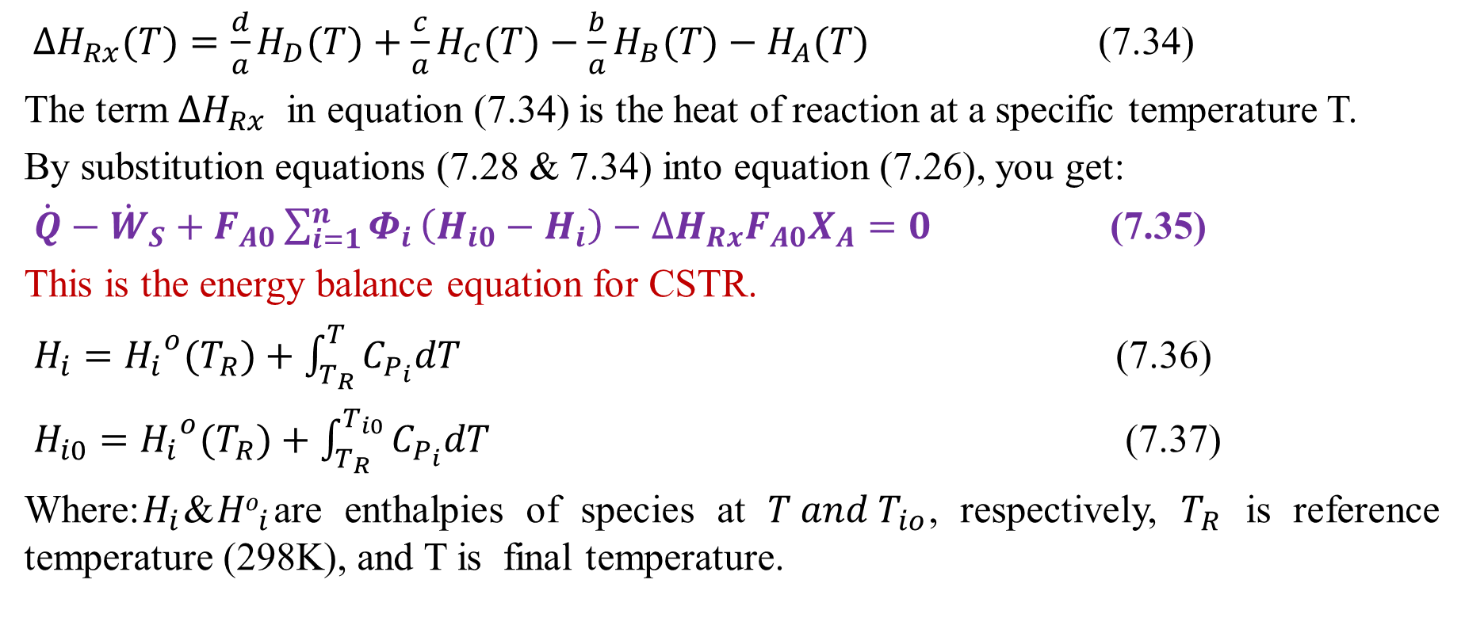
Cont’d
${∆H}_{Rx}(T)=\frac{d}{a}H_{D}(T)+\frac{c}{a}H_{C}(T)−\frac{b}{a}H_{B}(T)−H_{A}(T)$ (7.34)
The term ${∆H}_{Rx}$ in equation (7.34) is the heat of reaction at a specific temperature T.
By substitution equations (7.28 & 7.34) into equation (7.26), you get:
$\dot{Q}−{\dot{W}}_{S}+F_{A0}\sum_{i=1}^{n}{Φ_{i}}\left(H_{i0}−H_{i}\right)−{∆H}_{Rx}F_{A0}X_{A}=0$ (7.35)
This is the energy balance equation for CSTR.
$H_{i}={H_{i}}^{o}(T_{R})+\int_{T_{R}}^{T}{C_{P_{i}}dT}$ (7.36)
$H_{i0}={H_{i}}^{o}(T_{R})+\int_{T_{R}}^{T_{i0}}{C_{P_{i}}dT}$ (7.37)
Where:$H_{i}$&${Ho}_{i}$are enthalpies of species at $T and T_{io}$, respectively, $T_{R}$ is reference temperature (298K), and T is final temperature.
35

Slide 36
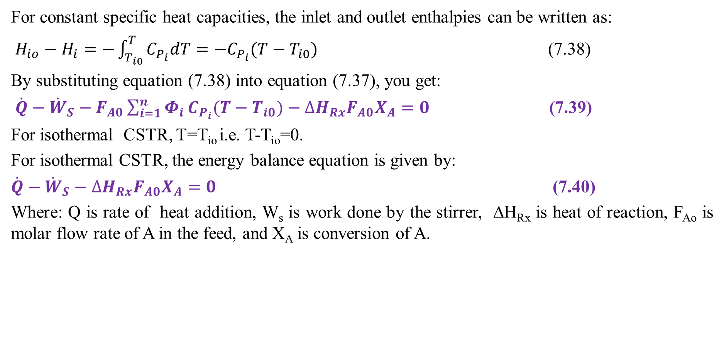
Cont’d
For constant specific heat capacities, the inlet and outlet enthalpies can be written as:
$H_{io}−H_{i}=−\int_{T_{i0}}^{T}{C_{P_{i}}dT=−C_{P_{i}}(T−T_{i0})}$ (7.38)
By substituting equation (7.38) into equation (7.37), you get:
$\dot{Q}−{\dot{W}}_{S}−F_{A0}\sum_{i=1}^{n}{Φ_{i}}C_{P_{i}}(T−T_{i0})−{∆H}_{Rx}F_{A0}X_{A}=0$ (7.39)
For isothermal CSTR, T=T_{io} i.e. T-T_{io}=0.
For isothermal CSTR, the energy balance equation is given by:
$\dot{Q}−{\dot{W}}_{S}−{∆H}_{Rx}F_{A0}X_{A}=0$ (7.40)
Where: Q is rate of heat addition, W_{s} is work done by the stirrer, ΔH_{Rx} is heat of reaction, F_{Ao} is molar flow rate of A in the feed, and X_{A} is conversion of A.
36

Slide 37
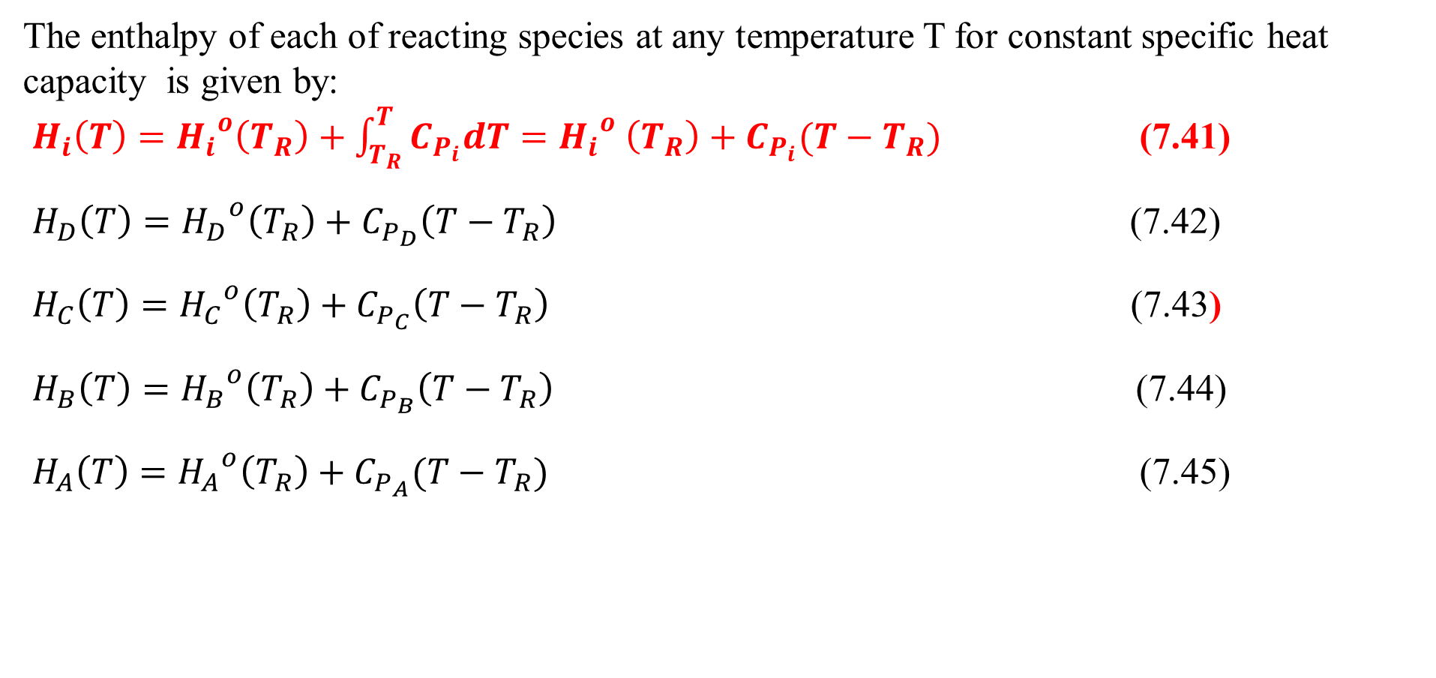
Cont’d
The enthalpy of each of reacting species at any temperature T for constant specific heat capacity is given by:
$H_{i}\left(T\right)={H_{i}}^{o}\left(T_{R}\right)+\int_{T_{R}}^{T}{C_{P_{i}}dT}={H_{i}}^{o} \left(T_{R}\right)+C_{P_{i}}(T−T_{R})$ (7.41)
$H_{D}\left(T\right)={H_{D}}^{o}\left(T_{R}\right)+C_{P_{D}}\left(T−T_{R}\right)$ (7.42)
$H_{C}\left(T\right)={{H_{C}}^{o}\left(T_{R}\right)+C}_{P_{C}}\left(T−T_{R}\right)$ (7.43)
$H_{B}\left(T\right)={H_{B}}^{o}\left(T_{R}\right)+C_{P_{B}}\left(T−T_{R}\right)$ (7.44)
$H_{A}\left(T\right)={H_{A}}^{o}\left(T_{R}\right)+C_{P_{A}}(T−T_{R})$ (7.45)
37

Slide 38
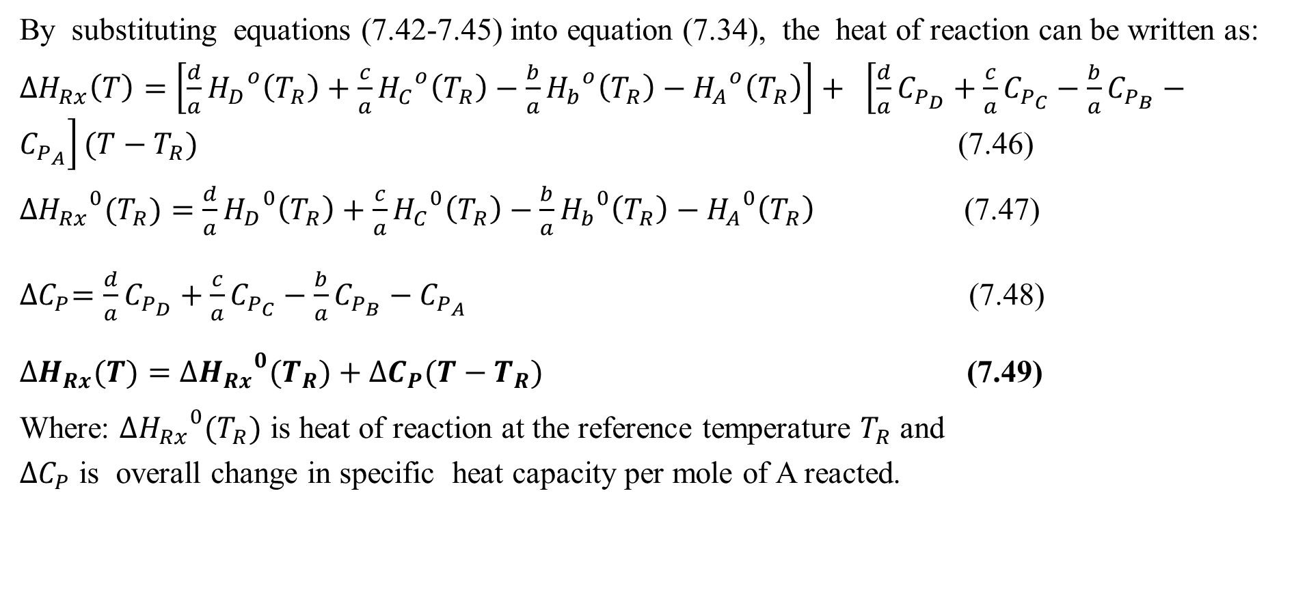
Cont’d
By substituting equations (7.42-7.45) into equation (7.34), the heat of reaction can be written as:
${∆H}_{Rx}\left(T\right)=\left[\frac{d}{a}{H_{D}}^{o}\left(T_{R}\right)+\frac{c}{a}{H_{C}}^{o}\left(T_{R}\right)−\frac{b}{a}{H_{b}}^{o}\left(T_{R}\right)−{H_{A}}^{o}\left(T_{R}\right)\right]+ \left[\frac{d}{a}C_{P_{D}}+\frac{c}{a}C_{P_{C}}−\frac{b}{a}C_{P_{B}}−C_{P_{A}}\right](T−T_{R})$ (7.46)
${{∆H}_{Rx}}^{0}(T_{R})=\frac{d}{a}{H_{D}}^{0}\left(T_{R}\right)+\frac{c}{a}{H_{C}}^{0}\left(T_{R}\right)−\frac{b}{a}{H_{b}}^{0}\left(T_{R}\right)−{H_{A}}^{0}\left(T_{R}\right)$ (7.47)
${∆C}_{P}=\frac{d}{a}C_{P_{D}}+\frac{c}{a}C_{P_{C}}−\frac{b}{a}C_{P_{B}}−C_{P_{A}}$ (7.48)
${∆H}_{Rx}(T)={{∆H}_{Rx}}^{0}(T_{R})+{∆C}_{P}(T−T_{R})$ (7.49)
Where: ${{∆H}_{Rx}}^{0}(T_{R})$ is heat of reaction at the reference temperature $T_{R}$ and
${∆C}_{P}$ is overall change in specific heat capacity per mole of A reacted.
38

Slide 39
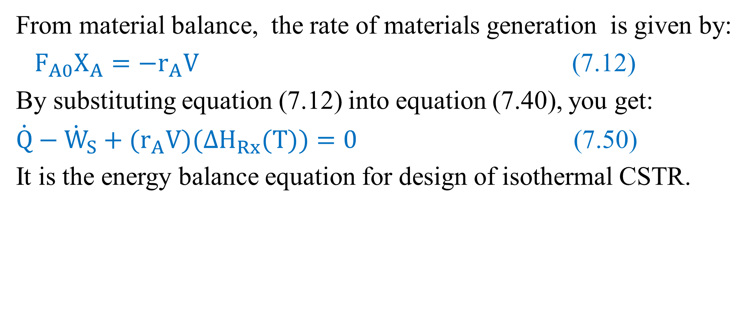
Cont’d
From material balance, the rate of materials generation is given by:
$F_{A0}X_{A}={−r}_{A}V$ (7.12)
By substituting equation (7.12) into equation (7.40), you get:
$\dot{Q}−{\dot{W}}_{S}+(r_{A}V)({∆H}_{Rx}(T))=0$ (7.50)
It is the energy balance equation for design of isothermal CSTR.
39

Slide 40
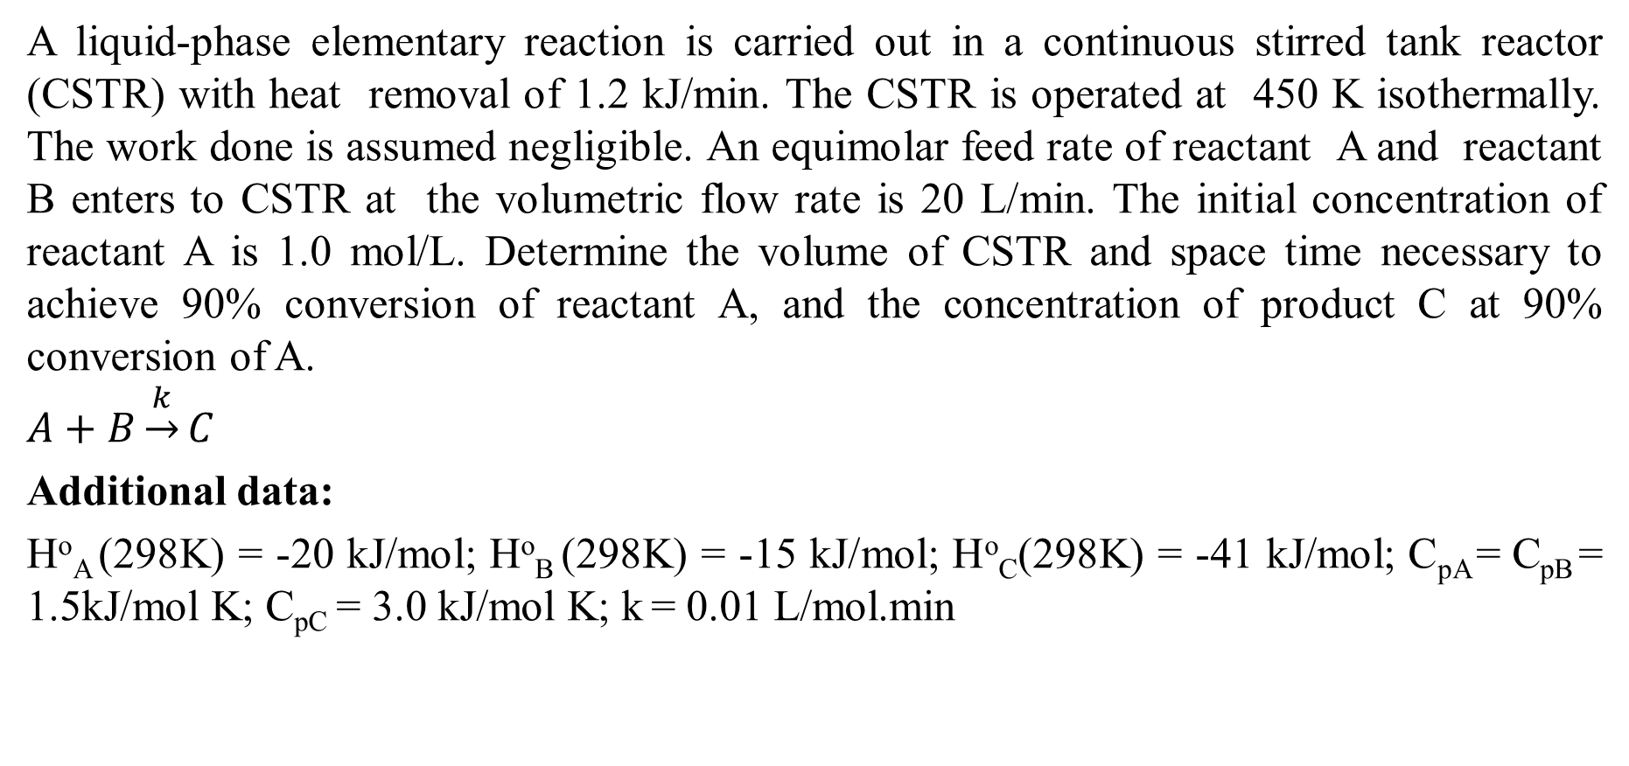
Activity 7.3
A liquid-phase elementary reaction is carried out in a continuous stirred tank reactor (CSTR) with heat removal of 1.2 kJ/min. The CSTR is operated at 450 K isothermally. The work done is assumed negligible. An equimolar feed rate of reactant A and reactant B enters to CSTR at the volumetric flow rate is 20 L/min. The initial concentration of reactant A is 1.0 mol/L. Determine the volume of CSTR and space time necessary to achieve 90% conversion of reactant A, and the concentration of product C at 90% conversion of A.
$$A+B\underset{→}{k}C$$
Additional data:
Hº_{A} (298K) = -20 kJ/mol; Hº_{B} (298K) = -15 kJ/mol; Hº_{C}(298K) = -41 kJ/mol; C_{pA} = C_{pB} = 1.5kJ/mol K; C_{pC} = 3.0 kJ/mol K; k = 0.01 L/mol.min
40

Slide 41
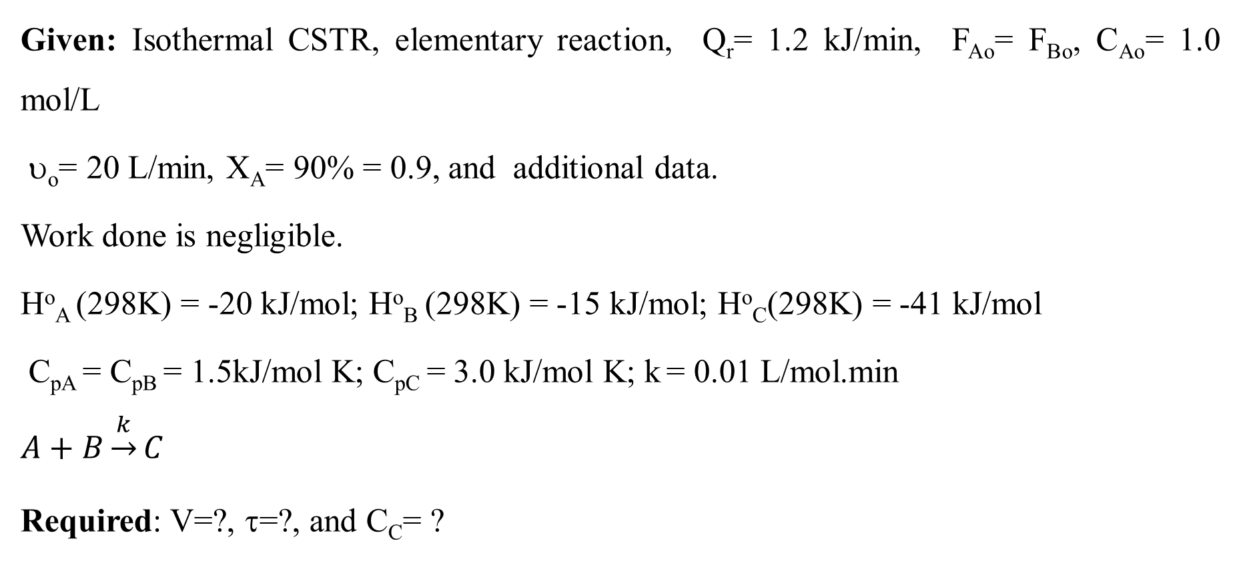
Cont’d
Given: Isothermal CSTR, elementary reaction, Q_{r}= 1.2 kJ/min, F_{Ao}= F_{Bo}, C_{Ao}= 1.0 mol/L
υ_{o}= 20 L/min, X_{A}= 90% = 0.9, and additional data.
Work done is negligible.
Hº_{A} (298K) = -20 kJ/mol; Hº_{B} (298K) = -15 kJ/mol; Hº_{C}(298K) = -41 kJ/mol
C_{pA} = C_{pB} = 1.5kJ/mol K; C_{pC} = 3.0 kJ/mol K; k = 0.01 L/mol.min
$$A+B\underset{→}{k}C$$
Required: V=?, τ=?, and C_{C}= ?
41

Slide 42
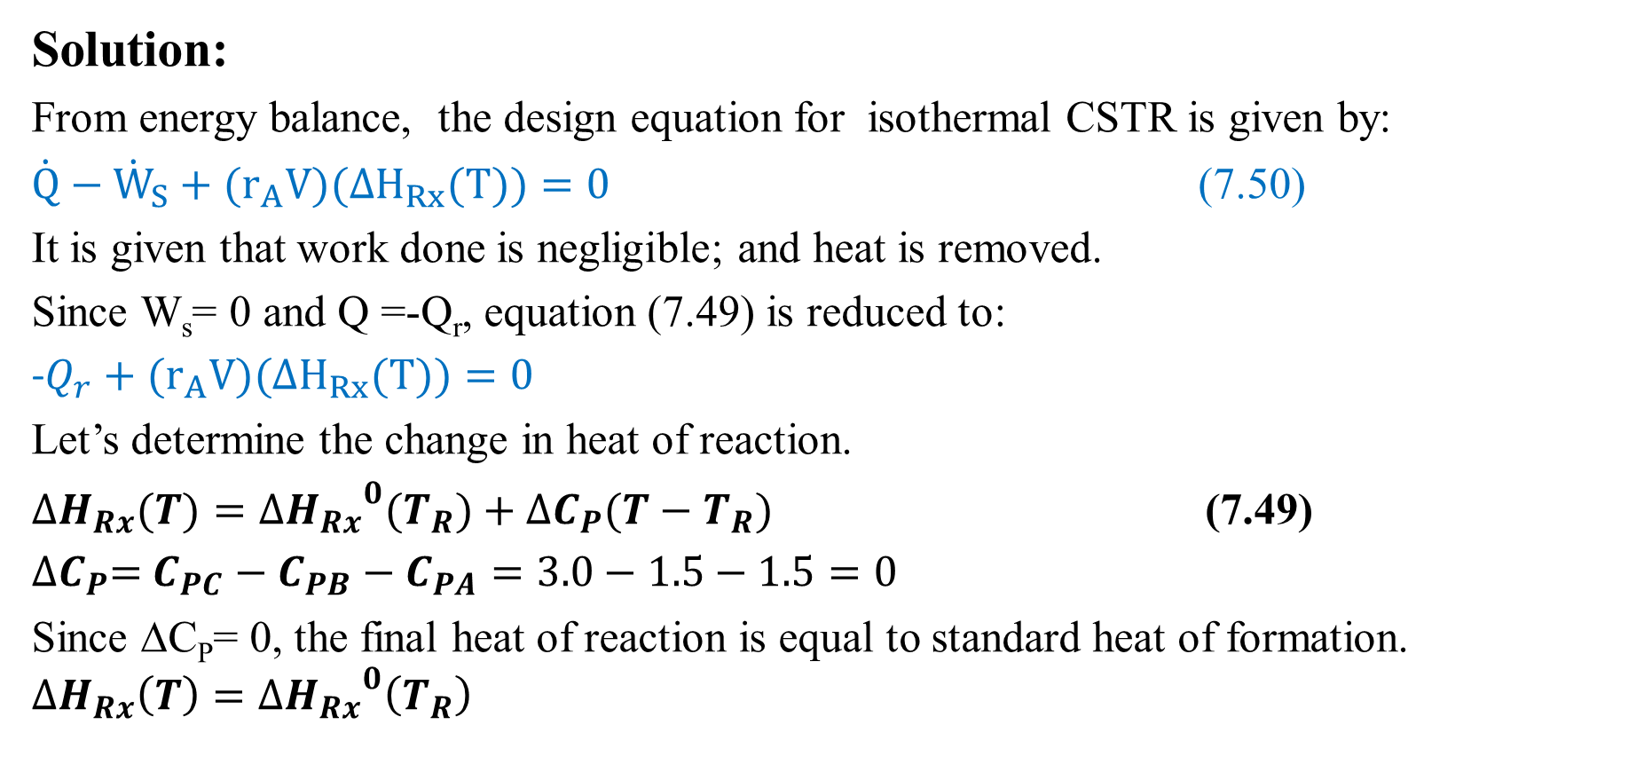
Cont’d
Solution:
From energy balance, the design equation for isothermal CSTR is given by:
$\dot{Q}−{\dot{W}}_{S}+(r_{A}V)({∆H}_{Rx}(T))=0$ (7.50)
It is given that work done is negligible; and heat is removed.
Since W_{s}= 0 and Q =-Q_{r}, equation (7.49) is reduced to:
-$Q_{r}+(r_{A}V)({∆H}_{Rx}(T))=0$
Let’s determine the change in heat of reaction.
${∆H}_{Rx}(T)={{∆H}_{Rx}}^{0}(T_{R})+{∆C}_{P}(T−T_{R})$ (7.49)
${∆C}_{P}=$ $C_{PC}−C_{PB}−C_{PA}=3.0−1.5−1.5=0$
Since ΔC_{P}= 0, the final heat of reaction is equal to standard heat of formation.
$${∆H}_{Rx}\left(T\right)={{∆H}_{Rx}}^{0}\left(T_{R}\right)$$
42

Slide 43
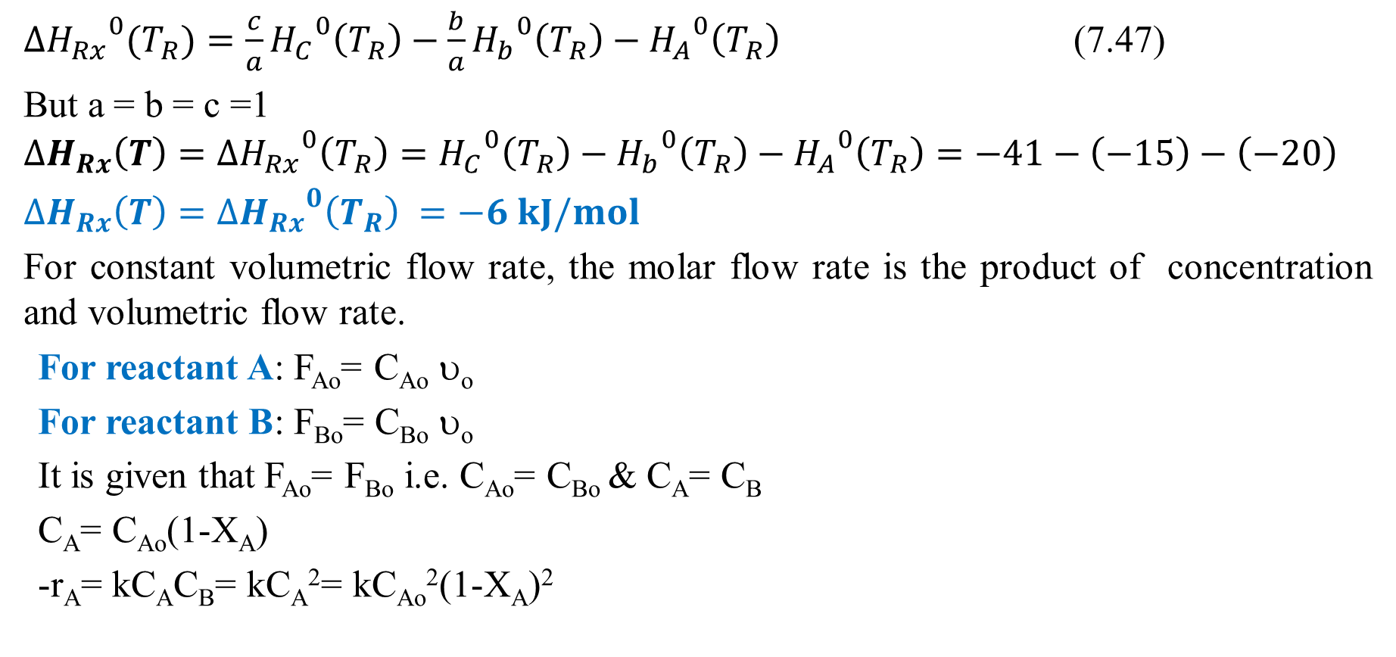
Cont’d
${{∆H}_{Rx}}^{0}(T_{R})=\frac{c}{a}{H_{C}}^{0}\left(T_{R}\right)−\frac{b}{a}{H_{b}}^{0}\left(T_{R}\right)−{H_{A}}^{0}\left(T_{R}\right)$ (7.47)
But a = b = c =1
$${∆H}_{Rx}\left(T\right)={{∆H}_{Rx}}^{0}\left(T_{R}\right)={H_{C}}^{0}\left(T_{R}\right)−{H_{b}}^{0}\left(T_{R}\right)−{H_{A}}^{0}\left(T_{R}\right)=−41−\left(−15\right)−\left(−20\right)$$
${∆H}_{Rx}\left(T\right)={{∆H}_{Rx}}^{0}\left(T_{R}\right) =−6 kJ/mol$
For constant volumetric flow rate, the molar flow rate is the product of concentration and volumetric flow rate.
For reactant A: F_{Ao}= C_{Ao} υ_{o}
For reactant B: F_{Bo}= C_{Bo} υ_{o}
It is given that F_{Ao}= F_{Bo} i.e. C_{Ao}= C_{Bo} & C_{A}= C_{B}
C_{A}= C_{Ao}(1-X_{A})
-r_{A}= kC_{A}C_{B}= kC_{A}²= kC_{Ao}²(1-X_{A})²
43

Slide 44
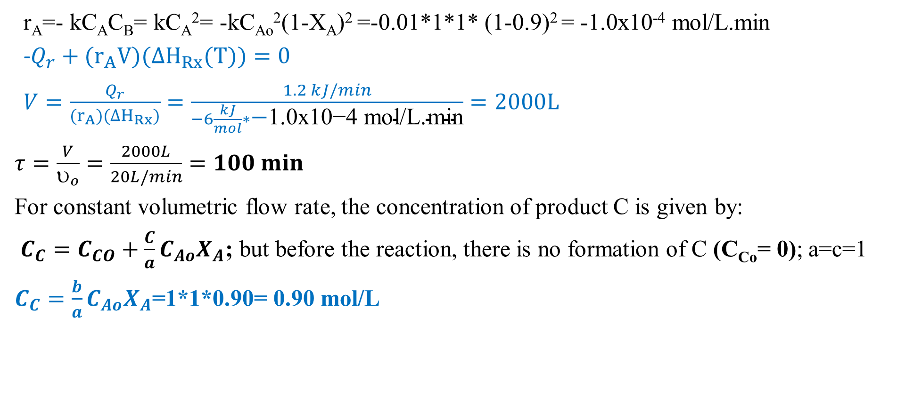
Cont’d
r_{A}=- kC_{A}C_{B}= kC_{A}²= -kC_{Ao}²(1-X_{A})² =-0.01*1*1* (1-0.9)² = -1.0x10⁻⁴ mol/L.min
-$Q_{r}+(r_{A}V)({∆H}_{Rx}(T))=0$
$V=\frac{Q_{r}}{(r_{A})({∆H}_{Rx})}=\frac{1.2 kJ/min}{−6\frac{kJ}{mol}∗\text{−}\text{1.0}\text{x}\text{10−4 }\text{mol}\text{/}\text{L}\text{.}\text{min}}=2000L$
$τ=\frac{V}{υ_{o}}=\frac{2000L}{20L/min}=100 min$
For constant volumetric flow rate, the concentration of product C is given by:
$C_{C}=C_{CO}+\frac{C}{a}C_{Ao}X_{A}$; but before the reaction, there is no formation of C (C_{Co}= 0); a=c=1
$C_{C}=\frac{b}{a}C_{Ao}X_{A}$=1*1*0.90= 0.90 mol/L
44

Slide 45
7.5. Summary
Some characteristics of ideal CSTR are: fluids in the reactor are assumed to be perfectly mixed; the space time of all molecules is assumed identical; and it is operated at steady state condition.
There is no time dependence or position dependence of the temperature, concentration, or reaction rate inside the CSTR. i.e. every variable is the same at every point inside the reactor.
Some of the key design parameters for a CSTR are reactor volume, volumetric flow rate, molar feed rate, space time and reaction kinetics.
Some of the key performance measures for a CSTR are conversion, yield, selectivity, residence time, space time and reaction rate.
For isothermal CSTR, volume of a reactor can be determined using either materials balance equation or energy balance equation.
45

Slide 46
References
Chemical Reaction Engineering, Levenspiel, O John Wiely & Sons, 3rd edition, 2011.
Elements of Chemical Engineering, Fogler, HS Prentice- Hall Inc Prentice- Hall Inc, 5th edition, 2015.
Thank you!
46

