Slide 1
Chemical Reaction Engineering II- Reactor Design (ChEg 4101)
Prerequisite: Chemical Reaction Engineering I-Reaction Kinetics (ChEg3104)
Lecture 8: Design of Non-isothermal Ideal Continuous Stirred Tank Reactor
Week 8
Lecturer: Adamu Esubalew (PhD, ChEg)
Addis Ababa, Ethiopia

Slide 2
Lecture learning outcomes
At the end of the lecture, you will be able to:
describe the characteristics of non-isothermal continuous stirred tank reactor (CSTR),
identify the design parameters for non- isothermal CSTR,
explain the performance measures for non- isothermal CSTR, and
design non-isothermal ideal CSTR using materials and energy balance equations.

Slide 3
Presentation outlines
Introduction to non-isothermal continuous stirred tank reactor (CSTR)
Design parameters for non-isothermal CSTR
Performance measures for non-isothermal CSTR
Design of non-isothermal ideal CSTR using materials and energy balance equations
Summary

Slide 4
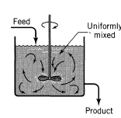
8.1 Introduction to non-isothermal CSTR
Non-isothermal CSTR: It is a type of chemical reactor where the reaction takes place continuously, and the temperature within the reactor is not maintained at a constant level.
The contents of the reactor are mixed thoroughly using an agitator or stirrer, which promotes uniform distribution of temperature and concentration throughout the reactor.
Figure 8.1 depicts the feed enters to CSTR and the product leaves from it (Levenspiel, 2011, pg.90).
Figure 8.1. CSTR with its feed and product streams
4

Slide 5
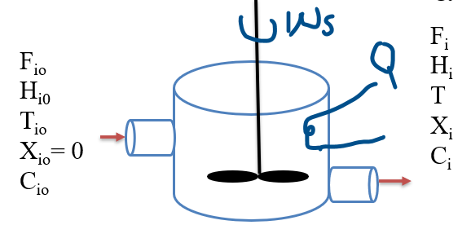
Cont’d
For non-isothermal CSTR, the heat transfer occurs either to the reactor or from the reactor using heat exchanger, cooling or heating jackets or coils to manage the temperature effectively.
The reactants are fed into the reactor and products are removed simultaneously, which ensures a steady state operation.
Figure 8.2 shows the flow of materials and energy for non-isothermal CSTR.
Figure 8.2. Non-isothermal CSTR with its feed and product
5

Slide 6
Cont’d
The temperature profile within a non-isothermal CSTR can change depending on feed composition, flow rates, and reaction kinetics.
The temperature variations occur due to heat generation from the reaction and heat transfer with the surroundings. i.e. Variation of temperature inside the reactor is occurred due to exothermic or endothermic reactions.
The temperature variation can significantly affect reaction rates, conversion, and product distribution
6

Slide 7
Cont’d
Chemical reactions can be exothermic (releasing heat) or endothermic (absorbing heat).
The heat generated or consumed affects the reactor temperature.
Heat exchangers are often integrated to maintain desired temperature profiles of CSTR.
Non-isothermal CSTRs can experience changes in temperature due to heat generated from exothermic reactions, heat absorbed by endothermic reactions or heat exchange with the surrounding environment or through heat exchangers.
A non-isothermal CSTR is characterized by its continuous operation, thorough mixing, variable temperature conditions, and heat transfer capabilities.
7

Slide 8
8.2. Design parameters of non-isothermal CSTR
Designing a non-isothermal CSTR comprises several key parameters that influence its performance, efficiency, and safety.
Some of the key design parameters for non-isothermal CSTR are the followings:
Reactor volume: It is critical for determining the residence time of the reactants and the overall capacity of the reactor.
It is influenced by the desired production rate and the reaction kinetics.
Heat transfer area: The surface area available for heat exchange is essential for maintaining the desired temperature in the reactor.
It affects the reaction rate and conversion of reactants.
8

Slide 9
Cont’d
Heat transfer coefficient: It is a measure of how effectively heat can be transferred between the reactor contents and the cooling/heating medium.
It depends on flow rates, temperature differences, and materials used.
Efficient heat transfer is crucial for maintaining optimal reaction temperatures, especially in exothermic reactions.
The flow rate: The flow of the feed should minimize dead zones and ensure good mixing. The outlet flow rate should facilitate continuous removal of products while preventing back-mixing.
9

Slide 10
Cont’d
Space time: It is the time that reactants spend in the reactor is determined by the volume and volumetric flow rate.
Reaction kinetics: It is essential for determining the optimal temperature and concentration profiles. The rate constant and reaction order should be considered for predicting conversion and designing CSTR.
Operating temperature: The operating temperature is expressed by the reaction requirements, and should be controlled to optimize reaction rates.
10

Slide 11
Cont’d
Pressure conditions: The reactor may operate under atmospheric or elevated pressures, depending on the nature of the reaction and the volatility of reactants/products.
Pressure affects reaction rates and phase behavior.
A significant pressure drop may indicate issues with flow or mixing and can affect reactor performance.
The process design of a non-isothermal CSTR requires a comprehensive understanding of reaction kinetics, heat transfer, and fluid flow.
Hence, careful consideration of the design parameters will lead to an efficient and safe reactor operation that meets production goals by optimizing reaction conditions.
11

Slide 12
8.3. Performance Measures for Non-isothermal CSTR
The performance measures collectively provide a comprehensive understanding of a CSTR operational efficiency, effectiveness, and stability.
Some of the key performance measures for non-isothermal CSTR are the followings:
Conversion: It is conversion is crucial to measure the performance of CSTR, but it may vary with temperature changes due to reaction kinetics.
High conversion indicates effective use of reactants and efficient reactor operation.
Yield: It measures the efficiency of converting reactants into desired products.
It provides insight into the efficiency of the conversion process.
12

Slide 13
Cont’d
Selectivity: It refers to the ability of the reactor to produce a desired product over undesired product.
High selectivity indicates that the reactor is favoring the formation of the desired product over undesired product.
Temperature profile: The temperature profile within the reactor should be monitored to ensure optimal reaction conditions.
Non-uniform temperature distribution can lead to inefficient reactions.
Maintaining an optimal temperature profile is essential for controlling reaction rates and preventing thermal runaways.
13

Slide 14
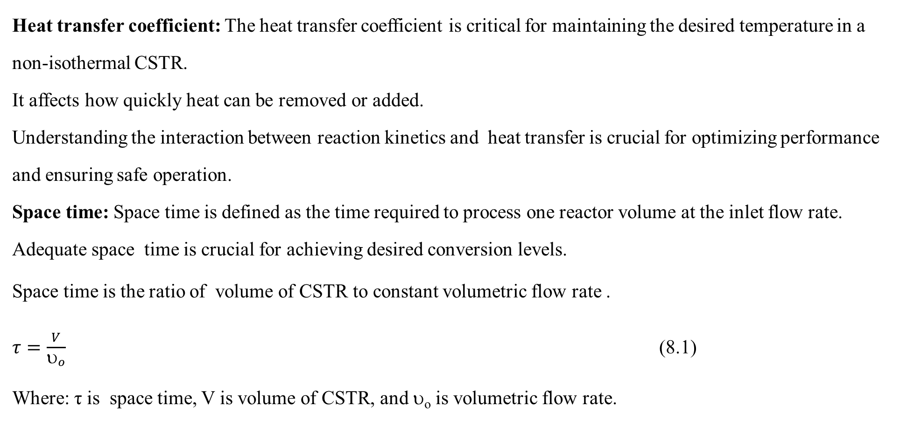
Cont’d
Heat transfer coefficient: The heat transfer coefficient is critical for maintaining the desired temperature in a non-isothermal CSTR.
It affects how quickly heat can be removed or added.
Understanding the interaction between reaction kinetics and heat transfer is crucial for optimizing performance and ensuring safe operation.
Space time: Space time is defined as the time required to process one reactor volume at the inlet flow rate. Adequate space time is crucial for achieving desired conversion levels.
Space time is the ratio of volume of CSTR to constant volumetric flow rate .
$τ=\frac{V}{υ_{o}}$ (8.1)
Where: τ is space time, V is volume of CSTR, and υ_{o} is volumetric flow rate.
14

Slide 15
Cont’d
Reaction rate: The rate at which reactants are converted to products, often expressed in terms of concentration change per unit time.
Understanding the reaction rate helps for optimizing reactor conditions to maximize efficiency.
Due to temperature variation and heat effect, non-isothermal CSTR is more complex to model compared to isothermal CSTR.
Regular monitoring and optimization based on these parameters can significantly enhance reactor performance and product quality.
15

Slide 16
Activity 8.1.
(a). What is non-isothermal CSTR?
(b). Describe some characteristics of non-isothermal CSTR.
(c). What are some of the performance measures for non-isothermal CSTR?
(d). Identify some design parameters for non-isothermal CSTR.
16

Slide 17
Cont’d
Answers:
(a). What is non-isothermal CSTR?
Non-isothermal CSTR is a type of chemical reactor where the reaction takes place continuously, and the temperature within the reactor is not maintained at a constant level.
(b). Describe some characteristics of non-isothermal CSTR.
Some characteristics of non-isothermal CSTR are:
continuous operation,
thorough mixing,
variable temperature conditions, and
heat transfer capability.
17

Slide 18
Cont’d
(c). What are some of the performance measures for non-isothermal CSTR?
Some of the performance measures for non-isothermal CSTR are conversion, yield, selectivity, temperature profile, heat transfer coefficient, and reaction rate.
(d). Identify some design parameters for non-isothermal CSTR.
The reactor volume, flow rate, heat transfer area, space time, reaction kinetic operating temperature and pressure conditions are some of the design parameters for non-isothermal CSTR.
18

Slide 19
8.4 Design of non-isothermal CSTR
Non-isothermal CSTR is designed by using both materials balance and energy balance equations.
Both materials and energy balance equations are used to quantify flows of materials and energy across system boundary.
8.4.1. Material balance equation
For non-isothermal CSTR, the materials balance equation is used to quantify the flow of materials across CSTR boundary.
A simple CSTR with materials flow across its boundary is shown in Figure 8.3 (Fogler, 2015, pg. 292).
F_{io}
C_{io}
X_{i} = 0
C_{i}, X_{i}
F_{i}
C_{i}
X_{i}
Figure 8.3. CSTR with materials flow
19

Slide 20
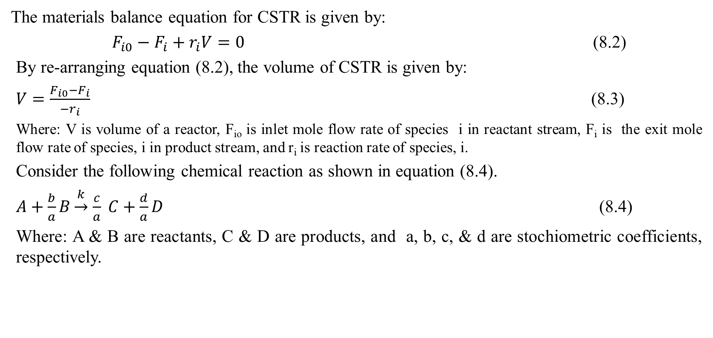
Cont’d
The materials balance equation for CSTR is given by:
$F_{i0}−F_{i}+r_{i}V=0$ (8.2)
By re-arranging equation (8.2), the volume of CSTR is given by:
$V=\frac{F_{i0}−F_{i}}{{−r}_{i}}$ (8.3)
Where: V is volume of a reactor, F_{io} is inlet mole flow rate of species i in reactant stream, F_{i} is the exit mole flow rate of species, i in product stream, and r_{i} is reaction rate of species, i.
Consider the following chemical reaction as shown in equation (8.4).
$A+\frac{b}{a}B\underset{→}{k}$ $\frac{c}{a} C+\frac{d}{a}D$ (8.4)
Where: A & B are reactants, C & D are products, and a, b, c, & d are stochiometric coefficients, respectively.
20

Slide 21
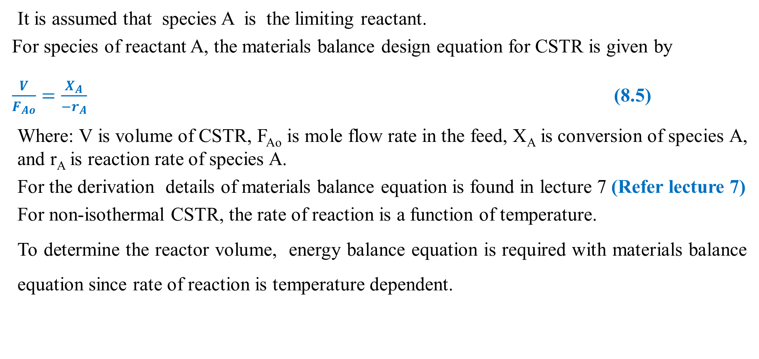
Cont’d
It is assumed that species A is the limiting reactant.
For species of reactant A, the materials balance design equation for CSTR is given by
$\frac{V}{F_{Ao}}=\frac{X_{A}}{{−r}_{A}}$ (8.5)
Where: V is volume of CSTR, F_{Ao} is mole flow rate in the feed, X_{A} is conversion of species A, and r_{A} is reaction rate of species A.
For the derivation details of materials balance equation is found in lecture 7 (Refer lecture 7)
For non-isothermal CSTR, the rate of reaction is a function of temperature.
To determine the reactor volume, energy balance equation is required with materials balance equation since rate of reaction is temperature dependent.
21

Slide 22
8.4.2 Energy balance equation for non-isothermal CSTR
For non-isothermal CSTR, the temperature of the reacting mixture can vary inside the reactor due to heat generation from the reaction or absorption of heat from external source.
The variation in temperature affects reaction rate and conversion, which makes the design of non-isothermal CSTR more complex than isothermal CSTR.
The energy balance for a non-isothermal CSTR takes into account the heat generated by the exothermic reaction, and heat exchange with any heating jackets for endothermic reaction.
22

Slide 23


Cont’d
For open system, there is flow of mass and energy across system boundary.
To develop energy balance equation, it is assumed that heat (Q ) is added to the reactor and work (W_{s}) is done by the system.
Consider the following non-isothermal CSTR to develop energy balance equation as shown in Figure 8. 4.
W_{s}
F_{i}
T
H_{i}
X_{i}
C_{i}
F_{io}
T_{io}
H_{io}
C_{io}
X_{io}= 0
C_{i}, X_{i}, T
Q
Figure 8.4. Non-isothermal CSTR
23

Slide 24
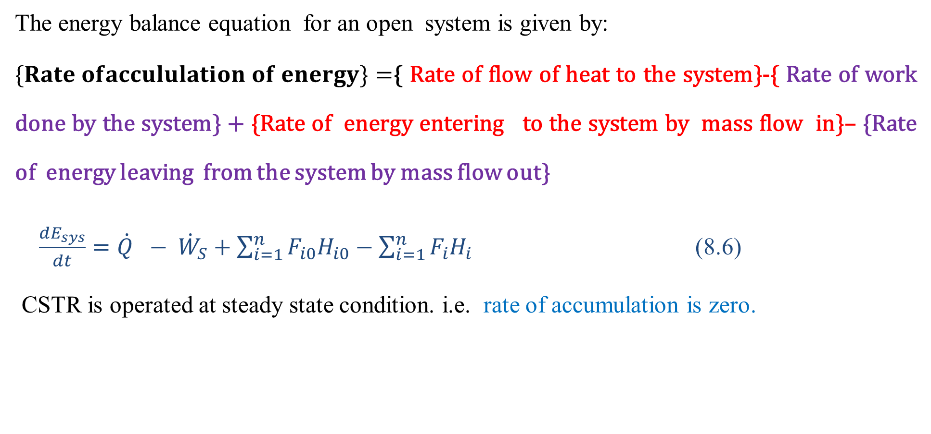
Cont’d
The energy balance equation for an open system is given by:
$\{Rate ofaccululation of energy\}=${ Rate of flow of heat to the system}-{ Rate of work done by the system} + {Rate of energy entering to the system by mass flow in}– {Rate of energy leaving from the system by mass flow out}
$\frac{{dE}_{sys}}{dt}=\dot{Q} − {\dot{W}}_{S}+\sum_{i=1}^{n}{F_{i0}H_{i0}}−\sum_{i=1}^{n}{F_{i}H_{i}}$ (8.6)
CSTR is operated at steady state condition. i.e. rate of accumulation is zero.
24

Slide 25
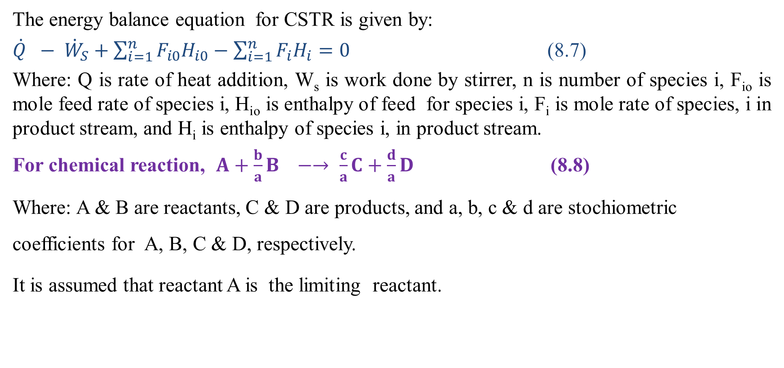
Cont’d
The energy balance equation for CSTR is given by:
$\dot{Q} − {\dot{W}}_{S}+\sum_{i=1}^{n}{F_{i0}H_{i0}}−\sum_{i=1}^{n}{F_{i}H_{i}=0}$ (8.7)
Where: Q is rate of heat addition, W_{s} is work done by stirrer, n is number of species i, F_{io} is mole feed rate of species i, H_{io} is enthalpy of feed for species i, F_{i} is mole rate of species, i in product stream, and H_{i} is enthalpy of species i, in product stream.
For chemical reaction, $A+\frac{b}{a}B −→ \frac{c}{a}C+\frac{d}{a}D$ (8.8)
Where: A & B are reactants, C & D are products, and a, b, c & d are stochiometric coefficients for A, B, C & D, respectively.
It is assumed that reactant A is the limiting reactant.
25

Slide 26
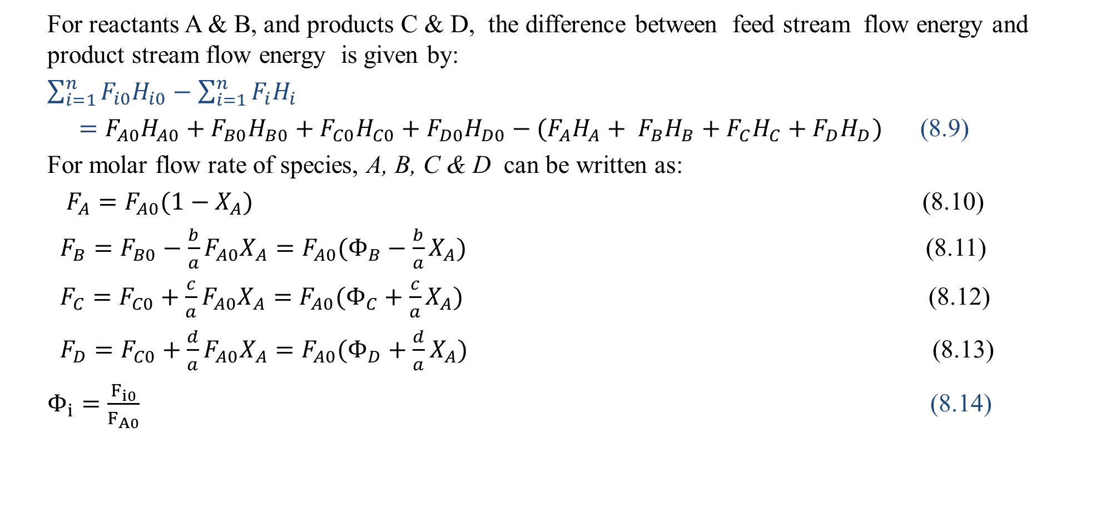
Cont’d
For reactants A & B, and products C & D, the difference between feed stream flow energy and product stream flow energy is given by:
$\sum_{i=1}^{n}{F_{i0}H_{i0}}−\sum_{i=1}^{n}{F_{i}H_{i}}$
$=F_{A0}H_{A0}+F_{B0}H_{B0}+F_{C0}H_{C0}+F_{D0}H_{D0}−(F_{A}H_{A}+ F_{B}H_{B}+F_{C}H_{C}+F_{D}H_{D})$ (8.9)
For molar flow rate of species, A, B, C & D can be written as:
$F_{A}=F_{A0}(1−X_{A})$ (8.10)
$F_{B}=F_{B0}−\frac{b}{a}{F_{A0}X}_{A}=F_{A0}(Φ_{B}−\frac{b}{a}X_{A})$ (8.11)
$F_{C}=F_{C0}+\frac{c}{a}{F_{A0}X}_{A}=F_{A0}(Φ_{C}+\frac{c}{a}X_{A})$ (8.12)
$F_{D}=F_{C0}+\frac{d}{a}{F_{A0}X}_{A}=F_{A0}(Φ_{D}+\frac{d}{a}X_{A})$ (8.13)
$Φ_{i}=\frac{F_{i0}}{F_{A0}}$ (8.14)
26

Slide 27
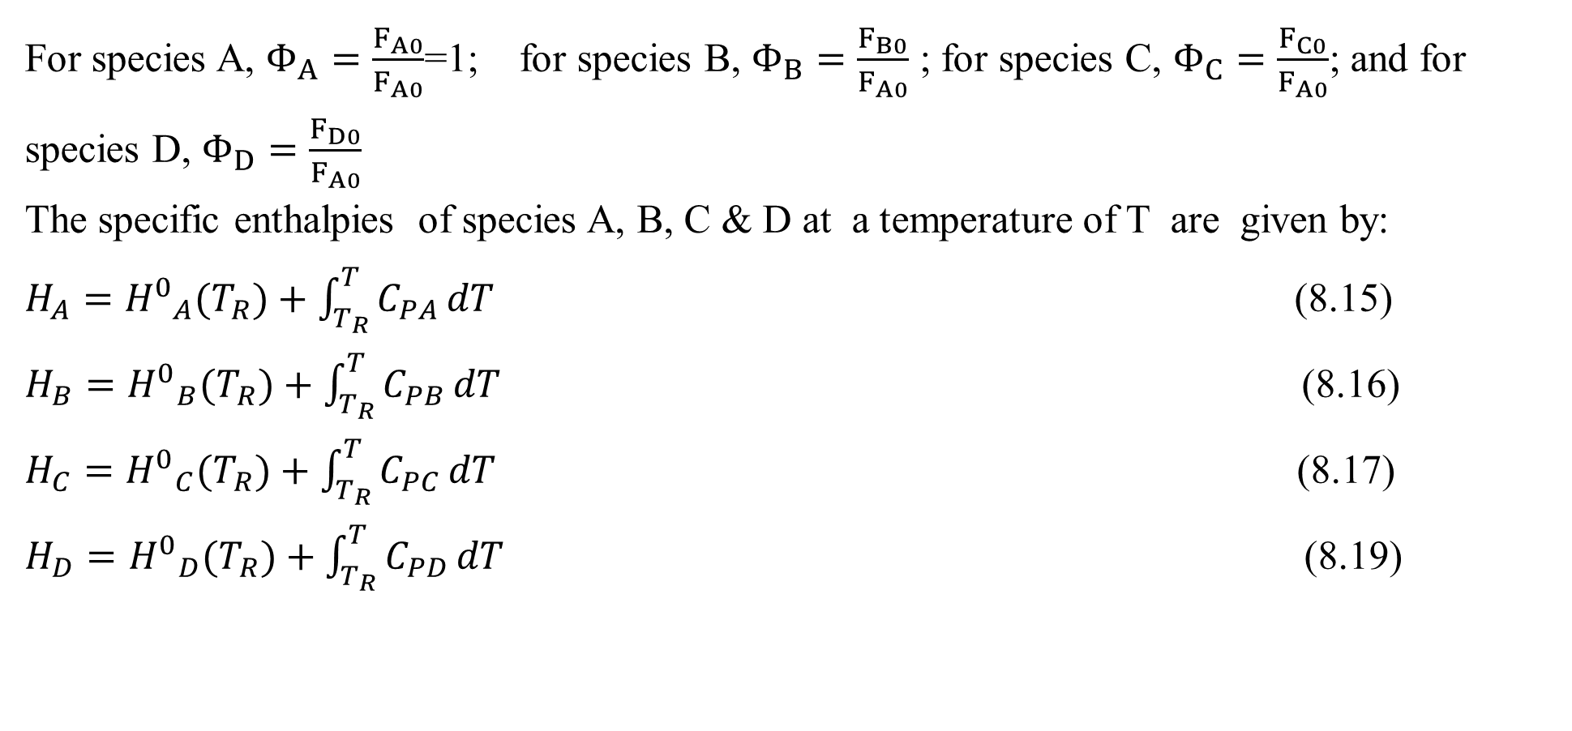
Cont’d
For species A, $Φ_{A}=\frac{F_{A0}}{F_{A0}}$=1; for species B, $Φ_{B}=\frac{F_{B0}}{F_{A0}}$ ; for species C, $Φ_{C}=\frac{F_{C0}}{F_{A0}}$; and for species D, $Φ_{D}=\frac{F_{D0}}{F_{A0}}$ The specific enthalpies of species A, B, C & D at a temperature of T are given by:
$H_{A}={H^{0}}_{A}(T_{R})+\int_{T_{R}}^{T}{C_{PA}}dT$ (8.15)
$H_{B}={H^{0}}_{B}(T_{R})+\int_{T_{R}}^{T}{C_{PB}}dT$ (8.16)
$H_{C}={H^{0}}_{C}(T_{R})+\int_{T_{R}}^{T}{C_{PC}}dT$ (8.17)
$H_{D}={H^{0}}_{D}(T_{R})+\int_{T_{R}}^{T}{C_{PD}}dT$ (8.19)
27

Slide 28
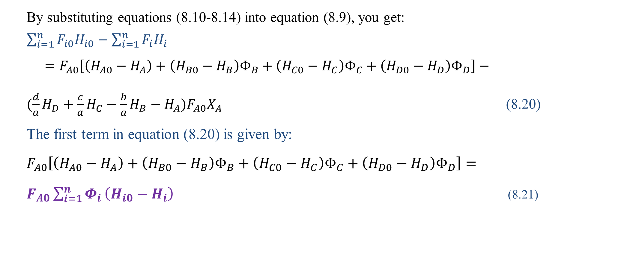



Cont’d
By substituting equations (8.10-8.14) into equation (8.9), you get:
$\sum_{i=1}^{n}{F_{i0}H_{i0}}−\sum_{i=1}^{n}{F_{i}H_{i}}$
$=F_{A0}\left[\left(H_{A0}−H_{A}\right)+\left(H_{B0}−H_{B}\right)Φ_{B}+\left(H_{C0}−H_{C}\right)Φ_{C}+\left(H_{D0}−H_{D}\right)Φ_{D}\right]−$
$(\frac{d}{a}H_{D}+\frac{c}{a}H_{C}−\frac{b}{a}H_{B}−H_{A})F_{A0}X_{A}$ (8.20)
The first term in equation (8.20) is given by:
$F_{A0}\left[\left(H_{A0}−H_{A}\right)+\left(H_{B0}−H_{B}\right)Φ_{B}+\left(H_{C0}−H_{C}\right)Φ_{C}+\left(H_{D0}−H_{D}\right)Φ_{D}\right]=$
$F_{A0}\sum_{i=1}^{n}{Φ_{i}}\left(H_{i0}−H_{i}\right)$ (8.21)
28

Slide 29
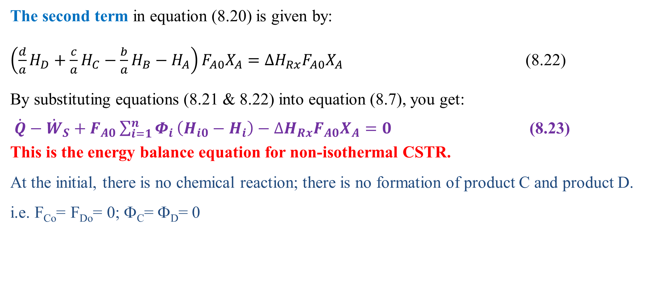
Cont’d
The second term in equation (8.20) is given by:
$\left(\frac{d}{a}H_{D}+\frac{c}{a}H_{C}−\frac{b}{a}H_{B}−H_{A}\right)F_{A0}X_{A}={∆H}_{Rx}F_{A0}X_{A}$ (8.22)
By substituting equations (8.21 & 8.22) into equation (8.7), you get:
$\dot{Q}−{\dot{W}}_{S}+F_{A0}\sum_{i=1}^{n}{Φ_{i}}\left(H_{i0}−H_{i}\right)−{∆H}_{Rx}F_{A0}X_{A}=0$ (8.23)
This is the energy balance equation for non-isothermal CSTR.
At the initial, there is no chemical reaction; there is no formation of product C and product D. i.e. F_{Co}= F_{Do}= 0; Φ_{C}= Φ_{D}= 0
29

Slide 30
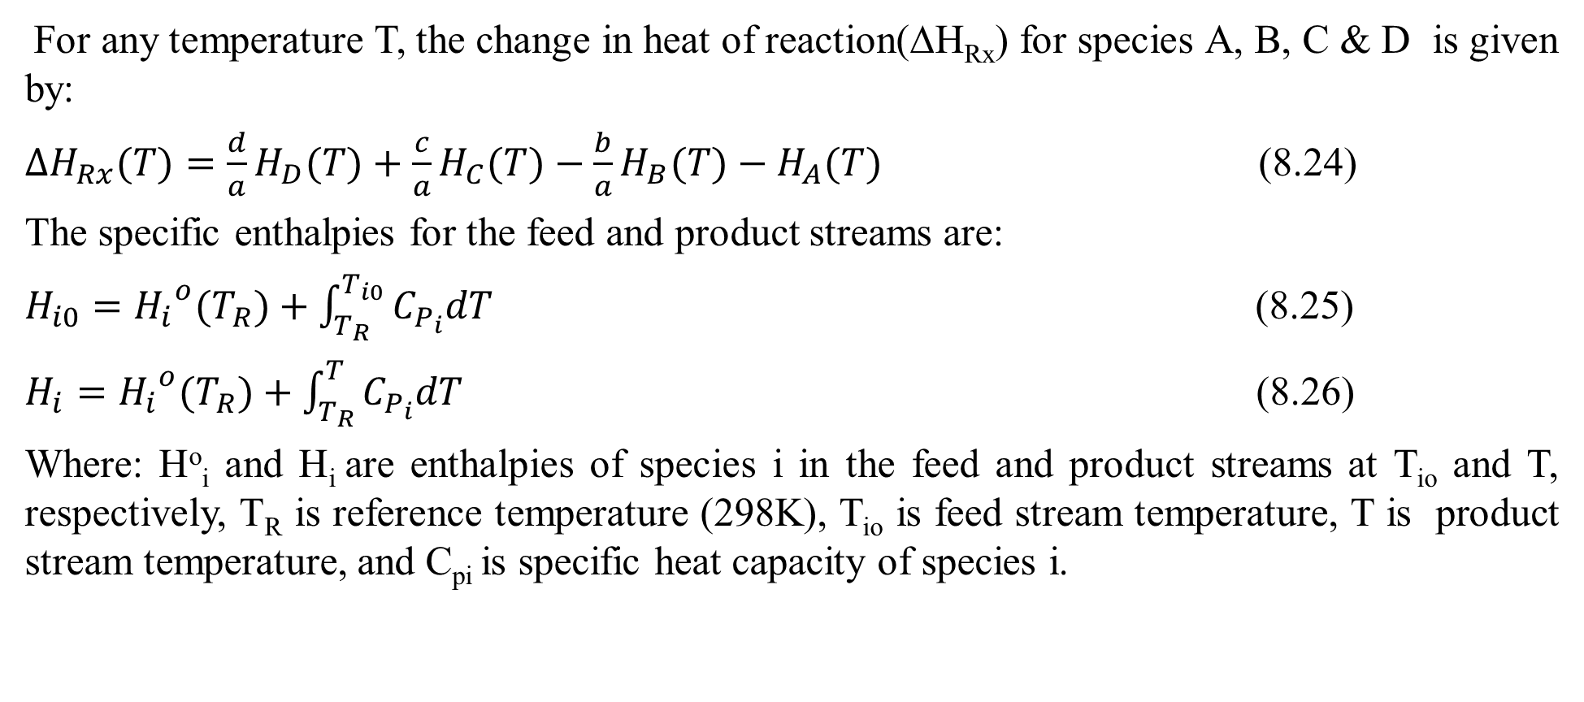
Cont’d
For any temperature T, the change in heat of reaction(ΔH_{Rx}) for species A, B, C & D is given by:
${∆H}_{Rx}(T)=\frac{d}{a}H_{D}(T)+\frac{c}{a}H_{C}(T)−\frac{b}{a}H_{B}(T)−H_{A}(T)$ (8.24)
The specific enthalpies for the feed and product streams are:
$H_{i0}={H_{i}}^{o}(T_{R})+\int_{T_{R}}^{T_{i0}}{C_{P_{i}}dT}$ (8.25)
$H_{i}={H_{i}}^{o}(T_{R})+\int_{T_{R}}^{T}{C_{P_{i}}dT}$ (8.26)
Where: Hº_{i} and H_{i} are enthalpies of species i in the feed and product streams at T_{io} and T, respectively, T_{R} is reference temperature (298K), T_{io} is feed stream temperature, T is product stream temperature, and C_{pi} is specific heat capacity of species i.
30

Slide 31
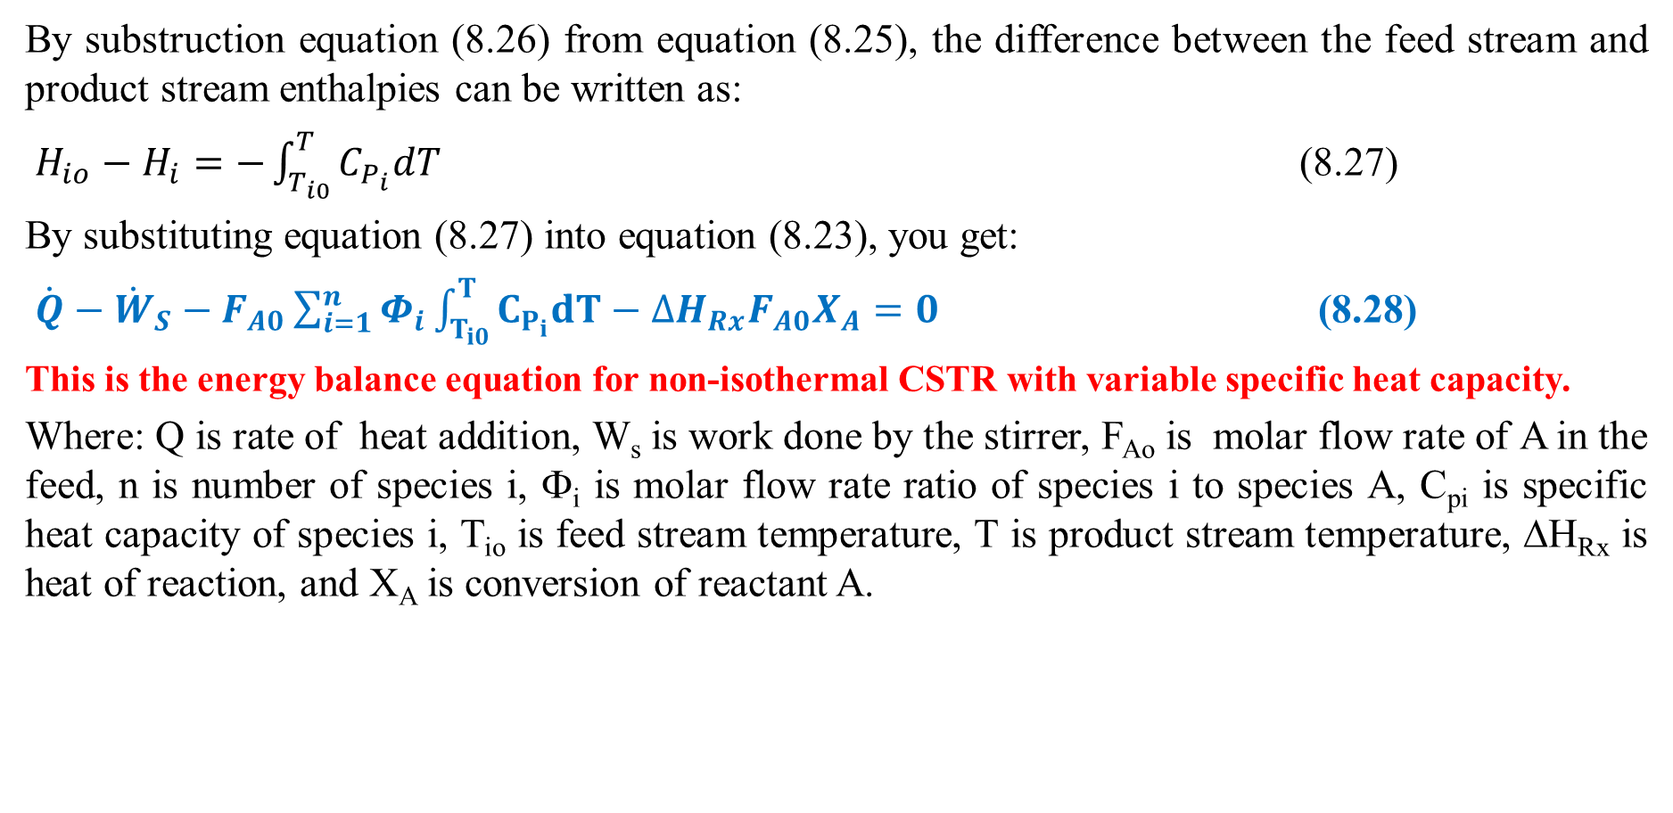
Cont’d
By substruction equation (8.26) from equation (8.25), the difference between the feed stream and product stream enthalpies can be written as:
$H_{io}−H_{i}=−\int_{T_{i0}}^{T}{C_{P_{i}}dT}$ (8.27)
By substituting equation (8.27) into equation (8.23), you get:
$\dot{Q}−{\dot{W}}_{S}−F_{A0}\sum_{i=1}^{n}{Φ_{i}}\int_{T_{i0}}^{T}{C_{P_{i}}dT}−{∆H}_{Rx}F_{A0}X_{A}=0$ (8.28)
This is the energy balance equation for non-isothermal CSTR with variable specific heat capacity.
Where: Q is rate of heat addition, W_{s} is work done by the stirrer, F_{Ao} is molar flow rate of A in the feed, n is number of species i, Φ_{i} is molar flow rate ratio of species i to species A, C_{pi} is specific heat capacity of species i, T_{io} is feed stream temperature, T is product stream temperature, ΔH_{Rx} is heat of reaction, and X_{A} is conversion of reactant A.
31

Slide 32
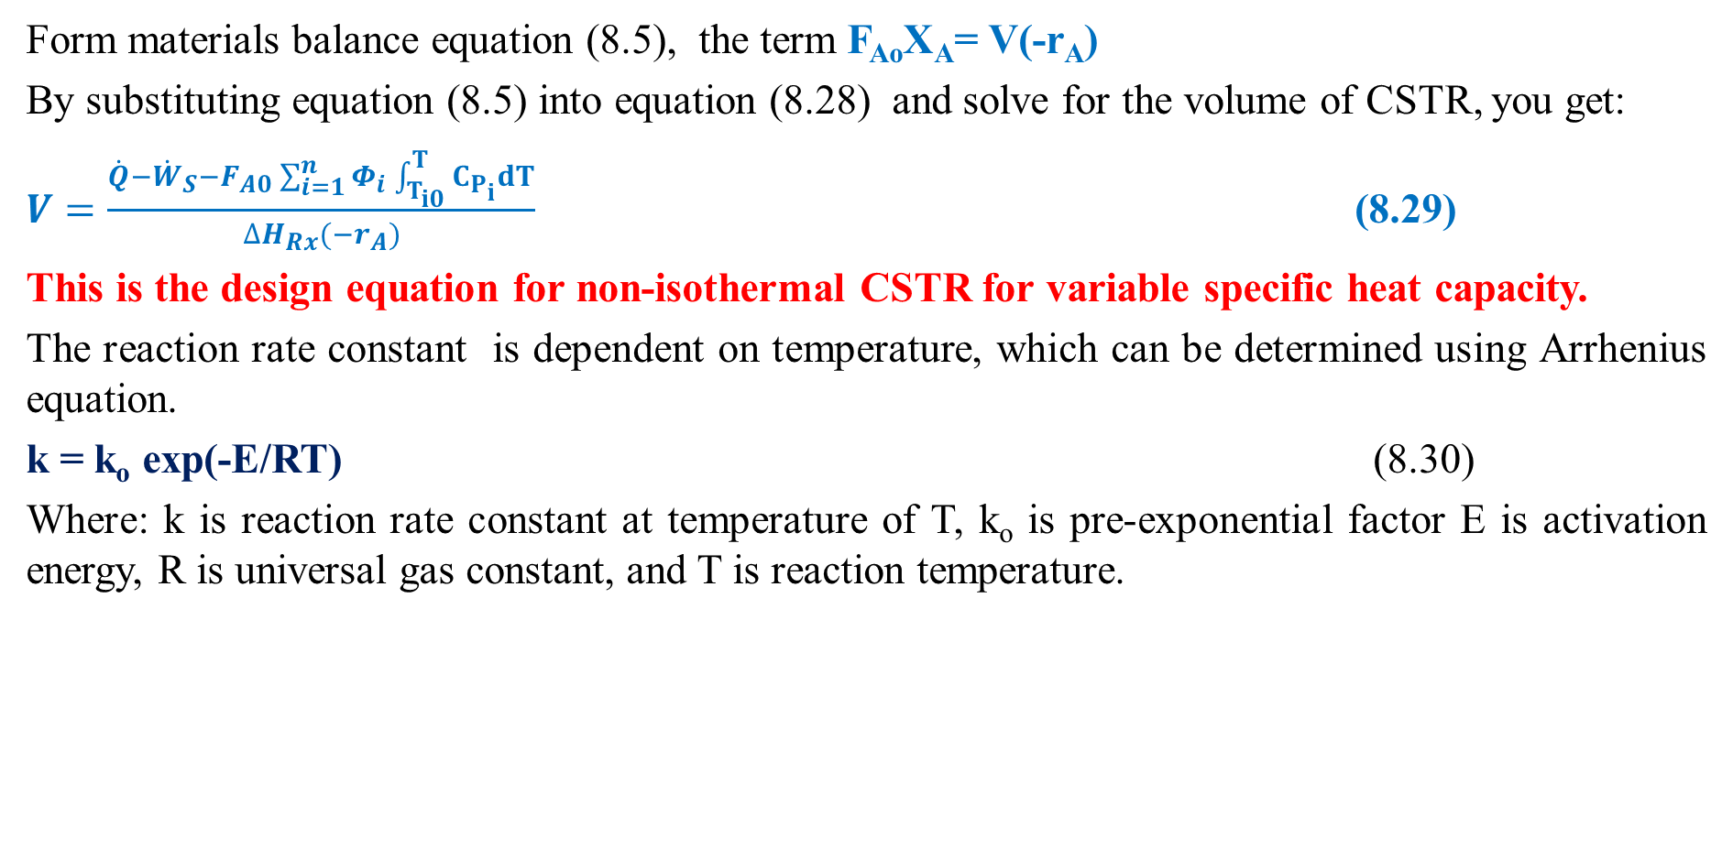
Cont’d
Form materials balance equation (8.5), the term F_{Ao}X_{A}= V(-r_{A})
By substituting equation (8.5) into equation (8.28) and solve for the volume of CSTR, you get:
$V=\frac{\dot{Q}−{\dot{W}}_{S}−F_{A0}\sum_{i=1}^{n}{Φ_{i}}\int_{T_{i0}}^{T}{C_{P_{i}}dT}}{{∆H}_{Rx}{(−r}_{A})}$ (8.29)
This is the design equation for non-isothermal CSTR for variable specific heat capacity.
The reaction rate constant is dependent on temperature, which can be determined using Arrhenius equation.
k = k_{o} exp(-E/RT) (8.30)
Where: k is reaction rate constant at temperature of T, k_{o} is pre-exponential factor E is activation energy, R is universal gas constant, and T is reaction temperature.
32

Slide 33
Cont’d
The temperature dependency of reactions is determined by the activation energy and temperature level of the reaction.
From Arrhenius' law a plot of ln(k) vs 1/T gives a straight line, with large slope for large activation energy and small slope for small activation energy.
Reactions with high activation energies are very temperature-sensitive; reactions with low activation energies are relatively temperature-insensitive (Levenspiel, 2011, pg.28).
33

Slide 34
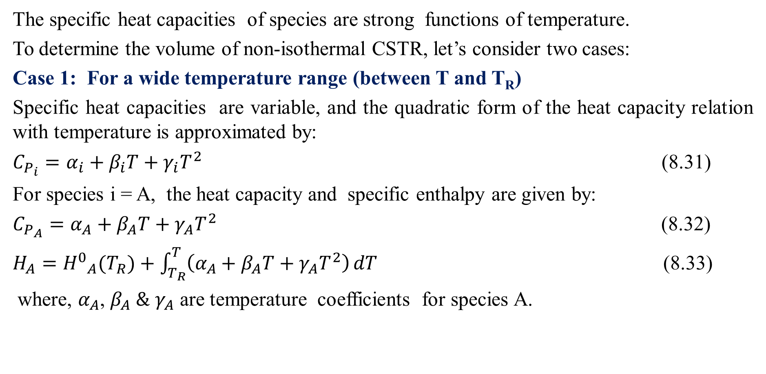
Cont’d
The specific heat capacities of species are strong functions of temperature.
To determine the volume of non-isothermal CSTR, let’s consider two cases:
Case 1: For a wide temperature range (between T and T_{R})
Specific heat capacities are variable, and the quadratic form of the heat capacity relation with temperature is approximated by:
$C_{P_{i}}=α_{i}+β_{i}T+γ_{i}T^{2}$ (8.31)
For species i = A, the heat capacity and specific enthalpy are given by:
$C_{P_{A}}=α_{A}+β_{A}T+γ_{A}T^{2}$ (8.32)
$H_{A}={H^{0}}_{A}(T_{R})+\int_{T_{R}}^{T}{\left(α_{A}+β_{A}T+γ_{A}T^{2}\right)}dT$ (8.33)
where, $α_{A}$, $β_{A} \&$ $γ_{A}$ are temperature coefficients for species A.
34

Slide 35
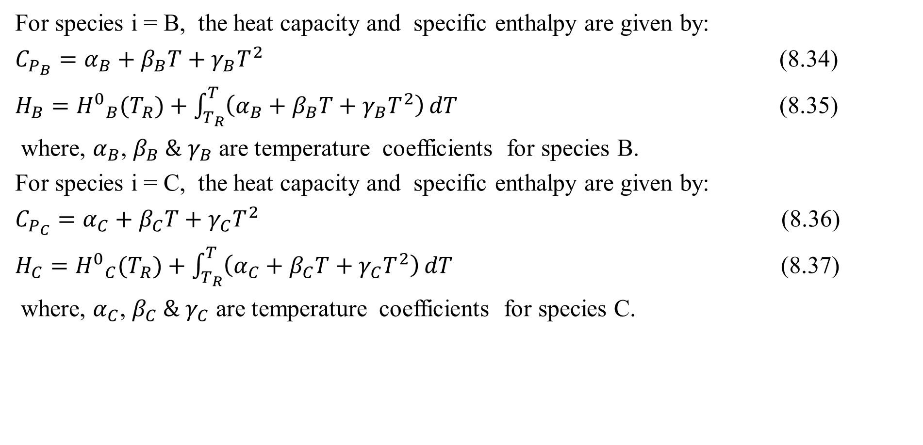
Cont’d
For species i = B, the heat capacity and specific enthalpy are given by:
$C_{P_{B}}=α_{B}+β_{B}T+γ_{B}T^{2}$ (8.34)
$H_{B}={H^{0}}_{B}(T_{R})+\int_{T_{R}}^{T}{\left(α_{B}+β_{B}T+γ_{B}T^{2}\right)}dT$ (8.35)
where, $α_{B}$, $β_{B} \&$ $γ_{B}$ are temperature coefficients for species B.
For species i = C, the heat capacity and specific enthalpy are given by:
$C_{P_{C}}=α_{C}+β_{C}T+γ_{C}T^{2}$ (8.36)
$H_{C}={H^{0}}_{C}(T_{R})+\int_{T_{R}}^{T}{\left(α_{C}+β_{C}T+γ_{C}T^{2}\right)}dT$ (8.37)
where, $α_{C}$, $β_{C} \& γ_{C}$ are temperature coefficients for species C.
35

Slide 36
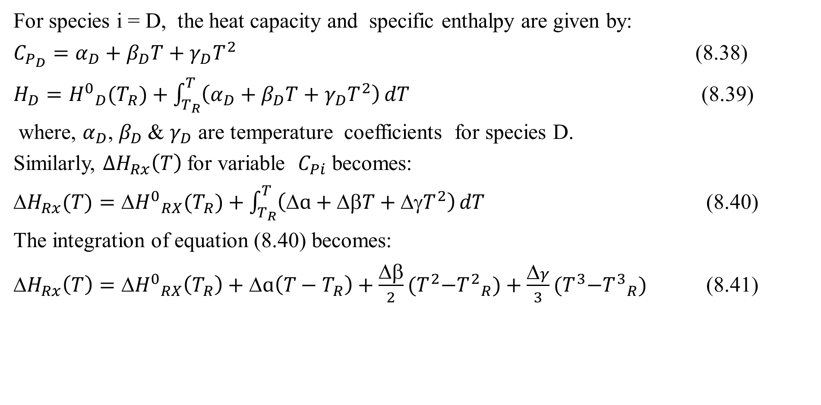
Cont’d
For species i = D, the heat capacity and specific enthalpy are given by:
$C_{P_{D}}=α_{D}+β_{D}T+γ_{D}T^{2}$ (8.38)
$H_{D}={H^{0}}_{D}(T_{R})+\int_{T_{R}}^{T}{\left(α_{D}+β_{D}T+γ_{D}T^{2}\right)}dT$ (8.39)
where, $α_{D}$, $β_{D}$& $γ_{D}$ are temperature coefficients for species D.
Similarly, ${∆H}_{Rx}\left(T\right)$for variable $C_{Pi}$ becomes:
${H}_{Rx}(T)={{H}^{0}}_{RX}(T_{R})+\int_{T_{R}}^{T}{\left(ɑ+βT+{γT}^{2}\right)}dT$ (8.40)
The integration of equation (8.40) becomes:
${H}_{Rx}\left(T\right)={{H}^{0}}_{RX}\left(T_{R}\right)+ɑ\left(T−T_{R}\right)+\frac{β}{2}{(T}^{2}−{T^{2}}_{R})+\frac{γ}{3}{(T}^{3}−{T^{3}}_{R})$ (8.41)
36

Slide 37
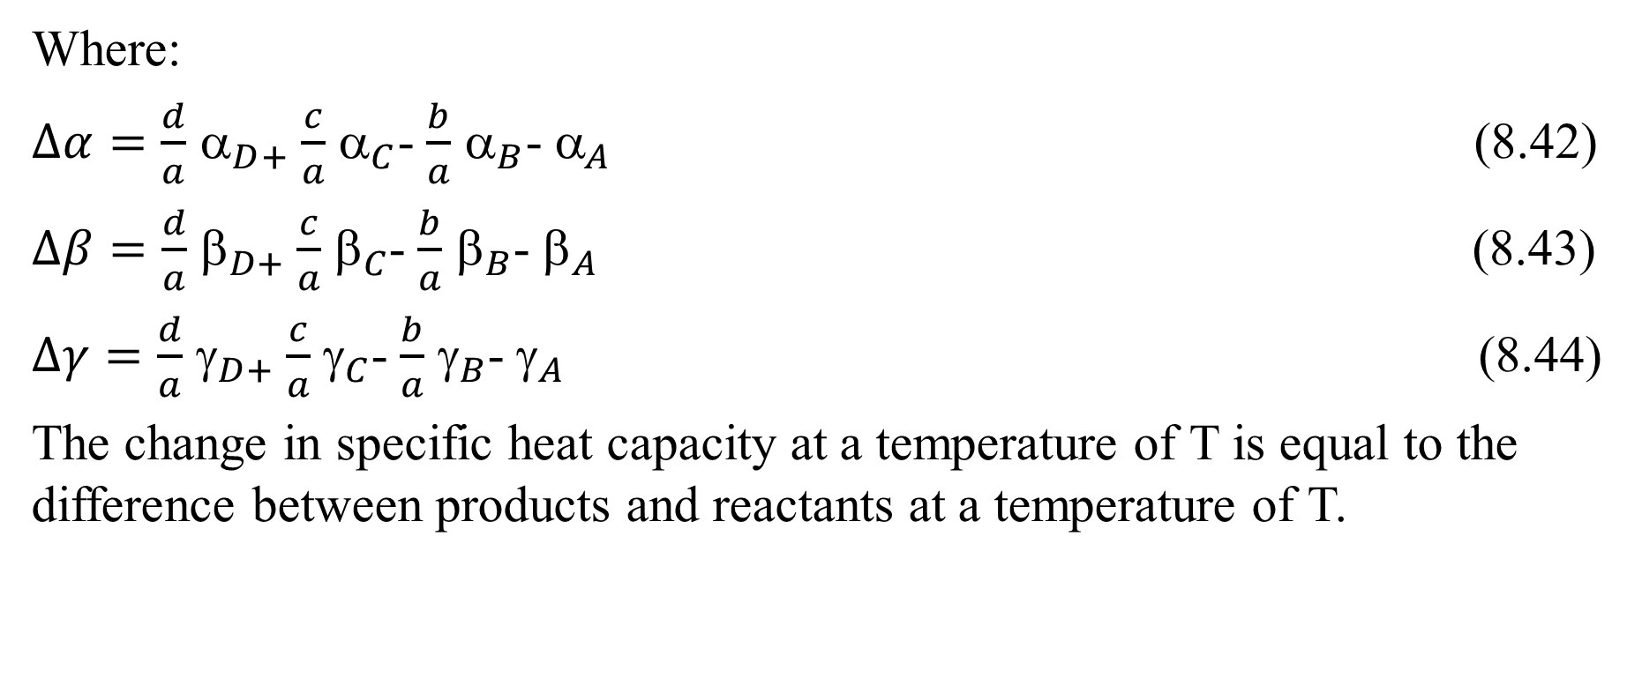
Cont’d
Where:
$∆α=\frac{d}{a}$ $_{D+}$ $\frac{c}{a}$ $_{C}$- $\frac{b}{a}$ $_{B}$- $_{A}$ (8.42)
$∆β=\frac{d}{a}$ $_{D+}$ $\frac{c}{a}$ $_{C}$- $\frac{b}{a}$ $_{B}$- $_{A}$ (8.43)
$∆γ=\frac{d}{a}$ $_{D+}$ $\frac{c}{a}$ $_{C}$- $\frac{b}{a}$ $_{B}$- $_{A}$ (8.44)
The change in specific heat capacity at a temperature of T is equal to the difference between products and reactants at a temperature of T.
37

Slide 38
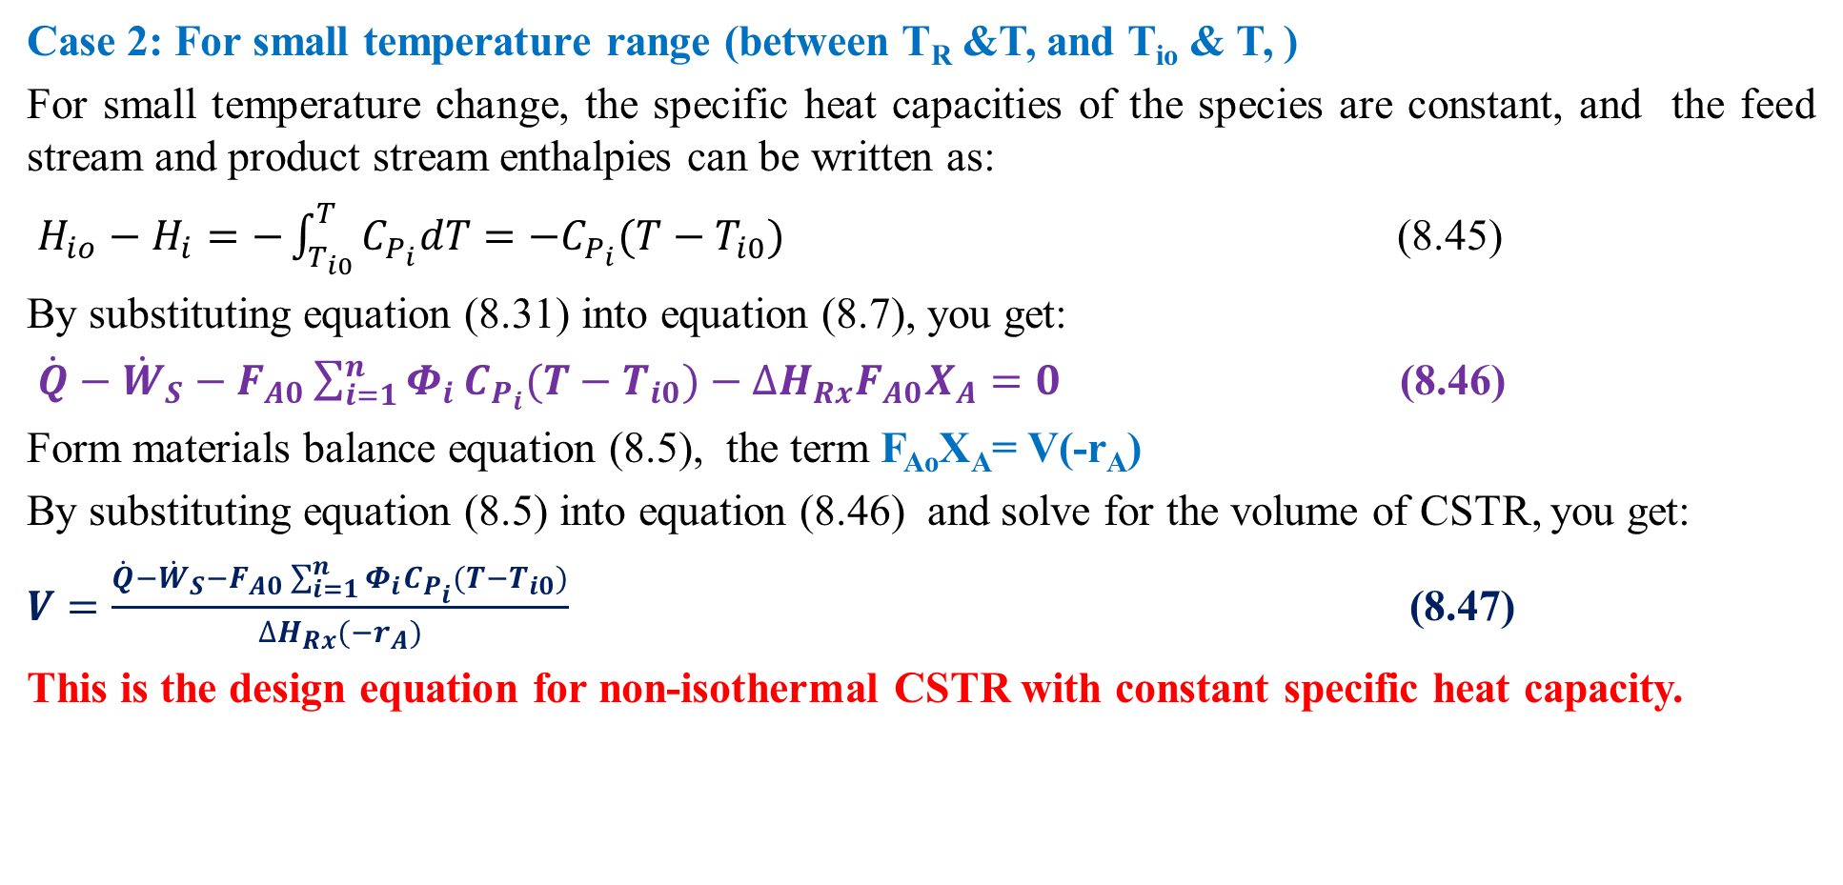
Cont’d
Case 2: For small temperature range (between T_{R} &T, and T_{io} & T, )
For small temperature change, the specific heat capacities of the species are constant, and the feed stream and product stream enthalpies can be written as:
$H_{io}−H_{i}=−\int_{T_{i0}}^{T}{C_{P_{i}}dT=−C_{P_{i}}(T−T_{i0})}$ (8.45)
By substituting equation (8.31) into equation (8.7), you get:
$\dot{Q}−{\dot{W}}_{S}−F_{A0}\sum_{i=1}^{n}{Φ_{i}}C_{P_{i}}(T−T_{i0})−{∆H}_{Rx}F_{A0}X_{A}=0$ (8.46)
Form materials balance equation (8.5), the term F_{Ao}X_{A}= V(-r_{A})
By substituting equation (8.5) into equation (8.46) and solve for the volume of CSTR, you get:
$V=\frac{\dot{Q}−{\dot{W}}_{S}−F_{A0}\sum_{i=1}^{n}{Φ_{i}}C_{P_{i}}(T−T_{i0})}{{∆H}_{Rx}{(−r}_{A})}$ (8.47)
This is the design equation for non-isothermal CSTR with constant specific heat capacity.
38

Slide 39
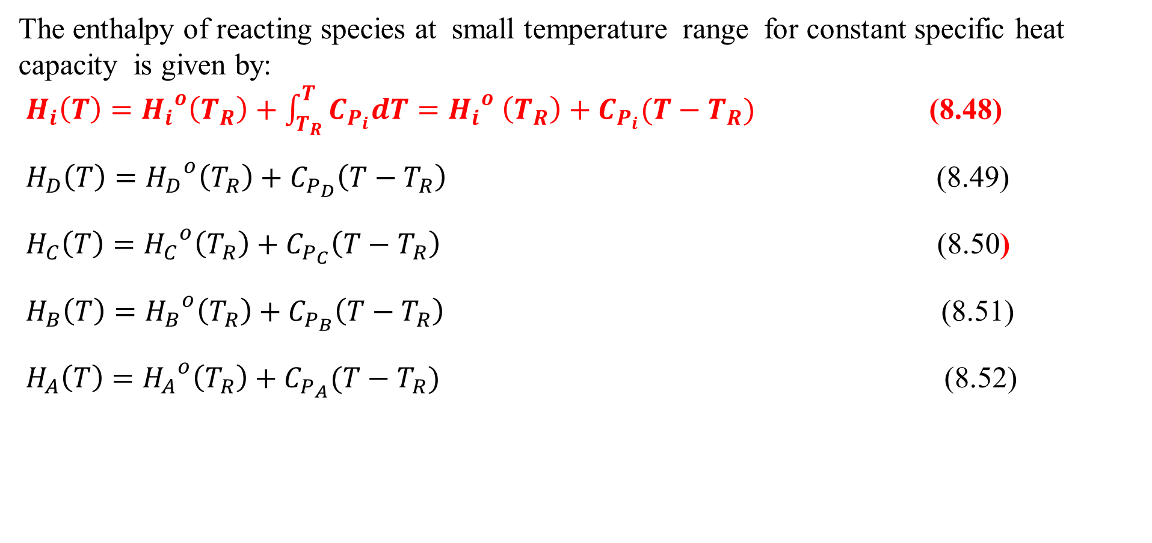
Cont’d
The enthalpy of reacting species at small temperature range for constant specific heat capacity is given by:
$H_{i}\left(T\right)={H_{i}}^{o}\left(T_{R}\right)+\int_{T_{R}}^{T}{C_{P_{i}}dT}={H_{i}}^{o} \left(T_{R}\right)+C_{P_{i}}(T−T_{R})$ (8.48)
$H_{D}\left(T\right)={H_{D}}^{o}\left(T_{R}\right)+C_{P_{D}}\left(T−T_{R}\right)$ (8.49)
$H_{C}\left(T\right)={{H_{C}}^{o}\left(T_{R}\right)+C}_{P_{C}}\left(T−T_{R}\right)$ (8.50)
$H_{B}\left(T\right)={H_{B}}^{o}\left(T_{R}\right)+C_{P_{B}}\left(T−T_{R}\right)$ (8.51)
$H_{A}\left(T\right)={H_{A}}^{o}\left(T_{R}\right)+C_{P_{A}}(T−T_{R})$ (8.52)
39

Slide 40
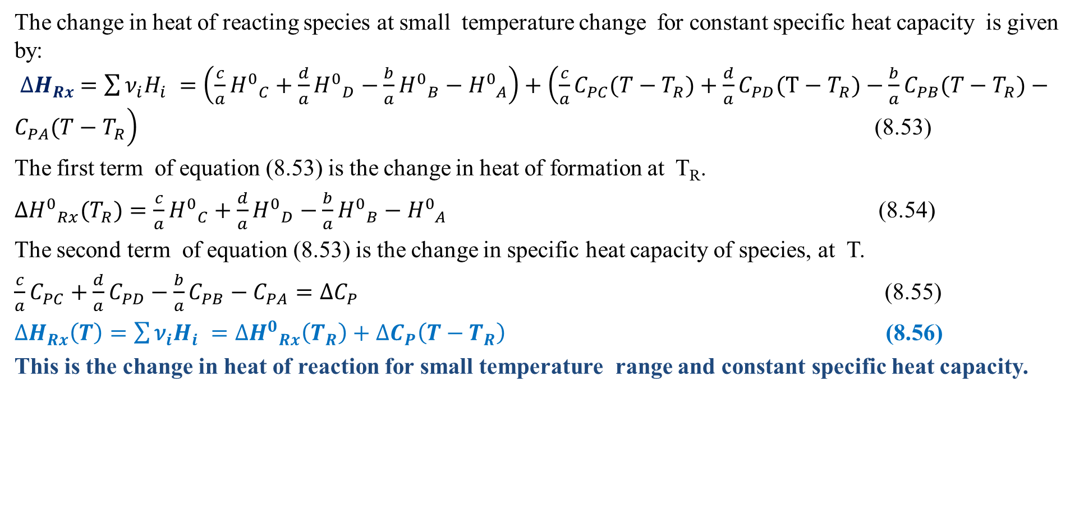
Cont’d
The change in heat of reacting species at small temperature change for constant specific heat capacity is given by:
${∆H}_{Rx} =\sum{{\text{ν}}_{i}H_{i} }=\left(\frac{c}{a}{H^{0}}_{C}+\frac{d}{a}{H^{0}}_{D}−\frac{b}{a}{H^{0}}_{B}−{H^{0}}_{A}\right)+\left(\frac{c}{a}C_{PC}(T−T_{R})+\frac{d}{a}C_{PD}(T−T_{R})−\frac{b}{a}C_{PB}(T−T_{R})−C_{PA}(T−T_{R}\right)$ (8.53)
The first term of equation (8.53) is the change in heat of formation at T_{R}.
${{∆H}^{0}}_{Rx}(T_{R})=\frac{c}{a}{H^{0}}_{C}+\frac{d}{a}{H^{0}}_{D}−\frac{b}{a}{H^{0}}_{B}−{H^{0}}_{A}$ (8.54)
The second term of equation (8.53) is the change in specific heat capacity of species, at T.
$\frac{c}{a}C_{PC}+\frac{d}{a}C_{PD}−\frac{b}{a}C_{PB}−C_{PA}={∆C}_{P}$ (8.55)
${∆H}_{Rx}\left(T\right)=\sum{{\text{ν}}_{i}H_{i} }={{∆H}^{0}}_{Rx}\left(T_{R}\right)+{∆C}_{P}\left(T−T_{R}\right)$ (8.56)
This is the change in heat of reaction for small temperature range and constant specific heat capacity.
40

Slide 41
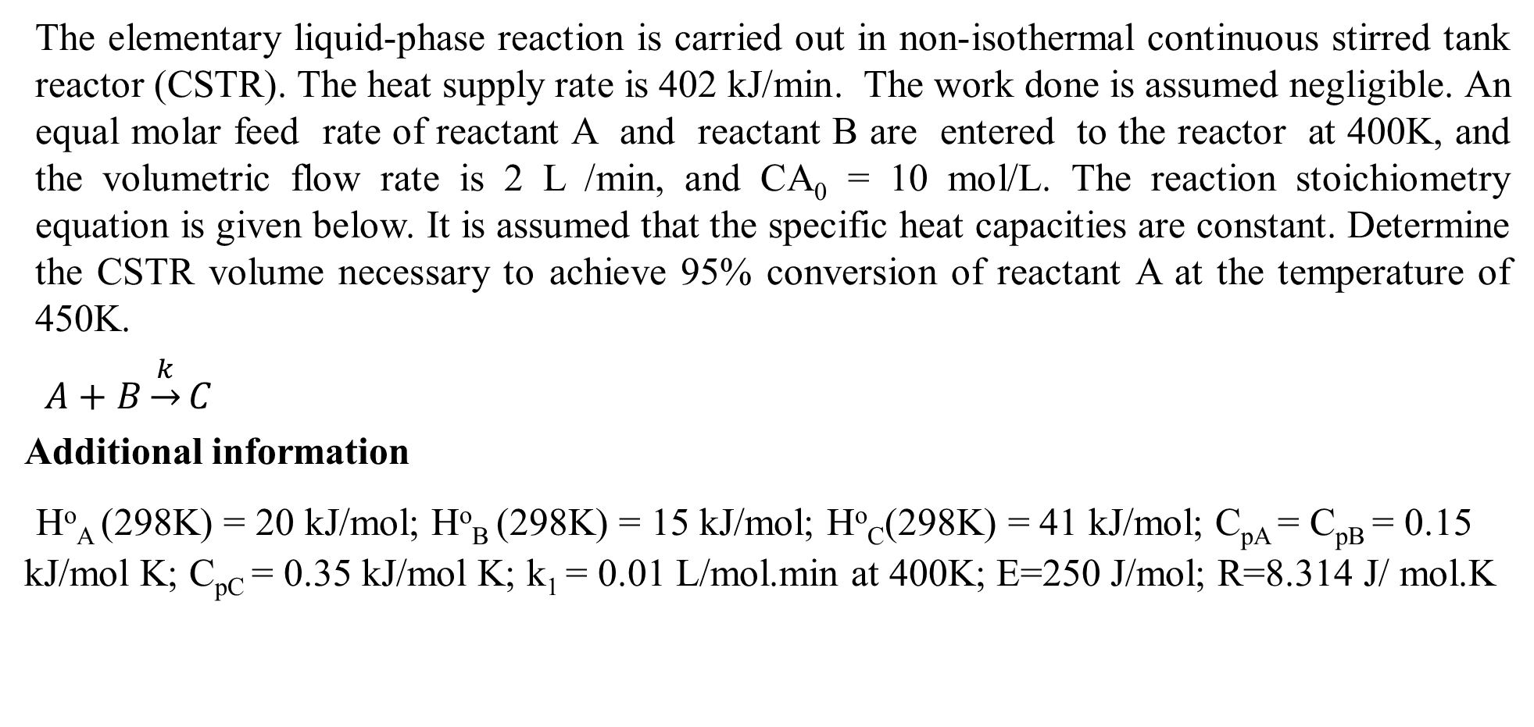
Activity 8.2.
The elementary liquid-phase reaction is carried out in non-isothermal continuous stirred tank reactor (CSTR). The heat supply rate is 402 kJ/min. The work done is assumed negligible. An equal molar feed rate of reactant A and reactant B are entered to the reactor at 400K, and the volumetric flow rate is 2 L /min, and CA₀ = 10 mol/L. The reaction stoichiometry equation is given below. It is assumed that the specific heat capacities are constant. Determine the CSTR volume necessary to achieve 95% conversion of reactant A at the temperature of 450K.
$A+B\underset{→}{k}C$
Additional information
Hº_{A} (298K) = 20 kJ/mol; Hº_{B} (298K) = 15 kJ/mol; Hº_{C}(298K) = 41 kJ/mol; C_{pA} = C_{pB} = 0.15 kJ/mol K; C_{pC} = 0.35 kJ/mol K; k₁ = 0.01 L/mol.min at 400K; E=250 J/mol; R=8.314 J/ mol.K
41

Slide 42
Cont’d
Given:
Elementary reaction, non-isothermal CSTR,
C_{Ao}=10 mol/L, υ_{o}=2 L/min, Q = 402 kJ/min,
X_{A}= 95% = 0.95, W_{s}= 0
F_{Ao}= F_{Bo}, C_{Ao}= C_{Bo} & C_{A}= C_{B}
The reaction is second order reaction.
-r_{A}= kC_{A}C_{B}= kC_{A}²= kC_{Ao}²(1-X_{A})²
Additional data are also given.
Required:
V=?
42

Slide 43
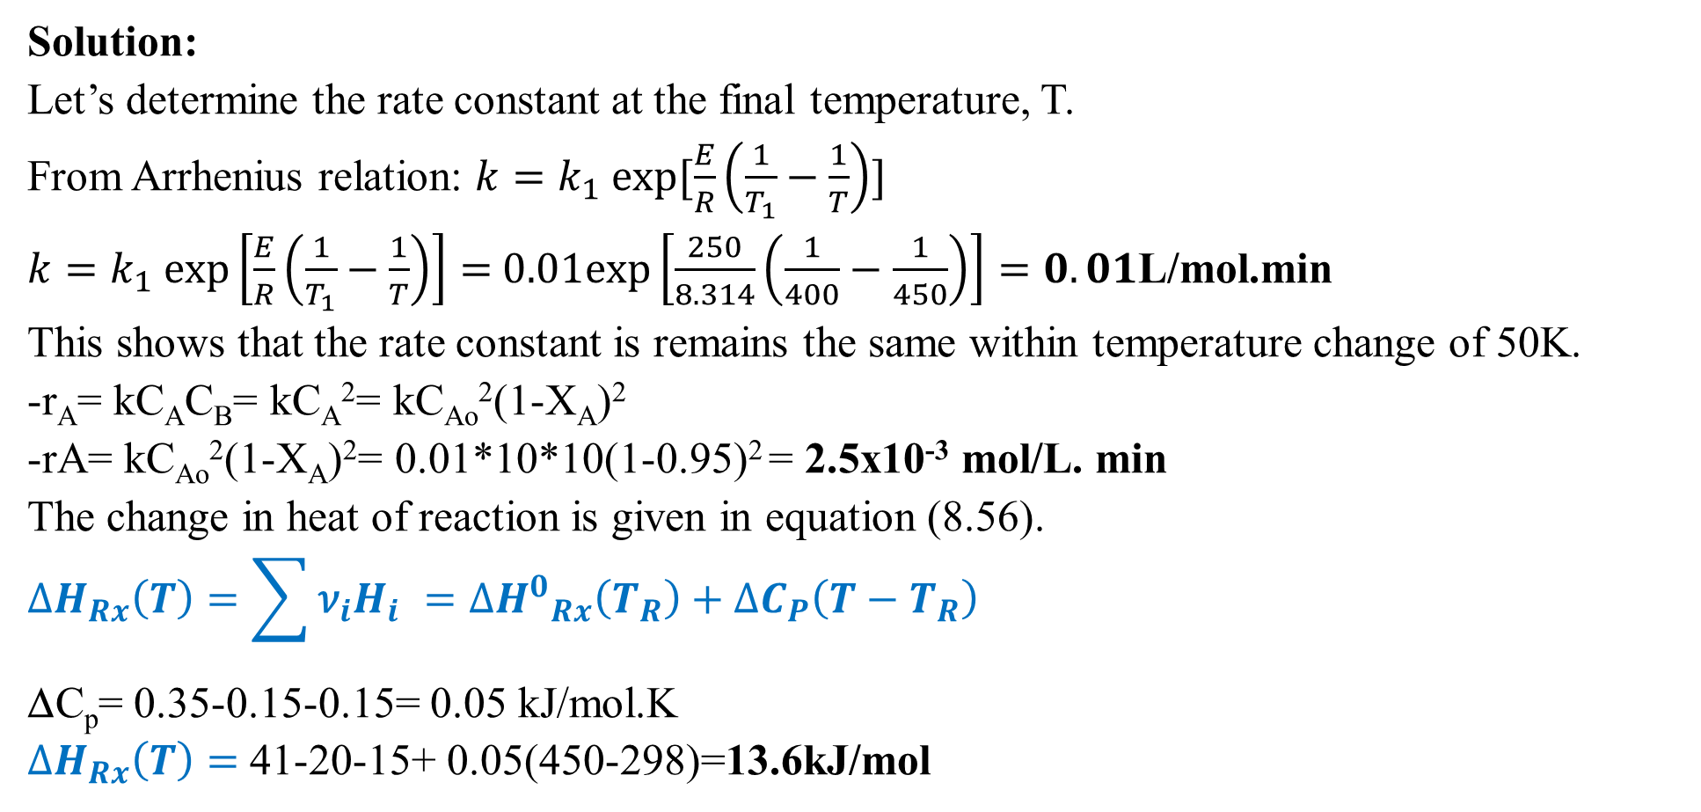
Cont’d
Solution:
Let’s determine the rate constant at the final temperature, T.
From Arrhenius relation: $k=k_{1} exp[\frac{E}{R}\left(\frac{1}{T_{1}}−\frac{1}{T}\right)]$
$k=k_{1} exp\left[\frac{E}{R}\left(\frac{1}{T_{1}}−\frac{1}{T}\right)\right]=$ $0.01exp\left[\frac{250}{8.314}\left(\frac{1}{400}−\frac{1}{450}\right)\right]=0.01$L/mol.min
This shows that the rate constant is remains the same within temperature change of 50K.
-r_{A}= kC_{A}C_{B}= kC_{A}²= kC_{Ao}²(1-X_{A})²
-rA= kC_{Ao}²(1-X_{A})²= 0.01*10*10(1-0.95)² = 2.5x10⁻³ mol/L. min
The change in heat of reaction is given in equation (8.56).
$${∆H}_{Rx}\left(T\right)=\sum{{\text{ν}}_{i}H_{i} }={{∆H}^{0}}_{Rx}\left(T_{R}\right)+{∆C}_{P}\left(T−T_{R}\right)$$
ΔC_{p}= 0.35-0.15-0.15= 0.05 kJ/mol.K
${∆H}_{Rx}\left(T\right)=$41-20-15+ 0.05(450-298)=13.6kJ/mol
43

Slide 44
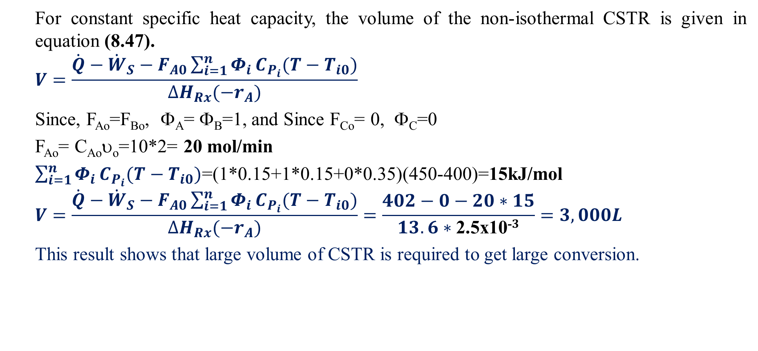
Cont’d
For constant specific heat capacity, the volume of the non-isothermal CSTR is given in equation (8.47).
$$V=\frac{\dot{Q}−{\dot{W}}_{S}−F_{A0}\sum_{i=1}^{n}{Φ_{i}}C_{P_{i}}(T−T_{i0})}{{∆H}_{Rx}{(−r}_{A})}$$
Since, F_{Ao}=F_{Bo}, Φ_{A}= Φ_{B}=1, and Since F_{Co}= 0, Φ_{C}=0
F_{Ao}= C_{Ao}υ_{o}=10*2= 20 mol/min
$\sum_{i=1}^{n}{Φ_{i}}C_{P_{i}}(T−T_{i0})$=(1*0.15+1*0.15+0*0.35)(450-400)=15kJ/mol
$$V=\frac{\dot{Q}−{\dot{W}}_{S}−F_{A0}\sum_{i=1}^{n}{Φ_{i}}C_{P_{i}}(T−T_{i0})}{{∆H}_{Rx}{(−r}_{A})}=\frac{402−0−20∗15}{13.6∗\text{2.5}\text{x}\text{10−}3}=3,000L$$
This result shows that large volume of CSTR is required to get large conversion.
44

Slide 45
8.5. Summary
For non-isothermal CSTR, the temperature of the reacting mixture can vary inside the reactor due to heat generation from the reaction or absorption of heat from external sources.
For non-isothermal CSTR, the rate of reaction is a function of temperature.
The reactor volume, flow rate, heat transfer area, space time, reaction kinetic operating temperature and pressure conditions are some of the design parameters for non-isothermal CSTR.
Some of the performance measures for non-isothermal CSTR are conversion, yield, selectivity, temperature profile, heat transfer coefficient, and reaction rate.
To determine the reactor volume, energy balance equation is required with materials balance equation since rate of reaction and conversion are temperature dependent for non-isothermal CSTR.
45

Slide 46
References
Chemical Reaction Engineering, Levenspiel, O John Wiely & Sons, 3rd edition, 2011.
Elements of Chemical Engineering, Fogler, HS Prentice- Hall Inc Prentice- Hall Inc, 5th edition, 2015.
Thank you!
46

