Slide 1
Chemical Reaction Engineering II- Reactor Design (ChEg 4101)
Prerequisite: Chemical Reaction Engineering I-Reaction Kinetics (ChEg3104)
Lecture 12: Design of Catalytic Reactors: Design of Fluidized Bed Reactor
Week 12
Lecturer: Adamu Esubalew (PhD, ChEg)
Addis Ababa, Ethiopia

Slide 2
Lecture learning outcomes
At the end of the lecture, you will be able to:
identify characteristics of fluidized bed reactor,
describe the design parameters for fluidized bed reactor, and
design of fluidized bed reactor using Kunii-Levenspiel bubbling bed model.

Slide 3
Presentation outlines
Introduction to fluidized bed reactor
Fluidized bed reactor design parameters
Design of fluidized bed reactor
Summary

Slide 4
12.1. Introduction to fluidized bed reactor
A catalytic fluidized bed reactor is a type of reactor that combines the principles of fluidization with catalysis to enhance chemical reactions.
The fluid velocity is sufficient to suspend the particles, but it is not large enough to carry them out of the vessel.
The solid particles swirl around the bed rapidly, creating excellent mixing among them.
The fluidized material is almost a solid and the fluidizing medium is either a liquid or gas.
The characteristics and behavior of a fluidized bed are strongly dependent on both the solid and liquid or gas properties.

Slide 5
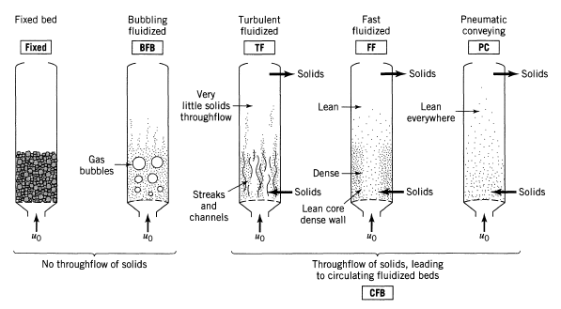
Cont’d
The gas-solid catalyst contacting regimes, from low to very high gas velocity, in the fluidized bed reactor is shown in Figure 12.1 (Levenspiel, 2011, pg.488).
Figure 12.1. Gas-solid catalyst contacting regimes in the fluidized bed reactor

Slide 6
Cont’d
Fluidized bed reactor has several characteristics.
Some of the characteristics of fluidized bed reactor are the described in the following paragraphs:
Fluidization: Solid catalyst particles are suspended in an upward-flowing gas or liquid, creating a fluidized state.
Fluidization enhances mass and heat transfer, which leads to improved reaction rates.
Catalyst particles sizes: The catalyst used in a FBR is typically in the form of small particles.
In FBR, the choice of catalyst is crucial for reaction efficiency and selectivity.
Temperature control: The fluidized state allows for uniform temperature distribution.
Reaction kinetics: FBR allows for high reaction rates due to enhanced mixing and contact between reactants and catalyst.

Slide 7
Cont’d
Fluidized bed reactors are well able to use small-size particles of catalysts without much pressure drop.
FBR is effective to control temperature for exothermic reactions that prevents hot spots or collapse of the catalyst due to rapid mixing of solids in fluidized beds.
The fluid flow is complex and not well known (fluid mechanics is not well known) which is far from plug flow.
This behavior is unsatisfactory from the standpoint of effective contacting and requires much more catalyst for high conversion of gases.
The design of FBR is not as easy as PBR since FBR incorporates three broad concepts: the mechanics of fluidized bed, mass transfer in fluidized bed, and reaction behavior in a fluidized bed.

Slide 8
12.2. Fluidized bed reactor design parameters
There are various design parameters of FBR that influence its performance, efficiency, and operational stability.
Some of the design parameters of FBR are the followings:
Fluidization velocity: The minimum fluidization velocity and operating velocity are the main design parameters as fluidization velocity.
The minimum fluidization velocity is the velocity at which the bed transitions from a fixed state to a fluidized state.
It is crucial for ensuring proper fluidization and should be determined based on particle size, density, and fluid properties.
The operating velocity is the actual gas or liquid velocity during operation, typically set above minimum fluidization velocity but below the velocity that causes excessive entrainment of particles.

Slide 9
Cont’d
Particles size and distribution: The particles diameter influences fluidization state.
The size of catalyst particles affects fluidization behavior, pressure drop, and reaction kinetics.
Catalyst properties: The catalyst activity, selectivity, shape and surface area affects rate of reaction and mass transfer rate.
The geometric shape and surface area of catalyst particles influence mass transfer rates.
Hydrodynamics: It affects the behavior of the catalyst and the efficiency of the reactions.
Therefore, the design of a catalytic fluidized bed reactor is a complex interplay of various parameters that should be carefully balanced to achieve optimal performance.

Slide 10
12.3. Design of fluidized bed reactor
In fluidized catalytic beds, the bulk density (ρ_{b}) is a function of the volumetric flow rate through the bed.
In designing ideal fluidized-bed catalytic reactors, it is assumed that the activity of the catalyst remains constant throughout the catalyst’s life.
To design fluidized bed reactor, let’s use the Kunii-Levenspiel bubbling bed model to describe reactions in fluidized beds.
In this model, the reactant gas enters the bottom of the bed and flows up the reactor in the form of bubbles.
As the bubbles rise, mass transfer of the reactant gases takes place as they flow (diffuse) in and out of the bubble to contact the solid particles where the reaction product is formed.
The product then flows back into a bubble and finally exits the bed when the bubble reaches the top of the bed.

Slide 11
Cont’d
Consequently, it is required to describe the velocity at which the bubbles move through the column and the rate of transport of gases in and out of the bubbles.
To calculate these parameters, it is needed to determine a number of fluid mechanics parameters associated with the fluidization process, mass transfer and reaction rate parameters.
Specifically, to determine the velocity of the bubble through the bed, it is needed to calculate the
porosity at minimum fluidization(ε_{mf}), minimum fluidization velocity (u_{mf}), and bubble size (d_{b}).
To calculate the mass transport coefficient, first calculate porosity at minimum fluidization(ε_{mf}), minimum fluidization velocity (u_{mf}), velocity of bubble rise (u_{b}), and bubble size (d_{b}).

Slide 12
Cont’d
To determine the reaction rate parameters in the bed, we need to first calculate fraction of bed occupied by bubbles (δ), fraction of the bed consisting of wakes (αδ), and volume fraction of catalyst in the bubbles, clouds, and emulsion, γ_{b}, γ_{c}, and γ_{e}, respectively.
12.3.1. The mechanics of fluidized beds
It is evident that before we begin to study fluidized-bed reactors, we must obtain an understanding of the fluid mechanics of fluidization to calculate all the fluid mechanic parameters.
The regions of fluidization is used to calculate the minimum and maximum fluidization velocities.

Slide 13
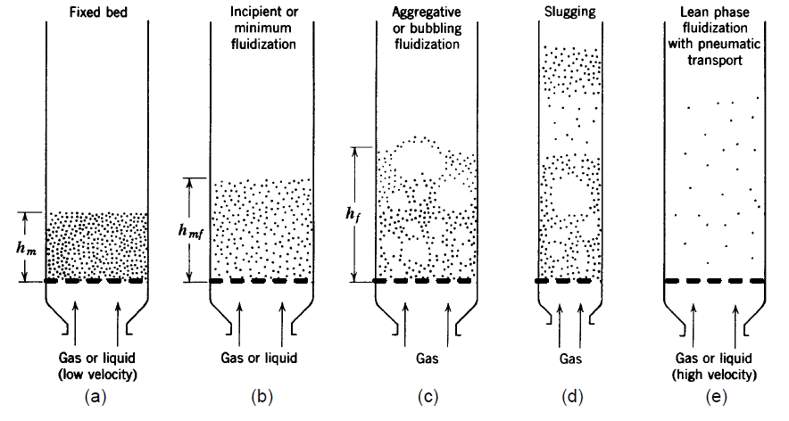
Cont’d
Let's consider a vertical bed of solid particles supported by a porous or perforated distributor plate as shown in Figure 12.2(a-e) (Kunii-Levenspiel, 3rd Edition, CD ROM Shelf, pg. R12-3).
The direction of gas flow is upward through this bed.
Figure 12.2. Various kinds of contacting of a batch of solids by fluid.

Slide 14
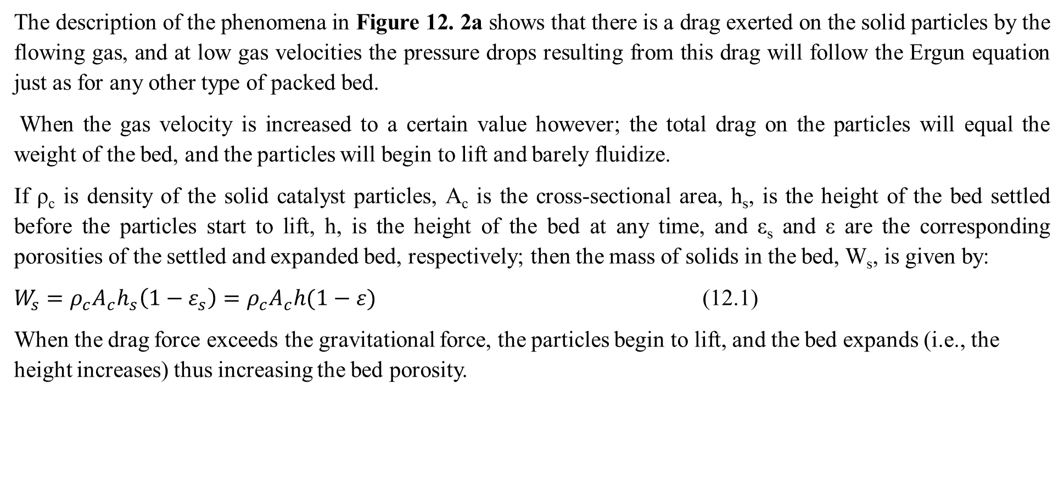
Cont’d
The description of the phenomena in Figure 12. 2a shows that there is a drag exerted on the solid particles by the flowing gas, and at low gas velocities the pressure drops resulting from this drag will follow the Ergun equation just as for any other type of packed bed.
When the gas velocity is increased to a certain value however; the total drag on the particles will equal the weight of the bed, and the particles will begin to lift and barely fluidize.
If ρ_{c} is density of the solid catalyst particles, A_{c} is the cross-sectional area, h_{s}, is the height of the bed settled before the particles start to lift, h, is the height of the bed at any time, and ε_{s} and ε are the corresponding porosities of the settled and expanded bed, respectively; then the mass of solids in the bed, W_{s}, is given by:
$W_{s}=ρ_{c}A_{c}h_{s}\left(1−ε_{s}\right)=ρ_{c}A_{c}h(1−ε)$ (12.1)
When the drag force exceeds the gravitational force, the particles begin to lift, and the bed expands (i.e., the height increases) thus increasing the bed porosity.

Slide 15
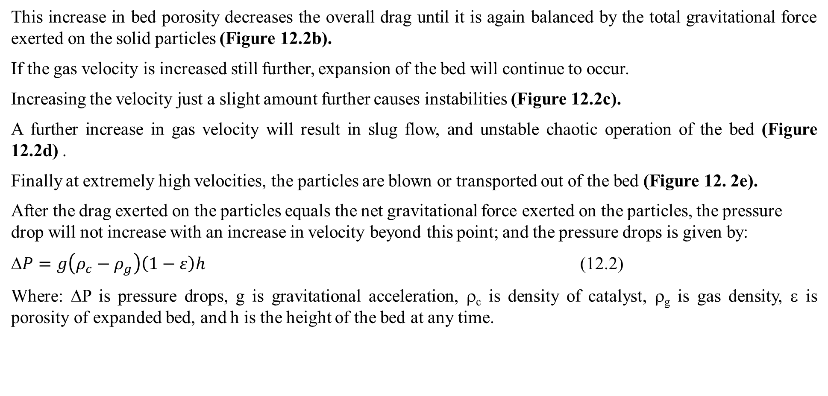
Cont’d
This increase in bed porosity decreases the overall drag until it is again balanced by the total gravitational force exerted on the solid particles (Figure 12.2b).
If the gas velocity is increased still further, expansion of the bed will continue to occur.
Increasing the velocity just a slight amount further causes instabilities (Figure 12.2c).
A further increase in gas velocity will result in slug flow, and unstable chaotic operation of the bed (Figure 12.2d) .
Finally at extremely high velocities, the particles are blown or transported out of the bed (Figure 12. 2e).
After the drag exerted on the particles equals the net gravitational force exerted on the particles, the pressure drop will not increase with an increase in velocity beyond this point; and the pressure drops is given by:
$P=g\left(ρ_{c}−ρ_{g}\right)\left(1−ε\right)h$ (12.2)
Where: ΔP is pressure drops, g is gravitational acceleration, ρ_{c} is density of catalyst, ρ_{g} is gas density, ε is porosity of expanded bed, and h is the height of the bed at any time.

Slide 16
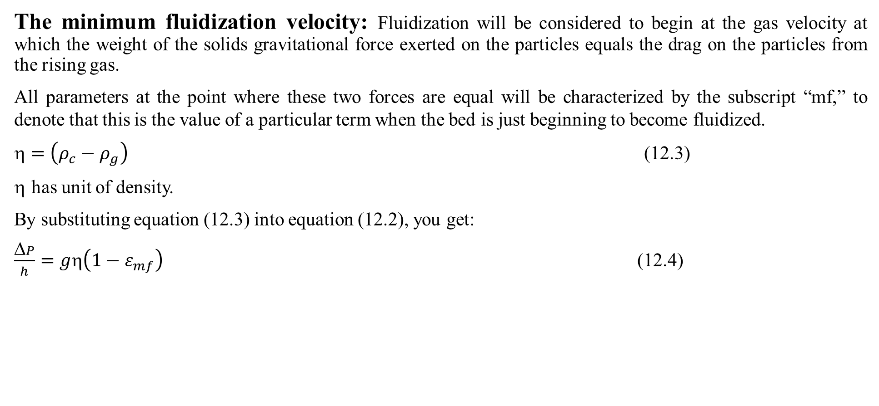
Cont’d
The minimum fluidization velocity: Fluidization will be considered to begin at the gas velocity at which the weight of the solids gravitational force exerted on the particles equals the drag on the particles from the rising gas.
All parameters at the point where these two forces are equal will be characterized by the subscript “mf,” to denote that this is the value of a particular term when the bed is just beginning to become fluidized.
$=\left(ρ_{c}−ρ_{g}\right)$ (12.3)
has unit of density.
By substituting equation (12.3) into equation (12.2), you get:
$\frac{ΔP}{h}=gη\left(1−ε_{mf}\right)$ (12.4)

Slide 17
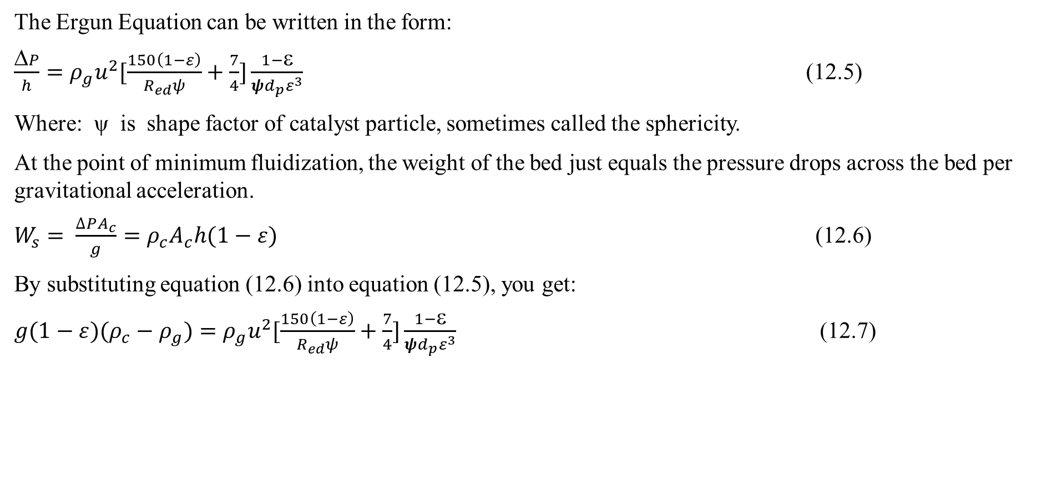
Cont’d
The Ergun Equation can be written in the form:
$\frac{ΔP}{h}=ρ_{g}u^{2}[\frac{150\left(1−ε\right)}{R_{ed}ψ}+\frac{7}{4}]\frac{1−ε}{ψd_{p}ε^{3}}$ (12.5)
Where: ψ is shape factor of catalyst particle, sometimes called the sphericity.
At the point of minimum fluidization, the weight of the bed just equals the pressure drops across the bed per gravitational acceleration.
$W_{s}= \frac{∆PA_{c}}{g}=ρ_{c}A_{c}h(1−ε)$ (12.6)
By substituting equation (12.6) into equation (12.5), you get:
$g(1−ε)(ρ_{c}−ρ_{g})=ρ_{g}u^{2}[\frac{150\left(1−ε\right)}{R_{ed}ψ}+\frac{7}{4}]\frac{1−ε}{ψd_{p}ε^{3}}$ (12.7)

Slide 18
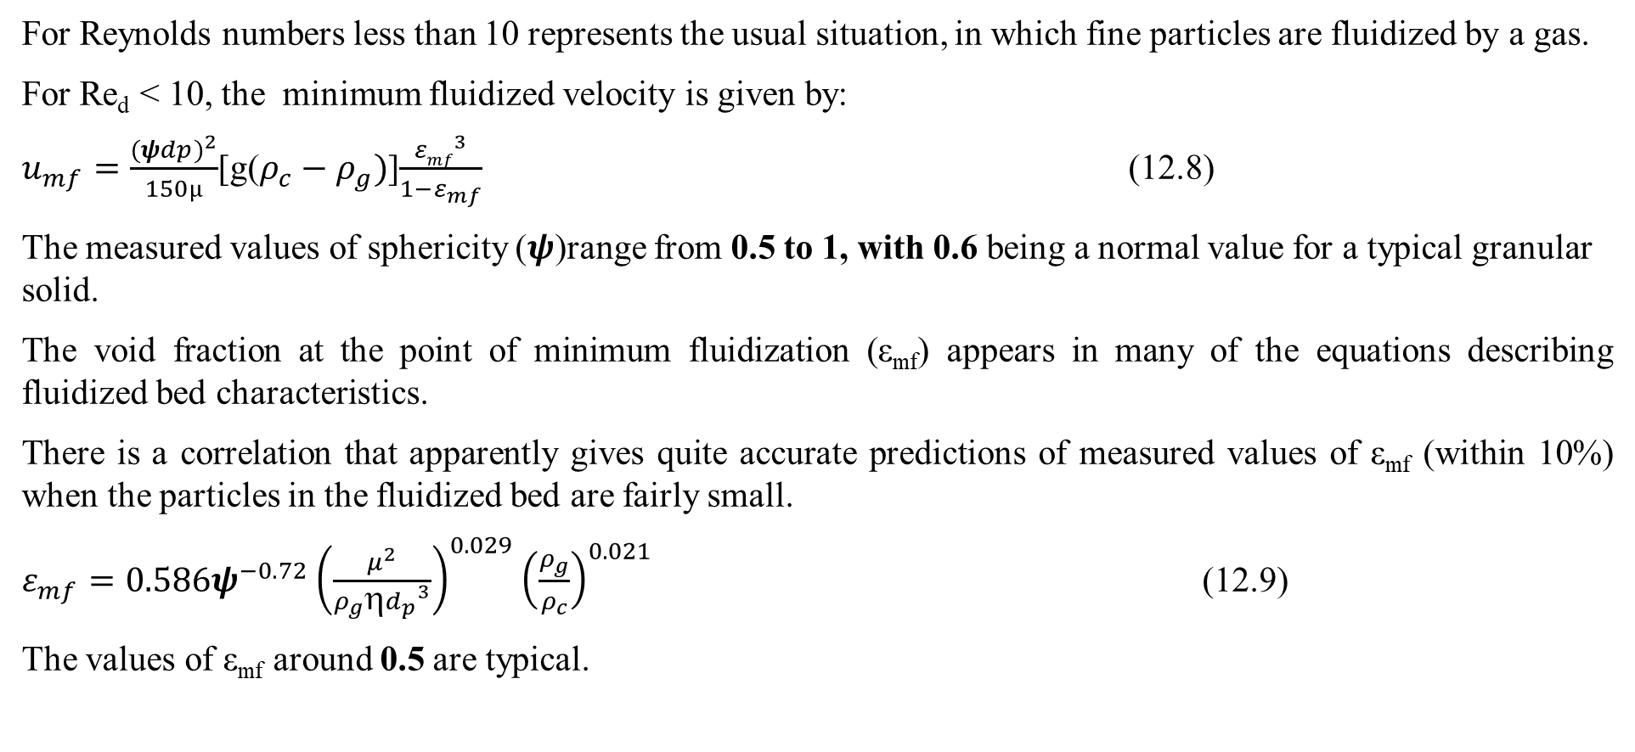
Cont’d
For Reynolds numbers less than 10 represents the usual situation, in which fine particles are fluidized by a gas.
For Re_{d} < 10, the minimum fluidized velocity is given by:
$u_{mf}=\frac{{(ψdp)}^{2}}{150µ}$[g($ρ_{c}−ρ_{g})$]$\frac{{εmf}^{3}}{1−ε_{mf}}$ (12.8)
The measured values of sphericity (𝝍)range from 0.5 to 1, with 0.6 being a normal value for a typical granular solid.
The void fraction at the point of minimum fluidization (ε_{mf}) appears in many of the equations describing fluidized bed characteristics.
There is a correlation that apparently gives quite accurate predictions of measured values of ε_{mf} (within 10%) when the particles in the fluidized bed are fairly small.
$ε_{mf}=0.586ψ^{−0.72}{\left(\frac{μ^{2}}{ρ_{g}{{ηd}_{p}}^{3}}\right)}^{0.029}{\left(\frac{ρ_{g}}{ρ_{c}}\right)}^{0.021}$ (12.9)
The values of ε_{mf} around 0.5 are typical.

Slide 19
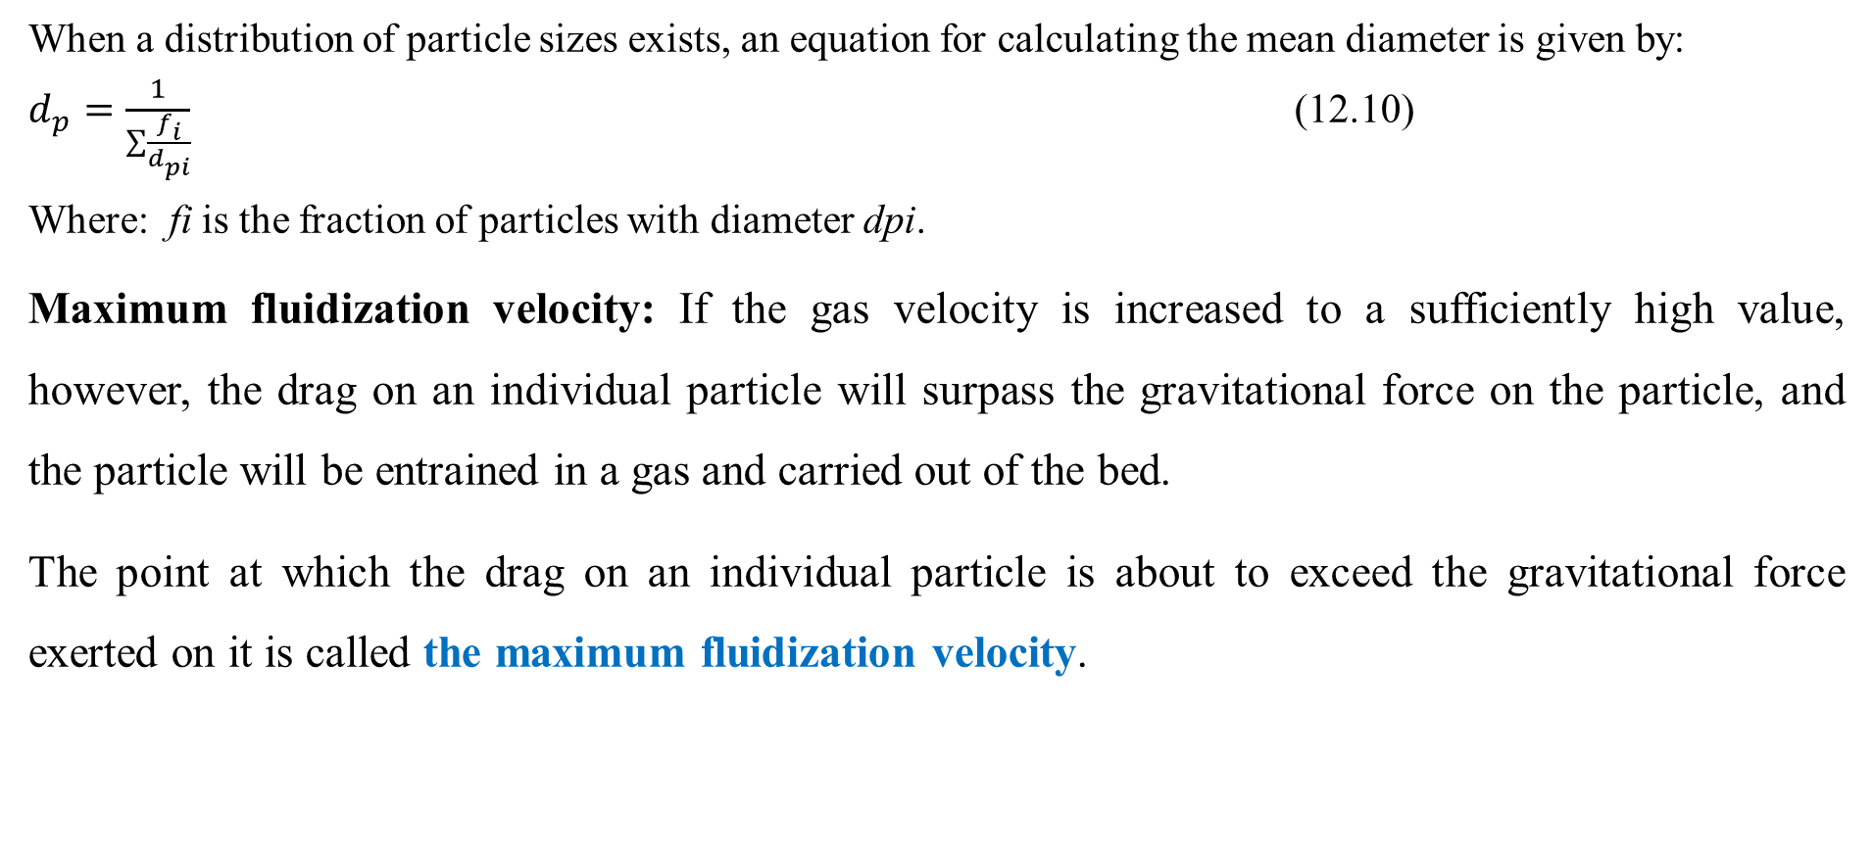
Cont’d
When a distribution of particle sizes exists, an equation for calculating the mean diameter is given by:
$d_{p}=\frac{1}{\sum{\frac{f_{i}}{d_{pi}}}}$ (12.10)
Where: fi is the fraction of particles with diameter dpi.
Maximum fluidization velocity: If the gas velocity is increased to a sufficiently high value, however, the drag on an individual particle will surpass the gravitational force on the particle, and the particle will be entrained in a gas and carried out of the bed.
The point at which the drag on an individual particle is about to exceed the gravitational force exerted on it is called the maximum fluidization velocity.

Slide 20
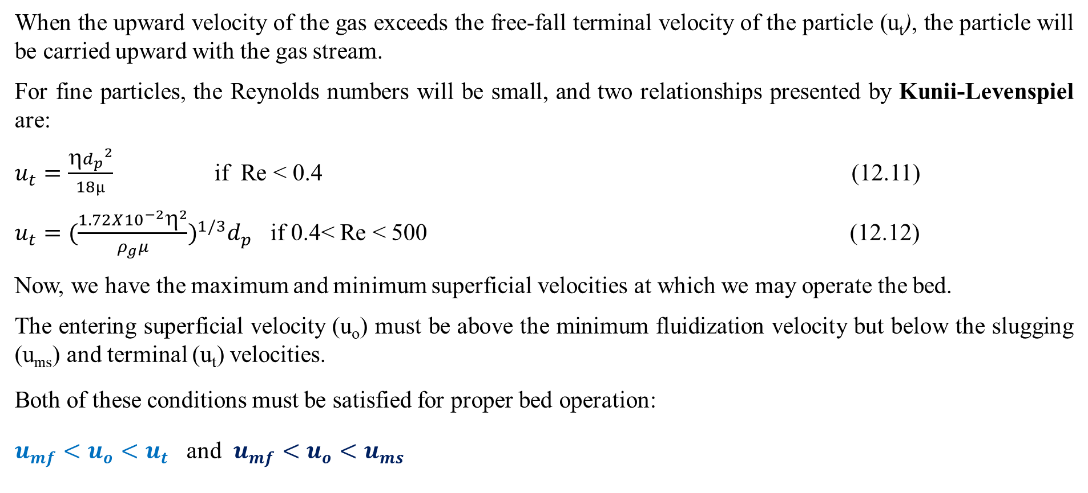
Cont’d
When the upward velocity of the gas exceeds the free-fall terminal velocity of the particle (u_{t}), the particle will be carried upward with the gas stream.
For fine particles, the Reynolds numbers will be small, and two relationships presented by Kunii-Levenspiel are:
$u_{t}=\frac{{{ηd}_{p}}^{2}}{18µ}$ if Re < 0.4 (12.11)
$u_{t}=(\frac{1.72X{10}^{−2}η^{2}}{ρ_{g}μ})^{1/3}d_{p}$ if 0.4< Re < 500 (12.12)
Now, we have the maximum and minimum superficial velocities at which we may operate the bed.
The entering superficial velocity (u_{o}) must be above the minimum fluidization velocity but below the slugging (u_{ms}) and terminal (u_{t}) velocities.
Both of these conditions must be satisfied for proper bed operation:
$u_{mf}<u_{o}<u_{t}$ and $u_{mf}<u_{o}<u_{ms}$

Slide 21
Cont’d
Descriptive Behavior of a Fluidized Bed: The Model of Kunii -Levenspiel
At gas flow rates above the point of minimum fluidization, a fluidized bed appears much like a vigorously boiling liquid; bubbles of gas rise rapidly and burst on the surface, and the emulsion phase is thoroughly agitated.
The bubbles form very near the bottom of the bed, very close to the distributor plate and as a result the
design of the distributor plate has a significant effect on fluidized-bed characteristics.

Slide 22
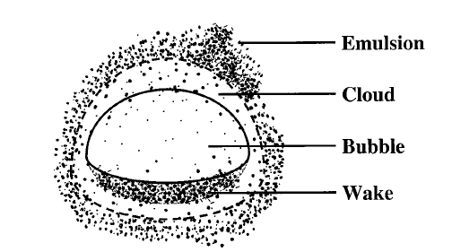
Cont’d
According Kunii-Levenspiel model for fluidization, fluidization characteristics phases are illustrated in Figure 12.3 (Fogler, 2015, pg. 753; Kunii-Levenspiel, 3rd Edition, CD ROM Shelf, pg. R12-9).
The gas within a particular bubble remains largely within that bubble, only penetrating a short distance into the surrounding emulsion phase. The region penetrated by gas from a rising bubble is called the cloud.
Figure 12.3. Schematic of bubble, cloud, emulsion and wake

Slide 23
Cont’d
The bubbles contain very small amounts of solids.
Each bubble of gas has a wake that contains a significant quantity of solids.
The assumptions in the Kunii-levenspiel Model are the followings:
The bubbles are all of one size,
The solids in the emulsion phase flow smoothly downward, essentially in plug flow,
The emulsion phase exists at minimum fluidizing conditions, and
In the wakes, the concentration of solids is equal to the concentration of solids in the emulsion phase, and therefore the gaseous void fraction in the wake is also the same as in the emulsion phase.

Slide 24
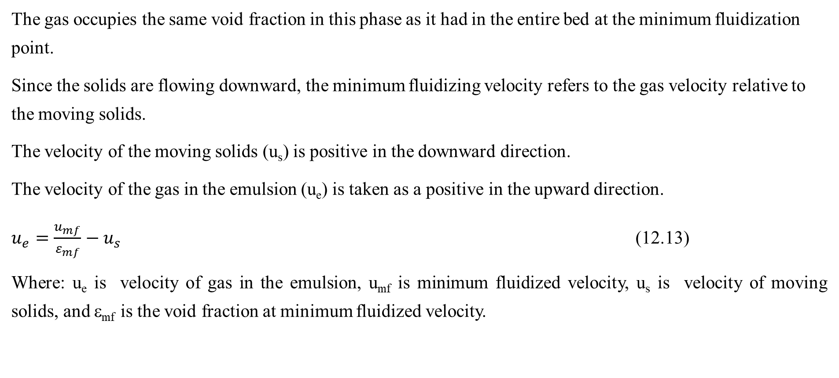
Cont’d
The gas occupies the same void fraction in this phase as it had in the entire bed at the minimum fluidization point.
Since the solids are flowing downward, the minimum fluidizing velocity refers to the gas velocity relative to the moving solids.
The velocity of the moving solids (u_{s}) is positive in the downward direction.
The velocity of the gas in the emulsion (u_{e}) is taken as a positive in the upward direction.
$u_{e}=\frac{u_{mf}}{ε_{mf}}−u_{s}$ (12.13)
Where: u_{e} is velocity of gas in the emulsion, u_{mf} is minimum fluidized velocity, u_{s} is velocity of moving solids, and ε_{mf} is the void fraction at minimum fluidized velocity.

Slide 25
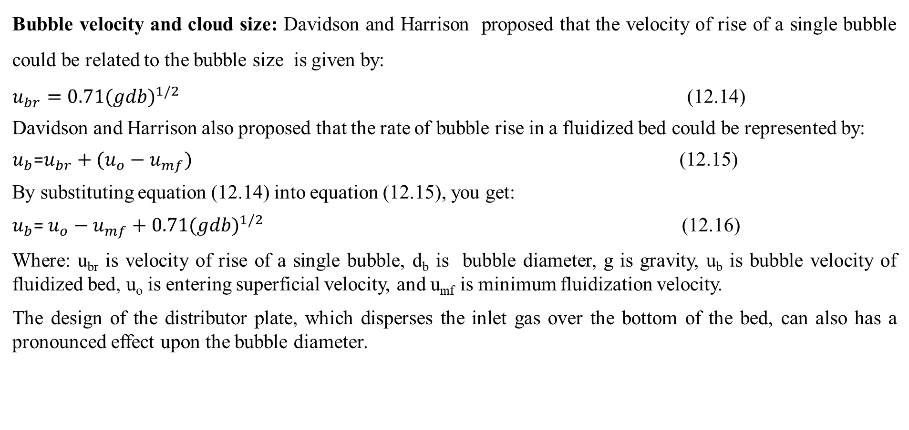
Cont’d
Bubble velocity and cloud size: Davidson and Harrison proposed that the velocity of rise of a single bubble could be related to the bubble size is given by:
$u_{br}=0.71{(gdb)}^{1/2}$ (12.14)
Davidson and Harrison also proposed that the rate of bubble rise in a fluidized bed could be represented by:
$u_{b}$=$u_{br}+(u_{o}−u_{mf})$ (12.15)
By substituting equation (12.14) into equation (12.15), you get:
$u_{b}$= $u_{o}−u_{mf}+0.71{(gdb)}^{1/2}$ (12.16)
Where: u_{br} is velocity of rise of a single bubble, d_{b} is bubble diameter, g is gravity, u_{b} is bubble velocity of fluidized bed, u_{o} is entering superficial velocity, and u_{mf} is minimum fluidization velocity.
The design of the distributor plate, which disperses the inlet gas over the bottom of the bed, can also has a pronounced effect upon the bubble diameter.

Slide 26
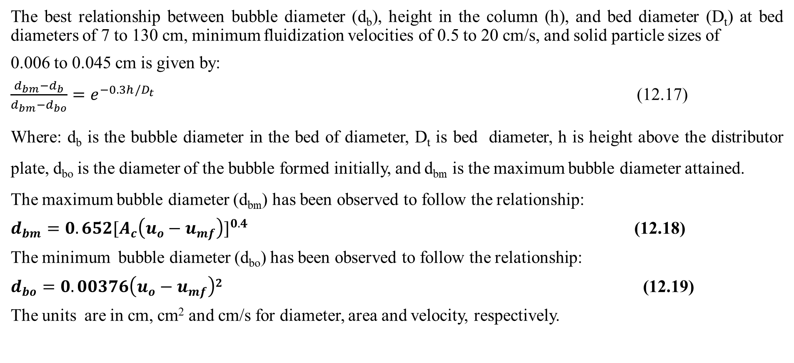
Cont’d
The best relationship between bubble diameter (d_{b}), height in the column (h), and bed diameter (D_{t}) at bed diameters of 7 to 130 cm, minimum fluidization velocities of 0.5 to 20 cm/s, and solid particle sizes of
0.006 to 0.045 cm is given by:
$\frac{d_{bm}−d_{b}}{d_{bm}−d_{bo}}=e^{−0.3h/D_{t}}$ (12.17)
Where: d_{b} is the bubble diameter in the bed of diameter, D_{t} is bed diameter, h is height above the distributor plate, d_{bo} is the diameter of the bubble formed initially, and d_{bm} is the maximum bubble diameter attained.
The maximum bubble diameter (d_{bm}) has been observed to follow the relationship:
$d_{bm}=0.652[A_{c}\left(u_{o}−u_{mf}\right)]^{0.4}$ (12.18)
The minimum bubble diameter (d_{bo}) has been observed to follow the relationship:
$d_{bo}=0.00376\left(u_{o}−u_{mf}\right)2$ (12.19)
The units are in cm, cm² and cm/s for diameter, area and velocity, respectively.

Slide 27
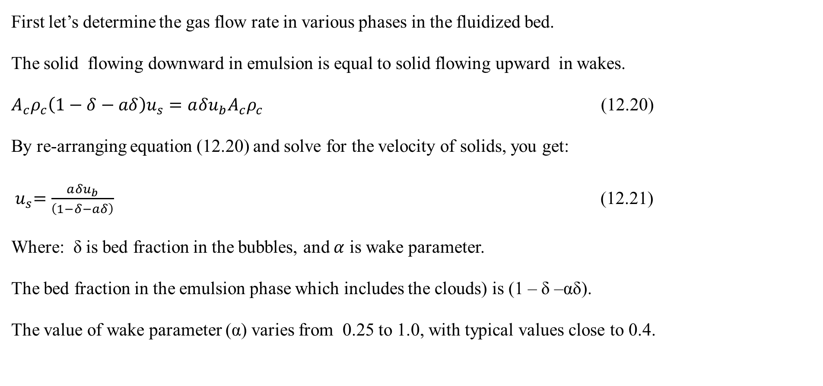
Cont’d
First let’s determine the gas flow rate in various phases in the fluidized bed.
The solid flowing downward in emulsion is equal to solid flowing upward in wakes.
$A_{c}ρ_{c}\left(1−δ−aδ\right)u_{s}={a{δu}_{b}A}_{c}ρ_{c}$ (12.20)
By re-arranging equation (12.20) and solve for the velocity of solids, you get:
${ u}_{s}=\frac{a{δu}_{b}}{\left(1−δ−aδ\right)}$ (12.21)
Where: δ is bed fraction in the bubbles, and $α$ is wake parameter.
The bed fraction in the emulsion phase which includes the clouds) is (1 – δ –αδ).
The value of wake parameter (α) varies from 0.25 to 1.0, with typical values close to 0.4.

Slide 28
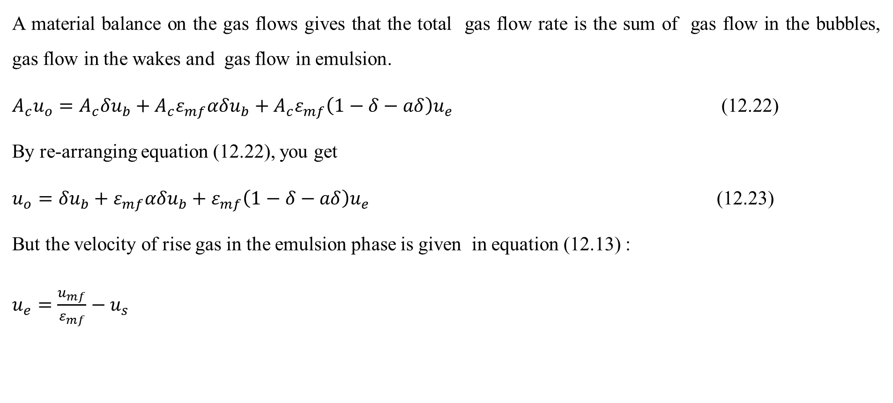
Cont’d
A material balance on the gas flows gives that the total gas flow rate is the sum of gas flow in the bubbles, gas flow in the wakes and gas flow in emulsion.
$A_{c}u_{o}=A_{c}{δu}_{b}+A_{c}ε_{mf}{αδu}_{b}+A_{c}ε_{mf}\left(1−δ−aδ\right)u_{e}$ (12.22)
By re-arranging equation (12.22), you get
$u_{o}={δu}_{b}+ε_{mf}{αδu}_{b}+ε_{mf}\left(1−δ−aδ\right)u_{e}$ (12.23)
But the velocity of rise gas in the emulsion phase is given in equation (12.13) :
$u_{e}=\frac{u_{mf}}{ε_{mf}}−u_{s}$

Slide 29
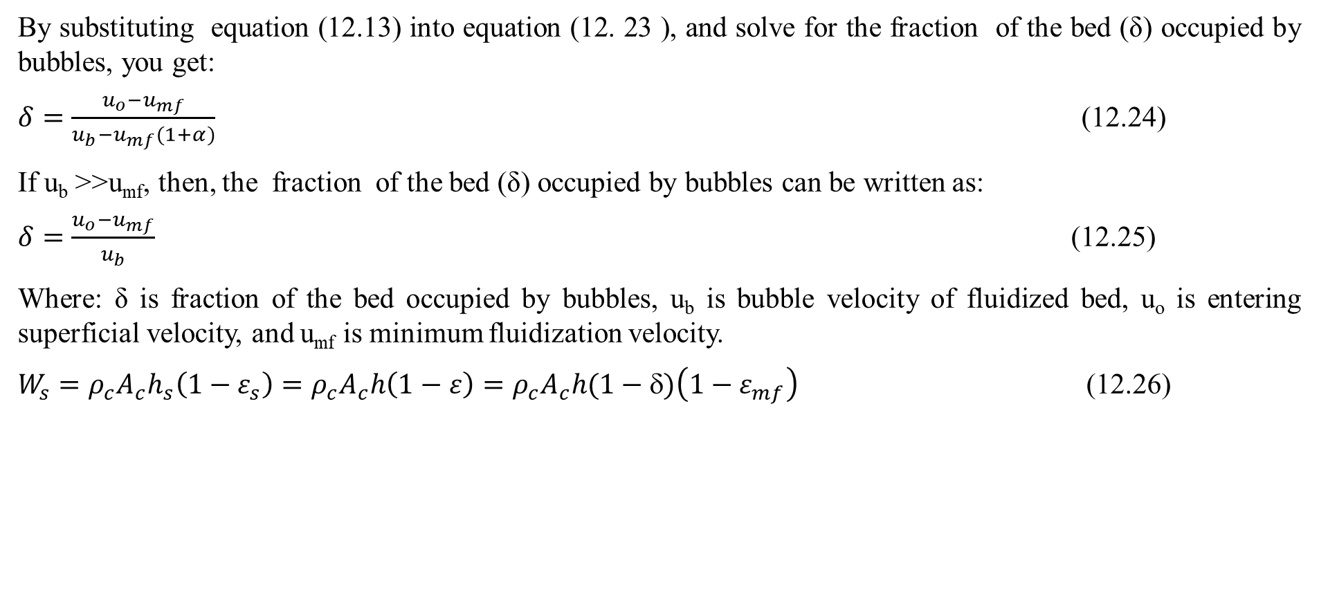
Cont’d
By substituting equation (12.13) into equation (12. 23 ), and solve for the fraction of the bed (δ) occupied by bubbles, you get:
$δ=\frac{u_{o}−u_{mf}}{u_{b}−u_{mf}(1+α)}$ (12.24)
If u_{b} >>u_{mf}, then, the fraction of the bed (δ) occupied by bubbles can be written as:
$δ=\frac{u_{o}−u_{mf}}{u_{b}}$ (12.25)
Where: δ is fraction of the bed occupied by bubbles, u_{b} is bubble velocity of fluidized bed, u_{o} is entering superficial velocity, and u_{mf} is minimum fluidization velocity.
$W_{s}=ρ_{c}A_{c}h_{s}\left(1−ε_{s}\right)=ρ_{c}A_{c}h\left(1−ε\right)=ρ_{c}A_{c}h(1−δ)\left(1−ε_{mf}\right)$ (12.26)

Slide 30
Activity 12.1
A pilot fluidized bed is to be used to test a chemical reaction. The bed diameter is 91.4 cm. You wish to process 28.3 × 10³ cm³ of gaseous material. The average particle diameter is 100 μm. The reactor height is 10 feet. Allowing for a disengaging height of 7 feet, this means we have a maximum bed height of 91.4 cm. The distributor plate is a porous disc. Additional data is given below. Determine the maximum weight of solids catalyst in the bed.
Ψ= 0.7; ρ_{g} = 1.07 × 10^{–3} g/cm³; ρ_{c}= 1.3 g/cm³; μ = 1.5 × 10^{–4} g/cm.s
Given: D = 91.4 cm; h = 91.4cm; dp =100 µm ; υ= 28.3 × 10³ cm³
Required:
W_{s}= ?

Slide 31
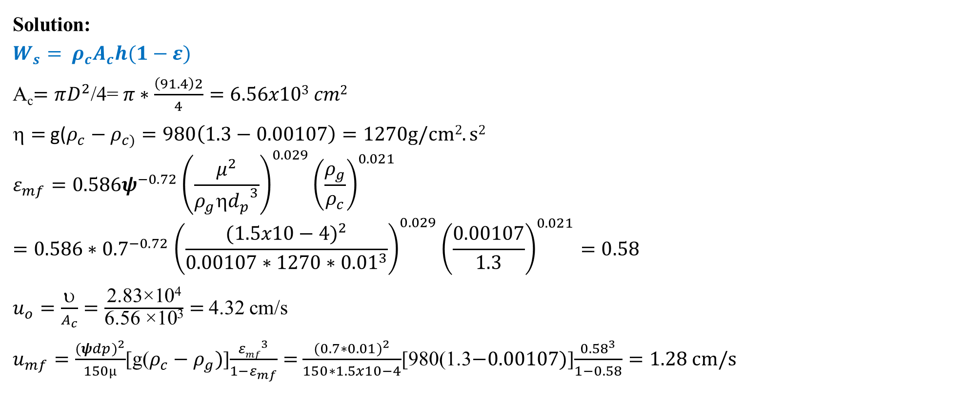
Cont’d
Solution:
$$W_{s}= ρ_{c}A_{c}h(1−ε)$$
A_{c}$=πD^{2}$/4= $π∗\frac{\left(91.4\right)2}{4}=6.56x103 cm2$
$=$ g($ρ_{c}−ρ_{c)}=980\left(1.3−0.00107\right)=1270g/cm2.s2$
$$ε_{mf}=0.586ψ^{−0.72}{\left(\frac{μ^{2}}{ρ_{g}{{ηd}_{p}}^{3}}\right)}^{0.029}{\left(\frac{ρ_{g}}{ρ_{c}}\right)}^{0.021}=0.586{∗0.7}^{−0.72}{\left(\frac{{(1.5x10−4)}^{2}}{0.00107∗1270{∗0.01}^{3}}\right)}^{0.029}{\left(\frac{0.00107}{1.3}\right)}^{0.021}=0.58$$
$u_{o}=\frac{}{A_{c}}=\frac{\text{2.83×10}\text{4}}{\text{6.56 ×10}\text{3}}=$4.32 cm/s
$u_{mf}=\frac{{(ψdp)}^{2}}{150µ}$[g($ρ_{c}−ρ_{g})$]$\frac{{εmf}^{3}}{1−ε_{mf}}=$ $\frac{{(0.7∗0.01)}^{2}}{150∗1.5x10−4}$[980(1.3$−0.00107)$]$\frac{{0.58}^{3}}{1−0.58}=1.28 cm/s$

Slide 32
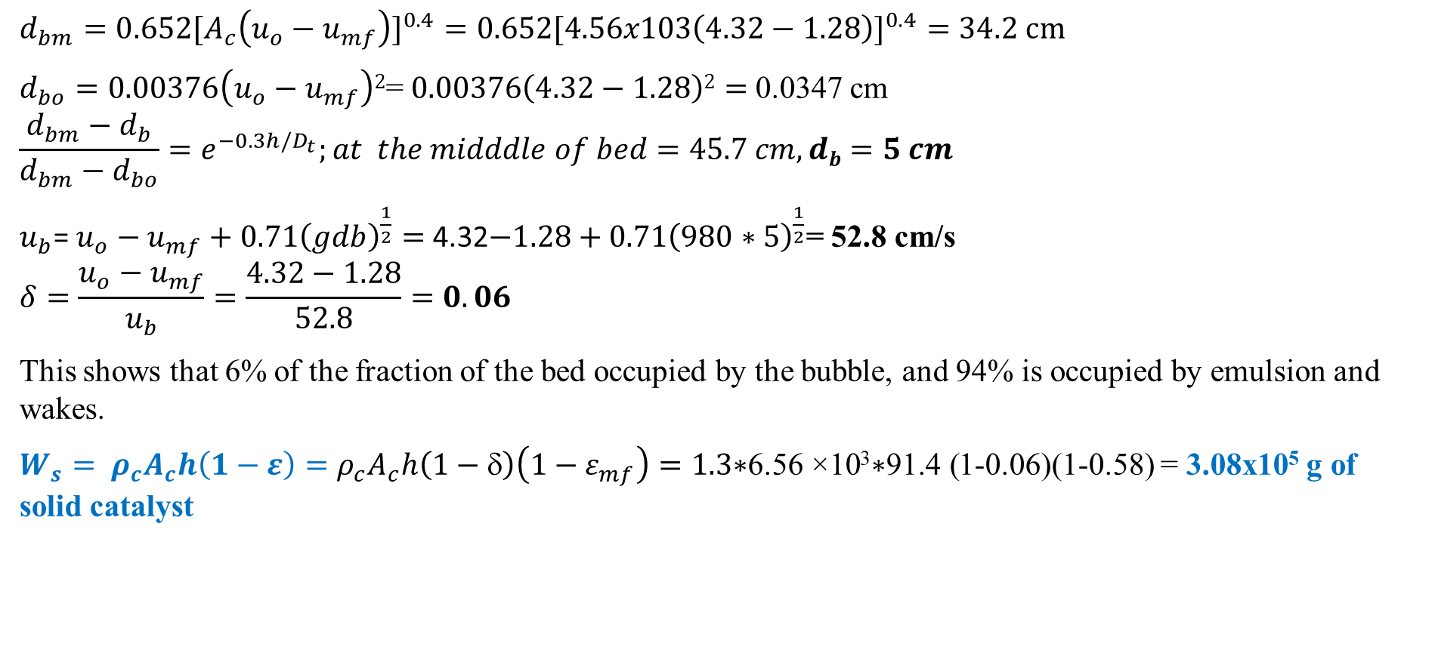
Cont’d
$d_{bm}=0.652[A_{c}\left(u_{o}−u_{mf}\right)]^{0.4}=0.652[4.56x103\left(4.32−1.28\right)]^{0.4}=34.2 cm$
$d_{bo}=0.00376\left(u_{o}−u_{mf}\right)2$= $0.00376\left(4.32−1.28\right)2=$0.0347 cm
$$\frac{d_{bm}−d_{b}}{d_{bm}−d_{bo}}=e^{−0.3h/D_{t}};at the midddle of bed=45.7 cm, db=5 cm$$
$u_{b}$= $u_{o}−u_{mf}+0.71{\left(gdb\right)}^{\frac{1}{2}}=$ 4.32$−1.28+0.71{\left(980∗5\right)}^{\frac{1}{2}}$= 52.8 cm/s
$$δ=\frac{u_{o}−u_{mf}}{u_{b}}=\frac{4.32−1.28}{52.8}=0.06$$
This shows that 6% of the fraction of the bed occupied by the bubble, and 94% is occupied by emulsion and wakes.
$W_{s}= ρ_{c}A_{c}h\left(1−ε\right)=ρ_{c}A_{c}h\left(1−\right)\left(1−ε_{mf}\right)=1.3\text{∗}\text{6.56 ×10}\text{3}\text{∗91.4 (}$1-0.06)(1-0.58) = 3.08x10⁵ g of solid catalyst

Slide 33
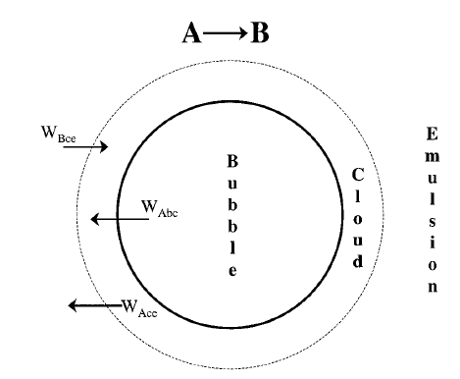
Cont’d
12.3.2. Mass transfer between the fluidized bed phases
The mass transfer between bubble, cloud, and emulsion is depicted in Figure 12. 4 (Kunii-Levenspiel, 3rd Edition, CD ROM Shelf, pg. R12-17).
Figure 12. 4. Mass transfer between bubble, cloud, and emulsion

Slide 34
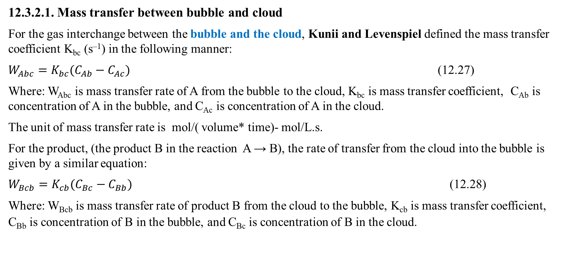
Cont’d
12.3.2.1. Mass transfer between bubble and cloud
For the gas interchange between the bubble and the cloud, Kunii and Levenspiel defined the mass transfer coefficient K_{bc} (s^{–1}) in the following manner:
$W_{Abc}=K_{bc}(C_{Ab}−C_{Ac})$ (12.27)
Where: W_{Abc} is mass transfer rate of A from the bubble to the cloud, K_{bc} is mass transfer coefficient, C_{Ab} is concentration of A in the bubble, and C_{Ac} is concentration of A in the cloud.
The unit of mass transfer rate is mol/( volume* time)- mol/L.s.
For the product, (the product B in the reaction A → B), the rate of transfer from the cloud into the bubble is given by a similar equation:
$W_{Bcb}=K_{cb}(C_{Bc}−C_{Bb})$ (12.28)
Where: W_{Bcb} is mass transfer rate of product B from the cloud to the bubble, K_{cb} is mass transfer coefficient, C_{Bb} is concentration of B in the bubble, and C_{Bc} is concentration of B in the cloud.

Slide 35
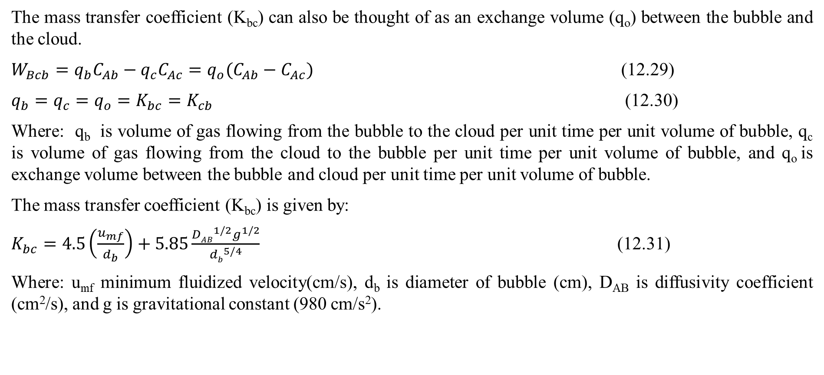
Cont’d
The mass transfer coefficient (K_{bc}) can also be thought of as an exchange volume (q_{o}) between the bubble and the cloud.
$W_{Bcb}=q_{b}C_{Ab}−q_{c}C_{Ac}=q_{o}(C_{Ab}−C_{Ac})$ (12.29)
$q_{b}=q_{c}=q_{o}=K_{bc}=K_{cb}$ (12.30)
Where: q_{b} is volume of gas flowing from the bubble to the cloud per unit time per unit volume of bubble, q_{c} is volume of gas flowing from the cloud to the bubble per unit time per unit volume of bubble, and q_{o} is exchange volume between the bubble and cloud per unit time per unit volume of bubble.
The mass transfer coefficient (K_{bc}) is given by:
$K_{bc}=4.5\left(\frac{u_{mf}}{d_{b}}\right)+5.85\frac{{DAB}^{1/2}g^{1/2}}{{db}^{5/4}}$ (12.31)
Where: u_{mf} minimum fluidized velocity(cm/s), d_{b} is diameter of bubble (cm), D_{AB} is diffusivity coefficient (cm²/s), and g is gravitational constant (980 cm/s²).

Slide 36
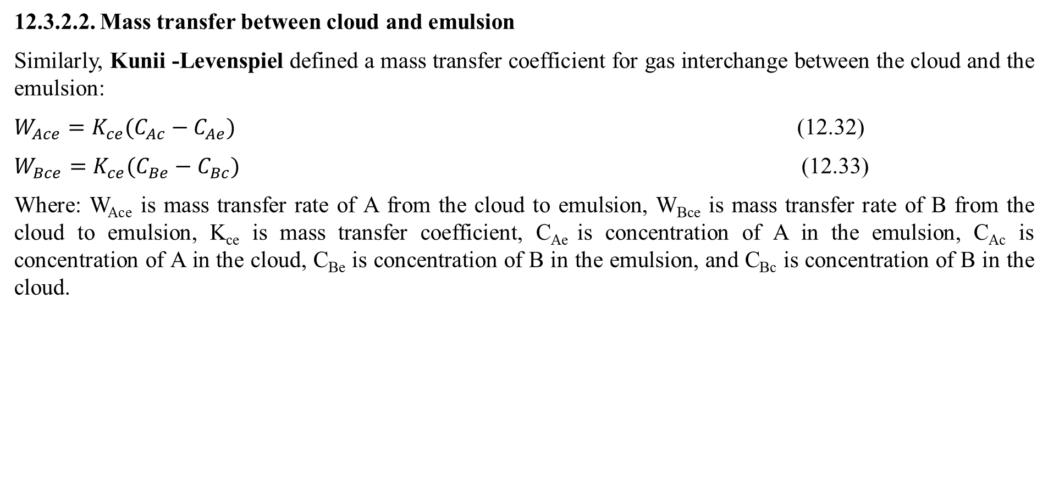
Cont’d
12.3.2.2. Mass transfer between cloud and emulsion
Similarly, Kunii -Levenspiel defined a mass transfer coefficient for gas interchange between the cloud and the emulsion:
$W_{Ace}=K_{ce}(C_{Ac}−C_{Ae})$ (12.32)
$W_{Bce}=K_{ce}(C_{Be}−C_{Bc})$ (12.33)
Where: W_{Ace} is mass transfer rate of A from the cloud to emulsion, W_{Bce} is mass transfer rate of B from the cloud to emulsion, K_{ce} is mass transfer coefficient, C_{Ae} is concentration of A in the emulsion, C_{Ac} is concentration of A in the cloud, C_{Be} is concentration of B in the emulsion, and C_{Bc} is concentration of B in the cloud.

Slide 37
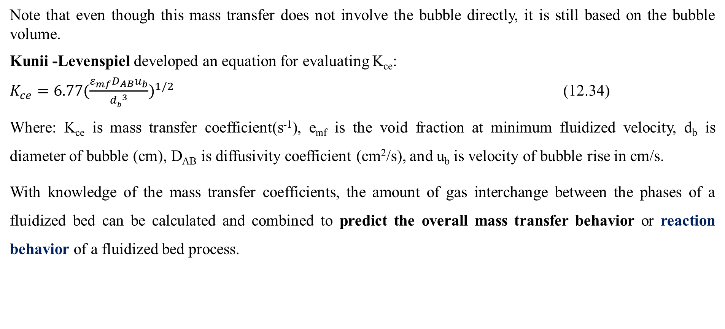
Cont’d
Note that even though this mass transfer does not involve the bubble directly, it is still based on the bubble volume.
Kunii -Levenspiel developed an equation for evaluating K_{ce}:
$K_{ce}=6.77(\frac{ε_{mf}D_{AB}u_{b}}{{db}^{3}})^{1/2}$ (12.34)
Where: K_{ce} is mass transfer coefficient(s⁻¹), e_{mf} is the void fraction at minimum fluidized velocity, d_{b} is diameter of bubble (cm), D_{AB} is diffusivity coefficient (cm²/s), and u_{b} is velocity of bubble rise in cm/s.
With knowledge of the mass transfer coefficients, the amount of gas interchange between the phases of a fluidized bed can be calculated and combined to predict the overall mass transfer behavior or reaction behavior of a fluidized bed process.

Slide 38
Cont’d
12.3.3. Reaction behavior in a fluidized bed
To use the Kunii-Levenspiel model to predict reaction rates in a fluidized bed reactor, the reaction rate law for the heterogeneous reaction per gram of solid must be known.
Then the reaction rate in the bubble phase, the cloud, and the emulsion phase, all per unit of bubble volume, can be calculated.
Assuming that these reaction rates are known, the overall reaction rate can be evaluated using the mass transfer relationships presented in the previous section.

Slide 39
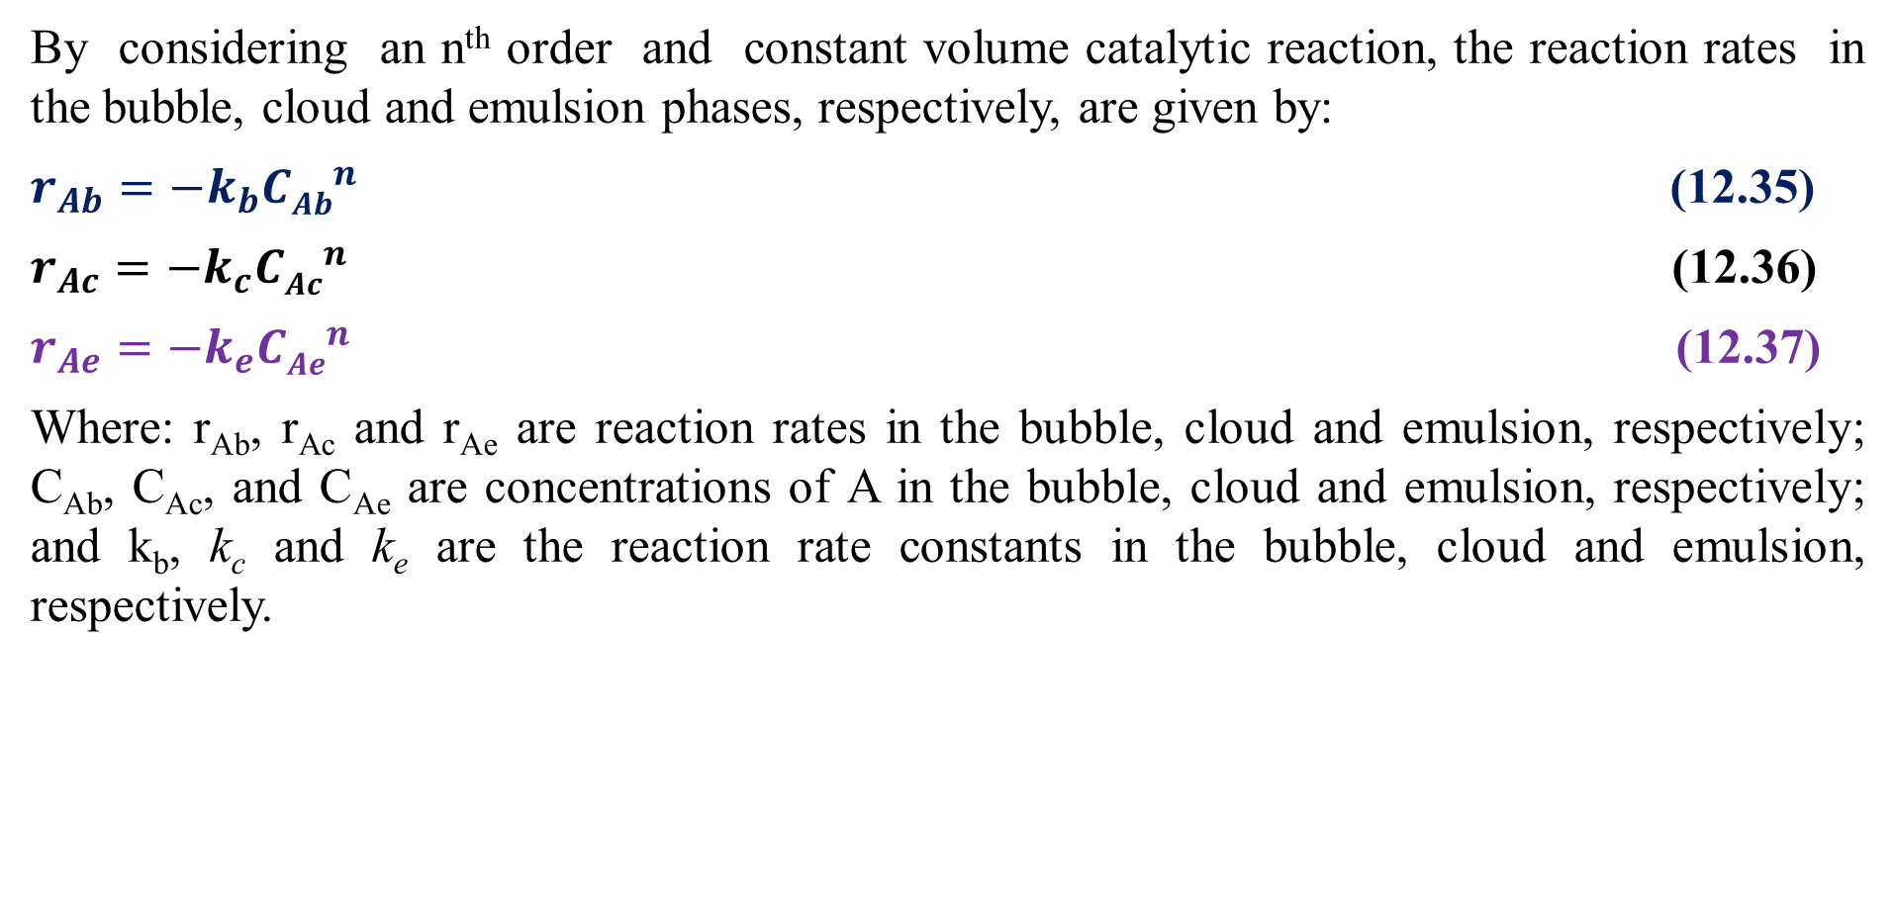
Cont’d
By considering an n^{th} order and constant volume catalytic reaction, the reaction rates in the bubble, cloud and emulsion phases, respectively, are given by:
$r_{Ab}={−k}_{b}{CAb}^{n}$ (12.35)
$r_{Ac}={−k}_{c}{CAc}^{n}$ (12.36)
$r_{Ae}={−k}_{e}{CAe}^{n}$ (12.37)
Where: r_{Ab}, r_{Ac} and r_{Ae} are reaction rates in the bubble, cloud and emulsion, respectively; C_{Ab}, C_{Ac}, and C_{Ae} are concentrations of A in the bubble, cloud and emulsion, respectively; and k_{b}, k_{c} and k_{e} are the reaction rate constants in the bubble, cloud and emulsion, respectively.

Slide 40
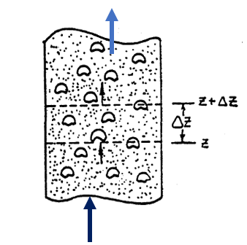
Cont’d
12.3.4. Materials balance on the bubble, the cloud, and the emulsion
Material balances will be written over an incremental height (Δz) for reactant A in each of the three phases (bubble, cloud, and emulsion) as shown in Figure 12.5 (Kunii-Levenspiel, 3rd Edition, CD ROM Shelf, pg. R12-20).
Figure 12.5. Section of a bubbling fluidized bed

Slide 41
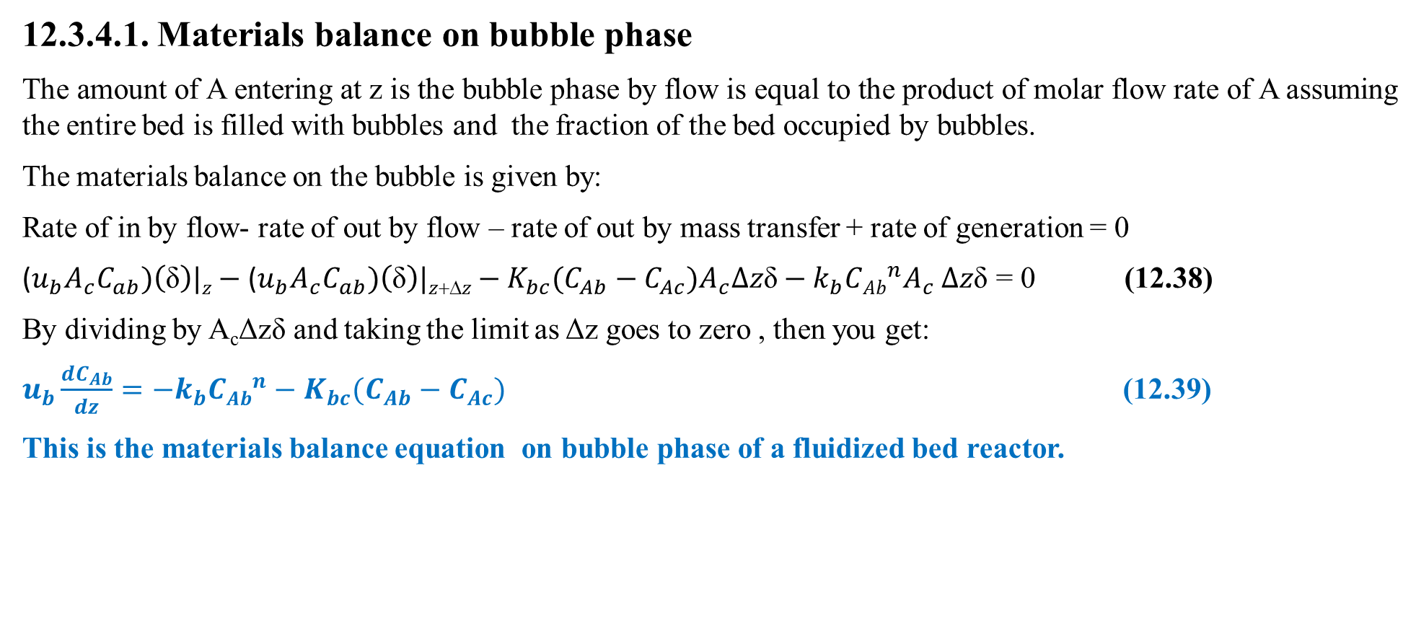
Cont’d
12.3.4.1. Materials balance on bubble phase
The amount of A entering at z is the bubble phase by flow is equal to the product of molar flow rate of A assuming the entire bed is filled with bubbles and the fraction of the bed occupied by bubbles.
The materials balance on the bubble is given by:
Rate of in by flow- rate of out by flow – rate of out by mass transfer + rate of generation = 0
($u_{b}A_{c}C_{ab})\left(\text{δ}\right)|z−$ ($u_{b}A_{c}C_{ab})\left(\text{δ}\right)|z+Δz−K_{bc}{(C_{Ab}−C_{Ac})A}_{c}∆z\text{δ}−k_{b}{CAb}^{n}A_{c}$ $∆z\text{δ}\text{ = 0}$ (12.38)
By dividing by A_{c}Δzδ and taking the limit as Δz goes to zero , then you get:
$u_{b}\frac{dC_{Ab}}{dz}={−k}_{b}{CAb}^{n}−K_{bc}(C_{Ab}−C_{Ac})$ (12.39)
This is the materials balance equation on bubble phase of a fluidized bed reactor.

Slide 42
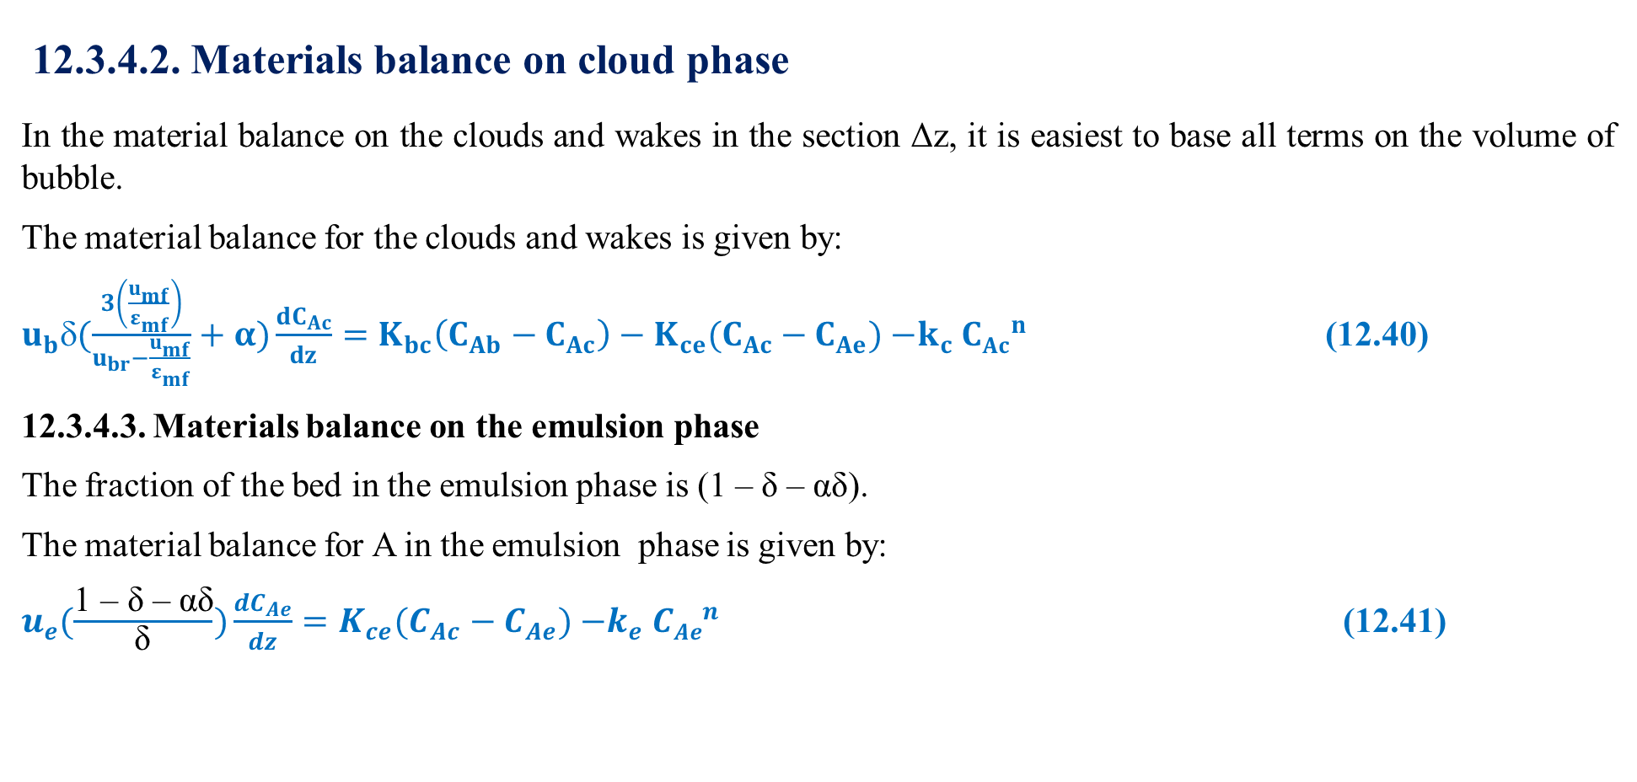
Cont’d
12.3.4.2. Materials balance on cloud phase
In the material balance on the clouds and wakes in the section Δz, it is easiest to base all terms on the volume of bubble.
The material balance for the clouds and wakes is given by:
$u_{b}δ(\frac{3\left(\frac{u_{mf}}{ε_{mf}}\right)}{u_{br}−\frac{u_{mf}}{ε_{mf}}}+α)\frac{dC_{Ac}}{dz}=K_{bc}\left(C_{Ab}−C_{Ac}\right)−K_{ce}(C_{Ac}−C_{Ae}){−k}_{c}{CAc}^{n}$ (12.40)
12.3.4.3. Materials balance on the emulsion phase
The fraction of the bed in the emulsion phase is (1 – δ – αδ).
The material balance for A in the emulsion phase is given by:
$u_{e}(\frac{\text{1 – }\text{δ}\text{ – }\text{αδ}}{\text{δ}})\frac{dC_{Ae}}{dz}=K_{ce}(C_{Ac}−C_{Ae}){−k}_{e}{CAe}^{n}$ (12.41)

Slide 43
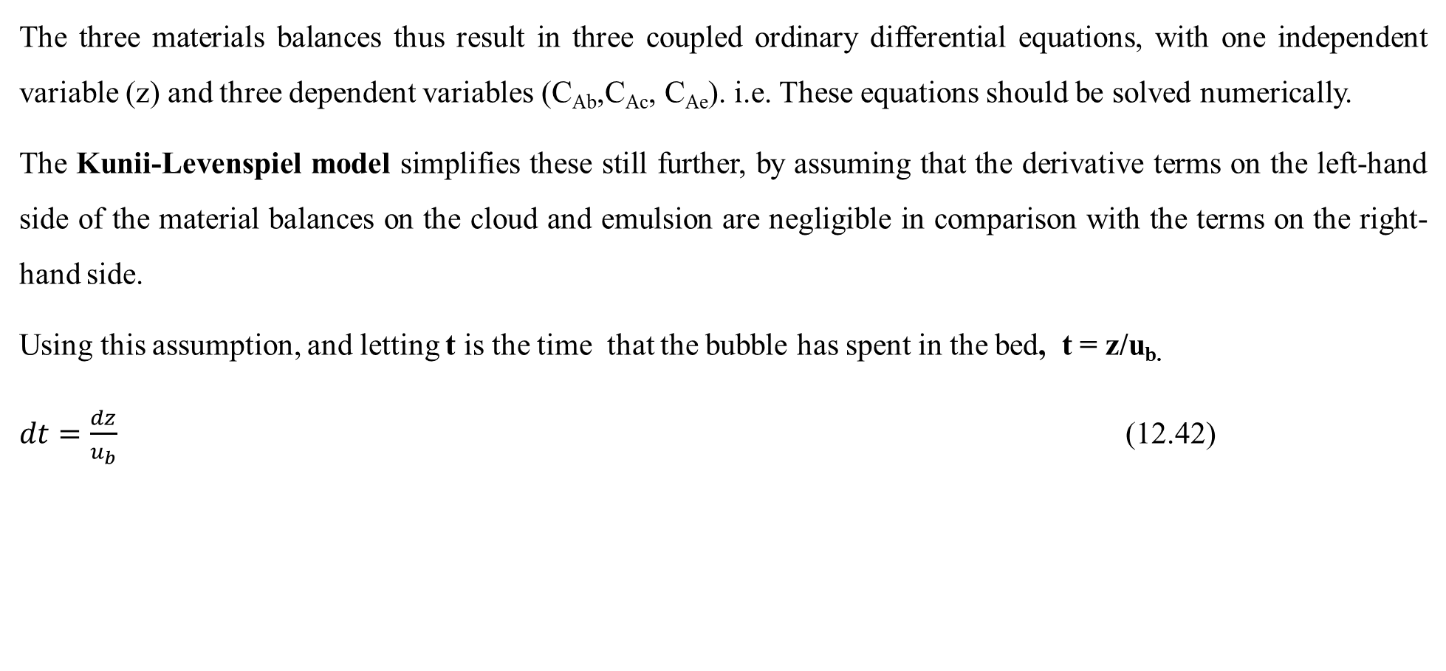
Cont’d
The three materials balances thus result in three coupled ordinary differential equations, with one independent variable (z) and three dependent variables (C_{Ab},C_{Ac}, C_{Ae}). i.e. These equations should be solved numerically.
The Kunii-Levenspiel model simplifies these still further, by assuming that the derivative terms on the left-hand side of the material balances on the cloud and emulsion are negligible in comparison with the terms on the right-hand side.
Using this assumption, and letting t is the time that the bubble has spent in the bed, t = z/u_{b.}
$dt=\frac{dz}{u_{b}}$ (12.42)

Slide 44
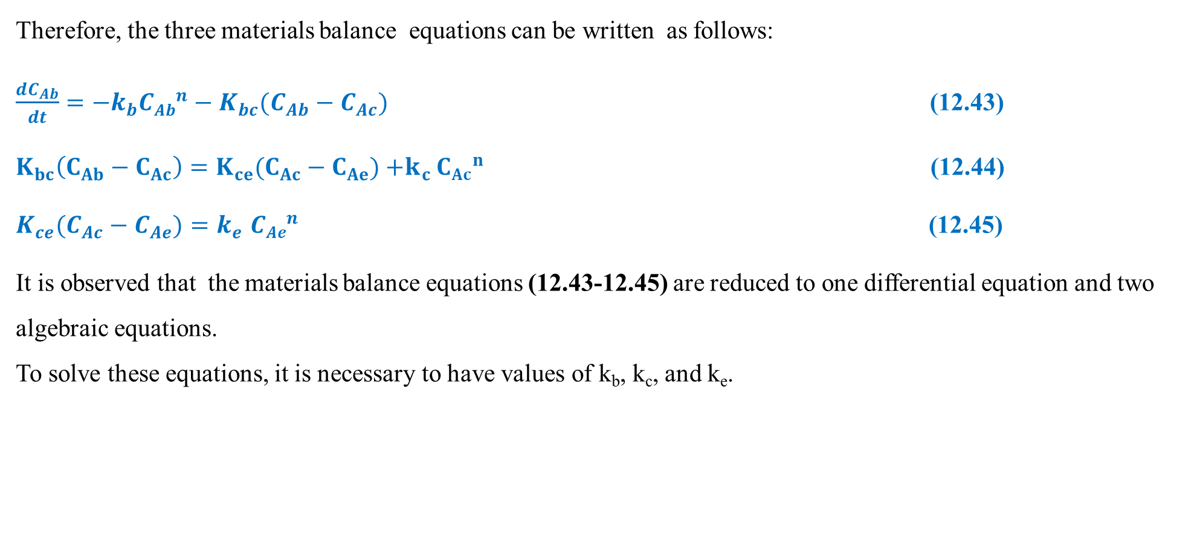
Cont’d
Therefore, the three materials balance equations can be written as follows:
$\frac{dC_{Ab}}{dt}={−k}_{b}{CAb}^{n}−K_{bc}(C_{Ab}−C_{Ac})$ (12.43)
$K_{bc}\left(C_{Ab}−C_{Ac}\right)=K_{ce}(C_{Ac}−C_{Ae}){+k}_{c}{CAc}^{n}$ (12.44)
$K_{ce}(C_{Ac}−C_{Ae}){=k}_{e}{CAe}^{n}$ (12.45)
It is observed that the materials balance equations (12.43-12.45) are reduced to one differential equation and two algebraic equations.
To solve these equations, it is necessary to have values of k_{b}, k_{c}, and k_{e}.

Slide 45
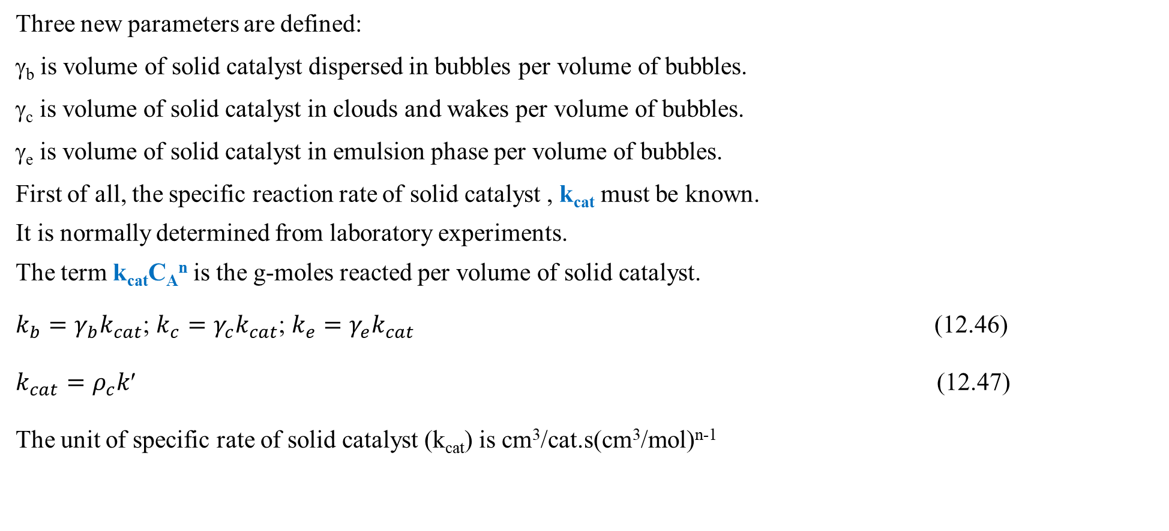
Cont’d
Three new parameters are defined:
γ_{b} is volume of solid catalyst dispersed in bubbles per volume of bubbles.
γ_{c} is volume of solid catalyst in clouds and wakes per volume of bubbles.
γ_{e} is volume of solid catalyst in emulsion phase per volume of bubbles.
First of all, the specific reaction rate of solid catalyst , k_{cat} must be known.
It is normally determined from laboratory experiments.
The term k_{cat}C_{A}^{n} is the g-moles reacted per volume of solid catalyst.
$k_{b}=γ_{b}k_{cat}$; $k_{c}=γ_{c}k_{cat}$; $k_{e}=γ_{e}k_{cat}$ (12.46)
$k_{cat}=ρ_{c}k$ (12.47)
The unit of specific rate of solid catalyst (k_{cat}) is cm³/cat.s(cm³/mol)^{n-1}

Slide 46
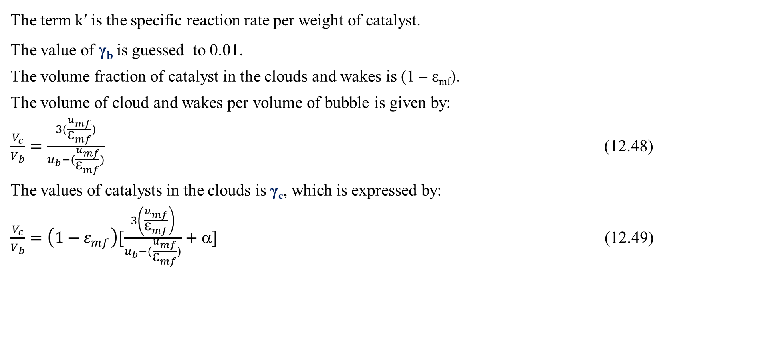
Cont’d
The term k′ is the specific reaction rate per weight of catalyst.
The value of γ_{b} is guessed to 0.01.
The volume fraction of catalyst in the clouds and wakes is (1 – ε_{mf}).
The volume of cloud and wakes per volume of bubble is given by:
$\frac{V_{c}}{V_{b}}=\frac{3(\frac{u_{mf}}{ε_{mf}})}{u_{b}−(\frac{u_{mf}}{ε_{mf}})}$ (12.48)
The values of catalysts in the clouds is γ_{c}, which is expressed by:
$\frac{V_{c}}{V_{b}}=\left(1−ε_{mf}\right)[\frac{3\left(\frac{u_{mf}}{ε_{mf}}\right)}{u_{b}−(\frac{u_{mf}}{ε_{mf}})}+α]$ (12.49)

Slide 47
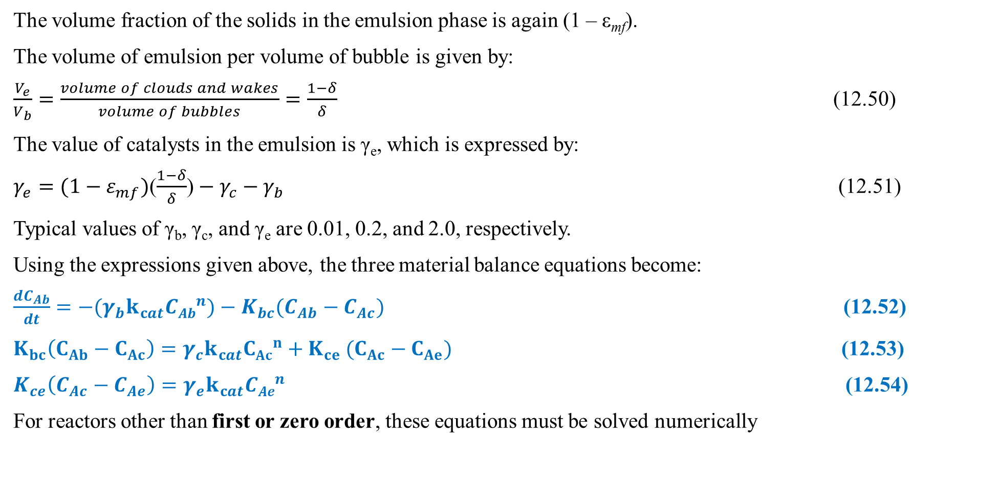
Cont’d
The volume fraction of the solids in the emulsion phase is again (1 – ε_{mf}).
The volume of emulsion per volume of bubble is given by:
$\frac{V_{e}}{V_{b}}=\frac{volume of clouds and wakes}{volume of bubbles}=\frac{1−δ}{δ}$ (12.50)
The value of catalysts in the emulsion is γ_{e}, which is expressed by:
$γ_{e}=(1−ε_{mf})$($\frac{1−δ}{δ}$) $− γ_{c}−γ_{b}$ (12.51)
Typical values of γ_{b}, γ_{c}, and γ_{e} are 0.01, 0.2, and 2.0, respectively.
Using the expressions given above, the three material balance equations become:
$\frac{dC_{Ab}}{dt}={−(γ}_{b}k_{cat}{CAb}^{n})−K_{bc}(C_{Ab}−C_{Ac})$ (12.52)
$K_{bc}\left(C_{Ab}−C_{Ac}\right)=γ_{c}k_{cat}{CAc}^{n}{+ K}_{ce}(C_{Ac}−C_{Ae})$ (12.53)
$K_{ce}\left(C_{Ac}−C_{Ae}\right)=γ_{e}k_{cat}{CAe}^{n}$ (12.54)
For reactors other than first or zero order, these equations must be solved numerically

Slide 48
Cont’d
12.3.5. Solution to the materials balance equations for a first order reaction
If the reaction is first order, then the C_{Ac} and C_{Ae} can be eliminated using the two algebraic equations, and the differential equation can be solved analytically for C_{Ab} as a function of t.
For first-order reaction, we can combine the three balance equations into one differential equation, to determine the conversion achieved in a fluidized bed reactor.
In addition, it allows to determine which operating parameters are most influential in dictating bed performance.
To arrive at our fluidized bed design equation for a first order reaction, we simply express both the concentration of A in the emulsion (C_{Ae}), and in the cloud (C_{Ac}), in terms of the bubble concentration (C_{Ab}).

Slide 49
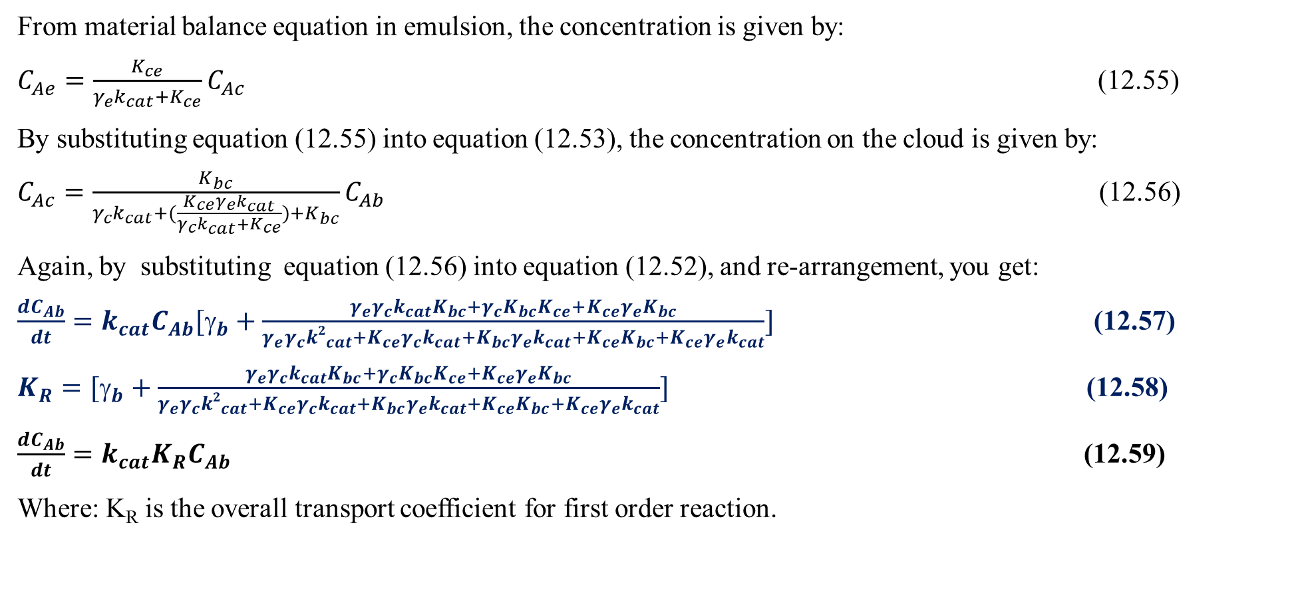
Cont’d
From material balance equation in emulsion, the concentration is given by:
$C_{Ae}=\frac{K_{ce}}{γ_{e}k_{cat}+K_{ce}}C_{Ac}$ (12.55)
By substituting equation (12.55) into equation (12.53), the concentration on the cloud is given by:
$C_{Ac}=\frac{K_{bc}}{γ_{c}k_{cat}+(\frac{K_{ce}γ_{e}k_{cat}}{γ_{c}k_{cat}+K_{ce}})+K_{bc}}C_{Ab}$ (12.56)
Again, by substituting equation (12.56) into equation (12.52), and re-arrangement, you get:
$\frac{dC_{Ab}}{dt}=k_{cat}C_{Ab}[γ_{b}+\frac{γ_{e}γ_{c}k_{cat}K_{bc}+γ_{c}K_{bc}K_{ce}+K_{ce}γ_{e}K_{bc}}{γ_{e}γ_{c}{k2}_{cat}+K_{ce}γ_{c}k_{cat}+K_{bc}γ_{e}k_{cat}+K_{ce}K_{bc}+K_{ce}γ_{e}k_{cat}}]$ (12.57)
$K_{R}=[γ_{b}+\frac{γ_{e}γ_{c}k_{cat}K_{bc}+γ_{c}K_{bc}K_{ce}+K_{ce}γ_{e}K_{bc}}{γ_{e}γ_{c}{k2}_{cat}+K_{ce}γ_{c}k_{cat}+K_{bc}γ_{e}k_{cat}+K_{ce}K_{bc}+K_{ce}γ_{e}k_{cat}}]$ (12.58)
$\frac{dC_{Ab}}{dt}=k_{cat}{K_{R}C}_{Ab}$ (12.59)
Where: K_{R} is the overall transport coefficient for first order reaction.

Slide 50
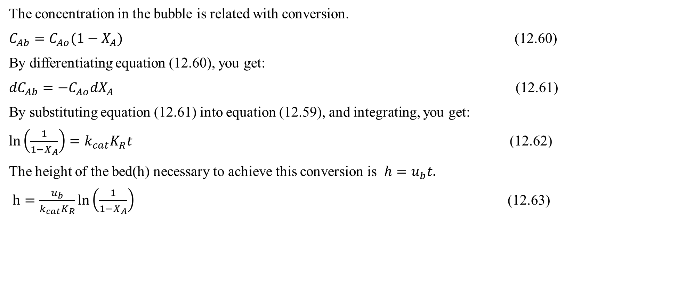
Cont’d
The concentration in the bubble is related with conversion.
$C_{Ab}=C_{Ao}(1−X_{A})$ (12.60)
By differentiating equation (12.60), you get:
${dC}_{Ab}={−C}_{Ao}{dX}_{A}$ (12.61)
By substituting equation (12.61) into equation (12.59), and integrating, you get:
$\ln\left(\frac{1}{1−X_{A}}\right)=k_{cat}K_{R}t$ (12.62)
The height of the bed(h) necessary to achieve this conversion is $h=u_{b}t.$
$h=\frac{u_{b}}{k_{cat}K_{R}}ln\left(\frac{1}{1−X_{A}}\right)$ (12.63)

Slide 51
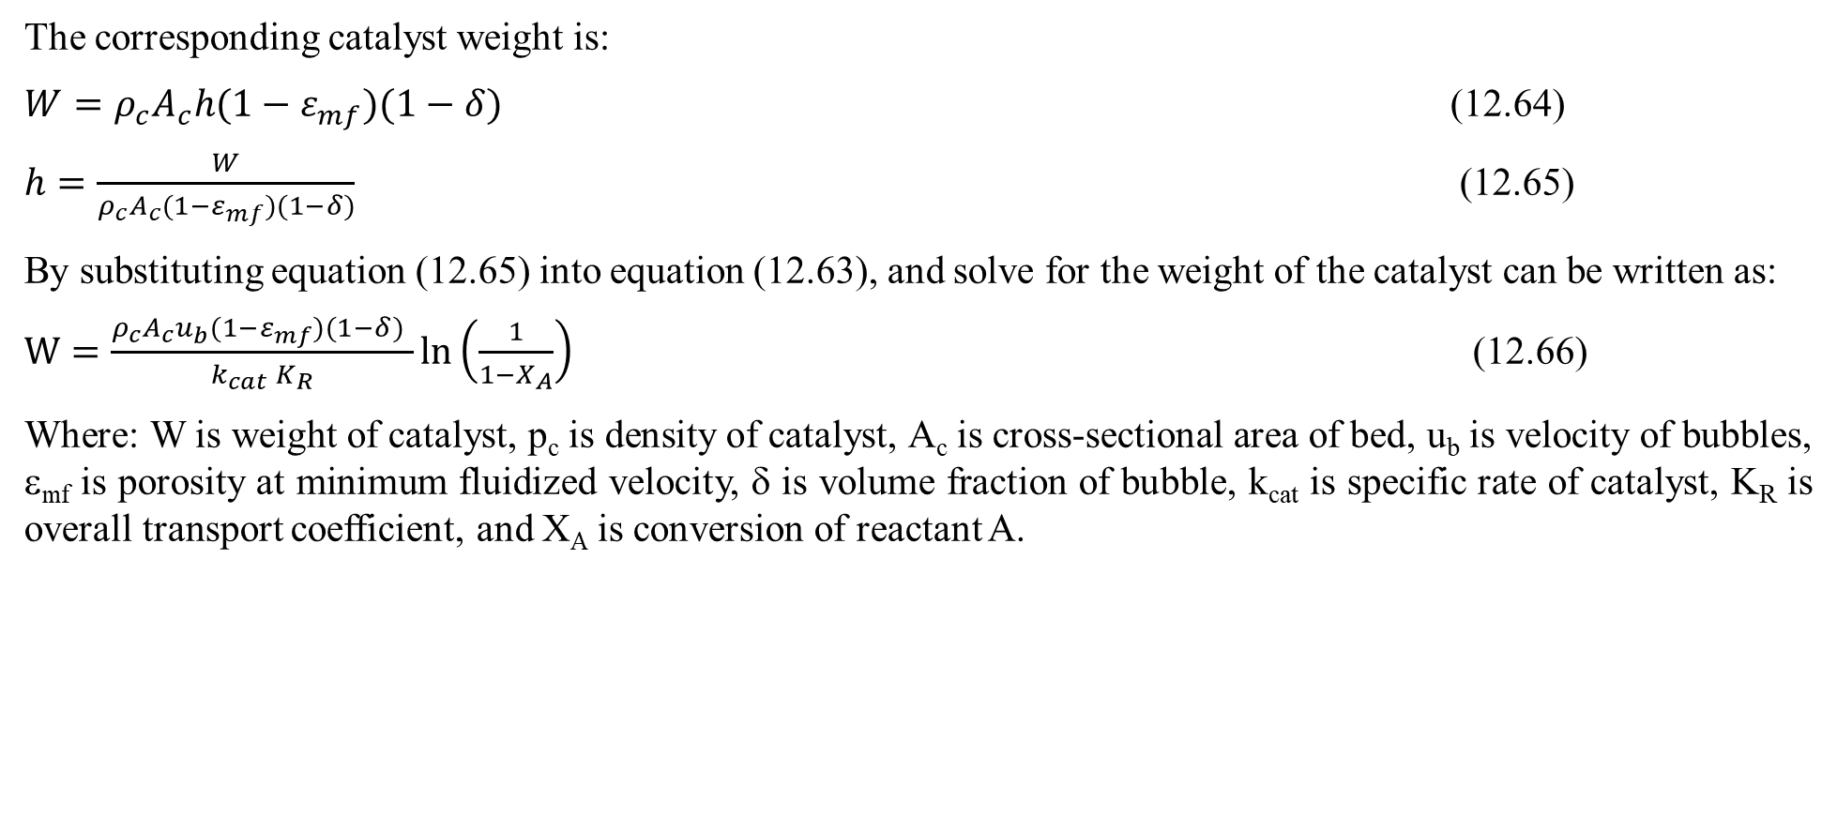
Cont’d
The corresponding catalyst weight is:
$W=ρ_{c}A_{c}h(1−ε_{mf})(1−δ)$ (12.64)
$h=\frac{W}{ρ_{c}A_{c}(1−ε_{mf})(1−δ)}$ (12.65)
By substituting equation (12.65) into equation (12.63), and solve for the weight of the catalyst can be written as:
$W=\frac{ρ_{c}A_{c}u_{b}(1−ε_{mf})(1−δ) }{k_{cat}{ K}_{R}}ln\left(\frac{1}{1−X_{A}}\right)$ (12.66)
Where: W is weight of catalyst, p_{c} is density of catalyst, A_{c} is cross-sectional area of bed, u_{b} is velocity of bubbles, ε_{mf} is porosity at minimum fluidized velocity, δ is volume fraction of bubble, k_{cat} is specific rate of catalyst, K_{R} is overall transport coefficient, and X_{A} is conversion of reactant A.

Slide 52
Activity 12.2
A researcher plans to study the catalytic oxidation of ammonia in a fluidized bed reactor at 1 atm and 520K. Under his/her experimental conditions, the reaction is first order. For this fluidized bed reactor, 8,000g of catalyst is used with a gas volumetric flow rate of 810 cm³/s at reaction conditions. The diameter of the bed is 12 cm. The minimum fluidized velocity and porosity at minimum fluidized velocity are 1.48 cm/s and 0.65, respectively. The overall transport rate and the specific reaction rate of solid catalyst are 2.1 and 0.086 s⁻¹, respectively. The diameter of bubble is 5 cm, and the density of solid catalyst is 2.06 g/cm³. Determine the conversion using the Kunii-Levenspiel model.
Given: Catalytic fluidized bed reactor, first order reaction
W= 8, 000g; υ= 810 cm³; D = 12 cm; g = 980 cm/s² ρ_{c}= 2.06g/cm³; K_{R}= 2.1;k_{cat}=0.085 s⁻¹; u_{mf} = 1.48 cm/s; ε_{mf} = 0.65; d_{b}= 5cm
Required:
X_{A} = ?

Slide 53
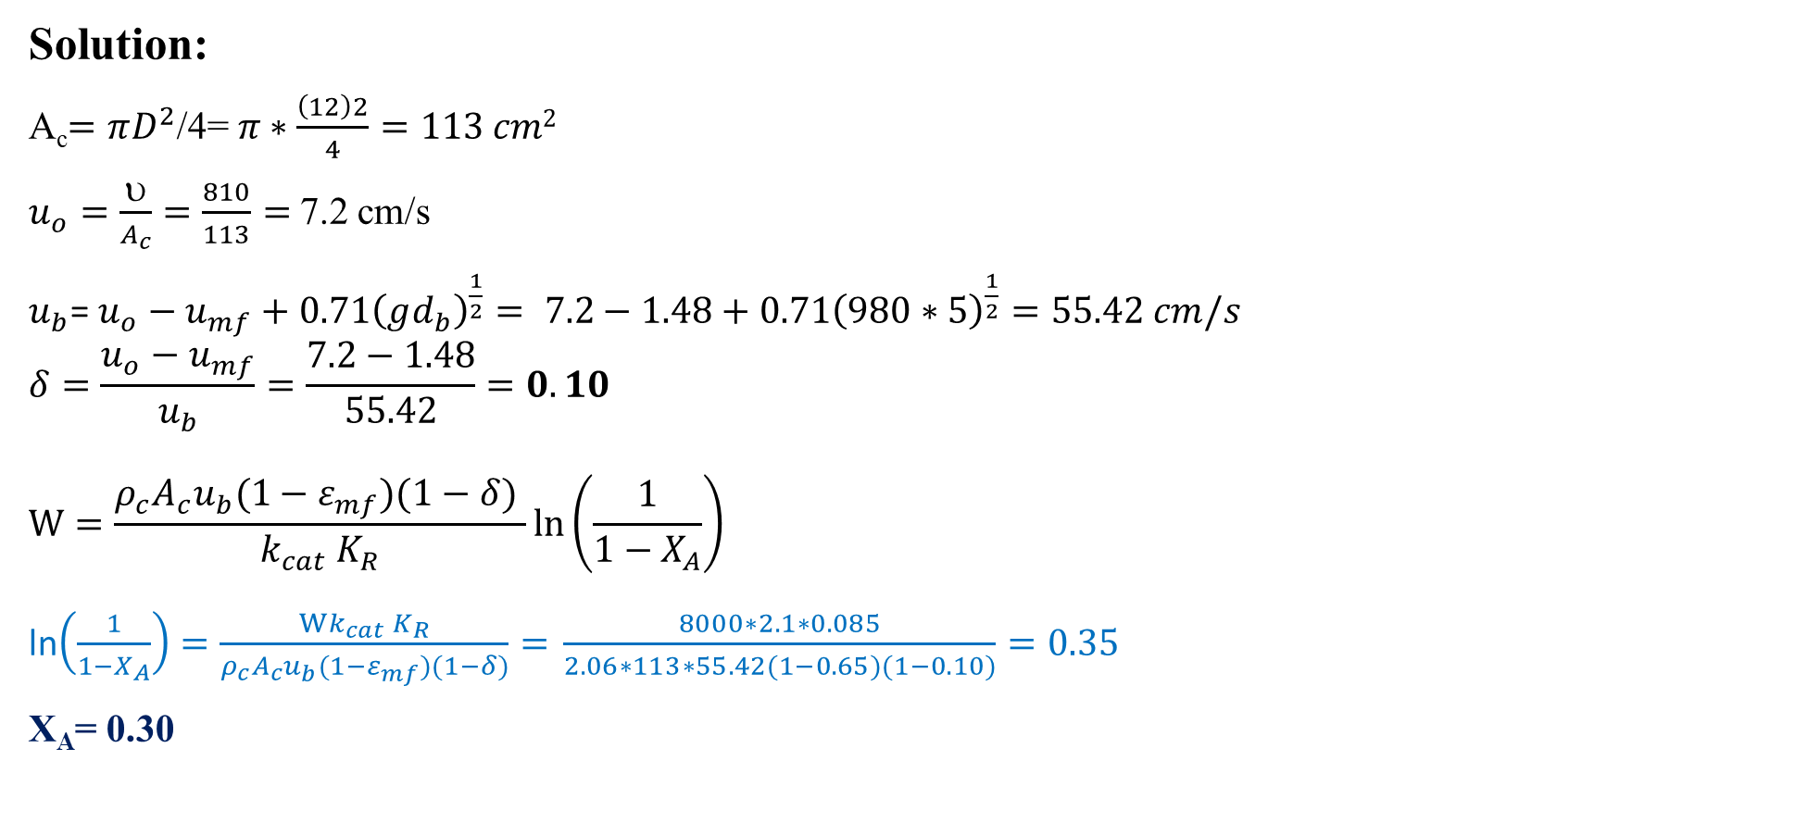
Cont’d
Solution:
A_{c}$=πD^{2}$/4= $π∗\frac{\left(12\right)2}{4}=113 cm2$
$u_{o}=\frac{}{A_{c}}=\frac{810}{113}=$7.2 cm/s
$u_{b}$= $u_{o}−u_{mf}+0.71{\left(gd_{b}\right)}^{\frac{1}{2}}= 7.2−1.48+0.71{\left(980∗5\right)}^{\frac{1}{2}}=55.42 cm/s$
$$δ=\frac{u_{o}−u_{mf}}{u_{b}}=\frac{7.2−1.48}{55.42}=0.10$$
$$W=\frac{ρ_{c}A_{c}u_{b}(1−ε_{mf})(1−δ) }{k_{cat}{ K}_{R}}ln\left(\frac{1}{1−X_{A}}\right)$$
ln$\left(\frac{1}{1−X_{A}}\right)=\frac{Wk_{cat}{ K}_{R}}{ρ_{c}A_{c}u_{b}(1−ε_{mf})(1−δ)}={\frac{8000∗2.1∗0.085}{2.06∗113∗55.42(1−0.65)(1−0.10)}=0.35}$
X_{A}= 0.30

Slide 54
12.4. Summary
A catalytic fluidized bed reactor is a type of reactor that combines the principles of fluidization with catalysis to enhance chemical reactions.
The characteristics and behavior of a fluidized bed are strongly dependent on both the solid catalyst and fluid properties.
FBR is effective to control temperature for exothermic reactions that prevents hotspots or collapse of the catalyst due to rapid mixing of solids in fluidized beds.
The design of FBR is not as easy as PBR since FBR incorporates three broad concepts: the mechanics of fluidized bed, mass transfer in fluidized bed, and reaction behavior in a fluidized bed.
Catalytic fluidized bed reactor is designed using Kunii-Levenspiel bubbling bed model to describe reactions in fluidized beds.

Slide 55
References
Chemical Reaction Engineering, Levenspiel, O John Wiely & Sons, 3rd edition, 2011.
Elements of Chemical Engineering, Fogler, HS Prentice- Hall Inc Prentice- Hall Inc, 5th edition, 2015.
Kunii-Levenspiel model for fluidization, 3rd Edition, CD-Ch12FluidizedBed.doc, Professional Reference Shelf (i.e. CD ROM Shelf).
(https://www.coursehero.com/file/6953251/FluidizedBed/)
Thank you!

