Slide 1
Chemical Reaction Engineering II- Reactor Design (ChEg 4101)
Prerequisite: Chemical Reaction Engineering I-Reaction Kinetics (ChEg3104)
Lecture 14: Non-Ideal Flows of Fluids and Reactor Models: Tanks-in-Series and Axial Dispersion Models
Week 14
Lecturer: Adamu Esubalew (PhD, ChEg)
Addis Ababa, Ethiopia

Slide 2
Lecture learning outcomes
At the end of the lecture, you will be able to:
identify model requirements for real reactors,
apply tanks-in-series and dispersion models for real reactors,
determine conversion using tanks-in-series and dispersion models for real reactors, and
compare the performance of tanks-in-series and axial dispersion models with ideal continuous stirred tank reactor (CSTR) and plug flow (PFR) for conversion determination.

Slide 3
Presentation outlines
Introduction to real reactor models
Tanks-in-series model
Axial dispersion model
Summary

Slide 4
14.1 Introduction to real reactor models
For ideal stirred tank reactors (CSTRs) and plug flow reactors (PFRs), it is assumed that all CSTRs are perfectly mixed and all tubular reactors exhibit plug flow behavior.
However, in real situation, not all tank reactors are perfectly mixed nor do all tubular reactors exhibit plug flow behavior.
In these situations, some means must be used to allow for deviations from ideal behavior.
To predict conversions and product distributions using an existing reactor in storage and want to carry out a new reaction in that reactor, a model of reactor flow patterns and/or residence time distribution (RTD) is necessary.
The choice of the particular model to be used depends largely on the engineering judgment of the person carrying out the analysis.
It is the engineers’ job to choose the model that best combines the conflicting goals of mathematical simplicity and physical realism.
There is a certain amount of art in the development of a model for a particular reactor.

Slide 5
Cont’d
A model must fit the data, be able to extrapolate theory and experiment, and have realistic parameters.
The following guidelines are suggested when developing models for non-ideal reactors:
The model must be mathematically tractable: The equations used to describe a chemical reactor should be able to be solved without an excessive expenditure of human or computer time.
The model must realistically describe the characteristics of the non-ideal reactor: The phenomena occurring in the non-ideal reactor must be reasonably described physically, chemically, and mathematically.
The model should not have more than two adjustable parameters: This constraint is often used because an expression with more than two adjustable parameters can be fitted to a great variety of experimental data, and the modeling process in this circumstance is nothing more than an exercise in curve fitting.

Slide 6
Cont’d
A one-parameter model is superior to a two-parameter model if the one-parameter model is sufficiently realistic.
To be fair, however, in complex systems (internal diffusion and conduction, mass transfer limitations) where other parameters may be measured independently, then more than two-parameters are quite acceptable.
Real reactor models can be classified as either a one-parameter model ( tanks-in-series model and dispersion model) or a two-parameter model (reactor with bypassing and dead volume).
This lecture focuses on one-parameter model (tanks-in-series model and axial dispersion model).

Slide 7
Cont’d
One parameter models: One-parameter models are used to account for the non-ideality of the reactors.
The parameter is evaluated by analyzing the RTD determined from a tracer test.
Tanks-in-series and dispersion models are one- parameter models for tubular reactors.
For the tanks-in-series model, the one-parameter is the number of tanks, n, and for the dispersion model, the one-parameter is the dispersion coefficient, D_{a}.
Knowing the parameter values, we then proceed to determine the conversion and/or effluent concentrations for the reactor.
Tubular reactors may be empty, or they may be packed with some material that acts as a catalyst, heat-transfer medium, or means of promoting interphase contact.

Slide 8
Cont’d
For ideal tubular reactors, it has been assumed that the fluid moves through the reactor in a piston-like flow (plug flow), the velocity profile is flat and no axial mixing.
Both of these assumptions are ideal in every tubular reactor, requires some modification.
There are two approaches which are usually taken to compensate for failure of both of the ideal assumptions.
The first approach is tanks-in-series model which involves modeling the non-ideal tubular reactor as a series of identically sized CSTRs.
The second approach is the dispersion model which involves a modification of the ideal reactor by imposing axial dispersion on plug flow.

Slide 9
Cont’d
Two parameter models: Two-parameter models are combinations of ideal reactors that are created to model non-ideal reactors.
Two-parameter models are combination of ideal reactors by considering reactor with bypassing and dead volume.
The RTD is used to calculate the model parameters such as fraction bypassed, fraction dead volume, exchange volume, and ratios of reactor volumes that can be used along with the reaction kinetics to predict conversion.
Tracer tests can be used to determine the RTD, which can be used in a similar manner to determine the suitability of the model and the value of its parameters.
Two- parameter model is not the focus of this lecture.

Slide 10
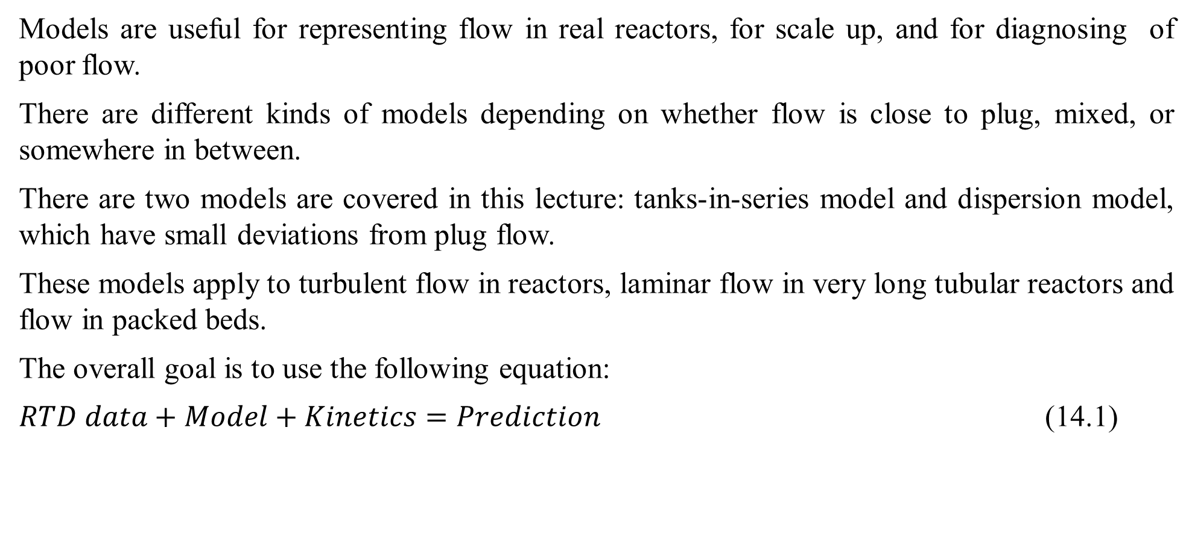
Cont’d
Models are useful for representing flow in real reactors, for scale up, and for diagnosing of poor flow.
There are different kinds of models depending on whether flow is close to plug, mixed, or somewhere in between.
There are two models are covered in this lecture: tanks-in-series model and dispersion model, which have small deviations from plug flow.
These models apply to turbulent flow in reactors, laminar flow in very long tubular reactors and flow in packed beds.
The overall goal is to use the following equation:
$RTD data+Model+Kinetics=Prediction$ (14.1)

Slide 11
14.2. Tanks-in-series model
The tanks-in-series model is simple, and it can be used with any kinetics.
It can be extended without too much difficulty to any arrangement of compartments, with or without recycle.
Tanks-in-series (T-I-S) is a one-parameter model. i.e. a single parameter is used to account for the non-ideality of a reactor.
For tanks-in-series model, the one parameter is the number of tanks, n.
This parameter is evaluated by analyzing the RTD determined from a tracer test.

Slide 12
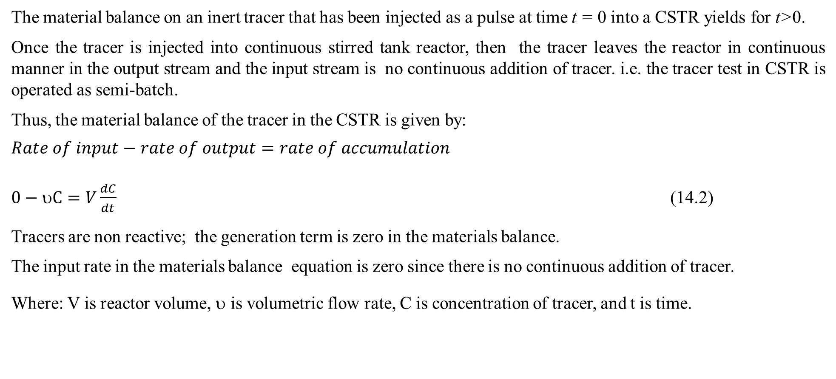
Cont’d
The material balance on an inert tracer that has been injected as a pulse at time t = 0 into a CSTR yields for t>0.
Once the tracer is injected into continuous stirred tank reactor, then the tracer leaves the reactor in continuous manner in the output stream and the input stream is no continuous addition of tracer. i.e. the tracer test in CSTR is operated as semi-batch.
Thus, the material balance of the tracer in the CSTR is given by:
$$Rate of input−rate of output=rate of accumulation$$
$0−υC=V\frac{dC}{dt}$ (14.2)
Tracers are non reactive; the generation term is zero in the materials balance.
The input rate in the materials balance equation is zero since there is no continuous addition of tracer.
Where: V is reactor volume, υ is volumetric flow rate, C is concentration of tracer, and t is time.

Slide 13
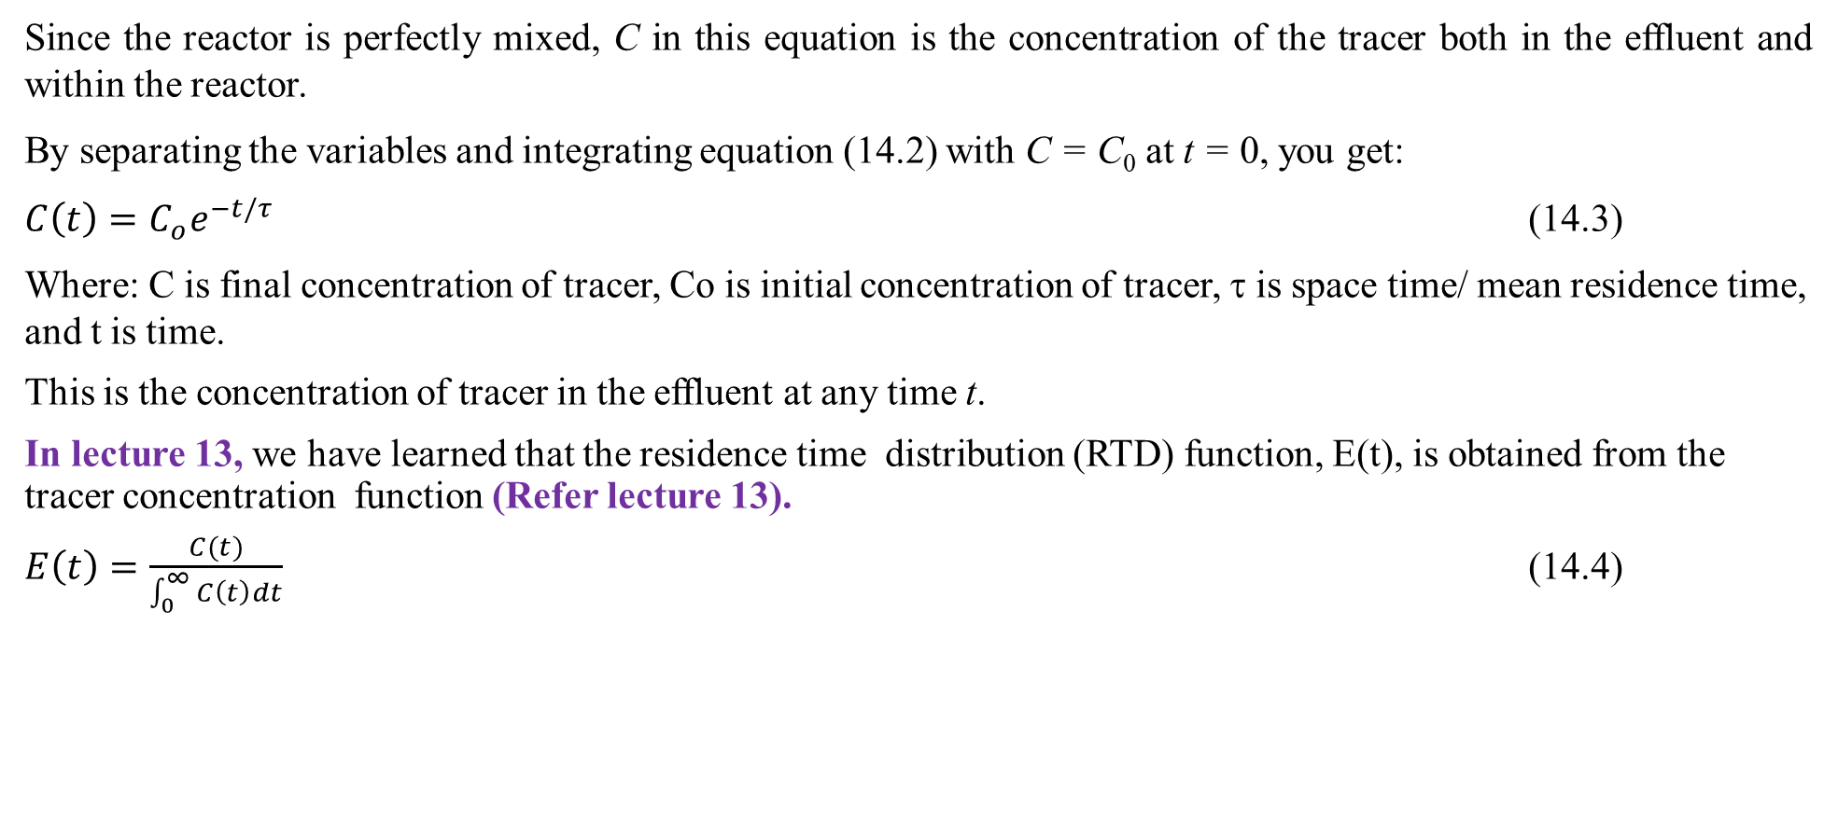
Cont’d
Since the reactor is perfectly mixed, C in this equation is the concentration of the tracer both in the effluent and within the reactor.
By separating the variables and integrating equation (14.2) with C = C₀ at t = 0, you get:
$C\left(t\right)=C_{o}e^{−t/τ}$ (14.3)
Where: C is final concentration of tracer, Co is initial concentration of tracer, τ is space time/ mean residence time, and t is time.
This is the concentration of tracer in the effluent at any time t.
In lecture 13, we have learned that the residence time distribution (RTD) function, E(t), is obtained from the tracer concentration function (Refer lecture 13).
$E\left(t\right)=\frac{C(t)}{\int_{0}^{∞}{C\left(t\right)dt}}$ (14.4)

Slide 14
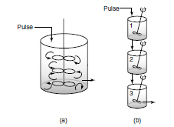
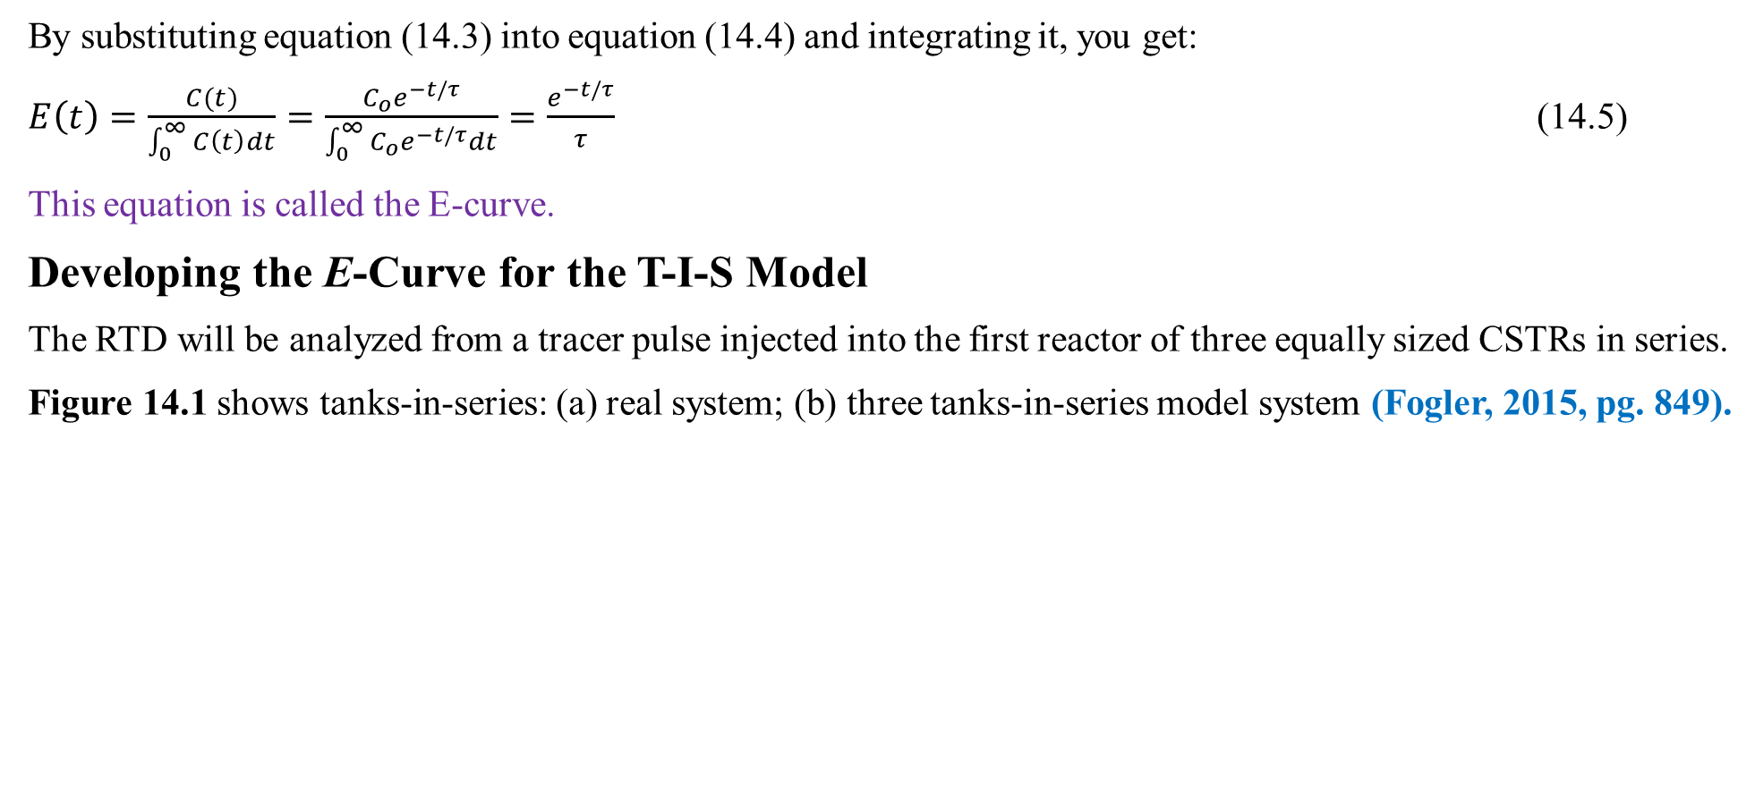
Cont’d
By substituting equation (14.3) into equation (14.4) and integrating it, you get:
$E\left(t\right)=\frac{C(t)}{\int_{0}^{∞}{C\left(t\right)dt}}=\frac{C_{o}e^{−t/τ}}{\int_{0}^{∞}{C_{o}e^{−t/τ}dt}}=\frac{e^{−t/τ}}{τ}$ (14.5)
This equation is called the E-curve.
Developing the E-Curve for the T-I-S Model
The RTD will be analyzed from a tracer pulse injected into the first reactor of three equally sized CSTRs in series.
Figure 14.1 shows tanks-in-series: (a) real system; (b) three tanks-in-series model system (Fogler, 2015, pg. 849).
Figure 14.1. tanks-in-series: (a) real system; (b) three tanks-in-series model system

Slide 15
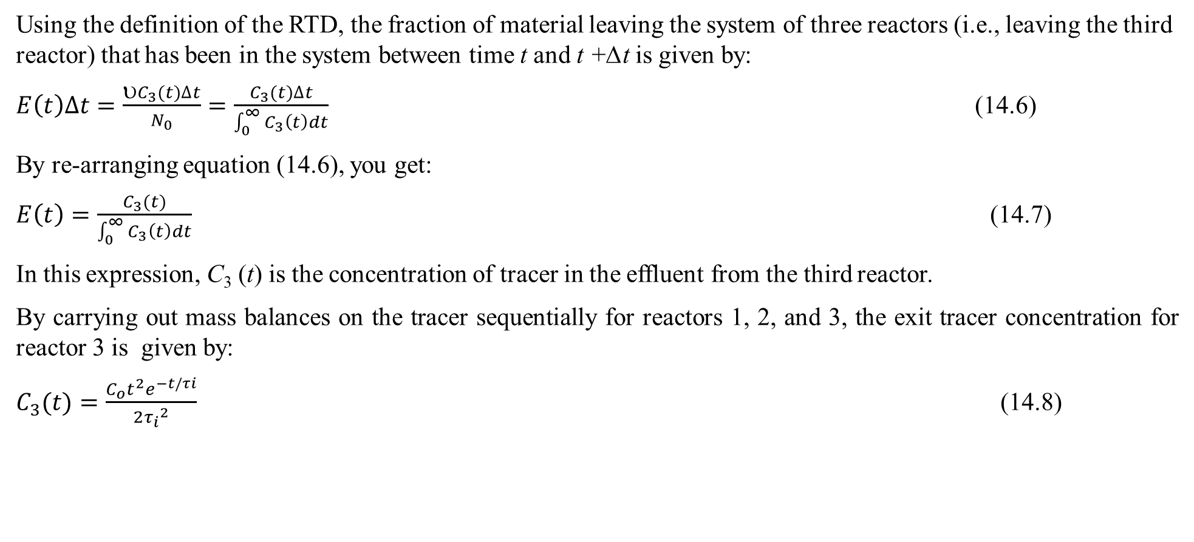
Cont’d
Using the definition of the RTD, the fraction of material leaving the system of three reactors (i.e., leaving the third reactor) that has been in the system between time t and t +∆t is given by:
$E\left(t\right)∆t=\frac{υC_{3}(t)∆t}{N_{0}}=\frac{C_{3}(t)∆t}{\int_{0}^{∞}{C_{3}\left(t\right)dt}}$ (14.6)
By re-arranging equation (14.6), you get:
$E\left(t\right)=\frac{C_{3}(t)}{\int_{0}^{∞}{C_{3}\left(t\right)dt}}$ (14.7)
In this expression, C₃ (t) is the concentration of tracer in the effluent from the third reactor.
By carrying out mass balances on the tracer sequentially for reactors 1, 2, and 3, the exit tracer concentration for reactor 3 is given by:
$C_{3}(t)=\frac{C_{o}t^{2}e^{−t/τi}}{2{τ_{i}}^{2}}$ (14.8)

Slide 16
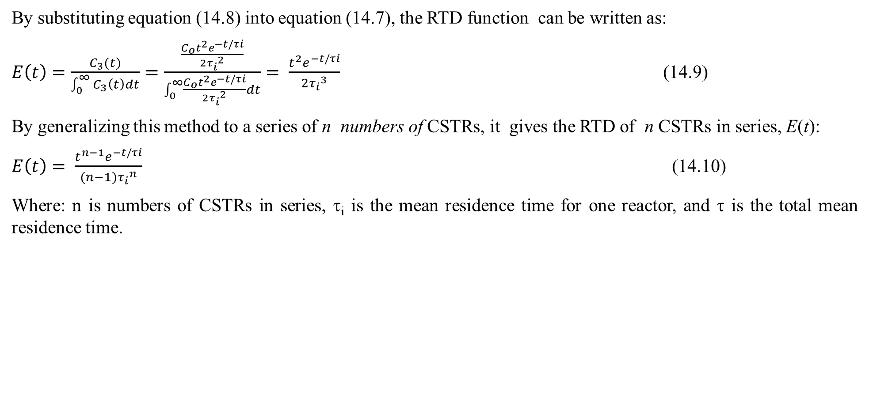
Cont’d
By substituting equation (14.8) into equation (14.7), the RTD function can be written as:
$E\left(t\right)=\frac{C_{3}(t)}{\int_{0}^{∞}{C_{3}\left(t\right)dt}}=\frac{\frac{C_{o}t^{2}e^{−t/τi}}{2{τ_{i}}^{2}}}{\int_{0}^{∞}{\frac{C_{o}t^{2}e^{−t/τi}}{2{τ_{i}}^{2}}dt}}= \frac{t^{2}e^{−t/τi}}{2{τ_{i}}^{3}}$ (14.9)
By generalizing this method to a series of n numbers of CSTRs, it gives the RTD of n CSTRs in series, E(t):
$E\left(t\right)= \frac{t^{n−1}e^{−t/τi}}{(n−1){τ_{i}}^{n}}$ (14.10)
Where: n is numbers of CSTRs in series, τ_{i} is the mean residence time for one reactor, and τ is the total mean residence time.

Slide 17
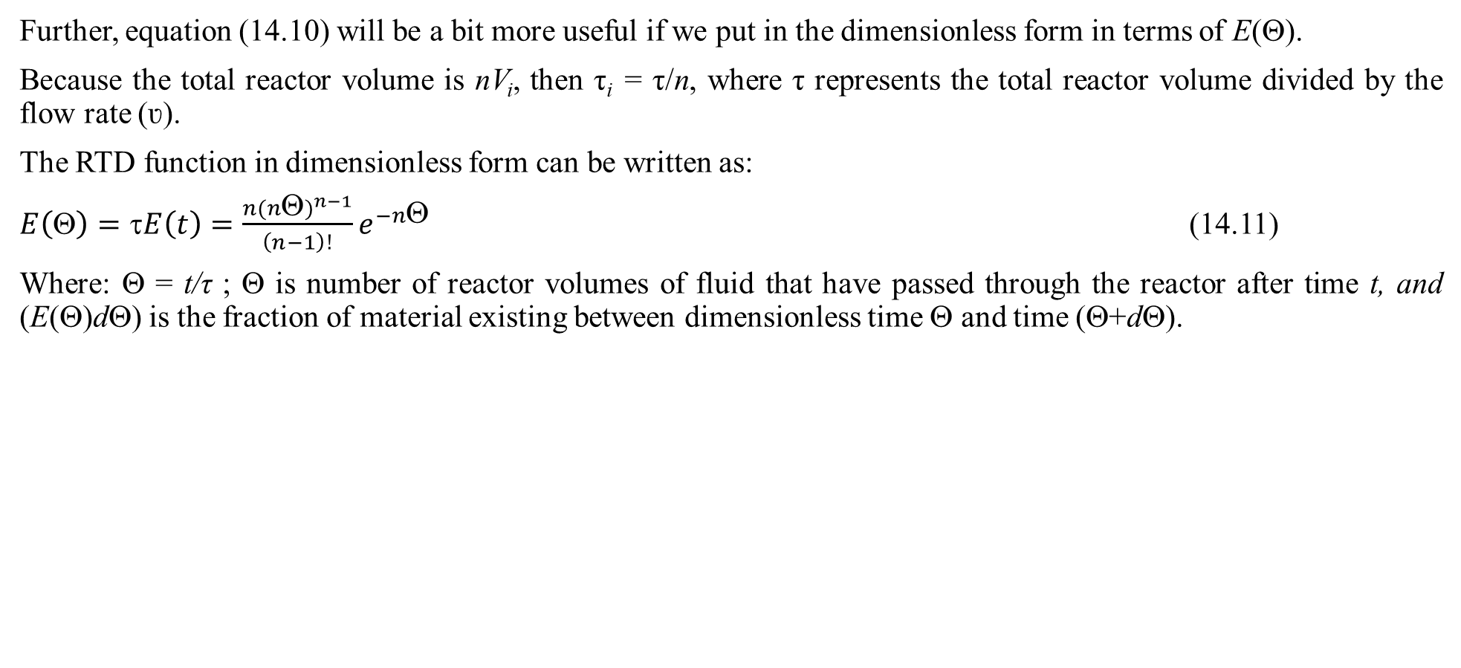
Cont’d
Further, equation (14.10) will be a bit more useful if we put in the dimensionless form in terms of E(Θ).
Because the total reactor volume is nV_{i}, then τ_{i} = τ/n, where τ represents the total reactor volume divided by the flow rate (ʋ).
The RTD function in dimensionless form can be written as:
$E\left(Θ\right)=τE\left(t\right)=\frac{n{(nΘ)}^{n−1}}{\left(n−1\right)!}e^{−nΘ}$ (14.11)
Where: Θ = t/τ ; Θ is number of reactor volumes of fluid that have passed through the reactor after time t, and (E(Θ)dΘ) is the fraction of material existing between dimensionless time Θ and time (Θ+dΘ).

Slide 18
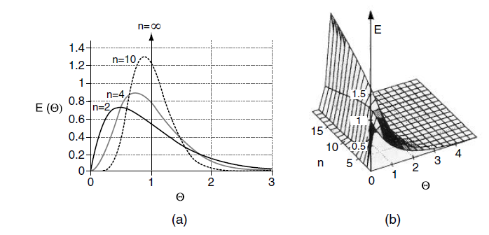
Cont’d
Figure 14.2 illustrates the RTDs of various numbers of CSTRs in series in a two-dimensional plot (a) and in a three-dimensional plot (b) (Fogler, 2015, pg. 850).
As the number becomes very large, the behavior of the system approaches that of a plug flow reactor.
Figure 14.2. Tanks-in-series response to a pulse tracer input for different
numbers of tanks (a) 2D plot, and(b) 3D plot

Slide 19
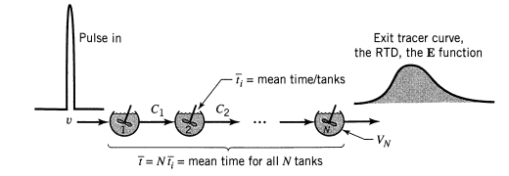
Cont’d
The mean residence time for all equal n tanks-in-series is n times the mean residence time of the single reactor as shown in Figure 14.3 (Levenspiel, 2011, pg. 323).
Figure 14.3. Mean residence time of n equal size tanks-in-series

Slide 20
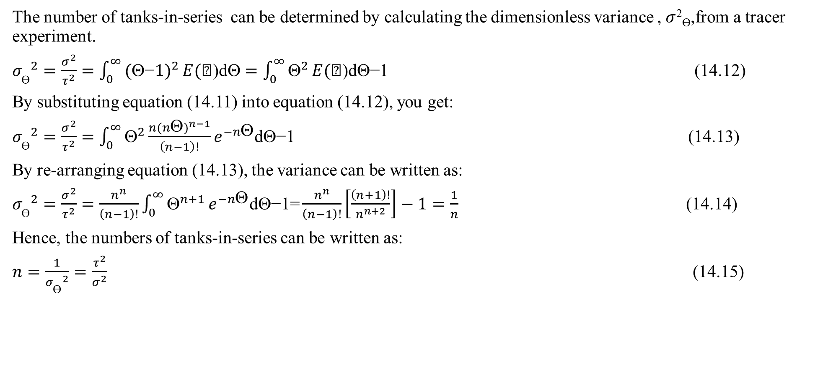
Cont’d
The number of tanks-in-series can be determined by calculating the dimensionless variance , $σ$²_{Ɵ},from a tracer experiment.
${σ_{\text{Ɵ}}}^{2}=\frac{σ^{2}}{τ^{2}}=\int_{0}^{∞}{\text{(}\text{−}\text{1})^{2}}E(\text{)}\text{d}=\int_{0}^{∞}{^{2}}E(\text{)}\text{d}\text{−1}$ (14.12)
By substituting equation (14.11) into equation (14.12), you get:
${σ_{\text{Ɵ}}}^{2}=\frac{σ^{2}}{τ^{2}}=\int_{0}^{∞}{Θ^{2}}\frac{n{(nΘ)}^{n−1}}{\left(n−1\right)!}e^{−nΘ}\text{d}Θ\text{−1}$ (14.13)
By re-arranging equation (14.13), the variance can be written as:
${σ_{\text{Ɵ}}}^{2}=\frac{σ^{2}}{τ^{2}}=\frac{n^{n}}{\left(n−1\right)!}\int_{0}^{∞}{Θ^{n+1}}e^{−nΘ}\text{d}Θ\text{−}\text{1=}\frac{n^{n}}{\left(n−1\right)!}\left[\frac{\left(n+1\right)!}{n^{n+2}}\right]−1=\frac{1}{n}$ (14.14)
Hence, the numbers of tanks-in-series can be written as:
$n=\frac{1}{{σ_{\text{Ɵ}}}^{2}}=\frac{τ^{2}}{σ^{2}}$ (14.15)

Slide 21
Cont’d
This expression of equation (14.15) represents the number of tanks necessary to model the real reactor as n ideal tanks-in-series.
If the number of reactors, n, turns out to be small, the reactor characteristics turn out to be those of a single CSTR or perhaps two CSTRs in series.
At the other extreme, when n turns out to be large, we recall from Lecture 10 (multiple CSTRs in series) that the reactor characteristics approach those of a plug flow reactor.
The conversion for stirred tank reactors in series can be determined using this model equation.
The conversion of reactants is dependent on the number of tanks which are connected in series.
Large number of tanks-in-series provides high conversion.

Slide 22
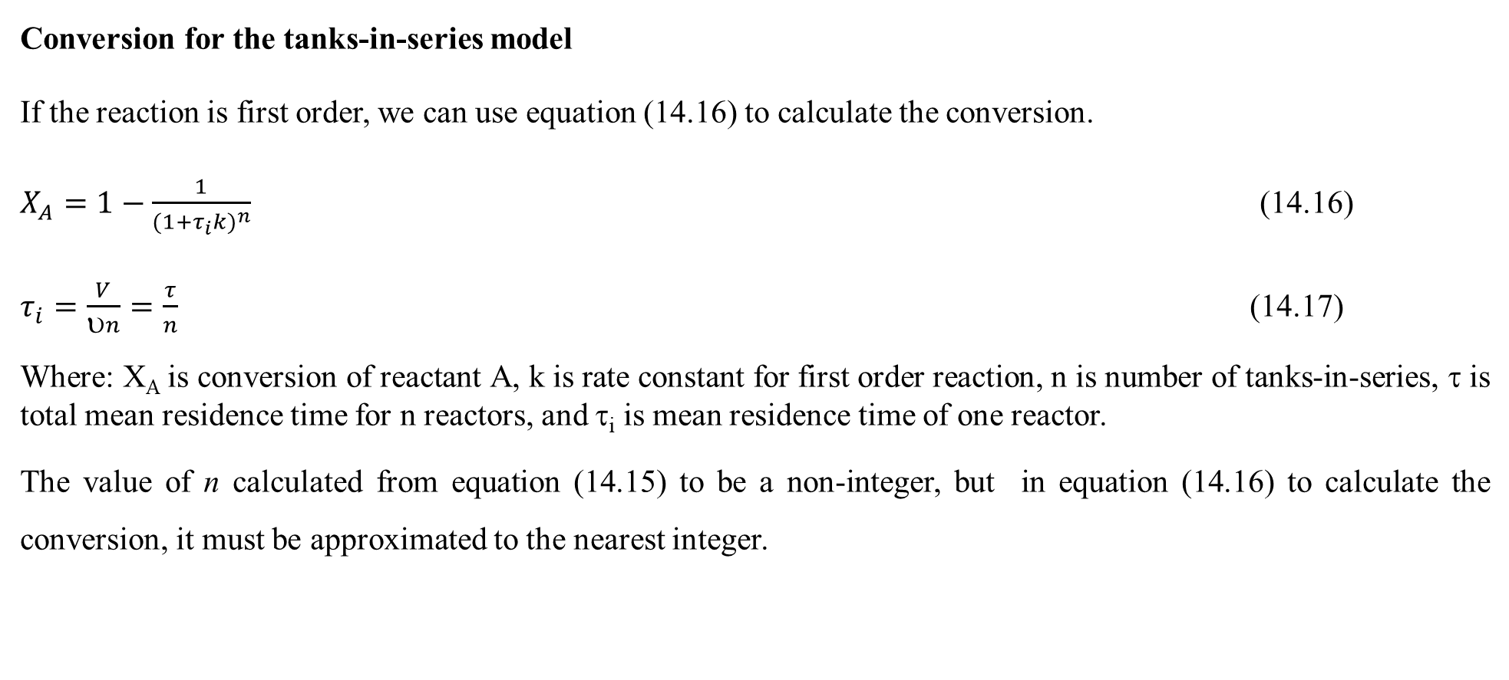
Cont’d
Conversion for the tanks-in-series model
If the reaction is first order, we can use equation (14.16) to calculate the conversion.
$X_{A}=1−\frac{1}{{(1+τ_{i}k)}^{n}}$ (14.16)
$τ_{i}=\frac{V}{υn}=\frac{τ}{n}$ (14.17)
Where: X_{A} is conversion of reactant A, k is rate constant for first order reaction, n is number of tanks-in-series, τ is total mean residence time for n reactors, and τ_{i} is mean residence time of one reactor.
The value of n calculated from equation (14.15) to be a non-integer, but in equation (14.16) to calculate the conversion, it must be approximated to the nearest integer.

Slide 23
Cont’d
For reactions other than first order, an integer number of reactors must be used and sequential mole balances on each reactor must be carried out.
If, for example, n = 2.53, then one could calculate the conversion for two tanks and also for three tanks to bound the conversion. i.e. it must be round off to three tanks.
The conversion and effluent concentrations would be solved sequentially using the algorithm developed in lecture 10 (CSTRs in series). i.e. after solving for the effluent from the first tank, it would be used as the input to the second tank and so on.

Slide 24
Activity 14.1
What are the basic requirements of models for non-ideal reactors?
Why do we choose tanks-in-series model for real reactors?

Slide 25
Cont’d
Answers
1. What are the basic requirements of models for non-ideal reactors?
The model must be mathematically tractable/ manageable/ controllable;
The model must realistically describe the characteristics of the non-ideal reactors; and
The model should not have more than two adjustable parameters.
2. Why do we choose tanks-in-series model for real reactors?
Tanks-in-series model is simple, and it can be used with any kinetics.
It can be extended without too much difficulty to any arrangement of compartments, with or without recycle.
It is a one-parameter model that is used to account for the non-ideality of a reactor.

Slide 26
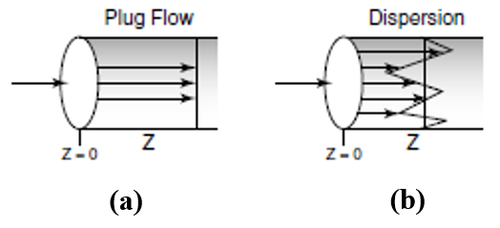
14.3. Axial dispersion model
Dispersion models for real reactor flows provide a framework for capturing the complexities of non-ideal flow behaviors in chemical reactors.
Dispersion models can help identify issues related to poor mixing or unexpected flow patterns that may affect reactor performance.
The axial dispersion model is also often used to describe non-ideal tubular reactors.
Concentration profiles for plug-flow(a) without dispersion and (b) with dispersion as shown in Figure 14.4 (Fogler, 2015, pg. 852).
.
Figure 14.4. Concentration profiles: (a) without and (b) with dispersion

Slide 27
Cont’d
Dispersion models account for the spread of reactants and products in the reactor due to variations in flow velocities and mixing.
This is often represented using a dispersion coefficient.
Dispersion models often utilize residence time distribution (RTD) to describe how long different fluid elements spend in the reactor, providing insight into flow behavior.
The governing equations often involve an advection-dispersion equation that combines convective transport (advection) with diffusion-like effects (dispersion).

Slide 28
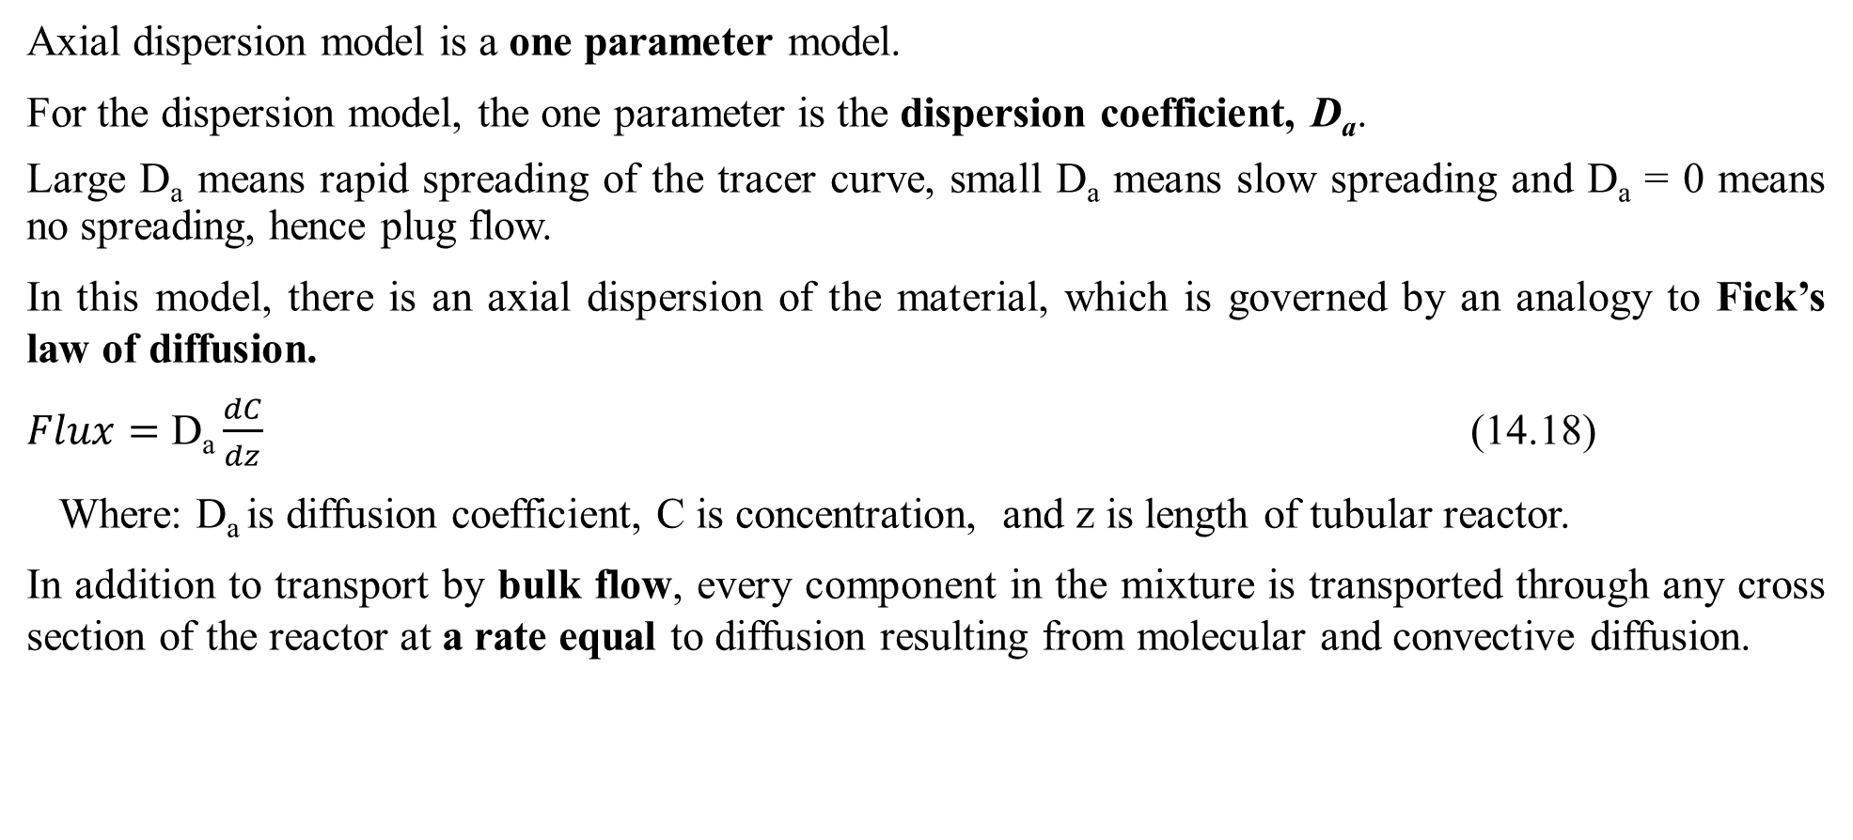
Cont’d
Axial dispersion model is a one parameter model.
For the dispersion model, the one parameter is the dispersion coefficient, D_{a}.
Large D_{a} means rapid spreading of the tracer curve, small D_{a} means slow spreading and D_{a} = 0 means no spreading, hence plug flow.
In this model, there is an axial dispersion of the material, which is governed by an analogy to Fick’s law of diffusion.
$Flux=\text{D}\text{a}\frac{dC}{dz}$ (14.18)
Where: D_{a} is diffusion coefficient, C is concentration, and z is length of tubular reactor.
In addition to transport by bulk flow, every component in the mixture is transported through any cross section of the reactor at a rate equal to diffusion resulting from molecular and convective diffusion.

Slide 29
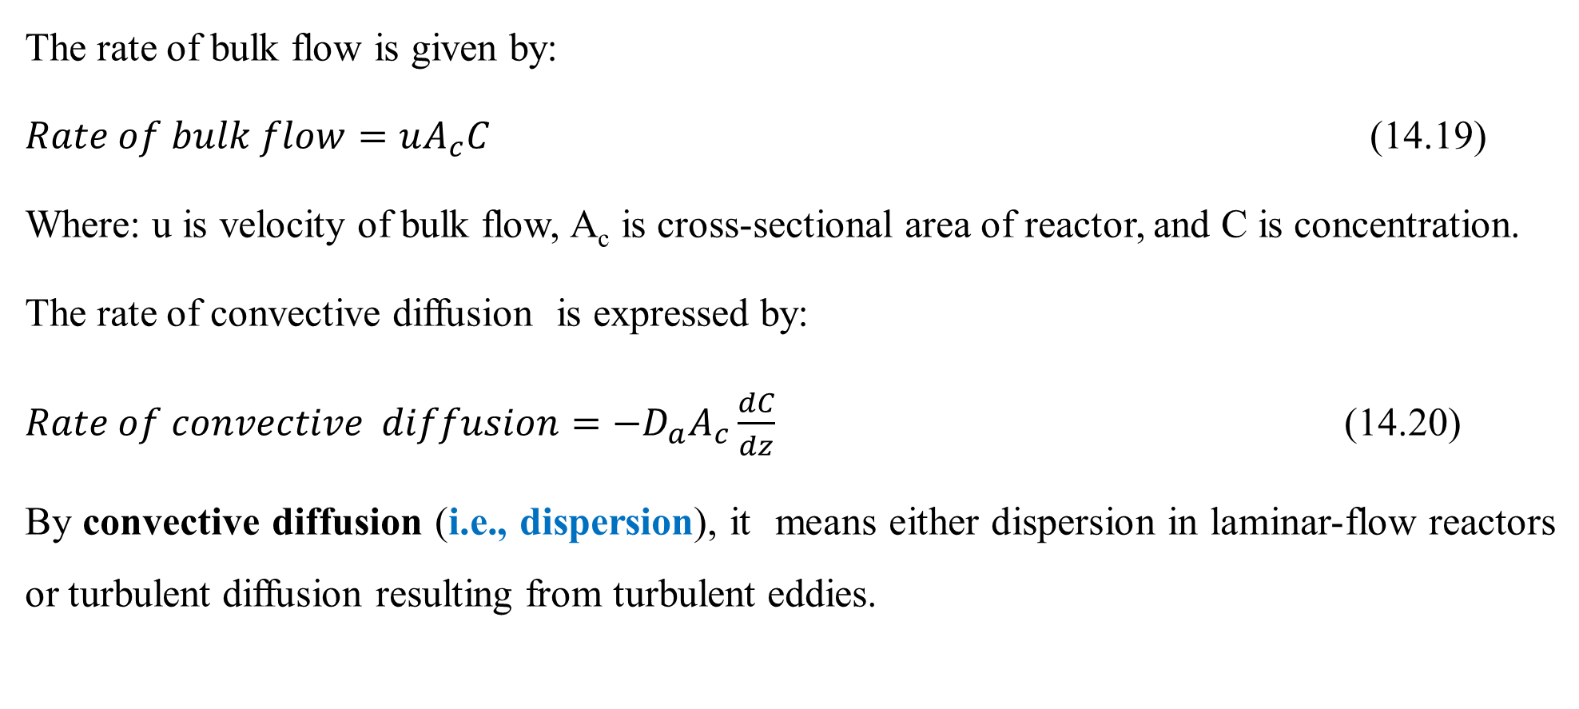
Cont’d
The rate of bulk flow is given by:
$Rate of bulk flow=uA_{c}C$ (14.19)
Where: u is velocity of bulk flow, A_{c} is cross-sectional area of reactor, and C is concentration.
The rate of convective diffusion is expressed by:
$Rate of convective diffusion={−D}_{a}A_{c}\frac{dC}{dz}$ (14.20)
By convective diffusion (i.e., dispersion), it means either dispersion in laminar-flow reactors or turbulent diffusion resulting from turbulent eddies.

Slide 30
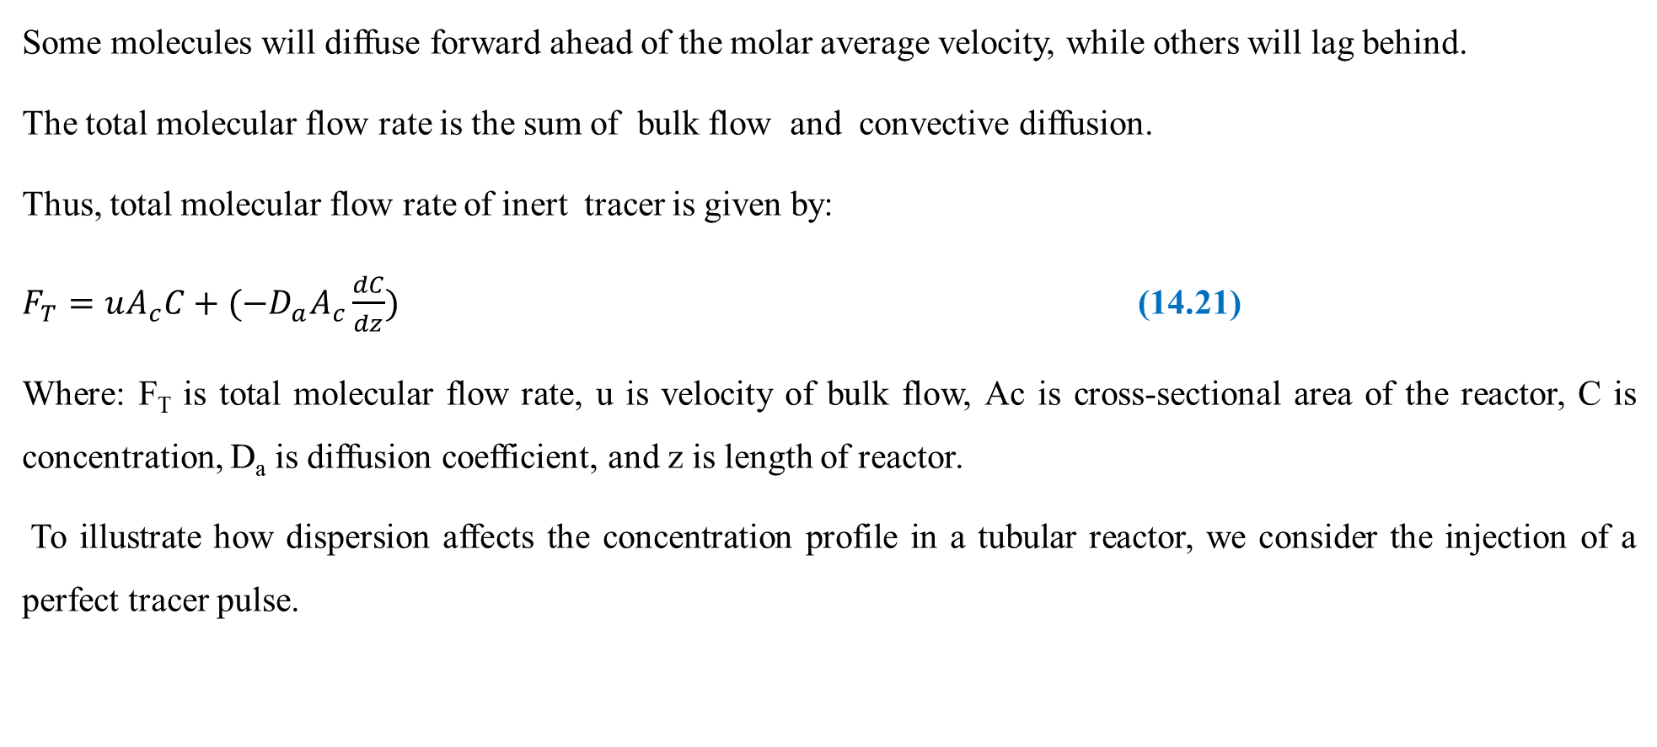
Cont’d
Some molecules will diffuse forward ahead of the molar average velocity, while others will lag behind.
The total molecular flow rate is the sum of bulk flow and convective diffusion.
Thus, total molecular flow rate of inert tracer is given by:
$F_{T}=uA_{c}C+({−D}_{a}A_{c}\frac{dC}{dz})$ (14.21)
Where: F_{T} is total molecular flow rate, u is velocity of bulk flow, Ac is cross-sectional area of the reactor, C is concentration, D_{a} is diffusion coefficient, and z is length of reactor.
To illustrate how dispersion affects the concentration profile in a tubular reactor, we consider the injection of a perfect tracer pulse.

Slide 31
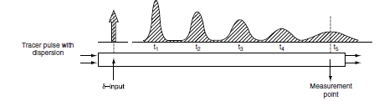
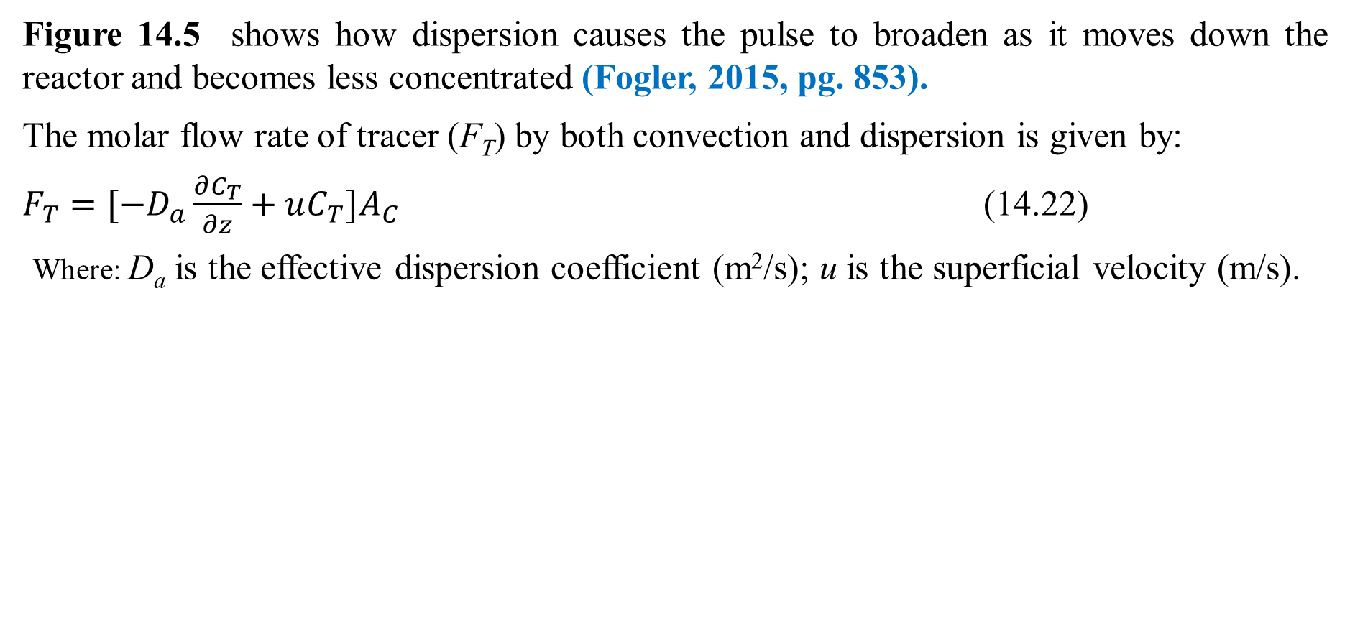
Cont’d
Figure 14.5 shows how dispersion causes the pulse to broaden as it moves down the reactor and becomes less concentrated (Fogler, 2015, pg. 853).
The molar flow rate of tracer (F_{T}) by both convection and dispersion is given by:
$F_{T}=[−D_{a}\frac{∂C_{T}}{∂z}+uC_{T}]A_{C}$ (14.22)
Where: D_{a} is the effective dispersion coefficient (m²/s); u is the superficial velocity (m/s).
Figure 14.5. Dispersion in tubular reactor

Slide 32
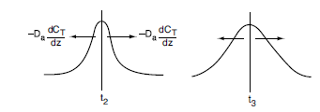
Cont’d
To better understand how the pulse broadens, we refer to the concentration peaks t₂ and t₃ in Figure 14.6 (Fogler, 2015, pg. 853).
We see that there is a concentration gradient on both sides of the peak causing molecules to diffuse away from the peak and thus broaden the pulse.
The pulse broadens as it moves through the reactor.
Figure 14.6. Symmetric concentration gradients causing
the spreading by dispersion of a pulse input

Slide 33
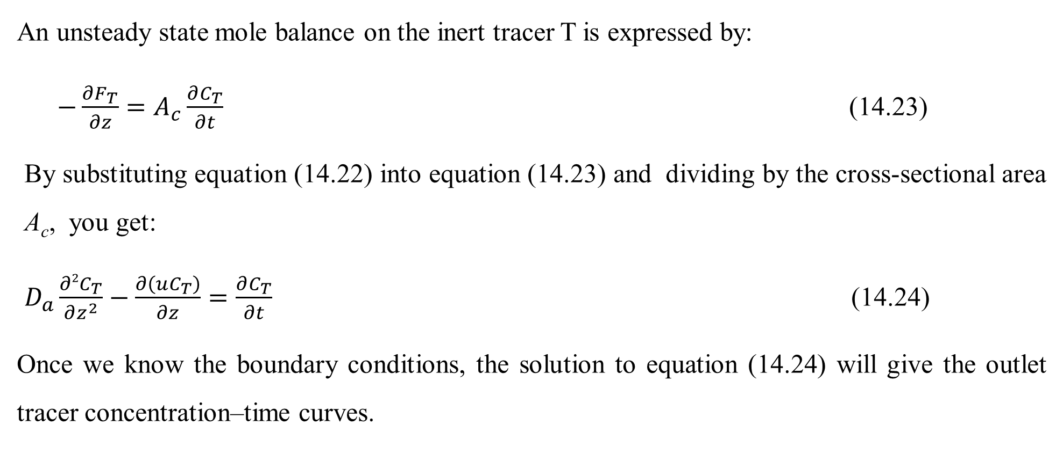
Cont’d
An unsteady state mole balance on the inert tracer T is expressed by:
$−\frac{∂F_{T}}{∂z}=A_{c}\frac{∂C_{T}}{∂t}$ (14.23)
By substituting equation (14.22) into equation (14.23) and dividing by the cross-sectional area A_{c}, you get:
$D_{a}\frac{∂2C_{T}}{∂z^{2}}−\frac{∂\left(uC_{T}\right)}{∂z}=\frac{∂C_{T}}{∂t}$ (14.24)
Once we know the boundary conditions, the solution to equation (14.24) will give the outlet tracer concentration–time curves.

Slide 34
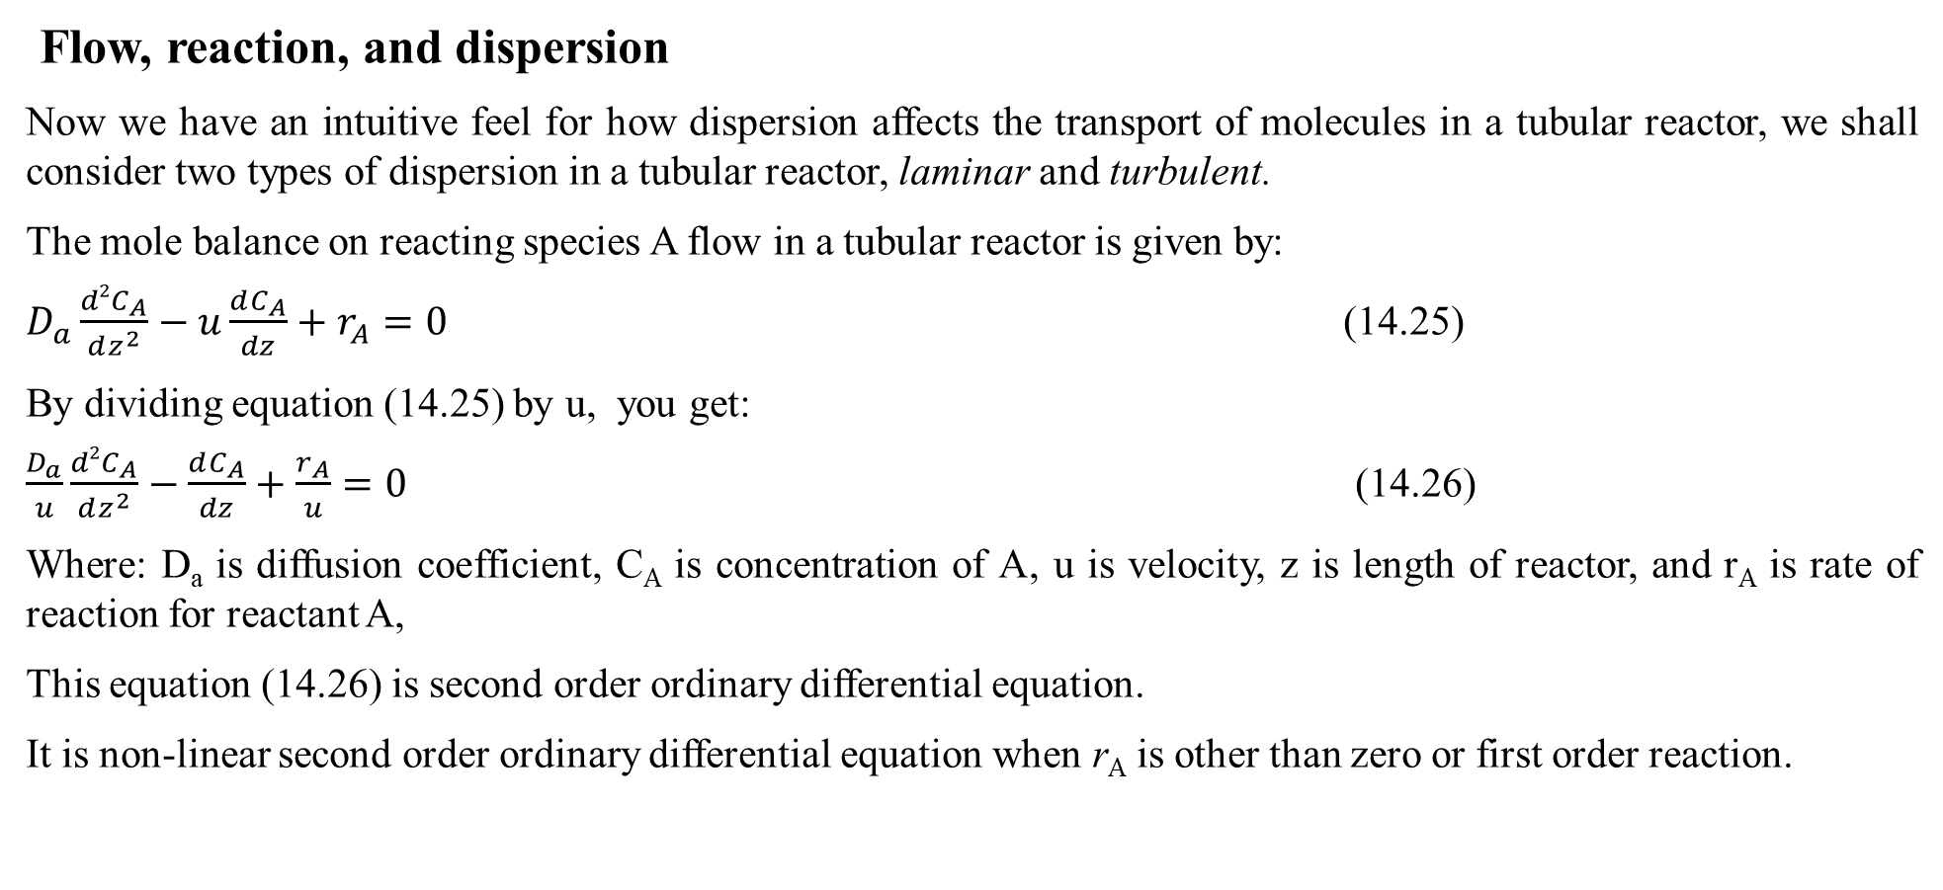
Cont’d
Flow, reaction, and dispersion
Now we have an intuitive feel for how dispersion affects the transport of molecules in a tubular reactor, we shall consider two types of dispersion in a tubular reactor, laminar and turbulent.
The mole balance on reacting species A flow in a tubular reactor is given by:
$D_{a}\frac{d2C_{A}}{dz^{2}}−u\frac{dC_{A}}{dz}+r_{A}=0$ (14.25)
By dividing equation (14.25) by u, you get:
$\frac{D_{a}}{u}\frac{d2C_{A}}{dz^{2}}−\frac{dC_{A}}{dz}+\frac{r_{A}}{u}=0$ (14.26)
Where: D_{a} is diffusion coefficient, C_{A} is concentration of A, u is velocity, z is length of reactor, and r_{A} is rate of reaction for reactant A,
This equation (14.26) is second order ordinary differential equation.
It is non-linear second order ordinary differential equation when r_{A} is other than zero or first order reaction.

Slide 35
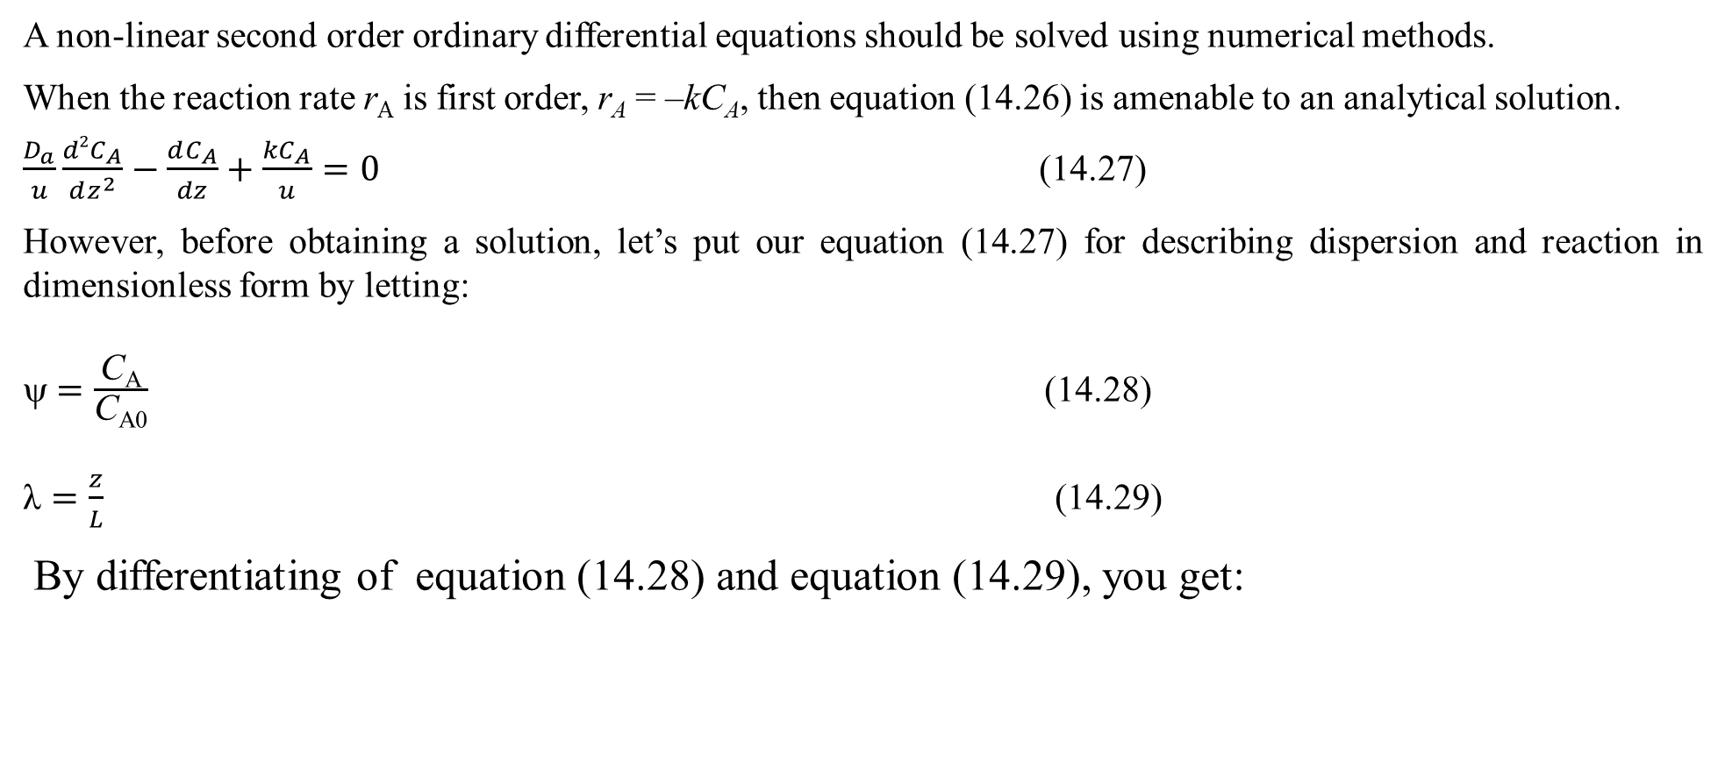
Cont’d
A non-linear second order ordinary differential equations should be solved using numerical methods.
When the reaction rate r_{A} is first order, r_{A} = –kC_{A}, then equation (14.26) is amenable to an analytical solution.
$\frac{D_{a}}{u}\frac{d2C_{A}}{dz^{2}}−\frac{dC_{A}}{dz}+\frac{{kC}_{A}}{u}=0$ (14.27)
However, before obtaining a solution, let’s put our equation (14.27) for describing dispersion and reaction in dimensionless form by letting:
ψ $=\frac{\text{C}\text{A}}{\text{C}\text{A}\text{0}}$ (14.28)
$\text{λ}=\frac{z}{L}$ (14.29)
By differentiating of equation (14.28) and equation (14.29), you get:

Slide 36
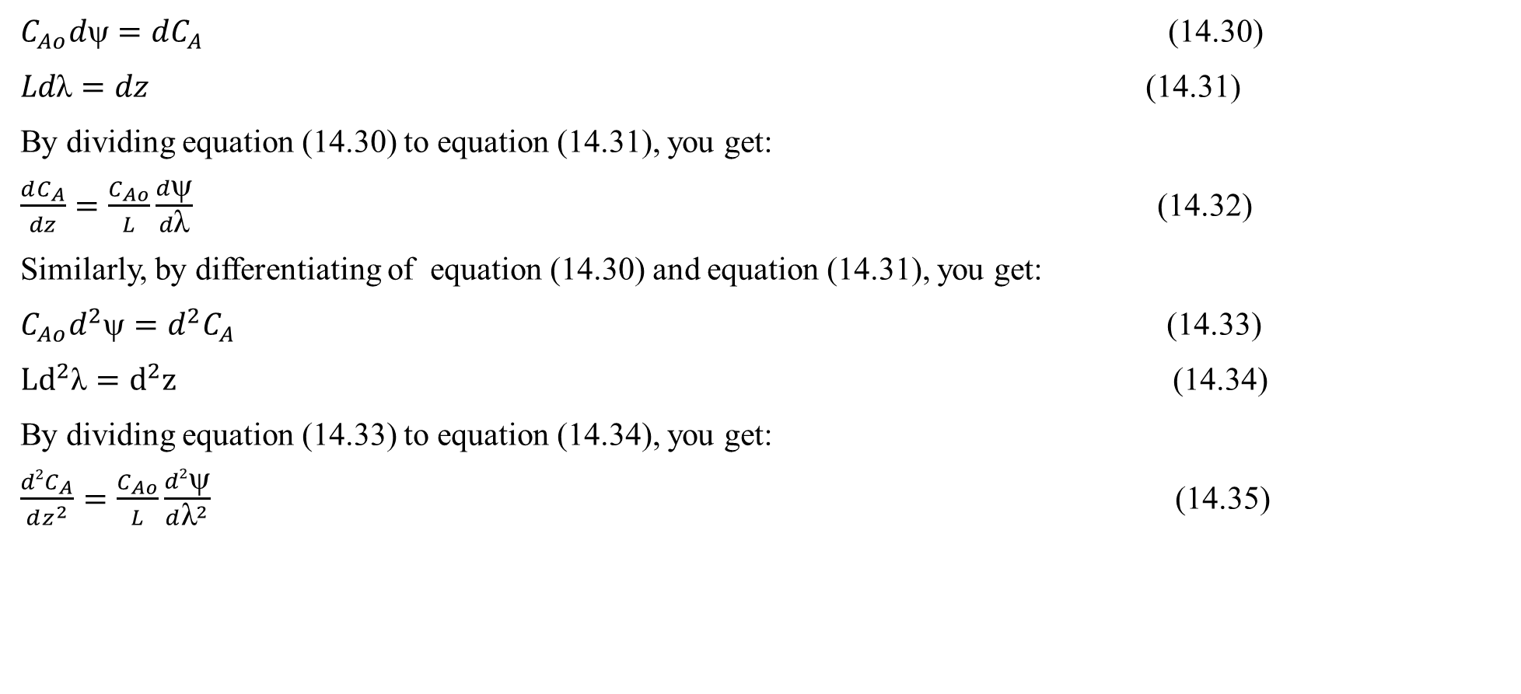
Cont’d
$C_{Ao}d=dC_{A}$ (14.30)
$Ld\text{λ}=dz$ (14.31)
By dividing equation (14.30) to equation (14.31), you get:
$\frac{dC_{A}}{dz}=\frac{C_{Ao}}{L}\frac{dψ}{d\text{λ}}$ (14.32)
Similarly, by differentiating of equation (14.30) and equation (14.31), you get:
${C_{Ao}d}^{2}=d^{2}C_{A}$ (14.33)
${Ld}^{2}\text{λ}=d^{2}z$ (14.34)
By dividing equation (14.33) to equation (14.34), you get:
$\frac{d2C_{A}}{dz^{2}}=\frac{C_{Ao}}{L}\frac{d2ψ}{d{\text{λ}}^{2}}$ (14.35)

Slide 37
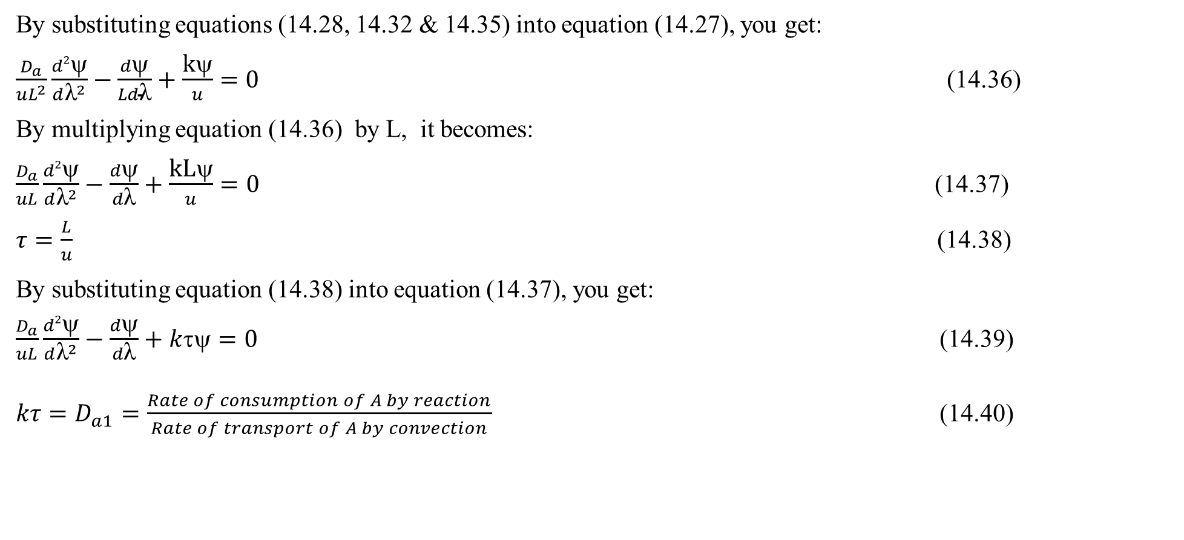
Cont’d
By substituting equations (14.28, 14.32 & 14.35) into equation (14.27), you get:
$\frac{D_{a}}{uL^{2}}\frac{d2ψ}{d{\text{λ}}^{2}}−\frac{dψ}{Ld\text{λ}}+\frac{\text{k}\text{ψ}}{u}=0$ (14.36)
By multiplying equation (14.36) by L, it becomes:
$\frac{D_{a}}{uL}\frac{d2ψ}{d{\text{λ}}^{2}}−\frac{dψ}{d\text{λ}}+\frac{\text{k}\text{L}\text{ψ}}{u}=0$ (14.37)
$τ=\frac{L}{u}$ (14.38)
By substituting equation (14.38) into equation (14.37), you get:
$\frac{D_{a}}{uL}\frac{d2ψ}{d{\text{λ}}^{2}}−\frac{dψ}{d\text{λ}}+kτψ=0$ (14.39)
$kτ=D_{a1}=\frac{Rate of consumption of A by reaction}{Rate of transport of A by convection}$ (14.40)

Slide 38
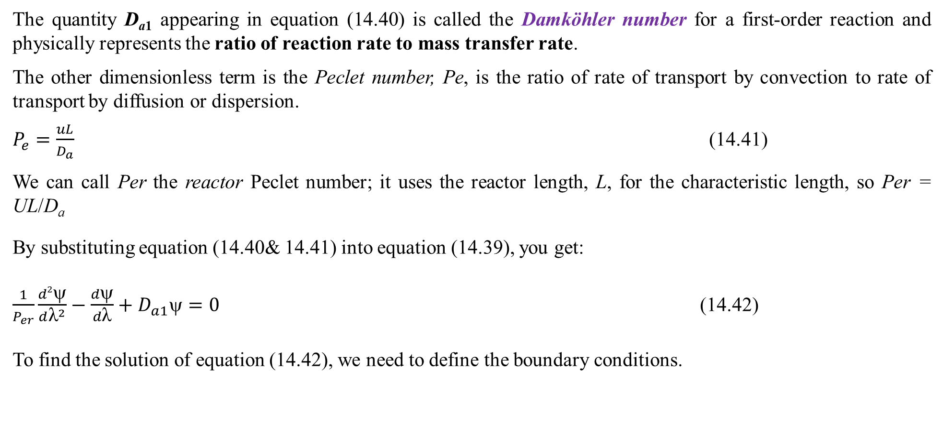
Cont’d
The quantity D_{a1} appearing in equation (14.40) is called the Damköhler number for a first-order reaction and physically represents the ratio of reaction rate to mass transfer rate.
The other dimensionless term is the Peclet number, Pe, is the ratio of rate of transport by convection to rate of transport by diffusion or dispersion.
$P_{e}=\frac{uL}{D_{a}}$ (14.41)
We can call Per the reactor Peclet number; it uses the reactor length, L, for the characteristic length, so Per = UL/D_{a}
By substituting equation (14.40& 14.41) into equation (14.39), you get:
$\frac{1}{P_{er}}\frac{d2ψ}{d{\text{λ}}^{2}}−\frac{dψ}{d\text{λ}}+D_{a1}ψ=0$ (14.42)
To find the solution of equation (14.42), we need to define the boundary conditions.

Slide 39
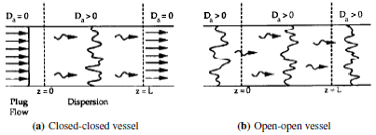
Cont’d
Boundary conditions
There are two cases that we need to consider: boundary conditions for closed vessels and for open vessels as shown in Figure 14.7 (Fogler, 2015, pg. 855).
Figure 14.7. (a) closed-closed vessel, and (b) open-open vessel boundary conditions

Slide 40
Cont’d
In the case of closed-closed vessels, we assume that there is no dispersion or radial variation in concentration either upstream (closed) or downstream (closed) of the reaction section; hence, this is a closed-closed vessel.
In an open vessel, dispersion occurs both upstream (open) and downstream (open) of the reaction section;
A closed-open vessel boundary condition is one in which there is no dispersion in the entrance section but there is dispersion in the reaction and exit sections.
Boundary conditions for closed-closed system
For a closed-closed vessel, we have plug flow (no dispersion) to the immediate left of the entrance line (z = 0–) (closed) and to the immediate right of the exit z = L (z = L⁺) (closed).
However, between z = 0⁺ and z = L–, we have dispersion and reaction.
The corresponding entrance boundary condition is At z = 0: F_{A}(0–) = F_{A}(0⁺)

Slide 41
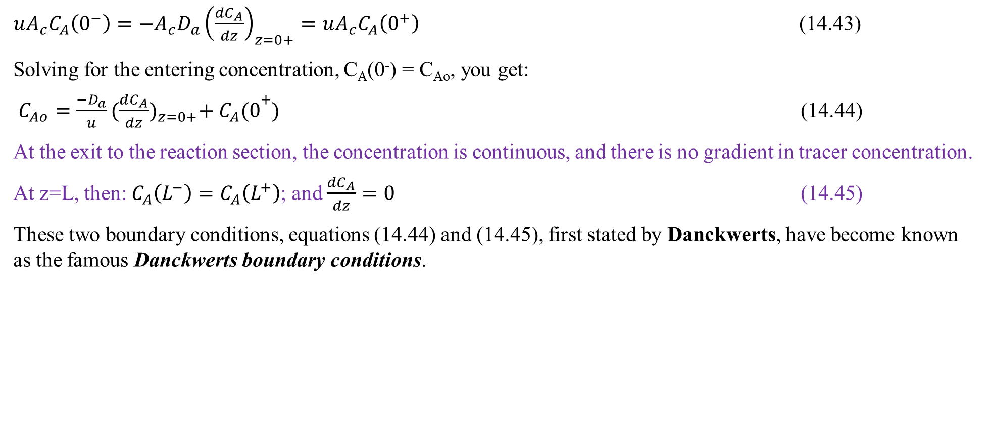
Cont’d
$uA_{c}C_{A}\left(0^{−}\right)=−A_{c}D_{a}{\left(\frac{{dC}_{A}}{dz}\right)}_{z=0+}=uA_{c}C_{A}\left(0^{+}\right)$ (14.43)
Solving for the entering concentration, C_{A}(0⁻) = C_{Ao}, you get:
$C_{Ao}=\frac{{−D}_{a}}{u}{(\frac{dC_{A}}{dz})}_{z=0+}+{ C}_{A}(0+)$ (14.44)
At the exit to the reaction section, the concentration is continuous, and there is no gradient in tracer concentration.
At z=L, then: $C_{A}\left(L^{−}\right)=C_{A}\left(L^{+}\right)$; and $\frac{{dC}_{A}}{dz}=0$ (14.45)
These two boundary conditions, equations (14.44) and (14.45), first stated by Danckwerts, have become known as the famous Danckwerts boundary conditions.

Slide 42
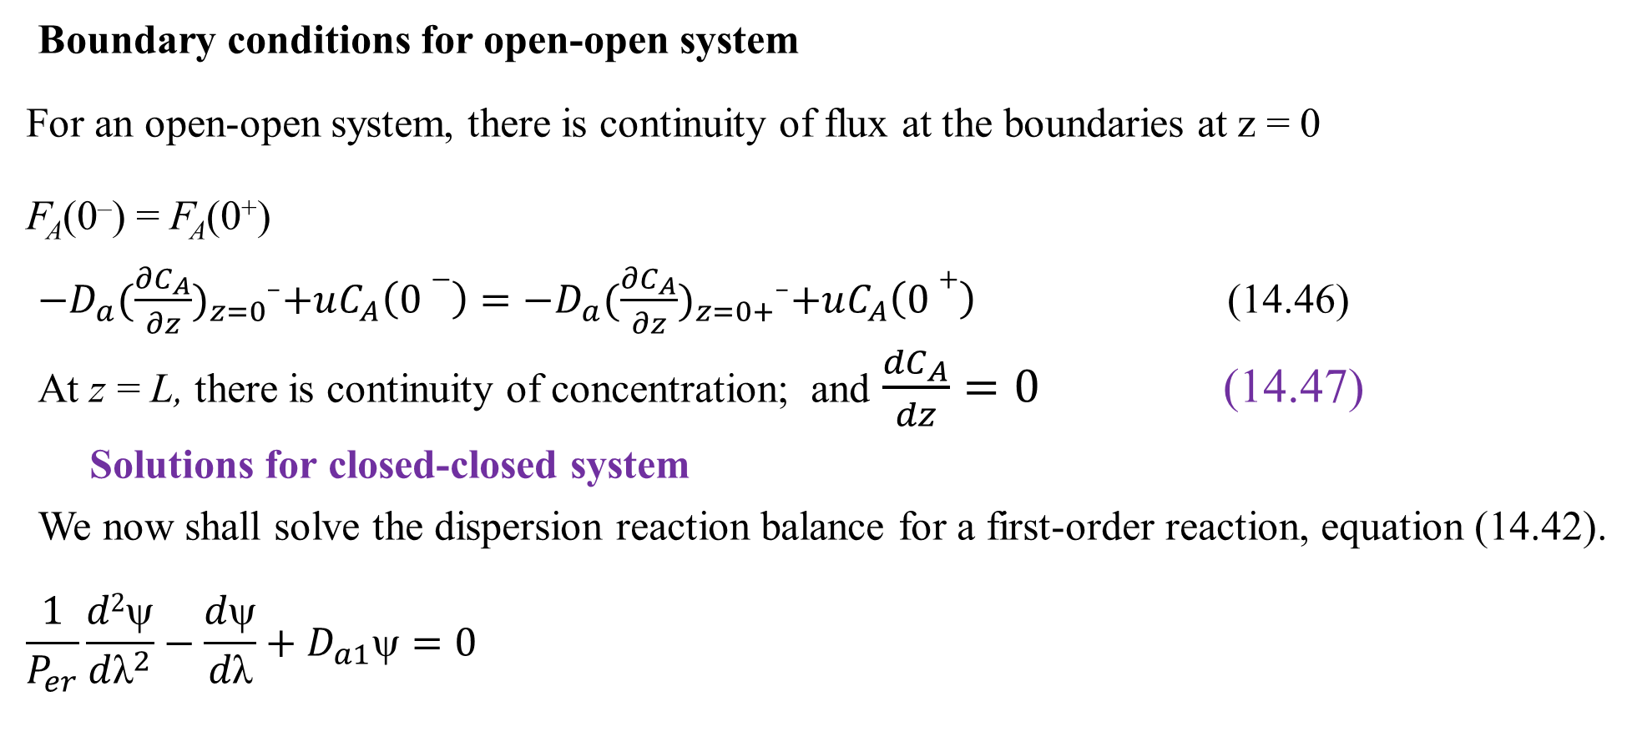
Cont’d
Boundary conditions for open-open system
For an open-open system, there is continuity of flux at the boundaries at z = 0
F_{A}(0–) = F_{A}(0⁺)
${−D}_{a}{(\frac{∂C_{A}}{∂z})}_{z=0−}+uC_{A}\left(0−\right)={−D}_{a}{(\frac{∂C_{A}}{∂z})}_{z=0+−}+uC_{A}\left(0+\right)$ (14.46)
At z = L, there is continuity of concentration; and $\frac{{dC}_{A}}{dz}=0$ (14.47)
Solutions for closed-closed system
We now shall solve the dispersion reaction balance for a first-order reaction, equation (14.42).
$$\frac{1}{P_{er}}\frac{d2ψ}{d{\text{λ}}^{2}}−\frac{dψ}{d\text{λ}}+D_{a1}ψ=0$$

Slide 43
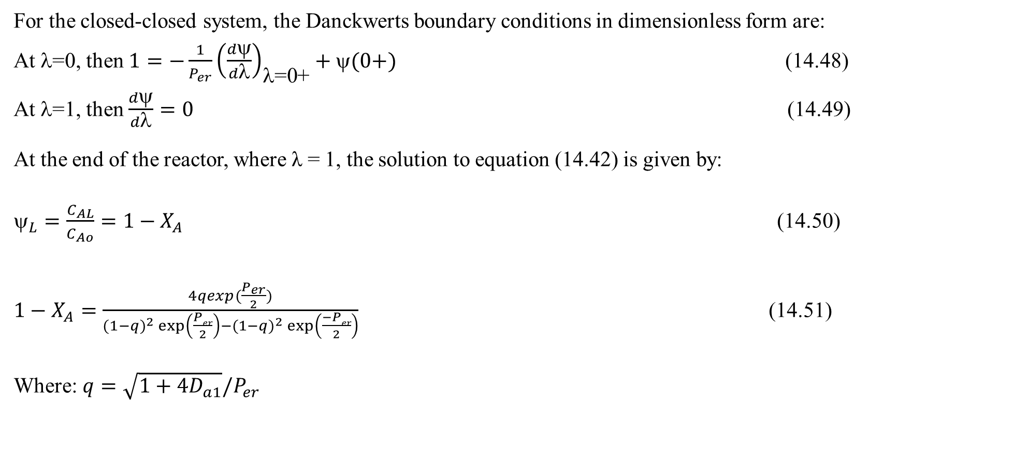
Cont’d
For the closed-closed system, the Danckwerts boundary conditions in dimensionless form are:
At λ=0, then $1=−\frac{1}{P_{er}}{\left(\frac{dψ}{d\text{λ}}\right)}_{\text{λ}\text{=0+}}+ψ(0+)$ (14.48)
At λ=1, then $\frac{dψ}{d\text{λ}}=0$ (14.49)
At the end of the reactor, where λ = 1, the solution to equation (14.42) is given by:
$_{L}=\frac{C_{AL}}{C_{Ao}}=1−X_{A}$ (14.50)
$1−X_{A}=\frac{4qexp(\frac{P_{er}}{2})}{(1−q)^{2}\exp\left(\frac{Per}{2}\right)−(1−q)^{2}\exp\left(\frac{−Per}{2}\right)}$ (14.51)
Where: $q=\sqrt{1+4D_{a1}}/P_{er}$

Slide 44
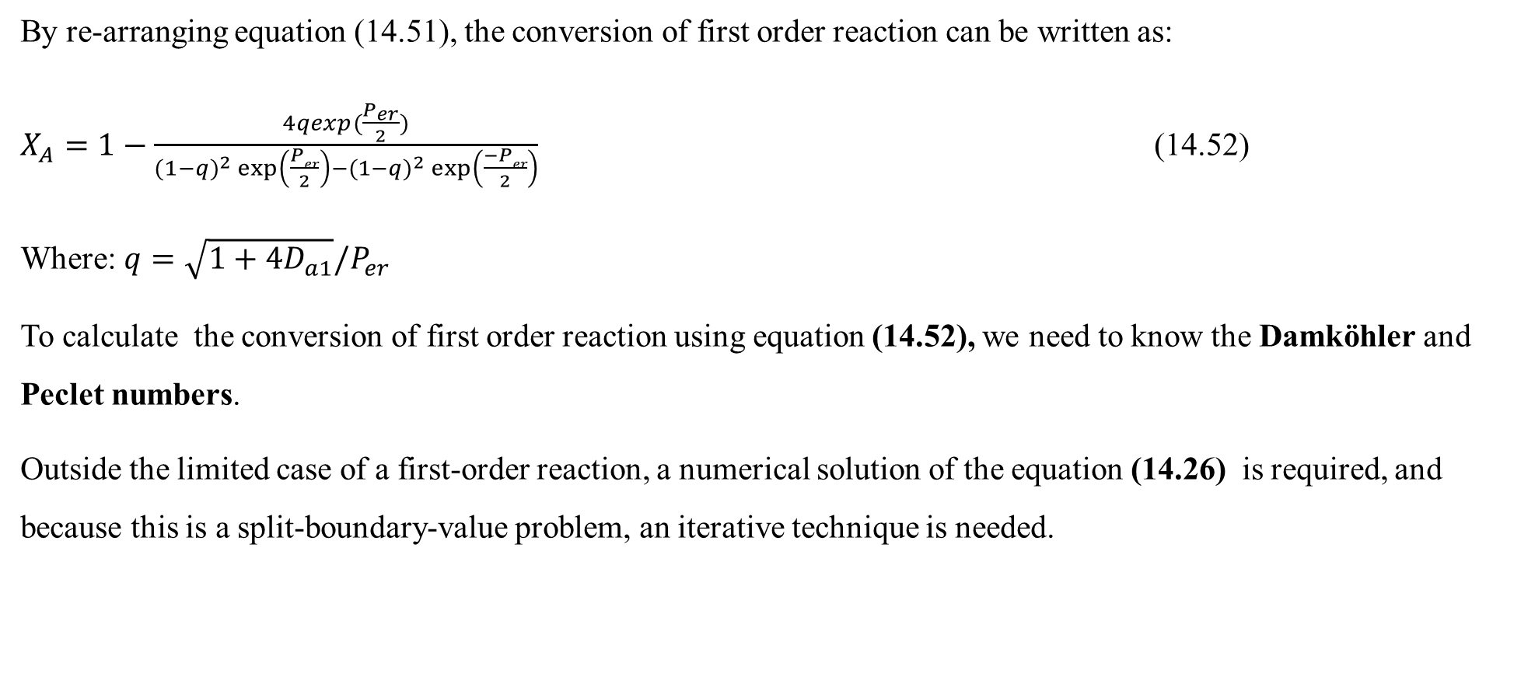
Cont’d
By re-arranging equation (14.51), the conversion of first order reaction can be written as:
$X_{A}=1−\frac{4qexp(\frac{P_{er}}{2})}{(1−q)^{2}\exp\left(\frac{Per}{2}\right)−(1−q)^{2}\exp\left(\frac{−Per}{2}\right)}$ (14.52)
Where: $q=\sqrt{1+4D_{a1}}/P_{er}$
To calculate the conversion of first order reaction using equation (14.52), we need to know the Damköhler and Peclet numbers.
Outside the limited case of a first-order reaction, a numerical solution of the equation (14.26) is required, and because this is a split-boundary-value problem, an iterative technique is needed.

Slide 45
Cont’d
Experimental determination of D_{a}
The dispersion coefficient can be determined from a pulse tracer experiment.
Use t_{m} and σ² to solve for the Peclet number, P_{er} and then the dispersion coefficient D_{a}.
Here the effluent concentration of the reactor is measured as a function of time.
From the effluent concentration data, the mean residence time, t_{m}, and variance, σ², are calculated, and these values are then used to determine D_{a}.

Slide 46
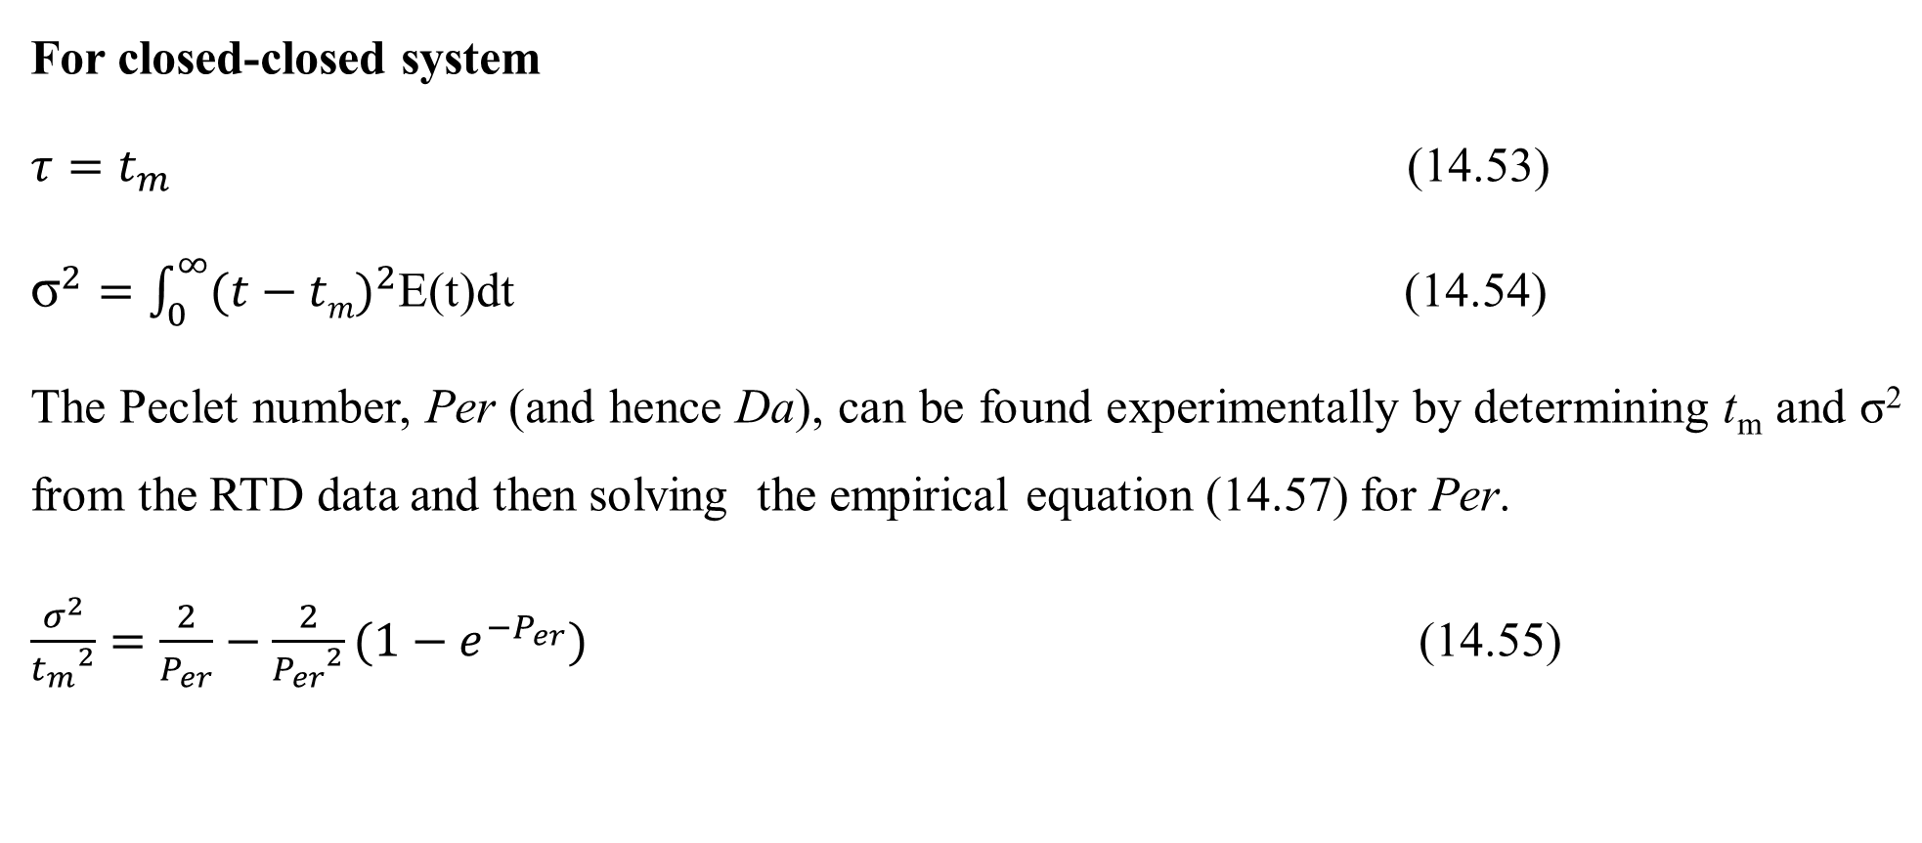
Cont’d
For closed-closed system
$τ=t_{m}$ (14.53)
${\text{σ}}^{2}=\int_{0}^{∞}{{(t−tm)}^{2}}$E(t)dt (14.54)
The Peclet number, Per (and hence Da), can be found experimentally by determining t_{m} and σ² from the RTD data and then solving the empirical equation (14.57) for Per.
$\frac{σ^{2}}{{t_{m}}^{2}}=\frac{2}{P_{er}}−\frac{2}{{P_{er}}^{2}}(1−e^{−P_{er}})$ (14.55)

Slide 47
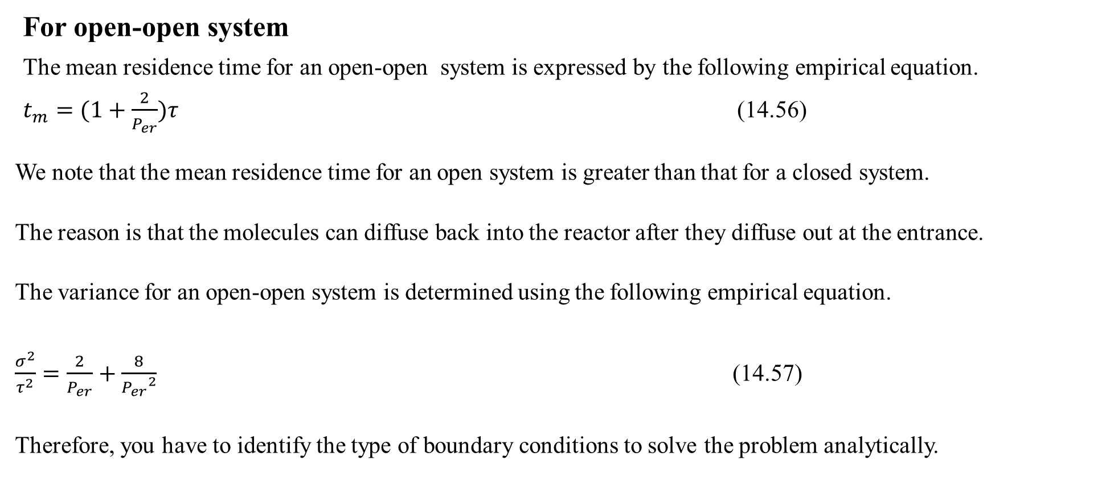
Cont’d
For open-open system
The mean residence time for an open-open system is expressed by the following empirical equation.
$t_{m}=(1+\frac{2}{P_{er}})τ$ (14.56)
We note that the mean residence time for an open system is greater than that for a closed system.
The reason is that the molecules can diffuse back into the reactor after they diffuse out at the entrance.
The variance for an open-open system is determined using the following empirical equation.
$\frac{σ^{2}}{τ^{2}}=\frac{2}{P_{er}}+\frac{8}{{P_{er}}^{2}}$ (14.57)
Therefore, you have to identify the type of boundary conditions to solve the problem analytically.

Slide 48
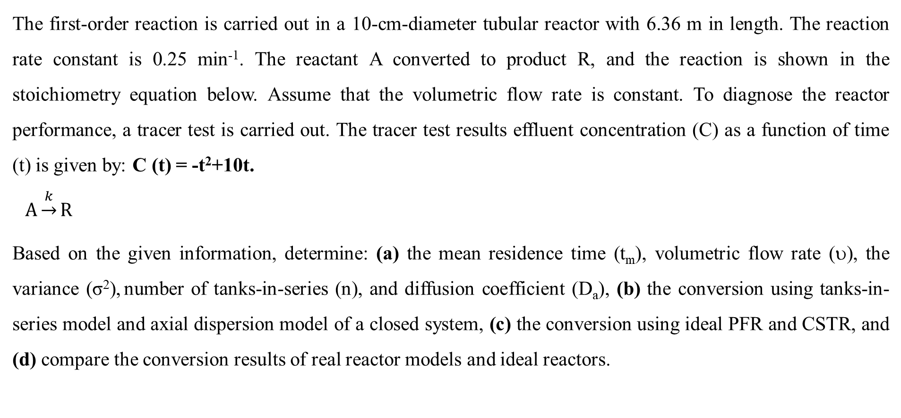
Activity 14.2
The first-order reaction is carried out in a 10-cm-diameter tubular reactor with 6.36 m in length. The reaction rate constant is 0.25 min⁻¹. The reactant A converted to product R, and the reaction is shown in the stoichiometry equation below. Assume that the volumetric flow rate is constant. To diagnose the reactor performance, a tracer test is carried out. The tracer test results effluent concentration (C) as a function of time (t) is given by: C (t) = -t²+10t.
$A\underset{→}{k}R$
Based on the given information, determine: (a) the mean residence time (t_{m}), volumetric flow rate (υ), the variance (σ²), number of tanks-in-series (n), and diffusion coefficient (D_{a}), (b) the conversion using tanks-in-series model and axial dispersion model of a closed system, (c) the conversion using ideal PFR and CSTR, and (d) compare the conversion results of real reactor models and ideal reactors.

Slide 49
Cont’d
Given: First order reaction
Diameter of reactor, D = 10 cm = 0.1 m; length of reactor, L=6.36 m, k = 0.25 min⁻¹, tracer test response function, C(t)= -t²+10t
Use closed-closed system boundary conditions.
Required
t_{m}, σ², υ & D_{a} =?
X_{A}= ? , for both tanks-in-series model and axial dispersion model
X_{A}= ? , for ideal CSTR and PFR
Compare the conversion results of real reactor models and ideal reactors

Slide 50
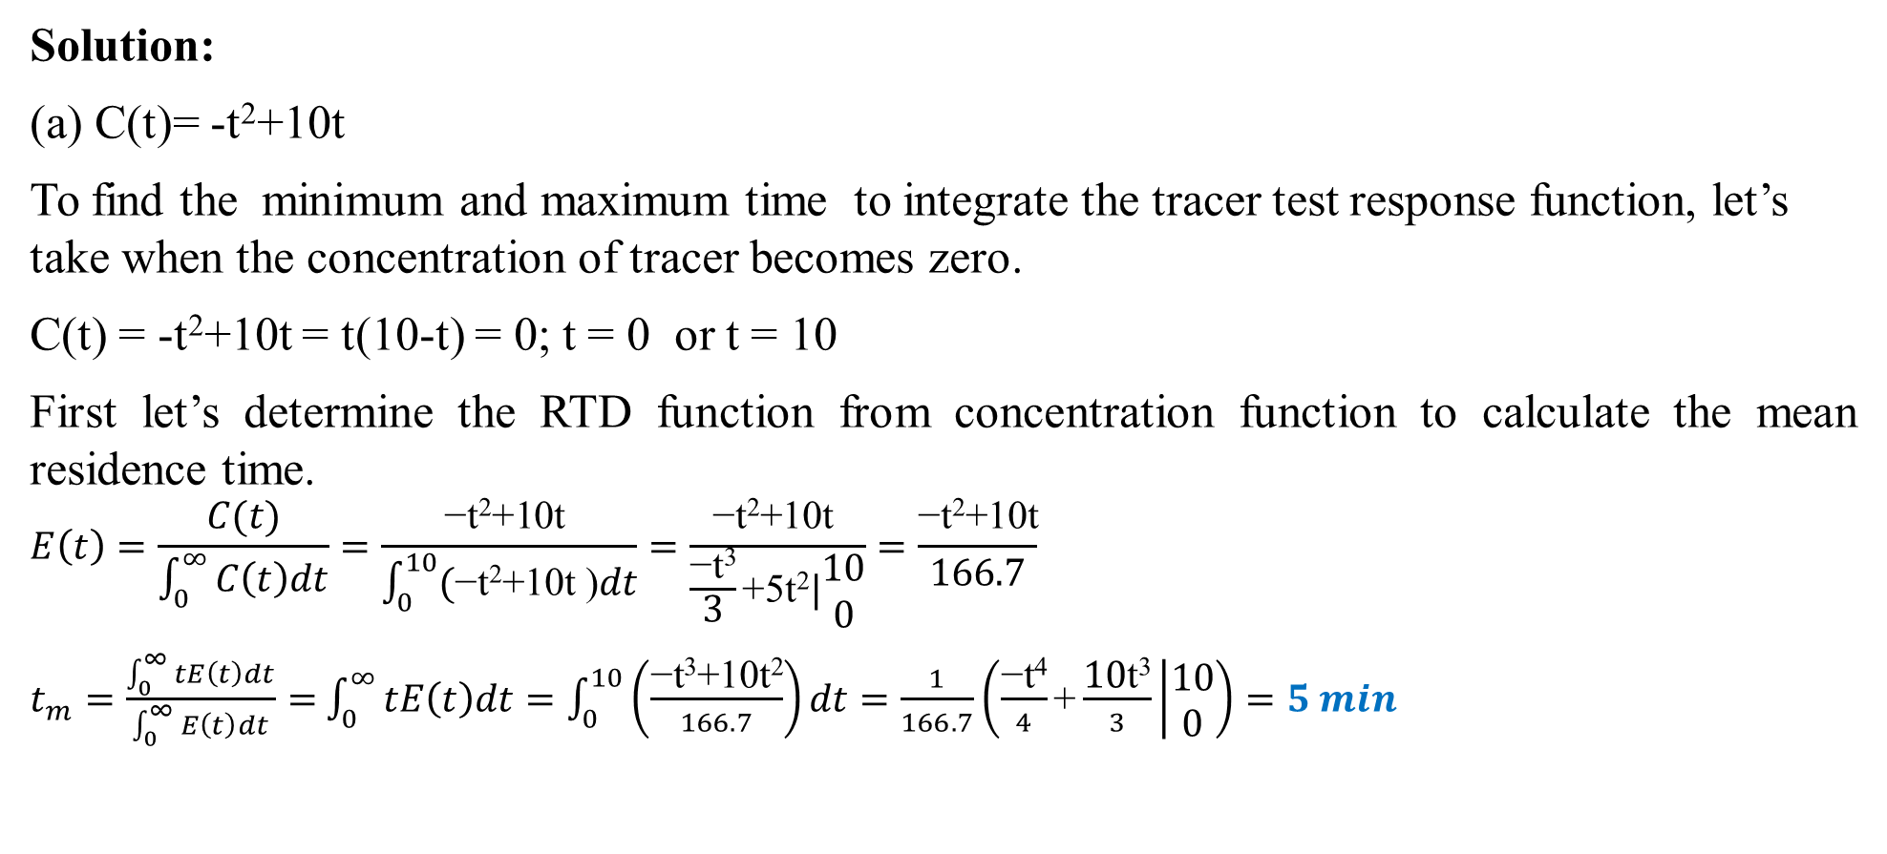
Cont’d
Solution:
(a) C(t)= -t²+10t
To find the minimum and maximum time to integrate the tracer test response function, let’s take when the concentration of tracer becomes zero.
C(t) = -t²+10t = t(10-t) = 0; t = 0 or t = 10
First let’s determine the RTD function from concentration function to calculate the mean residence time.
$$E\left(t\right)=\frac{C(t)}{\int_{0}^{∞}{C\left(t\right)dt}}=\frac{\text{−}\text{t}\text{2}\text{+10}\text{t} }{\int_{0}^{10}{(\text{−}\text{t}\text{2}\text{+10}\text{t}\text{ )}dt}}=\frac{\text{−}\text{t}\text{2}\text{+10}\text{t} }{\frac{\text{−}\text{t}\text{3}}{3}\text{+5}\text{t}\text{2}|\begin{matrix}10 \\ 0\end{matrix}}=\frac{\text{−}\text{t}\text{2}\text{+10}\text{t}}{166.7}$$
$t_{m}=\frac{\int_{0}^{∞}{tE\left(t\right)dt}}{\int_{0}^{∞}{E\left(t\right)dt}}=$ $\int_{0}^{∞}{tE\left(t\right)dt}=\int_{0}^{10}{\left(\frac{\text{−}\text{t}\text{3}\text{+10}\text{t}\text{2}}{166.7}\right)dt=\frac{1}{166.7}\left(\frac{\text{−}\text{t}\text{4}}{4}\text{+}\frac{\text{10}\text{t}\text{3}}{3} | \begin{matrix}10 \\ 0\end{matrix}\right)=5 min}$

Slide 51
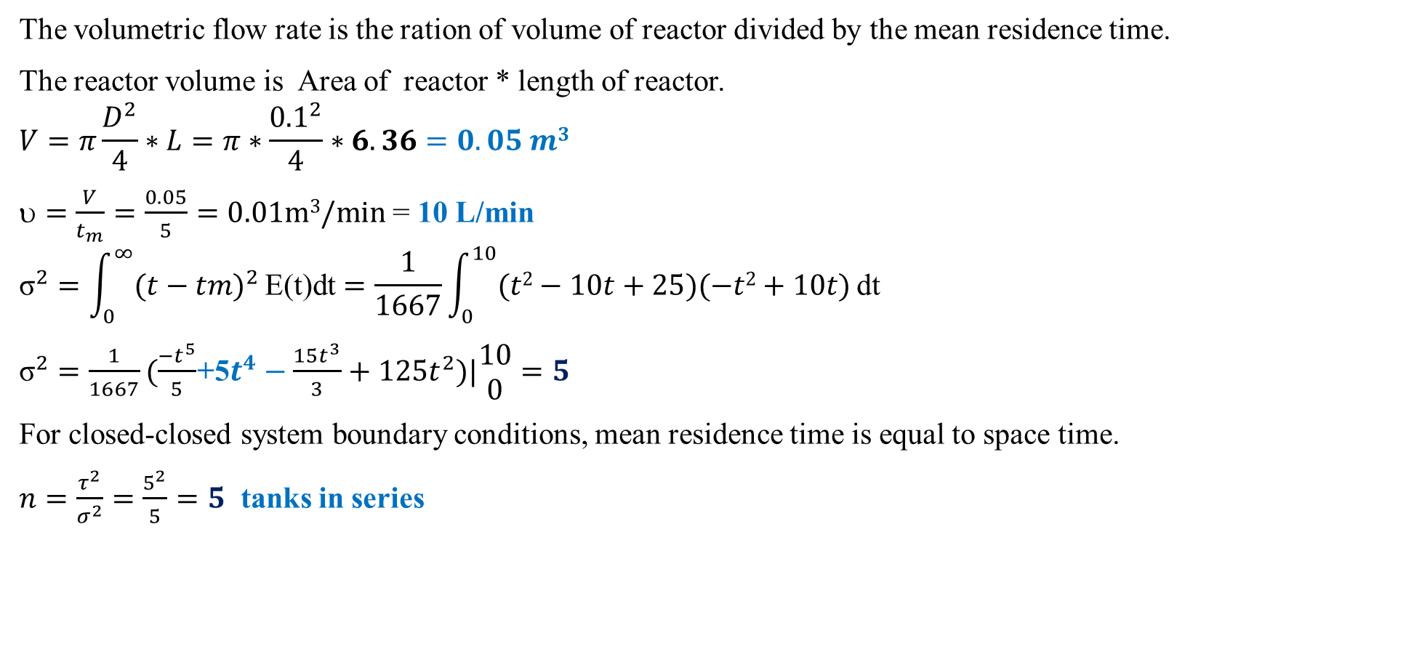
Cont’d
The volumetric flow rate is the ration of volume of reactor divided by the mean residence time.
The reactor volume is Area of reactor * length of reactor.
$$V=π\frac{D^{2}}{4}∗L=π∗\frac{{0.1}^{2}}{4}∗6.36=0.05 m3$$
$=\frac{V}{t_{m}}=\frac{0.05}{5}=0.01m3/min$ = 10 L/min
$${\text{σ}}^{2}=\int_{0}^{∞}{{(t−tm)}^{2}}\text{E}\text{(}\text{t}\text{)}\text{dt}=\frac{1}{1667}\int_{0}^{10}{(t2−10t+25)(−t2+10t)}\text{dt}$$
${\text{σ}}^{2}=\frac{1}{1667}(\frac{{−t}^{5}}{5}$+5$t^{4}−\frac{{15t}^{3}}{3}+125t^{2})|\begin{matrix}10 \\ 0\end{matrix}=5$
For closed-closed system boundary conditions, mean residence time is equal to space time.
$n=\frac{τ^{2}}{σ^{2}}=\frac{5^{2}}{5}=5$ tanks in series

Slide 52
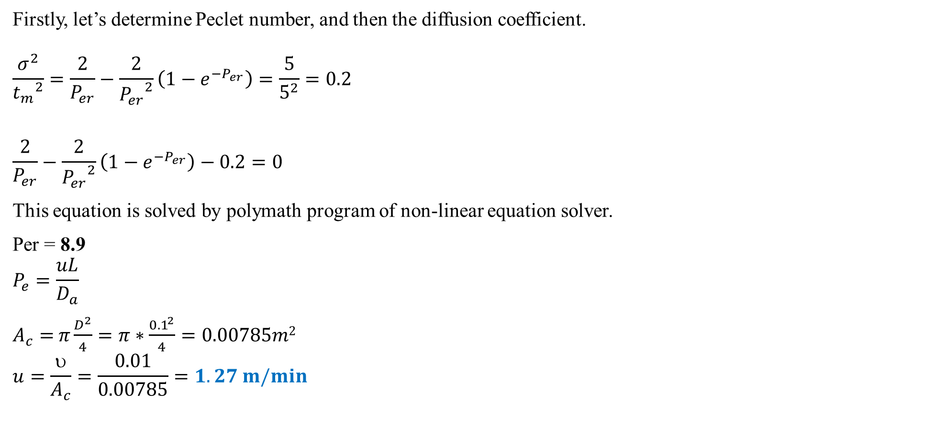
Cont’d
Firstly, let’s determine Peclet number, and then the diffusion coefficient.
$$\frac{σ^{2}}{{t_{m}}^{2}}=\frac{2}{P_{er}}−\frac{2}{{P_{er}}^{2}}\left(1−e^{−P_{er}}\right)=\frac{5}{5^{2}}=0.2$$
$$\frac{2}{P_{er}}−\frac{2}{{P_{er}}^{2}}\left(1−e^{−P_{er}}\right)−0.2=0$$
This equation is solved by polymath program of non-linear equation solver.
Per = 8.9
$$P_{e}=\frac{uL}{D_{a}}$$
$A_{c}=$ $π\frac{D^{2}}{4}=π∗\frac{{0.1}^{2}}{4}=0.00785m2$
$$u=\frac{υ}{A_{c}}=\frac{0.01}{0.00785}=1.27 m/min$$

Slide 53
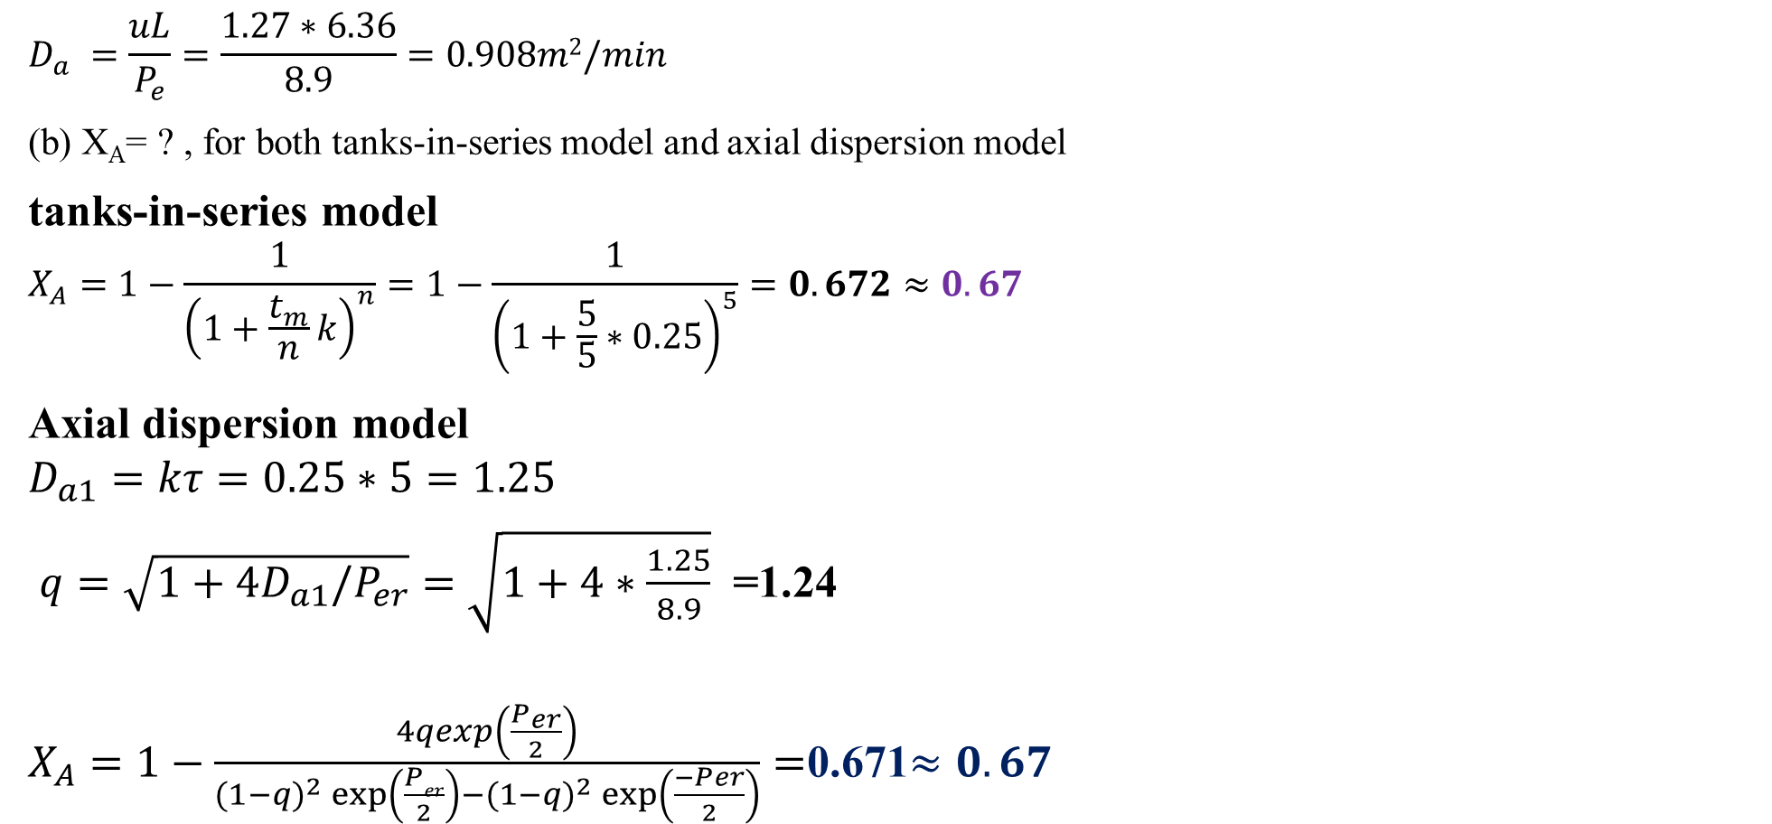
Cont’d
$$D_{a} =\frac{uL}{P_{e}}=\frac{1.27∗6.36}{8.9}=0.908m2/min$$
(b) X_{A}= ? , for both tanks-in-series model and axial dispersion model
tanks-in-series model
$$X_{A}=1−\frac{1}{{\left(1+\frac{t_{m}}{n}k\right)}^{n}}=1−\frac{1}{{\left(1+\frac{5}{5}∗0.25\right)}^{5}}=0.672≈0.67$$
Axial dispersion model
$$D_{a1}=kτ=0.25∗5=1.25$$
$q=\sqrt{1+4D_{a1}/P_{er}}=$ $\sqrt{1+4∗\frac{1.25}{8.9}}$ =1.24
$X_{A}=1−\frac{4qexp\left(\frac{P_{er}}{2}\right)}{(1−q)^{2}\exp\left(\frac{Per}{2}\right)−(1−q)^{2}\exp\left(\frac{−Per}{2}\right)}=$0.671$≈0.67$

Slide 54
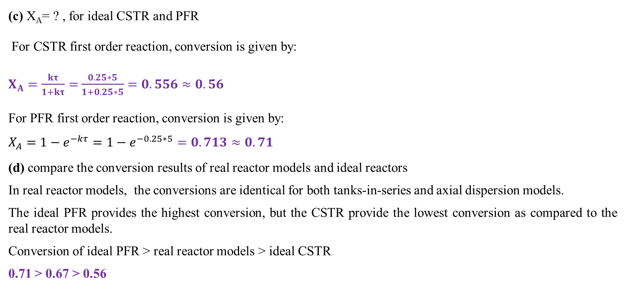
Cont’d
(c) X_{A}= ? , for ideal CSTR and PFR
For CSTR first order reaction, conversion is given by:
$X_{A}=\frac{kτ}{1+kτ}=$ $\frac{0.25∗5}{1+0.25∗5}=0.556≈0.56$
For PFR first order reaction, conversion is given by:
$$X_{A}=1−e^{−kτ}=1−e^{−0.25∗5}=0.713≈0.71$$
(d) compare the conversion results of real reactor models and ideal reactors
In real reactor models, the conversions are identical for both tanks-in-series and axial dispersion models.
The ideal PFR provides the highest conversion, but the CSTR provide the lowest conversion as compared to the real reactor models.
Conversion of ideal PFR > real reactor models > ideal CSTR
0.71 > 0.67 > 0.56

Slide 55
14.4. Summary
Tanks-in-series model and axial dispersion model, which have small deviations from plug flow.
The basic requirements of models for non-ideal reactors are:
the model must be mathematically tractable/ manageable/ controllable;
the model must realistically describe the characteristics of the non-ideal reactors; and
the model should not have more than two adjustable parameters.
Tanks-in-series model and axial dispersion model are a one-parameter model that is used to account for the non-ideality of a reactor.
The axial dispersion material balance equation can be non linear second order ordinary differential equation if the order of reaction is not zero order or first order, which should be solved using numerical techniques.

Slide 56
References
Chemical Reaction Engineering, Levenspiel, O John Wiely & Sons, 3rd edition, 2011.
Elements of Chemical Engineering, Fogler, HS Prentice- Hall Inc Prentice- Hall Inc, 5th edition, 2015.
Thank you!

