Slide 1
Power Plant Engineering
Lecture 1
Introduction
Lecturer: Dr. Melaku Desta

Slide 2
Lecture learning outcomes:
At the end of this lecture, you will be able to:
Identify and classify raw energy resources such as fossil fuels, nuclear, solar, wind, hydro, and geothermal sources.
Explain the environmental and economic impacts of utilizing various raw energy resources.
Describe the principles of direct energy conversion systems, including thermoelectric, photovoltaic, and fuel cell technologies.
Compare direct and indirect energy conversion methods in terms of efficiency, scalability, and application.
Understand the working principles of indirect energy
conversion power plants, such as steam turbines, gas turbines
and internal combustion engines.

Slide 3
Content
Fundamentals of Power Plant
Classifications of Power Plant
Raw Energy Resources
Energy Conversion Systems
Direct Energy Conversion Systems
Indirect Energy Conversion Power Plants
Summary
References

Slide 4
1. Fundamentals of Power Plant
Power Plant Engineering is a specialized branch of energy engineering that deals with the design, construction, operation, and maintenance of power plants used for electricity generation [1].
It is assembly of systems or subsystems to generate electricity, i.e, to produce power with economy and requirements.
So the power produced must be:
  Economically useful
  Environmental friendly to society
In general, power plant can be defined as:
“A machine or assembly of equipment that generate and deliver a flow of
mechanical or electrical energy.’’

Slide 5
1. Fundamentals of Power Plant Cont…
Power Plant is a highly interdisciplinary field that combines principles from:
  Mechanical Engineering (thermodynamics, fluid mechanics, heat transfer, turbine design)
  Electrical Engineering (power generation, transformers, grid integration, control systems)
  Civil Engineering (structural design of dams, building foundations, cooling towers)
  Chemical Engineering (combustion, emissions control,
  water chemistry)
  Environmental Science (pollution control, waste management,
  sustainability)

Slide 6
1. Fundamentals of Power Plant Cont…
The fundamental process that power plant engineering manages is the energy conversion chain. i.e. all power plants are energy conversion systems.
Primary Energy Source → Thermal/Mechanical Energy → Electrical Energy
(Input Energy) (Conversion Process) (Output Energy)
This process can be broken down as follows:
  Energy Release
  Mechanical Work
  Electricity Generation
  Transmission & Distribution

Slide 7
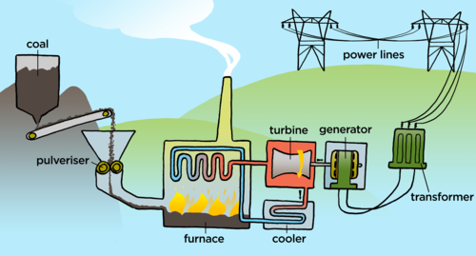
1. Fundamentals of Power Plant Cont…
Figure 1. Fundamental Processes of Power Plant. Siyavula Education, n.d.
url: https://www.siyavula.com/read/za/natural-sciences/grade-7/the-national-electricity-supply-system/images/gr7ec06-gd-0005.png

Slide 8
2. Classifications of Power Plant
Understanding the classification of power plants helps in selecting the appropriate type for specific applications, optimizing efficiency, cost, and environmental impact [2].
Power plants can be classified based on several criteria, including:
  The primary energy source used
  The energy conversion method
  The type of load they serve
  Their operational strategy, and
  The technology they employ

Slide 9
2. Classifications of Power Plant Cont…
  1. Based on Primary Energy Source
This is the most common method of classification.
Thermal Power Plants
  Use heat energy (from coal, oil, natural gas, or nuclear reactions) to produce steam that drives turbines.
  Examples: Coal-fired, Gas turbine, Nuclear power plants.
Hydroelectric Power Plants
  Use potential energy of stored or flowing water to drive
  turbines.
  Example: Dam-based or run-of-river hydro plants.

Slide 10
2. Classifications of Power Plant Cont…
Renewable Energy Power Plants
Utilize naturally replenished sources.
  Solar Power Plants: Convert sunlight using photovoltaic cells or solar thermal systems.
  Wind Power Plants: Use wind turbines to generate electricity.
  Biomass Power Plants: Use organic materials as fuel.
  Geothermal Power Plants: Extract heat from the Earth’s crust.

Slide 11
2. Classifications of Power Plant Cont…
2. Based on Energy Conversion Method
Direct Energy Conversion Systems
  Convert primary energy directly into electrical energy without intermediate mechanical processes.
  Examples: Fuel cells, Solar PV, Thermoelectric generators.
Indirect Energy Conversion Systems
  Convert primary energy into thermal/mechanical energy first, then into electricity.
  Examples: Steam turbines in coal, nuclear, and geothermal
  plants.

Slide 12
2. Classifications of Power Plant Cont…
3. Based on Prime Mover Used
    Steam Turbine Plants
    Gas Turbine Plants
    Hydraulic Turbine Plants
    Internal Combustion Engine Plants

Slide 13
3. Raw Energy Resources
  Energy sources are systems or materials capable of delivering sufficient energy in a usable form over extended periods.
  Raw energy sources are natural sources of energy used directly or after minor processing to produce electricity [3].
  The primary sources of energy, excluding human and animal power, include fossil fuels (such as petroleum, natural gas, and coal), biomass, geothermal energy, nuclear power, wind, and solar energy.
  Raw energy resources can be renewable or non-renewable
  energy sources.

Slide 14
3. Raw Energy Resources Cont.…
Classification of Raw Energy Sources
Non-Renewable Energy Sources
Non-renewable energy sources are those that exist in finite quantities and cannot be replenished within a human timescale.
Once consumed, they take millions of years to form again-making them unsustainable in the long run.
Examples:
  Coal
  Petroleum (Oil)
  Natural Gas
  Nuclear (Uranium, Thorium)

Slide 15
3. Raw Energy Resources Cont.…
Classification of Raw Energy Sources
Renewable Energy Sources
Renewable energy sources are those that are naturally replenished on a human timescale and can be used to generate electricity, heat, or fuel without depleting the Earth's resources.
They have low environmental impact and increasing role in sustainable power generation.
Examples:
  Solar Energy
  Wind Energy
  Hydro Energy
  Biomass Energy
  Geothermal Energy

Slide 16
3. Raw Energy Resources Cont.…
1. Non-Renewable Energy Sources
Coal
Coal is a combustible black or brownish-black sedimentary rock formed from the fossilized remains of ancient plants.
Most widely used in thermal power plants
Coal comes in four main types, also known as ranks based on its carbon content, i.e., Lignite, Bituminous, Subbituminous, Anthracite
While it boasts a high energy density, its combustion
releases substantial pollutants, making it a major contributor
to climate change.

Slide 17
3. Raw Energy Resources Cont.…
Petroleum (Oil) and Natural Gas
Petroleum (also called crude oil) and natural gas are two of the most important fossil fuels.
They’re formed from ancient organic matter, i.e., plants and animals, that was buried under layers of sediment and subjected to heat and pressure over millions of years.
They are used in gas turbines and diesel power plants
They offer high energy efficiency and rapid start-up capabilities,
but are hindered by price volatility and finite reserves.

Slide 18
3. Raw Energy Resources Cont.…
Nuclear Energy
Nuclear energy is the power released from the nucleus of an atom-the dense center made up of protons and neutrons.
It’s one of the most concentrated forms of energy.
The principal fuel types used in nuclear energy are Uranium-235 and Thorium-232.
Nuclear energy offers a high energy output with minimal greenhouse gas emissions, but its drawbacks include the generation of
radioactive waste and significant safety concerns.

Slide 19
3. Raw Energy Resources Cont.…
Renewable Energy Sources
Solar Energy
  Solar energy is the radiant energy emitted by the Sun, which can be harnessed to produce heat, electricity, or drive chemical reactions.
  It’s the most abundant energy source on Earth and a cornerstone of renewable energy technologies
  Solar energy is captured using two main methods:
    Photovoltaic (PV) Systems
    Concentrated Solar Power (CSP) Systems
  Solar energy faces challenges due to its reliance on weather
  conditions and time of day, along with the high upfront cost
  of installation.

Slide 20
3. Raw Energy Resources Cont.…
Wind Energy
Wind energy is a form of renewable energy that harnesses the kinetic energy of moving air to generate electricity.
It’s clean, sustainable, scalable technology, and one of the fastest-growing energy sources globally.
Wind turbines are primarily categorized into two types:
  Horizontal-axis wind turbines (HAWT) and,
  Vertical-axis wind turbines (VAWT)

Slide 21
3. Raw Energy Resources Cont.…
Hydro Energy
Hydro energy, also known as hydroelectric energy, harnesses the power of moving water-typically from rivers, streams, or dams-to generate electricity.
Hydropower plants can be classified by size into large-scale and small or micro-scale systems.
Hydropower plants offer clean, renewable energy with low operating costs and reliable electricity generation, especially in regions with
abundant water resources.
However, they can cause significant environmental disruption,
including habitat loss, and often require high initial investment.

Slide 22
3. Raw Energy Resources Cont.…
iv. Biomass and Geothermal
Biomass energy is derived from organic materials-such as wood, crop residues, animal waste, and even food scraps.
When these materials are burned or biologically processed, they release energy that can be used for electricity, heating, or biofuels like ethanol and biodiesel.
Geothermal energy harnesses the heat from beneath Earth’s surface.
This heat originates from the planet’s core and can be accessed
through wells that bring hot water or steam to the surface to
drive turbines and generate electricity.

Slide 23
3. Raw Energy Resources Cont.…
What are the Key Factors in Source Selection?
  Cost and availability
  Environmental impact
  Energy demand
  Plant location
  Technological maturity

Slide 24
4. Energy Conversion Systems
An energy conversion system refers to the process and machinery that transforms raw energy sources-like coal, natural gas, nuclear fuel, solar radiation, or wind-into usable electrical energy [4].
These systems are the heart of any power plant, and they operate based on principles of thermodynamics, fluid mechanics, and electrical engineering.
Each system has unique conversion paths, efficiencies, and environmental impacts.
Energy conversion systems are central to power generation,
industrial processes, and sustainable energy development.

Slide 25
4. Energy Conversion Systems Cont…
Components of Energy Conversion Systems
The main components of energy conversion system in power plants are:
  Energy Source: Raw input (coal, gas, uranium, sunlight, wind, etc.)
  Prime Mover: Converts energy into mechanical work (e.g., turbines, engines)
  Generator: Converts mechanical energy into electrical energy
  Auxiliary Systems: Boilers, condensers, cooling towers, control systems
Energy conversion system is divided into two:
  Direct energy conversion system
  Indirect energy conversion system

Slide 26
5. Direct Energy Conversion Systems
  Direct energy conversion refers to the transformation of one form of energy (e.g., chemical, solar, nuclear) directly into electrical energy without intermediate mechanical steps [5].
  However, traditional conventional power plants use mechanical systems (e.g., turbines) to convert thermal energy into electricity. Direct systems skip this step.
  This offers potential for:
    Higher efficiencies (not limited by Carnot efficiency).
    Higher reliability and longer life (no moving parts to wear out).
    Quiet operation and minimal maintenance.
    Modularity and portability.

Slide 27
5. Direct Energy Conversion Systems Cont…
Types of Direct Energy Conversion Systems
Thermoelectric Generators (TEGs)
Thermoelectric generators (TEGs) are fascinating devices that convert heat directly into electricity using a principle called the Seebeck Effect [6].
The Seebeck Effect is the phenomenon in which a voltage (electromotive force, or EMF) is generated across the junction of two different conductors or semiconductors when there is a temperature difference between them.
Unlike conventional power systems that rely on turbines and
moving parts, TEGs are solid-state, meaning they have no
moving components, making them quiet, durable, and ideal for
highly specific applications.

Slide 28
5. Direct Energy Conversion Systems Cont…
Applications of Thermoelectric Generators (TEGs)
  Spacecraft
  Automotive
  Industrial
  Remote Sensors
  Waste Heat Recovery
However, TEGs have very low efficiency, typically 5-8%.

Slide 29
5. Direct Energy Conversion Systems Cont…
Photovoltaic Cells (Solar Cells)
Photovoltaic (PV) cells, commonly known as solar cells, are semiconductor devices that converts sunlight directly into electricity using the photovoltaic effect.
They're the fundamental building blocks of solar panels and play a central role in harnessing solar energy.
Some of its advantage are:
  Renewable, abundant and clean energy source
  Reduces dependence on fossil fuels
  Scalable for both small and large installations
  Key to global decarbonization efforts

Slide 30
5. Direct Energy Conversion Systems Cont…
Application areas of photovoltaic cells
  Rooftop solar panels for homes and businesses
  Solar farms for utility-scale power
  Portable solar chargers and calculators
  Spacecraft and satellites

Slide 31
5. Direct Energy Conversion Systems Cont…
Fuel Cells
Fuel cells are electrochemical devices that convert the chemical energy of a fuel directly into electricity, without combustion.
They operate much like batteries but with a key difference: they continuously generate electricity as long as fuel and oxidizer are supplied.
Fuel cells are used in powering spacecraft, electric vehicles, backup systems, and even submarines.
They're a cornerstone of clean energy innovation.

Slide 32
5. Direct Energy Conversion Systems Cont…
Advantages of Fuel Cells
  High Efficiency
  Clean and Quite
  Reliable
  Flexible and Scalable
Application areas of fuel cells
  Transportation
  Stationary Power
  Portable Power

Slide 33
6. Indirect Energy Conversion Systems
An indirect energy conversion system is one where the energy from a source is not transformed directly into electricity (or useful work).
Instead, it is first converted into an intermediate form of energy, almost always thermal energy (heat), which is then used to produce the final desired form of energy, typically electrical energy.
In short, indirect energy conversion refers to the multi-step process of converting energy.
Unlike direct conversion systems (e.g., solar PV or fuel cells),
these systems rely on thermal and mechanical processes
before producing usable energy.

Slide 34
6. Indirect Energy Conversion Systems Cont…
Key characteristics of indirect energy systems:
Multi-stage conversion: Energy is transformed through heat, mechanical work, and finally electricity.
Thermodynamic cycles: These systems operate based on cycles like Rankine, Brayton, Otto, or Diesel.
High power output: Suitable for large-scale applications
like power plants and industrial facilities.

Slide 35
6. Indirect Energy Conversion Systems Cont…
Types of Indirect Energy Conversion Systems
1. Steam Power Plants
  A Steam Power Plant (also known as a thermal power plant) is a facility that converts heat energy from fuel combustion into mechanical energy, and then into electrical energy using a steam-driven turbine and generator [1].
  It operates on the Rankine cycle, which involves boiling water to produce steam, expanding it through a turbine, and condensing it back to water.
  Application Areas
    Electric Power Generation
    Industrial Heating

Slide 36
6. Indirect Energy Conversion Systems Cont…
Main Components Steam Power Plants:
  Boiler-Converts water into high-pressure steam using heat from fuel combustion
  Steam Turbine-Converts thermal energy of steam into mechanical energy
  Generator-Converts mechanical energy into electrical energy
  Condenser-Condenses exhaust steam from the turbine back into water
  Feed water Pump-Pumps condensed water back into the boiler

Slide 37
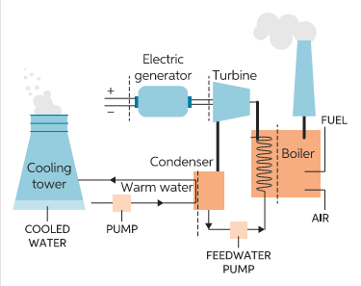
6. Indirect Energy Conversion Systems Cont…
Main Components of Steam Power Plants:
Figure 2. Harvesting Fusion Power – Main components of steam power plant." EDN Network, n.d
url: https://www.edn.com/wp-content/uploads/Power-Points-Blog-151_harvesting-fusion-power_Fig2.png?w=375&resize=375,297

Slide 38
6. Indirect Energy Conversion Systems Cont…
2. Gas Turbine Plants
  A gas turbine power plant is a type of thermal power station where air is compressed, mixed with fuel, and ignited to produce high-temperature gases that spin a turbine connected to a generator [1].
  Application Areas
    Electricity generation
    Aircraft propulsion
    Marine engines
    Industrial mechanical drives

Slide 39
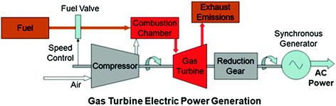
6. Indirect Energy Conversion Systems Cont…
Main Components of Gas Turbine Power Plants
  Compressor
  Combustion Chamber
  Turbine
  Generator
  Auxiliary Systems
Figure 3. Main Components of Gas Turbine Electric Power Plant.” GEMCO Pellet Mills, n.d.
url: http://www.gemcopelletmills.com/uploads/allimg/gas-turbine-electric-power-generation.jpg
Types of Gas Turbine Cycles
Open Cycle: Air enters and exits the system once.
Closed Cycle: Working fluid is recirculated.
Combined Cycle: Integrates a steam turbine for higher efficiency.

Slide 40
6. Indirect Energy Conversion Systems Cont…
3. Internal Combustion Engine
  An Internal Combustion Engine (ICE) is a heat engine where the combustion of fuel occurs with an oxidizer (usually air) inside a combustion chamber.
  The expanding gases directly apply force to engine components, converting chemical energy into mechanical work.
  Application Areas
    Automobiles and motorcycles
    Aircraft and ships
    Power generators
    Agricultural and construction machinery

Slide 41
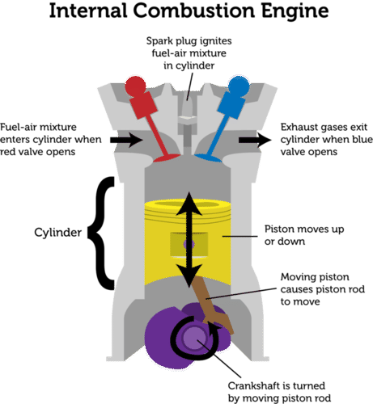
6. Indirect Energy Conversion Systems Cont…
Main Components of Internal Combustion Engine
  Cylinder
  Piston
  Crankshaft
  Valves
  Spark Plug
  Camshaft
Figure 4. Main components of internal combustion engine
url: https://encrypted-tbn0.gstatic.com/images?q=tbn:ANd9GcTFl5uFYgispiThpxBFOPZMirjvvk4HpGF9mA1u09VJfz_KavCqCiTd59z4&s
According to the combustion process, IC Engines can be classified:
SI Engine: Uses spark plug to ignite air-fuel mixture
CI Engine: Air is compressed to high temperature; fuel is injected
and auto-ignites

Slide 42
6. Indirect Energy Conversion Systems Cont…
4. Hydro Electric Plant
  A hydroelectric power plant converts the kinetic and potential energy of flowing or falling water into mechanical energy, which is then transformed into electrical energy using a generator [2].
  The key features of hydro electric plant are:
    Renewable and clean energy source
    High efficiency (up to 90%)
    Long operational lifespan

Slide 43
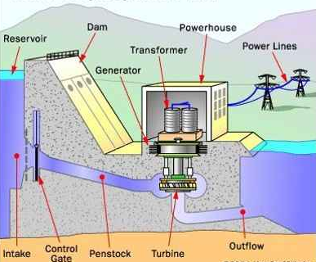
6. Indirect Energy Conversion Systems Cont…
Main components of hydro electric energy:
  Dam
  Reservoir
  Penstock
  Turbine
  Generator
  Transformer
Figure 5. Main components of hydro electric power
url: https://encrypted-tbn1.gstatic.com/images?q=tbn:ANd9GcSOaD180HlbwdmcOsLmk-Ae_T6YEhmjQoLWRECuq5RicY6YKdyg

Slide 44
6. Indirect Energy Conversion Systems Cont…
5. Nuclear Power Plant
  A nuclear power plant generates electricity using heat produced by nuclear fission, a process where the nucleus of an atom splits into smaller parts, releasing a tremendous amount of energy [1].
  The key features of nuclear power plant are:
    High energy density
    Low greenhouse gas emissions
    Reliable base-load power source

Slide 45
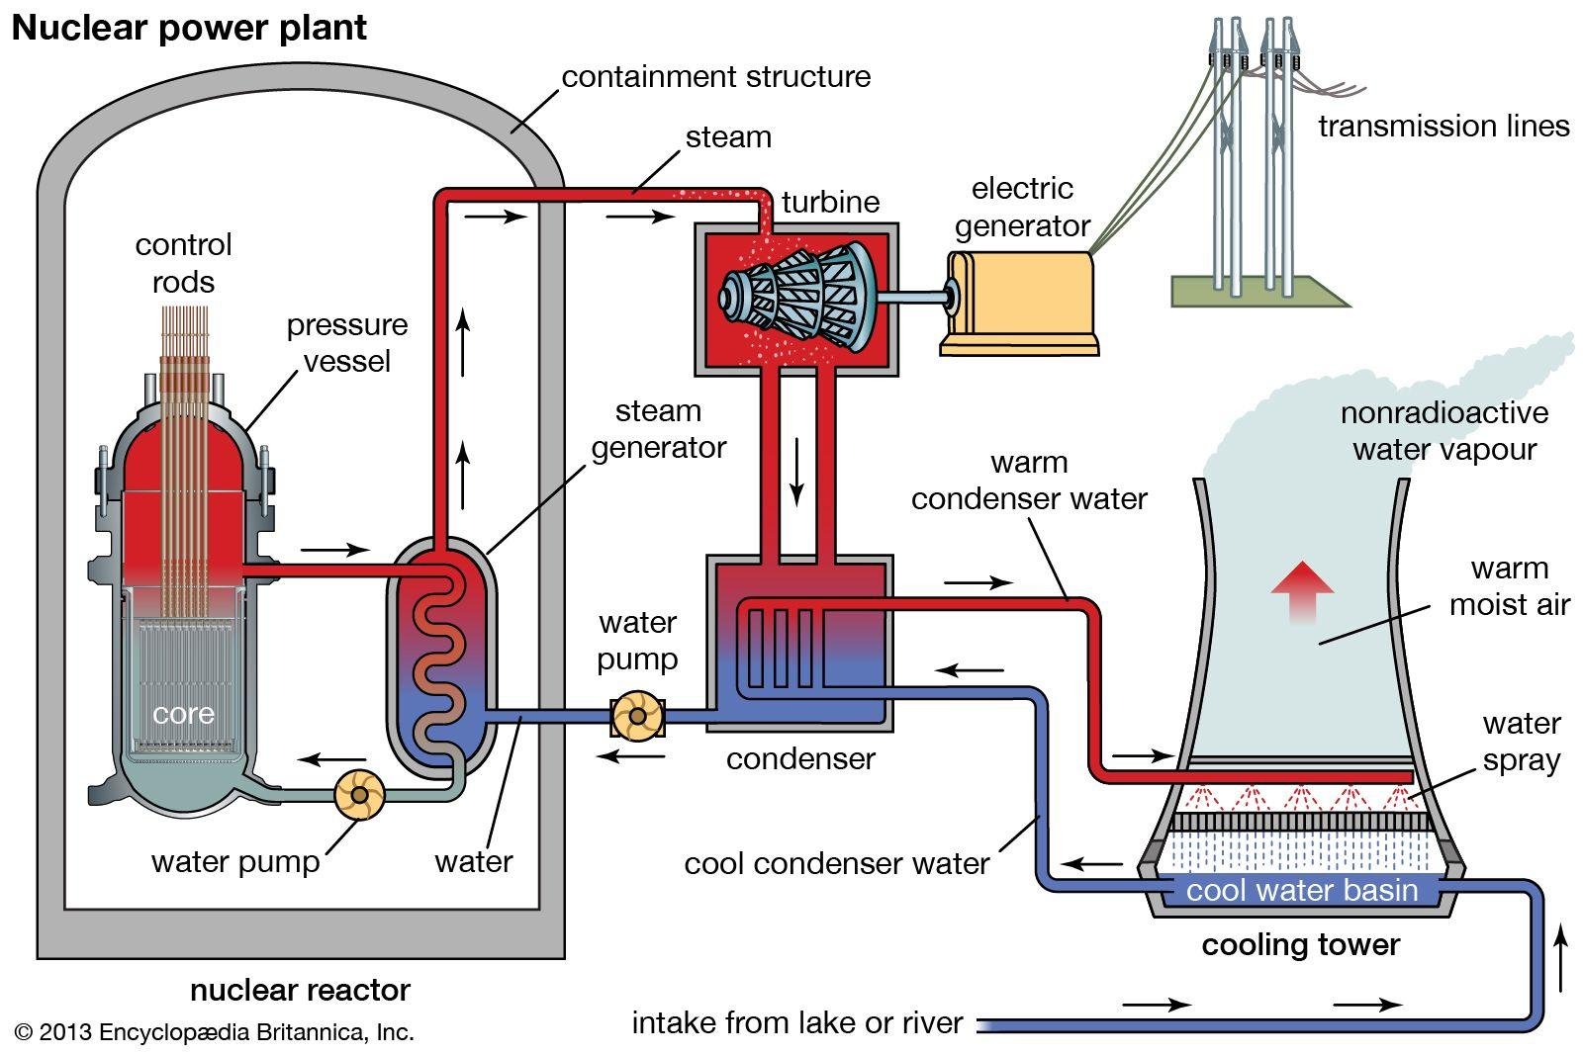
5. Indirect Energy Conversion Systems
Major components of nuclear power plant:
  Reactor Core
  Control Rods
  Coolant
  Steam Generator
  Turbine and Generator
  Containment Structure
Figure 6. Main components of nuclear power plant Reactor.” Encyclopædia Britannica, Inc., n.d.
url: https://cdn.britannica.com/62/162162-050-586ADA35/diagram-nuclear-power-plant-reactor.jpg

Slide 46
Summary
Power plants convert various forms of energy into electrical energy using mechanical systems and thermodynamic principles.
Power plants are categorized as thermal, hydroelectric, nuclear, solar, wind, and diesel based on energy source and conversion method.
Raw Energy Resources include conventional (coal, oil, natural gas) and renewable (solar, wind, hydro, biomass) sources used to fuel power generation.
Direct Energy Conversion Systems are technologies like fuel cells, thermoelectric generators, and solar PV convert energy directly into electricity without mechanical motion.
Indirect Energy Conversion Power Plants are systems like steam
turbines and gas turbines that convert thermal energy into
mechanical energy, then into electricity.

Slide 47
References
[1]. Power Plant Engineering, Larry Drbal, Kayla Westra, and Pat Boston, Springer, 2011.
[2]. Power Plant Engineering, R.K. Rajput, 3rd Edition, 2011.
[3]. The role of renewable energy in the global energy transformation, D. Gielen, F. Boshell, D. Saygin, M.D. Bazilian, N. Wagner, R. Gorini, Energy Strategy Reviews, 2021, https://doi.org/10.1016/j.esr.2019.01.006
[4]. A comprehensive review of hybrid renewable energy systems: Modeling, optimization, and applications, Khalid, F., Duan, J., Ouyang, T., & Naqvi, S. A. A. (2023). Energy Reports, 9, 5251–5282. https://doi.org/10.1016/j.egyr.2023.04.332
[5]. Thermoelectricity: Direct Energy Conversion from Heat to Electricity, D.M. Rowe, Institute of Physics Publishing, 2018.
[6]. Thermoelectric Generators: A Review of Applications,
D. Champier, Energy Conversion and
Management, 2017, https://doi.org/10.1016/j.enconman.2017.02.070

Slide 48
Thank you !

