Slide 1
Power Plant Engineering
Lecture 2
Analysis of Steam Cycles
Lecturer: Dr. Melaku Desta

Slide 2
Lecture learning outcomes:
At the end of this lecture, you will be able to:
Understand the Carnot Cycle's role as the theoretical benchmark for maximum possible thermal efficiency between two temperature reservoirs and recognize its practical limitations.
Grasp the Rankine Cycle's components and processes as the practical, foundational model for modern steam power plants, and be able to analyze its performance.
Identify sources of irreversibility that cause actual vapor cycles to deviate from idealized models, resulting in lower overall performance.
Explain the efficiency benefits of reheat and regeneration: reheat increases average heat addition temperature and reduces turbine exhaust moisture, while regeneration raises the average temperature of heat addition by using internal energy transfer.
Differentiate between the two main types of feed-water heaters:
open heaters and closed heaters, and understand their distinct roles
and integration points within a regenerative cycle.

Slide 3
Content
Power Plant Cycles
The Carnot Cycle
The Rankine Cycle
Deviation of Actual Vapor Power Cycles from Idealized Ones
The Ideal Reheat Rankine Cycle
The Ideal Regenerative Rankine Cycle
Types of Feed-Water Heaters
Summary
References

Slide 4
1. Power Plant Cycles
A power plant cycle is a conceptual and engineering model that describes the series of thermodynamic processes through which a working fluid (like water, steam, or gas) is circulated to convert heat into useful mechanical work, which is then almost always used to generate electricity [1].
In short, a power plant cycle is the fundamental blueprint that defines how a power plant operates to convert thermal energy into electrical energy.
The key principle behind these cycles is the
Second Law of Thermodynamics: heat cannot be
completely converted into work in a continuous process.

Slide 5
1. Power Plant Cycles Cont…
Therefore, a cycle must also reject a portion of the heat to a cold reservoir (like a river, ocean, or atmosphere via cooling towers).
Characteristics of all power plant cycles:
  i. Working fluid iv. Heat Rejection
  ii. Heat Addition v. Compression/Pumping
  iii. Work Output
Understanding power plant cycles is fundamental to:
  Increasing efficiency
  Designing power plants
  Selecting the right technology

Slide 6
1. Power Plant Cycles Cont…
Classification of Power Plant Cycles
  Power plant cycles are generally categorized by their working fluid and process.
  Thermal power plants in general may work on vapor or gas power cycles.
Vapor power cycles:
  Vapor power cycles are thermodynamic cycle where the working fluid is alternately vaporized and condensed.
  The key characteristic is that the working fluid undergoes a
  phase change from liquid to vapor and back again during
  the cycle.
Example: Rankine cycle, Reheat cycle, Regenerative cycle,
Binary vapor cycle

Slide 7
1. Power Plant Cycles Cont…
Gas power cycles
  A gas power cycle is a thermodynamic cycle in which the working fluid remains in the gaseous phase throughout the entire cycle.
  Unlike vapor power cycles (like the Rankine cycle), there is no phase change from liquid to vapor; the working fluid is always a gas.
  The most common working fluid is air, which is treated as an ideal gas for analysis.
Example: Otto cycles, Dual combustion cycle, Diesel cycles,
Gas turbine cycles

Slide 8
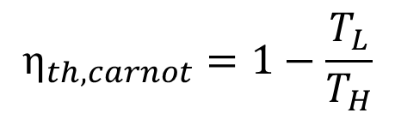
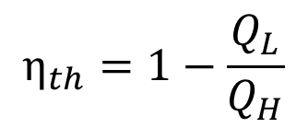
2. The Carnot Cycle
The Carnot cycle is a theoretical, idealized thermodynamic cycle that provides the maximum possible efficiency that any heat engine can achieve when converting heat into work, operating between two constant-temperature thermal reservoirs (a hot source and a cold sink) [2].
The fluid is heated reversibly and isothermally in a boiler (process 1-2), expanded isentropically in a turbine (process 2-3), condensed reversibly and isothermally in a condenser (process 3-4), and compressed isentropically by a compressor to the initial state (process 4-1).
$$η_{th,carnot}=1−\frac{T_{L}}{T_{H}}$$
$$η_{th}=1−\frac{Q_{L}}{Q_{H}}$$

Slide 9
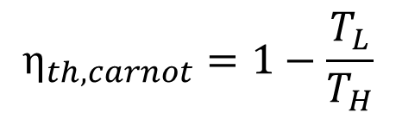
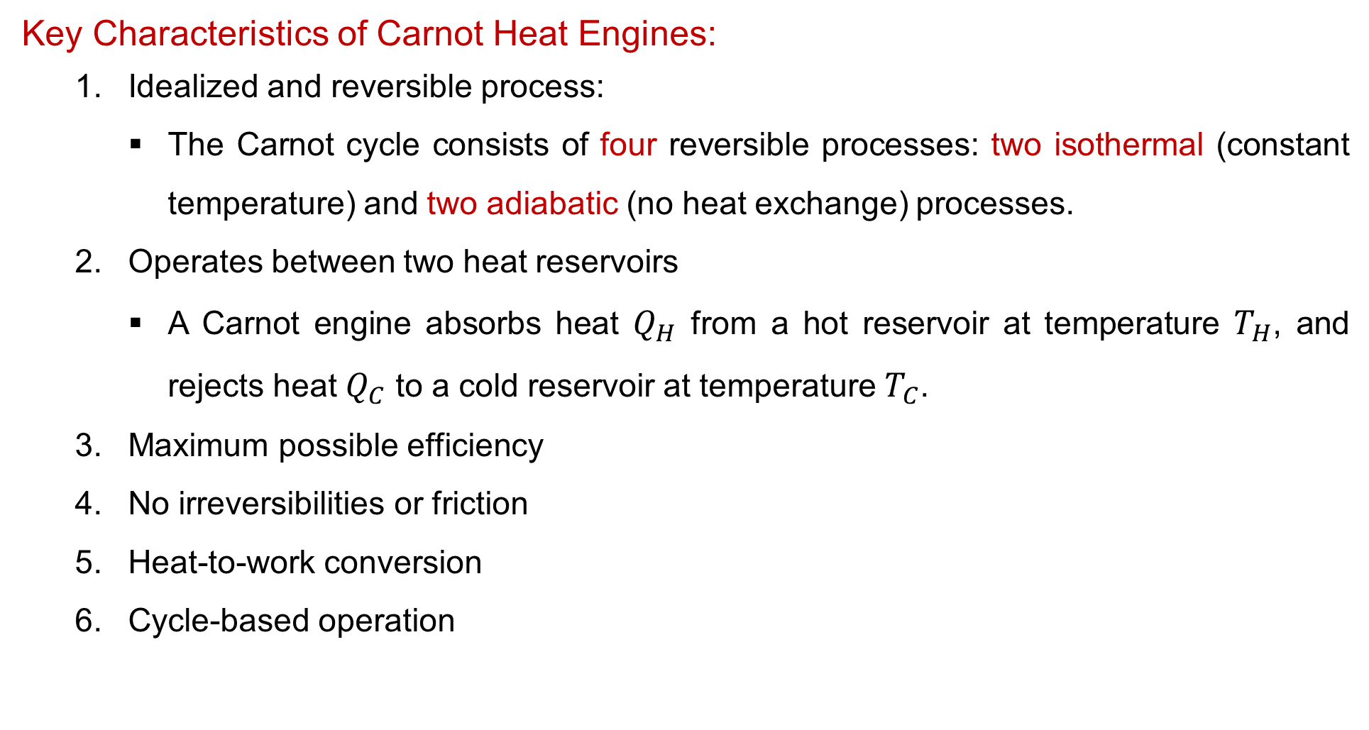
2. The Carnot Cycle Cont…
Key Characteristics of Carnot Heat Engines:
  Idealized and reversible process:
    The Carnot cycle consists of four reversible processes: two isothermal (constant temperature) and two adiabatic (no heat exchange) processes.
  Operates between two heat reservoirs
    A Carnot engine absorbs heat $Q_{H}$ from a hot reservoir at temperature $T_{H}$​, and rejects heat $Q_{C}$ to a cold reservoir at temperature $T_{C}$.
  Maximum possible efficiency
  No irreversibilities or friction
  Heat-to-work conversion
  Cycle-based operation
$$η_{th,carnot}=1−\frac{T_{L}}{T_{H}}$$

Slide 10
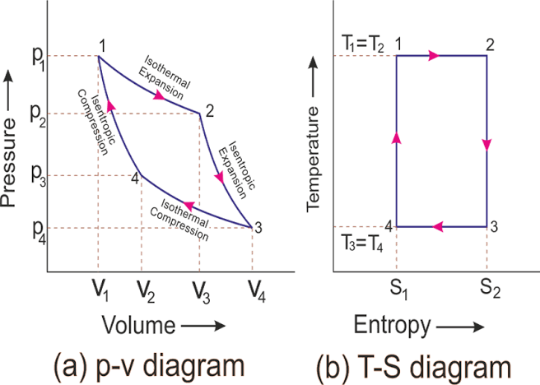
2. The Carnot Cycle Cont…
The P-v and T-s Diagrams of a Carnot Cycle
  Figure 1: P-V diagram (a) and T-s diagram (b) of a Carnot Cycle, Lignell, D., Brigham Young University
url: https://lh3.googleusercontent.com/proxy/YCYZgvXVm1kHOF9kpiO-O6ekmLCpiGWh000Tdyc2l6mG9m7UKJGuyA2Ke8VuuqUCarKjKUjCNdPNACqKhzzK7amxX2qRKHVkezkNH381cMMuLkfomjY4lep4GDyA--OyK3zxSj3mf2OWlmcLX57hurk

Slide 11
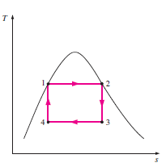
2. The Carnot Cycle Cont…
Practical Limitations of the Carnot Cycle:
  Temperature Constraints
  Turbine Erosion
  Fluid Selection
  Control Challenges
  Compressor Issues

Slide 12
3. The Rankine Cycle
Many of the limitations inherent in the Carnot cycle can be overcome by superheating the steam within the boiler and ensuring complete condensation in the condenser.
The cycle that results is the Rankine cycle, which is the ideal cycle for vapor power plants.
The Rankine Cycle is a thermodynamic cycle widely used in steam power plants to convert heat into mechanical work, which is then transformed into electricity [1].
As an idealized representation of vapor power cycles, Rankine cycle
forms the foundation for modern power generation technologies.

Slide 13
3. The Rankine Cycle Cont…
The Rankine cycle consists of four main components:
  Pump – Compresses liquid water to high pressure (isentropic process).
  Boiler (heat addition) – Heats high-pressure water to produce steam (isobaric process).
  Turbine – Expands steam to produce work (isentropic expansion).
  Condenser – Condenses exhaust steam back into liquid (isobaric heat rejection).
  The Rankine cycle follows the following four processes
  on a T-s (Temperature-Entropy) diagram:

Slide 14
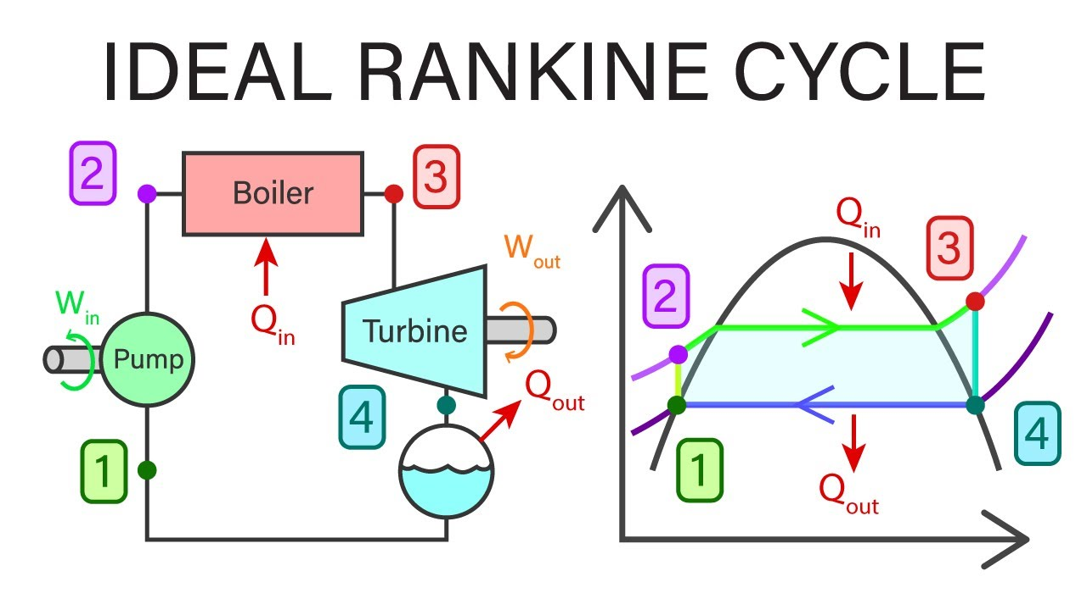
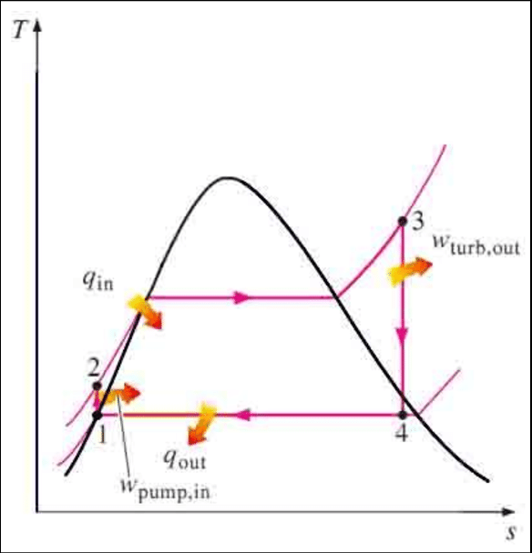
3. The Rankine Cycle Cont…
Four processes of a Rankine Cycle:
Process 1-2: Isentropic compression in a pump
Process 2-3: Constant pressure heat addition in a boiler
Process 3-4: Isentropic expansion in a turbine
Process 4-1: Constant pressure heat rejection in a condenser
Figure 2: Components of a Rankine Cycle, Modi Mechanical Engineering Tutorials, (2019)
url: https://i.ytimg.com/vi/21XFZaxity8/maxresdefault.jpg
Figure 3: T-s diagram of a Rankine Cycle, Alhwayzee, M., Kadhim, H. J., & Rashid, F. L. (2021).
url: https://www.researchgate.net/publication/336647595/figure/fig1/AS:815342993547265@1571404326643/deal-Rankine-Cycle.png

Slide 15
3. The Rankine Cycle Cont…
Comparison with Carnot Cycle
Rankine Cycle is more practical than the Carnot cycle because:
  It avoids two-phase compression (pump handles only liquid).
  It allows superheating steam to higher temperatures.
However, Carnot efficiency is higher for the same temperature limits.
(a) (b)
Figure 4: T-s diagram of (a) Carnot Cycle, (b) Rankine Cycle

Slide 16
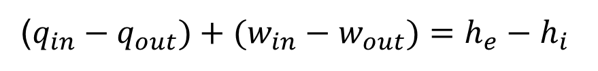
3. The Rankine Cycle Cont…
Energy Analysis of the Rankine Cycle
Rankine cycle can be analyzed as steady-flow processes.
Neglecting changes in kinetic and potential energies.
The steady-flow energy equation per unit mass of steam
Assumptions:
The boiler and the condenser do not involve any work.
The pump and the turbine are assumed to be isentropic.
($q_{in}−q_{out})+(w_{in}−w_{out})=h_{e}−h_{i}$

Slide 17
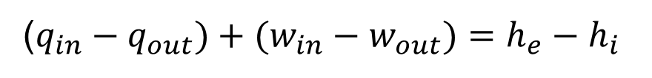
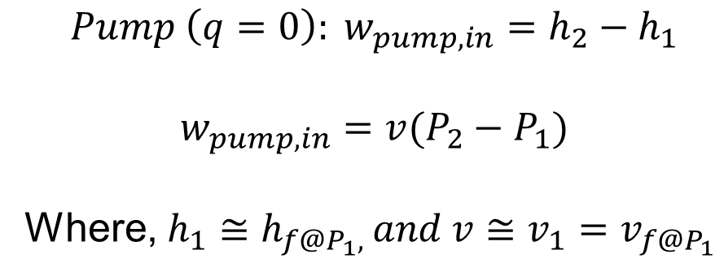
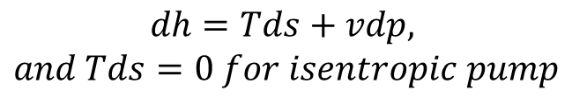
3. The Rankine Cycle Cont…
The conservation of energy relation for each device can be expressed as follows:
1. Isentropic Compression (Pump Work Input)
  Since this process is ideally isentropic, there is no entropy generation.
  The work input to the pump is given by:
($q_{in}−q_{out})+(w_{in}−w_{out})=h_{e}−h_{i}$
$$Pump \left(q=0\right): w_{pump,in}=h_{2}−h_{1}$$
$$w_{pump,in}=v(P_{2}−P_{1})$$
Where, $h_{1}≅h_{f@P_{1}, }and v≅v_{1}=v_{f@P_{1}}$
$$dh=Tds+vdp,$$
$$and Tds=0 for isentropic pump$$

Slide 18
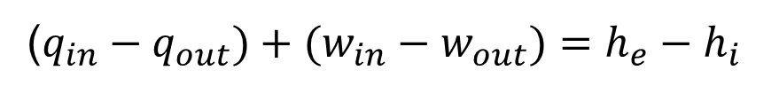

3. The Rankine Cycle Cont…
2. Isobaric Heat Addition (Boiler)
  The high-pressure liquid enters the boiler and absorbs heat, causing it to evaporate into steam.
  This process occurs at constant pressure.
  The heat energy added is:
($q_{in}−q_{out})+(w_{in}−w_{out})=h_{e}−h_{i}$
$$q_{in}=h_{3}−h_{2}$$

Slide 19

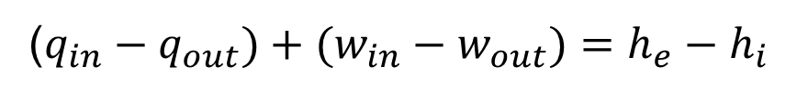
3. The Rankine Cycle Cont…
3. Isentropic Expansion (Turbine Work Output)
  The high-energy steam expands in the turbine, producing mechanical work.
  Since the process is ideally isentropic, no entropy is generated.
  The turbine work output is:
($q_{in}−q_{out})+(w_{in}−w_{out})=h_{e}−h_{i}$
$$w_{out}=h_{3}−h_{4}$$

Slide 20
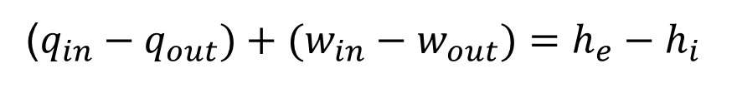
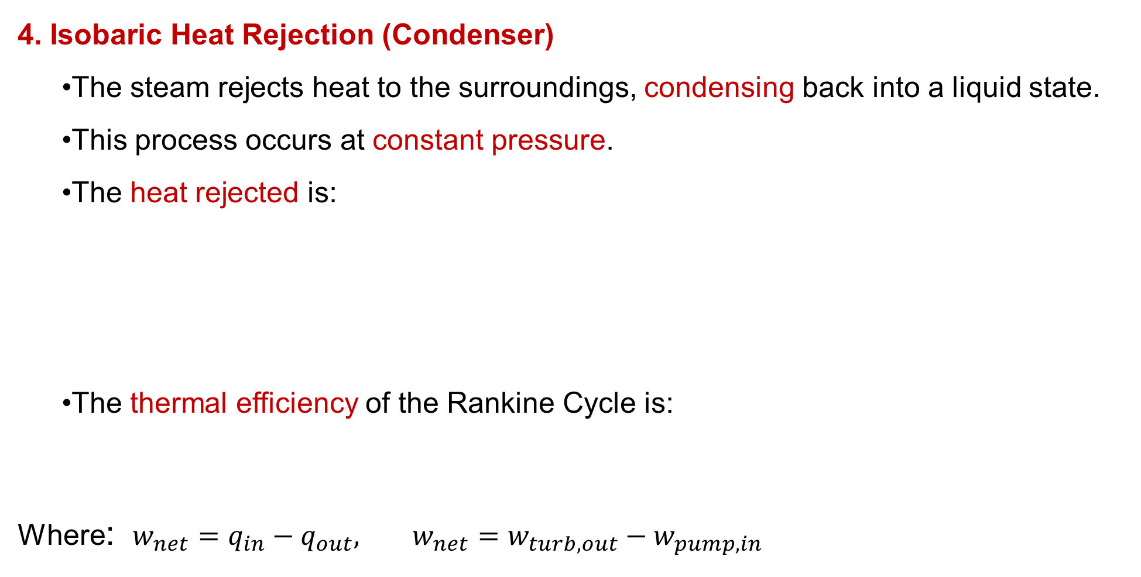
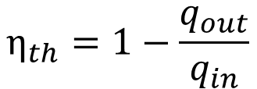

3. The Rankine Cycle Cont…
4. Isobaric Heat Rejection (Condenser)
  The steam rejects heat to the surroundings, condensing back into a liquid state.
  This process occurs at constant pressure.
  The heat rejected is:
  The thermal efficiency of the Rankine Cycle is:
Where: $w_{net}=q_{in}−q_{out}, w_{net}=w_{turb,out}−w_{pump,in}$
($q_{in}−q_{out})+(w_{in}−w_{out})=h_{e}−h_{i}$
$$q_{out}=h_{4}−h_{1}$$
$$η_{th}=1−\frac{q_{out}}{q_{in}}$$

Slide 21
4. Deviation of Actual Vapor Power Cycles from Idealized Ones
In real-world power plants, actual vapor power cycles deviate from the ideal Rankine cycle due to various irreversibilities and practical limitations.
These deviations reduce efficiency and affect performance.
Below are the key reasons for these differences:
  Turbine and pump irreversibilities (friction, turbulence, and heat losses)
  Pressure drops in pipes and heat exchangers
  Heat losses to the surroundings
  Incomplete condensation & subcooling
  Fluid property variations

Slide 22
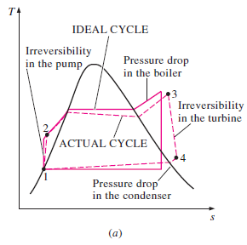
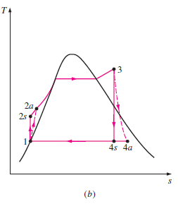
4. Deviation of Actual Vapor Power Cycles from Idealized Ones Cont…
The T-s Diagram of an Ideal and Actual Vapor Power Cycles
Figure 5: Deviation of Actual Vapor Power Cycles from Idealized One, Skill-Lync. (2020)
url: https://sklc-tinymce-2021.s3.amazonaws.com/2020/11/mceclip5_1605032619.png

Slide 23
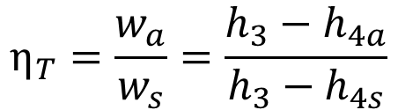
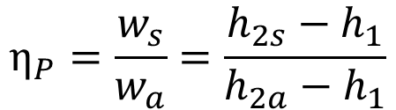
4. Deviation of Actual Vapor Power Cycles from Idealized Ones Cont…
A pump requires a greater work input, and a turbine produces a smaller work output as a result of irreversibilities.
Under ideal conditions, the flow through these devices is isentropic.
The deviation of actual pumps and turbines from the isentropic ones can be accurately accounted for, however, by utilizing adiabatic efficiencies, defined as:
$$η_{P}=\frac{w_{s}}{w_{a}}=\frac{h_{2s}−h_{1}}{h_{2a}−h_{1}}$$
$$η_{T}=\frac{w_{a}}{w_{s}}=\frac{h_{3}−h_{4a}}{h_{3}−h_{4s}}$$

Slide 24
4. Deviation of Actual Vapor Power Cycles from Idealized Ones Cont…
How can we increase the efficiency of the Rankine Cycle?
Improving the efficiency of the Rankine cycle-a widely used thermodynamic cycle in power plants-can lead to better energy output and lower operational costs [3].
The basic idea behind all the modifications to increase the thermal efficiency of a power cycle is the same:
  Increase the average temperature at which heat is transferred to the working fluid in the boiler, or
  decrease the average temperature at which heat is
  rejected from the working fluid in the condenser.

Slide 25
4. Deviation of Actual Vapor Power Cycles from Idealized Ones Cont…
Some of the ways to enhance the efficiency of a Rankine Cycle are [3]:
  Lowering the condenser pressure
  Superheating the steam to high temperatures
  Increasing the boiler pressure
  Using reheat cycles
  Regenerative feedwater heating
  Improved turbine design

Slide 26
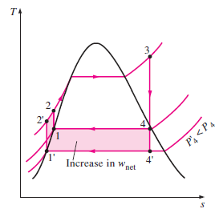
4. Deviation of Actual Vapor Power Cycles from Idealized Ones Cont…
Lowering the Condenser Pressure (Lowers T_{low,av})
Decreasing the pressure in the condenser reduces the temperature at which heat is rejected, increasing the thermal efficiency.
The colored area on this diagram represents the increase in net work output as a result of lowering the condenser pressure from P4 to P4'.
The heat input requirements also increase, but this increase is very small.
The overall effect of lowering the condenser pressure is an increase in the thermal efficiency of the cycle.
Figure 6: T-s diagram of a Rankine Cycle with Lowering Condenser Pressure, Khalid, N. (2015)
url: https://encrypted-tbn0.gstatic.com/images?q=tbn:ANd9GcS5ByxSCRb5CAo-kkO1buQIiHLy0Pyv7njasDjq3DbGDeH3wiElbCpsm-4t&s

Slide 27
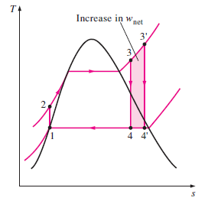
4. Deviation of Actual Vapor Power Cycles from Idealized Ones Cont…
Superheating the Steam to High Temperatures (Increases T_{high,av})
  Increasing the temperature of the steam beyond the saturation point (before entering the turbine) helps improve efficiency by reducing moisture content in the later turbine stages.
  The colored area on this diagram represents the increase in the net work.
  The total area under the process curve 3-3’ represents the increase in the heat input.
Figure 7: T-s diagram of a Rankine Cycle with Superheating the Steam, Kosasih, Buyung. 2013, University of Wollongong
url: https://encrypted-tbn0.gstatic.com/images?q=tbn:ANd9GcSrnUU9zg3wGZAlY7SFpjSli-cxvRtLdIsMdA&s

Slide 28
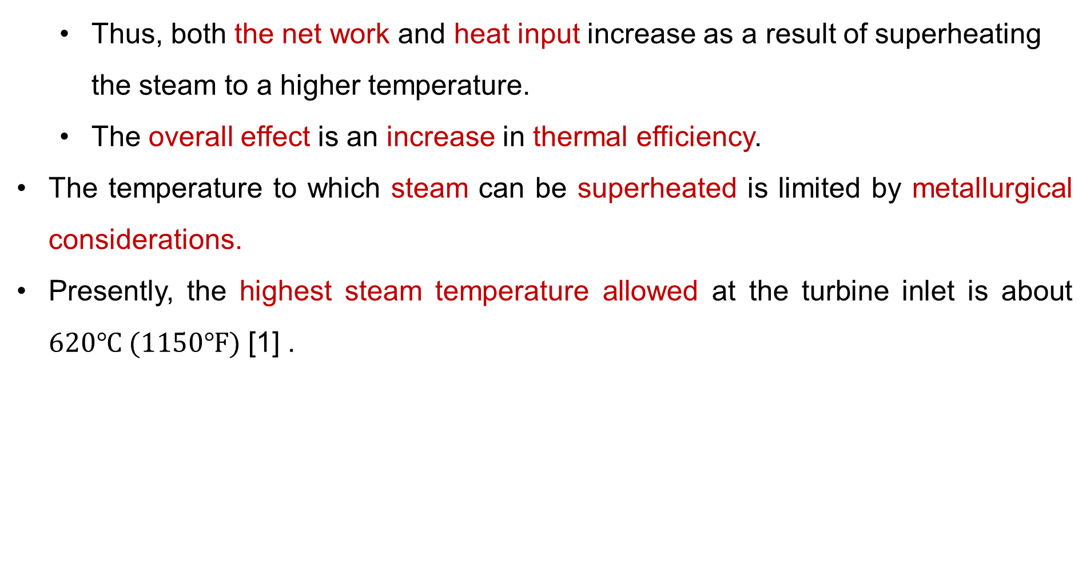
4. Deviation of Actual Vapor Power Cycles from Idealized Ones Cont…
  Thus, both the net work and heat input increase as a result of superheating the steam to a higher temperature.
  The overall effect is an increase in thermal efficiency.
The temperature to which steam can be superheated is limited by metallurgical considerations.
Presently, the highest steam temperature allowed at the turbine inlet is about $620℃ (1150℉)$ [1] .

Slide 29
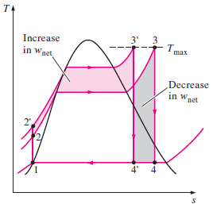
4. Deviation of Actual Vapor Power Cycles from Idealized Ones Cont…
Increasing the Boiler Pressure (Increase T_{high,av} )
Raising the steam pressure in the boiler increases the average temperature at which heat is added, boosting efficiency.
This, in turn, raises the average temperature at which heat is added to the steam and thus raises the thermal efficiency of the cycle.
However, this requires materials that can withstand higher pressures.
Figure 8: T-s diagram of a Rankine Cycle with Increasing the Boiler Pressure, Osman, Mohd Zulkifli, et.al. (2020)
url: https://encrypted-tbn0.gstatic.com/images?q=tbn:ANd9GcQ_6cizBmbDS2Vw1v7sGsVrGZXqJaSktl2HXA6pY7yVKROYr7I1ij5jhoxe&s

Slide 30
5. The Ideal Reheat Rankine Cycle
Increasing the boiler pressure increases the thermal efficiency of the Rankine cycle, but it also increases the moisture content of the steam to unacceptable levels.
Then,
How can we harness the improved efficiencies of higher boiler pressures while mitigating the risk of excessive moisture in the turbine's final stages?

Slide 31
5. The Ideal Reheat Rankine Cycle Cont…
Two possibilities to mind:
1. Superheating the steam to very high temperatures before it enters the turbine
  This would be the ideal solution because increasing the steam temperature raises the average heat addition temperature, thereby improving cycle efficiency.
  However, this approach is not feasible, as it would require steam temperatures beyond safe metallurgical limits for the turbine materials.

Slide 32
5. The Ideal Reheat Rankine Cycle Cont…
2. Expand the steam in the turbine in two stages, and reheat it in between
The simple ideal Rankine cycle can be enhanced by incorporating a reheat process.
Reheating effectively addresses the issue of excessive moisture in turbine stages, making it a widely adopted solution in modern steam power plants [4].
Therefore, the Ideal Reheat Rankine Cycle is a modification of the simple Rankine cycle designed to improve efficiency and reduce moisture content in the later stages of the turbine.
This is achieved by expanding the steam in two turbine
stages and reheating it between expansions.

Slide 33
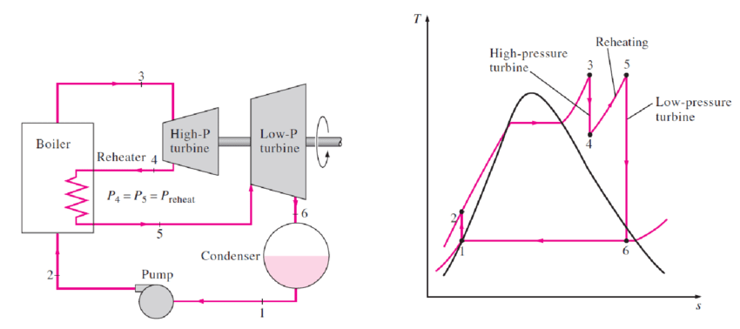
5. The Ideal Reheat Rankine Cycle Cont…
The T-s diagram of the ideal reheat Rankine cycle and the schematic of the power plant operating on this cycle are shown below:
Figure 9: Schematic and T-s diagram of an Ideal Rehaet Rankine Cycle, Dadach, Z.-E. (2020)
url: https://www.researchgate.net/profile/Zin-Eddine-Dadach/publication/348295259/figure/fig7/AS:977200316702723@1609994119970/deal-Reheat-Rankine-Cycle-18.png

Slide 34
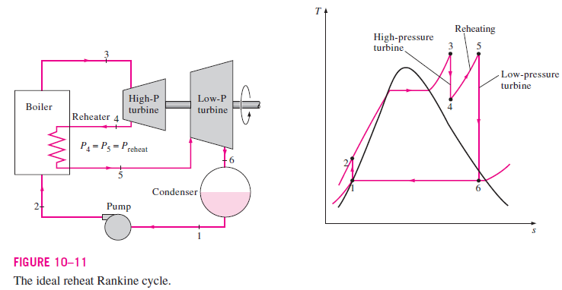
5. The Ideal Reheat Rankine Cycle Cont…
The ideal reheat Rankine cycle differs from the simple ideal Rankine cycle in that the expansion process takes place in two stages.
In the first stage (the high-pressure turbine), steam is expanded isentropically to an intermediate pressure and sent back to the boiler where it is reheated at constant pressure, usually to the inlet temperature of the first turbine stage.
Steam then expands isentropically in the second stage (low-pressure turbine) to the condenser pressure.

Slide 35
5. The Ideal Reheat Rankine Cycle Cont…
The total heat input and the total turbine work output for a reheat cycle become
$$q_{in}=q_{primary}+q_{reheat}=\left(h_{3}−h_{2}\right)+(h_{5}−h_{4})$$
$$w_{turb, out}=w_{turb I}+w_{turb II}=\left(h_{3}−h_{4}\right)+(h_{5}−h_{6})$$

Slide 36
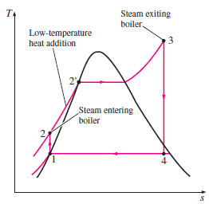
6. The Ideal Regenerative Rankine Cycle
A careful examination of the T-s diagram of the Rankine cycle shown reveals that heat is added to the working fluid during process 2-2’ at a relatively low temperature.
This lowers the average temperature at which heat is added and thus the cycle efficiency.
To remedy this shortcoming, we look for ways to raise the temperature of the liquid leaving the pump (called the feedwater) before it enters the boiler.

Slide 37
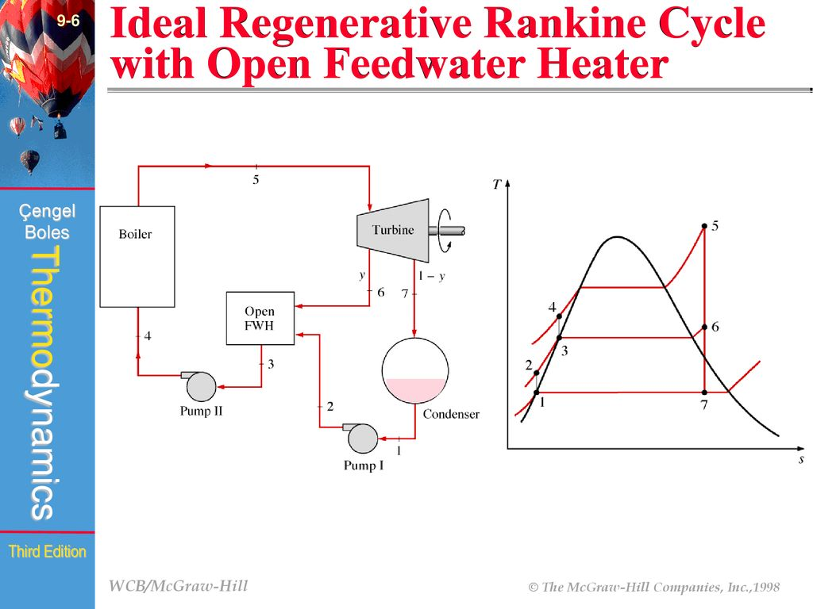
6. The Ideal Regenerative Rankine Cycle Cont…
A practical regeneration process in steam power plants is accomplished by extracting, or “bleeding,” steam from the turbine at various points [5].
This steam, which could have produced more work by expanding further in the turbine, is used to heat the feedwater instead.
Figure 10: Schematic and T-s diagram of an Ideal Regenerative Rankine Cycle, Jung Jin Lee, (2023).
url: https://image4.slideserve.com/9116143/the-ideal-regenerative-rankine-cycle-with-an-open-l.jpg

Slide 38
6. The Ideal Regenerative Rankine Cycle Cont…
The device where the feedwater is heated by regeneration is called a regenerator.
A feedwater heater is basically a heat exchanger where heat is transferred from the steam to the feedwater either by mixing the two fluid streams (open feedwater heaters) or without mixing them (closed feedwater heaters) [6].

Slide 39
7. Types of Feed-Water Heaters
Feedwater heaters are essential components in steam power plants, designed to preheat the water before it enters the boiler.
This process improves thermal efficiency, reduces fuel consumption, and minimizes thermal stress on boiler components.
Purpose of Feedwater Heating
  Increases cycle efficiency by reducing irreversibilities.
  Lowers fuel requirements for steam generation.
  Prevents thermal shock to boiler tubes.
  Enhances overall plant reliability and lifespan.

Slide 40
7. Types of Feed-Water Heaters
Classification of Feedwater Heaters
Based on mode of heat transfer between the extracting steam and the feedwater, feedwater heaters are broadly classified into two types:
Open Feedwater Heaters (Direct Contact Type)
An open, or direct-contact, feedwater heater functions as a mixing chamber in which steam extracted from the turbine directly combines with feedwater discharged from the pump [6].
Under ideal conditions, this mixture exits the heater as a saturated liquid corresponding to the heater’s operating pressure.

Slide 41
7. Types of Feed-Water Heaters
Open Feedwater Heaters
Figure 11: Schematic and T-s diagram of Open Feed-Water Heater, Jung Jin Lee, (2023).
url: https://image4.slideserve.com/9116143/the-ideal-regenerative-rankine-cycle-with-an-open-l.jpg

Slide 42
7. Types of Feed-Water Heaters
Closed (Surface) Feedwater Heaters
A closed feedwater heater is a shell-and-tube heat exchanger used in the regenerative Rankine cycle to preheat feedwater before it enters the boiler.
Its core principle is the indirect transfer of thermal energy from extracted steam to the feedwater, without the two streams mixing. That is:
  The extracted steam and the feedwater do not mix.
  They are separated by metal tubes or plates.
Heat is transferred from the steam to the feedwater through these
solid surfaces via conduction and convection.

Slide 43
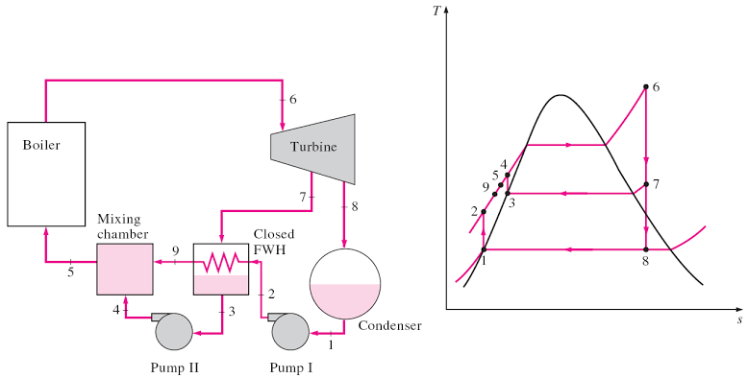
7. Types of Feed-Water Heaters
Closed (Surface) Feedwater Heaters
Figure 12: Schematic and T-s diagram of Closed Feed-Water Heater, Kim, K. B. (2016)
url: https://encrypted-tbn0.gstatic.com/images?q=tbn:ANd9GcQJKaHiVMALFVg1PYT8wegKk_cOzWf11KM_HA&s

Slide 44
7. Types of Feed-Water Heaters
More Ways to Increase Power plant Thermal Efficiency
The overall thermal efficiency of a power plant can be increased by using:
  Binary cycles or,
  Combined cycles.
Mercury-Water Binary Vapor Cycle
Binary vapor cycles use two different working fluids to optimize thermal efficiency.
The Mercury-Water Binary Vapor Cycle is a classic example, combining mercury for the high-temperature heat addition and water/steam
for the low-temperature heat rejection and mid-temperature
expansion, creating a more efficient combined cycle.

Slide 45
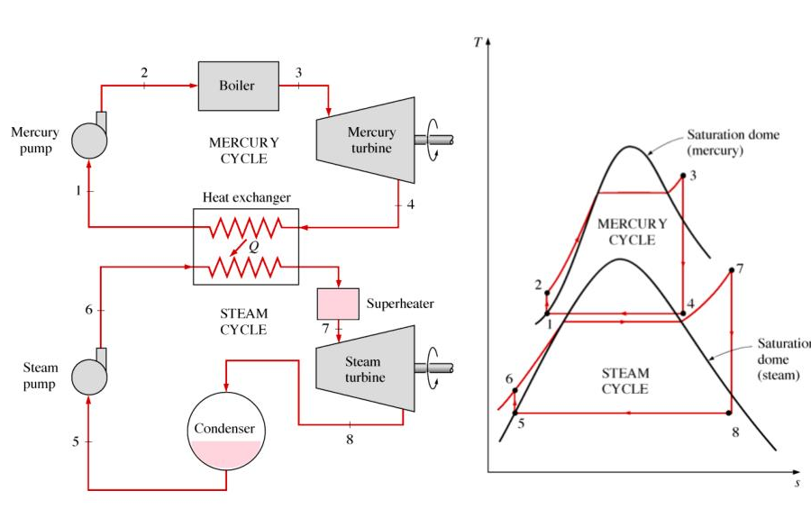
7. Types of Feed-Water Heaters
By using mercury for high-temperature heat addition, the cycle operates over a wider temperature range with less irreversibility.
The steam cycle operates at lower pressures than it would if it tried to use the same high-temperature heat source directly.
Figure 13: Schematic and T-s diagram of Mercury-Water Binary Vapor Cycle, Kim, K. B. (2016)
url: https://image1.slideserve.com/3531405/slide5-l.jpg

Slide 46
Summary
Carnot Cycle represents the theoretical maximum efficiency a heat engine can achieve between two temperature limits;
Rankine Cycle is a more realistic and widely used cycle for steam power plants, involving four key processes; pressurization, heat addition, expansion, and condensation.
Real-world vapor power cycles differ from ideal ones due to irreversibilities like friction, pressure drops, and non-isentropic turbine and pump behavior, reducing overall efficiency.
Ideal Reheat Rankine Cycle improves efficiency and reduces moisture content at turbine exit by expanding steam in multiple stages with reheating between stages.
Ideal Regenerative Rankine Cycle & Feedwater Heaters enhances
cycle efficiency by preheating feedwater using extracted steam, typically
using open or closed feedwater heaters to reduce fuel consumption
and thermal stress on boiler components.

Slide 47
References
[1].Thermodynamics – An Engineering Approach, Cengel Y A.,Bole M A., McGraw-Hill Education, 8th edition 2015.
[2]. Energy and exergy analyses of thermal power plants: A review. Kaushik, S. C., Reddy, V. S., & Tyagi, S. K. (2011). Renewable and Sustainable Energy Reviews, 15(4), 1857–1872. https://doi.org/10.1016/j.rser.2010.12.007
[3]. Thermodynamic analysis of reheat Rankine cycle. Dincer, I., & Al-Muslim, H. (2001). International Journal of Energy Research, 25(8), 727–739. https://doi.org/10.1002/er.713
[4]. Fundamentals of engineering thermodynamics, Moran, M. J., Shapiro, H. N., Boettner, D. D., & Bailey, M. B. (2018). (9th ed.). Wiley.
[5]. Thermodynamic Analysis of a Regenerative Rankine Cycle with Feedwater Heaters, Koroglu, Tahsin, and Osman S. Sogut. Energy Conversion and Management, 2018, pp. 382–394.
[6]. Taner, T., & Dincer, I. (2019). Performance assessment of a high steam
parameter coal-fired power plant with feedwater heater retrofits.
Energy, 189, 116210. https://doi.org/10.1016/j.energy.2019.116210

Slide 48
Thank you !

