Slide 1
Power Plant Engineering
Lecture 3
Fuels and Combustion
Lecturer: Dr. Melaku Desta

Slide 2
Lecture learning outcomes:
At the end of this lecture, you will be able to:
Understand the classification of fuels and their relevance in energy systems.
Analyze coal using proximate and ultimate methods to assess its combustion properties.
Apply combustion stoichiometry to calculate air-fuel ratios and predict reaction outcomes.
Identify and interpret experimental techniques used to determine combustion products.
Evaluate the environmental impacts of fuel combustion and
strategies for emission control.
vi. Relate fuel characteristics and combustion analysis to practical
applications in power generation and industry.

Slide 3
Content
Classification of Fuels
Proximate and Ultimate Analysis of Coal
Combustion Stoichiometry and Air-Fuel Ratio
Experimental Techniques for Determining Combustion Products
Environmental Impacts of Fuel Combustion
Fuel Properties and Selection Criteria
Applications in Power Generation, Industrial Processes and
Transportation
Summary
References

Slide 4
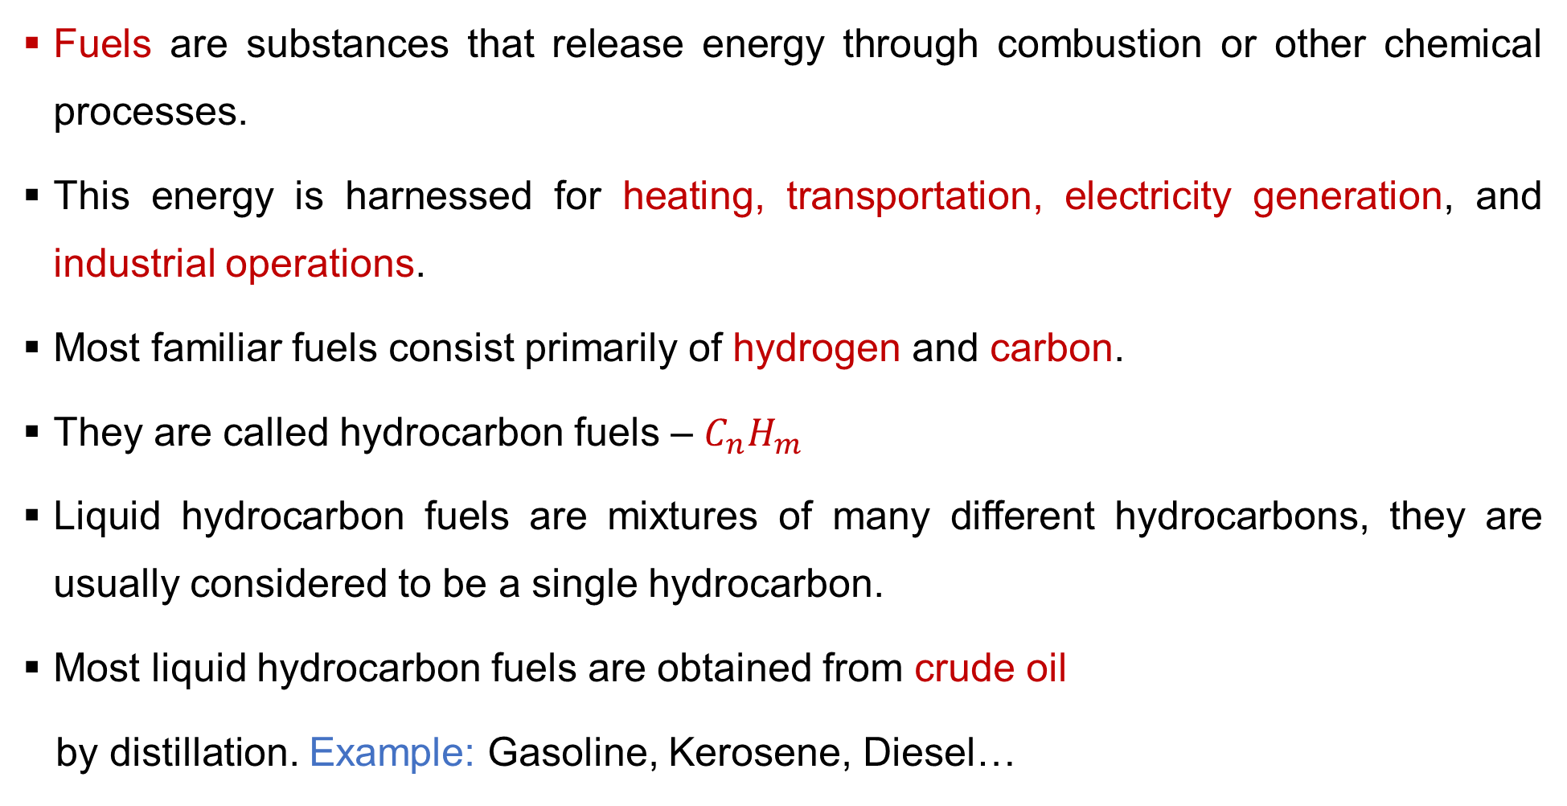
1. Classification of Fuels
Fuels are substances that release energy through combustion or other chemical processes.
This energy is harnessed for heating, transportation, electricity generation, and industrial operations.
Most familiar fuels consist primarily of hydrogen and carbon.
They are called hydrocarbon fuels – $C_{n}H_{m}$
Liquid hydrocarbon fuels are mixtures of many different hydrocarbons, they are usually considered to be a single hydrocarbon.
Most liquid hydrocarbon fuels are obtained from crude oil
by distillation. Example: Gasoline, Kerosene, Diesel…

Slide 5
1. Classification of Fuels Cont…
Key components of a good fuel:
  High calorific value: Should release a lot of energy per unit mass/volume.
  Moderate ignition temperature: Should ignite easily but not too easily to be dangerous.
  Low moisture content: Moisture reduces the heating value.
  Easy to transport & store: Should be stable and non-hazardous.
  Low cost & abundantly available.
  Clean combustion: Should produce minimal smoke or
  harmful gases (e.g., SO₂, NOₓ).

Slide 6
1. Classification of Fuels Cont…
Understanding fuel classification is essential for selecting appropriate energy sources based on efficiency, cost, and environmental impact.
Fuels can be classified on several bases. The two most common methods are:
Classification Based on Occurrence
  Primary Fuels (natural)
  Secondary Fuels (derived)
Classification Based on Physical State
  Solid Fuels
  Liquid Fuels
  Gaseous Fuels

Slide 7
1. Classification of Fuels Cont…
Classification Based on Occurrence
Primary Fuels
  Found in nature in their natural form.
  They are unprocessed.
  Example: Solid: Wood, Coal, Peat
  Liquid: Crude Oil
  Gaseous: Natural Gas
Secondary Fuels
  Produced by processing or refining primary fuels.
  They are artificial or manufactured.
  Example: Solid: Coke, Charcoal
  Liquid: Petrol, Diesel, Kerosene
  Gaseous: LPG, CNG, Biogas, Coal Gas

Slide 8
1. Classification of Fuels Cont…
Classification Based on Physical State
Solid Fuels
Easy to transport, require large storage space, high ash content, combustion is often incomplete and smoky.
Example: Wood, Peat, Lignite, Bituminous Coal, Anthracite, Coke, Charcoal, Briquettes
2. Liquid Fuels
Higher calorific value than solids, easier to transport through pipelines, less storage space needed, burns without ash, cleaner combustion.
Example: Crude Oil, Petrol, Diesel, Kerosene, Heavy Fuel Oil.

Slide 9
1. Classification of Fuels Cont…
3. Gaseous Fuels
Highest calorific value by mass, easiest to transport via pipelines, mixes with air for complete combustion (smokeless), immediate control of heat, requires specialized storage.
Example:
  Natural Gas
  Liquefied Petroleum Gas (LPG)
  Compressed Natural Gas (CNG)
  Coal Gas, Biogas, Hydrogen Gas

Slide 10
1. Classification of Fuels Cont…
While not a formal classification, it's an important modern distinction to classify fuels as:
Conventional Fuels: Mostly fossil-based and finite.
Example:
  Coal
  Petroleum products
  Natural Gas
Alternative Fuels: Fuels aimed at replacing conventional fuels to enhance energy security and reduce environmental impact.
Example:
  Biofuels (Biodiesel, Bioethanol)
  Hydrogen
  Biogas
  Syngas

Slide 11
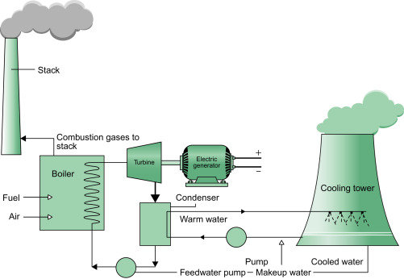
2. Proximate and Ultimate Analysis of Coal
Coal is a complex organic rock composed primarily of carbon, hydrogen, oxygen, nitrogen, and sulfur.
Figure 1: Coal-Fired Power Station, Paul Breeze, Power Generation Technologies (3rd Edition), (2019).
url: https://ars.els-cdn.com/content/image/3-s2.0-B9780128040058000033-f03-01-9780128040058.jpg

Slide 12
2. Proximate and Ultimate Analysis of Coal
To use coal efficiently and economically in industries like power generation and steel production, understanding its properties is essential.
To evaluate its quality and suitability for various applications, two key analytical methods are used:
  Proximate Analysis
  Ultimate Analysis
1. Proximate Analysis
Proximate analysis is a practical, industry-standard test that provides a breakdown of a coal sample into four key components based on specific heating conditions [2].

Slide 13
2. Proximate and Ultimate Analysis of Coal Cont…
Proximate analysis is relatively quick and inexpensive.
It is used to determine the relative amounts of the following four components:
  Moisture: The water content present in the coal
  Volatile Matter (VM): The gases and vapors (e.g., H₂, CH₄, CO, tar) released when coal is heated in the absence of air.
  Fixed Carbon (FC): The solid combustible residue left after the
  volatile matter is driven off. It is mostly carbon.
  Ash: The inorganic, non-combustible residue left after all the
  combustible matter has been burned off.

Slide 14
2. Proximate and Ultimate Analysis of Coal Cont…
2. Ultimate Analysis
Ultimate analysis provides a more fundamental and precise composition of coal.
It gives the elemental composition of the organic mass of coal, expressed as percentages of the primary elements.
The elements measured are:
  Carbon (C)
  Hydrogen (H)
  Nitrogen (N)
  Sulfur (S)
  Oxygen (O)
  Ash and Moisture are also reported.

Slide 15
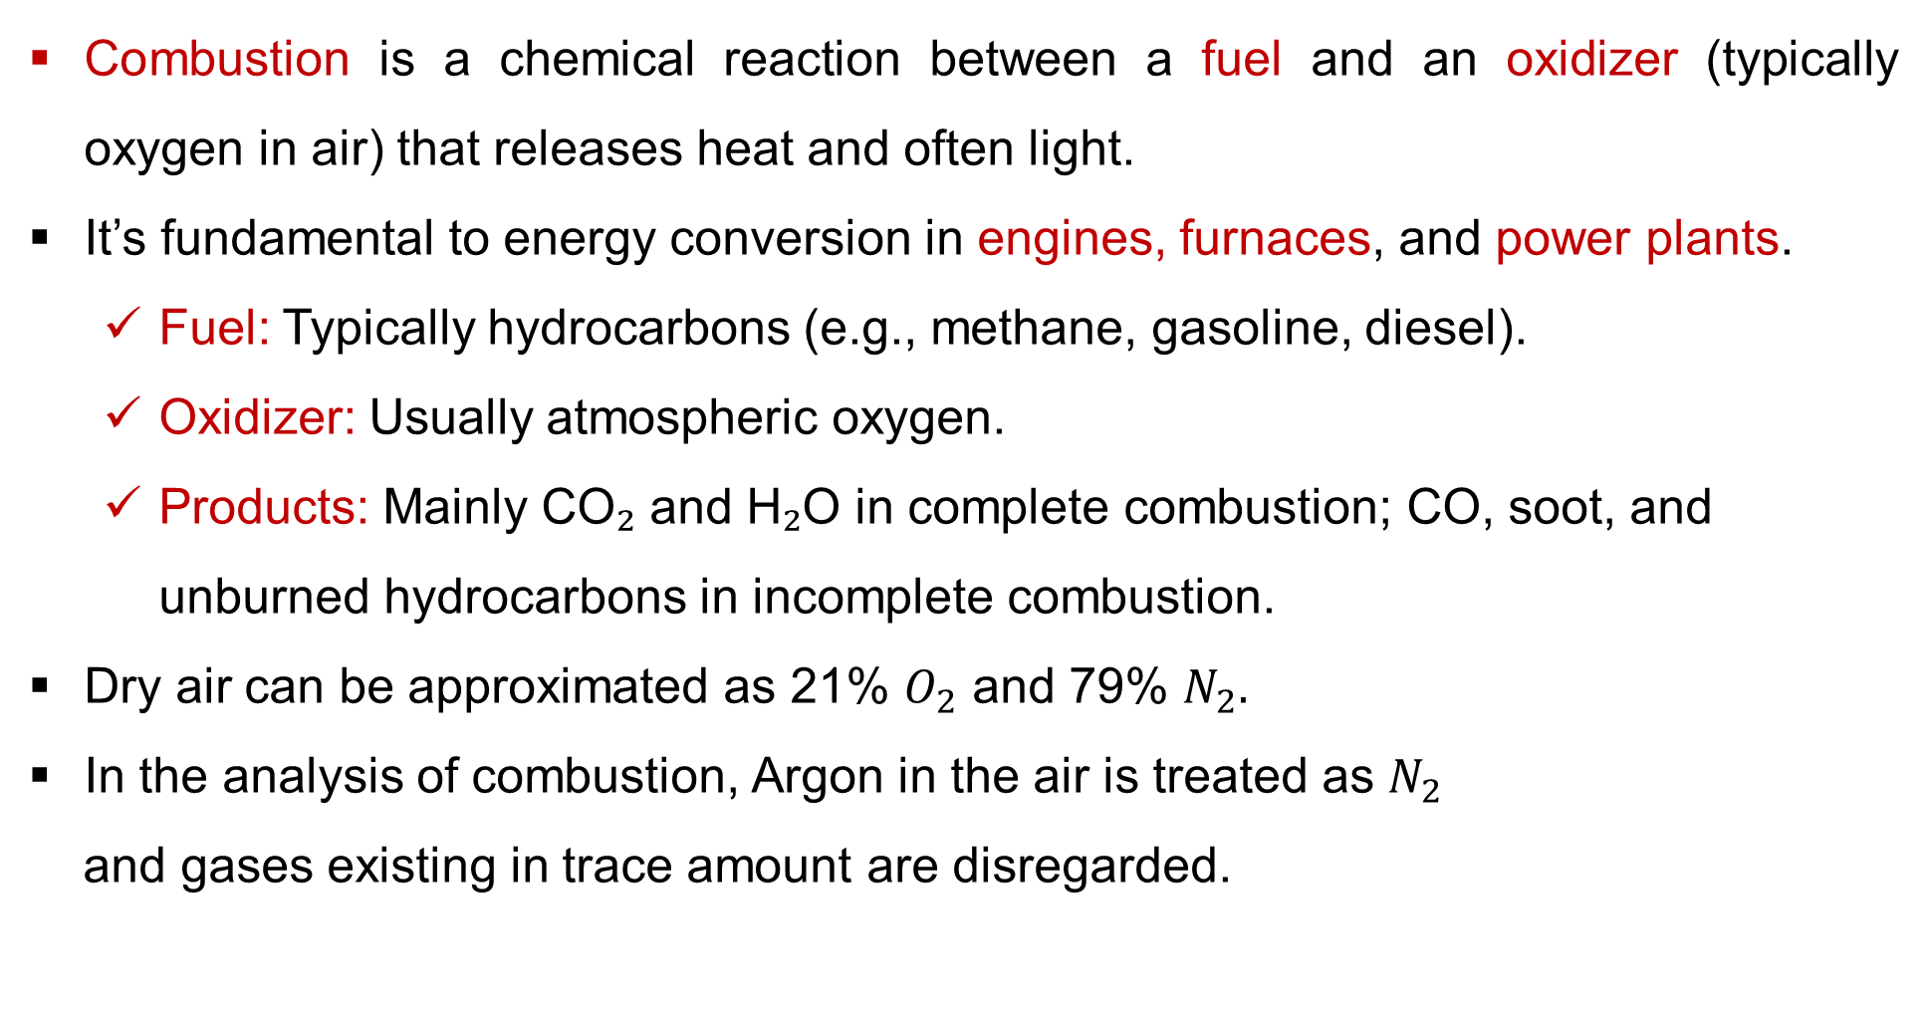
3. Combustion Stoichiometry and Air-Fuel Ratio
Combustion is a chemical reaction between a fuel and an oxidizer (typically oxygen in air) that releases heat and often light.
It’s fundamental to energy conversion in engines, furnaces, and power plants.
  Fuel: Typically hydrocarbons (e.g., methane, gasoline, diesel).
  Oxidizer: Usually atmospheric oxygen.
  Products: Mainly CO₂ and H₂O in complete combustion; CO, soot, and unburned hydrocarbons in incomplete combustion.
Dry air can be approximated as 21% $O_{2}$ and 79% $N_{2}.$
In the analysis of combustion, Argon in the air is treated as $N_{2}$
and gases existing in trace amount are disregarded.

Slide 16
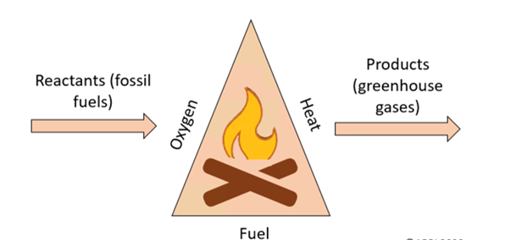
3. Combustion Stoichiometry and Air-Fuel Ratio
Figure 2: Combustion & Its Effects, GrittyTech Academy Blogs, (2025).
url: https://www.abpischools.org.uk/media/qu3fjbzt/combustion-triangle.png

Slide 17
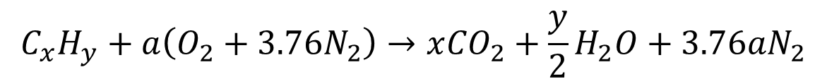
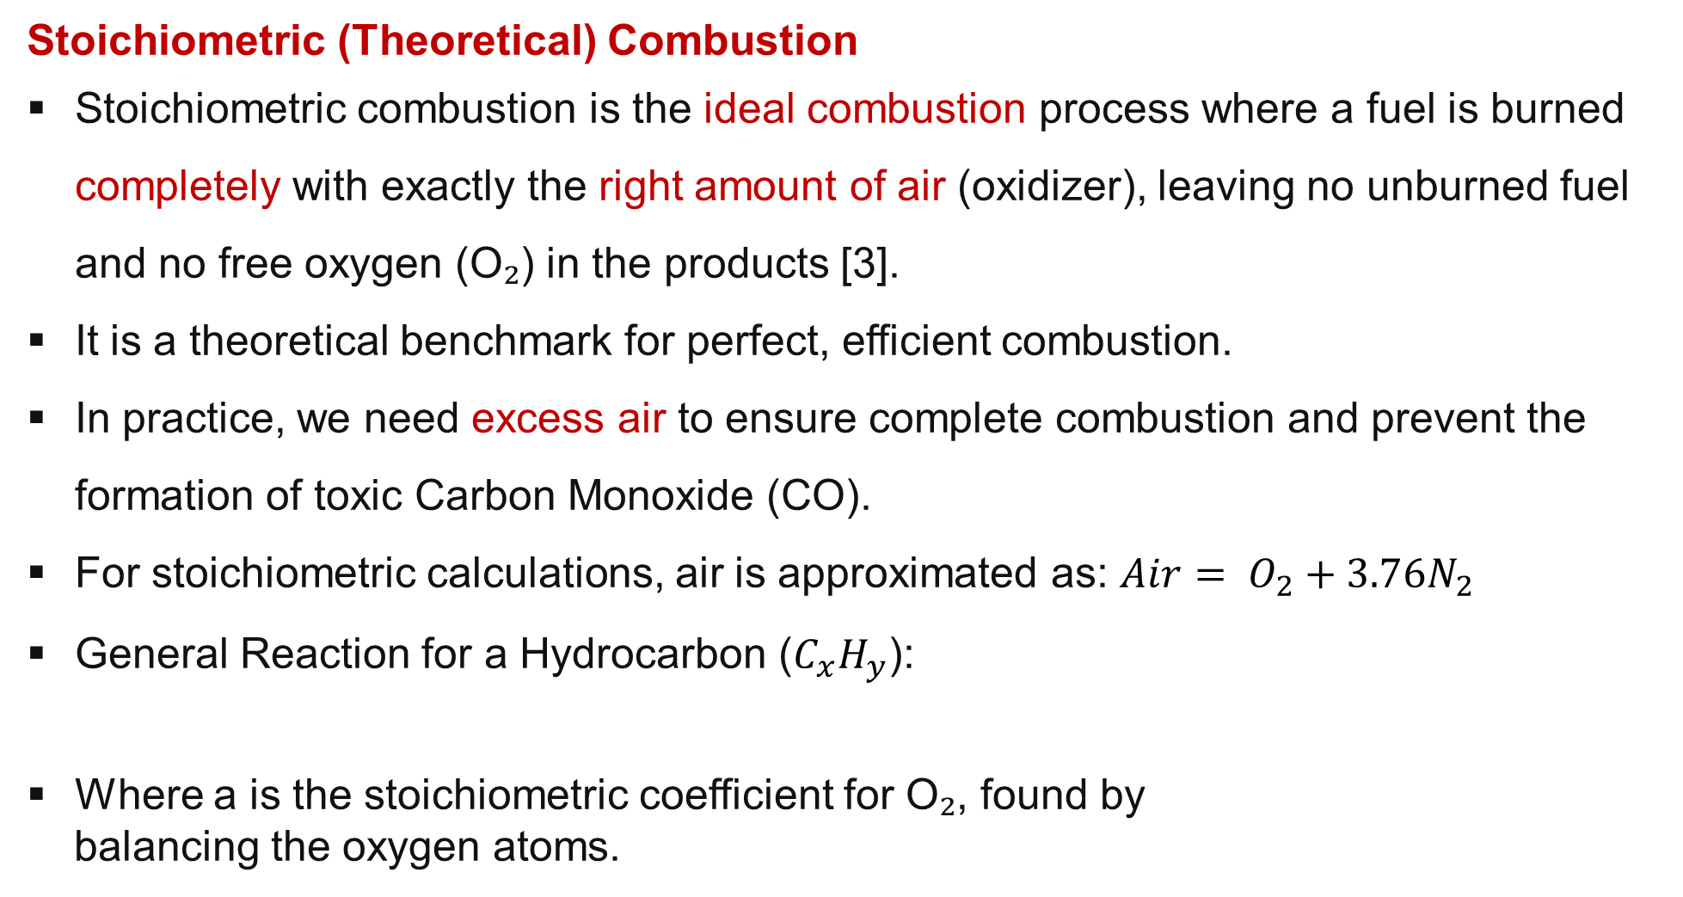
3. Combustion Stoichiometry and Air-Fuel Ratio Cont…
Stoichiometric (Theoretical) Combustion
Stoichiometric combustion is the ideal combustion process where a fuel is burned completely with exactly the right amount of air (oxidizer), leaving no unburned fuel and no free oxygen (O₂) in the products [3].
It is a theoretical benchmark for perfect, efficient combustion.
In practice, we need excess air to ensure complete combustion and prevent the formation of toxic Carbon Monoxide (CO).
For stoichiometric calculations, air is approximated as: ${Air= O}_{2}+3.76N_{2}$
General Reaction for a Hydrocarbon ($C_{x}H_{y}$):
Where a is the stoichiometric coefficient for O₂, found by
balancing the oxygen atoms.
$$C_{x}H_{y}+a\left(O_{2}+3.76N_{2}\right)→x{CO}_{2}+\frac{y}{2}H_{2}O+3.76aN_{2}$$

Slide 18
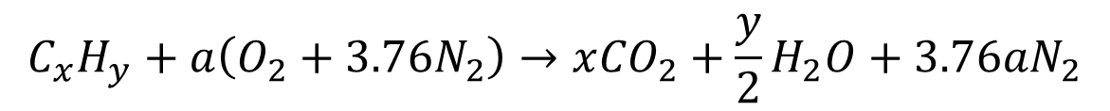
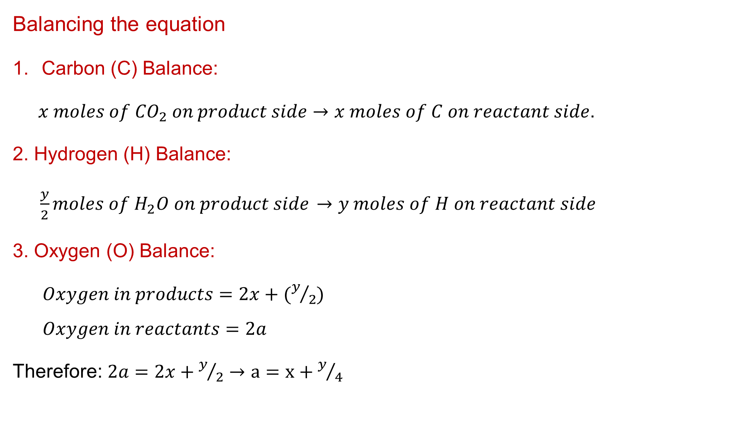
3. Combustion Stoichiometry and Air-Fuel Ratio Cont…
Balancing the equation
Carbon (C) Balance:
$x moles of {CO}_{2} on product side→x moles of C on reactant side$.
2. Hydrogen (H) Balance:
$\frac{y}{2}moles of H_{2}O on product side$ $→y moles of H on reactant side$
3. Oxygen (O) Balance:
$Oxygen in products=2x+(y/2)$
$$Oxygen in reactants=2a$$
Therefore: $2a=2x+y/2→a=x+y/4$
$$C_{x}H_{y}+a\left(O_{2}+3.76N_{2}\right)→x{CO}_{2}+\frac{y}{2}H_{2}O+3.76aN_{2}$$

Slide 19
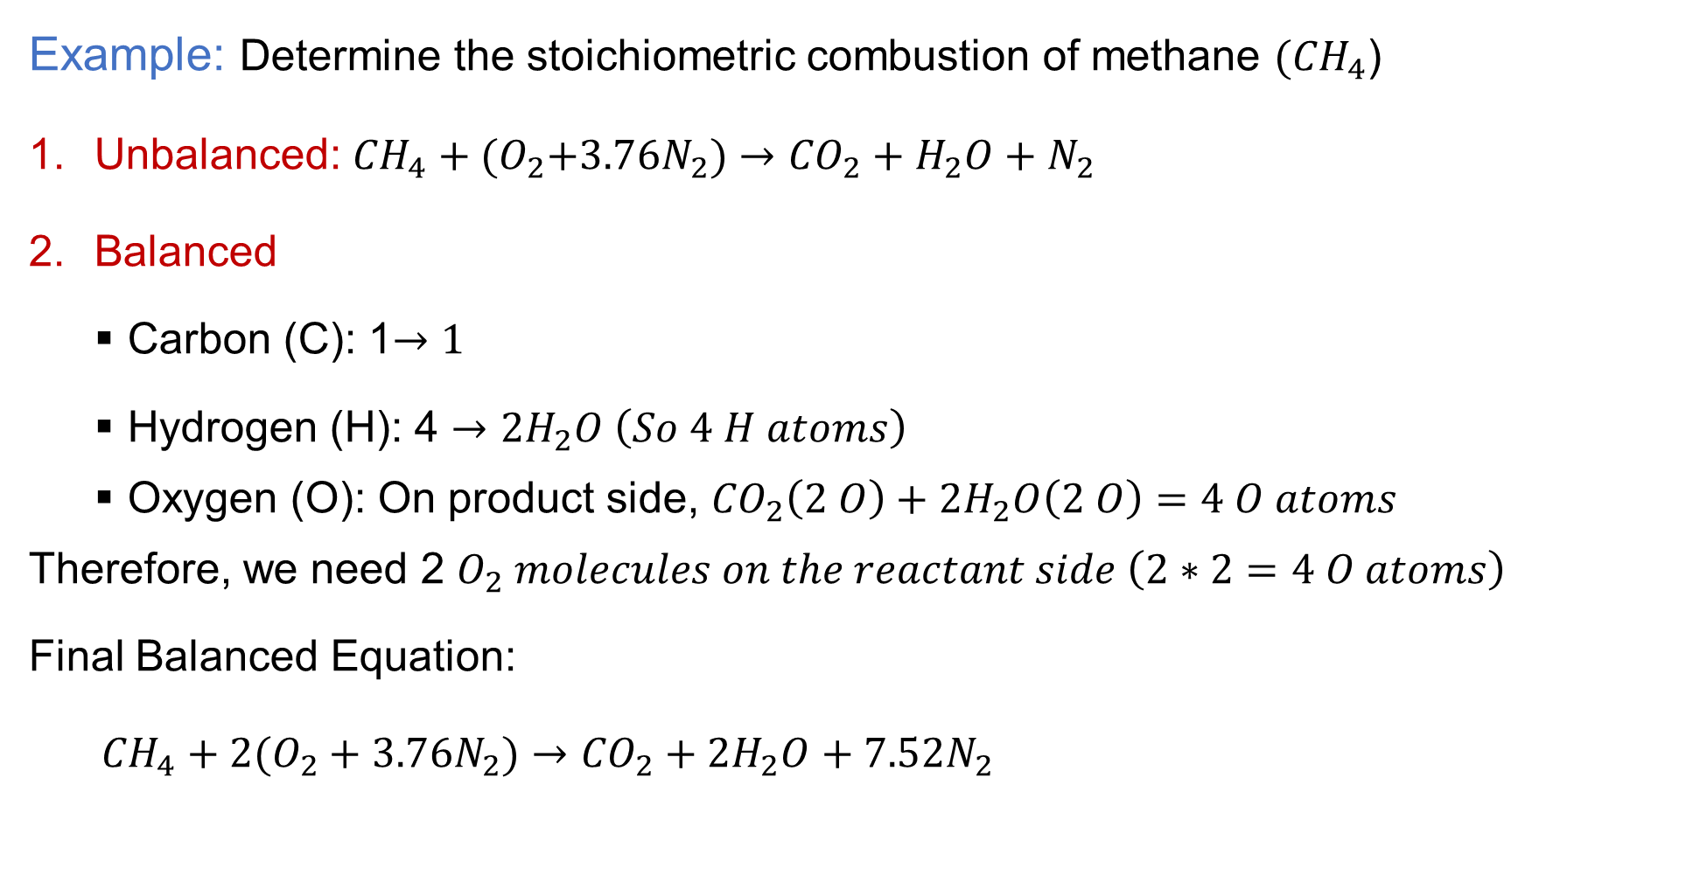
3. Combustion Stoichiometry and Air-Fuel Ratio Cont…
Example: Determine the stoichiometric combustion of methane $({CH}_{4}$)
Unbalanced: ${CH}_{4}+{(O}_{2}+3.76N_{2})→{CO}_{2}+H_{2}O+N_{2}$
Balanced
  Carbon (C): 1$→1$
  Hydrogen (H): 4 $→{2H}_{2}O \left(So 4 H atoms\right)$
  Oxygen (O): On product side, ${CO}_{2}\left(2 O\right)+2H_{2}O\left(2 O\right)=4 O atoms$
Therefore, we need 2 $O_{2} molecules on the reactant side \left(2∗2=4 O atoms\right)$
Final Balanced Equation:
${CH}_{4}+{2(O}_{2}+3.76N_{2})→{CO}_{2}+{2H}_{2}O+7.52N_{2}$

Slide 20
3. Combustion Stoichiometry and Air-Fuel Ratio Cont…
Non-Stoichiometric (Actual) Combustion
In actual combustion processes, it is common practice to use more air than the stoichiometric amount:-
  to increase the chances of complete combustion, or
  to control the temperature of the combustion chamber.
The amount of air in excess of the stoichiometric amount is called excess air.
The amount of excess air is usually expressed in terms of the stoichiometric air as percent excess air or percent theoretical air [4].
Amounts of air less than the stoichiometric amount are called
deficiency of air and are often expressed as percent deficiency
of air.

Slide 21
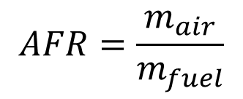
3. Combustion Stoichiometry and Air-Fuel Ratio Cont…
Air-Fuel Ratio (AFR)
A frequently used quantity in the analysis of combustion processes to quantify the amounts of fuel and air is the air-fuel ratio, AFR.
The air-fuel ratio (AFR) is the ratio of the mass of air to the mass of fuel used in a combustion process.
The stoichiometric (theoretical) Air-Fuel Ratio (AFR) is
the AFR for a stoichiometric mixture.
$$AFR=\frac{m_{air}}{m_{fuel}}$$

Slide 22

3. Combustion Stoichiometry and Air-Fuel Ratio Cont…
Example: AFRₛ for Methane (CH₄)
From our balanced equation:
Unbalanced:
Final balanced equation:
Fuel mass: 1 mol CH₄ = (12 + 4*1) = 16 g
Air mass: 2 mol O₂ + 2*3.76 mol N₂ = 2*32 + 7.52*28 = 64 g + 210.56 g = 274.56 g
This means 17.2 kg of air is required to completely burn
1 kg of methane.
$${CH}_{4}+\left(O_{2}+3.76N_{2}\right)→{CO}_{2}+H_{2}O+N_{2}$$
$${CH}_{4}+2\left(O_{2}+3.76N_{2}\right)→{CO}_{2}+{2H}_{2}O+7.52N_{2}$$
$AFR=\frac{274.56}{16}≈$17.2

Slide 23
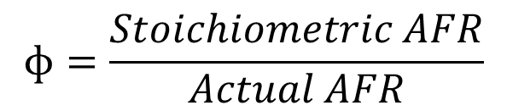
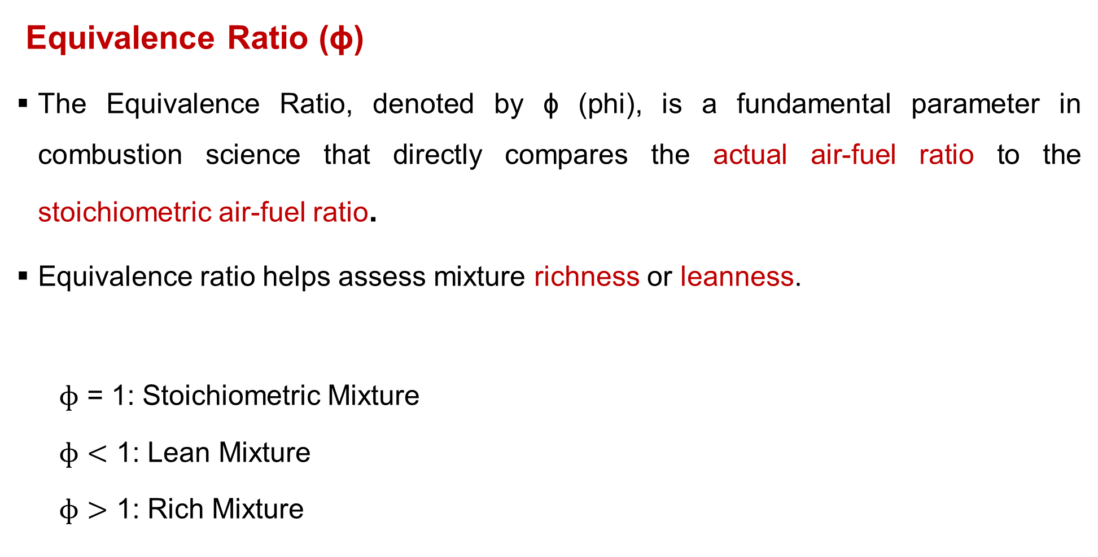
3. Combustion Stoichiometry and Air-Fuel Ratio Cont…
Equivalence Ratio (ϕ)
The Equivalence Ratio, denoted by ϕ (phi), is a fundamental parameter in combustion science that directly compares the actual air-fuel ratio to the stoichiometric air-fuel ratio.
Equivalence ratio helps assess mixture richness or leanness.
  $ɸ$ = 1: Stoichiometric Mixture
  $ɸ<$ 1: Lean Mixture
  $ɸ>$ 1: Rich Mixture
$$ɸ=\frac{Stoichiometric AFR}{Actual AFR}$$

Slide 24
4. Experimental Techniques for Determining Combustion Products
Experimental techniques for determining combustion products involve analyzing the gases and byproducts produced during the combustion of a fuel.
Analyzing the composition of combustion exhaust is critical for:
  Efficiency optimization
  Controlling emissions
  Designing combustion systems
  Ensuring environmental compliance
The experimental techniques includes:
  Sampling methods
  Analysis techniques

Slide 25
4. Experimental Techniques for Determining Combustion Products Cont...
Sampling Methods: The first critical step
Sampling techniques refer to the methods used to extract, collect, and prepare gas or particle samples from a combustion system (like a flame, furnace, engine exhaust, or reactor) for further analysis [5].
Before analysis, combustion products must be properly sampled.
The common sampling techniques are:
1. Direct (In-situ) Sampling
Measurements are taken directly in the combustion zone without extracting the sample.
Often used with non-intrusive optical methods like laser diagnostics.
Example: Laser-Induced Fluorescence (LIF) and , FTIR spectroscopy.

Slide 26
4. Experimental Techniques for Determining Combustion Products Cont...
2. Extractive Sampling
  Gases are withdrawn from the duct or stack through a probe and conditioned (filtered, cooled, dried) before being transported to the analyzer.
  Most common in practical applications.
  Requires proper design to avoid chemical changes (oxidation, condensation) and minimize losses or contamination.
3. Cryogenic Sampling
  Rapidly freezes the combustion sample to preserve reactive or
  unstable species.
  Often used in research-grade experiments.

Slide 27
4. Experimental Techniques for Determining Combustion Products Cont...
4. Filter Sampling (for solids/particulates)
Combustion exhaust is passed through filters to trap particulate matter like soot.
Collected samples are then analyzed using Microscopy, Elemental analysis (XRF) and Carbon content analysis.
Key considerations in sampling
Temperature control to avoid condensation of water or tars.
Pressure compatibility with detectors.
Chemical inertness of probes and lines (e.g., use stainless steel).
Residence time minimization to avoid chemical reactions.
Calibration of sampling systems to ensure quantitative accuracy.

Slide 28
4. Experimental Techniques for Determining Combustion Products Cont...
Analysis Techniques
1. Gas Chromatography (GC)
  Separates and quantifies individual species in a complex mixture.
  Used for: hydrocarbons, CO, CO₂, CH₄
2. Mass Spectrometry (MS)
  Identifies chemical species by mass-to-charge ratio
  It helps identify the amount and type of chemicals present in
  a sample by generating a mass spectrum.

Slide 29
4. Experimental Techniques for Determining Combustion Products Cont...
3. Non-Dispersive Infrared (NDIR) Sensors
  Common for measurement of CO₂, CO, CH₄, and SO₂.
  Based on IR absorption at specific wavelengths
4. Fourier Transform Infrared Spectroscopy (FTIR)
  Measures absorption of infrared light by gases
  Detects functional groups (e.g., CO₂, H₂O, CH₄, NOₓ)
5. Laser-based Diagnostics (In-Situ)
  Tunable Diode Laser Absorption Spectroscopy (TDLAS)
  Laser-Induced Fluorescence (LIF)
  Used for species like hydroxyl radicals (OH), NO, H₂O, CO

Slide 30
5. Environmental Impacts of Fuel Combustion
Fuel combustion is a primary source of energy worldwide, powering vehicles, industries, and homes.
However, it also contributes significantly to environmental degradation through the release of pollutants and greenhouse gases.
The major pollutants can be categorized by their impact:
  Climate forcers: CO₂, CH₄, N₂O, Soot
  Health & ecosystem damagers: NOx, SOx, CO, PM, Ozone, UHCs
  Toxics: Heavy metals, polycyclic aromatic hydrocarbons (PAHs)

Slide 31
5. Environmental Impacts of Fuel Combustion Cont…
Primary pollutants and their formation
1. Carbon Dioxide (CO₂)
  Main product of complete combustion of any carbon-containing fuel (coal, oil, natural gas, biomass).
  Major contributor to global warming
2. Carbon Monoxide (CO)
  Produced from incomplete combustion
  Occurs when there is insufficient oxygen, poor mixing, or
  low temperature, preventing CO from oxidizing to CO₂.
  Toxic even at low concentrations
  Weakens oxygen delivery in the body

Slide 32
5. Environmental Impacts of Fuel Combustion Cont…
3. Nitrogen Oxides (NOₓ)
  Formed at high combustion temperatures
  Contribute to smog and acid rain
  Precursor to ground-level ozone
4. Sulfur Dioxide (SO₂)
  Emitted from sulfur-containing fuels (e.g., coal, diesel)
  Causes acid rain
  Damages vegetation and aquatic ecosystems
5. Particulate Matter (PM)
  Includes soot, ash, and aerosols
  Penetrates deep into lungs
  Linked to respiratory and cardiovascular diseases

Slide 33
5. Environmental Impacts of Fuel Combustion Cont…
6. Volatile Organic Compounds (VOCs)
  Released from unburned hydrocarbons
  React with NOₓ to form ozone
  Include carcinogenic compounds like benzene
7. Unburned Hydrocarbons (UHCs)
  Produced from incomplete combustion due to low temperature, poor mixing, or flame quenching

Slide 34
6. Fuel Properties and Selection Criteria
  A deep understanding of fuel properties ensures optimal system design, safe operation, and sustainable energy use [6].
  The key fuel properties are:
  Calorific Value (Heating Value): Amount of energy released during complete combustion of a unit mass or volume of fuel.
    Higher Heating Value (HHV): Includes latent heat of vaporization of water.
    Lower Heating Value (LHV): Excludes latent heat; more relevant for gas turbines.
  Flash Point and Fire Point: Safety in storage and handling.
    Flash Point: Lowest temperature at which fuel vapors ignite
    momentarily.
    Fire Point: Temperature at which fuel sustains combustion.

Slide 35
6. Fuel Properties and Selection Criteria Cont…
  Viscosity: Resistance to flow/ thickness.
  Density and Specific Gravity
    Density: Mass per unit volume.
    Specific Gravity: Ratio of fuel density to water density.
  Volatility: Tendency of fuel to vaporize.
  Sulfur Content: Amount of sulfur in fuel.
  Ash Content: Non-combustible residue after burning.
  Moisture Content: Water present in fuel.
  Ignition Temperature: Minimum temperature required to
  initiate combustion.

Slide 36
6. Fuel Properties and Selection Criteria Cont…
  Fuel Selection Criteria
  1. Application Suitability
    Power generation, transportation, heating, or industrial processing.
    Example: Natural gas for turbines; coal for boilers.
  Availability and Accessibility
  Cost and Economic Viability
    Fuel price, transportation, and processing costs.
    Consider lifecycle cost, not just purchase price.
  Environmental Impact
    Emissions (CO₂, NOx, SOx, particulates).
    Preference for low-carbon and renewable fuels.

Slide 37
6. Fuel Properties and Selection Criteria Cont…
  Storage and Handling
    Safety, space requirements, and regulatory compliance.
    Example: LPG requires pressurized tanks; coal needs large yards.
  Combustion Efficiency
    Completeness of combustion and heat recovery potential.
    Influences system design and operational cost.
  Compatibility with Equipment
    Burner type, engine design, and material constraints.
    Example: High-viscosity fuels may clog injectors.

Slide 38
7. Applications in Power Generation, Industrial Processes and Transportation
  Combustion is the primary mechanism for:
    Power Generation: Producing electricity for grids, industries, and homes.
    Industrial Processes: Providing high-temperature heat for direct use in manufacturing and processing.
    Transportation: Propelling vehicles
  Power Generation
  The goal is to convert the chemical energy in fuel into
  mechanical energy (shaft work) and then into electrical energy.

Slide 39
4. Applications Cont…
Application in Major Power Generation Power Plant Types
Steam Power Plants (Rankine Cycle)
  Fuel is combusted in a large boiler. The heat generated converts water into high-pressure steam.
Gas Turbine Power Plants (Brayton Cycle)
  Air is compressed, mixed with fuel, and combusted internally in a combustion chamber.
Combined Cycle Gas Turbine (CCGT) Plants
  Exhaust heat from a gas turbine (Brayton Cycle) is used to
  generate steam in a Heat Recovery Steam Generator (HRSG).
  This steam then drives a steam turbine (Rankine Cycle).

Slide 40
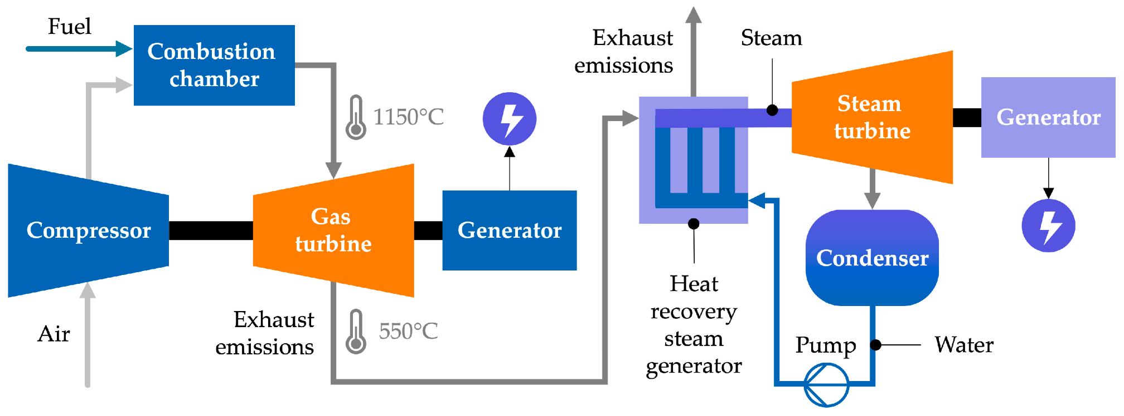
4. Applications Cont…
Application in Major Power Generation Power Plant Types
Figure 3: Combined Cycle Gas Turbine (CCGT) Plants, Matos, D., Lassio, J. G., Garcia, K. C., Raupp, I., Medeiros, A. M., & Abreu, J. L. S. (2024)
url: https://www.mdpi.com/gases/gases-04-00018/article_deploy/html/images/gases-04-00018-g002.png

Slide 41
4. Applications Cont…
2. Industrial Processes
The heat from combustion is used directly for process heating, often at very high temperatures.
Application in Major Industrial Process Power Plant Types
Cement Manufacturing
  Raw materials (limestone, clay) are fed into a long, rotating kiln heated to ~1450°C.
  This causes a chemical reaction (calcination) to form clinker.
Metal Production (e.g., Steel in a blast furnace)
  Iron ore, coke, and limestone are loaded into the top of
  a blast furnace.

Slide 42
4. Applications Cont…
Glass Manufacturing
  Raw materials (silica sand, soda ash, limestone) are melted in a regenerative furnace at temperatures around 1700°C.
General Process Heating
  Boilers for steam, furnaces for heat treatment of metals, drying ovens for food and materials, refinery heaters.
3. Transportation
Transportation systems rely heavily on fuels and combustion
processes to power vehicles, aircraft, ships, and trains.

Slide 43
4. Applications Cont…
Application in Major Transportation Systems
Road Transport
  Petrol and diesel are primary fuels.
  Combustion in internal combustion engines (ICEs).
Aviation
  Refined kerosene-based fuels.
  Combustion in gas turbine jet engines.
Marine Transport
  Uses heavy fuel oil or marine diesel.
  Combustion in large marine diesel engines.

Slide 44
4. Applications Cont…
The Future: Transition and Innovation of the Transportation Systems
  Transition to Low-Carbon Fuels: Switching from coal to natural gas, and incorporating biofuels (e.g., biodiesel, ethanol).
  Hydrogen Combustion: Hydrogen can be burned in turbines and engines, producing only water vapor (no CO₂) if produced using renewable energy ("green hydrogen").
  Efficiency Improvements: Advanced materials allow for higher operating temperatures, leading to more efficient engines and turbines,
  which use less fuel for the same output.

Slide 45
Summary
Fuels are systematically classified by their physical state, origin, and characteristics like calorific value and volatility.
Coal analysis is split into Proximate (practical, immediate qualities) and Ultimate (elemental chemical composition) to determine its quality and behaviour.
Stoichiometry calculates the exact air-fuel ratio for complete combustion, which is critical for maximizing efficiency and minimizing pollutants.
Experimental techniques like gas chromatography and infrared spectroscopy help identify combustion products
Fuel selection for power, industry, and transport is a complex
trade-off between properties like energy density, cost, handling,
and environmental impact.

Slide 46
References
[1]. Power Plant Engineering, R.K. Rajput, 3rd Edition, 2011.
[2]. Combustion, Glassman, I., Yetter, R. A., & Glumac, N. G. (2014). (5th ed.). Academic Press.
[3]. An Introduction to Combustion: Concepts and Applications, Turns, S. R. (2012). (3rd ed.).
[4]. Gas Turbine Combustion: Alternative Fuels and Emissions, Arthur H. Lefebvre, Dilip R. Ballal (3rd Edition), CRC Press, 2010.
[5]. Non-intrusive optical diagnostics of co- and counter-swelling flames in a dual swirl pulverized coal combustion burner. Sung, Y., & Choi, G. (2016). Fuel, 174, 76-88. https://doi.org/10.1016/j.fuel.2016.01.014
[6]. Fuel Property Estimation and Combustion Process Characterization. Kiang, Y.-H. (2018), Academic Press.

Slide 47
Thank you !

