Slide 1
Power Plant Engineering
Lecture 4
Fuels and Combustion
Lecturer: Dr. Melaku Desta

Slide 2
Lecture learning outcomes:
At the end of this lecture, you will be able to:
Explain the concept of reference state and reference values and their importance in thermochemical calculations.
Analyze the composition and behavior of reacting mixtures using mole fractions, mass fractions, and chemical equilibrium principles.
Define the enthalpy of formation and use it to compute the enthalpy changes of reactions.
Apply the First Law of Thermodynamics to closed and open reacting systems to evaluate energy changes.
Determine the adiabatic flame temperature for combustion
reactions under idealized conditions.
Distinguish between higher and lower heating values of fuels and
describe standard methods for their experimental determination.

Slide 3
Content
Reference State and Reference Values
Reacting Mixtures
Enthalpy of Formation
First Law Analysis of Reacting Systems
Adiabatic Flame Temperature
Heating Values of Fuels
Experimental Determination of Heating Values of Fuels
Summary
References

Slide 4
1. Reference State and Reference Values
Thermodynamic properties like enthalpy, entropy, and internal energy are relative-not absolute.
The values cannot be measured directly, and they are calculated from measurable properties using the relations between thermodynamic properties.
However, those relations give the changes in properties, not the values of properties at specified state.
Reference state and reference values are foundational for calculating thermodynamic properties.
They provide a baseline against which we measure and compare
thermodynamic properties like enthalpy, entropy, and internal energy.

Slide 5
1. Reference State and Reference Value Cont…
A reference state is a defined condition (temperature, pressure, phase) used as a baseline for measuring thermodynamic properties [1].
Standard reference state is the most stable form of an element at 1 atm and 25°C.
Reference states are conventions, not physical truths.
Commonly used reference conditions:
  Temperature: 25°C (298.15 K)
  Pressure: 1 atm (101.325 kPa)
  Phase: Most stable form at the reference temperature and
  pressure

Slide 6
1. Reference State and Reference Value Cont…
Example:
  For oxygen (O₂), reference state is gaseous O₂ at 25°C and 1 atm.
  For water (H₂O), the state saturated liquid at 0.01°C is taken as the reference state, and the internal energy and entropy are assigned zero values at that sate.
  For refrigerant 134a, the state saturated liquid at -40°C is taken as the reference state, and the enthalpy and entropy are assigned zero values at that state.
In thermodynamics, the focus is on changes in properties,
and the reference chosen has no consequences in the calculations.

Slide 7
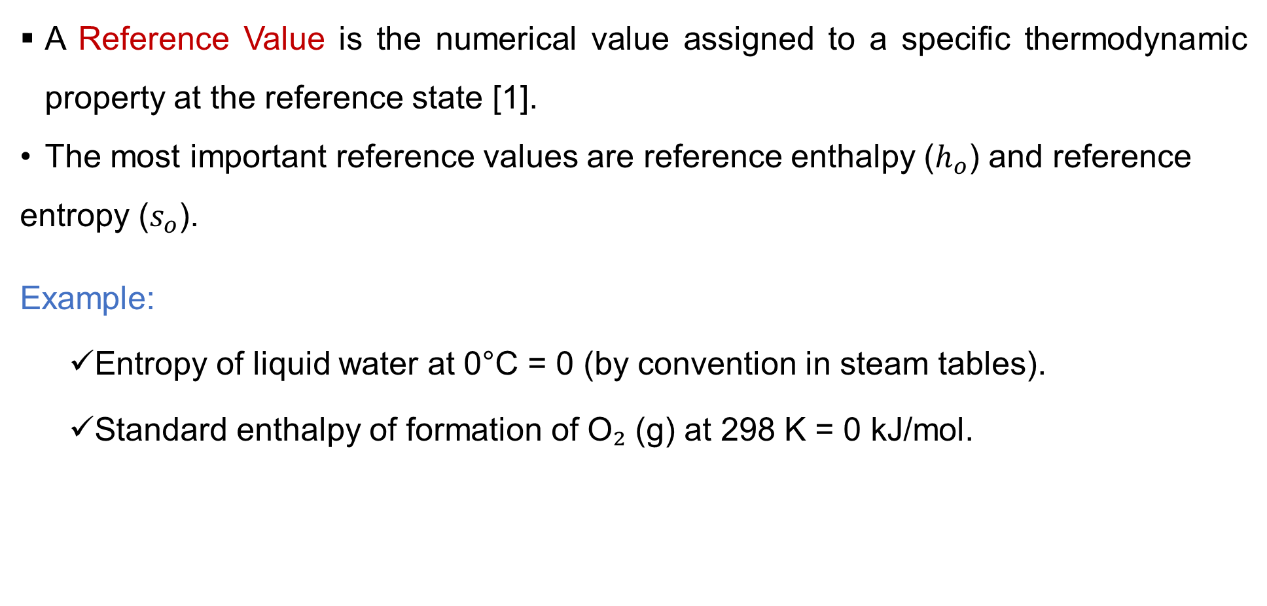
1. Reference State and Reference Value Cont…
A Reference Value is the numerical value assigned to a specific thermodynamic property at the reference state [1].
The most important reference values are reference enthalpy ($h_{o}$) and reference entropy ($s_{o}$).
Example:
  Entropy of liquid water at 0°C = 0 (by convention in steam tables).
  Standard enthalpy of formation of O₂ (g) at 298 K = 0 kJ/mol.

Slide 8
2. Reacting Mixtures
A reacting mixture is a system containing two or more chemical species that undergo a chemical reaction.
It is a combination of chemical species undergoing a chemical reaction, typically involving combustion or synthesis.
A chemical reaction changes the molecular identity of the substances involved.
This transformation releases or absorbs a significant amount of energy, primarily as heat and is used to understand energy release, fuel efficiency, and environmental impact in engines, furnaces, and chemical reactors.
When chemical reaction occurs, reactants disappear and products
are formed, so differences can not be calculated for all substances
involved.

Slide 9
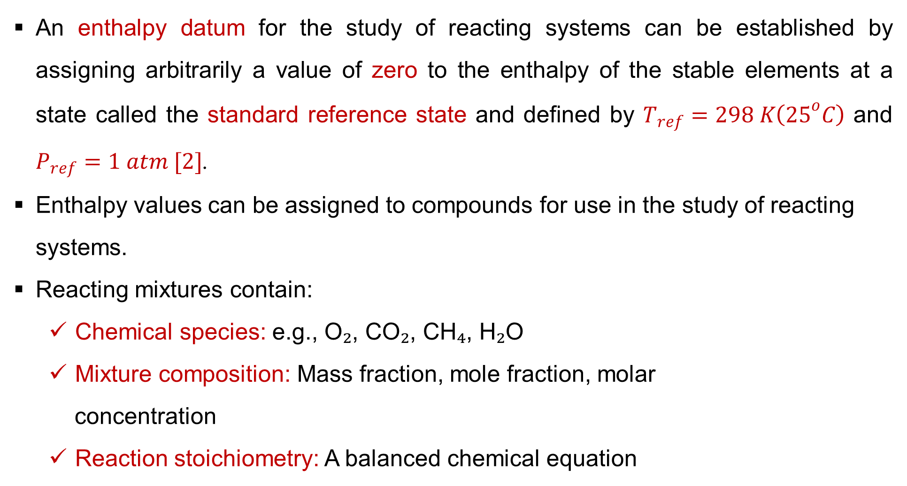
2. Reacting Mixtures Cont…
An enthalpy datum for the study of reacting systems can be established by assigning arbitrarily a value of zero to the enthalpy of the stable elements at a state called the standard reference state and defined by $T_{ref}=298 K\left({25}^{o}C\right)$ and $P_{ref}=1 atm [2]$.
Enthalpy values can be assigned to compounds for use in the study of reacting systems.
Reacting mixtures contain:
  Chemical species: e.g., O₂, CO₂, CH₄, H₂O
  Mixture composition: Mass fraction, mole fraction, molar
  concentration
  Reaction stoichiometry: A balanced chemical equation

Slide 10
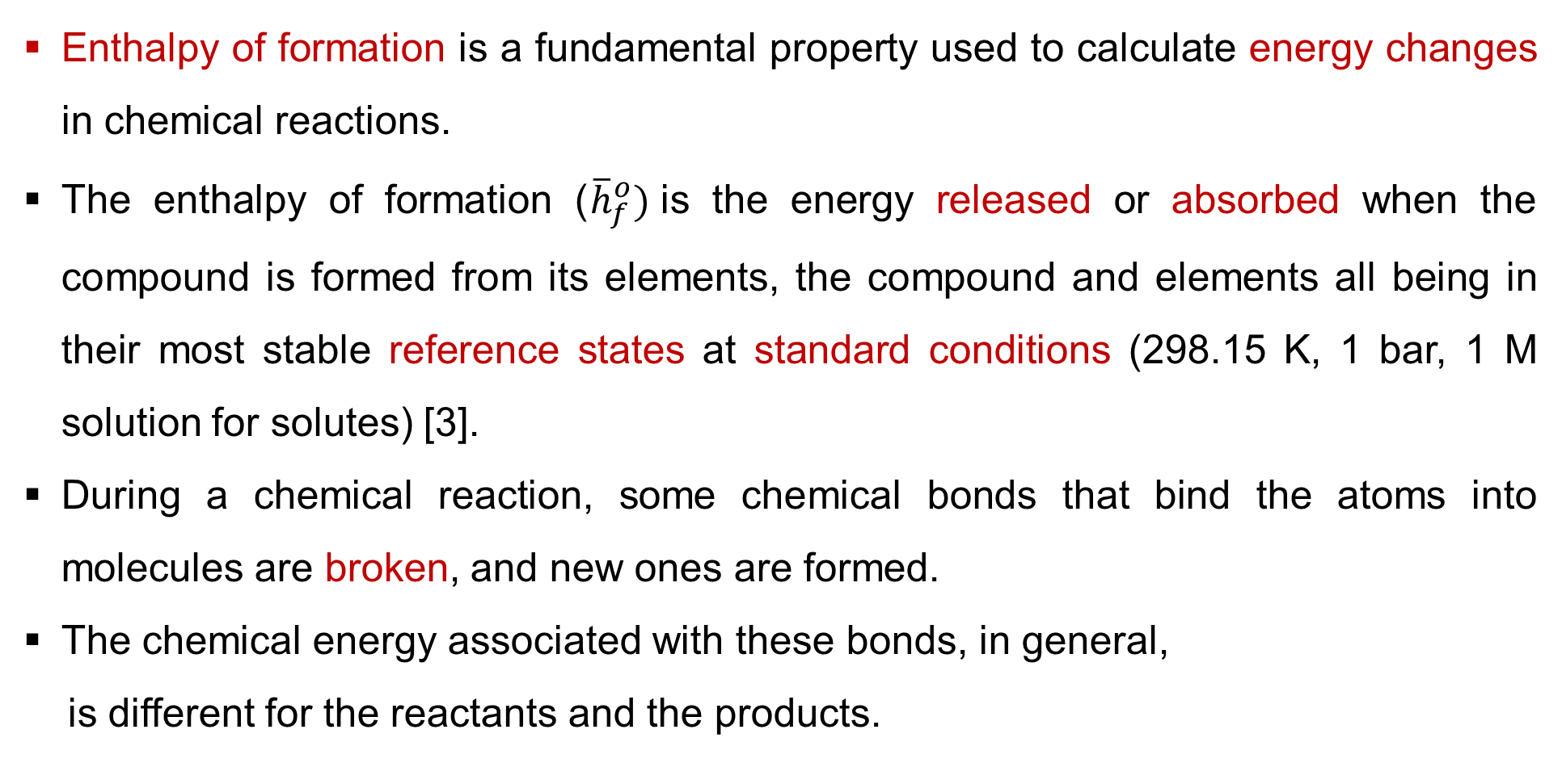
3. Enthalpy of Formation
Enthalpy of formation is a fundamental property used to calculate energy changes in chemical reactions.
The enthalpy of formation (${\overline{h}}_{f}^{o})$is the energy released or absorbed when the compound is formed from its elements, the compound and elements all being in their most stable reference states at standard conditions (298.15 K, 1 bar, 1 M solution for solutes) [3].
During a chemical reaction, some chemical bonds that bind the atoms into molecules are broken, and new ones are formed.
The chemical energy associated with these bonds, in general,
is different for the reactants and the products.

Slide 11
3. Enthalpy of Formation Cont…
A process that involves chemical reactions will involve changes in chemical energies, which must be accounted for in an energy balance.
Assuming that the atoms of each reactant remains intact (no nuclear reactions) and disregarding any changes in kinetic and potential energies, the energy change of a system during a chemical reaction will be due to a change in state and a change in chemical composition [4]. That is,
In thermodynamics we are concerned with the changes in the energy of a system during a process, and not the energy values at the particular states.

Slide 12
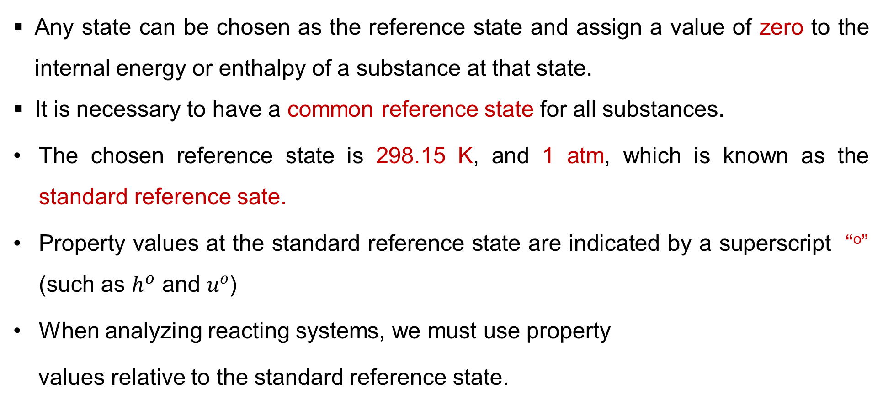
3. Enthalpy of Formation Cont…
Any state can be chosen as the reference state and assign a value of zero to the internal energy or enthalpy of a substance at that state.
It is necessary to have a common reference state for all substances.
The chosen reference state is 298.15 K, and 1 atm, which is known as the standard reference sate.
Property values at the standard reference state are indicated by a superscript “º” (such as $h^{o}$ and $u^{o}$)
When analyzing reacting systems, we must use property
values relative to the standard reference state.

Slide 13

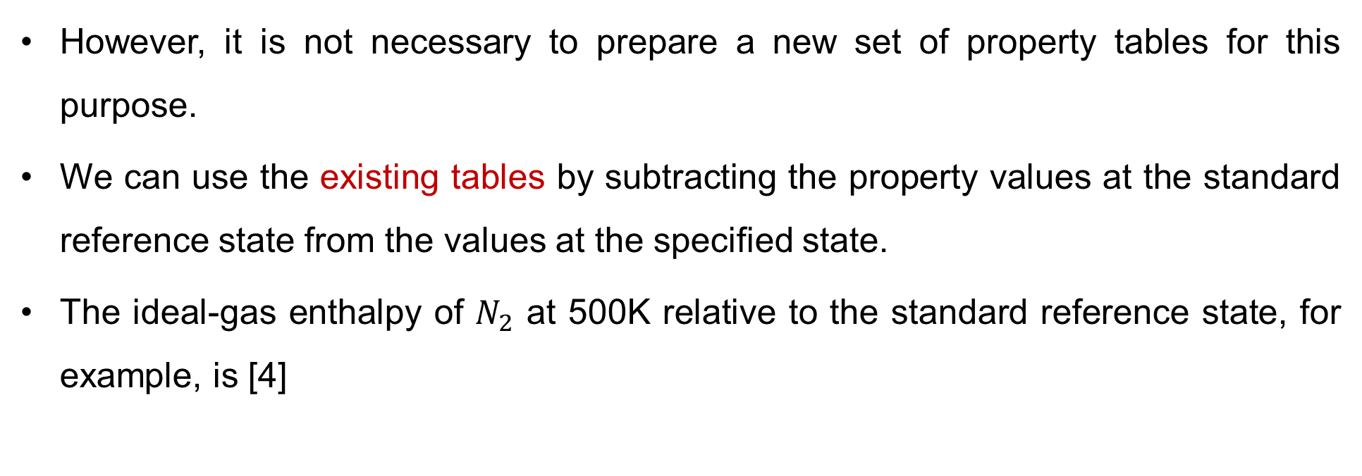
3. Enthalpy of Formation Cont…
However, it is not necessary to prepare a new set of property tables for this purpose.
We can use the existing tables by subtracting the property values at the standard reference state from the values at the specified state.
The ideal-gas enthalpy of $N_{2}$ at 500K relative to the standard reference state, for example, is [4]
$$\left.Enthalpy={\overline{h}}_{f}^{o}+\left(\overline{h}−{\overline{h}}^{o}\right) (kJ/kmol \right)$$
$${\overline{h}}_{500K}−{\overline{h}}^{o}=14,581−8669=5912 kJ/kmol$$

Slide 14
3. Enthalpy of Formation Cont…
The enthalpy of formation of the elements found naturally as diatomic elements, such as nitrogen, oxygen, and hydrogen, is defined to be zero.
Table 1: Enthalpy of Formation at 298 K and 1 atm [4]
Substance | Formula | M | kJ/kmol
Air |  | 29 | 0
Oxygen | O₂ | 32 | 0
Nitrogen | N₂ | 28 | 0
Carbon Dioxide | CO₂ | 44 | -393,520
Carbon Monoxide | CO | 28 | -110,530
Water (vapor) | H₂Ovap | 18 | -241,820
Water (liquid) | H₂Oliq | 18 | -285,830
Methane | CH₄ | 16 | -74,850
Acetylene | C₂H₂ | 26 | +226,730
Ethane | C₂H₆ | 30 | -84,680
Propane | C₃H₈ | 44 | -103,850
Butane | C₄H₁₀ | 58 | -126,150
Octane (vapor) | C₈H₁₈ | 114 | -208,450
Dodecane | C₁₂H₂₆ | 170 | -291,010

Slide 15
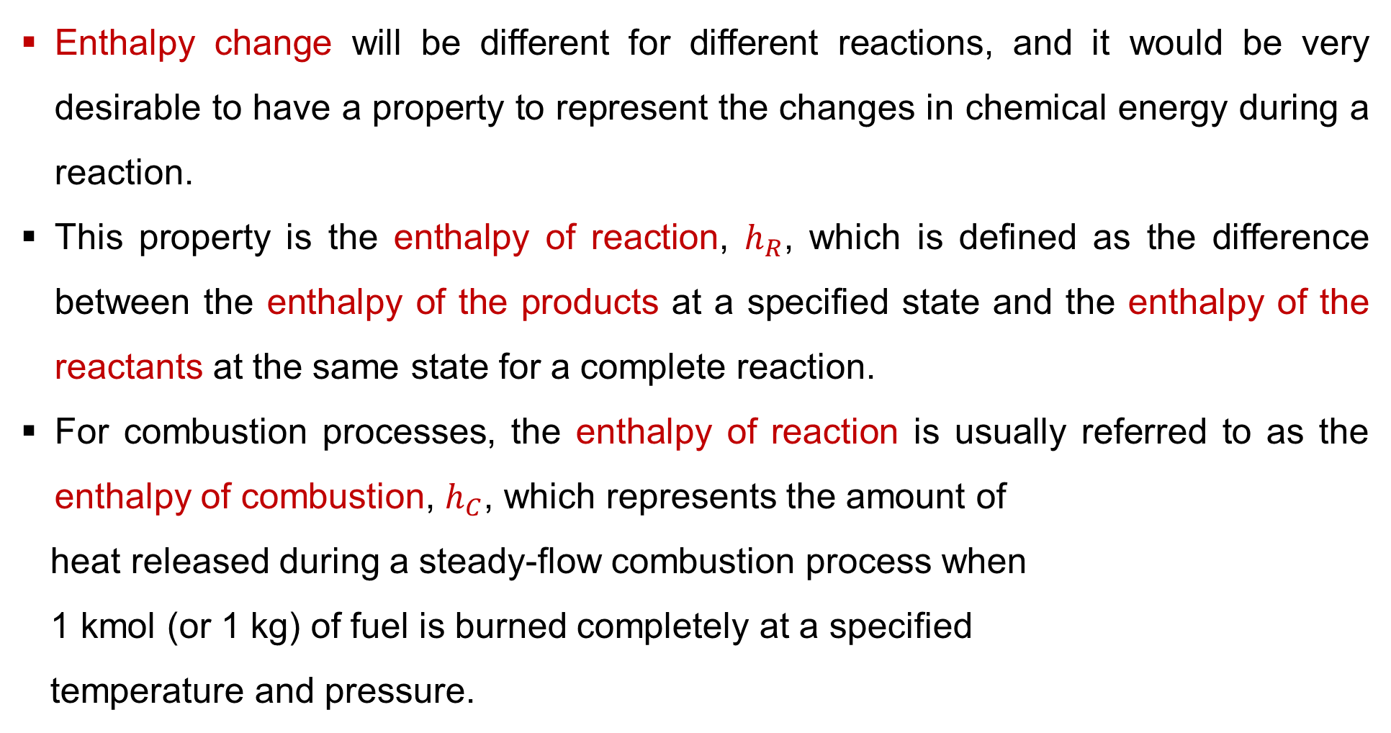
3. Enthalpy of Formation Cont…
Enthalpy change will be different for different reactions, and it would be very desirable to have a property to represent the changes in chemical energy during a reaction.
This property is the enthalpy of reaction, $h_{R}$, which is defined as the difference between the enthalpy of the products at a specified state and the enthalpy of the reactants at the same state for a complete reaction.
For combustion processes, the enthalpy of reaction is usually referred to as the enthalpy of combustion, $h_{C}$, which represents the amount of
heat released during a steady-flow combustion process when
1 kmol (or 1 kg) of fuel is burned completely at a specified
temperature and pressure.

Slide 16

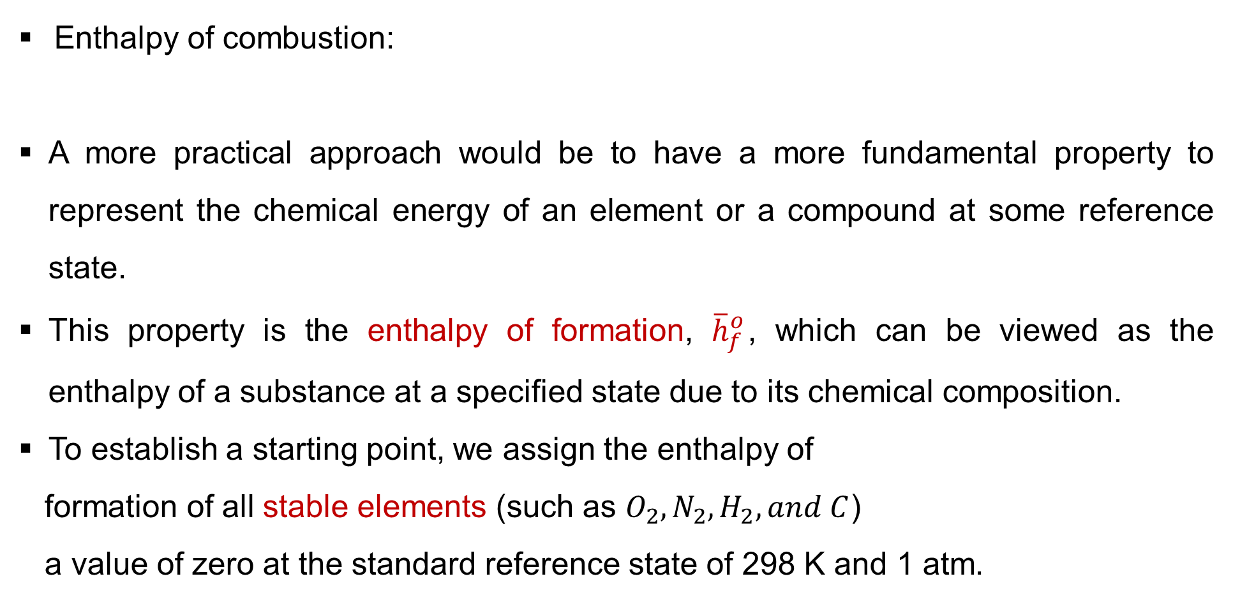
3. Enthalpy of Formation Cont…
Enthalpy of combustion:
A more practical approach would be to have a more fundamental property to represent the chemical energy of an element or a compound at some reference state.
This property is the enthalpy of formation, ${\overline{h}}_{f}^{o}$, which can be viewed as the enthalpy of a substance at a specified state due to its chemical composition.
To establish a starting point, we assign the enthalpy of
formation of all stable elements (such as $O_{2}, N_{2},H_{2}, and C$)
a value of zero at the standard reference state of 298 K and 1 atm.
$$h_{C}=H_{Product}−H_{Reactant}$$

Slide 17
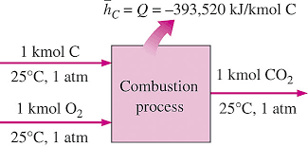

3. Enthalpy of Formation Cont…
Example: Enthalpy of formation of ${CO}_{2}$
$$h_{C}=H_{Product}−H_{Reactant}$$
Figure 1: Enthalpy of Combustion, Combustion, Parente, A. (2011)
url:https://encrypted-tbn0.gstatic.com/images?q=tbn:ANd9GcRIoIK7yznyqCRbTEuwYIXY3mJgjDrcYFjgF_o-58ga4FEPuETO

Slide 18

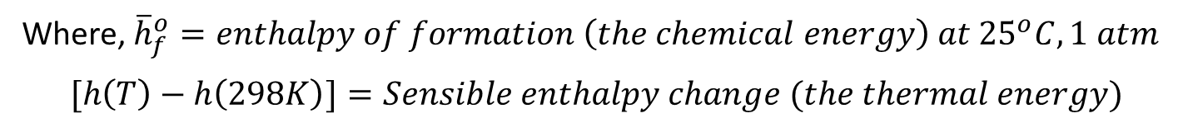
4. First Law Analysis of Reacting Systems
The energy balance relations (the first law) are applicable to both reacting and non-reacting systems.
However, chemically reacting systems involve changes in their chemical energy, and thus it is more convenient to rewrite the energy balance relations so that the changes in chemical energies are explicitly expressed.
For a substance involved in a chemical reaction, its total enthalpy is the sum of its chemical energy (formation enthalpy) and its sensible energy relative to the standard state (25°C) [4].
$$h\left(T\right)={\overline{h}}_{f}^{o}+[h\left(T\right)−h\left(298K\right)]$$
Where, ${\overline{h}}_{f}^{o}=enthalpy of formation \left(the chemical energy\right) at {25}^{o}C, 1 atm$
$$[h\left(T\right)−h\left(298K\right)]=Sensible enthalpy change (the thermal energy)$$

Slide 19
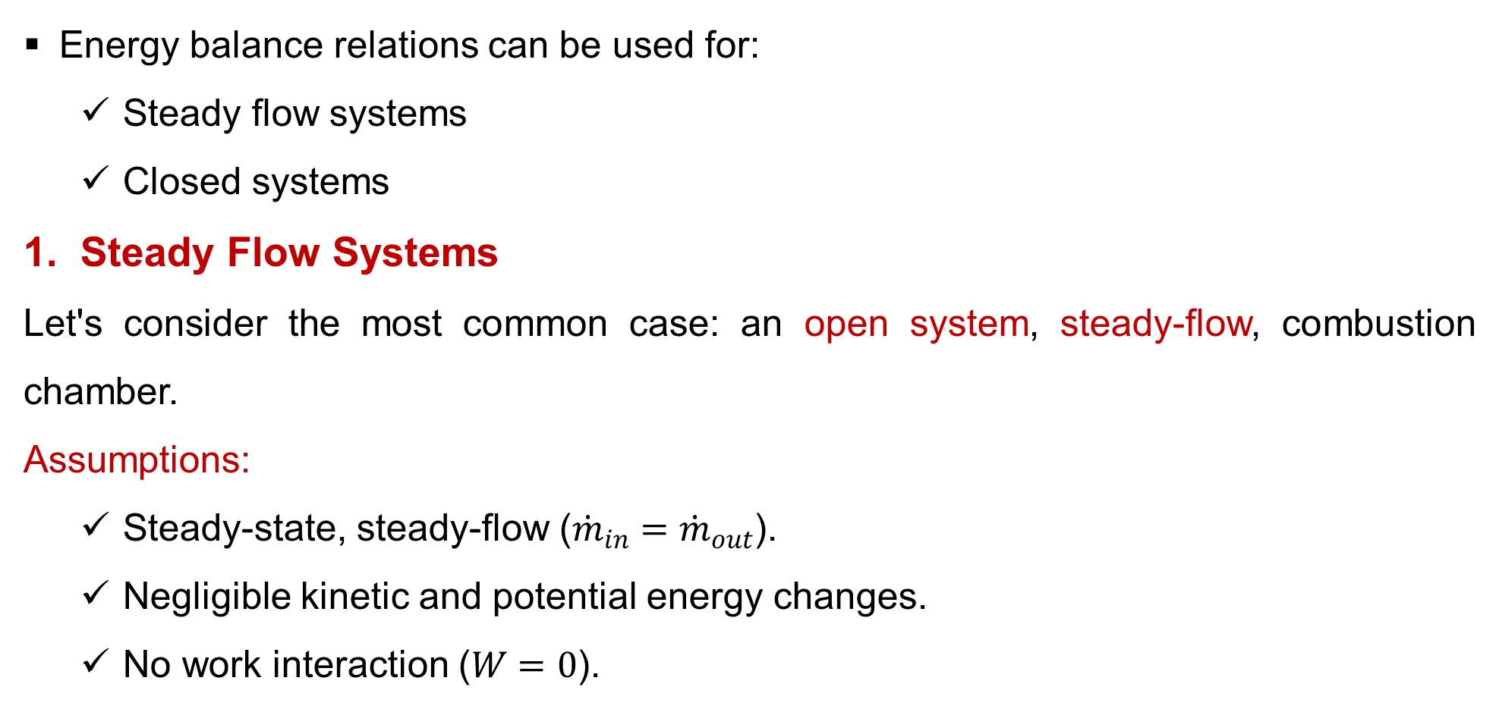
4. First Law Analysis of Reacting Systems Cont…
Energy balance relations can be used for:
  Steady flow systems
  Closed systems
Steady Flow Systems
Let's consider the most common case: an open system, steady-flow, combustion chamber.
Assumptions:
  Steady-state, steady-flow (${\dot{m}}_{in}={\dot{m}}_{out}$).
  Negligible kinetic and potential energy changes.
  No work interaction ($W=0$).

Slide 20

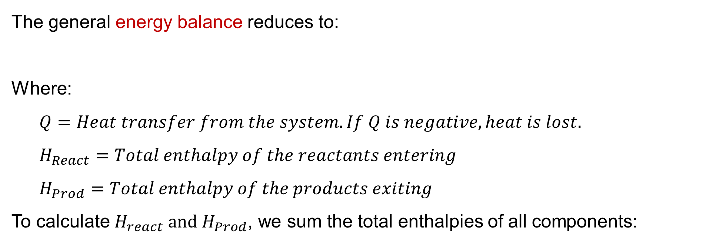
4. First Law Analysis of Reacting Systems Cont…
The general energy balance reduces to:
Where:
  $Q=Heat transfer from the system. If Q is negative, heat is lost.$
  $H_{React}=Total enthalpy of the reactants entering$
  $H_{Prod}=Total enthalpy of the products exiting$
To calculate $H_{react} and H_{Prod}$, we sum the total enthalpies of all components:
$$Q=H_{Prod}−H_{React}$$

Slide 21

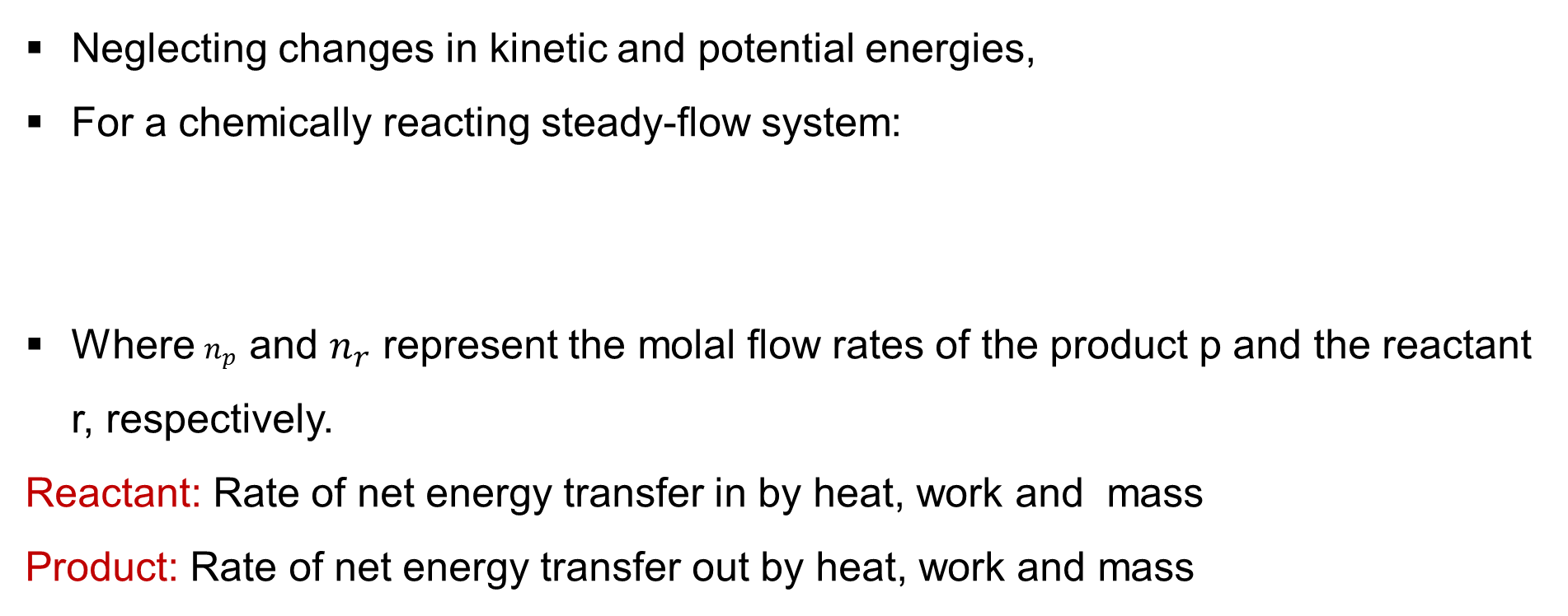
4. First Law Analysis of Reacting Systems Cont…
Neglecting changes in kinetic and potential energies,
For a chemically reacting steady-flow system:
Where $n_{p}$ and $n_{r}$ represent the molal flow rates of the product p and the reactant r, respectively.
Reactant: Rate of net energy transfer in by heat, work and mass
Product: Rate of net energy transfer out by heat, work and mass
$E_{in}=E_{out}$.
$$Q_{in}+W_{in}+\sum{\left.n_{r}\right(}{\left.{\overline{h}}_{f}^{o}+\left(\overline{h}−{\overline{h}}^{o}\right)\right)}_{r}=Q_{out}+W_{out}+\sum{\left.n_{p}\right(}{\left.{\overline{h}}_{f}^{o}+\left(\overline{h}−{\overline{h}}^{o}\right)\right)}_{p}$$

Slide 22
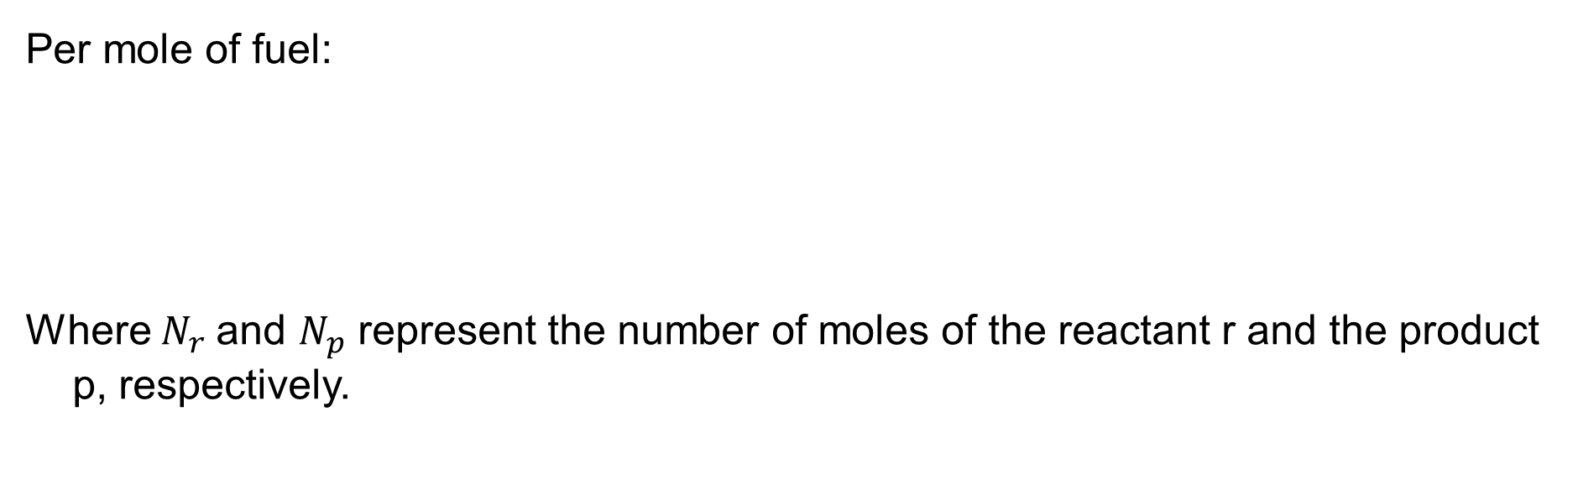
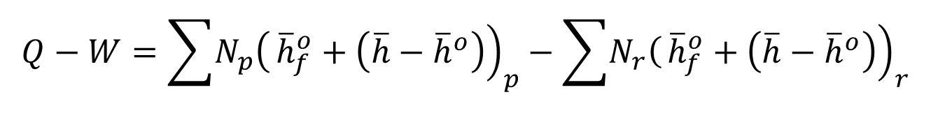
4. First Law Analysis of Reacting Systems Cont…
Per mole of fuel:
Where${ N}_{r}$ and $N_{p}$ represent the number of moles of the reactant r and the product p, respectively.
$$Q_{in}+W_{in}=Q_{out}+W_{out}+\sum{N_{p}{\left.{\left(\overline{h}\right.}_{f}^{o}+\left(\overline{h}−{\overline{h}}^{o}\right)\right)}_{p}−\sum{N_{r}{\left.{\left(\overline{h}\right.}_{f}^{o}+\left(\overline{h}−{\overline{h}}^{o}\right)\right)}_{r}}}$$
$$Q−W=\sum{\left.N_{p}\right(}{\left.{\overline{h}}_{f}^{o}+\left(\overline{h}−{\overline{h}}^{o}\right)\right)}_{p}−\sum{\left.N_{r}\right(}{\left.{\overline{h}}_{f}^{o}+\left(\overline{h}−{\overline{h}}^{o}\right)\right)}_{r}$$
$$\left.Q−W=H_{prod}−H_{react }(kJ/kmol fuel\right)$$

Slide 23
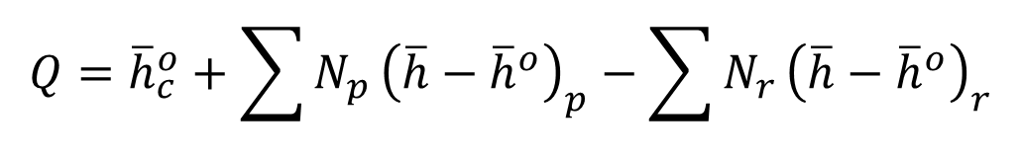
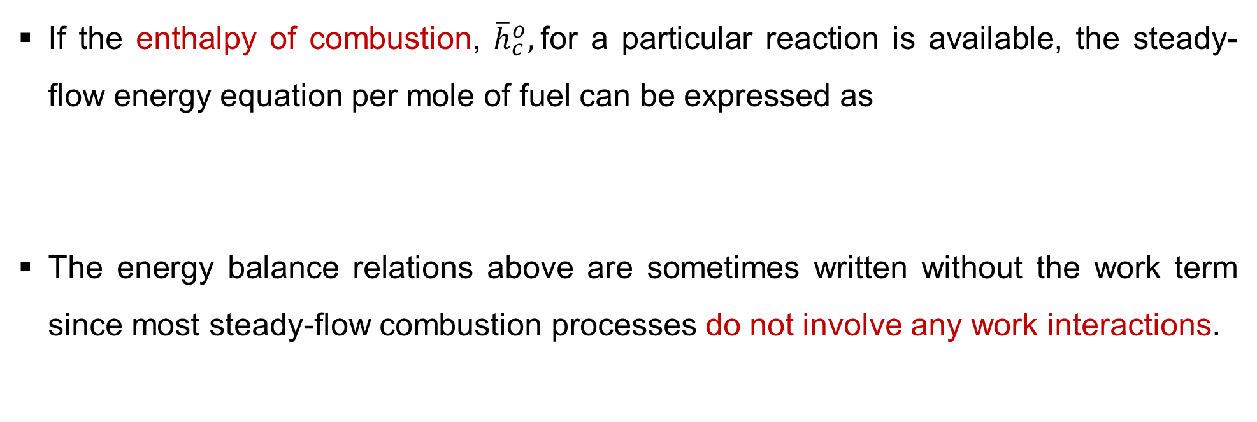
4. First Law Analysis of Reacting Systems Cont…
If the enthalpy of combustion, ${\overline{h}}_{c}^{o},$for a particular reaction is available, the steady-flow energy equation per mole of fuel can be expressed as
The energy balance relations above are sometimes written without the work term since most steady-flow combustion processes do not involve any work interactions.
$$Q={\overline{h}}_{c}^{o}+\sum{N_{p}}{\left(\overline{h}−{\overline{h}}^{o}\right)}_{p}−\sum{N_{r}}{\left(\overline{h}−{\overline{h}}^{o}\right)}_{r}$$

Slide 24
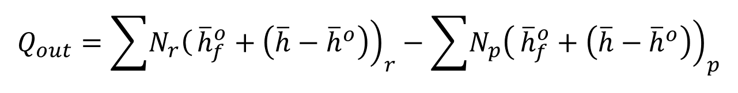
4. First Law Analysis of Reacting Systems Cont…
A combustion chamber normally involves heat output but no heat input.
Then the energy balance for a typical steady-flow combustion process becomes
It expresses that the heat output during a combustion process is simply the difference between the energy of the reactants entering and the energy of the products leaving the combustion chamber.
$$Q_{out}=\sum{\left.N_{r}\right(}{\left.{\overline{h}}_{f}^{o}+\left(\overline{h}−{\overline{h}}^{o}\right)\right)}_{r}−\sum{\left.N_{p}\right(}{\left.{\overline{h}}_{f}^{o}+\left(\overline{h}−{\overline{h}}^{o}\right)\right)}_{p}$$

Slide 25

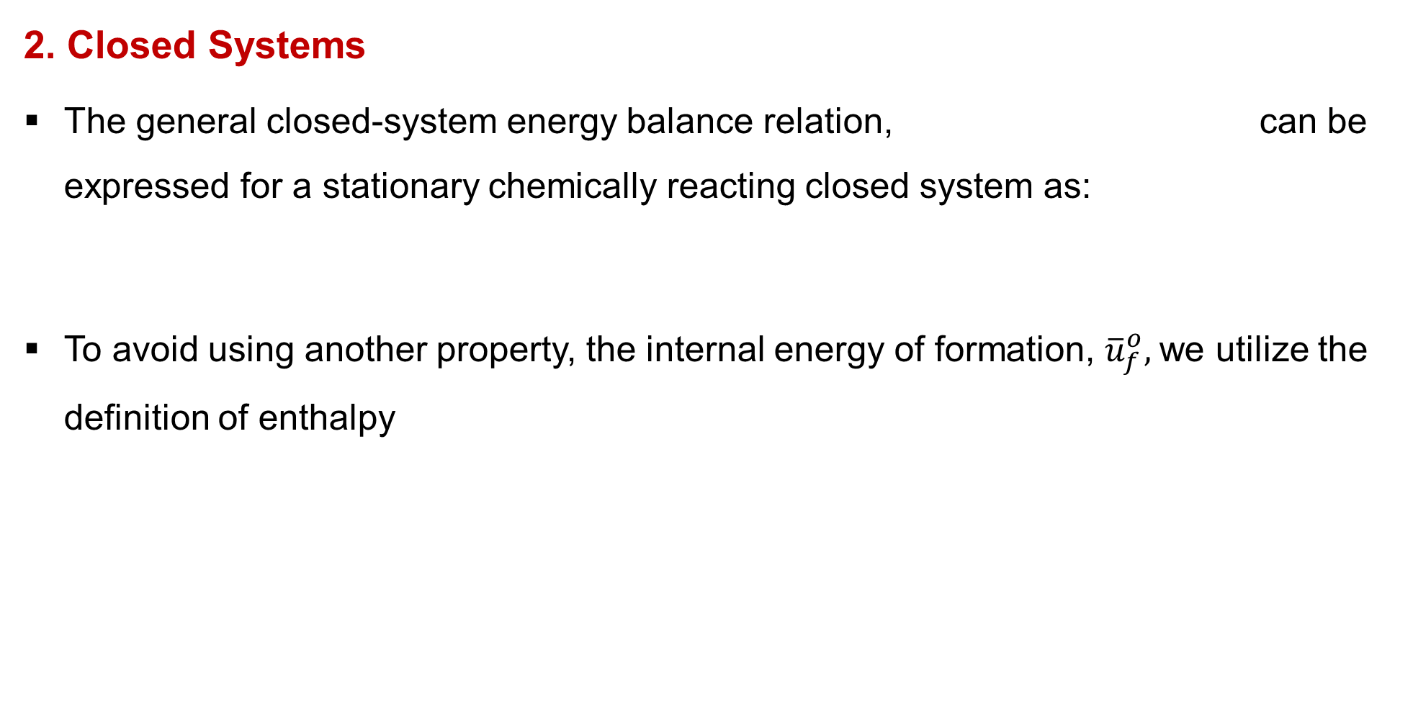
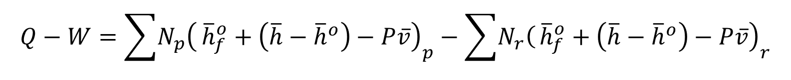
4. First Law Analysis of Reacting Systems Cont…
2. Closed Systems
The general closed-system energy balance relation, can be expressed for a stationary chemically reacting closed system as:
To avoid using another property, the internal energy of formation, ${\overline{u}}_{f}^{o},$we utilize the definition of enthalpy
$E_{in}−E_{out}=∆E_{System}$,
$$\left.{\left(Q\right.}_{in}−Q_{out}{\left)+(W\right.}_{in}−W_{out})=U_{prod}{−U}_{react} (kJ/kmol fuel\right)$$
$$\left(\overline{u}=\overline{h}−P\overline{v} or {\overline{u}}_{f}^{o}+u−\overline{u}={\overline{h}}_{f}^{o}+\overline{h}−{\overline{h}}^{o}−P\overline{v}\right)$$
$$Q−W=\sum{\left.N_{p}\right(}{\left.{\overline{h}}_{f}^{o}+\left(\overline{h}−{\overline{h}}^{o}\right)−P\overline{v}\right)}_{p}−\sum{\left.N_{r}\right(}{\left.{\overline{h}}_{f}^{o}+\left(\overline{h}−{\overline{h}}^{o}\right)−P\overline{v}\right)}_{r}$$

Slide 26
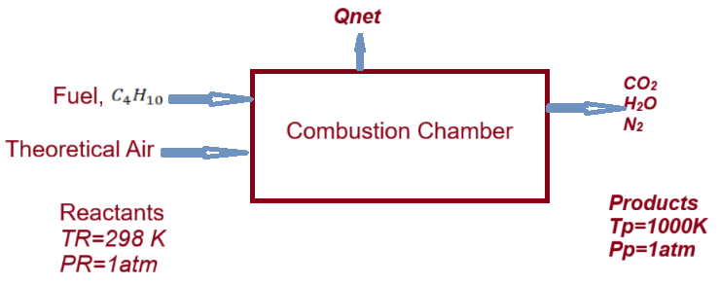
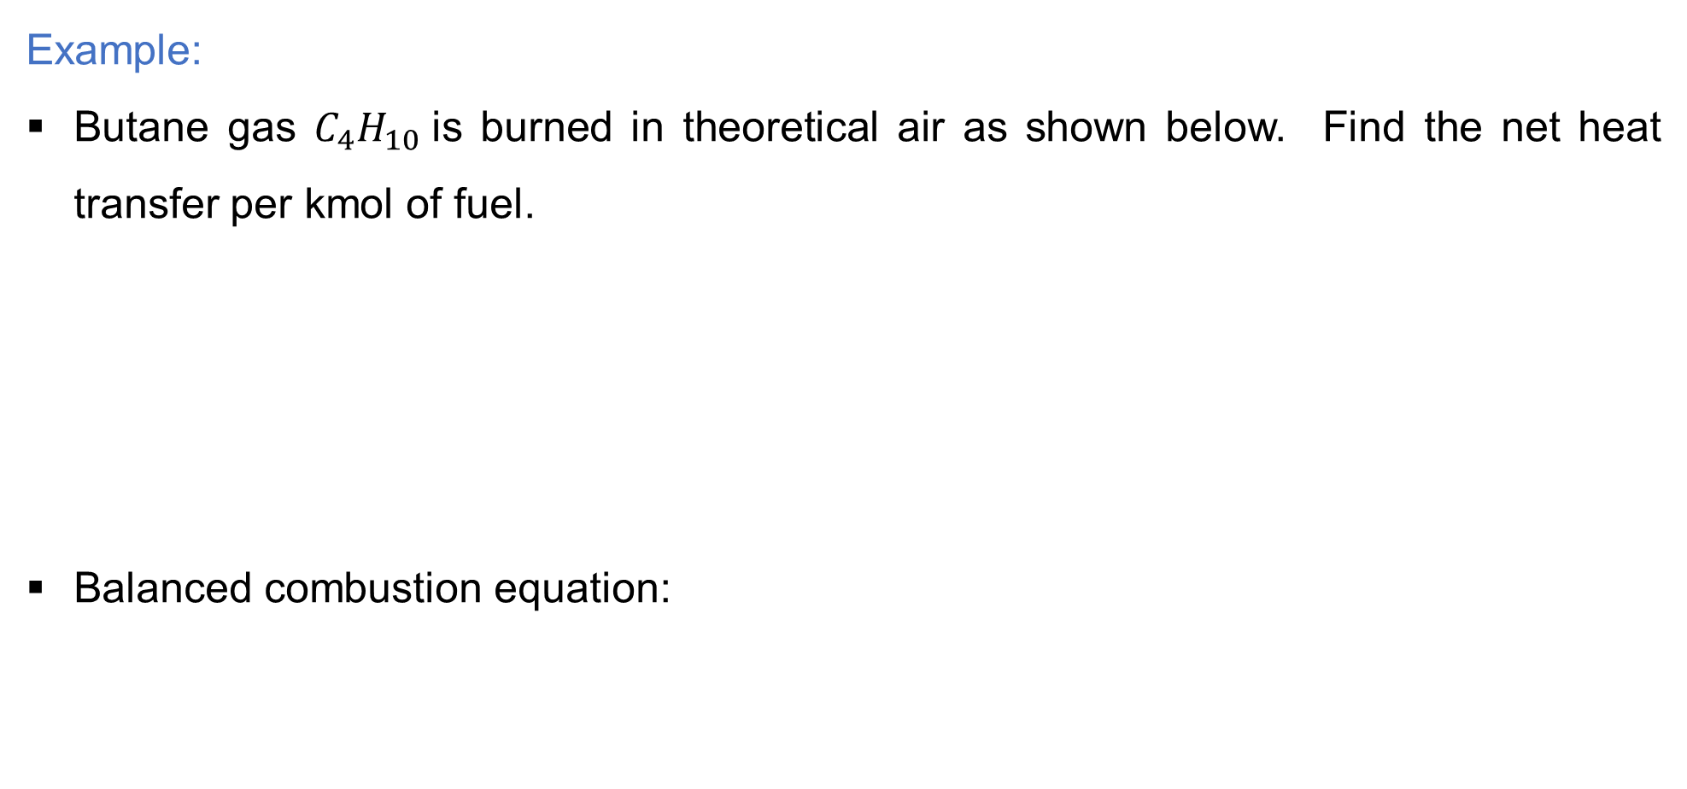
4. First Law Analysis of Reacting Systems Cont…
Example:
Butane gas $C_{4}H_{10}$is burned in theoretical air as shown below. Find the net heat transfer per kmol of fuel.
Balanced combustion equation:
$$C_{4}H_{10}+6.5\left(O_{2}+3.76N_{2}\right)→4{CO}_{2}+5H_{2}O+24.44N_{2}$$

Slide 27
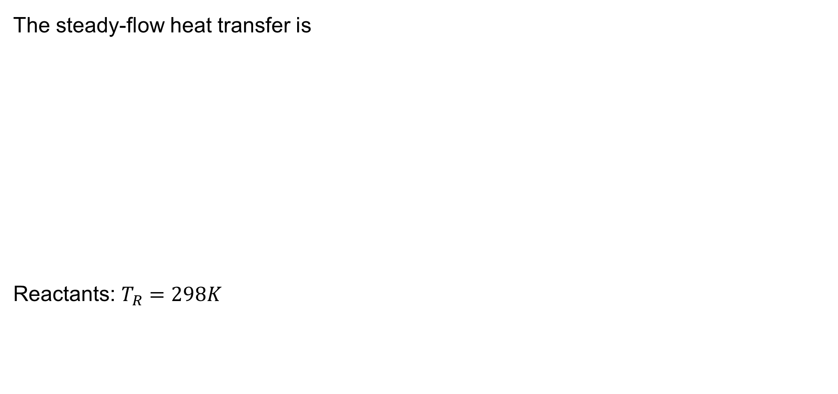
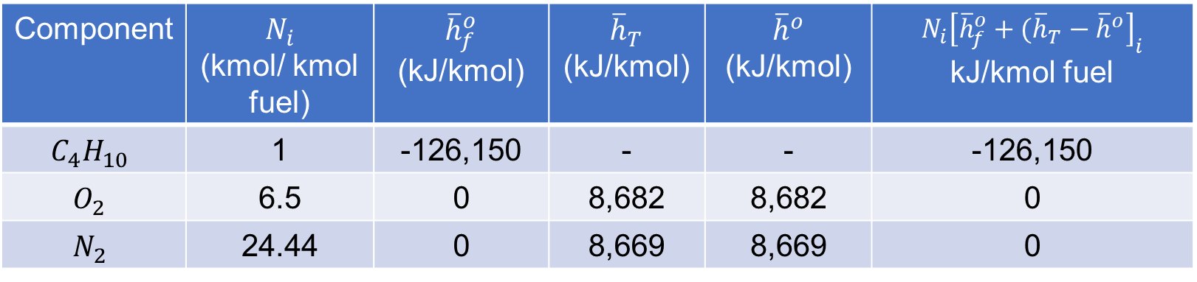
4. First Law Analysis of Reacting Systems Cont…
$$C_{4}H_{10}+6.5\left(O_{2}+3.76N_{2}\right)→4{CO}_{2}+5H_{2}O+24.44N_{2}$$
The steady-flow heat transfer is
Reactants: $T_{R}=298K$
$$Q_{net}=H_{P}−H_{R}=\sum_{Products}{N_{e}{\left[{\overline{h}}_{f}^{o}+({\overline{h}}_{T}−{\overline{h}}^{o}\right]}_{e}}−\sum_{Reactants}{N_{i}{\left[{\overline{h}}_{f}^{o}+({\overline{h}}_{T}−{\overline{h}}^{o}\right]}_{i}}$$
Component | $N_{i}$ (kmol/ kmol fuel) | ${\overline{h}}_{f}^{o}$ (kJ/kmol) | ${\overline{h}}_{T}$ (kJ/kmol) | ${\overline{h}}^{o}$ (kJ/kmol) | $$N_{i}{\left[{\overline{h}}_{f}^{o}+({\overline{h}}_{T}−{\overline{h}}^{o}\right]}_{i}$$ kJ/kmol fuel
$$C_{4}H_{10}$$ | 1 | -126,150 | - | - | -126,150
$$O_{2}$$ | 6.5 | 0 | 8,682 | 8,682 | 0
$$N_{2}$$ | 24.44 | 0 | 8,669 | 8,669 | 0
$$H_{R}=\sum_{Reactants}{N_{i}{\left[{\overline{h}}_{f}^{o}+({\overline{h}}_{T}−{\overline{h}}^{o}\right]}_{i}}=−126,150\frac{kJ}{Kmol C_{4}H_{10}}$$

Slide 28
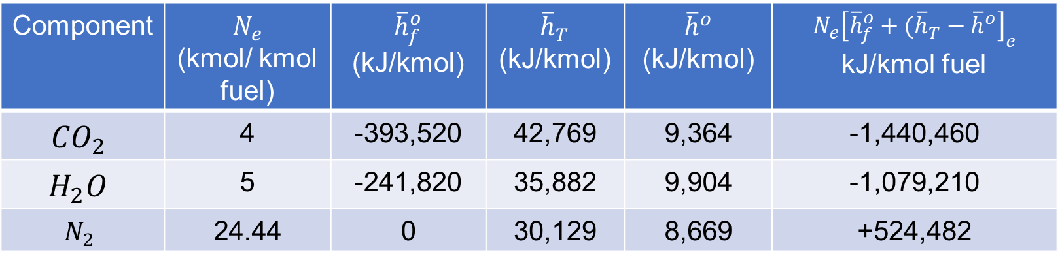
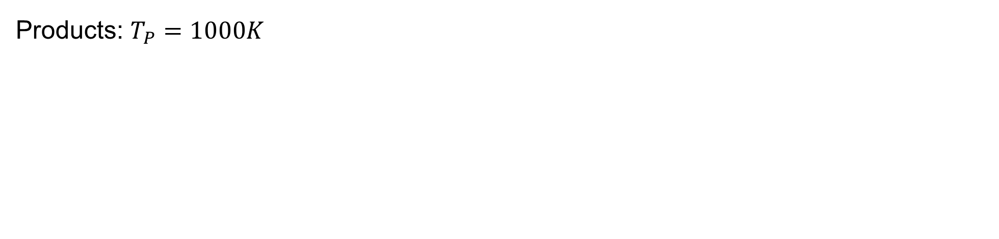
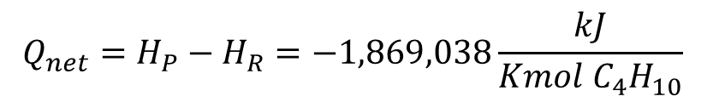
4. First Law Analysis of Reacting Systems Cont…
$$C_{4}H_{10}+6.5\left(O_{2}+3.76N_{2}\right)→4{CO}_{2}+5H_{2}O+24.44N_{2}$$
Products: $T_{P}=1000K$
Component | $N_{e}$ (kmol/ kmol fuel) | ${\overline{h}}_{f}^{o}$ (kJ/kmol) | ${\overline{h}}_{T}$ (kJ/kmol) | ${\overline{h}}^{o}$ (kJ/kmol) | $$N_{e}{\left[{\overline{h}}_{f}^{o}+({\overline{h}}_{T}−{\overline{h}}^{o}\right]}_{e}$$ kJ/kmol fuel
$${CO}_{2}$$ | 4 | -393,520 | 42,769 | 9,364 | -1,440,460
$$H_{2}O$$ | 5 | -241,820 | 35,882 | 9,904 | -1,079,210
$$N_{2}$$ | 24.44 | 0 | 30,129 | 8,669 | +524,482
$$H_{P}=\sum_{Products}{N_{e}{\left[{\overline{h}}_{f}^{o}+({\overline{h}}_{T}−{\overline{h}}^{o}\right]}_{e}}=−1,995,188\frac{kJ}{Kmol C_{4}H_{10}}$$
$$Q_{net}=H_{P}−H_{R}=−1,869,038\frac{kJ}{Kmol C_{4}H_{10}}$$

Slide 29
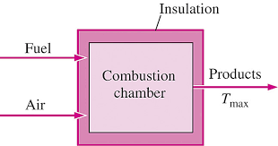
5. Adiabatic Flame Temperature
The chemical energy released during a combustion process either is:-
  lost as heat to the surroundings or,
  used internally to raise the temperature of the combustion products.
The smaller the heat loss, the larger the temperature rise.
In the limiting case of no heat loss to the surroundings (Q=0), the temperature of the products will reach a maximum, which is called the adiabatic flame or adiabatic combustion temperature of the reaction.
Figure 2: Adiabatic Flame Temperature, Bahaidarah, H. M. S. Chemical Reactions.
url:https://encrypted-tbn0.gstatic.com/images?q=tbn:ANd9GcT_7i8qxqyTnaKTYLhKmj4_CptBa-Uk2sZFkW6NdXs6CyOWEnclnq9kau2SUR4uJy0EDHY&usqp=CAU

Slide 30
5. Adiabatic Flame Temperature Cont…
The Adiabatic Flame Temperature (AFT) is the maximum temperature achieved by a combustion process when [5]:
  The reaction occurs adiabatically (no heat loss to surroundings).
  The reactants are completely burned.
  The products reach thermal equilibrium.
In simpler terms, it is the maximum possible temperature achievable for a given fuel and oxidizer under specific conditions.
Assumptions:
  Adiabatic process
  Complete combustion
  Stoichiometric mixture
  Excess air
  Steady state, steady-flow

Slide 31
5. Adiabatic Flame Temperature Cont…
The importance of adiabatic flame temperature are:
  It sets the upper temperature limit for engines (like rockets, jet engines, IC engines) and furnaces, which dictates material selection and cooling requirements. (Metallurgical limits)
  It helps in calculating the theoretical maximum efficiency of a combustion process.
  High temperatures promote the formation of thermal NOx;
  predicting AFT helps in designing low-NOx burners.

Slide 32
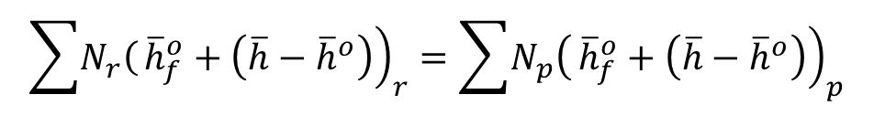
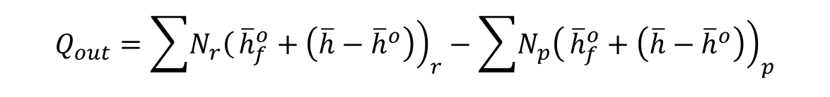
5. Adiabatic Flame Temperature Cont…
For a typical steady-flow combustion process:
For a typical closed combustion process
T - adiabatic flame temperature
$$Q_{out}=\sum{\left.N_{r}\right(}{\left.{\overline{h}}_{f}^{o}+\left(\overline{h}−{\overline{h}}^{o}\right)\right)}_{r}−\sum{\left.N_{p}\right(}{\left.{\overline{h}}_{f}^{o}+\left(\overline{h}−{\overline{h}}^{o}\right)\right)}_{p}$$
$$\sum{\left.N_{r}\right(}{\left.{\overline{h}}_{f}^{o}+\left(\overline{h}−{\overline{h}}^{o}\right)\right)}_{r}=\sum{\left.N_{p}\right(}{\left.{\overline{h}}_{f}^{o}+\left(\overline{h}−{\overline{h}}^{o}\right)\right)}_{p}$$
$$Q_{out}=\sum{\left.N_{r}\right(}{\left.{\overline{h}}_{f}^{o}+\left(\overline{h}−{\overline{h}}^{o}\right)−R_{u}T\right)}_{r}−\sum{\left.N_{p}\right(}{\left.{\overline{h}}_{f}^{o}+\left(\overline{h}−{\overline{h}}^{o}\right)−R_{u}T\right)}_{p}$$
$$\sum{\left.N_{r}\right(}{\left.{\overline{h}}_{f}^{o}+\left(\overline{h}−{\overline{h}}^{o}\right)−R_{u}T\right)}_{r}=\sum{\left.N_{p}\right(}{\left.{\overline{h}}_{f}^{o}+\left(\overline{h}−{\overline{h}}^{o}\right)−R_{u}T\right)}_{p}$$

Slide 33
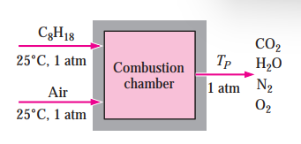
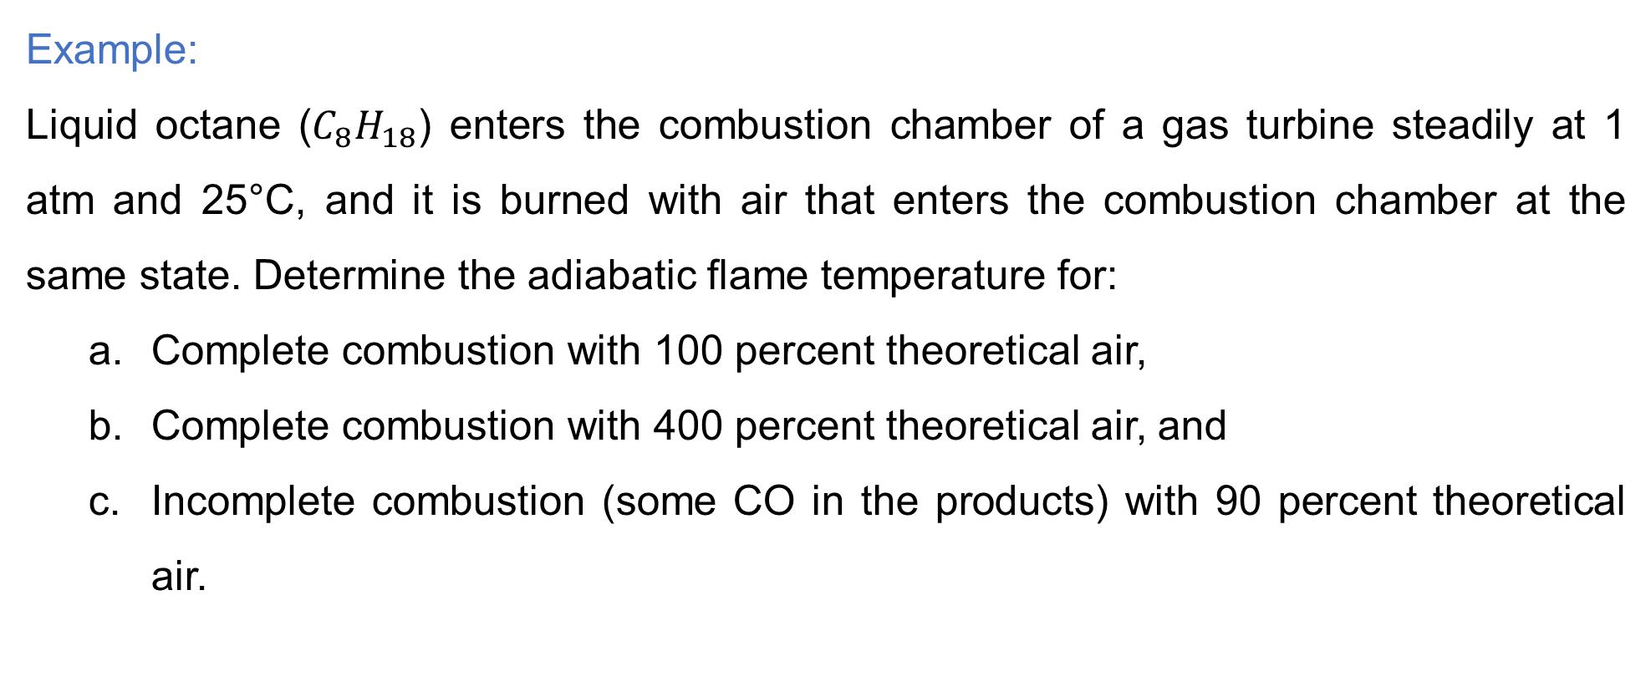
5. Adiabatic Flame Temperature Cont…
Example:
Liquid octane ($C_{8}H_{18}$) enters the combustion chamber of a gas turbine steadily at 1 atm and 25°C, and it is burned with air that enters the combustion chamber at the same state. Determine the adiabatic flame temperature for:
  Complete combustion with 100 percent theoretical air,
  Complete combustion with 400 percent theoretical air, and
  Incomplete combustion (some CO in the products) with 90 percent theoretical air.

Slide 34
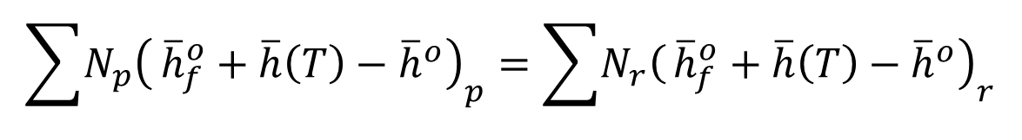
5. Adiabatic Flame Temperature Cont…
Solution:
The balanced equation for the combustion process with the theoretical amount of air is:
a. The combustion equation with 100 percent theoretical air
Energy balance for steady-flow system
$$C_{8}H_{18}\left(l\right)+12.5\left(O_{2}+3.76N_{2}\right)→8{CO}_{2}+9H_{2}O+47N_{2}$$
$$\sum{\left.N_{p}\right(}{\left.{\overline{h}}_{f}^{o}+\overline{h}\left(T\right)−{\overline{h}}^{o}\right)}_{p}=\sum{\left.N_{r}\right(}{\left.{\overline{h}}_{f}^{o}+\overline{h}\left(T\right)−{\overline{h}}^{o}\right)}_{r}$$

Slide 35
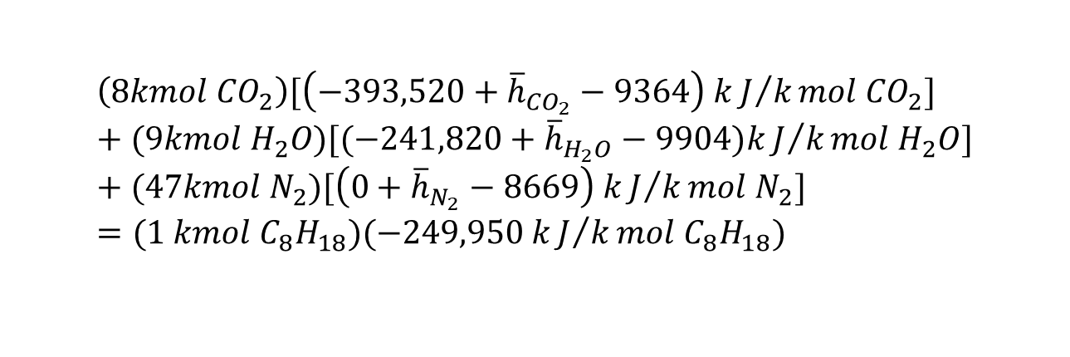
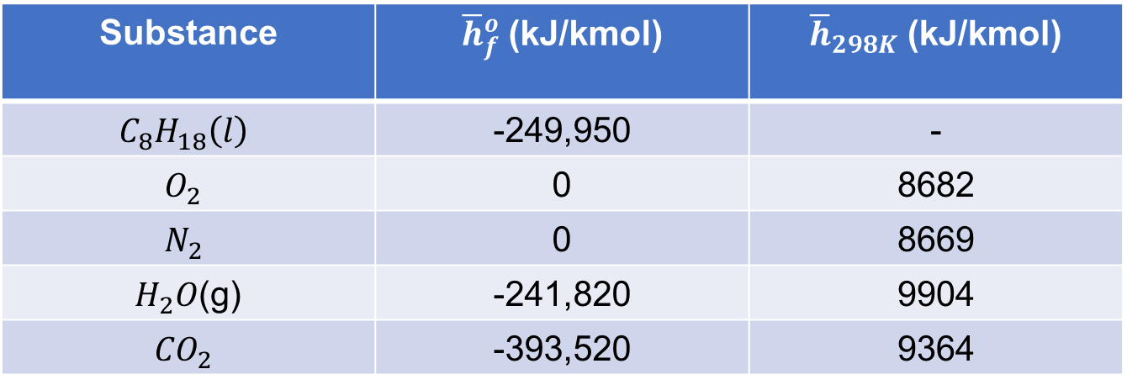
5. Adiabatic Flame Temperature Cont…
The enthalpy of formation values for the reactants and products are summarized:
Substituting, we have
Substance | ${\overline{h}}_{f}^{o}$ (kJ/kmol) | ${\overline{h}}_{298K}$ (kJ/kmol)
$$C_{8}H_{18}\left(l\right)$$ | -249,950 | -
$$O_{2}$$ | 0 | 8682
$$N_{2}$$ | 0 | 8669
$H_{2}O$(g) | -241,820 | 9904
$${CO}_{2}$$ | -393,520 | 9364
$$C_{8}H_{18}\left(l\right)+12.5\left(O_{2}+3.76N_{2}\right)→8{CO}_{2}+9H_{2}O+47N_{2}$$
$$\left(8kmol {CO}_{2}\right)[\left(−393,520+{\overline{h}}_{{CO}_{2}}−9364\right) kJ/kmol {CO}_{2}]+(9kmol H_{2}O)[(−241,820+{\overline{h}}_{H_{2}O}−9904)kJ/kmol H_{2}O]+(47kmol N_{2})[\left(0+{\overline{h}}_{N_{2}}−8669\right) kJ/kmol N_{2}]=(1 kmol C_{8}H_{18})(−249,950 kJ/kmol C_{8}H_{18})$$

Slide 36
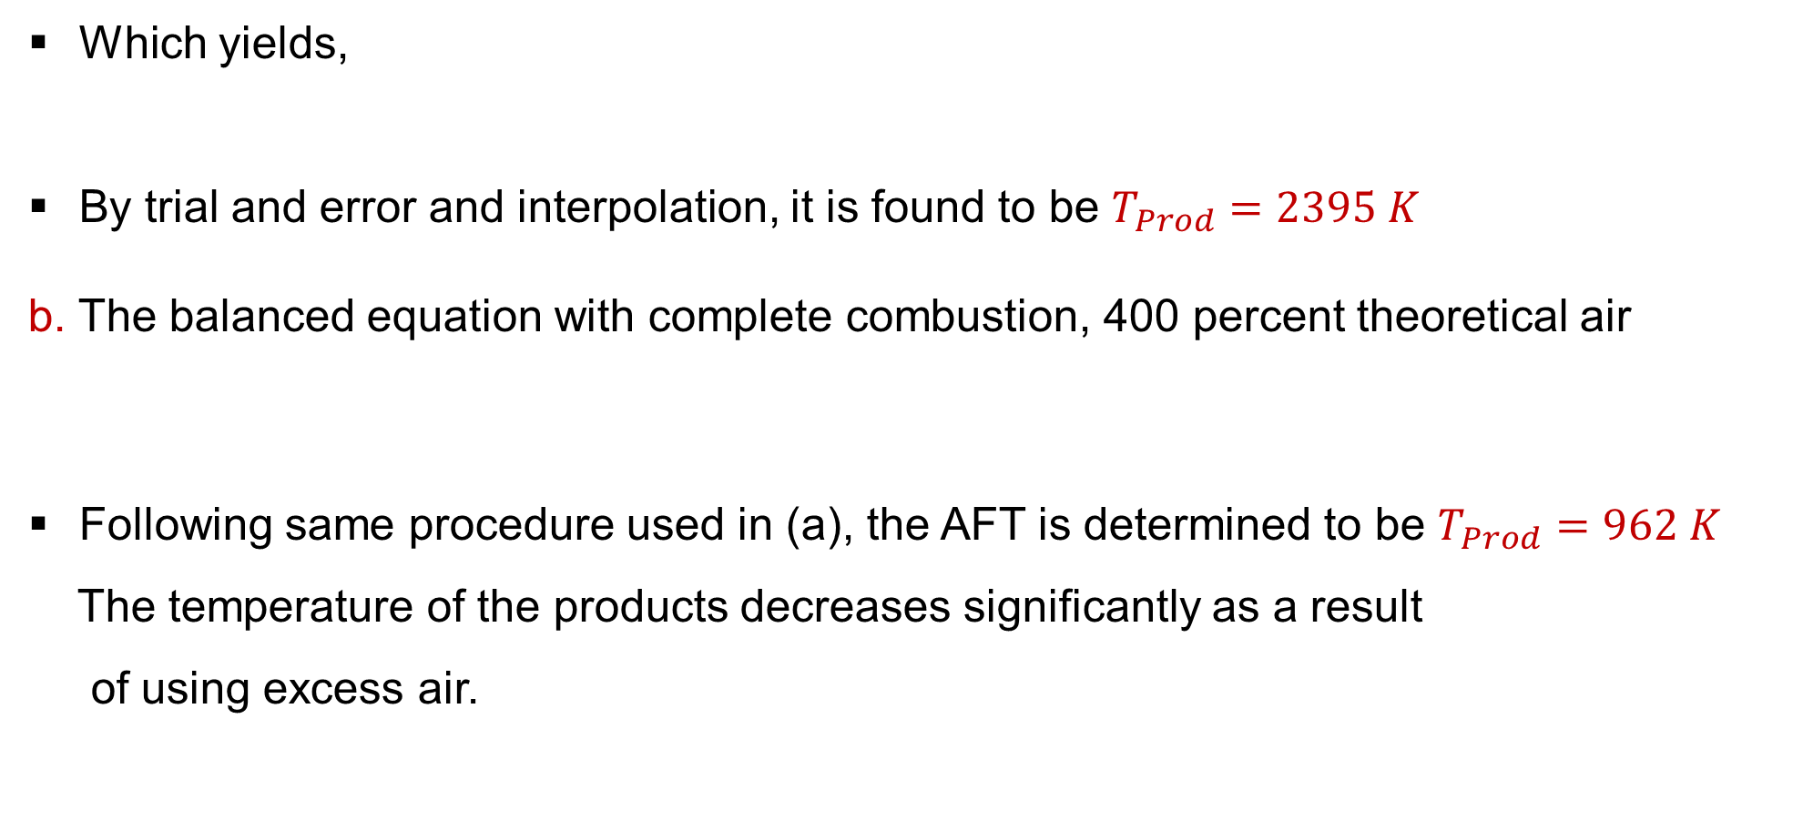
5. Adiabatic Flame Temperature Cont…
Which yields,
By trial and error and interpolation, it is found to be $T_{Prod}=2395 K$
b. The balanced equation with complete combustion, 400 percent theoretical air
Following same procedure used in (a), the AFT is determined to be $T_{Prod}=962 K$
The temperature of the products decreases significantly as a result
of using excess air.
$$8{\overline{h}}_{{CO}_{2}}+9{\overline{h}}_{H_{2}O}+47{\overline{h}}_{N_{2}}=5,646,081 kJ$$
$$C_{8}H_{18}\left(l\right)+50\left(O_{2}+3.76N_{2}\right)→8{CO}_{2}+9H_{2}O+188N_{2}$$

Slide 37
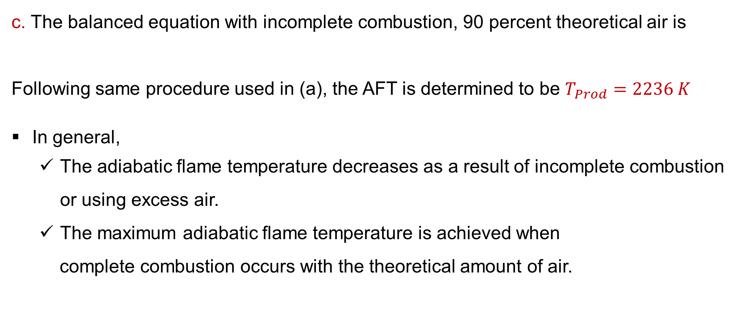
5. Adiabatic Flame Temperature Cont…
c. The balanced equation with incomplete combustion, 90 percent theoretical air is
Following same procedure used in (a), the AFT is determined to be $T_{Prod}=2236 K$
In general,
  The adiabatic flame temperature decreases as a result of incomplete combustion or using excess air.
  The maximum adiabatic flame temperature is achieved when
  complete combustion occurs with the theoretical amount of air.
$$C_{8}H_{18}\left(l\right)+11.25\left(O_{2}+3.76N_{2}\right)→5.5{CO}_{2}+2.5{CO+9H}_{2}O+42.3N_{2}$$

Slide 38

6. Heating Values of Fuels
When a fuel undergoes combustion, its chemical energy is released mainly in the form of heat.
The quantity of heat released per unit mass (or mole, or volume) of fuel is called the Heating Value or Calorific Value.
Heating Value is the amount of heat released during the combustion of a specified amount of fuel is burned completely in a steady-flow process and the products are returned to the state of the reactants [4].
Heating value equals to the absolute value of the enthalpy of
combustion of the fuel.
$$Heating Value=\left|h_{C}\right|$$

Slide 39
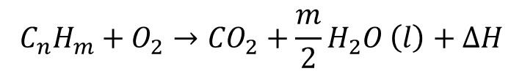
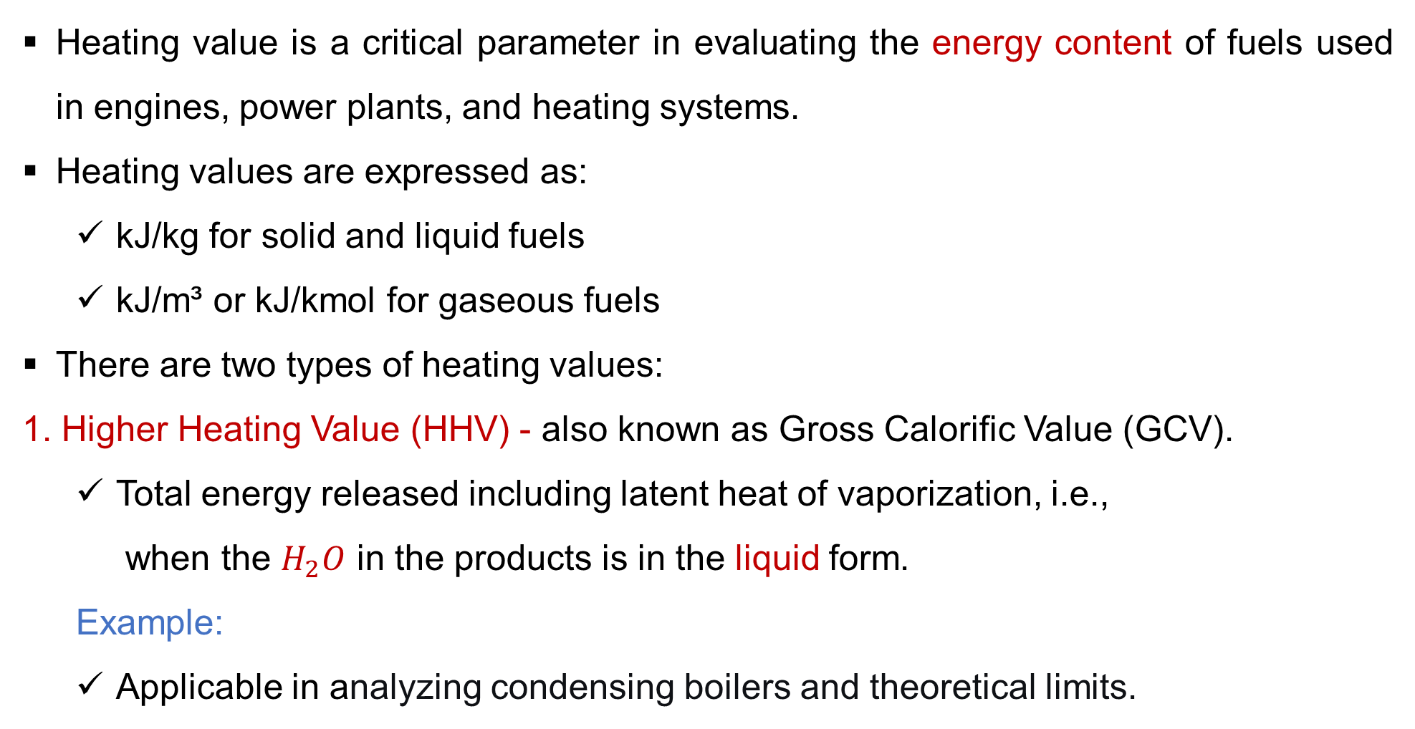
6. Heating Values of Fuels Cont…
Heating value is a critical parameter in evaluating the energy content of fuels used in engines, power plants, and heating systems.
Heating values are expressed as:
  kJ/kg for solid and liquid fuels
  kJ/m³ or kJ/kmol for gaseous fuels
There are two types of heating values:
1. Higher Heating Value (HHV) - also known as Gross Calorific Value (GCV).
  Total energy released including latent heat of vaporization, i.e.,
  when the $H_{2}O$ in the products is in the liquid form.
  Example:
  Applicable in analyzing condensing boilers and theoretical limits.
$$C_{n}H_{m}+O_{2}→{CO}_{2}+\frac{m}{2}H_{2}O \left(l\right)+∆H$$

Slide 40
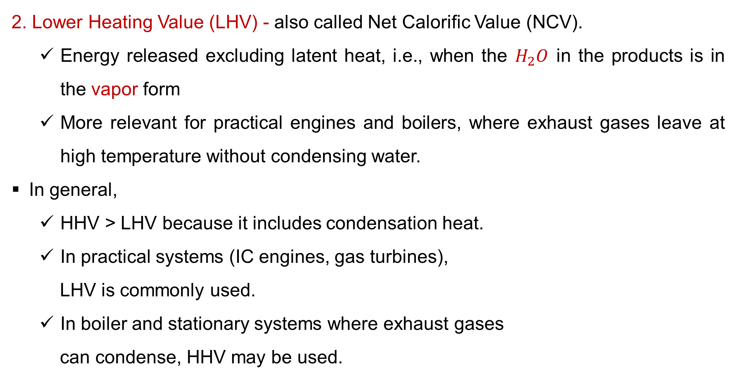
6. Heating Values of Fuels Cont…
2. Lower Heating Value (LHV) - also called Net Calorific Value (NCV).
  Energy released excluding latent heat, i.e., when the $H_{2}O$ in the products is in the vapor form
  More relevant for practical engines and boilers, where exhaust gases leave at high temperature without condensing water.
In general,
  HHV > LHV because it includes condensation heat.
  In practical systems (IC engines, gas turbines),
  LHV is commonly used.
  In boiler and stationary systems where exhaust gases
  can condense, HHV may be used.

Slide 41
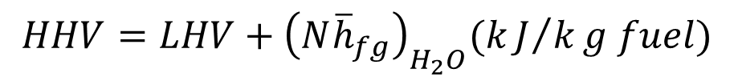
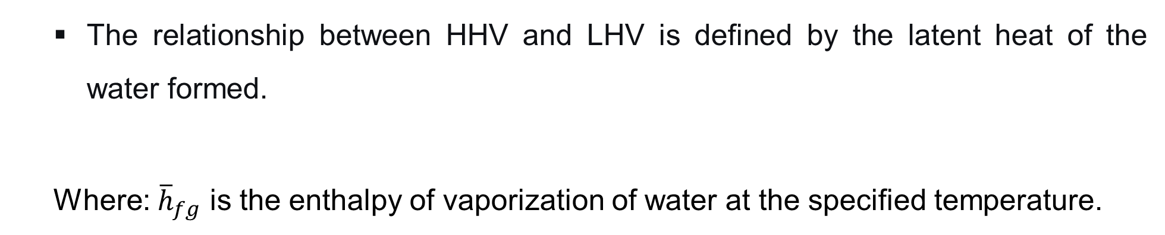
6. Heating Values of Fuels Cont…
  The relationship between HHV and LHV is defined by the latent heat of the water formed.
  Where: ${\overline{h}}_{fg}$ is the enthalpy of vaporization of water at the specified temperature.
$$HHV=LHV+{\left(N{\overline{h}}_{fg}\right)}_{H_{2}O}(kJ/kg fuel)$$

Slide 42
7. Experimental Determination of Heating Values of Fuels
Experimentally determining heating value is essential for evaluating fuel efficiency, designing combustion systems, and comparing energy sources.
While theoretical values can be estimated from composition, experimental measurement provides accurate results.
Laboratory calorimeters are the primary tools used to determine Higher Heating Value (HHV), and from it, the Lower Heating Value (LHV) can be obtained [6].
All calorimeters operate on the First Law of Thermodynamics:
i.e., the heat released by the combustion reaction is
transferred to a surrounding medium, causing a measurable
temperature rise.

Slide 43
7. Experimental Determination of Heating Values of Fuels Cont…
Experimental Determination Methods
1. Bomb Calorimeter: The standard for solids & liquids
The Bomb Calorimeter is the most common apparatus for precisely determining the Higher Heating Value (HHV) of solid and liquid fuels (e.g., coal, biomass, fuel oil, gasoline).
Key Components:
  The bomb
  Oxygen supply
  Thermometer or temperature sensors
  Water jacket
  Ignition system

Slide 44
7. Experimental Determination of Heating Values of Fuels Cont…
2. Gas Calorimetry: Measures the heating value of gases
Measures HHV by burning gas and capturing heat in a water-cooled chamber.
Key Components:
  Continuous gas burner
  Flow meter
  Calorimeter chamber
  Water flow and temperature sensors

Slide 45
7. Experimental Determination of Heating Values of Fuels Cont…
3. Combustion in Flow Calorimeter: for Liquid and gaseous fuels
Measures: HHV or LHV
A flow calorimeter is an apparatus where combustion occurs in a continuous flow of fuel and oxidizer, and the released heat is absorbed by a flowing stream of water.
Unlike a bomb calorimeter, a standard flow calorimeter (like the Junkers) typically measures the Lower Heating Value (LHV) because the water vapor in the products does not fully condense.
This method is the backbone of natural gas quality monitoring
and energy billing in the gas industry.

Slide 46
Summary
Thermodynamic properties are measured relative to a defined reference state, typically at 25°C and 1 atm, enabling consistent energy calculations.
Reacting mixtures involve multiple species undergoing chemical change; their analysis requires tracking mole fractions, mass balance, and reaction stoichiometry.
The enthalpy of formation quantifies the energy change when one mole of a compound forms from its elements in their reference states.
Adiabatic flame temperature is the maximum temperature achieved during combustion without heat loss, influenced by fuel type, mixture
ratio, and initial conditions.
Fuels are characterized by their higher and lower heating
values, indicating the energy released during complete combustion.

Slide 47
References
[1]. Power Plant Engineering, R.K. Rajput, 3rd Edition, 2011.
[2]. Standard thermodynamic properties for the energy grade and exergy analyses in power systems, W. Huang, Renewable & Sustainable Energy Reviews, vol. 130, 2020.
[3]. Enthalpy of formation as part of energy efficiency analyses – case: olefin plant. Tuomaala, M., Holmberg, H., & Auvinen, H. (2009). Chemical Engineering Transactions, 18, 543-548. doi:10.3303/CET0918088
[4]. Thermodynamics: An Engineering Approach (6th ed.). Çengel, Y. A., & Boles, M. (2006). McGraw-Hill.
[5]. Thermodynamics of Combustion. In Fundamentals of Combustion Processes, McAllister, S., Chen, J.-Y., & Fernández-Pello, A. C. (2011). Springer. DOI: 10.1007/978-1-4419-7943-8_2
[6]. Fundamentals of Combustion Processes, Sara McAllister, Jyh-Yuan Chen, A. Carlos Fernández-Pello, Elsevier, 2012.

Slide 48
Thank you !

