Slide 1
Power Plant Engineering
Lecture 5
Steam Generators (Boilers)
Lecturer: Dr. Melaku Desta

Slide 2
Lecture learning outcomes:
At the end of this lecture, you will be able to:
Explain the basic principles of boiler operation and classify boilers based on design, fuel type, and application.
Identify and describe the different types of boilers and their industrial and power generation applications.
Distinguish between boiler mountings and accessories and explain their functions in ensuring efficient and safe boiler operation.
Evaluate boiler performance and efficiency using key performance indicators and methods of improving thermal efficiency.
Analyze the concept of boiler draught, differentiate its types, and
discuss their roles in combustion and heat transfer.
Demonstrate understanding of boiler operation, maintenance, and
safety practices to ensure reliable and hazard-free performance.

Slide 3
Content
Introduction and Classification of Boilers
Types of Boilers and their Applications
Boiler Mountings and Accessories
Boiler Performance and Efficiency
Boiler Draught and its Types
Boiler Operation, Maintenance, and Safety
Summary
References

Slide 4
1. Introduction and Classification of Boilers
A boiler is a closed vessel in which water is heated to produce steam using heat energy from fuel combustion [1].
The steam produced may be supplied
  At high pressure to steam engine or turbines for power generation.
  At low pressure for industrial process work in sugar factories, breweries, textiles etc…
  Example:- in the textiles for sizing and bleaching.
  For producing hot water which can be used for heating
  a building in cold weather and for hot water supply.

Slide 5
1. Introduction and Classification of Boilers Cont…
The primary requirements of steam generators or boilers are:
  The water must be contained safely,
  The steam must be safely delivered in desired condition as regards to its pressure, temperature, quality, and required rate
In general, the functions of a Boiler are to:
  Convert water into steam at desired pressure and temperature
  Transfer heat efficiently from fuel to water
  Provide safe and controlled steam generation

Slide 6
1. Introduction and Classification of Boilers Cont…
Essential Components of a Boiler
  Shell: The main outer cylindrical body of a boiler.
  Furnace: Where fuel is burned to generate heat
  Burner: The device that mixes and ignites the fuel and air.
  Water space: Holds water to be converted into steam
  Steam space: Collects the generated steam
  Grate: Supports the burning fuel
  Chimney: Releases combustion gases
  Feedwater System: Pumps and controls to supply water to
  the boiler.

Slide 7
1. Introduction and Classification of Boilers Cont…
Classification of Boilers
Boilers can be classified based on several key design and operational features.
  Based on tube content
  Based on fuel Used
  Method of firing
  Axis of the shell
  Pressure of steam
  Number of tubes
  Method of water circulation

Slide 8
2. Types of Boilers and Their Applications
Understanding the types of boilers helps in selecting the right system for industrial, commercial, or domestic use [2].
Boilers are classified based on design, fuel type, pressure, and application.
Based on Tube Content
a. Fire-tube (smoke-tube) Boiler
  The flame and hot gasses produced by combustion of fuel pass through the tubes which are surrounded by water.
  Heat is conducted through the walls of the tubes from the
  hot gasses to the surrounded water.
Examples: Simple vertical boiler, Cochran boiler, Lancashire
boilers, Cornish boiler, Scotch marine boiler, Locomotive boiler.

Slide 9
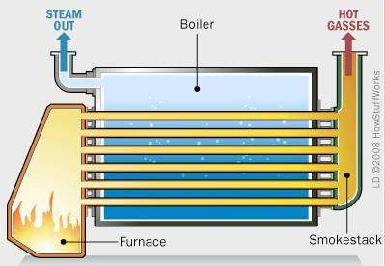
2. Types of Boilers and Their Applications Cont…
Fire-Tube Boiler
Figure 1: Fire Tube Boiler, Fauzan, M. Faizal., Hamzah, M. H., & Navaretsnasinggam, A. (2009)
url:https://www.researchgate.net/publication/263878729/figure/fig1/AS:392425462878209@1470572929372/Fire-tube-boilers.png

Slide 10
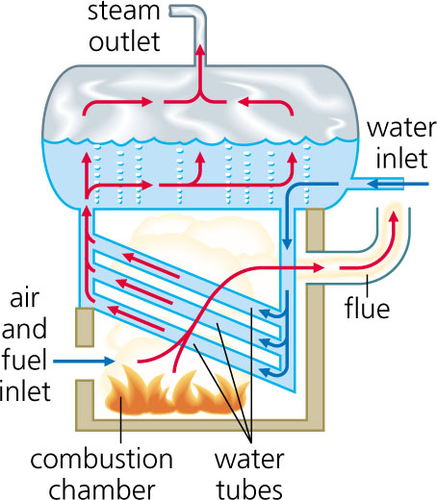
2. Types of Boilers and Their Applications Cont…
b. Water-Tube Boilers
The water is contained inside the tubes which are surrounded by the flames and hot gasses from the outside.
Example: Babcock and Wilcox boiler, Sterling boiler , Yarrow boiler, La-Mont boiler.
Figure 2: Water Tube Boiler, Types of boilers, Fire tube, water tube and combination. Sivaranjith. (2019)
url:https://4.bp.blogspot.com/-q7B44_q6zM8/TwoR8rcGGZI/AAAAAAAAAC8/FV0BNdbvRi4/s1600/schematic+water+tube+boiler+design.jpg

Slide 11
2. Types of Boilers and Their Applications Cont…
2. Based on Fuel Used
  Coal-fired
  Oil-fired
  Gas-fired
  Electric boilers
  Biomass boilers
3. Method of Firing
  a. Internally fired boiler
    The furnace is located inside the boiler shell.
    Most fire-tube boilers are internally fired.
  b. Externally fired boiler
    The furnace is located outside the boiler shell.
    The furnace is arranged underneath in a brickwork setting.

Slide 12
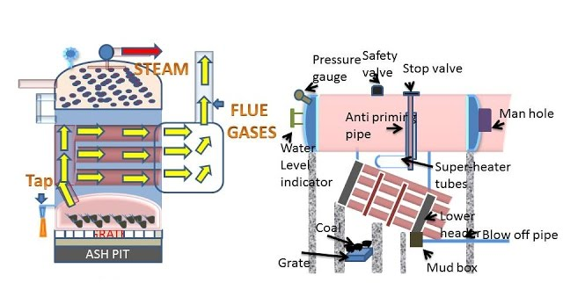
2. Types of Boilers and Their Applications Cont…
Internally and Externally Fired Boilers
(a) (b)
Figure 3: Internally (a) and Externally (b) Fired Boilers, Attique Arshad. (2021). Power Plant.
url: https://i.ytimg.com/vi/oLlw0fFVtsA/sddefault.jpg

Slide 13
2. Types of Boilers and Their Applications Cont…
4. Axis of the Shell
  Vertical shell boiler- If the axis of the boiler is vertical
  Example: Cochran boiler.
  Horizontal shell boiler- If the axis of the boiler is horizontal, most common type,
  Example: Lancashire, Locomotive.
  Inclined shell boiler- If the axis of the boiler is inclined
5. Pressure of Steam
  Low-pressure boilers: Operating pressure ≤ 25 bar.
  High-pressure boilers: Operating pressure > 25 bar.
  Example: Modern water tube boilers.

Slide 14
2. Types of Boilers and Their Applications Cont…
6. Number of Tubes
  Single tube boiler - there is only one fire tube or water tube.
  Multi-tubular boiler - there are two or more fire tubes or water tubes.
7. Method of Water Circulation
  Natural circulation
    Water circulates due to density difference between hot water (less dense) and cold water (more dense).
    Used in most conventional boilers.

Slide 15
2. Types of Boilers and Their Applications Cont…
  Forced circulation
    A pump is used to circulate water through the tubes.
    Essential for high-pressure and certain specific designs.
8. Mobility
  Stationary boilers: Permanently installed in power plants or industries.
  Portable/mobile boilers: Mounted on wheels or vehicles (e.g., locomotive boilers).

Slide 16
2. Types of Boilers and Their Applications Cont…
Selection Criteria for a Boiler
Choosing the right boiler depends on:
Steam requirement: The required pressure, temperature, and quantity (kg/hr).
Available floor space: Fire tube boilers are more compact for smaller capacities.
Fuel availability: Coal, oil, gas, or biomass.
Operating cost: Fire tube has lower initial cost; water tube has better long-term efficiency.
Efficiency: Higher efficiency reduces fuel costs.
Safety and reliability: Critical for high-pressure applications.

Slide 17
3. Boiler Mountings and Accessories
Boilers require various fittings to ensure safe, efficient, and controlled operation. These are categorized into [3]:
  Mountings: Essential for the safe operation of the boiler.
  Accessories: Improve efficiency and performance.
a. Boiler Mountings
The devices mounted on a boiler for its safe operation and to control the process are called boiler mountings.
They are compulsory fittings without which a boiler cannot be
operated.
According to boiler regulations, every boiler must be equipped
with the following mountings:

Slide 18
3. Boiler Mountings and Accessories Cont…
1. Safety Valve
  To automatically blow off the steam when the pressure inside the boiler exceeds a predetermined safe limit.
  It is the most critical safety device.
  Safety valves are mounted directly on the boiler shell, typically in pairs.
2. Water Level Indicator
  Shows the water level inside the boiler drum.
  It is crucial to prevent the boiler from running dry, which can lead to overheating and catastrophic failure.

Slide 19
3. Boiler Mountings and Accessories Cont…
3. Pressure Gauge
  Measures steam pressure inside the boiler.
  Typically calibrated in bar or psi (usually a Bourdon tube pressure gauge).
4. Steam Stop Valve
  Controls the supply of steam from the boiler to the main steam line.
  Mounted at the highest point of the boiler shell.
  It is a non-return valve, meaning steam flows only from the boiler to the main steam line.
5. Feed Check Valve
  Controls the supply of feed water into the boiler and,
  Prevents backflow from the boiler to the feed pump.

Slide 20
3. Boiler Mountings and Accessories Cont…
6. Blow-Off Cock
  Used to remove sediments, impurities, and water during maintenance.
  Connected to the bottom of the boiler shell.
7. Fusible Plug
  A safety device that melts at a fixed temperature.
  Prevents boiler explosion in case of low water level by extinguishing fire.
8. Manhole / Mudhole
  Provides access for inspection, cleaning, and maintenance.

Slide 21
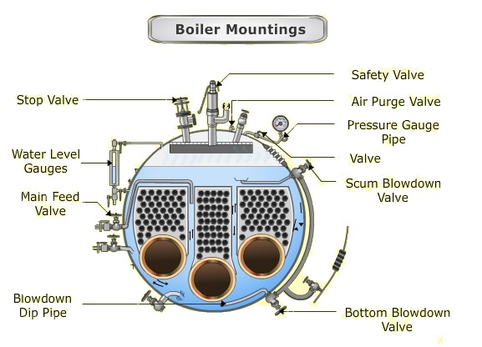
3. Boiler Mountings and Accessories Cont…
Boiler Mountings
Figure 4: Boiler Mountings, Metta, N. K. (2020, September 9). Essential list of mountings on the marine boiler.
url: https://blogger.googleusercontent.com/img/a/AVvXsEjS2rWphGohcXzJVpztMvndujok0nYfzE2irBJPx1GQlk519hkYVU6XT4M-Y8EXl5A7GXS9i_TFDDa091xATPbPmJNxybaMY38AhwAz-m6dTz24M7U1OnuOVBUjXWzIbPHeMnymaSkeHXCyZavJ3tRdoxZkcUp9jFw-cVKmyRmfZTPT-A8C7qxOS6iE=w640-h462

Slide 22
3. Boiler Mountings and Accessories Cont…
b. Boiler Accessories
  Accessories are installed to improve the plant's overall efficiency and are typically located in the path of the flue gases [4].
  They are not essential for boiler operation but help save fuel and increase output.
1. Economizer
  It is a heat exchanger, placed in the flue gas path, consisting of a series of vertical cast iron or steel pipes through which feed water passes.
  Hot flue gases flow around these pipes, transferring heat to
  the water.
  Pre-heats the feed water before it enters the boiler by using the
  waste heat from the flue gases, increases efficiency and saves fuel.

Slide 23
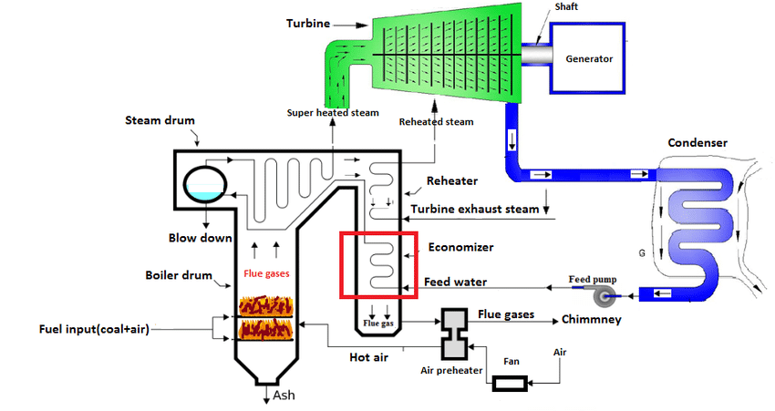
3. Boiler Mountings and Accessories Cont…
Economizer
Figure 5: Economizer, Chunchula, R. B., Perumal, K., & Rajamohan, G. (2017). Computational investigation of fluid flow
url:https://www.researchgate.net/publication/318289043/figure/fig1/AS:513931779076096@1499542292557/Economizer-in-a-coal-fired-Boiler-adapted-from-7-Fig-1-shows-the-location-of.png

Slide 24
3. Boiler Mountings and Accessories Cont…
2. Air Pre-heater
  Pre-heats the combustion air supplied to the furnace using the residual heat from the flue gases leaving the economizer.
  Placed after the economizer in the flue gas path.
  Enhances combustion and overall efficiency.
3. Superheater
  Increases the temperature of the steam generated in the boiler above its saturation point.
  The resulting steam is called superheated steam.
  Increases the thermal efficiency of the plant and reduces
  steam consumption.
  Prevents condensation of steam in the turbines and steam pipes

Slide 25
3. Boiler Mountings and Accessories Cont…
4. Feed Pump
  To pump feed water into the boiler against the high boiler pressure.
  Feed water pressures are, generally set 20% more than the boiler pressure.
5. Steam Injector
  Uses steam pressure to inject feed water into the boiler.
  Useful in small boilers without feed pumps.
6. Steam Separator (steam purifier)
  Removes water droplets from steam, providing dry steam.
7. Steam Trap
  Discharges condensate automatically without losing steam.

Slide 26
4. Boiler Performance and Efficiency
Boiler performance and efficiency are critical parameters that determine how effectively a boiler converts fuel energy into usable steam.
Understanding these metrics helps optimize fuel usage, reduce operational costs, and ensure environmental compliance.
Boiler efficiency is the ratio of useful heat output to the total energy supplied by the fuel.
If the heat input is expressed as the higher heating value (HHV)
of the fuel per kg of fuel, then the output heat is the heat
absorbed by the water and steam per kg of fuel burnt.

Slide 27
4. Boiler Performance and Efficiency Cont…
Methods of Determining Boiler Efficiency
There are two principal methods for determining boiler efficiency.
  The Direct Method (Input-Output Method)
  This method involves a direct measurement of the energy gained by the water and the energy contained in the fuel.
  The advantages of this method are:
    Simple and requires few measurements.
    Quick evaluation of boiler performance.

Slide 28
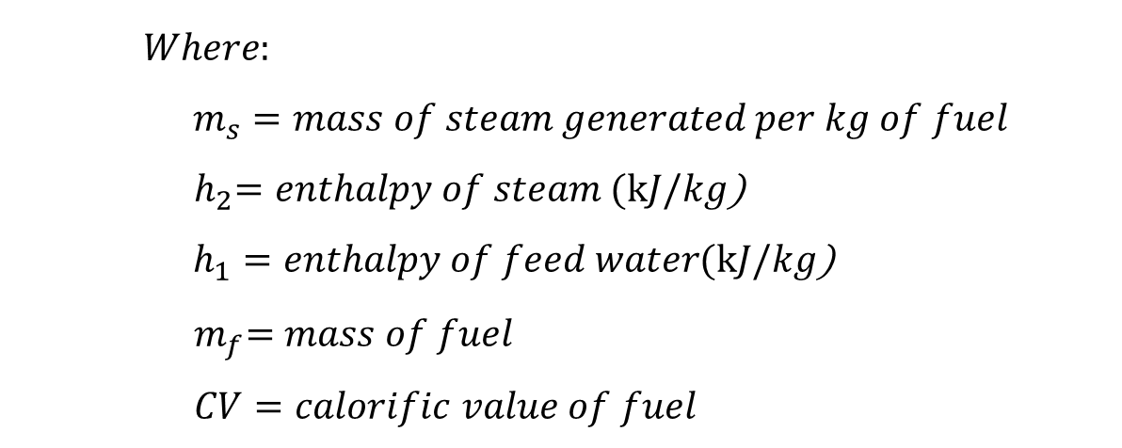
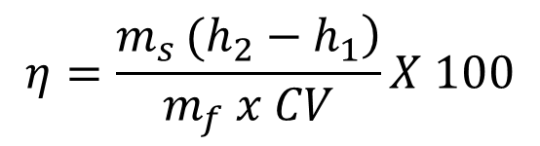
4. Boiler Performance and Efficiency Cont…
Boiler efficiency can be determined,
$$η=\frac{\left.m_{s }(h_{2}−h_{1}\right)}{m_{f} x CV}X 100$$
$$Where:$$
$m_{s}=mass of steam generated per kg of fuel$
${ h}_{2}=enthalpy of steam (kJ/kg$)
$h_{1}=enthalpy of feed water(kJ/kg\text{)}$
$${ m}_{f}=mass of fuel$$
$$CV=calorific value of fuel$$

Slide 29
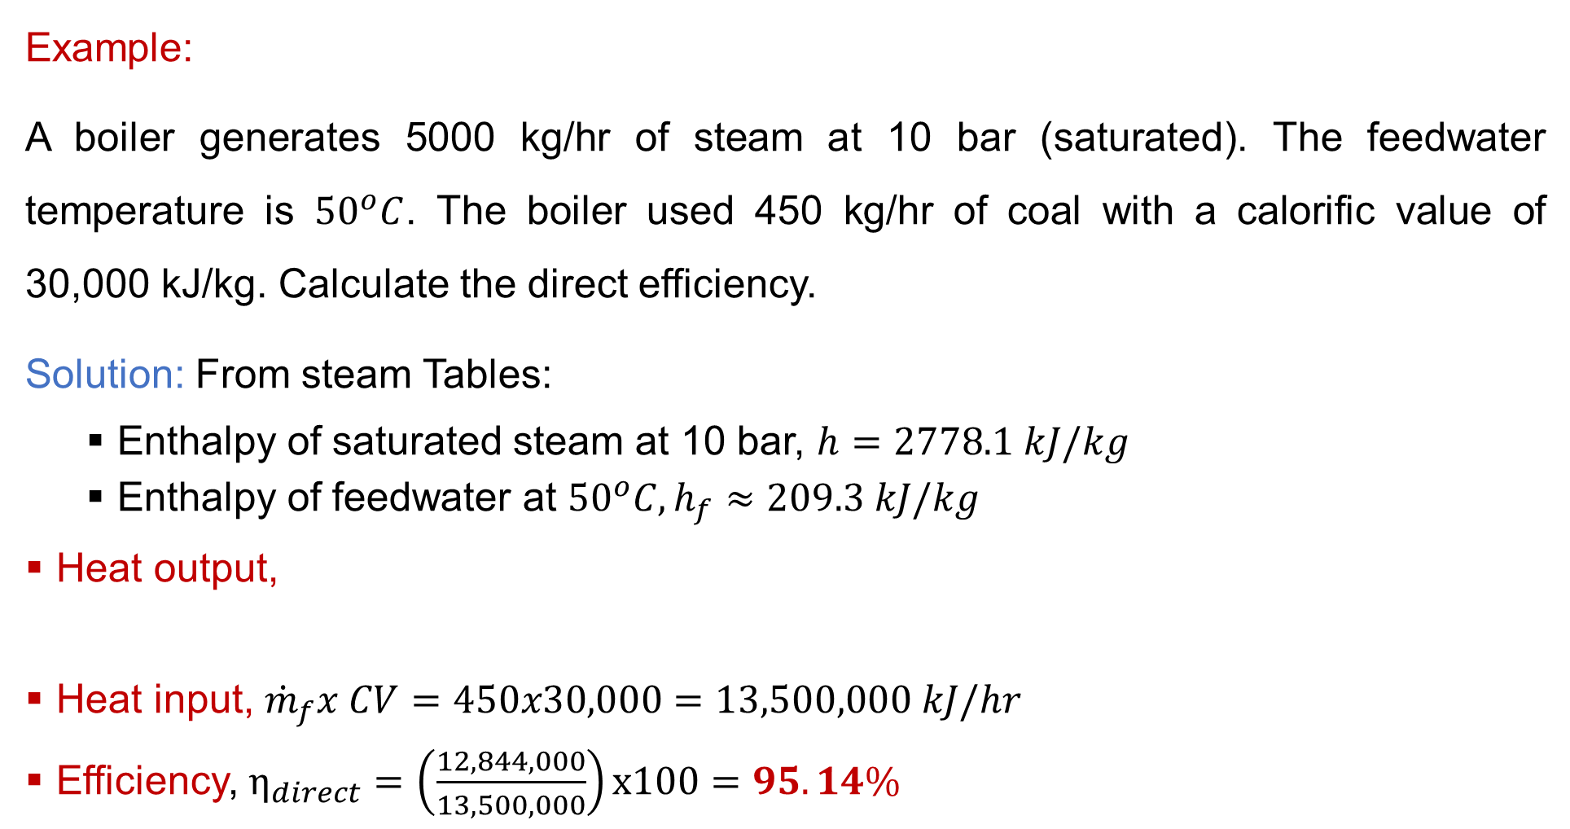
4. Boiler Performance and Efficiency Cont…
Example:
A boiler generates 5000 kg/hr of steam at 10 bar (saturated). The feedwater temperature is ${50}^{o}C$. The boiler used 450 kg/hr of coal with a calorific value of 30,000 kJ/kg. Calculate the direct efficiency.
Solution: From steam Tables:
  Enthalpy of saturated steam at 10 bar, $h=2778.1 kJ/kg$
  Enthalpy of feedwater at ${50}^{o}C, h_{f}≈209.3 kJ/kg$
Heat output,
Heat input, ${\dot{m}}_{f}x CV=450x30,000=13,500,000 kJ/hr$
Efficiency, $η_{direct}=\left(\frac{12,844,000}{13,500,000}\right)x100=95.14\%$
$$Q={\dot{m}}_{s}\left(h−h_{f}\right)=5000 x \left(2778.1−209.3\right)=12,844,000 kJ/hr$$

Slide 30
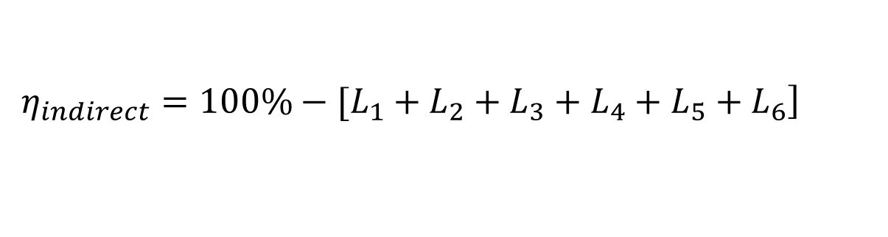
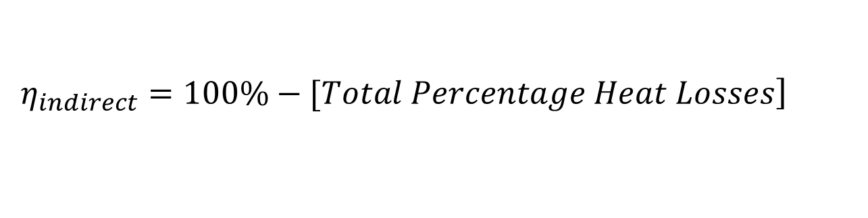
4. Boiler Performance and Efficiency Cont…
  2. The Indirect Method (Heat Loss Method)
This method calculates efficiency by identifying and quantifying all the individual heat losses from the boiler system.
The efficiency is then calculated by subtracting the total losses from 100%.
This is the more informative and widely used method in detailed
energy audits.
$$\left.η_{indirect}=100\%−[Total Percentage Heat Losses\right]$$
$$\left.η_{indirect}=100\%−[L_{1}+L_{2}+L_{3}+L_{4}+L_{5}+L_{6}\right]$$

Slide 31
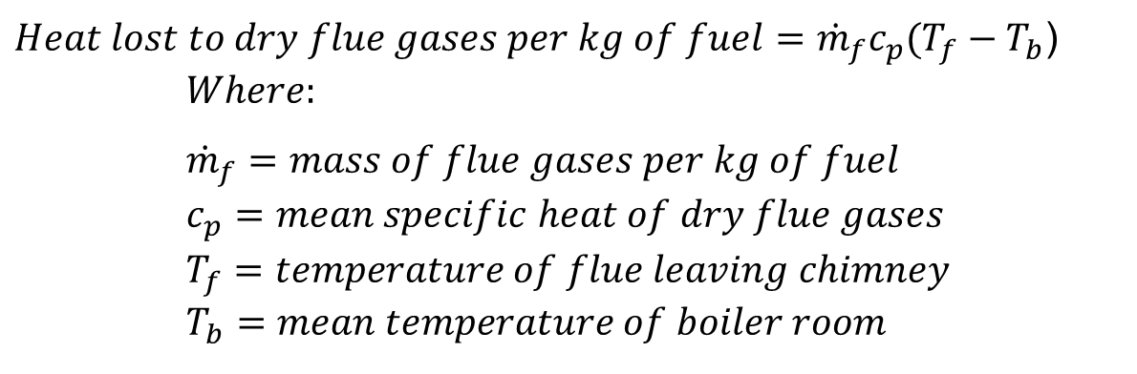
4. Boiler Performance and Efficiency Cont…
  Major Heat Losses in a Boiler
Heat loss due to dry flue gas
  This is the largest loss in a well-operated boiler.
  It is the heat carried away by the hot dry products of combustion (CO₂, N₂, O₂, SO₂) exiting the chimney.
$Heat lost to dry flue gases per kg of fuel={\dot{m}}_{f}c_{p}(T_{f}−T_{b}$) $Where:$
$${\dot{m}}_{f}=mass of flue gases per kg of fuel \\ c_{p}=mean specific heat of dry flue gases \\ T_{f}=temperature of flue leaving chimney \\ T_{b}=mean temperature of boiler room$$

Slide 32
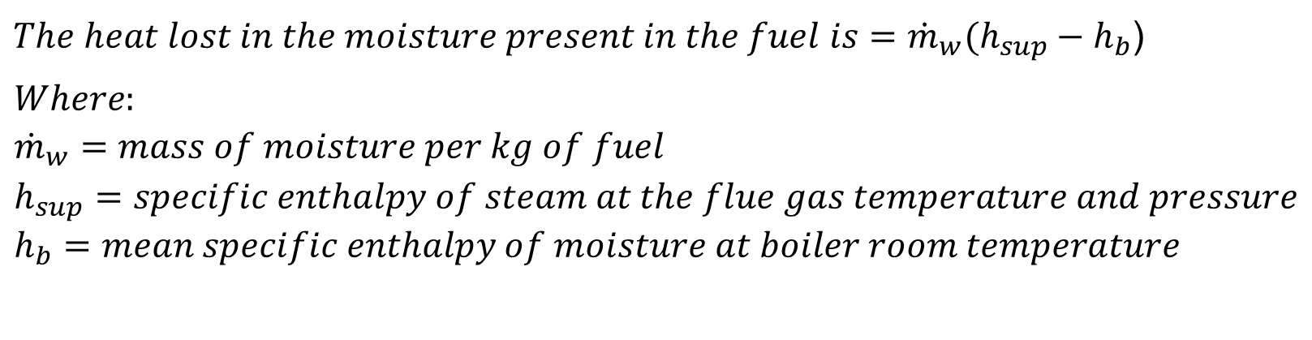
4. Boiler Performance and Efficiency Cont…
Heat loss due to moisture in fuel & steam formation
  The moisture present in the fuel must be heated and evaporated, consuming a portion of the heat input.
  The atmospheric air used for combustion contains moisture.
  This moisture is heated and superheated in the furnace, consuming energy.
$The heat lost in the moisture present in the fuel is={\dot{m}}_{w}(h_{sup}−h_{b}$)
$$Where: \\ {\dot{m}}_{w}=mass of moisture per kg of fuel \\ h_{sup}=specific enthalpy of steam at the flue gas temperature and pressure \\ h_{b}=mean specific enthalpy of moisture at boiler room temperature$$

Slide 33
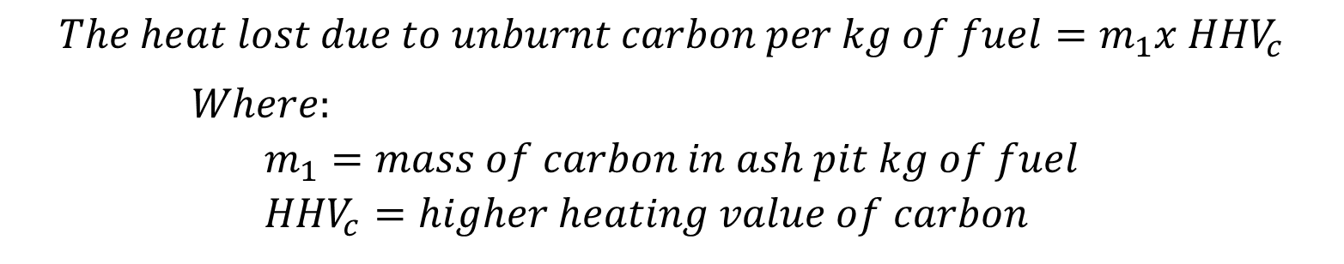
4. Boiler Performance and Efficiency Cont…
Heat loss due to unburnt fuel (in ash)
  A portion of the combustible carbon is lost with the ash (fly ash and bottom ash) without being burnt.
Heat loss due to radiation & convection
  Heat lost from the hot boiler shell and components
  to the surrounding atmosphere by radiation and convection.
$$The heat lost due to unburnt carbon per kg of fuel=m_{1}x {HHV}_{c}$$
$Where:$
$$m_{1}=mass of carbon in ash pit kg of fuel \\ {HHV}_{c}=higher heating value of carbon$$

Slide 34
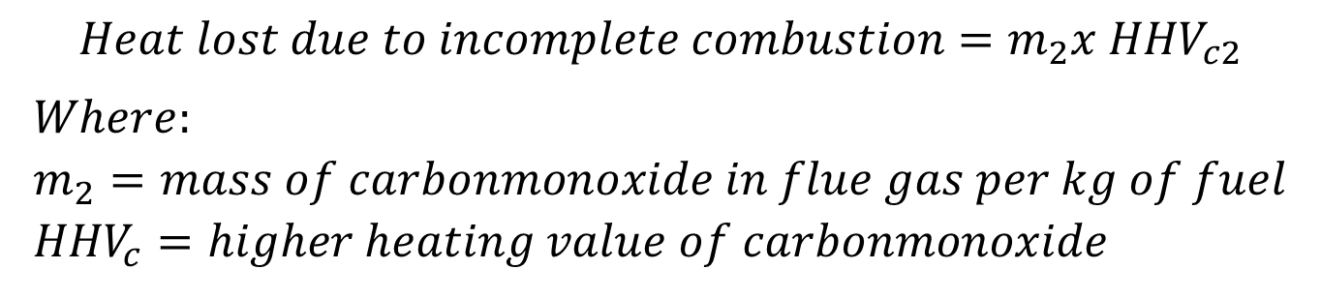
4. Boiler Performance and Efficiency Cont…
Heat loss due to incomplete combustion (CO formation)
  This occurs when the carbon in the fuel is not fully converted to CO₂, but instead partially forms Carbon Monoxide (CO).
$$Heat lost due to incomplete combustion=m_{2}x {HHV}_{c2}$$
$$Where: \\ m_{2}=mass of carbonmonoxide in flue gas per kg of fuel \\ {HHV}_{c}=higher heating value of carbonmonoxide$$

Slide 35
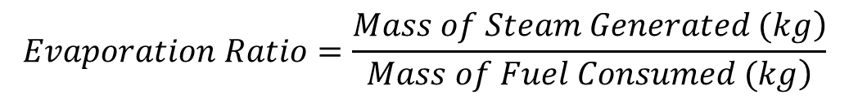
4. Boiler Performance and Efficiency Cont…
  Factors Affecting Boiler Efficiency
Evaporation Ratio
  The ratio of the mass of steam generated to the mass of fuel consumed.
  A higher ratio indicates better performance.
  Example: A typical value for a coal-fired boiler is 5-6 (i.e., 5-6 kg of steam per kg of coal).
Excess Air Level
  There is an optimum excess air level that minimizes the sum
  of losses from unburnt carbon and dry flue gas.
$$Evaporation Ratio=\frac{\left.Mass of Steam Generated (kg\right)}{\left.Mass of Fuel Consumed (kg\right)}$$

Slide 36
4. Boiler Performance and Efficiency Cont…
Fuel-Related Factors
  Calorific value of fuel, moisture content in fuel, ash content, fuel size and quality
4. Combustion Factors
  Air-fuel ratio, combustion temperature, furnace design
5. Heat Losses
  Flue gas losses, radiation and convection losses, unburnt fuel
6. Operational Factors
  Boiler load, blowdown losses, maintenance and cleaning
7. Use of Boiler Accessories
  Economizers, air preheaters, superheaters

Slide 37
5. Boiler Draught and Its Types
Boiler draught refers to the difference in pressure that causes the flow of air into the furnace and the removal of flue gases through the chimney [5].
In a simpler terms, draught is the difference in pressure between the atmosphere and the gas inside the furnace or flue.
It is essential for:
  Supplying adequate amount of air for combustion
  Removing combustion products from the combustion chamber
  Maintaining continuous fuel burning
Without proper draught, combustion would be inefficient or
even impossible.

Slide 38
5. Boiler Draught and Its Types Cont…
Types of Boiler Draught
Boiler draught is broadly classified into two main categories, distinguished by the method used to generate the pressure difference.
a. Natural Draught
  The pressure difference is created naturally due to the density difference between the hot flue gases inside the chimney and the colder, denser ambient air outside.
  Natural draught utilizes a chimney.
  The draught produced is proportional to the height of the
  chimney (H) and the difference in density (temperature) between
  the outside air and the hot gases.

Slide 39
5. Boiler Draught and Its Types Cont…
b. Artificial Draught
When the draught required is more than what can be produced by a natural draught chimney, artificial draught is used.
It is classified into two main types.
  Mechanical Draught
  Steam Jet Draught
Mechanical Draught
  This system uses mechanical fans (centrifugal or axial) to
  create the pressure difference.

Slide 40
5. Boiler Draught and Its Types Cont…
Mechanical draught is the most common system in modern power plants.
The subtypes of mechanical draught includes:
  Forced Draught (FD) System - is installed at the inlet of the boiler, forcing fresh air into the furnace. Pressure inside furnace > atmospheric.
  Induced Draught (ID) - is installed at the outlet of the boiler, between the air pre-heater and the chimney. It sucks the flue gases out of the boiler. Pressure inside furnace < atmospheric.
  Balanced Draught - this is the most efficient and widely used
  system in modern boilers. It uses a combination of both
  FD and ID fans. Maintains furnace pressure nearly atmospheric.

Slide 41
5. Boiler Draught and Its Types Cont…
2. Steam Jet Draught
  High-velocity steam jet is passed through a nozzle to create suction.
  Used in locomotive and marine boilers.
There are two types of steam jet draught
Forced Steam Jet Draught - A jet of high-pressure steam is directed into the air entering the furnace from a steam nozzle.
The momentum of the steam entrains the air and forces it into the furnace.
Induced Steam Jet Draught - A jet of high-pressure steam is directed into the flue gas duct towards the chimney.
The steam jet sucks the flue gases from the furnace and throws
them up the chimney.

Slide 42
6. Boiler Operation, Maintenance, and Safety
The safe and efficient operation of boilers requires proper handling, routine maintenance, and adherence to safety protocols.
Boiler Operation
a. Startup Procedure
  Pre-checks: Inspect water level, fuel supply, and mountings.
  Purge Furnace: Remove residual gases.
  Ignition: Start burners or fuel feed.
  Pressure Build-up: Gradually increase pressure to operating
  level.
  Steam Flow: Open steam stop valve to supply steam.

Slide 43
6. Boiler Operation, Maintenance, and Safety Cont…
Normal Operation
  Maintain proper water level (neither too high nor too low).
  Regulate fuel and air supply for efficient combustion.
  Monitor steam pressure and temperature.
  Regularly check safety valves, gauges, and control systems.
Shutdown Procedure
  Reduce fuel and steam flow slowly.
  Shut steam and feed water valves.
  Use blow-off cock if needed.
  Check for leaks, deposits, and wear.

Slide 44
6. Boiler Operation, Maintenance, and Safety Cont…
Boiler Maintenance
Proper maintenance ensures efficiency, safety, and long service life.
Types of Boiler Maintenance
Preventive Maintenance
  Routine inspection and servicing.
  Cleaning of tubes, filters, and burners.
  Checking for leaks and wear.
2. Corrective Maintenance
  Repairs after a fault occurs
  Example: tube replacement, pump repair

Slide 45
6. Boiler Operation, Maintenance, and Safety
Predictive Maintenance
  Using sensors and monitoring systems to predict failures.
  Vibration analysis, temperature monitoring, and water quality analysis.
Boiler Safety
Since boilers operate under high pressure, safety measures are critical.
Safety Devices
  Safety Valve → Prevents excessive pressure.
  Fusible Plug → Protects against low water level overheating.
  Water Level Indicator → Prevents dry running.
  Pressure Gauge → Monitors internal steam pressure.
  Blow-off Cock → Removes sediments safely.

Slide 46
Summary
Boilers are closed vessels that generate steam by heating water, and they are classified by design, fuel type, and circulation method.
Fire-tube and water-tube boilers are the main types, each suited for specific industrial and domestic uses based on pressure and capacity.
Boiler mountings ensure safety and operation control, while accessories improve efficiency by enhancing heat utilization and fuel economy.
Boiler performance and efficiency depend on factors like heat losses, combustion quality, and maintenance, which can be optimized through regular
inspection and performance analysis.
Boiler draught systems regulate air and gas flow for proper combustion,
and safe operation and maintenance practices are vital to prevent
accidents and ensure long-term reliability.

Slide 47
References
[1]. Power Plant Engineering, R.K. Rajput, 3rd Edition, 2011.
[2]. Perry's Chemical Engineers' Handbook, Perry, Robert H., Don W. Green, and James O. Maloney. 7th ed. New York: McGraw-Hill, 1997.
[3].Environmentally oriented modernization of power boilers. Pronobis, M. (2020). Elsevier. https://doi.org/10.1016/B978-0-12-819921-3.00005-0
[4]. Principles, operational challenges, and perspectives in boiler feedwater treatment Shokri, A. (2023). Journal of Energy Storage, 48, 103456. https://doi.org/10.1016/j.est.2023.103456
[5]. Boilers and burners: Design and theory, Basu, P., Kefa, C., & Jestin, L. (2020). Springer Science & Business Media.

Slide 48
Thank you !

