Slide 1
Power Plant Engineering
Lecture 7
Steam Turbines
Lecturer: Dr. Melaku Desta

Slide 2
Lecture learning outcomes:
At the end of this lecture, you will be able to:
Explain the working principle and main components of an impulse turbine and how energy is converted from steam to mechanical work.
Differentiate between impulse and reaction turbines based on pressure and velocity changes through the nozzles and blades.
Construct and interpret the velocity diagram for an impulse turbine blade to determine blade speed and steam velocities.
Determine the blade efficiency of a steam turbine and analyze
factors influencing turbine performance.
Describe and evaluate the concept of axial thrust on a rotor and
discuss methods used to minimize or balance it in turbine design.

Slide 3
Content
Introduction
Impulse Turbine
Reaction Turbine
Velocity Diagram for Impulse Turbine Blade
Steam Turbine Blade-efficiency
Axial Thrust on Rotor
Summary
References

Slide 4
1. Introduction
Steam turbines are vital components in modern power generation systems, where thermal energy from steam is efficiently converted into mechanical work.
Among various types of turbines, impulse and reaction turbines are the two fundamental classifications based on how energy conversion occurs within the blades [1].
The theory of turbo machines is based on the relationship between jets and vanes, where:
  Jets – high velocity stream of fluid
  Vanes – the mechanical element of the machine
A jet is a stream of fluid (liquid or gas) that is projected into a
surrounding medium, or against a surface, at a high velocity.

Slide 5
1. Introduction Cont…
A vane is a blade or a surface designed to guide, direct, or be pushed by a fluid flow.
Vane is a term usually used in fluid mechanics, while blade is the term used in power plant, and therefore it is to be used further on.
In a steam turbine, the steam flow passes through two main types of blades which work together to convert steam energy into mechanical work.
Fixed Blades
Moving Blades

Slide 6
1. Introduction Cont…
Fixed Blades (Nozzles)
  These blades are stationary and attached to the turbine casing.
  Their main function is to convert the pressure energy of steam into kinetic energy by accelerating the steam jet (act as nozzles).
  They direct the high-velocity steam onto the moving blades at an appropriate angle for efficient energy transfer.
Moving Blades (Rotor Blades)
  These blades are mounted on the turbine rotor and rotate when
  struck by high-velocity steam.
  Their main role is to convert the kinetic energy of steam
  into mechanical energy (rotational motion).

Slide 7
1. Introduction Cont…
As far as power plant is concerned, moving blade system is of main interest, although nozzles are also used and may be considered as fixed element together with the moving blades.
In the moving blade system, the following remarks are of special interest:
  The fluid flows tangentially on the blade to prevent sudden impact force (shock).
  Such tangential fluid entry means almost negligible friction with the blade surface.
  Tangential velocity in a circular (curved) shapes means
    tangent to the curved surface
    perpendicular to the curved section.

Slide 8
1. Introduction Cont…
Principle of Turbine Operation
Turbines operate on the principle of converting fluid energy—such as steam, gas, or water—into mechanical energy through rotational motion.
This mechanical work is almost always used to rotate a shaft, which can then drive a generator to produce electricity, power a ship's propeller, or run a pump.
The operation of turbines is based on Newton’s Third Law of Motion and the conservation of energy [1]:
  A high-energy fluid (steam, gas, or water) strikes the turbine blades.
  The blades deflect the fluid, and the reaction force causes
  the rotor to spin.
  This rotational motion is transferred to a shaft, which can
  drive generators or other machinery.

Slide 9
1. Introduction Cont…
Steam turbines can be classified according to several factors:
According to the Principle of Operation
  Impulse Turbine
  Reaction Turbine
According to the Direction of Steam Flow
  Axial Flow Turbine
    Steam flows parallel to the axis of rotation.
    Most modern turbines are of this type.
  Radial Flow Turbine
    Steam flows perpendicular to the axis of rotation
    Used mainly in small turbines or special-purpose
    applications.

Slide 10
1. Introduction Cont…
According to the Number of Stages
  Single-Stage Turbine
    Expansion of steam occurs in one set of fixed and moving blades.
    Suitable for small power outputs.
  Multi-Stage Turbine
    Steam expands through multiple sets (stages) of blades.
    Used in large power plants for better efficiency and
    smoother expansion.

Slide 11
1. Introduction Cont…
According to the Pressure of Steam
  High-Pressure Turbine - Steam inlet pressure above 40 bar.
  Medium-Pressure Turbine - Steam inlet pressure between 10–40 bar.
  Low-Pressure Turbine - Steam inlet pressure below 10 bar.
According to Exhaust Conditions
  Condensing Turbine
    Steam exhausts into a condenser under vacuum.
  Non-Condensing (Back-Pressure) Turbine
    Steam exhausts at atmospheric or higher pressure
    for use in industrial heating or processes.

Slide 12
1. Introduction Cont…
According to the Type of Governing
  Throttle Governing
    Controls steam pressure by throttling at the inlet.
  Nozzle Governing
    Controls steam flow by opening or closing groups of nozzles.
  Bypass Governing
    Bypasses steam to control load in multi-stage turbines

Slide 13
2. Impulse Turbine
An impulse turbine converts the kinetic energy of a high-velocity fluid jet into mechanical energy by striking blades mounted on a rotor.
Impulse turbines are a class of hydraulic or steam turbines where the fluid’s pressure energy is first converted into kinetic energy before striking the turbine blades [2].
They are widely used in hydroelectric power plants and steam power systems.
Impulse turbines operate based on the principle of impulse,
where high-velocity jets of fluid are directed onto the turbine
blades. The force of the fluid jet causes the turbine blades to rotate.
Example: Pelton turbines and Turgo turbines

Slide 14
2. Impulse Turbine Cont…
Principle of Operation of Impulse Turbines
  The impulse turbine works on Newton’s Second Law of Motion — the rate of change of momentum of a fluid is equal to the force acting on it [2].
  The steam expands completely in the nozzle, converting pressure energy into kinetic energy.
  The high-velocity jet of steam impinges on the curved moving blades (or buckets).
  The change in momentum of the steam as it strikes and
  leaves the blades produces an impulse force on the blades.
  This impulse force rotates the turbine wheel, and the mechanical
  energy is transmitted to the generator through the shaft.

Slide 15
2. Impulse Turbine Cont…
Main Components of Impulse Turbines
An impulse turbine mainly consists of the following parts:
Nozzles – Convert steam pressure energy into kinetic energy; direct steam jets onto moving blades.
Blades or Buckets – Mounted on the rotor; change the direction of the steam jet, thus producing an impulse.
Rotor (Wheel) – The rotating part carrying blades; converts linear impulse into rotational motion.
Casing – Encloses the turbine to prevent steam leakage and
direct exhaust steam properly.
Shaft – Connected to the rotor; transmits mechanical energy
to the generator.

Slide 16
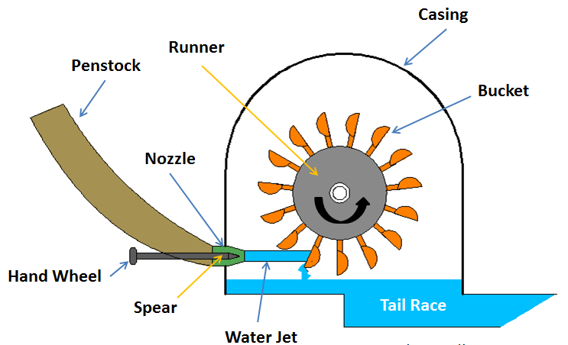
2. Impulse Turbine Cont…
Main Components of Impulse Turbines
Figure 1: Main Components of Impulse Turbine, Mechanical Booster, (2018)
url:https://mechanicalbooster.com/wp-content/uploads/2018/01/Impulse-Turbine-1.png

Slide 17
2. Impulse Turbine Cont…
The Pelton Wheel
The Pelton Wheel is the quintessential example of an impulse turbine, used in high-head hydroelectric power plants.
It converts the kinetic energy of a high-velocity water jet into mechanical energy.
Invented by Lester Allan Pelton in 1870s, it is especially suited for high head and low discharge sites.
It is one of the most efficient types of water turbines, with
efficiencies up to 90% [3].

Slide 18
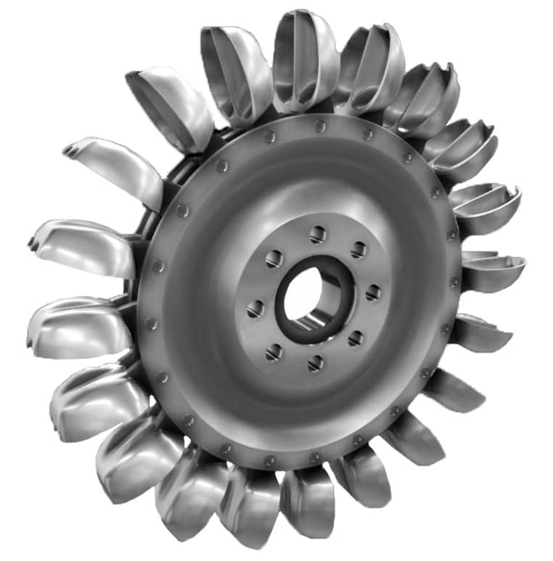
2. Impulse Turbine Cont…
The Pelton Wheel
Figure 2: A Pelton Turbine (Pelton Wheel), Newfoundland and Labrador Hydro. (2025)
url:https://savree-storage.s3.amazonaws.com/Articles/optimised/Pelton-Turbine-2-2.jpg

Slide 19
2. Impulse Turbine Cont…
Compounding of Impulse Turbine
In a simple impulse turbine, steam expands completely in one or more nozzles to a very high velocity and then strikes the moving blades attached to a single wheel.
However, this high-velocity steam causes:
  Very high rotational speed of the rotor,
  Mechanical stresses,
  Frictional losses, and
  Difficulty in directly coupling to generators
To overcome these limitations, compounding is introduced.

Slide 20
2. Impulse Turbine Cont…
Compounding in an impulse turbine means dividing the total pressure drop or velocity of steam into several stages, so that the rotational speed of the turbine is reduced to a practical level without sacrificing efficiency [4].
Each stage converts a part of the available energy, allowing the turbine to operate at lower speeds while still extracting the same total energy from the steam so that:
  The turbine runs at a manageable speed
  Efficiency improves
  Energy extraction is more uniform

Slide 21
2. Impulse Turbine Cont…
There are three main types of compounding used in impulse turbines:
  Velocity Compounding (Curtis Turbine)
    Used to reduce the rotor's high speed by splitting the total pressure drop and using multiple stages of moving blades.
  Pressure Compounding (Rateau Turbine)
    a method used in steam turbines to split the total pressure drop across multiple stages of stationary nozzles and moving blades.
  Pressure-Velocity Compounding (Combination or
  Zoelly Turbine)

Slide 22
2. Impulse Turbine Cont…
  1. Velocity Compounding (Curtis Turbine)
The compounding is done for velocity of steam only i.e. drop in velocity is arranged in many small drops through many moving rows of blades instead of a single row of moving blades.
It consists of a nozzle or a set of nozzles and rows of moving blades attached to the rotor or wheel and rows of fixed blades attached to.
The fixed blades are guide blades which guide the steam to succeeding rows of moving blades, suitably arranged between the moving blades
and set in a reversed manner.
Three rows or rings of moving blades are fixed on a single wheel
or rotor and this type of wheel is termed as the three row wheel.

Slide 23
2. Impulse Turbine Cont…
The whole expansion of steam from the steam chest pressure to the exhaust pressure takes place in the nozzles only.
There is no drop in either in the moving blades or the fixed i.e. the pressure remains constant in the blades as in the simple impulse turbine.
The steam velocity from the exit of the nozzle is very high as in the simple impulse turbine.
Steam with this high velocity enters the first row of moving blades and on passing through these blades, the velocity slightly reduces .
It then enters the first row of guide blades which directs the
steam to the second row of moving blades.

Slide 24
2. Impulse Turbine Cont…
  Pressure Compounding (Rateau Turbine)
The compounding is done for pressure of steam only i.e. to reduce the high rotational speed of turbine.
The whole expansion of steam is arranged in a number of steps by employing a number of simple turbine in a series keyed on the same shaft.
Each of these simple impulse turbine consisting of one set of nozzles and one row of moving blades is known as a stage of the turbine and thus this turbine consists of several stages.
The exhaust from each row of moving blades enters the
succeeding set of nozzles.

Slide 25
2. Impulse Turbine Cont…
Thus we can say that this arrangement is nothing but splitting up the whole pressure drop.
From the steam chest pressure to the condenser pressure into a series of smaller pressure drop across several stages of impulse turbine and hence this turbine is called, pressure-compound impulse turbine.
In general, in pressure compounding,
Pressure: Drops in steps, only across the nozzles. It remains
constant across the moving blades.
Velocity: Peaks at the exit of each nozzle and then drops as it
passes through the moving blades.

Slide 26
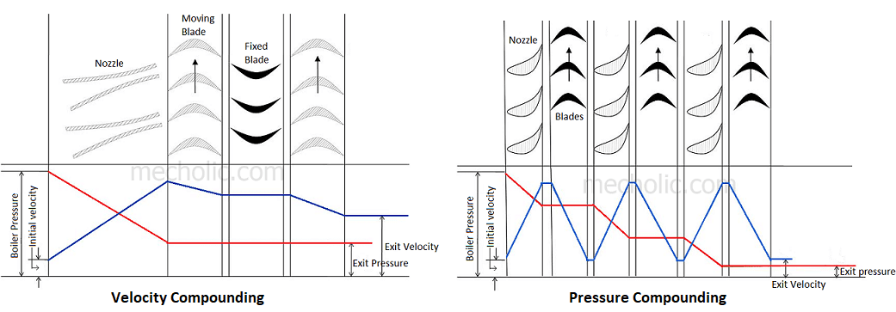
2. Impulse Turbine Cont…
  Velocity Compounding and Pressure Compounding
Figure 3: Difference between velocity compounding turbine and pressure compounding turbine, Mecholic. (2018).
url:https://encrypted-tbn3.gstatic.com/images?q=tbn:ANd9GcT9wqdKgt7NNH3H7sTqu-WfIaH9_0z5seEElsLTBZ8_Ou6V3CaB

Slide 27
2. Impulse Turbine Cont…
  Pressure-Velocity Compounding (Combination or Zoelly Turbine)
This type of turbine is a combination of pressure and velocity compounding.
There are two wheels or rotors and on each, only two rows of moving blades are attached cause two-row wheel are more efficient than three-row wheel.
In each wheel or rotor, velocity drops i.e. drop in velocity is achieved by many rows of moving blades hence it is velocity compounded.
There are two sets of nozzles in which whole pressure drop
takes place i.e. whole pressure drop has been divided in small
drops, hence it is pressure-compounded.

Slide 28
2. Impulse Turbine Cont…
In the first set of nozzles, there is some decrease in pressure which gives some kinetic energy to the steam and there is no drop in pressure in the two rows of moving blades of the first wheel and in the first row of fixed blades.
There is a velocity drop in moving blades though there is also a slight drop in velocity due to friction in the fixed blades.
In second set of nozzles, the remaining pressure drop takes place but the velocity here increases and the drop in velocity takes place in the moving blades of the second wheel or rotor.
Compared to the pressure-compounded impulse turbine this
arrangement was more popular due to its simple construction.
It is, however, very rarely used now due to its low efficiency.

Slide 29
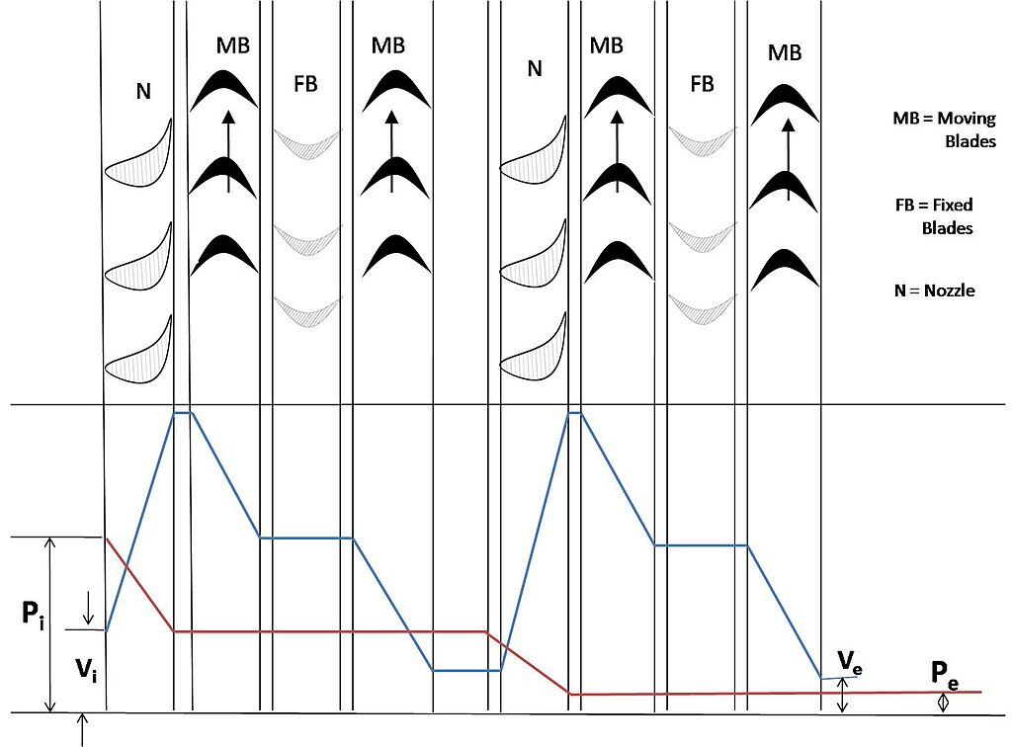
2. Impulse Turbine Cont…
Pressure-Velocity Compounding
Figure 4: Pressure-Velocity Compounding of a Turbine, Kumar, Subikkumar, (2012).
url: https://upload.wikimedia.org/wikipedia/commons/thumb/7/77/Fig5-Subik_Kumar-Schematic_Diagram_of_Pressure-Velocity_compounded_Impulse_Turbine.jpg/1024px-Fig5-Subik_Kumar-Schematic_Diagram_of_Pressure-Velocity_compounded_Impulse_Turbine.jpg

Slide 30
3. Reaction Turbine
A reaction turbine is a type of steam turbine in which steam expands continuously as it flows through both fixed and moving blades, causing a reaction force that produces rotation [5].
Reaction turbines operate based on the principle of reaction, where the fluid flows through the turbine blades, and both pressure and velocity energy are converted into rotational energy.
Examples: Francis turbines, Kaplan turbines, and Propeller
turbines are common types of reaction turbines
used in hydroelectric power plants.

Slide 31
3. Reaction Turbine Cont…
Unlike the impulse turbine, where expansion occurs only in nozzles, in a reaction turbine:
  Expansion of steam occurs partly in the fixed blades (nozzles) and
  Partly in the moving blades, resulting in both impulse and reaction forces acting on the rotor.
An impulse-reaction turbine combines features of both impulse and reaction turbines within a single stage.
The turbine rotor alternates between sections that operate on
the impulse and reaction principles.

Slide 32
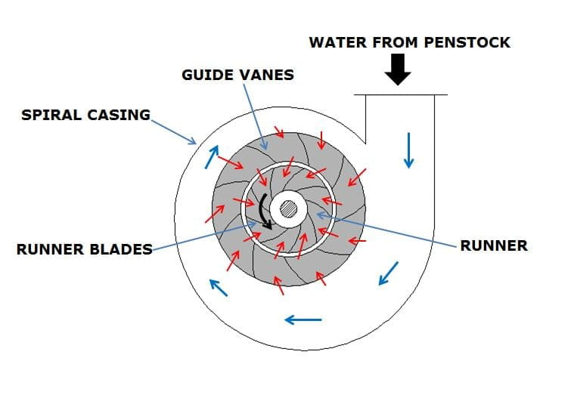
3. Reaction Turbine Cont…
Reaction Turbine
Figure 5: Reaction Turbine, The Mechanical Engineering, (2022)
url:https://themechanicalengineering.com/wp-content/uploads/2022/02/FEATURE-IMAGE-OF-REACTION-TURBINE.jpg

Slide 33
3. Reaction Turbine Cont…
As steam expands while flowing over the moving blades:
  It accelerates, producing a change in momentum.
  The reaction force due to this change in momentum acts in the opposite direction, causing the rotor to turn.
Thus, the rotation of the turbine rotor is due to:
  Impulse force (from steam striking the blades), and
  Reaction force (from steam expansion within the blades).

Slide 34
3. Reaction Turbine Cont…
A reaction turbine consists of the following main parts:
Fixed Blades (Nozzles)
  Attached to the stationary casing.
  Act as nozzles, converting part of the pressure energy into kinetic energy.
  Direct the steam onto the moving blades at a suitable angle.
Moving Blades
  Attached to the rotor.
  Steam expands further within these blades, producing
  reaction force and doing work on the rotor.

Slide 35
3. Reaction Turbine Cont…
Rotor
  A shaft carrying the moving blades.
  Converts the kinetic and reaction energy of steam into rotational energy.
Casing
  Encloses the turbine to contain the steam and guide it properly from stage to stage.
Glands and Bearings
  Prevent steam leakage and support the rotor in smooth
  rotation.

Slide 36
4. Velocity Diagram for Impulse Turbine Blade
In an impulse turbine, steam expands in nozzles only, converting its pressure energy into kinetic energy.
The high-velocity jet of steam then impinges on the moving blades, changing direction and producing an impulse force that rotates the turbine wheel.
To understand how this force produces work and efficiency, it is necessary to analyze the velocity of steam and blades using a velocity diagram.
The velocity diagram helps in understanding the relationship
between different velocities and in determining the efficiency
of the turbine.

Slide 37
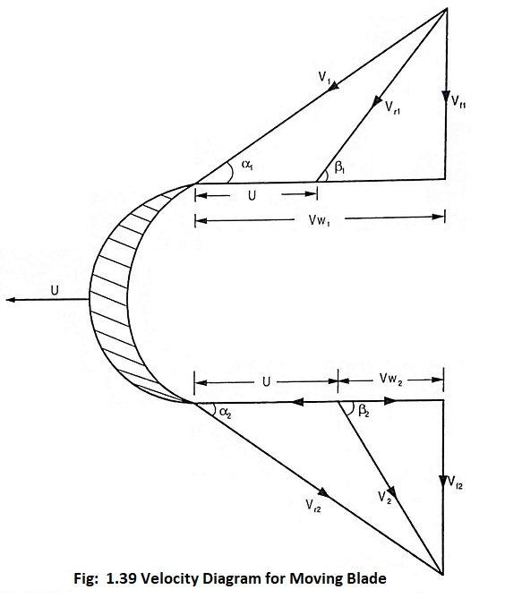
4. Velocity Diagram for Impulse Turbine Blade Cont…
Where
V₁ and V₂ = Absolute velocity of steam at entry and exit respectively
V_{w1} and V_{w2} = Velocity of whirl at the entry and exit respectively = Radial component of V₁ and V₂ respectively
V_{f1} = Velocity of flow at entry of moving blade = axial component of V₁
V_{f2} = Velocity of flow at exit and
moving blade = Axial component of V₂
U = Blade velocity
Figure 6: Velocity Diagram for Moving Blade, EEE Guide, (2022)
url:https://www.eeeguide.com/wp-content/uploads/2022/12/Steam-Turbine-Working-Principle-01.jpg

Slide 38
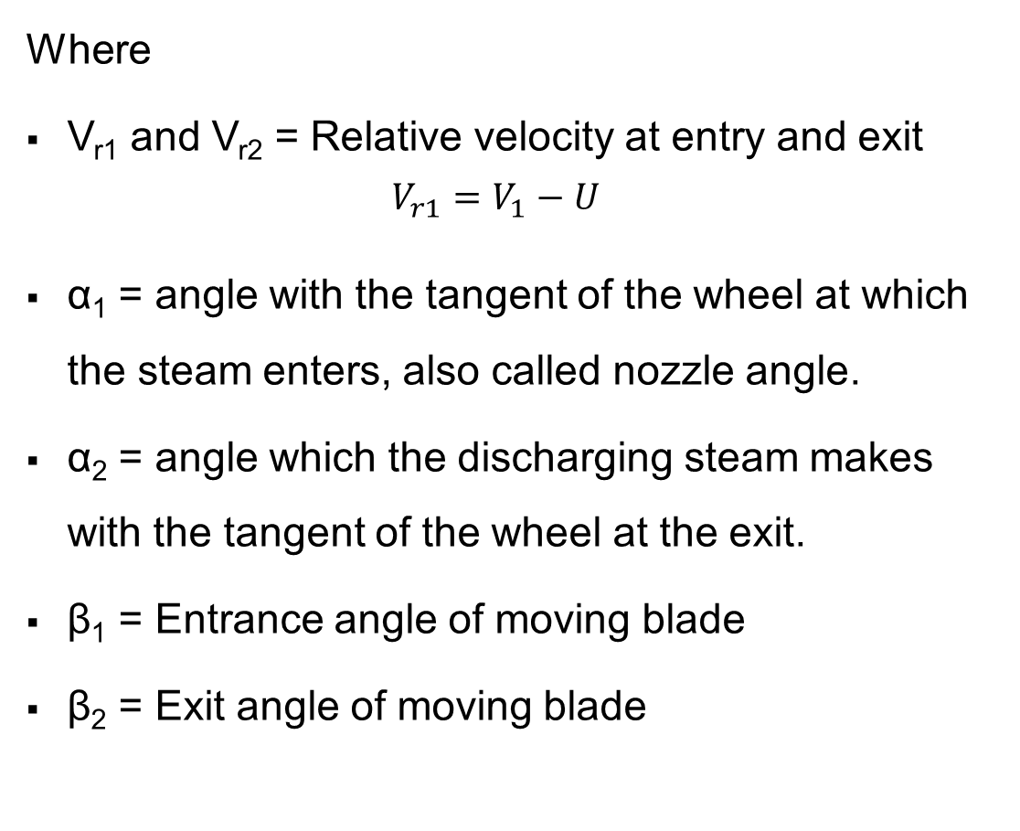
4. Velocity Diagram for Impulse Turbine Blade Cont…
Where
V_{r1} and V_{r2} = Relative velocity at entry and exit
$$V_{r1}=V_{1}−U$$
α₁ = angle with the tangent of the wheel at which the steam enters, also called nozzle angle.
α₂ = angle which the discharging steam makes with the tangent of the wheel at the exit.
β₁ = Entrance angle of moving blade
β₂ = Exit angle of moving blade

Slide 39
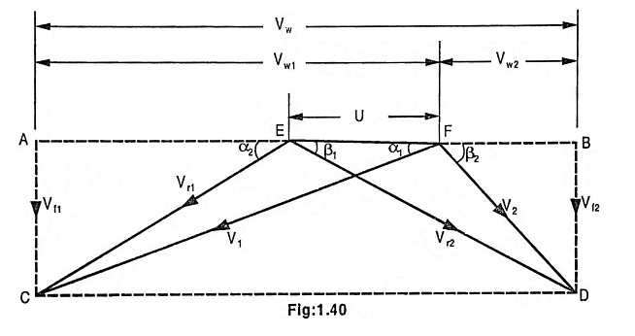
4. Velocity Diagram for Impulse Turbine Blade Cont…
In order to have simplicity while solving problem, it is a common practice to combine the two vector velocity diagrams on a common base.
The diagram has been obtained by superimposing the inlet velocity diagram on the outlet diagram in order to coincide the blade velocity U.
Figure 7: Velocity Diagram for Impulse Turbine, EEE Guide, (2022)
url:https://www.eeeguide.com/wp-content/uploads/2022/12/Steam-Turbine-Working-Principle-02.jpg

Slide 40
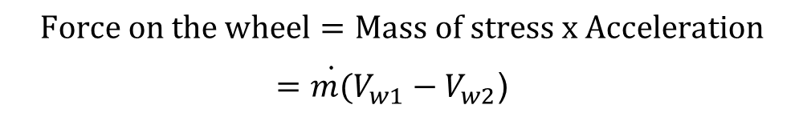
4. Velocity Diagram for Impulse Turbine Blade Cont…
Work done on the Blade
The work done on the blade may be found out from the change of momentum of the steam jet during its flow over the blade.
It is only the velocity of whirl which performs work on the blade since it acts in its (blade) direction of motion.
V_{w2} is actually negative as the steam is discharged in the opposite
direction to blade motion, therefore consideration should be given
to the fact that the values of V_{w1} and V_{w2} are to be added while
solving the problems:
$$Force on the wheel=Mass of stress x Acceleration$$
$=\dot{m(}V_{w1}−V_{w2}$)

Slide 41
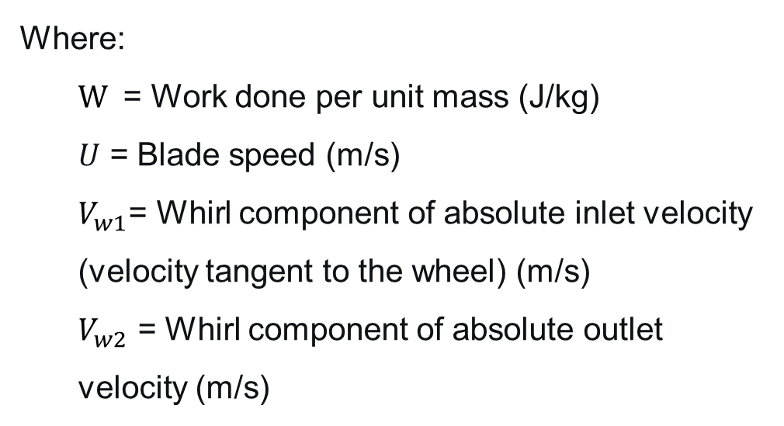
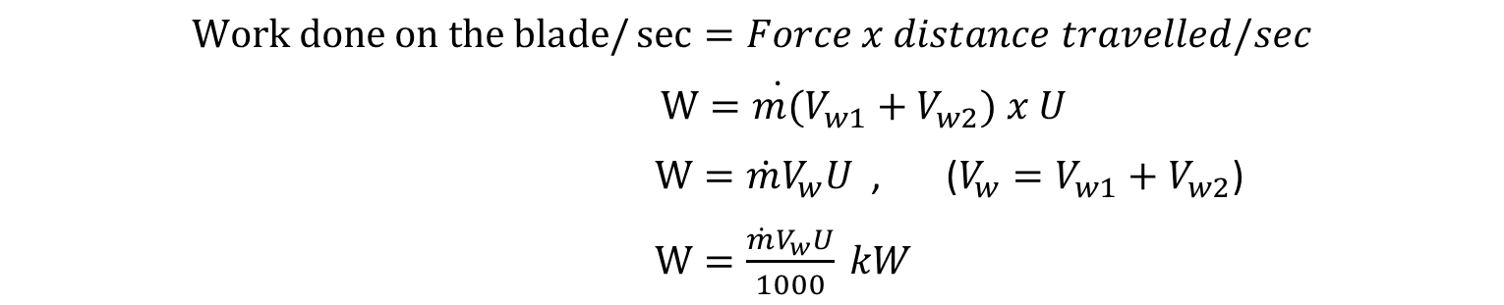
4. Velocity Diagram for Impulse Turbine Blade Cont…
Work done on the Blade/Sec
$$Work done on the blade/\sec{=Force x distance travelled/sec}$$
$W=\dot{m(}V_{w1}+V_{w2}) x U$
$W=\dot{m}V_{w}U$ , ($V_{w}=V_{w1}+V_{w2}$)
$W=\frac{\dot{m}V_{w}U}{1000} kW$
Where:
  $W$ = Work done per unit mass (J/kg)
  𝑈 = Blade speed (m/s)
  $V_{w1}$= Whirl component of absolute inlet velocity (velocity tangent to the wheel) (m/s)
  $V_{w2}$​ = Whirl component of absolute outlet velocity (m/s)

Slide 42
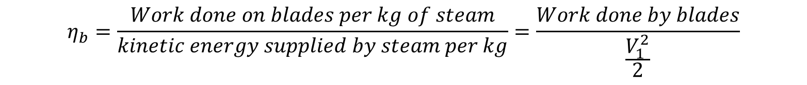
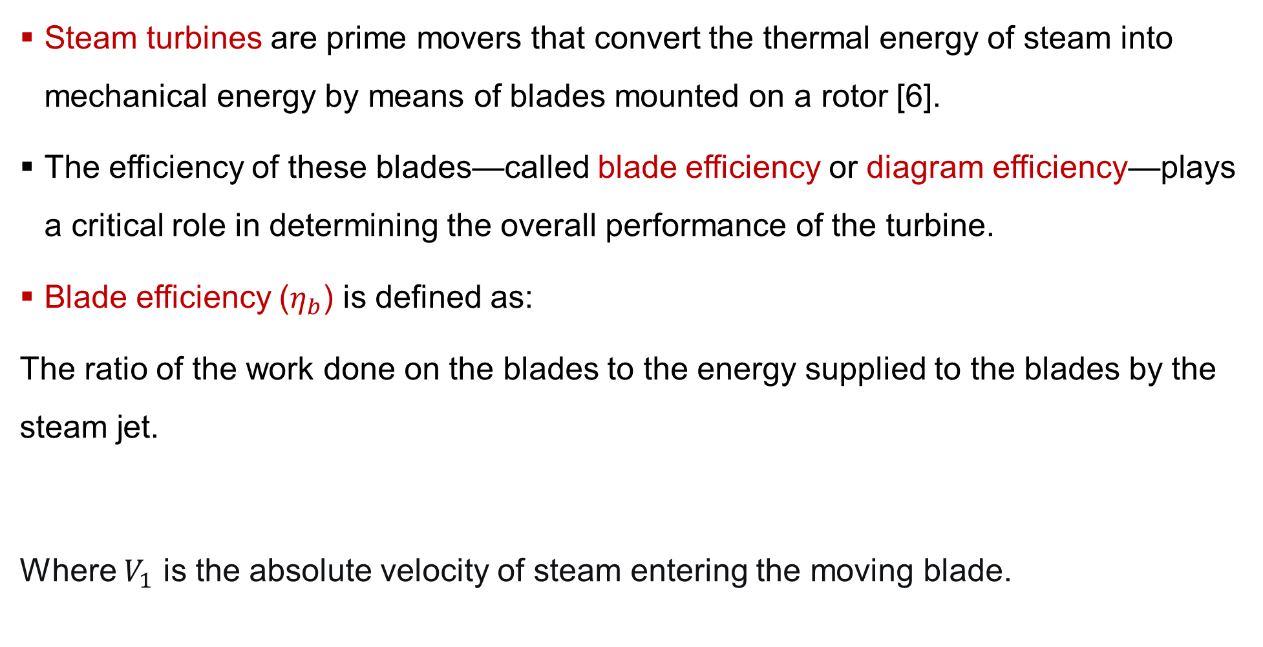
5. Steam Turbine Blade-efficiency
Steam turbines are prime movers that convert the thermal energy of steam into mechanical energy by means of blades mounted on a rotor [6].
The efficiency of these blades—called blade efficiency or diagram efficiency—plays a critical role in determining the overall performance of the turbine.
Blade efficiency ($η_{b}$) is defined as:
The ratio of the work done on the blades to the energy supplied to the blades by the steam jet.
Where $V_{1}$​ is the absolute velocity of steam entering the moving blade.
$$η_{b}=\frac{Work done on blades per kg of steam}{kinetic energy supplied by steam per kg}=\frac{Work done by blades}{\frac{V_{1}^{2}}{2}}$$

Slide 43
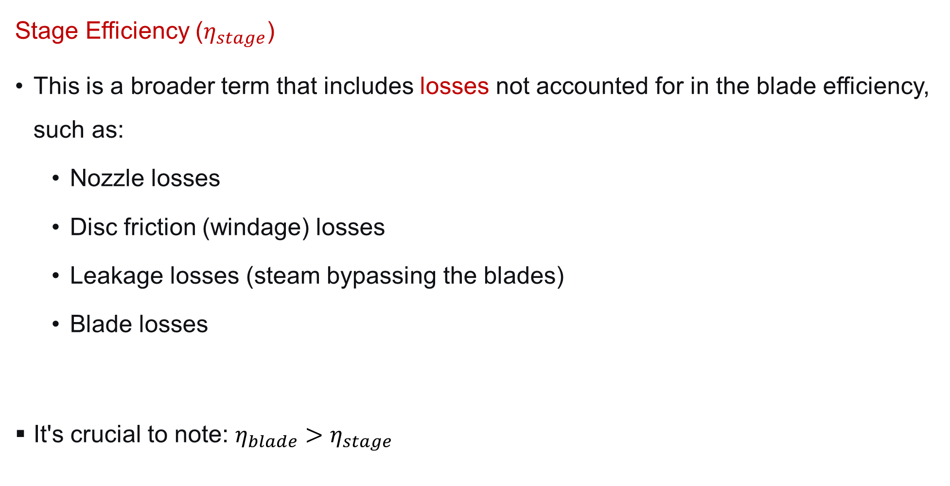
5. Steam Turbine Blade-efficiency Cont…
Stage Efficiency ($η_{stage}$)
This is a broader term that includes losses not accounted for in the blade efficiency, such as:
  Nozzle losses
  Disc friction (windage) losses
  Leakage losses (steam bypassing the blades)
  Blade losses
It's crucial to note: $η_{blade}>η_{stage}$
$$η_{stage}=\frac{Actual Work Output of the Stage}{Isentropic Enthalpy Drop across the Entire Stage}$$

Slide 44
5. Steam Turbine Blade-efficiency Cont…
Factors Affecting Blade Efficiency
Blade speed (u) – must be optimized for maximum energy transfer.
Inlet steam velocity (V₁) – higher velocity increases available energy.
Blade angle (α₁, β₁, β₂) – affects flow direction and losses.
Blade friction (k) – decreases relative velocity and efficiency.
Blade surface condition – rough surfaces cause turbulence and energy loss.

Slide 45
6. Axial Thrust on Rotor
In steam turbines, steam expands and passes through stationary and moving blades, exerting forces on them.
While most of these forces act tangentially (producing torque and useful work), there is also a longitudinal component of force acting along the axis of the turbine shaft.
This longitudinal or axial force is known as axial thrust (or end thrust).
Axial thrust is an unavoidable consequence of the pressure distribution and fluid momentum changes within a turbomachine.
If not properly balanced, axial thrust can cause mechanical stress
on the rotor and bearings, leading to wear, vibration, and
performance issues.

Slide 46
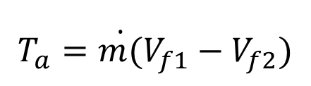
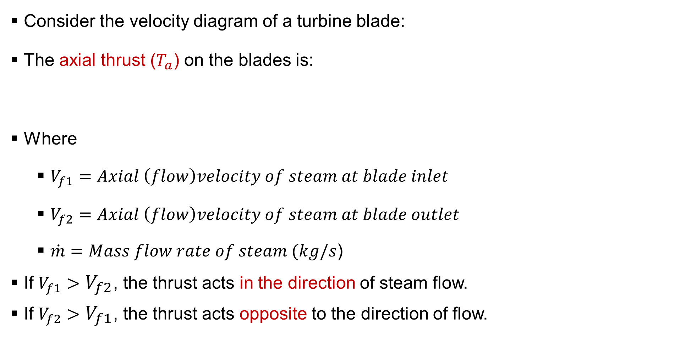
6. Axial Thrust on Rotor Cont…
Consider the velocity diagram of a turbine blade:
The axial thrust ($T_{a}$) on the blades is:
Where
  $V_{f1}=Axial \left(flow\right)velocity of steam at blade inlet$
  $V_{f2}=Axial \left(flow\right)velocity of steam at blade outlet$
  $\dot{m}=Mass flow rate of steam (kg/s$)
If $V_{f1}>V_{f2}$​, the thrust acts in the direction of steam flow.
If $V_{f2}>V_{f1}$​, the thrust acts opposite to the direction of flow.
$$T_{a}=\dot{m(}V_{f1}−V_{f2})$$

Slide 47
Summary
In an impulse turbine, steam expands completely in nozzles, producing high-velocity jets that strike the blades, causing rotation by change of momentum only.
In reaction turbines, steam expands both in fixed and moving blades, producing torque through combined impulse and reactive forces.
Velocity diagram for impulse turbine blade illustrates relationships among absolute, relative, and blade velocities, used to determine blade work and efficiency.
The blade efficiency of steam turbine depends on velocity ratio, blade
angles, and friction; maximum efficiency occurs when blade speed is
about half the jet speed.
Axial thrust on rotor is the net force along the turbine axis due to change
in steam velocity; must be balanced or minimized to protect
bearings and maintain alignment.

Slide 48
References
[1]. Power Plant Engineering, R.K. Rajput, 3rd Edition, 2011.
[2]. Pelton and Crossflow Impulse Hydraulic Turbines — Zulcy de Souza, Geraldo Lúcio Tiago Filho. Springer Cham, 2025.
[3]. Pelton and Crossflow Impulse Hydraulic Turbines — de Souza, Zulcy & Tiago Filho, Geraldo Lúcio. Springer Cham, 2025.
[4]. Turbines, Compressors and Fans (4th ed.), Yahya S.M, Tata McGraw Hill Education Private Limited, 2011.
[5]. Influence of Partial Admission on the Downstream Stages of a Reaction Turbine: An Analytical Approach Verified by Measurements — W. Beer. ASME, 2013.
[6]. Essentials of Steam Turbine Design and Analysis, Kumana, J. D, AIChE CEP, 2018.

Slide 49
Thank you !

