Slide 1
Power Plant Engineering
Lecture 8
Steam Turbines
Lecturer: Dr. Melaku Desta

Slide 2
Lecture learning outcomes:
At the end of this lecture, you will be able to:
Explain the effect of friction on steam turbine blade efficiency and identify factors influencing friction losses.
Analyze the relationship between blade efficiency and overall energy conversion in steam turbines.
Evaluate key performance parameters of steam turbines such as power output, efficiency, and specific steam consumption.
Describe various governing methods used in steam turbines and
their role in maintaining constant speed under varying loads.
Assess the combined impact of friction, efficiency, and governing
mechanisms on the overall performance and operation of steam
turbines.

Slide 3
Content
Effect of Friction on Blade Efficiency
Blade Efficiency and Energy Conversion
Performance of Steam Turbines
Governing of Steam Turbines
Combined Effect on Turbine Operation and Efficiency
Summary
References

Slide 4
1. Effect of Friction on Blade Efficiency
Definition and Causes of Blade Friction
In a steam turbine, steam expands and flows over the blades, transferring energy to the rotor.
Ideally, this flow is frictionless, allowing maximum energy transfer. However, in practical situations, friction between the steam and blade surfaces reduces the relative velocity of steam, leading to losses in efficiency.
Blade friction refers to the resistance to motion experienced by steam (or gas) as it flows over the surface of turbine blades [1].
This friction arises due to viscous forces between the moving
steam and the blade surface, causing loss of kinetic energy and
a reduction in the relative velocity of steam.

Slide 5
1. Effect of Friction on Blade Efficiency Cont…
Causes of Blade Friction
Surface roughness of blades
  Uneven or rough blade surfaces increase turbulence and energy loss.
High steam velocity
  Increased relative velocity leads to higher shear forces and frictional losses.
Steam wetness
  Presence of water droplets in wet steam increases drag and erosion, enhancing friction.
Blade geometry and shape
  Poor aerodynamic design causes flow separation and
  vortex formation.

Slide 6
1. Effect of Friction on Blade Efficiency Cont…
Contamination or deposits
  Dust, oil, or corrosion products increase surface resistance.
Operating conditions
  Changes in steam temperature and pressure can alter viscosity and frictional behavior.
Impact of Friction on Velocity Diagrams
Ideal (Frictionless) Condition
  Steam enters and leaves the blade with no loss in relative
  velocity.
  The velocity triangles (at inlet and outlet) are sharp and
  geometrically accurate.
  Work output is maximum for a given set of velocities.

Slide 7
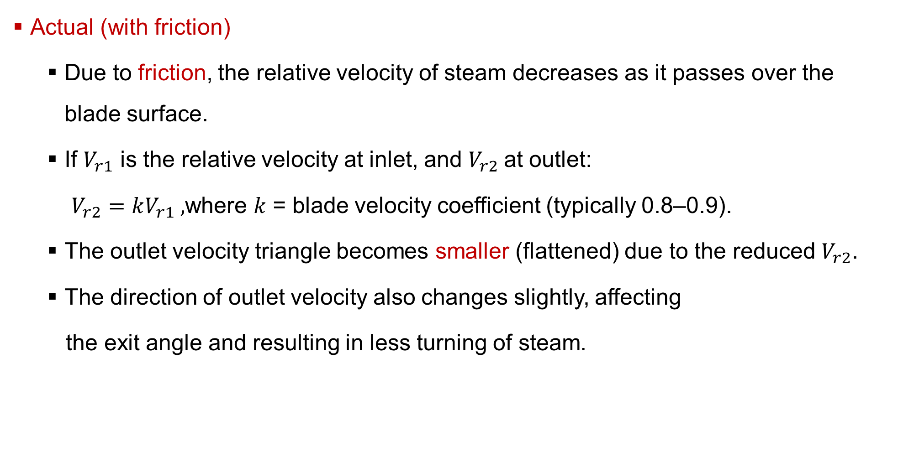
1. Effect of Friction on Blade Efficiency Cont…
Actual (with friction)
  Due to friction, the relative velocity of steam decreases as it passes over the blade surface.
  If $V_{r1}$ is the relative velocity at inlet, and $V_{r2}$at outlet:
  $V_{r2}=kV_{r1} ,$where 𝑘 = blade velocity coefficient (typically 0.8–0.9).
  The outlet velocity triangle becomes smaller (flattened) due to the reduced $V_{r2}$.
  The direction of outlet velocity also changes slightly, affecting
  the exit angle and resulting in less turning of steam.

Slide 8
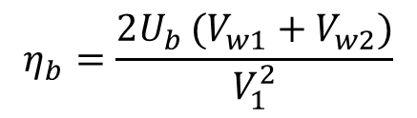
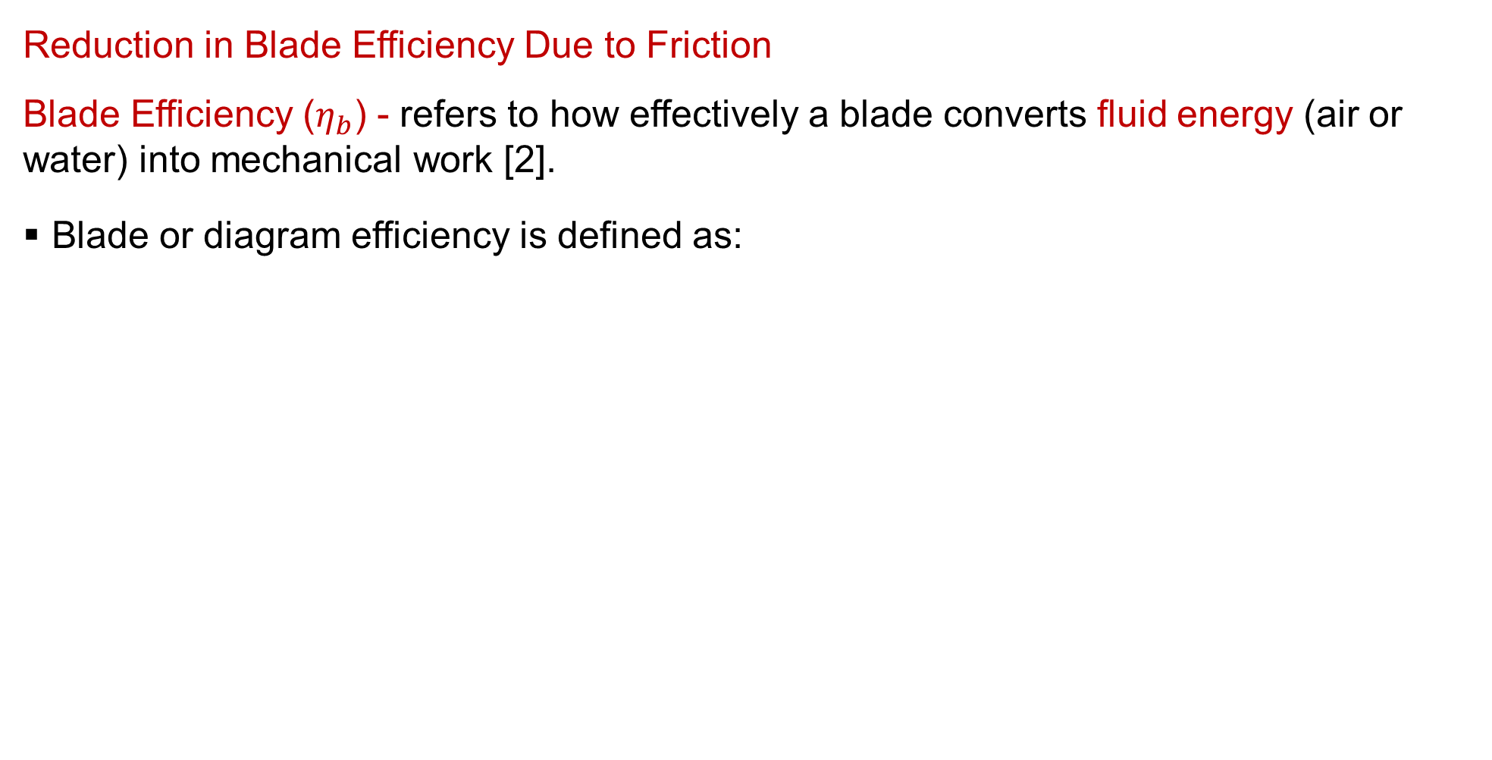
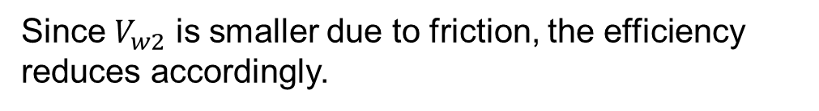
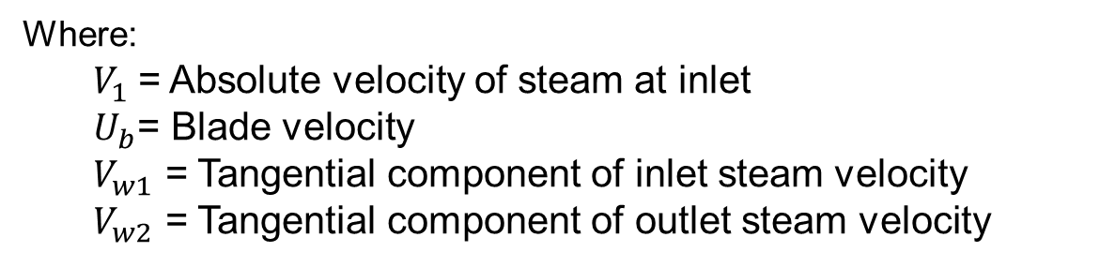
1. Effect of Friction on Blade Efficiency Cont…
Reduction in Blade Efficiency Due to Friction
Blade Efficiency ($η_{b}$) - refers to how effectively a blade converts fluid energy (air or water) into mechanical work [2].
Blade or diagram efficiency is defined as:
$$η_{b}=\frac{Work done on blades}{Kinetic energy supplied to blades}=\frac{Work done on blades}{\frac{V_{1}^{2}}{2}}$$
$$η_{b}=\frac{2U_{b }(V_{w1}+V_{w2})}{V_{1}^{2}}$$
Since$V_{w2}$​ is smaller due to friction, the efficiency reduces accordingly.
Where:
  $V_{1}​$= Absolute velocity of steam at inlet
  $U_{b}$= Blade velocity
  $V_{w1}$​ = Tangential component of inlet steam velocity
  $V_{w2}$​ = Tangential component of outlet steam velocity

Slide 9
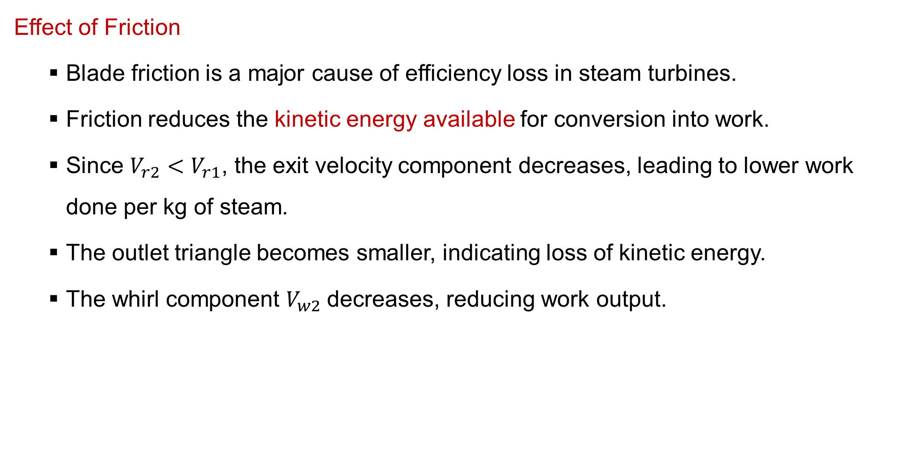
1. Effect of Friction on Blade Efficiency Cont…
Effect of Friction
  Blade friction is a major cause of efficiency loss in steam turbines.
  Friction reduces the kinetic energy available for conversion into work.
  Since $V_{r2}<V_{r1}$​, the exit velocity component decreases, leading to lower work done per kg of steam.
  The outlet triangle becomes smaller, indicating loss of kinetic energy.
  The whirl component $V_{w2}$decreases, reducing work output.

Slide 10
1. Effect of Friction on Blade Efficiency Cont…
Methods to Minimize Frictional Losses
Improved surface finish - Polished or mirror-finished blades reduce boundary layer thickness and flow resistance.
Lubrication - moisture control and anti-corrosive coatings act as indirect lubrication.
Selection of blade materials - Selection of smooth surface properties, high resistance to erosion and corrosion, stable microstructure materials.
Steam quality control - Ensure superheated steam to prevent droplet impact and erosion and drain moisture from steam lines before entry to turbine.
Aerodynamic blade design - Optimize blade curvature and
thickness to maintain laminar flow.

Slide 11
2. Performance of Steam Turbines
Key Performance Parameters
These are the primary metrics used to gauge the effectiveness and economic value of a steam turbine.
The performance of a steam turbine is evaluated using several important parameters that describe how effectively it converts steam energy into mechanical work.
Efficiency
Efficiency is the ratio of useful energy output to the energy input.
In steam turbines, several types of efficiencies are considered:

Slide 12
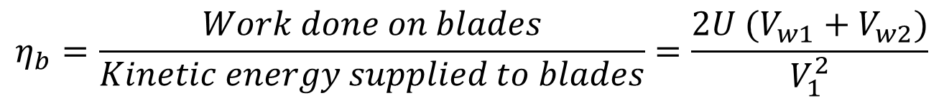
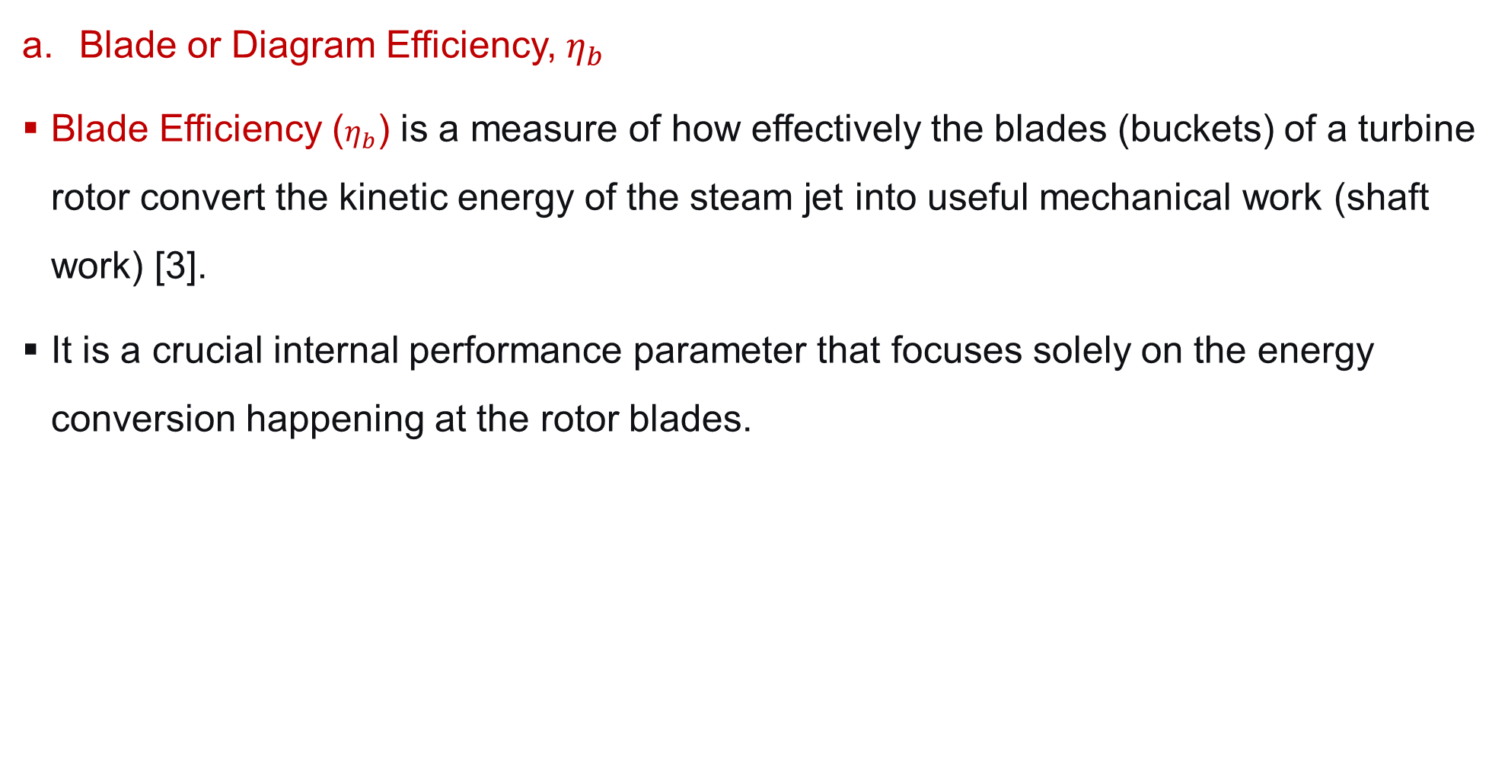
2. Performance of Steam Turbines Cont…
Blade or Diagram Efficiency, $η_{b}$
Blade Efficiency ($η_{b}$) is a measure of how effectively the blades (buckets) of a turbine rotor convert the kinetic energy of the steam jet into useful mechanical work (shaft work) [3].
It is a crucial internal performance parameter that focuses solely on the energy conversion happening at the rotor blades.
$$η_{b}=\frac{Work done on blades}{Kinetic energy supplied to blades}=\frac{2U (V_{w1}+V_{w2})}{V_{1}^{2}}$$

Slide 13
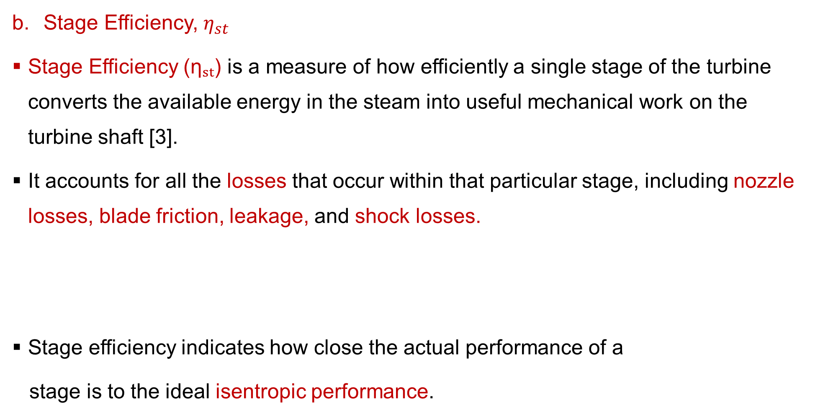
2. Performance of Steam Turbines Cont…
Stage Efficiency, $η_{st}$
Stage Efficiency (ηₛₜ) is a measure of how efficiently a single stage of the turbine converts the available energy in the steam into useful mechanical work on the turbine shaft [3].
It accounts for all the losses that occur within that particular stage, including nozzle losses, blade friction, leakage, and shock losses.
Stage efficiency indicates how close the actual performance of a
stage is to the ideal isentropic performance.
$$η_{st}=\frac{Actual work done per kg of steam per stage}{Isentropic energy \left(enthalpy\right) drop available in the stage}$$

Slide 14
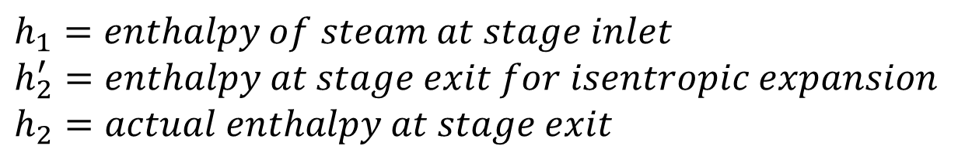
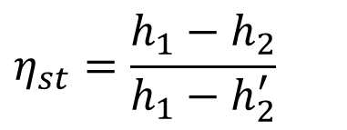
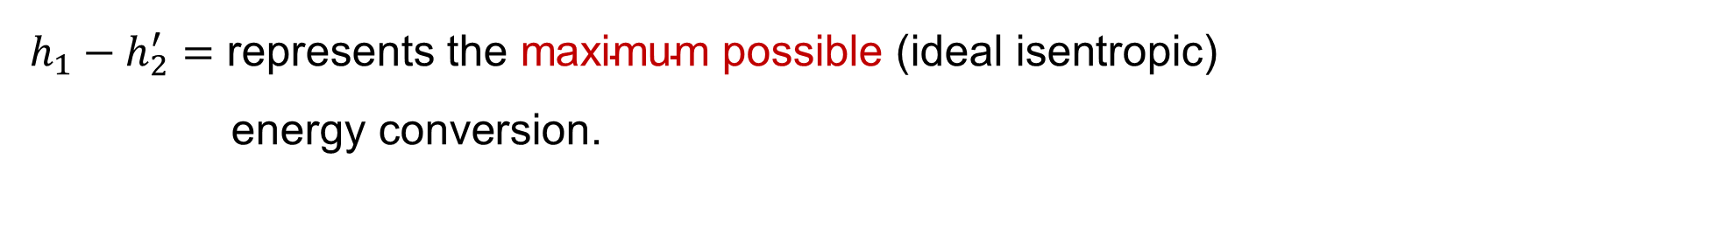
2. Performance of Steam Turbines Cont…
Mathematically,
Where,
$$η_{st}=\frac{h_{1}−h_{2}}{h_{1}−h_{2}^{′}}$$
$$h_{1}=enthalpy of steam at stage inlet$$
$$h_{2}^{′}=enthalpy at stage exit for isentropic expansion$$
$$h_{2}=actual enthalpy at stage exit$$
$h_{1}−h_{2}=$represents the actual energy converted to mechanical work in the stage.
$h_{1}−h_{2}^{′}=\text{represents} \text{the} \text{maximum} \text{possible}\text{ (}\text{ideal} \text{isentropic}\text{) }$
$\text{energy} \text{conversion}\text{.}$

Slide 15
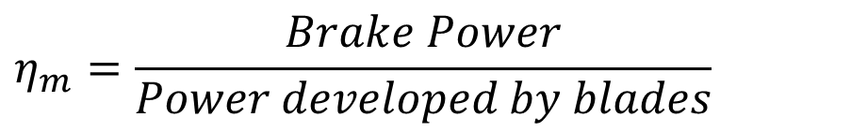
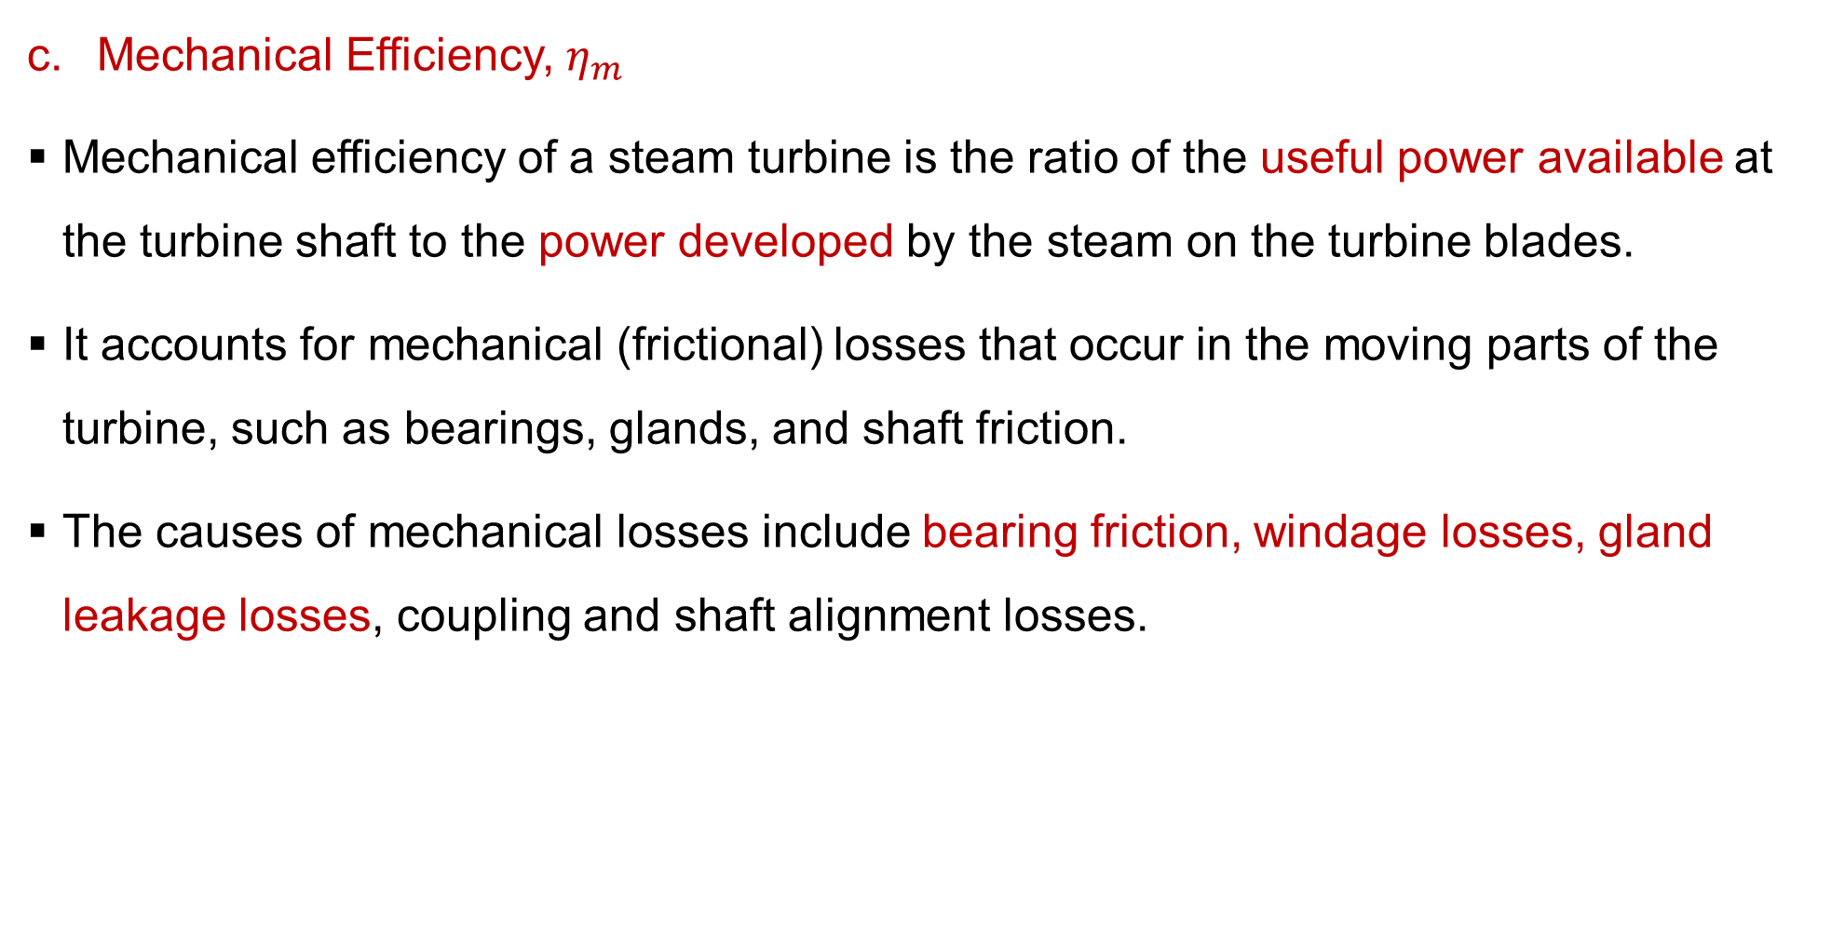
2. Performance of Steam Turbines Cont…
Mechanical Efficiency, $η_{m}$
Mechanical efficiency of a steam turbine is the ratio of the useful power available at the turbine shaft to the power developed by the steam on the turbine blades.
It accounts for mechanical (frictional) losses that occur in the moving parts of the turbine, such as bearings, glands, and shaft friction.
The causes of mechanical losses include bearing friction, windage losses, gland leakage losses, coupling and shaft alignment losses.
$$η_{m}=\frac{Brake Power}{Power developed by blades}$$

Slide 16
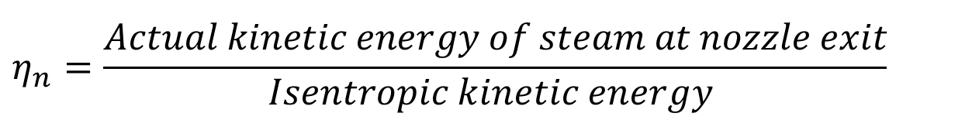
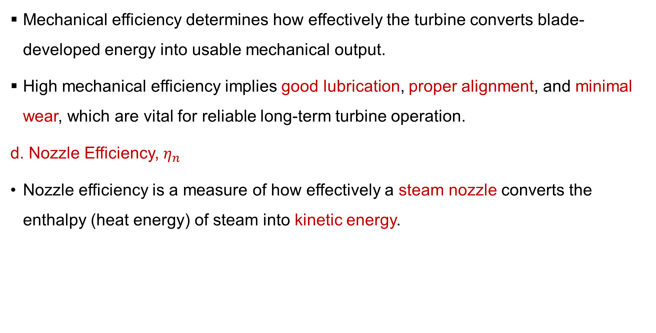
2. Performance of Steam Turbines Cont…
Mechanical efficiency determines how effectively the turbine converts blade-developed energy into usable mechanical output.
High mechanical efficiency implies good lubrication, proper alignment, and minimal wear, which are vital for reliable long-term turbine operation.
d. Nozzle Efficiency, $η_{n}$
Nozzle efficiency is a measure of how effectively a steam nozzle converts the enthalpy (heat energy) of steam into kinetic energy.
$$η_{n}=\frac{Actual kinetic energy of steam at nozzle exit​}{Isentropic kinetic energy }$$

Slide 17
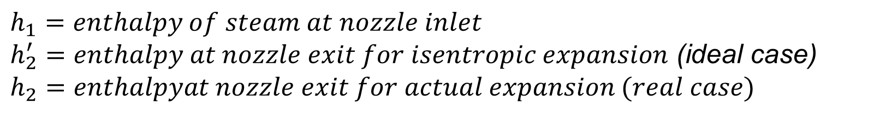
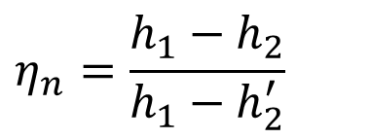
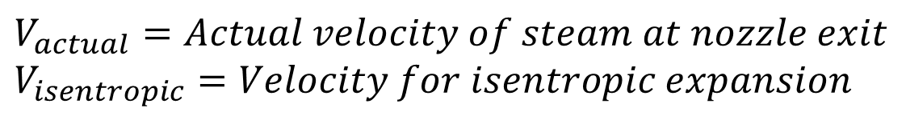
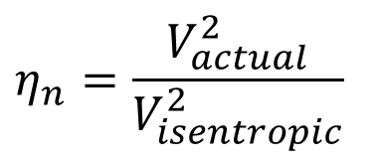
2. Performance of Steam Turbines Cont…
Mathematically,
Where,
Velocity form,
$$η_{n}=\frac{h_{1}−h_{2}}{h_{1}−h_{2}^{′}}$$
$$h_{1}=enthalpy of steam at nozzle inlet$$
$h_{2}^{′}=enthalpy at nozzle exit for isentropic expansion$ (ideal case)
$$h_{2}=enthalpyat nozzle exit for actual expansion (real case)$$
.
$$η_{n}=\frac{V_{actual}^{2}}{V_{isentropic}^{2}}$$
$$V_{actual}=Actual velocity of steam at nozzle exit \\ V_{isentropic}=Velocity for isentropic expansion$$

Slide 18
2. Performance of Steam Turbines Cont…
In steam turbines, nozzles are used to expand high-pressure steam and convert its thermal energy into high-velocity jets that strike the turbine blades to produce mechanical work.
Nozzle efficiency determines the velocity of steam jets entering the turbine blades.
The factors affecting nozzle efficiency includes:
  Surface friction between steam and nozzle walls,
  Shock losses due to sudden changes in steam direction,
  Heat losses to the surroundings,
  Steam wetness (moisture reduces expansion efficiency),
  Poor nozzle design or rough internal surface finish.

Slide 19
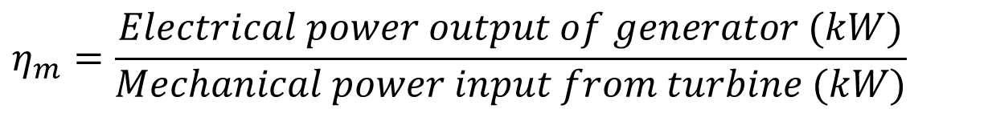
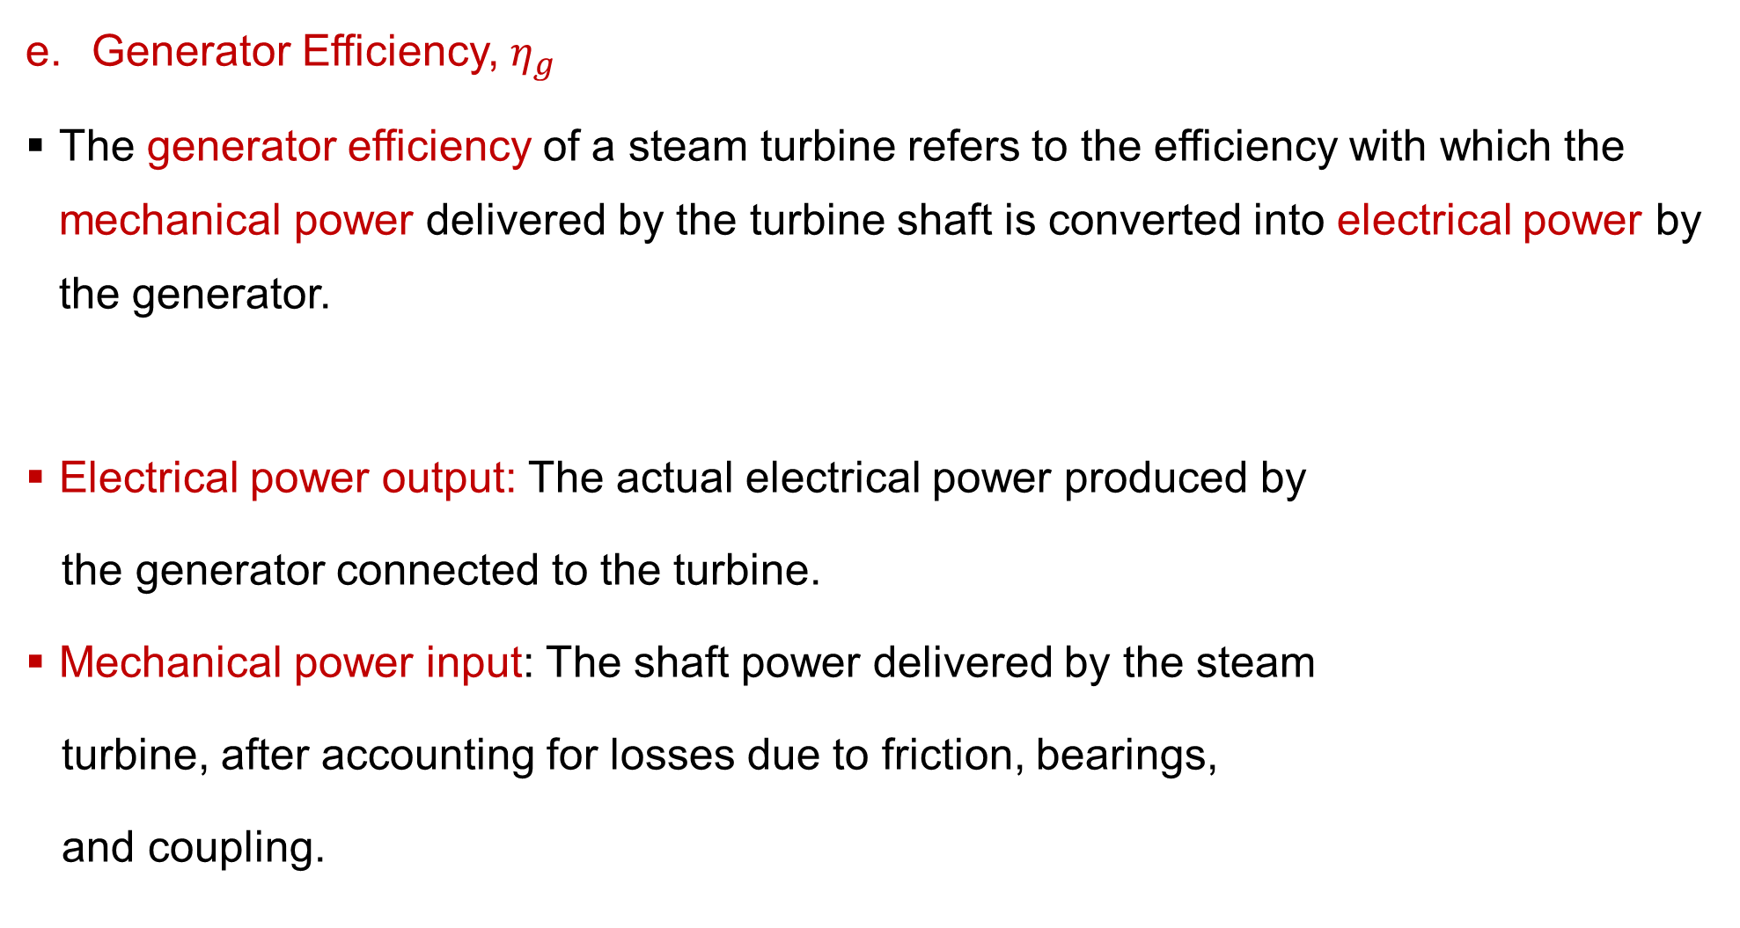
2. Performance of Steam Turbines Cont…
Generator Efficiency, $η_{g}$
The generator efficiency of a steam turbine refers to the efficiency with which the mechanical power delivered by the turbine shaft is converted into electrical power by the generator.
Electrical power output: The actual electrical power produced by
the generator connected to the turbine.
Mechanical power input: The shaft power delivered by the steam
turbine, after accounting for losses due to friction, bearings,
and coupling.
$$η_{m}=\frac{Electrical power output of generator (kW)​}{Mechanical power input from turbine (kW)}$$

Slide 20
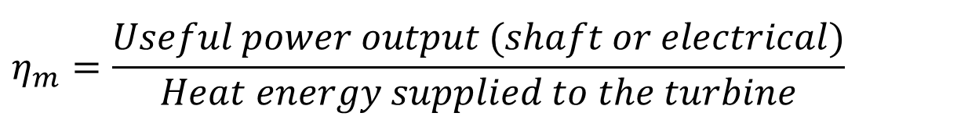
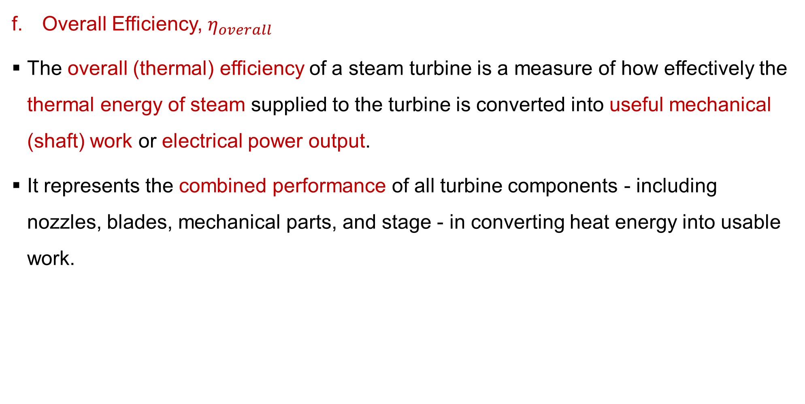
2. Performance of Steam Turbines Cont…
Overall Efficiency, $η_{overall}$
The overall (thermal) efficiency of a steam turbine is a measure of how effectively the thermal energy of steam supplied to the turbine is converted into useful mechanical (shaft) work or electrical power output.
It represents the combined performance of all turbine components - including nozzles, blades, mechanical parts, and stage - in converting heat energy into usable work.
$$η_{m}=\frac{Useful power output (shaft or electrical)​}{Heat energy supplied to the turbine}$$

Slide 21
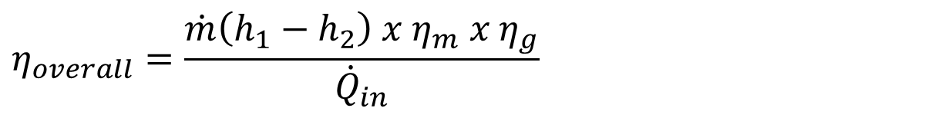
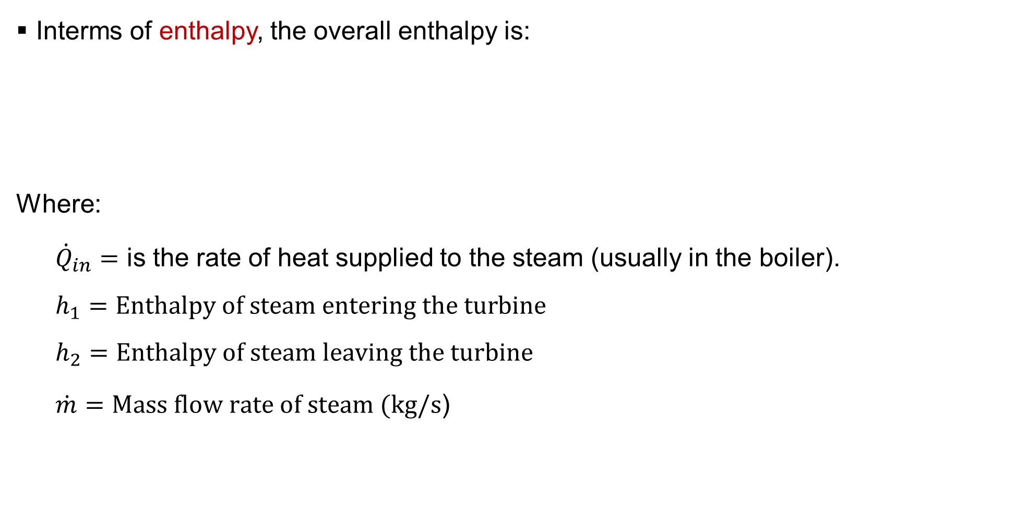
2. Performance of Steam Turbines Cont…
Interms of enthalpy, the overall enthalpy is:
Where:
  ${\dot{Q}}_{in}=$ ​is the rate of heat supplied to the steam (usually in the boiler).
  $$h_{1}=Enthalpy of steam entering the turbine$$
  $$h_{2}=Enthalpy of steam leaving the turbine$$
  $\dot{m}=Mass flow rate of steam (kg/s$)
$$η_{overall}=\frac{\dot{m}\left(h_{1}−h_{2}\right) x{ η}_{m}​ x{ η}_{g}​}{{\dot{Q}}_{in}}$$

Slide 22
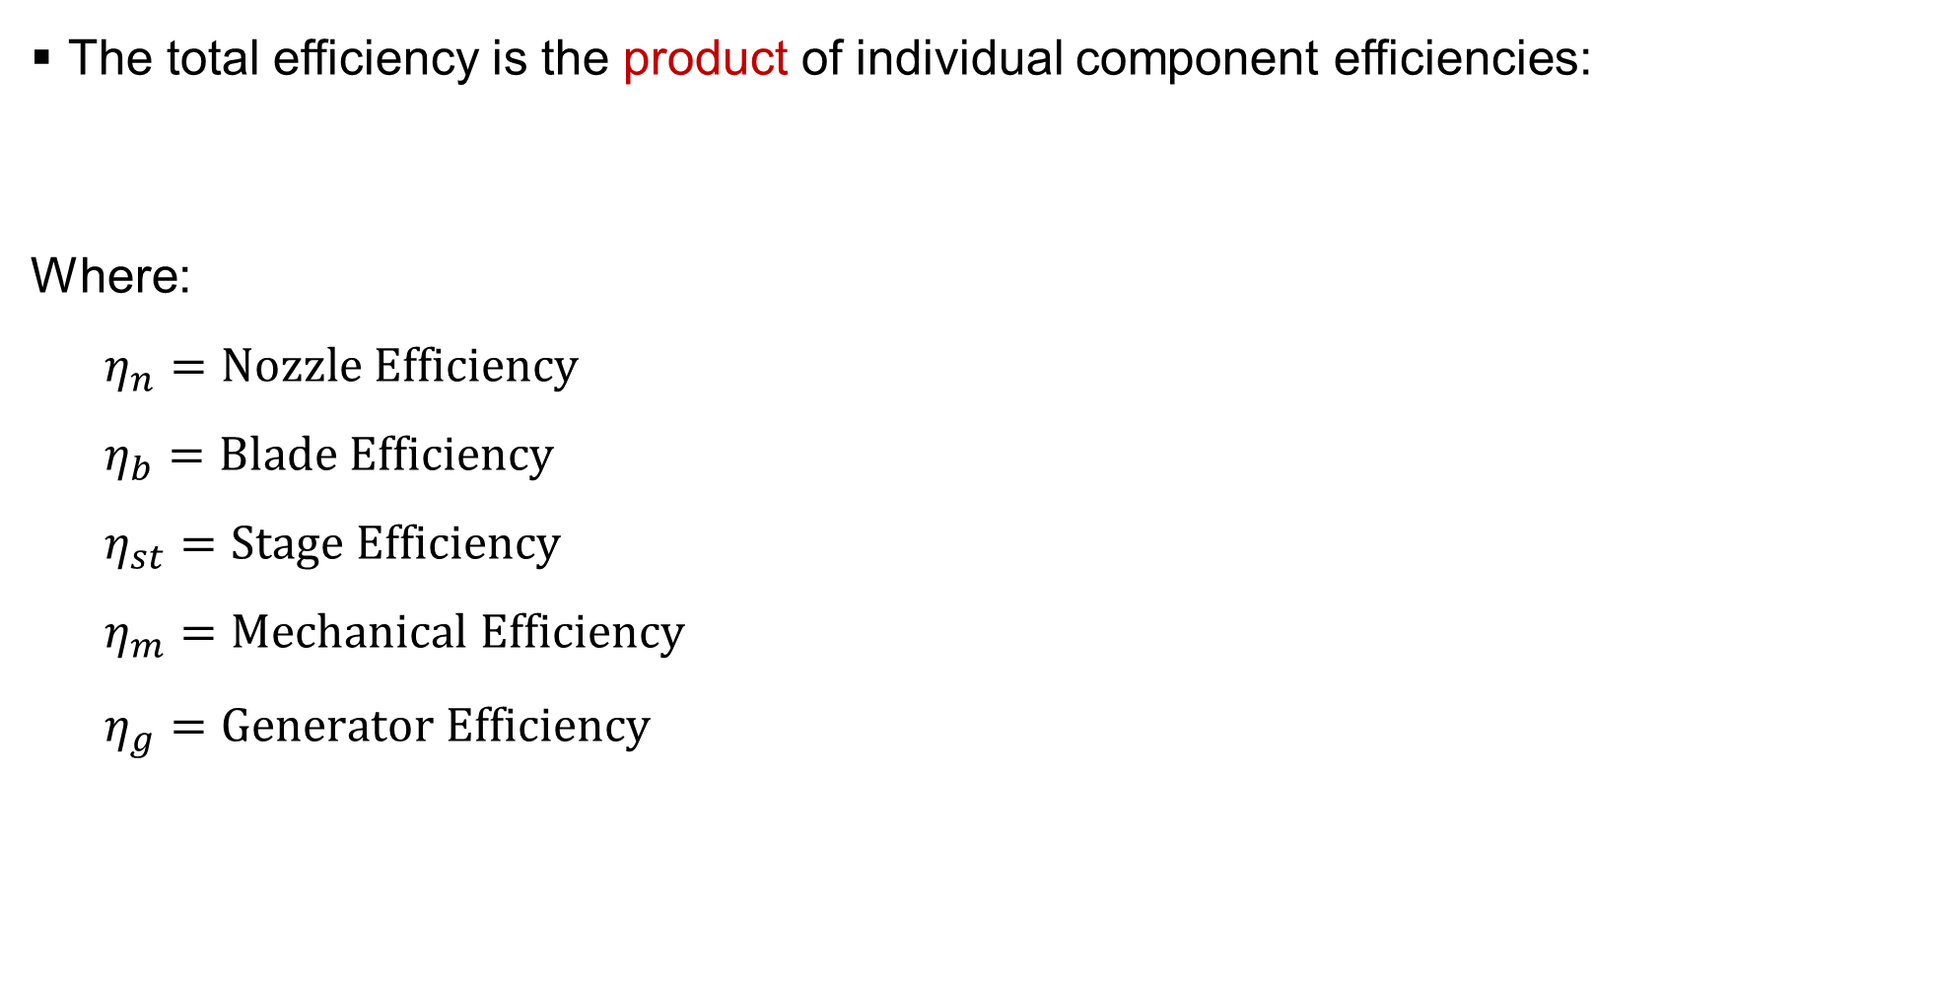
2. Performance of Steam Turbines Cont…
The total efficiency is the product of individual component efficiencies:
Where:
  $$η_{n}=Nozzle Efficiency$$
  $$η_{b}=Blade Efficiency$$
  $$η_{st}=Stage Efficiency$$
  $$η_{m}=Mechanical Efficiency$$
  $$η_{g}=Generator Efficiency$$
$$η_{overall}=η_{n} x η_{b} x η_{st} x η_{m} x η_{g}$$

Slide 23
2. Performance of Steam Turbines Cont…
Factors Affecting Turbine Performance
The performance of a steam turbine is influenced by several factors that affect its efficiency, power output, and operational reliability [4].
Understanding these factors helps in improving design, optimizing operation, and maintaining efficiency throughout the turbine’s life.
The factors that influence the actual performance of a steam turbine include:
Blade friction and surface roughness
Friction between steam and blade surfaces causes energy loss.
It reduces the relative velocity of steam as it passes over the blades.
Surface roughness due to corrosion or erosion increases drag
and turbulence.

Slide 24
2. Performance of Steam Turbines Cont…
Steam leakage
Leakage occurs through blade tips, seals, and between stages.
It occurs through clearances between stationary and moving parts (e.g., at the shaft seals, blade tips, and casing joints).
Results in reduced steam flow through the intended paths and decreases output.
Moisture content
In low-pressure stages, steam expands below the saturation line, forming water droplets.
Droplets strike the blades, causing erosion, efficiency loss, and
unbalanced forces.
Moisture also reduces kinetic energy conversion since
part of the flow is liquid.

Slide 25
2. Performance of Steam Turbines Cont…
Mechanical losses
Include friction in bearings, glands, and shaft couplings.
Lead to loss of mechanical efficiency.
Steam flow and pressure losses
Steam experiences pressure losses in nozzles, blades, and pipelines due to resistance.
Non-optimal flow angles (inlet/outlet) cause velocity triangles
to deviate from ideal design.
Leads to reduced stage efficiency.

Slide 26
2. Performance of Steam Turbines Cont…
Throttling and nozzle losses
Imperfect expansion of steam in nozzles reduces kinetic energy supplied to blade.
Heat losses
Through casing and piping by conduction and radiation.
Prevented by proper insulation and lagging.
Steam quality and conditions
Turbine performance depends strongly on inlet steam pressure,
temperature, and degree of superheat.
Any drop in these parameters leads to less available enthalpy
for work conversion.

Slide 27
3. Governing of Steam Turbines
Steam turbines are designed to operate efficiently at a specific speed and load.
However, in practical applications — especially when driving electrical generators or mechanical loads — the load on the turbine continuously varies.
To maintain a constant speed and ensure stable operation under changing load conditions, a governing system is employed.
Governing of a steam turbine refers to the process of controlling and regulating or adjusting the flow of steam to the turbine in order to maintain
its speed constant, irrespective of variations in load [5].

Slide 28
3. Governing of Steam Turbines Cont…
Objectives of Governing
The main purposes of governing in steam turbines are:
To maintain constant turbine speed despite load changes.
To prevent over-speeding when the load suddenly decreases.
To ensure efficient utilization of steam.
To maintain steady output in coupled electrical generators.
To protect the turbine and connected equipment from mechanical
damage due to excessive speed.

Slide 29
3. Governing of Steam Turbines Cont…
Principle of Governing
The governing system works on the principle of speed feedback control.
When the load on the turbine increases → the speed tends to fall.
  The governor detects the speed drop and increases the steam supply.
When the load decreases → the speed tends to rise.
  The governor detects the speed rise and reduces the steam supply.
This automatic regulation is achieved using a centrifugal governor
mechanism that senses the turbine speed and adjusts the steam
control valve position accordingly.

Slide 30
3. Governing of Steam Turbines Cont…
Components of a Governing System
A typical governing system consists of the following parts:
  Governor (mechanical, hydraulic, or electronic) - Senses turbine speed and generates control signal.
  Linkages and relay mechanism - Transmit motion from governor to the control valve.
  Steam control valve - Regulates the amount of steam entering the turbine.
  Servomotor or actuator - Uses hydraulic or pneumatic power to
  move the control valve as per governor signal.
  Oil pump and piping system - Provide pressurized oil for
  hydraulic operation.

Slide 31
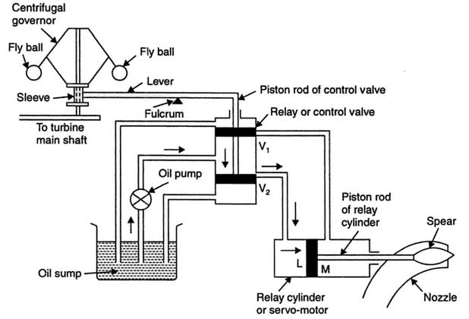
3. Governing of Steam Turbines Cont…
Components of a Governing System
Figure 1: Main Components of Governing of Impulse Turbine, Fluid Mechanics and Hydraulic Machines, R. K Bansal, 2010.
url: https://figures.academia-assets.com/52582534/figure_033.jpg

Slide 32
3. Governing of Steam Turbines Cont…
Types of Governing in Steam Turbines
Depending on how the steam flow is controlled, turbine governing can be classified into three main types:
Throttle governing
The simplest and most common method used in small and medium turbines.
The flow of steam to the turbine is regulated by throttling, i.e., by partially closing the throttle valve.
Used in small power plants or auxiliary turbines where efficiency
is not very critical.

Slide 33
3. Governing of Steam Turbines Cont…
Nozzle control governing
Used in large impulse turbines (like the Curtis and Rateau types).
Instead of throttling, the number of nozzles through which steam flows is varied.
Steam is admitted through a group of nozzles controlled by separate valves.
At full load: all nozzle groups are open.
At part load: some nozzle groups are closed.
Pressure remains constant at the nozzle inlet — only mass flow
rate is reduced.

Slide 34
3. Governing of Steam Turbines Cont…
Bypass governing
Used in large reaction turbines.
A portion of the steam is diverted (bypassed) directly to later stages of the turbine when load increases suddenly.
At normal load: steam passes through all stages normally.
When load increases: extra steam is supplied by opening bypass valves to later stages.
When load reduces: bypass valves close to restrict steam flow.

Slide 35
3. Governing of Steam Turbines Cont…
Modern Governing Systems
Modern steam turbines use electro-hydraulic or electronic governing systems that provide:
  Faster response and higher precision.
  Integration with automatic control systems.
  Digital feedback using sensors and servo-actuators.
Proper governing ensures steady turbine speed, load sharing, and
safe operation.
Malfunctioning governors can lead to overspeed accidents and
mechanical failure.

Slide 36
4. Combined Effect on Turbine Operation and Efficiency
While the ideal (isentropic) expansion process is a benchmark, real turbine operation deviates significantly due to irreversibilities.
The thermal efficiency of a Rankine cycle and the isentropic efficiency of the turbine itself are critically dependent on a combination of design and operational factors [6].
The factors affecting turbine performance includes:
Initial steam conditions (throttle conditions)
Higher initial pressure and temperature increase the average
temperature of heat addition, which improves the cycle efficiency
(as per Carnot's principle).
However, this is limited by material strength (creep) and boiler cost.

Slide 37
4. Combined Effect on Turbine Operation and Efficiency Cont…
Exhaust pressure
Lowering P₂ (the condenser back pressure) significantly increases work output and efficiency.
However, it is limited by the temperature of the cooling medium (river, sea, or air) and the escalating size and cost of the condenser.
Reheat
Steam is expanded part-way in the High-Pressure (HP) turbine,
returned to the boiler for reheating, and then expanded in the
Intermediate-Pressure (IP) and Low-Pressure (LP) turbines.

Slide 38
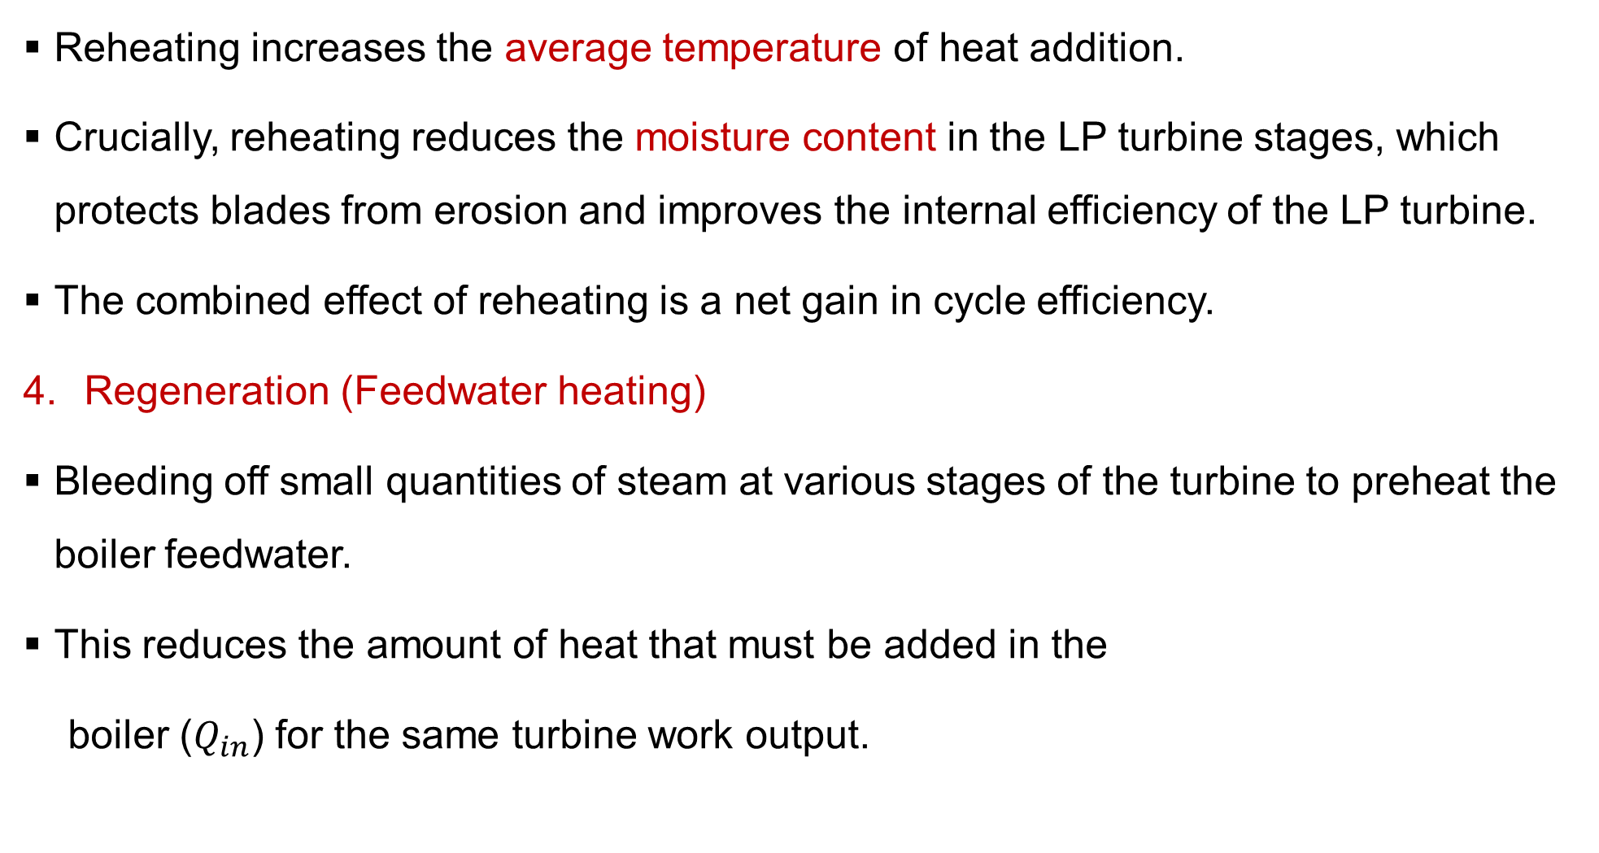
4. Combined Effect on Turbine Operation and Efficiency Cont…
Reheating increases the average temperature of heat addition.
Crucially, reheating reduces the moisture content in the LP turbine stages, which protects blades from erosion and improves the internal efficiency of the LP turbine.
The combined effect of reheating is a net gain in cycle efficiency.
Regeneration (Feedwater heating)
Bleeding off small quantities of steam at various stages of the turbine to preheat the boiler feedwater.
This reduces the amount of heat that must be added in the
boiler ($Q_{in}$) for the same turbine work output.

Slide 39
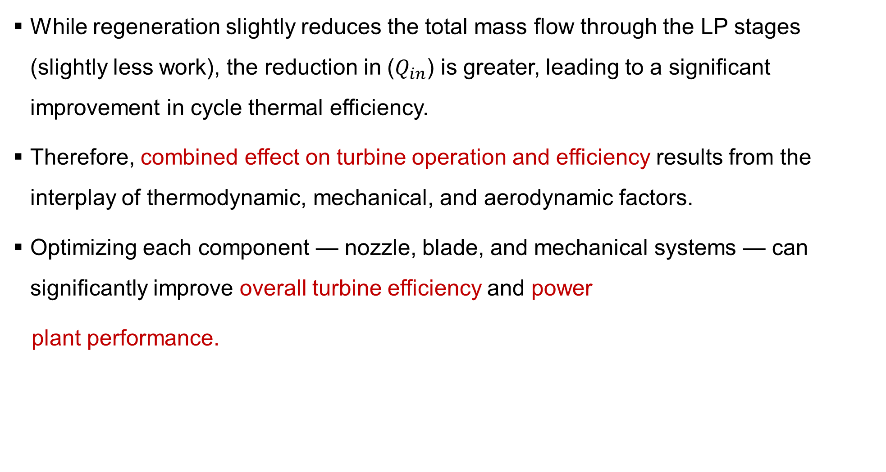
4. Combined Effect on Turbine Operation and Efficiency Cont…
While regeneration slightly reduces the total mass flow through the LP stages (slightly less work), the reduction in ($Q_{in}$) is greater, leading to a significant improvement in cycle thermal efficiency.
Therefore, combined effect on turbine operation and efficiency results from the interplay of thermodynamic, mechanical, and aerodynamic factors.
Optimizing each component — nozzle, blade, and mechanical systems — can significantly improve overall turbine efficiency and power
plant performance.

Slide 40
4. Combined Effect on Turbine Operation and Efficiency Cont…
The Combined Effect - The Interaction of Parameters
The Efficiency vs. Load Characteristic
A turbine's efficiency is not constant across its operating range.
It is typically highest at its Economic Load or Valve-Wide-Open (VWO) point and drops off at both higher and lower loads.
Combined Effect of Exhaust Pressure and Load
At high loads, a rise in exhaust pressure (e.g., due to poor
condenser performance or high cooling water temperature)
has a severe negative impact on efficiency and output.

Slide 41
4. Combined Effect on Turbine Operation and Efficiency Cont…
At low loads, the same rise in exhaust pressure has a less pronounced but still significant negative effect.
The turbine is operating less efficiently overall, and the back-pressure effect compounds this.
Combined Effect of Reheat and Initial Temperature
High initial temperature T₁ is beneficial, but its effect is magnified when combined with reheat.
A high reheat temperature ensures the benefits of
reheat (moisture reduction, efficiency gain) are fully realized.

Slide 42
4. Combined Effect on Turbine Operation and Efficiency Cont…
The Regeneration-Reheat-Moisture Nexus
This is a critical combined effect in modern power plants.
Reheat's Role: Reheat dries the steam entering the LP turbine.
Regeneration's Role: Regeneration improves cycle efficiency but removes mass flow from the turbine. The steam bled for the last feedwater heater is often taken from the LP turbine's wet region.
The combination of Reheat + Regeneration
(Regenerative-Reheat Cycle) represents the peak of
conventional steam cycle design.

Slide 43
4. Combined Effect on Turbine Operation and Efficiency Cont…
To summarize the combined effect of different parameters on turbine performance,
Turbine operation is a complex balancing act.
The final efficiency and output are the result of the combined, non-linear interaction of:
  Initial conditions (P₁, T₁)
  Final condition (P₂)
  Cycle modifications (Reheat, Regeneration)
  Load demand (Governor valve position)
  Internal health (Isentropic efficiency)

Slide 44
Summary
Friction between steam and blade surfaces reduces kinetic energy transfer, lowering turbine blade efficiency and increasing thermal losses.
Blade design, steam velocity, and pressure gradients directly influence how effectively steam energy is converted into mechanical work.
Speed and load regulation through governing systems (like throttle or nozzle control) ensure stable turbine operation under varying demand.
Frictional losses can interfere with governing accuracy, requiring compensation mechanisms to maintain optimal performance and prevent overspeed.
The synergy between blade design, friction control, and precise
governing determines overall turbine efficiency, reliability,
and energy output.

Slide 45
References
[1]. Power Plant Engineering, R.K. Rajput, 3rd Edition, 2011.
[2]. Power Plant Engineering, Kundur, P., & Gupta, A. (2020). New Delhi: McGraw Hill Education.
[3]. Performance Improvement of Steam Turbines through Energy Audit – S. K. Gupta, Energy Reports – 2018.
[4]. Power Plant Performance Monitoring: A Case Study on Steam Turbine Efficiency – M. S. Mahmoud –Journal of Energy Engineering – 2017.
[5]. Steam Turbine Control Systems: Principles and Practices – Mike C. Jenkins – Elsevier Butterworth-Heinemann – 2018.
[6]. Performance Optimization of Steam Turbines: Combined Effects
of Load, Pressure, and Temperature – M. S. Mahmoud,
Energy Reports – 2018.

Slide 46
Thank you !

