Slide 1
Power Plant Engineering
Lecture 9
Steam Condensers, Condensate-Feed-water and Circulating Water Systems
Lecturer: Dr. Melaku Desta

Slide 2
Lecture learning outcomes:
At the end of this lecture, you will be able to:
Explain the role of steam condensers in thermal power plants and their impact on cycle efficiency.
Identify the components, functions, and operational requirements of condensate and feed-water systems.
Evaluate the design and operation of circulating water systems used for condenser cooling, including open and closed-loop configurations.
Analyze how steam condensers, feed-water, and circulating water systems interact and affect overall plant efficiency.
Assess strategies for performance monitoring, routine
maintenance, and operational optimization of condenser
systems.

Slide 3
Content
Introduction to Steam Condensers
Condensate Feed-Water Systems
Circulating Water Systems for Condensers
Integration of Steam Condensers with Feed-Water and Circulating Systems
Maintenance, Performance Monitoring, and Optimization
Summary
References

Slide 4
1. Introduction to Steam Condensers
Steam condensers are essential components in thermal power plants and various industrial processes.
A steam condenser is a closed vessel or heat exchanger designed to condense the exhaust steam from a turbine back into water (condensate) by rejecting its latent heat to a cooling medium, which can then be reused in the cycle [1].
This not only conserves water but also significantly improves the efficiency of steam turbines by maintaining a low backpressure at the turbine exhaust.
The condenser facilitates the phase change of the exhaust steam
from a vapor to a liquid.

Slide 5
1. Introduction to Steam Condensers
A steam condenser has the following major objectives:
  It maintains a low pressure (below atmospheric pressure) so as to obtain maximum possible energy from steam and thus to secure high efficiency.
  It supplies pure feed water to the hot well, from where it is pumped back to boiler.
  It enables removal of air and non-condensable gases from steam.
Steam condensers are vital for energy conservation, turbine
efficiency, and water reuse in thermal power systems.

Slide 6
1. Introduction to Steam Condensers Cont…
Principles of Condensation
Condensation is the phase change of steam from vapor to liquid as it releases latent heat.
The condensation process inside a condenser is a heat transfer phenomenon.
Condensation occurs at nearly constant pressure.
The condensation process is exothermic (releases heat).
Efficient condensation lowers the turbine exhaust pressure, which
increases turbine work output according to the Rankine cycle.

Slide 7
1. Introduction to Steam Condensers Cont…
Condensation involves two key principles:
Latent Heat Transfer
When steam comes into contact with a surface colder than its saturation temperature, it condenses.
The energy released is not used to change temperature but to change state from gas to liquid.
This latent heat is much larger than the sensible heat involved
in simply cooling water.

Slide 8
1. Introduction to Steam Condensers Cont…
Vacuum Creation
When steam condenses into a much smaller volume of water, it creates a vacuum.
This vacuum is crucial because it lowers the turbine exhaust pressure, also known as condenser back-pressure.
Types of Steam Condensers
Steam condensers can be classified based on the method of
condensation and cooling, i.e. how the exhaust steam and the
cooling medium interact

Slide 9
1. Introduction to Steam Condensers Cont…
The main types are:
Surface Condenser
Steam does not mix with cooling water. The condensate is collected separately.
Consists of a shell-and-tube arrangement where steam flows over tubes carrying cold water.
Advantages:
  High thermal efficiency.
  Produces clean condensate suitable for reuse.
  Prevents contamination of feedwater.
Common in thermal power plants with high-quality feedwater
requirements.

Slide 10
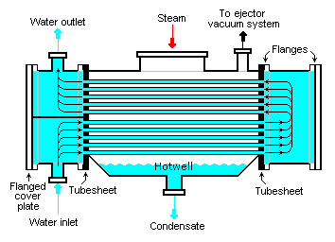
1. Introduction to Steam Condensers Cont…
Disadvantages:
  Large, bulky, and expensive.
  Requires a separate circulating water system.
Figure 1: Surface Condenser, Mbeychok. (2007).
url: https://upload.wikimedia.org/wikipedia/commons/8/8b/Surface_Condenser.png

Slide 11
1. Introduction to Steam Condensers Cont…
Jet Condenser (Contact Condenser)
Exhaust steam and cooling water are brought into direct physical contact.
The cooling water is sprayed into the steam, causing instantaneous condensation.
There are two types of Jet condensers:
  Direct jet condenser: Steam is directly sprayed into cold water.
  Ejector condenser: Uses a vacuum pump to assist condensation.
Advantages:
  Simpler construction and lower cost.
  Compact design.
  High condensing efficiency due to direct contact.

Slide 12
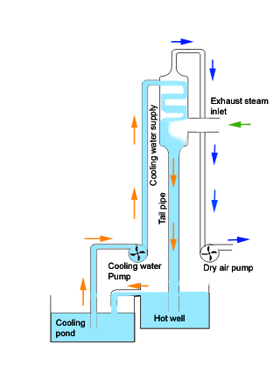
1. Introduction to Steam Condensers Cont…
The disadvantage of jet condenser is it contaminates condensate and cannot be reused directly as feedwater.
It is applied for small-scale plants or older installations where water quality is less critical.
Figure 2: Jet Condenser, Electrical4U, (2012)
url: https://www.electrical4u.com/images/high-level-jet-condenser.gif

Slide 13
1. Introduction to Steam Condensers Cont…
Air-Cooled Condenser
Uses ambient air as the cooling medium instead of water.
Exhaust steam flows through finned tubes, and large fans force air over the tubes to remove the latent heat.
Steam is condensed by air flowing over finned tubes instead of water, i.e., no water consumption for cooling.
Advantages:
  Ideal for locations with water scarcity.
  Eliminates the need for large water sources and water
  treatment plants.

Slide 14
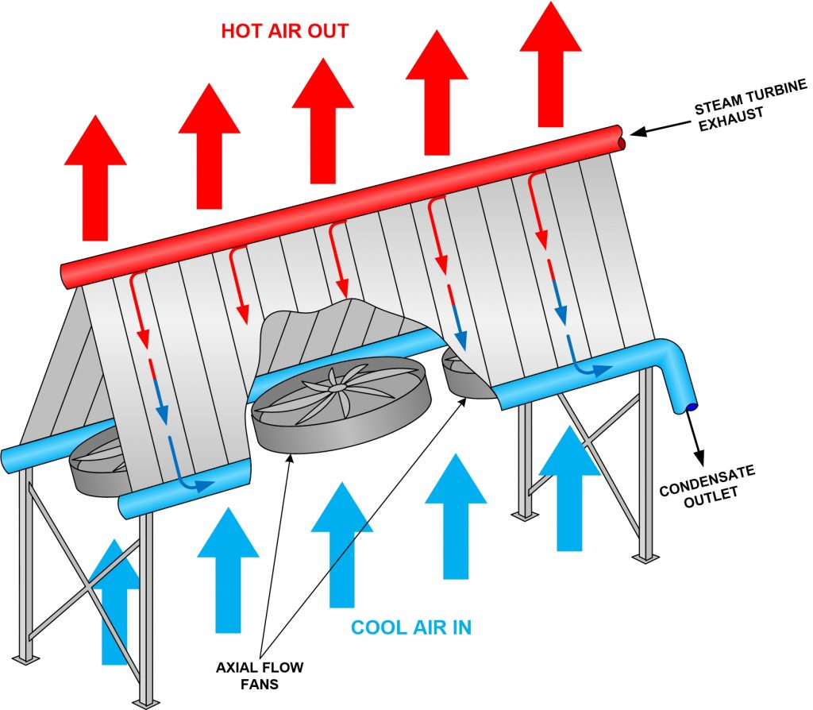
1. Introduction to Steam Condensers Cont…
Disadvantages:
  Larger size and higher capital cost.
  Lower efficiency, especially in hot ambient conditions, leading to higher back-pressure and reduced plant output.
Its application areas are in nuclear power plants and desert locations.
Figure 3: Air-Cooled Condenser, Filar, A. (2020),
url: https://www.fossilconsulting.com/wp-content/uploads/2020/10/ACC-Markup-2-1024x894-1.jpeg

Slide 15
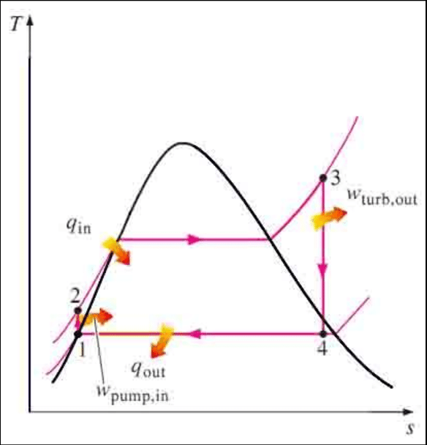
1. Introduction to Steam Condensers Cont…
The condenser's role is not to add energy but to enable a much larger energy extraction in the turbine.
Let's analyze the simplified Temperature-Entropy (T-S) diagram below:
Process 3-4: Turbine Expansion - Steam expands isentropically (ideally) from high pressure/temperature to low pressure.
Process 4-1: Condensation - Exhaust steam is condensed at constant pressure and temperature back into liquid.
Figure 4: T-s diagram of a Rankine Cycle, Alhwayzee, M., Kadhim, H. J., & Rashid, F. L. (2021).
url: https://www.researchgate.net/publication/336647595/figure/fig1/AS:815342993547265@1571404326643/deal-Rankine-Cycle.png

Slide 16
1. Introduction to Steam Condensers Cont…
Condensers play a crucial role in the overall efficiency of the Rankine cycle:
Lowers Turbine Exhaust Pressure (Back-Pressure)
  By condensing exhaust steam at a low pressure, the turbine can expand the steam more, converting more thermal energy into mechanical work.
Heat Recovery
  The condensate is returned to the boiler as feedwater, reducing the energy required to heat the water to steam.
  Minimizes fuel consumption and improves thermal efficiency.
Maintenance of Vacuum
  Condensers maintain a vacuum at the turbine exhaust,
  ensuring smooth operation and preventing air ingress
  into the system.

Slide 17
2. Condensate Feed-Water Systems
The condensate feed-water system forms a critical part of a steam power plant.
It is responsible for collecting the condensate (condensed steam) from the condenser and returning it to the boiler as feed-water after proper heating, purification, and pressurization [2].
This closed-loop system minimizes losses, conserves energy, and enhances the thermal efficiency of the power plant.
In summary, the functions of the condensate and feed-water systems are:
Condensate collection from the steam condenser.
Deaeration – removal of dissolved gases (oxygen, CO₂)
to prevent corrosion.

Slide 18
2. Condensate Feed-Water Systems Cont…
Feed-water heating using steam from various turbine extraction points.
Pressurization – supplying feed-water at high pressure to the boiler drum or economizer.
Water treatment and purification to maintain boiler water quality.
Energy recovery and conservation by utilizing waste heat in heaters.

Slide 19
2. Condensate Feed-Water Systems Cont…
Components of a Feed-Water System
The system is a series of components that work in sequence to move, heat, and purify the water.
A modern feed-water system typically includes the following major components:
Condensate Extraction Pump
  Located at the condenser outlet.
  Lifts the condensate from the low-pressure region of the
  condenser to the next stage (e.g., low-pressure heater).
  Must handle high temperatures and operate reliably under
  vacuum conditions.

Slide 20
2. Condensate Feed-Water Systems Cont…
Condensate Polishing Unit
  Removes impurities and dissolved solids that enter with condensate.
  Usually contains ion-exchange resins or filters to maintain high purity.
Low-Pressure (LP) Feedwater Heaters
  These are shell-and-tube heat exchangers that use steam extracted from the low-pressure stages of the steam turbine to heat the condensate.
  This extraction steam is called bleed steam or extraction steam.
  Increase water temperature gradually before it reaches the
  deaerator, improving cycle efficiency.

Slide 21
2. Condensate Feed-Water Systems Cont…
Deaerator
  The deaerator is the transition point between the low-pressure and high-pressure sections of the feed-water system.
  It removes dissolved oxygen and CO₂ from feed-water, preventing corrosion in the boiler and piping system.
  Usually combines mechanical and thermal methods using steam injection.
  Also serves as a feed-water storage tank and maintains
  steady pressure.

Slide 22
2. Condensate Feed-Water Systems Cont…
Feed-Water Pump (FWP)
  Draws deaerated water from the deaerator and delivers it at boiler pressure.
  Usually a multi-stage centrifugal pump.
  Must overcome the boiler drum pressure and line friction losses.
High-Pressure Heaters
  Receive feed-water from the feed pump and use high-pressure extraction steam from the turbine to raise its temperature close to saturation
  before entering the economizer.
  Improve overall thermal efficiency by utilizing waste steam
  energy.

Slide 23
2. Condensate Feed-Water Systems Cont…
Valves and Control Devices
  Regulate flow, maintain pressure balance, and ensure safe operation.
  Include check valves, pressure-reducing valves, control valves, and bypass valves for operational flexibility.

Slide 24
3. Circulating Water Systems for Condensers
In thermal power plants, refineries, chemical plants, and large HVAC systems for commercial buildings, the circulating water system (CWS) plays a vital role in transferring waste heat from the condenser to the environment [3].
The condenser converts turbine exhaust steam into water by cooling it with circulating water.
They manage heat dissipation efficiently, ensuring equipment longevity and operational stability.
The efficiency of this system directly affects turbine performance,
condenser vacuum, and overall plant efficiency.

Slide 25
3. Circulating Water Systems for Condensers Cont…
The fundamental principle of a CWS is:
A working fluid (e.g., steam in a turbine condenser) absorbs heat from a process and needs to be cooled and condensed to complete the cycle.
The Circulating Water System provides a cooler medium (water) to absorb this waste heat and dissipate it, ensuring the primary process operates efficiently and continuously [3].
The main functions of a CWS include:
Heat Rejection
  To remove low-grade waste heat from the condenser and
  discharge it to the cooling medium (water or air).

Slide 26
3. Circulating Water Systems for Condensers Cont…
Maintaining Process Temperature
  To control and maintain optimal operating temperatures for various equipment like heat exchangers, intercoolers, and reactors.
Recycling of Cooling Water (in closed systems)
  Allows reuse of water, minimizing consumption and reducing environmental impact.
Environmental Protection
  Designed to minimize thermal pollution and water wastage.

Slide 27
3. Circulating Water Systems for Condensers Cont…
Types of Circulating Water Systems
The circulating water system can be broadly classified into three types:
Once-Through System (Open-Cycle)
Water is drawn from a natural source (river, lake, or sea), circulated through the condenser, and discharged back to the source after absorbing heat.
The operation procedure is:
  Water is pumped from an intake structure.
  It passes through condenser tubes, cooling the steam.
  Warmed water is returned to the source.

Slide 28
3. Circulating Water Systems for Condensers Cont…
Closed-Loop System (Recirculating or Cooling Tower System)
The same water is recirculated repeatedly.
The heated water returning from the process is cooled in a cooling tower by evaporating a small portion of the water into the atmosphere.
The cooled water is then collected and pumped back to the process.
The operation procedure is:
  Hot water from the condenser goes to the cooling tower.
  Cooling tower releases heat to the atmosphere.
  Cooled water returns to the condense

Slide 29
3. Circulating Water Systems for Condensers Cont…
Hybrid / Wet-Surface Cooling System
It is a combination of once-through (open cycle) and closed-loop systems.
Often used in areas where the primary water source is too warm for efficient once-through cooling or during peak load conditions.
It may involve a smaller cooling tower to assist in heat rejection.
Design Considerations for Water Flow and Temperature Control
Proper design of the circulating water system ensures efficient
condenser cooling and minimal energy loss.

Slide 30

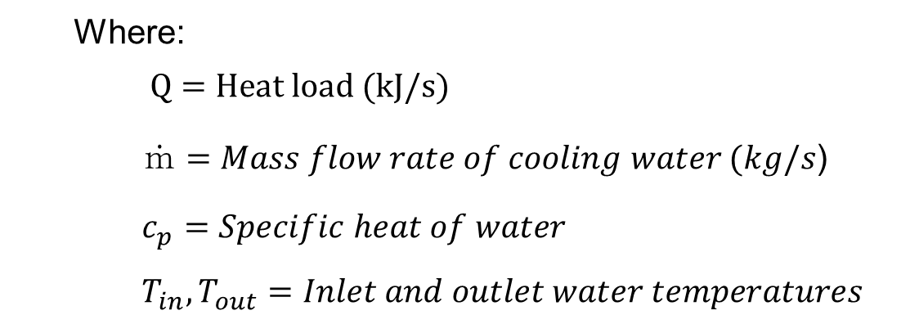
3. Circulating Water Systems for Condensers Cont…
The key design parameters include:
Water Flow Rate Determination
The objective is to provide sufficient flow rate to keep condenser pressure low while minimizing pumping power.
The rate of heat removal from the condenser is given by:
$${Q=\dot{m}c}_{p}(T_{out}−T_{in})$$
Where:
$$Q=Heat load (kJ/s)$$
$\dot{ｍ}=Mass flow rate of cooling water (kg/s$)
$c_{p}=Specific heat of water$
$T_{in},T_{out}=Inlet and outlet water temperatures$

Slide 31
3. Circulating Water Systems for Condensers Cont…
Temperature Control
  Inlet Temperature: Should be as low as possible for good vacuum (typically 25–30°C).
  Outlet Temperature: Must be below environmental discharge limits (usually < 40°C).
  Flow Regulation: Achieved through valves, variable-speed pumps, or bypass control.
Pump Selection and Head Losses
  Use axial-flow or mixed-flow pumps for large flow and low
  head applications.
  Consider pipe friction losses, elevation, and condenser
  pressure drop when determining total dynamic head.

Slide 32
3. Circulating Water Systems for Condensers Cont…
Cooling Tower Sizing: Factors affecting cooling tower design:
  Heat load
  Wet-bulb temperature of air
  Desired range and approach
  Type of tower (natural or mechanical draft)
  Site conditions (humidity, altitude)
Energy Efficiency Considerations
  Optimize pump efficiency (typically 80–85%).
  Minimize pipe friction by proper sizing and smooth internal
  surfaces.
  Use variable frequency drives (VFDs) to match flow with
  load demand.

Slide 33
3. Circulating Water Systems for Condensers Cont…
Materials and Corrosion Issues
Circulating water systems operate in a corrosive environment due to the presence of dissolved oxygen, salts, suspended solids, and biological growth.
Selecting appropriate materials and controlling corrosion are critical for reliability and long service life.
The major corrosion mechanisms include:
Galvanic Corrosion - Occurs when dissimilar metals are in
contact in water.
Pitting Corrosion - Localized attack forming small pits, often
due to chlorides.
Erosion-Corrosion - Accelerated wear due to high water velocity
or suspended solids.

Slide 34
3. Circulating Water Systems for Condensers Cont…
The common materials used are [4]:
Component | Typical Material | Properties
Condenser Tubes | Copper alloys (Admiralty brass, Cu-Ni), stainless steel, titanium | High thermal conductivity and corrosion resistance
Piping | Carbon steel, ductile iron, FRP (fiberglass-reinforced plastic) | Strength, cost-effective, easy fabrication
Pumps & Valves | Cast iron or stainless steel | Corrosion and erosion resistance
Cooling Tower Structure | Reinforced concrete, FRP, treated wood | Durability in humid and wet environments

Slide 35
4. Integration of Steam Condensers with Feed-Water and Circulating Systems
In a steam power plant, several systems work together to convert heat energy into mechanical and then electrical energy.
Among them, the steam condenser, feed-water system, and circulating water system form the heat rejection and recovery section of the plant.
Their integration ensures that:
  Exhaust steam is condensed effectively,
  Condensate is recovered and purified as feed-water, and
  Cooling water circulates continuously to remove the rejected
  heat.

Slide 36
4. Integration of Steam Condensers with Feed-Water and Circulating Systems Cont…
The efficient integration of these three systems is paramount for achieving:
  High cycle efficiency
  Maximum turbine power output
  Plant reliability and availability
They form the back end of the Rankine cycle:
  Exhaust Steam from Turbine → Condenser: Steam releases latent heat and condenses into water.
  Condensate → Feed-Water System: Condensate is pumped,
  purified, and heated before entering the boiler again.
  Circulating Water → Condenser: Circulating water absorbs
  rejected heat and carries it to a cooling tower or discharge.

Slide 37
4. Integration of Steam Condensers with Feed-Water and Circulating Systems Cont…
The process integration steps are:
Condensation
  Turbine exhaust steam enters the condenser and condenses on the outer surface of cooling tubes.
  Cooling water inside tubes absorbs the heat.
Condensate Recovery
  Condensed water collects in the hotwell at the bottom of the
  condenser.
  Condensate extraction pump transfers it to the
  feed-water system.

Slide 38
4. Integration of Steam Condensers with Feed-Water and Circulating Systems Cont…
Feed-Water Heating and Return:
  The condensate passes through low-pressure heaters and deaerator to remove dissolved gases.
  Then it is pressurized by the Boiler Feed Pump and further heated in high-pressure heaters before returning to the boiler.
Cooling Water Circulation:
  Circulating pumps draw water from a cooling source (river or cooling tower basin).
  Water passes through condenser tubes, absorbing heat, and returns to the source or cooling tower for reuse.

Slide 39
4. Integration of Steam Condensers with Feed-Water and Circulating Systems Cont…
Role of Integration in Efficiency Improvement
Enhanced Turbine Efficiency:
  Maintaining a low condenser pressure through effective cooling increases the turbine output.
Energy Recovery through Feed-Water Heating:
  Using recovered condensate and regenerative feed-water heating reduces fuel consumption in the boiler.
Reduced Water Consumption:
  Closed-loop circulation and condensate reuse minimize
  makeup water requirements.

Slide 40
4. Integration of Steam Condensers with Feed-Water and Circulating Systems Cont…
Lower Environmental Impact:
  Reduced thermal discharge to natural water bodies and improved resource utilization.
Stable Operation:
  Properly integrated systems provide steady condenser temperature and pressure control, improving reliability.

Slide 41
5. Maintenance, Performance Monitoring, and Optimization Cont…
A perfectly designed system can fail without proper operation and maintenance.
The steam condenser, circulating water system, and feed-water system operate continuously under high load and harsh environmental conditions [5].
Efficient operation of these systems is vital for maintaining low condenser pressure, high turbine efficiency, and reliable power generation.
However, operational issues such as air leakage, scaling, corrosion, and mechanical failures can degrade performance.
Thus, systematic operation, maintenance, and troubleshooting
are essential for reliability and long service life.

Slide 42
5. Maintenance, Performance Monitoring, and Optimization Cont…
Common Operational Problems
Air Leakage
It is entry of non-condensable gases (mainly air) into the condenser, reducing vacuum quality and heat transfer efficiency.
The remedies are:
  Tighten or replace gaskets and seals.
  Regular vacuum testing.
  Maintain air ejectors or vacuum pumps properly.
  Conduct periodic leak detection tests.

Slide 43
5. Maintenance, Performance Monitoring, and Optimization Cont…
Scaling and Fouling
It is a deposition of impurities (salts, suspended solids, biological matter) on tube surfaces, impeding heat transfer.
The prevention and removal methods are:
  Chemical treatment (phosphate, lime softening, dispersants).
  Mechanical cleaning (brushing, sponge-ball system).
  Maintaining water velocity within design range.
  Biocide dosing for biological fouling.

Slide 44
5. Maintenance, Performance Monitoring, and Optimization Cont…
Corrosion
Gradual deterioration of metal surfaces due to electrochemical reactions with water, oxygen, or salts.
The prevention methods include:
  Proper material selection (Cu-Ni alloys, stainless steel, titanium).
  Cathodic protection using sacrificial anodes.
  Water chemistry control (pH, oxygen scavengers).
  Use of protective coatings

Slide 45
5. Maintenance, Performance Monitoring, and Optimization Cont…
Maintenance Practices
Preventive Maintenance
  Performed at regular intervals to prevent failures and ensure reliability.
Predictive Maintenance
  Based on condition monitoring to predict failures before they occur.
Corrective Maintenance
  Performed after failure or during scheduled overhaul.

Slide 46
5. Maintenance, Performance Monitoring, and Optimization Cont…
Performance Test Procedure
Record inlet and outlet temperatures of cooling water.
Measure vacuum pressure in the condenser.
Determine condensate temperature and flow rate.
Calculate heat rejected and overall heat transfer coefficient.
Compare with design values to assess condition.

Slide 47
Summary
Steam condensers convert exhaust steam from turbines back into water under vacuum, improving thermal efficiency and enabling condensate reuse.
The condenser is the link between two essential auxiliary systems: the Circulating Water System and the Feed-Water System.
Circulating systems (once-through or closed-loop) supply cooling water to the condenser, maintaining low exhaust pressure and efficient condensation through temperature control.
The condenser, feed-water, and circulating water systems operate as a closed thermal loop—recovering heat, conserving energy, and ensuring stable turbine
and boiler performance.
Regular inspection, cleaning, and performance testing help prevent air
leakage, scaling, and corrosion, ensuring reliable operation, reduced
losses, and sustained power plant efficiency.

Slide 48
References
[1]. Power Plant Engineering, R.K. Rajput, 3rd Edition, 2011.
[2]. Condensate, Boiler Feed, and Deaerator Systems, Rishel, James B. In HVAC Pump Handbook, 2nd ed., 539–558, 2006, New York: McGraw-Hill.
[3]. An Introduction to Fuel, Ash, and Water Systems for Steam Electric Power Plants. , Guyer, J. CreateSpace, 2017.
[4]. Materials selection for fossil and nuclear power plants (Chapter on Condenser and Feedwater Heater Tubing), R. B. Dooley, R. C. Swanekamp, Elsevier, 2007.
[5]. Liu, Y., Chu, M., Ye, Q., Li, J., & Han, D. (2025). Optimization of an industrial circulating water system based on process simulation and machine learning. Processes, 13(2), 332. https://doi.org/10.3390/pr13020332.

Slide 49
Thank you !

