Slide 1
Power Plant Engineering
Lecture 10
Internal Combustion Power Plants
Lecturer: Dr. Melaku Desta

Slide 2
Lecture learning outcomes:
At the end of this lecture, you will be able to:
Explain the fundamental operating principle of a diesel engine, distinguishing the Diesel cycle from the Otto cycle and identifying the key factor of compression ignition.
Describe the main components and energy conversion process in internal combustion engine power plants.
Analyze how supercharging and turbocharging improve engine performance and efficiency.
Identify the layout and functions of major auxiliary systems in
diesel power plants.
Evaluate different methods used to enhance the efficiency
and performance of gas turbine cycles.

Slide 3
Content
Principles and Operation of Diesel Engines
Internal Combustion Engine Power Plants
Supercharging and Turbocharging in Diesel Engines
Diesel Engine Power Plant Layout and Auxiliary Systems
Modifications and Enhancements of Gas Turbine Cycles
Summary
References

Slide 4
1. Principles and Operation of Diesel Engines
The core principle that distinguishes a diesel engine from a gasoline engine is Compression Ignition (CI).
Gasoline Engine (Spark Ignition - SI): A mixture of air and fuel is drawn into the cylinder, compressed, and then ignited by a spark plug.
The basic principle of a diesel engine is compression ignition.
  Only air is compressed in the cylinder.
  The temperature of the air rises due to compression.
  Fuel is injected at the end of the compression stroke.
  The fuel self-ignites due to the high temperature.
  The resulting combustion forces the piston downward,
  producing mechanical work.

Slide 5
1. Principles and Operation of Diesel Engines Cont…
Diesel engines are widely used in power plants, heavy vehicles, ships, locomotives, and industrial machinery due to their high efficiency and durability [1].
The Working Cycle: Four-Stroke vs. Two-Stroke
Four-stroke means the cycle is completed in four distinct piston movements (two up, two down) over two revolutions of the crankshaft.
Two-stroke means the cycle is completed in just two piston movements (one up, one down) over a single revolution of the crankshaft.
Two-stroke is a more powerful but less efficient and cleaner cycle.

Slide 6
1. Principles and Operation of Diesel Engines Cont…
For four-stroke cycle, one power stroke is produced for every two revolutions of the crankshaft.
Stroke | Description | Valve Operation
1. Suction (Intake) | The piston moves downward, drawing fresh air into the cylinder. | Inlet valve open, exhaust valve closed.
2. Compression | The piston moves upward, compressing the air to a high pressure (30–40 bar) and temperature (500–700°C). | Both valves closed.
3. Power (Expansion) | Fuel is injected near the end of the compression stroke. The high temperature of air causes auto-ignition and rapid combustion, forcing the piston down. | Both valves closed.
4. Exhaust | The piston moves upward, expelling burnt gases through the exhaust valve. | Exhaust valve open, inlet valve closed.

Slide 7
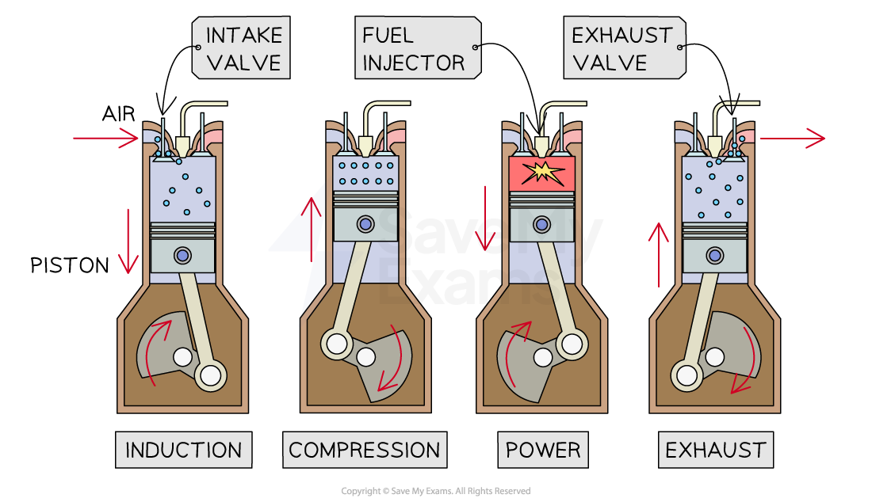
1. Principles and Operation of Diesel Engines Cont…
Principles of four-stroke diesel cycle
Figure 1: Working principle of Air Standard Diesel Cycle, Engineering Physics: Thermodynamics & Engines — Diesel Engine Cycle, Ashika. (2024)
url: https://cdn.savemyexams.com/uploads/2023/10/11-2-5-diesel-engine.png

Slide 8
1. Principles and Operation of Diesel Engines Cont…
Two-stroke cycle
The advantage of two-stroke diesel engine is its simpler
design, lighter, and produces power every revolution.
However, it has lower efficiency and more wear due to higher
operating frequency.
Stroke | Description
1. Compression and Fuel Injection | The upward stroke compresses air; fuel is injected and ignited. Combustion drives the piston down.
2. Power and Exhaust/Scavenging | As the piston nears bottom dead center, exhaust ports open to expel gases and inlet ports allow fresh air to enter for the next cycle.

Slide 9
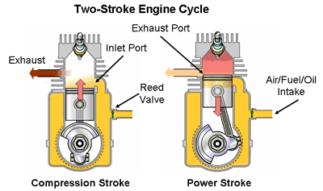
1. Principles and Operation of Diesel Engines Cont…
Principles of four-stroke diesel cycle
Figure 2: Working Principle of Two Stroke Cycle Diesel Engines, BrainKart, (2016)
url: https://encrypted-tbn0.gstatic.com/images?q=tbn:ANd9GcRIhYN8bieVYRlJWYp05Ss3phiBRWnpsjnWGw&s

Slide 10
1. Principles and Operation of Diesel Engines Cont…
Fuel Injection and Combustion Process
This is the heart of the diesel engine's operation and efficiency.
The objective is to atomize the fuel into a fine mist and distribute it evenly throughout the high-temperature air in the combustion chamber for complete and efficient combustion.
Fuel Injection System
The fuel injection system controls:
  Timing - when fuel is injected
  Quantity - how much fuel is injected
  Atomization - breaking fuel into fine droplets
  Distribution - even spread of fuel in air

Slide 11
1. Principles and Operation of Diesel Engines Cont…
Combustion Process in Diesel Engines
Ignition delay period: Time between the start of injection and start of combustion.
Rapid combustion: Accumulated fuel burns rapidly, increasing pressure sharply.
Controlled combustion: Injection continues and pressure remains fairly constant.
After-burning: Remaining fuel burns as the piston moves downward.
Efficient combustion depends on:
  Proper air-fuel mixing
  Adequate fuel atomization
  Correct injection timing
  Proper compression ratio

Slide 12
1. Principles and Operation of Diesel Engines Cont…
Performance Parameters and Efficiency
Performance parameters provide a quantitative assessment of how efficiently and effectively a diesel engine converts chemical energy in the fuel into useful mechanical work [2].
Understanding these parameters helps in:
  Evaluating engine condition and performance.
  Comparing different engines.
  Identifying opportunities for improving fuel economy
  and efficiency.

Slide 13
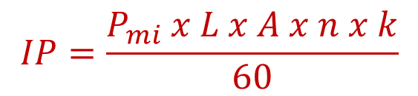
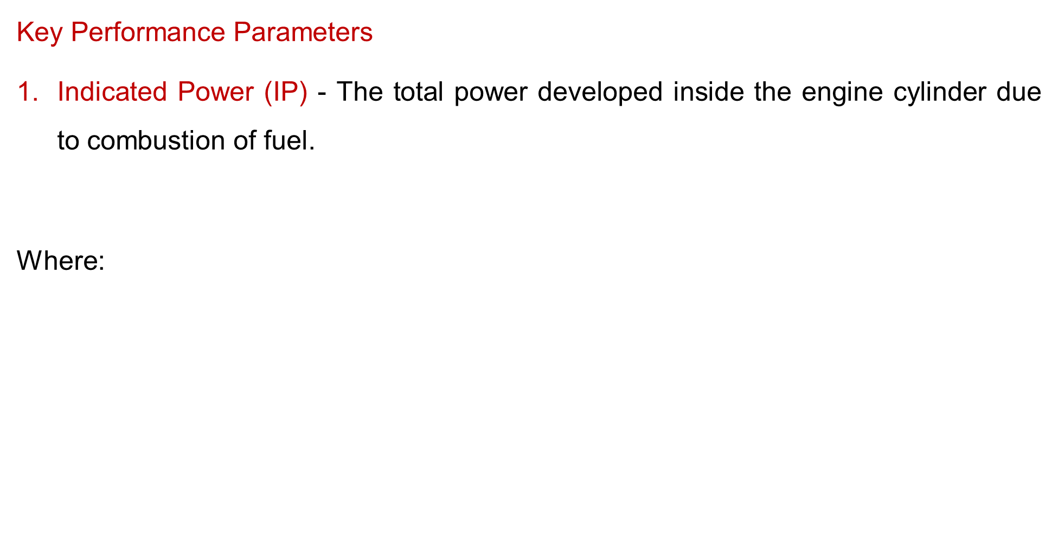
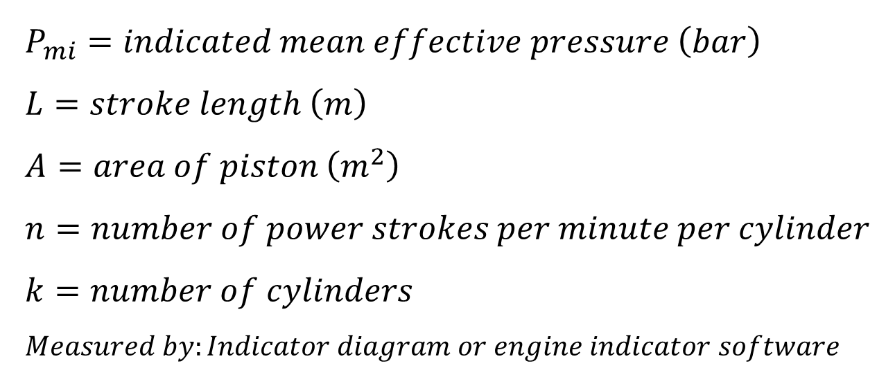
1. Principles and Operation of Diesel Engines Cont…
Key Performance Parameters
Indicated Power (IP) - The total power developed inside the engine cylinder due to combustion of fuel.
Where:
$$IP=\frac{P_{mi} x L x A x n x k}{60}$$
$$P_{mi}=indicated mean effective pressure \left(bar\right) \\ L=stroke length \left(m\right) \\ A=area of piston \left(m^{2}\right) \\ n=number of power strokes per minute per cylinder \\ k=number of cylinders \\ Measured by:Indicator diagram or engine indicator software$$

Slide 14


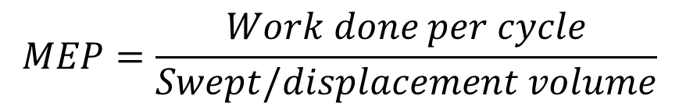

1. Principles and Operation of Diesel Engines Cont…
Brake Power (BP)
The useful power available at the crankshaft output.
Where:
Mean Effective Pressure (MEP)
The hypothetical constant pressure that, if it acted on the piston
during the power stroke, would produce the same work as
actually done.
$$BP=2πNT/60$$
$$N=Engine speed \left(rpm\right)$$
$$T=torque (N.m)$$
$$MEP=\frac{Work done per cycle}{Swept/displacement volume}$$

Slide 15
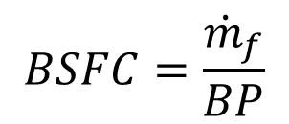
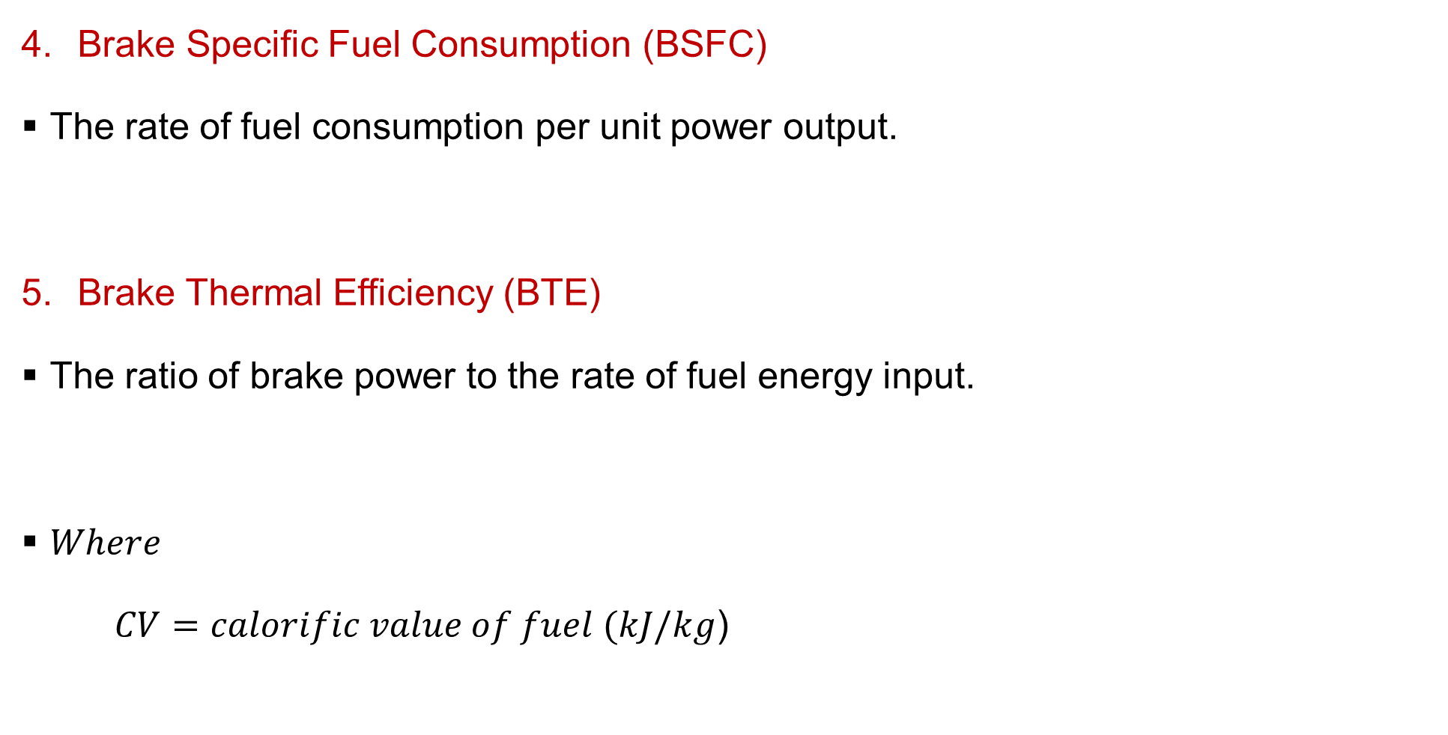
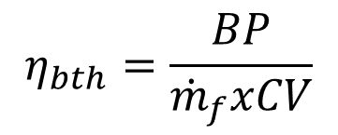
1. Principles and Operation of Diesel Engines Cont…
Brake Specific Fuel Consumption (BSFC)
The rate of fuel consumption per unit power output.
Brake Thermal Efficiency (BTE)
The ratio of brake power to the rate of fuel energy input.
$Where$
$CV=calorific value of fuel (kJ/kg$)
$$BSFC=\frac{{\dot{m}}_{f}}{BP}$$
$$η_{bth}=\frac{BP}{{\dot{m}}_{f}xCV}$$

Slide 16
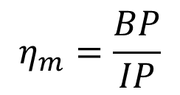
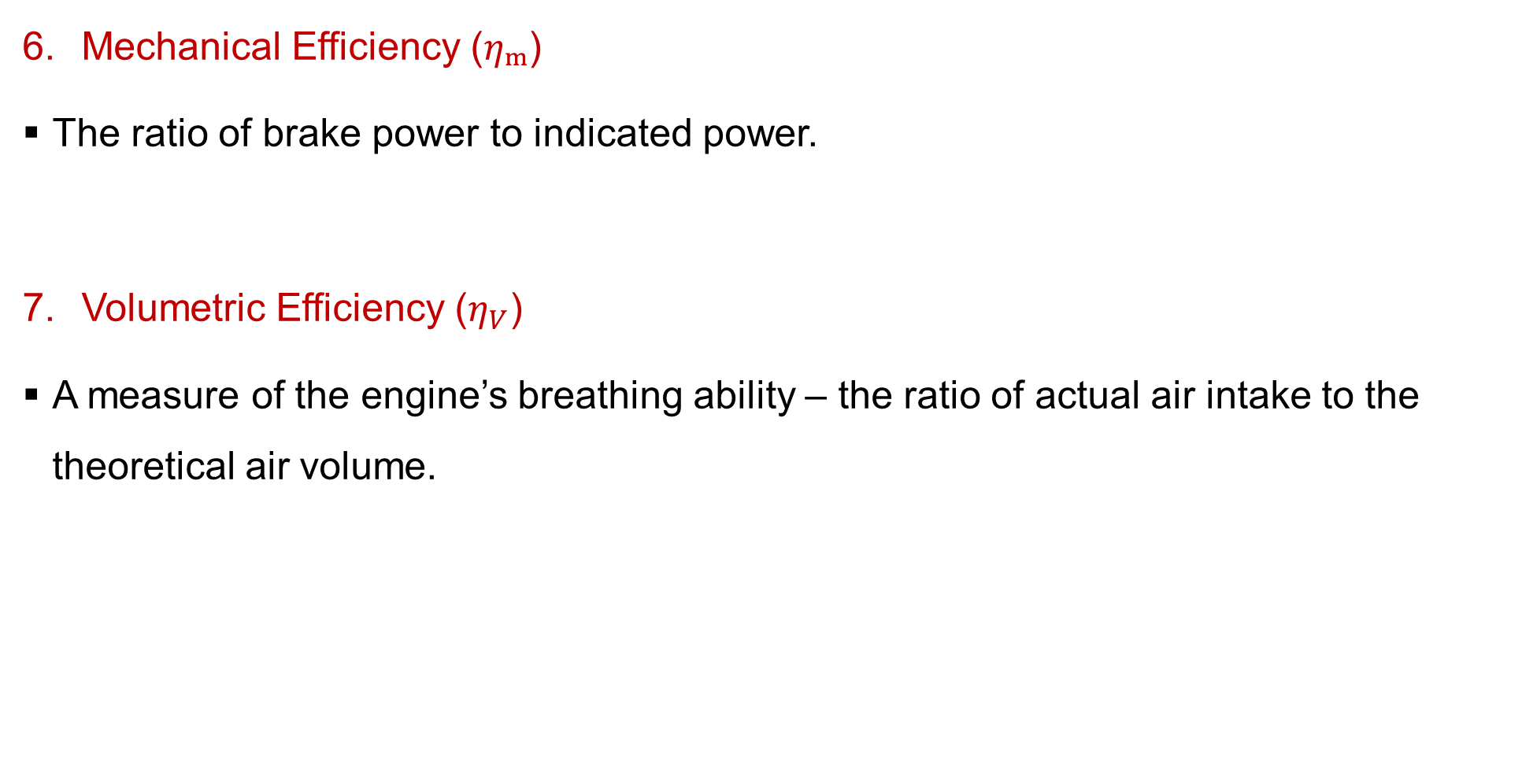
1. Principles and Operation of Diesel Engines Cont…
Mechanical Efficiency ($ηₘ$)
The ratio of brake power to indicated power.
Volumetric Efficiency ($η_{V}$)
A measure of the engine’s breathing ability – the ratio of actual air intake to the theoretical air volume.
$$η_{m}=\frac{BP}{IP}$$
$$η_{v}=\frac{Actual mass of air inducted}{Theoretical mass of air that could fill the cylinder at ambient conditions}$$

Slide 17
1. Principles and Operation of Diesel Engines Cont…
Factors Affecting Diesel Engine Efficiency
  Design parameters: Compression ratio, combustion chamber shape.
  Operating conditions: Speed, load, and fuel quality.
  Mechanical losses: Friction, pumping, and auxiliary loads.
  Heat losses: Incomplete combustion, exhaust and cooling system losses.
  Supercharging/Turbocharging: Improves volumetric and thermal efficiency.
Methods of Improving Efficiency
  Use of turbochargers and intercoolers.
  Optimized injection timing and fuel atomization.
  Regular maintenance to reduce friction and wear.
  Exhaust heat recovery (e.g., waste heat boilers).
  Advanced materials for reduced heat losses.

Slide 18
2. Internal Combustion Engine Power Plants
An Internal Combustion Engine Power Plant is an electricity generation facility that uses one or more internal combustion engines as its prime mover [3].
Unlike external combustion systems (like steam plants), combustion occurs inside the engine cylinder.
Applications:
Standby and emergency power supply
Peak load stations
Remote and isolated power generation
Marine propulsion and transportation systems

Slide 19
2. Internal Combustion Engine Power Plants Cont…
Principle of Operation
The working principle of an IC engine power plant is based on the conversion of heat energy from fuel combustion into mechanical work through the expansion of gases in the cylinder [3].
Basic working steps:
Air Intake – Air is drawn into the cylinder.
Compression – Air is compressed to high pressure and temperature.
Combustion (Power Stroke) – Fuel is injected and ignited, producing high-temperature gases.
Expansion – The gases expand, pushing the piston and producing
mechanical work.
5. Exhaust – Spent gases are expelled from the cylinder.

Slide 20
2. Internal Combustion Engine Power Plants Cont…
Main Components of an IC Engine Power Plant
A full-scale ICE power plant is more than just an engine. It consists of several critical subsystems:
Engine (prime mover):
  Converts thermal energy to mechanical energy via piston movement.
  Usually a diesel engine for high efficiency and reliability.
Air Intake and Exhaust Systems:
  Air filter removes dust and impurities.
  Exhaust silencer reduces noise and releases exhaust gases.

Slide 21
2. Internal Combustion Engine Power Plants Cont…
Fuel Supply System:
  Includes fuel tank, fuel pump, filters, and injectors.
  Supplies fuel at required pressure and rate for combustion.
Cooling System:
  Removes excess heat to prevent overheating.
  Uses water or air as coolant.
Lubrication System
  Reduces friction between moving parts and minimizes wear.
  Includes oil pump, filters, and lubricating oil cooler.

Slide 22
2. Internal Combustion Engine Power Plants Cont…
Starting System
  Starts the engine using electric motors or compressed air.
Governing System
  Controls engine speed and maintains steady power output.
Alternator or Generator
  Converts mechanical energy from the engine into electrical energy.
Control and Protection System
  Monitors operating parameters (temperature, pressure,
  speed).
  Includes safety devices for automatic shutdown in case
  of faults.

Slide 23
2. Internal Combustion Engine Power Plants Cont…
Types of Internal Combustion Engine Power Plants
Type | Description | Typical Use
Diesel Power Plant | Uses compression ignition (CI) engine; most common type. | Standby, base-load, and marine stations
Gas Engine Power Plant | Uses natural gas as fuel with spark ignition. | Cogeneration and small-scale distributed power
Dual-Fuel Engine Power Plant | Operates on both gas and liquid fuel. | Flexible and fuel-efficient operations

Slide 24
2. Internal Combustion Engine Power Plants Cont…
Advantages of IC Engine Power Plants
  Quick starting and easy installation
  High efficiency at part loads
  Lower water requirement (compared to steam plants)
  Compact and portable design
  Suitable for decentralized power generation
Disadvantages
  High running and maintenance costs
  Limited capacity (typically below 50 MW)
  Higher noise and vibration levels
  Shorter life compared to steam or hydro plants
  Fuel supply (especially diesel) may be expensive

Slide 25
3. Supercharging and Turbocharging in Diesel Engines
Diesel engines are widely used in power generation, transport, and industrial applications due to their high efficiency and durability.
However, their power output is limited by the amount of air available for combustion.
To increase the engine’s performance, supercharging and turbocharging are used to force more air into the combustion chamber, improving power, efficiency, and overall performance [4].
Why Supercharging and Turbocharging?
Increase in power output: More air allows more fuel to burn,
thus increasing the engine’s power.
Improved volumetric efficiency: Forced induction helps fill
cylinders more effectively.

Slide 26
3. Supercharging and Turbocharging in Diesel Engines Cont…
Better combustion: Sufficient air ensures complete combustion, reducing smoke and unburned fuel.
Altitude compensation: Helps engines maintain power at high altitudes where air density is lower.
Reduction in engine size: Higher power from smaller engines results in weight and space savings.
Supercharging
Supercharging is the process of increasing the pressure of the
intake air above atmospheric pressure using a mechanically
driven compressor connected to the engine crankshaft.

Slide 27
3. Supercharging and Turbocharging in Diesel Engines Cont…
Types of Superchargers
Roots Supercharger
  Uses two meshing lobes to pump air.
  Provides high boost at low speeds.
  Common in racing and heavy-duty applications.
Centrifugal Supercharger
  Uses an impeller to accelerate air outward.
  Compact, efficient at high engine speeds.
Twin-Screw Supercharger
  Uses intermeshing helical rotors.
  Provides smoother and efficient compression than Roots type.

Slide 28
3. Supercharging and Turbocharging in Diesel Engines Cont…
Turbocharging
Turbocharging uses a turbine driven by exhaust gases to power a compressor that forces air into the engine cylinders.
It recovers energy from the exhaust that would otherwise be wasted.
Types of Turbochargers
Single Turbo: Simple and compact.
Twin Turbo: Two turbos—one small and one large—to cover a wide speed range.
3. Variable Geometry Turbo (VGT): Adjustable vanes optimize boost
pressure at all speeds.
4. Sequential Turbocharging: Smaller turbo operates at low speed,
larger one at high speed.

Slide 29
4. Diesel Engine Power Plant Layout and Auxiliary Systems
A typical diesel power plant consists of main and auxiliary components systematically arranged to ensure smooth operation, efficient power generation, and ease of maintenance.
The following are major and auxiliary units in the layout:
Air Intake System
  Supplies clean, filtered air for combustion.
  Includes air filters, turbochargers or superchargers, and intake
  manifolds.
  Air may be cooled by intercoolers after compression to
  improve density and combustion efficiency.

Slide 30
4. Diesel Engine Power Plant Layout and Auxiliary Systems Cont…
Fuel Supply System
Stores and delivers fuel at the required pressure and quantity.
Major components:
  Fuel storage tanks (main and day tanks)
  Fuel transfer pump
  Fuel filter and strainers
  Fuel injection pump and injectors
Cooling System
Removes excess heat from the engine to maintain optimal
operating temperature.
The types of cooling system are air cooling (for small engines)
and water cooling (for medium and large engines).

Slide 31
4. Diesel Engine Power Plant Layout and Auxiliary Systems Cont…
Components of cooling system:
  Radiator or heat exchanger
  Coolant pump
  Cooling tower (in large plants)
  Thermostat and expansion tank
Lubrication System
Reduces friction between moving parts, prevents wear, and removes heat.
Components of a lubrication system:
  Oil pump
  Oil filter
  Oil cooler
  Oil sump or reservoir
Lubrication methods: Splash system, pressure system, or combination.

Slide 32
4. Diesel Engine Power Plant Layout and Auxiliary Systems Cont…
Exhaust System
Expels combustion gases safely and reduces noise and emissions.
Components:
  Exhaust manifold
  Silencer or muffler
  Exhaust gas heat recovery system (optional) for heating or turbocharging.
Starting System
Provides the initial rotation for the engine crankshaft.
The methods of a starting system are:
  Electric starter motor (battery operated)
  Compressed air starting system (for large engines)

Slide 33
4. Diesel Engine Power Plant Layout and Auxiliary Systems Cont…
Governing and Control System
Maintains constant engine speed and load sharing.
Includes:
  Speed governor
  Load controller
  Automatic voltage regulator (AVR) for generator output control.
Generator (Alternator)
Converts mechanical energy into electrical energy.
Typically a synchronous alternator directly coupled to the
diesel engine.

Slide 34
4. Diesel Engine Power Plant Layout and Auxiliary Systems Cont…
Switchgear and Control Panel
  Manages power distribution and protection.
  Includes:
    Circuit breakers
    Meters and indicators
    Control relays and protection devices
Exhaust Gas Treatment and Emission Control (in modern plants)
  Systems such as diesel particulate filters (DPF), selective
  catalytic reduction (SCR), and oxidation catalysts are added
  for emission compliance.

Slide 35
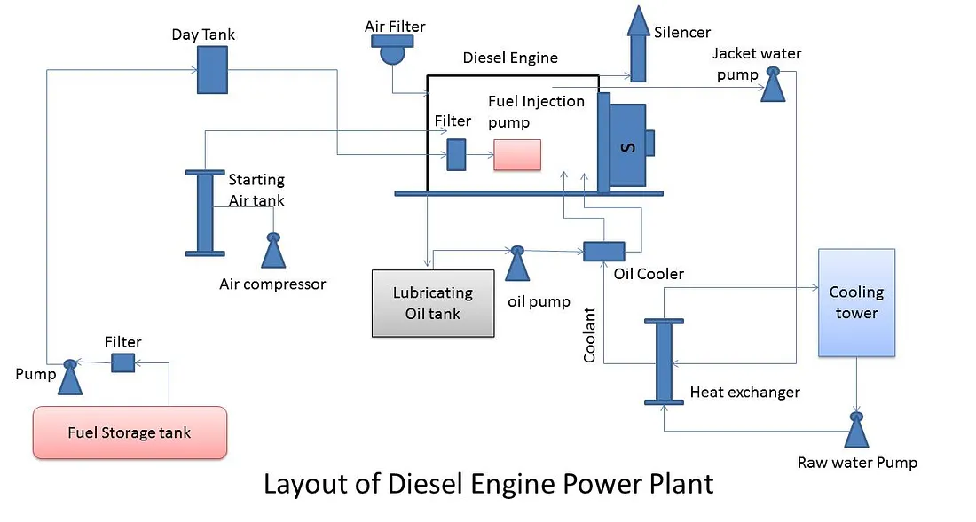
4. Diesel Engine Power Plant Layout and Auxiliary Systems Cont…
Diesel Power Plant Layout and Systems
Figure 3: Layout of Diesel Power Plant. Soetrisno, Y. A. A., Winardi, B. W., & Sinuraya, E. W. (2022).
url:https://miro.medium.com/v2/resize:fit:1100/format:webp/1*EZpwm1IYAarjqlEeDplk0g.jpeg

Slide 36
5. Modifications and Enhancements of Gas Turbine Cycles
Gas turbines are widely used in power generation because of their compactness, high power-to-weight ratio, and rapid start-up [5].
However, their efficiency is limited by the simple Brayton cycle’s temperature and pressure constraints.
It has fundamental limitations in practical power generation:
  High specific fuel consumption: Lower thermal efficiency compared to advanced steam plants at low pressure ratios.
  Significant power drop with temperature: Output and
  efficiency are highly sensitive to ambient air temperature.
  Poor part-load efficiency: Performance degrades rapidly
  when operating below the design capacity.

Slide 37
5. Modifications and Enhancements of Gas Turbine Cycles Cont…
To improve performance, several modifications and enhancements are applied to the basic gas turbine cycle, aiming to increase thermal efficiency, power output, or both.
The primary goal of modifications is to increase the net work output and the thermal efficiency of the cycle.
This is achieved by:
  Increasing the average temperature of heat addition.
  Decreasing the average temperature of heat rejection.
  Utilizing the exhaust gas energy, which is otherwise wasted.

Slide 38
5. Modifications and Enhancements of Gas Turbine Cycles Cont…
Key Modifications & Enhancements of Gas Turbine Cycles
Intercooling
Compressing air in multiple stages with cooling between stages reduces compressor work.
Intercooling decreases compressor work input, increases net work output, but slightly reduces thermal efficiency unless combined with regeneration.
Reheating
Expanding air in multiple turbine stages with reheating between
stages increases turbine work and specific power output.

Slide 39
5. Modifications and Enhancements of Gas Turbine Cycles Cont…
Regeneration (Recuperation)
Heat from the hot exhaust gases is used to preheat compressed air before combustion.
A heat exchanger (regenerator or recuperator) transfers heat from turbine exhaust to compressor outlet air.
It reduces fuel consumption (less heat required in the combustor)
and increases thermal efficiency, especially at low pressure ratios.

Slide 40
5. Modifications and Enhancements of Gas Turbine Cycles Cont…
Combined Cycle
Waste heat from the gas turbine exhaust is used to generate steam for a steam turbine (Rankine cycle).
The arrangement is:
Gas turbine → Heat Recovery Steam Generator (HRSG) → Steam turbine → Generator.
Increases overall plant efficiency, efficient utilization of exhaust
heat but higher capital cost and complexity.

Slide 41
5. Modifications and Enhancements of Gas Turbine Cycles Cont…
Cogeneration (Combined Heat and Power)
Exhaust heat is used directly for industrial heating, process steam, or district heating rather than generating additional power.
It increases overall energy utilization efficiency and reduces fuel cost and environmental impact.
6. Advanced Enhancements
Intercooled–Regenerative–Reheat Cycle (IRR Cycle)
  Combines intercooling, reheating, and regeneration.
  Provides high efficiency and power but complex and costly.

Slide 42
5. Modifications and Enhancements of Gas Turbine Cycles Cont…
Water or Steam Injection
  Injects water/steam into the combustor or compressor to increase mass flow and reduce NOx emissions.
  Enhances power output but reduces turbine life.
Chemical Recuperation
  Uses exhaust heat for endothermic reactions (e.g., steam reforming of methane).
  Increases efficiency and produces hydrogen-rich fuel.

Slide 43
Summary
Diesel engines operate on the compression ignition principle, converting chemical energy of fuel into mechanical work through four or two-stroke cycles.
Internal combustion engine power plants use diesel or gas engines to produce electricity efficiently, suitable for small to medium-scale and standby power generation.
Supercharging and turbocharging in diesel engines increases the air pressure using compressors or exhaust-driven turbines to enhance power output, efficiency, and fuel economy.
Diesel engine power plant layout and auxiliary systems includes main engine, air intake, exhaust, fuel, cooling, and lubrication systems arranged for smooth, safe, and efficient operation.
Modifications and enhancements of gas turbine cycles
includes techniques like intercooling, reheating, and
regeneration to improve thermal efficiency, power output,
and fuel utilization in gas turbine systems.

Slide 44
References
[1]. Diesel engines: Technologies, operation, and industrial applications, Inspenet.com, 2023.
[2]. Performance, Design and Operational Parameters of Variable Compression Ratio Diesel Engine. Khanyi, N. F., & Inambao, F. (2024). The Journal of Propulsion Technology & Power Technology.
[3]. Review of efficiencies of cogeneration units using internal combustion engines. Vukašinović, V., Gordić, D., Babić, M., Jelić, D., & Končalović, D. (2016). International Journal of Green Energy, 13(5), 446-453.
[4]. Diesel engine fuel economy improvement enabled by supercharging and down-speeding. Keidel, S., Wetzel, P., Biller, B., Bevan, K., & Birckett, A. (2012). SAE International Journal of Commercial Vehicles, 5(2).
[5]. Saravanamuttoo, H. I. H., et al. (2017). Gas Turbine Theory (7th ed.). Pearson. (Covers fundamental principles applicable to steam turbines).

Slide 45
Thank you !

