Slide 1
Power Plant Engineering
Lecture 11
Miscellaneous Topics
Lecturer: Dr. Melaku Desta

Slide 2
Lecture learning outcomes:
At the end of this lecture, you will be able to:
Explain the fundamental principles and working mechanisms of solar energy conversion and photovoltaic power generation systems.
Describe the components, operation, and site selection criteria for hydro-power generation systems.
Discuss the formation, extraction methods, and applications of geothermal energy for electricity production.
Analyze the aerodynamic principles and performance factors influencing wind energy power generation.
Compare the advantages, limitations, and efficiencies of major
renewable energy sources.
Evaluate strategies for the integration and hybridization of multiple
renewable energy sources into a sustainable power system.

Slide 3
Content
Solar Energy and Photovoltaic Power Generation
Hydro-Power Generation
Geothermal Power Generation
Wind Energy Power Generation
Comparative Analysis and Integration of Renewable Energy Sources
Summary
References

Slide 4
1. Solar Energy and Photovoltaic Power Generation
Overview of solar radiation and solar spectrum
The sun is the primary source of energy for the Earth, emitting electromagnetic radiation due to nuclear fusion reactions in its core.
This energy is the primary source for almost all energy systems on Earth.
There are three key terms in solar energy and atmospheric science:
The solar constant: It is the amount of solar radiation energy received per unit time on a unit area of surface perpendicular to the sun's rays
at the outer edge of the Earth’s atmosphere when the Earth is
at its average distance from the Sun [1].
Its value is approximately 1361 Watts per square meter (W/m²).

Slide 5
1. Solar Energy and Photovoltaic Power Generation Cont…
Solar radiation: It is the energy emitted by the sun, primarily in the form of electromagnetic waves.
As solar radiation passes through the atmosphere, it is absorbed, scattered in different directions, and reflected, reducing the radiation reaching the surface.
The sun emits radiation across a wide range of wavelengths ranging from ultraviolet (UV) to infrared (IR).
The distribution of this power is not uniform and the solar spectrum
includes:
  Ultraviolet (UV): < 400 nm (about 5% of total energy)
  Visible light: 400–700 nm (about 43%)
  Infrared (IR): > 700 nm (about 52%)

Slide 6
1. Solar Energy and Photovoltaic Power Generation Cont…
Types of solar radiation
  Direct (beam) radiation: Solar energy received directly from the sun’s rays without scattering.
  Diffuse radiation: Radiation scattered by clouds and particles
  in the atmosphere.
  Global radiation: The sum of direct and diffuse radiation on a horizontal surface.
Air Mass (AM): It describes the path length that sunlight takes
through the Earth’s atmosphere relative to the shortest possible
path (when the Sun is directly overhead).

Slide 7
1. Solar Energy and Photovoltaic Power Generation Cont…
Principles of Photovoltaic (PV) Conversion
The photovoltaic effect is the direct conversion of light (photons) into electricity (voltage) using semiconductor materials that exhibit the photovoltaic effect.
It is a physical and chemical phenomenon.
The key steps include:
  Absorption of sunlight by the semiconductor.
  Generation of charge carriers (electrons and holes).
  Separation of charge carriers across the p-n junction.
  Collection or current generation of electrons through external
  circuitry to produce electric power.

Slide 8
1. Solar Energy and Photovoltaic Power Generation Cont…
Types of Solar Cells
Monocrystalline Silicon (Mono-Si)
  Made from a single continuous crystal structure.
  High efficiency.
  Higher cost but longer lifespan and better performance in low-light conditions.
Polycrystalline Silicon (Poly-Si)
  Made from multiple silicon crystals melted together.
  Lower efficiency but cheaper to produce.
  Blueish appearance and slightly lower temperature tolerance.

Slide 9
1. Solar Energy and Photovoltaic Power Generation Cont…
Thin-Film Solar Cells
  Made by depositing thin semiconductor layers (e.g., cadmium telluride (CdTe), amorphous silicon (a-Si), copper indium gallium selenide (CIGS) on substrates.
  Lightweight and flexible, with efficiencies of 10–15%.
  Suitable for large-scale or building-integrated applications.
Perovskite Solar Cells
  Emerging technology using hybrid organic–inorganic lead halide
  materials.
  High efficiency (over 25%) and low production cost.
  Challenges include stability, toxicity, and scalability.

Slide 10
1. Solar Energy and Photovoltaic Power Generation Cont…
PV System Components
A complete PV system consists of several components that generate, control, store, and distribute electricity.
PV Modules (Panels)
  An array of interconnected PV cells encapsulated and protected from the environment.
  Converts solar energy into DC electricity.
Inverter
  Converts DC from solar panels to AC for grid or local use.

Slide 11
1. Solar Energy and Photovoltaic Power Generation Cont…
  Types of Inverters:
    String inverters - One inverter for a whole string of panels (cost-effective).
    Microinverters - One small inverter attached to each individual panel.
    Central inverters - parallel strings are fed into one centralized inverter unit.
Batteries
  Store excess energy for use during low sunlight or at night.
  Common types:
    Lead-acid - traditional, cheaper
    Li-ion - modern, higher efficiency, longer lifespan,
    more expensive.

Slide 12
1. Solar Energy and Photovoltaic Power Generation Cont…
4. Charge Controllers
  Regulate voltage and current from PV panels to batteries.
  Prevents overcharging or deep discharging.
  Types:
    Pulse Width Modulation (PWM)
    Maximum Power Point Tracking (MPPT)
Balance of System
  Includes mounting structures, wiring, circuit breakers, fuses,
  and grounding equipment.

Slide 13
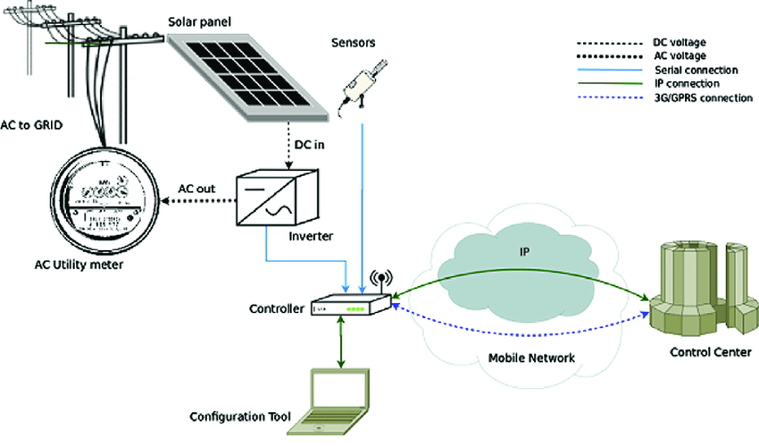
1. Solar Energy and Photovoltaic Power Generation Cont…
Components of Solar Photovoltaic System
Figure 1: Components of Solar Photovoltaic System, Meliones, A., Apostolacos, S., & Nouvaki, A. Applied Computing & Informatics (2014)
url:https://www.researchgate.net/publication/262194849/figure/fig15/AS:667896925655040@1536250444127/PV-System-components.png

Slide 14
1. Solar Energy and Photovoltaic Power Generation Cont…
Configurations of photovoltaic (solar power) setups
There are three common configurations:
Grid-Connected (On-Grid) System
  The PV system is connected to the public electricity grid.
  Surplus electricity is fed to the grid (net metering).
  No battery storage required; inverter synchronizes with grid voltage and frequency.
  Used in urban and commercial installations.
  The most common type.

Slide 15
1. Solar Energy and Photovoltaic Power Generation Cont…
Stand-Alone (Off-Grid) System
  The PV system operates independently of the utility grid.
  Require batteries for storage and charge controllers.
  Ideal for remote or rural areas without grid access.
  However, it has high cost due to batteries and requires careful sizing to match energy needs.
Hybrid Systems
  Combine PV with other sources (e.g., diesel generator or
  wind turbine).
  Improve reliability and power availability.

Slide 16
1. Solar Energy and Photovoltaic Power Generation Cont…
Efficiency Factors and Performance Evaluation
The key efficiency factors include:
Temperature: Efficiency decreases as temperature rises due to reduction in open-circuit voltage (Voc).
Solar Irradiance (Intensity of Sunlight): Higher sunlight increases output up to saturation level.
Angle of incidence: Optimal when sunlight is perpendicular to the panel.
Dust and shading: Reduce light absorption and power output.
Material properties: Band gap energy, reflectivity, and
recombination rates influence performance.

Slide 17
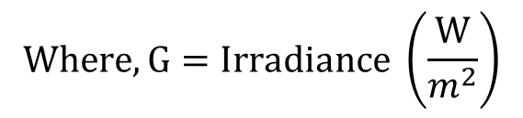
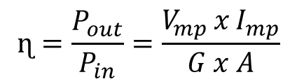

1. Solar Energy and Photovoltaic Power Generation Cont…
Efficiency Factors and Performance Evaluation
Module Efficiency (η): is the ratio of the electrical power output of a solar PV module to the solar power input received by the module’s surface area under standard test conditions (STC) [1].
Performance Ratio - It measures how well the system converts
available solar energy into actual electrical output, including
system losses.
$$ɳ=\frac{P_{out}}{P_{in}}=\frac{V_{mp }x I_{mp}}{G x A}$$
$$Where, G=Irradiance \left(\frac{W}{m^{2}}\right)$$
$A=area (m^{2}$)

Slide 18
1. Solar Energy and Photovoltaic Power Generation Cont…
Mathematically,
Capacity Factor – It is a measure of how effectively a power plant or PV system generates electricity compared to its maximum possible output over a certain period.
It indicates the utilization of installed capacity.
$$PR=\frac{Actual Energy Output of PV System}{Theoretical Energy Output under Ideal Conditions}=\frac{E_{actual}}{E_{theoretical}}$$
$$CF=\frac{Actual Energy produced over Time Period}{Maximum Possible Energy Output over the Same Period}=\frac{E_{actual}}{P_{rated} x T}$$

Slide 19
1. Solar Energy and Photovoltaic Power Generation Cont…
Diverse Applications of Solar Energy
  Utility-Scale Solar Farms
  Commercial & Industrial Rooftops
  Residential Rooftops
  Off-Grid Applications
  Building-Integrated Photovoltaics (BIPV)
  Transportation
  Portable Electronics

Slide 20
2. Hydro-Power Generation
Hydropower is the conversion of the potential and kinetic energy of water into mechanical energy, and subsequently into electrical energy [2].
This flow drives turbines connected to generators, producing electrical energy.
The process is clean, renewable, and relies on the hydraulic head (height difference) and flow rate.
The basic idea is that water stored at a height (due to gravity) possesses potential energy.
When released, it flows through a penstock, gaining kinetic
energy as it moves downward.

Slide 21
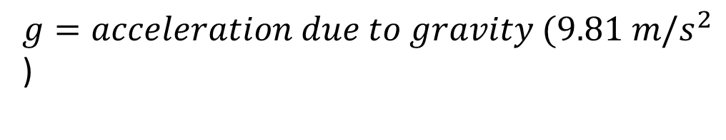
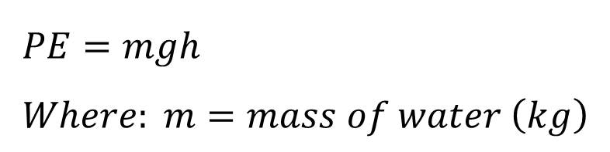
2. Hydro-Power Generation Cont…
This kinetic energy is used to rotate a turbine, which drives a generator to produce electricity.
Potential Energy (PE)
$$PE=mgh \\ Where: m=mass of water \left(kg\right)$$
$g=acceleration due to gravity (9.81 m/s^{2}$)
$$h=height difference \left(head\right) in meters$$

Slide 22
2. Hydro-Power Generation Cont…
Classification of Hydropower Plants
Hydropower plants are generally classified based on head, capacity, and storage characteristics.
Based on Head
Type | Head Range (m) | Example Turbine Type
Low Head | < 30 m | Kaplan, Propeller
Medium Head | 30–300 m | Francis
High Head | > 300 m | Pelton

Slide 23
2. Hydro-Power Generation Cont…
Based on Storage and Flow
Run-of-River (RoR) Plants
  Use natural river flow with little or no storage.
  Depend on river discharge — electricity generation varies seasonally.
  Environmentally less disruptive.
  Example: Small hydro plants in mountainous regions.
Reservoir (Storage) Plants
  Have large dams that store water in reservoirs.
  Can control flow and provide power on demand.
  Used for base-load and peak-load supply.

Slide 24
2. Hydro-Power Generation Cont…
Pumped Storage Plants
  Work as energy storage systems.
  Water is pumped to an upper reservoir during low demand (using surplus energy) and released to generate power during peak demand.
  Improve grid stability and load balancing.
Main Components of a Hydropower Plant
1. Dam
  Creates a reservoir to store potential energy of water.
  Controls water flow to the penstock.
  Also aids in flood control, irrigation, and recreation.

Slide 25
2. Hydro-Power Generation Cont…
Penstock
  A large conduit or pipe that carries water under pressure from the reservoir to the turbine.
  Friction losses in penstock should be minimized.
Turbine
  Converts hydraulic energy into mechanical energy (shaft rotation).
Generator
  Converts mechanical energy from turbine shaft into electrical
  energy using electromagnetic induction.
Control Systems
  Include gates, valves, and electronic controllers for regulating
  water flow, turbine speed, and voltage output.

Slide 26
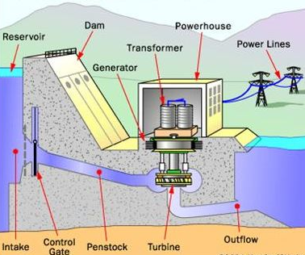
2. Hydro-Power Generation Cont…
Components of a Hydro Power Generation
Figure 2: Components of a Hydro Power Generation, Anderson, Elliott, University of Alaska Fairbanks, (2015)
url:https://encrypted-tbn0.gstatic.com/images?q=tbn:ANd9GcRylZsK2G89vEgKG5nGFzvjYUnKL2q1zCCUpYOZD5OWDeFlcgBe2KseDtsR&s

Slide 27
2. Hydro-Power Generation Cont…
Types of Turbines and Their Operating Ranges
Hydraulic turbines are selected based on head and flow rate.
Turbine Type | Head Range (m) | Flow Rate | Operation Principle | Typical Application
Pelton Wheel | 300–1800 | Low | Impulse turbine using water jets striking buckets | High-head, low-flow sites
Francis Turbine | 30–600 | Medium | Reaction turbine; radial and axial flow | Medium-head sites
Kaplan Turbine | 2–40 | High | Axial flow reaction turbine with adjustable blades | Low-head, high-flow sites

Slide 28
2. Hydro-Power Generation Cont…
Site Selection Criteria
Key factors for hydropower site selection:
  Adequate water availability and reliable hydrology
  Suitable head and flow rate
  Geological stability and topography
  Accessibility and proximity to grid
  Environmental and social acceptability
  Economic feasibility and lifespan

Slide 29
2. Hydro-Power Generation Cont…
Environmental and Social Impacts of Hydropower Projects
Environmental Impacts
  Alteration of river ecosystems and aquatic habitats
  Fish migration disruption (mitigated by fish ladders or bypasses)
  Sedimentation in reservoirs reducing capacity
  Water quality changes due to stagnation
  Greenhouse gas emissions from decaying biomass in reservoirs (especially in tropical zones)
Social Impacts
  Displacement of communities due to reservoir creation
  Loss of agricultural land and cultural heritage sites
  Changes in livelihoods (both negative and positive)
  Benefits include irrigation, flood control, and recreational use

Slide 30
3. Geothermal Power Generation
Geothermal energy is the heat stored beneath the Earth’s surface, originating from [3]:
  Residual heat from the Earth’s formation (~4.5 billion years ago)
  Radioactive decay of isotopes (Uranium-238, Thorium-232, Potassium-40)
  Magma intrusion and tectonic activity
Geothermal energy can be classified by Enthalpy (Heat Content):
This is the most common engineering classification for power
generation.
  High-Enthalpy (>150°C)
  Medium-Enthalpy (90°C - 150°C)
  Low-Enthalpy (<90°C)

Slide 31
3. Geothermal Power Generation Cont…
  Types of Geothermal Reservoirs
  Dry Steam Reservoirs
    Contain steam only (superheated)
    Steam directly drives the turbine
  Wet Steam (Two-phase) Reservoirs
    Mixture of steam and hot water
    Steam separated before entering the turbine
  Hot Water Reservoirs
    Contain liquid water at high pressure and temperature
    Used in flash steam or binary cycle systems depending
    on temperature

Slide 32
3. Geothermal Power Generation Cont…
The key challenges in geothermal power generation are:
Resource depletion – If extraction exceeds natural recharge.
Scaling and corrosion – Due to dissolved minerals and gases (e.g., silica, H₂S).
High initial cost – Especially for exploration and drilling.
Site specificity – Only viable in geothermally active regions.
Seismic risks – From fluid reinjection (induced seismicity).

Slide 33
3. Geothermal Power Generation Cont…
Environmental Aspects and Sustainability
Geothermal is one of the most environmentally benign energy sources.
Positive Aspects
  Low greenhouse gas emissions
  Small land footprint
  Continuous base-load energy source (unlike solar or wind)
Environmental Concerns
  Gas emissions: CO₂, H₂S, CH₄ (though much lower
  than fossil fuels)
  Thermal pollution: From discharged hot water
  Surface subsidence: Due to fluid withdrawal
  Noise and land use: During drilling

Slide 34
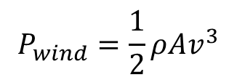
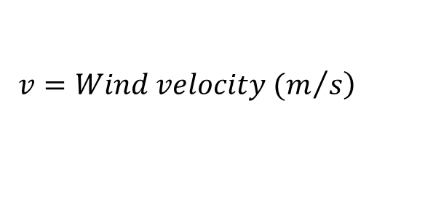
4. Wind Energy Power Generation
Wind energy is the kinetic energy possessed by moving air masses in the atmosphere, which can be converted into mechanical or electrical energy using wind turbines [4].
Differences in temperature and pressure create air movement.
The total power available in the wind is not extractable.
The fundamental equation for wind power is, i.e. the power available in the wind is:
$$P_{wind}=\frac{1}{2}ρAv^{3}$$
$Where: ρ=Air density (≈1.225\frac{kg}{m^{3}}at sea level$)
$$A=Swept area of turbine blades \left(m^{2}\right)$$
$$\left.v=Wind velocity (m/s\right)$$

Slide 35
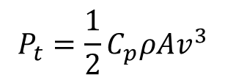
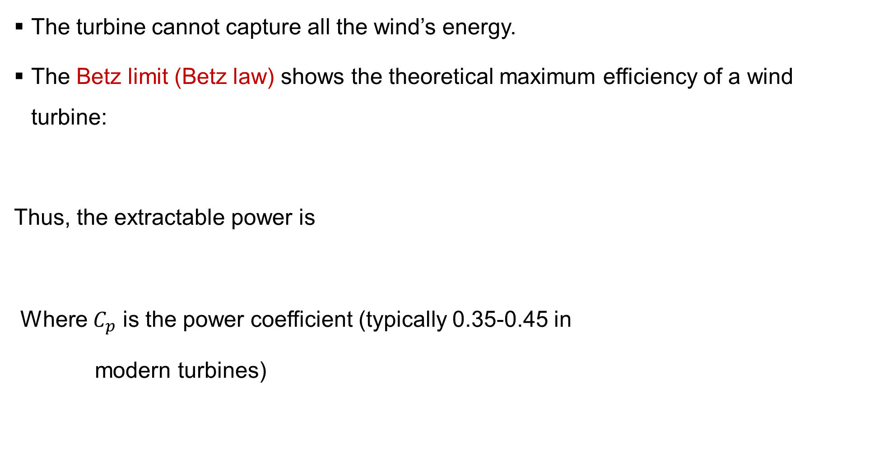

4. Wind Energy Power Generation Cont…
The turbine cannot capture all the wind’s energy.
The Betz limit (Betz law) shows the theoretical maximum efficiency of a wind turbine:
Thus, the extractable power is
Where $C_{p}$ is the power coefficient (typically 0.35-0.45 in
modern turbines)
$$C_{p}\left(max\right)=0.593$$
$$P_{t}=\frac{1}{2}C_{p}ρAv^{3}$$

Slide 36
4. Wind Energy Power Generation Cont…
Classification of Wind Energy Systems
Based on Axis Orientation
  Horizontal-Axis Wind Turbines (HAWTs)
    Rotor axis parallel to the ground and wind direction.
    Most common type used in large wind farms.
    Require yaw mechanism to face wind.
  Vertical-Axis Wind Turbines (VAWTs)
    Rotor axis perpendicular to the ground.
    Accepts wind from any direction.
    Easier maintenance, but lower efficiency.

Slide 37
4. Wind Energy Power Generation Cont…
Based on Power Output
Based on Location
  Onshore wind farms: Installed on land; lower cost but limited
  by terrain and land use.
  Offshore wind farms: Located at sea; higher wind speeds,
  larger turbines, higher cost.
Type | Power Range | Application
Micro | <1 kW | Battery charging, small devices
Small | 1-50 kW | Rural electrification
Medium | 50-500 kW | Distributed generation
Large | >500 kW-10 MW | Utility-scale wind farms

Slide 38
4. Wind Energy Power Generation Cont…
Main Components of a Wind Turbine
Rotor Blades
  Capture wind energy and convert it to rotational motion.
  Typically 3 blades for balance and efficiency.
  Made of fiberglass or carbon fiber composites.
Hub
  Connects blades to the main shaft.
  Transfers torque from blades to gearbox.
Nacelle
  Houses main components at the top of the tower, including
  Gearbox, Generator, Shaft system, Brake and control systems

Slide 39
4. Wind Energy Power Generation Cont…
Yaw Mechanism
  Rotates the nacelle to face the wind direction using sensors and motors.
Pitch Control System
  Adjusts blade angles to optimize lift and limit power output during high winds.
Tower
  Supports the rotor and nacelle.
Foundation
  Transfers loads to the ground; designed for static and
  dynamic stability.

Slide 40
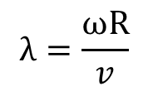
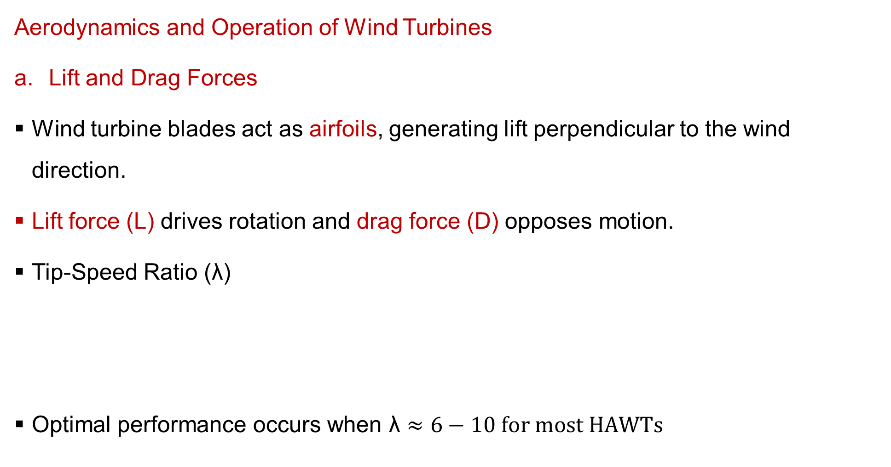
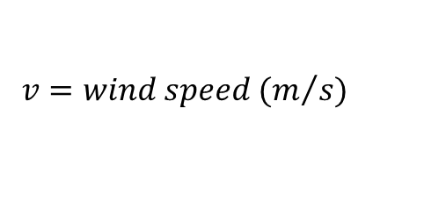

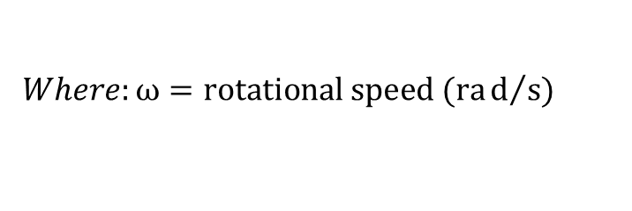
4. Wind Energy Power Generation Cont…
Aerodynamics and Operation of Wind Turbines
Lift and Drag Forces
Wind turbine blades act as airfoils, generating lift perpendicular to the wind direction.
Lift force (L) drives rotation and drag force (D) opposes motion.
Tip-Speed Ratio ($\text{λ}$)
Optimal performance occurs when $\text{λ}≈6−10 for most HAWTs$
$$λ=\frac{ωR}{v}$$
$$Where:ω=rotational speed (rad/s)$$
$$R=rotor radius \left(m\right)$$
$$v=wind speed (m/{s)}$$

Slide 41
4. Wind Energy Power Generation Cont…
Types of Wind Power Plants
Standalone (Off-grid) Systems
  Used in remote areas.
  Often combined with batteries or diesel generators.
Grid-connected Systems
  Feed generated power directly into the grid.
  Require inverters and control electronics for synchronization.
Hybrid Systems
  Combine wind with solar, hydro, or diesel for reliability.

Slide 42
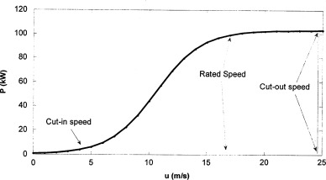
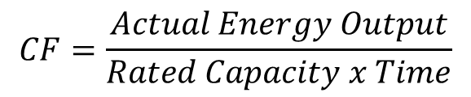
4. Wind Energy Power Generation Cont…
Efficiency, Performance, and Power Output Calculation
Power Curve
Characteristic curve showing output vs. wind speed.
Key parameters:
  Cut-in speed: 3–4 m/s
  Rated speed: 10–15 m/s
  Cut-out speed: 25 m/s
Capacity Factor- is a measure of how efficiently a wind turbine or wind farm generates electricity compared to its maximum possible output.
Figure 3: Wind Turbine Power Curve, M. Lydia, S. et. al, Renewable & Sustainable Energy Reviews, (2014)
url:https://ars.els-cdn.com/content/image/1-s2.0-S1364032113007296-gr1.jpg
$$CF=\frac{Actual Energy Output}{Rated Capacity x Time}$$

Slide 43
4. Wind Energy Power Generation Cont…
Site Selection Criteria
  Wind Speed and Consistency – Annual mean >6 m/s at hub height.
  Topography – Open plains, ridges, coastal areas ideal.
  Accessibility – For construction and maintenance.
  Grid Proximity – To minimize transmission losses.
  Environmental and Social Impact – Wildlife, noise, and visual concerns.

Slide 44
5. Comparative Analysis and Integration of Renewable Energy Sources
Integration refers to the technical and operational combination of multiple renewable sources (and possibly storage systems) to provide stable, reliable, and cost-effective power [5].
Why Integration Is Important?
  Individual renewable energy technologies have intermittent or variable outputs.
  Integration enhances energy reliability, efficiency, and grid stability.
  Supports sustainable and low-carbon energy systems.
Integration Approaches
Hybrid Renewable Energy Systems
  Combination of two or more renewable sources, possibly
  with storage or backup generation.
  Example: Solar–Wind–Diesel, Solar–Hydro, Wind–Biomass systems.

Slide 45
5. Comparative Analysis and Integration of Renewable Energy Sources
Grid-Connected Integration
  Renewable sources connected to national or regional grids.
  Requires grid codes, inverters, and energy management systems.
Off-Grid/Stand-Alone Integration
  Suitable for rural or remote electrification.
  Uses battery storage, load management, and possibly backup diesel generators.
Microgrids
  Localized energy networks integrating renewables, storage,
  and control systems.
  Can operate connected to or isolated from the main grid.

Slide 46
5. Comparative Analysis and Integration of Renewable Energy Sources
Strategies for Effective Integration
Diversified Energy Mix
  Combine base-load (hydro, geothermal) with variable (solar, wind).
Smart Grid Development
  Digital control, real-time monitoring, and flexible operation.
Forecasting and Scheduling
  Predict solar and wind output using meteorological data.
Policy and Market Mechanisms
  Feed-in tariffs, renewable portfolio standards, and carbon
  credits.

Slide 47
Summary
Solar and photovoltaic power converts sunlight directly into electricity using solar cells with efficiency affected by irradiance and temperature.
Hydro-power generation utilizes the potential and kinetic energy of flowing water to drive turbines and generate electricity.
Geothermal power generation harnesses Earth’s internal heat for steam production and power generation with high reliability.
Wind energy power generation converts kinetic energy of moving air into electrical power through wind turbines.
Integrated systems combines renewable sources and enhances
reliability, stability, and sustainability of energy supply.

Slide 48
References
[1]. Solar Energy and Photovoltaic Power Generation, Chetan Singh Solanki, PHI Learning Pvt. Ltd, 2013.
[2]. Hydro Power Engineering, Dandekar, M. M., and Sharma, K. N Vikas Publishing House Pvt. Ltd, 2010.
[3]. Geothermal Power Plants: Principles, Applications, Case Studies and Environmental Impact, DiPippo, Ronald, Butterworth-Heinemann, 2016.
[4]. Wind Energy Explained: Theory, Design and Application, Manwell, J. F., McGowan, J. G., and Rogers, A. L, John Wiley & Sons Ltd, 2010.
[5]. Integration of Renewable Energy Sources: Engineering, Technology, and Sustainability, Jahangir, H., and Al-Turki, Y. A, Springer Nature, 2021.

Slide 49
Thank you !

