Slide 1
Power Plant Engineering
Lecture 13
Power Plant Economy
Lecturer: Dr. Melaku Desta

Slide 2
Lecture learning outcomes:
At the end of this lecture, you will be able to:
Explain the role of engineering economy in the planning, design, and operation of power plants.
Utilize principles such as time value of money, interest rate, and cash flow analysis in power plant decision-making.
Evaluate capital investment, operating costs, and revenue streams to assess the economic feasibility of power generation systems.
Analyze key indicators such as payback period, net present value (NPV), internal rate of return (IRR), and cost-benefit ratio for different power
plant projects.
Compare the economic performance of various power generation
methods considering fuel cost, efficiency, and environmental
impacts.

Slide 3
Content
Introduction to Power Plant Economy
Engineering Economy and Principles of Engineering Economy
Financial Analysis and Indicators of Financial Performance
Economics of Power Generation
Summary
References

Slide 4
1. Introduction to Power Plant Economy
Introduction to Power Plant Economy
The goal of any power plant is to generate electricity reliably, safely, and at the lowest possible cost, while maintaining environmental and operational standards.
Power Plant Economy involves the study of cost, performance, and financial optimization of power generation systems [1].
Understanding the economy of power plants directly influences plant design, operation, investment decisions, and energy pricing.
A poor economic decision can lead to billions of dollars in losses,
while a sound one ensures energy security and financial viability.

Slide 5
1. Introduction to Power Plant Economy Cont…
Importance of Power Plant Economy
Power generation projects require large capital investments and long operating periods. Hence, understanding power plant economics helps in:
  Selecting the most economical type of power plant (thermal, hydro, nuclear, renewable, etc.)
  Reducing operational costs through improved efficiency and fuel management.
  Planning tariffs and cost recovery for power utilities.
  Guiding investment decisions for government and private
  investors.
  Ensuring sustainable and reliable energy supply at affordable
  rates.

Slide 6
1. Introduction to Power Plant Economy Cont…
Major Cost Components of a Power Plant
The total cost of generating electrical power includes several components:
Capital Cost
  The initial investment for land, building, machinery, transmission lines, and installation.
  Usually recovered over the life of the plant through depreciation and interest charges.
Fixed Cost
  Costs that remain constant regardless of the amount of
  power generated.
  Includes interest, depreciation, insurance, salaries of permanent
  staff, and taxes.

Slide 7
1. Introduction to Power Plant Economy Cont…
Operating (Running) Cost
  Costs that vary with the amount of power generated.
  Includes fuel, lubricants, maintenance, and wages for operating labor.
Maintenance Cost
  Regular expenses for upkeep and minor repairs to ensure reliability and performance.
Depreciation Cost
  Represents the loss in value of the plant equipment over time
  due to wear and tear, obsolescence, or age.

Slide 8
1. Introduction to Power Plant Economy Cont…
Economic Factors Affecting Power Plant Selection
To compare different power plant options fairly, the standardized metrics used are:
  Load Factor – Ratio of average load to maximum demand; higher load factor reduces cost per kWh.
  Plant Capacity Factor – Ratio of actual energy generated to the maximum possible generation in a given period.
  Plant Use Factor – Ratio of actual energy generated to
  the product of plant capacity and operating hours.
  Diversity Factor – Ratio of sum of individual maximum
  demands to the maximum demand on the station.

Slide 9
1. Introduction to Power Plant Economy Cont…
  Demand Factor – Ratio of maximum demand to connected load.
  Availability and cost of fuel – Influences the operating cost.
  Location and transmission cost – Affects the total investment and efficiency.
  Environmental constraints – Pollution control and emission standards influence design and cost.
Principles of Power Plant Economy
The main principle is to generate the required electrical power at
the lowest total cost while ensuring reliability and sustainability.

Slide 10
1. Introduction to Power Plant Economy Cont…
Key guiding principles include:
Balancing capital and operating costs
  A cheaper plant may have high fuel costs (e.g., diesel), while a costlier plant may have low running costs (e.g., hydro).
  Economic optimization involves trade-offs between these costs.
Maximizing load factor and utilization
  The higher the load factor, the lower the cost per unit of electricity.
Reducing energy losses
  Through improved plant efficiency and modern technology
  (e.g., combined-cycle plants).
Optimizing maintenance and life-cycle cost
  Preventive maintenance reduces unplanned downtime and
  total life-cycle cost.

Slide 11
1. Introduction to Power Plant Economy Cont…
Economic Performance Indicators
To assess and compare different power plants, several economic indicators are used:
Indicator | Formula | Description
Cost per kWh | Total annual cost ÷ Annual energy generated | Unit cost of electricity
Load Factor | (Average Load ÷ Maximum Load) × 100 | Measures plant utilization
Capacity Factor | (Actual Output ÷ Maximum Possible Output) × 100 | Indicates effective use of capacity
Plant Heat Rate | (Input energy / Output energy) | Lower values indicate better efficiency
Return on Investment (ROI) | (Net Profit ÷ Investment) × 100 | Financial performance measure
Payback Period | Investment ÷ Annual Profit | Time required to recover investment

Slide 12
1. Introduction to Power Plant Economy Cont…
Cost Optimization Strategies
To achieve minimum cost of generation, the following strategies are employed:
  Efficient plant design and selection of modern technology
  Fuel management and diversification (e.g., co-firing, natural gas blending)
  Preventive and predictive maintenance
  Automation and control systems to reduce manpower cost
  Load management and demand-side optimization
  Integration of renewable sources and cogeneration systems

Slide 13
2. Engineering Economy and Principles of Engineering Economy
Engineering economy is the application of economic techniques to evaluate alternatives in engineering projects, aiming to minimize cost and maximize economic benefits [2].
In the context of power plants, engineering economy helps determine:
  The most economical type of plant to build,
  The optimum capacity,
  The most efficient operating conditions, and
  The financial feasibility of proposed projects.

Slide 14
2. Engineering Economy and Principles of Engineering Economy Cont…
In power plants, engineering economy focuses on:
  Investment planning
  Cost analysis
  Revenue estimation
  Financial feasibility
  Decision-making under uncertainty

Slide 15
2. Engineering Economy and Principles of Engineering Economy Cont…
Scope in Power Generation
  Selection of type and size of power plant.
  Determination of capital investment and operating costs.
  Estimation of electricity tariff or selling price.
  Economic life determination of equipment.
  Replacement analysis for aging or inefficient units.
  Evaluation of renewable vs. non-renewable energy systems.

Slide 16
2. Engineering Economy and Principles of Engineering Economy Cont…
Fundamental Principles of Engineering Economy
The principles of engineering economy guide economic decision-making.
The following are the key ones relevant to power plant economics:
Principle 1: Develop alternatives
  Economic decisions require feasible alternatives — such as comparing a thermal plant vs. a hydro plant, or upgrading an old system vs. installing a new one.
Principle 2: Focus on differences
  Only the differences in cost, revenue, or performance between
  alternatives matter.
  This principle avoids evaluating irrelevant data that are common
  to all alternatives.

Slide 17
2. Engineering Economy and Principles of Engineering Economy Cont…
Principle 3: Use a consistent viewpoint
  All costs and benefits must be evaluated from the same perspective — usually the investor, utility, or government.
  For power projects, this ensures that costs, taxes, and revenues are analyzed consistently.
Principle 4: Consider the time value of money
  Money today is worth more than the same amount in the
  future due to interest or inflation.
  Hence, all cash flows must be adjusted to a common time
  base (present, annual, or future value).

Slide 18
2. Engineering Economy and Principles of Engineering Economy Cont…
Principle 5: Use a common unit of measure
  All costs and benefits should be expressed in monetary terms (e.g., USD per kWh).
  This allows fair comparison of different technical options.
Principle 6: Consider all relevant criteria
Besides direct costs, include:
  Maintenance and operating costs,
  Environmental impacts,
  Social or regulatory costs, and
  Residual (salvage) values.

Slide 19
2. Engineering Economy and Principles of Engineering Economy Cont…
Principle 7: Make uncertainty explicit
  Future costs (e.g., fuel prices or inflation) are uncertain.
  Sensitivity analysis and risk evaluation help test the impact of varying these assumptions.
Principles of Power Plant Economics
Power plant economics integrates engineering economy with operational and technical considerations to ensure least-cost generation [3].
Basic economic principle is achieved by:
  Optimizing capital and running costs,
  Maintaining high load factor, and
  Using efficient conversion systems.

Slide 20
2. Engineering Economy and Principles of Engineering Economy Cont…
Key Economic Factors
Capital Cost vs. Operating Cost Trade-off
  High initial cost may yield low running cost (e.g., hydro plants).
Plant Efficiency
  Higher efficiency reduces fuel cost.
Load Factor
  The higher the load factor, the lower the cost per kWh.
Plant Capacity Utilization
  Ensuring continuous operation reduces fixed cost burden.
Maintenance and Reliability
  Downtime increases cost due to loss of generation.

Slide 21
2. Engineering Economy and Principles of Engineering Economy Cont…
Cost Components in Power Plant Economics
Cost Type | Description | Examples
Fixed Cost | Independent of energy generation | Interest, depreciation, taxes
Variable Cost | Proportional to output | Fuel, lubricants
Semi-variable | Partly fixed and partly variable | Maintenance, operator wages

Slide 22
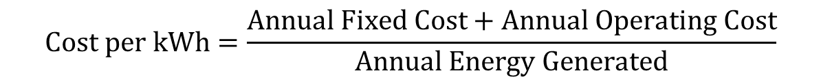
2. Engineering Economy and Principles of Engineering Economy Cont…
Cost of Energy (Generated Cost) can be calculated:
Decision-Making in Power Plant Economy
The decision-making process involves:
Defining objectives (e.g., minimize cost or emissions).
Developing feasible alternatives.
Estimating cash flows (investment, O&M, revenues).
Applying economic evaluation methods.
Selecting the best alternative.
$$Cost per kWh=\frac{Annual Fixed Cost+Annual Operating Cost}{Annual Energy Generated}$$

Slide 23
3. Financial Analysis and Indicators of Financial Performance
Financial analysis in power plant economics involves evaluating the costs, revenues, and profitability of a power generation project [4].
It helps determine whether investing in a particular power plant—be it thermal, hydro, nuclear, or renewable—is financially viable and sustainable over its lifetime.
Financial performance indicators are helpful to evaluate the economic viability, profitability, and long-term sustainability of power generation projects.
They form the foundation for investment decisions, plant design,
tariff setting, and policy analysis.

Slide 24
3. Financial Analysis and Indicators of Financial Performance Cont…
Financial indicators allow comparison between alternative technologies (coal, gas, hydro, renewable).
They are used in feasibility studies, financing negotiations, and
project performance monitoring.
Helps identify cost drivers, profit margins, and payback periods.
The major components of financial indicators include:
  Capital (investment) cost
  Operating and maintenance (O&M) costs
  Fuel costs
  Internal rate of return (IRR)

Slide 25
3. Financial Analysis and Indicators of Financial Performance Cont…
Major Components of Financial Analysis
Capital (Investment) Cost
These are one-time costs required to build and commission
the plant.
The components of capital costs include:
  Land acquisition and site preparation
  Plant and equipment costs: boilers, turbines, generators,
  reactors, etc.

Slide 26
3. Financial Analysis and Indicators of Financial Performance Cont…
  Civil works and infrastructure: buildings, foundations, cooling towers, roads
  Transmission connection cost
  Engineering, procurement, and construction services
  Interest during construction
  Capital cost is usually expressed as $/kW of installed capacity.

Slide 27
3. Financial Analysis and Indicators of Financial Performance Cont…
Operating and Maintenance (O&M) Costs
  These are recurring annual costs incurred to operate the plant.
  Fixed O&M costs: salaries, insurance, administrative expenses
  Variable O&M costs: fuel, lubricants, consumables, water treatment, waste disposal
  Maintenance costs: scheduled and unscheduled repair and replacement
  O&M costs are typically expressed in $/kWh or $/MW-year.

Slide 28
3. Financial Analysis and Indicators of Financial Performance Cont…
Fuel Costs
  Dominant cost component for thermal power plants (coal, gas, oil, biomass).
  Determined by fuel price, calorific value, and plant efficiency.
Depreciation and Taxation
  Depreciation: allocation of plant cost over its useful life (straight-line or declining balance).
  Purpose: reflects equipment wear and tear; affects taxable
  income.
  Taxation: corporate income tax on net profit after depreciation
  and interest deductions.

Slide 29
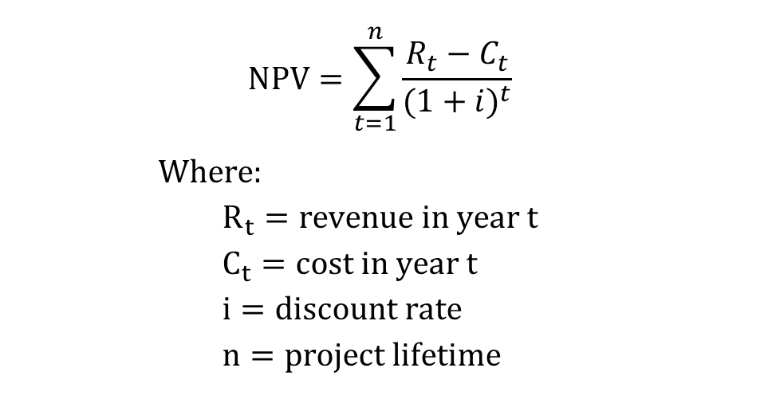
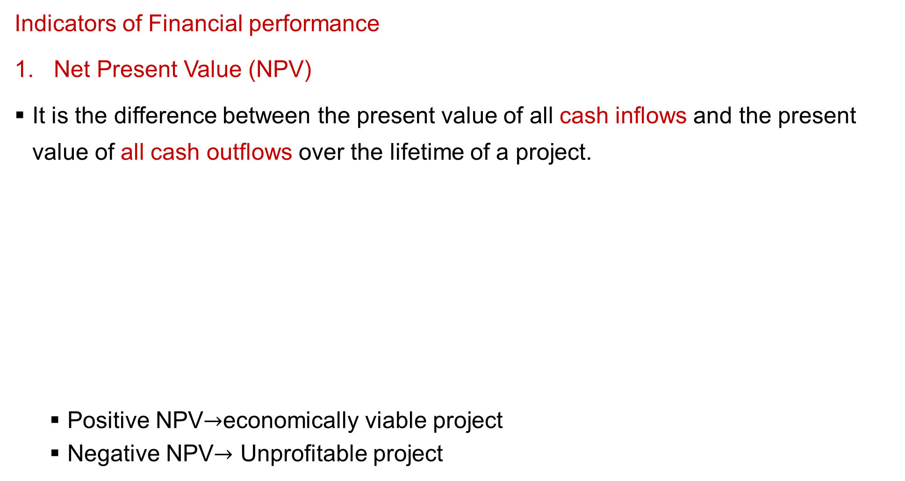
3. Financial Analysis and Indicators of Financial Performance Cont…
Indicators of Financial performance
Net Present Value (NPV)
It is the difference between the present value of all cash inflows and the present value of all cash outflows over the lifetime of a project.
  Positive NPV$→$economically viable project
  Negative NPV$→$ Unprofitable project
$$NPV=\sum_{t=1}^{n}{\frac{R_{t}−C_{t}}{({1+i)}^{t}}}$$
$Where:$
$$R_{t}=revenue in year t \\ C_{t}=cost in year t \\ i=discount rate \\ n=project lifetime$$

Slide 30
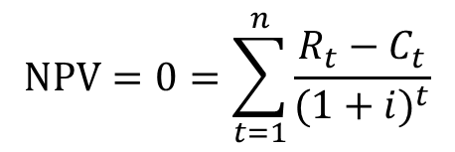
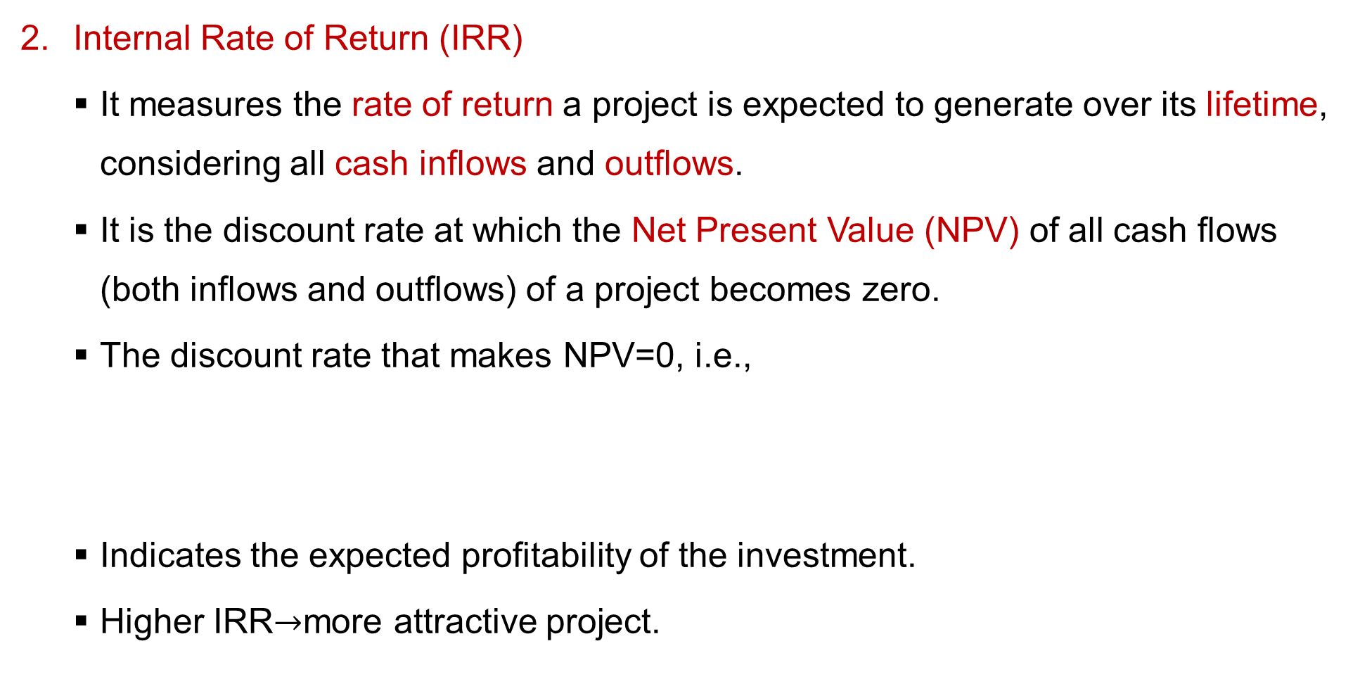
3. Financial Analysis and Indicators of Financial Performance Cont…
Internal Rate of Return (IRR)
  It measures the rate of return a project is expected to generate over its lifetime, considering all cash inflows and outflows.
  It is the discount rate at which the Net Present Value (NPV) of all cash flows (both inflows and outflows) of a project becomes zero.
  The discount rate that makes NPV=0, i.e.,
  Indicates the expected profitability of the investment.
  Higher IRR$→$more attractive project.
$$NPV=0=\sum_{t=1}^{n}{\frac{R_{t}−C_{t}}{({1+i)}^{t}}}$$

Slide 31
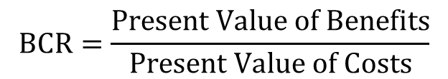
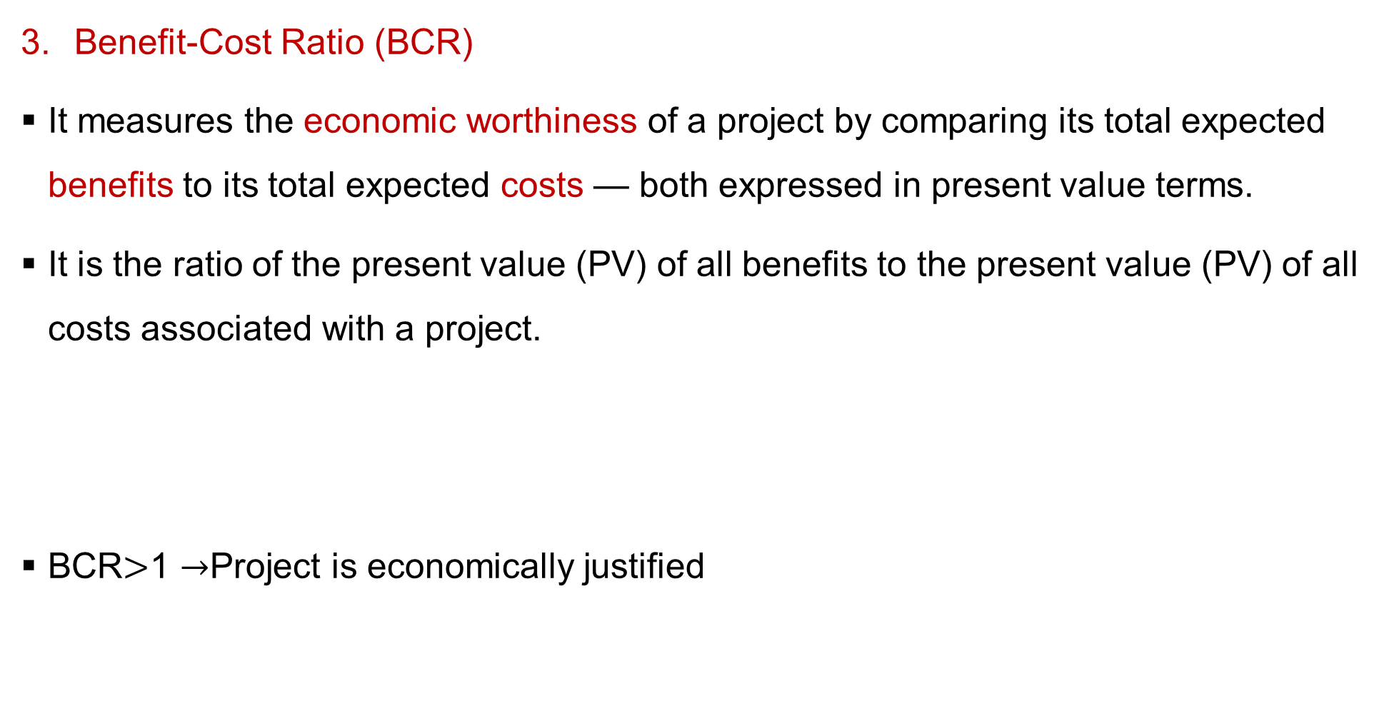
3. Financial Analysis and Indicators of Financial Performance Cont…
Benefit-Cost Ratio (BCR)
It measures the economic worthiness of a project by comparing its total expected benefits to its total expected costs — both expressed in present value terms.
It is the ratio of the present value (PV) of all benefits to the present value (PV) of all costs associated with a project.
BCR$>$1 $→$Project is economically justified
$$BCR=\frac{Present Value of Benefits}{Present Value of Costs}$$

Slide 32
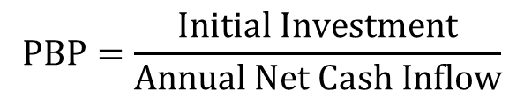
3. Financial Analysis and Indicators of Financial Performance Cont…
Payback Period (PBP)
  It measures how long it takes for an investment to recover its initial cost from the net cash inflows generated by the project.
  It is the time required for the cumulative cash inflows from a project to equal the initial investment.
  Shorter payback = faster recovery, lower risk.
$$PBP=\frac{Initial Investment}{Annual Net Cash Inflow}$$

Slide 33
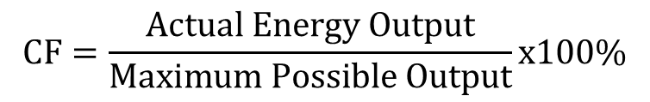
3. Financial Analysis and Indicators of Financial Performance Cont…
Capacity Factor (CF)
Used to evaluate the efficiency and utilization of a power plant — whether it’s thermal, hydro, nuclear, solar, wind, or biomass.
It is the ratio of the actual energy produced by a power plant during a specific period to the maximum possible energy it could have produced if it operated at full (rated) capacity for the same period.
  High CF indicates better financial performance
$$CF=\frac{Actual Energy Output}{Maximum Possible Output}x100\%$$

Slide 34
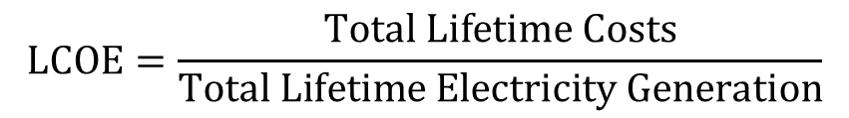
3. Financial Analysis and Indicators of Financial Performance Cont…
Levelized Cost of Electricity (LCOE)
  Represents the average cost per kWh of energy generated over the plant’s lifetime, taking into account all costs — from construction to operation, maintenance, fuel, and decommissioning.
  It is the present value of total lifetime costs of building and operating a power plant divided by the present value of the total electricity generated over its lifetime.
  Used to compare technologies on a consistent cost basis.
$$LCOE=\frac{Total Lifetime Costs}{Total Lifetime Electricity Generation}$$

Slide 35
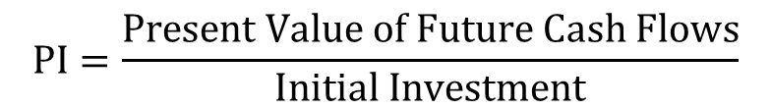
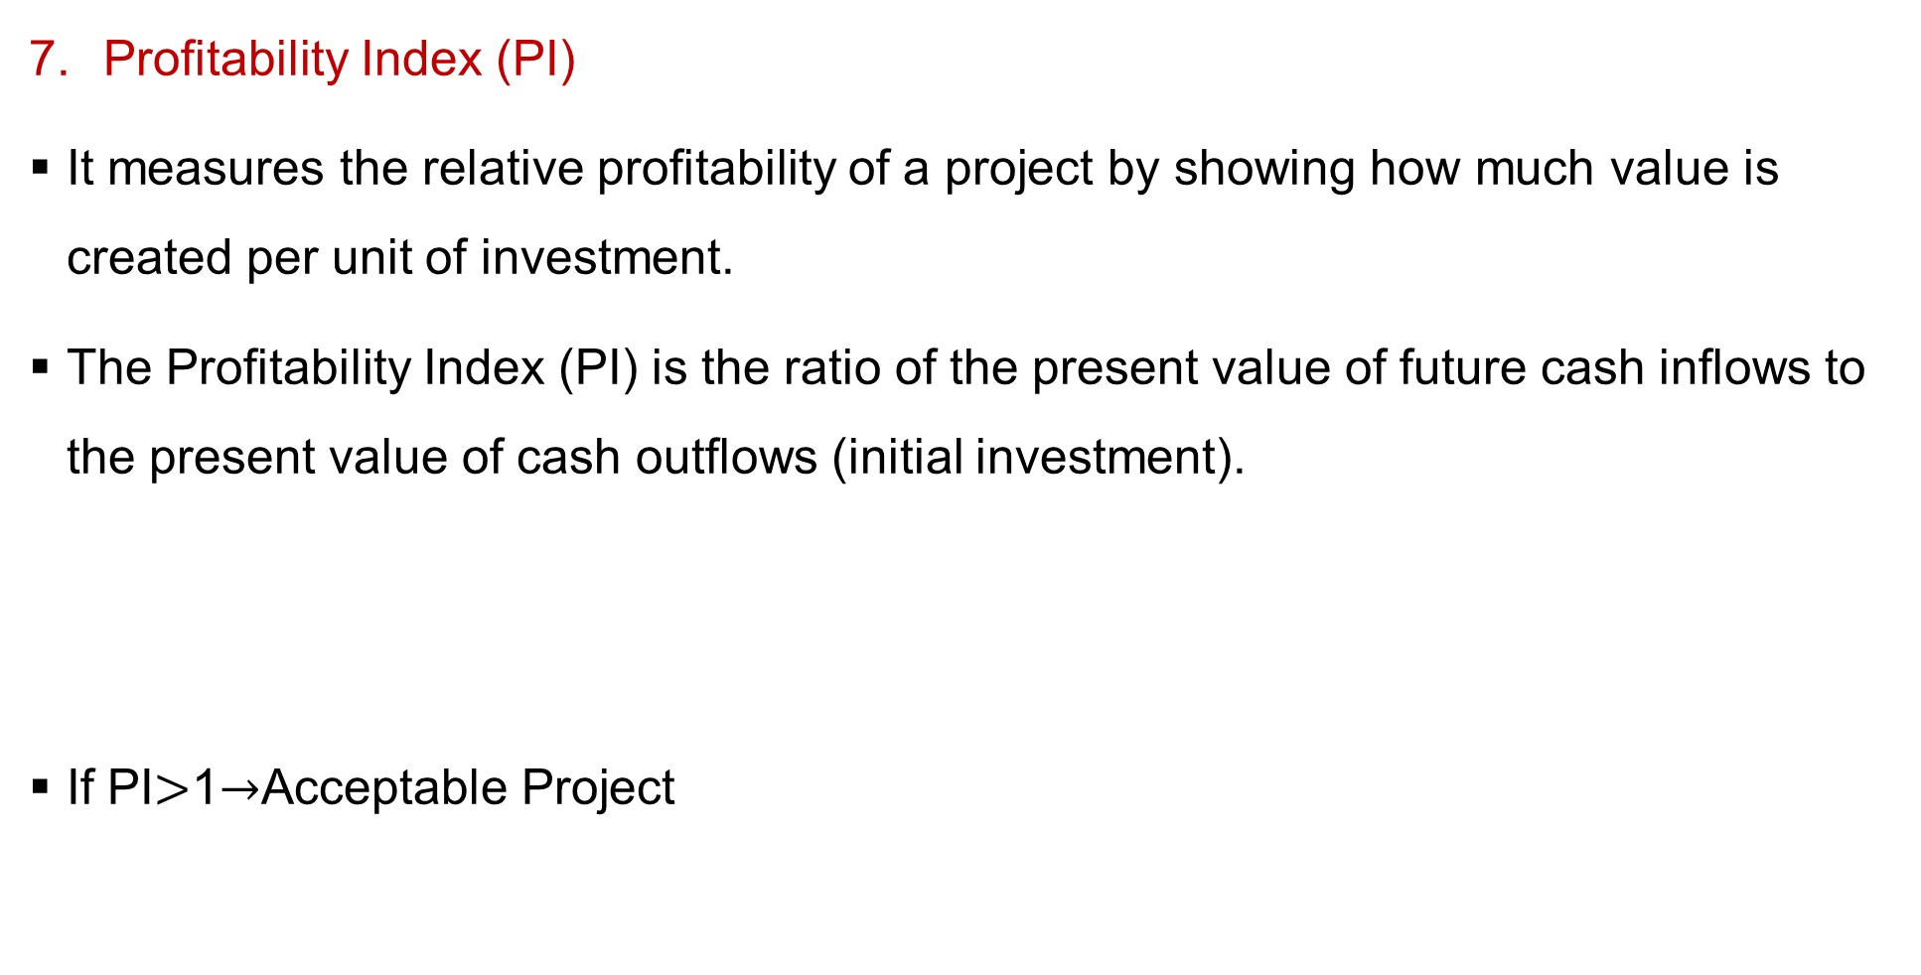
3. Financial Analysis and Indicators of Financial Performance Cont…
Profitability Index (PI)
It measures the relative profitability of a project by showing how much value is created per unit of investment.
The Profitability Index (PI) is the ratio of the present value of future cash inflows to the present value of cash outflows (initial investment).
If PI$>$1$→$Acceptable Project
$$PI=\frac{Present Value of Future Cash Flows}{Initial Investment}$$

Slide 36
4. Economics of Power Generation
The primary objective of power plant engineering, from an economic standpoint, is to generate electrical energy at the lowest possible cost while ensuring reliability and meeting environmental standards.
The economic viability of a power plant depends on various factors, including capital costs, operating costs, maintenance expenses, fuel prices, and plant performance metrics.
It’s must to balance the trade-offs between high-efficiency, high-cost
equipment and lower-efficiency, low-cost options to minimize the
total expenditure over the plant's life.

Slide 37
4. Economics of Power Generation Cont…
The economics of power generation deals with the study of cost, efficiency, and financial aspects of producing electricity from various energy sources [5].
It aims to determine the most cost-effective and reliable method for generating power while ensuring sustainability and meeting demand.
While designing and building a power station, efforts should be made to achieve overall economy so that the per unit cost of production is as low as possible.
Objectives of Economic Analysis
  To determine the total and unit cost of power generation.
  To compare the economic viability of different power plants.
  To aid in investment and operational decision-making.
  To ensure optimal utilization of resources.

Slide 38
4. Economics of Power Generation Cont…
Economics of Major Power Plants
Thermal Power Plant (Coal/Gas/Oil Based)
  High fuel cost – major recurring expense (up to 60–70% of total cost)
  Moderate capital cost
  High maintenance cost
  Short construction time
The economic features of thermal power plants are:
  Best for base-load operation.
  High load factor required for profitability.
  Economically viable where fuel supply is abundant and transport is easy.

Slide 39
4. Economics of Power Generation Cont…
Hydroelectric Power Plant
  High capital cost (due to dam, reservoir, and civil works)
  Low operating cost (no fuel)
  Long life span (50–100 years)
Its economic features are:
  Suitable for peak-load and base-load.
  Dependent on site topography and hydrology.
  Very low cost per kWh after capital recovery.

Slide 40
4. Economics of Power Generation Cont…
Nuclear Power Plant
  Very high capital cost
  Low fuel cost but requires expensive handling and waste disposal
  High safety and regulatory costs
The economic features include:
  Best for continuous base-load operation.
  Low running cost and high reliability.
  Economically viable for large-scale generation.

Slide 41
4. Economics of Power Generation Cont…
Solar Power Plant
  High capital cost for PV modules, inverters, and land.
  Negligible fuel cost (sunlight is free).
  Low O&M cost.
The economic features of solar power plant are:
  Best for distributed and off-grid applications.
  Intermittent generation → Requires storage or hybridization.
  Cost per kWh declining rapidly due to technology advancement.

Slide 42
4. Economics of Power Generation Cont…
Wind Power Plant
  High capital cost (turbines and installation)
  No fuel cost
  Low O&M cost
The economic features include:
  Suitable for areas with consistent wind speeds.
  Capacity factor ranges from 25–40%.
  Payback period: 5–8 years typically.

Slide 43
4. Economics of Power Generation Cont…
Biomass Power Plant
  Moderate capital cost
  Fuel cost depends on biomass availability
  Higher O&M cost due to handling and combustion systems.
The economic features are:
  Useful for rural electrification.
  Can utilize agricultural and organic waste.
  Provides carbon-neutral electricity.

Slide 44
4. Economics of Power Generation Cont…
Environmental and Social Cost Considerations
Economic analysis must include external costs such as:
  Air and water pollution
  Land degradation
  Greenhouse gas emissions
  Public health impacts
  Waste disposal costs
Renewable plants, though costly initially, are more economical in
the long term due to low externalities and policy incentives.

Slide 45
Summary
Power plant economy studies the costs, efficiency, and financial viability of electricity generation.
Engineering economy applies economic principles to evaluate and optimize engineering projects.
Principles of engineering economy, such as NPV, IRR, and payback period, guide investment and operational decisions.
Financial analysis uses performance indicators like profitability,
capacity utilization, and benefit-cost ratio to assess power plants.
Economics of power generation compares costs, revenues,
and efficiency across different energy technologies to support
informed decisions.

Slide 46
References
[1]. Economic Fundamentals of Power Plant Performance, Almas Heshmati, Routledge (Taylor & Francis), 2011.
[2]. The net economic benefits of power plants: International evidence, Bao Doan, Duc Hong Vo & Huy Nguyen Anh Pham; Elsevier (Energy Policy, Vol. 175), 2023. IDE
[3]. Economics of Power Generation, by C.L. Wadhwa, Khanna Publishers, 2010
[4]. Economic Fundamentals of Power Plant Performance, Almas Heshmati, Routledge (Taylor & Francis), 2012
[5]. Economics of Power Systems: Fundamentals for Sustainable Energy, Christoph Weber, Dominik Möst & Wolf Fichtner, Springer⁠/⁠Cham, 2022.

Slide 47
Thank you !

