Slide 1
Strategic Human Resource Management
Lecture 2
The Concept of Strategy
Lecturer: Dr. Amy vundi

Slide 2
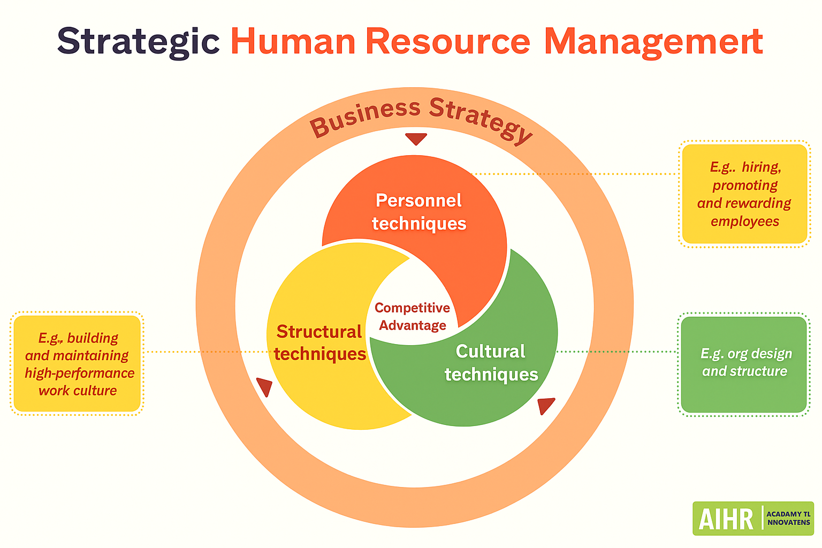
Introduction
SHRM is the alignment of HR practices with organizational strategy.
Fig. 1. "2D infographic titled 'Strategic Human Resource Management' with a Venn diagram of Personnel, Structural, and Cultural techniques highlighting competitive advantage, supported by example callouts." prompt, DALL·E, OpenAI, 28 Sept. 2025

Slide 3
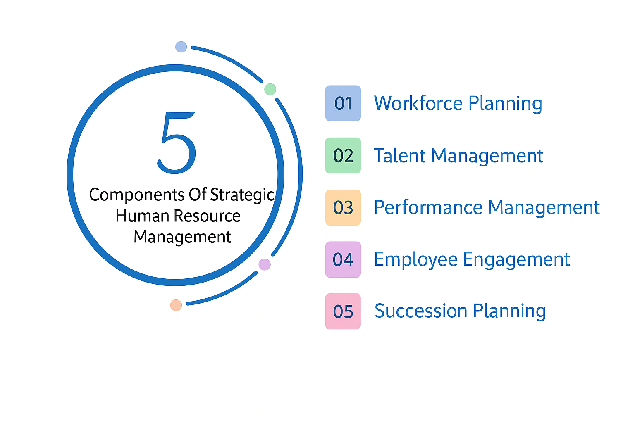
Why Strategic Human Resource Management Matters
Employees are strategic assets. SHRM supports long-term success.
Fig. 2. "Infographic illustrating five components of strategic human resource management: workforce planning, talent management, performance management, employee engagement, and succession planning." prompt, DALL·E, OpenAI, 28 Sept. 2025

Slide 4
Versions of HRM
Hard HRM: control and efficiency.
Soft HRM: trust and commitment.

Slide 5
Hard HRM
Focuses on costs, measurable output, and control.
Task Oriented
Hard HRM
Minimum Wages
Cost effective organizations

Slide 6
Features of Hard HRM
People as resources.
Goal = efficiency.
Performance measurement.

Slide 7
Soft HRM
Focuses on communication, leadership, and motivation.

Slide 8
Features of Soft HRM
People as valued assets.
Goal = commitment.
Trust and culture.

Slide 9
Comparing Hard and Soft HRM
Hard = efficiency-driven.
Soft = people-driven.
Hard vs Soft HRM
Hard HRM | Soft HRM
Company policies | Empowerment
Employee Contract | Rewards
Rules & Standards (SOP) | Recognition
 | Flexibility & Adaptability

Slide 10
Aims of HRM
Support goals, attract/retain staff, promote teamwork.

Slide 11
Aim 1
Enable organizations to achieve objectives through people.

Slide 12
Aim 2
Provide skilled, committed, motivated workforce.

Slide 13
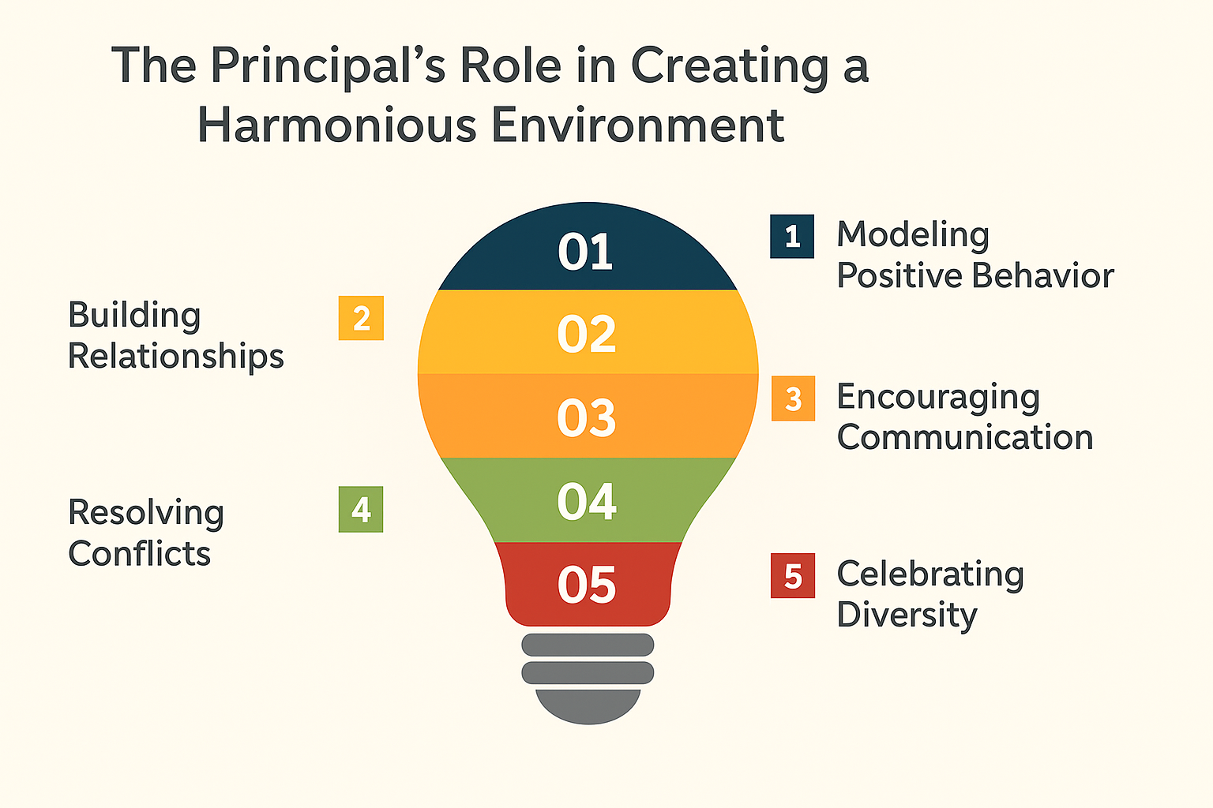
Aim 3
Create harmonious and flexible environments.
Fig. 3. "Infographic shaped like a lightbulb showing a principal’s role in creating a harmonious environment: modeling positive behavior, building relationships, encouraging communication, resolving conflicts, and celebrating diversity." prompt, DALL·E, OpenAI, 28 Sept. 2025

Slide 14
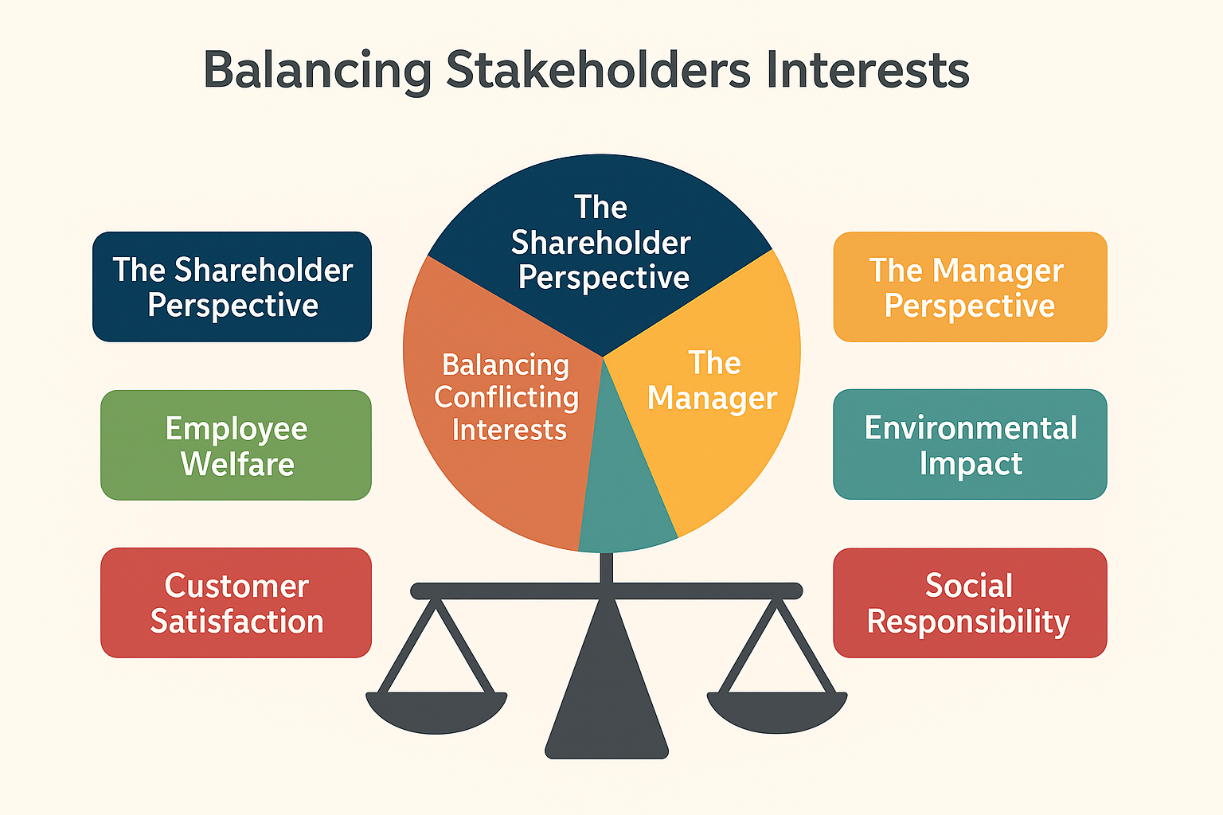
Aim 4
Balance stakeholder needs, reward fairly, manage diversity.
Fig. 4. "Infographic titled 'Balancing Stakeholders’ Interests' with a central balanced scale and segments representing shareholder perspective, manager perspective, employee welfare, customer satisfaction, balancing conflicting interests, social responsibility, and environmental impact." prompt, DALL·E, OpenAI, 28 Sept. 2025

Slide 15
Characteristics of HRM
Strategic alignment, culture building, employee focus.
Structure
Strategy
Systems
Shared Values
Skills
Styles
Staff

Slide 16
Characteristic 1
HR as strategic fit with goals.

Slide 17
Characteristic 2
People as assets; investment in training.

Slide 18
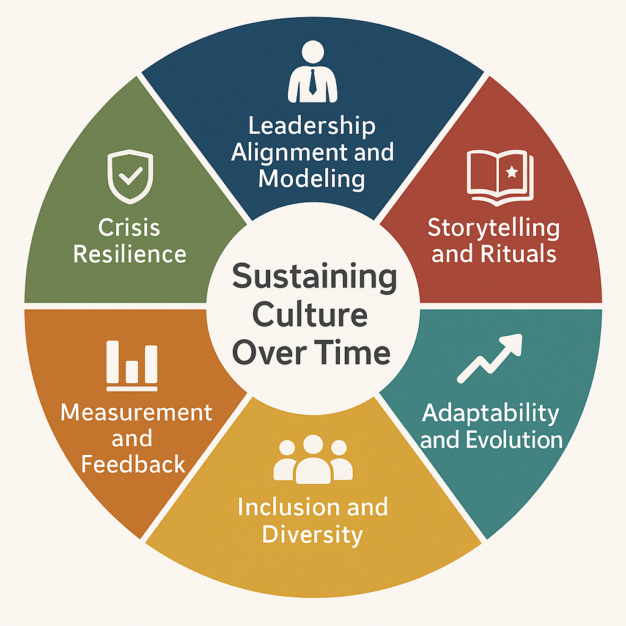
Characteristic 3
Corporate culture through mission, values, communication.
Fig. 5. "Infographic titled 'Sustaining Culture Over Time' with six segments: Leadership Alignment and Modeling, Storytelling and Rituals, Adaptability and Evolution, Inclusion and Diversity, Measurement and Feedback, and Crisis Resilience." prompt, DALL·E, OpenAI, 28 Sept. 2025

Slide 19
Characteristic 4
Responsibility of both top managers and line managers.
Executive Managers | Middle Managers | First-Line Managers
Conceptual | Conceptual | Conceptual
Human | Human | Human
Technical | Technical | Technical

Slide 20
Characteristic 5
Unitary employee relations vs. collective bargaining.

Slide 21
Development of HRM
From personnel management → HRM → SHRM.

Slide 22
McGregor’s Contribution
Theory Y: integration of organizational and individual needs.

Slide 23
Peters & Waterman
Focus on strong culture, commitment, and excellence.
Structure
Strategy
Systems
Shared Values
Skills
Styles
Staff

Slide 24
Modern SHRM Thinkers
Guest, Kaufman, Ulrich, Wright, etc.

Slide 25
Matching Model of HRM
Michigan model aligns HR with organizational strategy.

Slide 26
The HR Cycle
Selection, Appraisal, Rewards, Development.

Slide 27
Selection
Matching people to roles.

Slide 28
Appraisal
Managing and measuring performance.

Slide 29
Rewards
Compensation and recognition.

Slide 30
Development
Training, growth, high-quality employees.

Slide 31
Summary
SHRM aligns people with strategy.
Hard vs. Soft HRM.
Development and Matching Model.

Slide 32
Activity 1
Compare Guest’s model with the Michigan Model.
Case study: XYZ Company—choose hard or soft HRM.
Trace HRM development using McGregor’s Theory Y.

Slide 33
Conclusion
SHRM ensures long-term success through people.

Slide 34
References
Gomes, S., Oliveira, P., & Santos, M. (2022). Human resource practices and organizational performance: The mediating role of employee well-being. Journal of Business Research, 146, 465–474.
Kaufman, B. E. (2021). Evolution of strategic HRM: Theoretical perspectives and future directions. Human Resource Management Review, 31(3), 100–118.
Kim, S., & Park, S. (2021). Soft HRM, employee engagement, and organizational outcomes: Evidence from service industries. International Journal of Human Resource Studies, 11(2), 56–70.
Nguyen, T. H., & Tran, Q. H. (2022). Strategic fit between HRM and business strategy: Implications for performance. Asia Pacific Journal of Management, 39(2), 347–369.
Wright, P. M., & Ulrich, D. (2022). The future of HR and the role of strategic HRM. Academy of Management Perspectives, 36(1), 12–25.
Zhang, J., & Morris, J. (2023). Revisiting hard and soft HRM: A strategic balance. Human Resource Management Journal, 33(1), 45–62.
Guest, D. E. (2019). Human resource management: A critical review. International Journal of Human Resource Management, 30(1), 48–67.

Slide 35
THANK YOU

