Slide 1
Strategic Human Resource Management
Lecture 3
The Concept of Strategy (continuation)
Lecturer: Dr. Amy vundi

Slide 2
  Learning Outcomes
  Introduction to Strategy
  The Three Key Concepts
  Deep Dive: Competitive Advantage, Distinctive Capabilities, Strategic Fit
  The Strategy Formulation Process
  From Formulation to Implementation
  The Strategy-Execution Gap
  Barriers to HR Strategy Implementation
  Overcoming Implementation Barriers
  Corporate Issues Affecting Strategy
  Summary & Key Takeaways

Slide 3
Learning Outcomes
  Explain the concept of strategy in an organizational context.
  Evaluate the three key concepts: Competitive Advantage, Distinctive Capabilities, and Strategic Fit.
  Assess the sequential steps involved in formulating and implementing a strategy.
  Advise on practical methods to overcome common barriers during strategy implementation.

Slide 4
Introduction
What is Strategy? What is its role? What is a good strategy? Why strategy?

Slide 5
Defining Strategy
  "The direction and scope of an organization over the longer term which matches its resources to its changing environment..."
  It determines the organization's path in relation to its environment.
  It is the process of defining intentions and allocating resources.
  It aims for competitive advantage and strategic fit.

Slide 6
The Purpose of a Good Strategy
  Matches the company to its external and internal environment.
  Manages the expectations of the environment.
  Builds sustainable competitive advantage.
  Improves the company's overall performance.

Slide 7
The Three Dimensions of Strategic Fit
Achieving Alignment & Cohesion
  Matching: Organizational capabilities with external opportunities.
  Aligning: Strategic elements across different functions (e.g., HR, Marketing, Finance).
  Ensuring: Cohesive and supportive strategy execution.

Slide 8
The Three Key Concepts of Strategy
Competitive Advantage
Distinctive capabilities
Strategic fit

Slide 9
Concept 1: Competitive Advantage
Gaining an Edge in the Market
  Rooted in providing value that competitors fail to match.
  Formulated by Michael Porter (1985).
  Arises from creating superior value for customers.

Slide 10
Porter's Generic Strategies
The Pathways to Advantage
  Innovation: Being the unique producer.
  Quality: Delivering high-quality, unique products/services.
  Cost Leadership: Creating superior value by having the lowest cost.

Slide 11
Sustained vs. Temporary Advantage
Making it Last (Barney, 1991)
  Competitive Advantage: Others can copy it.
  Sustained Competitive Advantage: Competitions cannot imitate it.
  This is the ultimate goal.

Slide 12
Concept 2: Distinctive Capabilities
What We Do Best & Others Can't
  Capabilities determine the potential for sustaining advantage.
  Distinctive vs. Reproducible: The key is what competitors cannot replicate easily.
  They are the core competences that describe what the organization is uniquely capable of doing.

Slide 13
Examples of Distinctive Capabilities
Where Can These Capabilities Exist?
  Technology & R&D
  Innovation Processes
  Marketing & Brand Power
  Operational Excellence (Quality)
  Superior Human Capital (Talent)
  Financial Resource Management

Slide 14
The VRIO Framework
A Tool for Identifying Distinctive Capabilities
  If yes to all, it can provide sustained competitive advantage.

Slide 15
Concept 3: Strategic Fit
Aligning the Inside with the Outside
  To maximize advantage, a firm must match its capabilities/resources to external opportunities.
  Critical work of top management (Hofer & Schendel, 1986).
  Ensures the strategy is both effective and efficient.

Slide 16
Formulating Strategy
The Process of Developing Direction

Slide 17
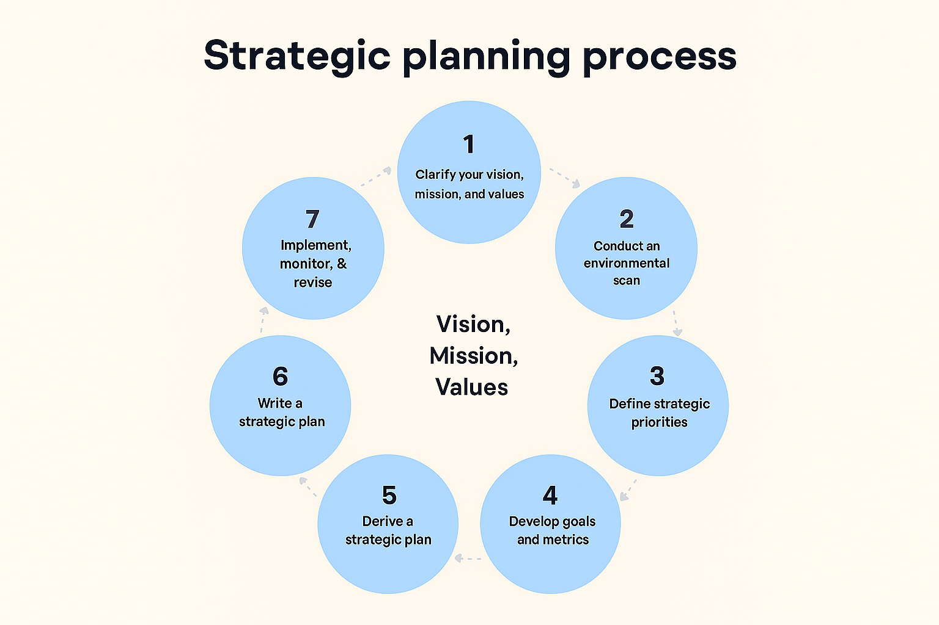
The 7-Step Formulation Process
“A 2D infographic of the strategic planning process in circular layout with seven steps and a central focus on Vision, Mission, Values” prompt, DALL·E, OpenAI, 28 Sept. 2025

Slide 18
Step 1: Defining Mission, Vision, Values
Define Organizational Vision, Mission, and Values: This step establishes the fundamental purpose and direction. It answers the "why" and "what."

Slide 19
Vision
The Aspiration
  Where the business is headed.
  The kind of organization we are trying to create.
  The ideal future state (gives direction).
  No time limit.
  Must be communicated and shared widely.

Slide 20
Mission
The Purpose & Path
  The process toward achieving the vision.
  A statement of attitude, outlook, and orientation.
  Provides a unifying theme for the organization.
  Communicates what is to be achieved.

Slide 21
Values
The Guiding Principles
  Define what is acceptable and unacceptable.
  Shape people's behavior.
  Form the basis of the organization's culture.

Slide 22
Step 2: Set Objectives
Making it Measurable
  Objectives translate the mission into specific, measurable, achievable, relevant, and time-bound (SMART) goals.
  They provide clear targets for the organization to aim for.

Slide 23
Step 3: Environmental Analysis (SWOT)
Seeing the Whole Picture
  Internal Scan: Strengths & Weaknesses (Resources, Capabilities)
  External Scan: Opportunities & Threats (Market, Competition, PESTEL factors)

Slide 24
Steps 4 & 5: Capabilities & Strategic Issues
From Analysis to Insight
  Step 4: Define the organization's Distinctive Capabilities based on the SWOT.
  Step 5: Define the key strategic issues (e.g., product-market scope, shareholder value, resource needs).

Slide 25
Step 6: Determine Strategies
Choosing the Path Forward
  Corporate Strategy: Growth, diversification, stability.
  Functional/Generic Strategies: Innovation, Quality, Cost Leadership.

Slide 26
Step 7: Prepare Integrated Plans
From Strategy to Action Plan
  Strategic plans must be integrated across all departments (HR, Finance, Operations, etc.).
  This ensures everyone is aligned and working towards the same goals.

Slide 27
Implementing Strategy
Where the Real Challenge Lies

Slide 28
The Strategy-Execution Gap
Why Strategies Fail in Implementation
Factors contributing to the gap:
  Employee resistance to change ("status quo" bias).
  Misunderstanding or different perceptions of initiatives.
  Hostility to changes seen as conflicting with identity.
  Lack of trust in senior management.
  Bureaucratic culture.
  Perceived unfairness.

Slide 29
Barriers to HR Strategy Implementation
Common Obstacles to Success
  Failure to understand business needs.
  Inadequate environmental/cultural assessment.
  Applying "best practices" that don't fit.
  Isolated initiatives without considering HR system impact.
  Inability to gain top management support.

Slide 30
Barriers to HR Strategy Implementation (Cont.)
6. Inability to achieve line manager ownership.
7. Failure to gain employee understanding/acceptance.
8. Lack of established supporting processes.
9. Failure to allocate adequate resources (people, time, money).
10. Failure to monitor, evaluate, and take remedial action.

Slide 31
Overcoming the Barriers: A 7-Step Process
From Barriers to Breakthroughs

Slide 32
Step 1: Conduct Analysis
Start with a Deep Understanding
Use:
  SWOT Analysis (Internal/External)
  PESTEL Analysis (Macro-environment)
  Analysis of business needs and corporate culture.

Slide 33
Step 2: Formulate the HR Strategy
Make the Case Clear
The formulated strategy should clearly articulate:
  Its rationale (the "why").
  Its aims and objectives.
  Its expected costs and benefits.

Slide 34
Step 3: Gain Support
Secure Buy-In Early
Actively gain the support of:
  Line Managers
  Employees
  Trade Unions
  Methods: Communication, involvement in planning, sharing rationale.

Slide 35
Steps 4 & 5: Assess Barriers & Prepare Action Plan
Plan for the Inevitable
  Step 4 (Assess): Proactively identify potential barriers (indifference, hostility, resource lack).
  Step 5 (Plan): Create a detailed action plan with timelines, responsibilities, and required activities (consultation, communication, training). Define success metrics.

Slide 36
Steps 6 & 7: Manage, Follow-up, Evaluate
Execute and Adapt
  Step 6 (Manage): Actively monitor progress and solve problems in real-time.
  Step 7 (Evaluate): Follow-up via interviews/surveys. Evaluate and be ready to amend proposals, add support, intensify communication, or get more resources.

Slide 37
Corporate Issues Affecting Strategy
The Broader Context
Key issues include:
  The Vision and Mission
  The Organization itself (Capabilities, Structure)
  Performance
  Quality and Customer Care

Slide 38
Summary & Key Takeaways
What We've Learned
  Strategy is about long-term direction, competitive advantage, and strategic fit.
  The 3 Key Concepts are Competitive Advantage, Distinctive Capabilities, and Strategic Fit.
  Formulation is a logical process from vision to plan.
Implementation is fraught with barriers but can be overcome with analysis, communication, and diligent management.

Slide 39
References
· CIPD. (2024). Strategic human resource management: Linking people management to long-term business goals.CIPD
· Resource-Based View of HRM. (2025). Human resources as a source of competitive advantage. HR Tutorial
· CriterionHCM. (2025). Strategic Human Resource Management Guide (2025). VRIO framework explained. Criterion HCM
· FourWeekMBA. (2025). Strategic fit and its business importance.

