Slide 1
Strategic Human Resource Management
Lecture 5
Strategies for Culture Management
Lecturer: Dr. Amy Vundi

Slide 2
Agenda
Introduction
Culture vs Climate
Culture change Strategies
Culture Analysis

Slide 3
Lecture Learning Outcome
Explain the difference between organizational culture and climate.
Evaluate the organizational ideologies proposed by Harrison and Hardy.
Discuss strategies to support, reinforce, and change organizational culture.

Slide 4
Introduction
Focuses on actively managing existing culture to achieve a desirable state.
Involves reinforcing positive aspects or guiding change.
We will explore analytical frameworks and practical strategies.

Slide 5
Organizational Culture vs. Climate: A Critical Distinction
Culture: The deep-seated, subconscious "personality" of the organization (shared beliefs, values, norms).
Climate: The surface-level, measurable "current mood" (perceptions of policies and environment).
Analogy: Climate is the weather, Culture is the long-term climate.

Slide 6
What are Culture Management Strategies?
Long-term plans to either change or reinforce the existing culture.
Aim to align "the way things are done" with business goals.

Slide 7
Culture Change vs. Reinforcement
Change Strategy: Moving culture from a present state to a future desired state.
Reinforcement Strategy: Preserving and strengthening the desirable features of the existing culture.

Slide 8
Analyzing Organizational Culture
To manage culture, you must first be able to analyze it.
Key models provide typologies to categorize cultural types.

Slide 9
Key Aspects for Cultural Analysis
  Employee Behavior Patterns
  The Organizational Chart (Structure)
  The Organization's Mission and Vision

Slide 10
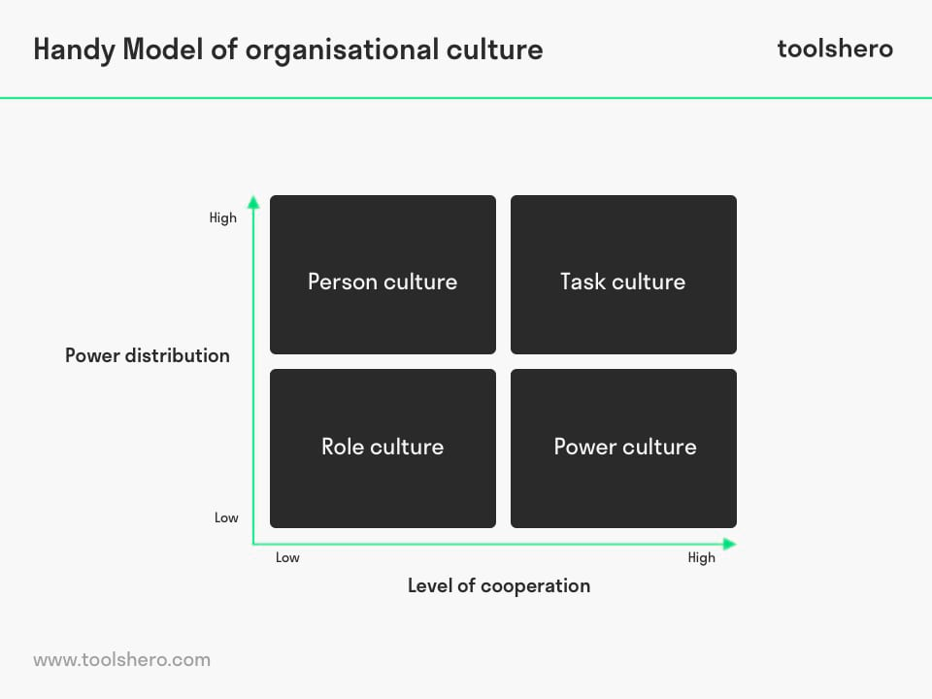
Harrison's (1972) Organizational Ideologies
A classic framework for categorizing culture into four types.

Slide 11
Harrison's Type 1: Power-Oriented
Competitive, centralized, responsive to strong personalities.

Slide 12
Harrison's Type 2: Role-Oriented
Bureaucratic, hierarchical, focused on rules, procedures, and job descriptions.

Slide 13
Harrison's Type 3: Task-Oriented
Dynamic, competency-based, structured around projects and teams.

Slide 14
Harrison's Type 4: People-Oriented
Existential; the organization serves the needs of the individuals within it.

Slide 15
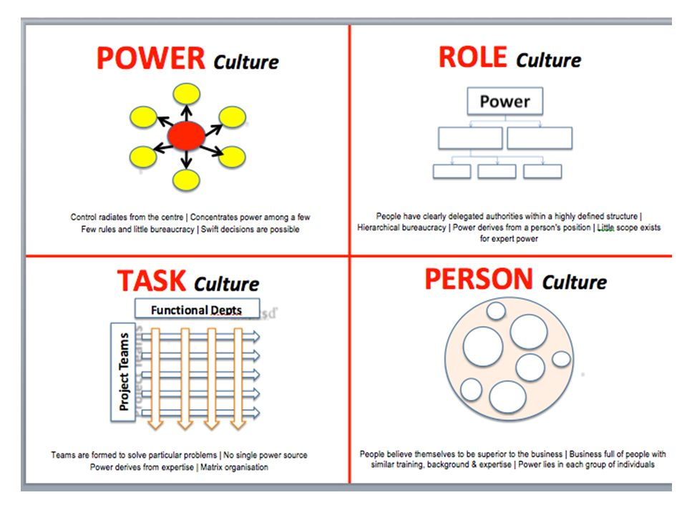
Hardy's (1981) Cultural Types
A similar but influential typology

Slide 16
Hardy's Power Culture
Control radiates from a central source. Competitive and political.

Slide 17
Hardy's Role Culture
Governed by rules and positional power. Characteristic of large bureaucracies.

Slide 18
Hardy's Task Culture
Based on expert power and teamwork. Adaptable and skill-focused.

Slide 19
Hardy's Person Culture
The organization exists solely to serve the individuals within it

Slide 20
The Need for a Performance-Oriented Culture
HR strategies must be congruent with the existing culture or designed to change it.
Analysis is essential to shape effective HR strategies.

Slide 21
Cooke and Lafferty's (1989) Organizational Culture Inventory
A more detailed model with 12 cultural styles.
Groups styles into Constructive, Passive-Defensive, and Aggressive-Defensive.

Slide 22
Constructive Styles (Examples)
Achievement: Valued goal accomplishment.
Self-Actualizing: Valued creativity and quality.

Slide 23
Defensive Styles (Examples)
Avoidance: Punishes mistakes.
Oppositional: Confrontation and negativism are rewarded.

Slide 24
Other Key Styles in the Inventory
Affiliative: Priority on constructive relationships.
Competitive: Winning is valued.

Slide 25
What is an "Appropriate Culture"?
No single "best" culture.
An appropriate culture is consistent, shared, and supports strategic goals.
It differentiates the organization (e.g., through quality, innovation).

Slide 26
The Goal: A High-Performance Culture
Aligns values and norms with strategic objectives.
Exerts a positive influence on behavior and performance.

Slide 27
Strategies for Culture Reinforcement
Programs aimed at preserving what is good and functional in the present culture.

Slide 28
Reinforcement Lever 1: Recognition and Rewards
Reaffirm important behaviors.
Provide financial and non-financial rewards for expected behaviors.

Slide 29
Reinforcement Lever 2: Articulating Core Values
Develop a clear statement of core values.
Communicate how people are expected to act.

Slide 30
Reinforcement Lever 3: Strategic Onboarding
Use induction to socialize new employees into the core culture from day one.

Slide 31
Reinforcement Lever 4: Continuous Development
Reinforce cultural expectations through ongoing training and leadership development.

Slide 32
Part 3: Strategies for Culture Change
Culture change programmes focus on particular aspects of the culture e.g. performance, commitment, quality, customer services, team work and organizational learning.
Programs focused on changing specific aspects of the culture.

Slide 33
Change Lever 1: Performance
Performance-related pay, performance management, leadership training

Slide 34
Change Lever 2: Commitment
Improve communication, participation, and involvement.
Develop a climate of cooperation and trust.

Slide 35
Change Lever 3: Quality
Incorporate Total Quality Management (TQM) programs.

Slide 36
Change Lever 4: Customer Service
Implement customer care programs.

Slide 37
Change Lever 5: Teamwork
Team building, team performance management, and team rewards.

Slide 38
Change Lever 6: Organizational Learning
Take steps to enhance intellectual capital.

Slide 39
Summary: The Goal of Strategic Culture Management
Ensure culture is a source of competitive advantage.
Drives high performance and employee commitment.

Slide 40
Q&A
Questions & Discussion
  Difference between culture and climate?
  Discuss Cooke and Lafferty's inventory.
  Evaluate programs for preserving a good culture.

Slide 41
References
Alvesson, M., & Sveningsson, S. (2020). The organizational culture myth: Conceptual and methodological challenges. Journal of Management Studies, 57(5), 1107-1113.
Cameron, K. S., & Quinn, R. E. (2020). Diagnosing and changing organizational culture: Based on the competing values framework. John Wiley & Sons.
Hartnell, C. A., Ou, A. Y., Kinicki, A. J., Choi, D., & Karam, E. P. (2019). A meta-analytic test of organizational culture’s association with elements of an organization’s system and its relative predictive validity on organizational outcomes. Journal of Applied Psychology, 104(6), 832–850.
Kaufman, B. E. (2021). The evolution of strategic HRM: Theoretical perspectives and future directions. Human Resource Management Review, 31(3), 100–118.
Schulte, M., Vogel, D., & Kauffeld, S. (2021). The organizational climate for innovation: A meta-analysis of the climate for innovation and its relationship with innovation outcomes. European Journal of Work and Organizational Psychology, 30(2), 243-260.

Slide 42
THANK YOU

