Slide 1
COURSE: MEASUREMENT METHODS AND TOOLS
Week 2. Fundamental basics of measurement
Lecturer: PhD. B.Khamdamov
(Andijan Technical Institute)
1

Slide 2
O’LCHASH USULLARI VA VOSITALARI
2-Ma’ruza. O‘lchashning fundamental asoslari.
Ma’ruzachi: PhD. B.Xamdamov
(Andijon davlat texnika Instituti)
2

Slide 3
2-Mavzu: O‘lchashning fundamental asoslari.
Reja:
2.1 Fizik kontinium. Materiya va harakat
2.2 O’lchashlarni fizik asoslari
2.3 Fizik kattaliklarni o‘lchashdagi asosiy qonuniyatlari
3

Slide 4
Hozirgi vaqtda materiyaning tarkibiy tashkil etilishining turli xil o‘lchovlarga mos keladigan quyidagi darajalari ajralib turadi, ularning har birida materiya turli xil xususiyatlarga, tuzilishga ega va harakatning turli xil o‘ziga xos qonunlariga bo‘ysunadi:
submikroskopik (elementar zarralar);
mikroskopik (atomlar va molekulalar);
kosmik (turli xil buyurtmalarning kosmik tizimlari).
makroskopik (inson sezgilari tomonidan idrok etiladigan ob’ektlar);
4

Slide 5
Materiya g‘oyasi texnik o‘lchovlarning rivojlanish darajasi bilan uzviy bog‘liqdir. Bu kosmosda diskret bo‘lgan va dam olish massasiga ega bo‘lgan shakllanishlar deb tushuniladi. Inson atrofidagi dunyo materiyadan iborat bo‘lib, u o‘z sezgilari bilan idrok etadi. Va bu dunyo materiya mavjudligining shakllari bo‘lgan makon va vaqtda amalga oshiriladi.
Turli darajadagi materiya quyidagicha ifodalanadi:
materiya, maydonlar, fizik vakuum ko‘rinishidagi kosmik tizimlar darajasida;
makroskopik darajada materiya va maydon shaklida;
mikroskopik va submikroskopik darajalarda kvant maydoni va fizik vakuum shaklida.
5

Slide 6
Inson qadim zamonlardan beri moddiy dunyo qanday ishlashini tushunishga harakat qilib keladi. Ma’lumki, qadimgi davrdan beri tabiatni tushuntirishga ikkita yondashuv mavjud edi.
mavjud bo‘lgan hamma narsaning asosi uzluksiz, bir xil materiya bo‘lib, hamma narsani o‘zi bilan to‘ldiradi, u bo‘sh joy qoldirmaydi. Ushbu vakillik kontinium (doimiylik) deyiladi (lotin tilidan kontinium – uzluksiz, bir tekis). Moddiy dunyoni bunday tushuntirishning vakili, masalan, qadimgi yunon faylasufi Aristotel edi.
Moddiy dunyoni diskret deb tushuntirgan qarama-qarshi tushunchaning kelib chiqishi (Lat. discretus - bo‘lingan, uzlukli), bo‘shliqda harakatlanadigan cheksiz sonli o‘zgarmas va bo‘linmas zarrachalardan (atomlardan) iborat tarkibiy, qadimgi yunon faylasufi Demokrit ta’limoti bilan bog‘liq.
6

Slide 7
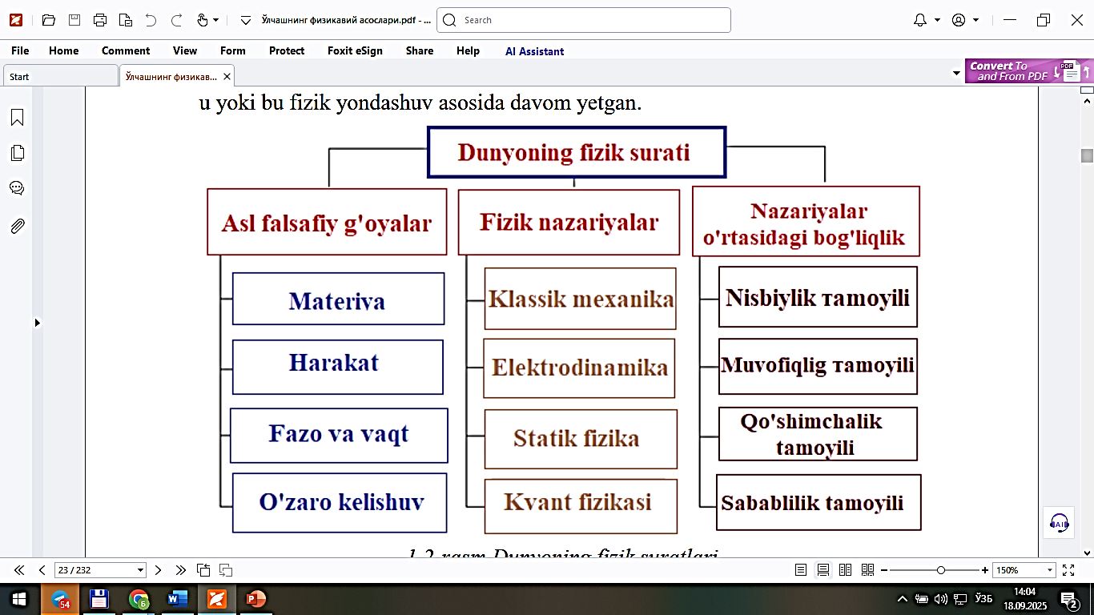
Materiya - bu koinotda bizdan mustaqil ravishda mavjud bo‘lgan hamma narsa, biz ko‘rgan narsalar (samoviy jismlar, hayvonlar, o‘simliklar va boshqalar.) va biz ko‘rmaydigan narsalar (yorug‘lik, radio to‘lqinlar, magnit nurlanish va boshqalar.)
7

Slide 8
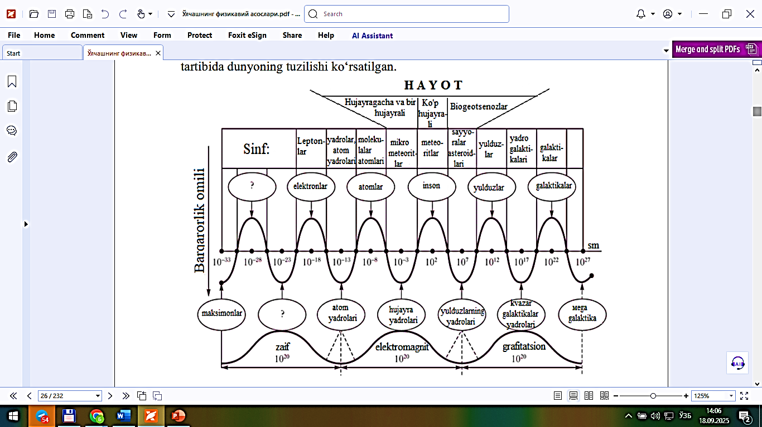
Ob'ektlar hajmi bo'yicha tuzilgan dunyoning tabiiy rasmining parchasi
8
studfile.net. (n.d.). Fragment of the natural picture of the world by object size [Image]. Retrieved September 20, 2025, from https://studfile.net/html/2706/10/html_1mJ7uT9CmO.mtxT/img-_aUPTY.png

Slide 9
Materiyani tashkil qilishning har bir pastki darajasida uchta asosiy qonunga ajratish nunkin. Ularning mavjudligi quyidagicha:
quvvat balansi
kuchlarning o‘zaro ta’siri
har qanday o‘zgarish paytida kuchlarni saqlash
Bu qonunlar bir xil tartibda, lekin o‘zgartirilgan shaklda, materiyaning keyingi shakllarida takrorlanadi.
Shu bilan birga, materiyaning eng past shaklining birinchi qonuni materiyaning keyingi (yuqori) shakllarining birinchi qonuniga mos keladi.
Ikkinchi va uchinchi qonunlar materiyaning keyingi darajalarida ham o‘zgartirilgan shaklda takrorlanadi va materiyaning asosiy shakllari qonunlariga mos keladi.
9

Slide 10
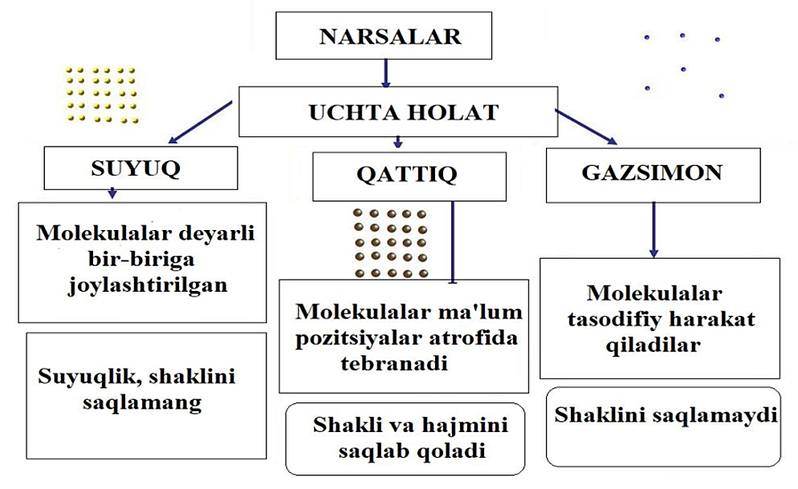
10

Slide 11
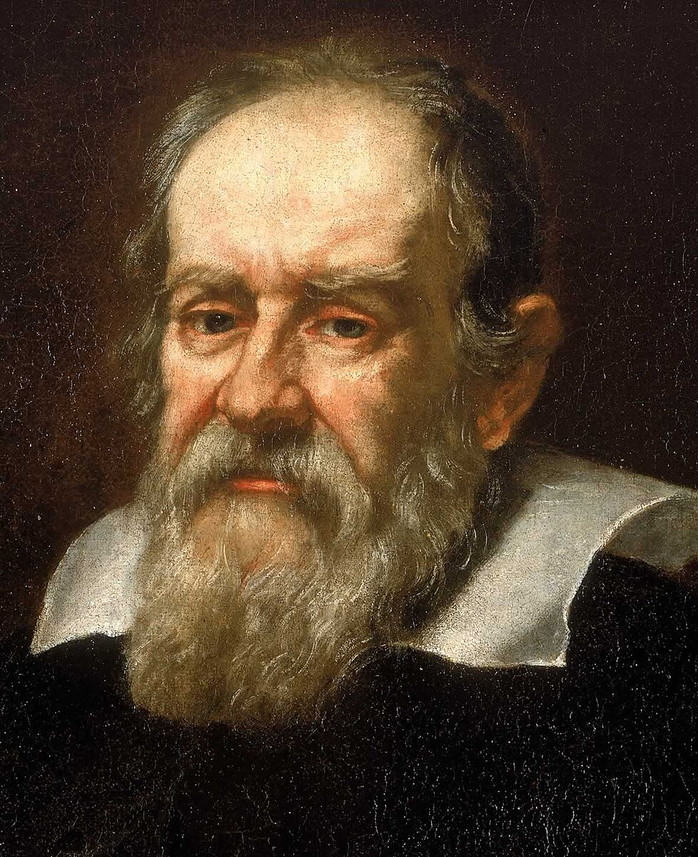
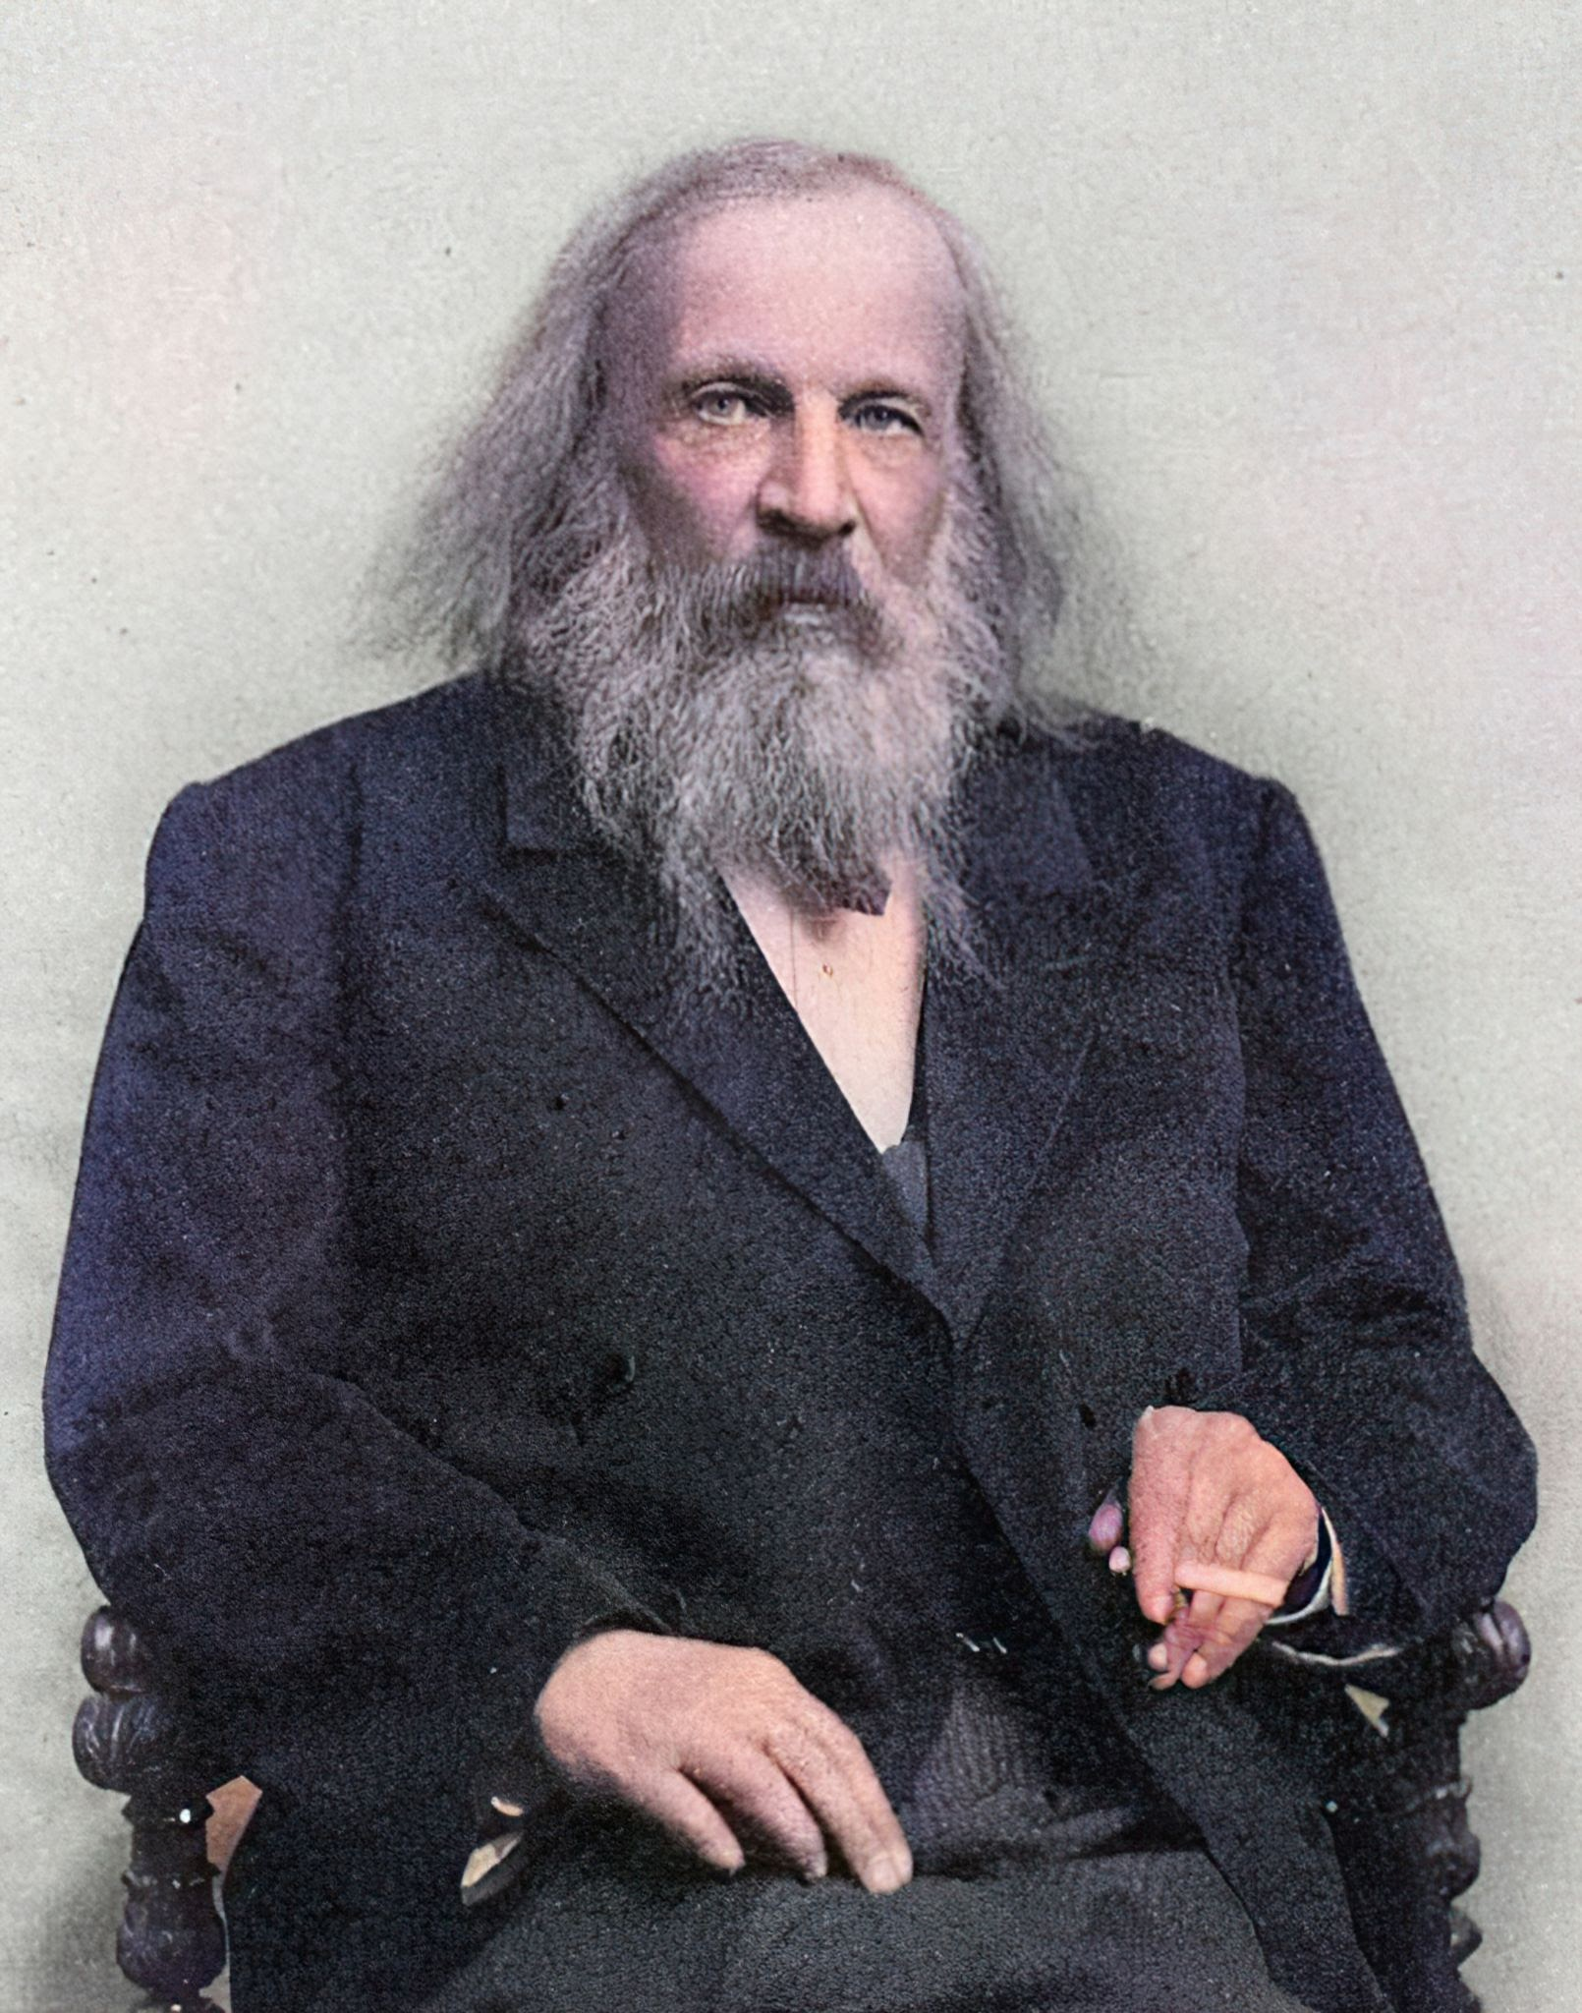
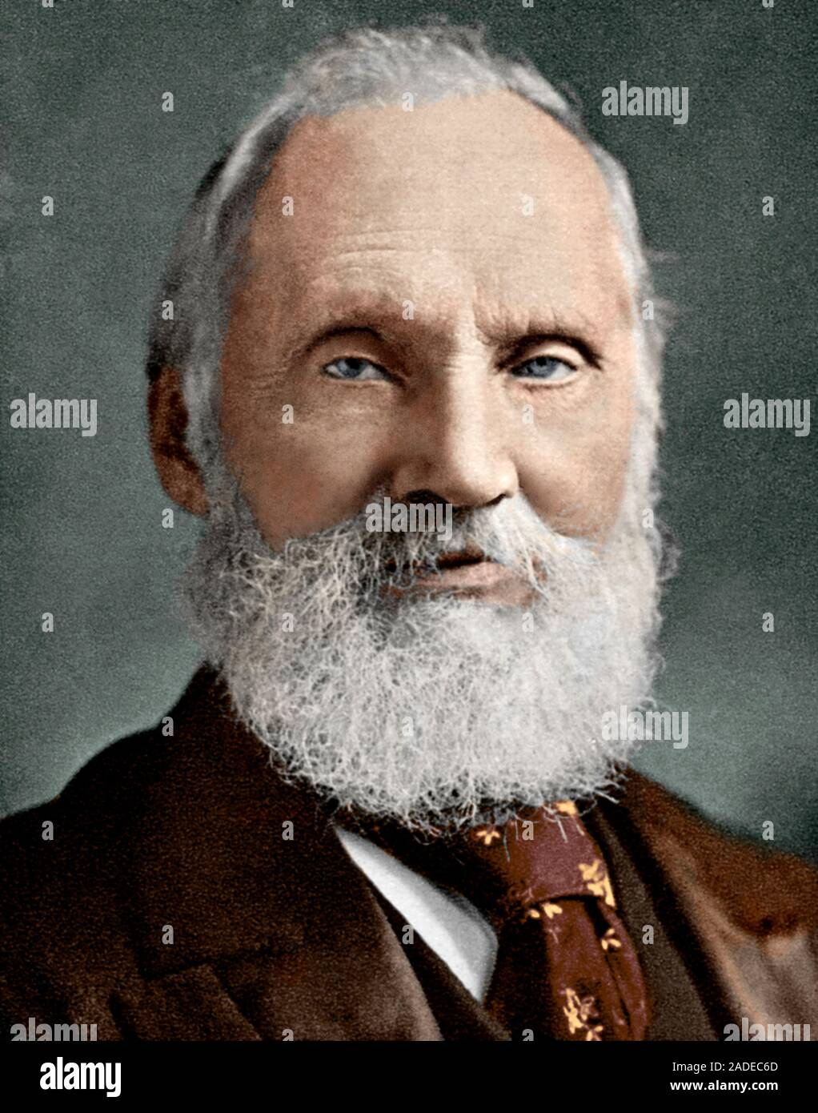
G. Galiley
"O’lchash uchun mavjud bo‘lgan hamma narsani o‘lchang va unga erishib bo‘lmaydigan hamma narsani qiling"
Galilei, G. (n.d.). Quotation on measurement [Portrait]. Retrieved September 20, 2025, from https://encrypted-tbn0.gstatic.com/images?q=tbn:ANd9GcSj7pOSpkT2KPu2qYm6K_VbYXGjUyx_lSgH-Y5hgBxecPE8BD8vyIlz1LSzdC7aOjd6w6c&usqp=CAU
D. I. Mendeleyev
"Ilm-fan o‘lchashni boshlashi bilanoq boshlanadi, aniq fanni o‘lchashsiz tasavvur qilib bo‘lmaydi"
Mendeleev, D. I. (n.d.). Quotation on measurement [Portrait]. Retrieved September 20, 2025, from https://encrypted-tbn0.gstatic.com/licensed-image?q=tbn:ANd9GcT-SNICj_l5uqfX_MK_NjHiClwHpuBJ5XnosYErjpnWsA4UvumiRQKt11geIszh-gimcByXyEX607y0Ieg
Kelvin (Lord Tompson)
"Har bir narsa faqat uni o‘lchash mumkin bo‘lgan darajada ma’lum"
Thomson, W. (Lord Kelvin). (n.d.). Portrait [Image]. Retrieved September 20, 2025, from https://c8.alamy.com/comp/2ADEC6D/william-thomson-1824-1907-british-physicist-and-mathematician-better-known-as-lord-kelvin-he-did-important-work-in-the-mathematical-analysis-of-e-2ADEC6D.jpg
11

Slide 12
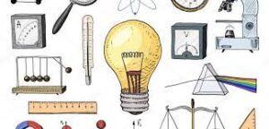
Eksperimentlar
Fizikada tabiatdagi jarayon va hodisalarni o‘rganishda turli tadqiqot metodlaridan foydalaniladi. Shuning uchun tajribalar fizik hodisalarni o‘rganishda alohida o‘rin tutadi.
Bundan tashqari jarayonlarga tegishli fizik parametrlar orasidagi bog‘lanishni matematik ifodalar orqali beriladi. Buning natijasida jarayonlarning bundan keyingi borishi yoki oldin qanday kechganligi haqida aniq ma‘lumot olish mumkin.
english-life.uz. (2022, March). Teaching physics technologies illustration [Image]. Retrieved September 20, 2025, from https://english-life.uz/wp-content/uploads/2022/03/fizikani-oqitishda-texnologiyalari-va-loyihalashtirish-1-300x144.jpg
12

Slide 13

Gipoteza
Kuzatilayotgan ko‘pgina hodisalar uchun ma’lum bir qonuniyatlar mavjudligi taxmin qilinadi. Bunday taxminlar ilmiy gipoteza deyiladi.
Gipotezani tekshirish uchun maxsus sharoitlar yaratilgan holda, tajribalar (eksperiment) o‘tkaziladi. Gipotezani shakllantirish va eksperiment o‘tkazish uchun mazkur jarayon yoki hodisaning modeli yaratiladi.
ifazo.uz. (2023, December 31). Scientific hypothesis illustration [Image]. Retrieved September 20, 2025, from https://ifazo.uz/wp-content/uploads/2023/12/photo_2023-12-31_10-44-37.jpg
13

Slide 14
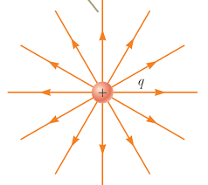
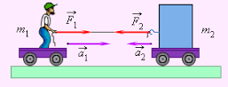
Fizik qonun
Fizik jarayonlar haqidagi gipoteza tasdiqlansa, u fizik qonunga aylanadi. Bunday qonunlarga Nyutonning uchta qonuni, butun olam tortishish qonuni, elastiklik va ishqalanish kuchiga oid qonunlar, gaz qonunlari, Kulon qonuni misol bo‘ladi.
Zaochnik.com. (2018, April 8). Physics law illustration [Image]. Retrieved September 20, 2025, from https://zaochnik.com/uploads/2018/04/08/image006.gif
Google Images. (n.d.). Coulomb law illustration [Image]. Retrieved September 20, 2025, from https://encrypted-tbn0.gstatic.com/images?q=tbn:ANd9GcTjeNobJxR3SU2po7fqalCvAYdyiysoZ6Oq8A&s
14

Slide 15
Avogadro Qonuni
Bir xil harorat va bosimdagi ideal gazlarning teng hajmlari bir xil miqdordagi molekulalarni o‘z ichiga oladi. Qonun 1811 yilda italiyalik fizik A. Avogadro (1776-1856) tomonidan kashf etilgan
Amper Qonuni
Bir-biridan qisqa masofada joylashgan o‘tkazgichlarda oqadigan ikkita tokning o‘zaro ta’siri qonuni: bir yo‘nalishdagi toklar parallel o‘tkazgichlarda birbiri o‘ziga tortadila va teskari yo‘nalishdagi toklar bir birini ittaradilar. Qonun 1820 yilda A.M.Amper tomonidan kashf etilgan.
Guk Qonuni
Ushbu qonunga ko‘ra, qattiq jismning yelastik deformatsiyalari ularni keltirib chiqaradigan tashqi ta’sirlarga to‘g‘ridan-to‘g‘ri proporsionaldir
15

Slide 16
Joule-Lenz Qonuni
Elektr tokining issiqlik ta’sirini tavsiflaydi: to‘g‘ridan-to‘g‘ri tok u orqali o‘tganda o‘tkazgichda chiqarilgan issiqlik miqdori tok kuchining kvadratiga, o‘tkazgichning qarshiligiga va o‘tish vaqtiga to‘g‘ri proporsionaldir.
Om Qonuni
elektron qismdagi to‘g‘ridan-to‘g‘ri elektr tokining kuchi ushbu qismning uchlaridagi kuchlanish bilan to‘g‘ridan-to‘g‘ri proporsional va uning qarshiligiga teskari proporsionaldir. U 1826 yilda G.S.Om tomonidan ochilgan.
Paskal Qonuni
Gidrostatikaning asosiy qonuni: suyuqlik yoki gaz yuzasida tashqi kuchlar tomonidan ishlab chiqarilgan bosim barcha yo‘nalishlarda teng ravishda uzatiladi.
16

Slide 17
Nyutonning birinchi Qonuni
moddiy nuqta, agar unga boshqa jismlar ta’sir qilmasa yoki bu jismlarning harakati qoplansa, to‘g‘ri chiziqli va bir xil harakat yoki tinch holatida bo‘ladi.
Nyutonning ikkinchi qonuni
jism tomonidan qabul qilingan tezlanish jismga ta’sir qiluvchi barcha kuchlarning natijasiga to‘g‘ri proporsional va jismning massasiga teskari proporsionaldir.
Nyutonning uchinchi qonuni
ikki jismning harakatlari har doim kattaligi bo‘yicha teng va qarama-qarshi yo‘nalishlarga yo‘naltirilgan
17

Slide 18
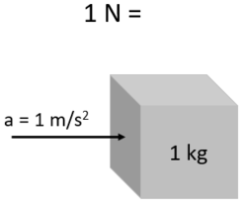
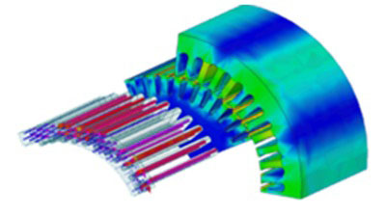
Ilmiy nazariya
Keng qamrovli hodisalarni tushuntiradigan qonunlar to‘plami ilmiy nazariya deyiladi. Masalan, Nyuton qonunlari maxanikaning klassik nazariyasini tashkil etadi. Ingliz fizigi D.K.Maksvell tomonidan shakllantirilgan qonunlar elektromagnitizm uchun klassik nazariya mazmunini tashkil etadi.
Wikipedia. (2018, July 6). Isaac Newton illustration [Image]. Retrieved September 20, 2025, from https://upload.wikimedia.org/wikipedia/commons/thumb/9/9d/Illustration_on_One_Newton%2C_2018-07-06.png/250px-Illustration_on_One_Newton%2C_2018-07-06.png
cadfem-cis.ru. (n.d.). Electromagnetism diagram [Image]. Retrieved September 20, 2025, from https://www.cadfem-cis.ru/media/items/images/hpc-1.jpg
18

Slide 19
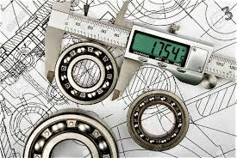
Moslik prinsipi
Barcha fizik qonunlar va nazariyalar haqiqatga yaqin bo‘lishi kerak. Har bir qonun va nazariyaning qo‘llanish chegarasi mavjud.
Yangidan topilgan fizik nazariyalar avvalgisini bekor qilmaydi, balki uni to‘ldiradi va aniqlashtiradi. Yangi fizik nazariyaga qo‘yilgan muhim talablardan biri moslik prisipidir. Bu degani berilgan chegarada yangi nazariya, avvalgi nazariya bilan mos tushishi kerak.
Google Images. (n.d.). Scientific principle illustration [Image]. Retrieved September 20, 2025, from https://encrypted-tbn0.gstatic.com/images?q=tbn:ANd9GcSrTbB6W1CkOlxxgqlHlyHZO226DW2SeGZ8kw&s
19

Slide 20
METROLOGIYA…
O’lchash asosida METROLOGIYA fani turadi !!!
Manba: ISO/IEC 99:2007
Metrologiya bo’yicha xalqaro lug’at
International Vocabulary of Metrology
bu o’lchashlar va ularning qo’llanilishi haqidagi fan
Metrologiya o’lchashlar noaniqligi darajasi va ularning qo’llanilish sohasidan qat’iy nazar o’lchashlarning barcha nazariy va amaliy jihatlarini qamrab oladi
20

Slide 21
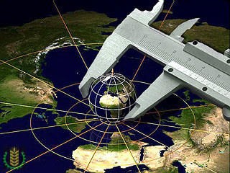
Metrologiya - bu o'lchashlar, ularning birligini ta'minlash usullari, vositalari va zarur bo'lgan aniqlikka erishish usullari to`g`risidagi fandir.
norma.uz. (n.d.). Metrology illustration [Image]. Retrieved September 20, 2025, from https://www.norma.uz/img/51/61/7f65eb8db017c06e1c444bf7c376.jpg
21

Slide 22
Metrologiya
Nazariy
Amaliy
Qonunlash-tiruvchi
22

Slide 23
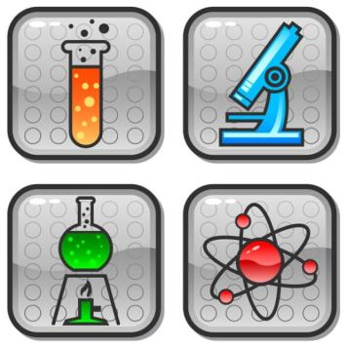
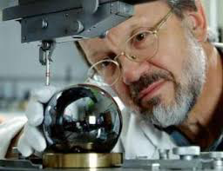
Nazariy
metrologiya
vesti.kz. (n.d.). Experimental physics illustration [Image]. Retrieved September 20, 2025, from https://encrypted-tbn0.gstatic.com/images?q=tbn:ANd9GcROFAY4fKfKieXxUDkmHTcZnLpShQAE8ED_4-MDrhZHwoLBcX-x
Google Images. (n.d.). Physics concept diagram [Image]. Retrieved September 20, 2025, from https://vesti.kz/userdata/0e72191834e1d331713472ecc917f6ee.jpg
Fundamental tadqiqotlar, o'lchov birliklari tizimini, fizik konstantalar yaratish, yangi o'lchash usullarini ishlab chiqish
23

Slide 24
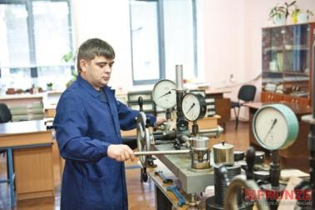
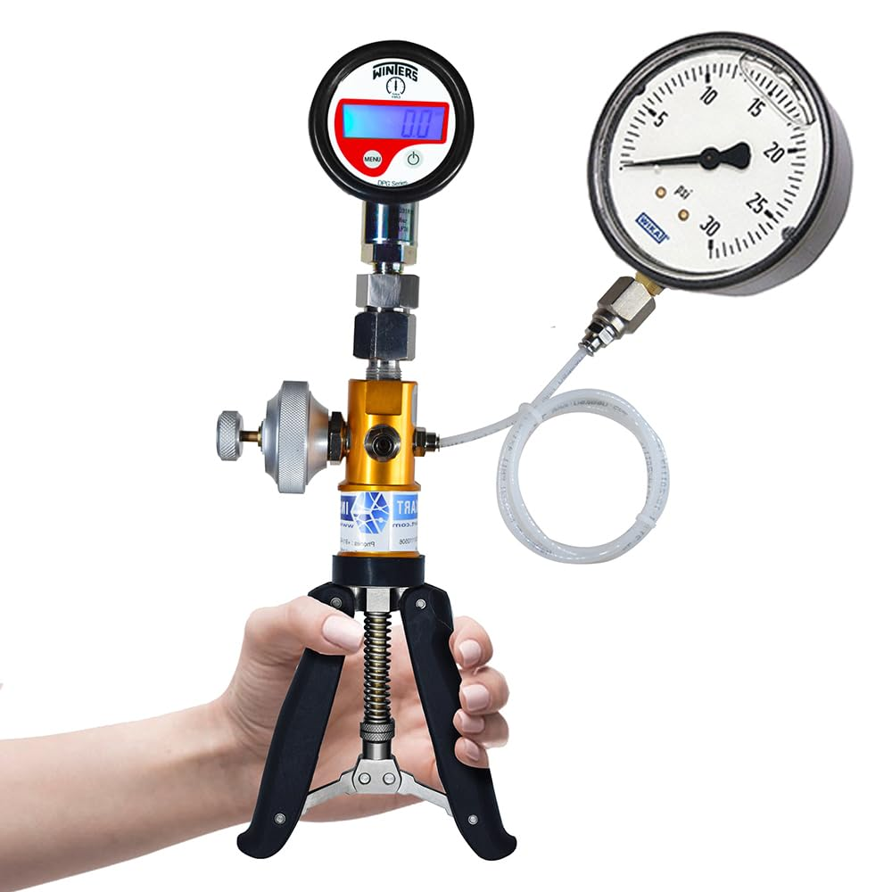
Amaliy metrologiya
Tetoprazdnik.ru. (2019, April). Measurement devices in laboratory [Image]. Retrieved September 20, 2025, from https://etotprazdnik.ru/wp-content/uploads/2019/04/https-st25-stblizko-ru-images-product-179-447-84.jpeg
Amazon.com. (n.d.). Pressure gauge device [Image]. Retrieved September 20, 2025, from https://m.media-amazon.com/images/I/51KGNsJUjkL._SL1000_.jpg
Nazariy metrologiya ishlanmalarini va qonunlashtiruvchi metrologiya qoidalarini amalda qo'llash
24

Slide 25


Qonunlashtiruvchi
metrologiya
O'lchash birliklari, etalonlar, o'lchash usullari, vositalari va boshqa masalalar uchun majburiy yuridik talablarni belgilash
Google Images. (n.d.). Legal metrology illustration [Image]. Retrieved September 20, 2025, from https://encrypted-tbn0.gstatic.com/images?q=tbn:ANd9GcRzj0s_96k4Vwtdv8GBOSsLRhmzYCr92oHl5A&s
Wikipedia. (n.d.). Metrology organization logo [Image]. Retrieved September 20, 2025, from https://upload.wikimedia.org/wikipedia/ru/8/84/%D0%9C%D0%9E%D0%97%D0%9C_%D0%9B%D0%BE%D0%B3%D0%BE.jpg
25

Slide 26
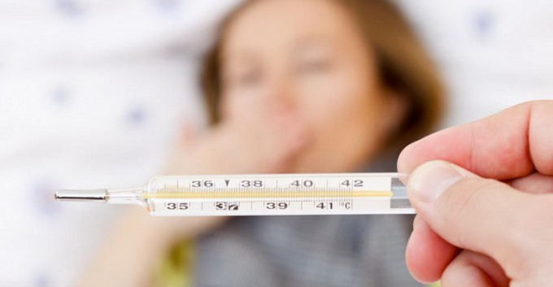
Har bir qaror o’lchash ma’lumoti asosida qabul qilinadi
Qanchalik to’g’ri o’lchasak
Shunchalik to’g’ri qaror qabul qilamiz
26
Daryo.uz. (n.d.). [Photograph of unknown subject] [Image]. Retrieved September 20, 2025, from https://data.daryo.uz/media/cache/2017/11/0_1135bd_c9b12a79_orig-680x353.jpg

Slide 27
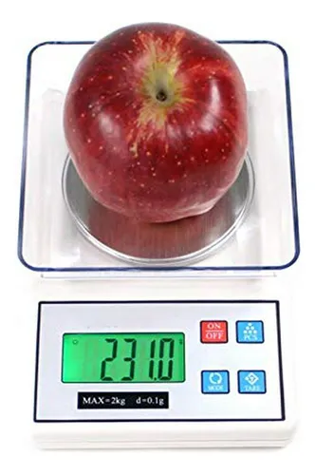
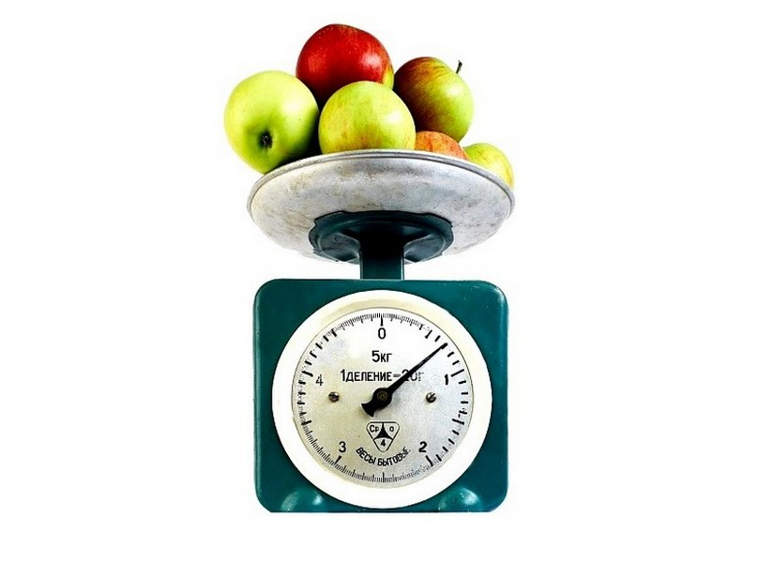
To’g’ri o’lchash – bu har doim ham aniq o’lchash degani emas!
MercadoLibre. (2024, June). Blood pressure measurement device [Image]. Retrieved September 20, 2025, from https://http2.mlstatic.com/D_NQ_NP_673266-MCO76778694361_062024-O.webp
To’g’ri o’chash – bu talab etilgan aniqlikni ta’minlashdir
20minutos. (2012, December 26). Weight measurement illustration [Image]. Retrieved September 20, 2025, from https://imagenes.20minutos.es/files/image_640_auto/uploads/imagenes/2012/12/26/88920.jpg
27

Slide 28
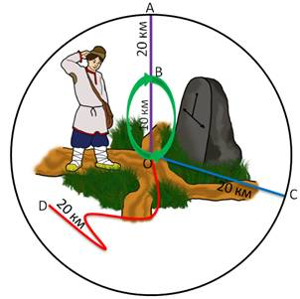
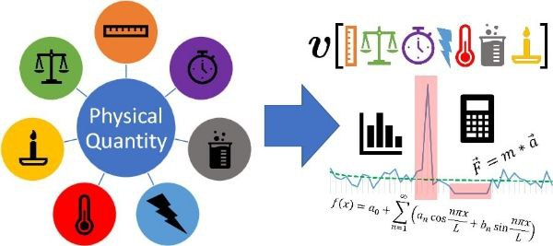
Fizik kattalik - bu ko'plab fizik ob'ektlar uchun sifat jihatidan umumiy bo'lgan, ammo har bir ob'ekt uchun miqdoriy jihatdan individual bo'lgan xususiyatdir
Multiurok. (2020, February 22). Physics class illustration [Image]. Retrieved September 20, 2025, from https://fsd.multiurok.ru/html/2020/02/22/s_5e50c5add4607/1362446_12.jpeg
ifazo.uz. (2023, June 25). Physics education photo [Image]. Retrieved September 20, 2025, from https://ifazo.uz/wp-content/uploads/2023/06/photo_2023-06-25_10-18-38.jpg
28

Slide 29
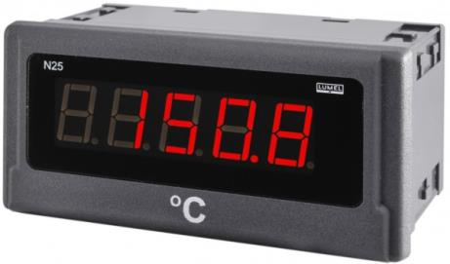
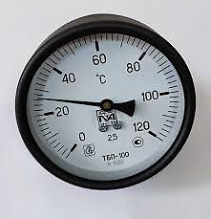
Fizik kattalikning qiymati - bu fizik kattalik o'lchamining uning uchun qabul qilingan birlikning ma'lum sonli ko'rinishdagi miqdoriy bahosidir
Fizik miqdor = Raqamli qiymat X O’lchash birligi
IndiaMART. (n.d.). Thermal device [Image]. Retrieved September 20, 2025, from https://4.imimg.com/data4/BW/IS/MY-15282457/time-temperature-indicator-500x500.jpg
Google Images. (n.d.). Time and temperature indicator [Image]. Retrieved September 20, 2025, from https://encrypted-tbn3.gstatic.com/images?q=tbn:ANd9GcQOLF5YCUIpMGkWzXI18l0sr0_qWebnYTF_mqfOqYHI3ol7a5Iy
29

Slide 30
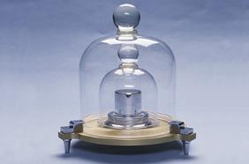
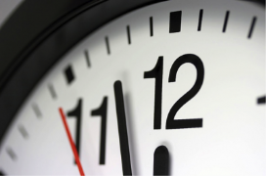
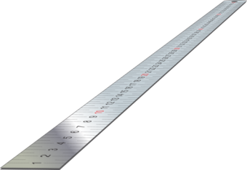
1 sek
1 kg
Google Images. (n.d.). Measurement illustration [Image]. Retrieved September 20, 2025, from https://encrypted-tbn2.gstatic.com/images?q=tbn:ANd9GcQXvn4343m5PPGM4UCYXB-rVfdDdxolsJ0-VkYSAczhozEbDBiZ
1 m
Instructables. (n.d.). DIY measurement device [Image]. Retrieved September 20, 2025, from https://content.instructables.com/FFB/NSJ0/FJPL6BZJ/FFBNSJ0FJPL6BZJ.jpg?auto=webp&crop=1.2:1&frame=1&width=270
Clipart Library. (n.d.). Measurement clipart [Image]. Retrieved September 20, 2025, from https://clipart-library.com/data_images/106579.jpg
Fizik kattalik birligi
– son jihatdan qiymati birga tenglashtirilgan ko`rsatkichga ega bo`lgan fizik kattalik
30

Slide 31
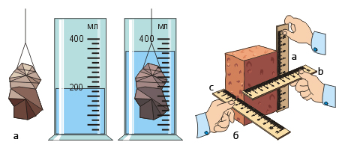
kabinet-337. (n.d.). Schoolbook illustration [Image]. Retrieved September 20, 2025, https://kabinet-337.narod.ru/uchebnik-6-class/images/page2/value.jpg
O'lchash
— fizik kattalik qiymatini tajribada maxsus texnik vositalar yordamida aniqlash jarayoni
31

Slide 32
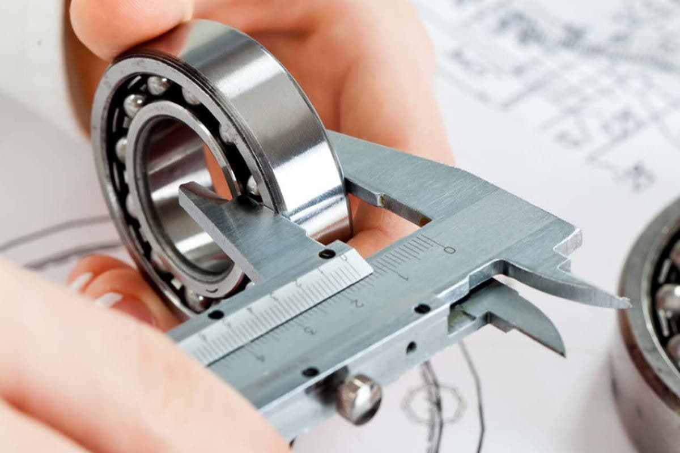

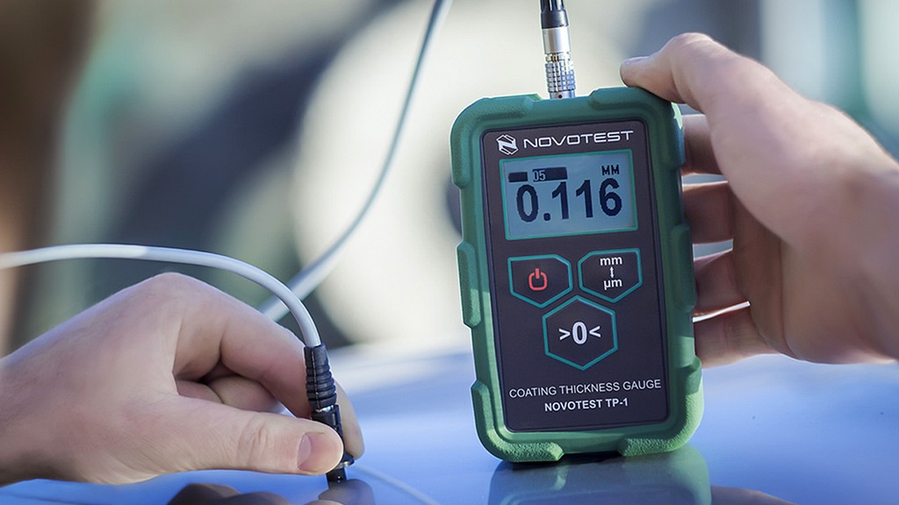
"O'lchash" tushunchasining belgilari
1. Faqat real mavjud ob'ektlarning xususiyatlarini o'lchash mumkin
2. O'lchash tajribalar o`tkazishni talab qiladi
3. O'lchash uchun maxsus texnik vositalar kerak
4. O'lchash natijasi fizik kattalikning qiymatidir
Kun.uz. (n.d.). Medical measurement photo [Image]. Retrieved September 20, 2025, from https://storage.kun.uz/source/7/kLwsXE5Tpu1CZl-_p0WyGVDwkUR3Lm-b.jpg
mymedic.uz. (n.d.). Blood pressure measurement [Image]. Retrieved September 20, 2025, from https://mymedic.uz/wp-content/uploads/qon-bosimini-olchash.jpg
Denetim. (n.d.). Material measurement illustration [Image]. Retrieved September 20, 2025, https://www.denetim.com/images/kaplama-kalinligi-olcumu.jpg
32

Slide 33
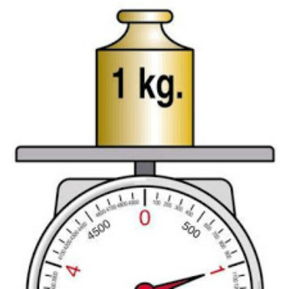
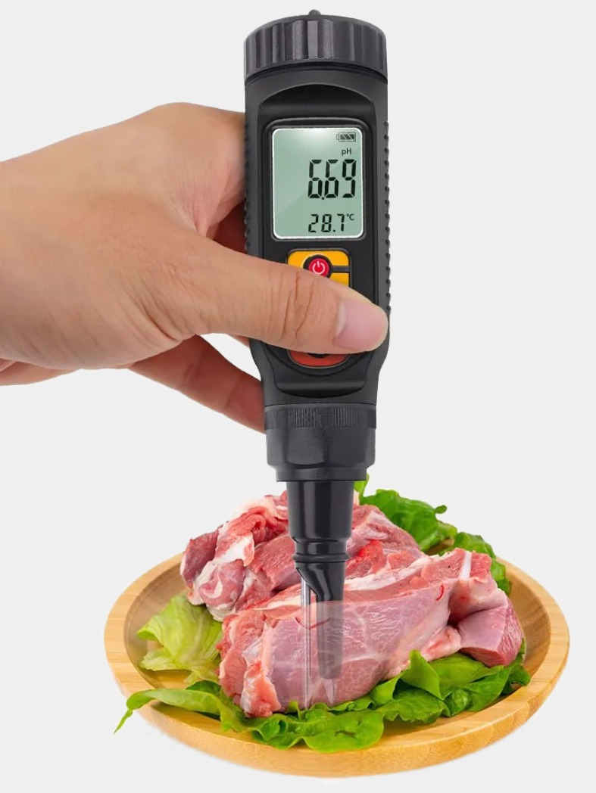
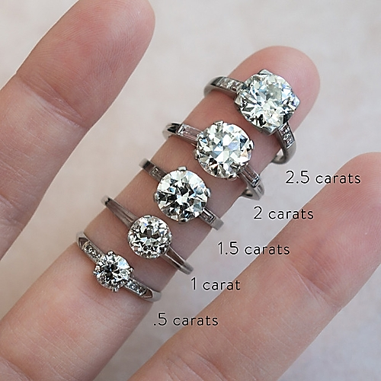
O'lchashlarning birliligi
- bu o'lchashlarning shunday holatiki, unda natijalar qonunlash-tirilgan birliklarda ifodalangan va o'lchash natijalarining xatoliklari ma'lum bo'ladi.
norma.uz. (n.d.). Diamond measurement [Image]. Retrieved September 20, 2025, from https://static.norma.uz/images/138352_1c5e93624f468254f8513c79cd70.jpg
zamin.uz. (2019, October). Diamond size illustration [Image]. Retrieved September 20, 2025, from https://images.uzum.uz/cs8f3d34nkdhfdv54v0g/original.jpg
Uzum. (n.d.). Ring illustration [Image]. Retrieved September 20, 2025, from https://zamin.uz/uploads/posts/2019-10/1571656314_how-different-diamond-sizes-actually-look-on-a-hand-2070499_640x0c_0-500x500.jpg
33

Slide 34
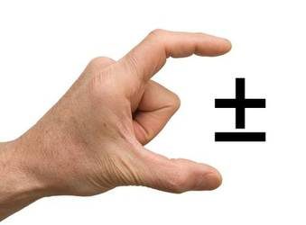
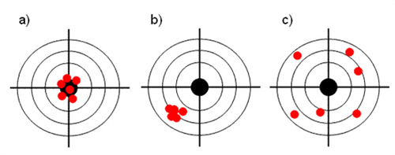
ekosf.ru. (2020, November). Uncertainty illustration [Image]. Retrieved September 20, 2025, from https://ekosf.ru/wp-content/uploads/2020/11/neopredelennost.jpg
cirlab.ru. (n.d.). Laboratory uncertainty illustration [Image]. Retrieved September 20, 2025, from https://www.cirlab.ru/upload/medialibrary/7e1/7e1137ff210662415efd3e3c67171e8c.jpg
O'lchash aniqligi
- o'lchash natijalarining o'lchanayotgan qiymatning chinakam qiymatiga yaqinlashganlik darajasi
34

Slide 35
Foydalanilgan adabiyotlar
1.O’lchash usullari va vositalari, O’quv qo’llanma. A.A.Mamajonov, M.O.Sattarov, D.V.Xakimov / Toshkent “NIF MSh” -2020 y. 254 b.
2.O’lchashning fizikaviy asoslari. Darslik. Kalandarov P.I.. / – T:” TIQXMMI” MTU, 2023, 232 b.
3.Fizikaviy-kimyoviy o’lchashlar, O’quv qo’llanma. Ismаtullаеv P.R. va boshq. / T.: TDTU, 2007.
4.Issiqlik texnikasida o’lchashlar. O’quv qo’llanma. Ismаtullаеv P.R., A’zamov A.A. va boshq. / T.: TDTU, 2007.
5.Studfile.net. (n.d.). Fragment of the natural picture of the world by object size [Image]. Retrieved September 20, 2025, from https://studfile.net
6.Galilei, G. (n.d.). Quotation on measurement [Portrait]. Retrieved September 20, 2025, from https://encrypted-tbn0.gstatic.com/
7.Mendeleev, D. I. (n.d.). Quotation on measurement [Portrait]. Retrieved September 20, 2025, from https://encrypted-tbn0.gstatic.com/
8.Thomson, W. (Lord Kelvin). (n.d.). Portrait [Image]. Retrieved September 20, 2025, from https://c8.alamy.com
9.English-life.uz. (2022, March). Teaching physics technologies illustration [Image]. Retrieved September 20, 2025, from https://english-life.uz/wp-content/uploads/2022/03/fizikani-oqitishda-texnologiyalari-va-loyihalashtirish-1-300x144.jpg
10.Zaochnik.com. (2018, April 8). Physics law illustration [Image]. Retrieved September 20, 2025, from https://zaochnik.com/uploads/2018/04/08/image006.gif
11.Google Images. (n.d.). Coulomb law illustration [Image]. Retrieved September 20, 2025, from https://encrypted-tbn0.gstatic.com/images?q=tbn:ANd9GcTjeNobJxR3SU2po7fqalCvAYdyiysoZ6Oq8A&s
12.Wikipedia. (2018, July 6). Isaac Newton illustration [Image]. Retrieved September 20, 2025, from https://upload.wikimedia.org/wikipedia/
13.cadfem-cis.ru. (n.d.). Electromagnetism diagram [Image]. Retrieved September 20, 2025, from https://www.cadfem-cis.ru/media/items/images/hpc-1.jpg
14.Google Images. (n.d.). Scientific principle illustration [Image]. Retrieved September 20, 2025, from https://encrypted-tbn0.gstatic.com/images?q=tbn:ANd9GcSrTbB6W1CkOlxxgqlHlyHZO226DW2SeGZ8kw&s
15.norma.uz. (n.d.). Metrology illustration [Image]. Retrieved September 20, 2025, from https://www.norma.uz/img/51/61/7f65eb8db017c06e1c444bf7c376.jpg
16.vesti.kz. (n.d.). Experimental physics illustration [Image]. Retrieved September 20, 2025, from https://vesti.kz/userdata/0e72191834e1d331713472ecc917f6ee.jpg
17.Google Images. (n.d.). Legal metrology illustration [Image]. Retrieved September 20, 2025, from https://encrypted-tbn0.gstatic.com/images?q=tbn:ANd9GcRzj0s_96k4Vwtdv8GBOSsLRhmzYCr92oHl5A&s
18.MercadoLibre. (2024, June). Blood pressure measurement device [Image]. Retrieved September 20, 2025, from https://http2.mlstatic.com/D_NQ_NP_673266-MCO76778694361_062024-O.webp
35

Slide 36
E’tiboringiz
uchun rahmat !!!
36

