Slide 1
COURSE: MEASUREMENT METHODS AND TOOLS
Week 4. Measuring tools and their classification
Lecturer: PhD. B.Khamdamov
(Andijan Technical Institute)
1

Slide 2
O’LCHASH USULLARI VA VOSITALARI
4-Ma’ruza. O’lchash vositalari va ularning tasnifi.
Ma’ruzachi: PhD. B.Xamdamov
(Andijon davlat texnika Instituti)
2

Slide 3
4-Mavzu: O’lchash vositalari va ularning tasnifi.
Reja:
4.1 O’lchаsh vоsitаlаrining tаbаqаlаnishi
4.2 O’lchоvlаr vа ulаrning turlаri
4.3 O’lchаsh o’zgаrtkichlаri
4.4 O’lchаsh аsbоblаri vа uning turlаri
4.5 O’lchаsh qurilmаlаri vа o’lchаsh tizimlаri
3

Slide 4
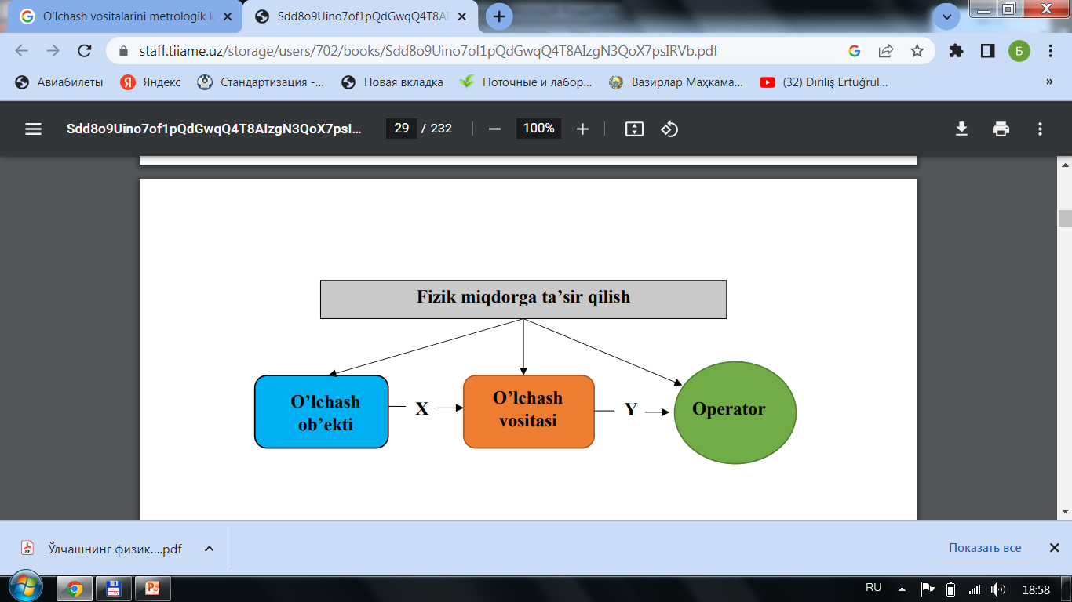
O’lchash jarayonining sxemasini quyidagi shaklda keltirish mumkin:
X-o‘lchangan qiymat; Y-axborotni o‘lchash signali;
4

Slide 5
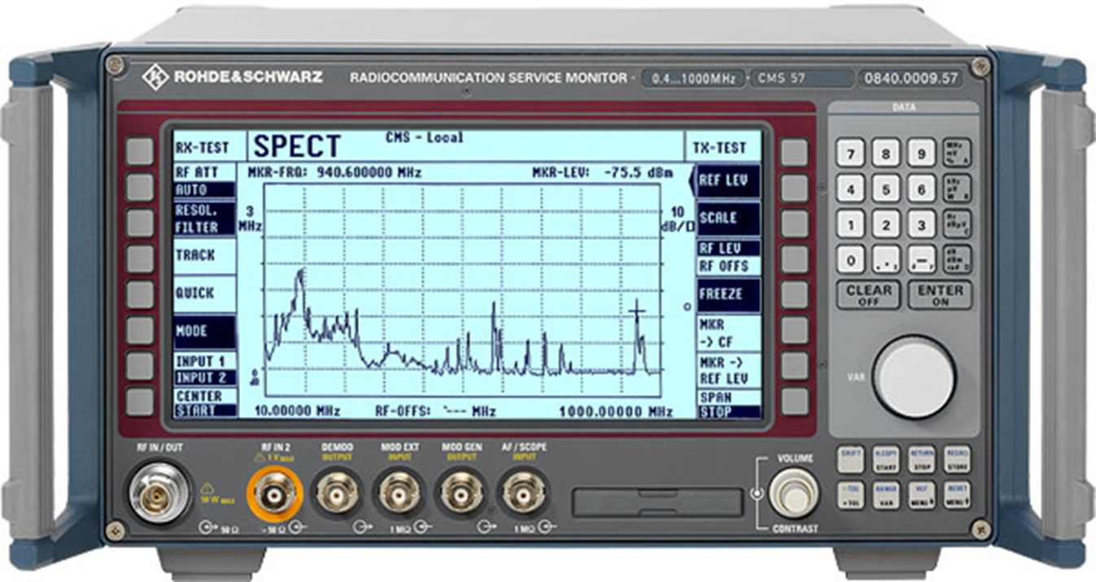
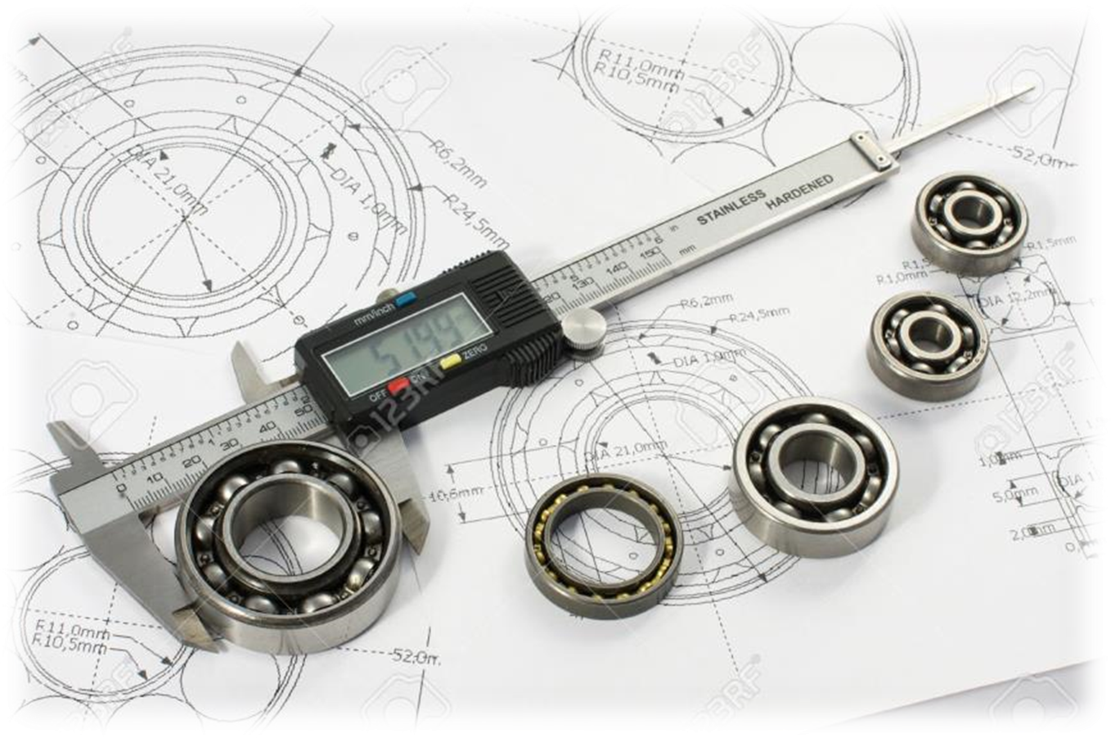
O’lchаshlаrdа qo’llаnilаdigаn vа mе’yorlаngаn mеtrоlоgik хususiyatlаrigа egа bo’lgаn tехnik vоsitаlаr
O’lchash vositasi
mеtrоlоgik хususiyatlаri mе’yor­lаngаn, bеlgilаngаn хаtоlik chеgаrаsidа bo’lgаn, mа’lum vаqt оrаlig’idа o’zgаrmаs dеb qаbul qilinаdigаn, kаttаlikning o’l­chоv birligini qаytа tiklаydigаn yoki sаqlаydigаn, o’lchаshlаr uchun mo’ljаllаngаn tехnik vоsitа
Fig. 1. "Measurement device" prompt, NSCA Inc., n.d.
https://i0.wp.com/nscainc.com/wp-content/uploads/2014/02/db_file_img_1023_500x450.jpg?fit=500,450&ssl=1
Fig. 2. "Classification of measuring instruments" prompt, Google Images, n.d. https://encrypted-tbn3.gstatic.com/images?q=tbn:ANd9GcSVf7iTPdtLksypwRjCAKA8TXZ6Q53CKykigUIr02y_m6wXDou8
5

Slide 6
O'lchash vositalarini tasniflash belgilari
O'lchash vositalari
Turi bo`yicha
Ishlash printsipi bo`yicha
Metrologik qo`llanilishi bo`yicha
6

Slide 7
O`lchash vositalarini turi bo`yicha tasniflash
O`lchash vositasi
O`lchovlar
O`lchash o`zgartkichlari
O`lchash asboblari
O`lchash qurilmalari va tizimlari
O`lchov magazini
Bir qiymatli
Ko`p qiymatli
Masshtabli
Birlamchi
Oraliq
Uzatuvchi
O`lchash usuli bo`yicha
Chiqish signali shakli bo`yicha
Ko`rsatkichlarni taqdim etish bo`yicha
Solishtirish
To`g`ridan-to`g`ri
Raqamli
Analogli
Jamlovchi
Ko`rsatuvchi
Qayd qiluvchi
7

Slide 8
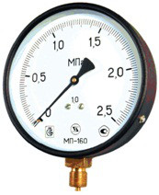
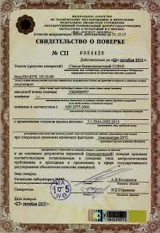
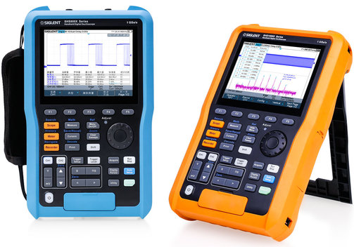
O'lchash vositalari -
o'lchash uchun mo'ljallangan va normalangan metrologik tavsiflarga ega texnik uskunalar yoki ularning majmui.
Fig. 4. "Measurement device" prompt, Belarusinfo, 2019.
https://www.belarusinfo.by/ru/images/stories/photo_gallery/70k/66153/3.jpg
Fig. 5. "Measuring tool" prompt, Google Images, n.d. https://encrypted-tbn1.gstatic.com/images?q=tbn:ANd9GcRJix3aB7_KyB3_dfbF9UPWIRD0r_xGrLV4qV188aBJyYaFSHO1
Fig. 3. "Digital oscilloscope" prompt, Meilhaus Electronic, 2021. https://www.meilhaus.de/cosmoshop/default/pix/a/n/shs800x-shs1000x.jpg
8

Slide 9

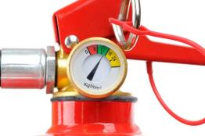
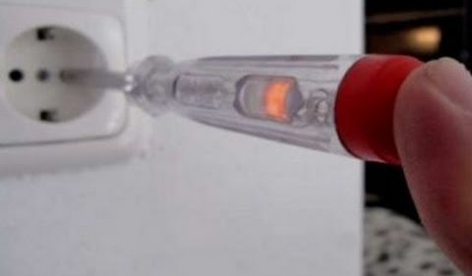
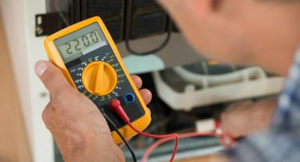
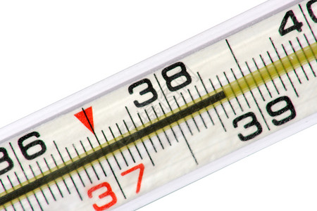
Fig. 6. "Transportir (protractor)" prompt, eodev.com, n.d.
https://tr-static.eodev.com/files/d48/cec481dd8d6e98750eabae2b5ac8d722.jpg
Fig. 7. "Scale weight balance" prompt, a.d-cd.net, 2018.
https://a.d-cd.net/c897d36s-960.jpg
Fig. 8. "Measurement device" prompt, YouTube, 2020 https://i.ytimg.com/vi/9ruxA-H1ydI/hqdefault.jpg
Indikatorlar (sensor)
Faqat ob’yektlarning fizik xossalarini aniqlaydi
Fig. 9. "Measurement tool" prompt, Google Images, n.d.
https://encrypted-tbn0.gstatic.com/images?q=tbn:ANd9GcR8DV3xtxiXSbe5oDiHjLkl6MMsWEPBONh6BVwAtIpreOEMt5xA
Fig. 10. "Measurement diagram" prompt, 699pic.com, 2022.
https://imgs.699pic.com/images/320/658/957.jpg!list1x.v2
O'lchash vositalari - ob’yektlarning fizik xossalarini aniqlaydi
va noma'lum o`lchamni ma'lum bo'lganga solishtiradi
9

Slide 10
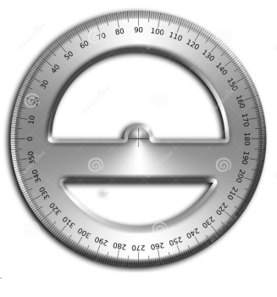
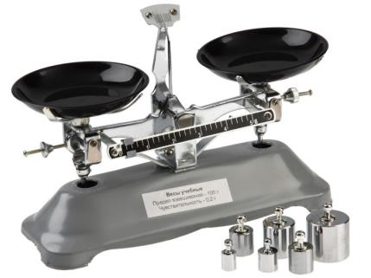
Fig. 11. "Multimeter" prompt, Google Images, n.d.
https://encrypted-tbn1.gstatic.com/images?q=tbn:ANd9GcRkLAEAQsV7-m7NxrUyOUxE08r1NUArUOiw0kFZnNaF6oAAojmX
Fig. 12. "Thermometer" prompt, Google Images, n.d.
https://encrypted-tbn1.gstatic.com/images?q=tbn:ANd9GcTqJwJPmA057lX6cswQ48keA-EfgqChxtPtwVJQqQXPAmS1ZiKg
Transportir
Qadoq toshli tarozi
Agar ma'lum o'lchamdagi fizik kattalik mavjud bo'lsa, u to'g'ridan-to'g'ri taqqoslash uchun ishlatiladi
10

Slide 11
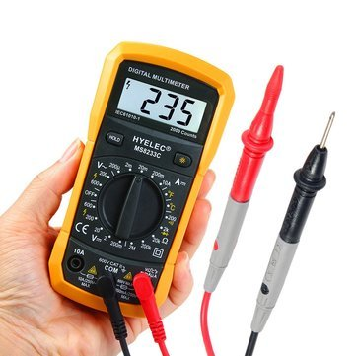
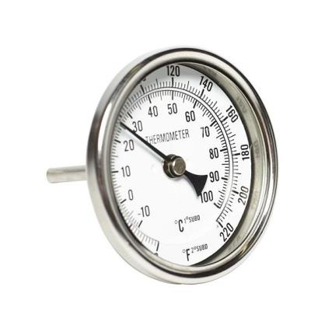
Multimetr
Termometr
Fig. 13. "Angle meter" prompt, Amazon, Amazon.com, n.d.
https://m.media-amazon.com/images/I/41J9vJ8iFAL.jpg
Fig. 14. "Scale weight" prompt, Dobro38.ru, n.d. https://www.dobro38.ru/upload/iblock/b6b/b6b465687d75a833ad00d536247e5e09.jpg
Agar ma'lum o'lchamdagi fizik kattalik mavjud bo'lmasa, unda qurilmaning reaktsiyasi ma'lum kattalik miqdorining ta'siriga ilgari namoyon bo'lgan reaktsiya bilan taqqoslanadi
11

Slide 12
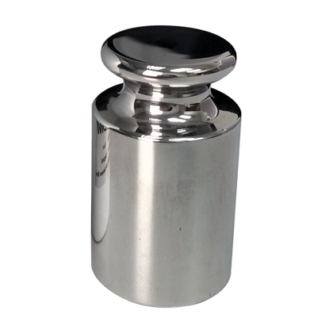
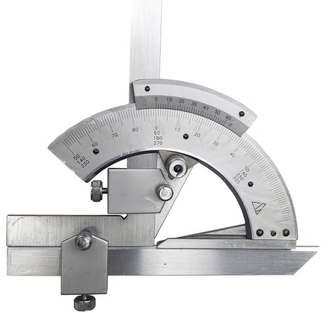
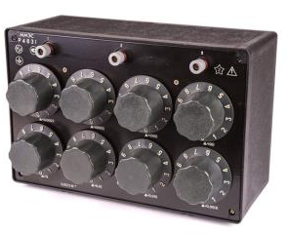
Bir qiymatli
Ko`p qiymatli
O`lchovlar to`plami (magazin)
Qadoq tosh
Burchak o`lchagich
Fig. 15. "Calibration weight" prompt, Eonghuat, n.d. https://eonghuat.com/cdn/shop/files/F2-200g_01TW-CH069_420x.png?v=1710130066
Fig. 17. "OIML calibration weight" prompt, Google Images, n.d. https://encrypted-tbn3.gstatic.com/images?q=tbn:ANd9GcRjFpCPFqXoTAnIO2iZp7VSmXr4VDDSRVGnYM03I2V0zmSt5b5T
Fig. 16. "Calibration weight set" prompt, Alibaba, 2020. https://gw.alicdn.com/imgextra/TB1EOcDo4D1gK0jSZFsXXbldVXa.jpg_540x540.jpg
O'lchov - bir yoki bir nechta berilgan o'lchamdagi fizik kattalikni tiklash va (yoki) saqlash uchun mo'ljallangan o'lchov vositasi
12

Slide 13
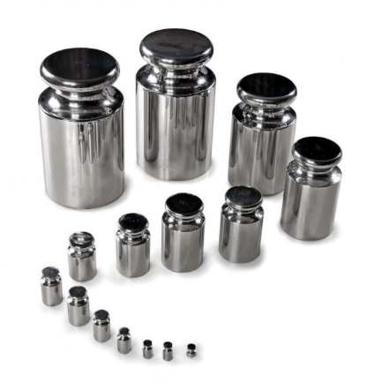
o'lchоv (O’z DSt 8.010.2:2003 gа ko'rа)
o'lchоv – qiymаtlаri bеlgilаngаn birliklаrdа ifоdаlаngаn vа zаrur аniqlikdа mа'lum bo'lgаn bir yoki bir nеchtа bеrilgаn o'lchаmlаrning kаttаligini qаytа tiklаsh vа (yoki) sаqlаsh uchun mo'ljаllаngаn o'lchаsh vоsitаsi quyidаgilаrgа bo'linаdi:
- bir o'lchаmli (qаdоq tоsh, uzunlikning kоntsеvоy) o'lchоvi);
- ko'p o'lchаmli (elеktr qаrshiligi mаgаzini);
- o'lchоvlаr to'plаmi (tоshlаr to'plаmi).
Fig 17a. Calibration Weights OIML CLASS M1. 2014, https://encrypted-tbn0.gstatic.com/images?q=tbn:ANd9GcTqHLhD75BOKoxmYi8IxrivjCpQ05vicss4Y8sIGzAeR2zlsYL9
13

Slide 14
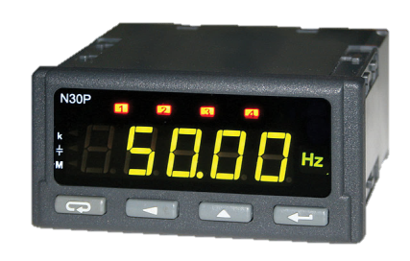
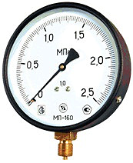
O'lchash asbobi - kuzatuvchi tomonidan bevosita idrok eta oladigan shaklda o'lchash ma'lumotlari signalini yaratish uchun mo'ljallangan o'lchov vositasi.
Analogli
Raqamli
Fig. 18. "Digital meter" prompt, JD Magic Box, n.d.
https://images.jdmagicbox.com/comp/def_content_category/digital-meter-manufacturers/digital-meter-6-digital-meter-manufacturers-1-s6bii.jpg
Fig. 19. "Analog meter" prompt, Belarusinfo, 2019.
https://www.belarusinfo.by/ru/images/stories/photo_gallery/70k/66153/3.jpg
Ko'rsatuvchi o'lchash asboblari faqat o'lchanayotgan fizik kattalikning lahzali qiymatlarini olishga imkon beradi. Shkalaga nisbatan harakatlanuvchi hisoblash qurilmasining ko'rsatkichi yoki raqamli indikator ko'rsatkichlari faqat vizual kuzatiladi.
14

Slide 15
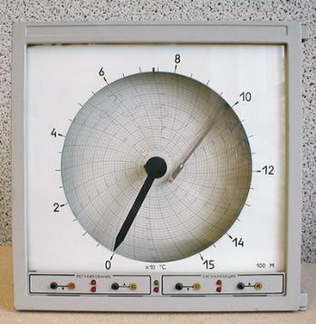
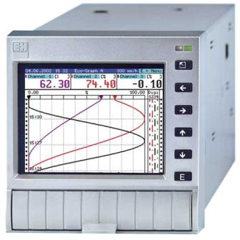
Qog`oz diagrammada qayd
qiluvchi asbob
Raqamli qayd qiluvcha va
xotirada saqlovchi asbob
Fig. 20. "Manometer" prompt, Tehpribory.ru, 2018.
https://tehpribory.ru/wp-content/uploads/2018/02/Manom-4.1.jpg
Fig. 21. "Recorder device" prompt, Endress+Hauser, 2017.
https://portal.endress.com/webapp/picturepool/500/0/RSG22.jpg
Qayd qiluvchi o'lchash vositalari ko`rsatkichlarni qayd qilich qurilmasi bilan ta’minlangan. Diagramma shaklida qayd qiluvchi asboblar o`ziyozar asboblar deb ataladi.
15

Slide 16
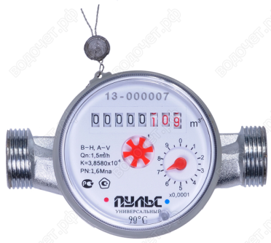
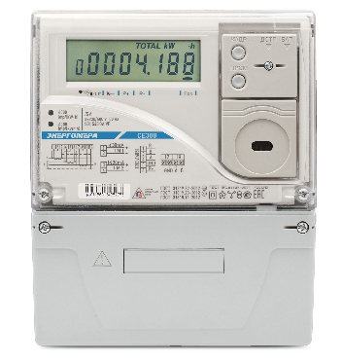
Jamlovchi (integratsiylovchi) o'lchash asboblari vaqt davomida (ma'lum vaqt oralig'ida fizik kattalik qiymatini yig'ish uchun) yoki boshqa mustaqil o'zgaruvchini jamlash qobiliyatiga ega.
Fig. 22. "Water meter" prompt, MVK Service, n.d.
https://mvk-service24.ru/img/vodoschetchiki-puls.jpg
Fig. 23. "Analog indicator" prompt, Energomera, n.d.
https://energomera.nt-rt.ru/files/price/images/90745/ct308_c31.jpg
16

Slide 17
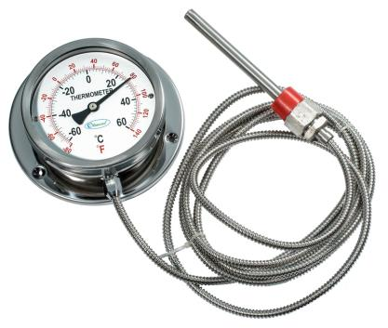
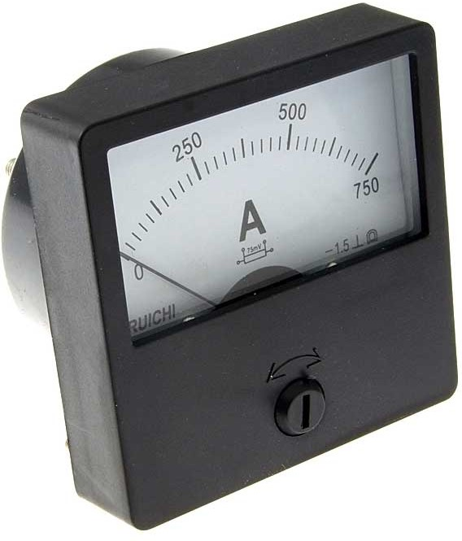
Analogli o'lchash asbobi - bu ko`rsatkichi o'lchanayotgan miqdorning doimiy funktsiyasi bo'lgan asbob. Analogli asbobning yaqqol belgisi ko`rsatish milining (strelka) mavjudligidir
Fig. 25. "Measuring device scheme" prompt, Chipdip.ru, n.d.
https://static.chipdip.ru/lib/678/DOC014678019.jpg
Fig. 24. "Digital measuring instrument" prompt, Aholod.ru, n.d.
https://aholod.ru/wa-data/public/shop/products/20/27/2720/images/2720/2720.750x0.jpg
17

Slide 18
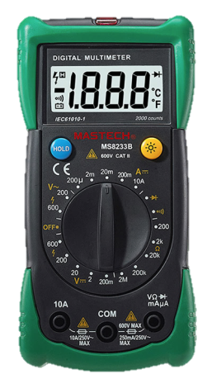
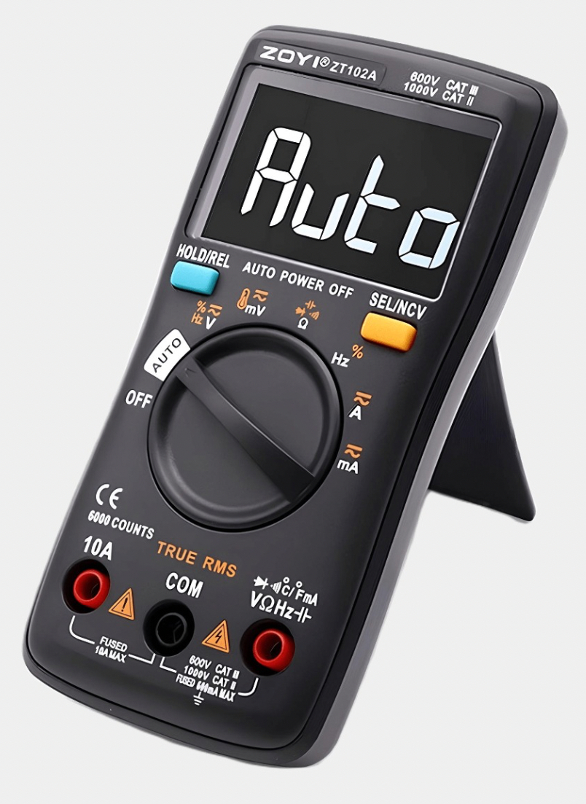
Fig. 26. "Digital multimeter" prompt, Ozon.ru, n.d.
https://ir.ozone.ru/s3/multimedia-r/c1000/6128192679.jpg
Fig. 27. "Measurement device photo" prompt, Uzum, 2024.
https://images.uzum.uz/cn9ad5ps99ouqbfv29k0/original.jpg
Raqamli o`lchash asbobi – bunday asbob o'lchanayotgan qiymat haqida ma'lumotni raqamli indikatsiya orqali beradi
18

Slide 19
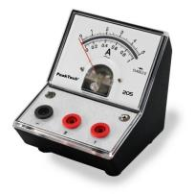
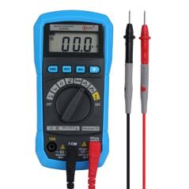
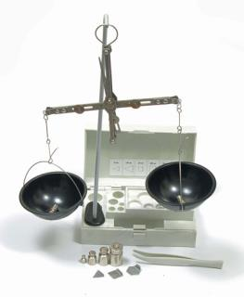
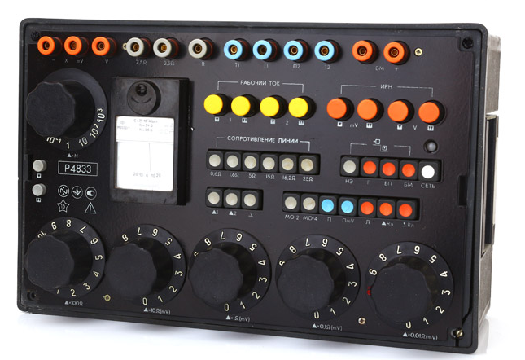
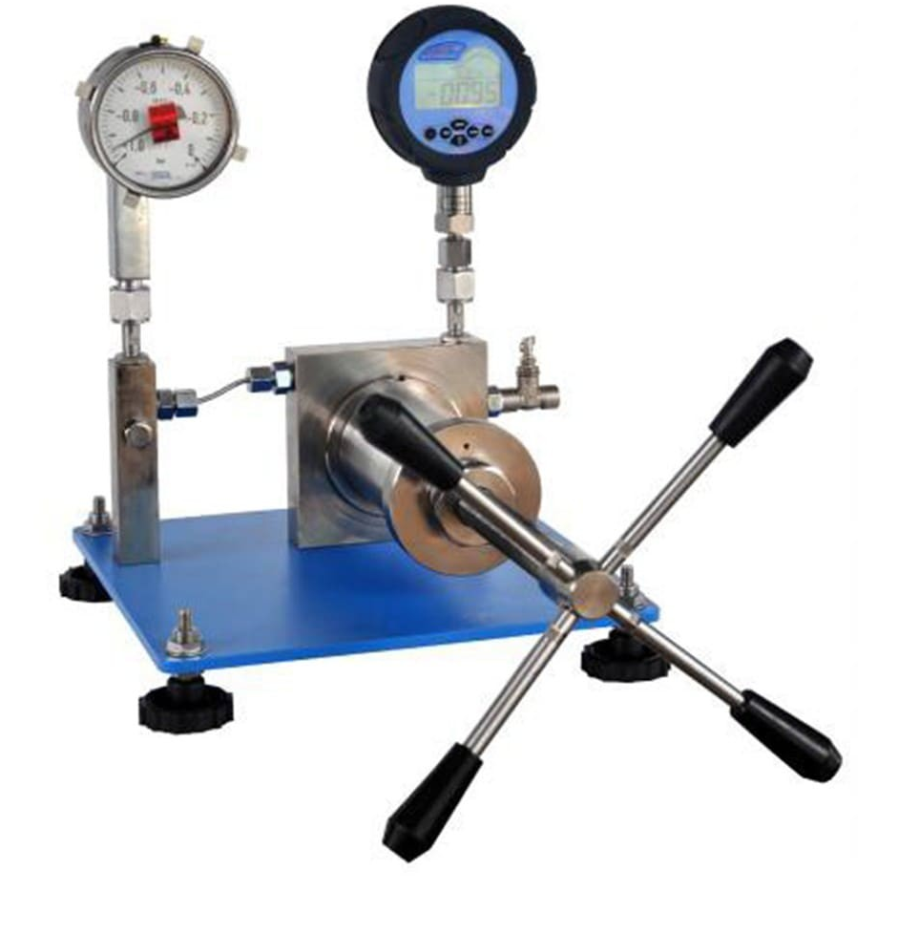
To'g'ridan-to'g'ri ishlovchi o'lchash asbobi – shunday asbobki, unda o'lchash natijasi bevosita uning indikatsiya qurilmasidan olinadi.
Fig. 28. "Oscilloscope" prompt, Reichelt.de, n.d.
https://cdn-reichelt.de/resize/330/-/web/artikel_ws/D100/PEAKTECH_205-10_01.jpg?type=Product&resize=330/-&
Fig. 29. "Measurement device" prompt, Belarusinfo, 2019. https://www.belarusinfo.by/ru/images/stories/photo_gallery/70k/66153/3.jpg
Fig. 30. "Digital indicator" prompt, Ozon.ru, n.d. https://ir.ozone.ru/s3/multimedia-1-1/c1000/6919536925.jpg
Solishtiruvchi o'lchash asbobi - o'lchanayotgan kattalikni ma'lum bo'lgan kattalik bilan bevosita taqqoslash uchun mo'ljallangan o'lchash asbobi
Fig. 33. "Resistance box" prompt, Lizantan.com, n.d.
https://lizantan.com/files/product-image/magazin-soprotivleniya-r4833.jpg
Fig. 31. "Measurement instrument" prompt, Bizkim.uz, n.d. https://bizkim.uz/foto_product/5307_101_OEwdL3K7yXnA_3.jpg
Fig. 32. "Measuring sensor" prompt, Izmerkon.ru, n.d. https://izmerkon.ru/assets/images/products/881/izmerkon-pn4-6-10-min.jpg
19

Slide 20
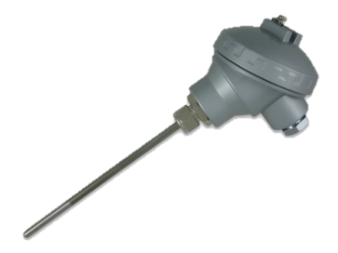
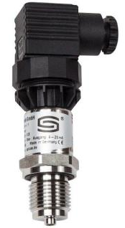
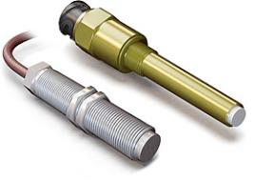
Fig. 35. "Thermocouple head" prompt, IndiaMART, n.d. https://5.imimg.com/data5/LA/ZF/YN/SELLER-12805322/head-hermocouple-500x500.jpg
Fig. 36. "Sensor image" prompt, Sensor.ua, n.d.
https://www.sensor.ua/wa-data/public/site/img/snimok-319.png
Fig. 34. "Temperature sensor" prompt, Regeltechnik.com.ru, n.d. https://regeltechnik.com.ru/images/virtuemart/product/PREMASGARD-SHD-SD.jpg
O'lchash o'zgartirgichi (datchik) - bu kuzatuvchi tomonidan bevosita idrok etilishi mumkin bo'lmagan, ammo masofaga uzatish, qayta ishlash va (yoki) saqlash uchun qulay shaklda o'lchash axboroti signalini ishlab chiqish uchun mo'ljallangan o'lchash vositasi.
20

Slide 21
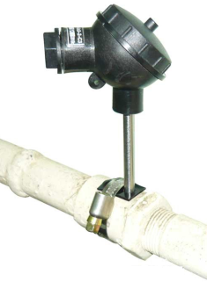
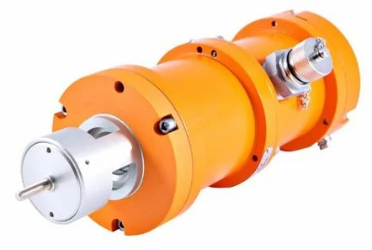
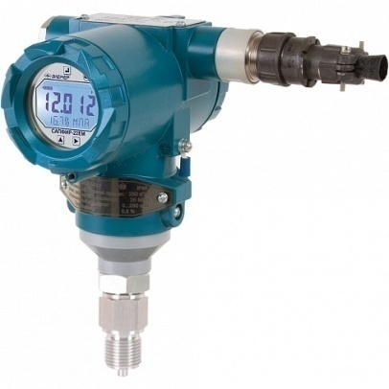
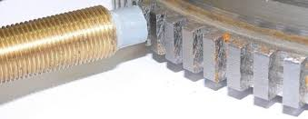
Fig. 38. "Temperature sensor" prompt, IndiaMART, 2025. https://5.imimg.com/data5/SELLER/Default/2025/7/532235102/BH/OW/HT/63665925/img-3438-1-2-500x500.jpg
Fig. 37. "Frequency sensor" prompt, Kipia.su, n.d. https://kipia.su/files/products/kl2_2_2.800x600w.jpg?9ff189c53d1909e204534a58bf0da227
Fig. 40. "Measurement sensor scheme" prompt, Studfile.net, n.d. https://studfile.net/html/94391/2571/html_L4LuwKNEFe.I28E/htmlconvd-PieqaO_html_359cc449fc381767.jpg
Fig. 39. "Rotation sensor" prompt, Promportal.su, n.d. https://img.promportal.su/foto/good_fotos/74/742867/datchik-chastoti-vraschenmya-dchv-2-2k_foto_largest.jpg
Birlamchi o'lchash o`zgartkichi bevosita o'lchanayotgan kattalik ta'siri ostida bo`ladi
21

Slide 22
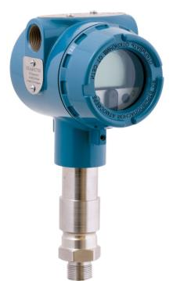
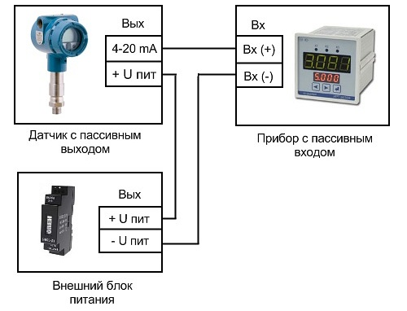
Fig. 41. "Signal converter logo" prompt, Prom.uz, 2024. https://www.prom.uz/_ipx/f_webp/https://devel.prom.uz/upload/product_logos/6a/e1/6ae14cf823c3ca23ce32eca4acea587e.jpeg
Fig. 42. "Converter device" prompt, a.d-cd.net, n.d.
https://a.d-cd.net/ea9024ds-960.jpg
Uzatuvchi o`zgartkich - o'lchash ma'lumotining unifikatsiyalashgan chiqish signalini ishlab chiquvchi o'lchash o`zgartkichidir
Unifikatsiyalashgan (birlashtirilgan) signal - bu o'lchanadigan kattalik turi, o'lchash usuli va diapazonidan qat’iy nazar, ma'lum bir belgilangan chegaralar ichida o'zgarib turadigan ma'lum bir fizik tabiatga ega bo`lgan signaldir.
22

Slide 23
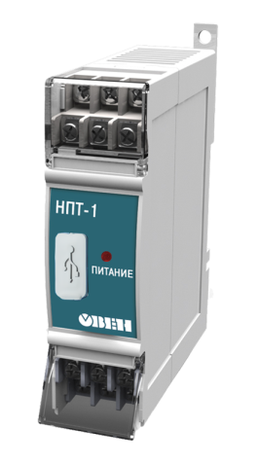
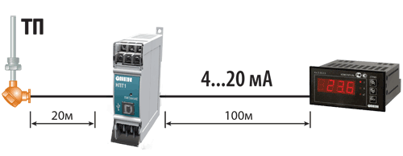
Fig. 44. "Measurement scheme" prompt, Isup.ru, n.d. https://isup.ru/upload/medialibrary/a26/Ris.2.png
Fig. 43. "Scale converter" prompt, Google Images, n.d. https://encrypted-tbn0.gstatic.com/images?q=tbn:ANd9GcQyI28PaVG2EgQT15TW8bfHNbKVZa3fzseAgGYqmm5gGjxGfPJd
Oraliq (normalovchi) o`zgartkich - bu birlamchi datchik signallarini birxillashtirilgan o`zgarmas tok yoki kuchlanish signallariga aylantirish uchun mo`ljallangan o`zgartkichdir. U o'lchash zanjirida birlamchi o`zgartkichdan keyingi o'rinni egallaydi va zamonaviy o'lchash tizimlarining ajralmas qismi hisoblanadi
23

Slide 24
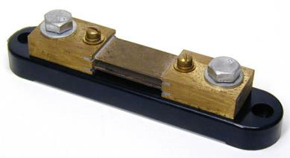
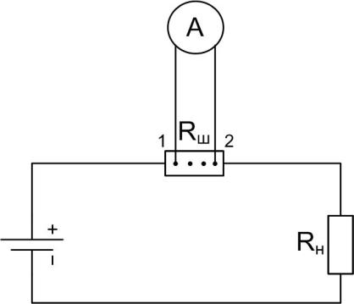
Fig. 45. "Amperemeter scheme" prompt, Google Images, n.d. https://encrypted-tbn1.gstatic.com/images?q=tbn:ANd9GcTlK5lJoNLfgbyJMHFofLkrgKrViWoX9DFFI17zKeaJ0OIE0Anj
Fig. 46. "Amperemeter circuit diagram" prompt, Profazu.ru, 2021. https://profazu.ru/wp-content/uploads/2021/12/12-shema-vklyucheniya-ampermetra-v-tsep-cherez-shunt.jpg
Masshtabli o`zgartkich - o'lchash zanjirida mavjud bo`lgan kattaliklardan birining qiymatini, uning fizik tabiatini o'zgartirmasdan, ma'lum marotaba o'zgartirishga mo'ljallangan o'lchash o`zgartirgichdir.
24

Slide 25
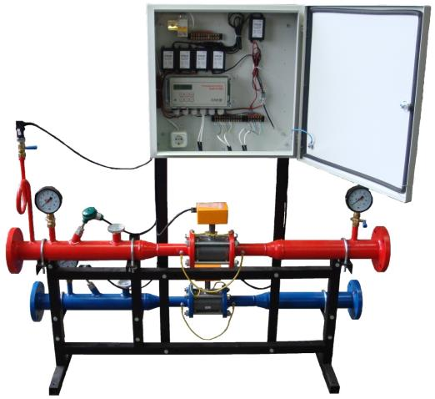
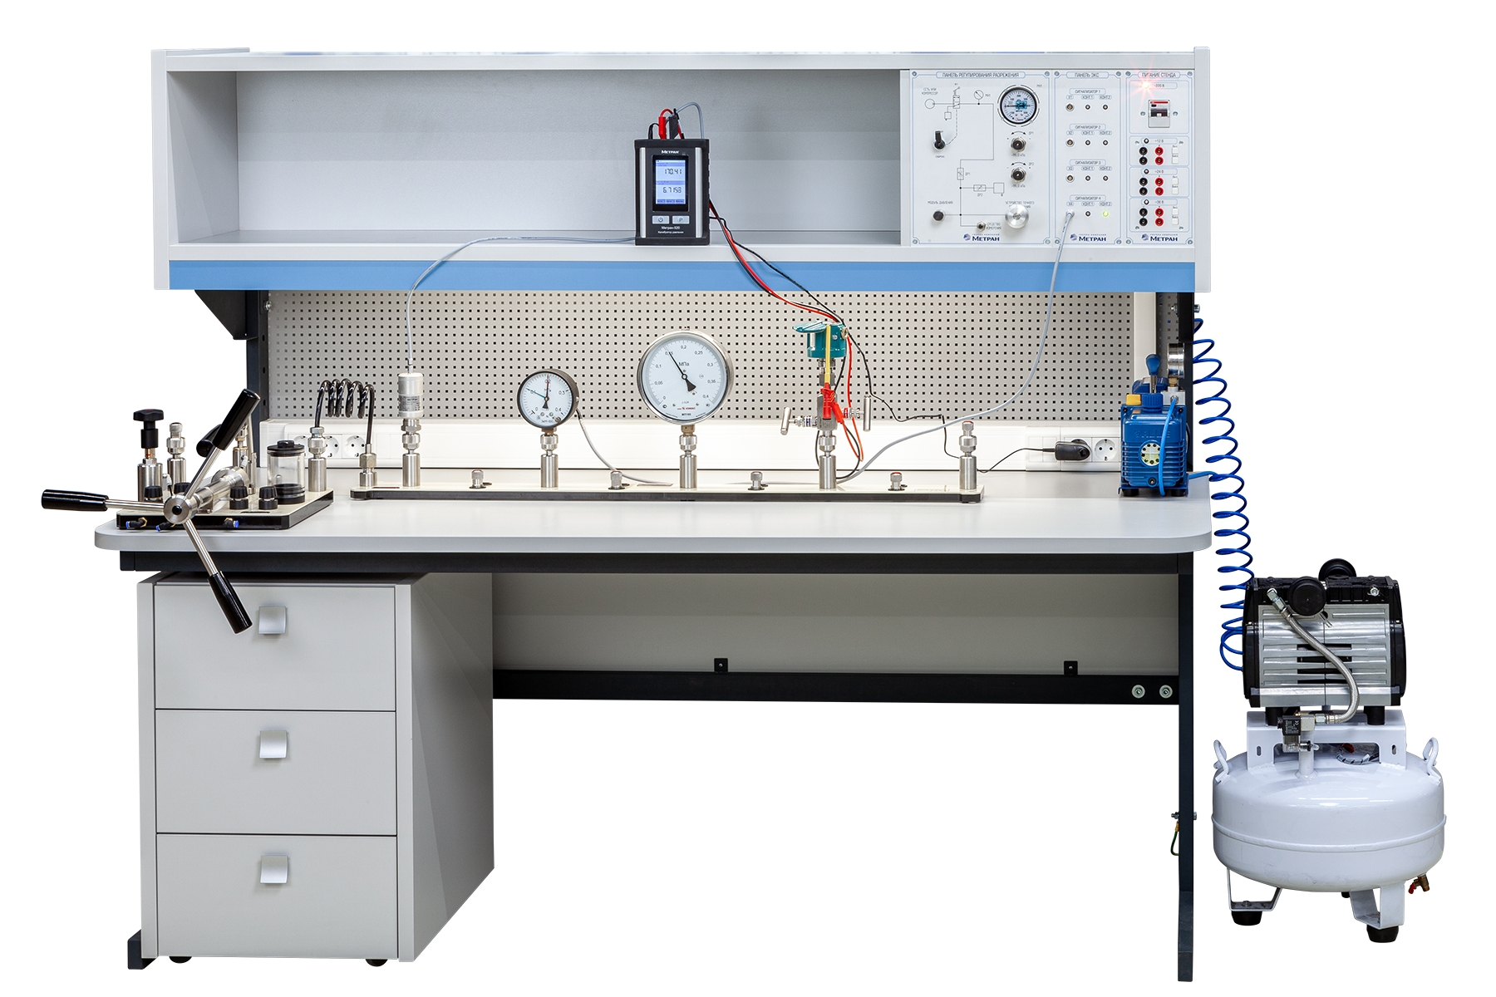
Fig. 47. "Measuring device" prompt, Bouw.ru, n.d. https://bouw.ru/userfiles/2137_image001.jpg
Fig. 48. "Measuring instrument diagram" prompt, Metran.ru, n.d. https://metran.ru/upload/iblock/265/w6mgvqgyn1bbzunm5reii33916ucxnup.png
O'lchash qurilmasi - bu funktsional integratsiyalashgan o'lchash vositalari (o'lchovlar, o`lchash asboblari, o'lchash o`zgartkichlari) va yordamchi asboblarning bir joyda joylashgan jamlanmasi bo`lib, kuzatuvchi tomonidan bevosita idrok etishi uchun qulay bo'lgan o'lchash ma'lumotlarini ishlab chiqish uchun mo'ljallangan
25

Slide 26
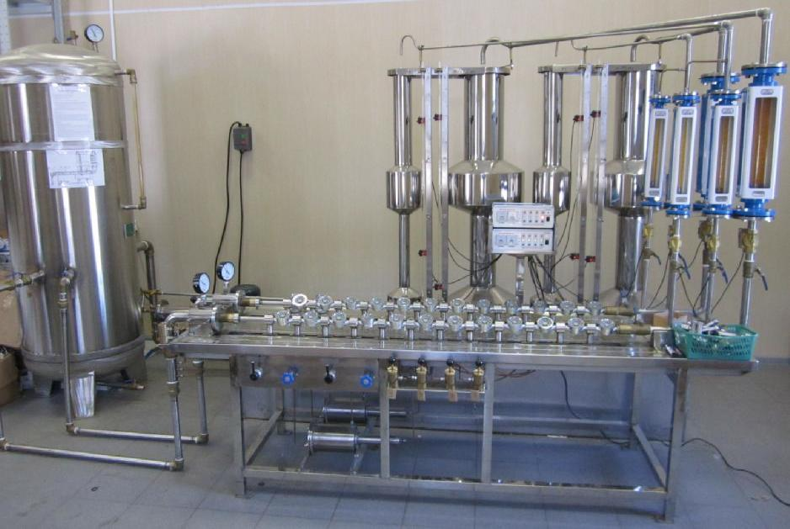
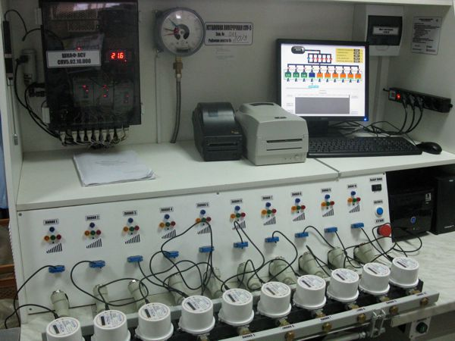
o'lchаsh uskunаsi (O’z DSt 8.010.2:2003 gа ko'rа)
bir yoki bir nеchtа kаttаliklаrni o'lchаshgа mo'ljаllаngаn, bir jоydа o'rnаtilgаn o'lchоvlаr, o'lchаsh аsbоblаri, o'lchаsh o'zgаrtkichlаri vа bоshqа qurilmаlаrning o'zаrо funktsiоnаl birlаshtirilgаn mаjmuаsi
Fig. 49. "Measurement system device" prompt, All-pribors.ru, n.d.
https://all-pribors.ru/images/ot/12/51498-12-1.jpg
Fig. 50. "Measurement illustration" prompt, Google Images, n.d.
https://encrypted-tbn2.gstatic.com/images?q=tbn:ANd9GcSdTPna32raJDfxanjz_6s3SLyUzTBtQtu_5yyjFufTmiBwcfwI
26

Slide 27

O'lchash tizimi - bu boshqariladigan muxitga xos bo'lgan bir yoki bir nechta fizik kattaliklarni o'lchash uchun mo`ljallangan hamda shu muxitning turli nuqtalarida joylashgan va funktsional jihatdan birlashtirilgan o'lchovlar, o'lchash asboblari, o'lchash vositasi, elektron hisoblash mashinalari va boshqa texnik vositalar jamlanmasidir
Fig. 51. "Measurement system illustration" prompt, Google Images, n.d.
https://encrypted-tbn2.gstatic.com/images?q=tbn:ANd9GcTOyMEuRFzqtSurPm9VMeGVhB8lzCfVKw3qeVUH_ide84WXMiuN
27

Slide 28


o'lchаsh tizimi (O’z DSt 8.010.2:2003 gа ko'rа)
nаzоrаt qilinаdigаn оb'еktgа хоs bir yoki bir nеchtа kаttаliklаrni o'lchаsh vа turli mаqsаdlаrdа o'lchаsh signаllаrini hоsil qilish uchun ushbu оb'еktning turli nuqtаlаridа jоylаshtirilib, o'zаrо аlоqа kаnаllаri bilаn bоg'lаngаn, funktsiоnаl birlаshtirilgаn o'chоvlаr, o'lchаsh аsbоblаri, o'lchаsh o'zgаrtkichlаri, ehm vа bоshqа tехnikа vоsitаlаri mаjmui
Fig. 52. ”Measurement device image” promt. Google Images. (n.d.).
https://encrypted-tbn2.gstatic.com/images?q=tbn:ANd9GcTavjQLOG7cl0LRn85fSjjGQdmQiXFph7R8ow7u6cILX6U9Hred
28

Slide 29


Fig. 53. "Etalon voltmeter" prompt, Google Images, n.d.
https://encrypted-tbn0.gstatic.com/images?q=tbn:ANd9GcQNeWqmNFCVlaKmFaTl2ofM-USgpEVctvuCZkGfJEmHt_RZS-Q5
Fig. 54. "Voltmeter photo" prompt, Felixmaocho.wordpress, 2017. https://felixmaocho.wordpress.com/wp-content/uploads/2017/06/voltimetro.jpg?w=350&h=350
Ishchi o'lchash vositasi - birlik qiymatini uzatish bilan bog'liq bo'lmagan o'lchashlar uchun ishlatiladigan asbob
29

Slide 30


Fig. 55. "Etalon device" prompt, Bizkim.uz, n.d.
https://bizkim.uz/foto_product/s/5341_218_3WPwBTbtafCP_1.jpg
Fig. 56. "Measurement tool" prompt, All-pribors.ru, n.d.
https://all-pribors.ru/images/ot/16//52189-16-1.jpg
Etalon - bu fizik kattalik birligini tiklash va saqlash uchun mo'ljallangan va uning o'lchamini shu kattalikni o`lchovchi boshqa o'lchash vositalariga uzatish uchun mo'ljallangan o'lchov vositasi (yoki o'lchov vositalari majmuasi).
30

Slide 31
Foydalanilgan adabiyotlar
1. Mеtrоlоgiya, аtаmаlаr vа tа’riflаr. Qo’llаnmа. Хаkimоv О.SH. Tоshkеnt. 2005 y.
2. Mеtrоlоgiya аsоslаri. O’quv qo’llаnmа. Ismаtullаеv P.R., Qоdirоvа SH.А. Tоshkеnt – 2012, 310 b.
3. O’lchashning fizikaviy asoslari. Darslik. Kalandarov P.I.. / – T:” TIQXMMI” MTU, 2023, 232 b.
4.Handbook of Metrology and Testing 2nd ed. 2011, Horst Czichos, Leslie E. Smith / Springer Edition, New York, 2011.
5.Aholod.ru. (n.d.). Digital measuring instrument [Image]. Retrieved October 2, 2025, from https://aholod.ru/wa-data/public/shop/products/20/27/2720/images/2720/2720.750x0.jpg
6.Chipdip.ru. (n.d.). Measuring device scheme [Image]. Retrieved October 2, 2025, from https://static.chipdip.ru/lib/678/DOC014678019.jpg
7.Ozon.ru. (n.d.). Digital multimeter [Image]. Retrieved October 2, 2025, from https://ir.ozone.ru/s3/multimedia-r/c1000/6128192679.jpg
8.Uzum. (2024). Measurement device photo [Image]. Retrieved October 2, 2025, from https://images.uzum.uz/cn9ad5ps99ouqbfv29k0/original.jpg
9.Reichelt.de. (n.d.). Oscilloscope [Image]. Retrieved October 2, 2025, from https://cdn-reichelt.de/resize/330/-/web/artikel_ws/D100/PEAKTECH_205-10_01.jpg
10.Belarusinfo.by. (2019). Measurement device [Image]. Retrieved October 2, 2025, from https://www.belarusinfo.by/ru/images/stories/photo_gallery/70k/66153/3.jpg
11.Bizkim.uz. (n.d.). Measurement instrument [Image]. Retrieved October 2, 2025, from https://bizkim.uz/foto_product/5307_101_OEwdL3K7yXnA_3.jpg
12.Lizantan.com. (n.d.). Resistance box [Image]. Retrieved October 2, 2025, from https://lizantan.com/files/product-image/magazin-soprotivleniya-r4833.jpg
·
31

Slide 32
E’tiboringiz
uchun rahmat !!!
32

