Slide 1
COURSE: MEASUREMENT METHODS AND TOOLS
Week 5. Measurement methods and errors
Lecturer: PhD. B.Khamdamov
(Andijan Technical Institute)
1

Slide 2
O’LCHASH USULLARI VA VOSITALARI
5-Ma’ruza. O’lchash usullari va o’lchash xatoliklari.
Ma’ruzachi: PhD. B.Xamdamov
(Andijon davlat texnika Instituti)
2

Slide 3
5-Mavzu: O’lchash usullari va o’lchash xatoliklari.
Reja:
5.1 O’lchаsh аmаlini bаjаrish usullаri
5.2 Stаtik, dinаmik o’lchаsh usullаri. Diskrеt o’lchаsh usuli.
5.3 O’lchаsh хаtоliklаri
5.4 Хаtоliklаrning turlаri
5.5 Muntаzаm хаtоliklаr vа ulаrning turlаri
3

Slide 4
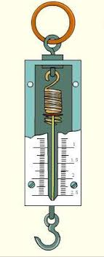
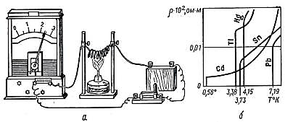
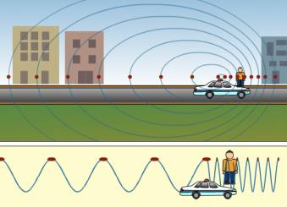
O'lchash prinsipi - u yoki bu o'lchash vositasi yordamida kattalikni o'lchash asosini tashkil etadigan fizik hodisa yoki effekt
Tortish orqali massani o'lchashda tortish kuchidan foydalanish
Tezlikni o'lchash uchun Doppler effektidan foydalanish
Metallar qarshiligining haroratga bog'liqligi
Fig. 3. "Haroratga bog‘liq qarshilik grafigi", Image from open source, Google Images, n.d.
https://encrypted-tbn0.gstatic.com/images?q=tbn:ANd9GcQpHAmC0AbaakLNknNqo7cn8cJVZXrzok6ysh8fwErohCbn4kB5
Fig. 1. "Doppler effekti tasviri", Image from open source, biliyoruz.biz, 29 Apr. 2020
https://biliyoruz.biz/wp-content/uploads/2020/04/tfaiye-Araci-Gecerken-Siren-Sesi-Neden-Degisir-e1611871246810-1.jpg
Fig. 2. "Doppler effekti ilustratsiyasi", Image from open source, Google Images, n.d.
https://encrypted-tbn3.gstatic.com/images?q=tbn:ANd9GcRpmlAeleyX37c6tspLF5EV7bPNasjJIzKYzUcLH3d_0rDgZQd2
4

Slide 5
O'lchash usuli - o'lchash printsipi va vositalaridan foydalanish amallari to'plami
O`lchash usullari
Bevosita baholash usuli
O`lchov bilan taqqoslash usuli
Mos keltirish usuli
O`rin almashtirish usuli
Nol usul
Differentsial usul
5

Slide 6
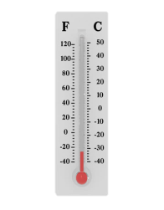
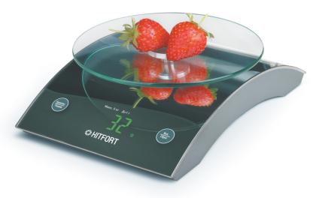
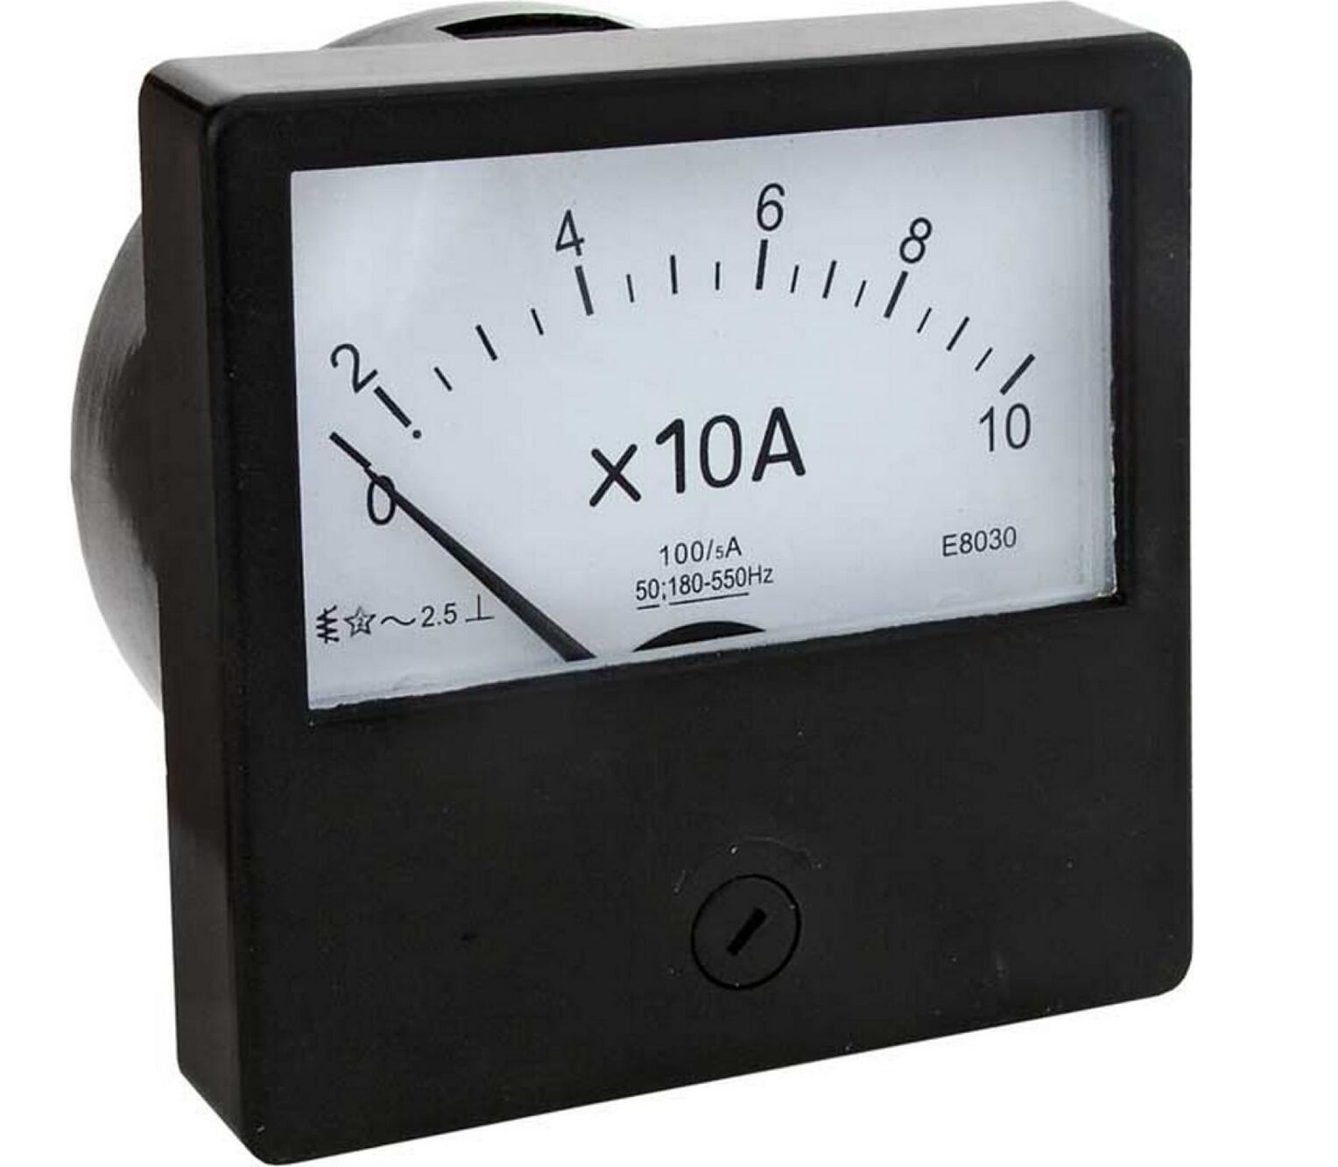
Fig. 4. "Voltmetr rasmi", Image from open source, STPulscen.ru, n.d.
https://st30.stpulscen.ru/images/product/454/745/550_original.jpg
Fig. 5. "Simobli termometr", Image from open source, pelajaran.co.id, Febr. 2017
https://www.pelajaran.co.id/wp-content/uploads/2017/02/Termometer.jpg
Fig. 6. "Elektr o‘lchash asbobi", Image from open source, elmarket.by, n.d.
https://www.elmarket.by/upload/medialibrary/ec9/ec98fd93db622a890a7fd0172499c88c.jpg
X
Y
O`lchanadigan kattalik
O`lchash asbobi
O`lchash natijasi
Bevosita baholash usuli - o'lchash natijasini to'g'ridan-to'g'ri o`zgartiruvchi o'lchash asbobining sanoq moslamasidan bevosita olishga asoslangan usul, bunda o`lchash asbobining shkalasi oldindan ko'p o'lchamli o'lchov yordamida darajalangan bo`ladi
6

Slide 7
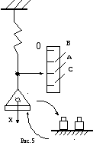
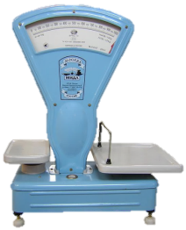
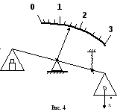
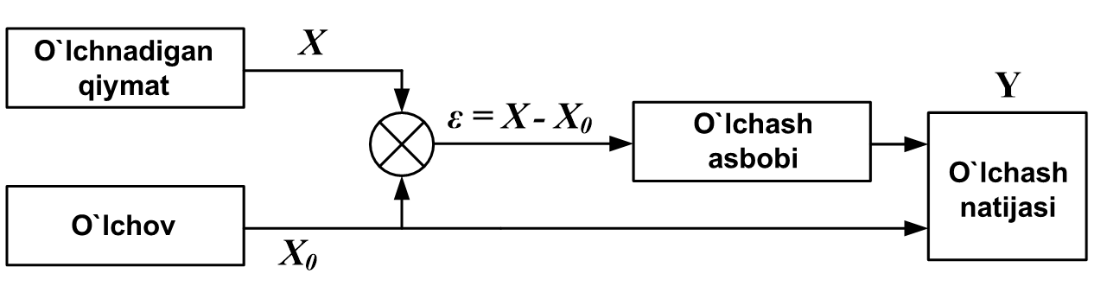
Differentsial usul - bu o'lchash usulida o'lchash asbobiga o'lchanayotgan qiymat va o'lchov bilan tiklangan qiymat o'rtasidagi farq ta'sir qiladi. O'lchash natijasi tiklangan o'lchov kattaligi va o'lchangan farqni qo'shish orqali olinadi
Fig. 7. "Grafik diagramma", Image from open source, Studfile.net, n.d.
https://studfile.net/html/2706/24/html_AVicsROrJy.PEo4/img-cmPtnh.png
Fig. 8. "Differentsial o‘lchash usuli grafikasi", Image from open source, Yandex Images, n.d. https://avatars.mds.yandex.net/i?id=0d4035f95613f2b2c42b5518d32167fe6e10592a-16187860-images-thumbs&n=13
Fig. 9. "O‘lchash usuli diagrammasi", Image from open source, Studfile.net, n.d.
https://studfile.net/html/2706/24/html_AVicsROrJy.PEo4/img-mUj15o.png
7

Slide 8
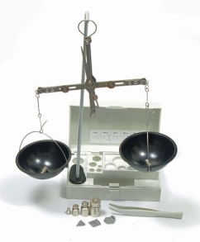
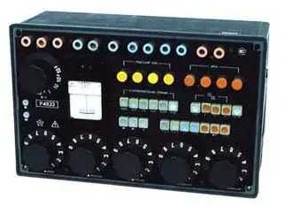
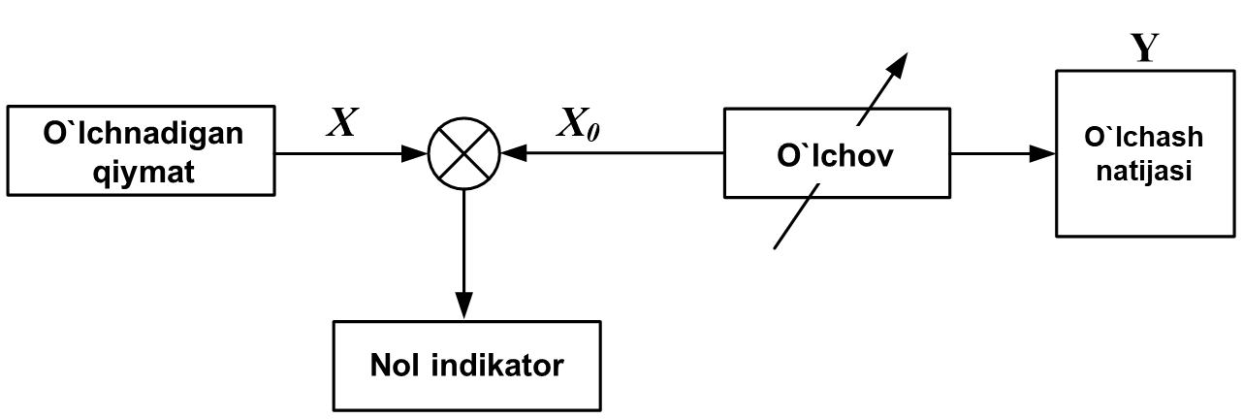
Nol usul - bu usulda o'lchash jarayonida aniqlangan qiymat va aniq qiymat o'rtasidagi farq nolga keltiriladi, bu o`z navbatida o`ta sezgir asbob – nol-indikator – yordamida nazorat qilinadi
Fig. 11. "Asbob tasviri", Image from open source, olxcdn.com, n.d. https://ireland.apollo.olxcdn.com/v1/files/f8swltnr7kvu3-UA/image
Fig. 10. "Nol-indikator asbobi", Image from open source, bizkim.uz, n.d.
https://bizkim.uz/foto_product/5307_101_OEwdL3K7yXnA_3.jpg
8

Slide 9
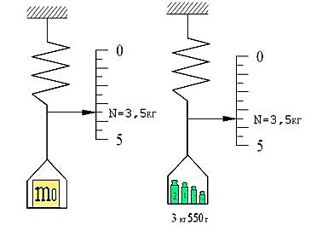
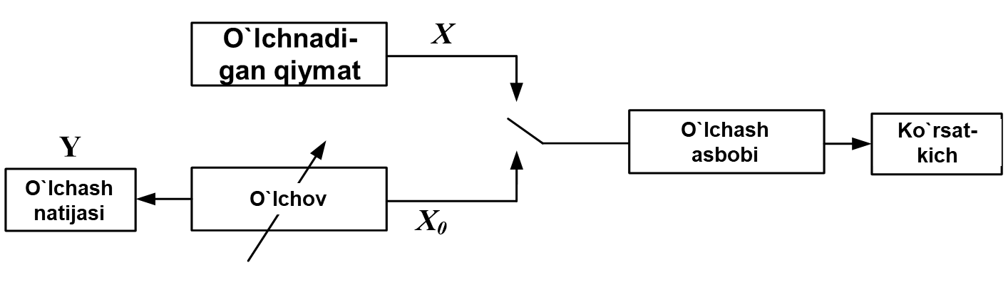
O`rin almashtirish usuli - o'lchash asbobining kirishiga navbat bilan aniqlanayotgan qiymat va o'lchov bilan ta’minlangan aniq qiymatlarni kiritib, ikki ko`rsatkich orqali izlanayotgan qiymatni aniqlash usuli
9

Slide 10
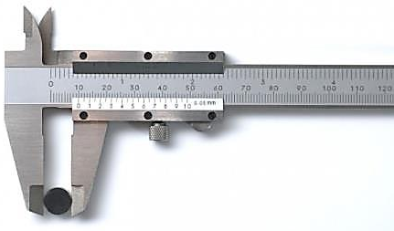
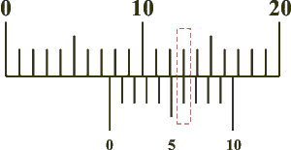
Mos keltirish usuli (“nonius” usuli) - o'lchanayotgan qiymat va o'lchov bilan tiklanuvchi qiymat o'rtasidagi farq shkala belgilariga yoki davriy signallarga mos kelishidan foydalanib o'lchanadigan usul.
Fig. 13. "Mos keltirish usuli grafikasi", Image from open source, Bstudy.net, n.d.
https://bstudy.net/htm/img/18/16631/18.png
Fig. 12. "Nonius usuli ilustratsiyasi", Image from open source, YouTube (preview), n.d. https://i.ytimg.com/vi/Co4L6ifKrkI/hq720.jpg?sqp=-oaymwEhCK4FEIIDSFryq4qpAxMIARUAAAAAGAElAADIQj0AgKJD&rs=AOn4CLDVZACw8ll7s9F89KSVaVY1btMRFA
10

Slide 11
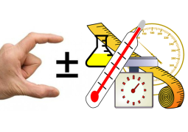
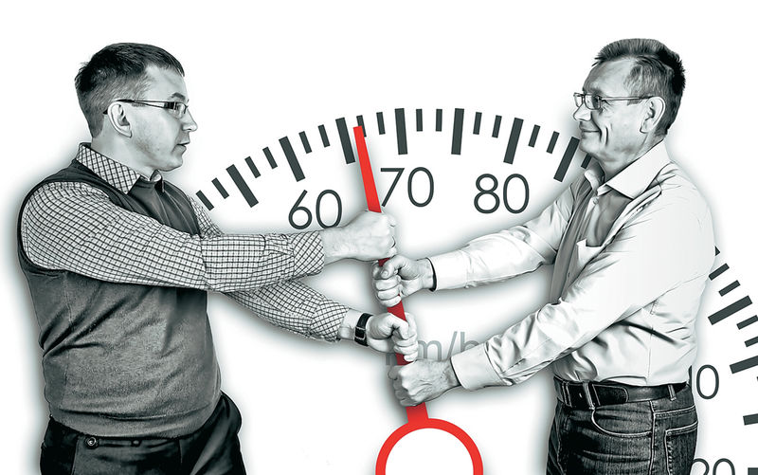
O‘lchash xatoligi – o‘lchash natijasini chinakam (haqiqiy) qiymatdan chetlashuvini (og‘ishuvini) ifodalovchi o‘lchashning sifat me’zoni.
O‘lchash xatoliklari turli sabablarga ko‘ra turlicha ko‘rinishda namoyon bo‘lishi mumkin. Bu sabablar qatoriga quyidagilarni kiritishimiz mumkin:
o‘lchash vositasidan foydalanishda uni sozlashdan yoki sozlash darajasini siljishidan kelib chiquvchi sabablar;
operatorning malakasi va holatiga bog‘liq sabablar va shu kabilar.
o‘lchash ob’yektning xususiyatlaridan kelib chiquvchi sabablar;
o‘lchash vositasi va ob’yektiga nisbatan tashqi ta’sirlar (harorat yoki bosimning o‘zgarishi, elektr va magnit maydonlarining ta’siri, turli tebranishlar va hokazolar)dan kelib chiquvchi sabablar;
o‘lchash vositalarining zanjirida o‘lchash ma’lumotini olish, saqlash, o‘zgartirish va tavsiya etish bilan bog‘liq sabablar;
o‘lchash ob’yektini o‘lchash joyiga (pozitsiyasiga) o‘rnatishdan kelib chiquvchi sabablar;
Fig. 14. "O‘lchash lenta rasmi", Image from open source, PNGitem.com, n.d.
https://www.pngitem.com/pimgs/m/3-38274_measuring-tape-clip-art-png-download-measure-clipart.png
Fig. 15. "Asbob o‘lchash xatoligi", Image from open source, zr.ru, 16 Dec. 2014. https://www.zr.ru/d/story/8b/747659/20141216_yaku3265.jpg
O‘lchash xatoliklarini kelib chiqish sabablarini tahlil qilishda eng avvalo o‘lchash natijasiga salmoqli ta’sir etuvchilarini aniqlash lozim bo‘ladi.
11

Slide 12
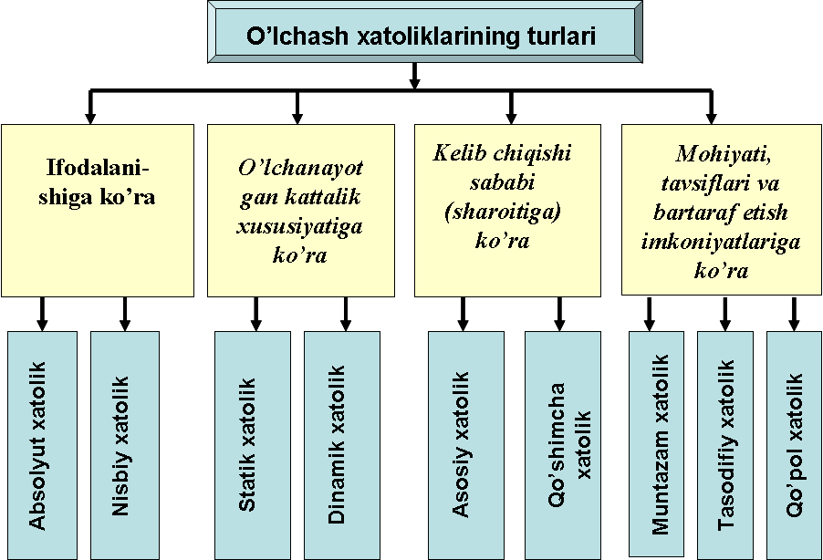
12

Slide 13
Fizik kattalikning chinakam qiymati - bu ob’yektning tegishli xossasini sifat va miqdoriy jihatdan ideal tarzda aks ettiradigan fizik kattalik ko`rsatkichi.
Fizik kattalikning haqiqiy qiymati - eksperimental tarzda topilgan fizik miqdorning qiymati va u haqiqiy qiymatga shunchalik yaqinki, uning o'rniga ishlatilishi mumkin.
Х_{h} ∼ Х_{ch}
13

Slide 14
O'lchash natijasining xatoligi - o'lchash natijasi X ning o'lchanayotgan kattalikning chinakam qiymati Х_{ch} dan farqi
ΔX = Х – Х_{ch} ≈ Х – Х_{h}
O'lchashning mutlaq xatoligi - o'lchanayotgan kattalik birligida ifodalangan xatolik
Δ = Х – Х_{h}
14

Slide 15
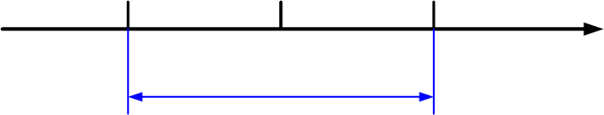
Х _{nat}- Δ
Х_{nat}
Х_{nat}+ Δ
2 Δ
Х
O'lchash natijasini to'g'ri yozib olishga misollar
U=(268 ± 8) В
yoki
U=268 В ± 8 В
15

Slide 16
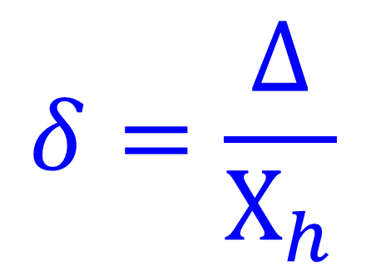
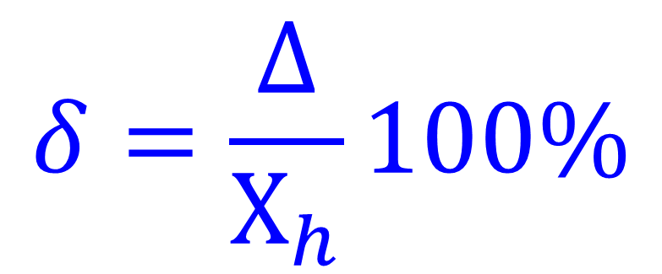
O'lchashning nisbiy xatoligi - mutlaq xatolikning o'lchangan kattalikning haqiqiy qiymatiga nisbati
$$δ=\frac{∆}{Х_{h}}$$
$$δ=\frac{∆}{Х_{h}}100\%$$
16

Slide 17
Ahamiyatli raqamlar – son tarkibidagi to'g'riligiga ishonch bo`lgan noldan farqli barcha raqamlar
Istisno: nol ahamiyatli hisoblanadi:
1. Agar u boshqa ahamiyatli raqamlar orasida tursa
2. Agar yaxlitlashdan keyin u tegishli razryadlarda birlik yo'qligini ko'rsatsa
L = 38,58 sm
To`rtta ahamiyatli raqam
Ishonchli raqamlar
Gumonli raqam
17

Slide 18
L = 0,3852 m
To`rtta ahamiyatli raqam
Ishonchli raqamlar
Ahamiyatsiz raqam
Gumonli raqam
L = 385,2 mm
To`rtta ahamiyatli raqam
L = 385200 mkm
To`rtta ahamiyatli raqam
Ahamiyatsiz raqamlar
L = 3,852⋅10⁵ mkm
Sonning standart yozilishi
18

Slide 19
Hisoblangan xatolik qiymatini
yaxlitlash qoidalari
1. Agar raqamlarning birinchisi 1 yoki 2 ga teng bo'lsa o'lchash natijasining xatoligi ikkita ahamiyatli raqam bilan, agar 3 yoki undan katta bo'lsa bitta ahamiyatli raqam bilan ko'rsatiladi
2. O'lchash natijasi mutlaq xatolikning yaxlitlangan qiymatining o`nlik razryadiga mos holda yahlitlanadi
3. Yahlitlash faqat oxirgi javobda amalga oshiriladi va barcha dastlabki hisob-kitoblar mavjud raqamlar bilan amalga oshiriladi
19

Slide 20
Δ = ψ + θ
xatolikni tasodifiy tashkil qiluvchisi
xatolikni sistematik tashkil qiluvchisi
20

Slide 21
Tasodifiy xatolik - bir xil qiymatni takroriy o'lchash paytida tasodifiy ravishda o'zgaradigan o'lchash xatoligining tarkibiy qismi
Tasodifiy xatolik
kutilayotgan
qo`pol
nomuvofiq
Kutilayotgan tasodifiy xatolik - bu xatolikning shakllanishiga ta'sir qiluvchi barcha omillarning ko'proq yoki kamroq barqaror intensivligida aniqlanadigan tasodifiy xatolik
21

Slide 22
Qo`pol tasodifiy xatolik - berilgan sharoitlarda kutilganidan sezilarli darajada yuqori bo`lgan o'lchash xatoligi
Nomuvofiq tasodifiy xatolik –natijani butkul va keskin buzadigan o'lchash xatoligi
22

Slide 23
Sistematik xatolik - bir xil qiymatni takroriy o'lchash paytida o`zgarishsiz qoladigan yoki davriy ravishda o'zgarib turadigan o'lchash xatoligining tarkibiy qismi
Sistematik xatolik
Paydo bo`lish sababiga ko`ra
Namoyon bo`lishiga ko`ra
Sub’yektiv
Uslubiy
Instrumental
O`rnatish xatoligi
Tashqi omillar tufayli
O`zgaruvchan
Doimiy
23

Slide 24
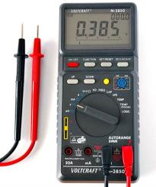
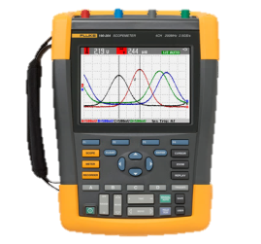
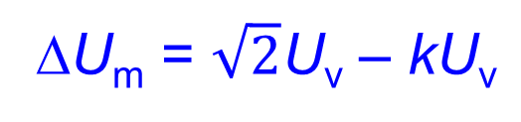
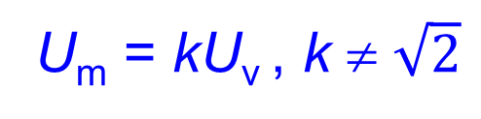
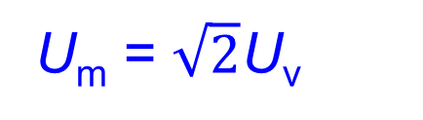
Uslubiy xatolik - o'lchash usulining nomukammalligi tufayli yuzaga keluvchi o'lchash xatoligining tarkibiy qismi
U_{m} = $\sqrt{2}$U_{v}
U_{m} = kU_{v} , k ≠ $\sqrt{2}$
ΔU_{m} = $\sqrt{2}$U_{v} – kU_{v}
Fig. 17. "Asbob xatoligi tasviri", Image from open source, ozbargain.com.au, n.d.
https://files.ozbargain.com.au/t/95/50895.jpg?h=444edd16
Fig. 16. "Metrologiya xatolik rasmi", Image from open source, Google Images, n.d. https://encrypted-tbn1.gstatic.com/images?q=tbn:ANd9GcSm0hVvGWBlRHm6ECNRjDIzEXAtDh0-KMaMECSbOteZgyLS6w6H
24

Slide 25
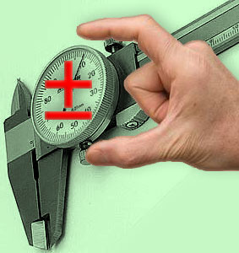
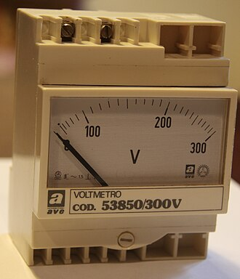
Instrumental o'lchash xatoligi - qo'llaniladigan o'lchash vositalarining xatoligi tufayli yuzaga keladigan o'lchash xatoligining tarkibiy qismi
Bu yerda,
– real sharoitlarda o'lchov vositasining xatoligi
– o'lchov vositasining o'lchov ob'ekti bilan o'zaro ta'siridan kelib chiqqan xatolik
Fig. 18. "Metrologik xatolik grafigi", Image from open source, k-a-t.ru, n.d. https://k-a-t.ru/metrologia/pogreshnost_izm/pgr.jpg
Fig. 19. "Voltmetr rasmi", Image from open source, Wikimedia Commons, n.d.
https://upload.wikimedia.org/wikipedia/commons/thumb/0/0f/Voltmetro_AVE-CGS_fronte.jpg/330px-Voltmetro_AVE-CGS_fronte.jpg
25

Slide 26
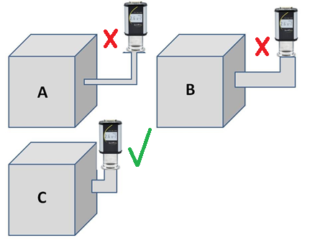
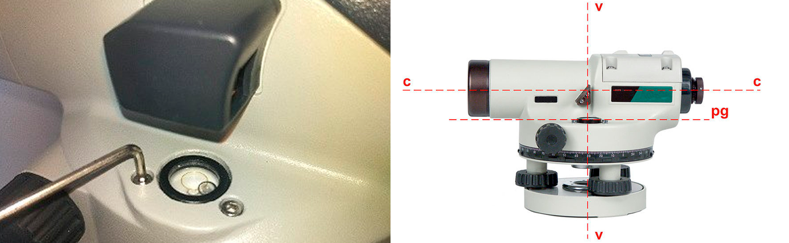
Fig. 21. "Kalibrlash jarayoni", Image from open source, RGK-shop.ru, n.d. https://nn.rgk-shop.ru/upload/images/content-upload/articles/poverka-i-kalibrovka-sredstv-izmerenij/3.webp
Fig. 20. "Asbob o‘rnatish xatoligi", Image from open source, Stripocdn.email, n.d.
https://eqcig.stripocdn.email/content/guids/CABINET_31f55fb93d1cdbd0ac750d2e19c72680/images/74391554898219842.png
O'rnatish xatoligi - o'lchov xatolarining tarkibiy qismi bo'lib, u o'lchash vositalarini noto'g'ri o'rnatilishi natijasida yuzaga keladi
26

Slide 27
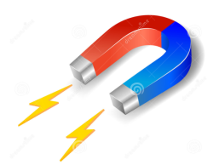

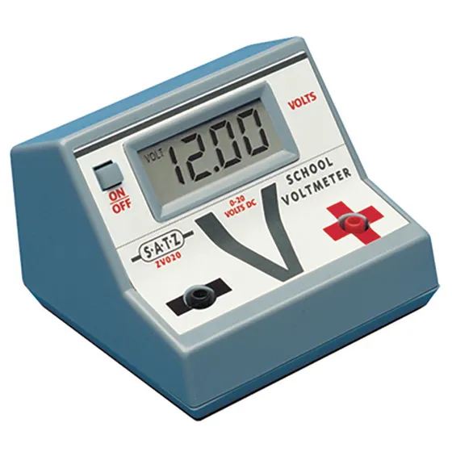

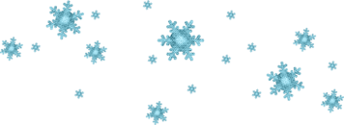
Tashqi omillar ta’siridagi xatolik - ob'ektga va o'lchash vositalariga tashqi omillarni (issiqlik va havo oqimlari, magnit, elektr, gravitatsion maydonlar va boshqalar) ta'sir qilish natijasida kelib chiqadigan o'lchash xatoligining tarkibiy qismidir.
Fig. 22. "Tashqi omil – havo oqimi", Image from open source, Pinterest, n.d. https://i.pinimg.com/736x/fc/3f/7c/fc3f7c7629eb2a895e1e11caafc6956f.jpg
Fig. 25. "Magnit rasmi", Image from open source, iStockphoto, n.d.
https://media.istockphoto.com/id/165518656/vector/horseshoe-magnet.jpg?s=612x612&w=0&k=20&c=zGyY-3L9pAGVznkhyrgSi-2U7TnmKeg98PmGmXhrVHE=
Fig. 24. "Asbob rasmi", Image from open source, espo.org, n.d.
https://www.espo.org/media/catalog/product/2/6/266833_5.jpg?width=560&height=560&canvas=560,560&quality=80&bg-color=255,255,255&fit=bounds
Fig. 23. "Bolalar uchun havo rasmi", Image from open source, Polinka.top, Jan. 2024 https://polinka.top/pics1/uploads/posts/2024-01/1706275239_polinka-top-p-vozdukh-kartinki-dlya-detei-v-detskom-sadu-31.jpg
Fig. 26. "Qor va muz rasmi", Image from open source, detskiy-sad.com, Dec. 2021
https://detskiy-sad.com/wp-content/uploads/2021/12/sneg-snejinki-i-sosulki10.jpg
27

Slide 28
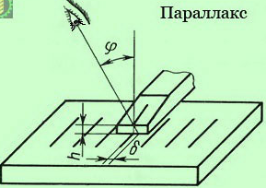
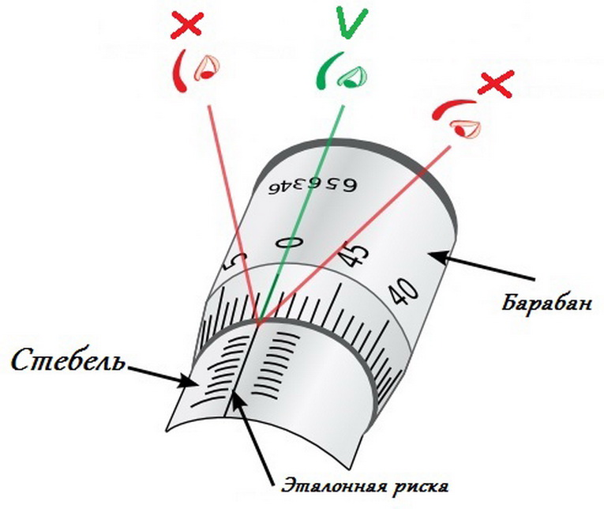
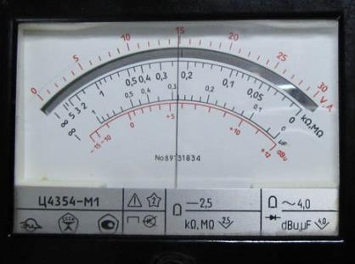
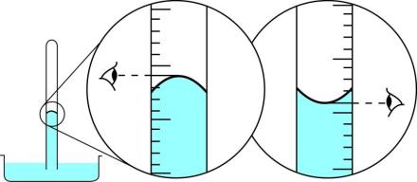
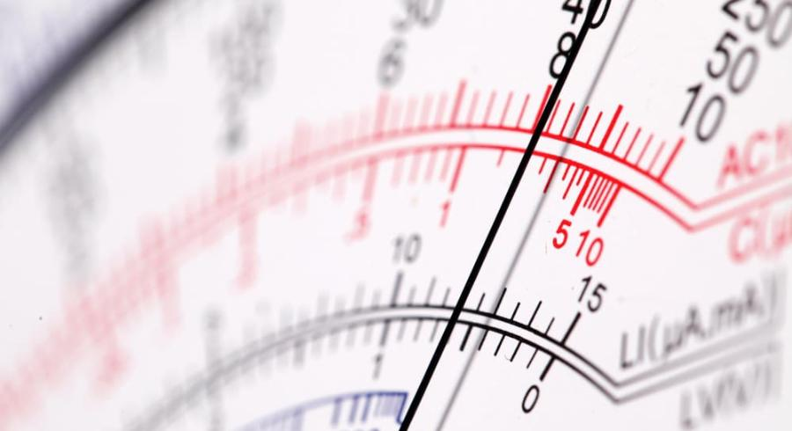
Sub’yektiv xatolik - o'lchashni amalga oshiruvchi shaxsning individual xususiyatlari tufayli yuzaga keladigan o'lchash xatoligining tarkibiy qismi
Fig. 27. "Parallaks xatolik ilustratsiyasi", Image from open source, k-a-t.ru, n.d.
https://k-a-t.ru/metrologia/metrologia_7/parallax.jpg
Fig. 28. "Mikrometr tasviri", Image from open source, vseinstrumenti.ru, n.d.
https://www.vseinstrumenti.ru/uploads/custom/images/mikrometr2.1486046881.jpg
Fig. 29. "Subyektiv xatolik rasmi", Image from open source, z-dn.net, n.d.
https://ru-static.z-dn.net/files/de2/38aeaf56decd4298561c47ebae07c177.jpg
28
Fig. 30. "Asbob rasmi", Image from open source, snta.ru, n.d.
https://www.snta.ru/upload/iblock/32d/32d86ac7461859f54241a3bfd1897f9c.jpg

Slide 29

Hisoblash xatoligi - o'lchov natijalarini matematik qayta ishlash jarayonida yuzaga keladigan o'lchash xatoligining tarkibiy qismi
Fig. 31. "Hisoblash xatoligi rasmi", Image from open source, Darakchi.uz, 29 July, 2024 https://api.darakchi.uz/media/news_preview/2024/07/29/SweFWnANKL6Ueylnwj6M-zWi05dEBAGW-xl_qoH8AoN_I6lTRl6_C182B4D.medium.webp
29

Slide 30
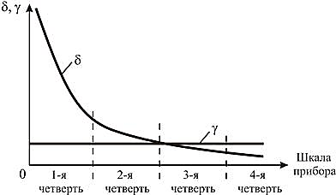
Doimiy sistematik xatoliklar - takroriy o'lchovlar paytida o`zining qiymatini o'zgartirmaydigan xatoliklar
Fig. 32. "Sistematik xatolik grafigi", Image from open source, Studfile.net, n.d.
https://studfile.net/html/2706/57/html_8L1ZytP_KL.ULUp/img-TQbWcI.jpg
O'zgaruvchan sistematik xatoliklar - takroriy o'lchashlarda turli xil qiymatlarni olishi mumkin bo`lgan xatoliklar
30

Slide 31
Foydalanilgan adabiyotlar
O’lchash usullari va vositalari, O’quv qo’llanma. A.A.Mamajonov, M.O.Sattarov, D.V.Xakimov /Toshkent “NIF MSh” -2020 y. 254 b.
Mеtrоlоgiya asoslari, O’quv qo’llanma. Ismаtullаеv P.R., Qodirova Sh.A. / T.: Tafakkur, Extremum –Press, 2012.
Fizikaviy-kimyoviy o’lchashlar, O’quv qo’llanma. IsmаtullаеvP.R. va boshq. / T.: TDTU, 2007
"Doppler effekti tasviri", Image from open source, biliyoruz.biz, 2020.
https://biliyoruz.biz/wp-content/uploads...
"Doppler effekti ilustratsiyasi", Image from open source, Google Images, n.d. https://encrypted-tbn3.gstatic.com/images...
"Haroratga bog‘liq qarshilik grafigi", Image from open source, Google Images, n.d.
https://encrypted-tbn0.gstatic.com/images ...
"Voltmetr rasmi", Image from open source, STPulscen.ru, n.d.
https://st30.stpulscen.ru/images ...
"Simobli termometr", Image from open source, pelajaran.co.id, 2017-02. https://www.pelajaran.co.id/wp-content/uploads/2017/02/Termometer.jpg
"Elektr o‘lchash asbobi", Image from open source, elmarket.by, n.d.
https://www.elmarket.by/upload/medialibrary ...
"Differentsial o‘lchash usuli grafikasi", Image from open source, Yandex Images, n.d. https://avatars.mds.yandex.net ….
"O‘lchash usuli diagrammasi", Image from open source, Studfile.net, n.d.
https://studfile.net/html/2706/24/html_AVicsROrJy.PEo4/img-mUj15o.png
"Grafik diagramma", Image from open source, Studfile.net, n.d.
– https://studfile.net/html/2706/24/html_AVicsROrJy.PEo4/img-cmPtnh.png
"Nol-indikator asbobi", Image from open source, bizkim.uz, n.d.
– https://bizkim.uz/foto_product/5307_101_OEwdL3K7yXnA_3.jpg
31

Slide 32
E’tiboringiz
uchun rahmat !!!
32

