Slide 1
COURSE: MEASUREMENT METHODS AND TOOLS
Week 13. Acoustic measurement methods and tools
Lecturer: PhD. B.Khamdamov
(Andijan State Technical Institute)
1

Slide 2
O’LCHASH USULLARI VA VOSITALARI
13-Ma’ruza. Akustik o'lchash usullari va vositalari.
Ma’ruzachi: PhD. B.Xamdamov
(Andijon davlat texnika Instituti)
2

Slide 3
13-Mavzu: Akustik o'lchash usullari va vositalari.
Reja:
13.1 Akustika va akustik o’lchash tushunchalari.
13.2 Akustik o’lchash usullari.
13.3 Defektoskoplar, qalinlik va qattiqlik o’lchagichlar.
13.4 Muxitlarning akustik xossalari.
13.5 Shovqin parametrlarini aniqlash
3

Slide 4
Akustik usullar
Akustik usullar ob'ektda qo'zg'aladigan yoki paydo bo'ladigan elastik tebranishlardan foydalanishga asoslangan usullardir.
Ular ikkita katta guruhga bo'linadi:
Aktiv usullar
Passiv usullar
faqat tebranish va to'lqinlarni qabul qilishga asoslangan.
akustik nurlanish hamda tebranish va to'lqinlarni qabul qilishdan foydalaniladi
4

Slide 5
Akustik usullar
Aktiv
Passiv
O`tuvchi
Xususiy tebranishlar
Impedansli
Aks etish
Aralash
Majburiy
tebranishlar
Erkin
tebranishlar
Aks-sado usuli
Aks-sado ko`zgu usuli
Delta-usul
Difraksion-vaqt usuli
Reverberatsoin usul
Ultratovush mikroskoriyasi
Kogerent usul
Ko`zgu-soya usuli
Aks-sado soya usuli
O`tuvchan aks-sado
O`tuvchan-reverberatsion
Amplituda-soyali
Vaqt-soyali
Ko`p conli soya
Velosimetrik
Intregral
Lokal
Akustik-topografik
Integral
Lokal
Egiluvchan to`lqinli
Bo`ylama to`lqinli
Kontakt impedansli
Akustik-emission
Tebranma-diagnostik
Shovqin-diagnostik
5

Slide 6
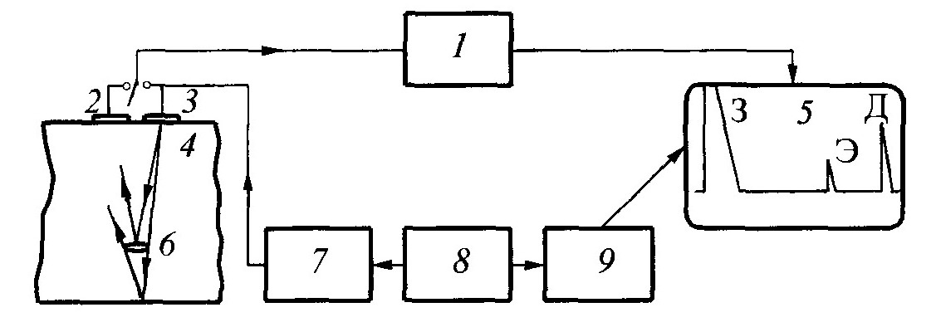
Aks-sado (exo) usuli
Usul bitta yoki ikkita o`zgartgich yordamida amalga oshiriladi va ikkita muxitni ajratuvchi yuzasidan aks etgan akustik to'lqin impulslarining parametrlarini tahlil qilishga asoslangan.
Exodetektoskopning soddalashtirilgan sxemasi
1-kuchaytirgich; 2,3-o`zgartkichlar; 4-OK; 5-skanerlash; 6-nuqson; 7-generator ZI; 8-sinxronizator; 9-generator R.
6
Fig. 1. "Echo method" prompt, Ultrasonic Flaw Detector, Defektoskopist.ru, 2020.
https://studfile.net/html/2706/238/html_xNyoR4WtO2.63M9/htmlconvd-pONSqe_html_db94d8ce30ef36b3.png

Slide 7
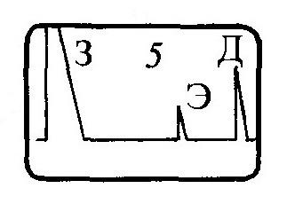
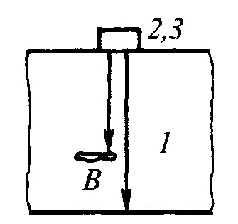
Aks-sado (exo) usuli
Usul nuqsonli joydan aks etayotgan exo signallarni qayd etishga asoslangan.
Ultratovush detektori ekranida ikki turdagi ma'lumot namoyish etiladi. Gorizontal chiziq impulsning nazorat ob’ektidan o`tish vaqtiga to'g'ri keladi va bu vaqt impuls yo'liga proportsionaldir. Cho'qqilarning (impulslar) balandligi aks exosignallar amplitüdlariga proportsional.
З – tekshirilayotgan impuls.
Д – tub (quyi) signal.
Э - nuqsondan aks etgan signal.
1-nazorat ob’ekti; 2-nurlatgich; 3-qabul qilgich.
Fig 2 " Echo method" prompt, Measurement methods and tools. Textbook, A.A.Mamajonov, M.O.Sattarov, D.V.Xakimov, Tashkent. “NIF MSh” 2020, 254 p.
7

Slide 8
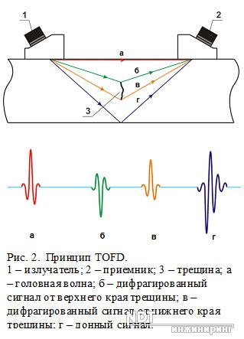
Aks etish usuli
Diffaktsion-vaqt usuli
Usul nuqsonning chetlaridan tarqalayotgan to'lqinlarni qabul qilishga asoslangan, bunda bo`ylamasıga va ko'ndalang yo`nalgan to'lqinlar taralishi va qabul qilinishi mumkin.
Asosiy ko`rsatkich bo`lib, signalning kelish vaqti hisoblanadi.
Amalda bo`ylama to'lqinlar tarqalishi va qabul qilinishi keng qo`llaniladi, chunki ular birinchi bo'lib qabul qiluvchiga etib keladi.
1-nur tarqatgich, 2-qabul qilgich, 3-yoriq
а) zarbali to‘lqin, б) yoriqning yuqori chetidan diafragma-langan signal, в) yoriqning pastki chetidan diafragmalangan signal, г) tub signal
Fig. 3. "Amplitude-shadow method" prompt, Amplitude-Shadow Ultrasonic System, NIF MSh Publishing (Tashkent), 2020.
https://defektoskopist.ru/data/attachments/4/4177-8f18ece10d98991b1f555b3694fe52c9.jpg
8

Slide 9
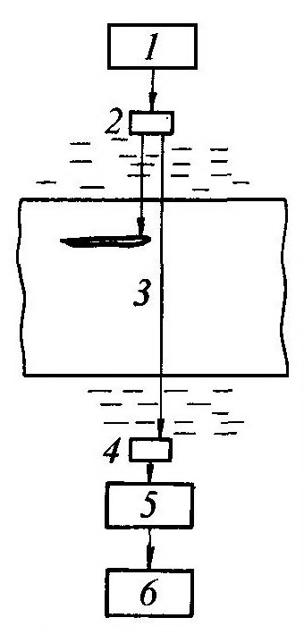
Tarqatuvchi va qabul qiluvchi o'zgartirgichlar nazorat ob’ektining ikkala tomonidan yoki bir tomondan, bir-biridan ma'lum masofada joylashtiriladi. Ma'lumot tarqatgichdan qabul qiluvchiga o`tayotgan signal parametrlarini o'lchash orqali olinadi.
Методы прохождения
Amplituda-soyaviy usul
1-generetor,
2-tarqatgich,
3-nazorat ob’ekti
4-qabul qilgich,
5-kuchaytirgich,
6-o`lchash asbobi.
Usul signalning o'tishiga to'sqinlik qiladigan va ovozli soyani yaratadigan nuqson ta'siri ostida signalning o`tish amplitudasini pasayishini qayd etishga asoslangan.
Fig 4 " Amplitude-shadow method" prompt, Measurement methods and tools. Textbook, A.A.Mamajonov, M.O.Sattarov, D.V.Xakimov, Tashkent. “NIF MSh” 2020, 254 p.
9

Slide 10
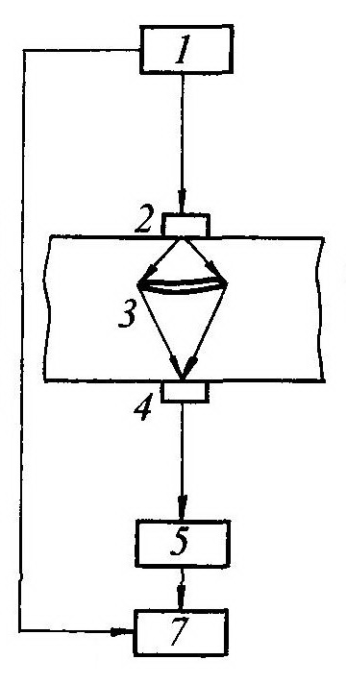
Vaqt-soyaviy usul
Nuqsonli joyni aylanib o`tish sababli kelib chiqqan impulsning kechikishini o'lchashga asoslanadi. Bunda, qayishqoq to'lqin turi o'zgarmaydi.
1-generator,
2-taratgich,
3-ob’ekt,
4-qabul qilgich,
5-kuchaytirgich, impuls o`tish vaqtini o`lchash.
Fig 5. "Time-shadow method" prompt, Measurement methods and tools. Textbook, A.A.Mamajonov, M.O.Sattarov, D.V.Xakimov, Tashkent. “NIF MSh” 2020, 254 p.
10

Slide 11
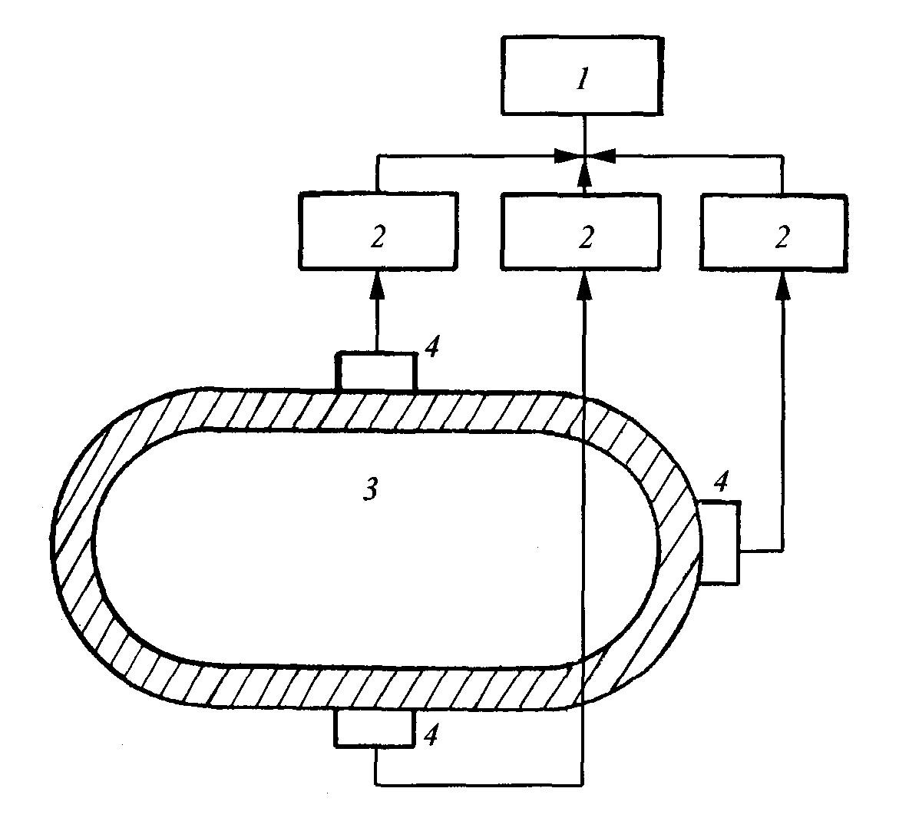
Passiv usullar
Akustik emissiya usul
Akustik emissiya natijasida yuzaga keladigan qayishqoq to'lqinlarni qayd qilishga asoslangan. Akustik emissiya fenomeni, o`z strukturasini ichki dinamik qayta qurish natijasida, materialning o'zi tomonidan qayishqoq to'lqinlarni tarqatishiga asoslanadi. Akustik emissiyaning eng xarakterli manbalari – bu yoriqlar paydo bo'lishi va rivojlanishi, fazaviy o'zgarishlar va boshqalar hisoblanadi.
1-ma’lumotni qayta ishlash bloki; 2-kuchaytirgich;
3-ob’ekt; 4-qabul qilgich.
Fig 6. "Acoustic emission method" prompt, Measurement methods and tools. Textbook, A.A.Mamajonov, M.O.Sattarov, D.V.Xakimov, Tashkent. “NIF MSh” 2020, 254 p.
11

Slide 12
Akustik asboblar tasnifi
Ish rejimiga ko'ra:
Impulsli
Uzluksiz
Qo`llanilishiga ko'ra:
Defektoskoplar
Qalinligi o'lchagichlar
Materiallarning fizik-mexanik xususiyatlari analizatorlari (struktura o'lchagichlar, qattiqlik o`lchagichlari, tenzometrlar, qayishqoqlik va mustahkamlik o'lchagichlari va boshqalar)
12

Slide 13
O'lchanadigan parametr turi bo'yicha:
Fazometrlar
Mikrosekundomerlar
Chastotamerlar
Velosimetrlar
So`nish o`lchagichlari
Akustik emissiya o`lchagichlari
Tebranishlarni kiritish va qabul qilish bo`yicha:
kontaktsiz
kontaktli
immersion
oqimli
ultratovush nurlarini fokuslovchi
13

Slide 14
Chastota diapazoni bo`yicha:
tovushli (20 ... 20,000 Gts)
past ultratovush chastotali (20 ... 200 kHz)
o'rta ultratovush chastotali (0,2 ... 10 MGts)
yuqori ultratovush chastotali (10⁷ ...10⁹ Hz)
o`ta yuqori ultratovush chastotali (10⁹ Gts dan yuqori)
O`zgartirgich turlari bo'yicha:
piezoelektrik
magnetostriktsion
elektromagnit-akustik
elektromexanik
mexanik
14

Slide 15
Indikator moslamasining turi bo'yicha:
raqamli ko`rsatkichli
ostsilografik
mexanik ko`rsatuvchi moslamali
televizion indikatorli
ovozli yoki yorug'lik signalizatorli
visualizatorli
strelkali indikatorli
Mexanizatsiya va avtomatlashtirish darajasiga qarab:
Qo'lda ishlovchi
Mexaniklashtirilgan
Avtomatlashtirilgan
EHMdan foydalanish
Televizion va hisoblash texnologiyalarining birlashtirish
15

Slide 16
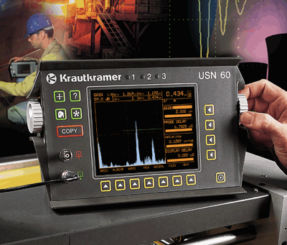
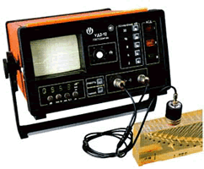
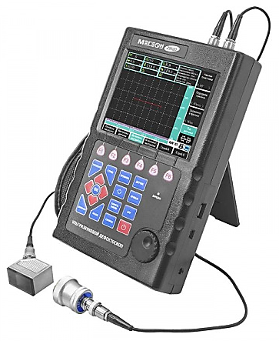
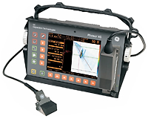
Defektoskoplar
Fig. 7. "Ultrasonic flaw detector UD2-70" prompt, Kazvek Instruments, Kazvek.com, 2021. https://kazvek.com/uploads/photo/236/9036649a8a57d694f9fee88328884a68.jpg
Fig. 8."Ultrasonic testing system" prompt, Ultrasonic Flaw Detector, NDT Innovations (Russia), 2020. https://www.ndt-innovations.ru/image/cache/catalog/ultrazvukovoj/01usp083-500x300.jpg
Fig. 9. "Ultrasonic thickness gauge" prompt, Pipe Wall Thickness Measurement Device, Mprofit Instruments, 2022. https://mprofit.ru/upload/resize_cache/iblock/971/450_450_140cd750bba9870f18aada2478b24840a/o1dsctsqzna6n8whbobo9baghh3zf221.jpg
Fig. 10. "Ultrasonic transducer schematic" prompt, Piezoelectric Ultrasonic Transducer, Google Images / GStatic CDN, n.d. https://encrypted-tbn2.gstatic.com/images?q=tbn:ANd9GcTv4CrPGgQVPil0tjLBrDTyr7AYQK7pNDvxRmR97b2uWQfw2T1w
16

Slide 17
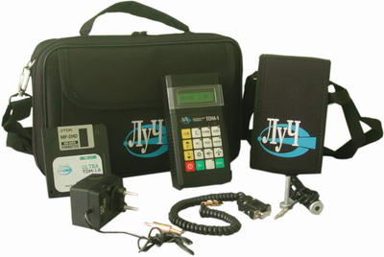
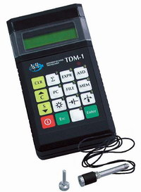
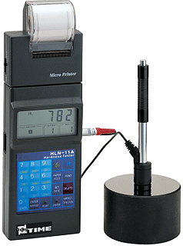
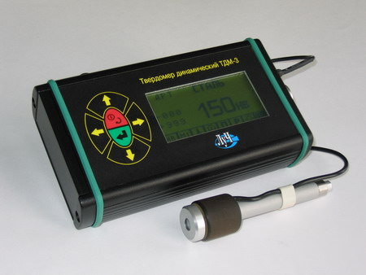
Qattiqlik o`lchagichlar
Fig. 11. "Ultrasonic flaw detector" prompt, GEO-Scan Ultrasonic Flaw Detection Unit, GEO-NDT.ru, 2021.
https://www.geo-ndt.ru/images/all/3/783/big/img_5.jpg
Fig. 12. "Ultrasonic transducer device" prompt, A3-ENG Ultrasonic Transducer, A3-ENG Engineering Systems, 2023. https://a3-eng.com/assets/cache_image/products/805/untitled3569_1500x1500_3f1.webp
Fig. 14. "Sound insulation material" prompt, Acoustic Wall Insulation Panel, Google Images / GStatic CDN, n.d. https://encrypted-tbn0.gstatic.com/images?q=tbn:ANd9GcQZEzb7ZeJTl3CH7GhUcXfURd1WJRvhazSVVkCtgBF62yUg1kKM
Fig. 13. "Sound level meter device" prompt, Digital Noise Level Meter, Amazon.com, 2023. https://m.media-amazon.com/images/I/41rzzNep42L._AC_UF894,1000_QL80_.jpg
17

Slide 18
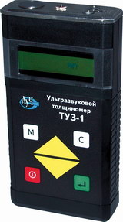
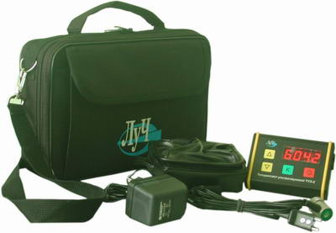
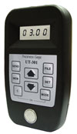
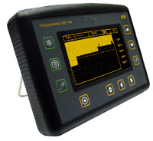
Qalinlik o`lchagichlar
Fig. 15. "Standard sample calibration block" prompt, KOY-2M Ultrasonic Calibration Block, Google Images / GStatic CDN, n.d. https://encrypted-tbn2.gstatic.com/images?q=tbn:ANd9GcRB2plE6sAOqRTub4DbLt5VDsScb5vCReDxIrC5A-0oWFS20eH4
Fig. 16. "Ultrasonic thickness gauge" prompt, Hardness Testing Device, Hardbroker.ru, 2022. https://hardbroker.ru/files/products/463a952bbc2b158a3c657b982203d167.jpg
Fig. 17. "Ultrasonic flaw detector" prompt, ANK-UD Ultrasonic Flaw Detector, ANK-NDT.ru, 2021. https://ank-ndt.ru/storage/products/4lVwOKxI4iGe2ENcN3FLcQ54R.jpg
Fig. 18. "Ultrasonic flaw detector" prompt, Kvazar-KZ Ultrasonic Flaw Detector B-1187, Kvazar-KZ.com, 2021.
https://kvazar-kz.com/images/detailed/16/b_1187.jpg
18

Slide 19
Muxitlarning akustik xossalari
To'lqin tarqalish tezligi
Suyuqlik va gazlardagi bo'ylama to'lqin tezligi::
bu yerda L – har taraflama siqilish moduli
O'lchamlari to'lqin tarqalish yo'nalishiga perpendikulyar bo'lgan to'lqin uzunligiga nisbatan kattaroq bo'lgan bo`ylama to'lqinning tqattiq jismdagi ezligi:
bu yerda E – normal qayishqoqlik moduli
Ko`ndalang to`lqin tezligi:
bu yerda G - siljish moduli
Tezlik muhitning fizik xususiyatlari bilan belgilanadi va to'lqinlarning chastotasi yoki amplitudasiga bog'liq emas
19

Slide 20
Muhitning nisbiy to'lqin qarshiligi (tavsifiy empedans)
Metalllarda ν = 0.3 bo'lganligi sababli, bo'ylama va ko'ndalang to'lqinlar o'rtasida aloqa mavjud
Bu akustik bosimning harakatlanuvchi to'lqindagi tebranish tezligiga nisbatini ko`rsatadi:
Ko'p hollarda, bu haqiqiy qiymat deb qaralishi mumkin va u zichlik va ovoz tezligi ko`paytmasiga teng bo'ladi :
To'lqin qarshiligi faqat muxitning xususiyatlari bilan belgilanadi
20

Slide 21
So`nish koeffitsienti:
U to'lqinning muhitda tarqalishi paytida qaytarib bo'lmaydigan yo'qotishlar tufayli pasayishini tavsiflaydi. So`nish koeffitsienti yutilish koeffitsienti va tarqalish koeffitsientining yig'indisidir :
So`nish koeffitsienti temperatura o'zgarishi bilan o'zgaradi :
Chang, pufakchalar bilan ifloslanmagan gaz va ko'plab suyuqliklarda tarqalish yo'q va yutilish koeffitsienti chastotaning kvadratiga proportsionaldir. :
21

Slide 22
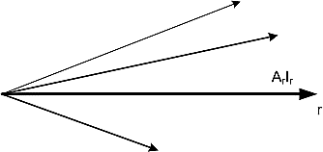
So`nish koeffitsientini bilgan holda, istalgan kesimda siljish amplitudasini va tebranish intensivligini aniqlash mumkin:
bu yerda: A₀ va A_{x} - bu siljish amplitudalari; I₀ va I_{x} - mos ravishda x₀ va x kesimlarda tebranish intensivligi.
x
Fig 18a " Function of displacement amplitude and oscillation intensity" prompt, Measurement methods and tools. Textbook, A.A.Mamajonov, M.O.Sattarov, D.V.Xakimov, Tashkent. “NIF MSh” 2020, 254 p.
22

Slide 23
Ultratovushli defektoskop
Impulsli aks-sado usuli turli buyumlarni, jumladan, katta gabaritli va murakkab formali buyumlarni nazorat qilishda eng ko`p qo`llaniladigan ultratovushli defektoskopiya usuli hisoblanadi. Aks-sado usuli buyumdagi nuqsonlarni, ularning koordinatlarini, o`lchamlarini va tavsiflarini aniqlash imkonini beradi
1-ОК; 2-излучатель; 3-приемник.
Fig 19 " Amplitude-shadow method" prompt, Measurement methods and tools. Textbook, A.A.Mamajonov, M.O.Sattarov, D.V.Xakimov, Tashkent. “NIF MSh” 2020, 254 p.
Ultratovushli defektoskop – bu elektron-akustik qurilma bo`lib, materiallardagi butlikni yoki bir jinslilikni va ularning tavsiflarini aniqlash maqsadida ultratovushli tebranishlarni tarqatish-qabul qilishga mo`ljallangan.
23

Slide 24
Funksional qo`llanilishiga qarab defektoskoplar quyidagi guruhlarga bo`linadi:
Nuqsonlarni aniqlash uchun (chegaraviy defektoskoplar, odatda ekran o`rniga, signal chegaraviy darajadan oshganligini ko`rsatuvchi, svetodiod indikatoriga ega;
Nuqsonlarni aniqlash uchun, ularning joylashish chuqurligi o`lchash va nuqsondan qaytgan signal amplitudasini o`lchash uchun;
Nuqsonlarni aniqlash uchun, ularning joylashish chuqurligi o`lchash va nuqsonlarning ekvivalent yusalarini yoki shartli o`lchamlarini aniqlash uchun;
Nuqsonlarni aniqlash uchun, ularning formalari yki joylashuvini topish, nuqsonlarning o`lchamlari yoki shartli o`lchamlarini aniqlash uchun.
Konstruktiv tayyorlanishi bo`yicha defektoskoplar: statsionar, ko`chma va portativ turlarga bo`linadi.
Sub’ektning ishtiroki bo`yicha qo`l, mexanizatsiyalashgan va avtomatlashtirilgan defektoskoplar mavjud.
24

Slide 25

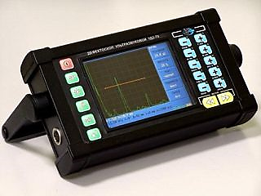
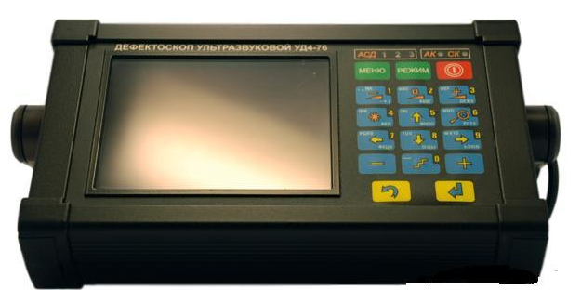
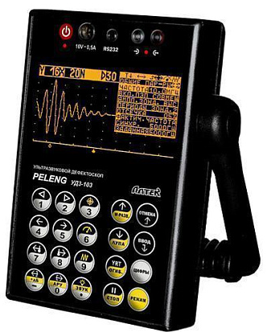
UD2-12, UD2-70, UD4-76, UDZ-103 defektoskoplari
Fig. 21. "Sound level meter" prompt, Digital Acoustic Noise Level Meter, Biolight.ru, 2023.
https://static.biolight.ru/images/items/0006864-1.jpg
Fig. 20. "Ultrasonic flaw detector UD2-70" prompt, Kazvek Instruments, Kazvek.com, 2021.
https://kazvek.com/uploads/photo/236/9036649a8a57d694f9fee88328884a68.jpg
Fig. 22. "Ultrasonic flaw detector" prompt, Armada Ultrasonic Testing Device, Armada-NDT.ru, 2021.
https://armada-ndt.ru/images/product_images/original_images/4_0.jpg
25
Fig. 23. "Ultrasonic flaw detector" prompt, ECNK Ultrasonic Flaw Detector, Ecnk.ru, 2021..
https://ecnk.ru/upload/resize_cache/iblock/7e3/500_500_1/7e3e4fb717d9e84686e6592d842c1227.jpg

Slide 26
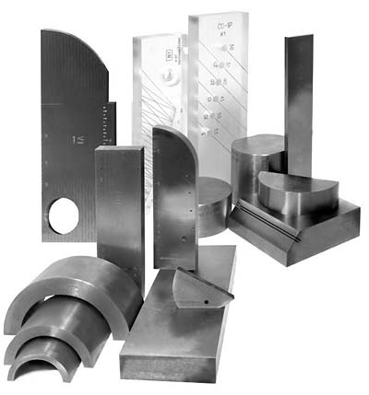
Ultratovushli nazorat uchun namunaviy vositalar
Namunaviy vosita deb, kattalikni saqlash va tiklash uchun mo`ljallangan hamda o`lchash asboblari va o`zgartkichlarning parametrlarini rostlashda qo`llanilaniladigan (geometrik o`lcham, tovush tezligi, so`nish) qattiq jism ko`rinishidagi ultratovushli nazorat vositasiga aytiladi.
Standart namunaning funktsional vazifasi – o`lchash birliligini va o`lchash natijalarini bir xil o`qilishini ta’minlash.
Namunaning xossalari kelgusida, ultratovushli tekshiruvning maqsadi bo`lmish, “yaroqli” – “yaroqsiz” degan xulosa berishga o`z ta’sirini ko`rsatadi.
Fig. 24. "Standard sample calibration block" prompt, KOY-2M Ultrasonic Calibration Block, VNIR.ru, 2022.
https://vnir.ru/upload/iblock/92e/koy-2m.jpg
Namunalar quyidagilarga bo`linadi:
standart namunalar (SN), tashkilotning standatr namunasi (TSN),
ular tegishli ravishda davlat standartlari va tashkilot standartlari bilan tasdiqlanadi.
26

Slide 27
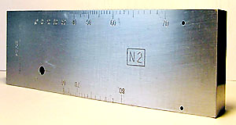
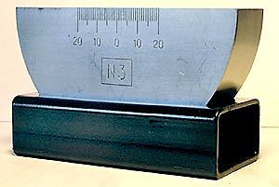
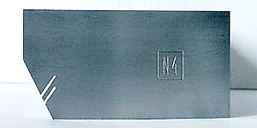
SN-2, SN-3 va SN-4 standart namunalar perlit sinfidagi kam uglerodli po`latdan (20 marka va 3 marka) tayyorlanadi. 20 OC temperaturada bo`ylama ultratovush to`lqinlarning tarqalish tezligi 5900±59 m/s ga teng bo`lishi kerak. Agar tekshirilayotgan material xossalari yuqoridagi po`lat markalaridan tubdan farq qilsa, o`sha tekshirilayotgan materialdan SN-2A va SN-3A standart namunalar tayyorlanishi mumkin.
SN-2
Fig. 25. "Standard sample calibration block" prompt, CO-2 Ultrasonic Calibration Block, VNIR.ru, 2022.
https://vnir.ru/upload/iblock/587/co-2.jpg
SN-4
SN-3
Fig. 26. "Acoustic emission method" prompt, Acoustic Emission Analyzer (Educational Illustration), Google Images / GStatic CDN, n.d. https://encrypted-tbn0.gstatic.com/images?q=tbn:ANd9GcSV1E25lL6gJ43IC_3gvVrYGGV_G8FwA16Op19RT7IPW7WQuFt4
Fig. 27. "Amplitude-shadow method" prompt, Ultrasonic Amplitude-Shadow Testing Illustration, Textarchive.ru, 2020. .
https://textarchive.ru/images/939/1876682/m6d6e71d7.jpg
27

Slide 28
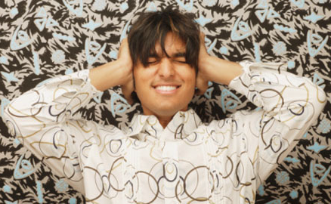

Shovqin - bu inson tanasiga zararli ta'sir ko'rsatadigan turli xil intensivlik va chastotadagi tovushlarning afsuski kombinatsiyasi.
Fig. 28. "Sound insulation material" prompt, Building Acoustic Insulation Panel, StrPort.ru, 2023. https://strport.ru/sites/default/files/imagecache/250_width/articles/zvukoizolyaciya_0.jpg
Uzoq muddatli mutlaq sukunat doimiy ravishda ko'tarilayotgan shovqin kabi inson ruhiyatiga ham zararli.
Fig. 29."Acoustic measurement system" prompt, Industrial Acoustic Emission Monitoring Setup, LinkedIn Media (media.licdn.com), 2018. https://media.licdn.com/dms/image/v2/C5112AQFVDOr7JihOuw/article-cover_image-shrink_720_1280/article-cover_image-shrink_720_1280/0/1520095646698?e=2147483647&v=beta&t=p3G_FulWmlXJnkgXhXN4zzpXVVEIUP3p6K3J8xnH7cQ
28

Slide 29
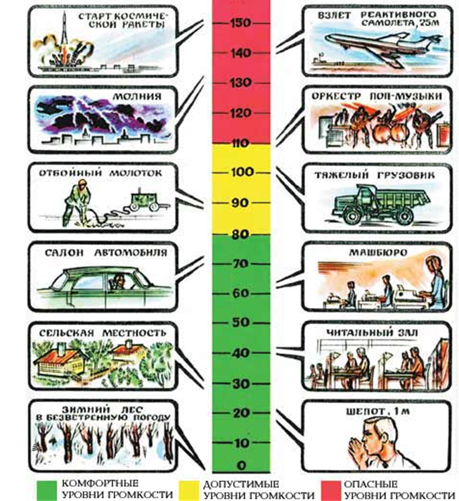
Tovush bosimi Paskallarda o'lchanadi (1 Pa = 1 N/m²).
Inson qulog'i 2*10⁻⁵ N/m² tovush bosimini sezadi
Tovush intensivligi to'lqin tarqalish yo'nalishiga (Vt/m²) perpendikulyar bo'lgan birlik maydoni orqali vaqt birligida tovush to'lqini tomonidan olib o`tiladigan vaqt bo`yicha o'rtacha energiya bilan aniqlanadi.
Ba'zi shovqin manbalarining ovoz bosimi darajasi:
• 10 dB – barglar shildirashi, soat urishi;
• 30 dB - sokin suhbat;
• 50 dB - baland suhbat;
• 80 dB - ishlayotgan yuk mashinasi dvigatelining shovqini;
• 100 dB - avtomobil sirenasi;
• 140dB - favqulodda neft yoki gaz favvorasi, og'riqning eng yuqori chegarasi, uning yuqorisida tovush bosimi quloq pardasining yorilishiga olib keladi.
29
Fig. 30. “image001.jpg” prompt, Source domain: studwood.net, n.d.
https://studwood.net/imag_/5/33250/image001.jpg

Slide 30
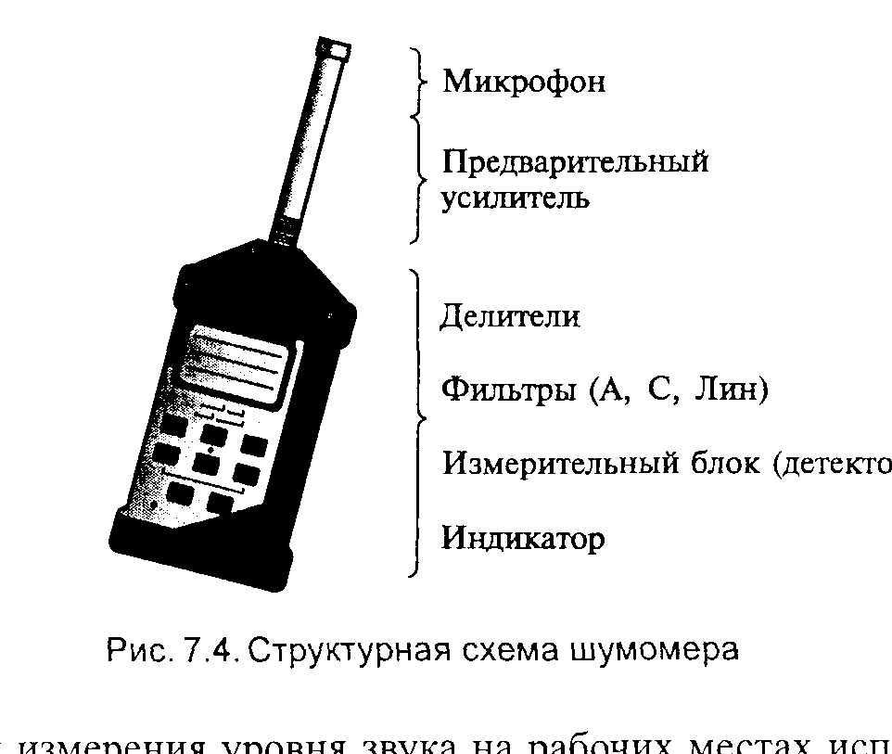
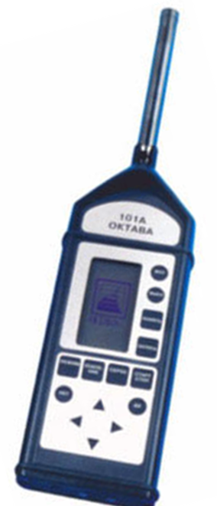
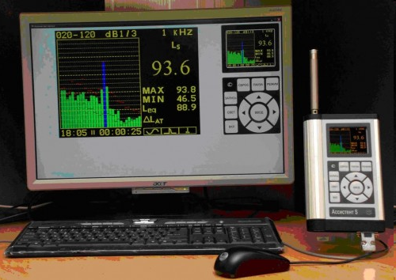
Ish joylarida tovush balandligi darajasini o'lchash uchun shovqin o'lchagichlar (shumomer) ishlatiladi.
Mikrofon
Birlamchi
kuchaytirgich
Taqsimlagich
Filtrlar (A, S, Lin)
O`lchash bloki
detektor
Indikator
Fig. 32. "Acoustic protection system" prompt, M-Zashita Acoustic Shield Assistant, Protechnology.ru, 2023. https://www.protehnology.ru/images/m-zashita-assistent-s.jpg
Fig. 31. "Noise level meter" prompt, Digital Noise Level Analyzer, Pribori24.ru, 2021.
https://pribori24.ru/wp-content/uploads/2021/01/50773-img-1-200x200.jpg
Shovqin o'lchagich o'lchash mikrofonidan, kuchaytirgichdan, trostlovchi filtrli elektr zanjiridan, ma'lum vaqt tavsiflariga ega (sekin, tez va impulsli) o'lchash asbobidan (detektor) iborat.
30

Slide 31
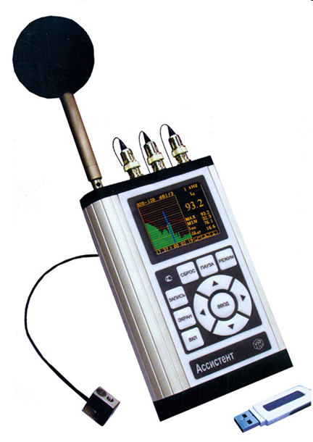
Shovqin o'lchagichlarda tovush tebranishlari mikrofon yordamida seziladi, uning vazifasi o'zgaruvchan tovush bosimini unga mos keladigan o'zgaruvchan elektr kuchlanishiga aylantirishdir.
Shovqinni o'lchashda mikrofon poldan yoki ish platformasidan 1,5 m balandlikda (agar ish tik turgan holda bajarilsa) yoki shovqin ta'siriga uchragan odamning qulog'ining balandligida (agar ish o'tirib bajariladigan bo'lsa) joylashtirilishi kerak.
Fig. 32. "Ultrasonic defectoscope" prompt, Ultrasonic Flaw Detection Sensor, Glotr.uz, 2024. https://files.glotr.uz/company/000/037/041/products/2024/12/05/2024-12-05-16-00-02-151495-85caa8b9e0303b808e8ea45652231c2f.webp?_=ozb9y
31

Slide 32
Ishlab chiqarishda keng qo`llaniladigan shovqin o`lchagichlarning asosiy tavsiflari
Asbob nomi, turi | O`lchash parametrlari | Rostlovchi filtrlar | Vaqt konstantalari | O`lchash diapazoni, dB | Chastota diapazoni, Gts
SVAN 943 (raqamli) | Tovush bosimi darajasi, tovushning ekvivalent darajasi | A, C, Lin | Sekin, Tez, Impulsli | 29 - 133 | 20 - 11000
ВШВ-003-М2 (analogli) | Tovush bosimi darajasi, A, B, C chastota tavsifli tovush darajasi | A, B, C, Lin | Sekin, Tez | 20 - 130 | 2 - 20000
32

Slide 33
Foydalanilgan adabiyotlar
O’lchash usullari va vositalari, O’quv qo’llanma. A.A.Mamajonov, M.O.Sattarov, D.V.Xakimov /Toshkent “NIF MSh” -2020 y. 254 b
Mеtrоlоgiya asoslari, O’quv qo’llanma. Ismаtullаеv P.R., Qodirova Sh.A. / T.: Tafakkur, Extremum –Press, 2012.
Электро-радиоизмерение, Учебная пособие. Исматуллаев П.Р., Кадырова Ш.А., Газиев Г.А. – Т:.ТГТУ 2007
O’lchashning fizikaviy asoslari. Darslik. Kalandarov P.I.. / – T:” TIQXMMI” MTU, 2023, 232 b.
Kazvek. “Ultrasonic flaw detector UD2-70” prompt, Kazvek.com, 2021.
NDT Innovations. “Ultrasonic testing system” prompt, NDT-Innovations.ru, 2020.
Mprofit. “Thickness gauge” prompt, Mprofit.ru, 2022.
“Ultrasonic flaw detector” prompt, GEO-NDT.ru, 2021.
Amazon. “Sound level meter device” prompt, Amazon.com, 2023.
Hardbroker. “Ultrasonic thickness gauge” prompt, Hardbroker.ru, 2022.
Kvazar KZ. “Ultrasonic flaw detector B-1187” prompt, Kvazar-KZ.com, 2021.
Biolight. “Digital acoustic noise level meter” prompt, Biolight.ru, 2023.,
Armada NDT. “Ultrasonic flaw detector” prompt, Armada-NDT.ru, 2021.
VNIR. “CO-2 calibration block” prompt, VNIR.ru, 2022.
TextArchive. “Amplitude-shadow method” prompt, Textarchive.ru, 2020.
StrPort. “Sound insulation material” prompt, StrPort.ru, 2023.
Studwood. “Echo method” prompt, Studwood.net, 2020.
Pribori24. “Noise level meter” prompt, Pribori24.ru, 2021.
33

Slide 34
E’tiboringiz
uchun rahmat !!!
34

