Slide 1
Strategic Human Resource Management
Lecture 1
Introduction to Strategic HRM
Lecturer: Dr. Amy Vundi

Slide 2
Agenda
Lecture Learning Outcomes
Introduction to HRM: Core Definition
The Evolution of HRM
The Goals of HRM
Core Functions of HRM (The HR Value Chain)
Strategic Human Resource Management (SHRM)
The Changing Context of HRM
Key Challenges for Modern HR
The New Mandate for HR
Key Takeaways & References

Slide 3
Lecture Learning Outcomes
At the end of this lecture, you will be able to:
Define Human Resource Management
Explain the evolution of human resource management
Define the goals of human resource management
Outline the core functions of human resource management
Explain the changing context of Human Resource Management

Slide 4
What Comes to Mind?
Title: What is Human Resource Management?
Content: (Image of a diverse group of professionals collaborating)
Question: Recruitment? Payroll? Firing? Strategy? Culture?

Slide 5
Core Definition of HRM
Definition: "HRM is the strategic approach to the effective management of people in an organization so that they help the business gain a competitive advantage."
Key Point: It is designed to maximize employee performance in service of an employer's strategic objectives.

Slide 6
People as a Strategic Asset
Title: From Cost to Capital
Content: HRM shifts the view of employees from a cost of doing business to human capital—a valuable asset that drives organizational success.

Slide 7
The Evolution of HRM
Title: From Personnel to Strategic Partner
Visual: A timeline graphic.

Slide 8
Historical View: Personnel Management
Focus: Administrative Tasks
Characteristics:
  Reactive
  Seen as a Cost Center
  Payroll & Employee Records
  Legal Compliance
  Labor Relations

Slide 9
Modern View: Strategic HRM
Focus: Strategic Integration
Characteristics:
  Proactive
  Strategic Partner
  Views people as valuable assets (Human Capital)
  Directly drives organizational success

Slide 10
Evolution Summary
Then (Personnel Admin): Paperwork, Rules, Reacting to Problems
Now (Strategic HRM): Strategy, Value, Driving Performance, Preventing Problems

Slide 11
Reference: Evolution
Snell, S., Morris, S., & Bohlander, G. W. (2023). Managing Human Resources (18th ed.). Cengage Learning.

Slide 12
The Goals of HRM
What HRM Aims to Achieve

Slide 13
Goal 1: Attract and Retain Talent
Focus: Building a strong workforce.
Activities: Employer branding, recruiting, creating a positive employee experience.

Slide 14
Goal 2: Motivate and Engage
Focus: Ensuring productivity and commitment.
Tools: Compensation, benefits, performance management, positive work environment.

Slide 15
Goal 3: Develop Skills and Knowledge
Focus: Building skills for the future.
Methods: Training, development, career management.

Slide 16
Goal 4: Ensure Legal Compliance & Ethics
Focus: Protecting the organization and ensuring fairness.
Areas: Legal compliance, fair treatment, safe work environment.

Slide 17
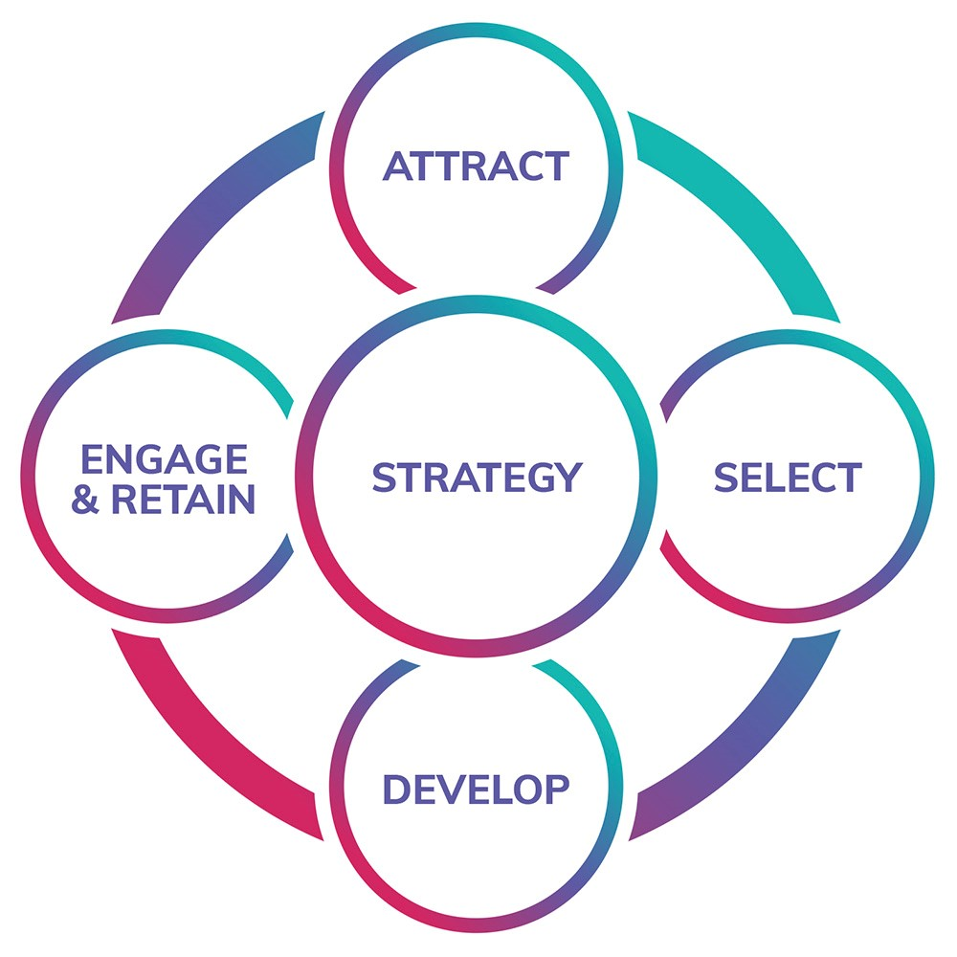
The Four Goals Visualized

Slide 18
Reference: Goals
Dessler, G. (2023). Human Resource Management (16th ed.). Pearson.

Slide 19
Core Functions of HRM
Title: The HR Value Chain
Subtitle: Key Activities to Achieve HR Goals

Slide 20
Core Function 1: Talent Acquisition & Planning
Purpose: Identifying needs and finding the right people.
Key Activities: Job analysis, workforce planning, recruiting, selection, onboarding.

Slide 21
Core Function 2: Learning & Development (L&D)
Purpose: Equipping employees with necessary skills.
Key Activities: Training, leadership development, career planning, succession planning.

Slide 22
Core Function 3: Performance Management
Purpose: Aligning employee output with goals.
Key Activities: Goal setting (OKRs), performance appraisals, feedback, coaching.

Slide 23
Core Function 4: Total Rewards
Purpose: Compensating and rewarding employees.
Key Activities: Compensation (pay, bonuses), benefits (healthcare), non-monetary rewards (recognition).

Slide 24
Core Function 5: Employee & Labor Relations
Purpose: Maintaining a positive work environment.
Key Activities: Employee engagement, communication, conflict resolution, union relations.

Slide 25
Core Function 6: HR Compliance & Risk Management
Purpose: Adhering to laws and regulations.
Key Activities: Health & safety (OSHA), EEO, data privacy, ethical practices.

Slide 26
The HR Value Chain Table
Function | Description | Key Activities
Talent Acquisition & Workforce Planning | Identifying staffing needs and finding the right people. | Job analysis, workforce planning, recruiting, selection, onboarding.
Learning & Development (L&D) | Equipping employees with necessary skills. | Training, leadership development, career planning, succession planning.
Performance Management | Ensuring employee output aligns with goals. | Goal setting (e.g., OKRs), performance appraisals, feedback, coaching.
Total Rewards | Compensating and rewarding employees. | Compensation (pay, bonuses), benefits (healthcare, retirement), non-monetary rewards (recognition, work-life balance).
Employee & Labor Relations | Maintaining a positive work environment. | Employee engagement, communication, conflict resolution, union relations.
HR Compliance & Risk Management | Adhering to laws and regulations. | Health & safety (OSHA), equal employment opportunity (EEO), data privacy, ethical practices.
Guest, Kaufman, Ulrich, Wright, etc.

Slide 27
Reference: Functions
Noe, R. A., Hollenbeck, J. R., Gerhart, B., & Wright, P. M. (2023). Human Resource Management: Gaining a Competitive Advantage (12th ed.). McGraw-Hill.

Slide 28
Strategic HRM (SHRM)
The Central Theme of Modern HR

Slide 29
What is SHRM?
Definition: The proactive integration of HR strategies with the overall business strategy.
Quote: "HR's worth is measured by its ability to improve organizational outcomes."

Slide 30
Key Element: Alignment
HR policies and practices must be aligned with the business strategy (e.g., innovation, cost leadership, customer intimacy).
Visual: Two gears interlocking, one labeled "Business Strategy" and the other "HR Strategy".

Slide 31
Key Element: HR Analytics
Using data to make evidence-based decisions.
Examples: Predicting employee turnover, measuring the ROI of training programs.

Slide 32
Reference: SHRM
Ulrich, D., & Dulebohn, J. H. (2023). HR from the Outside In: The Next Era of Human Resources Transformation. RBL Group.

Slide 33
The Changing Context of HRM
Operating in a Dynamic World

Slide 34
Change Driver 1: Technology & AI
HR Information Systems (HRIS)
Automation of admin tasks
AI in recruiting and performance management

Slide 35
Change Driver 2: The Gig Economy
Managing a blended workforce.
Full-time employees + contingent workers (freelancers, contractors).

Slide 36
Change Driver 3: Diversity, Equity, Inclusion & Belonging (DEIB)
Moving beyond legal compliance.
Creating inclusive cultures that leverage diversity for innovation.

Slide 37
Change Driver 4: Globalization
Managing a global workforce.
Navigating different cultures, laws, and time zones.

Slide 38
Change Driver 5: Employee Experience & Well-being
Prioritizing mental health.
Flexibility (hybrid/remote work).
The overall employee journey.

Slide 39
Reference: Changing Context
Cascio, W. F., & Aguinis, H. (2023). Applied Psychology in Talent Management (9th ed.). SAGE Publications.

Slide 40
Key Challenges for Modern HR
Demonstrating ROI of HR initiatives
Managing rapid technological and market change
Upskilling the workforce for new demands
Attracting and retaining critical talent
Maintaining culture in hybrid/dispersed teams

Slide 41
The New Mandate for HR
Title: The HR Professional of the Future
Key Message: "It's not about administering policies; it's about understanding the business, diagnosing organizational problems, and prescribing people-based solutions that drive strategic execution and results."
Conclusion: The most effective HR professionals are business people first, who specialize in the human side of the enterprise.

Slide 42
Key Takeaways
HRM is a strategic function for managing human capital.
It has evolved from administrative personnel management.
Its four main goals are to attract, motivate, develop, and protect employees.
These goals are achieved through six core functions.
Modern HR must be aligned with business strategy (SHRM) and adapt to a changing world.

Slide 43
Recommended Reading
Armstrong, M., & Taylor, S. (2024). Armstrong's Handbook of Human Resource Management Practice (16th ed.). Kogan Page.

Slide 44


