Slide 1
Basic Principles of Process Calculations in Chemical Engineering (ChEg2106)
Prerequisites: No prerequisite for this course
Lecture 2: Basic Concepts and Calculations in Chemical Engineering
Week 2
Lecturer: Adamu Esubalew (PhD, ChEg)
Addis Ababa, Ethiopia
1

Slide 2
Lecture learning outcomes
At the end of the lecture, you will be able to:
identify fundamental and derived dimensions and units,
explain units of measurement and SI units,
apply unit conversions for dimensions and units' consistency for process calculations, and
determine the units of physical quantities.

Slide 3
Presentation outlines
Introduction to dimensions and units
Unit conversions
Equations and units
Measurement errors and significant figures
Summary
3

Slide 4
2.1. Introduction to dimensions and units
A fundamental concept in chemical engineering that involves accounting for all materials and energy entering and leaving a system.
Material balances account for material entering and leaving a system.
Energy balances account for energy entering and leaving a system.
To determine material and energy balances, the dimensions and units of all flow streams shall be consistent throughout the calculations.
4

Slide 5
Cont’d
The dimensions of all the elements of the process with their respective units must be specified accurately because this information will be used to ensure that each part of the process is accurately manufactured or selected.
Dimensions and units are fundamental concepts in physics and engineering that help to quantify and describe physical quantities.
Units and dimensions are foundational to chemical engineering to ensure accuracy, and consistency in measurements and calculations (Richard M. Felder, 2005, pg. 8).
5

Slide 6
Cont’d
Dimensions represent the physical nature of a quantity, while units provide a standard measure of that quantity.
For example, length, time, mass, temperature, amount of substance, velocity, flow rates, volume, force, and pressure are the dimensions of physical quantities.
The dimensions of physical quantities are categorized into fundamental dimensions and derived dimensions.
6

Slide 7
Cont’d
Fundamental dimensions: They are from which all other dimensions can be derived.
There are several fundamental measures of physical quantities such as mass, length, time, temperature, and amount of substance.
The braces around a symbol like {M} mean “the dimension” of mass.
The terms of {M}, {L}, {T}, {θ}, and {N} are the dimensions of mass, length, time temperature and amount of substance, respectively.
7

Slide 8
Cont’d
Derived dimensions: They are obtained from fundamental dimensions by multiplication and/or division.
Velocity, volume, volumetric flow rate, mass flow rate, force, pressure etc. are derived dimensions.
For instance, the dimension of force is {M}{L/T²} and pressure has the dimensions {M}/{LT²}.
Force is directly related to the dimensions of mass, length, and time by Newton’s second law.
8

Slide 9
Cont’d
Pressure is also related to the dimensions of mass, length, and time.
The dimensions of force and pressure are obtained by multiplying and/ or division of the dimensions of mass, length and time.
Units: They are standard quantities used to measure dimensions.
Fundamental units are standard measures of fundamental dimensions.
For example, kg, m, s, K, and mol are the fundamental units of mass, length, time, temperature, and amount of substance, respectively.
9

Slide 10
Cont’d
The International System of Units (SI) for fundamental dimensions are given in Table 2.1 (Richard M. Felder, 2005, pg. 11).
Table 2.1 Fundamental dimensions and units
Physical quantity | Dimensions | Name of SI units | Symbol of SI units
Mass | {M} | kilogram | kg
Length | {L} | meter | m
Time | {T} | second | s
Temperature | {Θ} | Kelvin | K
Amount of substance | {N} | mole | mol
10

Slide 11
Cont’d
Fundamental units can be described in various forms.
For example, kilogram, gram and milligram are units of mass; meter, centimeter and millimeter are units of length; hour, minute and second are units of time; degree Celsius , Kelvin and degree Fahrenheit are units of temperature; and kilomole, mol and millimole are units of amount of substance.
Derived units are formed by combining fundamental units according to the relationships between different physical quantities.
11

Slide 12
Cont’d
Appropriate units are critical for designing experiments, analyzing results, and scaling up processes from the lab to pilot and full-scale production.
Chemical engineers often use computational models that require precise input of units and dimensions to yield valid results.
Hence, units and dimensions are essential for calculations related to reactor design, separation processes, heat exchangers, and other unit operations (Coulson & Richardson’s, 1999, pg. 14).
12

Slide 13
Activity 2.1
Identify the fundamental dimensions and SI units of some physical quantities.
What are the dimension and SI unit of the rate of heat transfer (Q) of a flowing fluid. Where: Q = mC_{p}ΔT.
The pressure of a fluid flow through a pipe is given by: P = ku². where P is pressure (Pa), u is fluid velocity (m/s), and k is constant. What is the unit of the constant, k?
How do we obtain derived dimensions of physical quantities?
13

Slide 14
Cont’d
Identify the fundamental dimensions and SI units of some physical quantities.
Answer:
The fundamental dimensions are the measures of physical quantities such as mass, length, time, temperature, and amount of substance.
The dimensions of mass, length, time, temperature, and amount of substance are {M}, {L}, {T}, {Θ}, and {N}, respectively.
The SI units of mass, length, time, temperature, and amount of substance are kg, m, s, K and mol, respectively.
14

Slide 15
Cont’d
2. What are the dimension and SI unit of rate of heat transfer (Q) of a flowing fluid. Where: Q = mCpΔT.
Answer:
The dimension of rate of heat transfer is derived from fundamental dimensions using multiplication and division of physical quantities.
Rate of heat transfer is the product of mass flow rate, specific heat capacity and temperature change.
15

Slide 16
Cont’d
The dimensions of mass flow rate, specific heat capacity and temperature change are {MT⁻¹}, {L²T⁻² Θ⁻¹} and{Θ}, respectively.
To find the dimension of the rate of heat transfer, you multiply the dimensions of mass flow rate, specific heat capacity and temperature change.
Hence, the dimension of rate of heat transfer (Q) is {ML²T⁻³ }.
The rate of heat transfer has unit of kg.m²s⁻³.
1 kg.m²s⁻³= 1 J/s =1 W
The SI units of Q is W.
16

Slide 17
Cont’d
3. The pressure of a fluid flow through a pipe is given by: P = ku². where P is pressure (Pa), u is fluid velocity (m/s), and k is constant. What is the unit of the constant, k?
Answer:
The unit of constant, k , is obtained by dividing the unit of pressure to the unit of velocity square.
The constant, k = P/u^{2.}
The unit of k = unit of P/ unit of u².
The unit of k is Pa/ (m²/s²) = (kg/ m.s²)/(m²/s²) = kg/m³.
17

Slide 18
Cont’d
4. How do we obtain derived dimensions of physical quantities?
Answer:
We obtain the derived dimensions from fundamental dimensions by multiplication and/or division of physical quantities.
For example, the dimension of acceleration is the division of the dimension of length and square of time. i.e. the dimension of acceleration (a) is {LT⁻²).
The dimension of force (F) is the product of dimension of mass and acceleration. i.e. the dimension of force (F) is {MLT⁻²}.
18

Slide 19
2.2. Unit conversions
2.2.1. SI unit and unit conversions
Some of the unit conversion relations are given in Table 2.2 (Coulson & Richardson’s, 1999, pg. 969).
Table 2.2 Units conversions for physical quantities
Physical quantity | SI units | Unit conversion
Mass | kg | 1kg = 1000 g; 1g = 1000 mg
Length | m | 1 m = 100 cm; 1 cm = 10 mm
Time | s | 60s = 1 min; 1h = 60 min
Temperature | K | K = ºC+ 273.15; 25ºC = 298.15 K
Amount of substance | Mol | 1 mol = 1000 milli mol; 1 kmol = 1000 mol
19

Slide 20
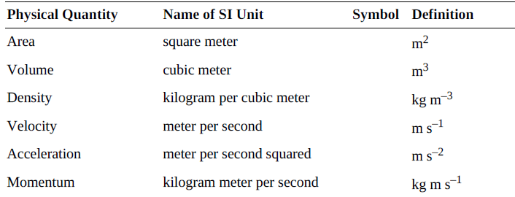
Cont’d
The SI units of some derived quantities are shown in Table 2.3 (Himmelblau, 2023, pg. 41).
Table 2.3. SI units of derived quantities
20

Slide 21
Cont’d
2.2.2. American Engineering Units, and unit conversion
The American engineering (AE) system of units originated from the British system of units.
The AE system is based on the foot and the pound force.
The AE system is considered a gravitationally based system.
It is based on defining force in terms of the gravitational field of the earth.
21

Slide 22
Cont’d
The fundamental units for the AE system are shown in Table 2.4 (Himmelblau, 2023, pg. 41).
Table 2.4 AE system fundamental units of physical quantities
Physical quantity | Name of AE unit | Symbol of AE unit
Force | Pound force | lb_{f}
Length | Foot | ft
Time | Second | s
Temperature | Degree Fahrenheit | ºF
Amount of substance | Pound mole | lb-mol
22

Slide 23
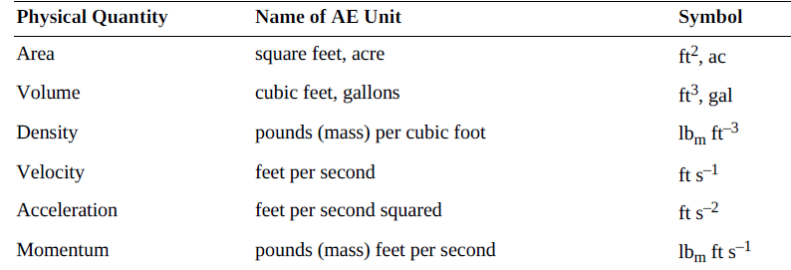
Cont’d
The AE derived units are shown in Table 2.5 (Himmelblau, 2023, pg. 42).
Table 2.5 AE derived units of some physical quantities
23

Slide 24
Activity 2.2
In the laboratory for solution preparation, you are ordered to prepare NaOH solution. If you are given 20 g of NaOH and 500mL of distilled water, what will be the concentration of NaOH solution in SI unit (M_{w} of Na = 23, O= 16, H=1).
Convert the following quantities from AE system unit to SI system unit.
20gal/hr to m³/s
50lb_{f}/in² to N/m².
24

Slide 25
Cont’d
1. In the laboratory for solution preparation, you are ordered to prepare NaOH solution. If you are given 20 g of NaOH and 500 mL of distilled water, what will be the concentration of NaOH solution in SI unit (M_{w} of Na = 23, O= 16, H=1).
Answer:
The molecular weight (M_{w}) of NaOH = 23 + 16 + 1 = 40 g/ mol
Number of moles (n) = given mass (m)/ molecular weight (M_{w}) = 20 g/40 g/mol = 0.5 mol. Concentration (C) = number of moles (n)/volume (V) = 0.5 mol/ 500 mL= 0.5 mol/(500 mL) * (1000 mL/ 1L) = 1 mol/L
Thus, the concentration of NaOH solution in SI unit is 1 mol/L.
25

Slide 26
Cont’d
2. Convert the following quantities from AE system unit to SI system unit.
20gal/hr to m³/s
50lb_{f}/in² to N/m².
Answer :
a). 20 gal/hr = 20 gal/hr×1hr/60min×1min/60s×3.78L/gal×1m³/1000L = 2.1×10⁻⁵m³/s
b). 50lb_{f}/in² = 50lb_{m}/in²×ft/s²×12in/1ft×0.454kg/lbm×1in/0.0254m = 10724.4kg/m.s²
= 10724.4N/m²
26

Slide 27
2.3. Equations and units
The use of units or dimensions along with the numbers in your calculations requires more attention than you probably have been giving to your computations.
In chemical engineering, understanding basic concepts and performing calculations is essential for designing and analyzing processes.
Furthermore, ensuring dimensional consistency and using appropriate units is critical for accurate results and safety.
The dimensions and units of equations must be consistent both in right- and left-hand sides of the equations.
27

Slide 28
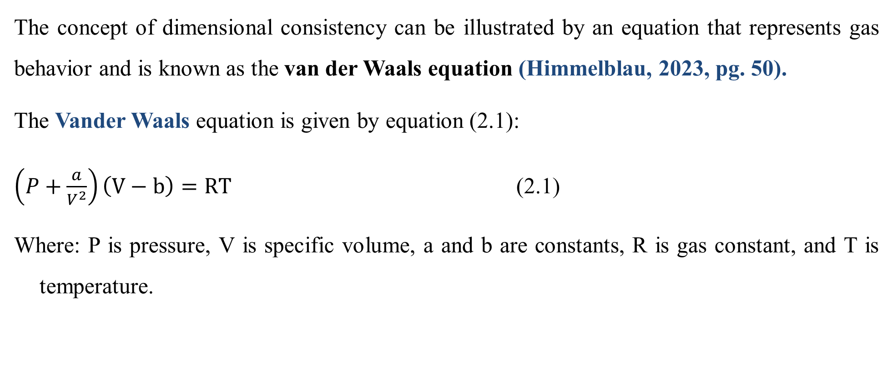
Cont’d
The concept of dimensional consistency can be illustrated by an equation that represents gas behavior and is known as the van der Waals equation (Himmelblau, 2023, pg. 50).
The Vander Waals equation is given by equation (2.1):
$\left(P+\frac{a}{V^{2}}\right)\left(V−b\right)=RT$ (2.1)
Where: P is pressure, V is specific volume, a and b are constants, R is gas constant, and T is temperature.
28

Slide 29
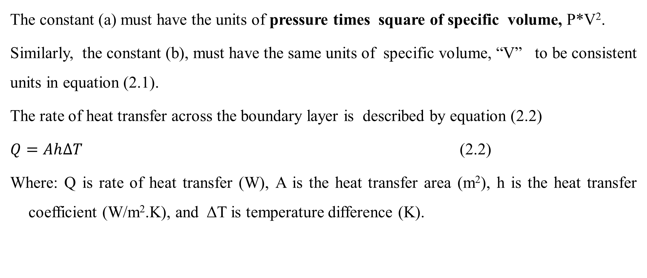
Cont’d
The constant (a) must have the units of pressure times square of specific volume, P*V².
Similarly, the constant (b), must have the same units of specific volume, “V” to be consistent units in equation (2.1).
The rate of heat transfer across the boundary layer is described by equation (2.2)
$Q=Ah∆T$ (2.2)
Where: Q is rate of heat transfer (W), A is the heat transfer area (m²), h is the heat transfer coefficient (W/m².K), and ΔT is temperature difference (K).
29

Slide 30
Cont’d
The rules for handling units for arithmetic operations has a crucial role to avoid mistakes.
Addition and substruction: For addition and substruction arithmetic operations, you can add, subtract, or equate numerical quantities only if the units of the physical quantities are the same.
For example, the sum of two masses of 100 mg + 5 g can be performed only after the units are transformed into the same.
1 g = 1000 mg
Thus, the sum of 100 mg + 5 g = 0.1 g + 5 g= 5.1 g.
30

Slide 31
Cont’d
If the units of physical quantities are not the same, addition and substruction arithmetic operation of physical quantities will be meaningless.
For example, the operation of 10 kg + 5 J is meaningless.
Multiplication and division: For multiplication and division arithmetic operations, you can multiply or divide different units.
For example, 10 kg * 10 m/s² = 100 kg.m/s².
The operation of 0.75 m²* 10 m/s= 7.5 m³/s.
31

Slide 32
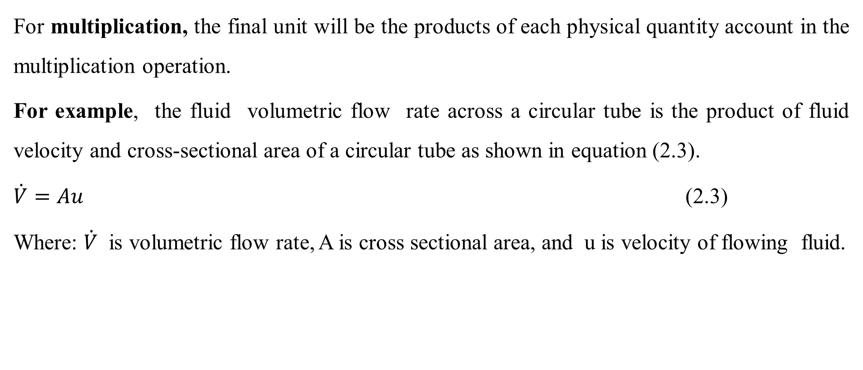
Cont’d
For multiplication, the final unit will be the products of each physical quantity account in the multiplication operation.
For example, the fluid volumetric flow rate across a circular tube is the product of fluid velocity and cross-sectional area of a circular tube as shown in equation (2.3).
$\dot{V}=Au$ (2.3)
Where: $\dot{V}$ is volumetric flow rate, A is cross sectional area, and u is velocity of flowing fluid.
32

Slide 33
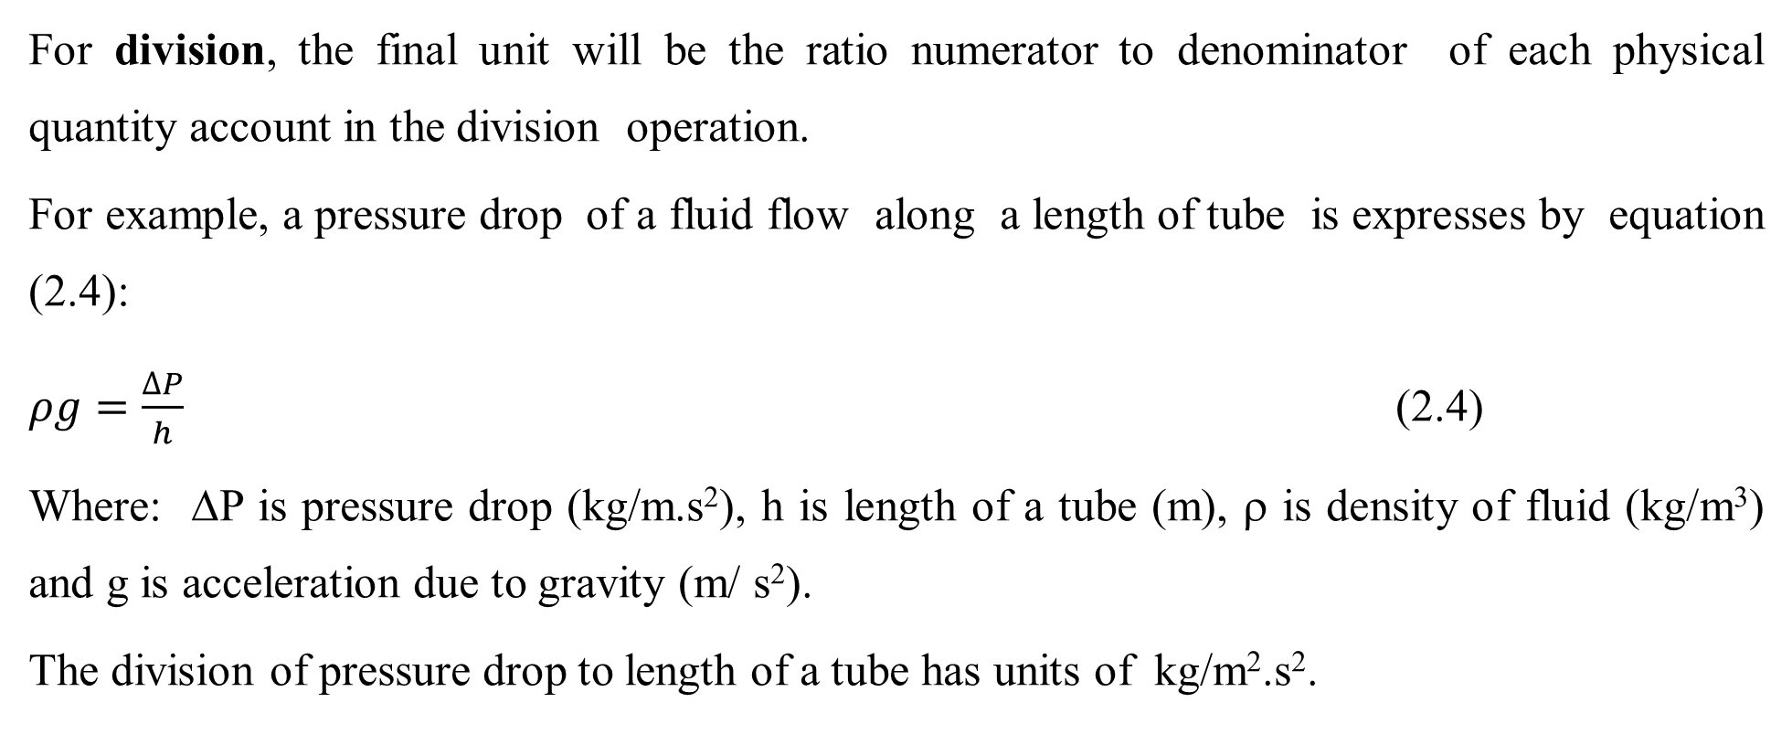
Cont’d
For division, the final unit will be the ratio numerator to denominator of each physical quantity account in the division operation.
For example, a pressure drop of a fluid flow along a length of tube is expresses by equation (2.4):
$ρg=\frac{∆P}{h}$ (2.4)
Where: ΔP is pressure drop (kg/m.s²), h is length of a tube (m), ρ is density of fluid (kg/m³) and g is acceleration due to gravity (m/ s²).
The division of pressure drop to length of a tube has units of kg/m².s².
33

Slide 34
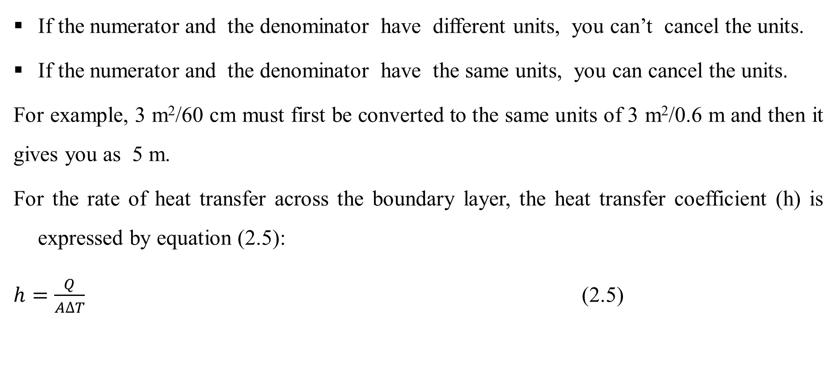
Cont’d
If the numerator and the denominator have different units, you can’t cancel the units.
If the numerator and the denominator have the same units, you can cancel the units.
For example, 3 m²/60 cm must first be converted to the same units of 3 m²/0.6 m and then it gives you as 5 m.
For the rate of heat transfer across the boundary layer, the heat transfer coefficient (h) is expressed by equation (2.5):
$h=\frac{Q}{A∆T}$ (2.5)
34

Slide 35
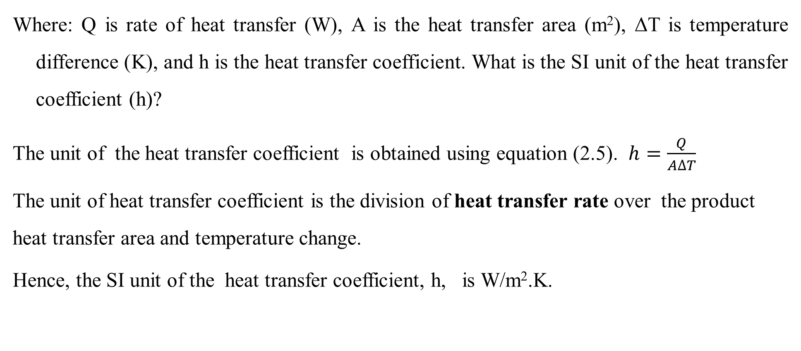
Cont’d
Where: Q is rate of heat transfer (W), A is the heat transfer area (m²), ΔT is temperature difference (K), and h is the heat transfer coefficient. What is the SI unit of the heat transfer coefficient (h)?
The unit of the heat transfer coefficient is obtained using equation (2.5). $h=\frac{Q}{A∆T}$
The unit of heat transfer coefficient is the division of heat transfer rate over the product heat transfer area and temperature change.
Hence, the SI unit of the heat transfer coefficient, h, is W/m².K.
35

Slide 36
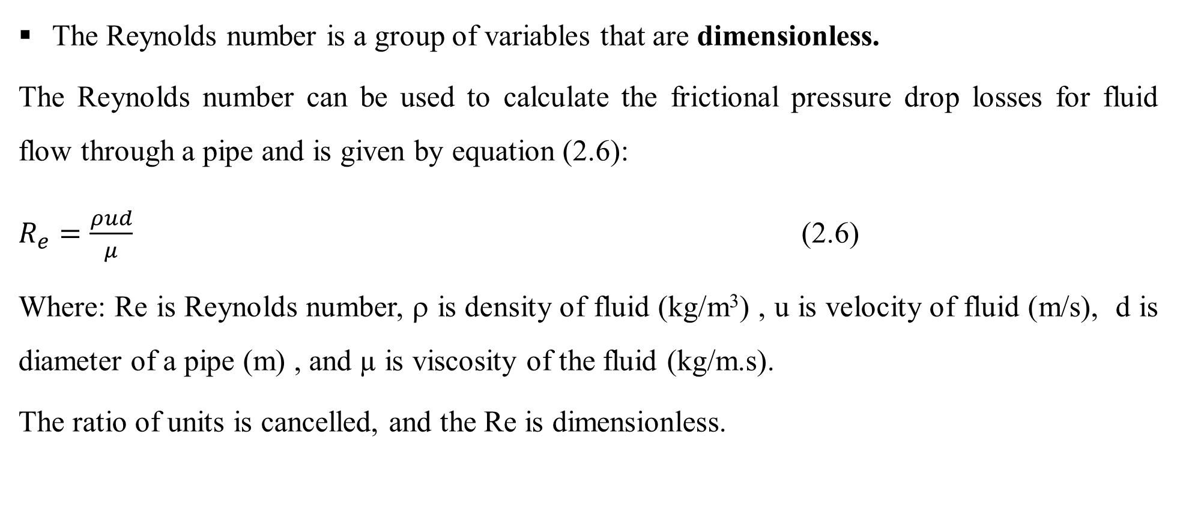
Cont’d
The Reynolds number is a group of variables that are dimensionless.
The Reynolds number can be used to calculate the frictional pressure drop losses for fluid flow through a pipe and is given by equation (2.6):
$R_{e}=\frac{ρud}{μ}$ (2.6)
Where: Re is Reynolds number, ρ is density of fluid (kg/m³) , u is velocity of fluid (m/s), d is diameter of a pipe (m) , and µ is viscosity of the fluid (kg/m.s).
The ratio of units is cancelled, and the Re is dimensionless.
36

Slide 37
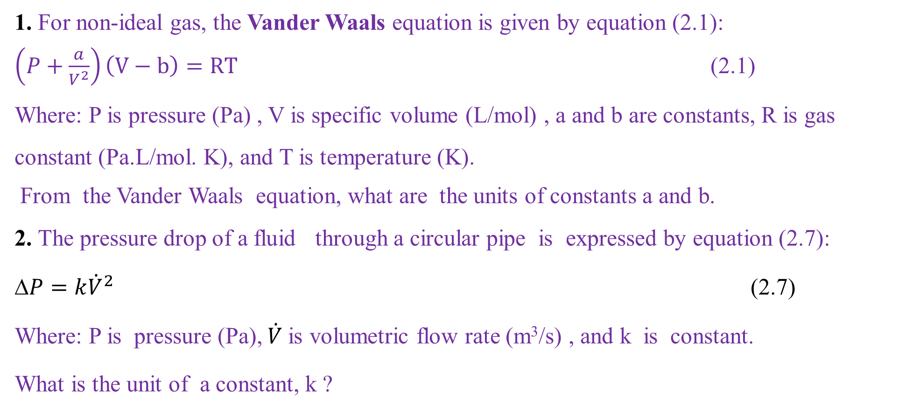
Activity 2.3
1. For non-ideal gas, the Vander Waals equation is given by equation (2.1):
$\left(P+\frac{a}{V^{2}}\right)\left(V−b\right)=RT$ (2.1)
Where: P is pressure (Pa) , V is specific volume (L/mol) , a and b are constants, R is gas constant (Pa.L/mol. K), and T is temperature (K).
From the Vander Waals equation, what are the units of constants a and b.
2. The pressure drop of a fluid through a circular pipe is expressed by equation (2.7):
$P=k{\dot{V}}^{2}$ (2.7)
Where: P is pressure (Pa), $\dot{V}$is volumetric flow rate (m³/s) , and k is constant.
What is the unit of a constant, k ?
37

Slide 38
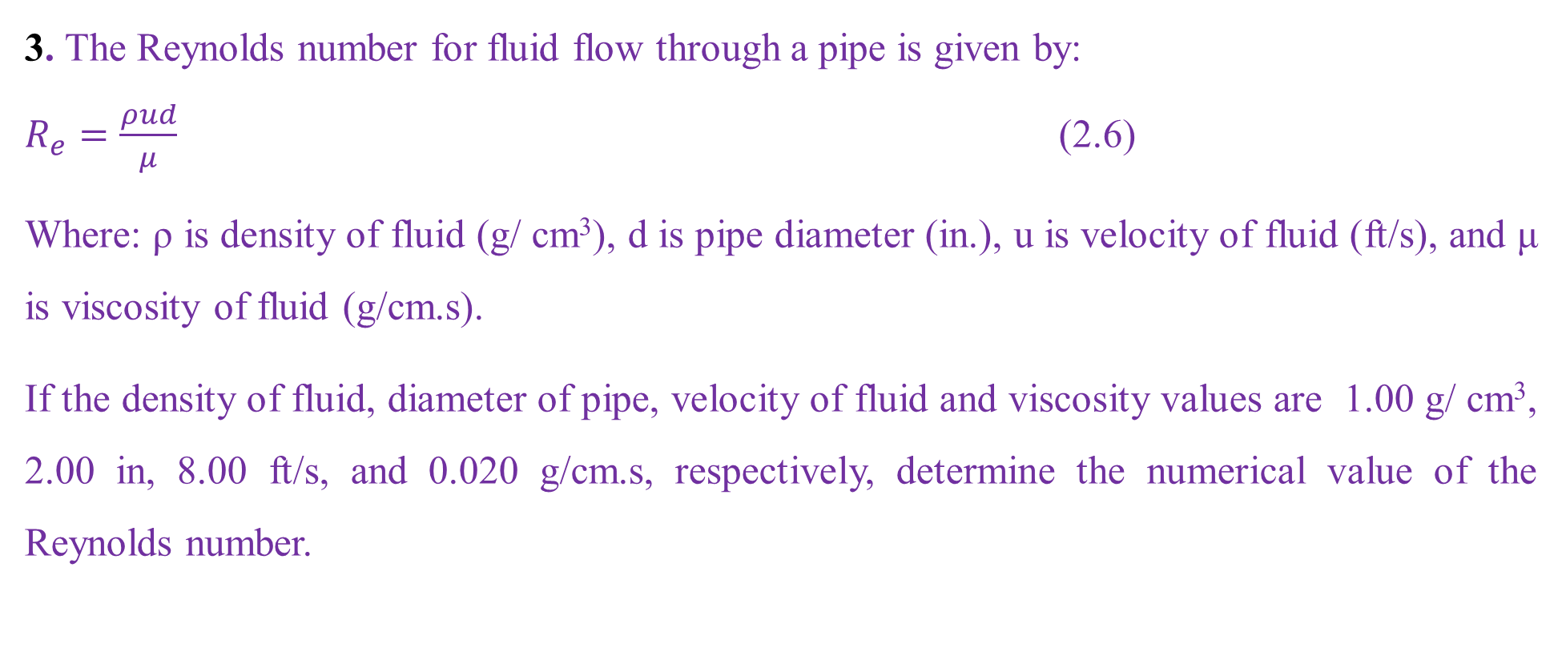
Cont’d
3. The Reynolds number for fluid flow through a pipe is given by:
$R_{e}=\frac{ρud}{μ}$ (2.6)
Where: ρ is density of fluid (g/ cm³), d is pipe diameter (in.), u is velocity of fluid (ft/s), and μ is viscosity of fluid (g/cm.s).
If the density of fluid, diameter of pipe, velocity of fluid and viscosity values are 1.00 g/ cm³, 2.00 in, 8.00 ft/s, and 0.020 g/cm.s, respectively, determine the numerical value of the Reynolds number.
38

Slide 39
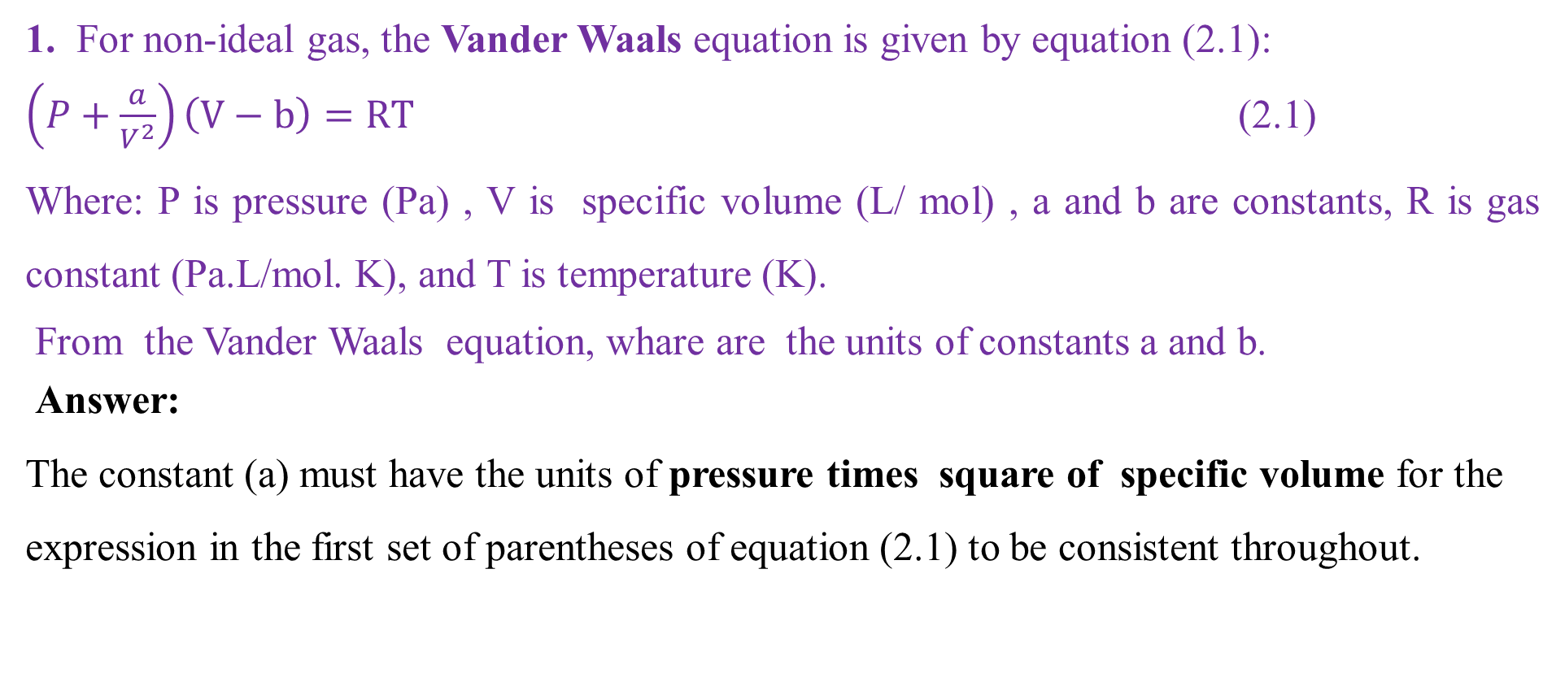
Cont’d
1. For non-ideal gas, the Vander Waals equation is given by equation (2.1):
$\left(P+\frac{a}{V^{2}}\right)\left(V−b\right)=RT$ (2.1)
Where: P is pressure (Pa) , V is specific volume (L/ mol) , a and b are constants, R is gas constant (Pa.L/mol. K), and T is temperature (K).
From the Vander Waals equation, whare are the units of constants a and b.
Answer:
The constant (a) must have the units of pressure times square of specific volume for the expression in the first set of parentheses of equation (2.1) to be consistent throughout.
39

Slide 40
Cont’d
The unit of constant (a) is P*V² = Pa * (L/mol)*( L/mol) = Pa. L²/mol².
The constant (b), must have the same units of specific volume, “V” to be consistent units for the expression in the first set of parentheses of equation (2.1).
The unit of constant (b) = unit of specific volume (V) = L/ mol.
Hence, the units of constants a and b in equation (2.1) are Pa.L²/mol² and L/mol, respectively.
40

Slide 41
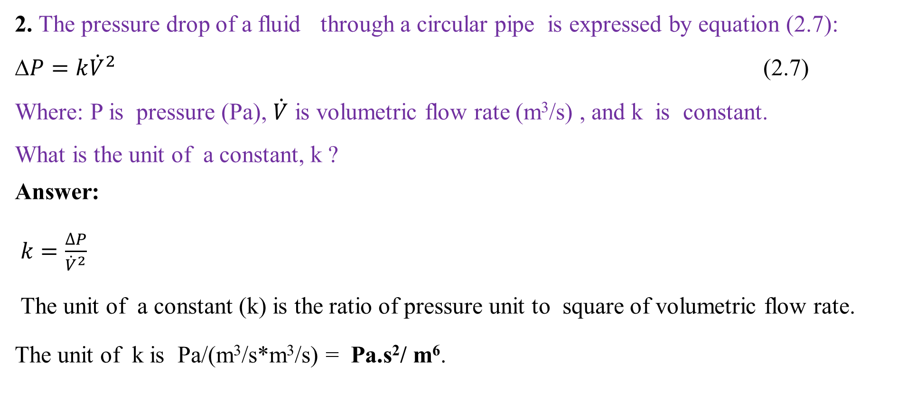
Cont’d
2. The pressure drop of a fluid through a circular pipe is expressed by equation (2.7):
$P=k{\dot{V}}^{2}$ (2.7)
Where: P is pressure (Pa), $\dot{V}$ is volumetric flow rate (m³/s) , and k is constant.
What is the unit of a constant, k ?
Answer:
$k=\frac{∆P}{{\dot{V}}^{2}}$
The unit of a constant (k) is the ratio of pressure unit to square of volumetric flow rate.
The unit of k is Pa/(m³/s*m³/s) = Pa.s²/ m⁶.
41

Slide 42
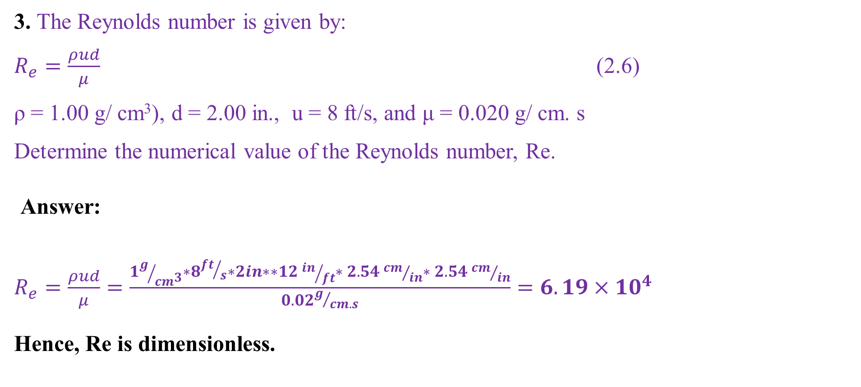
Cont’d
3. The Reynolds number is given by:
$R_{e}=\frac{ρud}{μ}$ (2.6)
ρ = 1.00 g/ cm³), d = 2.00 in., u = 8 ft/s, and μ = 0.020 g/ cm. s
Determine the numerical value of the Reynolds number, Re.
Answer:
$R_{e}=\frac{ρud}{μ}=\frac{1g/{{cm}^{3}}∗8{ft}/s∗2in∗∗12 {in}/{ft}∗ 2.54 {cm}/{in}∗ 2.54 {cm}/{in}}{0.02g/{cm.s}}=6.19×{10}^{4}$
Hence, Re is dimensionless.
42

Slide 43
2.4. Measurement errors and significant figures
Measurement errors and significant figures are fundamental in scientific measurements to ensure accuracy and precision in data reporting.
2.4.1 Measurement errors
Measurement errors refer to the differences between the measured value and the true value.
Measurement errors can arise from various sources and can be classified into two main categories: systemic errors and random errors.
43

Slide 44
Cont’d
Systematic errors: These are consistent, repeatable errors associated with defective equipment or experimental design.
Systematic errors can tilt results in a specific direction (either high or low).
For example, if a scale is not calibrated correctly, it may consistently give readings that are too high or low.
Random errors: They arise from unpredictable fluctuations in the measurement process.
They can vary from one measurement to another.
Measurement uncertainty quantifies the doubt about the result of a measurement.
44

Slide 45
Cont’d
Measurement uncertainty can be expressed in various ways, such as absolute uncertainty, relative uncertainty, and combined uncertainty.
Absolute uncertainty: It is a measure of the uncertainty of a measurement expressed in the same units as the measurement itself.
It provides an indication of the range within which the true value of the measurement is expected to occur.
For example, if a temperature is measured as 10.0ºC ± 0.5ºC, then 0.5ºC is the absolute uncertainty.
45

Slide 46
Cont’d
Relative uncertainty: It is a measure of the uncertainty of a measurement expressed as a fraction or percentage of the measured value.
It is calculated by dividing the absolute uncertainty by the measured value.
It is expressed as a fraction or percentage of the measured value (e.g., ±2% of 60ºC).
This means that the uncertainty in the measurement of the temperature is 2% of the measured value.
Combined uncertainty: It refers to the total uncertainty associated with a measurement that arises from multiple sources.
46

Slide 47
Cont’d
The uncertainty in a measurement depends on the type of measurement and the device used. The uncertainties for industrial measurements is shown in Table 2.6 (Himmelblau, pg. 54).
Table 2.6 Typical uncertainties for industrial measurements
Measurement | Measured by | Uncertainty
Temperature | Thermocouple | ±1ºC
Temperature | Resistance temperature detector (RTD) | ±0.1ºC
Pressure | Pressure sensor | ±1%
Mass flow rate | Orifice meter | ±3-5%
Solution pH | pH electrode | ±0.1%
47

Slide 48
Cont’d
In Table 2.6, the two sources of error are the background noise for the measuring instrument and the precision of the scale used to display the measurement.
They can be estimated by making repeated measurements under the same conditions.
The ability to achieve consistent measurements is known as the repeatability and indicates the precision of the measurement.
The repeatability of a measurement is an indication of the precision of the instrument, while the difference between the true reading and the measurement indicates the accuracy of the instrument.
48

Slide 49
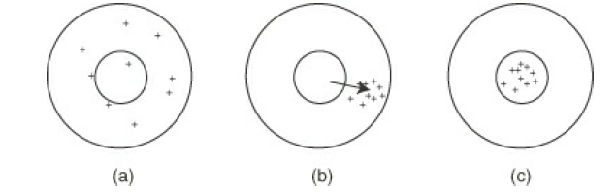
Cont’d
The difference between precision and accuracy is shown in Figure 2.1 (Himmelblau, 2023, pg. 54).
Figure 2.1 The difference between accuracy and precision (a) neither accurate nor repeatable, (b) repeatable but not accurate (the arrow indicates the bias error of the measurement), and (c) accurate and repeatable.
49

Slide 50
Cont’d
2.4.2. Significant figures
Significant figures are the digits in a number that carry meaningful information about its precision.
For example, 0.0074 has only two significant figures because the zeros preceding 74 are used to locate the decimal point. i.e., 7.4 × 10^{–3}.
Some quantities and their number of significant figures are shown in Table 2.7 (Himmelblau, 2023, pg. 54).
50

Slide 51
Cont’d
Table 2.7 shows the quantities and their number of significant figures
Quantity | Scientific notation | No. of Significant figures
8000 | 8.000 x 10³ | 4
8000 | 8.00 x 10³ | 3
8000 | 8.0 x 10³ | 2
0.01234 | 1. 234 x 10⁻² | 4
0.3001 | 3. 001 x 10⁻¹ | 4
55.64 | 5.564 x 10¹ | 4
0.003 | 3 x 10⁻³ | 1
51

Slide 52
Cont’d
The importance of measurement errors and significant figures are described as follows:
Understanding measurement errors helps scientists and engineers to improve their methods and equipment, leading to more accurate results.
Significant figures help to maintain clear communication of results, and ensures that reported data reflects the precision of measurements.
In industries, considering measurement errors and significant figures are crucial for quality assurance and meeting regulatory standards.
52

Slide 53
2.5. Summary
Dimensions and units are fundamental concepts in chemical engineering to quantify and describe physical quantities.
Consistent use of dimensional equations will assist us in avoiding silly mistakes.
Appropriate units are critical for designing experiments, analyzing results, and scaling up processes from the lab to pilot and full-scale production.
Measurement errors and significant figures are fundamental in scientific measurements to ensure accuracy and precision in data reporting, in industries, for quality assurance and meeting regulatory standards.
53

Slide 54
References
Basic Principles and Calculations in Chemical Engineering, Himmelblau, Pearson Education Inc, 9th edition, 2023.
Chemical Engineering Design, Volume 6, Coulson & Richardson’s, R. K. Sinnott, 3rd edition, 1999.
Elementary Principles of Chemical Processes, Richard M. Felder, John Wiley & Sons, 3rd edition, 2005.
Thank you!
54

