Slide 1
Basic Principles of Process Calculations in Chemical Engineering (ChEg2106)
Prerequisites: No prerequisite for this course
Lecture 3: Measurements and Methods of Analysis
Week 3
Lecturer: Adamu Esubalew (PhD, ChEg)
Addis Ababa, Ethiopia
1

Slide 2
Lecture learning outcomes
At the end of the lecture, you will be able to:
describe the purposes of measurements and methods of analysis for chemical engineering calculations,
Identify measurements and methods of analysis for density, volume, pressure, temperature and, concentration, and
determine mass faction and mole fractions of mixtures of substances.

Slide 3
Presentation outlines
Introduction to measurements and methods of analysis
Measurement of density and methods of analysis
Measurement of volume and methods of analysis
Measurement of pressure and methods of analysis
Measurement of temperature and methods of analysis
Concentration measurement, mass and mole fractions
Summary
3

Slide 4
3.1. Introduction to measurements and methods of analysis
Measurements and methods of analysis are fundamental concepts in various fields, including science, engineering, and social sciences.
Measurement is the process of obtaining the magnitude of a quantity relative to a defined standard/ reference.
Methods of analysis are systematic approaches used to process and interpret data obtained from measurements.
Measurements can be categorized: direct and indirect measurements or quantitative and qualitative measurements.
4

Slide 5
Cont’d
Measurements and methods of analysis are the fundamental principles of process calculations in chemical engineering.
Measurements and methods of analysis are helpful for chemical engineers to design, optimize, and control chemical processes.
Accurate measurements and reliable analytical methods are essential for ensuring that these calculations lead to effective process design and operation.
5

Slide 6
Cont’d
It is required to do regular calibration of measurement instruments to ensure accuracy for quality control.
It is also needed to implement standard operating procedures for consistent data collection and analysis.
The documentation of all measurements, calculations, and assumptions made during the analysis has to be recorded for reporting of the results.
6

Slide 7
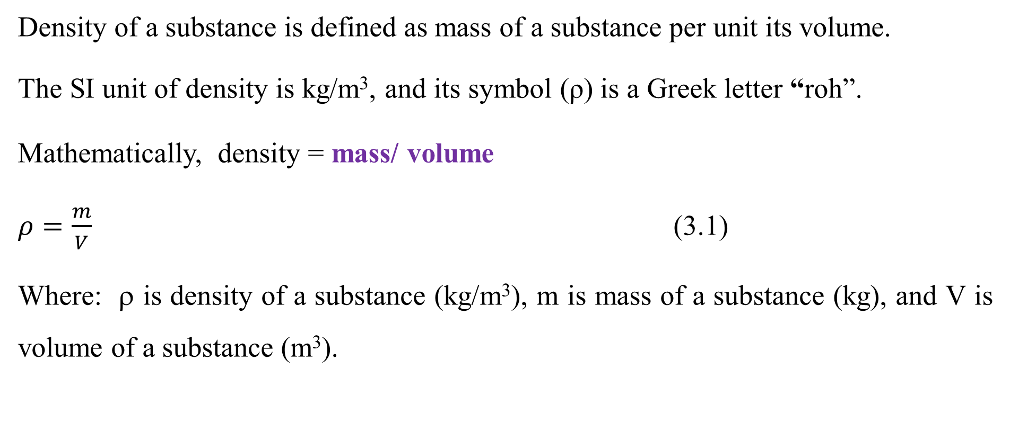
3.2. Measurement of density and methods of analysis
Density of a substance is defined as mass of a substance per unit its volume.
The SI unit of density is kg/m³, and its symbol (ρ) is a Greek letter “roh”.
Mathematically, density = mass/ volume
$ρ=\frac{m}{V}$ (3.1)
Where: ρ is density of a substance (kg/m³), m is mass of a substance (kg), and V is volume of a substance (m³).
7

Slide 8
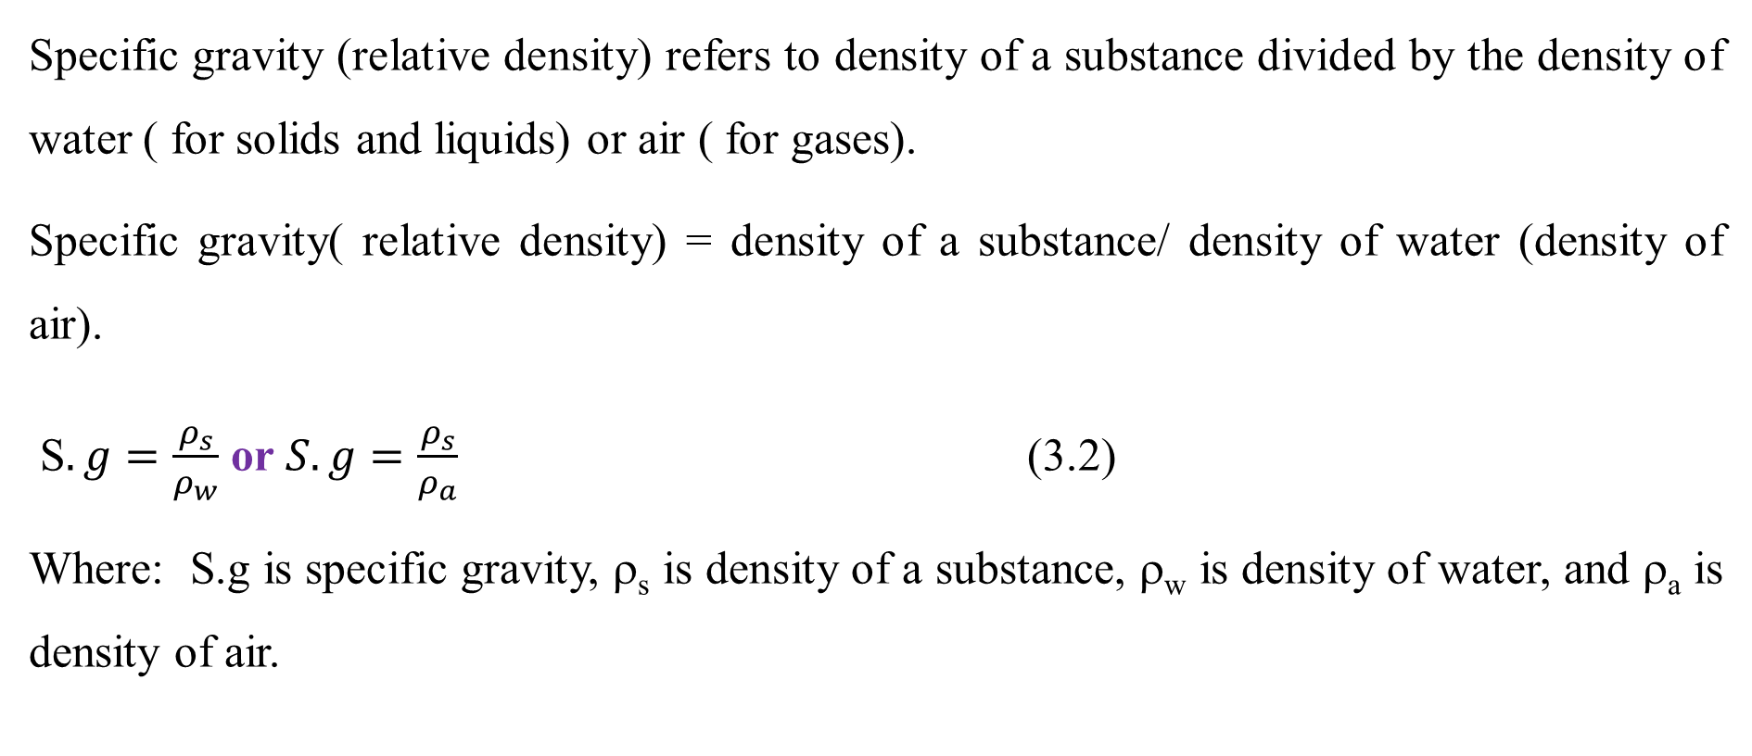
Cont’d
Specific gravity (relative density) refers to density of a substance divided by the density of water ( for solids and liquids) or air ( for gases).
Specific gravity( relative density) = density of a substance/ density of water (density of air).
S$.g=\frac{ρ_{s}}{ρ_{w}}$ or $S.g=\frac{ρ_{s}}{ρ_{a}}$ (3.2)
Where: S.g is specific gravity, ρ_{s} is density of a substance, ρ_{w} is density of water, and ρ_{a} is density of air.
8

Slide 9
Cont’d
For density measurement, a substance can be solid, liquid or gas state, which requires different measurement techniques.
Density measurement for solids: The density of solid substances can be measured by two ways on the basis of the shape of solid samples.
For regular shape solids, the mass of a solid sample can be measured using analytical balance, and the volume of a solid sample can be obtained from the given dimensions.
9

Slide 10
Cont’d
Then, the density of a solid sample can be obtained from the ratio of mass to volume.
For irregular shape, the mass of a solid sample can be measured using analytical balances.
The volume of the irregular shape of a solid sample can be determined by immersing it in a measuring cylinder with an inert and non- reactive liquid, where liquid displaces.
The volume of displaced liquid can be equal to the volume of a solid sample.
Thus, the density of solid will be the ratio of the mass of solid per displaced liquid volume.
10

Slide 11
Cont’d
Density measurement for liquids: The measurement of density of liquids depends on the availability of devices.
The density of liquids can be measured directly by hydrometer or density meter/ densitometer devices.
Hydrometer measures the specific gravity of liquids.
Vibrating tube densitometer provides direct density measurements by measuring the
frequency of oscillation of a tube filled with the liquid.
11

Slide 12
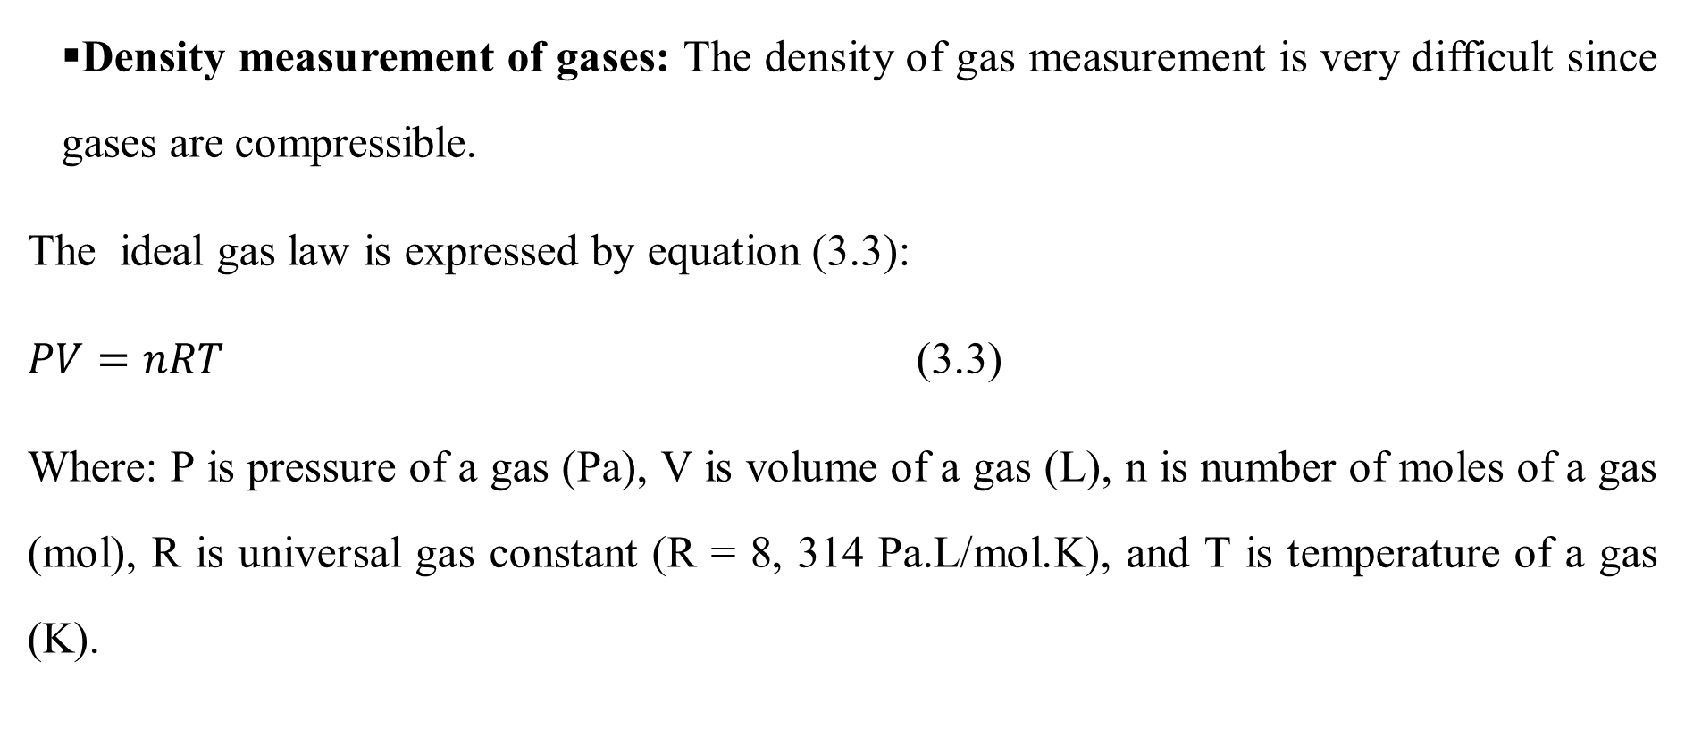
Cont’d
Density measurement of gases: The density of gas measurement is very difficult since gases are compressible.
The ideal gas law is expressed by equation (3.3):
$PV=nRT$ (3.3)
Where: P is pressure of a gas (Pa), V is volume of a gas (L), n is number of moles of a gas (mol), R is universal gas constant (R = 8, 314 Pa.L/mol.K), and T is temperature of a gas (K).
12

Slide 13
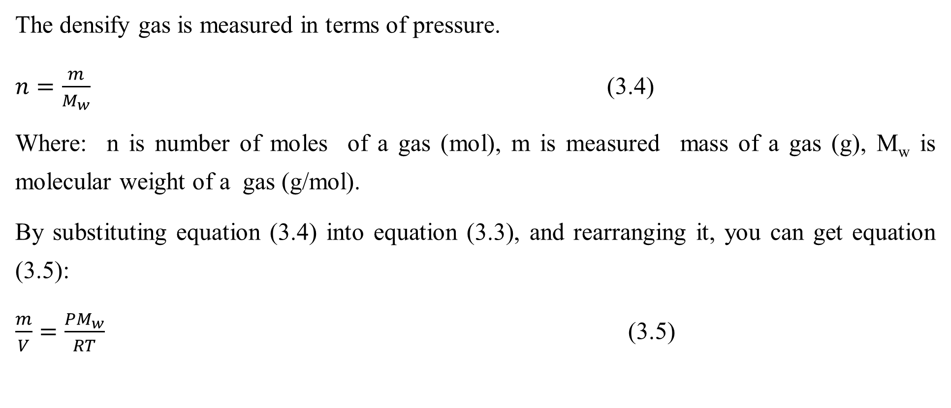
Cont’d
The densify gas is measured in terms of pressure.
$n=\frac{m}{M_{w}}$ (3.4)
Where: n is number of moles of a gas (mol), m is measured mass of a gas (g), M_{w} is molecular weight of a gas (g/mol).
By substituting equation (3.4) into equation (3.3), and rearranging it, you can get equation (3.5):
$\frac{m}{V}=\frac{PM_{w}}{RT}$ (3.5)
13

Slide 14
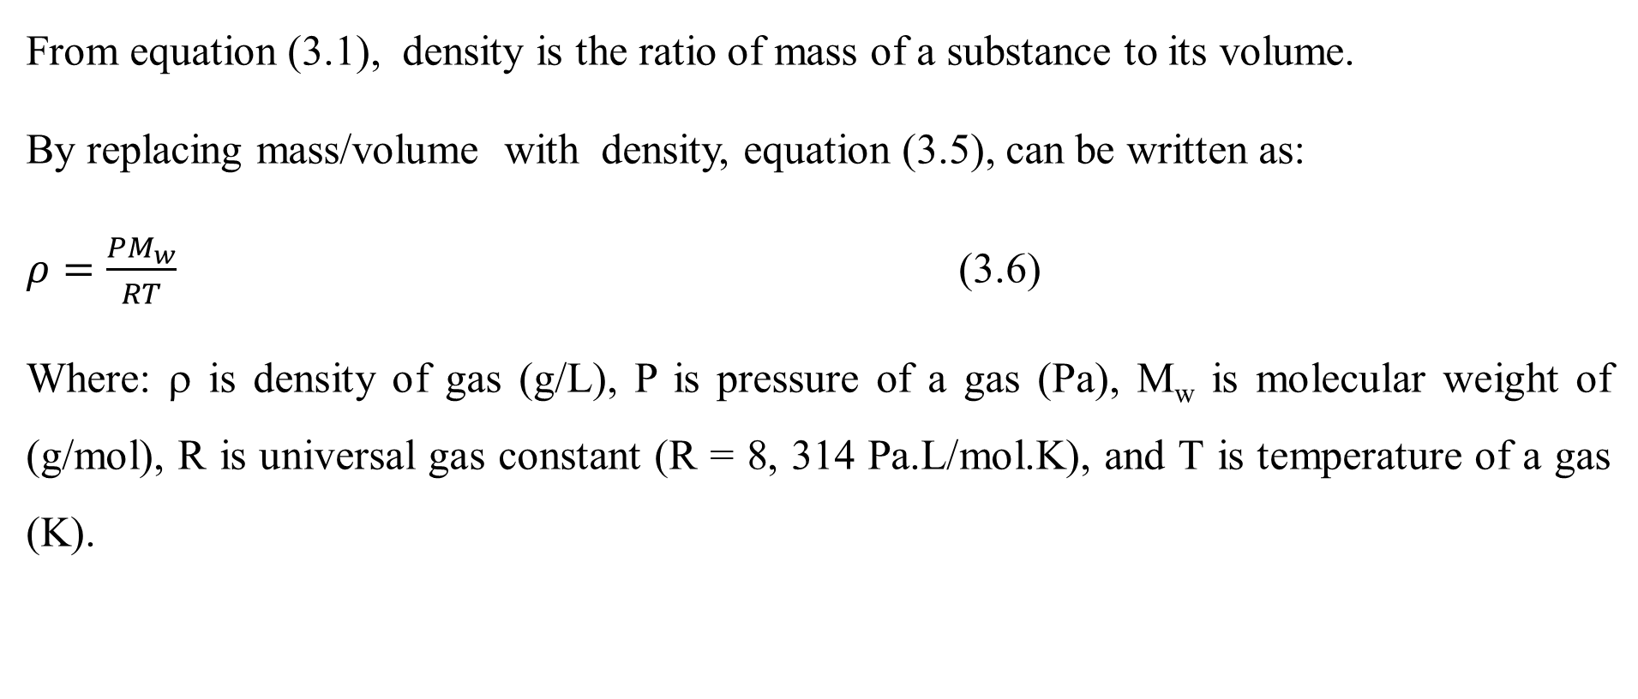
Cont’d
From equation (3.1), density is the ratio of mass of a substance to its volume.
By replacing mass/volume with density, equation (3.5), can be written as:
$ρ=\frac{PM_{w}}{RT}$ (3.6)
Where: ρ is density of gas (g/L), P is pressure of a gas (Pa), M_{w} is molecular weight of (g/mol), R is universal gas constant (R = 8, 314 Pa.L/mol.K), and T is temperature of a gas (K).
14

Slide 15
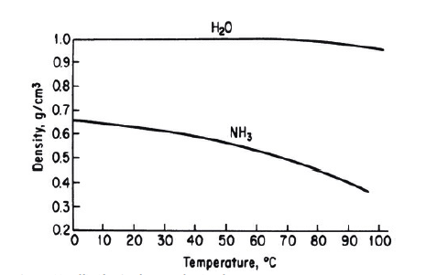
Cont’d
Density of fluids will change significantly with temperature if the temperature change is very large.
Figure 3.1 depicts the density change of water and ammonia with temperature change (Himmelblau, 2023, pg. 68).
Figure 3.1 Densities of liquid H₂O and NH₃ as a function of temperature
15

Slide 16
Activity 3.1
What is the importance of measurement and method of analysis for chemical engineers?
How do we ensure accurate measurement of physical quantities?
16

Slide 17
Cont’d
1. What is the importance of measurement and method of analysis for chemical engineers?
Answer:
They are important for chemical engineers to design, optimize, and control chemical processes.
2. How do we ensure accurate measurements of physical quantities?
Answer:
By doing regular calibration of instruments and implementing standard operating procedures, we ensure accurate measurements.
17

Slide 18
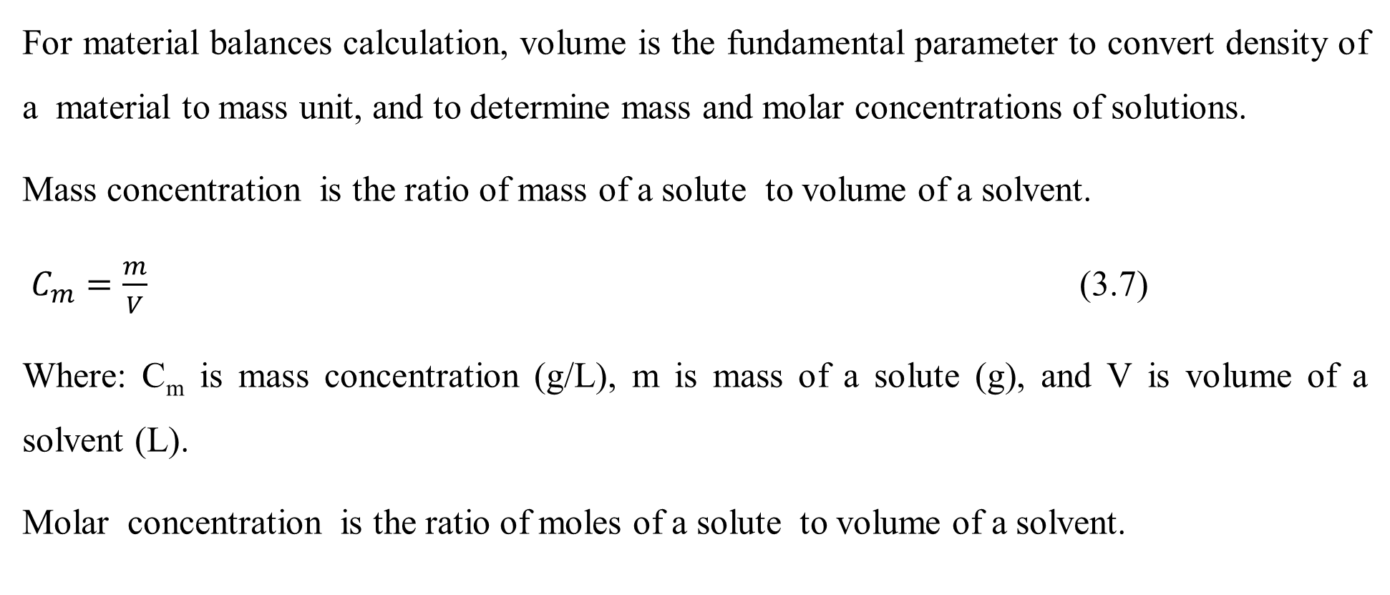
3.3. Volume measurement and methods of analysis
For material balances calculation, volume is the fundamental parameter to convert density of a material to mass unit, and to determine mass and molar concentrations of solutions.
Mass concentration is the ratio of mass of a solute to volume of a solvent.
$C_{m}=\frac{m}{V}$ (3.7)
Where: C_{m} is mass concentration (g/L), m is mass of a solute (g), and V is volume of a solvent (L).
Molar concentration is the ratio of moles of a solute to volume of a solvent.
18

Slide 19
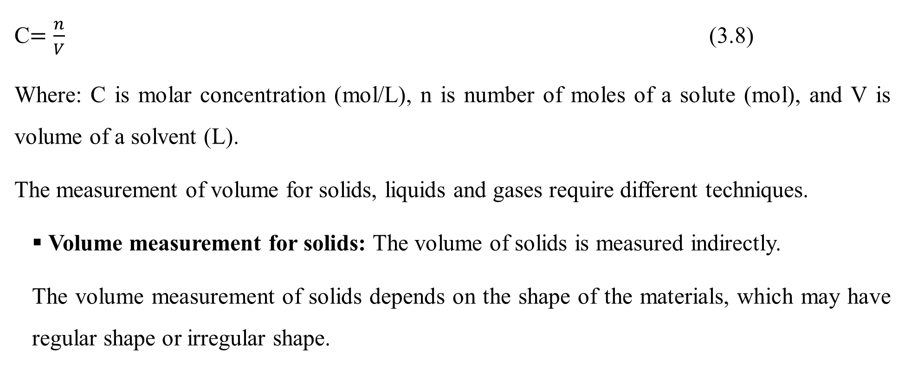
Cont’d
C$=\frac{n}{V}$ (3.8)
Where: C is molar concentration (mol/L), n is number of moles of a solute (mol), and V is volume of a solvent (L).
The measurement of volume for solids, liquids and gases require different techniques.
Volume measurement for solids: The volume of solids is measured indirectly.
The volume measurement of solids depends on the shape of the materials, which may have regular shape or irregular shape.
19

Slide 20
Cont’d
For regular shape of solids, the volume is determined from its length, width and height for rectangular shapes; and it is determined from diameter and length for cylindrical shapes.
For regular shape solid, the dimensions can be measure by meter or ruler.
For irregular shape of solids, the volume is obtained using Archimedes’ principles volume displacement techniques by immersing solid materials in a liquid .
In this techniques, a solid sample should be non-reactive with a liquid, and the density of a solid must be greater than a liquid density.
20

Slide 21
Cont’d
The volume of an irregular shape of a solid sample is equal to the volume of a displaced liquid.
Volume measurement for liquids: The volume of liquids is usually measured directly using graduated cylinders/ volumetric flasks in liter or milliliter scale.
Moreover, the flow meter devices such as rotameters or electromagnetic flow meters measure the flow rate of liquids, which can be integrated over time to determine total volume.
21

Slide 22
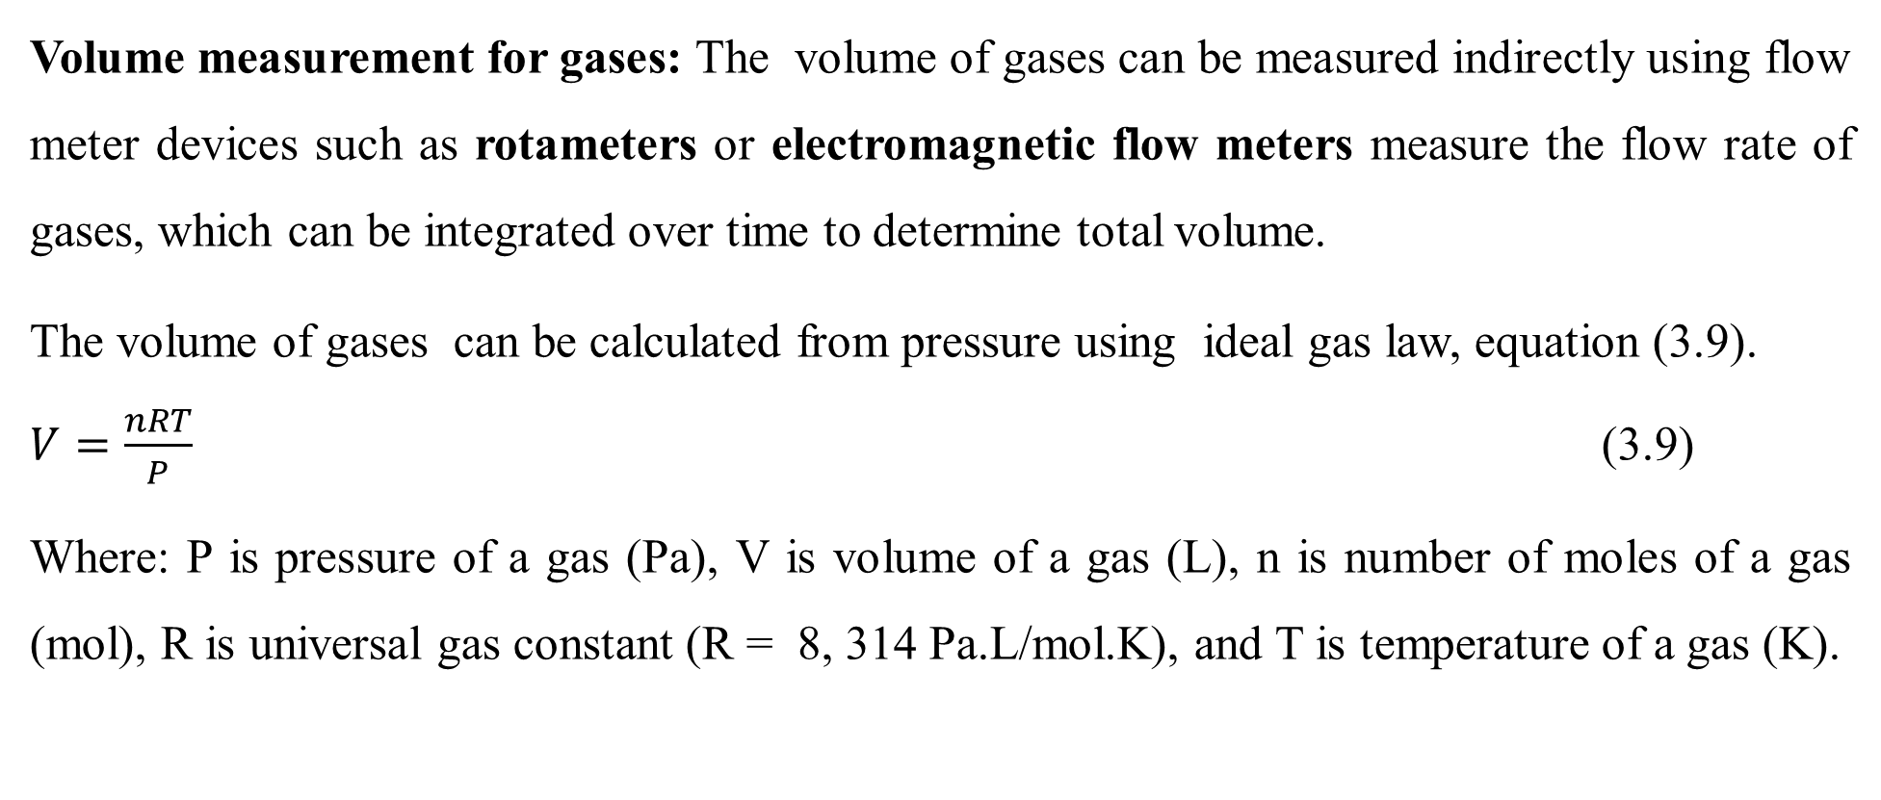
Cont’d
Volume measurement for gases: The volume of gases can be measured indirectly using flow meter devices such as rotameters or electromagnetic flow meters measure the flow rate of gases, which can be integrated over time to determine total volume.
The volume of gases can be calculated from pressure using ideal gas law, equation (3.9).
$V=\frac{nRT}{P}$ (3.9)
Where: P is pressure of a gas (Pa), V is volume of a gas (L), n is number of moles of a gas (mol), R is universal gas constant (R = 8, 314 Pa.L/mol.K), and T is temperature of a gas (K).
22

Slide 23
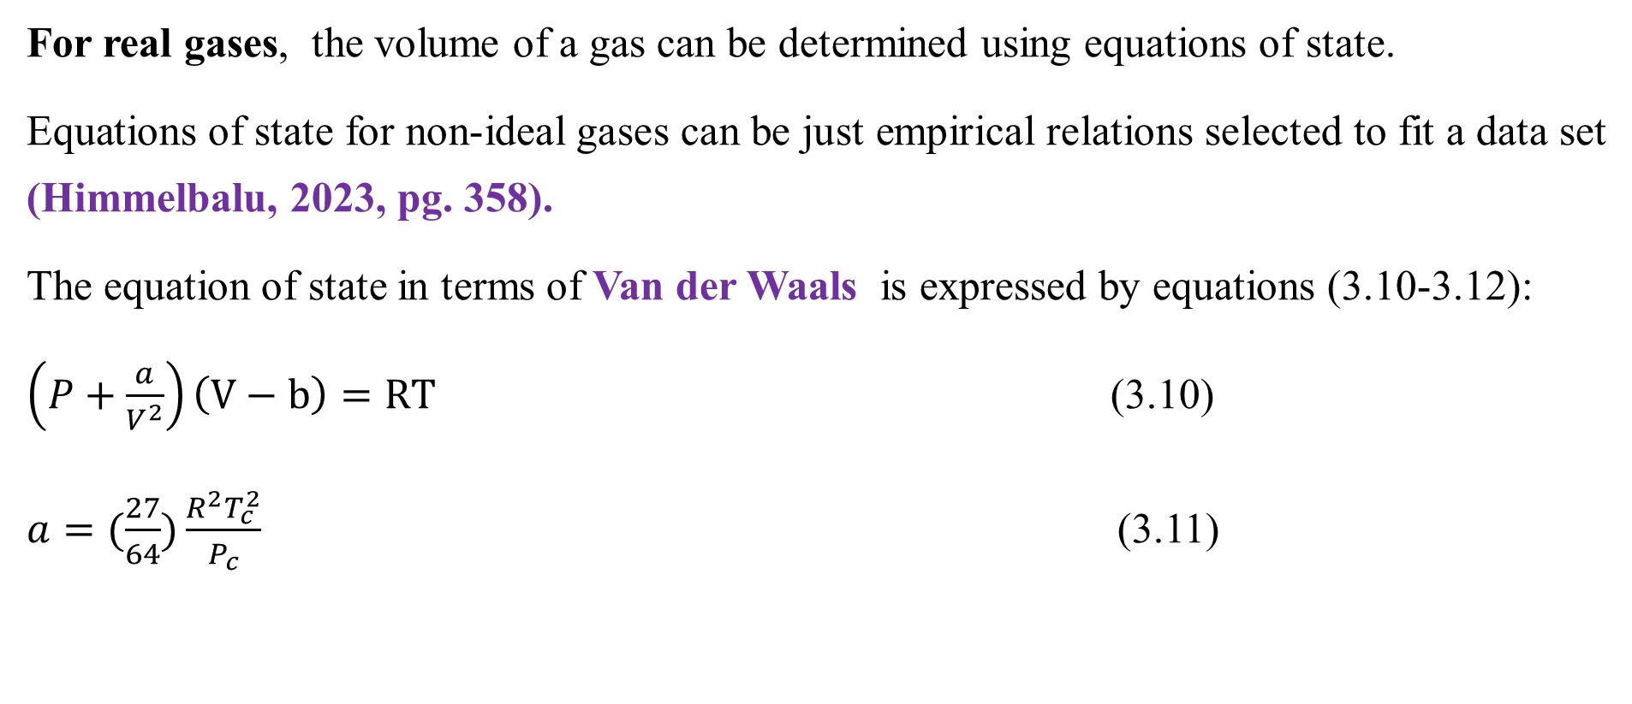
Cont’d
For real gases, the volume of a gas can be determined using equations of state.
Equations of state for non-ideal gases can be just empirical relations selected to fit a data set (Himmelbalu, 2023, pg. 358).
The equation of state in terms of Van der Waals is expressed by equations (3.10-3.12):
$\left(P+\frac{a}{V^{2}}\right)\left(V−b\right)=RT$ (3.10)
$a=(\frac{27}{64})\frac{R^{2}T_{c}^{2}}{P_{c}}$ (3.11)
23

Slide 24
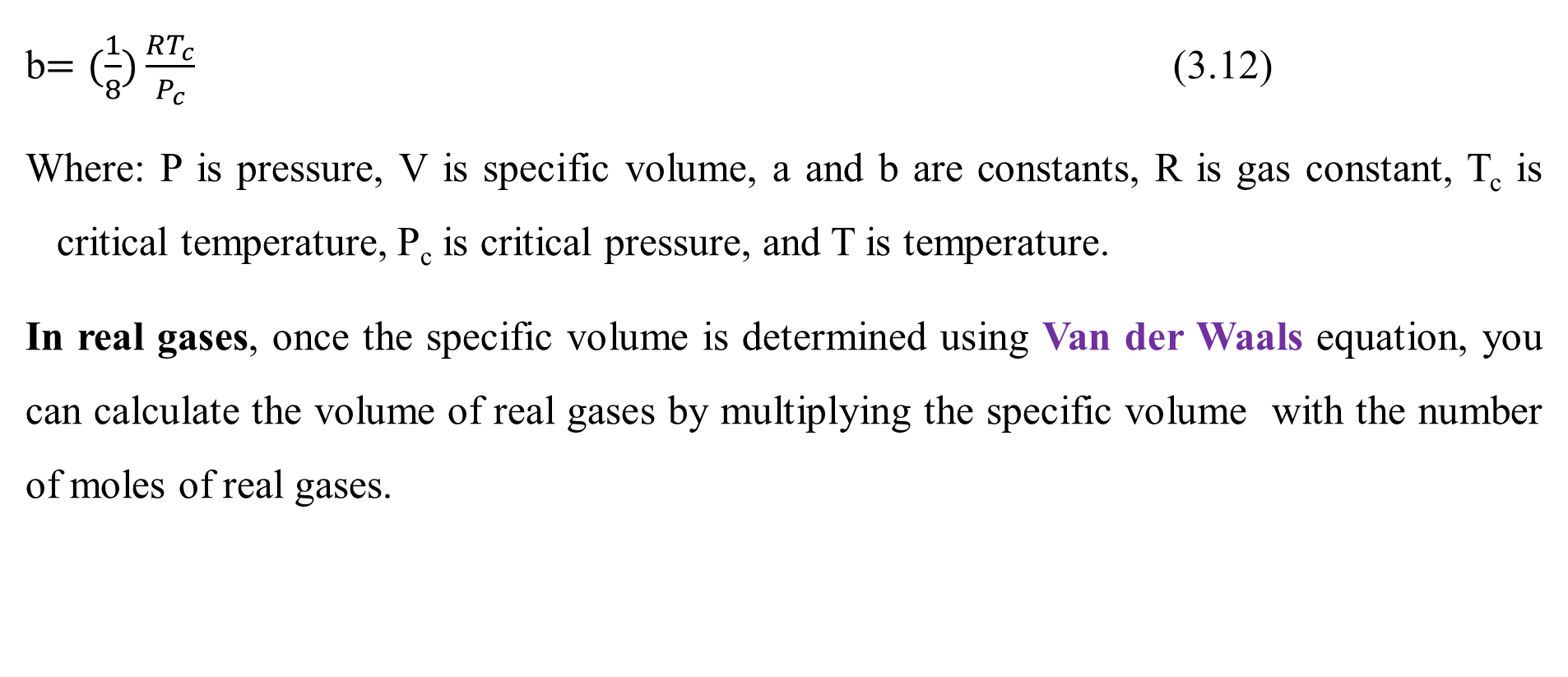
Cont’d
b$=(\frac{1}{8})\frac{RT_{c}}{P_{c}}$ (3.12)
Where: P is pressure, V is specific volume, a and b are constants, R is gas constant, T_{c} is critical temperature, P_{c} is critical pressure, and T is temperature.
In real gases, once the specific volume is determined using Van der Waals equation, you can calculate the volume of real gases by multiplying the specific volume with the number of moles of real gases.
24

Slide 25
3.4. Pressure measurement and methods of analysis
Pressure is defined as the normal (perpendicular) force per unit area.
In the SI system, the force is expressed in newtons and the area in square meters; then the pressure is N/m² or pascal (Pa).
For practical applications, the value of a pascal is so small that the kilopascal, kPa, is a more convenient unit of pressure.
25

Slide 26
Cont’d
The pressure at the bottom of the static fluid (hydrostatic pressure) exerted on the bottom of a container is shown in Figure 3.2 (Richard M. Felder, 2005, pg. 54).
P_{o} (N/m²)
Figure 3.2 Pressure of a static fluid at the bottom of the container
A (m²)
h (m)
P (N/m²)
ρ (kg/m³)
26

Slide 27
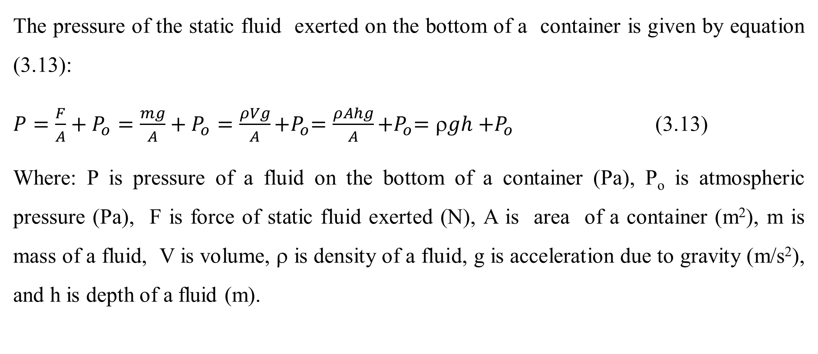
Cont’d
The pressure of the static fluid exerted on the bottom of a container is given by equation (3.13):
$P=\frac{F}{A}+P_{o}=\frac{mg}{A}+P_{o}=\frac{ρVg}{A}{+P}_{o}=\frac{ρAhg}{A}{+P}_{o}=ρgh{+P}_{o}$ (3.13)
Where: P is pressure of a fluid on the bottom of a container (Pa), P_{o} is atmospheric pressure (Pa), F is force of static fluid exerted (N), A is area of a container (m²), m is mass of a fluid, V is volume, ρ is density of a fluid, g is acceleration due to gravity (m/s²), and h is depth of a fluid (m).
27

Slide 28
Cont’d
For measurement of pressure, different types of devices are used, such as manometers, Bourdon gauges, and pressure transducers.
Manometers: They are devices that are used to measure pressure using a column of liquid.
They can be open-tube or closed-tube manometers.
An open-ended manometer is used to measure relative pressure since the reference for open-end is the atmospheric pressure at the open-end of the manometer.
28

Slide 29
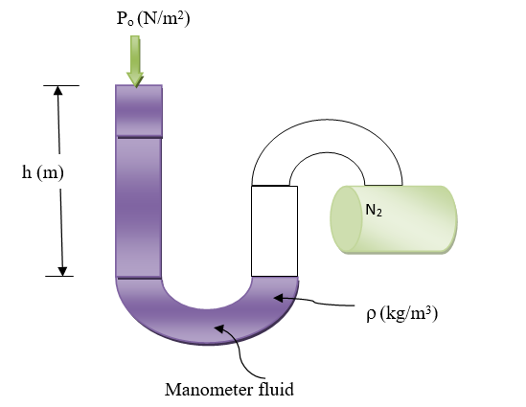
Cont’d
An open-ended manometer is shown in Figure 3.3 (Himmelblau, 2023, pg. 81).
Figure 3.3 An open-ended manometer to measure relative pressure N₂
29

Slide 30
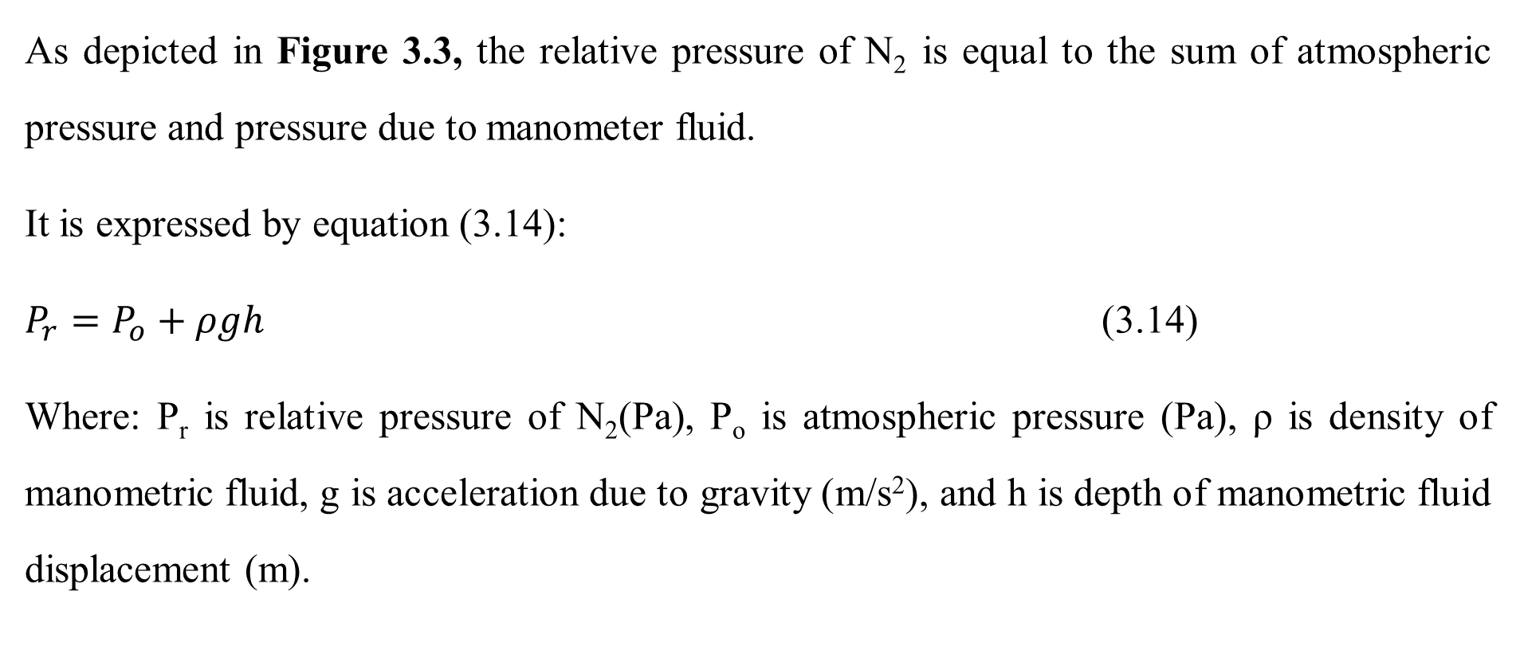
Cont’d
As depicted in Figure 3.3, the relative pressure of N₂ is equal to the sum of atmospheric pressure and pressure due to manometer fluid.
It is expressed by equation (3.14):
$P_{r}=P_{o}+ρgh$ (3.14)
Where: P_{r} is relative pressure of N₂(Pa), P_{o} is atmospheric pressure (Pa), ρ is density of manometric fluid, g is acceleration due to gravity (m/s²), and h is depth of manometric fluid displacement (m).
30

Slide 31
Cont’d
Closed-tube manometer is used to measure absolute pressure.
Closing off the end of the manometer and creating vacuum in the end results in a measurement against a complete vacuum.
Since absolute pressure is based on a complete vacuum, a fixed reference point is unchanged regardless of location or temperature.
Therefore, the reference point for an absolute pressure corresponds to perfect vacuum.
31

Slide 32
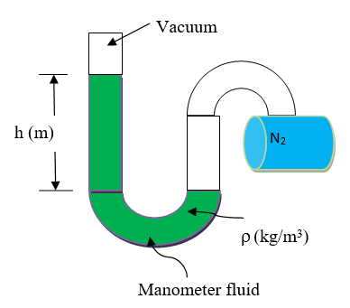
Cont’d
A closed-ended manometer is shown in Figure 3.4 (Himmelblau, 2023, pg. 81).
Figure 3.4 A closed-ended manometer to measure absolute pressure of N₂
32

Slide 33
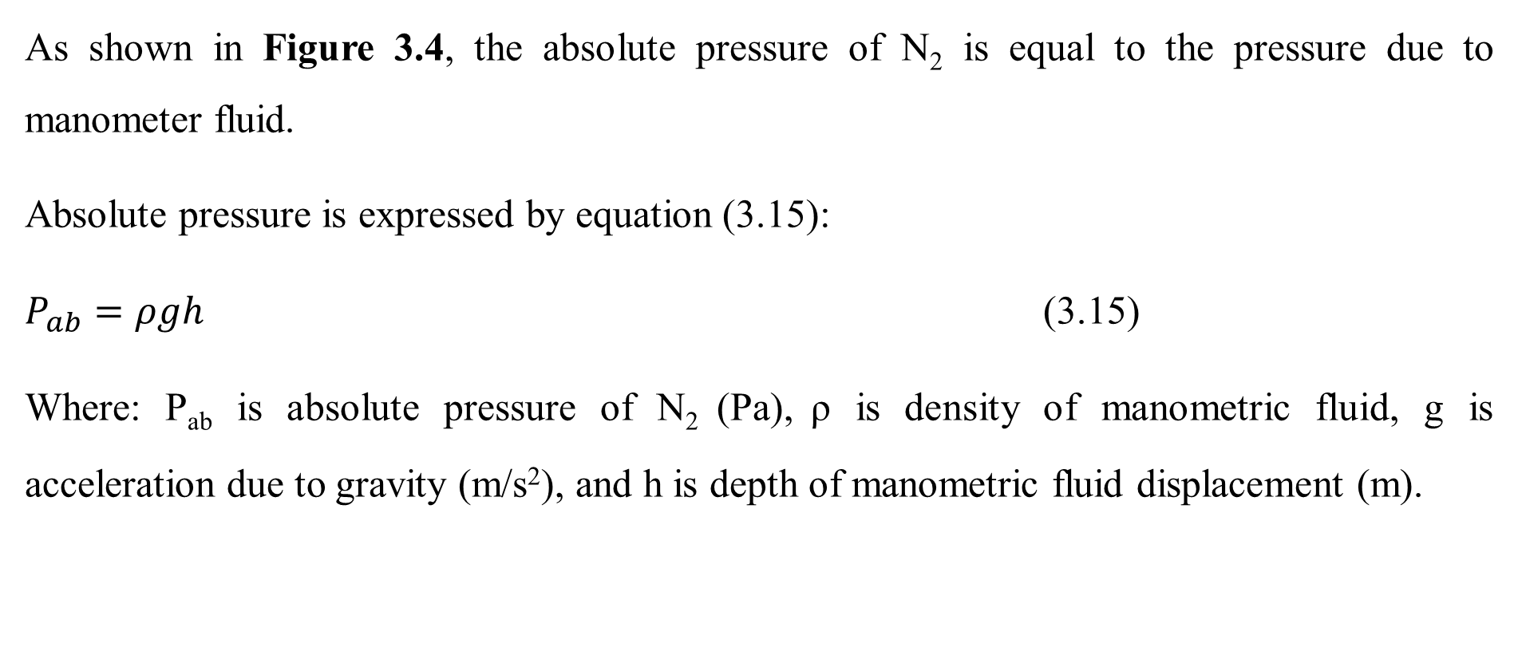
Cont’d
As shown in Figure 3.4, the absolute pressure of N₂ is equal to the pressure due to manometer fluid.
Absolute pressure is expressed by equation (3.15):
$P_{ab}=ρgh$ (3.15)
Where: P_{ab} is absolute pressure of N₂ (Pa), ρ is density of manometric fluid, g is acceleration due to gravity (m/s²), and h is depth of manometric fluid displacement (m).
33

Slide 34
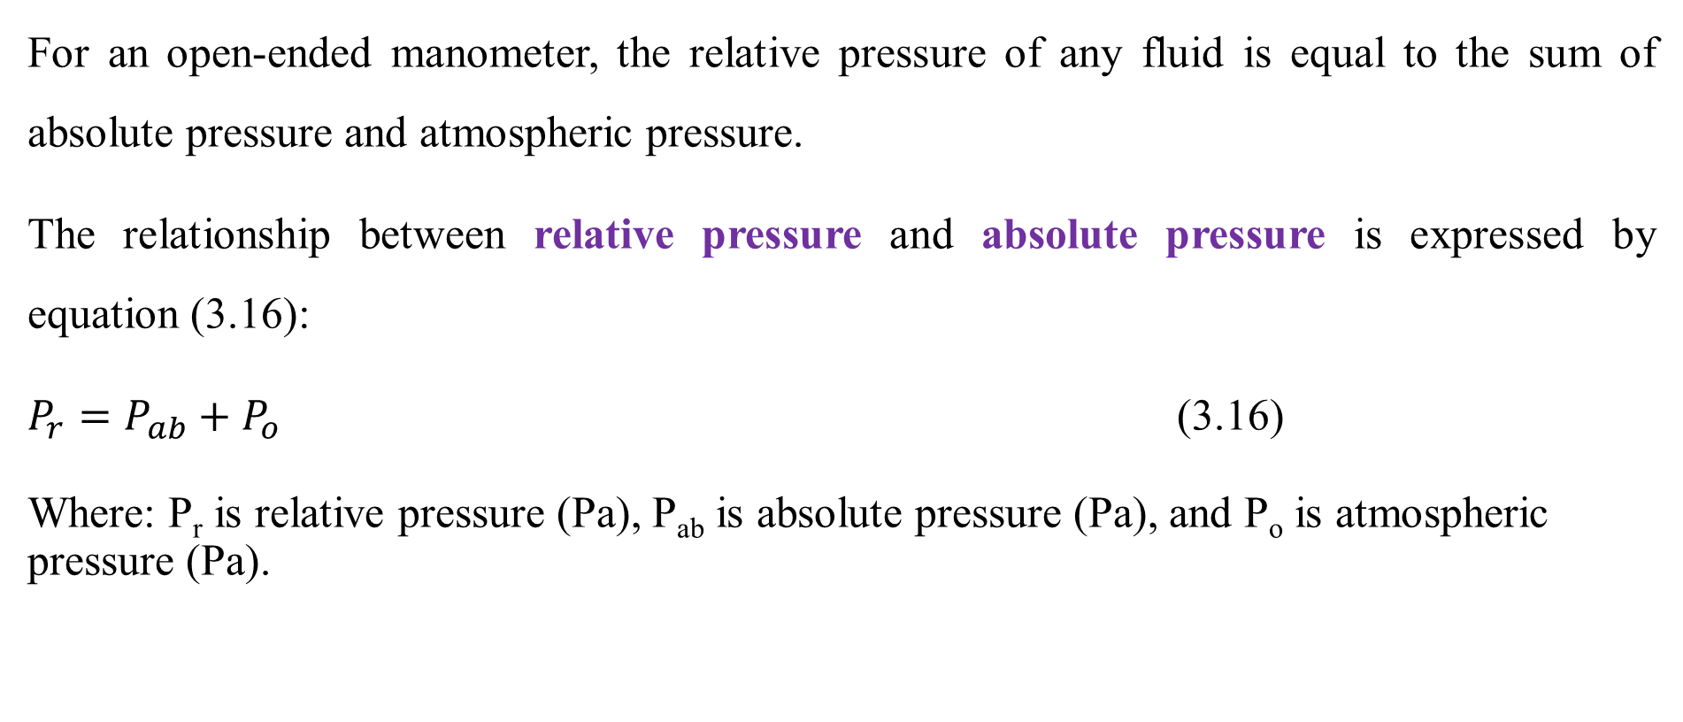
Cont’d
For an open-ended manometer, the relative pressure of any fluid is equal to the sum of absolute pressure and atmospheric pressure.
The relationship between relative pressure and absolute pressure is expressed by equation (3.16):
$P_{r}=P_{ab}+P_{o}$ (3.16)
Where: P_{r} is relative pressure (Pa), P_{ab} is absolute pressure (Pa), and P_{o} is atmospheric pressure (Pa).
34

Slide 35
Cont’d
The pressure of fluids in a process can also be measured using devices such as bourdon gauges, and pressure transducers.
Bourdon gauges: They are mechanical devices that use a coiled tube that straightens under pressure to indicate pressure on a control.
Pressure transducers: They are electronic devices that convert pressure into an electrical signal for more precise measurements.
35

Slide 36
Cont’d
To handle the required fluid and maintain safe operation, containers (pressure vessels) should be designed to withstand the pressure exerted on it.
Over-pressure is one of the most serious hazards in chemical plant operation.
Failure of a vessel can precipitate a sequence of events that culminate in a disaster.
Pressure vessels are invariably fitted with some form of pressure-relief device, set at the design pressure, so that potential over-pressure is relieved in a controlled manner (Coulson & Richardson’s, 1999, pg. 366).
36

Slide 37
3.5. Temperature measurement and methods of analysis
The temperature of a material is directly related to the kinetic energy of the atoms present in a material.
Temperature measurements are typically based on a relative scale defined by the conditions under which water freezes and boils.
Mercury-in-bulb thermometers are based on the fact that mercury expands when heated, and they are calibrated knowing that water boils at 100°C (212°F) at 1 atmosphere pressure.
37

Slide 38
Cont’d
Temperature measurement scales can be degree Fahrenheit (ºF) or degree Celsius (ºC), which are relative scales.
Kelvin is an absolute temperature scale.
The SI unit of temperature is Kelvin (K).
The relation between ºC and ºF is determined from water property.
The upper and lower limit temperature of liquid water in ºC scale to change it into vapor and solid is 100ºC and 0ºC, respectively.
38

Slide 39
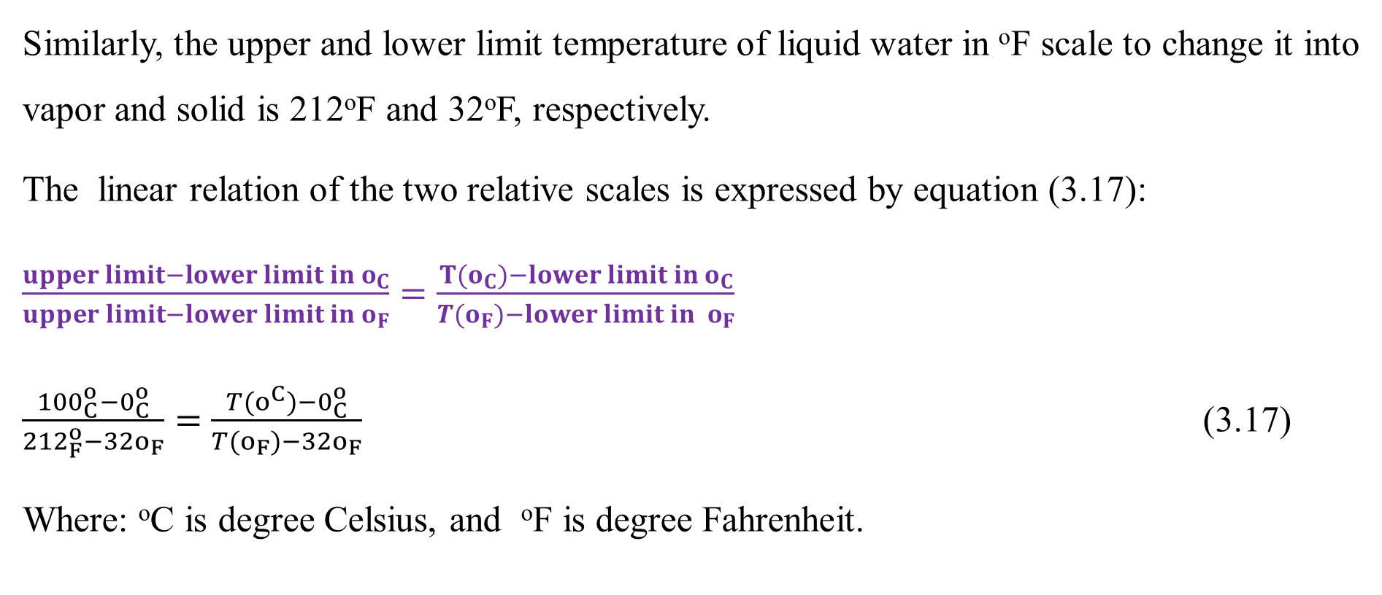
Cont’d
Similarly, the upper and lower limit temperature of liquid water in ºF scale to change it into vapor and solid is 212ºF and 32ºF, respectively.
The linear relation of the two relative scales is expressed by equation (3.17):
$\frac{upper limit−lower limit in o_{C}}{upper limit−lower limit in o_{F}}=\frac{{T(o}_{C})−lower limit in o_{C}}{T(o_{F})−lower limit{ in o}_{F}}$
$\frac{{100}_{C}^{o}−0_{C}^{o}}{{212}_{F}^{o}−32o_{F}}=$ $\frac{T(o^{C})−0_{C}^{o}}{T(o_{F})−32o_{F}}$ (3.17)
Where: ºC is degree Celsius, and ºF is degree Fahrenheit.
39

Slide 40
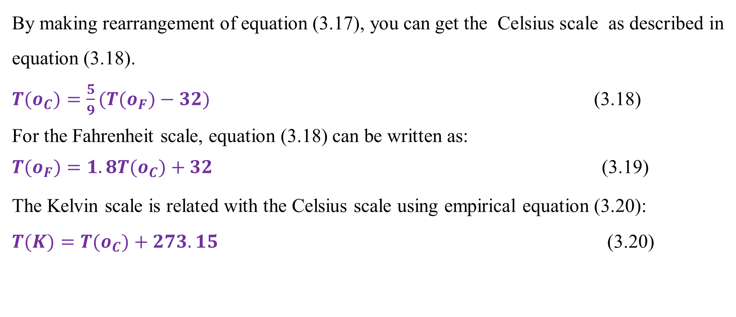
Cont’d
By making rearrangement of equation (3.17), you can get the Celsius scale as described in equation (3.18).
${T(o}_{C})=\frac{5}{9}({T(o}_{F})−32)$ (3.18)
For the Fahrenheit scale, equation (3.18) can be written as:
${T(o}_{F})=1.8{T(o}_{C})+32$ (3.19)
The Kelvin scale is related with the Celsius scale using empirical equation (3.20):
$T(K)=T(o_{C})+273.15$ (3.20)
40

Slide 41
Cont’d
Process temperatures are measured by temperature sensors.
The temperature sensors most commonly used by industry are thermocouples, resistance temperature detectors (RTDs), and optimal pyrometers.
Thermocouples: Thermocouples are based on the fact that two metal junctions at different temperature will generate a voltage proportional to the temperature difference.
Resistance temperature detectors (RTDs): They are based on the observation that the electrical resistance of certain metals is a strong function of temperature.
41

Slide 42
Cont’d
Thermocouples are less expensive and more rugged than RTDs, but RTDs are much more accurate.
RTDs are normally used for important temperatures, such as reactor temperatures or distillation tray temperatures while thermocouples are used for less important temperature points.
Optimal pyrometers: They are used to measure very high temperature (700°C to 4000°C), such as the temperature of the tubes on the inside wall of a furnace.
42

Slide 43
Cont’d
Temperature is an important process variable that requires close observation and control because it has a very strong effect on chemical and biochemical reactions.
In general, the reaction rate of a chemical reaction will double for a 10°C increase in reaction temperature.
For biological reactions, an increase in temperature will also cause an increase in the reaction rate, but above a certain temperature will cause decrease of reaction rate (Himmelblau, 2023, pg. 74).
43

Slide 44
Activity 3.2.
It is assumed that a cylindrical container has diameter of 0.6 m and length of 1.5 m. If 90% of the container is filled by water, what will be the volume of water?
A closed-ended manometer measurement of a gas sample reads a fluid height displacement of 20 cm. If the manometric fluid has a density of 1000 kg/m³, determine the absolute pressure of the gas exerted on the bottom of the container.
If a temperature sensor reads a process temperature of 176ºF, what will be the temperature in Celsius and kelvin scales?
44

Slide 45
Cont’d
1. It is assumed that a cylindrical container has diameter of 0.6 m and length of 1.5 m. If 90% of the container is filled by water, what will be the volume of water?
Answer:
Volume of container= area * length; V = A*L
V = A*L = L*pi *d²/4= 1.5* 3.14 *(0.6m)²/4 = 0.424 m³
Volume of water = 90% of volume of container = 0.9*0.424 = 0.382m³
45

Slide 46
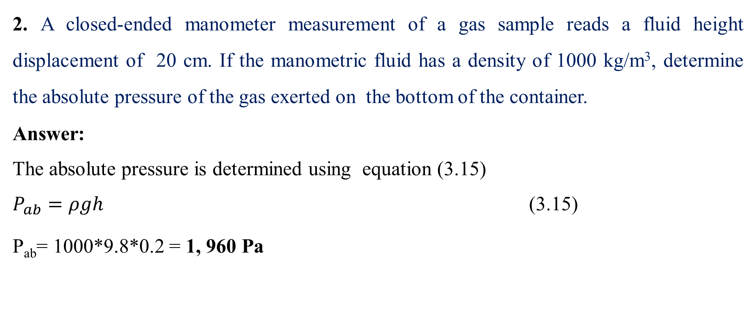
Cont’d
2. A closed-ended manometer measurement of a gas sample reads a fluid height displacement of 20 cm. If the manometric fluid has a density of 1000 kg/m³, determine the absolute pressure of the gas exerted on the bottom of the container.
Answer:
The absolute pressure is determined using equation (3.15)
$P_{ab}=ρgh$ (3.15)
P_{ab}= 1000*9.8*0.2 = 1, 960 Pa
46

Slide 47
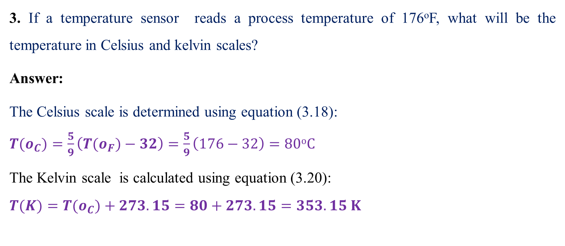
Cont’d
3. If a temperature sensor reads a process temperature of 176ºF, what will be the temperature in Celsius and kelvin scales?
Answer:
The Celsius scale is determined using equation (3.18):
${T(o}_{C})=\frac{5}{9}\left({T(o}_{F})−32\right)=\frac{5}{9}\left(176−32\right)=80oC$
The Kelvin scale is calculated using equation (3.20):
$T(K)={T(o}_{C})+273.15=80+273.15=353.15 K$
47

Slide 48
3.6. Concentration measurement, mass & mole fractions
Concentration is the quantity of some soluble solute per unit volume of a solvent.
It can be expressed in terms of mass concentration or mole (molar) concentration.
Mass concentration: It is the ratio of mass of a substances per unit volume of a solvent.
The unit of mass concentration can be mg/L, g/L or kg/ m³.
Mole concentration: It is the ratio of mole of a substances per unit volume of a solvent
The unit of molar concentration is mol/L or mmol/L.
48

Slide 49
Cont’d
3.6. 1. Concentration measurement
Concentrations can be measured using various techniques such as spectrophotometry, mass spectrometry, liquid chromatography and gas chromatography.
Spectrophotometry: It is used to measure the absorbance of light by a solution at a specific wavelength, which is commonly used for colored solutions.
Mass spectrometry: This technique is used to measure the mass-to-charge ratio of ions to identify and quantify compounds, which is often coupled with chromatography techniques.
49

Slide 50
Cont’d
Liquid chromatography: It is used to measure concentration for non-volatile compounds.
It separates components in a liquid mixture, and quantifies them based on their interaction with the stationary phase and retention time.
Gas chromatography: It is used to measure concentrations of gases or volatile organic compounds.
It separates volatile compounds in a gas phase, and quantifies them based on their retention time.
50

Slide 51
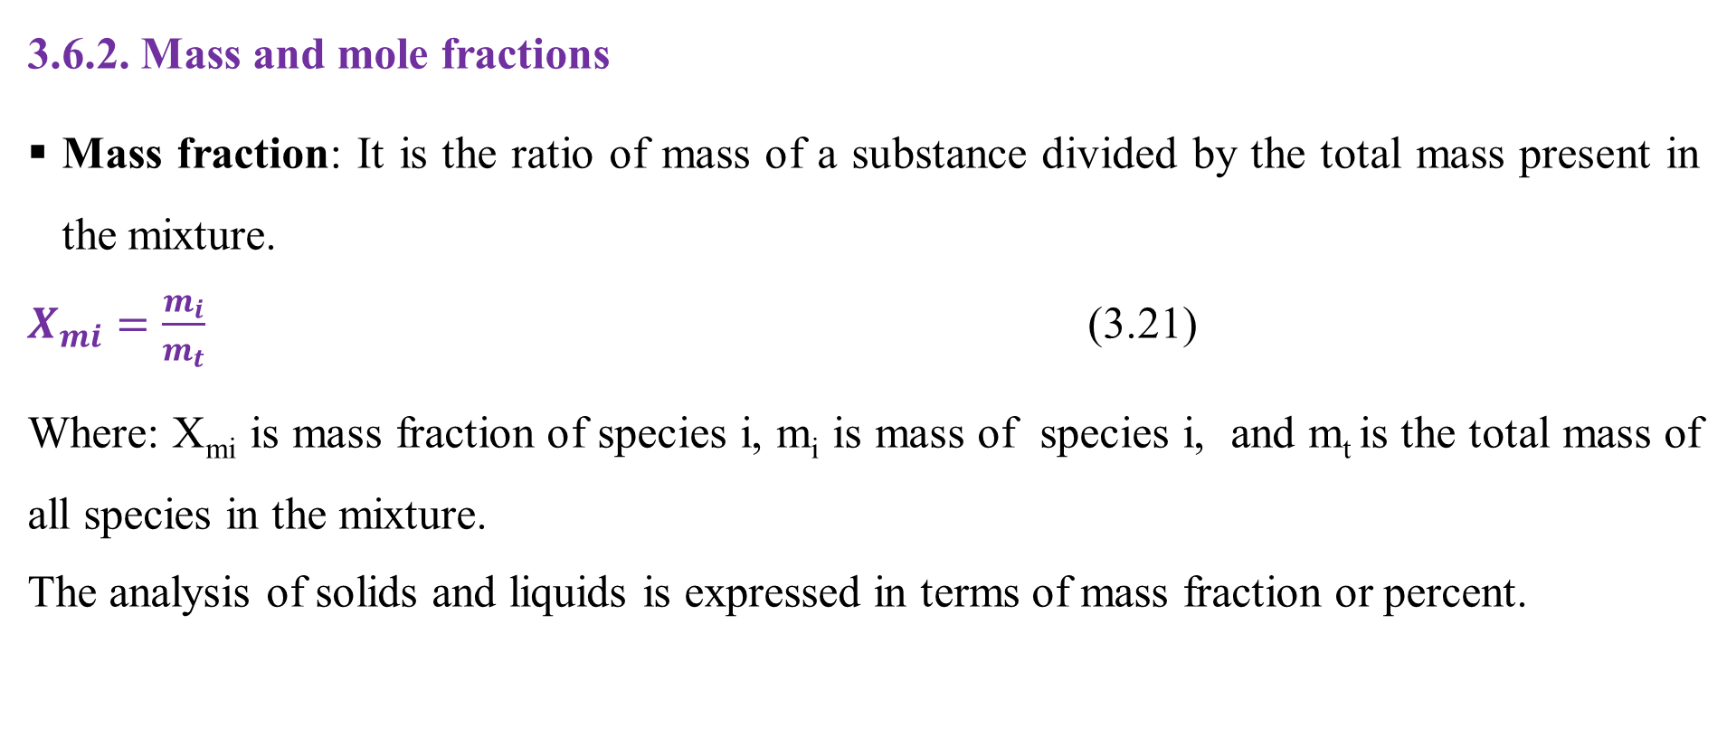
Cont’d
3.6.2. Mass and mole fractions
Mass fraction: It is the ratio of mass of a substance divided by the total mass present in the mixture.
$X_{mi}=\frac{m_{i}}{m_{t}}$ (3.21)
Where: X_{mi} is mass fraction of species i, m_{i} is mass of species i, and m_{t} is the total mass of all species in the mixture.
The analysis of solids and liquids is expressed in terms of mass fraction or percent.
51

Slide 52
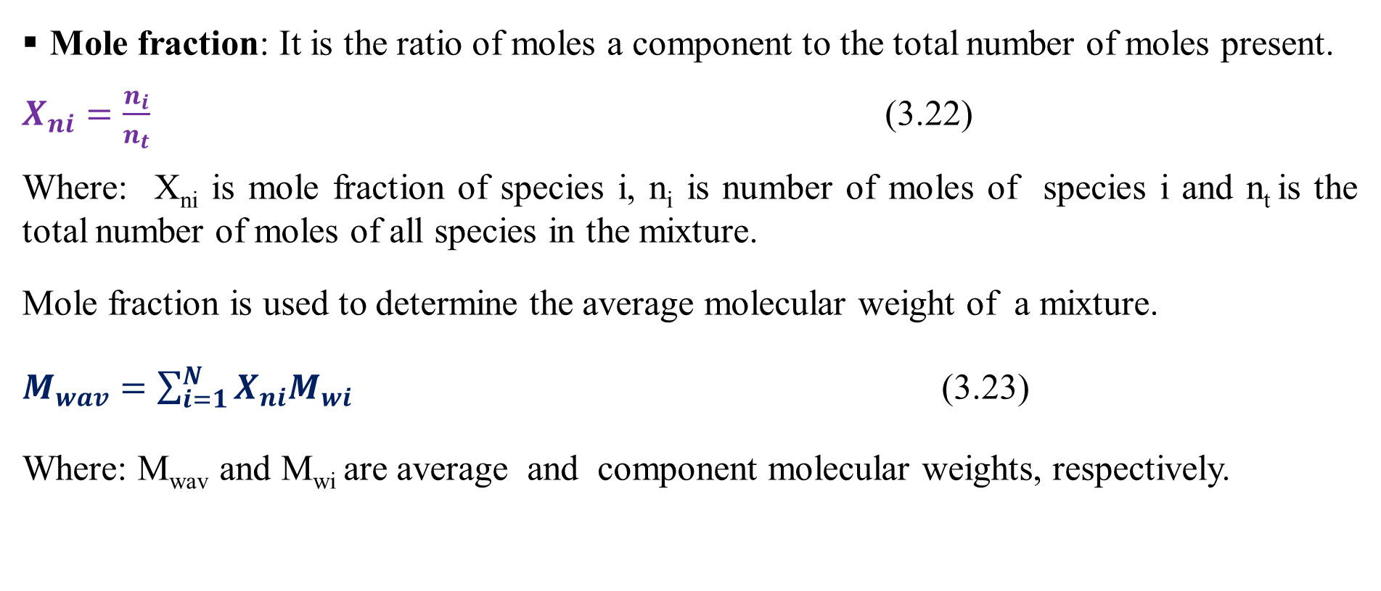
Cont’d
Mole fraction: It is the ratio of moles a component to the total number of moles present.
$X_{ni}=\frac{n_{i}}{n_{t}}$ (3.22)
Where: X_{ni} is mole fraction of species i, n_{i} is number of moles of species i and n_{t} is the total number of moles of all species in the mixture.
Mole fraction is used to determine the average molecular weight of a mixture.
$M_{wav}=\sum_{i=1}^{N}{X_{ni}M_{wi}}$ (3.23)
Where: M_{wav} and M_{wi} are average and component molecular weights, respectively.
52

Slide 53
Activity 3.3
A drain cleaner bottle has 8 g of NaOH in 2000 mL of water. Determine the mass and mole fractions of each component in the bottle (M_{w} of Na = 23, O = 16, H = 1).
A mixture of n-butane (C₄H₁₀), n-pentane (C₅H₁₂) and n-hexane (C₆H₁₄) has 0.862 mol of C₄H₁₀, 0.417 mol of C₅H₁₂ and 0.233 mol of C₆H_{14.} Determine the mole fractions of each component, and the average molecular weight of a mixture (M_{w} of C = 12, H = 1).
53

Slide 54
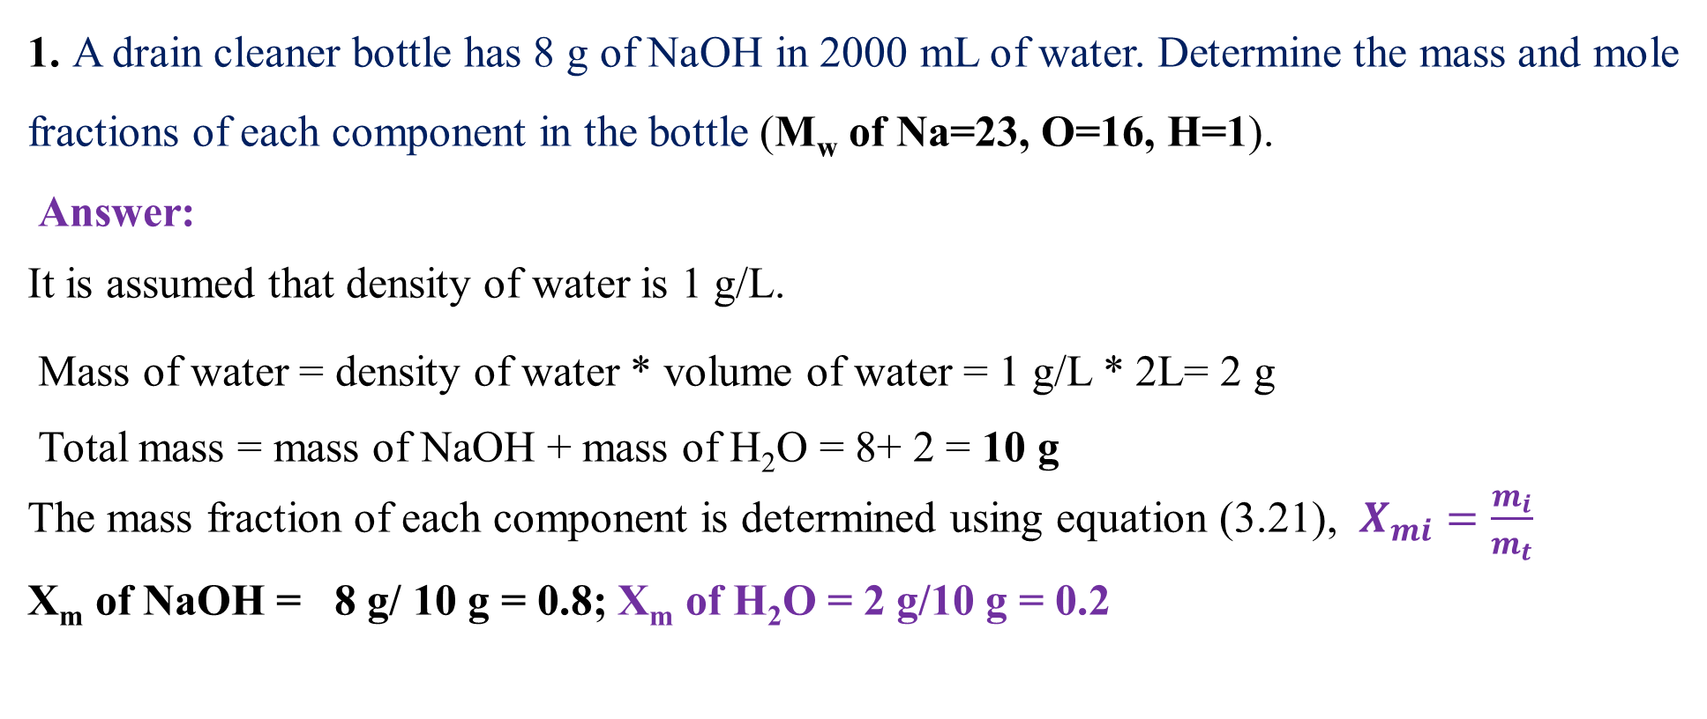
Cont’d
1. A drain cleaner bottle has 8 g of NaOH in 2000 mL of water. Determine the mass and mole fractions of each component in the bottle (M_{w} of Na=23, O=16, H=1).
Answer:
It is assumed that density of water is 1 g/L.
Mass of water = density of water * volume of water = 1 g/L * 2L= 2 g
Total mass = mass of NaOH + mass of H₂O = 8+ 2 = 10 g
The mass fraction of each component is determined using equation (3.21), $X_{mi}=\frac{m_{i}}{m_{t}}$
X_{m} of NaOH = 8 g/ 10 g = 0.8; X_{m} of H₂O = 2 g/10 g = 0.2
54

Slide 55
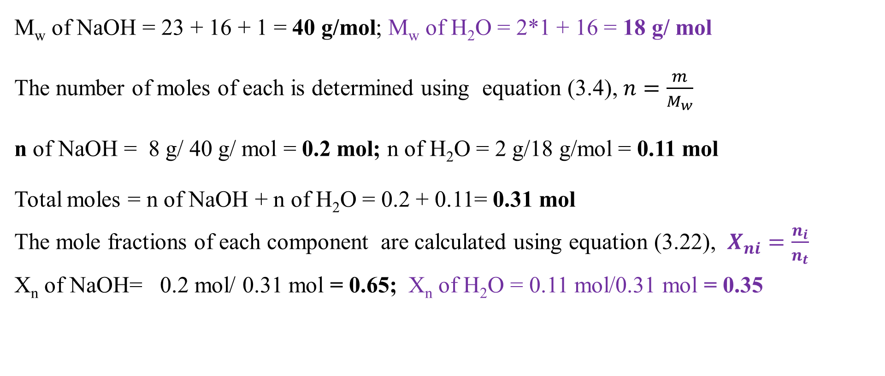
Cont’d
M_{w} of NaOH = 23 + 16 + 1 = 40 g/mol; M_{w} of H₂O = 2*1 + 16 = 18 g/ mol
The number of moles of each is determined using equation (3.4), $n=\frac{m}{M_{w}}$
n of NaOH = 8 g/ 40 g/ mol = 0.2 mol; n of H₂O = 2 g/18 g/mol = 0.11 mol
Total moles = n of NaOH + n of H₂O = 0.2 + 0.11= 0.31 mol
The mole fractions of each component are calculated using equation (3.22), $X_{ni}=\frac{n_{i}}{n_{t}}$
X_{n} of NaOH= 0.2 mol/ 0.31 mol = 0.65; X_{n} of H₂O = 0.11 mol/0.31 mol = 0.35
55

Slide 56
Cont’d
2. A mixture of n-butane (C₄H₁₀), n-pentane (C₅H₁₂) and n-hexane (C₆H₁₄) has 0.862 mol of C₄H₁₀, 0.417 mol of C₅H₁₂ and 0.233 mol of C₆H_{14.} Determine the mole fractions of each component, and the average molecular weight of a mixture (M_{w} of C = 12,H = 1).
Answer:
n_{t}= 0.862 + 0.417 + 0.233 = 1.512 mol
X_{n} of C₄H₁₀= 0.862/1.512= 0.570
X_{n} of C₅H₁₂= 0.417/1.512 = 0.276
X_{n} of C₆H₁₂= 0.233/1.512 = 0.154
56

Slide 57
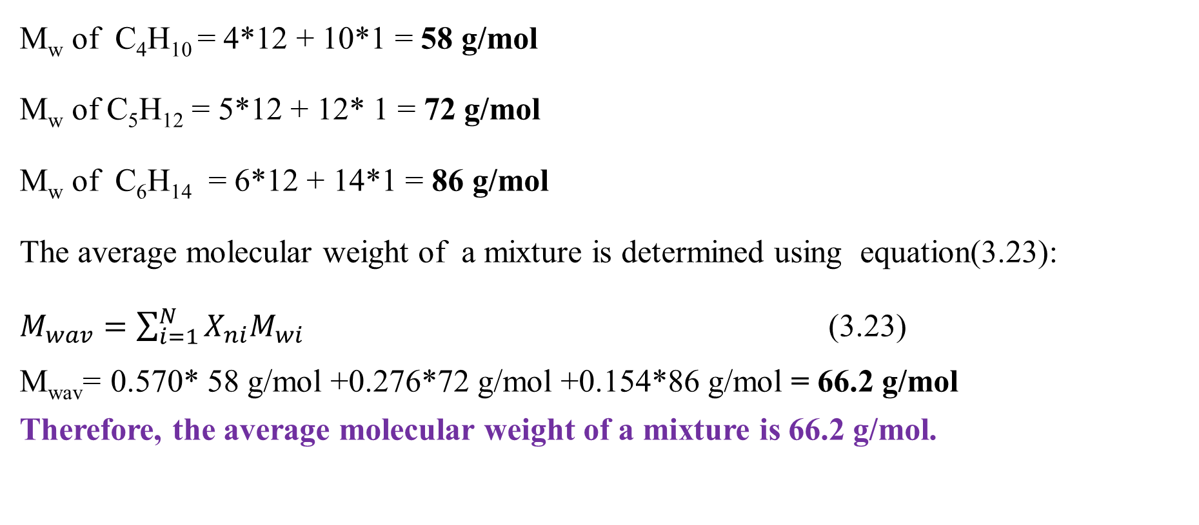
Cont’d
M_{w} of C₄H₁₀ = 4*12 + 10*1 = 58 g/mol
M_{w} of C₅H₁₂ = 5*12 + 12* 1 = 72 g/mol
M_{w} of C₆H₁₄ = 6*12 + 14*1 = 86 g/mol
The average molecular weight of a mixture is determined using equation(3.23):
$M_{wav}=\sum_{i=1}^{N}{X_{ni}M_{wi}}$ (3.23)
M_{wav}= 0.570* 58 g/mol +0.276*72 g/mol +0.154*86 g/mol = 66.2 g/mol
Therefore, the average molecular weight of a mixture is 66.2 g/mol.
57

Slide 58
3.7. Summary
Measurements and methods of analysis are the basics for process calculations in chemical engineering.
Regular calibration of measurement instruments and implement standard operating procedures are required to ensure accuracy, consistent data collection and analysis.
Density, volume, pressure, temperature and concentration measurements and methods of analysis are used to perform material balances, design processes, optimize, and control processes.
Mass and mole fractions are fundamentals for material balances calculations.
58

Slide 59
References
Basic Principles and Calculations in Chemical Engineering, Himmelblau, Pearson Education Inc, 9th edition, 2023.
Chemical Engineering Design, Volume 6, Coulson & Richardson’s, R. K. Sinnott, 3rd edition, 1999.
Elementary Principles of Chemical Processes, Richard M. Felder, John Wiley & Sons, 3rd edition, 2005.
Thank you!
59

