Slide 1
Basic Principles of Process Calculations in Chemical Engineering (ChEg2106)
Prerequisites: No prerequisite for this course
Lecture 5: Material Balances with Chemical Reaction
Week 5
Lecturer: Adamu Esubalew (PhD, ChEg)
Addis Ababa, Ethiopia
1

Slide 2
Lecture learning outcomes
At the end of the lecture, you will be able to:
identify the characteristics of material balances with chemical reaction,
define extent of reaction, limiting and excess reactants, selectivity and yield,
describe problem-solving techniques for material balances with chemical reaction, and
determine material balances with chemical reaction for steady state processes.
2

Slide 3
Presentation outlines
Introduction to material balances with chemical reaction
Problem-solving techniques for material balances with chemical reaction
Terminology for reaction systems
Material balances with chemical reaction
Summary
3

Slide 4
5.1. Introduction to material balances with chemical reaction
Material balances with chemical reactions involve accounting for the quantity of materials entering, leaving, and accumulating in a system while considering the effects of chemical reactions.
To determine material balance with chemical reaction, you have to consider the stoichiometry of a chemical reaction to account rate of generation of products/consumption of reactants in moles unit for material balances calculations.
The numbers of moles are not conserved for material balances with chemical reaction.
4

Slide 5
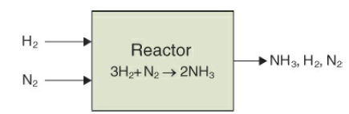
Cont’d
Consider a reactor in which ammonia is produced as depicted in Figure 5.1(Himmelblau, 2023, pg. 195).
Ammonia is produced industrially using the catalytic Haber-Bosch process.
Ammonia production is used to produce agricultural fertilizers as a source of nitrogen for plants.
Figure 5.1. A reactor for ammonia production from hydrogen and nitrogen molecules
5

Slide 6
Cont’d
As shown in Figure 5.1, the hydrogen and nitrogen molecules are reactants and ammonia is produced from chemical reaction.
In the inputs stream, there are reactants (hydrogen and nitrogen molecules).
In the outputs stream, there are unconverted reactants (hydrogen & nitrogen) and product (ammonia).
The reaction process shows that ammonia is generated during chemical reaction.
The stichometry of the reaction equation shows that 3 moles of hydrogen molecules react with 1 mole of nitrogen to generate 2 moles of ammonia.
6

Slide 7
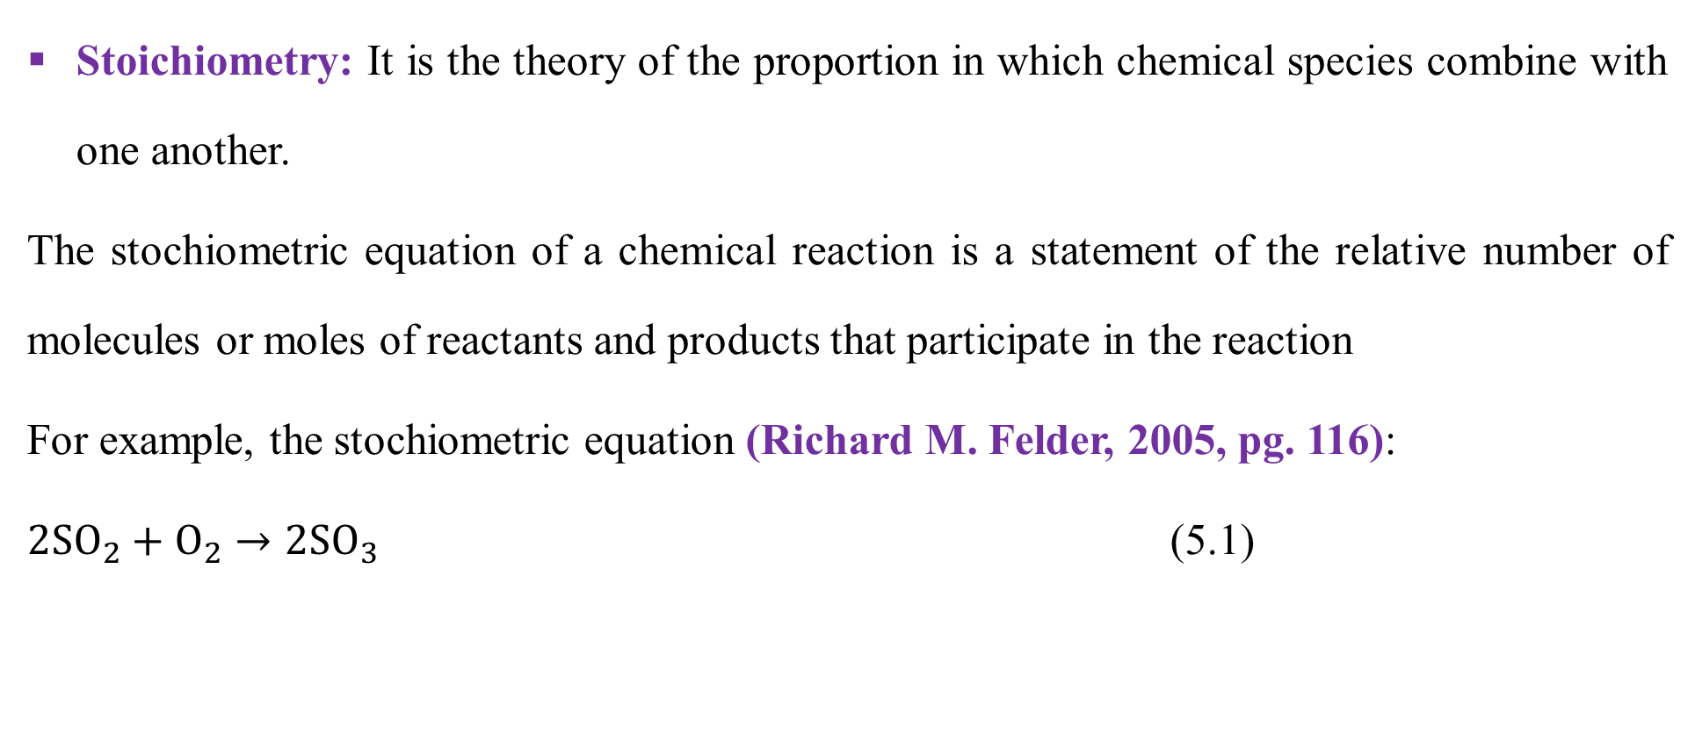
Cont’d
Stoichiometry: It is the theory of the proportion in which chemical species combine with one another.
The stochiometric equation of a chemical reaction is a statement of the relative number of molecules or moles of reactants and products that participate in the reaction
For example, the stochiometric equation (Richard M. Felder, 2005, pg. 116):
$2SO_{2}+O_{2}→2SO_{3}$ (5.1)
7

Slide 8
Cont’d
The stochiometric equation (5.1) indicates that for every two molecules (moles) of SO₂ that reacts, one molecule (mole) of O₂ reacts to produce two molecules (moles) of SO₃.
The numbers that precede the formulas for each species are the stochiometric coefficients of the reaction components.
The chemical equation shows the reaction of reactants and the output products with balanced constituents of elements.
8

Slide 9
Cont’d
Reaction stoichiometry allows you to predict the moles required for the reaction and the moles of each species remaining after the reaction has occurred.
Stoichiometry provides a quantitative means of relating the quantity of products produced by a chemical reaction to the amount of reactants feed to a process, or vice versa.
Chemical reaction equation provides both qualitative and quantitative information concerning chemical reactions that occur in a process.
9

Slide 10
Cont’d
Specifically, chemical reaction equation provides information of two types:
It tells you what substances are reactants (those being used up) and what substances are products (those being made).
The coefficients of a balanced chemical reaction equation tell you what the mole ratios are among the substances that react or are produced.
Make sure that chemical equation is correctly balanced when solving problems involving stoichiometry. i.e. the total quantities of each of the elements on the left side must be equal to those on the right side.
10

Slide 11
5.2. Problem-solving techniques for MBs with chem. reaction
The best way to tackle a problem will depend on the information given, the information required from the balance, and the constraints that arise from the nature of the problem.
The following step-by-step procedure is given as an aid to the efficient solution of material balance problems (Coulson & Richardson’s, 1999, pg. 56-57).
Read the problem carefully and understand it,
Draw the process system diagram with system boundaries,
Write all given values and required unknowns on the diagram,
11

Slide 12
Cont’d
Identify reaction species and write the balanced chemical equation,
Identify initial number of moles of each reactant and define the extent of reaction (ξ),
Check that number of degrees of freedom (NDF) is zero, and all units are consistent,
State all your assumptions and write the appropriate material balances equation,
Define all the symbols used in the material balances equation,
Solve the problem using appropriate equation, and
Analyze your final result and write your conclusion based on the results.
(Himmelblau, 2023, pg. 129-136).
12

Slide 13
5.3. Terminology for reaction systems
The key terminology for reaction systems includes extent of reaction, limiting and excess reactants, conversion, selectivity and yield.
Extent of reaction (ξ): It is based on a specified stoichiometric equation and denotes how much reaction occurs.
The extent of reaction applies to each species in the reaction.
It has unit of moles of reacting species.
You will find the extent of reaction useful in solving material balances involving chemical reactions if you can determine the reaction equations.
13

Slide 14
Cont’d
The extent of reaction is calculated by dividing the change in the number of moles of a species that occurs in a reaction, for either a reactant or a product, by the associated stoichiometric coefficient.
The extent of reaction, one that takes into account incomplete reaction and involves the initial amounts of reactants and products.
14

Slide 15
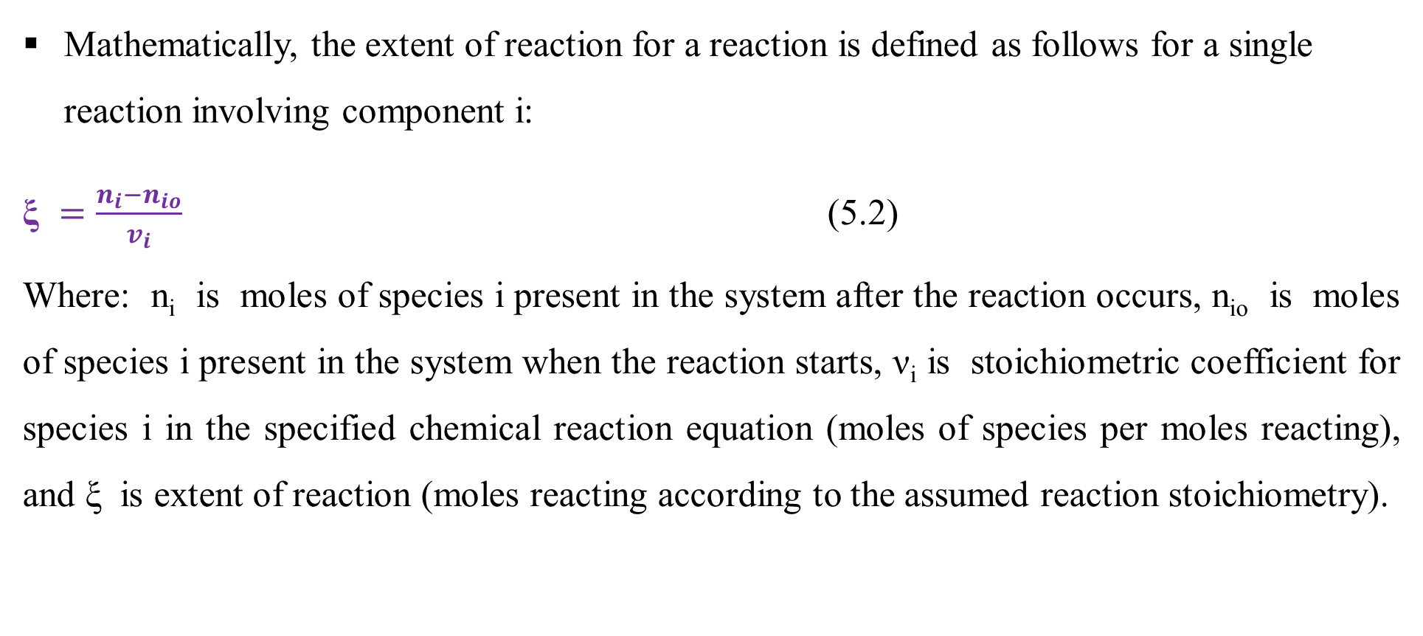
Cont’d
Mathematically, the extent of reaction for a reaction is defined as follows for a single reaction involving component i:
$\text{ξ} =\frac{n_{i}−n_{io}}{v_{i}}$ (5.2)
Where: n_{i} is moles of species i present in the system after the reaction occurs, n_{io} is moles of species i present in the system when the reaction starts, ν_{i} is stoichiometric coefficient for species i in the specified chemical reaction equation (moles of species per moles reacting), and ξ is extent of reaction (moles reacting according to the assumed reaction stoichiometry).
15

Slide 16
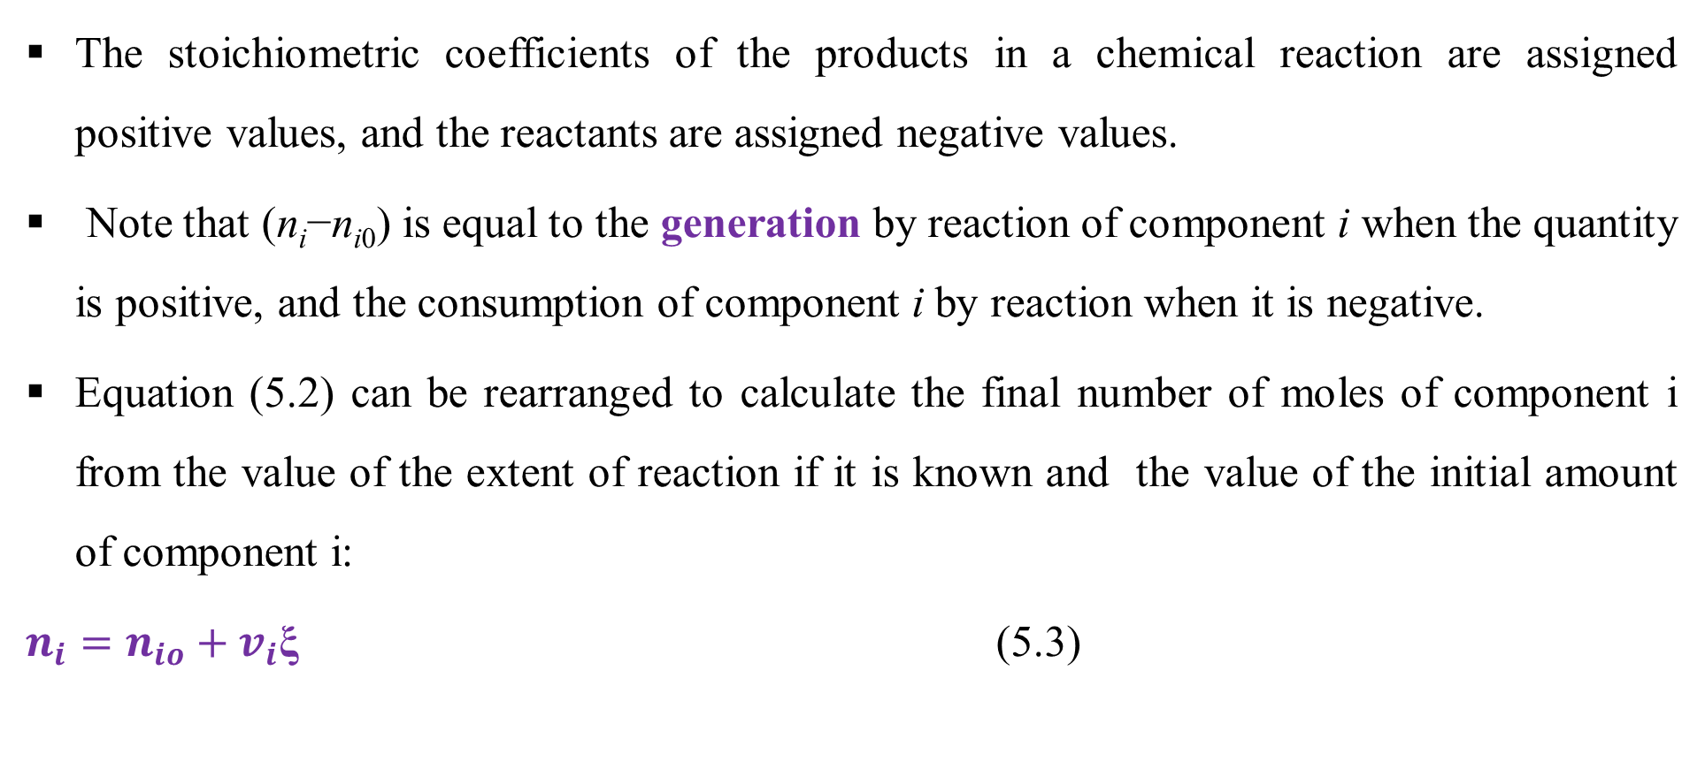
Cont’d
The stoichiometric coefficients of the products in a chemical reaction are assigned positive values, and the reactants are assigned negative values.
Note that (n_{i}−n_{i0}) is equal to the generation by reaction of component i when the quantity is positive, and the consumption of component i by reaction when it is negative.
Equation (5.2) can be rearranged to calculate the final number of moles of component i from the value of the extent of reaction if it is known and the value of the initial amount of component i:
${{n_{i}=n}_{io}+v}_{i}\text{ξ}$ (5.3)
16

Slide 17
Cont’d
The important characteristics of the extent of reaction, ξ, defined in Equation (5.2) is that it has the same value for each molecular species involved in a reaction.
The remining amount of all species after chemical reaction can be determined from extent of reaction, stochiometric coefficients and initial number of moles of the species present in the chemical reaction using equation (5.3) (Richard M. Felder, 2005, pg. 119).
The concept of extent of reaction can be extended to multiple reactions, only now each independent reaction has its own extent.
17

Slide 18
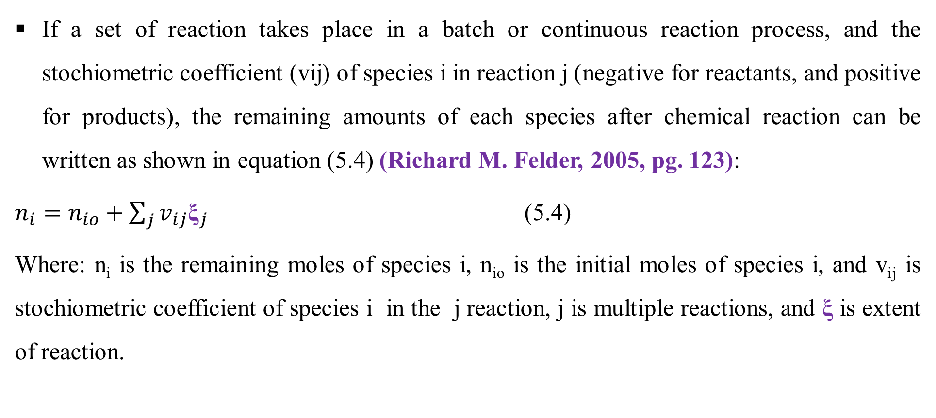
Cont’d
If a set of reaction takes place in a batch or continuous reaction process, and the stochiometric coefficient (vij) of species i in reaction j (negative for reactants, and positive for products), the remaining amounts of each species after chemical reaction can be written as shown in equation (5.4) (Richard M. Felder, 2005, pg. 123):
$n_{i}=n_{io}+\sum_{j}{v_{ij}{\text{ξ}}_{j}}$ (5.4)
Where: n_{i} is the remaining moles of species i, n_{io} is the initial moles of species i, and v_{ij} is stochiometric coefficient of species i in the j reaction, j is multiple reactions, and $\text{ξ}$ is extent of reaction.
18

Slide 19
Cont’d
Limiting and excess reactants: Limiting reactant is the reactant that present in the smallest stoichiometry amount whereas excess reactant is a reactant in excess amount of the limiting reactant (Richard M. Felder, 2005, pg. 118).
In industrial reactors, you will rarely find exact stoichiometric amounts of materials used.
To make a desired reaction take place, excess reactants are nearly always used.
The excess material comes out with the product and sometimes can be used again.
The limiting reactant is the species in a chemical reaction that theoretically will be completely consumed if the reaction is to proceed to completion.
19

Slide 20
Cont’d
If the reaction goes to completion, the amount of product that will be produced is controlled by the amount of the limiting reactant.
To determine which species is the limiting reactant, you can calculate the maximum extent of reaction, a quantity that is based on assuming the complete reaction of each reactant.
The reactant with the smallest maximum extent of reaction is the limiting reactant.
To make a desired reaction take place excess reactants are used. However, excess reactants must be in an optimum quantity.
20

Slide 21
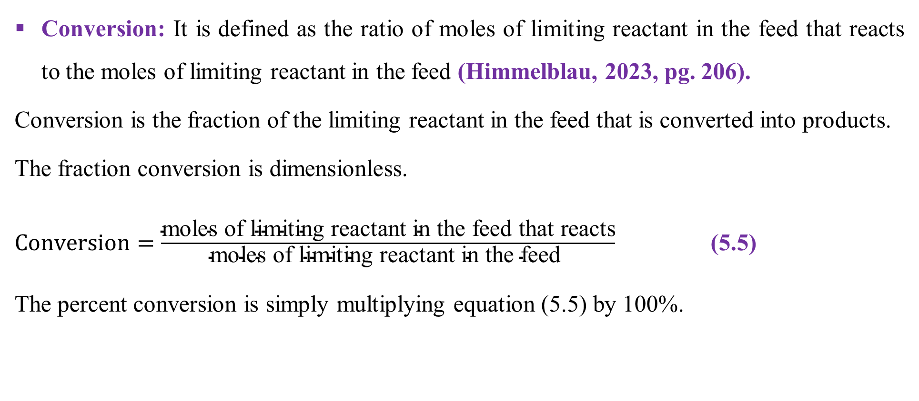
Cont’d
Conversion: It is defined as the ratio of moles of limiting reactant in the feed that reacts to the moles of limiting reactant in the feed (Himmelblau, 2023, pg. 206).
Conversion is the fraction of the limiting reactant in the feed that is converted into products.
The fraction conversion is dimensionless.
$Conversion=\frac{\text{moles} \text{of} \text{limiting} \text{reactant} \text{in} \text{the} \text{feed} \text{that} \text{reacts}}{\text{moles} \text{of} \text{limiting} \text{reactant} \text{in} \text{the} \text{feed} }$ (5.5)
The percent conversion is simply multiplying equation (5.5) by 100%.
21

Slide 22
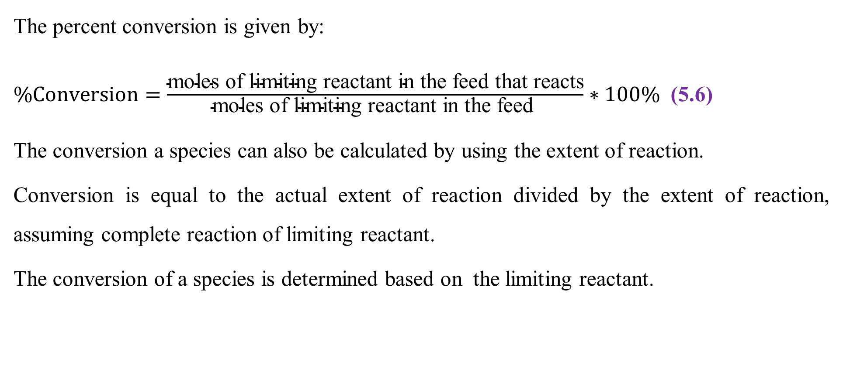
Cont’d
The percent conversion is given by:
$\%Conversion=\frac{\text{moles} \text{of} \text{limiting} \text{reactant} \text{in} \text{the} \text{feed} \text{that} \text{reacts}}{\text{moles} \text{of} \text{limiting} \text{reactant} \text{in} \text{the} \text{feed} }∗100\%$ (5.6)
The conversion a species can also be calculated by using the extent of reaction.
Conversion is equal to the actual extent of reaction divided by the extent of reaction, assuming complete reaction of limiting reactant.
The conversion of a species is determined based on the limiting reactant.
22

Slide 23
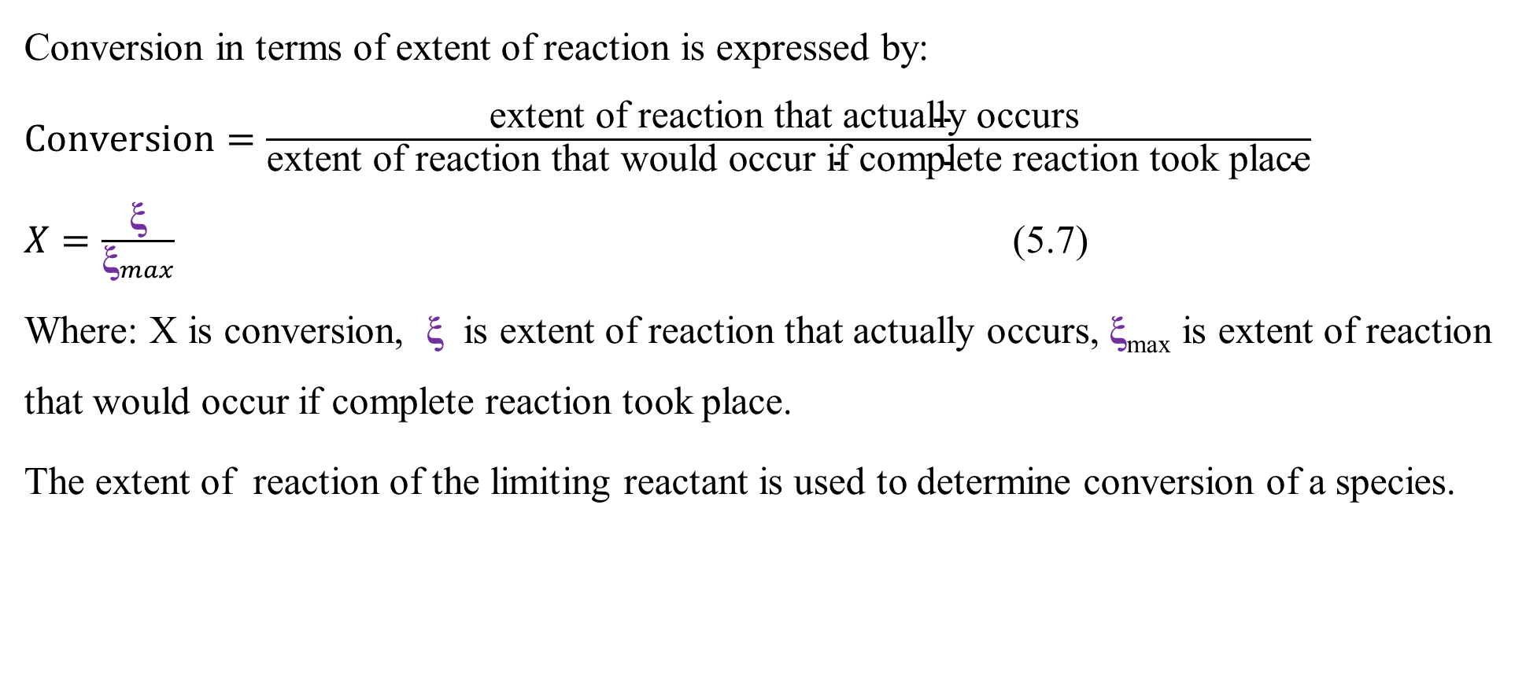
Cont’d
Conversion in terms of extent of reaction is expressed by:
$Conversion=\frac{\text{extent} \text{of} \text{reaction} \text{that} \text{actually} \text{occurs} }{\text{extent} \text{of} \text{reaction} \text{that} \text{would} \text{occur} \text{if} \text{complete} \text{reaction} \text{took} \text{place}}$
$X=\frac{\text{ξ}}{{\text{ξ}}_{max}}$ (5.7)
Where: X is conversion, $\text{ξ}$ is extent of reaction that actually occurs, $\text{ξ}$_{max} is extent of reaction that would occur if complete reaction took place.
The extent of reaction of the limiting reactant is used to determine conversion of a species.
23

Slide 24
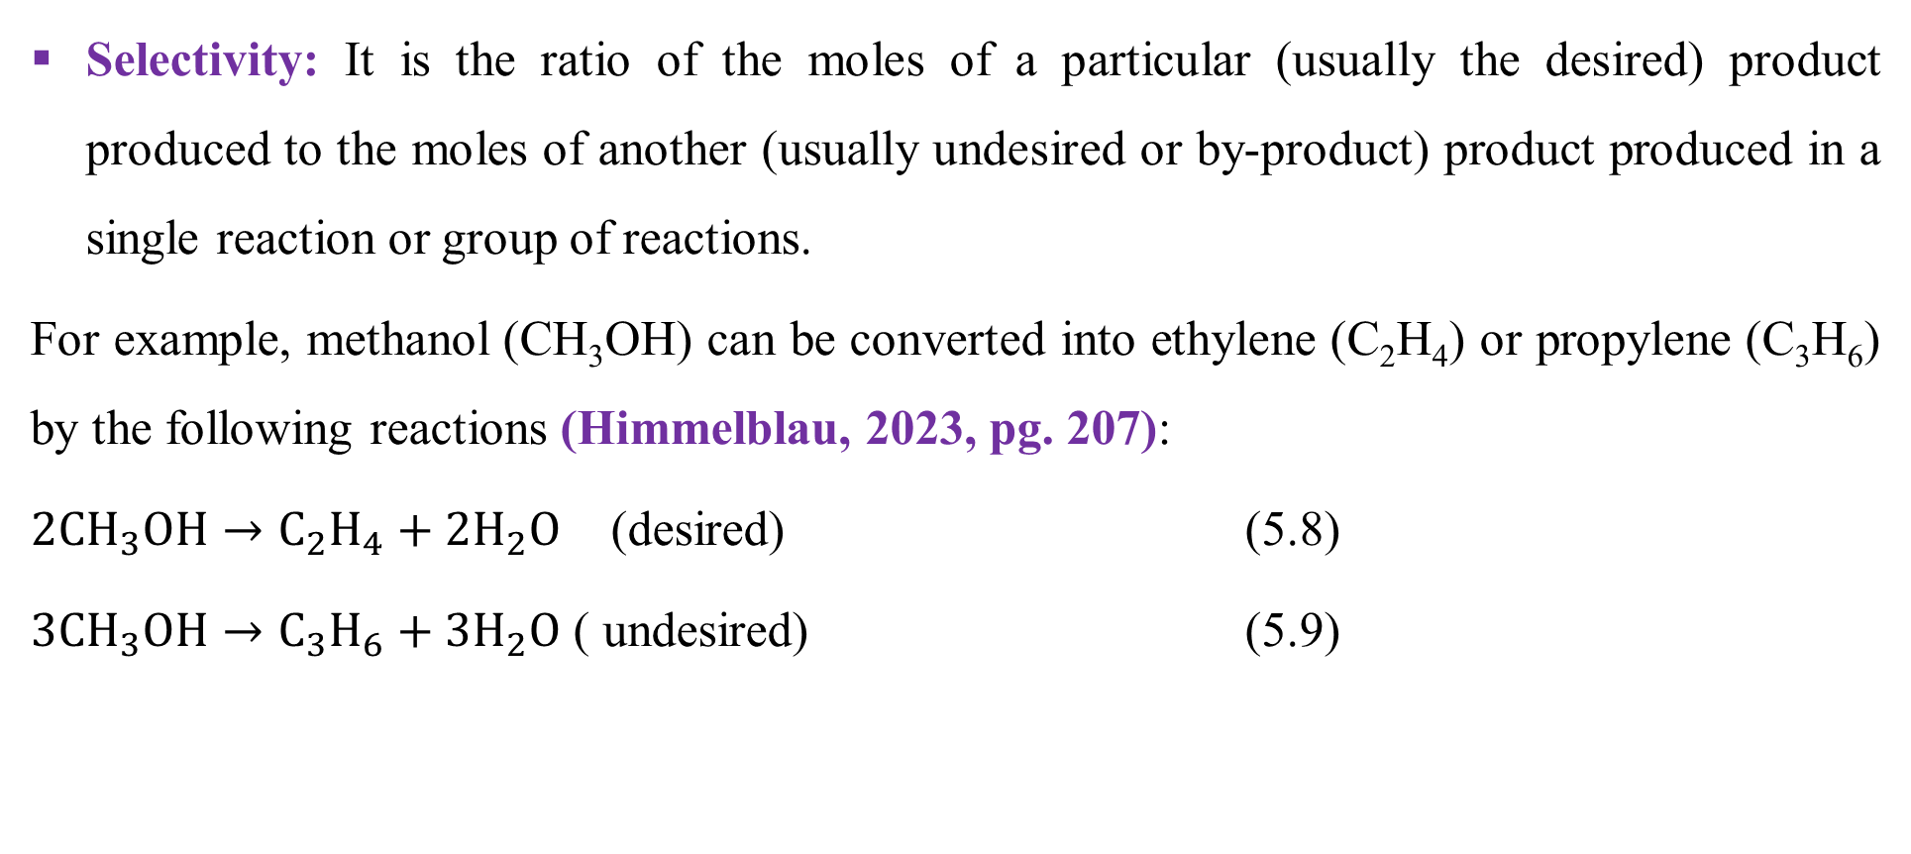
Cont’d
Selectivity: It is the ratio of the moles of a particular (usually the desired) product produced to the moles of another (usually undesired or by-product) product produced in a single reaction or group of reactions.
For example, methanol (CH₃OH) can be converted into ethylene (C₂H₄) or propylene (C₃H₆) by the following reactions (Himmelblau, 2023, pg. 207):
$2CH_{3}OH→C_{2}H_{4}+2H_{2}O$ (desired) (5.8)
$3CH_{3}OH→C_{3}H_{6}+3H_{2}O$ ( undesired) (5.9)
24

Slide 25
Cont’d
Large selectivity is required to maximize desired product and suppress undesired one.
The selectivity ratio guides you how to produce the most amount of our desired product and the least amount of our undesired product.
Selectivity confirms that the formation of desired product (ethylene) can be increased and the formation of undesired product (propylene) can be decreased by keeping the concentration of methanol is low.
Selectivity can also be affected by the reaction temperature.
25

Slide 26
Cont’d
Yield: It is a measure of the performance of a reaction, which can be defined based on feed, reactant consumed and complete conversion (Himmelblau, 2023, pg. 208).
Based on feed, yield is the amount of desired product obtained divided by the amount of the reactant fed (commonly the limiting) .
Based on reactant consumed, yield is the amount of desired product obtained divided by the amount of reactant consumed (often the limiting).
Based on complete conversion, yield is the amount of a product divided by the theoretical amount of product based on a limiting reactant completely consumed.
26

Slide 27
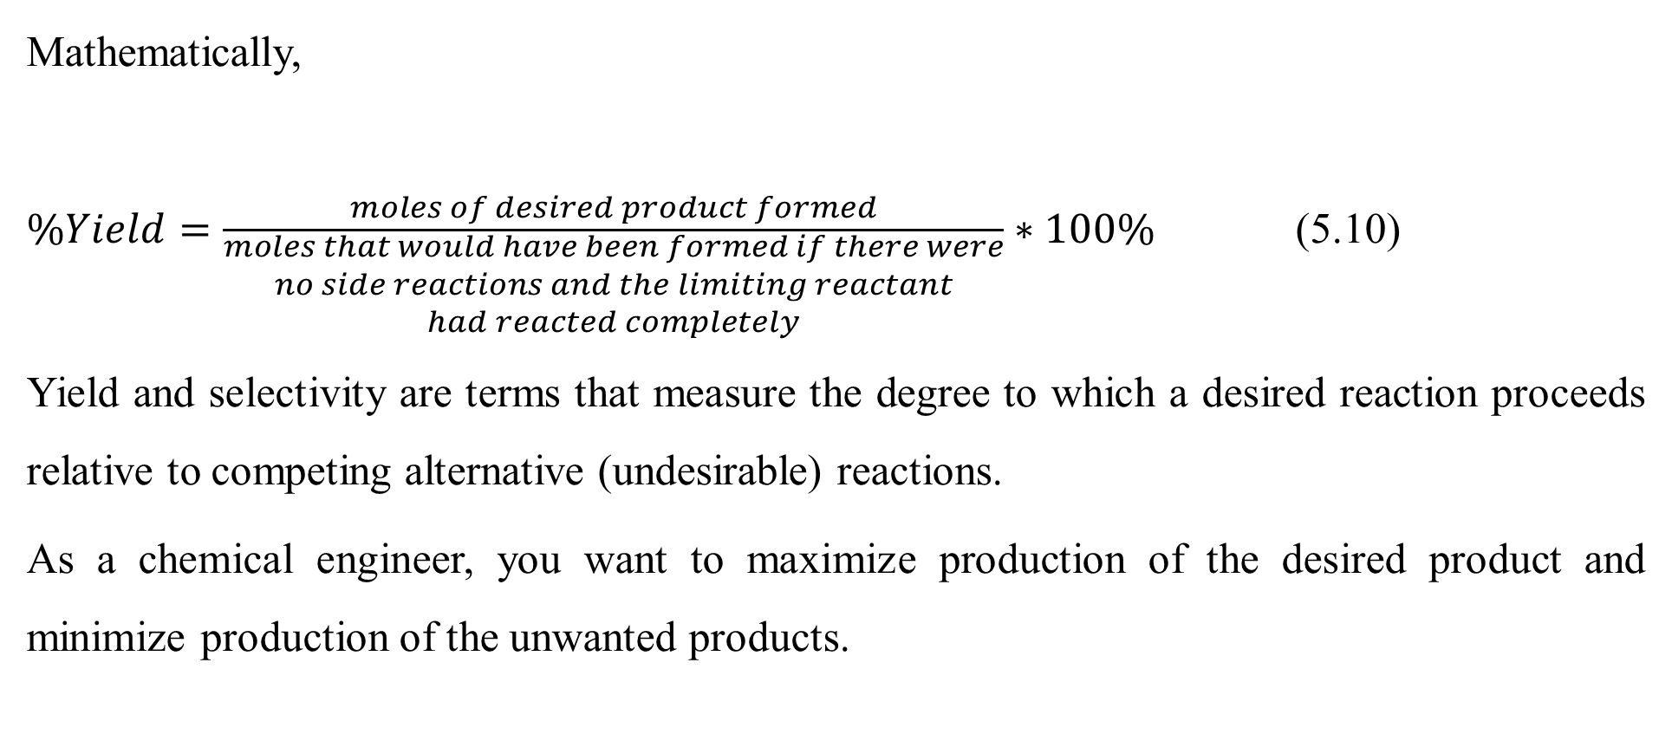
Cont’d
Mathematically,
$\%Yield=\frac{moles of desired product formed}{\begin{aligned}moles that would have been formed if there were \\ no side reactions and the limiting reactant \\ had reacted completely\end{aligned}}∗100\%$ (5.10)
Yield and selectivity are terms that measure the degree to which a desired reaction proceeds relative to competing alternative (undesirable) reactions.
As a chemical engineer, you want to maximize production of the desired product and minimize production of the unwanted products.
27

Slide 28
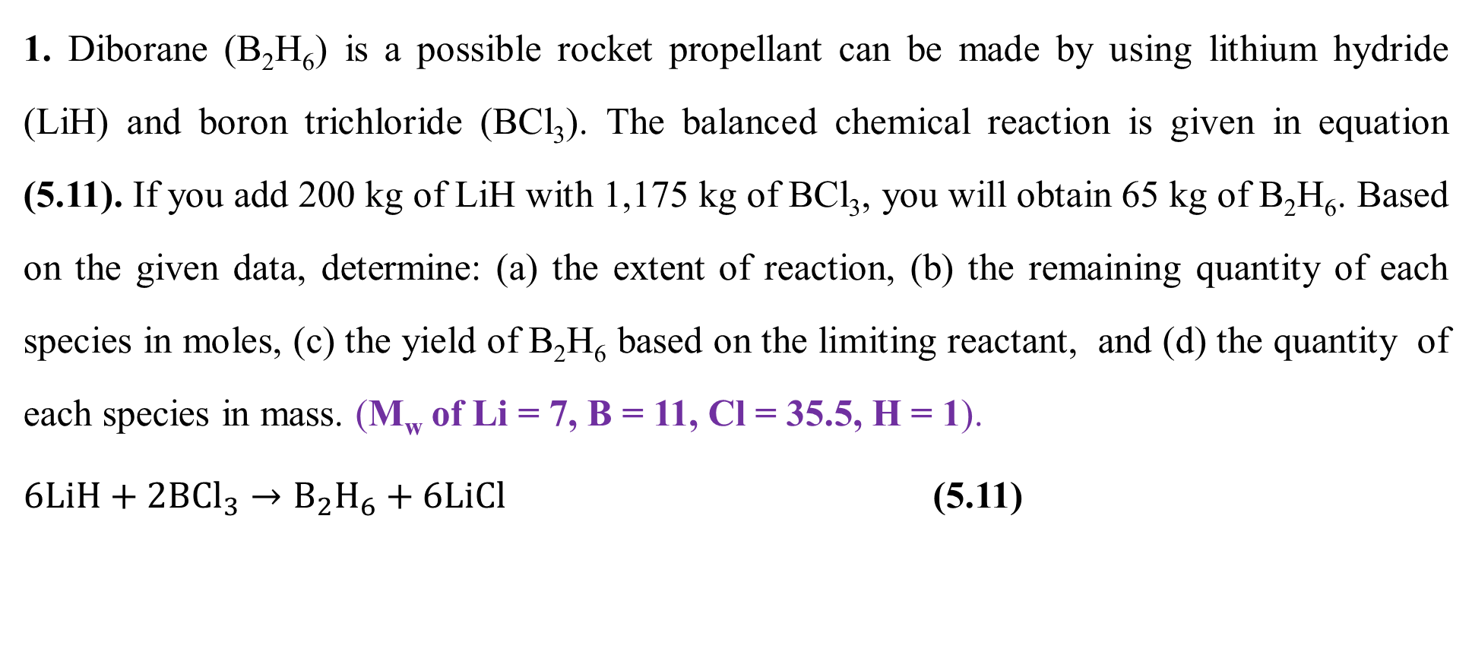
Activity 5.1
1. Diborane (B₂H₆) is a possible rocket propellant can be made by using lithium hydride (LiH) and boron trichloride (BCl₃). The balanced chemical reaction is given in equation (5.11). If you add 200 kg of LiH with 1,175 kg of BCl₃, you will obtain 65 kg of B₂H₆. Based on the given data, determine: (a) the extent of reaction, (b) the remaining quantity of each species in moles, (c) the yield of B₂H₆ based on the limiting reactant, and (d) the quantity of each species in mass. (M_{w} of Li = 7, B = 11, Cl = 35.5, H = 1).
$6LiH+2B{Cl}_{3}→B_{2}H_{6}+6LiCl$ (5.11)
28

Slide 29
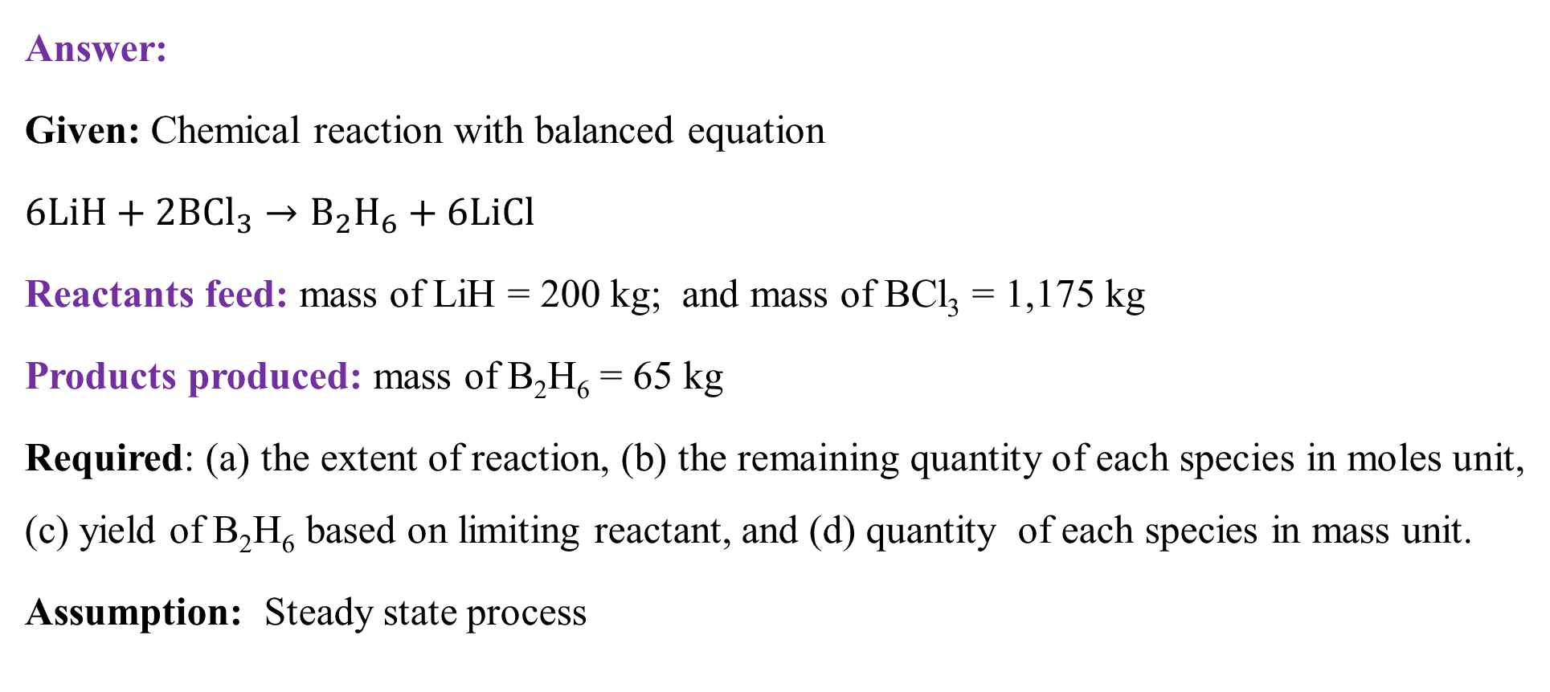
Cont’d
Answer:
Given: Chemical reaction with balanced equation
$6LiH+2B{Cl}_{3}→B_{2}H_{6}+6LiCl$
Reactants feed: mass of LiH = 200 kg; and mass of BCl₃ = 1,175 kg
Products produced: mass of B₂H₆ = 65 kg
Required: (a) the extent of reaction, (b) the remaining quantity of each species in moles unit, (c) yield of B₂H₆ based on limiting reactant, and (d) quantity of each species in mass unit.
Assumption: Steady state process
29

Slide 30
Cont’d
To determine the extent of reaction, you have to convert all the given values from mass units to mole units using the molecular weights of each species.
Molecular weights (M_{w}) of components:
M_{w} of LiH = 7 + 1 = 8 g/ mol = 8 kg/kmol
M_{w} of BCl₃ = 11+ 3*35.5 = 117.5 g/mol = 117.5 kg/kmol
M_{w} of B₂H₆ = 2*11 + 6*1 = 28 g/mol = 28 kg/kmol
M_{w} of LiCl = 7 + 35.5 = 42.5 g/mol = 42.5 kg/kmol
30

Slide 31
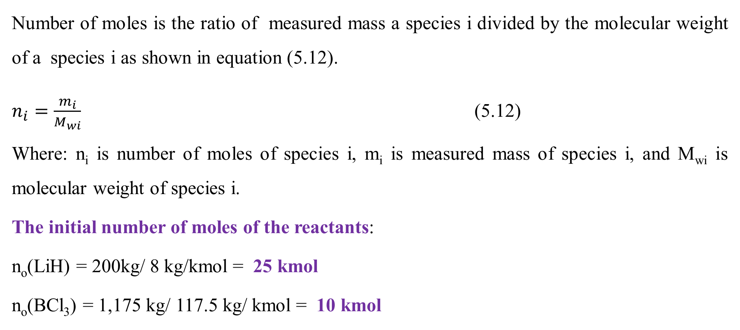
Cont’d
Number of moles is the ratio of measured mass a species i divided by the molecular weight of a species i as shown in equation (5.12).
$n_{i}=\frac{m_{i}}{M_{wi}}$ (5.12)
Where: n_{i} is number of moles of species i, m_{i} is measured mass of species i, and M_{wi} is molecular weight of species i.
The initial number of moles of the reactants:
n_{o}(LiH) = 200kg/ 8 kg/kmol = 25 kmol
n_{o}(BCl₃) = 1,175 kg/ 117.5 kg/ kmol = 10 kmol
31

Slide 32
Cont’d
The balanced chemical equation (5.11) shows that 6 kmol of LiH needs 2 kmol of BCl₃, the mole ratio of LiH to BCl₃ is 3: 1.
The number of moles of the reactants shows that 25 kmol of LiH and 10 kmol of BCl₃, which is the mole ratio of LiH to BCl₃ is 2.5:1.
This shows that LiH is the limiting reactant, and BCl₃ is the excess reactant.
The number of moles of the product:
n(B₂H₆) = 65 kg/ 28 kg/kmol = 2.32 kmol
32

Slide 33
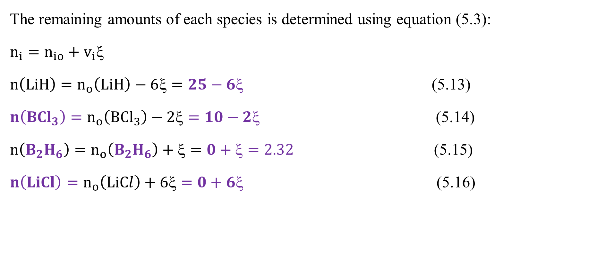
Cont’d
The remaining amounts of each species is determined using equation (5.3):
$n_{i}=n_{io}+v_{i}$
$n\left(LiH\right)=n_{o}\left(LiH\right)−6ξ=25−6ξ$ (5.13)
$n\left(B{Cl}_{3}\right)=n_{o}\left(B{Cl}_{3}\right)−2ξ=10−2ξ$ (5.14)
$n\left(B_{2}H_{6}\right)=n_{o}\left(B_{2}H_{6}\right)+ξ=0+ξ=2.32$ (5.15)
$n\left(LiCl\right)=n_{o}\left(LiCl\right)+6ξ=0+6ξ$ (5.16)
33

Slide 34
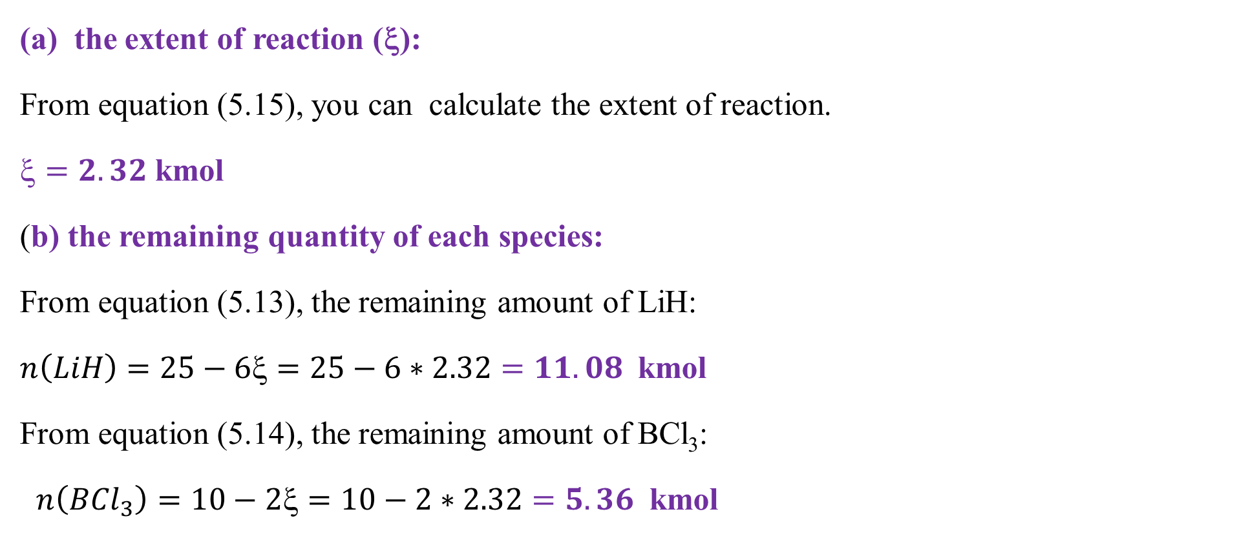
Cont’d
(a) the extent of reaction (ξ):
From equation (5.15), you can calculate the extent of reaction.
$=2.32$kmol
(b) the remaining quantity of each species:
From equation (5.13), the remaining amount of LiH:
$n\left(LiH\right)=25−6ξ=25−6∗2.32=11.08$ kmol
From equation (5.14), the remaining amount of BCl₃:
$n\left(B{Cl}_{3}\right)=10−2ξ=10−2∗2.32=5.36$ kmol
34

Slide 35
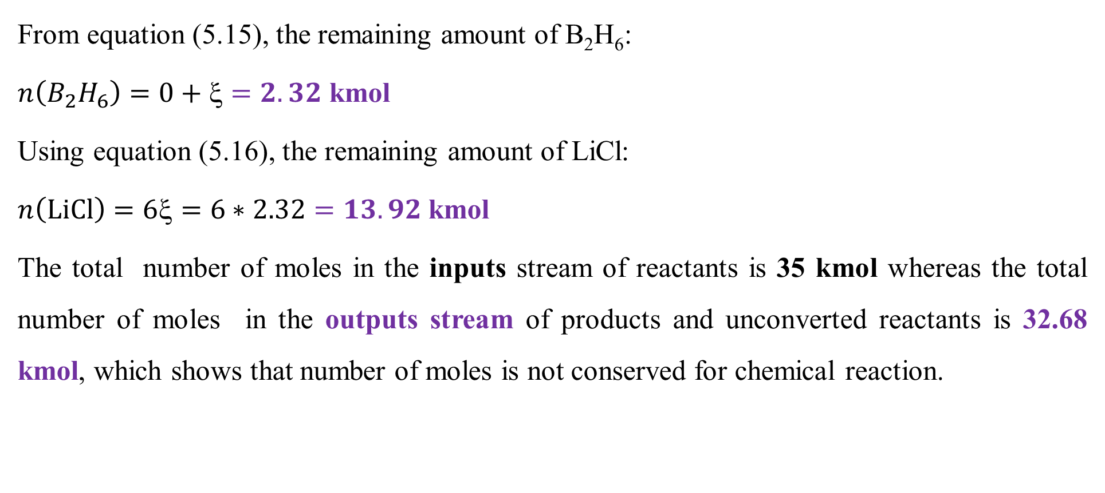
Cont’d
From equation (5.15), the remaining amount of B₂H₆:
$n\left(B_{2}H_{6}\right)=0+ξ=2.32$ kmol
Using equation (5.16), the remaining amount of LiCl:
$n\left(LiCl\right)=6ξ=6∗2.32=13.92$kmol
The total number of moles in the inputs stream of reactants is 35 kmol whereas the total number of moles in the outputs stream of products and unconverted reactants is 32.68 kmol, which shows that number of moles is not conserved for chemical reaction.
35

Slide 36
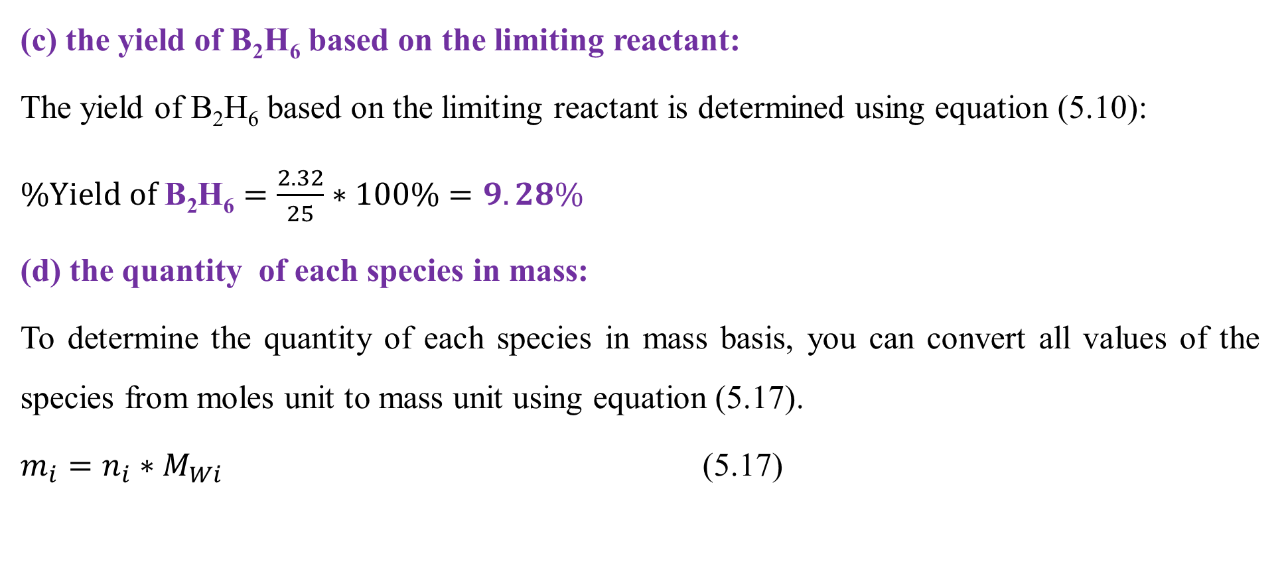
Cont’d
(c) the yield of B₂H₆ based on the limiting reactant:
The yield of B₂H₆ based on the limiting reactant is determined using equation (5.10):
$\%Yield of \text{B}\text{2}\text{H}\text{6}=\frac{2.32}{25}∗100\%=9.28\%$
(d) the quantity of each species in mass:
To determine the quantity of each species in mass basis, you can convert all values of the species from moles unit to mass unit using equation (5.17).
$m_{i}=n_{i}∗M_{Wi}$ (5.17)
36

Slide 37
Cont’d
Where: m_{i} is measured mass of species i, n_{i} is number of moles of species i, and M_{wi} is molecular weight of species i.
The inputs stream, reactants are given in mass unit:
m_{o}(LiH) = 200 kg
m_{o}(BCl₃) = 1, 175 kg
Total mass in the inputs stream = 200 + 1, 175 = 1, 375 kg
37

Slide 38
Cont’d
The outputs stream, products and unconverted reactants in mass unit:
m(B₂H₆) = 65 kg
m(LiH) = n(LiH)* M_{w}(LiH) = 11.08 kmol *8 kg/kmol = 88.6 kg
m(BCl₃) = n(BCl₃)* M_{w}(BCl₃) = 5.36 kmol *117.5 kg/kmol = 629.8 kg
m(LiCl) = n(LiCl)* M_{w}(LiCl) = 13.92 kmol *42.5 kg/kmol = 591.6 kg
Total mass in the outputs stream = 65 + 88.6 + 629.8 + 591.6 = 1, 375 kg
The results confirm that the amount of mass in the inputs and outputs streams is balanced.
38

Slide 39
5.4. Material balances with chemical reaction
The material balance for a species without reaction is simply what comes into a system is equals what goes out from it ( See lecture 4).
In the presence of chemical reaction, the material balances are performed with moles basis to account the rates of generation/consumption of species involve in a chemical reaction.
The rates of generation/consumption of the species by a chemical reaction must be considered when chemical reaction occurs.
The material balances of species in moles basis can be performed using general material balance equation.
39

Slide 40
Cont’d
The general material balances equation is given by:
Rate of accumulation of moles of i = rate of inputs moles of i - rate of outputs moles of i ± rate of generation/consumption of moles of i (5.18)
If the reaction process is conducted at steady state condition, the rate of accumulation is zero, and equation (5.18) will be reduced to equation (5.19).
rate of inputs moles of i - rate of outputs moles of i ± rate of generation/consumption of moles of i = 0 (5.19)
40

Slide 41
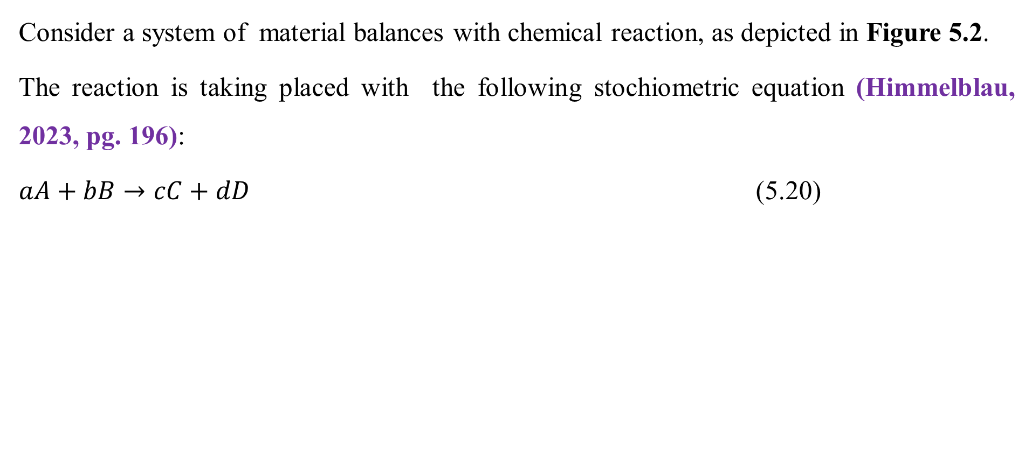
Cont’d
Consider a system of material balances with chemical reaction, as depicted in Figure 5.2.
The reaction is taking placed with the following stochiometric equation (Himmelblau, 2023, pg. 196):
$aA+bB→cC+dD$ (5.20)
Reactor
Figure 5.2. Material balances with chemical reaction
F_{io}
F_{i}
41

Slide 42
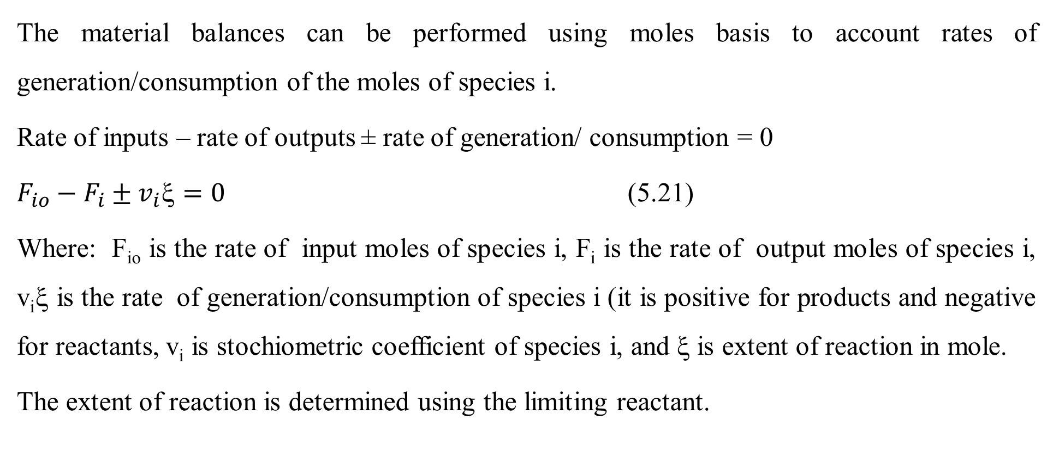
Cont’d
The material balances can be performed using moles basis to account rates of generation/consumption of the moles of species i.
Rate of inputs – rate of outputs ± rate of generation/ consumption = 0
$F_{io}−F_{i}±v_{i}=0$ (5.21)
Where: F_{io} is the rate of input moles of species i, F_{i} is the rate of output moles of species i, v_{i}ξ is the rate of generation/consumption of species i (it is positive for products and negative for reactants, v_{i} is stochiometric coefficient of species i, and ξ is extent of reaction in mole.
The extent of reaction is determined using the limiting reactant.
42

Slide 43
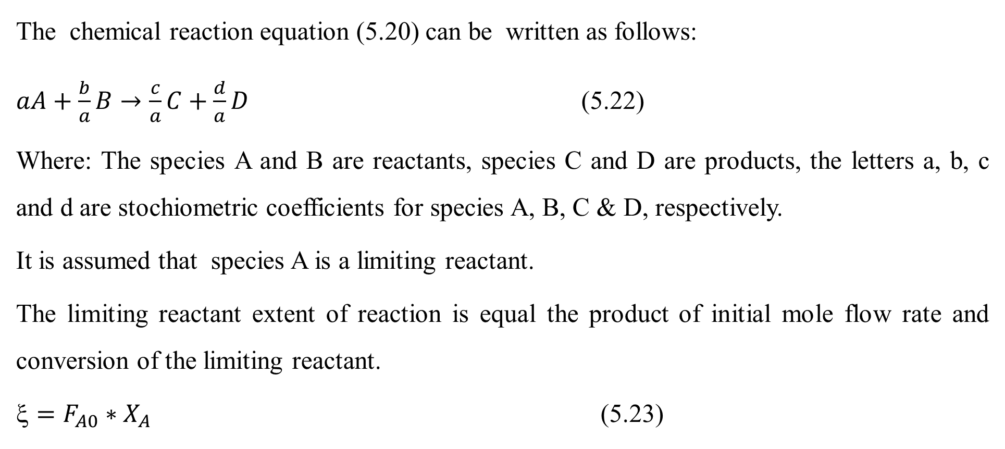
Cont’d
The chemical reaction equation (5.20) can be written as follows:
$aA+\frac{b}{a}B→\frac{c}{a}C+\frac{d}{a}D$ (5.22)
Where: The species A and B are reactants, species C and D are products, the letters a, b, c and d are stochiometric coefficients for species A, B, C & D, respectively.
It is assumed that species A is a limiting reactant.
The limiting reactant extent of reaction is equal the product of initial mole flow rate and conversion of the limiting reactant.
$=F_{A0}∗X_{A}$ (5.23)
43

Slide 44
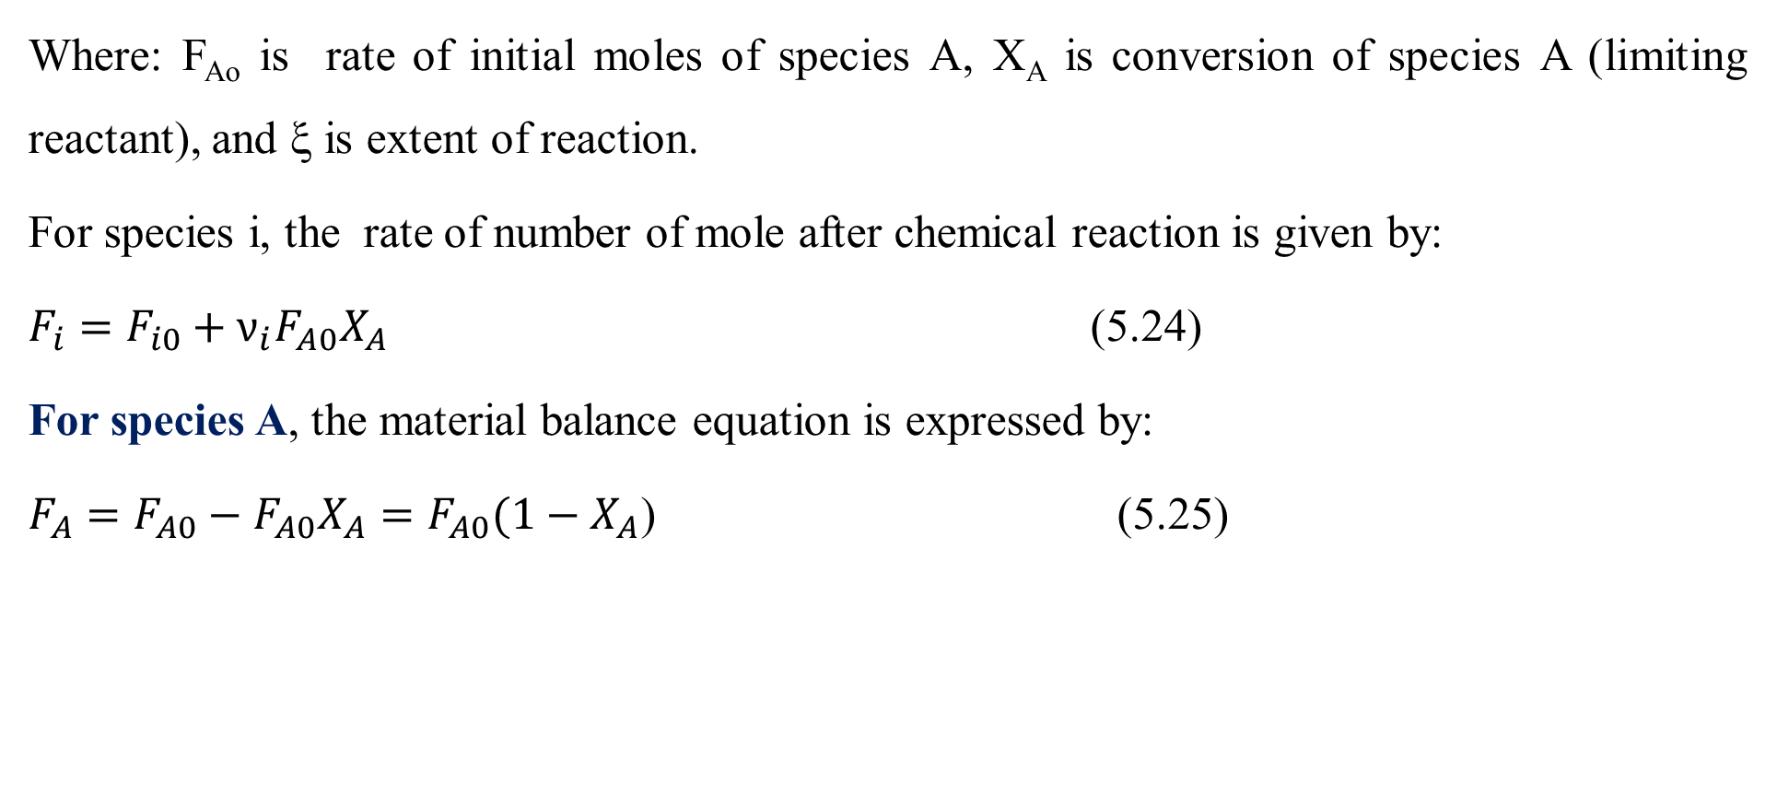
Cont’d
Where: F_{Ao} is rate of initial moles of species A, X_{A} is conversion of species A (limiting reactant), and ξ is extent of reaction.
For species i, the rate of number of mole after chemical reaction is given by:
$F_{i}=F_{i0}+ν_{i}F_{A0}X_{A}$ (5.24)
For species A, the material balance equation is expressed by:
$F_{A}=F_{A0}−F_{A0}X_{A}=F_{A0}(1−X_{A}$) (5.25)
44

Slide 45
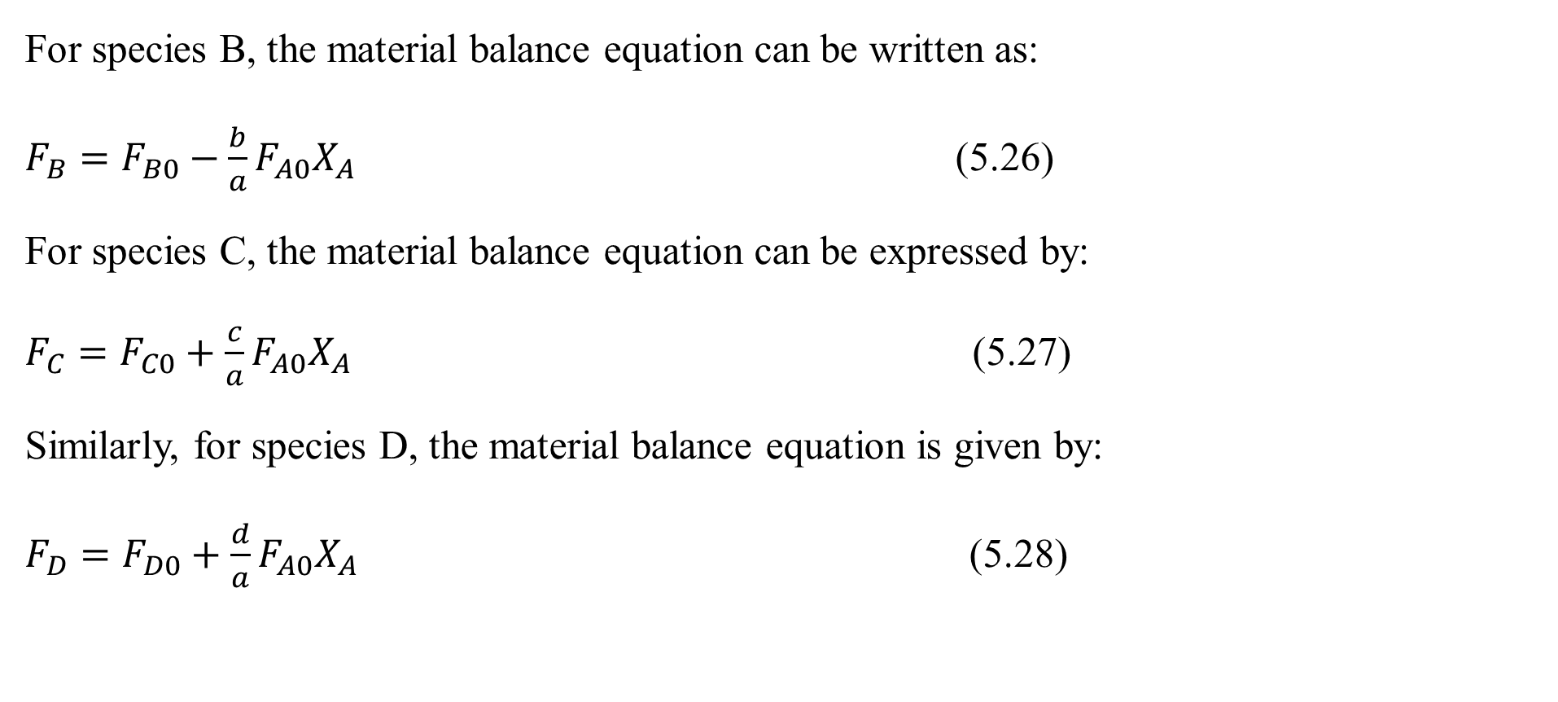
Cont’d
For species B, the material balance equation can be written as:
$F_{B}=F_{B0}−\frac{b}{a}F_{A0}X_{A}$ (5.26)
For species C, the material balance equation can be expressed by:
$F_{C}=F_{C0}+\frac{c}{a}F_{A0}X_{A}$ (5.27)
Similarly, for species D, the material balance equation is given by:
$F_{D}=F_{D0}+\frac{d}{a}F_{A0}X_{A}$ (5.28)
45

Slide 46
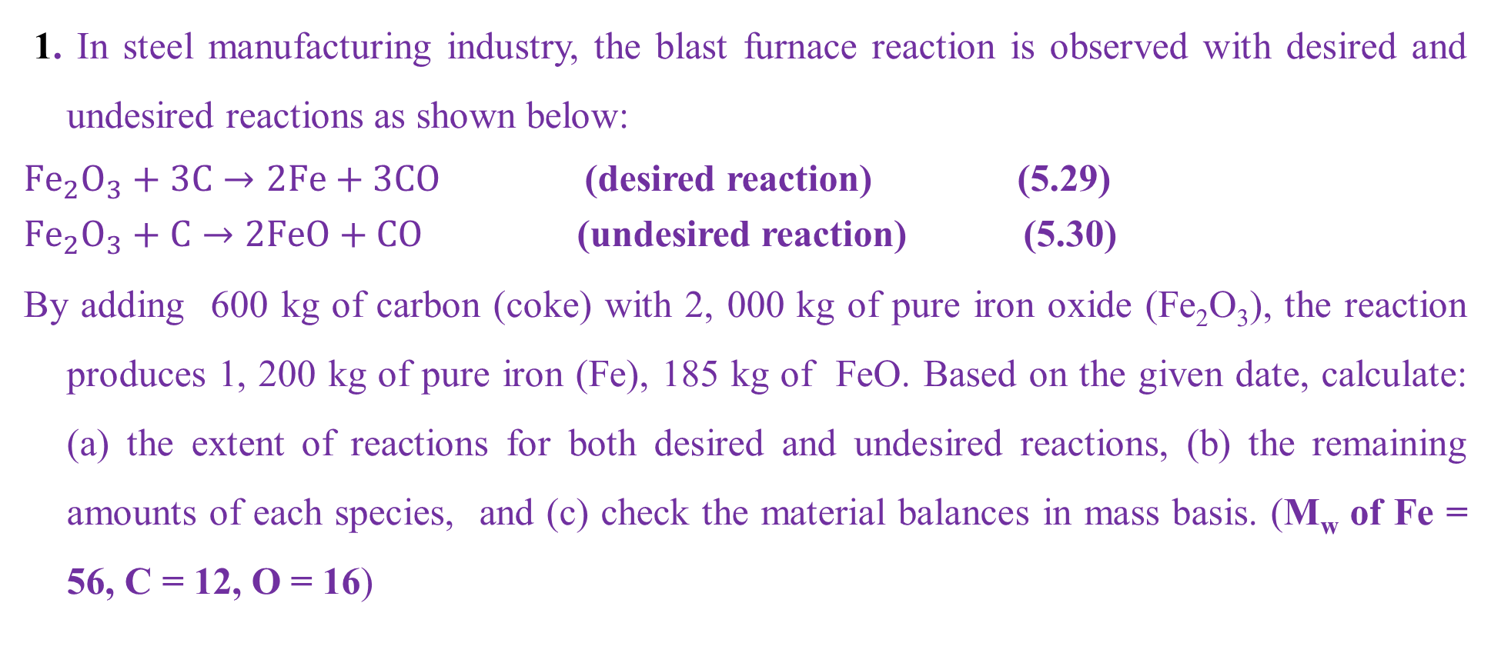
Activity 5.2
1. In steel manufacturing industry, the blast furnace reaction is observed with desired and undesired reactions as shown below:
${Fe}_{2}O_{3}+3C→2Fe+3CO$ (desired reaction) (5.29)
${Fe}_{2}O_{3}+C→2FeO+CO$ (undesired reaction) (5.30)
By adding 600 kg of carbon (coke) with 2, 000 kg of pure iron oxide (Fe₂O₃), the reaction produces 1, 200 kg of pure iron (Fe), 185 kg of FeO. Based on the given date, calculate: (a) the extent of reactions for both desired and undesired reactions, (b) the remaining amounts of each species, and (c) check the material balances in mass basis. (M_{w} of Fe = 56, C = 12, O = 16)
46

Slide 47
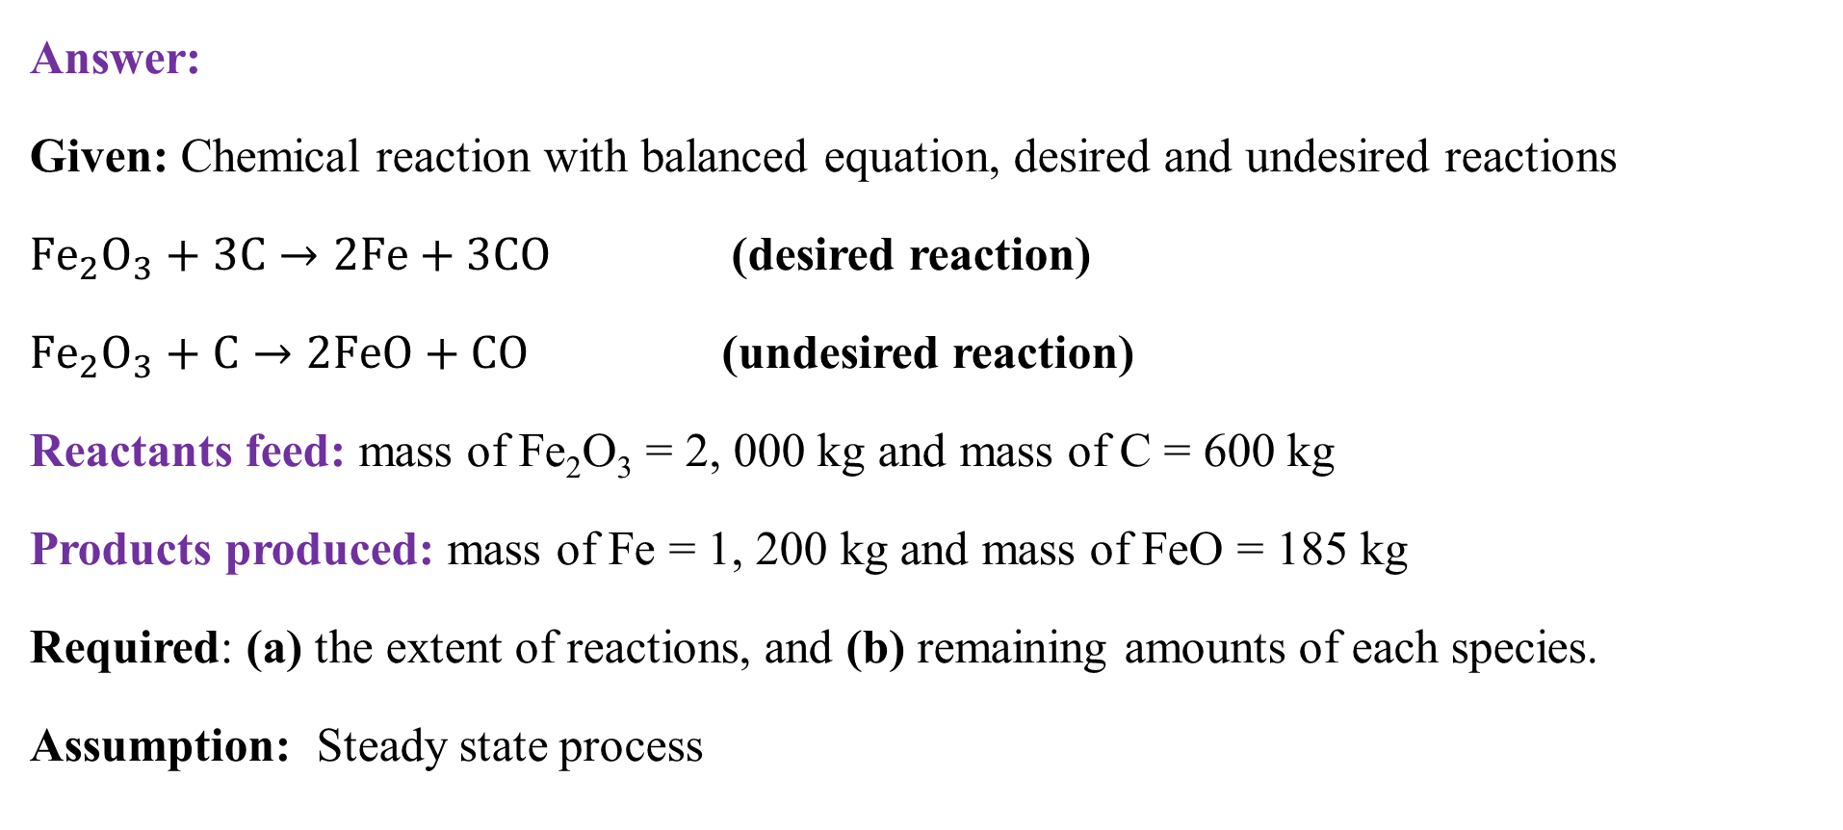
Cont’d
Answer:
Given: Chemical reaction with balanced equation, desired and undesired reactions
${Fe}_{2}O_{3}+3C→2Fe+3CO$ (desired reaction)
${Fe}_{2}O_{3}+C→2FeO+CO$ (undesired reaction)
Reactants feed: mass of Fe₂O₃ = 2, 000 kg and mass of C = 600 kg
Products produced: mass of Fe = 1, 200 kg and mass of FeO = 185 kg
Required: (a) the extent of reactions, and (b) remaining amounts of each species.
Assumption: Steady state process
47

Slide 48
Cont’d
To determine the extent of reactions, let’s convert all values from mass units to mole units Molecular weights (M_{w}) of components:
M_{w} of Fe₂O₃= 2*56 + 3* 16 = 160 g/mol = 160 kg/kmol
M_{w} of C = 12 g/mol = 12 kg/kmol
M_{w} of FeO = 56 + 16 = 72 g/mol = 72 kg/kmol
M_{w} of Fe = 56 g/mol = 56 kg/kmol
M_{w} of CO = 12+ 16 = 28 g/mol = 28 kg/kmol
48

Slide 49
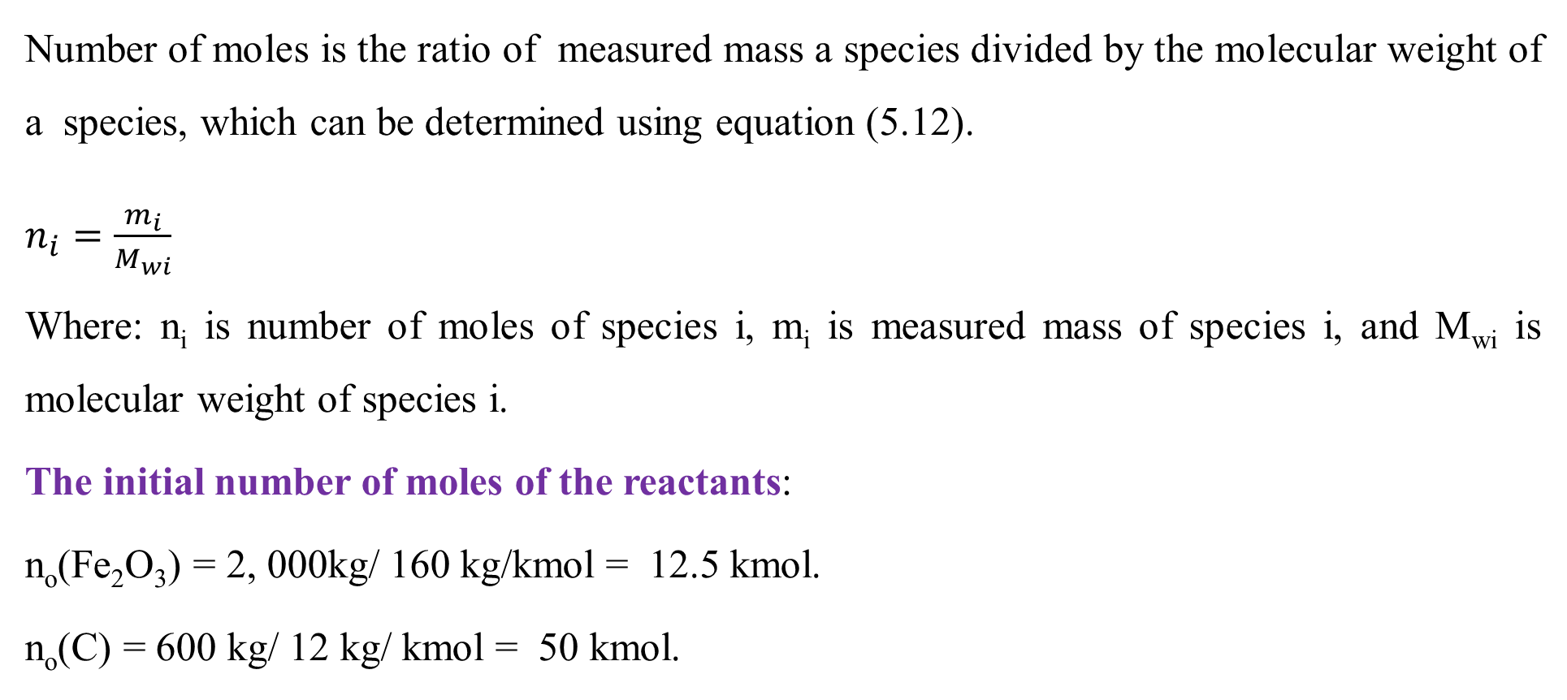
Cont’d
Number of moles is the ratio of measured mass a species divided by the molecular weight of a species, which can be determined using equation (5.12).
$n_{i}=\frac{m_{i}}{M_{wi}}$
Where: n_{i} is number of moles of species i, m_{i} is measured mass of species i, and M_{wi} is molecular weight of species i.
The initial number of moles of the reactants:
n_{o}(Fe₂O₃) = 2, 000kg/ 160 kg/kmol = 12.5 kmol.
n_{o}(C) = 600 kg/ 12 kg/ kmol = 50 kmol.
49

Slide 50
Cont’d
The balanced chemical equations (5.29 & 5.30) shows that 2 kmol of Fe₂O₃ needs 4 kmol of C, the mole ratio of C to Fe₂O₃ is 2: 1.
The initial number of moles of the reactants shows that 12.5 kmol of Fe₂O₃ and 50 kmol of C, which is the mole ratio of C to Fe₂O₃ is 4:1.
The mole ratio: 2:1 < 4:1
This shows that Fe₂O₃ is the limiting reactant and C is the excess reactant.
50

Slide 51
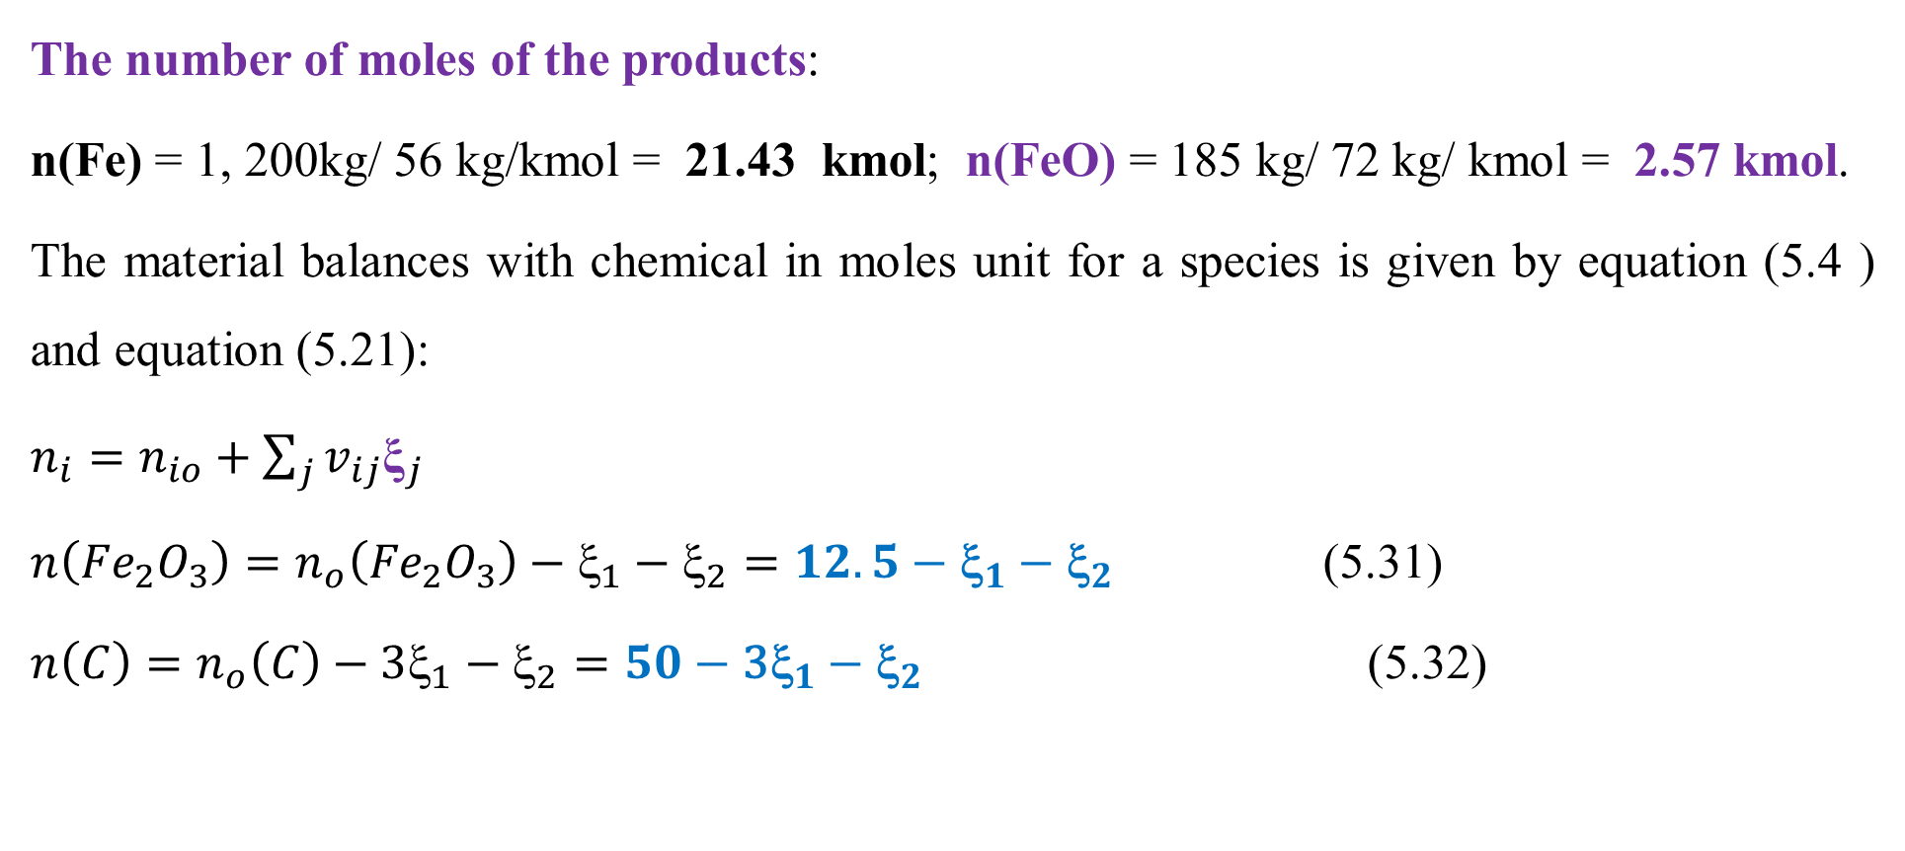
Cont’d
The number of moles of the products:
n(Fe) = 1, 200kg/ 56 kg/kmol = 21.43 kmol; n(FeO) = 185 kg/ 72 kg/ kmol = 2.57 kmol.
The material balances with chemical in moles unit for a species is given by equation (5.4 ) and equation (5.21):
$n_{i}=n_{io}+\sum_{j}{v_{ij}{\text{ξ}}_{j}}$
$n\left({Fe}_{2}O_{3}\right)=n_{o}\left({Fe}_{2}O_{3}\right)−{\text{ξ}}_{1}−{\text{ξ}}_{2}=12.5−{\text{ξ}}_{1}−{\text{ξ}}_{2}$ (5.31)
$n\left(C\right)=n_{o}\left(C\right)−{\text{3}\text{ξ}}_{1}−{\text{ξ}}_{2}=50−{\text{3}\text{ξ}}_{1}−{\text{ξ}}_{2}$ (5.32)
51

Slide 52
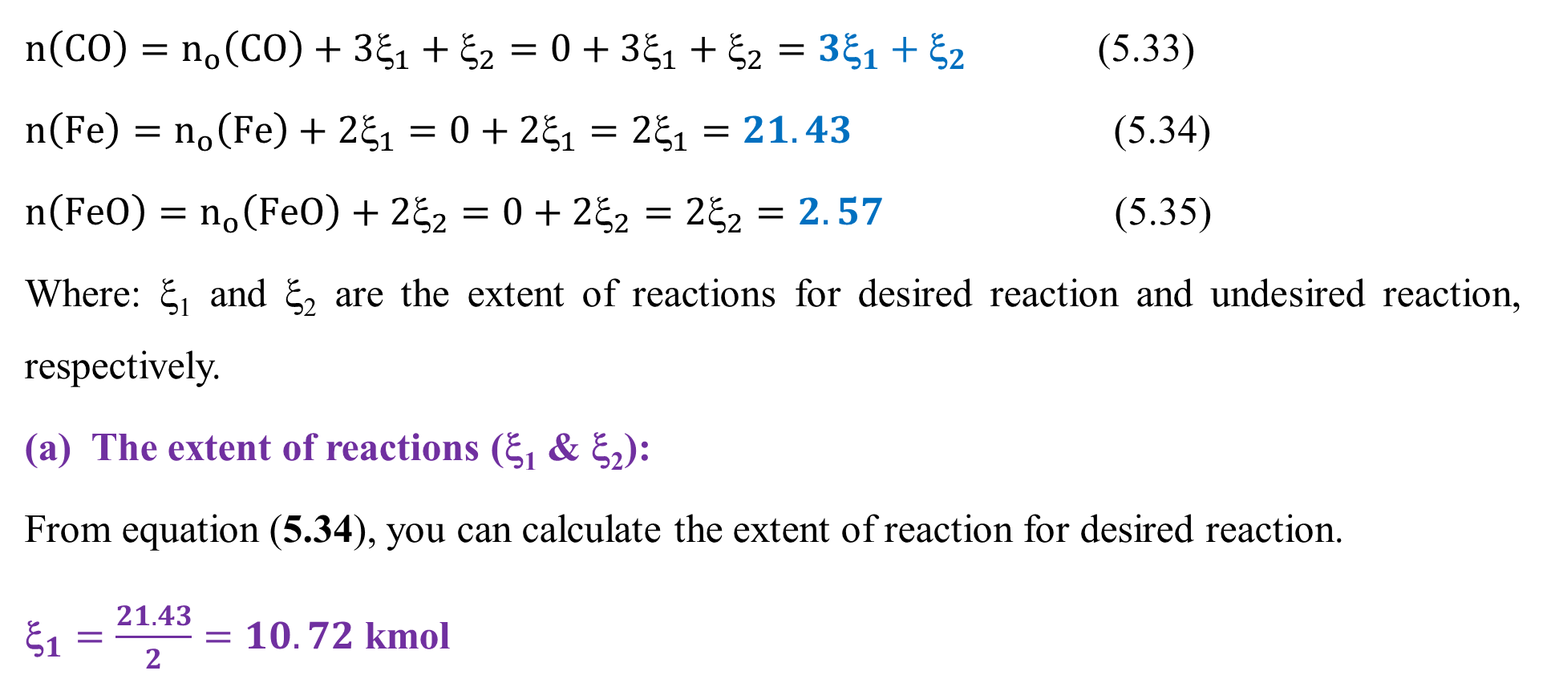
Cont’d
$n\left(CO\right)=n_{o}\left(CO\right)+3{\text{}}_{1}+{\text{}}_{2}=0+3{\text{}}_{1}+{\text{}}_{2}=3{\text{}}_{1}+{\text{}}_{2}$ (5.33)
$n\left(Fe\right)=n_{o}\left(Fe\right)+2{\text{ξ}}_{1}=0+2{\text{ξ}}_{1}=2{\text{ξ}}_{1}=21.43$ (5.34)
$n\left(FeO\right)=n_{o}\left(FeO\right)+2{\text{ξ}}_{2}=0+2{\text{ξ}}_{2}=2{\text{ξ}}_{2}=2.57$ (5.35)
Where: ξ₁ and ξ₂ are the extent of reactions for desired reaction and undesired reaction, respectively.
(a) The extent of reactions (ξ₁ & ξ₂):
From equation (5.34), you can calculate the extent of reaction for desired reaction.
${\text{}}_{1}=\frac{21.43}{2}=10.72$ kmol
52

Slide 53
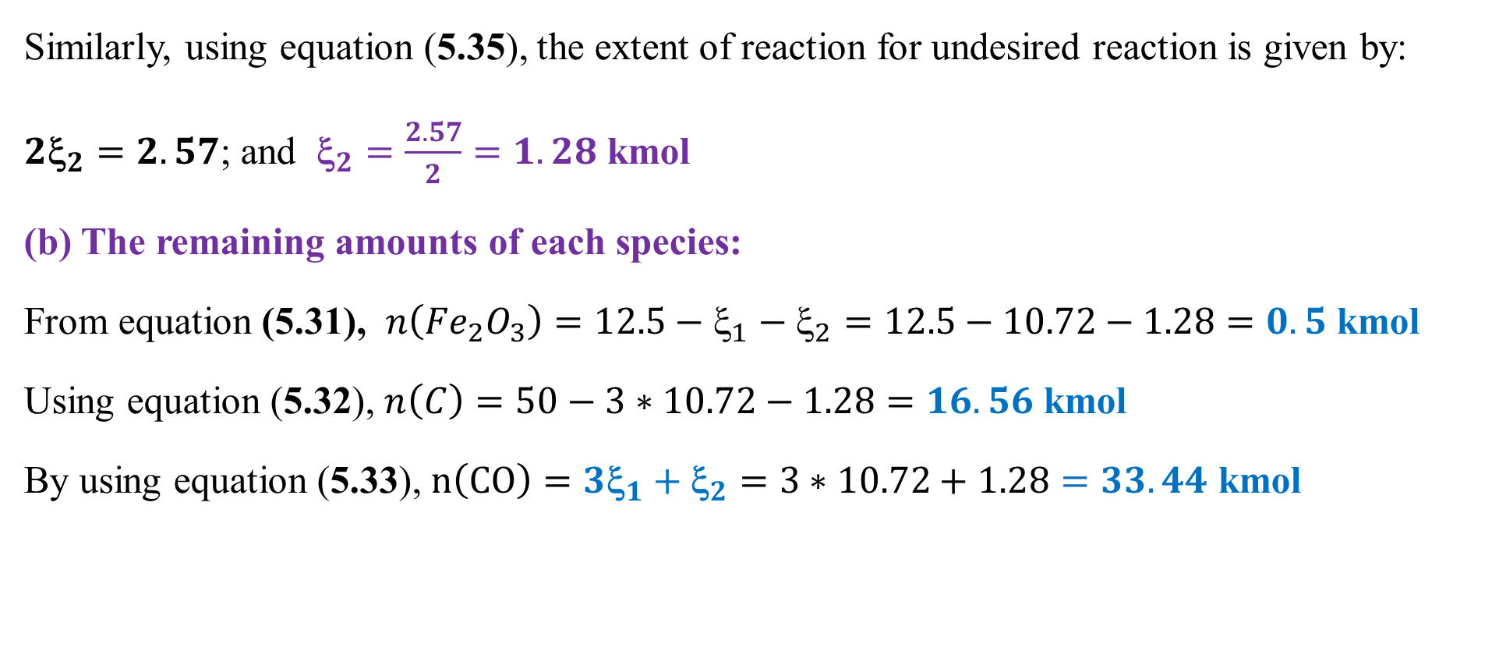
Cont’d
Similarly, using equation (5.35), the extent of reaction for undesired reaction is given by:
$2{\text{ξ}}_{2}=2.57$; and ${\text{}}_{2}=\frac{2.57}{2}=1.28$ kmol
(b) The remaining amounts of each species:
From equation (5.31), $n\left({Fe}_{2}O_{3}\right)=12.5−{\text{ξ}}_{1}−{\text{ξ}}_{2}=12.5−10.72−1.28=0.5$ kmol
Using equation (5.32), $n\left(C\right)=50−3∗10.72−1.28=16.56$ kmol
By using equation (5.33), $n\left(CO\right)=3{\text{ξ}}_{1}+{\text{ξ}}_{2}=3∗10.72+1.28=33.44$ kmol
53

Slide 54
Cont’d
The summary of material balances of the species in mole units is depicted in Figure 5.3
Furnace
n(Fe₂O₃) = 0.5 kmol
n(C) = 16.56 kmol
n(Fe) = 21. 43 kmol
n(FeO) = 2.57 kmol
n(CO) = 33.44 kmol
n_{o}(Fe₂O₃) = 12.5 kmol
n_{o}(C) = 50 kmol
Figure 5.3 Material balances of the species in mole units for Activity 5.2
54

Slide 55
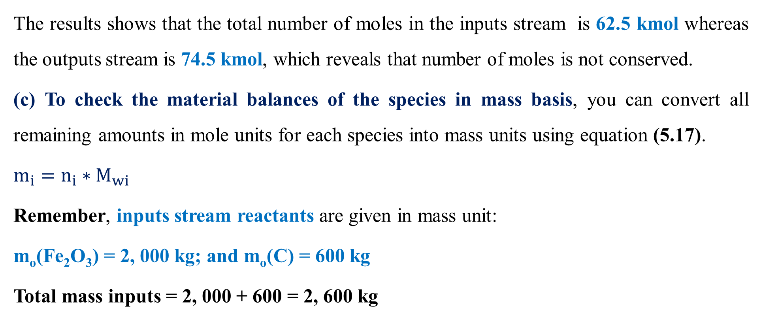
Cont’d
The results shows that the total number of moles in the inputs stream is 62.5 kmol whereas the outputs stream is 74.5 kmol, which reveals that number of moles is not conserved.
(c) To check the material balances of the species in mass basis, you can convert all remaining amounts in mole units for each species into mass units using equation (5.17).
${m_{i}=n}_{i}∗M_{wi}$
Remember, inputs stream reactants are given in mass unit:
m_{o}(Fe₂O₃) = 2, 000 kg; and m_{o}(C) = 600 kg
Total mass inputs = 2, 000 + 600 = 2, 600 kg
55

Slide 56
Cont’d
The outputs stream of the species in mass unit:
m(Fe) = 1, 200 kg
m(FeO) = 185 kg
m(Fe₂O₃) = n(Fe₂O₃)* M_{w}(Fe₂O₃) = 0.5 kmol*160 kg/kmol = 80 kg
m(C) = n(C)* M_{w}(C)= 16.56 kmol*12 kg/kmol = 198.7 kg
m(CO) = n(CO)* M_{w}(CO) = 33.44 kmol*28 kg/kmol = 936.3 kg
Total mass outputs =1, 200 + 185 + 80 +198.7 + 936.3 = 2, 600 kg
56

Slide 57
Cont’d
The summary of material balances of all the species in mass units is shown in Figure 5.4.
m(Fe₂O₃) = 80 kg
m(Fe) = 1, 200 kg
m(FeO) = 185 kg
m(C) = 198.7 kg
m(CO) = 936.3 kg
Total mass = 2, 600 kg
Furnace
m_{o}(Fe₂O₃) = 2, 000 kg
m(C) = 600 kg
Total mass = 2, 600 kg
Figure 5.4 Material balances of the species in mass units for Activity 5.2
57

Slide 58
5.5. Summary
Material balances (MBs) with chemical reaction accounts the rate of generation/consumption of species in mole unit at steady state condition.
To determine MBs with chemical reaction, chemical equations must be balanced.
The MBs with chemical reaction can be performed using overall material balance, components balance, extent of reaction and stochiometric coefficients.
The remaining amounts of species involve in chemical reactions can be determined based on the limiting reactant and the extent of reaction.
Conversion and yield measure the performance of a chemical reaction.
58

Slide 59
References
Basic Principles and Calculations in Chemical Engineering, Himmelblau, Pearson Education Inc, 9th edition, 2023.
Chemical Engineering Design, Volume 6, Coulson & Richardson’s, R. K. Sinnott, 3rd edition, 1999.
Elementary Principles of Chemical Processes, Richard M. Felder, John Wiley & Sons, 3rd edition, 2005.
Thank you!
59

