Slide 1
Basic Principles of Process Calculations in Chemical Engineering (ChEg2106)
Prerequisites: No prerequisite for this course
Lecture 6: Material Balances for Combustion Systems
Week 6
Lecturer: Adamu Esubalew (PhD, ChEg)
Addis Ababa, Ethiopia
1

Slide 2
Lecture 5 Discussion points: Revision
Lecture 5: Material balances with chemical reaction
Introduction to material balances (MBs) with chemical reaction
Problem-solving techniques for MBs with chemical reaction
Material balances with chemical reaction
Main points:
MBs with chemical reaction accounts rate of generation/consumption of species.
To determine MBs with chemical reaction, chemical equations must be balanced.
The remaining amounts of species can be determined by extent of reaction.

Slide 3
Lecture learning outcomes
At the end of the lecture, you will be able to:
explain the characteristics of combustion systems,
identify the extent of reaction, limiting and excess reactants for combustion reactions,
describe problem-solving techniques of material balances for combustion reactions, and
determine material balances for combustion reactions at steady state condition.
3

Slide 4
Presentation outlines
Introduction to combustion systems
Key terms for combustion systems
Problem-solving techniques of material balances for combustion systems
Material balances for combustion systems
Summary
4

Slide 5
6.1. Introduction to combustion systems
Combustion systems are the combustion of fuels with oxygen to generate electricity in utility power stations, and to operate engines.
A combustion reaction is a specific type of chemical reaction that involves the rapid oxidation of a fuel with oxygen resulting in release of energy in the form of heat and light.
The combustion reaction products are usually CO₂ and H₂O for complete combustion.
For incomplete combustion, combustion reaction can produce carbon monoxide (CO), dust, and other hydrocarbons.
Combustion reaction is generally used for energy production in engines, power plants, heating systems, and in various industrial processes.
5

Slide 6
Cont’d
Some typical examples of combustion systems are the combustion of coal and natural gas to generate electricity in utility power stations, and the combustion of gasoline or diesel fuel to operate engines.
Most of the fuels used in power plant combustion furnaces are:
coal (carbon, some hydrogen and sulfur, and various non-combustible materials),
fuel oil (mostly high molecular weight hydrocarbons, some sulfur),
gaseous fuel (such as natural gas which is primarily methane), or
liquefied petroleum gas which is usually propane and/or butane.
6

Slide 7
Cont’d
Combustion reaction can lead to significant environmental concerns due to emissions of greenhouse gas (CO₂), pollutants (NO_{x} and SO_{x}), and particulate matter.
Improving combustion efficiency is crucial for reducing fuel consumption and emissions.
Optimizing the air-to-fuel ratio is used to ensure complete combustion; and proper air supply is required to prevent accumulation of unburned fuels.
Combustion systems must be designed with safety in mind to prevent accidents such as explosions or fires.
7

Slide 8
Cont’d
Material balances (MBs) in a combustion process involves accounting for all the inputs and outputs of materials in a combustion reaction.
MBs ensures that the mass of the reactants equals the mass of the products.
The general material balances equation for combustion reaction is governed by law of conservation of mass.
To account the generation of products or consumption of reactants, the combustion reaction MBs calculation is performed in mole basis.
8

Slide 9
Cont’d
If the combustion system is the reaction of oxygen with fuels containing H₂, C, and S, it will generate product gases such as H₂O, CO₂, CO, and SO₂ associated with energy.
If the reactant has H₂, the product stream of the flue gas will have water vapor molecule.
If the reactant stream has C, N₂, and S, the product stream of the flue gases will have carbon oxides, nitrogen oxides and sulfur oxides, respectively.
The fuels constituents determine the types of product gases released to the environment.
The quantity of each gas released is determined using material balances.
9

Slide 10
Cont’d
Most combustion processes use air as the source of oxygen.
For air as a source of oxygen, you can assume that air contains 79% N₂ and 21% O₂, neglecting the other components that amount to a total of less than 1.0%, and that air has an average molecular weight of 29 g/mol.
Although a small amount of N₂ oxidizes to NO and NO₂, gases called NO_{x}, a pollutant, the amount is so small that we treat N₂ as a non-reacting component of air and fuel.
Figure 6.1 shows how the CO (unburned hydrocarbons), and NO_{x} vary with the air-fuel ratio in combustion.
10

Slide 11
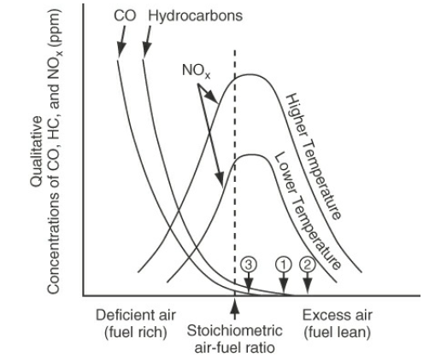
Cont’d
Figure 6.1 shows how the CO and NO_{x} vary with the air-fuel ratio in combustion of natural gas (Himmelblau, 2023, pg. 237).
Figure 6.1 CO and NO_{x} vary with the air-fuel ratio in combustion
11

Slide 12
Cont’d
As shown in Figure 6.1, the pollutants (CO & NO_{x}) resulting from combustion of natural gas vary with the air-fuel ratio and the temperature of combustion.
The amounts of hydrocarbons and CO increases with deficient air.
Efficiency goes down with too much excess air, but so does the NOx.
In Figure 6.1, (1) represents the optimal air-fuel ratio (no CO or unburned hydrocarbons), (2) represents inefficient combustion (excess air has to be heated), and (3) represents unsatisfactory combustion (because not all of the fuel is burned and the unburned products are released to the atmosphere).
12

Slide 13
6.2. Key terms for combustion systems
There are various key terms for combustion systems.
Some of the special terms associated with combustion systems are described in the following paragraphs:
Flue or stack gases: All of the gases resulting from a combustion process, including the water vapor, sometimes known as a wet basis.
Orsat analysis or dry basis: All of the gases resulting from a combustion process, excluding the water vapor.
13

Slide 14
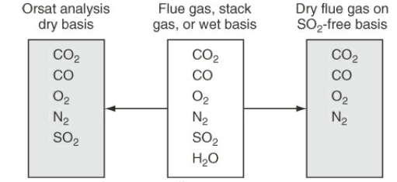
Cont’d
The gases analysis resulting from combustion systems on different bases is shown in Figure 6.2 (Himmelblau, 2023, pg. 237).
Figure 6.2. Comparison of gas analysis on different bases
14

Slide 15
Cont’d
Complete combustion: The complete reaction of the fuel producing CO₂ and H₂O.
Partial combustion: The combustion of the fuel producing at least some CO from the carbon source, the production of CO in a combustion process does not produce as much energy.
Theoretical air (or theoretical oxygen): The amount of air (or oxygen) required to be brought into the process for complete combustion. Sometimes this quantity is called the required air (or oxygen).
15

Slide 16
Cont’d
Limiting reactant: The limiting reactant is the substance that is completely consumed first in the combustion systems.
In a combustion reaction, if one of the reactants (a fuel or hydrocarbons) is present in a limited quantity compared to the other reactant (oxygen), the amount of combustion products (CO₂ and H₂O) will be limited by the amount of the limiting reactant.
This means that if you have excess oxygen but limited fuel, not all of the oxygen will be used up during combustion reaction.
16

Slide 17
Cont’d
Excess air (or excess oxygen): It is the amount of air (or oxygen) in excess of the theoretical air required for complete combustion.
The calculated amount of excess air does not depend on how much material is actually burned but what could be burned if complete reaction of the material occurred.
Even if only partial combustion takes place, C burning to both CO and CO₂, the excess air (or oxygen) is computed as if the process of combustion produced only CO₂.
17

Slide 18
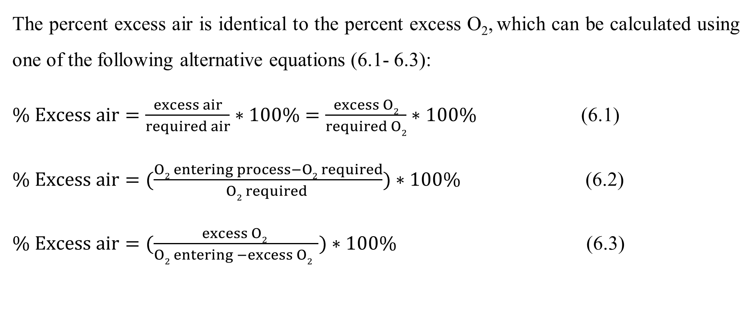
Cont’d
The percent excess air is identical to the percent excess O₂, which can be calculated using one of the following alternative equations (6.1- 6.3):
$\% Excess air=\frac{excess air}{required air}∗100\%=\frac{excess O2}{required O2}∗100\%$ (6.1)
$\% Excess air=(\frac{O2 entering process−O2 required}{O2 required })∗100\%$ (6.2)
$\% Excess air=(\frac{excess O2 }{O2 entering −excess O2 })∗100\%$ (6.3)
18

Slide 19
Cont’d
If the percent excess air is specified and the reaction equation for the combustion process is known; you can calculate how much air enters with the fuel.
The specification of the amount of excess air can be used to assign a value to one of the variables like other specifications in a combustion system.
In calculating the amount of excess air, remember that the excess is the amount of air that enters the combustion process over and above that required for complete combustion.
The excess air is determined relative to the required oxygen in the reaction balanced equation for complete combustion.
19

Slide 20
Cont’d
Extent of reaction: The extent of reaction (ξ) refers to how far the reaction proceeds towards completion of combustion reaction.
It is used to determine the degree a reaction proceeds towards complete combustion.
It is described in terms of the change in the number of moles of reactants and products.
The extent of reaction can determine whether you achieve complete combustion (where all fuel is converted to CO₂ and H₂O) or incomplete combustion (which can produce carbon monoxide, or other by-products).
20

Slide 21
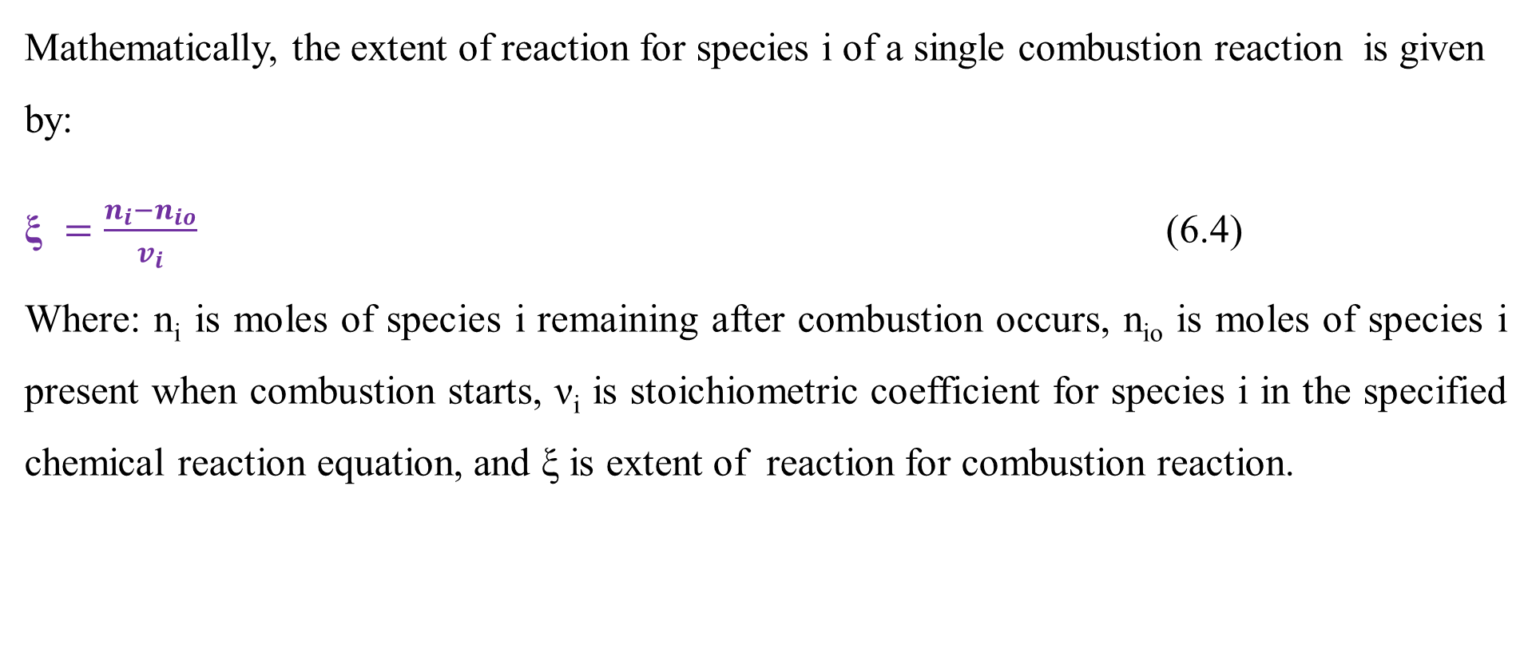
Cont’d
Mathematically, the extent of reaction for species i of a single combustion reaction is given by:
$\text{ξ} =\frac{n_{i}−n_{io}}{v_{i}}$ (6.4)
Where: n_{i} is moles of species i remaining after combustion occurs, n_{io} is moles of species i present when combustion starts, ν_{i} is stoichiometric coefficient for species i in the specified chemical reaction equation, and ξ is extent of reaction for combustion reaction.
21

Slide 22
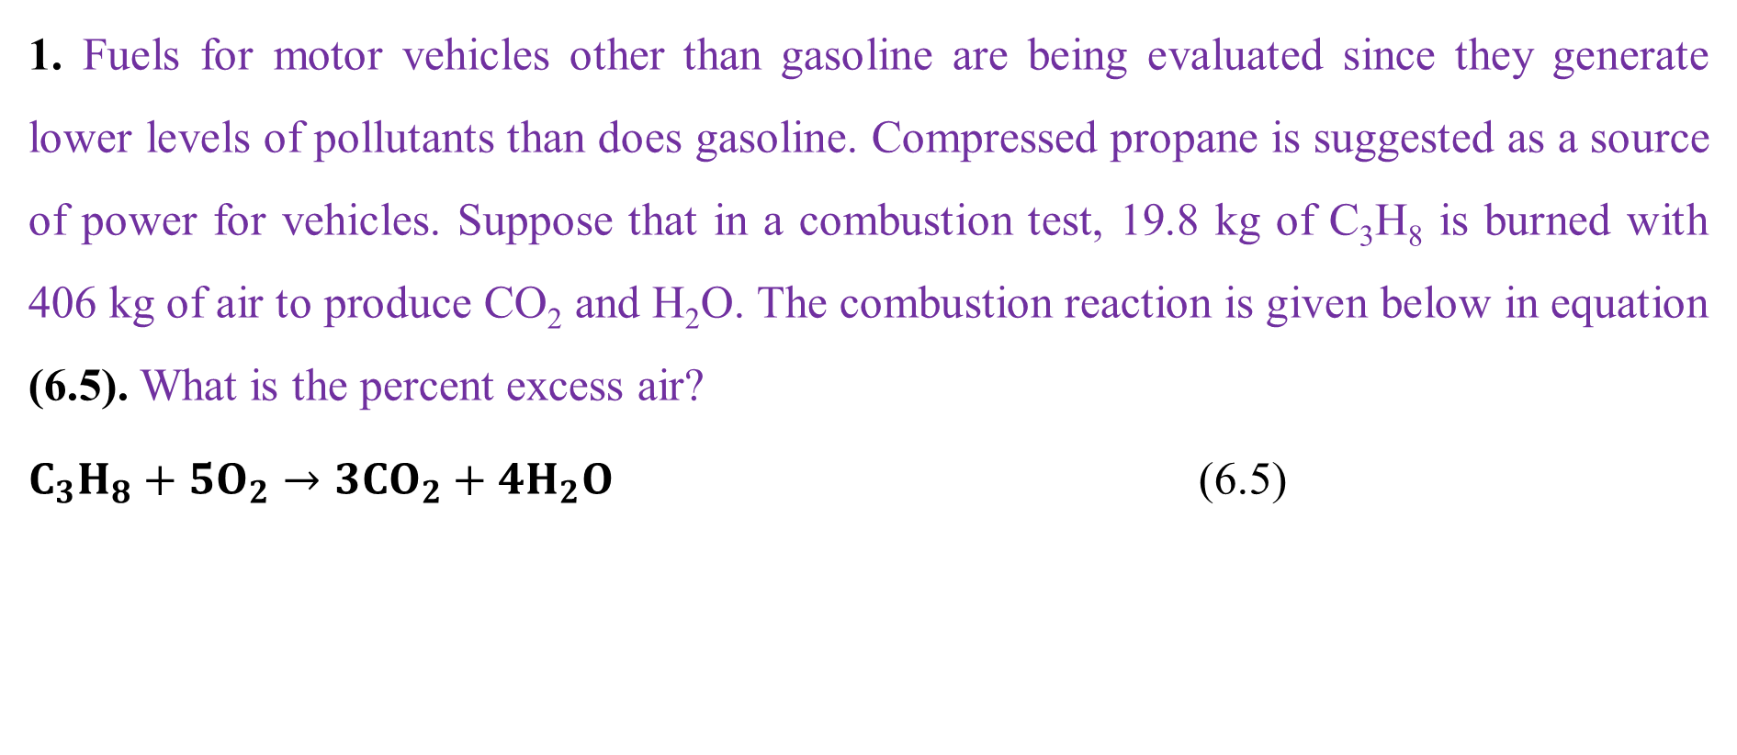
Activity 6.1
1. Fuels for motor vehicles other than gasoline are being evaluated since they generate lower levels of pollutants than does gasoline. Compressed propane is suggested as a source of power for vehicles. Suppose that in a combustion test, 19.8 kg of C₃H₈ is burned with 406 kg of air to produce CO₂ and H₂O. The combustion reaction is given below in equation (6.5). What is the percent excess air?
$C_{3}H_{8}+5O_{2}→3{CO}_{2}+4H_{2}O$ (6.5)
22

Slide 23
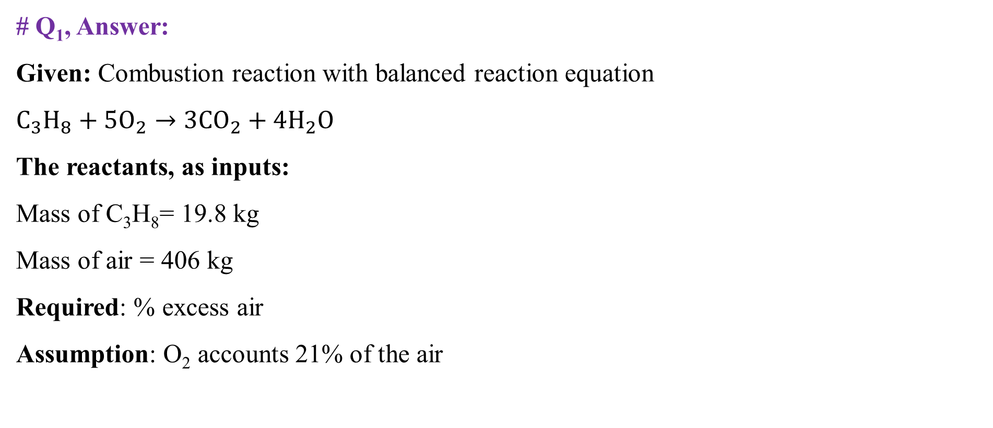
Cont’d
# Q₁, Answer:
Given: Combustion reaction with balanced reaction equation
$C_{3}H_{8}+5O_{2}→3{CO}_{2}+4H_{2}O$
The reactants, as inputs:
Mass of C₃H₈= 19.8 kg
Mass of air = 406 kg
Required: % excess air
Assumption: O₂ accounts 21% of the air
23

Slide 24
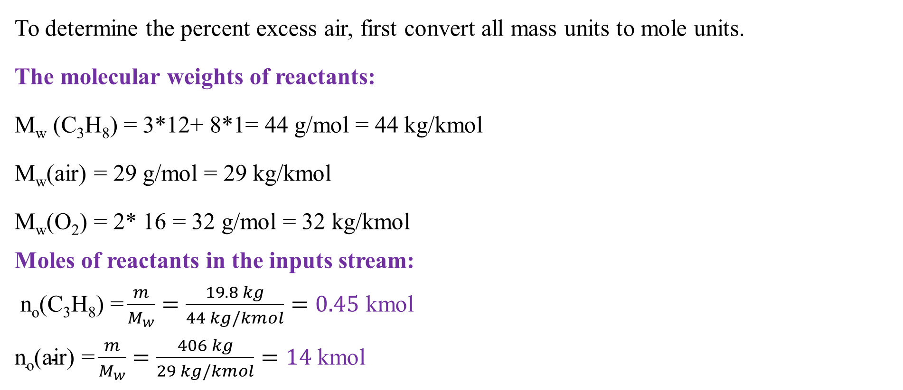
Cont’d
To determine the percent excess air, first convert all mass units to mole units.
The molecular weights of reactants:
M_{w} (C₃H₈) = 3*12+ 8*1= 44 g/mol = 44 kg/kmol
M_{w}(air) = 29 g/mol = 29 kg/kmol
M_{w}(O₂) = 2* 16 = 32 g/mol = 32 kg/kmol
Moles of reactants in the inputs stream:
$\text{n}\text{o}\text{(}\text{C}\text{3}\text{H}\text{8}\text{)}\text{ =}\frac{m}{M_{w}}=\frac{19.8 kg}{44 kg/kmol}=0.45$ kmol
$\text{n}\text{o}\text{(}\text{air}\text{) =}\frac{m}{M_{w}}=\frac{406 kg}{29 kg/kmol}=14$ kmol
24

Slide 25
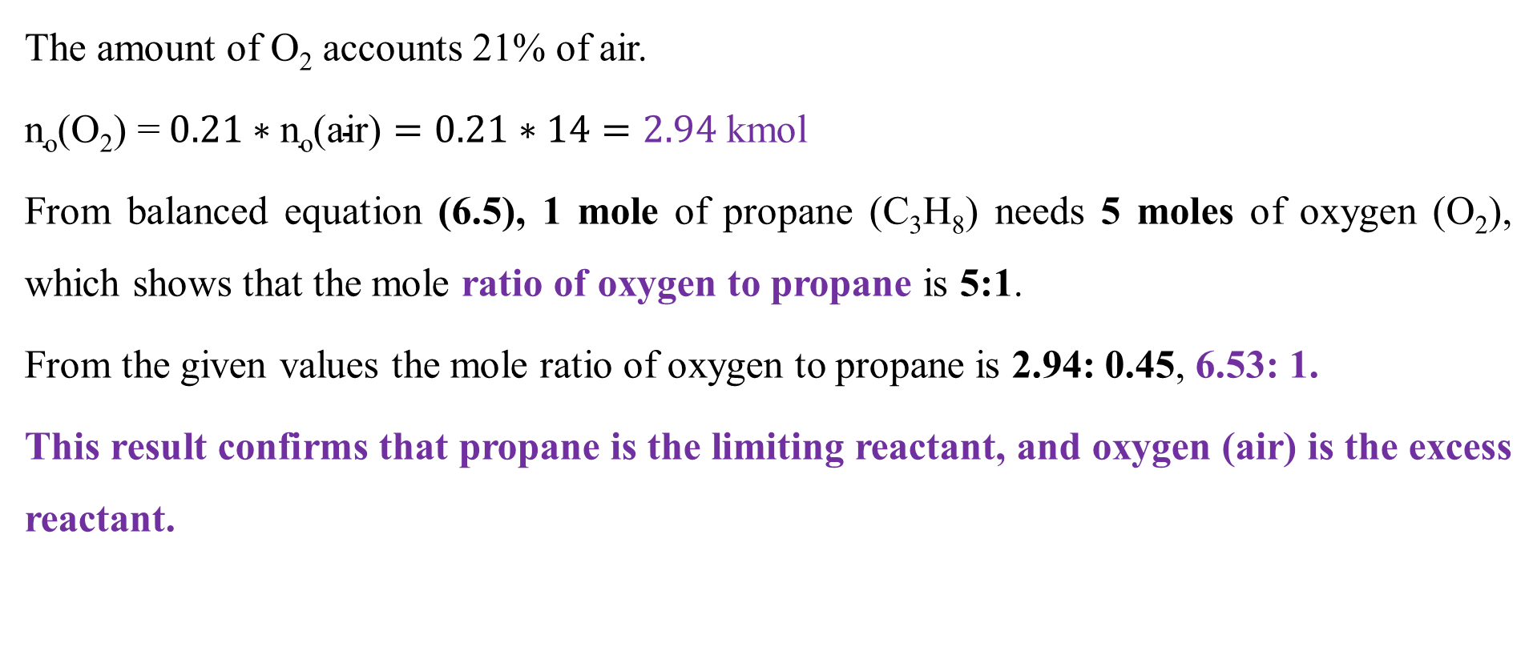
Cont’d
The amount of O₂ accounts 21% of air.
$\text{n}\text{o}\text{(}\text{O}\text{2}\text{) =} 0.21∗\text{n}\text{o}\text{(}\text{air}\text{)}=0.21∗14=2.94$ kmol
From balanced equation (6.5), 1 mole of propane (C₃H₈) needs 5 moles of oxygen (O₂), which shows that the mole ratio of oxygen to propane is 5:1.
From the given values the mole ratio of oxygen to propane is 2.94: 0.45, 6.53: 1.
This result confirms that propane is the limiting reactant, and oxygen (air) is the excess reactant.
25

Slide 26
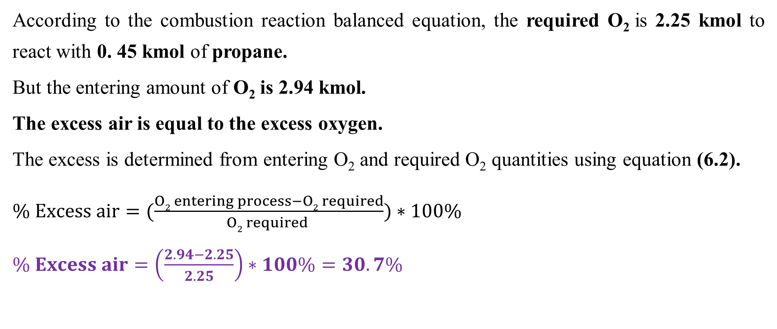
Cont’d
According to the combustion reaction balanced equation, the required O₂ is 2.25 kmol to react with 0. 45 kmol of propane.
But the entering amount of O₂ is 2.94 kmol.
The excess air is equal to the excess oxygen.
The excess is determined from entering O₂ and required O₂ quantities using equation (6.2).
$\% Excess air=(\frac{O2 entering process−O2 required}{O2 required })∗100\%$
$\% Excess air=\left(\frac{2.94−2.25}{2.25}\right)∗100\%=30.7\%$
26

Slide 27
6.3. Problem-solving techniques of MBs for combustion systems
Explaining material balances problems in combustion systems involves systematic techniques to account for all inputs and outputs of materials.
To perform material balances for combustion systems requires various steps.
The steps of material balance calculations of combustion systems depends on the reactant fuels type and quality of fuels.
Different combustion systems will have some specific steps for material balance calculations.
27

Slide 28
Cont’d
The general steps for material balances for combustion process are described in the following paragraphs (Coulson & Richardson’s, 1999, pg. 56-57; Richard M. Felder, 2005, pg. 146-149):
Step 1: understand the process and identify the combustion reaction
It is required to identify the fuel being combusted. E.g. natural gas, gasoline or coal.
It is needed to identify the oxidizer, which is oxygen from air or pure oxygen.
It is also mandatory to identify combustion type either complete combustion or incomplete combustion.
28

Slide 29
Cont’d
The combustion reactions usually involve a fuel (hydrocarbons) and an oxidizer (oxygen).
The general form of a combustion reaction of fuel with oxygen can be represented as:
Fuel + O₂ → CO₂ + H₂O + other products (6.6)
Depending on the fuel type and quality, the constituents of other products will vary for different combustion systems.
For material balances calculations, it is important to understand the combustion systems and identify the reactants and possible products.
29

Slide 30
Cont’d
Step 2: Write the balanced equation of the combustion reaction
It is required to balance the chemical equation based on the stoichiometry of the reactants and products.
For example, for complete combustion of methane (CH₄), combustion of methane with oxygen, the balanced chemical equation is given by:
CH₄ + 2O₂ → CO₂ + 2H₂O (6.7)
30

Slide 31
Cont’d
Step 3: Identify input and output streams
It is required to identify all input streams (reactants) and output streams (products).
For example, the combustion reaction of methane with oxygen produces carbon dioxide and water vapor, which shows that methane and oxygen are input streams, and the output streams are carbon dioxide, water vapor, and possibly unburned fuel, and other byproducts (NOₓ, SOₓ).
Step 4: Draw process flow diagram
Draw a process flow diagram, and write all the inputs and output streams.
31

Slide 32
Cont’d
Step 5: Check numbers of degree of freedom
Identify the number unknowns and number of independent equations to check the numbers of degree of freedom must be zero.
Step 6: Check units’ consistency
It is required to ensure units consistency by performing units’ conversion if there are different units in the given values of the problem.
For example, the units of mass basis can be converted to moles using molecular weights; and use stoichiometric coefficients from the balanced equation to relate moles of reactants to moles of products.
32

Slide 33
Cont’d
Step 7: Write the appropriate material balance equation
It is required to apply the appropriate material balance equation for both overall balance and each component balances.
For example, in mole basis of combustion reaction, the material balances calculation is performed based on the limiting reactant.
From combustion systems (reaction of oxygen with fuels), products of different oxides can be generated and reactants can be consumed, which are included in the material balances calculation.
33

Slide 34
Cont’d
Step 8: Write the materials balance by considering excess air
In practical applications of combustion reaction, air is often supplied in excess to ensure complete combustion.
This affects the amount of O₂ available and sometimes it can lead to unreacted fuel or incomplete combustion products like carbon monoxide (CO).
Step 9: Perform material balance calculations for combustion reaction
It is required to calculate the inputs or outputs of the combustion reaction using material balances calculations.
34

Slide 35
Cont’d
Step 10: Calculate efficiency and analyze emissions quantities
Based on the material balances calculations, it is also possible to calculate combustion efficiency and analyze the quantities of emissions to the environment.
Hence, using the above-described steps, you can conduct a comprehensive material balance for any combustion systems, ensuring that all reactants and products are accounted for correctly for analysis.
35

Slide 36
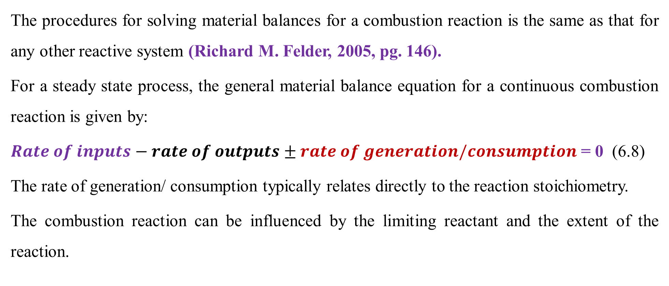
6.4. Material balances for combustion systems
The procedures for solving material balances for a combustion reaction is the same as that for any other reactive system (Richard M. Felder, 2005, pg. 146).
For a steady state process, the general material balance equation for a continuous combustion reaction is given by:
$Rate of inputs−rate of outputs±rate of generation/consumption$ = 0 (6.8)
The rate of generation/ consumption typically relates directly to the reaction stoichiometry.
The combustion reaction can be influenced by the limiting reactant and the extent of the reaction.
36

Slide 37
Cont’d
Consider a combustion system with a continuous flow of materials which enter to the furnace and leave from the furnace as shown in Figure 6.3.
Furnace
F_{io}
F_{i}
Figure 6.3. A combustion system with a continuous flow of materials
37

Slide 38
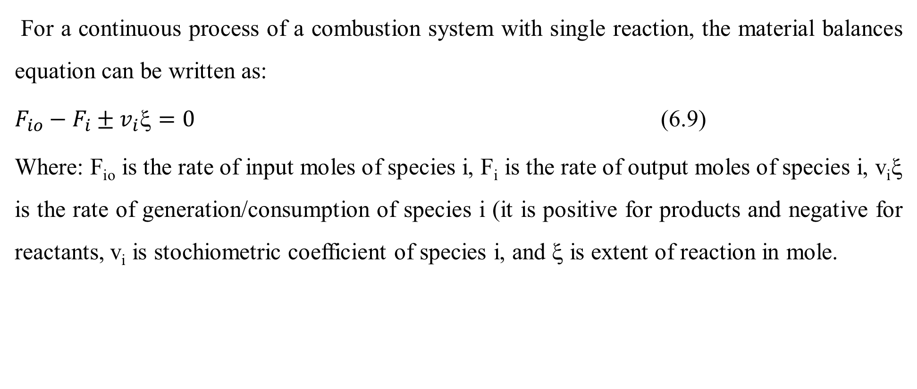
Cont’d
For a continuous process of a combustion system with single reaction, the material balances equation can be written as:
$F_{io}−F_{i}±v_{i}=0$ (6.9)
Where: F_{io} is the rate of input moles of species i, F_{i} is the rate of output moles of species i, v_{i}ξ is the rate of generation/consumption of species i (it is positive for products and negative for reactants, v_{i} is stochiometric coefficient of species i, and ξ is extent of reaction in mole.
38

Slide 39
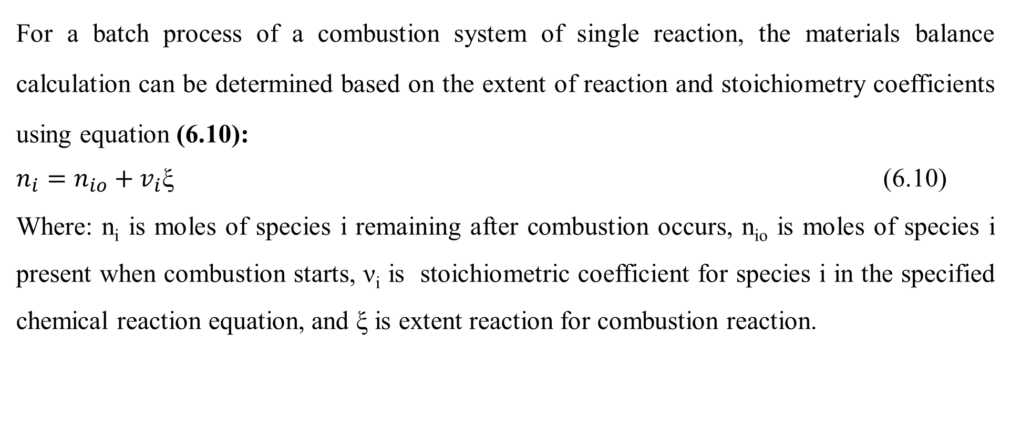
Cont’d
For a batch process of a combustion system of single reaction, the materials balance calculation can be determined based on the extent of reaction and stoichiometry coefficients using equation (6.10):
$n_{i}=n_{io}+v_{i}\text{ξ}$ (6.10)
Where: n_{i} is moles of species i remaining after combustion occurs, n_{io} is moles of species i present when combustion starts, ν_{i} is stoichiometric coefficient for species i in the specified chemical reaction equation, and ξ is extent reaction for combustion reaction.
39

Slide 40
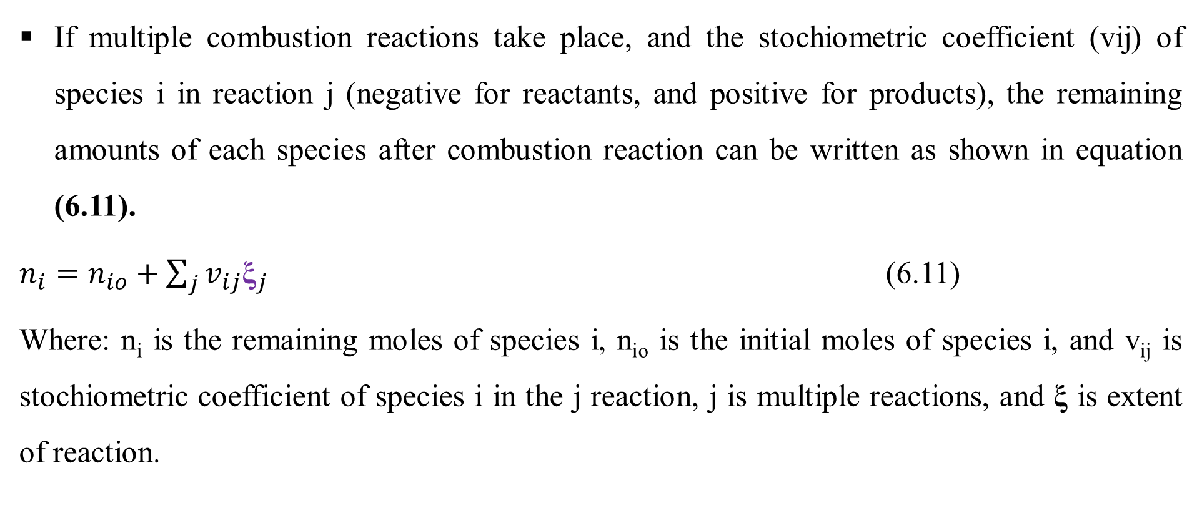
Cont’d
If multiple combustion reactions take place, and the stochiometric coefficient (vij) of species i in reaction j (negative for reactants, and positive for products), the remaining amounts of each species after combustion reaction can be written as shown in equation (6.11).
$n_{i}=n_{io}+\sum_{j}{v_{ij}{\text{ξ}}_{j}}$ (6.11)
Where: n_{i} is the remaining moles of species i, n_{io} is the initial moles of species i, and v_{ij} is stochiometric coefficient of species i in the j reaction, j is multiple reactions, and $\text{ξ}$ is extent of reaction.
40

Slide 41
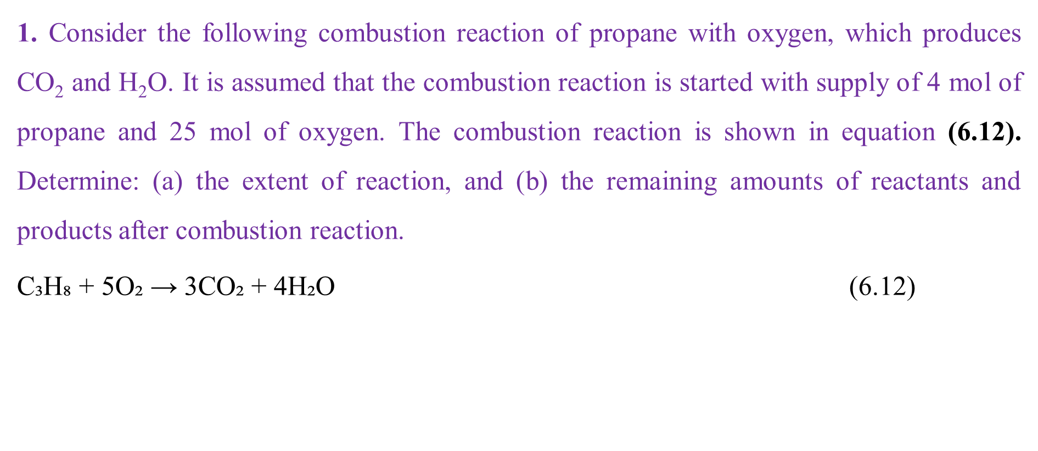
Activity 6.2
1. Consider the following combustion reaction of propane with oxygen, which produces CO₂ and H₂O. It is assumed that the combustion reaction is started with supply of 4 mol of propane and 25 mol of oxygen. The combustion reaction is shown in equation (6.12). Determine: (a) the extent of reaction, and (b) the remaining amounts of reactants and products after combustion reaction.
$\text{C}\text{₃}\text{H}\text{₈ + 5}\text{O}\text{₂ → 3}\text{CO}\text{₂ + 4}\text{H}\text{₂}\text{O}$ (6.12)
41

Slide 42
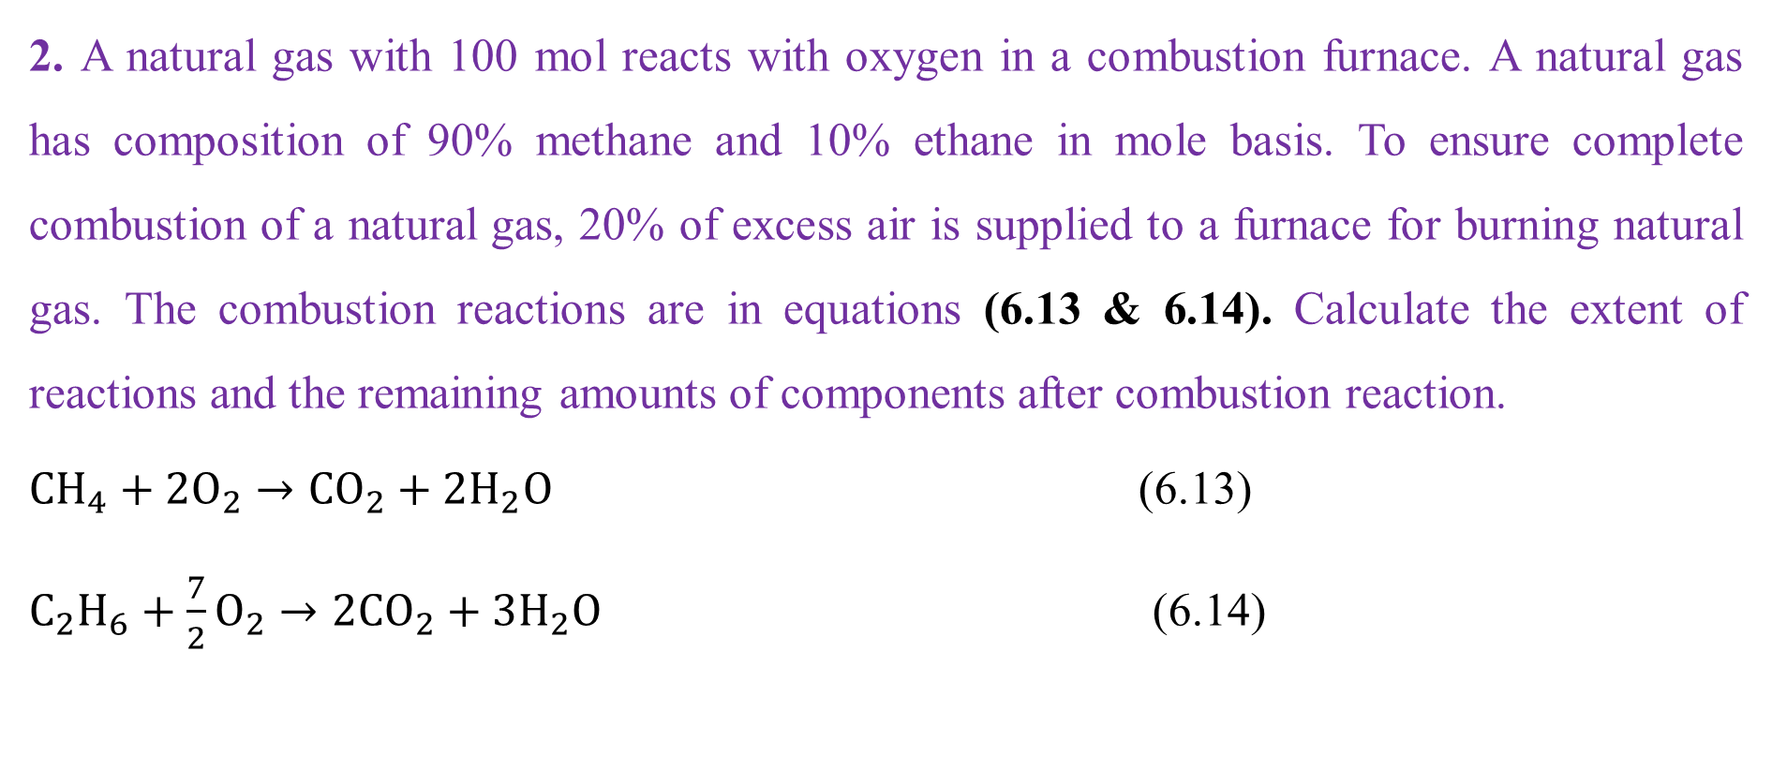
Cont’d
2. A natural gas with 100 mol reacts with oxygen in a combustion furnace. A natural gas has composition of 90% methane and 10% ethane in mole basis. To ensure complete combustion of a natural gas, 20% of excess air is supplied to a furnace for burning natural gas. The combustion reactions are in equations (6.13 & 6.14). Calculate the extent of reactions and the remaining amounts of components after combustion reaction.
$CH_{4}+2O_{2}→CO_{2}+2H_{2}O$ (6.13)
$C_{2}H_{6}+\frac{7}{2}O_{2}→2CO_{2}+3H_{2}O$ (6.14)
42

Slide 43
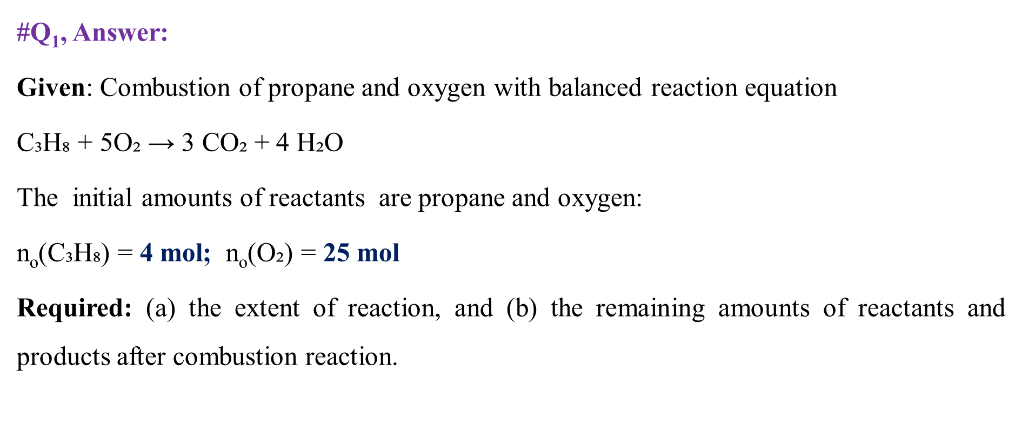
Cont’d
#Q₁, Answer:
Given: Combustion of propane and oxygen with balanced reaction equation
$\text{C}\text{₃}\text{H}\text{₈ + 5}\text{O}\text{₂ → 3 }\text{CO}\text{₂ + 4 }\text{H}\text{₂}\text{O}$
The initial amounts of reactants are propane and oxygen:
n_{o}(C₃H₈) = 4 mol; n_{o}(O₂) = 25 mol
Required: (a) the extent of reaction, and (b) the remaining amounts of reactants and products after combustion reaction.
43

Slide 44
Cont’d
Assumption: The limiting reactant is completely consumed during a combustion reaction.
From combustion reaction balanced equation (6.12), 1 mol of propane needs 5 mol of oxygen, which indicates the moles ratio of oxygen to propane is 5:1.
From the given values the moles ratio of oxygen to propane is 6.25: 1.
This shows that propane is the limiting reactant and oxygen is the excess reactant.
Thus, it is assumed that propane is completely consumed during combustion reaction.
44

Slide 45
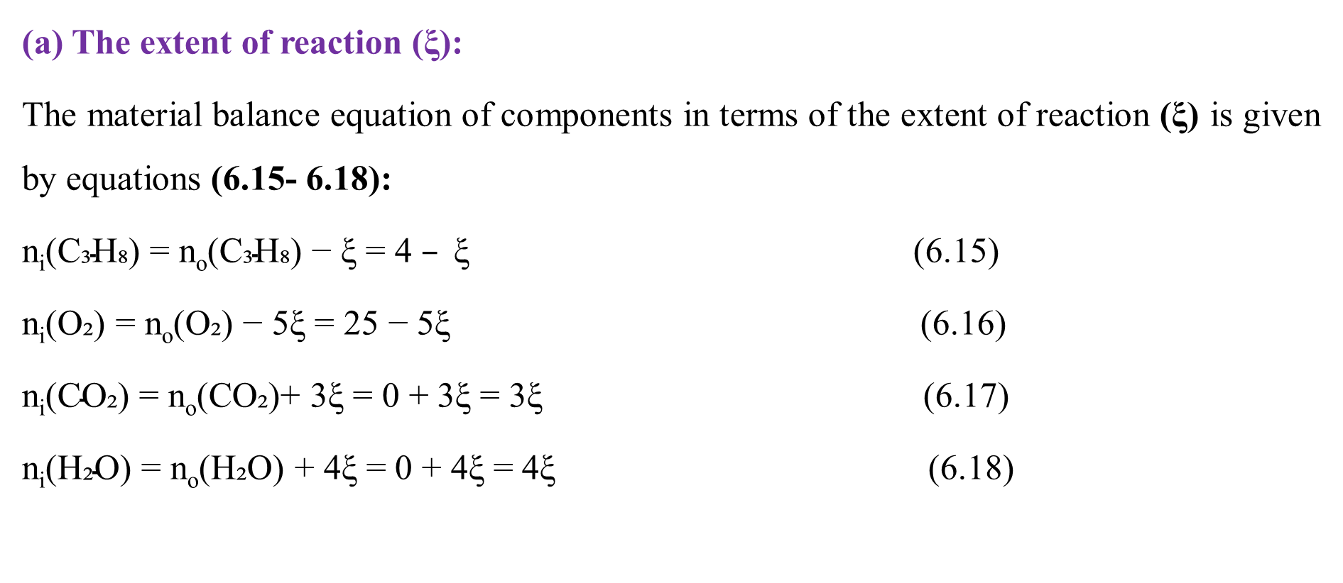
Cont’d
(a) The extent of reaction (ξ):
The material balance equation of components in terms of the extent of reaction (ξ) is given by equations (6.15- 6.18):
$\text{n}\text{i}\text{(}\text{C}\text{₃}\text{H}\text{₈) = }\text{no}\text{(}\text{C}\text{₃}\text{H}\text{₈) − }\text{ξ}\text{ = 4 }– \text{ξ}$ (6.15)
$\text{n}\text{i}\text{(}\text{O}\text{₂) = }\text{no}\text{(}\text{O}\text{₂) − 5}\text{ξ}\text{ = 25 − 5}\text{ξ}$ (6.16)
$\text{n}\text{i}\text{(}\text{CO}\text{₂) = }\text{no}\text{(}\text{CO}\text{₂)+ 3}\text{ξ}\text{ = 0 + 3}\text{ξ}\text{ = 3}\text{ξ}$ (6.17)
$\text{n}\text{i}\text{(}\text{H}\text{₂}\text{O}\text{) = }\text{no}\text{(}\text{H}\text{₂}\text{O}\text{) + 4}\text{ξ}\text{ = 0 + 4}\text{ξ}\text{ = 4}\text{ξ}$ (6.18)
45

Slide 46
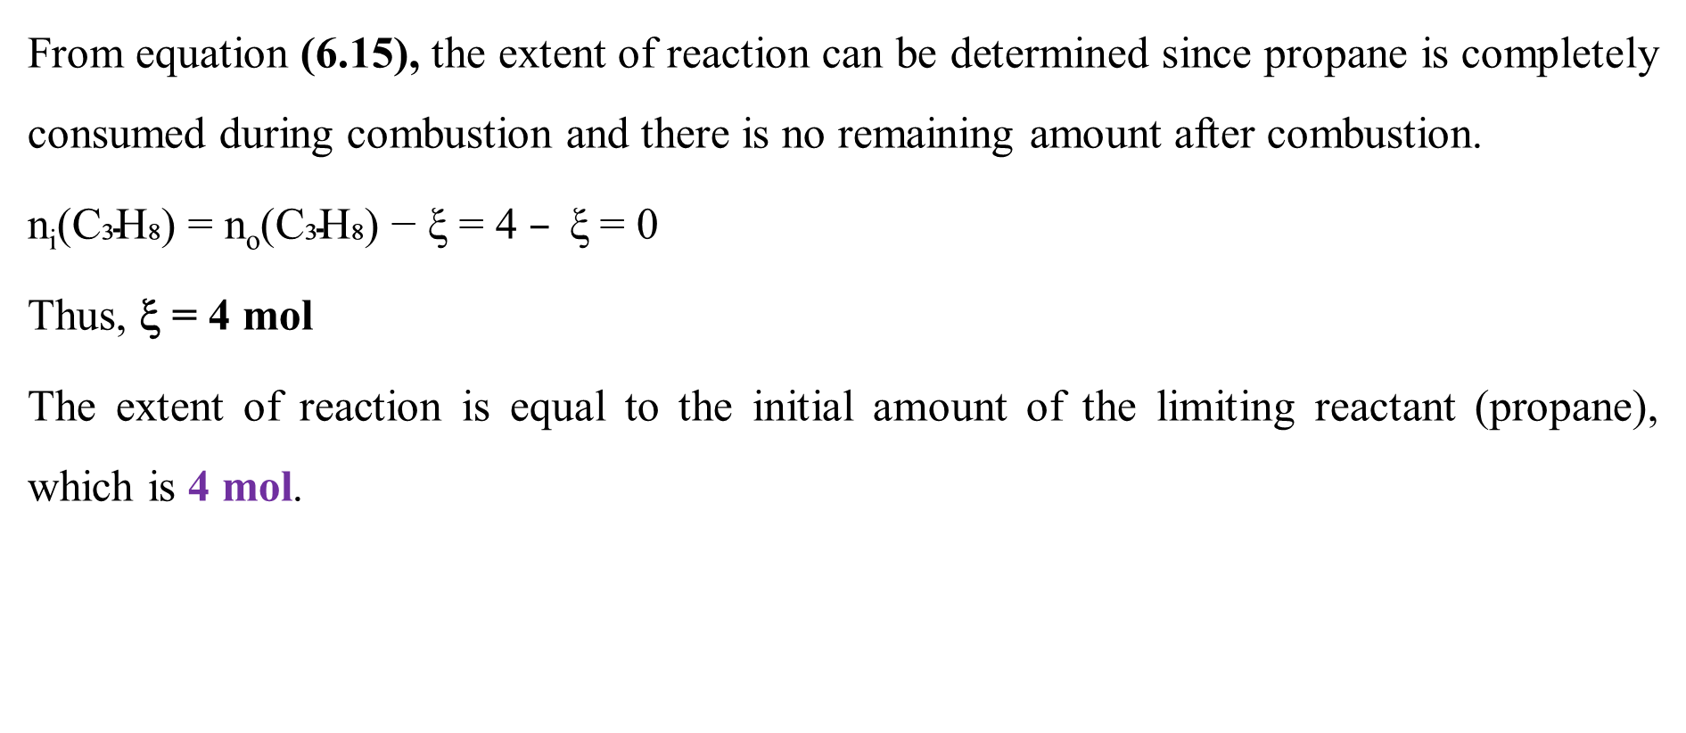
Cont’d
From equation (6.15), the extent of reaction can be determined since propane is completely consumed during combustion and there is no remaining amount after combustion.
$\text{n}\text{i}\text{(}\text{C}\text{₃}\text{H}\text{₈) = }\text{no}\text{(}\text{C}\text{₃}\text{H}\text{₈) − }\text{ξ}\text{ = 4 }– \text{ξ}$ = 0
Thus, ξ = 4 mol
The extent of reaction is equal to the initial amount of the limiting reactant (propane), which is 4 mol.
46

Slide 47
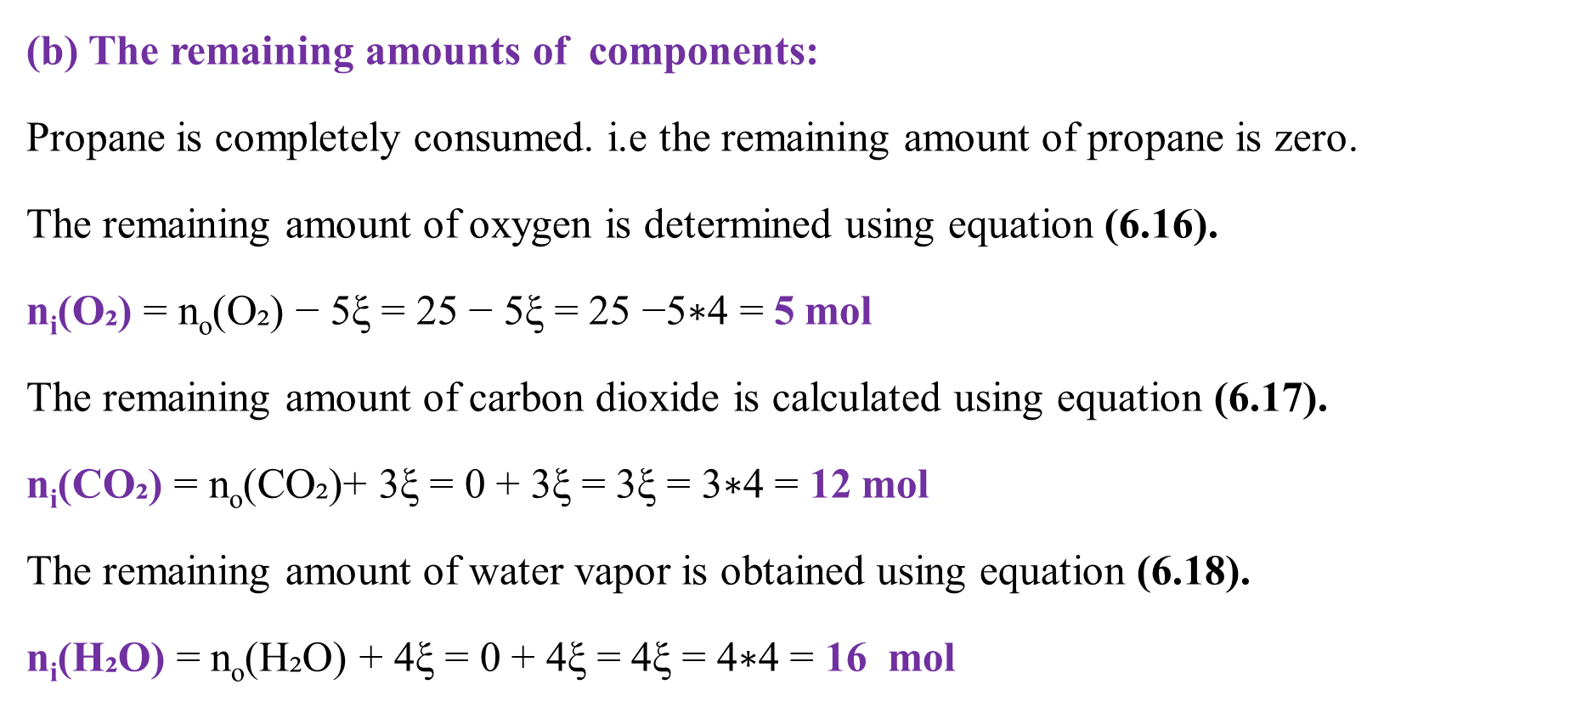
Cont’d
(b) The remaining amounts of components:
Propane is completely consumed. i.e the remaining amount of propane is zero.
The remaining amount of oxygen is determined using equation (6.16).
$\text{n}\text{i}\text{(}\text{O}\text{₂) }\text{= }\text{no}\text{(}\text{O}\text{₂) − 5}\text{ξ}\text{ = 25 − 5}\text{ξ}\text{ = 25 −5∗4 = }\text{5}$ mol
The remaining amount of carbon dioxide is calculated using equation (6.17).
$\text{n}\text{i}\text{(}\text{CO}\text{₂) }\text{= }\text{no}\text{(}\text{CO}\text{₂)+ 3}\text{ξ}\text{ = 0 + 3}\text{ξ}\text{ = 3}\text{ξ}\text{ = 3∗4 = }\text{12}$ mol
The remaining amount of water vapor is obtained using equation (6.18).
$\text{n}\text{i}\text{(}\text{H}\text{₂}\text{O}\text{) }\text{= }\text{no}\text{(}\text{H}\text{₂}\text{O}\text{) + 4}\text{ξ}\text{ = 0 + 4}\text{ξ}\text{ = 4}\text{ξ}\text{ = 4∗4 = }\text{16 }$ mol
47

Slide 48
Cont’d
The total number of moles in the inputs stream (reactants) is 29 mol whereas the total number of moles in the outputs stream (products and unconverted reactant) is 33 mol.
This result reveals that the number of moles is not conserved for combustion reaction.
In mass basis, the total mass in the inputs stream (reactants) is equal the total mass in the outputs stream (products & unconverted reactant).
Mass of inputs stream (reactants):
m_{o}(C₃H₈) = 4 mol *44 g/mol = 176 g
m_{o}(O₂) = 25 mol* 32 g/mol = 800 g
48

Slide 49
Cont’d
Total mass in the inputs stream = 176 + 800 = 976 g
Mass of outputs stream ( products & unconverted reactant):
m(CO₂) = 12 mol *44 g/mol = 528 g
m(H₂O) = 16 mol *18 g/mol = 288 g
m(O₂) = 5 mol* 32 g/mol = 160 g
Total mass in the outputs stream = 976 g
The results confirm that mass is conserved for combustion reaction.
49

Slide 50
Cont’d
#Q₂, Answer:
Given: Combustion of natural gas and oxygen with balanced reaction equations
The reactants entering to a furnace as inputs:
Natural gas = methane + ethane
Natural gas = 100 mol
Methane = 90 % of natural gas = 0.9* 100 = 90 mol
Ethane = 10 % of natural gas = 0.1*100 = 10 mol
20% of excess air is supplied to a furnace for burning natural gas.
50

Slide 51
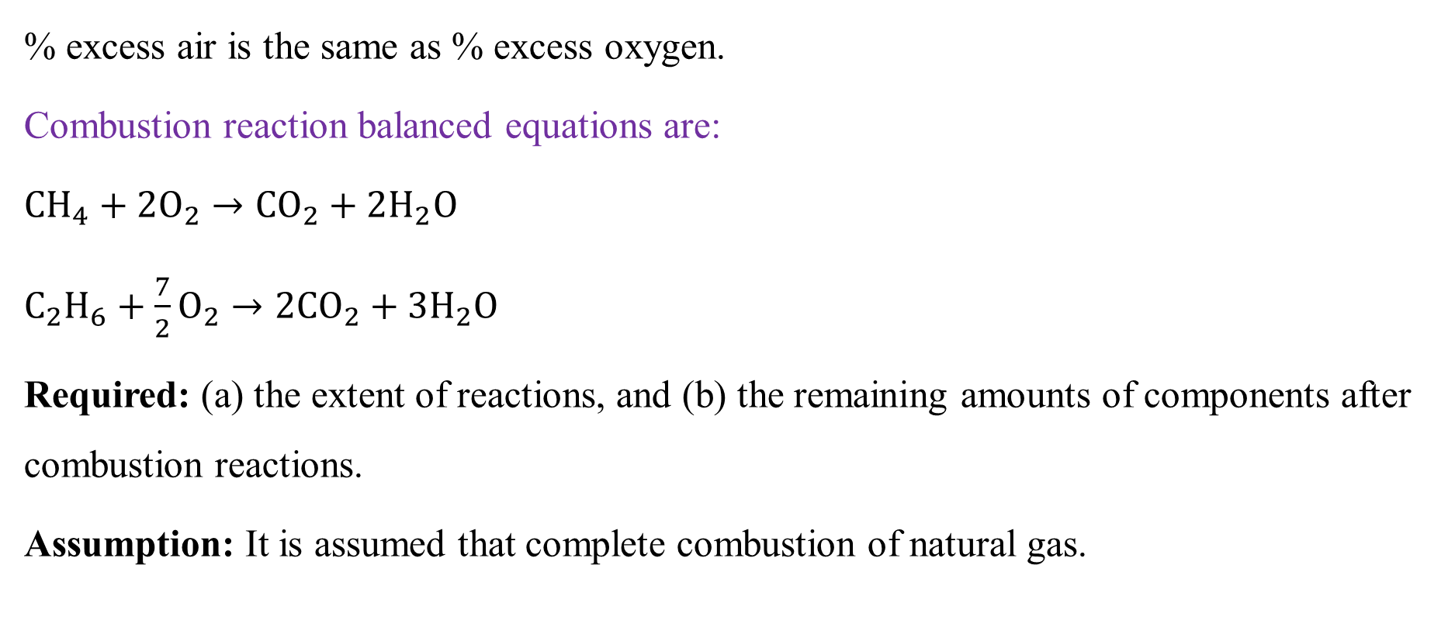
Cont’d
% excess air is the same as % excess oxygen.
Combustion reaction balanced equations are:
$CH_{4}+2O_{2}→CO_{2}+2H_{2}O$
$C_{2}H_{6}+\frac{7}{2}O_{2}→2CO_{2}+3H_{2}O$
Required: (a) the extent of reactions, and (b) the remaining amounts of components after combustion reactions.
Assumption: It is assumed that complete combustion of natural gas.
51

Slide 52
Cont’d
From combustion reaction balanced equation (6.13), 1 mol of methane needs 2 mol of oxygen, which indicates the moles ratio of oxygen to methane is 2:1.
Similarly, from combustion reaction balanced equation (6.14), 1 mol of ethane needs 3.5 mol of oxygen, which indicates the moles ratio of oxygen to ethane is 3.5:1.
But it is given that 20% excess oxygen is supplied to the furnace.
For 90 mol methane, the oxygen feed = 2*90 *1.2 = 216 mol
For 10 mol of ethane, the oxygen feed = 3.5*10*1.2 = 42 mol
n_{o}(O₂) = 216 + 42 = 258 mol
52

Slide 53
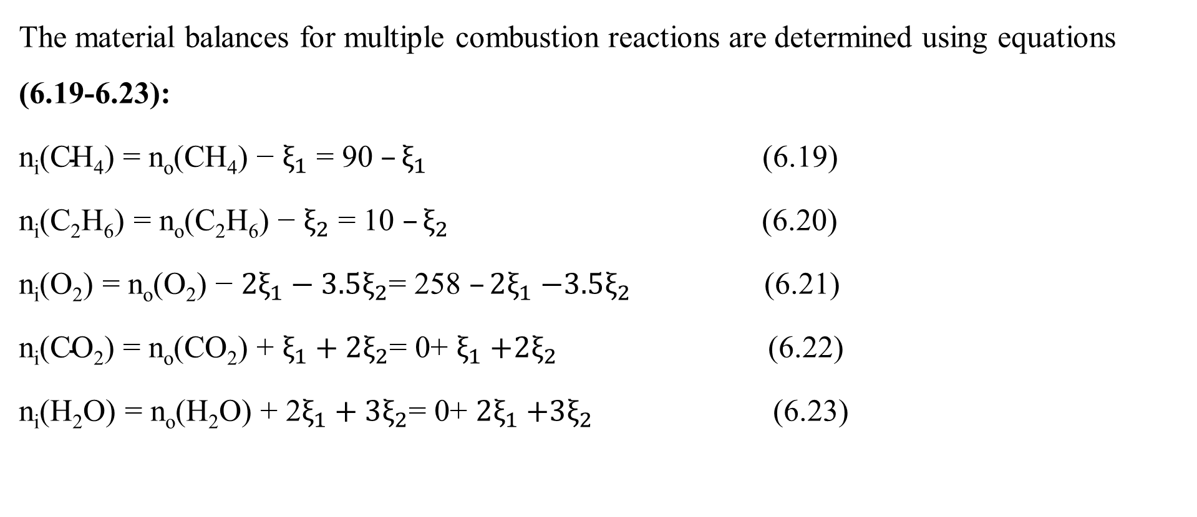
Cont’d
The material balances for multiple combustion reactions are determined using equations (6.19-6.23):
$\text{n}\text{i}\text{(}\text{CH}\text{4}\text{) = }\text{no}\text{(}\text{CH}\text{4}\text{) − }ξ_{1}\text{ = }\text{90} –ξ_{1}$ (6.19)
$\text{n}\text{i}\text{(}\text{C}\text{2}\text{H}\text{6}\text{) = }\text{no}\text{(}\text{C}\text{2}\text{H}\text{6}\text{) − }ξ_{2}\text{ = }\text{1}\text{0 }–ξ_{2}$ (6.20)
$\text{n}\text{i}\text{(}\text{O}\text{2}\text{) = }\text{no}\text{(}\text{O}\text{2}\text{) − }{2ξ}_{1}−3.5ξ_{2}\text{= }\text{258} –{2ξ}_{1}$ $−3.5ξ_{2}$ (6.21)
$\text{n}\text{i}\text{(}\text{C}\text{O}\text{2}\text{) = }\text{no}\text{(}\text{C}\text{O}\text{2}\text{) }\text{+} ξ_{1}+2ξ_{2}\text{= }\text{0+} ξ_{1}$ $+2ξ_{2}$ (6.22)
$\text{n}\text{i}\text{(}\text{H}\text{2}\text{O}\text{) = }\text{no}\text{(}\text{H}\text{2}\text{O}\text{) + }\text{2}ξ_{1}+3ξ_{2}\text{= 0+ }{2ξ}_{1}$ $+3ξ_{2}$ (6.23)
53

Slide 54
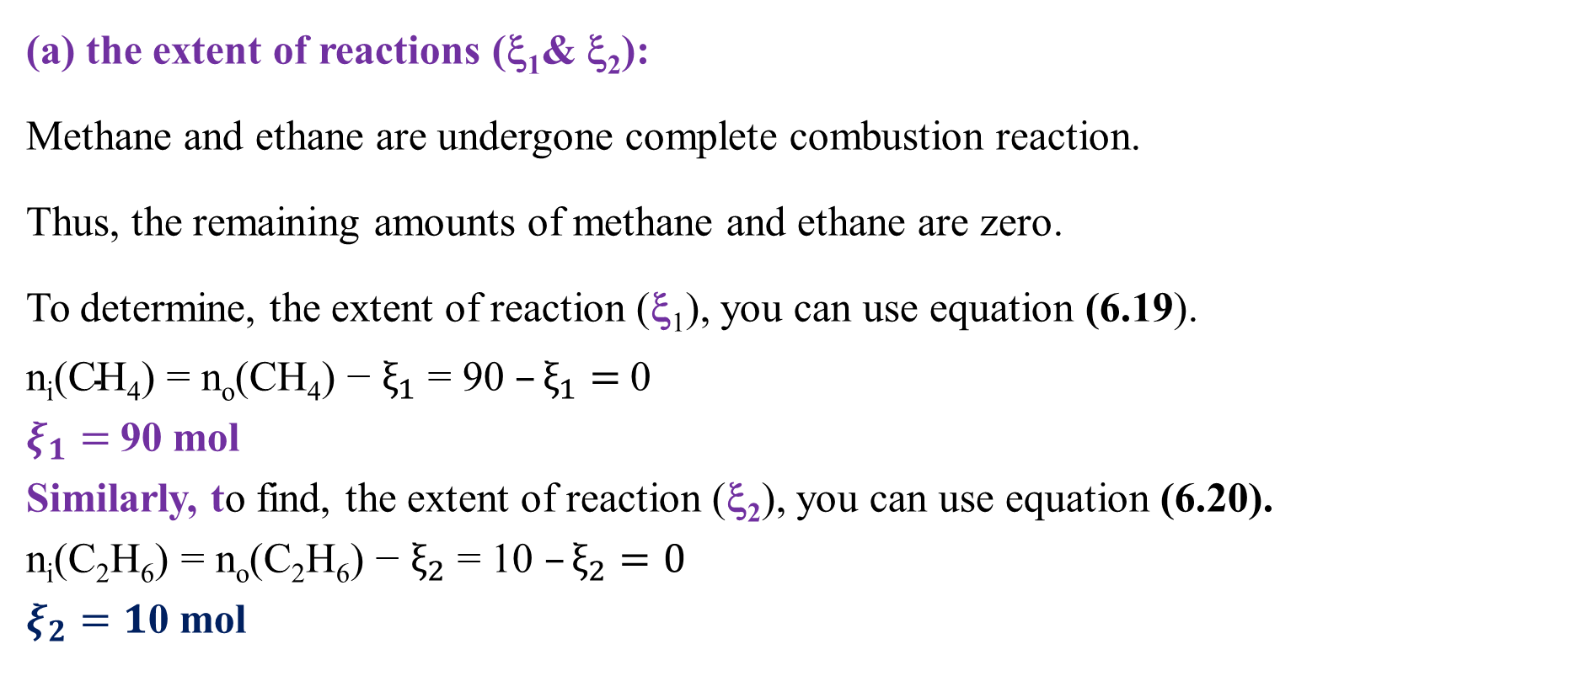
Cont’d
(a) the extent of reactions (ξ₁& ξ₂):
Methane and ethane are undergone complete combustion reaction.
Thus, the remaining amounts of methane and ethane are zero.
To determine, the extent of reaction (ξ₁), you can use equation (6.19).
$\text{n}\text{i}\text{(}\text{CH}\text{4}\text{) = }\text{no}\text{(}\text{CH}\text{4}\text{) − }ξ_{1}\text{ = 90 }–ξ_{1}=$0
$ξ_{1}=$90 mol
Similarly, to find, the extent of reaction (ξ₂), you can use equation (6.20).
$\text{n}\text{i}\text{(}\text{C}\text{2}\text{H}\text{6}\text{) = }\text{no}\text{(}\text{C}\text{2}\text{H}\text{6}\text{) − }ξ_{2}\text{ = 10 }–ξ_{2}=0$
$ξ_{2}=1$0 mol
54

Slide 55
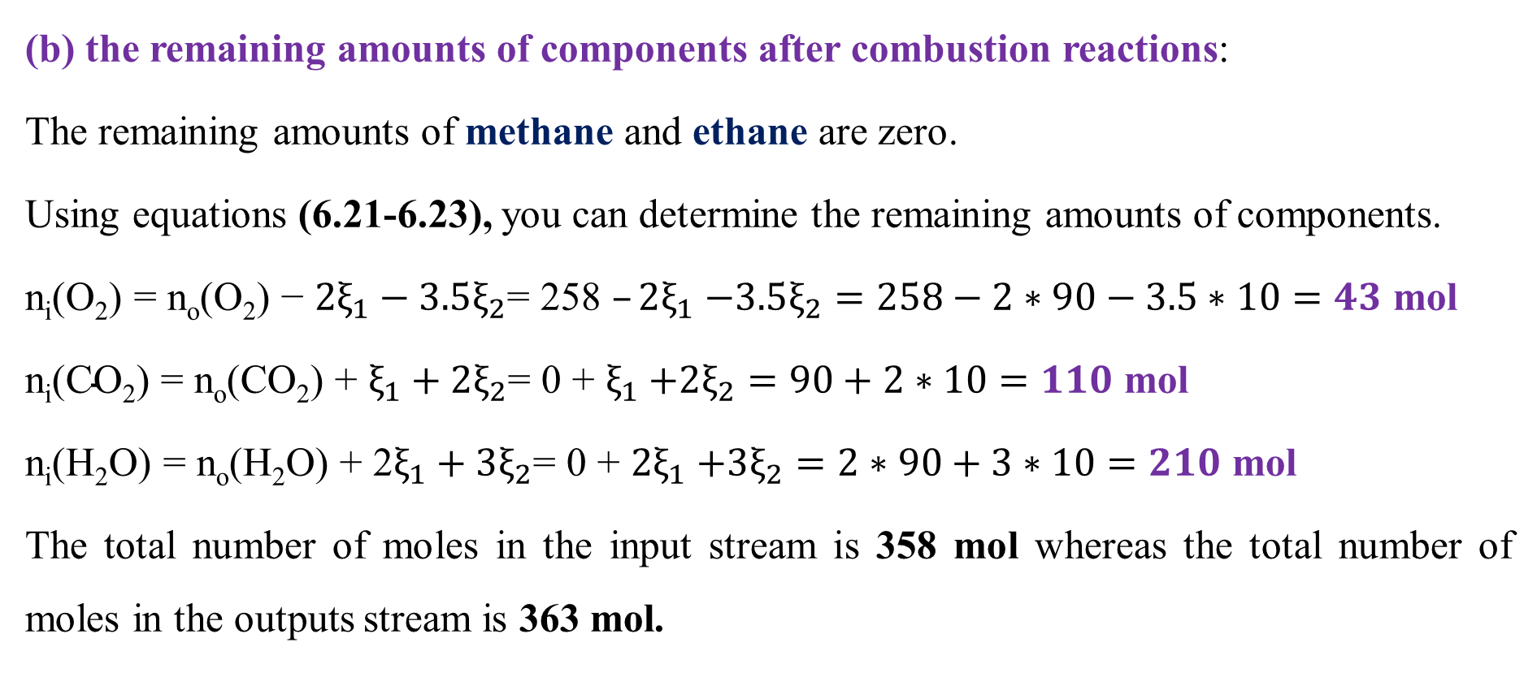
Cont’d
(b) the remaining amounts of components after combustion reactions:
The remaining amounts of methane and ethane are zero.
Using equations (6.21-6.23), you can determine the remaining amounts of components.
$\text{n}\text{i}\text{(}\text{O}\text{2}\text{) = }\text{no}\text{(}\text{O}\text{2}\text{) − }{2ξ}_{1}−3.5ξ_{2}\text{= 258 }–{2ξ}_{1}$ $−3.5ξ_{2}=258−2∗90−3.5∗10=43$ mol
$\text{n}\text{i}\text{(}\text{CO}\text{2}\text{) = }\text{no}\text{(}\text{CO}\text{2}\text{) + }ξ_{1}+2ξ_{2}\text{= 0} \text{+ }ξ_{1}$ $+2ξ_{2}=90+2∗10=110$ mol
$\text{n}\text{i}\text{(}\text{H}\text{2}\text{O}\text{) = }\text{no}\text{(}\text{H}\text{2}\text{O}\text{) + 2}ξ_{1}+3ξ_{2}\text{= 0} \text{+ }{2ξ}_{1}$ $+3ξ_{2}=2∗90+3∗10=210$ mol
The total number of moles in the input stream is 358 mol whereas the total number of moles in the outputs stream is 363 mol.
55

Slide 56
Cont’d
The results show that the number of moles is not conserved for combustion reactions.
To change from mole unit to mass unit, you can multiply the number of moles of each component by its molecular weight.
The mass of inputs stream (reactant):
m_{o}(CH₄) = 90 mol *16 g/mol = 1, 440 g
m_{o}(C₂H₆) = 10 mol *30 g/mol = 300 g
m_{o}(O₂) = 258 mol *32 g/mol = 8, 256 g
Total mass in the inputs stream = 1, 440 + 300 + 8, 256 = 9, 996 g
56

Slide 57
Cont’d
The mass of outputs stream:
m(O₂) = 43 mol *32 g/mol =1, 376 g
m(CO₂) = 110 mol *44 g/mol = 4, 840 g
m(H₂O) =210 mol* 18 g/mol =3, 780 g
The total mass in the outputs stream = 1, 376 + 4, 840 + 3,780 = 9, 996 g
The total mass of the inputs steam (reactants) is equal to the total mass of the outputs stream (products and unconverted reactant).
Therefore, mass is conserved for combustion reactions.
57

Slide 58
6.5. Summary
A combustion reaction is a special chemical reaction that involves the reaction of a fuel with oxygen resulting in release of energy in the form of heat and light.
The combustion reaction main products are carbon dioxide and water when complete combustion occurs.
Problem-solving techniques are the tools to determine MBs for combustion systems.
MBs for a combustion reaction can be determined based on the extent of reaction and stoichiometry coefficients.
To perform MBs, the combustion reaction equations must be balanced.
58

Slide 59
References
Basic Principles and Calculations in Chemical Engineering, Himmelblau, Pearson Education Inc, 9th edition, 2023.
Chemical Engineering Design, Volume 6, Coulson & Richardson’s, R. K. Sinnott, 3rd edition, 1999.
Elementary Principles of Chemical Processes, Richard M. Felder, John Wiley & Sons, 3rd edition, 2005.
Thank you!
59

